Slide 1
CARDIOMETABOLIC AND SLEEP PATHWAYS TO COGNITIVE FUNCTIONING AT MIDLIFE
Lauren n. Whitehurst, phd
American Psychosomatic Society
Vancouver, BC
March 2019

Slide 2
Disclosure:
I have no actual or potential conflict of interest in relation to this program/presentation.
#APS2019VAN

Slide 3
Team Science
Department of Psychology
University of California, Riverside
Chandra Reynolds PhD
Institute of Behavioral Genetics
University of Colorado – Boulder
Andrew Smolen PhD
Luke M Evans PhD
John C De Fries PhD
John K Hewitt PhD
Sally J Wadsworth PhD

Slide 4
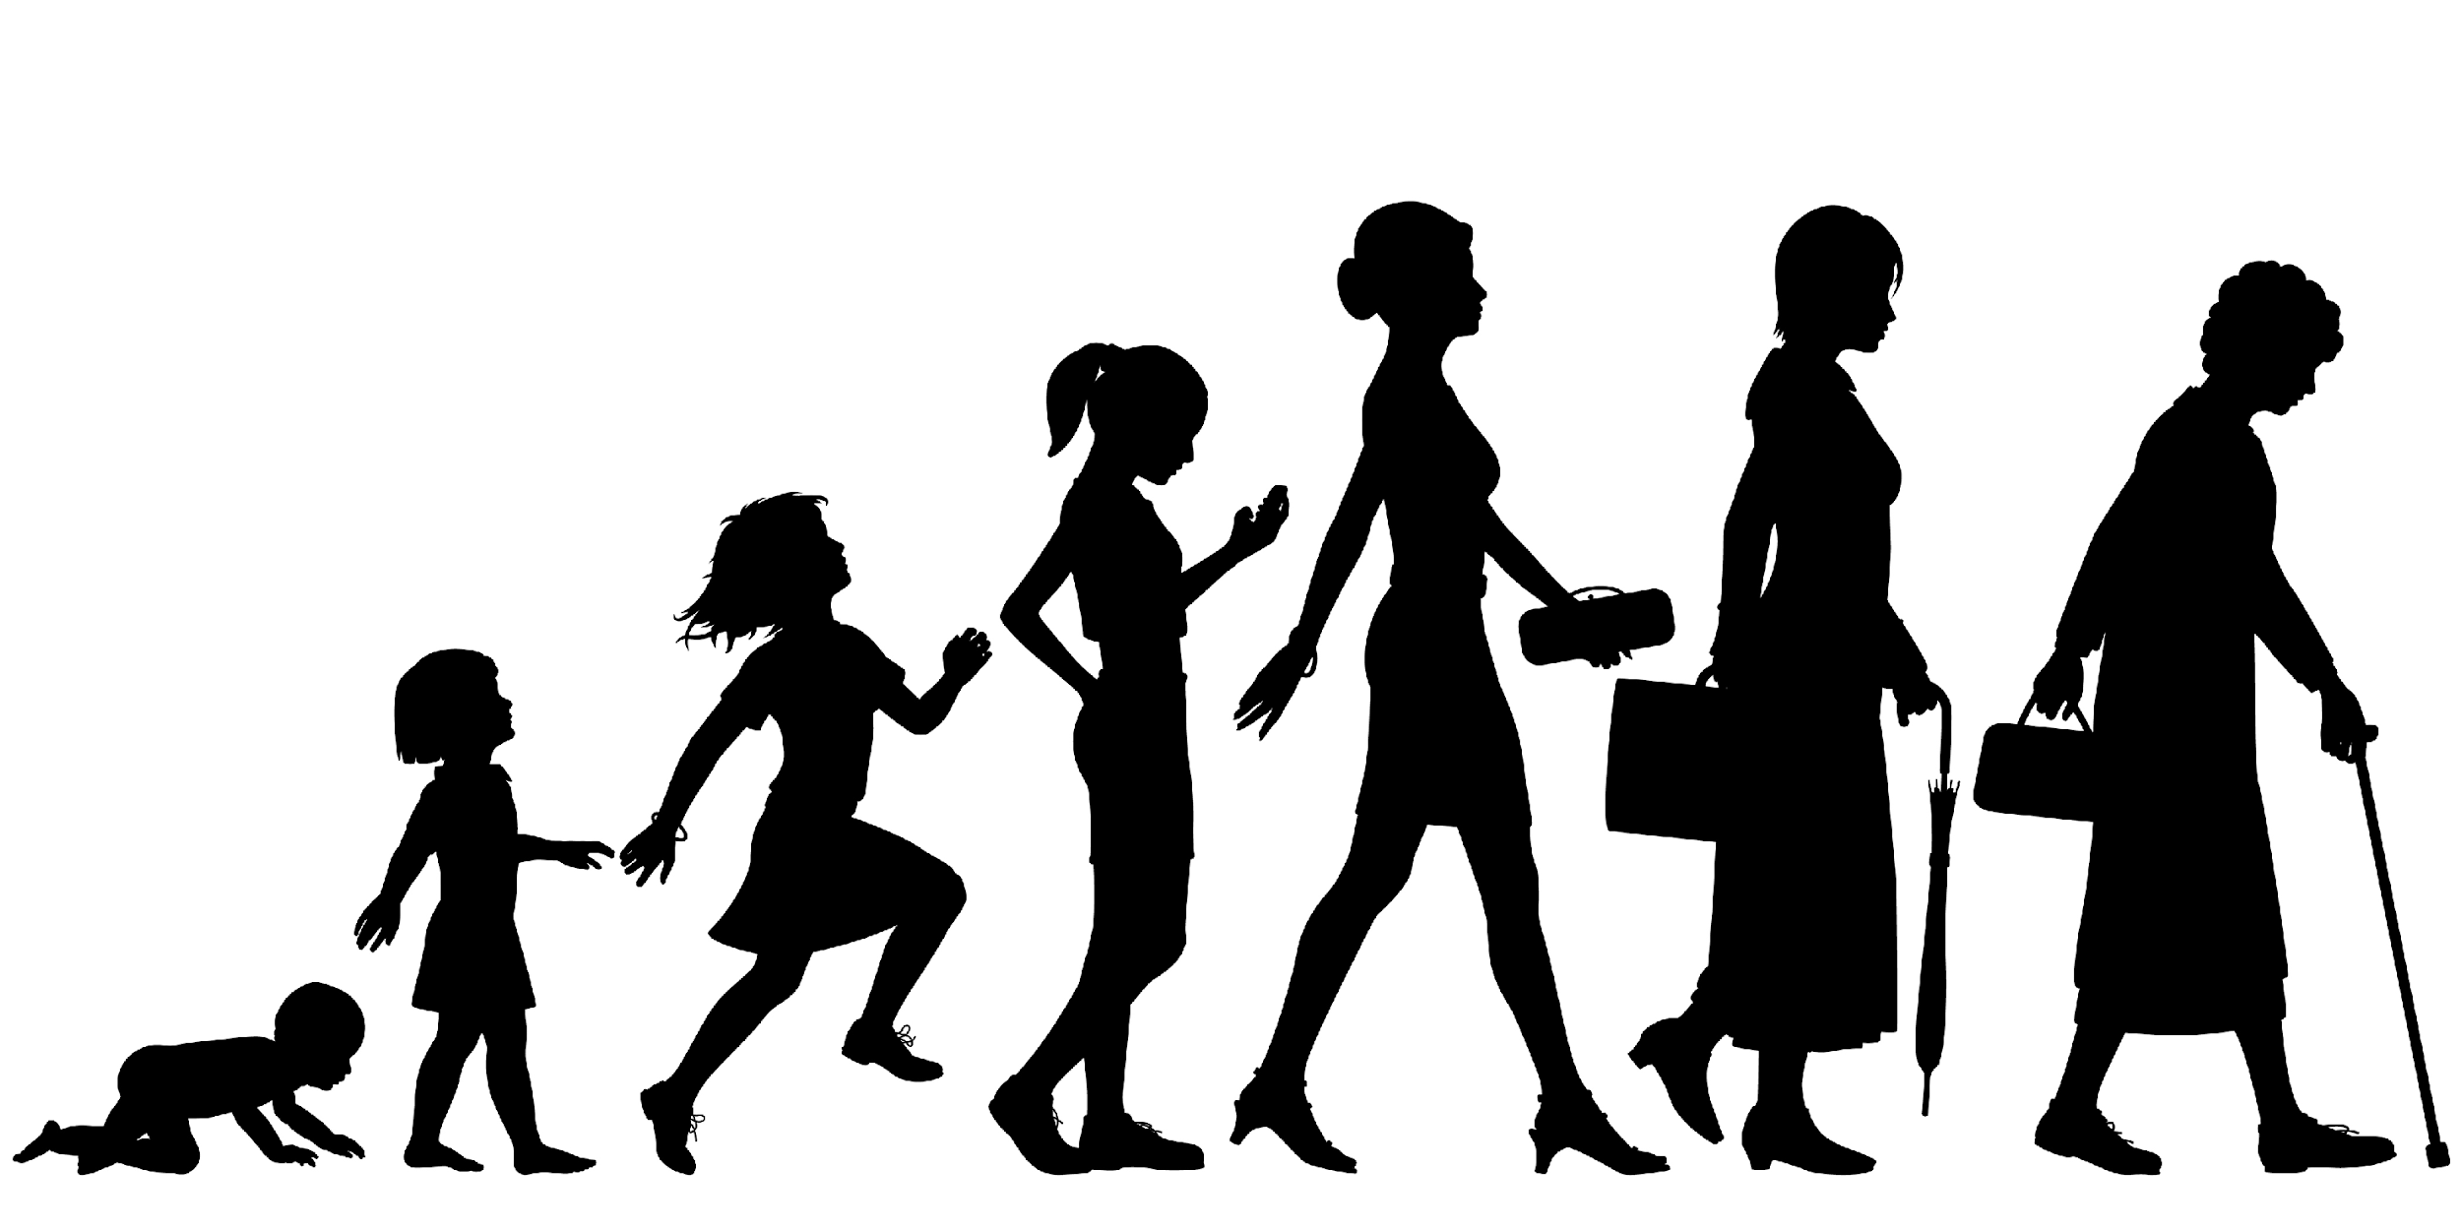

Slide 5
Background: Pathways to Cognitive Health
Cardiometabolic (CM) factors:
Hypercholesterolemia predicts cognitive decline^{1,2,3,4}
low levels of high density lipoprotein (HDL) cognitive function
high levels of low density lipoprotein (LDL) cognitive function
Hypertriglyceridemia associated with reduced verbal skills and memory⁵
Sleep factors:
Short and long sleepers have worse cognitive outcomes⁶ and poor sleep quality (self-report) is associated with increased dementia risk⁷
Poor sleep predicts and may exacerbate cognitive decline⁸
CM and Sleep have a bidirectional relationship
¹ Reynolds et al., 2010; ²Anstey et al., 2017; ²Solomon et al., 2009; ³de Frias et al., 2007; ⁴Yaffe et al., 2002; ⁵Farr et al., 2008; ⁶Virta et al., 2013; ⁷Sprecher et al., 2015; ⁸Spira et al. 2017;

Slide 6
Study Questions:
1. Do CM and/or sleep factors uniquely predict cognitive performance?
2. Does this relationship differ based on cognitive domain?
Mid-life

Slide 7
Study Methods
Sample:
CATSLife
The Colorado Adoption Project (CAP), initiated in 1975 with 245 adoptive and 245 control families
The Longitudinal Twin Study (LTS), initiated in 1985 with 483 twin pairs (265 MZ, 218 DZ)
N = 1981
Current Analysis Sample
N = 702
Mage = 33 years; 28 - 47 years
> 90% White
> 90% Non-Hispanic

Slide 8
Study Measures
Cognition
WAIS III
Total IQ Score
Performance IQ (perceptual organization, processing speed): e.g. digit symbol, block design
Verbal IQ (verbal ability & working memory): e.g. vocabulary, arithmetic, digit span
Cardiometabolic predictors
Cholesterol
HDL
LDL
Triglycerides
Sleep predictor
Pittsburgh Sleep Quality Index
higher scores indicate worse sleep

Slide 9
Statistical Approach:
Liner mixed modeling
Model I: CM Model
Model II: Sleep Model
Model III: CM and Sleep Model
Each model adjusted for:
sex
age
ethnicity
race
adoption status
family nesting
genetic factors: number of APOE e4 & e2

Slide 10
Results: Bivariate Correlations
 | WAIS-Full | Performance | Verbal | HDL | LDL | TRIG | PSQI
WAIS-Full |  | 0.90 | 0.86 | -0.006 | -0.004 | -0.05 | -0.12**
Performance |  |  | 0.55 | 0.02 | -0.007 | -0.08* | -0.08*
Verbal |  |  |  | -0.02 | -0.002 | -0.01 | -0.12**
HDL_{logn} |  |  |  |  | 0.69 | 0.30 | -0.01
LDL_{logn} |  |  |  |  |  | 0.58 | 0.03
TRIG_{logn} |  |  |  |  |  |  | 0.04
PSQI

Slide 11
Model I: CM on Full Scale IQ
 | B | SE | t Value | p Value | Lower CI | Upper CI
Intercept | 115.65 | 2.02 | 57.16 | <.0001 | 111.67 | 119.63
eproj | -4.99 | 2.41 | -2.07 | 0.04 | -9.73 | -0.26
Sex | -2.59 | 0.99 | -2.61 | 0.01 | -4.55 | -0.64
LipidBatch | -0.14 | 1.03 | -0.14 | 0.89 | -2.18 | 1.89
Age | 0.18 | 0.25 | 0.73 | 0.47 | -0.31 | 0.67
fasting | -0.13 | 0.14 | -0.96 | 0.34 | -0.41 | 0.14
White | -0.07 | 1.73 | -0.04 | 0.97 | -3.49 | 3.35
Hispanic | -3.98 | 2.41 | -1.65 | 0.10 | -8.73 | 0.77
Adopted | -4.81 | 1.51 | -3.19 | 0.00 | -7.79 | -1.84
APOE-e4 | -1.22 | 1.02 | -1.19 | 0.23 | -3.22 | 0.79
APOE-e2 | -0.94 | 1.13 | -0.83 | 0.41 | -3.18 | 1.29
LDL_{logn} | -0.98 | 1.20 | -0.82 | 0.41 | -3.34 | 1.38
HDL_{logn} | 2.27 | 1.18 | 1.93 | 0.06 | -0.05 | 4.59
TRIG_{logn} | -1.64 | 0.76 | -2.15 | 0.03* | -3.15 | -0.14
N= 683

Slide 12
Model II: Sleep on Full Scale IQ
 | B | SE | t Value | p Value | Lower CI | Upper Ci
Intercept | 115.22 | 2.11 | 54.54 | <.0001 | 111.07 | 119.37
eproj | -3.96 | 2.39 | -1.66 | 0.10 | -8.65 | 0.74
Sex | -1.68 | 0.94 | -1.79 | 0.08 | -3.54 | 0.17
LipidBatch | -0.21 | 0.96 | -0.22 | 0.82 | -2.11 | 1.68
Age | 0.23 | 0.24 | 0.92 | 0.36 | -0.26 | 0.71
fasting | -0.20 | 0.15 | -1.38 | 0.17 | -0.49 | 0.09
White | -0.15 | 1.82 | -0.08 | 0.94 | -3.73 | 3.43
Hispanic | -3.50 | 2.43 | -1.44 | 0.15 | -8.28 | 1.28
Adopted | -4.98 | 1.50 | -3.32 | 0.00 | -7.93 | -2.02
APOE-e4 | -1.24 | 1.01 | -1.24 | 0.22 | -3.22 | 0.74
APOE-e2 | -0.92 | 1.11 | -0.83 | 0.41 | -3.10 | 1.27
PSQI | -0.24 | 0.12 | -1.96 | 0.05 | -0.48 | 0.00
N= 683

Slide 13
Model III: CM & Sleep on Full Scale IQ
 | B | SE | t Value | p Value | Lower CI | Upper CI
Intercept | 116.61 | 2.22 | 52.59 | <.0001 | 112.25 | 120.97
eproj | -4.71 | 2.43 | -1.94 | 0.05 | -9.49 | 0.07
Sex | -2.40 | 1.00 | -2.40 | 0.02 | -4.36 | -0.43
LipidBatch | -0.34 | 1.05 | -0.33 | 0.74 | -2.41 | 1.73
Age | 0.19 | 0.25 | 0.75 | 0.45 | -0.30 | 0.68
fasting | -0.22 | 0.15 | -1.46 | 0.15 | -0.51 | 0.08
White | 0.00 | 1.82 | 0.00 | 1.00 | -3.59 | 3.60
Hispanic | -3.70 | 2.42 | -1.53 | 0.13 | -8.46 | 1.06
Adopted | -4.55 | 1.51 | -3.01 | 0.00 | -7.53 | -1.57
APOE-e4 | -1.05 | 1.02 | -1.04 | 0.30 | -3.06 | 0.95
APOE-e2 | -0.84 | 1.14 | -0.74 | 0.46 | -3.09 | 1.41
LDL_{logn} | -0.42 | 1.22 | -0.35 | 0.73 | -2.83 | 1.99
HDL_{logn} | 1.97 | 1.19 | 1.65 | 0.10 | -0.38 | 4.32
TRIG_{logn} | -1.80 | 0.78 | -2.31 | 0.02 | -3.33 | -0.26
PSQI | -0.25 | 0.12 | -2.05 | 0.04 | -0.49 | -0.01
N= 683
N= 683

Slide 14
Model III: CM & Sleep on Performance IQ
 | B | SE | t Value | Pr > |t| | Lower | Upper
Intercept | 119.16 | 2.60 | 45.75 | <.0001 | 114.04 | 124.28
eproj | -8.00 | 2.87 | -2.79 | 0.01 | -13.63 | -2.37
Sex | -0.79 | 1.14 | -0.69 | 0.49 | -3.04 | 1.46
LipidBatch | -0.13 | 1.23 | -0.10 | 0.92 | -2.55 | 2.30
Age | 0.00 | 0.29 | 0.02 | 0.99 | -0.58 | 0.59
fasting | -0.15 | 0.19 | -0.80 | 0.43 | -0.53 | 0.23
White | -0.45 | 2.13 | -0.21 | 0.83 | -4.64 | 3.75
Hispanic | -3.78 | 2.64 | -1.43 | 0.15 | -9.00 | 1.43
Adopted | -2.62 | 1.74 | -1.51 | 0.13 | -6.04 | 0.81
APOE-e4 | -1.48 | 1.16 | -1.27 | 0.21 | -3.77 | 0.82
APOE-e2 | -1.01 | 1.31 | -0.77 | 0.44 | -3.58 | 1.57
LDL_{logn} | -0.62 | 1.52 | -0.41 | 0.68 | -3.63 | 2.38
HDL_{logn} | 2.89 | 1.48 | 1.95 | 0.05 | -0.03 | 5.80
TRIG_{logn} | -2.66 | 0.95 | -2.78 | 0.01 | -4.54 | -0.78
PSQI | -0.23 | 0.15 | -1.51 | 0.13 | -0.53 | 0.07
N= 683

Slide 15
Model III: CM & Sleep on Verbal IQ
 | B | SE | t Value | Pr > |t| | Lower | Upper
Intercept | 112.59 | 2.16 | 52.18 | <.0001 | 108.35 | 116.83
eproj | -2.58 | 2.33 | -1.11 | 0.27 | -7.15 | 1.99
Sex | -2.85 | 0.98 | -2.92 | 0.00 | -4.77 | -0.92
LipidBatch | -0.64 | 1.03 | -0.62 | 0.54 | -2.66 | 1.39
Age | 0.18 | 0.24 | 0.73 | 0.47 | -0.30 | 0.65
fasting | -0.31 | 0.14 | -2.17 | 0.03 | -0.60 | -0.03
White | 0.26 | 1.79 | 0.15 | 0.88 | -3.26 | 3.78
Hispanic | -3.45 | 2.44 | -1.41 | 0.16 | -8.26 | 1.37
Adopted | -5.01 | 1.44 | -3.48 | 0.00 | -7.84 | -2.18
APOE-e4 | -0.74 | 0.98 | -0.75 | 0.45 | -2.68 | 1.20
APOE-e2 | -0.40 | 1.10 | -0.36 | 0.72 | -2.56 | 1.76
LDL_{logn} | 0.03 | 1.18 | 0.02 | 0.98 | -2.29 | 2.35
HDL_{logn} | 0.98 | 1.15 | 0.85 | 0.40 | -1.30 | 3.25
TRIG_{logn} | -1.23 | 0.75 | -1.63 | 0.10 | -2.71 | 0.25
PSQI | -0.25 | 0.12 | -2.10 | 0.04 | -0.48 | -0.02
N= 683

Slide 16
Summary/Conclusion
Both CM and sleep uniquely predict cognitive performance at midlife
CM predicts perceptual organization and processing speed
Sleep predicts working memory and verbal outcomes
Targeted interventions that reduce CM risk and boost sleep may be particularly beneficial for cognitive health

Slide 17
Thanks & Acknowledgments
University of California, Riverside
Chandra Reynolds PhD
University of Colorado – Boulder
Andrew Smolen PhD
Luke M Evans PhD
John C De Fries PhD
John K Hewitt PhD
Sally J Wadsworth PhD
University of California, San Francisco
Aric Prather PhD
Wendy Mendes PhD
Andrew Krystal PhD
Funding:
NIH T32MH019291
“My mission in life is not to merely survive, but to thrive; and to do so with some passion, some compassion, some humor and some style” – Maya Angelou

Slide 20
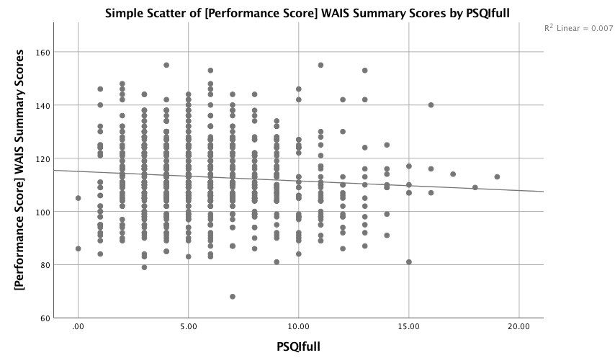
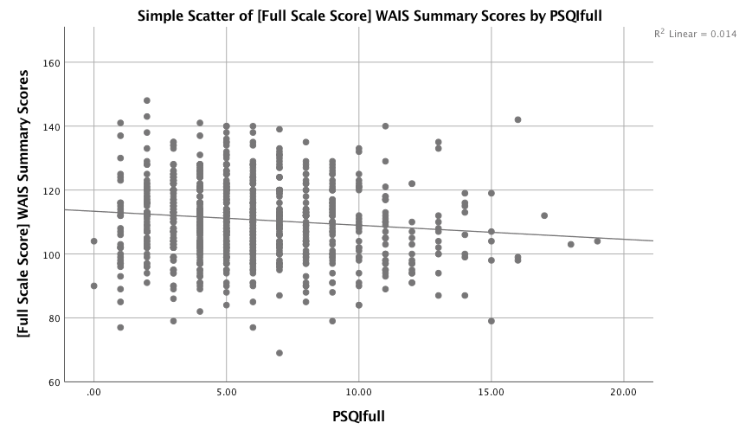
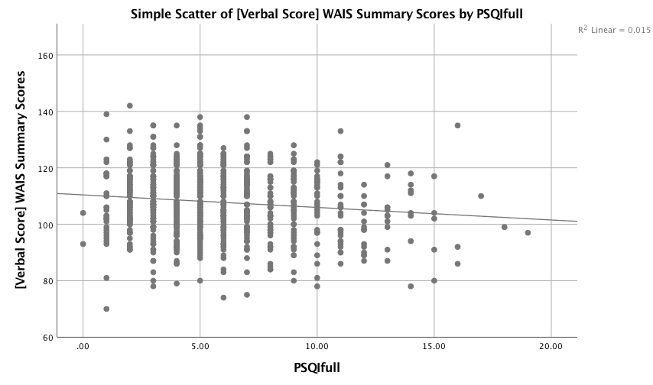
Results I
r = -0.083, p = 0.01
r = -0.117, p = 0.001
r = -0.122, p < 0.001

