Slide 1

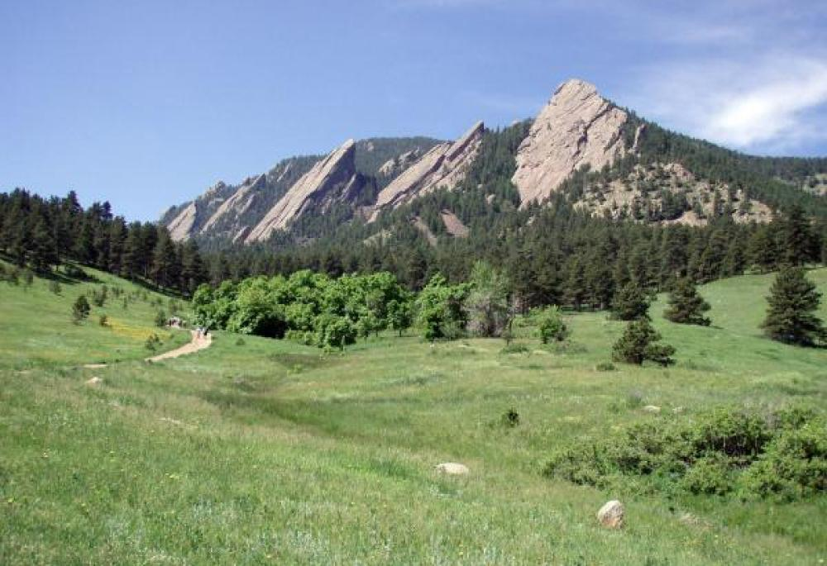
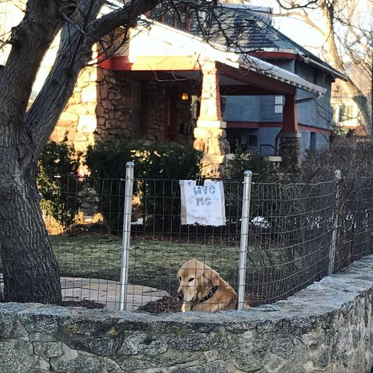

Mendelian randomization: Practical 2
Does BMI causally affect Coronary Heart Disease?
Pearl St Mall
Hotel St Julien
The Flatirons
“Ajax”- A Boulder Resident

Slide 2
Inverse variance weighted (IVW) fixed effects method
There is one underlying ‘true’ effect
All deviations of sample effects from the ‘true’ effect are due to chance
For N studies, each study i contributes more to the meta-analysis if its standard error is lower

Slide 3
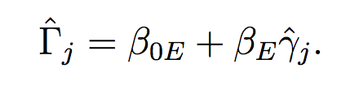
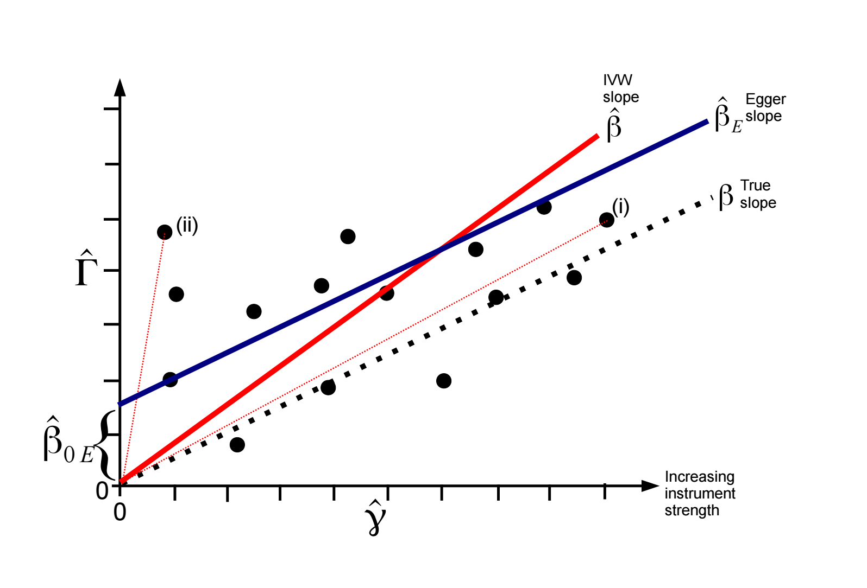
Egger regression:
Intercept not constrained to zero
MR Egger Regression

Slide 4
Simple and Weighted Median Method
Order instrumental variables estimates and take the median
Like all subsequent estimators it enjoys a 50% breakdown limit

Slide 5
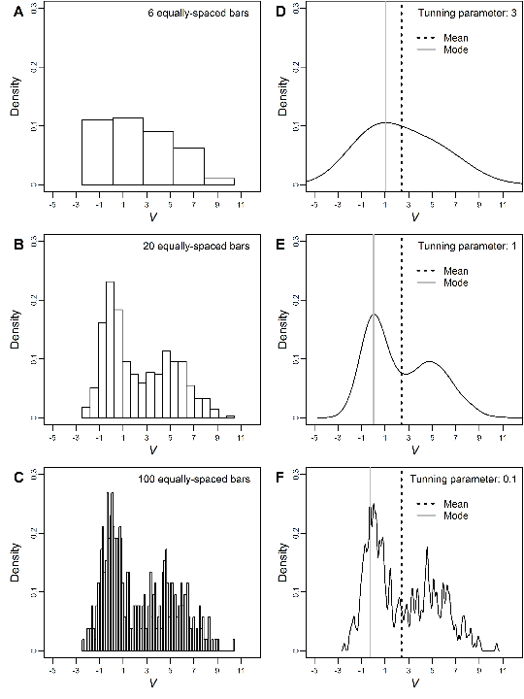
Modal Methods

Slide 6
Mendelian randomization: Practical 2
Does BMI causally affect Coronary Heart Disease?
Web utilities and software packages exist to carry out two sample MR analyses quickly and efficiently
This practical is not meant to illustrate the most efficient way to perform an MR study!
This practical is designed to show you what goes on “under the hood” of these black boxes and to get you familiar with some of the data cleaning and interpretation issues when performing two sample Mendelian randomization. We will also get you to run some of the MR sensitivity analyses too.

Slide 7
We have limited time!!!
DO NOT FOCUS ON THE SYNTAX!!! (just accept that the code does what it says on the tin- go back later and check/run through)
Remember to set your working directory at the beginning of the prac in R studio e.g.
  setwd("/home/**YOURNAMEHERE**/MR/PRACTICAL2/")
Run the code in 5 blocks (labelled PART ONE through PART 5)
Timetable
00-10 Minutes INTRO
10-20 minutes PART ONE
20-30 minutes PART TWO
30-40 minutes PART THREE
40-50 minutes PART FOUR
50-60 minutes PART FIVE
60-70 minutes Group Discussion

Slide 8
Mendelian randomization: Practical 2
# Use your web browser to navigate to: https://workshop.colorado.edu/
#Login with your username and password
# Click on the link “OnDemand”
# Click on the R Studio pinned app and start a session
#Click on the “terminal” tab. This will take you to a UNIX like environment where you can copy the files over for this session’s #practical exercise
# Now go to your home directory, and move to the directory “MR” you previously created:
cd
cd MR
# Copy the PRACTICAL2 directory from David Evans’ Faculty drive into this directory
cp -r /faculty/davide/BOULDER2026/PRACTICAL2 .
#Move into your newly created PRACTICAL2 directory and print the working directory here
cd PRACTICAL2
pwd
#Instructions, commands and questions for this practical are located in the file Practical2.R

Slide 9
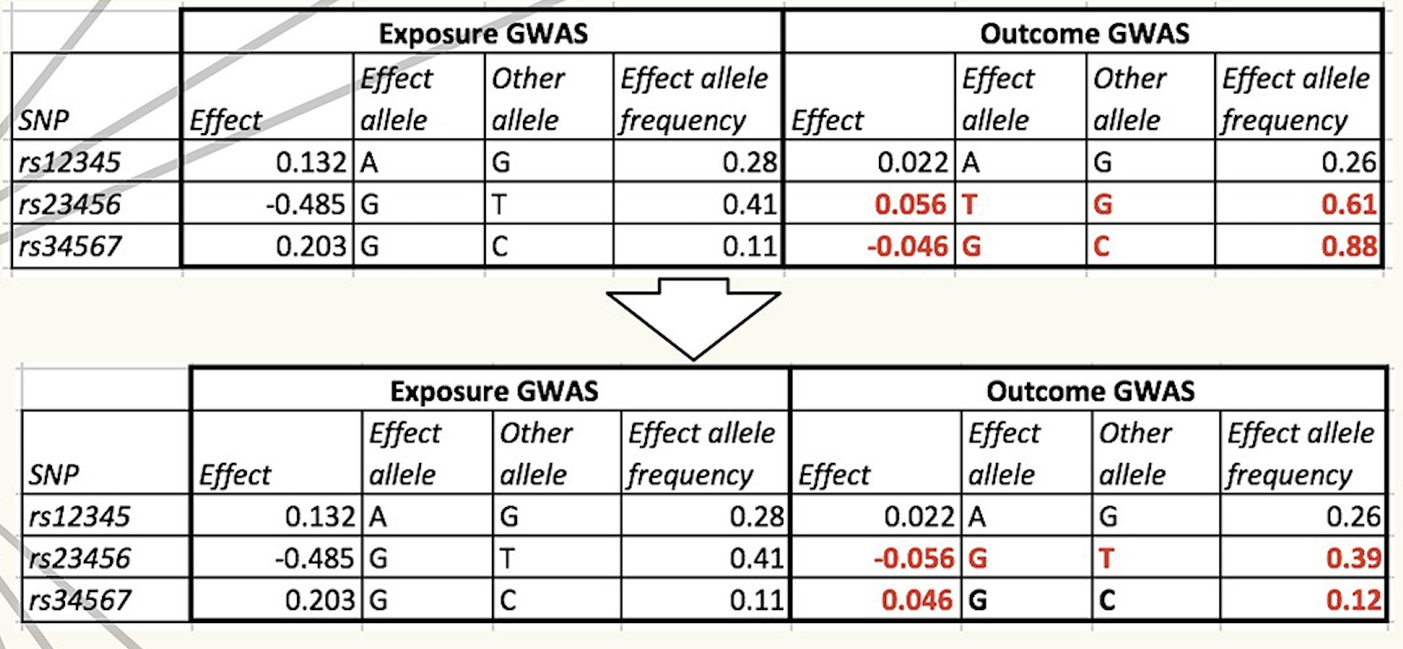
Harmonise exposure and outcome effects

Slide 10
The Issue of Strand
SNP 1
SNP 2
A/C
G/C
5’
A
C
A
C
G
G
G
A
3’
Forward Strand
Chromosome
3’
T
G
T
G
C
C
C
T
5’
Reverse Strand
Individual 1
5’
A
A
A
C
C
G
G
A
3’
Forward Strand
Chromosome
3’
T
T
T
G
G
C
C
T
5’
Reverse Strand
5’
A
C
A
C
G
G
G
A
3’
Forward Strand
Chromosome
3’
T
G
T
G
C
C
C
T
5’
Reverse Strand
Individual 2
5’
A
C
A
C
G
G
G
A
3’
Forward Strand
Chromosome
3’
T
G
T
G
C
C
C
T
5’
Reverse Strand
5’
A
C
A
C
C
G
G
A
3’
Forward Strand
Chromosome
3’
T
G
T
G
G
C
C
T
5’
Reverse Strand
Individual 3
5’
A
A
A
C
C
G
G
A
3’
Forward Strand
Chromosome
3’
T
T
T
G
G
C
C
T
5’
Reverse Strand

Slide 11
Sensitivity Analyses- BMI and CHD
parameter estimate se lower_CI upper_CI p_value
1 IVW beta 0.287658553 0.086237732 0.11590122 0.459415882 0.001318512
2 MR-Egger beta 0.375935570 0.209803912 -0.04201525 0.793886395 0.077191677
3 MR-Egger alpha -0.002791481 0.006041587 -0.01482694 0.009243978 0.645387108
4 Weighted_median beta 0.379652982 0.117839188 0.08299413 0.554455224 0.005920437
5 Weighted_mode beta 0.311258179 0.129426222 0.05758745 0.564928912 0.018610428
Results look very consistent!
MR Egger lacks power- so look at coefficient rather than p value!
MR Egger intercept is a test for directional horizontal pleiotropy

