Slide 1
Introduction to Cloud Genomics with Hail
Edmund Higham
Software Engineer, Hail Team
Stanley Center for Psychiatric Research, Broad Institute of MIT and Harvard
Analytic and Translational Genetics Unit, MGH

Slide 2
Structure
Why the cloud?
What is hail?
Hail’s core data model
Scalable Variant Call Representation

Slide 3
1
Why the Cloud?

Slide 4
“genomics research will generate between 2 and 40 exabytes of data within the next decade”
National Human Genome Research Institute (2021)
Available at: https://www.genome.gov/about-genomics/fact-sheets/Genomic-Data-Science (Accessed 27 February 2025)

Slide 5
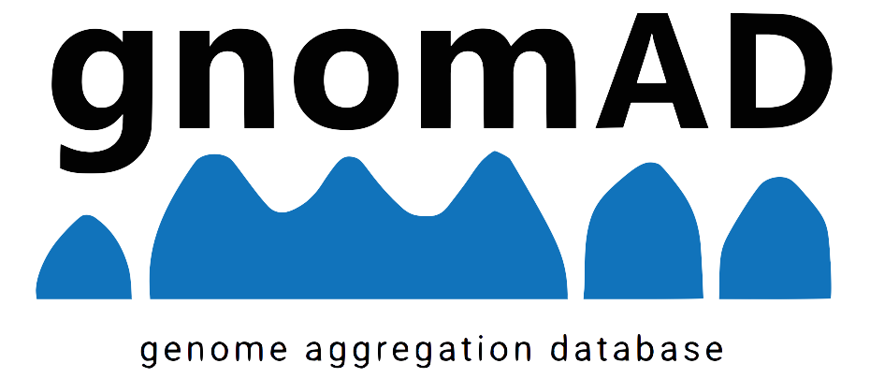
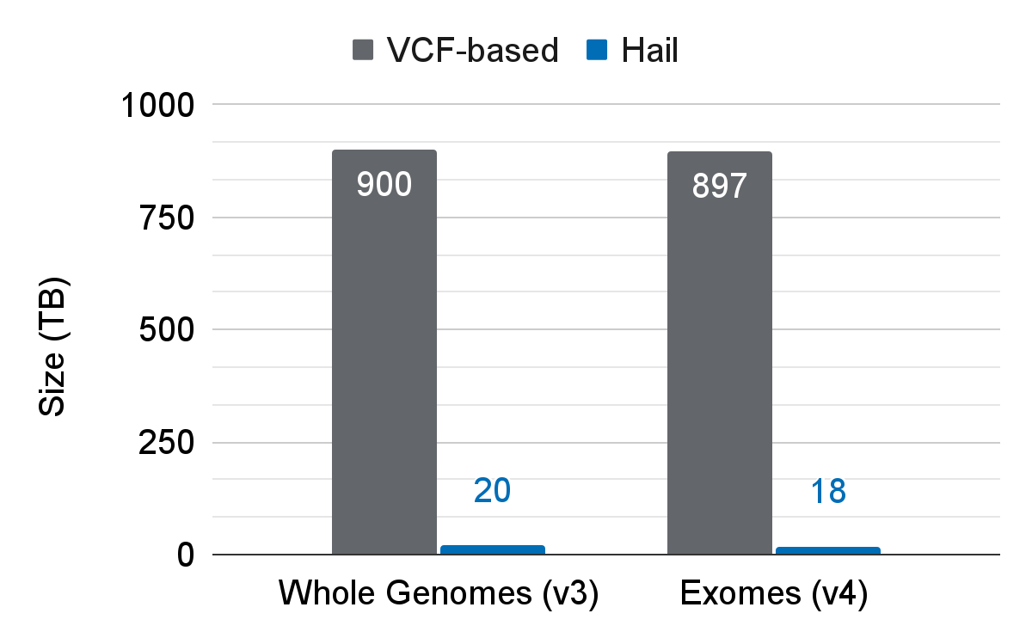
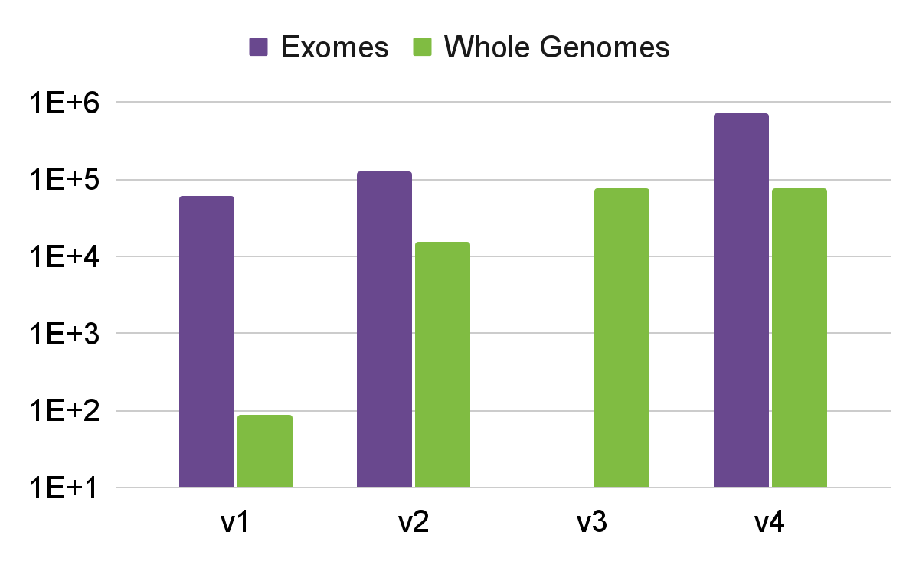
Storage requirements for VDS vs (estimated) traditional formats for aggregated whole genome and exome sequencing data. [2,3]
Sample Size with Major Release [1]
Notes:
Notes:
Left:
Number of exome sequencing samples increasing exponentially.
Number of whole genome samples increased by 3 orders of magnitude.
Storage requirement estimates are made for traditional formats (ie non-hail).
Right:
Storage requirements for traditional, vcf-based formats are estimated
References:
[1] gnomAD Browser. Available at: https://gnomad.broadinstitute.org/stats. (Accessed on 28 February 2025)
[2] gnomAD Browser. Available at: https://gnomad.broadinstitute.org/news/2019-10-gnomad-v3-0/. (Accessed on February 2025)
[3] gnomAD Browser. Available at https://gnomad.broadinstitute.org/news/2023-11-gnomad-v4-0/. (Accessed on 28 February 2025)

Slide 6
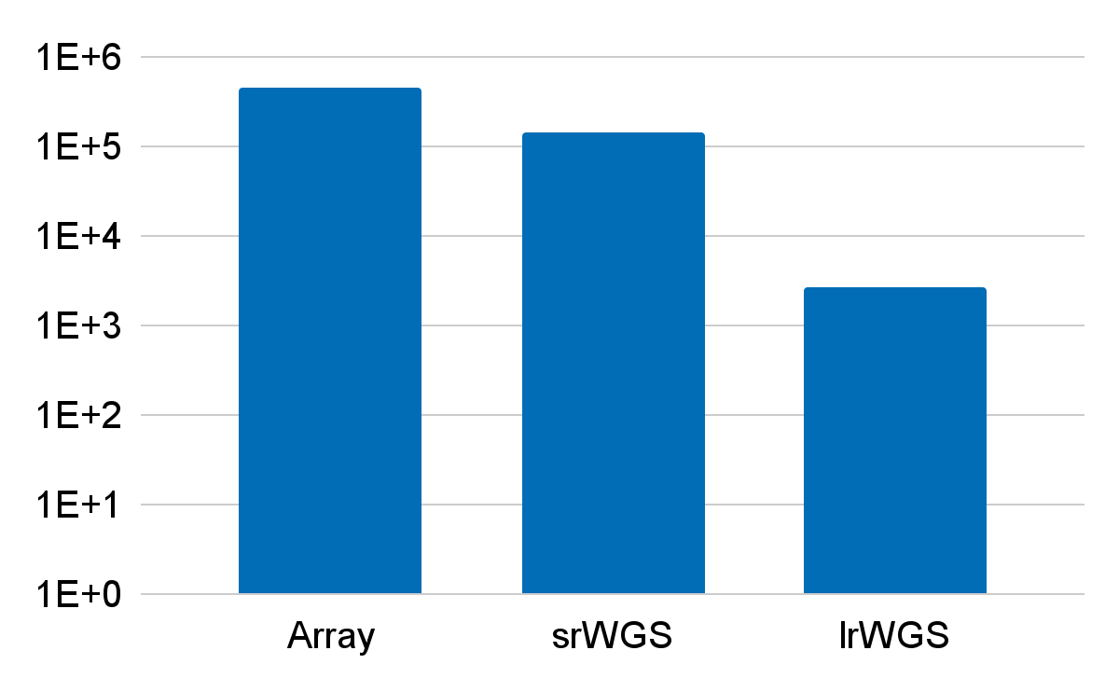
Number of Participants per Data Type in AoU Curated Data Repository v8 [1]
Notes:
Notes:
Raw, variant and auxiliary data available for each data type [2]
Nomenclature:
Array = microarray genotyping array
srWGS = short-read whole genome sequencing data
lrWGS = long-read whole genome sequencing data
References:
[1] All of Us Research Program (2025) Curated Data Repository (CDR) version 8 Release Notes. Available at https://support.researchallofus.org/hc/en-us/articles/30294451486356-Curated-Data-Repository-CDR-version-8-Release-Notes. (Accessed on 28 February 2025)
[2]. All of Us Research Program (2024) Incremental Data Release for CDRv7 Genotyping Array and Short-Read Genomic Data. Available at https://support.researchallofus.org/hc/en-us/articles/29475228181908-How-the-All-of-Us-Genomic-data-are-organized. (Accessed 28 February 2025)

Slide 7
Summary and Perspective
Scale of data mandates the cloud for all but simplest analyses.
The cloud offers a number of advantages:
Collaborate and share data at no additional cost.
Fine-grained access controls and fault-tolerance.
No resource contention/sharing with colleagues.
High compute utilization means good cost efficiency.
Things to be aware of:
Each cloud is different and steep learning curve.
Every operation has a cost; understanding cost model is vital.
Difficult to know how many resources to provision
Notes:
Notes:
Pros:
No need to buy HDDs and physically send to collaborators or use FTPs; the data is already available.
Access controls control who has access to the data and fault tolerance means data is always available.
Don’t need to fight colleagues for resources - these days clouds are mostly infinite
Pay for what you use. Compute can be cheap - UK Biobank Rapid GWAS averaged to $1/phenotype [citation needed] across some 361,194 individuals and 4,236 phenotypes [1]
Cons:
Every cloud vendor has their own way of doing things and there’s a learning curve to using any. Sometimes you need software engineers and they’re basically vampires.
Must be mindful of costs; vendors are all-too-happy to take your money. Things like data access, compute, additional services like AI or accelerators all cost. Cross-cloud operations and cross-region operations are expensive.
Estimating number of CPUs or how much memory is very difficult. Being wrong can lead to very slow pipelines or massive cost overheads from overprovisioning.
References:
[1]: Neale Lab (2019) Updating SNP heritability results from 4,236 phenotypes in UK Biobank https://www.nealelab.is/blog/2019/10/24/updating-snp-heritability-results-from-4236-phenotypes-in-uk-biobank. (Accessed 4 March 2025)

Slide 8
2
What is Hail?

Slide 9
Hail is…
Open-source, general-purpose, scalable analysis software
Designed and optimised for genomics
Scales from a single laptop core to an entire region of cloud VMs
A DSL exposed through a python library with
first-class support for multi-dimensional structured data
primitives for distributed queries and linear algebra
A library for building arbitrary computational pipelines
Implicit handling of file and job dependencies
Cloud-agnostic handling of data in cloud object/blob storage
An elastic, multi-tenant batch execution service
Currently only available to Broad Institute affiliates
GCP and Azure
Learn more at hail.is
Notes:
Hail is a collection of tools bundled into a python package
It’s open-source and you can inspect the source at github.com/hail-is/hail
While it’s been through a number of changes, the current version was conceived as data-science software exposed through a python package
Influenced on dataframe-style libraries like pandas and later pola.rs
Scaling allows you to prototype in a python notebook and then use the same code in the cloud at scale
It’s worth calling-out that hail isn’t just the query product. While we’ll be focusing on the query product, hail also includes
a python library for creating arbitrarily complex batch pipelines
A cloud-agnostic, asynchronous file system
In addition, we build and host a batch execution service for the Broad and affiliates
Elastic means that it can scale from a few VMs to an entire region
Multi-tenancy allows to share compute on under-utilised VMs
Optimised for preemptible VMs, meaning users get cheapest compute rates
Allows users to set billing limits so they don’t blow their entire research budget in one go!

Slide 10
Hail as a Data-Science Library
Filter, Group, Aggregate
Compute mean depth per variant
Count transitions/transversions called per sample
Import and export common file formats
VCF, TSV, PLINK, BGEN
Visualize
ggplot interface
Built-in functions for creating scatter, manhattan, cdf, histogram, etc
Annotate
Join annotations by variant, locus, interval, gene, etc
VEP and Nirvana support
1st class support for reference genomes
Notes:
Get data into and out of hail
Support for common file formats used by the genomics community
Native format for efficient reading and scanning
Once you’ve imported your data,
Filter your data to variants or samples of interest
group by ancestry labels
and compute statistics
Annotate your data and combine with other datasets
Join with external annotation databases such as gnomAD annotation db
Built-in support for variant effect predictor (VEP)
Never mix data aligned to other references
Visualise your results
ggplot interface directly in hail (previously had to export and import into R)
other tools for creating various plots currently implemented using bokeh, soon ggplot
Export and share data with collaborators
Graphic shamelessly taken from https://stock.adobe.com/images/ring-diagram-circle-of-four-colored-arrows/117707944

Slide 11
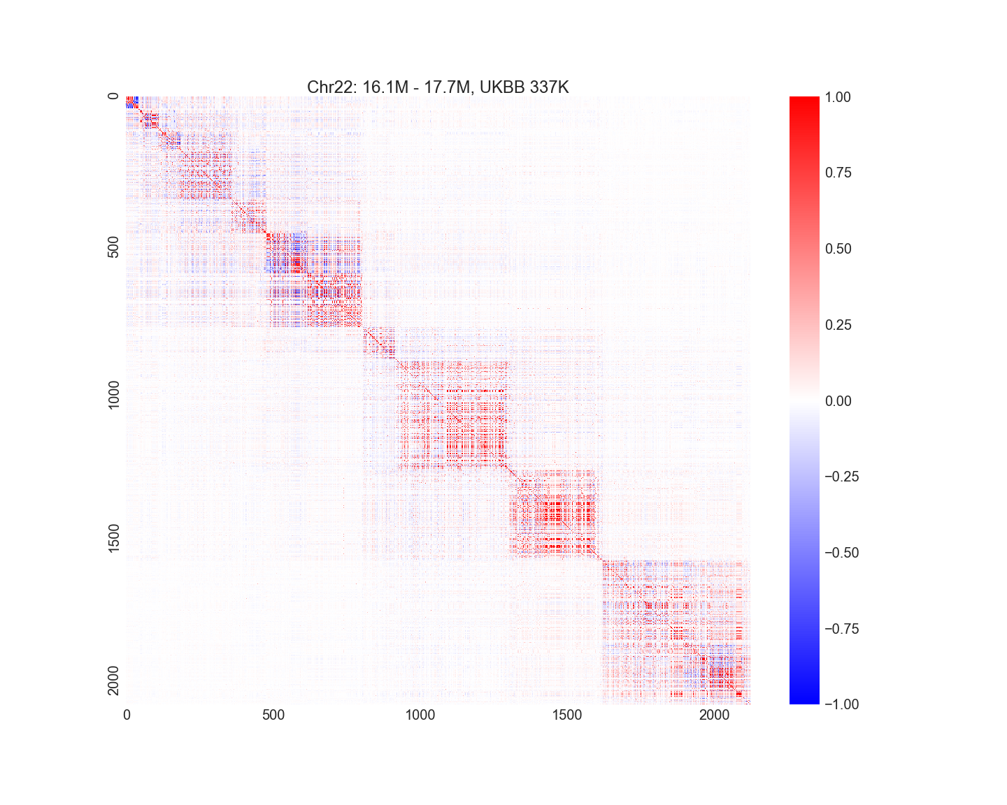
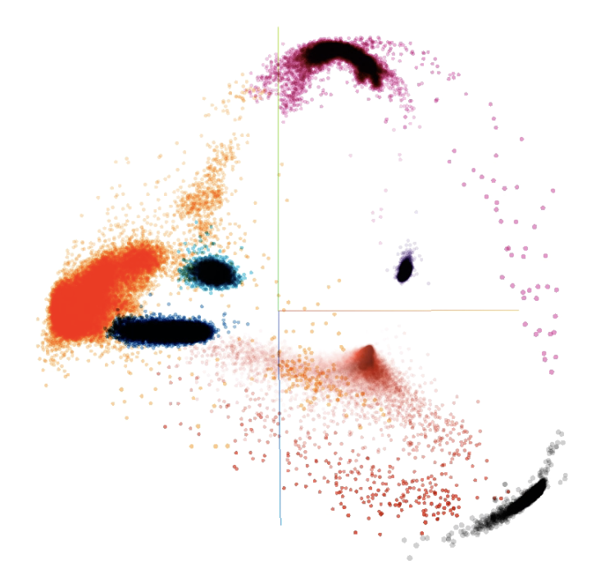
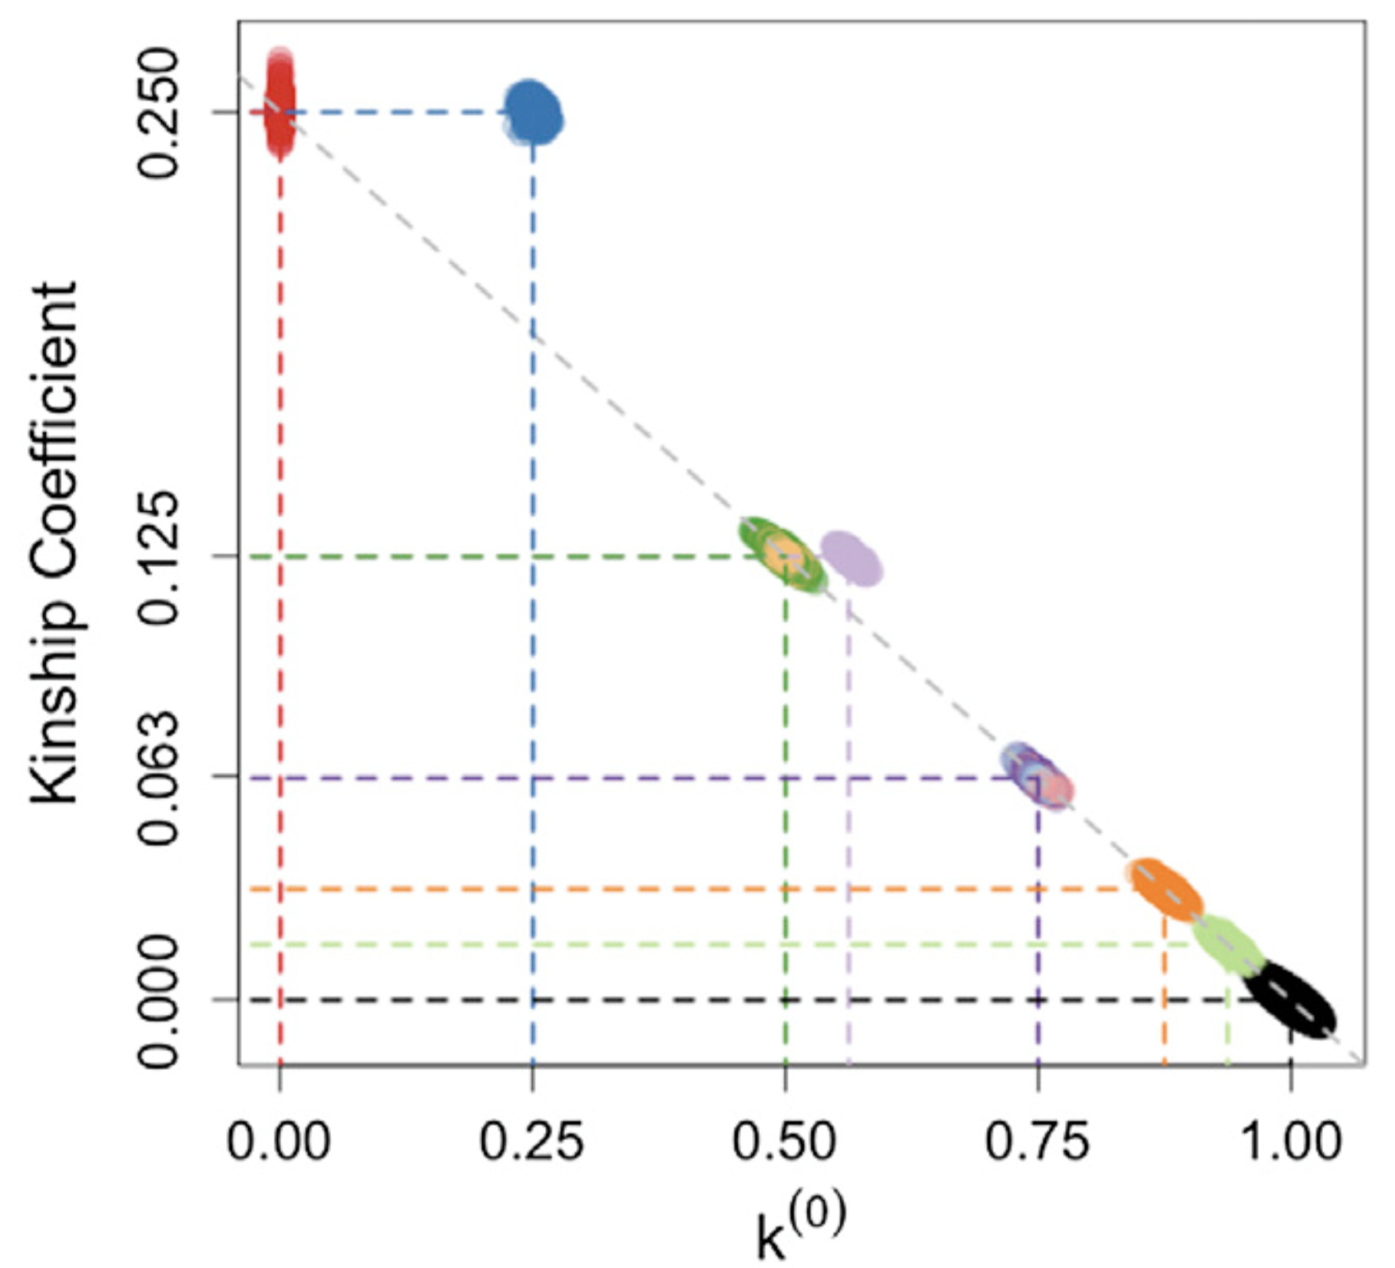
Hail as a Linear-Algebra Library
Linkage Disequilibrium
Relatedness
Principal Components Analysis
Notes:
Quality control often involves the LD matrix, the relatedness matrix, and the principal components of the dataset.
Hail supports all three by way of a robust system for linear algebra on arbitrarily large matrices.
Moreover, that system is first-class and general: you can use Hail to do linear algebra on any large dataset, not just a matrix of genotypes.

Slide 12
3
Core Data Model

Slide 13
Table
Globals
Dataset constants
Rows
Variant annotations
Inspired by
R dataframes
Pandas / Pola.rs
SQL
G
Rows
Try the tutorial at https://hail.is/docs/0.2/tutorials/03-tables.html
Notes:
Tables are 1 dimensional data structures composed of
A set of global constants for the dataset
A number of rows, optionally partitioned in some key space
Tables may be indexed (or `keyed`) by some orderable property
Eg genetic locus
Tables support the usual relational operations such as
aggregating over groups of rows
joining with other tables
filtering
annotating
etc

Slide 14
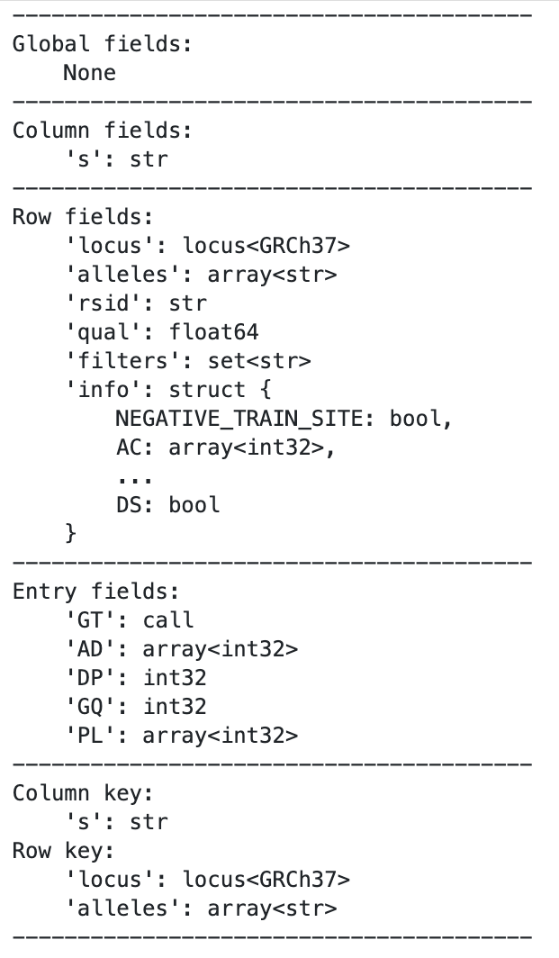
MatrixTable
Globals
Dataset constants
Rows
Variants
Columns
Samples
Entries Matrix
Genotypes
G
Columns
Rows
Entries
Try the tutorial at https://hail.is/docs/0.2/tutorials/07-matrixtable.html
Notes:
To support the Variant Call Format (VCF), hail introduced a 2D generalisation of a Table, called the MatrixTable.
MatrixTables extend the concept of Tables with
A table of columns for storing things like sample metadata
keyed some orderable property (sample id)
A matrix of entries for storing things like genotype metadata
Indexed by the row key and column key
The print-out on the right is an example of the result of importing a VCF into hail as a MatrixTable

Slide 15
4
Scalable Variant Call Representation
Read more here: https://academic.oup.com/bioinformatics/article/41/1/btae746/7932121
Notes:
In the following slides, we’ll take a look at the Scalable Variant Call Format, or SVCR, and it’s implementation in Hail as VDS.

Slide 16
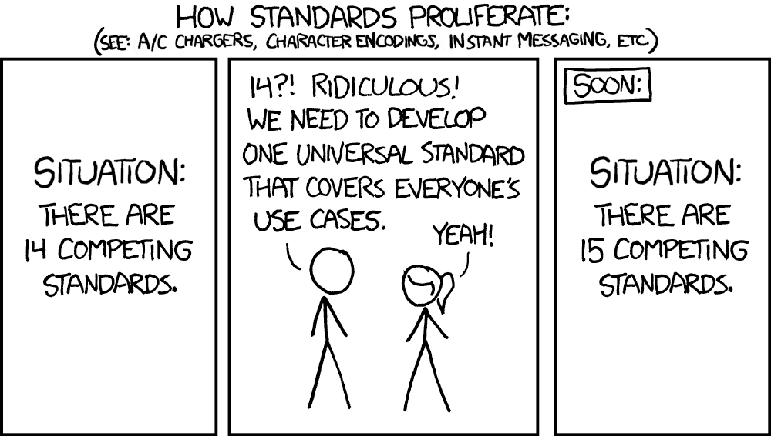
obligatory xkcd

Slide 17
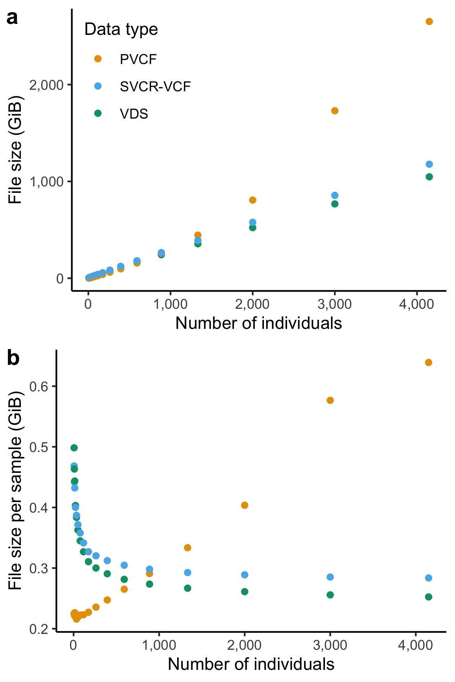
SVCR
Scaling of dataset size of sequenced whole genomes represented in Hail LZ4-compressed VDS, gzip-compressed SVCR-VCF and gzip-compressed PVCF. [1]
Notes:
When you have two or more gVCFs, you could joint-call them into a traditional VCF representation like pVCF.
A problem arises when you want to join-call many gVCFs:
pVCF file size scales superlinearly with number of samples
Merging is a lossy operation as data is stored as a dense matrix
Instead, you could convert your gVCFs into a format implementing the Scalar Variant Call Representation, or SVCR.
SVCR has a number of advantages over traditional VCF formats:
File size scales linearly with the number of samples
supports lossless combination with other gVCFs and formats supporting SVCR
Why does pVCF scale so badly?
Consider adding a new sample to a pVCF that contains N samples
pVCF requires, for every novel variant in a new sample, an additional row containing one variant genotype and N homozygous reference genotypes.
Furthermore, each new allele that the N+1th sample introduces requires extension of existing fields to account for the new allele
For instance, the first N samples’ allele depth (AD) fields need a new “0” (no reads) entry for the new allele.
Worse, the Phred-scaled genotype likelihood (PL) field grows quadratically in the number of alleles.
References
[1] Poterba T, Vittal C, King D, et al. The scalable variant call representation: enabling genetic analysis beyond one million genomes. Bioinformatics. 2024;41(1):btae746. doi:10.1093/bioinformatics/btae746

Slide 18
Column-Sparsity
CHR | POS | Ref | Alt | Sample1
chr1 | 3330 | C | <NON_REF> | GT=0/0, DP=10, GQ=30, END=3330
chr1 | 3331 | T | G, <NON_REF> | GT=0/1, DP=10, GQ=99, AD=[6, 4], PL=[100, 0, 105]
chr1 | 3332 | C | <NON_REF> | GT=0/0, DP=11, GQ=30, END=3349
chr1 | 3350 | A | C, <NON_REF> | GT=1/1, DP=15, GQ=55, AD=[0, 15], PL=[1002, 55, 0]
CHR | POS | Ref | Alt | Sample2
chr1 | 3330 | C | <NON_REF> | GT=0/0, DP=9, GQ=30, END=3334
chr1 | 3335 | G | C, <NON_REF> | GT=1/1, DP=7, GQ=22 AD=[0, 7], PL=[154, 22, 0]
chr1 | 3336 | T | <NON_REF> | GT=0/0, DP=10, GQ=30, END=3349
chr1 | 3350 | A | T, <NON_REF> | GT=0/1, DP=12, GQ=99 AD=[7, 5], PL=[154, 0, 102]
…
gVCFs
CHR | POS | Ref | Alt | Sample1 | Sample2
chr1 | 3330 | C | <NON_REF> | LGT=0/0, DP=10, GQ=30, END=3330 | LGT=0/0, DP=9, GQ=30, END=3334
chr1 | 3331 | T | G, <NON_REF> | LA=[0, 1], LGT=0/1, DP=10, GQ=99, LAD=[6, 4], LPL=[100, 0, 105]
chr1 | 3332 | C | <NON_REF> | LGT=0/0, DP=11, GQ=30, END=3349
chr1 | 3335 | G | C, <NON_REF> |  | LA=[0, 1], LGT=1/1, DP=7, GQ=22 LAD=[0, 7], LPL=[154, 22, 0]
chr1 | 3336 | T | <NON_REF> |  | LGT=0/0, DP=10, GQ=30, END=3349
chr1 | 3350 | A | C, T, <NON_REF> | LA=[0, 1], LGT=1/1, DP=15, GQ=55, LAD=[0, 15], LPL=[1002, 55, 0] | LA=[0, 2], LGT=0/1, DP=12, GQ=99 LAD=[7, 5], LPL=[154, 0, 102]
SVCR
Notes:
So how does SVCR achieve this scaling?
Let’s compare what happens if we combine two or more gVCFs via SVCR and joint-calling to pVCF.
The first way SVCR improves on pVCF is column sparsity:
Reference blocks from the gVCFs are preserved.
Loci where a sample has a reference block are left empty
Makes it very efficient to insert non-reference blocks for new samples

Slide 19
Local allele information
Example: locus: chr22:10678889 alleles: ["CAT", "C", "TAT"]
Old Representation |  | Local allele information
GT | 0/2 | LGT | 0/1
AD | [3, 0, 6] | LAD | [3, 6]
PL | [137, 137, 137, 0, 137, 77] | LPL | [137, 0, 77]
 |  | LA | [0, 2]
CHR | POS | Ref | Alt | Sample1 | Sample2
chr1 | 3330 | C | <NON_REF> | LGT=0/0, DP=10, GQ=30, END=3330 | LGT=0/0, DP=9, GQ=30, END=3334
chr1 | 3331 | T | G, <NON_REF> | LA=[0, 1], LGT=0/1, DP=10, GQ=99, LAD=[6, 4], LPL=[100, 0, 105]
chr1 | 3332 | C | <NON_REF> | LGT=0/0, DP=11, GQ=30, END=3349
chr1 | 3335 | G | C, <NON_REF> |  | LA=[0, 1], LGT=1/1, DP=7, GQ=22 LAD=[0, 7], LPL=[154, 22, 0]
chr1 | 3336 | T | <NON_REF> |  | LGT=0/0, DP=10, GQ=30, END=3349
chr1 | 3350 | A | C, T, <NON_REF> | LA=[0, 1], LGT=1/1, DP=15, GQ=55, LAD=[0, 15], LPL=[1002, 55, 0] | LA=[0, 2], LGT=0/1, DP=12, GQ=99 LAD=[7, 5], LPL=[154, 0, 102]
SVCR
Notes:
The second way SVCR wins is using local allele information instead of the traditional genotype fields, like GT, AD, PL.
At each locus, for each sample, a `local alleles` field, LA, indicates which alleles were observed in this sample.
These local alleles are indices into the set of global alleles observed in any sample at this locus.
Using this, we can greatly reduce the amount of information required to store the various genotype metadata.
For example AD and PL, the latter of which scales quadratically with the number of alleles

Slide 20
Variant Dataset
Project
VCF
Lossless conversion from gVCF
Allows for new QC methods and “N + 1” processing
Efficient data format: >10X less storage
Separates reference from variant data, enabling easier computation
gVCF1
gVCF2
gVCF3
gVCF4
gVCF5
…
Variant Dataset (VDS)
Learn more at https://hail.is/docs/0.2/vds/index.html
Notes:
The Variant Dataset (or VDS) is hail’s native implementation of SVCR.
Within hail, you can
combine one or more gVCFs into VDS losslessly.
Extract a single gVCF
Combine many VDS
Export to pVCF but note this is a lossy transformation and the resultant file might be huge.
VDS stores reference data and variant data separately which we’ll see next slide

Slide 21
VDS consists of two sparse matrices
Reference blocks
Variant calls
Entry = { ‘GT’ ‘AD’ ‘DP’ ‘GQ’ ‘PL’ ... }
samples
samples
Entry = { ‘END’ ‘DP’ ‘GQ’ }
reference sites
variants
Reference calls are defined as intervals (reference blocks) exactly as they appear in the original gVCFs
Notes:
VDS stores reference and variant data as two separate, sparse MatrixTables.
The big reason for doing this is that the reference data is huge and not always needed
Why pay to read all that data when it’s not used?
Conceptually, it makes sense to keep them separate:
Variant mt entries are single variants, while
Reference mt entries are intervals
Storing them in one big sparse mt would incur a lot of wasted empty values

Slide 22
Thank you
All source code available the MIT License
All development in the open at github.com/hail-is/hail
Development discussion at hail.zulipchat.com
Support at discuss.hail.is and on GitHub
Qualtrics link for Practical:
https://qimr.az1.qualtrics.com/jfe/form/SV_8pEKV30Dw74HVt4

