Slide 1
Genetic association tests for rare variants
2025 International Statistical Genetics Workshop
Duncan Palmer

Slide 2
Learning objectives
Talk
Understand rationale and methodology behind rare variant association testing
Be aware of approaches to increase statistical power
Practical
Perform simple burden tests using R
Get SAIGE-gene running

Slide 3
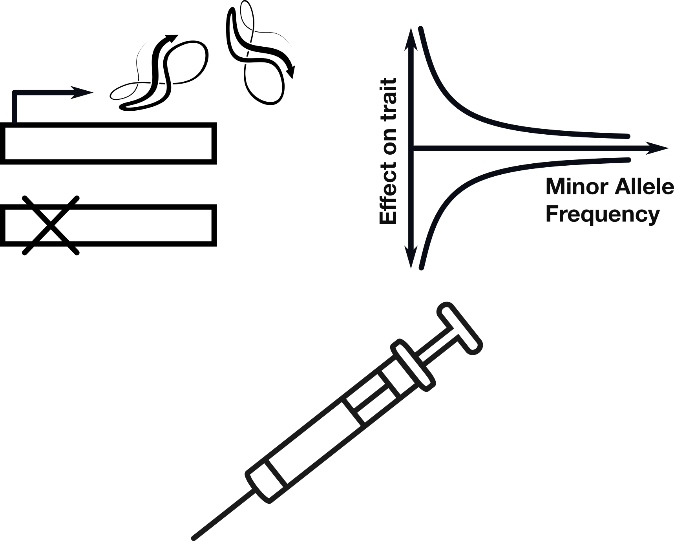
Why study rare genetic variation?
Interpretability of results
Large effects
Translational opportunities

Slide 4
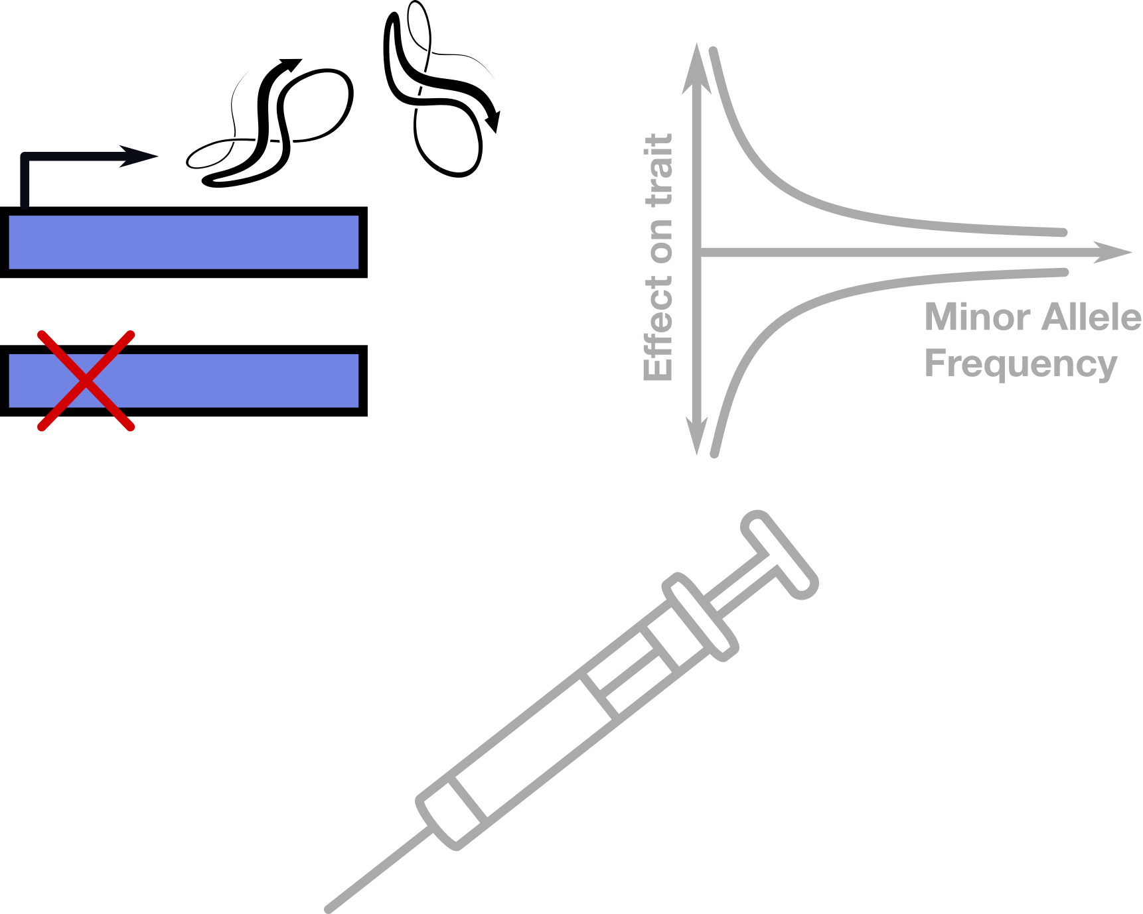
Why study rare genetic variation?
Interpretability of results
Large effects
Translational opportunities
Notes:
Chief among them is interpretability, as usually both the gene target and causative variation are known, in stark contrast to common variant association studies, or ‘GWAS’, where refining a significant genetic association is notoriously difficult.

Slide 5
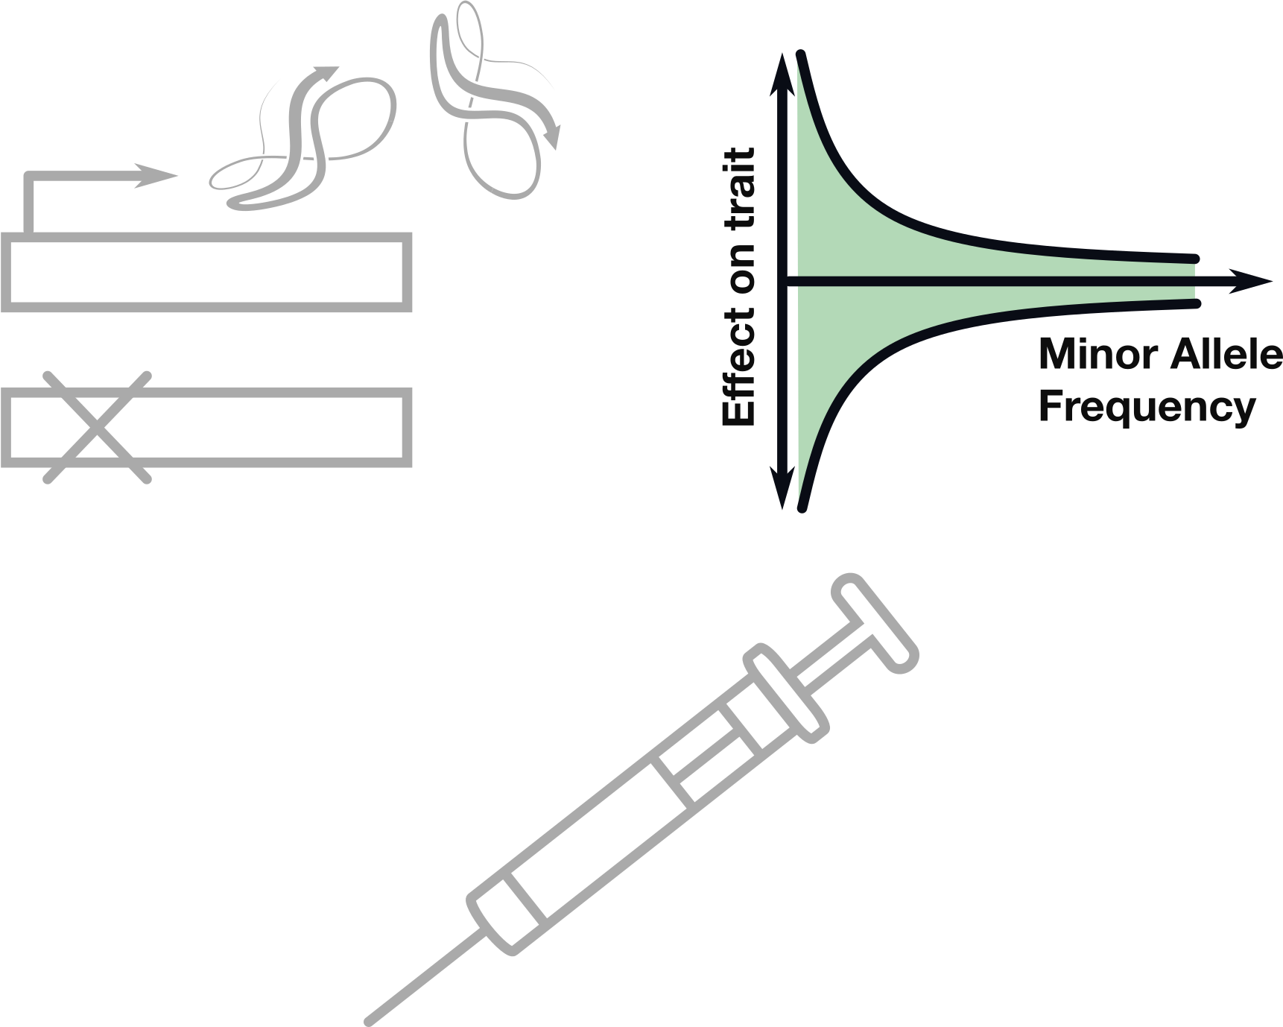
Why study rare genetic variation?
Interpretability of results
Large effects
Translational opportunities
Notes:
Secondly, since these variants are rare, if we’re able to detect their effects, they have to be large - that’s just how the maths works.

Slide 6
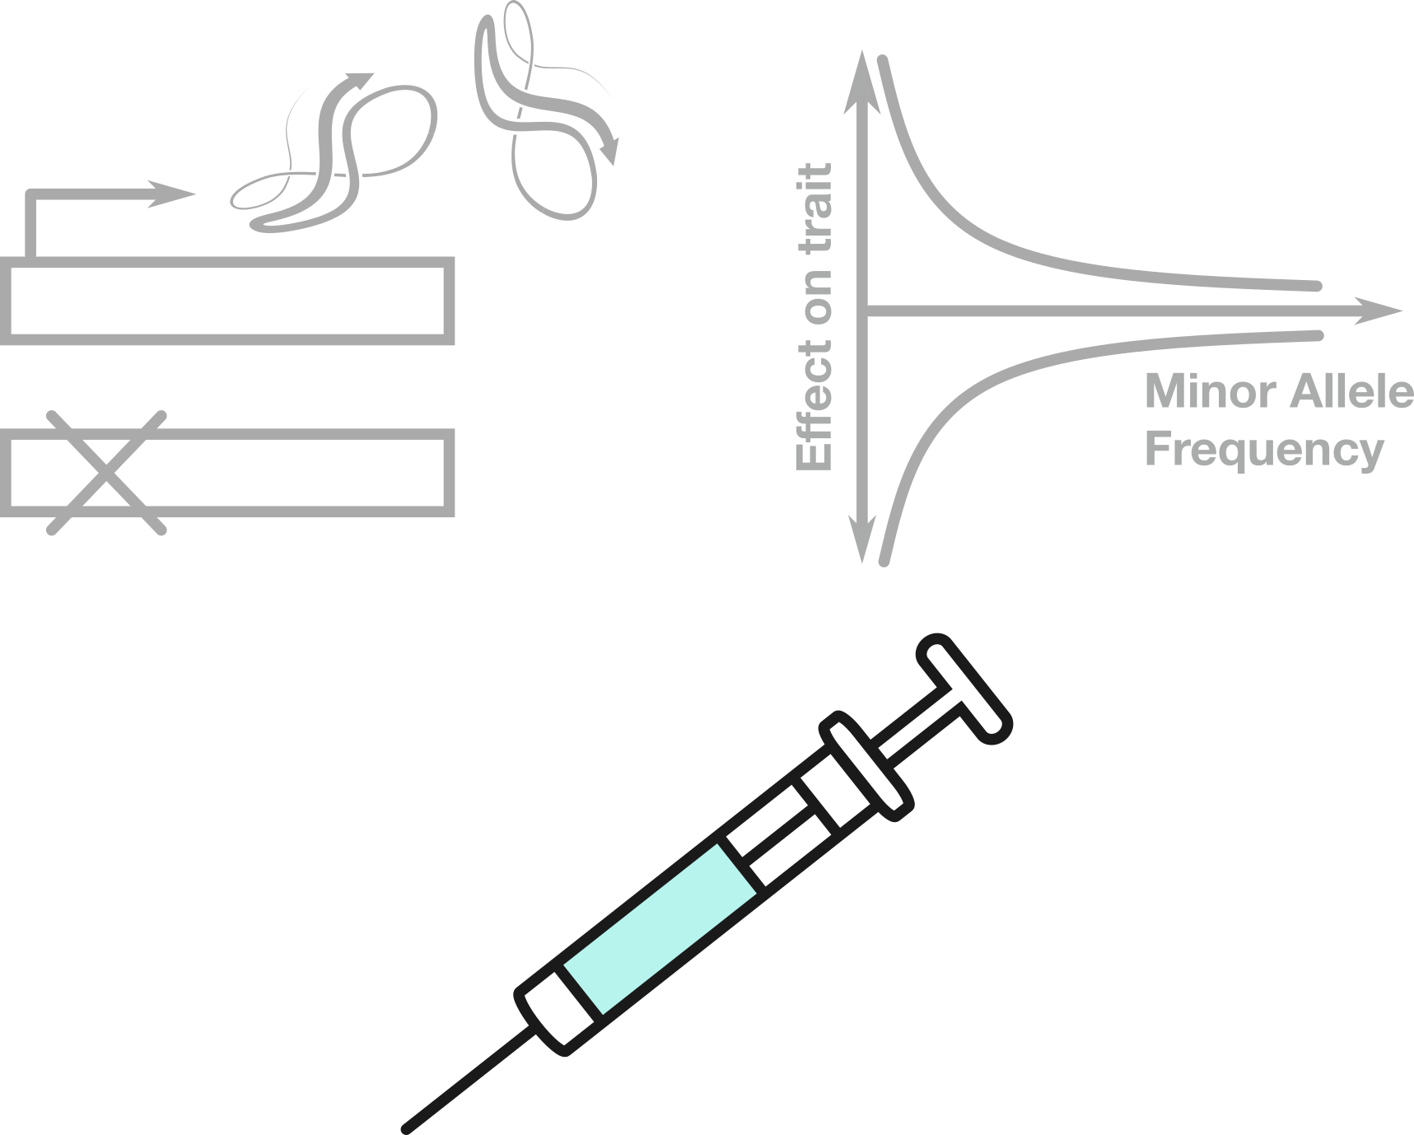
Why study rare genetic variation?
Interpretability of results
Large effects
Translational opportunities
Notes:
Thirdly, the translational opportunities. If we’re able to target or replace these genes the resultant effects have the potential to be large, due to point 2.
To make this concrete, let’s consider the gene PCSK9.
It turns out that rare gain of function mutations in the gene are associated with high LDL cholesterol, and loss of function mutations in the gene are associated with low LDL cholesterol. Aha, so maybe PCSK9 plays a central role in regulating cholesterol levels. Pretty interpretable!
The effects are big too - rare loss of function mutations in PCSK9 are associated with reductions in LDL of up to ~28%. And, it turns out that carriers, so those with only one ‘damaged’ copy, have massively reduced risk of coronary heart disease. And I mean massive (up to an ~88% reduction in risk). Ok that’s cool, but maybe having two copies of the gene with loss of function variants is bad? Well we can check that too, and it turns out that no, it’s not, there are people walking around completely healthy with loss of function variants on both their copies of PCSK9 - they just have super low LDL levels. That’s fantastic from a drug development perspective, as inhibiting the gene would likely have minimal side effects. And that bares out - PCSK9 loss of function variants directly informed the development of PCSK9 inhibitors as effective treatments for high LDL cholesterol and prevention of coronary heart disease.

Slide 7
Why study rare genetic variation?
Largest impact (loss-of-function)
Variants with large effects on protein function are often rare, due to negative selection.
Proportion of variants that are very rare
Figure adapted from Karczewski et al. Nature 2020

Slide 8
Single-variant association tests are underpowered for rare variants
Sample size required to observe a variant with MAF = p with > 99.9% chance is…
MAF | 0.1 | 0.01 | 0.001 | 0.0001
N | 33 | 344 | 3,453 | 34,537
Notes:
(1-p)^2N > 1 - theta

Slide 9
Why study rare genetic variation?
Variants with large effects on protein function are often rare, due to negative selection.
Collectively, rare variants are very common:
~200 very rare (MAF<0.1%) coding variants per person
Rare variants (MAF<0.1%)
Gudmondsson et al., 2021 “Variant interpretation using population databases: Lessons from gnomAD”

Slide 10
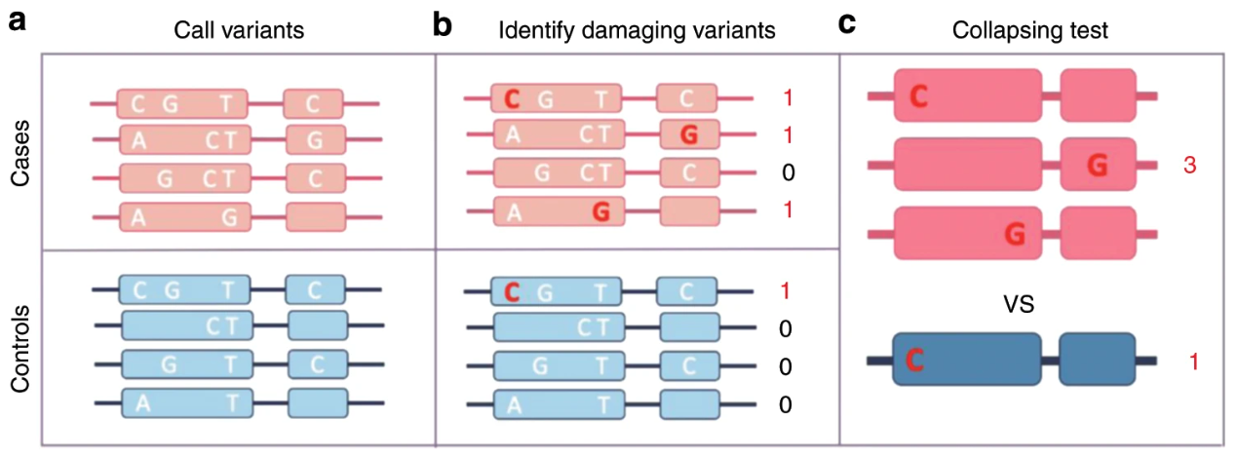
Rare variant collapsing tests
Rather than testing individual variants, we can aggregate across a gene or functional unit
All variants
Rare variants
Collapsing test
Adapted from Cirulli et al. Nat Comms 2020
Notes:
SIFT
Sequence homology
Conservation + amino acid substitution
PolyPhen-2
Naïve Bayes classifier
Evolutionary conservation + structural impact
CADD
SVM model
Integrates functional annotations and conservation
REVEL
Random forest ensemble
Combines multiple predictors for higher accuracy

Slide 11
Simple burden test
Has rare variant in gene?
All variants
Rare variants
Collapsing test
Yes
No
Yes
3
1
Has disease?
1
3
No
Use these counts in a 2x2 table

Slide 12
Genetic association testing
Genotype is associated if prevalence of disease is different between genotype carriers vs. non-carriers:
Odds ratio =
Has rare variant in gene?
Yes
No
Yes
a
b
Case/control ratio in carriers
Has disease?
Case/control ratio in non-carriers
c
d
No
a/c
a/b
=
=
b/d
c/d

Slide 13
Genetic association testing
Has rare variant in gene?
Calculating statistical significance:
Yes
No
Fisher’s Exact Test
Yes
a
b
(a+b)!(c+d)!(a+c)!(b+d)!
Has disease?
c
d
a! b! c! d! (a+b+c+d)!
No
Notes:
This is a Fisher’s exact test
Remember this guy from earlier
Some lady claimed that she could tell whether milk was out in her tea before or after the water

Slide 14
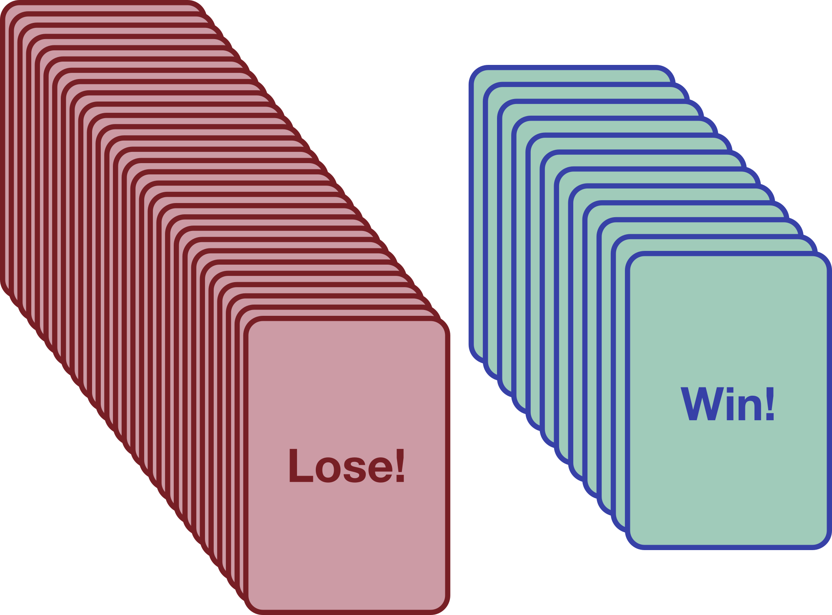
Genetic association testing

Slide 15
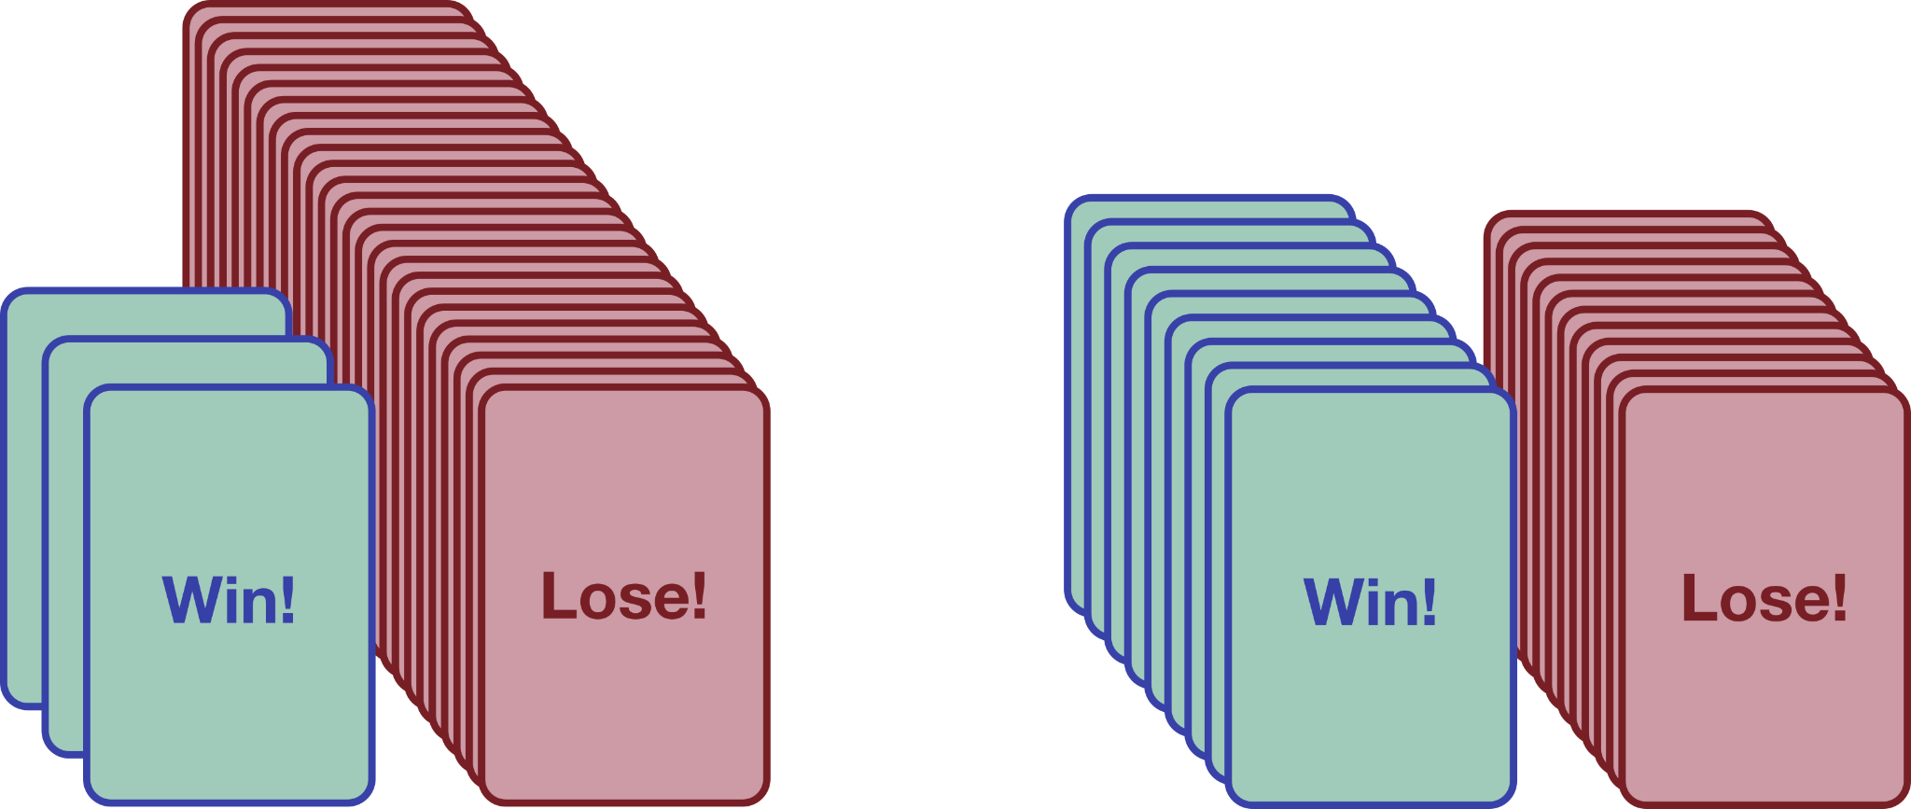
Genetic association testing
Dan
Duncan

Slide 16
Genetic association testing
scratch card win?
Yes
No
( )( )
28
3
21
9
Dan
3
25
( )
9
12
49
12
Duncan

Slide 17
Genetic association testing
scratch card win?
Yes
No
( )( )
28
3
21
9
Dan
3
25
P = 0.017
( )
9
12
49
12
Duncan
Notes:
Can you think of some problems with this?
What aren’t we doing?
Where’s the covariates?

Slide 18
Methods for region/gene-based tests
Consider the following question: Given N independent observations, and suppose we know:
Phenotype we’re interested in
Covariates we need to adjust
Genotype information of rare variants in a region
Can we get an appropriate P-value for association between rare variation in this region, and the phenotype?

Slide 19
Model
For continuous traits
For binary traits
: probability of having disease given X and G

Slide 20
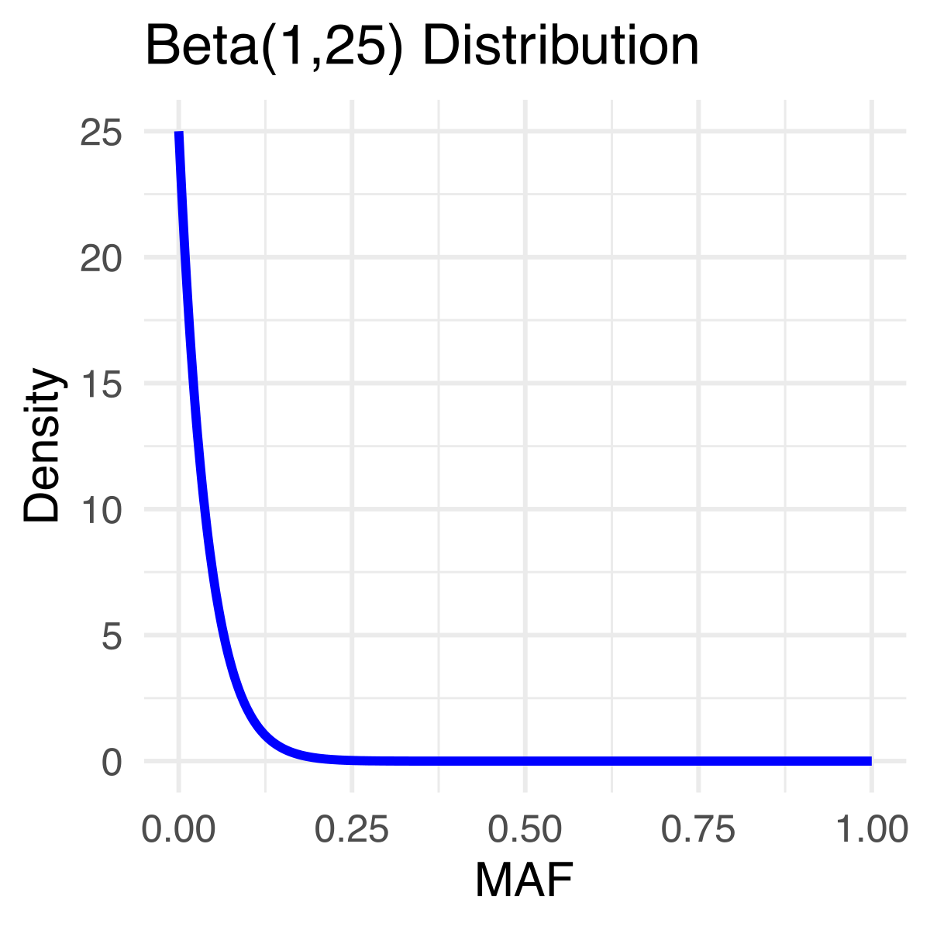
Model for burden tests
Reduce the number of degrees of freedom
Incorporate weights for each variant
: probability of having disease given X and G
Notes:
So let’s focus in on the binary traits and consider the burden of rare variation in the gene. So, what are we looking for? Well, an association between burden of the class of variation under interrogation, and the trait.
A common thing is to assume they have the same effect (beta_c) here, and group them up. Why? To increase statistical power!

Slide 21
Score test to look for association between rare variant burden and a binary trait
β > 0
β = 0
β < 0
Notes:
Wei talked about score tests the other day.
If you remember, there are a few tests that we can consider when running logistic regression
Wald test - tests whether beta is significantly different from 0
Likelihood ratio test - compare the null to the alternative
Score test - ask, would I massively improve in likelihood if I moved away from the null?
The massive benefit of the score test, is that we only need to fit the null model. The score test evaluates the steepness of the likelihood surface at the null model parameter values. If the score is large, it indicates that the data strongly suggest the null hypothesis is not correct.

Slide 22
Rare variant collapsing tests
Burden tests
(unidirectional, linear statistics)
CAST [Morgenthaler & Thilly, 2007]
CMC [Li & Leal, 2008]
w-Sum [Madsen & Browning, 2009]
SST [Morris & Zeggini, 2010]
VT [Price et al., 2010]
Best powered when:
All variants are causal
All variants have the same direction of effect

Slide 23
Rare variant collapsing tests
Burden tests
(unidirectional, linear statistics)
CAST [Morgenthaler & Thilly, 2007]
CMC [Li & Leal, 2008]
w-Sum [Madsen & Browning, 2009]
SST [Morris & Zeggini, 2010]
VT [Price et al., 2010]
Best powered when:
All variants are causal
All variants have the same direction of effect

Slide 24
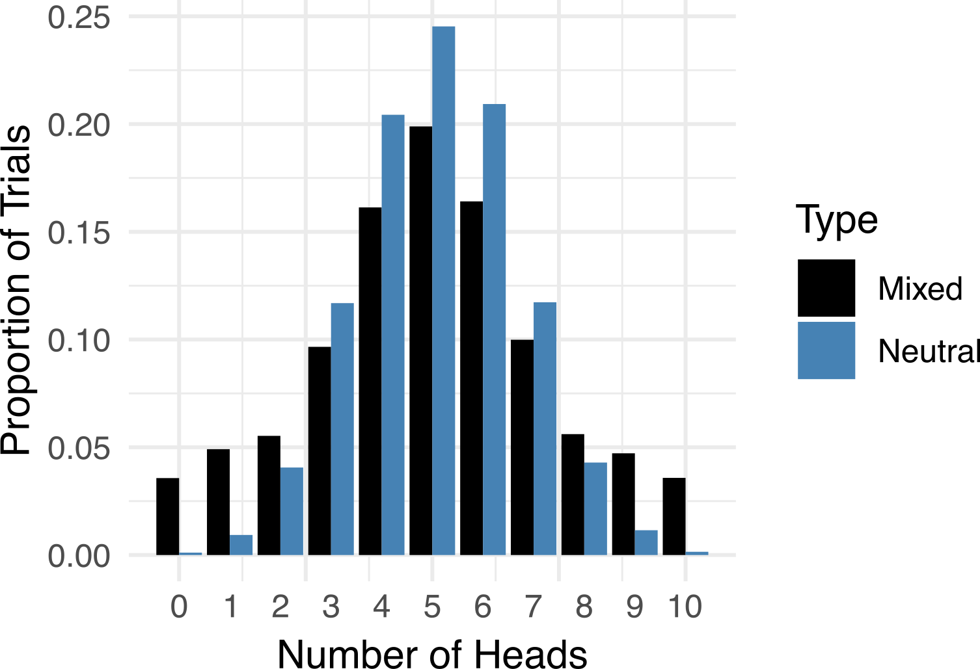
What about when the effects vary in direction?
It’s like flipping a bunch of biased coins
Neale et al., PLoS Genetics, 2011
Notes:
To gain insight into a new test. Let’s consider the scenario where a gene is important for a trait. Then it stands to reason that you might expect there to be both risk increasing and risk decreasing variants in the gene (among a bunch of variants that are neutral). We can equate this to flipping a bunch of coins, some which are biased towards heads, and some which are biased towards tails, and count the number of heads we observe after flipping the coins. Here’s a toy example. The light blue is if there are no biased coins (so the null), and the dark blue is if there are some biased coins in there. And you’ll notice that there’s increased spread in the mixed version. Aha! So maybe we could look for this!
The C-alpha test is a non-burden-based test and is hence robust to the direction and magnitude of effect. For case-control data, it compares the expected variance to the actual variance of the distribution of allele frequencies.
But it doesn’t allow for covariate adjustments.
SKAT came along later in 2011 and generalised this

Slide 25
Score test for rare variant association using variance components
β > 0
β = 0
β < 0
Notes:
This is called SKAT
So what’s the idea here and where has this guy come from?
Well, you might spot that this guy on the right here looks a bit familiar
What’s happening is that you’re summing a bunch of squared score statistics
Follows a mixture of chi squared distributions under the null

Slide 26
Collapsing tests
Better powered when:
Not all variants are causal
Variants have different directions of effect
Burden tests
(unidirectional, linear statistics)
CAST [Morgenthaler & Thilly, 2007]
CMC [Li & Leal, 2008]
w-Sum [Madsen & Browning, 2009]
SST [Morris & Zeggini, 2010]
VT [Price et al., 2010]
Variance component
(bidirectional, quadratic statistics)
C-alpha [Neale et al., 2011]
SKAT [Wu et al., 2011]

Slide 27
Collapsing tests
Burden tests
(unidirectional, linear statistics)
CAST [Morgenthaler & Thilly, 2007]
CMC [Li & Leal, 2008]
w-Sum [Madsen & Browning, 2009]
SST [Morris & Zeggini, 2010]
VT [Price et al., 2010]
Variance component
(bidirectional, quadratic statistics)
C-alpha [Neale et al., 2011]
SKAT [Wu et al., 2011]
Hybrid tests
(combining both)
SKAT-O [Lee et al., 2012]
Minimum P [Derkach et al., 2013]
Fisher’s statistic [Derkach et al., 2013]
Figure adapted from Sung et al., 2014

Slide 28
What about combining the two?
β > 0
β = 0
β < 0
β > 0
β = 0
β < 0

Slide 29
SKAT-O is more powerful that Burden and SKAT
β > 0
β = 0
β < 0
β > 0
β = 0
β < 0

Slide 30
Variants can be split into functional ‘categories’
For many genes full loss-of-function may be needed to cause disease
For others, an effect may be limited to missense variants impacting a specific protein domain

Slide 31
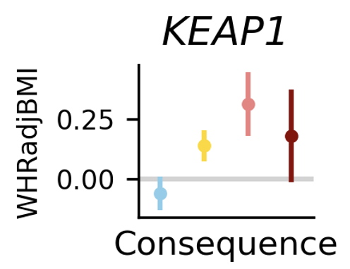
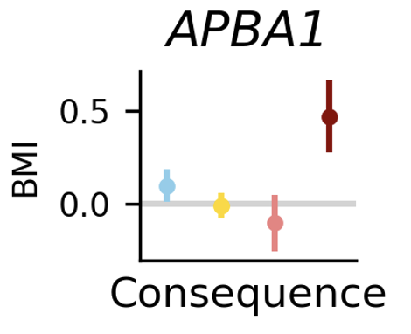
Variants can be split into functional ‘categories’
For many genes full loss-of-function may be needed to cause disease
For others, an effect may be limited to missense variants impacting a specific protein domain
Notes:
So if you believe different categories have different effect sizes, you can gain power that way - check out the coding variant allelic series test

Slide 32
Software for gene-level testing
“Perhaps the single greatest challenge facing rare-variant analyses is the issue of scalability”
Povysil et al. Nature Reviews Genetics 2019

Slide 33
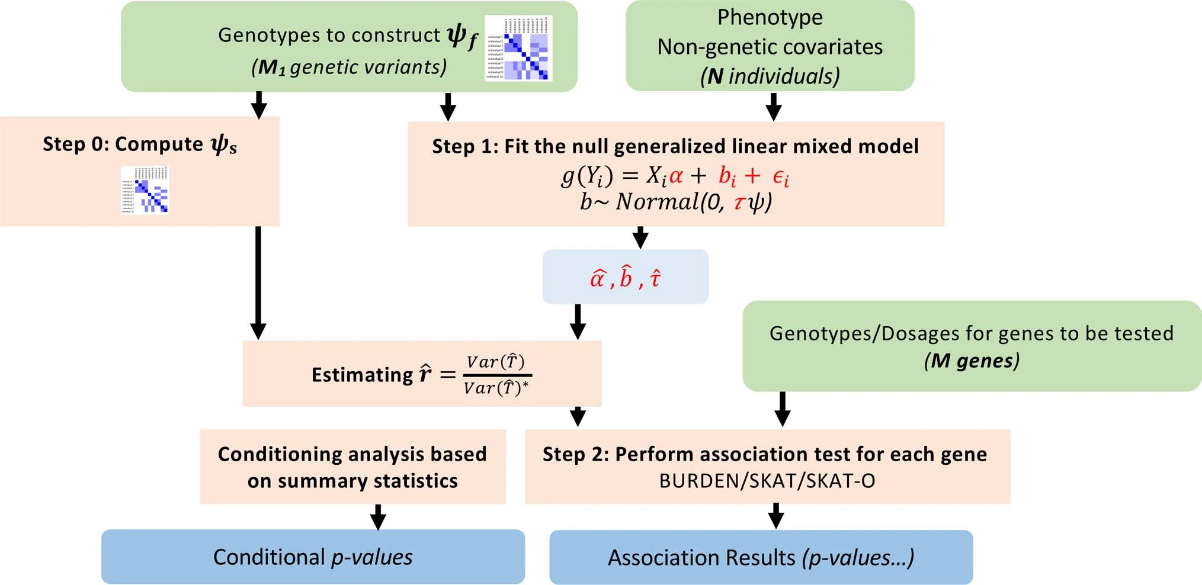
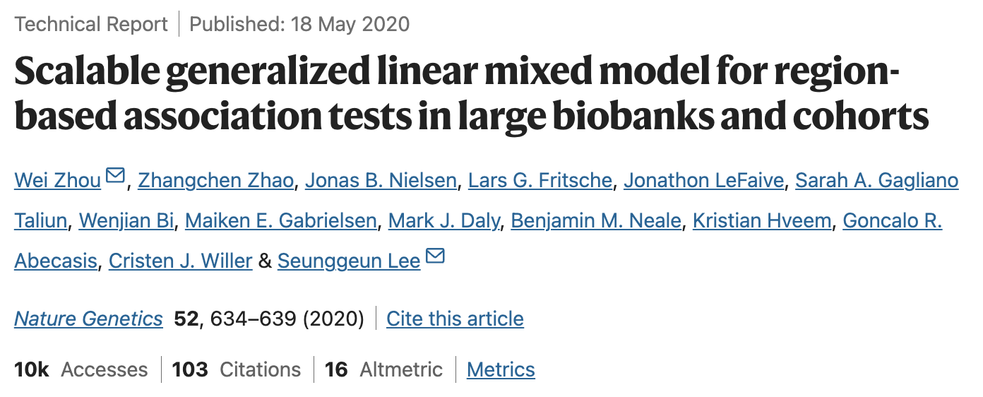
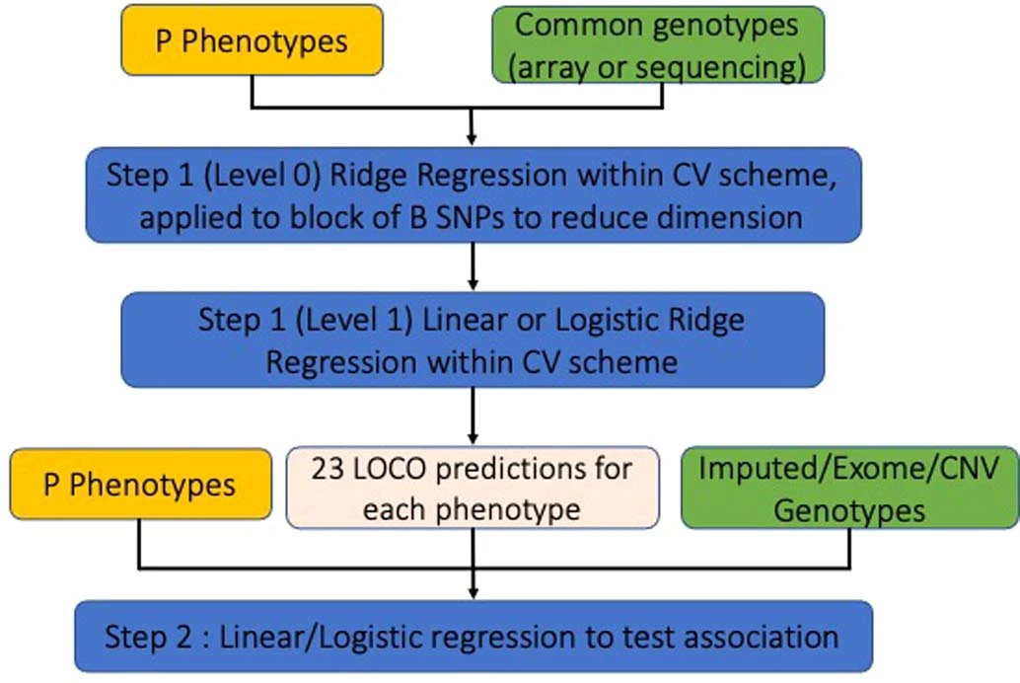
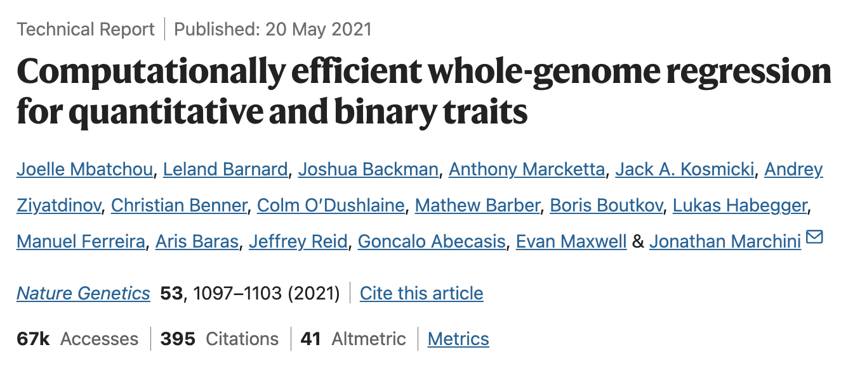
Software for gene-level testing
SAIGE-GENE
Zhou et al. Nature Genetics 2020
Phenotypes
Common genotypes (e.g. array)
Step 1: Fit null model
Variants to be tested (e.g. MAF cutoffs, annotations)
Regenie
Mbatchou et al. Nature Genetics 2021
Step 2: Association tests
Note: Possible (but now outdated) to code gene burden as variant-level genotypes and use variant-level testing frameworks (see Cirulli et al., 2020 using BOLT-LMM)
Notes:
SAIGE Step 1: Fits a full mixed model using a sparse GRM to estimate variance components Step 2: Uses a score test for each variant while adjusting for population structure REGENIE’s Two-Step Approach
Step 1: Whole-Genome Ridge Regression for Polygenic Modeling
REGENIE first fits a ridge regression model using genome-wide SNPs to predict phenotype (either binary or continuous).
It uses a leave-one-chromosome-out (LOCO) strategy to prevent overfitting.
This step does not perform association testing but estimates individual trait variance components.
Step 2: Fast Association Testing Using a Score Test
After Step 1, REGENIE performs single-variant association tests using a score test.
The score test is computationally efficient and does not require refitting a full mixed model for each SNP.
It corrects for confounding using the residuals from Step 1.

Slide 34
SAIGE-GENE+
Improved computational efficiency
Improved type 1 error
Improved power
Multiple functional annotations, e.g.
LoF
LoF+non-synonymous
Multiple max-MAF cutoffs, e.g.
0.01%
0.1%
1%
Linear/logistic mixed model
Saddlepoint approximation
Related samples
Case:control imbalance
Optimisation strategies
Group-based testing
Large-scale data
Rare variant testing
Zhou*, Bi*, Zhao* et al., Nature Genetics, 2022

Slide 35
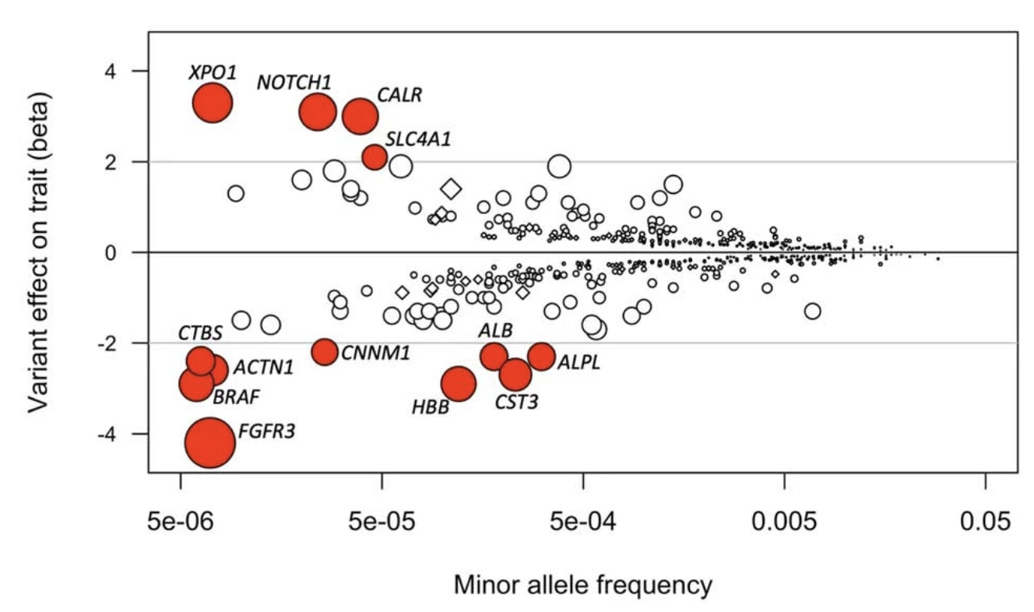
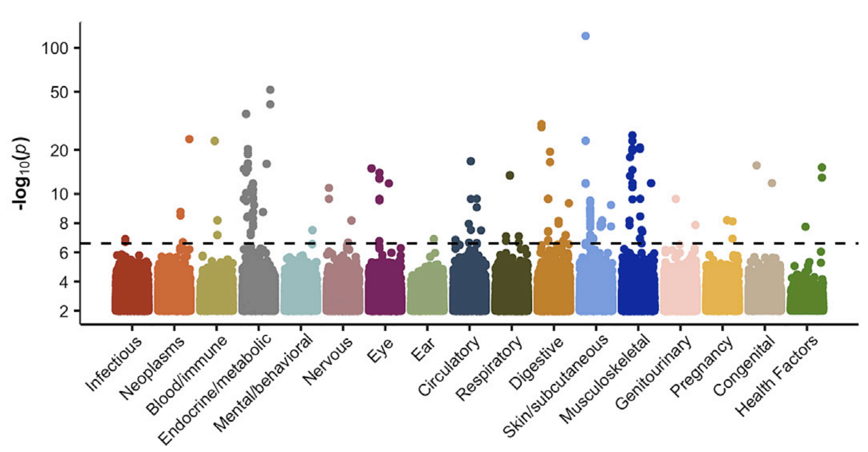
Recent applications
Regeneron UKB 450k exomes
Backman et al. Nature 2021
Genebass UKB 450k exomes
Karczewski et al. Cell Genomics 2022
Pan-ancestry ~750k (UKB, AoU, MGB)
Jurgens et al. Nature Genetics 2024

Slide 36
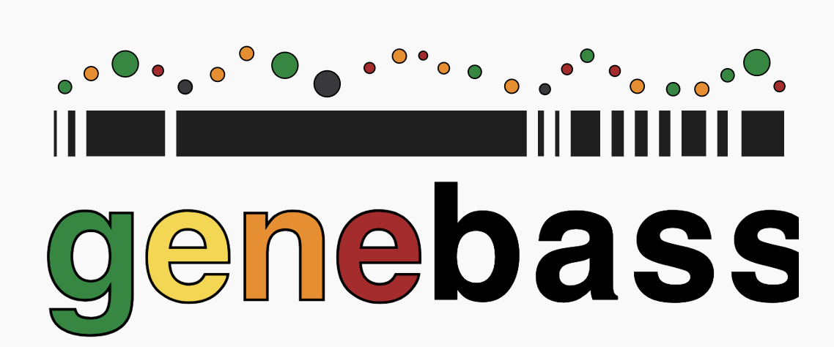
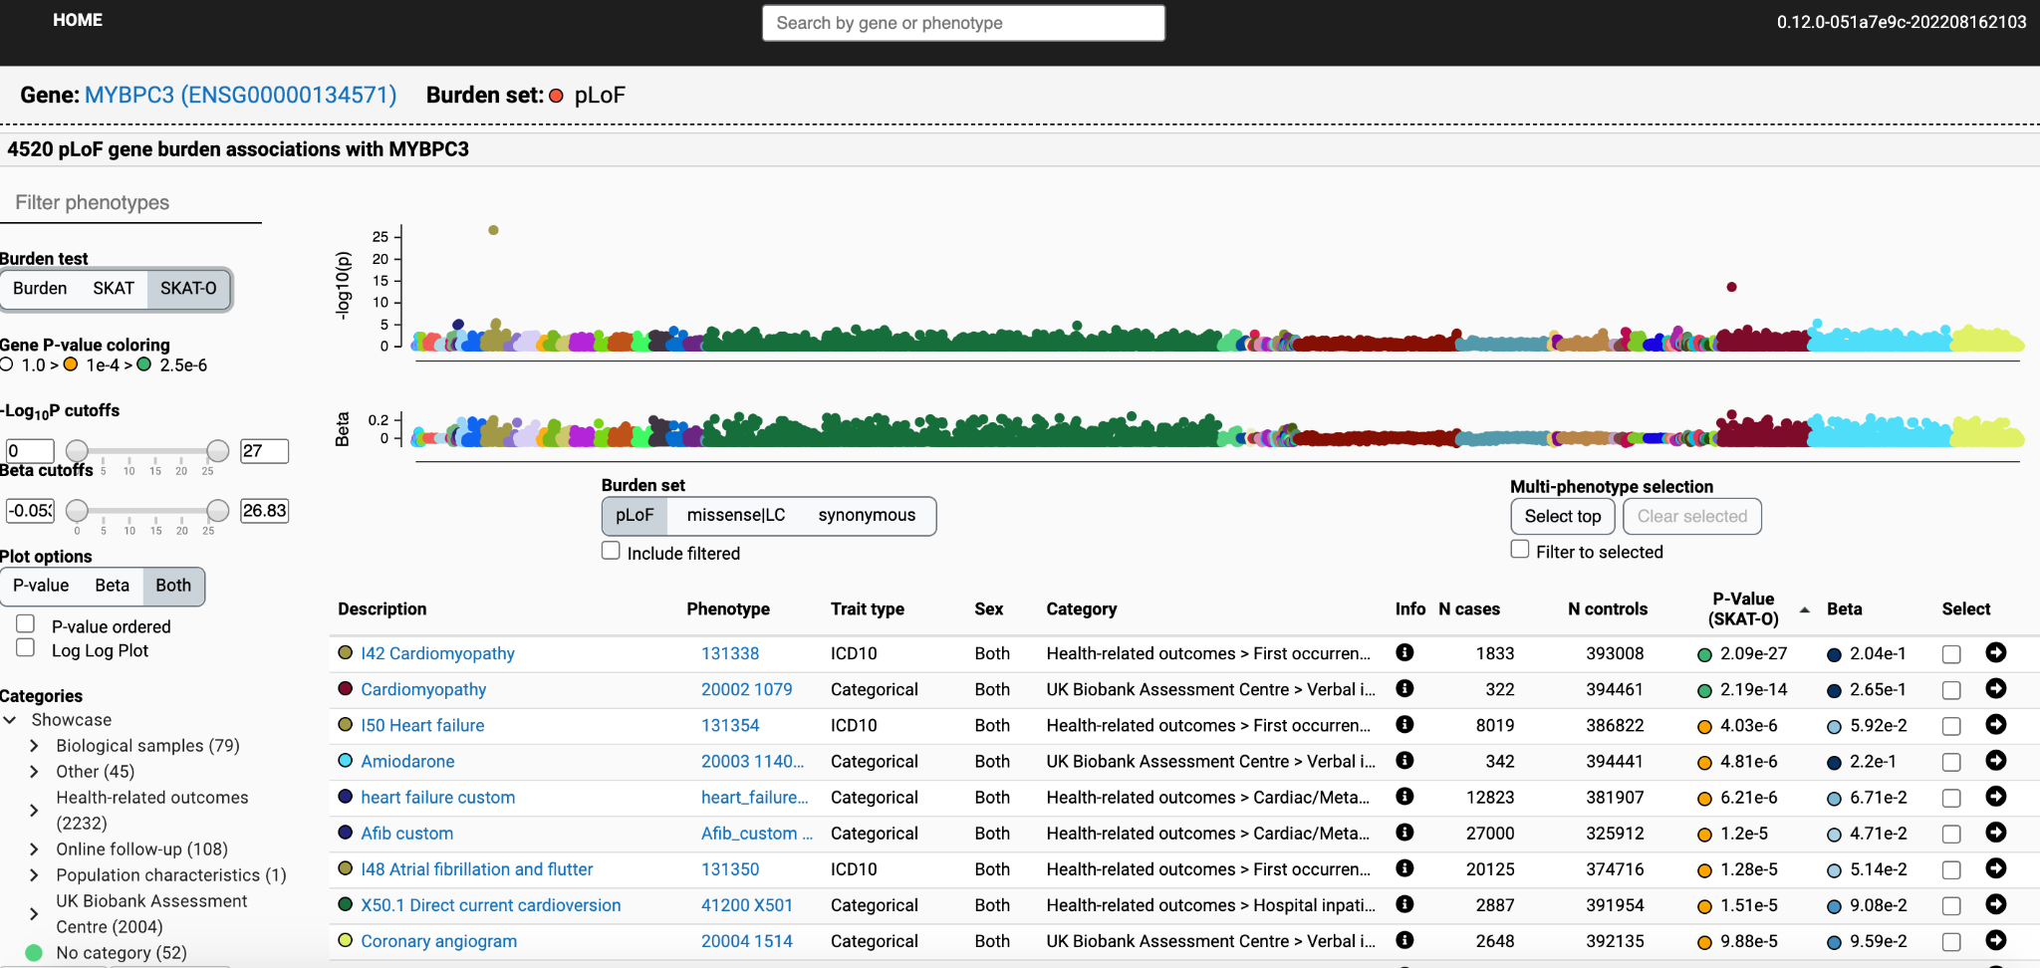
Recent applications
Regeneron UKB 450k exomes
Backman et al. Nature 2021
Genebass
Karczewski et al. Cell Genomics 2022
Pan-ancestry ~750k (UKB, AoU, MGB)
Jurgens et al. Nature Genetics 2024
app.genebass.org

Slide 37
Quantitative traits
Common variants
Rare variants
Related samples?
Large sample (N > 10,000)
Yes
No
SKAT
Yes
No
SAIGE-GENE+
Regenie
STAAR
SMMAT
EmmaX-SKAT
Notes:
EmmaX-SKAT: Linear mixed-model for set-based tests
SMMAT: Logistic mixed model for set-based rare variant test for binary phenotypes
STAAR is an R package for performing variant-Set Test for Association using Annotation infoRmation (STAAR) procedure in whole-genome sequencing (WGS) studies. STAAR is a general framework that incorporates both qualitative functional categories and quantitative complementary functional annotations using an omnibus multi-dimensional weighting scheme. STAAR accounts for population structure and relatedness, and is scalable for analyzing biobank-scale WGS studies of continuous and dichotomous traits with balanced or imbalanced case-control ratios.

Slide 38
Binary traits
Common variants
Rare variants
Related samples?
Yes
No
case:control < 1:10
case:control < 1:10
Yes
No
Yes
No
SAIGE-GENE+
Regenie
SMMAT EmmaX-SKAT SAIGE-GENE+
Regenie
STAAR
SKAT binary
SKAT

Slide 39
Lecture summary
Low power to detect single-variant associations with low frequency
Grouping rare variants increases power
Various methods to test grouped variants (e.g. burden, SKAT, SKAT-O)
Various software to make this scalable (e.g. SAIGE, Regenie)
Next up: Put this knowledge into practice and do some association testing!
Questions and instructions are here:
https://qimr.az1.qualtrics.com/jfe/form/SV_5vZEC9z5y2RXckS
Slides adapted from earlier versions from Nicky Whiffin and Nik Baya

Slide 40
Reading list
Review articles:
Lee et al., 2014 *
Povysil et al., 2019 ***
Applications:
Questions:
What methods are used to annotate variants with consequence? What variant masks are used?
What association tests are used? (e.g. burden, SKAT, SKAT-O)
What multiple testing correction do they use?
Cirulli et al., Nature Comms 2020 (first phenome-wide burden testing: 4.2k phenos, 50k + 22k individuals)
Backman et al. Nature 2021 (Regeneron 450k WES flagship)
Karczewski et al. Cell Genomics 2022 (Genebass, 4.5k phenos, 400k individuals)
Jurgens et al. Nature Genetics 2024 (Pan-ancestry, 601 diseases, ~750k individuals across 3 biobanks)
Methods:
CMC (early burden testing) – Li & Leal 2008
SKAT-O: Lee et al., 2012

