Slide 1





Power, Sample Size and Replication
David Evans^{1,2,3}
1 Institute for Molecular Bioscience, University of Queensland
2 University of Queensland Diamantina Institute
3 MRC Integrative Epidemiology Unit, University of Bristol

Slide 2
Outline
1. Aims
2. Statistical power
3. Estimate the power of association analysis
Analytically
Empirically
4. Multiple Testing
5. Replication

Slide 3
1. Aims

Slide 4
1. Know what type-I error and power are
2. Know that you can/should estimate the power of your association analyses (analytically or empirically)
3. Know that there a number of tools that you can use to estimate power
4. Be aware that there are many factors that increase type-I error and decrease power
5. Be able to understand strategy and criteria for replication

Slide 5
2. Statistical power

Slide 6
H₀: There is NO association between a marker and a trait
H₁: There is association between a marker and a trait
In reality…
H₀ is true
H₁ is true
β
1 - α
H₀ is true
Type-2 error
We decide…
α
1 - β
H₁ is true
Type-1 error
Power
Power: probability of detecting association when H₁ is true.

Slide 7
Definitions
Power
The probability of detecting a given size effect in a population from a sample size N, using significance criterion alpha
Type I error
The probability of incorrectly rejecting the null hypothesis of no association

Slide 8
H₀: There is NO association between a marker and a trait
H₁: There is association between a marker and a trait
Association test statistic has different distributions under H₀ and H₁
x
x
x
x
x
x
x
x
x
x
x
x
x
x
x
x
x
x
x
x
x
x
x
x
x
x
x
x
x
x
x
x
x
x
x
x
x
x
x
x
x
x
x
x
x
x
x
x
x
x
x
x
x
x

Slide 9
Where should I set the threshold to determine significance?
I decide H₀ is true
I decide H₁ is true (Association)
x
Threshold
Power (1 – β)
Type-1 error (α)
Too low
High
High

Slide 10
Where should I set the threshold to determine significance?
I decide H₀ is true
I decide H₁ is true
x
Threshold
Power (1 – β)
Type-1 error (α)
Too low
High
High
Too high
Low
Low

Slide 11
How do I maximise Power while minimising Type-1 error rate?
I decide H₀ is true
I decide H₁ is true
Power (1 – β)
x
Type-1 error (α)
1. Set a high threshold for significance (i.e. results in low α [e.g. 0.05-0.00002])
2. Try to shift the distribution of the association test statistic when H₁ is true as far as possible from the distribution when H₀ is true.

Slide 12
Non-centrality parameter
NCP
H₀
H₁
Central Χ²
Non-central Χ²
Mean (μ)
df
df + NCP
Variance (σ²)
2*(df)
2*(df) + 4*NCP
These distributions ARE NOT chi-sq with 1df!! Just for illustration… (Question- why do we use chi-sq?)

Slide 13
NCP
H₀
H₁
Small NCP
Big overlap between H₀ and H₁ distributions
Lower power
Large NCP
Small overlap between H₀ and H₁ distributions
Greater power
Sample size does NOT scale linearly with Power
But, sample size scales linearly with NCP

Slide 14
3. Estimate power for association

Slide 15
Theoretical power estimation
I decide H₀ is true
I decide H₁ is true
Power (1 – β)
Type-1 error rate (α)
1. Set type 1 error rate (e.g. α = 0.05)
2. Determine what critical value this corresponds to on the X axis
3. Work out the non-centrality parameter of the test (NCP = E(H₁) – E(H₀))
4. Calculate the area to the right of the threshold under H₁

Slide 16
Trivial Example: OLS Linear Regression
Under H₀:
(β = 0)
b - 0
____
Z(0,1) (*in large samples)
SE
(b – 0)²
____
χ²₁ Central chi-square distribution
SE²
Under H₁:
(β ≠ 0)
b - 0
β
___
__
Z( ,1)
SE
SE
(b – 0)²
β²
____
__
χ²₁( ) Non-central chi-square distribution
SE²
SE²

Slide 17
Trivial Example: OLS Linear Regression
(b – 0)²
β²
____
__
χ²₁( )
SE²
SE²
1. Set type 1 error rate (e.g. α = 0.05)
2. Determine what critical value this corresponds to on the X axis
qchisq(p = 0.05, df = 1, ncp = 0, lower.tail = FALSE, log.p = FALSE)
[1] 3.841459
β²
3. Work out the non-centrality parameter of the test
__
SE²
β = 0.1
SE ≈ 1/√N
(Assume N = 1000)
4. Calculate the area to the right of the threshold under H₁
pchisq(q=3.84, df=1, ncp = 0.1^2/(1/1000), lower.tail = FALSE, log.p = FALSE)
[1] 0.8854512

Slide 18
Factors that influence power and type-1 error
Association
Quantitative
Case-control
1. Disease model
✓
✓
Effect size, MAF, disease prevalence
✓
✓
2. Genome coverage (r^2)
✓
✓
3. Sample size
✓
✓
4. Ascertainment
✓
✓
5. Deviations in trait distribution
✓
6. Measurement error*
✓
✓
✓
✓
7. Genotyping errors*
8. Missing data*
✓
✓
*Assume random

Slide 19
Theoretical power estimation: Exercise
What case control sample size do we need to achieve 80% power for
genome-wide significance for an odds ratio of 1.2 in a multiplicative
model and an allele frequency of 20% when we directly type the locus
for a disease with 5% prevalence?

Slide 20
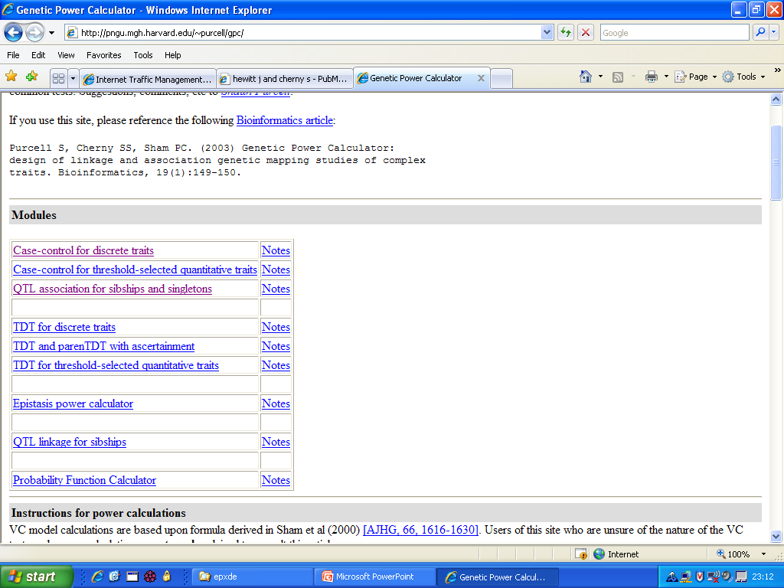
Practical Exercise
http://zzz.bwh.harvard.edu/gpc/ (Note new location!)
Click this link

Slide 21
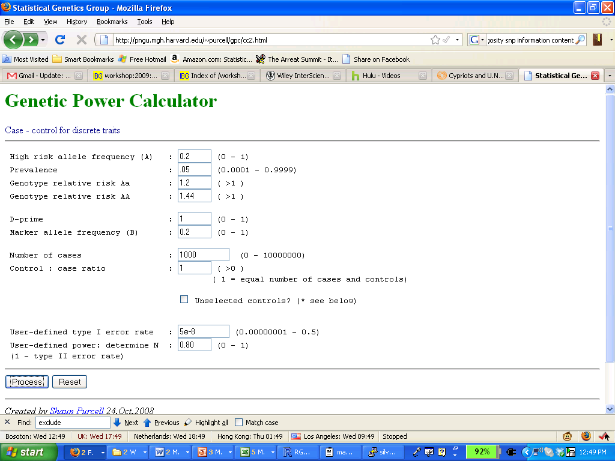
Practical Exercise
Allele frequency at the risk locus

Slide 22
Practical Exercise
How common disease is

Slide 23
Practical Exercise
This is the relative risk—not the odds ratio. The OR is approximately equivalent to the RR for small values of RR.

Slide 24
Practical Exercise
Risk of the AA genotype. Note that the model of risk is defined by the relationship between Aa and AA. We have a multiplicative model because 1.44 = 1.2*1.2.

Slide 25
Practical Exercise
The LD statistic D’ which represents recombination patterns historically. D’ + allele frequency at the typed locus information yields r²

Slide 26
Practical Exercise
Sample size for cases

Slide 27
Practical Exercise
Ratio of Controls to Cases

Slide 28
Practical Exercise
Genome-wide significance threshold
We’ll learn about this later in the session

Slide 29
Practical Exercise
Power level—what we’re interested in observing

Slide 30
Practical Exercise
Click here to process

Slide 31
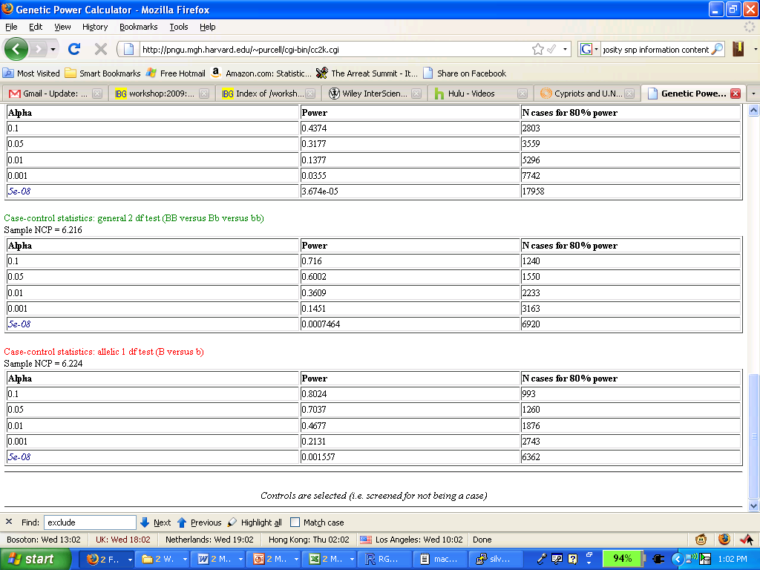
Practical Exercise
Scroll to the bottom for answer

Slide 32
Practical Exercise
Scroll to the bottom for answer
6,362 case samples required: total sample size 12,724

Slide 33
Practical Exercise
What power do we have to detect a locus with an odds ratio of 1.5 at
genome-wide significance assuming a multiplicative disease model, a
disease allele frequency of 5%, a disease prevalence of 0.5% and
3000 cases and controls?

Slide 34
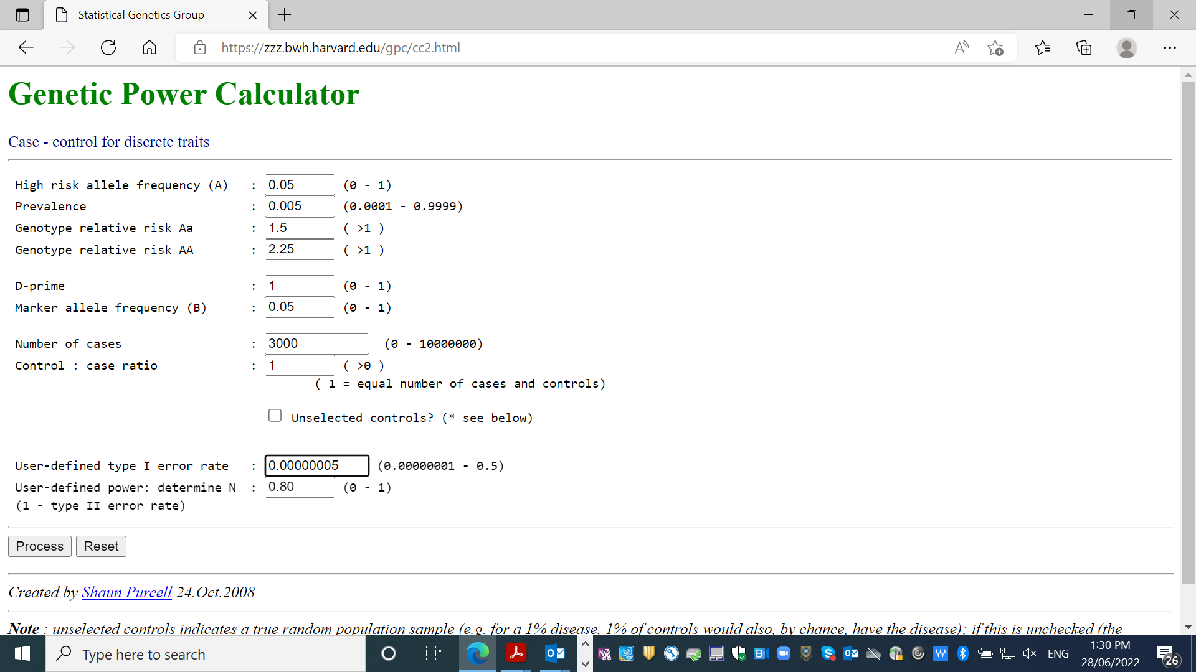

Slide 35
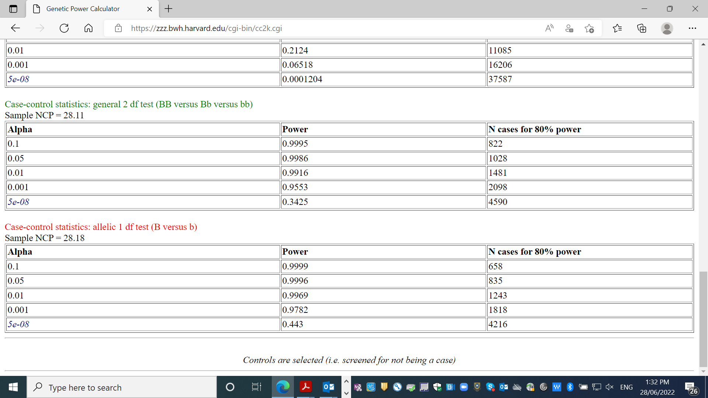

Slide 36
Empirical power estimation
1. Simulate Data
2. Test marker for association with phenotype
3. Evaluate significance against α
4. Repeat N times
5. Power = proportion of replicates with p < α

Slide 37
rm(list=ls())
set.seed(12345) #Set seed to enable repeatability
p <- 0.5 #(Decreaser) Allele frequency
q <- 1 - p #Other allele
Nsample <- 1000 #Set sample size
Nrep <- 1000 #Set number of replications
Nsig <- 0 #Count variable for number of significant replicates
threshold <- 0.05 #Threshold for declaring significance
beta <- 0.1 #Effect size
a <- sqrt(1/(2*p*q)) #Additive value
residvar <- 1 - beta^2 #Residual variance
for (i in seq(1,Nrep)) { #Loop over replicates
#Simulate genotypes assuming HWE
x <- sample(x=c(-a,0,a) ,size=Nsample, replace=TRUE, prob=c(p^2,2*p*q,q^2))
y <- beta*x + rnorm(n=Nsample, mean=0, sd=sqrt(residvar))
if(summary(lm(y~x))$coefficients[2,4] < threshold) {Nsig=Nsig+1}
}
power = Nsig/Nrep #Power is proportion of significant replicates
Power #0.885

Slide 38
Trivial Example: OLS Linear Regression
(b – 0)²
β²
____
__
χ²₁( )
SE²
SE²
1. Set type 1 error rate (e.g. α = 0.05)
2. Determine what critical value this corresponds to on the X axis
qchisq(p = 0.05, df = 1, ncp = 0, lower.tail = FALSE, log.p = FALSE)
[1] 3.841459
β²
3. Work out the non-centrality parameter of the test
__
SE²
β = 0.1
SE ≈ 1/√N
(Assume N = 1000)
4. Calculate the area to the right of the threshold under H₁
pchisq(q=3.84, df=1, ncp = 0.1^2/(1/1000), lower.tail = FALSE, log.p = FALSE)
[1] 0.8854512

Slide 39
4. Multiple Testing

Slide 40
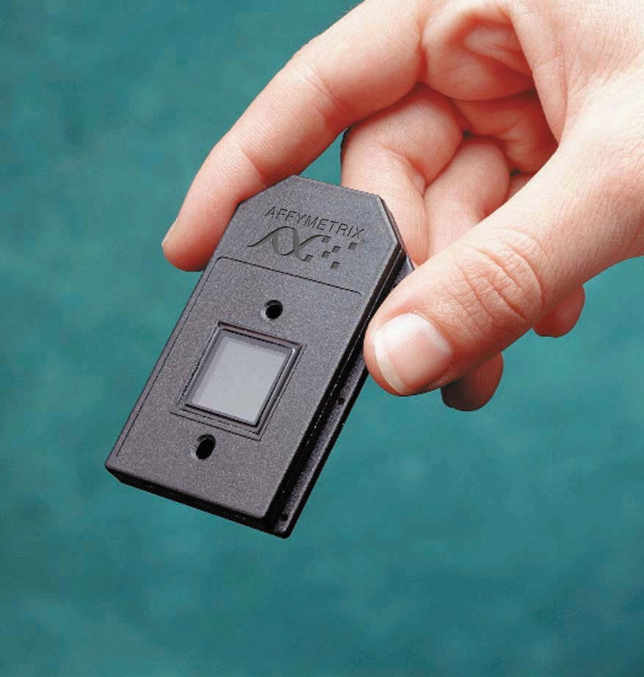
Genome-wide Association
High throughput genotyping

Slide 41
Other Multiple Testing Considerations
Genome-wide association is really bad
  At 1 test per SNP for 500,000 SNPs
  25,000 expected to be significant at p<0.05, by chance alone

Slide 42
Other Multiple Testing Considerations
Genome-wide association is really bad
  At 1 test per SNP for 500,000 SNPs
  25,000 expected to be significant at p<0.05, by chance alone
To make things worse
  Dominance (additive/dominant/recessive)
  Epistasis (multiple combinations of SNPs)
  Multiple phenotype definitions
  Subgroup analyses
  Multiple analytic methods

Slide 43
Bonferroni Correction
For testing 500,000 SNPs
  5,000 expected to be significant at p<0.01
  500 expected to be significant at p<0.001
  ……
  0.05 expected to be significant at p<0.0000001
Suggests setting significance level to α = 10^{-7*}
Bonferroni correction for m tests
  set significance level for p-values to α = 0.05 / m
  (or adjust the p-values to m × p, before applying the usual α = 0.05 significance level)
*See Risch and Merikangas 1999

Slide 44
Genome-wide Significance
Multiple testing theory requires an estimate of the number of ‘independent tests’
Risch and Merikangas 1996 estimated a threshold of 10⁻⁶ = (0.05/(5*10,000))
HapMap 2005 estimate 10⁻⁸ based on encode deep sequencing in ENCODE regions
Dudbridge and Gusnato, and Pe’er et al. 2008 Genetic Epidemiology estimate based on ‘infinite density’ like Lander and Kruglyak 1995 generate 5x10⁻⁸

Slide 45
5. Replication

Slide 46
Replication
Replicating the genotype-phenotype association is the “gold standard” for “proving” an association is genuine
Most loci underlying complex diseases will not be of large effect
It is unlikely that a single study will unequivocally establish an association without the need for replication

Slide 47
Winner’s Curse
If the location of a variant and its phenotypic effect size are estimated from the same data sets, the effect size will be over-estimated, in many cases substantially. Statistical significance and the estimated magnitude of the parameter are highly correlated.
H Göring et al. Am J Hum Genetics 2001;69:1357-69

Slide 48
Guidelines for Replication
Replication studies should be of sufficient size to demonstrate the effect
The same SNP should be tested
The replicated signal should be in the same direction
Replication studies should conducted in independent datasets
Joint analysis should lead to a lower p value than the original report
Replication should involve the same phenotype
Replication should be conducted in a similar population
Well designed negative studies are valuable

Slide 49
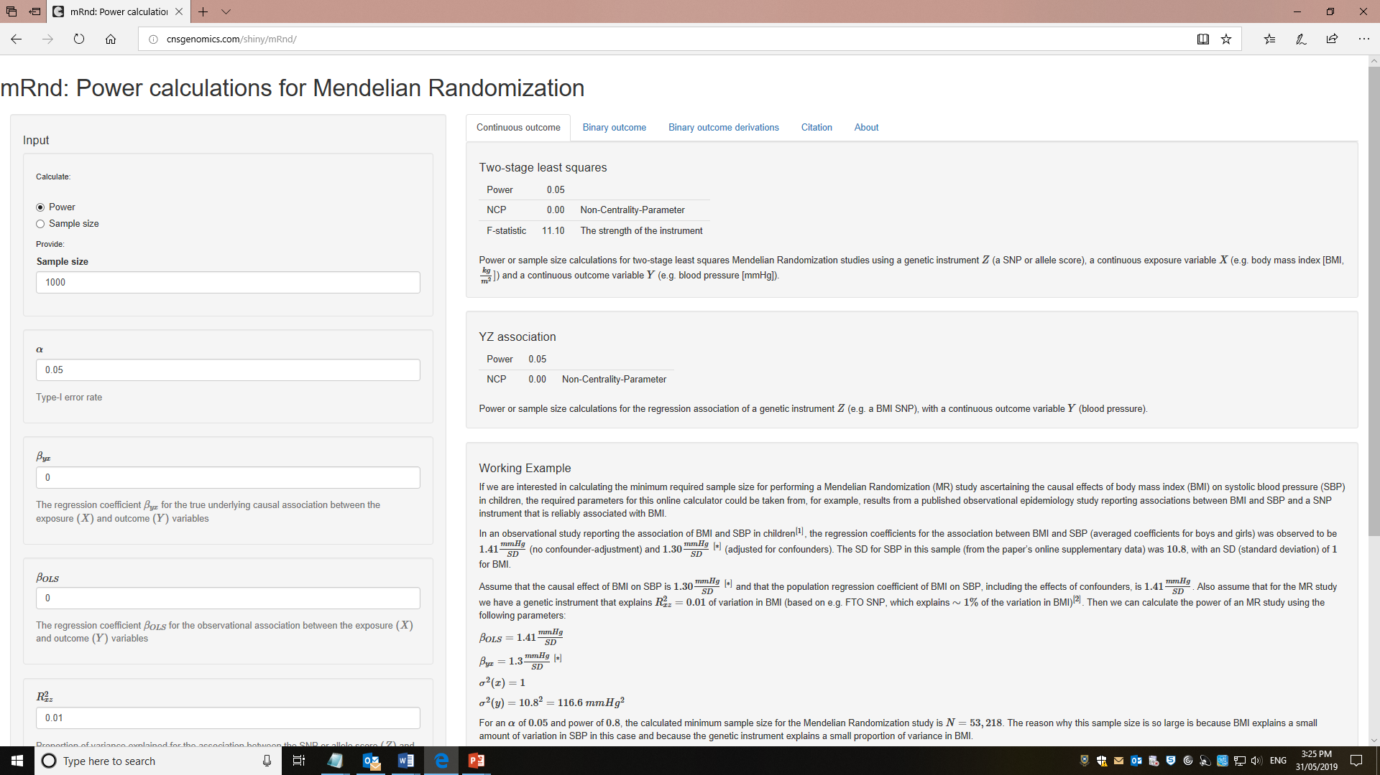
Mendelian randomization Power
http://cnsgenomics.com/shiny/mRnd/

Slide 50
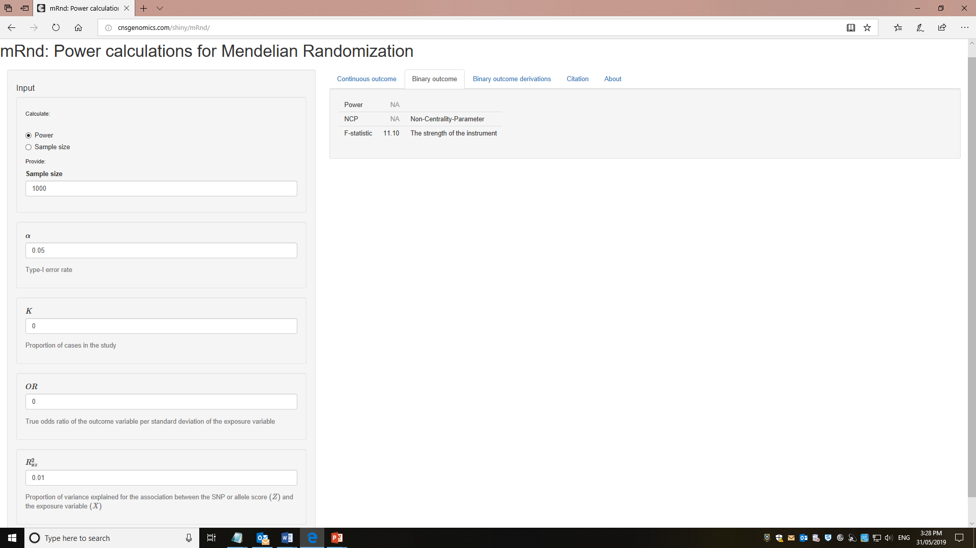
Mendelian randomization Power
http://cnsgenomics.com/shiny/mRnd/

