Slide 1
Fine-mapping and colocalization
Ran Cui, Ph.D.
Neale lab and Daly lab at Broad Institute
Analytic and Translational Genetics Unit, MGH

Slide 2
Outline
A context: Variant to Function model (V2F)
Fine-mapping
The goal of fine-mapping
Factors that influence fine-mapping
Overview of methods and benchmarking
Multi-cohort fine-mapping
Resources
Colocalization
The goal of colocalization
Methods and outputs
How well does it work
Resources

Slide 3
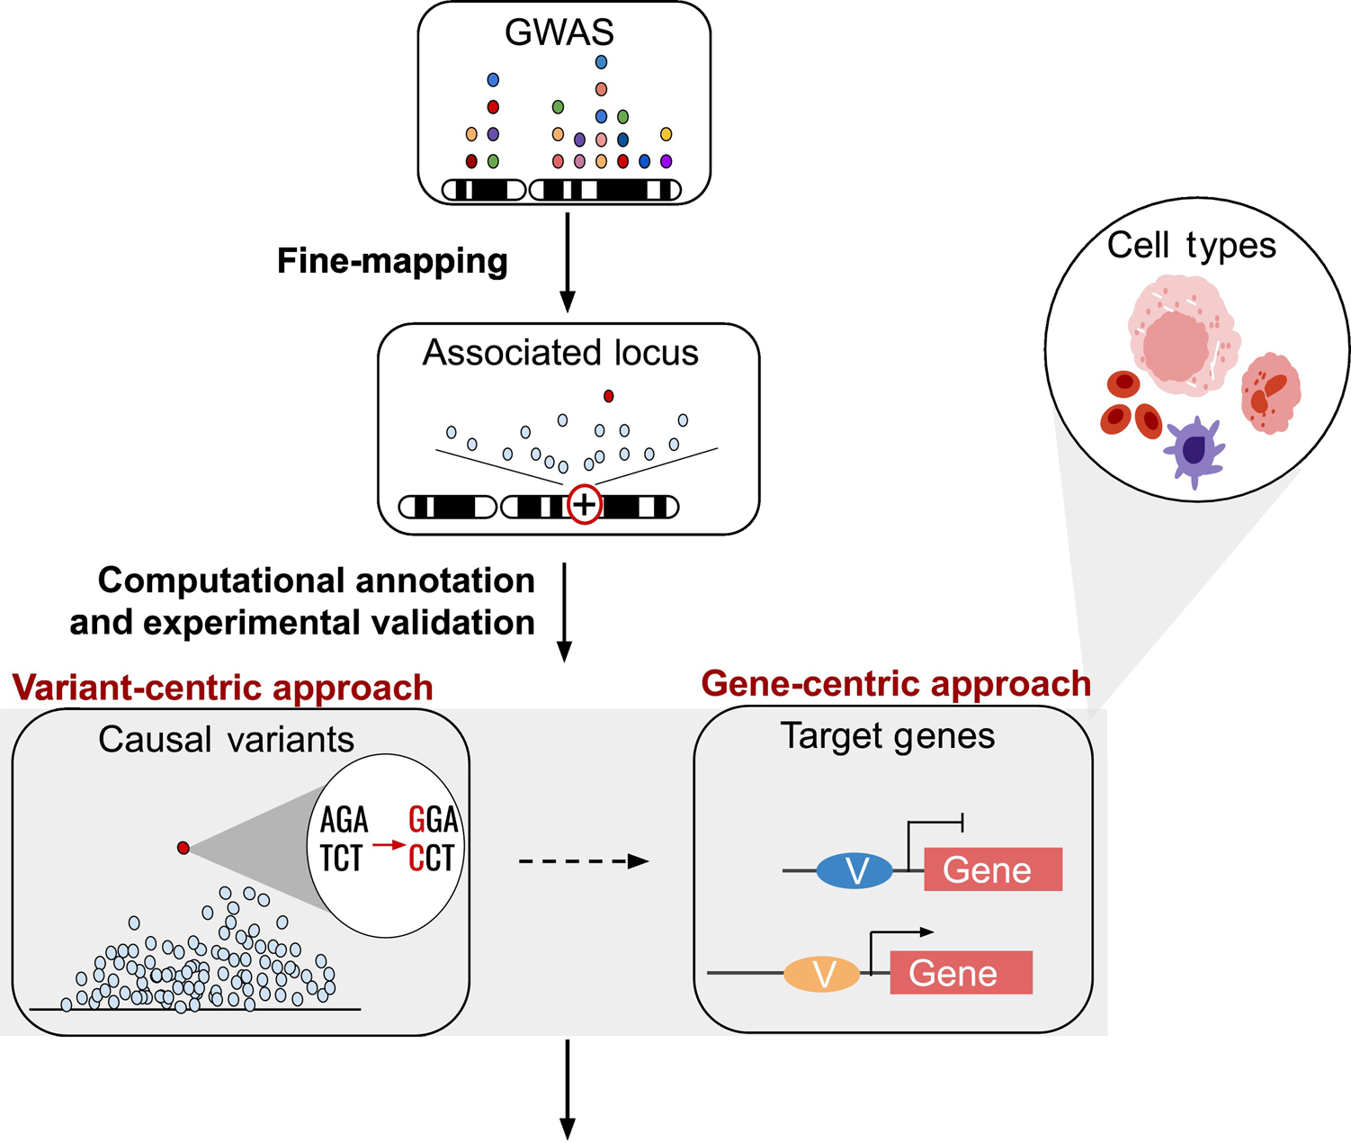
Variant to Function (V2F)
Colocalization
Mechanisms
Therapeutics
Nandakumar et al. Trends Genet. 2021

Slide 4
Part 1: Fine-mapping

Slide 5
The goal of fine-mapping

Slide 6
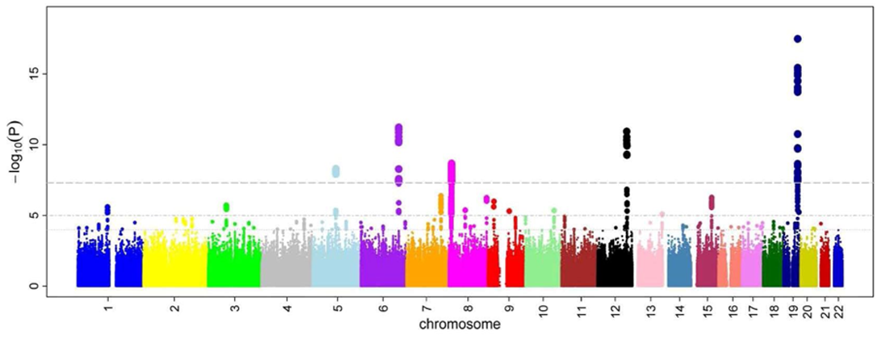
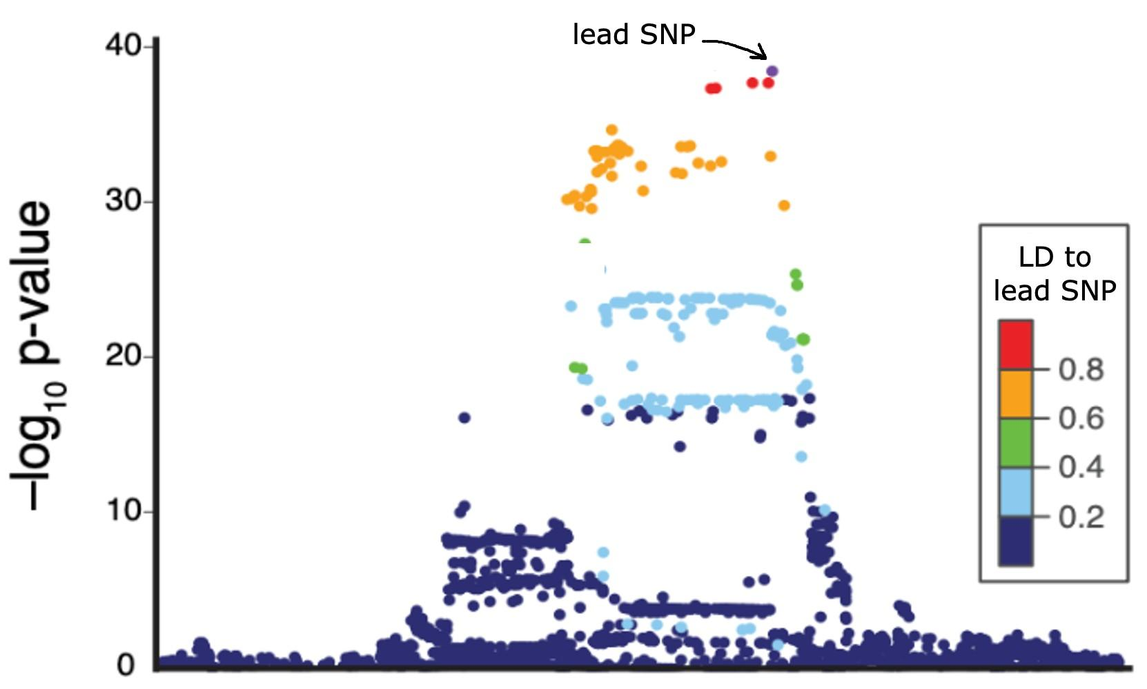
GWAS aims to detect association
One locus
Association is not necessarily causation (cause: influence target trait in a nontrivial way)

Slide 7
Fine-mapping aims to nominate causal variants
Causal SNP 1
Causal SNP 2
Causal SNPs (unobserved)
One locus
LD,
noise
Fine-mapping goal
GWAS
(observed)
Ulirsch and Kanai et al., in review

Slide 8
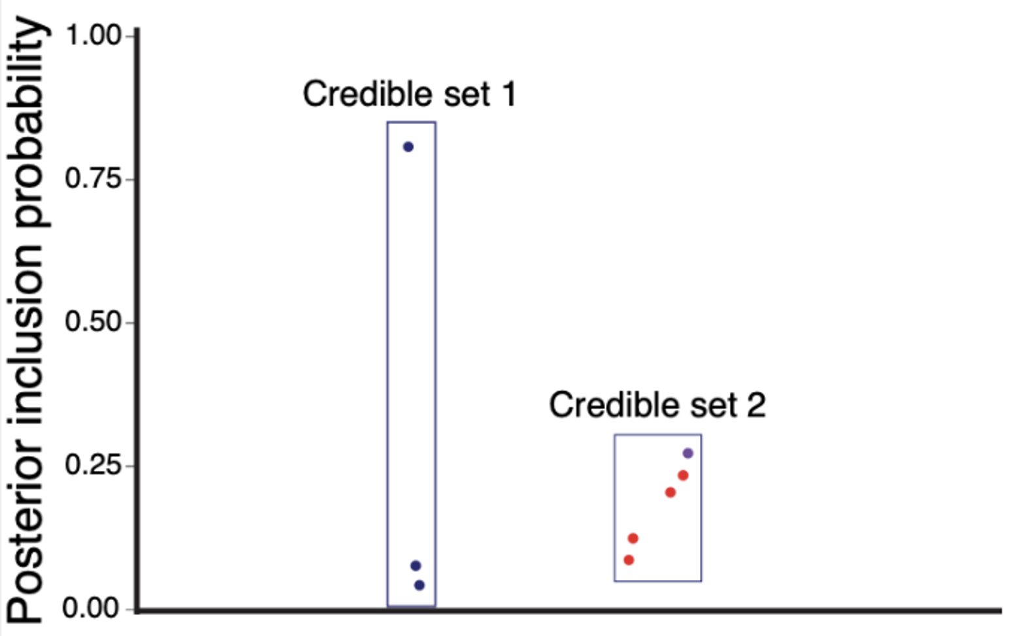
Fine-mapping outputs PIP and credible sets
Causal SNP 1
Causal SNP 2
Goal
Outputs
Posterior Inclusion Probability (PIP) is the probability that a SNPs is causal given the observed data.
Outputs
Credible sets capture the uncertainty of the identity of causal SNP due to LD.
Ulirsch and Kanai et al., in review

Slide 9
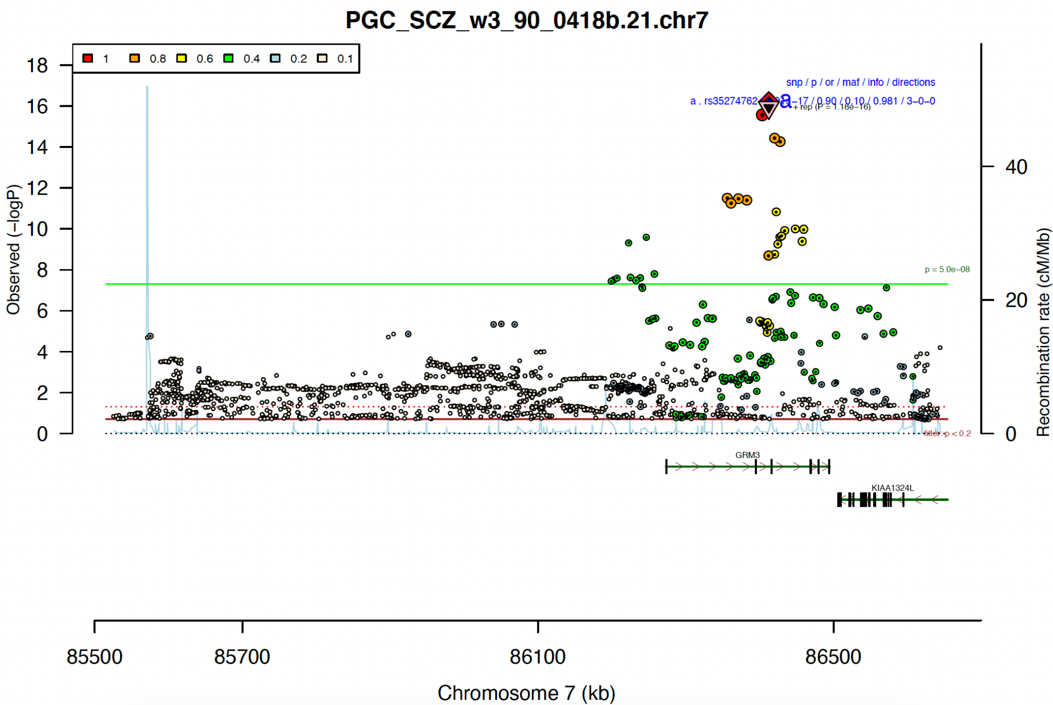
A simpler case
PIPs:
rs6943762: 0.591
rs35274762: 0.362
Corresponding gene: GRM3
Trubetskoy et al. 2022 Nature

Slide 10
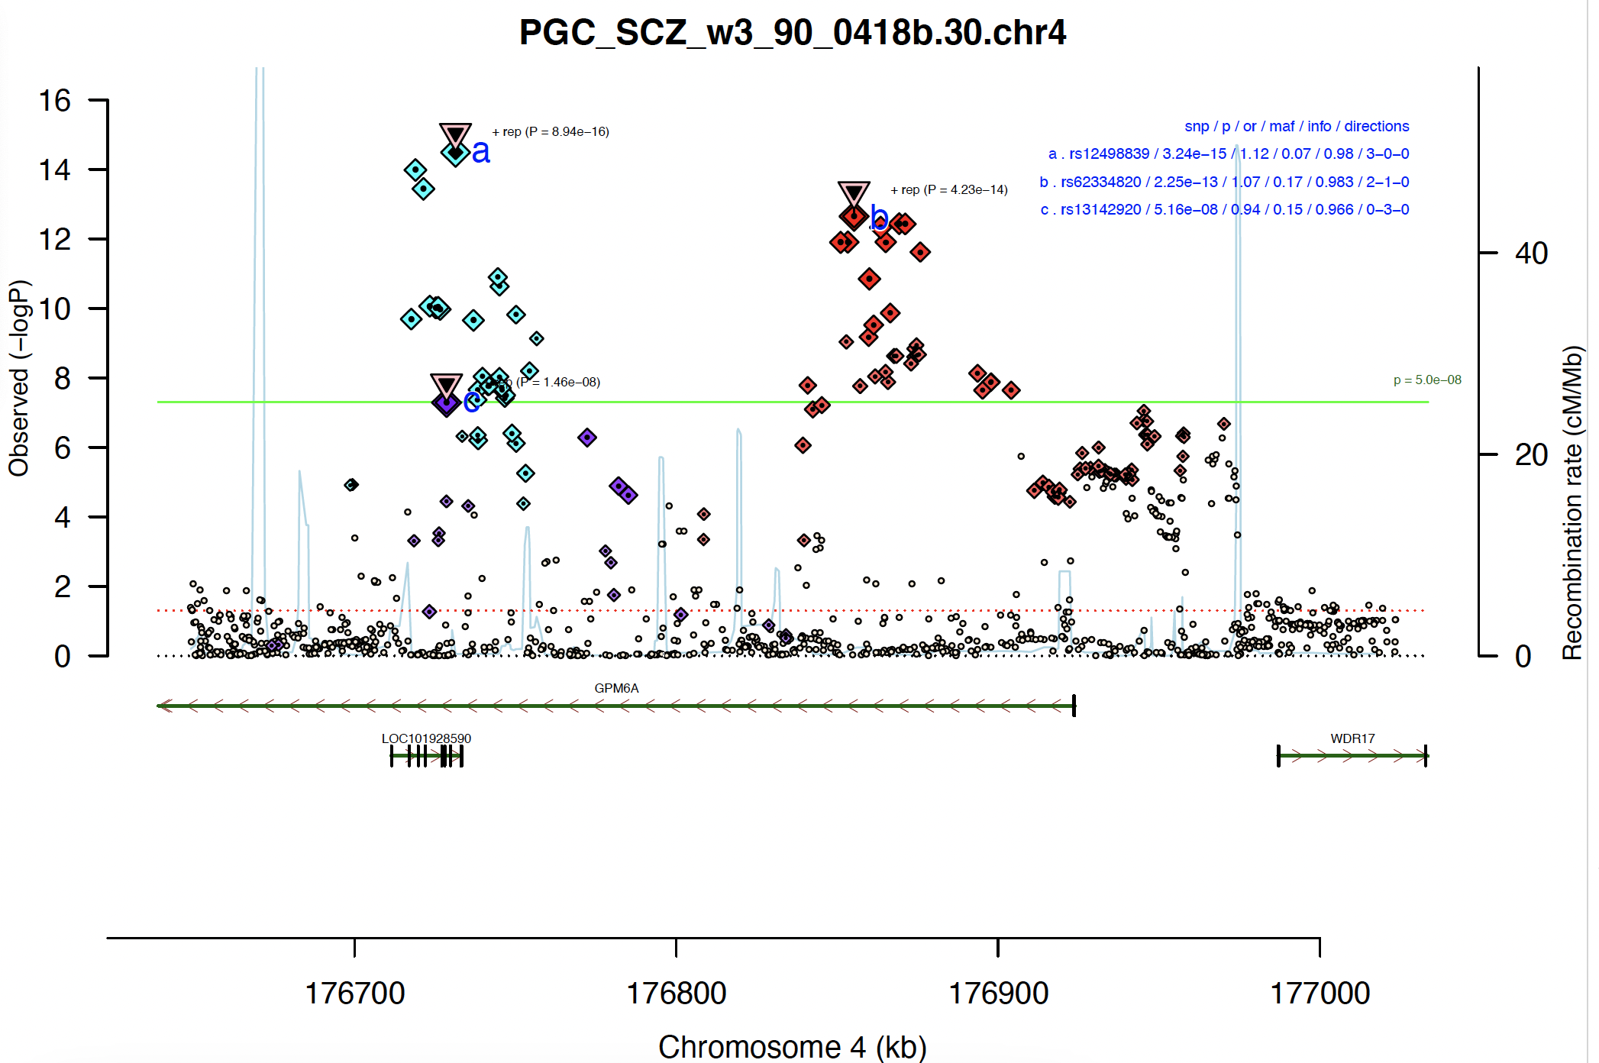
Multiple independent signals
PIPs:
(a) rs12498839: 0.33
(b) rs62334820: 0.134
(c) rs13142920: 0.75
Corresponding gene: GPM6A
Trubetskoy et al. 2022 Nature

Slide 11
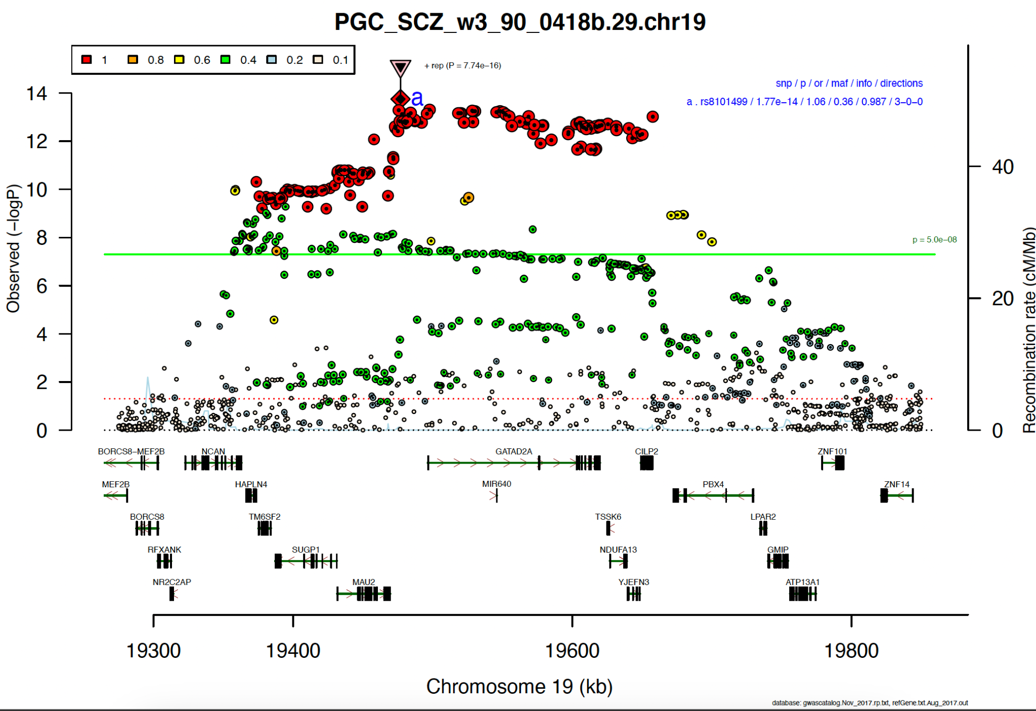
A more complicated case
Credible sets spanning:
MAU2
GATAD2A
TSSK6
YJEFN3
CILP2
Trubetskoy et al. 2022 Nature

Slide 12
Factors that influence fine-mapping

Slide 13
Factors that influence fine-mapping
Linkage Disequilibrium (LD)
Sample size
Simulation settings:
Single causal SNP;
All SNPs are correlated with correlation 𝜌;
Region contains 5 - 40 SNPs.
Schaid et al. 2018 Nat. Rev. Genet.

Slide 14
Factors that influence fine-mapping
Linkage Disequilibrium (LD)
Sample size
SNP density
Number of causal variants
Effect sizes
Missing causal variants
You will explore some of these factors and their effects on fine-mapping PIPs in the practicals.
Simulation settings:
Single causal SNP;
All SNPs are correlated with correlation 𝜌;
Region contains 5 - 40 SNPs.
Schaid et al. 2018 Nat. Rev. Genet.

Slide 15
Overview of methods

Slide 16
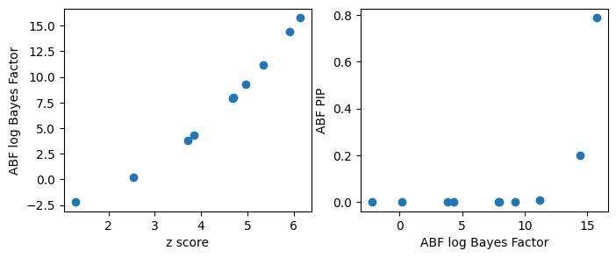
(Approximate) Bayes Factor method: ABF
In this case, Bayes factors are roughly monotonic transformations of z scores. Highest PIP is almost always given to the most significant variant.
Maller et al. 2012 NatGenet.

Slide 17
Generalizing to multiple causal SNPs
Conditional analysis:
COJO+ABF
Direct modeling of casual configurations:
CAVIAR, CAVIARBF,
FINEMAP, DAP-G
Sum of single effects:
SuSiE
Single effect causal configurations
𝛾₁ :
0 | 1 | 0 | 0 | 0 | 0 | 0 | 0 | 0 | 0
𝛾₂ :
0 | 0 | 0 | 1 | 0 | 0 | 0 | 0 | 0 | 0
Causal configuration :
…
0 | 1 | 0 | 1 | 0 | 0 | 0 | 1 | 0 | 0
𝛾_{L} :
Condition out the lead SNP
0 | 0 | 0 | 0 | 0 | 0 | 0 | 1 | 0 | 0
Compute:
Using Iterative Bayesian Stepwise Selection (IBSS) to compute posterior distributions:
$$p\left(γ_{i} \right|y,X, γ_{−i}, β_{−i})$$
Spain et al. 2015 Hum Mol Genet.
Benner et al. 2016 Bioinformatics
Wang et al. 2020 JRSS

Slide 18
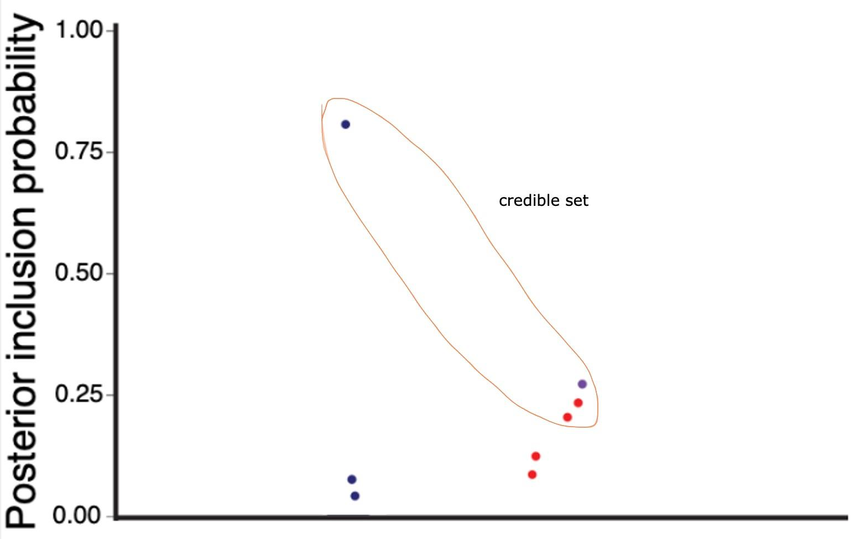
Two ways to define credible sets
Aims to capture one causal SNP in each credible set of minimal size and report as many credible sets as the data supports (SuSiE).
Aims to find the smallest set of SNPs that contain all the causal SNPs. (ABF, CAVIAR, FINEMAP etc.)
The two definitions coincide when assuming single causal variant per locus

Slide 19
Benchmarking

Slide 20
Benchmarking fine-mapping: in simulations
Two main metrics:
Calibration: Of variants with PIP≅x%, are x% truly causal?
Recall: What proportion of all causal variants are captured by the x% variants with highest PIP?
X
X
PIP≧0.9
Expected
Truth
X
X
X
X
X
X
Calibrated
Mis-calibrated
Ulirsch and Kanai et al., in review

Slide 21
Benchmarking fine-mapping: in simulations
Two main metrics:
Calibration: Of variants with PIP=x%, are x% truly causal?
Recall: What proportion of all causal variants are captured by the x% variants with highest PIP?
All causal variants
Top 0.01% variants
Top 1% variants
Ulirsch and Kanai et al., in review

Slide 22
Benchmarking fine-mapping: in real data
Fine-mapping with subset of individuals
Low PIP
High PIP
?
Fine-mapping with full set of individuals
Replication failure: when a variant’s PIP drops from high (>0.9) to low (<0.1)
when sample size increases.
RFR (Replication Failure Rate): the proportion of replication failures.
Cui et al. 2023 NatGenet.

Slide 23
Multi-cohort fine-mapping

Slide 24
Multi-cohort fine-mapping
The meta-analysis approach
The joint modeling approach
The combining approach
Cohort 1
Cohort 2
Cohort 1
Cohort 2
Cohort 1
Cohort 2
GWAS 1 & LD 1
GWAS 2 & LD 2
GWAS 1 & LD 1
GWAS 2 & LD 2
GWAS 1 & LD 1
GWAS 2 & LD 2
Meta GWAS
Average LD
Fine-mapping result 1
Fine-mapping result 2
Jointly fine-map
Fine-map as single cohort
Combine results
Post-hoc QC

Slide 25
Resources

Slide 26
Fine-mapping resources
Published fine-mapping results by large studies:
FinnGen: https://finngen.gitbook.io/documentation/methods/finemapping
UK Biobank: https://www.finucanelab.org/data
PGC Schizophrenia study: Supplementary Table 11
LD resources:
PolyFun published UK Biobank LD matrices.
Pan-UKBB published multi ancestry LD matrices.
Fine-mapping pipelines:
FinnGen pipeline: https://github.com/FINNGEN/finemapping-pipeline
UK Biobank pipeline: https://github.com/mkanai/finemapping-pipeline
Derivations:
ABF paper, CAVIARBF paper, Schaid et al. NatRev.

Slide 27
Use caution when applying fine-mapping
Beware of reference LD, follow Weissbrod et al. 2020 NG guidelines.
Meta-analysis fine-mapping is tricky, see Kanai et al. 2022 Cell Genomics.
Don’t forget to use covariate-adjusted LD when the cohort has more complex population structure, e.g. admixture. See Pan-UKBB LD documents.
Keep in mind that model misspecifications and missing causal variants exist in real data applications. Use caution when interpreting fine-mapping results.
Run different methods if you can.

Slide 28
Part 2: Colocalization

Slide 29
The goal of colocalization
High-level goal: Prioritize gene and cell type targets for functional follow-ups.
Some assumptions are made here.
CETP locus in adipose tissue
Specific goal: To test if two associations at a locus share the same causal variant.
LDL-C
GWAS:
variant effect on trait
eQTL: variant effect on gene expression
Modified from Baca et al. 2022 NatGenet
Hakim et al. 2025 Genes

Slide 30
Colocalization is closely related to fine-mapping
SNP i is causal for trait
Data from GWAS analysis
SNP i is causal for expression
Data from eQTL analysis

Slide 31
Colocalization methods and outputs

Slide 32
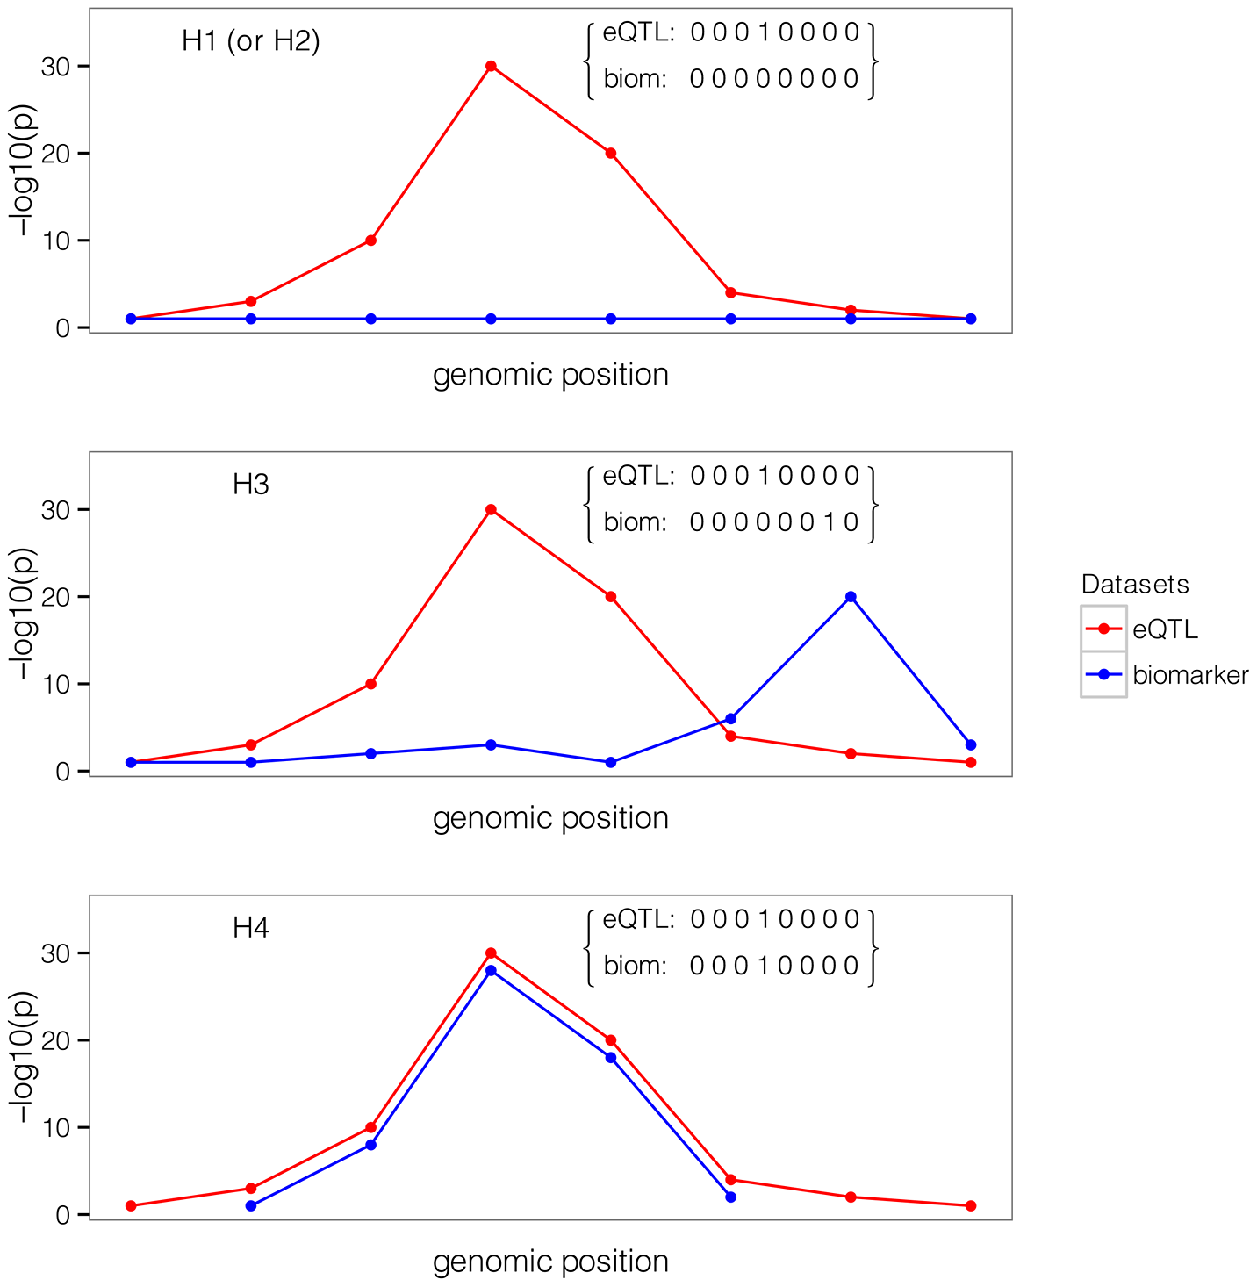
coloc outputs
coloc considers 5 hypotheses:
H₀: No association with either trait.
H₁: Association with trait 1, none for trait 2.
H₂: Association with trait 2, none for trait 1.
H₃: Different SNPs associated with trait 1 and 2.
H₄: Same SNP associated with trait 1 and 2.
coloc outputs posterior probabilities for all $H_{i}$:
$$p\left(H_{0} | Data\right), p\left(H_{1}\right|Data), ⋯, p\left(H_{4}\right|Data)$$
Giambartolomei et al. 2014 PLOS Genetics

Slide 33
Colocalization methods and their outputs
coloc
coloc.abf: Giambartolomei et al. 2013 PLoS Genet.
coloc.susie: Wallace et al. 2021 PLoS Genet.
eCAVIAR
Hormozdiari et al. 2016 AJHG
enloc/fastENLOC
Wen et al. 2017 PLoS Genet.
Pividori et al. 2020 Sci. Adv.
Hukku et al. 2022 AJHG
Posterior probabilities of 5 hypotheses
CLPP for each variant
SNP and regional level colocalization probabilities (SCP and RCP)

Slide 34
How well does colocalization work

Slide 35
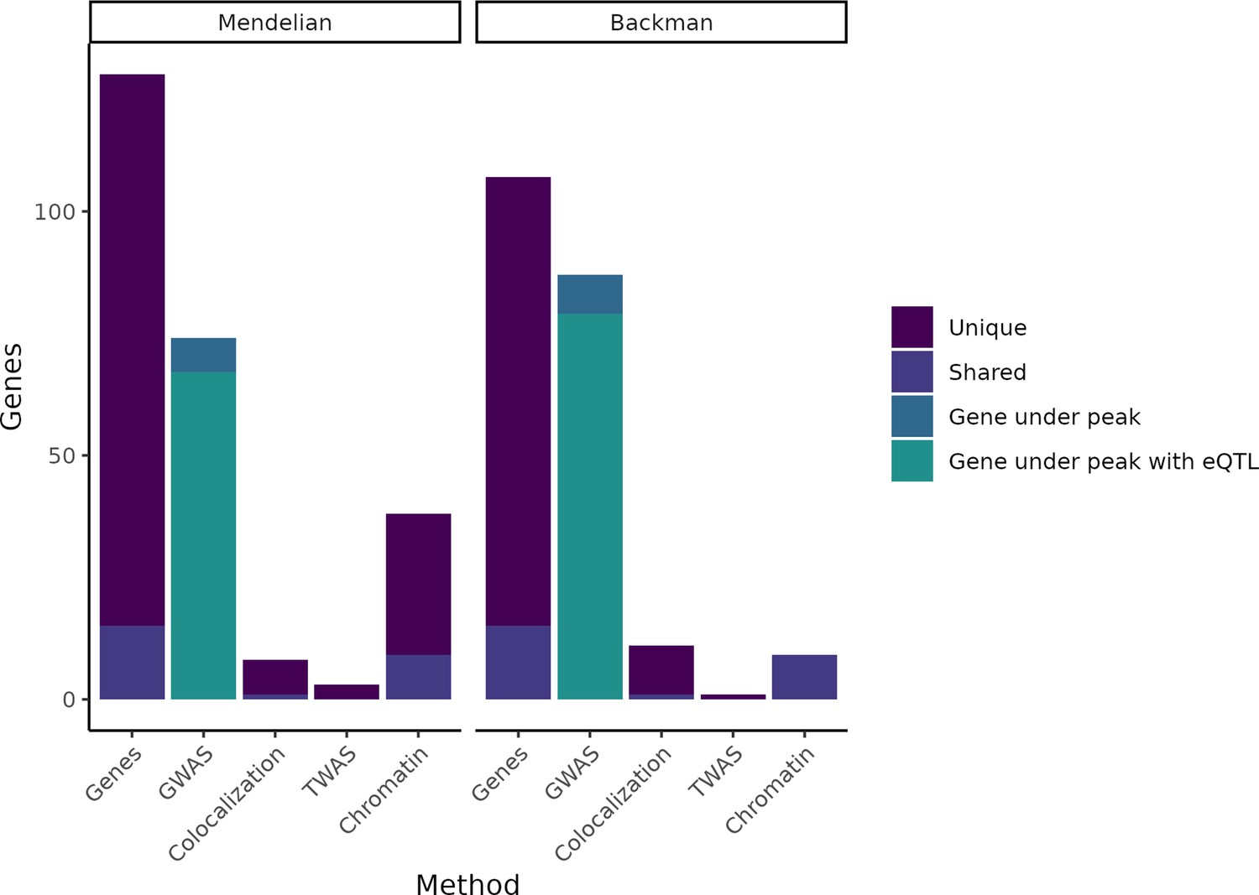
It doesn’t work as well as we had hoped
We have reasons to believe that most trait associations should be eQTLs.
However, only 5-40% of trait associations colocalize with eQTLs using various methods.
Connally et al. 2023 eLife

Slide 36
Some possible explanations
Power
Cell type
Cell context
Other molecular phenotypes (sQTL, pQTL etc.)
Gene by environment interaction (GxE)
Development
Fine-mapping inaccuracies
Re-examine assumptions (Mostafavi et al. 2023 NatGenet)

Slide 37
Resources
Published fine-mapping results by large studies:
https://gtexportal.org/home
GTEx fine-mapping results
twas_hub.org
Visualization tool:
Locuscomparer
Derivations:
coloc paper, eCAVIAR paper, enloc paper, TWAS paper

Slide 38
Qualtrics link: https://qimr.az1.qualtrics.com/jfe/form/SV_5bifqSVk0lrbCd0

