Slide 1



Pathway analysis
Douglas Wightman
And thanks to Christiaan de Leeuw and Danielle Posthuma
CTG lab – VU Amsterdam
BRAINSCAPES

Slide 2
To avoid straining the system:
  mkdir thursday_magma
  cd thursday_magma
  cp /home/douglasw/Boulder2025/magma_session.zip .
  Practical https://vuamsterdam.eu.qualtrics.com/jfe/form/SV_3f5d2iC6AvneNr8

Slide 3
Outline
  What is pathway analysis in a GWAS context?
  Why is it useful?
  Different pathways
  What type of pathway analyses are there?
    MAGMA
    GSEA
    LDSC
  Self-contained vs competitive
  Conditional gene-set analysis
  Applications of gene-set analysis

Slide 4
Pathway analysis
  Pathway analysis (in our context) is a way to identify pathways relevant to our data using:
    A pre-defined set of genes based on some functional/biological grouping (e.g. genes in the citric acid cycle)
    A set of genes identified in our data (e.g. significant genes from a GWAS)
  Often this is called gene-set enrichment analysis
    Where you define a set of genes from your data and identify the probability of overlap between your set and a pre-defined set
  If a disproportionally large portion of your genes in your set (e.g. genes significant in a diabetes GWAS) were also present in a gene-set defined by genes involved in insulin production.
    Then there is evidence for insulin production being relevant to diabetes

Slide 5
Why perform gene-set enrichment?
Many traits are polygenic (many variants contribute to the trait)
These variants can be aggregated together to highlight higher order biological processes
This may allow for easier translation to functional experiments where pathways can be targeted rather than specific variants

Slide 6
Testing for functional clustering of SNP associations
Single SNP analysis
- GWAS
- single SNPs
SNP-set or gene-based analysis with gene as unit of analysis
- whole genome
Gene-based analysis
Gene-set analysis with sets of genes as unit of analysis
- targeted gene-sets/pathways
- all known gene-sets/pathways
Gene-set analysis

Slide 7
Testing for functional clustering of SNP associations
Single SNP analysis
Gene-based analysis
Using quantitative characteristics of genes
e.g. expression levels or probability of being a member of a gene-set
Gene-set analysis
Gene-property analysis

Slide 8
Gene-based analysis
Instead of testing single SNPs and annotating GWAS-significant ones to genes, we test for the joint association effect of all SNPs in a gene, taking into account LD (correlation between SNPs)
No single SNP needs to reach genome-wide significance, yet if multiple SNPs in the same gene have a lower P-value than expected under the null, the gene-based test can result in low P

Slide 9
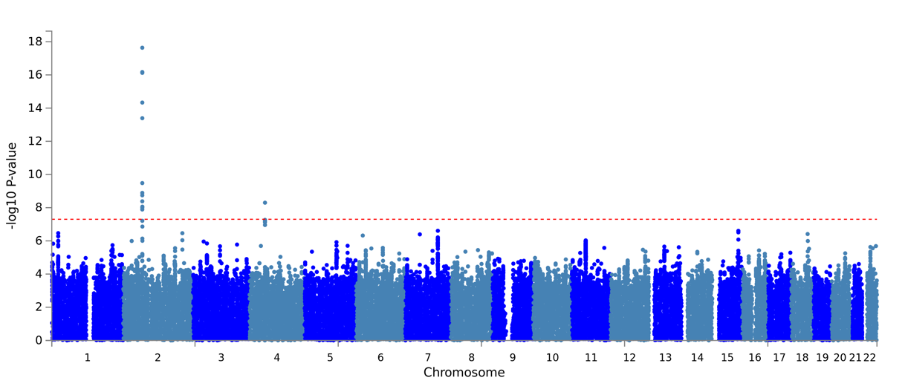
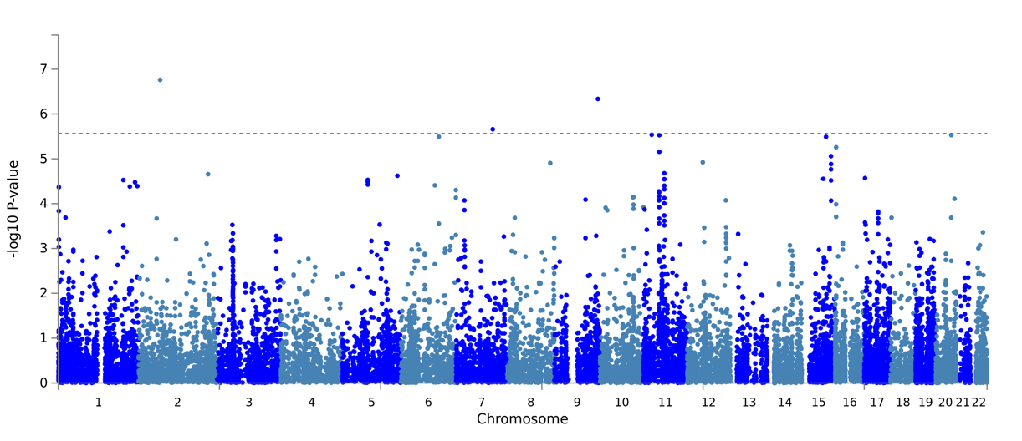
SNP Manhattan plot
Gene Manhattan plot

Slide 10
Gene-based analysis
Unit of analysis is the gene
Pro’s:
  reduce multiple testing (from 2.5M SNPs to 23k genes)
  accounts for heterogeneity in gene
  Immediate gene-level interpretation
Cons:
  disregards regulatory (often non-genic) information when based on location-based annotation
  Still a lot of tests

Slide 11
Gene-set analysis
Unit of analysis is a set of functionally related genes
Pro’s:
  Genes below significance threshold can converge on the same gene-set
  Provides biological insight
Cons
Crucial to select reliable sets of genes!

Slide 12
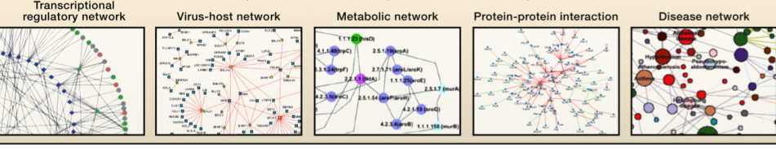
Choosing gene-sets
Gene-sets can be based on e.g.
protein-protein interaction
co-expression
transcription regulatory network
biological pathway
Functional relations

Slide 13
Protein interaction networks
Using Y2H or Immunoprecipitations

Slide 14
Co-expression networks
https://doi.org/10.1371/journal.pone.0003911.g006

Slide 15
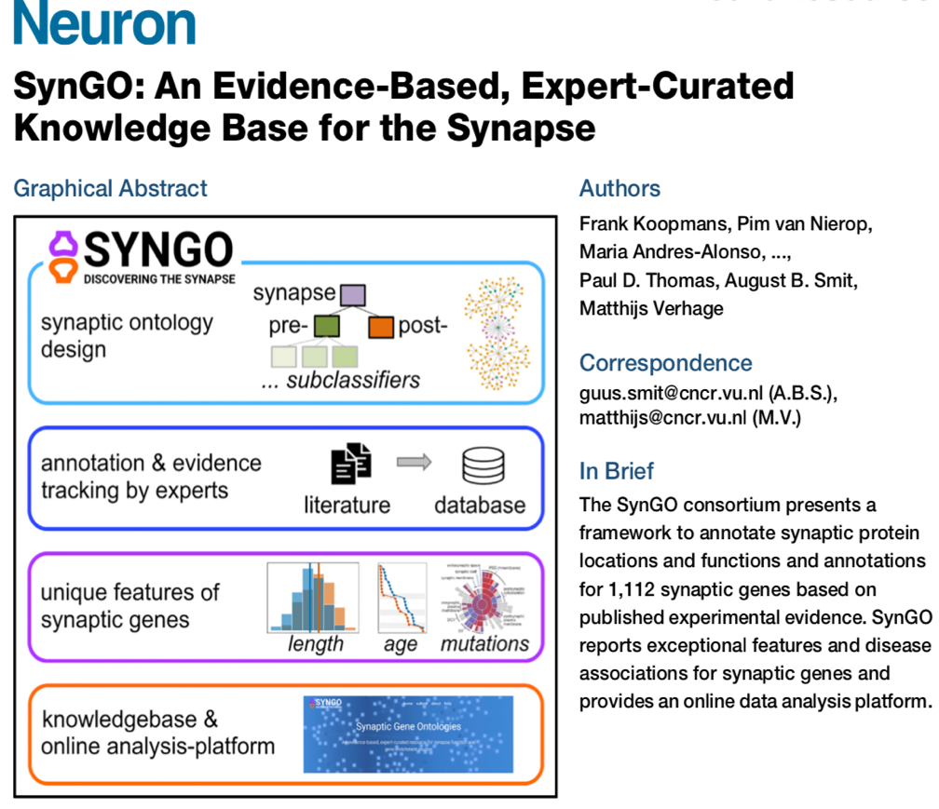
Based on function - SYNGO

Slide 16
Selecting cell types based on GWAS results
GWAS-based gene P values can be combined with single cell expression values to imply cell types in complex traits
Basically it tests whether there is an association between the association strength of genes with a trait and their expression levels in specific cell types
FUMA includes cell type enrichment analyses based on GWAS results
(Watanabe, Mirkov, de Leeuw, Heuvel, Posthuma Nat Comm, 2019)

Slide 17
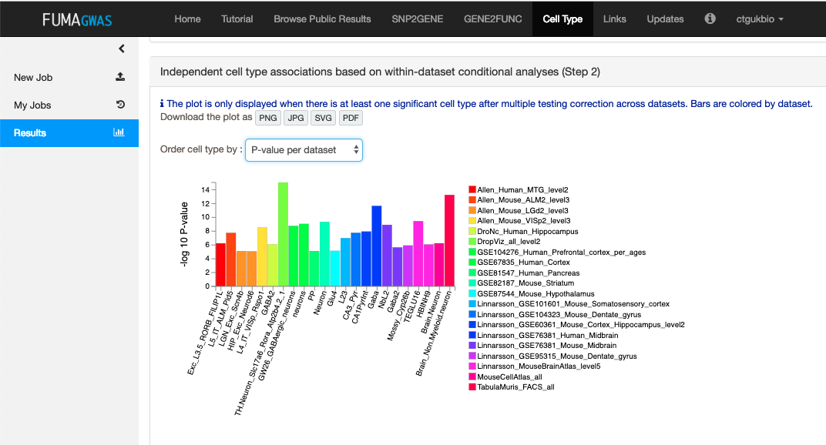
Cell type specificity analysis
scRNA-seq dataset
GWAS summary statistics
MAGMA regression model
Association of specific cell type
+
+
Currently datasets from 34 studies are available

Slide 18

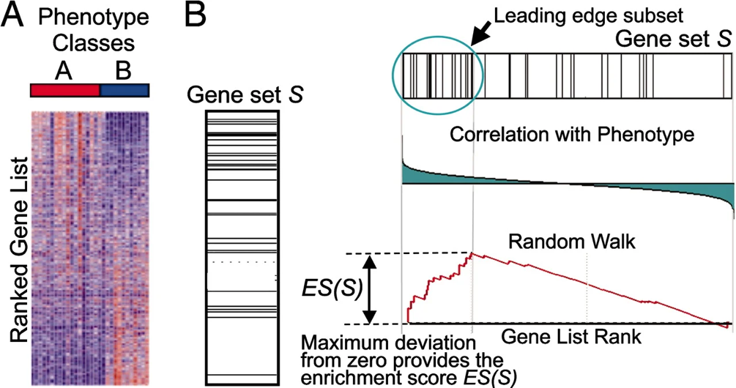
Tools for statistical analysis of gene-sets
  GSEA – Gene set enrichment analysis
    A user supplies a ranked set of genes from their analysis (e.g. ranked by P-value or effect size)
    Then a random walk algorithm assesses the deviation from a null enrichment
https://doi.org/10.1073/pnas.0506580102

Slide 19
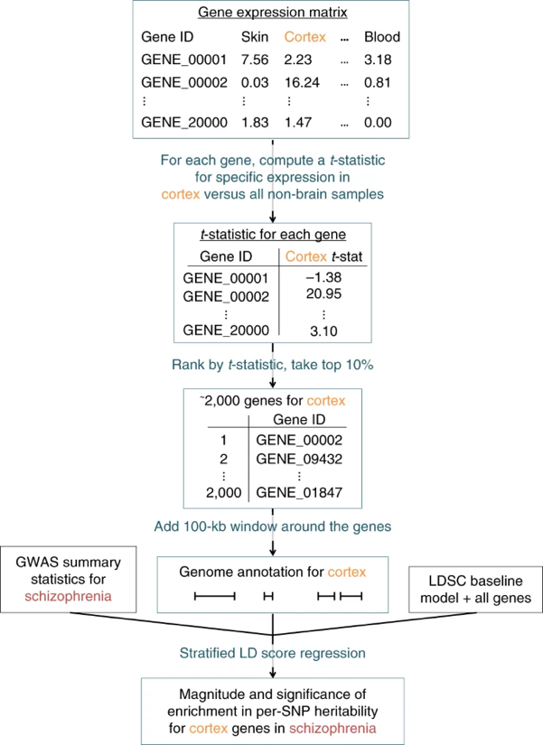
Tools for statistical analysis of gene-sets
  LD Score regression – partitioned heritability
    Assess whether the heritability of a set of genes within an annotation (e.g. highly expressed genes in a specific cell type) is significantly different from 0 after conditioning on the baseline model
    Baseline model includes 53 functional categories:
      Includes regions expected to have more heritability (coding, UTR, promoter regions, histone marks etc)
https://doi.org/10.1038/s41588-018-0081-4

Slide 20

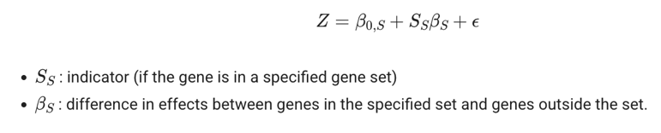
Tools for statistical analysis of gene-sets
  MAGMA – competitive gene set analysis
    Regression based model
    First, SNP P-values are used to estimate a gene Z-score for association with a trait
    Then the vector of gene Z-scores is the outcome variable in a regression model
    The predictors are either
      a vector of membership for all genes in gene-set where included=1 and excluded=0
      Or some quantitative gene-property (expression)
    The regression framework is flexible so allows for conditional analyses
    Approach accounts for LD between SNPs and genes, gene size, and number of SNPs
    Compares enrichment of association signal in genes within a gene-set against genes not in the gene-set
      Prevent inflation for traits with wide spread of signal

Slide 21
Statistical issues in gene-set analyses
Self-contained vs. competitive tests
Different statistical algorithms test different alternative hypotheses
Different statistical algorithms have different sensitivity to LD, ngenes, nSNPs, background h²

Slide 22
Self-contained vs. competitive tests
Null hypothesis:
Self-contained:
H0: The genes in the gene-set are not associated with the trait
Competitive:
H0: The genes in the gene-set are not more strongly associated with the trait than the genes not in the gene-set

Slide 23
Why use competitive tests
Polygenic traits influenced by thousands of SNPs in hundreds of genes
Very likely that many combinations (i.e. gene-sets) of causal genes are significantly related
Competitive tests define which combinations are biologically most interpretable

Slide 24
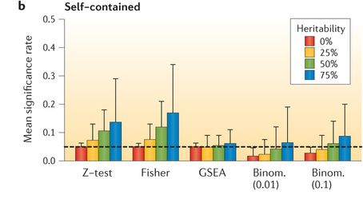
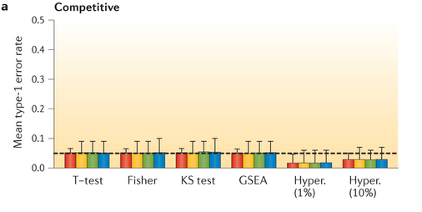
Polygenicity and number of significant gene-sets in self-contained versus competitive testing
For self-contained methods, rates increase with heritability, whereas they are constant for competitive methods.
De Leeuw, Neale, Heskes, Posthuma. Nat Rev Genet, 2016

Slide 25
Different statistical algorithms test different alternative hypotheses
How to estimate gene association from SNP associations?
Strategy | Alternative hypothesis
Minimal P-value | At least one SNP in the gene or gene-set is associated with the trait
Combined P-value | The combined pattern of individual P-values provides evidence for association with the trait

Slide 26
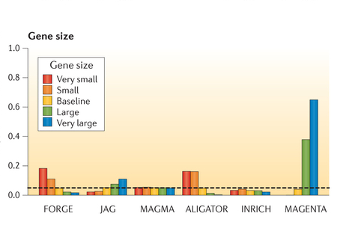
Different tools are differentially affected by gene size
De Leeuw, Neale, Heskes, Posthuma. Nat Rev Genet, 2016

Slide 27
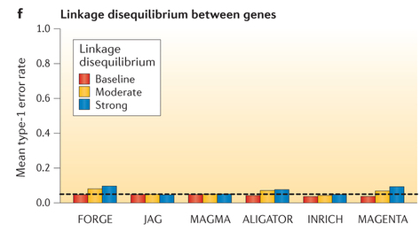
Different tools are differentially affected by LD between genes
De Leeuw, Neale, Heskes, Posthuma. Nat Rev Genet, 2016

Slide 28
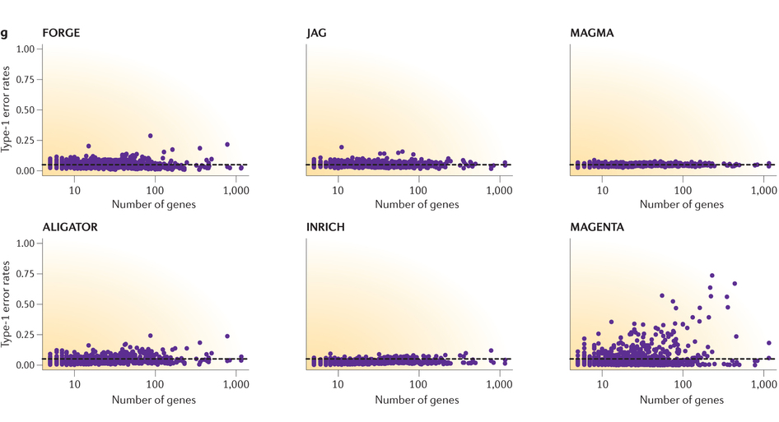
Different tools are differentially affected by the number of genes
De Leeuw, Neale, Heskes, Posthuma. Nat Rev Genet, 2016

Slide 29
Issues of interpretation in gene-set analyses
GSA tests for accumulation of genetic association in the set, which may be because:
  Direct effect: the set (or biological function) itself is involved
  Confounding: the set itself is not involved, but many genes in the set overlap with genes in another set that is involved

Slide 30
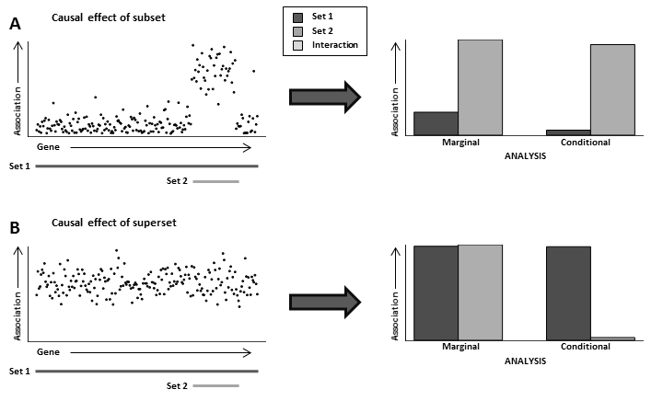

Slide 31
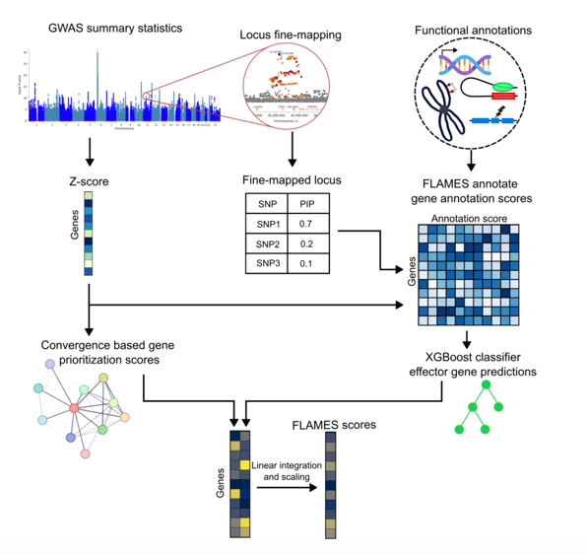
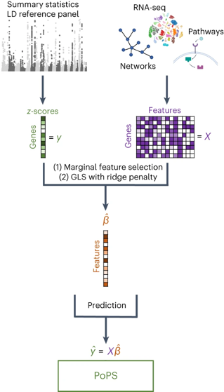
Applications of gene-set analysis
Gene prediction tools
  PoPS https://doi.org/10.1038/s41588-023-01443-6
  PIGEAN https://youtu.be/b1fmzhgE3lI?si=2EWKQ7Y9U77uemH2
  FLAMES https://doi.org/10.1038/s41588-025-02084-7
https://doi.org/10.1038/s41588-025-02084-7
  https://doi.org/10.1038/s41588-023-01443-6

Slide 32

Practical
Developed and maintained by
Christiaan de Leeuw

Slide 33
Practical
Annotate SNPs to genes
Perform gene analysis (with 10 PCs as covariates)
Perform gene-set analysis
Perform tissue expression analysis
Perform joint gene-set / tissue expression analysis
Notes:
Optional extra steps for people who are fast enough

Slide 34
Practical
Annotate SNPs to genes
Perform gene analysis (with 10 PCs as covariates)
Perform gene-set analysis
Perform tissue expression analysis
Perform joint gene-set / tissue expression analysis
Data
  Simulated GWAS data and phenotype; 400K SNPs, N = 2,500
  1011 Reactome gene sets
  Tissue-specific expression data for 11 tissues
    Simulated, but based on real expression data

Slide 35

Practical
Open terminal window
Make folder for practical and copy files
  mkdir thursday_magma
  cd thursday_magma
  cp /home/douglasw/Boulder2025/magma_session.zip .
  unzip magma_session.zip
Questions/instructions are here https://vuamsterdam.eu.qualtrics.com/jfe/form/SV_3f5d2iC6AvneNr8
Instructions are also in instructions.txt file

Slide 36
Practical - key points
Step 1: annotation
  Out of 19,427 protein-coding genes in the gene location file, only 13,772 had any SNPs annotated to them
    Restricts any conclusions to the annotated genes, we cannot be sure whether the same relations hold in the other genes
Step 2: gene analysis
  Two genes are genome-wide significant
    Threshold = 0.05/13,772 = 3.63e-6
  Only 6.22% of genes have a p-value below 0.05
    Would expect 5% by chance, so only modest genetic signal in data

Slide 37
Practical - key points
Step 3a: basic competitive gene-set analysis
  Out of 1013, there are 10 significant gene sets
    Suggests that the underlying properties (known pathway, cell function, biological process, etc.) may play a role in the phenotype
    Looking at the names, probably overlap between these gene sets
      Use conditional gene-set analysis to improve specificity
  For first significant gene-set (SIGNALING_BY_NOTCH1_T)
    Lowest gene p-value is 0.00035, so not genome-wide significant
    But: 28.3% of genes have a p-value below 0.05
      Much higher than the 6.22% genome-wide
    Gene-set association is driven by larger number of modestly associated genes

Slide 38
Practical - key points
Step 3b: conditional competitive gene-set analysis
  6 out of 9 gene-sets are no longer significant after conditioning on the Critical Pathway gene-set
Set | P (step 3a) | P (step 3b)
Signaling by Notch1 T | 1.08e-6 | 9.32e-7
Constitutive Signaling by Notch1 HD + Pest Domain Mutants | 1.02e-5 | 9.02e-6
Elastic Fibre Formation | 6.71e-7 | 0.135
Activation of the Phototransduction Cascade | 8.20e-6 | 0.052
The Phototransduction Cascade | 4.27e-9 | 0.143
Notch1 Intracellular Domain Regulates Transcription | 3.65e-5 | 3.27e-5
Inactivation Recovery And Regulation of the Phototransduction Cascade | 1.18e-9 | 0.058
Molecules Associated with Elastic Fibres | 4.86e-5 | 0.857
Another Critical Pathway | 3.05e-12 | 0.153
Critical Pathway | 3.17e-12 | -

Slide 39
Practical - key points
Step 3b: conditional competitive gene-set analysis
  6 out of 9 gene-sets are no longer significant after conditioning on the Critical Pathway gene-set
  Conversely, for 5 of these 6 sets, Critical Pathway remains significant when conditioning on that set, suggesting that
    Of these sets, the Critical Pathway set is most likely to be the true ‘causal’ gene set
    The originally observed associations of the 5 sets that are no longer significant are driven entirely by their overlapping with this causal set
  For Another Critical Pathway, both it and Critical Pathway no longer significant
    Likely a single underlying signal, but too much overlap to determine which of the two sets is more likely the relevant one

Slide 40
Practical - key points
Step 4a: basic tissue expression analysis
  All the tissue expression levels are significant, as is the mean expression level across tissues
    In all likelihood, the associations per tissue are driven by the more general relation between gene expression and genetic association; not very informative
Step 4b: conditional tissue expression analysis
  Only the brain-specific expression level remains significant after conditioning on average gene expression level
    More strongly (specifically) brain-expressed genes also tend to be more strongly associated with our phenotype; suggests that brain expression plays a role in (the genetics of) our phenotype

Slide 41
Practical - key points
Step 5: joint gene set and gene expression analysis
  The p-values remain effectively the same when conditioning on the average gene expression level, as well as when additionally conditioning brain-specific expression level
  This suggests that the gene-set associations are not driven merely by gene expression effects (at least of the tissues we tested), which helps strengthen our interpretation of the gene-set associations

Slide 42
Practical - conclusion
Full answer file and all output:
  /home/douglasw/Boulder2025/magma_answers.zip
Any further questions?
  MAGMA program, manual and auxiliary files can be found on the MAGMA site: http://ctglab.nl/software/magma
  Contact for questions, suggestions, etc. at d.p.wightman@vu.nl

