Slide 1
Using GREML to estimate SNP- heritability among ‘unrelated’ individuals
Matthew Keller
University of Colorado at Boulder

Slide 2
Three flavors of h2
Twin h2
  estimate of the narrow-sense (but in practice, broad-sense) h2
  Can be biased if strong assumptions are unmet
SNP-h2
  Estimate of the narrow-sense h2 captured by causal variants tagged by SNPs in your analysis
GWAS h2
  Sum of r2 from all independent genome-wide significant SNPs from a GWAS

Slide 3
Three types of missing h2
Almost always Twin h2 > SNP-h2 > GWAS h2
Twin h2
SNP-h2
GWAS h2
Missing heritability
Notes:
CVs not in LD with SNPs on chip; Twin h2 over-estimated; trait heterogeneity

Slide 4
Three types of missing h2
Almost always Twin h2 > SNP-h2 > GWAS h2
Twin h2
SNP-h2
GWAS h2
Missing heritability
Hidden h2
Notes:
CVs not in LD with SNPs on chip; Twin h2 over-estimated; trait heterogeneity

Slide 5
Three types of missing h2
Almost always Twin h2 > SNP-h2 > GWAS h2
Twin h2
SNP-h2
GWAS h2
Still-missing h2
Missing heritability
Hidden h2
Notes:
CVs not in LD with SNPs on chip; Twin h2 over-estimated; trait heterogeneity

Slide 6
Why care about SNP-h2?
  h2_{snp} should be unbiased by environmental factors that increase close relative similarity. In particular, doesn’t rely on rMZ > rDZ due only to genetic differences (although still assumes no relationship between genetic & env. similarity among distant relatives)
  Estimating h2_{snp} from binned SNPs allows for estimates of relative importance of different SNP annotations. E.g., allows for estimates of allelic spectra (distribution of CV MAF)
  Can estimate r_{g} between low prevalence disorders that are impractical or impossible to estimate using twins/family designs
  As we continue to capture lower MAF SNPs through imputation or sequencing, GREML (but not LDSC) estimates of h2_{snp} approach full narrow-sense h2.

Slide 7
Multiple approaches to
estimating h2_{snp}
  LD-score regression
  Least Squares Regression (Haseman-Elston)
  Mixed effects models (GREML):
      Typical approach (GCTA assumptions)
      Multi-GRM approaches
  Bayesian approaches

Slide 8
Multiple approaches to
estimating h2_{snp}
  LD-score regression
  Least Squares Regression (Haseman-Elston)
  Mixed effects models (GREML):
      Typical approach (GCTA assumptions)
      Multi-GRM approaches
  Bayesian approaches
YESTERDAY
TODAY

Slide 9
pihat

Slide 10
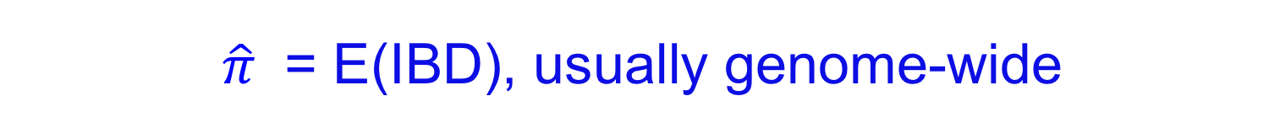
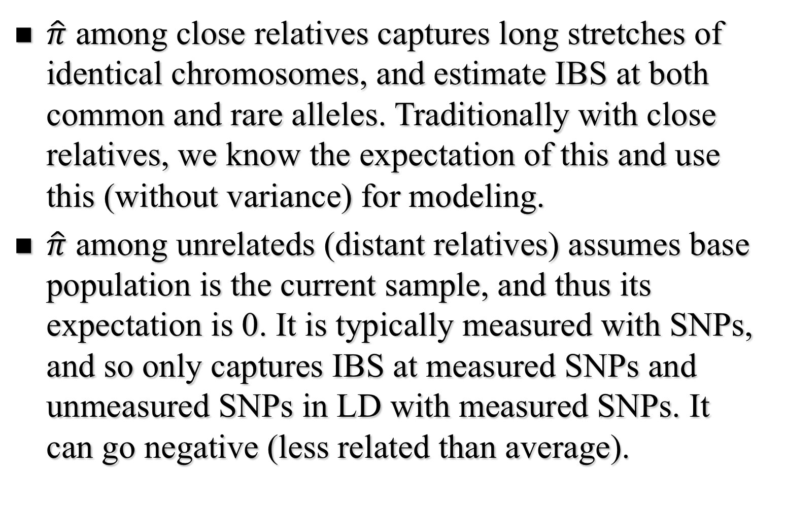

Slide 11
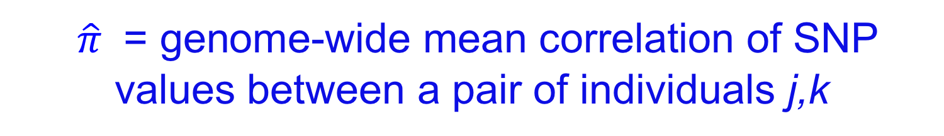
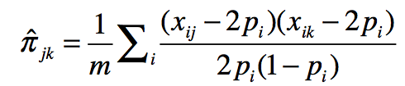
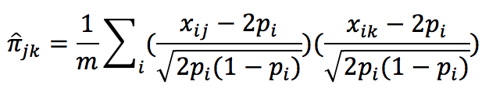
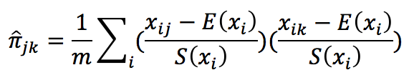
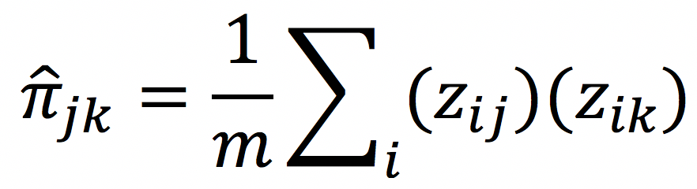
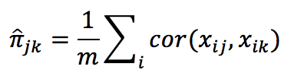

Slide 12
H-E REGRESSION

Slide 13
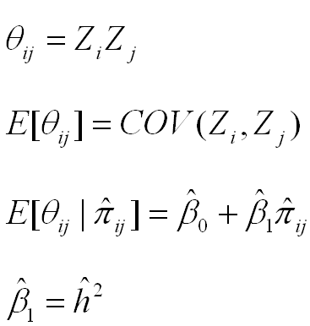
Regression estimates of h2
product of centered scores (here, z-scores)
(the slope of the regression is an estimate of h2)

Slide 14
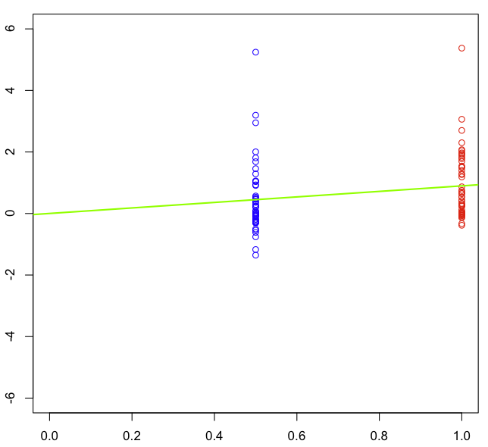


Regression estimates of h2
(the slope of the regression is an estimate of h2)

Slide 15
Regression estimates of h2
COR(MZ)
(the slope of the regression is an estimate of h2)

Slide 16
Regression estimates of h2
COR(DZ)
(the slope of the regression is an estimate of h2)

Slide 17
Regression estimates of h2
2*[COR(MZ)-COR(DZ)]
= h2 = slope
(the slope of the regression is an estimate of h2)

Slide 18
Regression estimates of h2
(the slope of the regression is an estimate of h2)

Slide 19
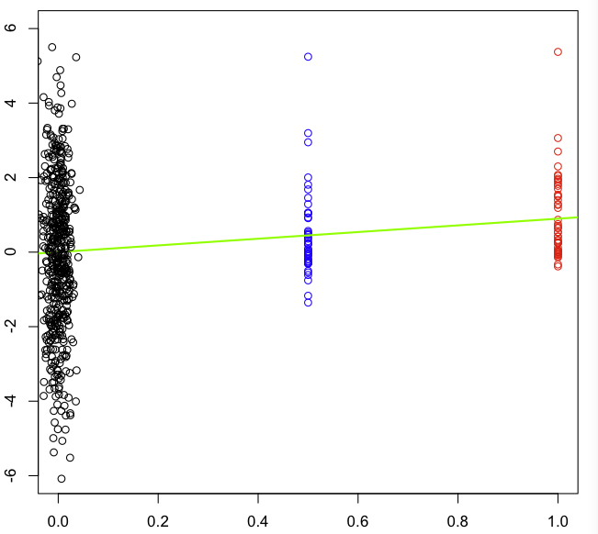
Regression estimates of h2
(the slope of the regression is an estimate of h2)

Slide 20
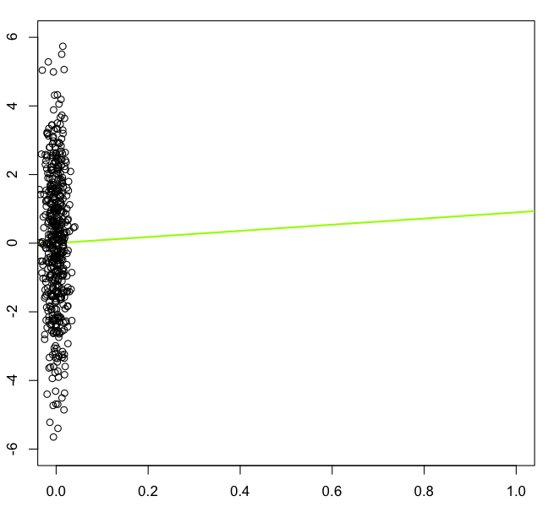
Regression estimates of h2_{snp}
snp
(the slope of the regression is an estimate of h2_{snp})

Slide 21
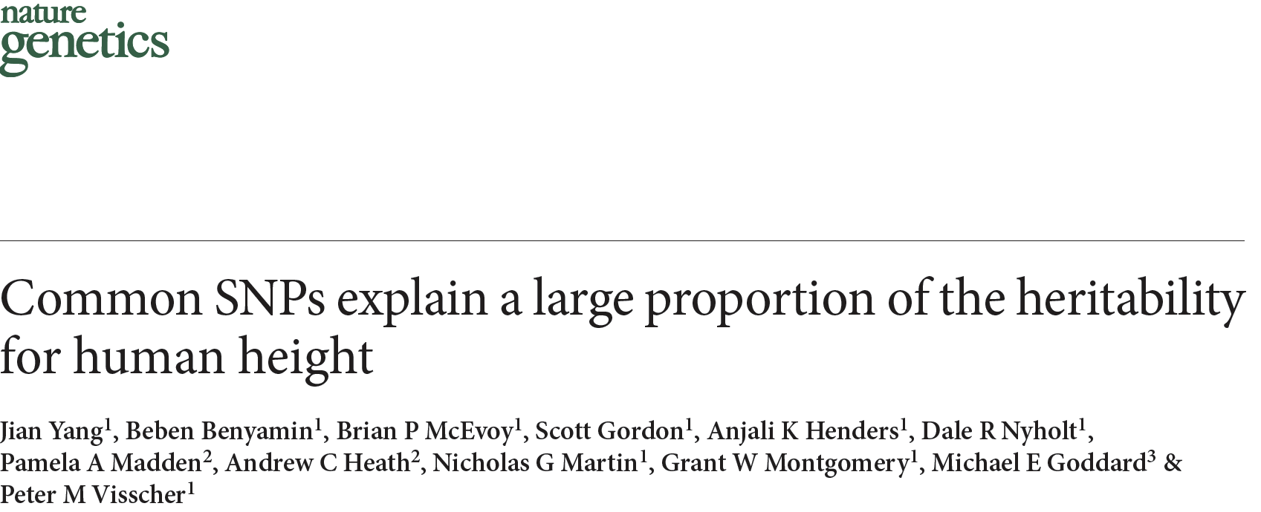
GREML
2010

Slide 22



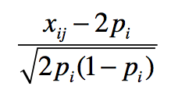
GREML Model
-.64
-2.58
3.21
-.58 1.41 -.93
1.15 .05 2.53
-.58 -1.30 .79
*
=
+
y_{.x}
design matrix for SNP effects =
SNP effects
residuals

Slide 23
GREML Model
-.64
-2.58
3.21
-.58 1.41 -.93
1.15 .05 2.53
-.58 -1.30 .79
*
=
+
y_{.x}
design matrix for SNP effects =
SNP effects
residuals
We aren’t interested in estimates of each u_{i} because such individual estimates are unreliable when m > n. Instead, estimate the variance of u_{i}.

Slide 24


GREML Model
-.64
-2.58
3.21
-.58 1.41 -.93
1.15 .05 2.53
-.58 -1.30 .79
*
=
+
y_{.x}
design matrix for SNP effects =
SNP effects
residuals
We assume and are iid
and therefore

Slide 25







GREML Model
(we treat u as random and estimate and thus )
.41 1.65 -2.05
1.65 6.66 -8.28
-2.05 -8.28 10.3
.99 -.02 -.01
-.02 1.0 .01
-.01 .01 1.02
0 0
0 1 0
0 0 1
=
+
observed n-by-n var/covar matrix of y
Genomic Relationship Matrix (GRM) at measured SNPs. Each element =
Identity matrix

Slide 26


GREML
.41 1.65 -2.05
1.65 6.66 -8.28
-2.05 -8.28 10.3
.99 -.02 -.01
-.02 1.0 .01
-.01 .01 1.02
0 0
0 1 0
0 0 1
=
+
observed var/covar
implied var/covar
REML find values of & that maximizes the likelihood of the observed data. Intuitively, this makes the observed and implied var-covar matrices be as similar as possible.

Slide 27
Interpreting h2 estimated from SNPs (h2_{snp})
If close relatives included (e.g., sibs), h2_{snp} ≅ h2 estimated from a family-based method, because great influence of extreme pihats. Interpret h2_{snp} as from these designs.
If use ‘unrelateds’ (e.g., pihat < .05):
  h2 estimate 'uncontaminated' by shared environment and non-additive genetic effects
  Does not rely on family/twin study assumptions
  Evidence for h2_{snp} to degree similarity at SNPs corresponds to phenotypic similarity. Thus, h2_{snp} = proportion of V_{P} due to CVs tagged by (in LD with) SNPs used in the GRM.
  Typically, h2_{snp} < h2. It is the max r2 possible from a PRS using those SNPs.

Slide 28
LD

Slide 29
Linkage disequilibrium (LD)
Statistical association (e.g., r2) between 2 SNPs
Typically arises from a mutation that occurs on a haplotype. This mutation will co-segregate with nearby SNPs. As it rises in frequency, so too will nearby SNPs.
Decays as a function of number of recombination events that break the two SNPs apart, which is itself a function of:
  Time (# generations) since the mutational event
  Distance (cM) between the two SNPs
SNPs can only predict SNPs that are similar in MAF. Rare-rare or common-common. Rare-common is not possible.

Slide 30
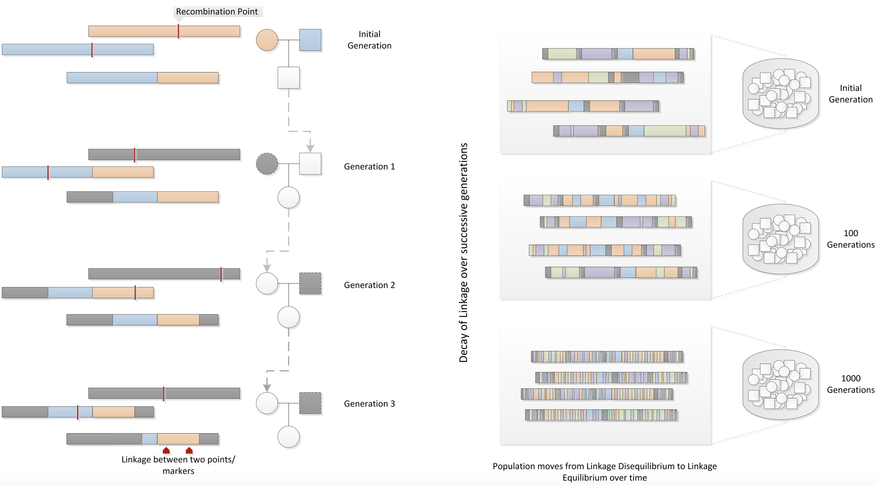
How LD arises & decays
Bush & Moore, PLoS Comp Bio, 2012

Slide 31
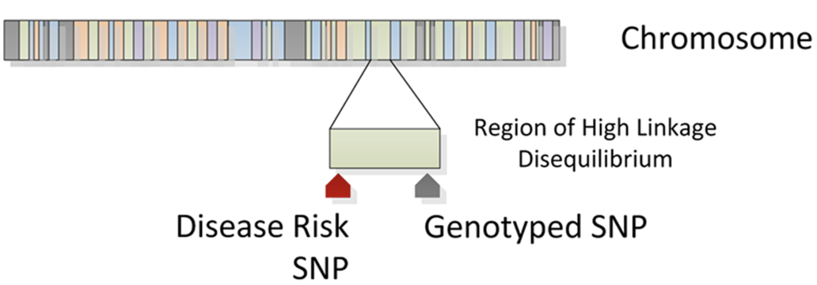
SNPs can tag other nearby SNPs…
Bush & Moore, PLoS Comp Bio, 2012

Slide 32
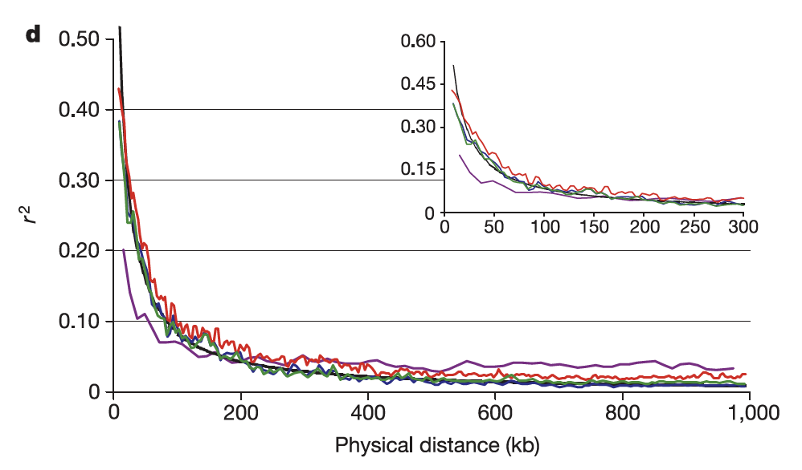
LD drops as a function of distance
Dawson et al, Nature, 2002

Slide 33
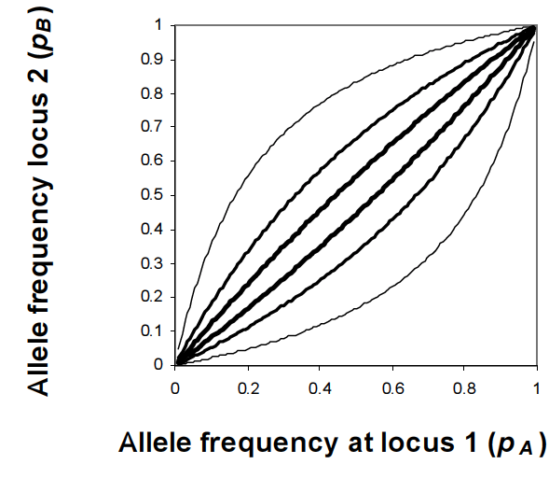
…and high LD possible only if the two alleles are of similar frequencies.
Possible range of allele frequencies given LD (r2) between 2 SNPs
.2
.5
.8
.5
.2
Wray, TRHG, 2006

Slide 34
High LD possible only if the two alleles are of similar frequencies. Here A/B are major and a/b are minor alleles on haplotypes.
Max LD
r2=1.0
Min LD
r2=0.0
Max LD
r2=.25
a & b; A & B “in phase”
Random phase
a & B; A & b “in phase”
A
B
A
b
A
B
A
B
A
B
A
B
A
B
A
B
A
B
A
B
A
b
A
b
A
B
A
B
A
b
A
B
A
B
A
b
a
b
a
b
a
B
a
b
a
B
a
B
a
b
a
B
a
B

Slide 35
…and high LD possible only if the two alleles are of similar frequencies.
Possible range of allele frequencies given LD (r2) between 2 SNPs
.2
.5
.8
.5
.2
Wray, TRHG, 2006

Slide 36
…and high LD possible only if the two alleles are of similar frequencies…
Possible range of allele frequencies given LD (r2) between 2 SNPs
.2
.5
.8
.5
.2
Wray, TRHG, 2006

Slide 37
…and high LD possible only if the two alleles are of similar frequencies…
Possible range of allele frequencies given LD (r2) between 2 SNPs
.2
.5
.8
.5
.2
Wray, TRHG, 2006

Slide 38
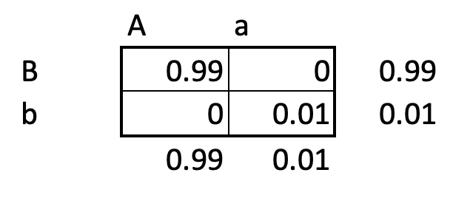
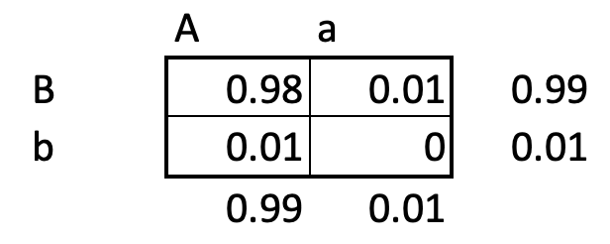
…AND where the rare allele at SNP 1 is in PHASE with the rare allele at SNP 2
In Phase
Out of Phase
Very high LD
Very low LD

Slide 39
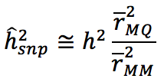


Why h2_{snp} < h2 (almost always)
Because we only estimate genetic variance from CVs in LD with the SNPs used in the analysis. Common CVs are in high LD with array/imputed SNPs, but this is less the case with rare CVs.
In particular:
where
is the average LD r2 between CVs and SNPs
is the average LD r2 between SNPs and SNPs

Slide 40
THE END
(extra slides after)

Slide 41
RUNNING GCTA

Slide 42
SNP QC
Poor SNP calls can inflate SE and cause downward bias in h²_{snp}
Clean data for
  SNPs missing > ~.05
  HWE p < 10e-6
  MAF < ~.01
  Plate effects:
    Remove plates with extreme average inbreeding coefficients or high average missingness

Slide 43
Individual QC
Remove individuals missing > ~.02
Remove close relatives (e.g., --grm-cutoff 0.05)
  Correlation between pi-hats and shared environment can inflate h²_{snp} estimates
Control for stratification (usually 5 to 20 PCs)
  Different prevalence rates (or ascertainments) between populations can show up as h²_{snp}
Control for plates and other technical artifacts
  Be careful if cases & controls are not randomly placed on plates (can create upward bias in h²_{snp})

Slide 44
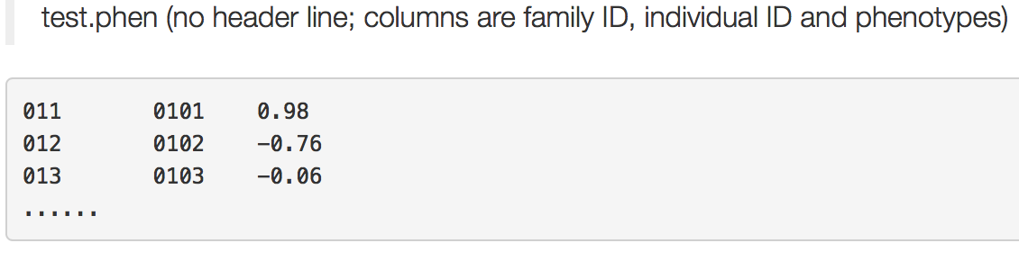
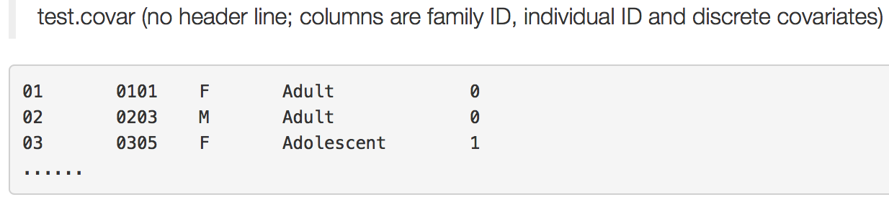
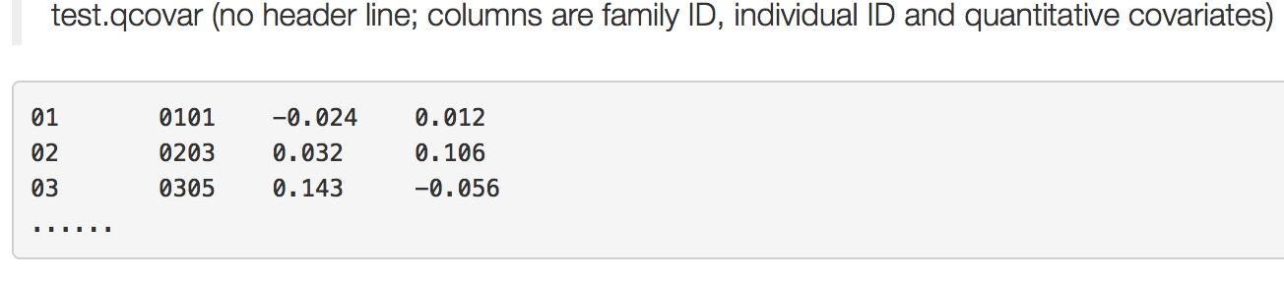
GCTA command & input
COMMAND:
gcta
--grm-bin <path>/SNPs.rel05
--pheno <path>/test.phen
--covar <path>/test.covar
--qcovar <path>/test.qcovar
--reml --out SNPgrm.randomCV
gcta --bfile SNPs --make-grm-bin --out SNPs.rel05

Slide 45
GCTA command & output
COMMAND:
gcta --grm-bin <path>/SNPs.rel05 --pheno <path>/pheno.txt --covar <path>/cov.txt --reml --out SNPgrm.randomCV
OUTPUT:
cat SNPgrm.randomCV.hsq
Source Variance SE
V(G) 0.300098 0.275857
V(e) 1.730548 0.279257
Vp 2.030646 0.049529
V(G)/Vp 0.147785 0.135820
logL -2876.706
logL0 -2877.338
LRT 1.264
Df 1
Pval 0.1305
N 3363

Slide 46
GCTA command & output
COMMAND:
gcta --grm-bin <path>/SNPs.rel05 --pheno <path>/pheno.txt --covar <path>/cov.txt --reml --out SNPgrm.randomCV
OUTPUT:
cat SNPgrm.randomCV.hsq
Source Variance SE
V(G) 0.300098 0.275857
V(e) 1.730548 0.279257
Vp 2.030646 0.049529
V(G)/Vp 0.147785 0.135820
logL -2876.706
logL0 -2877.338
LRT 1.264
Df 1
Pval 0.1305
N 3363
h2_{snp & SE}
95% CI:
0.147-1.96*0.134 = -0.12
0.147-1.96*0.134 = 0.41

Slide 47
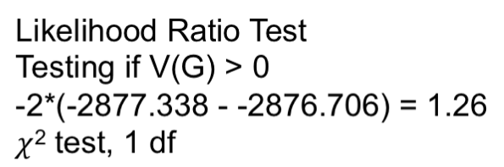
GCTA command & output
COMMAND:
gcta --grm-bin <path>/SNPs.rel05 --pheno <path>/pheno.txt --covar <path>/cov.txt --reml --out SNPgrm.randomCV
OUTPUT:
cat SNPgrm.randomCV.hsq
Source Variance SE
V(G) 0.300098 0.275857
V(e) 1.730548 0.279257
Vp 2.030646 0.049529
V(G)/Vp 0.147785 0.135820
logL -2876.706
logL0 -2877.338
LRT 1.264
Df 1
Pval 0.1305
N 3363

Slide 48
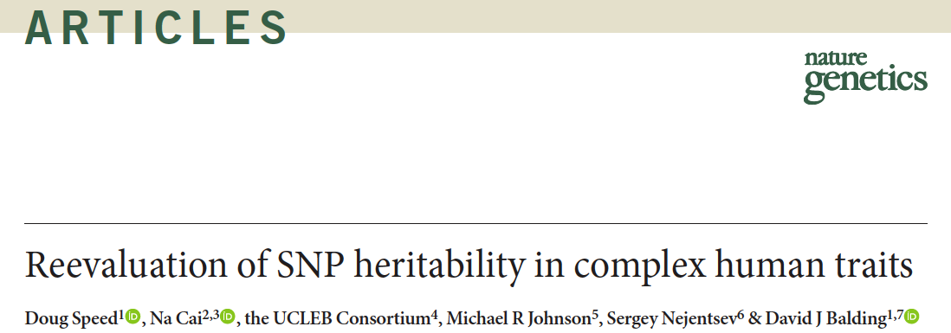
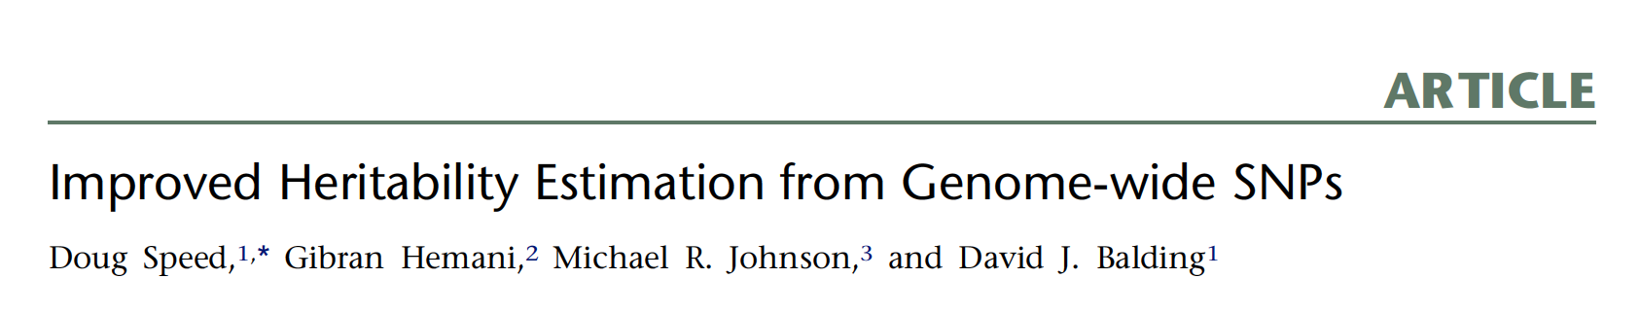
LDAK
2017
2012

Slide 49
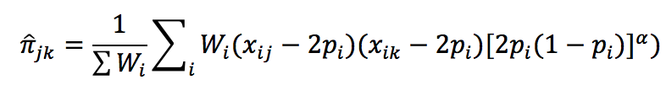


    A more general form of this formula is:
Which reduces to the typical formulation above when:
&
    The choice of W_{i} and α are arbitrary and depend on implicit assumptions about which types of SNPs tag CVs & CV effect sizes. If we heavily weight a certain type of SNP (e.g., those in genes), we assume such SNPs better tag CVs.

Slide 50


Assumptions
Consequences
SNPs have equal weight, even if they are poorly imputed and redundantly tag the same CV
Rarer SNPs (which tag rarer CVs) receive more weight, ostensibly due to NS. This means the variance explained per SNP is invariant across MAF:

Slide 51

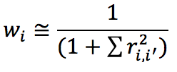

Assumptions
Consequences
Where r_{i} is the imputation INFO score and w_{i} is the LD score. High LD SNPs receive less weight, and poorly imputed SNPs receive less weight.
Lower MAF SNPs (which tag rarer CVs) receive less (vs. GCTA) weight. This means the variance explained per SNP increases with MAF:

Slide 52
Speed & Balding argued that
LDAK weights are superior
Common sense: Redundantly tagged CVs should not have higher effect sizes. Poorly imputed SNPs must tag CVs worse.
Model Fit: log-likelihood from LDAK models was typically higher than log-likelihood from “GCTA” models
  Moreover, h2_{snp} 25-43% higher than GCTA models

Slide 53
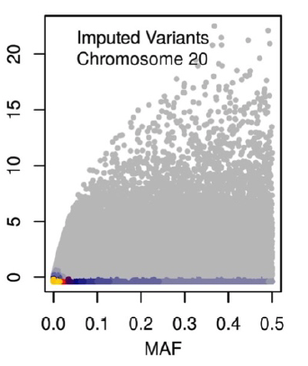
Problems with LDAK approach
Single GRM models depend heavily on assumptions and CV MAF matching the SNP MAF distribution
Nothing about maximizing likelihoods ensures unbiasedness
LD and imputation r2 are highly positively related, but LDAK weights them oppositely. This gives extreme weight to a small number of unusual (well imputed, low LD, high MAF SNPs)

Slide 54
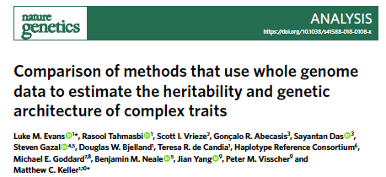
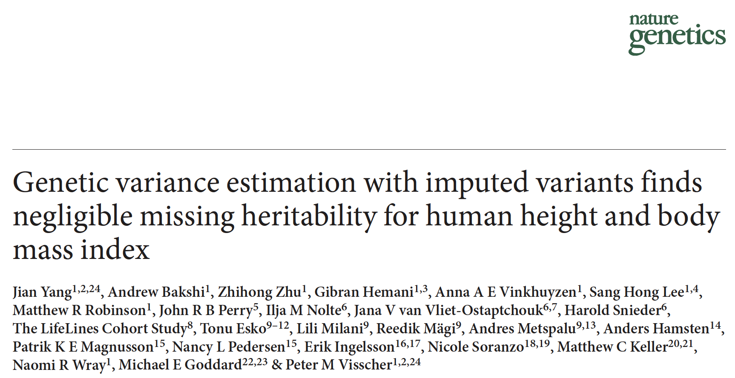
GREML-LDMS-I & -R
2018
LDMS-I
2015
LDMS-R

Slide 55
The LDMS Approach
  Single-GRM models are highly sensitive to assumptions about CV-SNP LD (e.g., that SNPs have same distribution as CVs) and CV effect size-MAF relationships. We don’t want our estimates of genetic architecture to depend on our assumptions of genetic architecture.
  Moreover, even if we were to guess at these relationships perfectly for a trait, they are unlikely to hold across all traits.
  Akin to multiple regression, an alternative (LDMS) is to let the data tell us by fitting multiple GRMs, each with SNPs binned according to different MAF levels and LD levels
  Estimates associated with each GRM are free to soak up whatever variance is explained by those MAF/LD SNPs

Slide 56
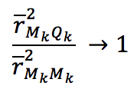

LDMS justification
  Note that
  The range of MAF and range of LD will be smaller within a particular MAF/LD bin. As the MAF & LD range shrink for a given MAF/LD bin k of SNPs (M_{k}) and CVs (Q_{k}),
  and thus

Slide 57
LDMS-R vs. LDMS-I
  LDMS-R: Create 20 GRMs across 5 MAF bins (< .001, .001-.01, .05-.1, .1-.25,.25-.5) and 4 quartiles of LD scores within each bin, where SNPs take the average LD of SNPs in the surrounding ~ 200kb region.
  However, SNPs with individually low LD that exist in regions of high LD explain more variation (Gazal et al, Nature Genetics, 2017)
  Thus, LDMS-I (unlike LDMS-R) uses each individual SNP’s LD score for binning
  Because SEs tend to be ~2.5x larger than single-GRM estimates, both require large sample sizes (e.g., N > 30k) and therefore large amounts of RAM (e.g., >100 Gb)

Slide 58
RUNNING LDMS-I

Slide 59
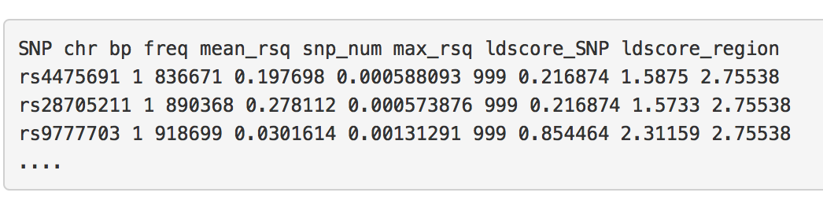
Create LD quartiles
GCTA LD command:
gcta --bfile <path>/test
--ld-score-region 200
--out LD.txt
Create LD quartiles in R:
LD <- read.table(“LD.txt”,header=T)
quants <- quantile(LD$ldscore_SNP)
LD1 <- LD$SNP[LD$ldscore_SNP <= quants[2]]
write.table(LD1,”snp_group1.txt”,row.names=F,col.names=F,quote=F)
<etc…>
Create GRMs in GCTA:
gcta --bfile <path>/test
--extract snps_group1.txt
--make-grm-bin
--out GRM.1
test.bed, test.bim, test.fam

Slide 60
Run LDMS-I using GCTA
Text file
COMMAND:
gcta
--mgrm-bin <path>/multi_GRMs.txt
--pheno <path>/test.phen
--covar <path>/test.covar
--qcovar <path>/test.qcovar
--reml --out Multi.SNPgrm
--thread-num 20
<path>/GRM.1
<path>/GRM.2
…
<path>/GRM.last
As before
You can use multiple cores; make this as many cores as you can spare

Slide 61
LDMS-I Output (3 GRM example)
TYPE: cat mgrm.randomCV.hsq
Source Variance SE
V(G1) 0.303900 0.184182
V(G2) 0.127654 0.309142
V(G3) 0.653199 0.328909
V(e) 0.926493 0.435653
Vp 2.011246 0.049641
V(G1)/Vp 0.151100 0.091277
V(G2)/Vp 0.063470 0.153765
V(G3)/Vp 0.324773 0.164408
logL -2872.894
N 3363
h2_{SNP} = 0.15+0.06+0.32 = 0.5391

Slide 62
GREML vs. LDAK vs. LDMS-I

Slide 63
We hope it’s useful as a guide for best practices and proper interpretation of ĥ²_{SNP}.
  We simulated 16 genetic architectures, 3 levels of stratification, and 3 SNP types (array, imputed, WGS) in order to compare ĥ²_{SNP} across 12 estimation methods (1728 different combos)
Here I highlight just a few of what I think are the most important points

Slide 64
Overview of Simulation Approach
  Genotypes from real WGS data (n=8k). Choose 1K rare (MAF < .0025) or common (MAF > .05) CVs.
  Pull out SNPs on UKB array & impute
  Vary 2 CV effect size dimensions (λ_{i}=u_{i}[2pq]α/2):
    λ-LD (via u_{i})
    λ-MAF (via α)
  Compare ĥ2_{SNP} to true h2 (=.50) across 3 methods on imputed data
  Repeat this 100 times for different sets of CVs; look at mean (to get bias) and SD (to get SE) ĥ2_{SNP}

Slide 65
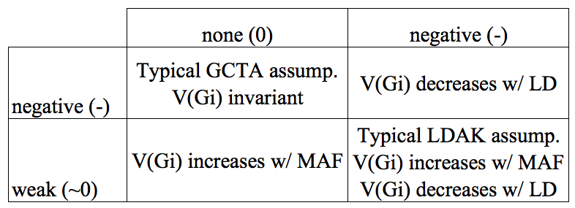
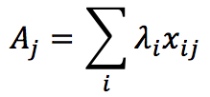

Simulation of phenotypes
  CV effect size = λ_{i}= u_{i}[2pq]α/2
  λ-LD relationship
  u_{i}~N(0,1) or u_{i}~N(0,w_{i})
  λ-MAF
  α=-.25 or α=-1
  Breeding values =
  Phenotype values =

Slide 66
3 Estimation Methods Compared
  GREML-SC: predictor is a single GRM (aka, “GCTA approach”). GRM built as usual from all imputed SNPs with MAC > 5 & imputation r2 > .3
  LDAK: predictor is a single GRM from imputed SNPs and weighted by LD and imputation r2.
  GREML-LDMS-I: predictors are k = 8 GRMs created by binning imputed SNPs into 2 individual LD by 4 MAF categories. Within each bin, GRMs built as usual. ĥ2_{SNP} = Σ(ĥ2_{SNP_k})

Slide 67
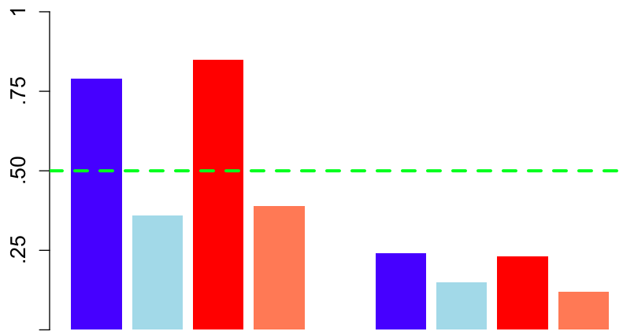
GREML-SC results
CV MAF > .05
CV MAF < .0025
ĥ2_{SNP}
CVs:
LD-λ
0 - 0 - 0 + 0 +
MAF-λ
- - ~0 ~0 + + ~0 ~0
GCTA assumps.
LDAK
assumps.
GCTA assumps.
LDAK
assumps.

Slide 68
GREML-SC results
CV MAF > .05
CV MAF < .0025
r2_{MQ} > r2_{MM}
ĥ2_{SNP}
CVs:
LD-λ
0 - 0 - 0 + 0 +
MAF-λ
- - ~0 ~0 + + ~0 ~0
GCTA assumps.
LDAK
assumps.
GCTA assumps.
LDAK
assumps.

Slide 69
GREML-SC results
CV MAF > .05
CV MAF < .0025
r2_{MQ} < r2_{MM}
ĥ2_{SNP}
CVs:
LD-λ
0 - 0 - 0 + 0 +
MAF-λ
- - ~0 ~0 + + ~0 ~0
GCTA assumps.
LDAK
assumps.
GCTA assumps.
LDAK
assumps.

Slide 70
GREML-SC results
CV MAF > .05
CV MAF < .0025
ĥ2_{SNP}
r2_{MQ} < r2_{MM}
CVs:
LD-λ
0 - 0 - 0 - 0 -
MAF-λ
- - ~0 ~0 - - ~0 ~0
GCTA assumps.
LDAK
assumps.
GCTA assumps.
LDAK
assumps.

Slide 71
GREML-SC results
CV MAF > .05
CV MAF < .0025
ĥ2_{SNP} = h2 (r2_{MQ}/r2_{MM})
ĥ2_{SNP}
CVs:
LD-λ
0 - 0 - 0 - 0 -
MAF-λ
- - ~0 ~0 - - ~0 ~0
GCTA assumps.
LDAK
assumps.
GCTA assumps.
LDAK
assumps.

Slide 72
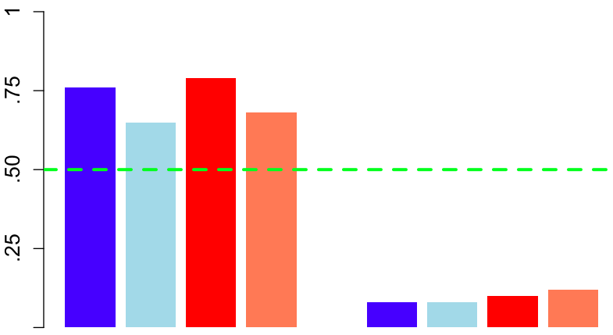
LDAK results
CV MAF > .05
CV MAF < .0025
ĥ2_{SNP}
CVs:
LD-λ
0 - 0 - 0 + 0 +
MAF-λ
- - ~0 ~0 + + ~0 ~0
GCTA assumps.
LDAK
assumps.
GCTA assumps.
LDAK
assumps.

Slide 73
LDAK results
CV MAF > .05
CV MAF < .0025
upweights low LD SNPs but this is partially offset by downweighting poorly imputed ones
ĥ2_{SNP}
CVs:
LD-λ
0 - 0 - 0 + 0 +
MAF-λ
- - ~0 ~0 + + ~0 ~0
GCTA assumps.
LDAK
assumps.
GCTA assumps.
LDAK
assumps.

Slide 74
LDAK results
CV MAF > .05
CV MAF < .0025
ĥ2_{SNP}
CVs:
LD-λ
0 - 0 - 0 - 0 -
MAF-λ
- - ~0 ~0 - - ~0 ~0
GCTA assumps.
LDAK
assumps.
GCTA assumps.
LDAK
assumps.

Slide 75
LDAK results
CV MAF > .05
CV MAF < .0025
ĥ2_{SNP}
Again,
r2_{MQ} < r2_{MM}
CVs:
LD-λ
0 - 0 - 0 - 0 -
MAF-λ
- - ~0 ~0 - - ~0 ~0
GCTA assumps.
LDAK
assumps.
GCTA assumps.
LDAK
assumps.

Slide 76
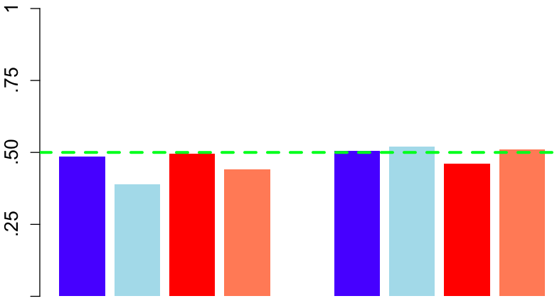
GREML-LDMS-I results
CV MAF > .05
CV MAF < .0025
ĥ2_{SNP}
CVs:
LD-λ
0 - 0 - 0 + 0 +
MAF-λ
- - ~0 ~0 + + ~0 ~0
GCTA assumps.
LDAK
assumps.
GCTA assumps.
LDAK
assumps.

Slide 77
GREML-LDMS-I results
CV MAF > .05
CV MAF < .0025
ĥ2_{SNP}
CVs:
LD-λ
0 - 0 - 0 - 0 -
MAF-λ
- - ~0 ~0 - - ~0 ~0
GCTA assumps.
LDAK
assumps.
GCTA assumps.
LDAK
assumps.

Slide 78
GREML-LDMS-I results
CV MAF > .05
CV MAF < .0025
Within a given MAF/LD bin, r2_{MQ} ≅ r2_{MM}
Thus, ĥ2_{SNP} = h2 (r2_{MQ}/r2_{MM}) = h2
ĥ2_{SNP}
CVs:
LD-λ
0 - 0 - 0 - 0 -
MAF-λ
- - ~0 ~0 - - ~0 ~0
GCTA assumps.
LDAK
assumps.
GCTA assumps.
LDAK
assumps.

Slide 79
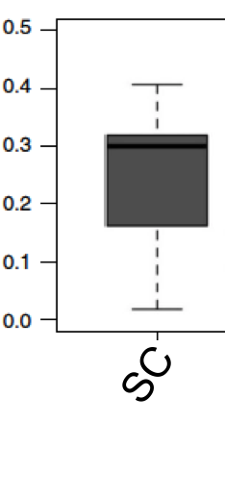
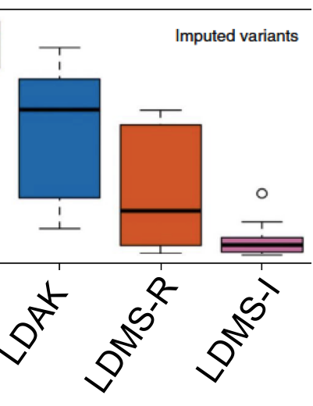
Absolute Bias Across 4 Methods and hundreds of genetic architectures

Slide 80
Regarding LD-Score regression
  LD-score regression is robust to stratification and sample overlap. However:
    it cannot estimate h2 due to rare CVs, even when using imputed/WGS data
    it is sensitive to assumptions about LD-λ
    should provide a lower-bound of ĥ2_{SNP} from other methods
  So long as genetic covariance is affected in the same way as genetic variances, estimates of genetic correlations should be OK.

Slide 81
Summary
  With datasets imputed to large WGS reference panels, ĥ2_{SNP} can estimate full h2. It’s important that we have unbiased estimators to know the true h2 and for comparison to twin/family estimates (o/w things will get really confusing).
  Single-GRM approaches (incl. GREML-SC (“GCTA”) and LDAK) are extremely sensitive to CV LD being similar to SNP LD across genome.
    This is mostly influence by CV vs. SNP MAF, and also by assumptions of LD-λ relationship. MAF-λ less so.
  Binning SNPs by LD & MAF provides ~ unbiased estimates for the CVs tagged by SNPs used in analysis.
    Even on well-imputed data, you’ll still get an underestimate due to extremely rare variants

Slide 82
REAL TRAITS

Slide 83
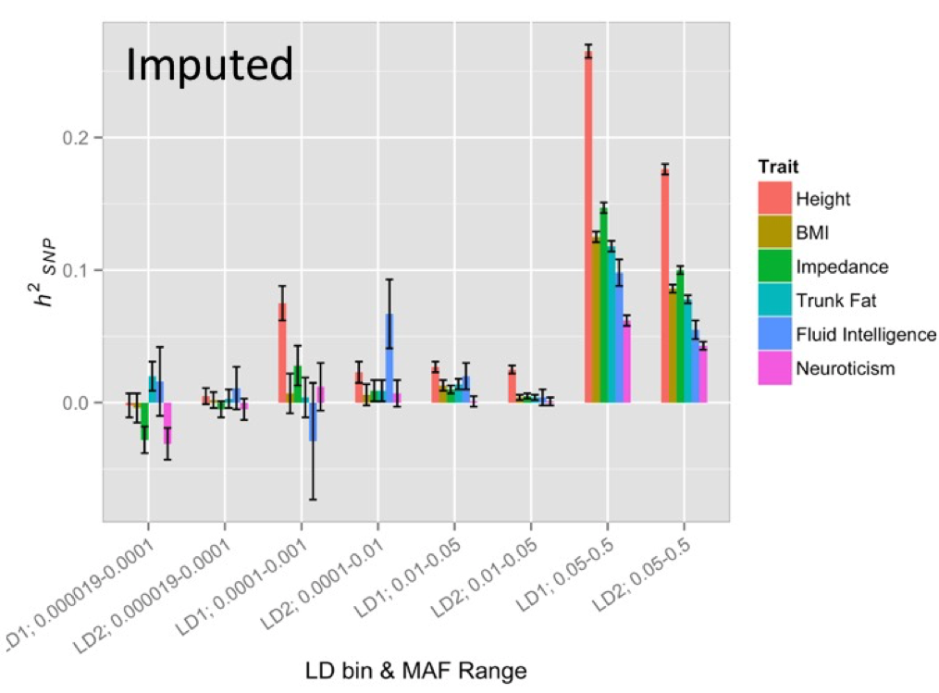
LDMS-I on UKB phenotypes

Slide 84
STRATIFICATION
& LONG-RANGE LD

Slide 85

Chance allele frequency differences b/w populations can induce long-range LD in stratified samples
Population 1
Population 2
 | A | a
B | .54 | .36 | .9
b | .06 | .04 | .1
 | .6 | .4
 | A | a
B | .03 | .27 | .3
b | .07 | .63 | .7
 | .1 | .9
=0
=0

Slide 86
Chance allele frequency differences b/w populations can induce long-range LD in stratified samples
Population 1
Population 2
 | A | a
B | .54 | .36 | .9
b | .06 | .04 | .1
 | .6 | .4
 | A | a
B | .03 | .27 | .3
b | .07 | .63 | .7
 | .1 | .9
=0
=0
Stratified Population
 | A | a
B | .285 | .315 | .6
b | .065 | .335 | .4
 | .35 | .65
=.10

Slide 87
However, such “stratification-LD” is typically very small for pairs of common SNPs
Population 1
Population 2
 | A | a
B | .54 | .36 | .9
b | .06 | .04 | .1
 | .6 | .4
 | A | a
B | .44 | .36 | .8
b | .11 | .09 | .2
 | .55 | .45
=0
=0
Stratified Population
 | A | a
B | .490 | .360 | .85
b | .085 | .065 | .15
 | .575 | .425
=.00005

Slide 88
But higher b/w rare (often ~ private) SNPs and common ancestry-informative SNPs
Population 1
Population 2
 | A | a
B | .003 | .897 | .9
b | .00 | .099 | .1
 | .003 | .997
 | A | a
B | .04 | .76 | .8
b | .01 | .19 | .2
 | .05 | .95
=0
=0
Stratified Population
 | A | a
B | .021 | .829 | .85
b | .005 | .145 | .15
 | .027 | .973
=.0004

Slide 89
Effects of stratification on r²_{QM}/r²_{MM}
  In general, stratification inflates long-range r² between SNPs. However, within a given MAF bin, the ratio of r²_{QM}/r²_{MM} is ~ 1 because SNP-SNP & SNP-CV LDs are inflated similarly.

Slide 90
Effects of stratification on r²_{QM}/r²_{MM}
  In general, stratification inflates long-range r² between SNPs. However, within a given MAF bin, the ratio of r²_{QM}/r²_{MM} is ~ 1 because SNP-SNP & SNP-CV LDs are inflated similarly.
However, across CVs and SNPs of different MAF, stratification induces differences in r²_{QM} & r²_{MM.} We observed:
  For rare CVs, r²_{QM}/r²_{MM} > 1. Rare (ancestry specific) CVs are tagged by every common SNP that differs in allele frequency across ancestry (note r²_{QM}/r²_{MM} < 1 in unstratified samples).
  For very common CVs, r²_{QM}/r²_{MM} ~ 1. Very common CVs tend to have smaller MAF differences, and therefore less LD with common SNPs than typical between SNPs (note r²_{QM}/r²_{MM} > 1 in unstratified samples).

Slide 91
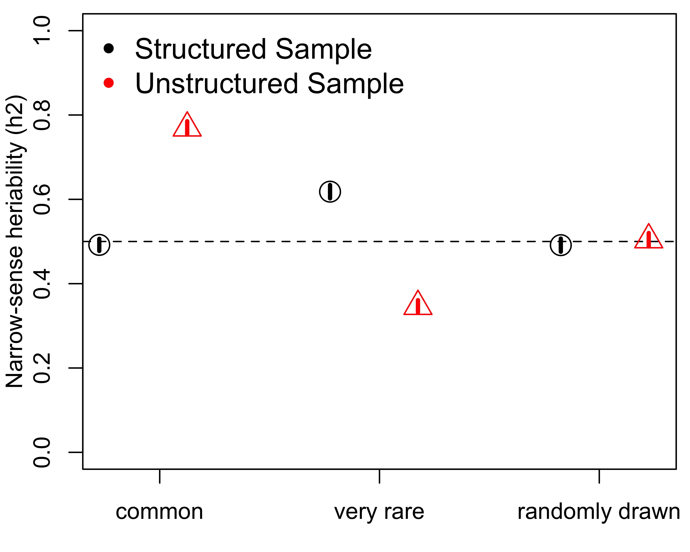
This led to an opposite pattern of bias in stratified (”structured”) samples when using single GRM GREML
Single GRM using WGS
Causal Variant Minor Allele Frequency

Slide 92
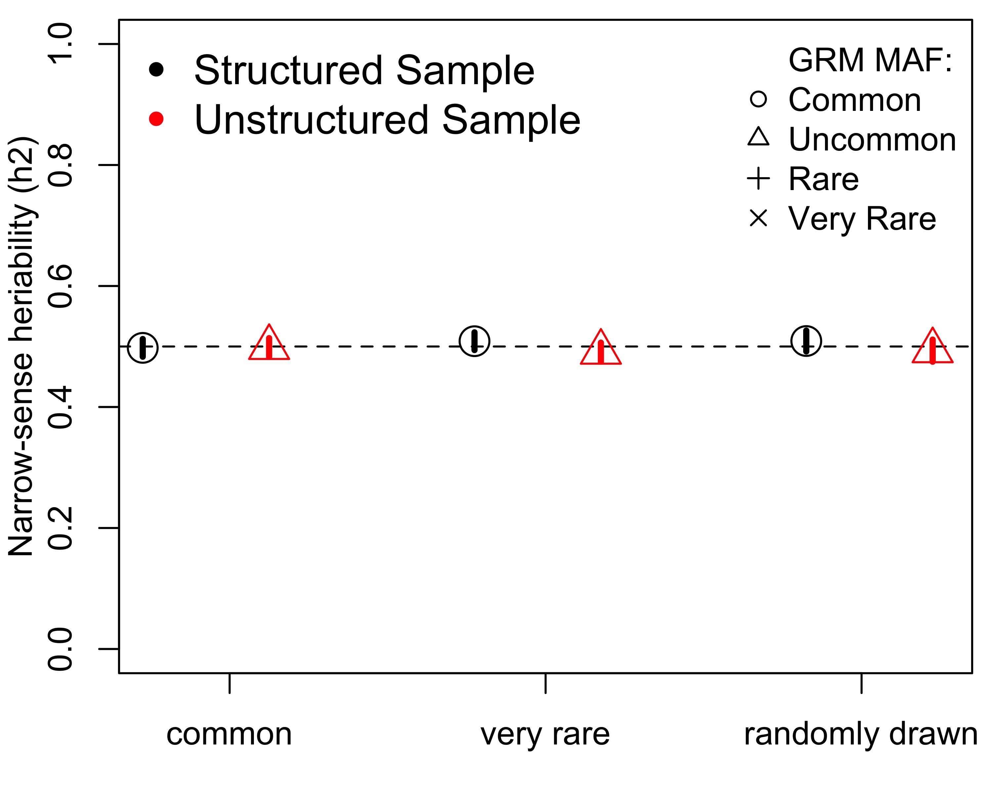
Which once again was corrected by using LDMS GREML
Single GRM using WGS
MAF-stratified GRMs using WGS
Causal Variant Minor Allele Frequency
Causal Variant Minor Allele Frequency

Slide 93
ASSORTATIVE MATING

Slide 94
Positive primary phenotypic
assortative mating (AM)
AM: Assortment between mates leading to a correlation between phenotypic (and hence genetic) scores. Often conceptualized as mate choice based on similarity.
Induces long-range (across chromosome) “directional” LD (δ) b/w CVs
  δ = covariance among CV effects; under positive AM, E[δ]> 0; allelic effects in the same direction.
Directional LD increases true V_{G} & h2 in the population.
  This occurs for same reason the variance of a sum of positively correlated X_{i} > variance of sum of independent X_{i}
  For polygenic traits, the vast majority (>99%) of this increase is due to δ between different CVs, not to δ within CVs (homozygosity)

Slide 95



AM effects on pihat
Assortment has ~ no influence on
Recall that
However, this is much different than the reverse conditional*:
where r is the mate correlation and m is the # CVs
This is because δ between CVs, the major factor influencing h2, plays no role in (or means in general)
*Robinson et al., Nature Human Behavior, 2017
Yengo et al., BioarXiv, 2018

Slide 96
However, AM does bias h2_{snp} estimates
AM typically leads to upward bias in estimates of equilibrium h2_{snp}
Occurs because AM creates positive covariances between CVs and these are correctly reflected in phenotypic covariances between individuals (product of means) but poorly reflected in pihat matrix (mean of products).
Thus, variance of pihats is too small. Underestimated variance in a predictor leads to overestimates of the coefficients associated with that predictor.
We derived this bias algebraically in HE regression estimates and confirmed it in simulation.
REML also upwardly biased, but bias depends on ratio N/m.

Slide 97


Parameter h2_{snp}
Define parameter h2_{snp}: proportion of phenotypic variance tagged by SNPs, accounting for their inter-correlations
Equilibrium h2_{snp}: R2 from linear model for all m SNPs fit simultaneously as
The parameter depends on how well CVs are tagged by SNPs (e.g., SNP density). Thus, it depends on the SNP chip and the population it is estimated in.

Slide 98



HE regression estimate of h2_{snp}

Slide 99


HE regression estimate of h2_{snp}

Slide 100
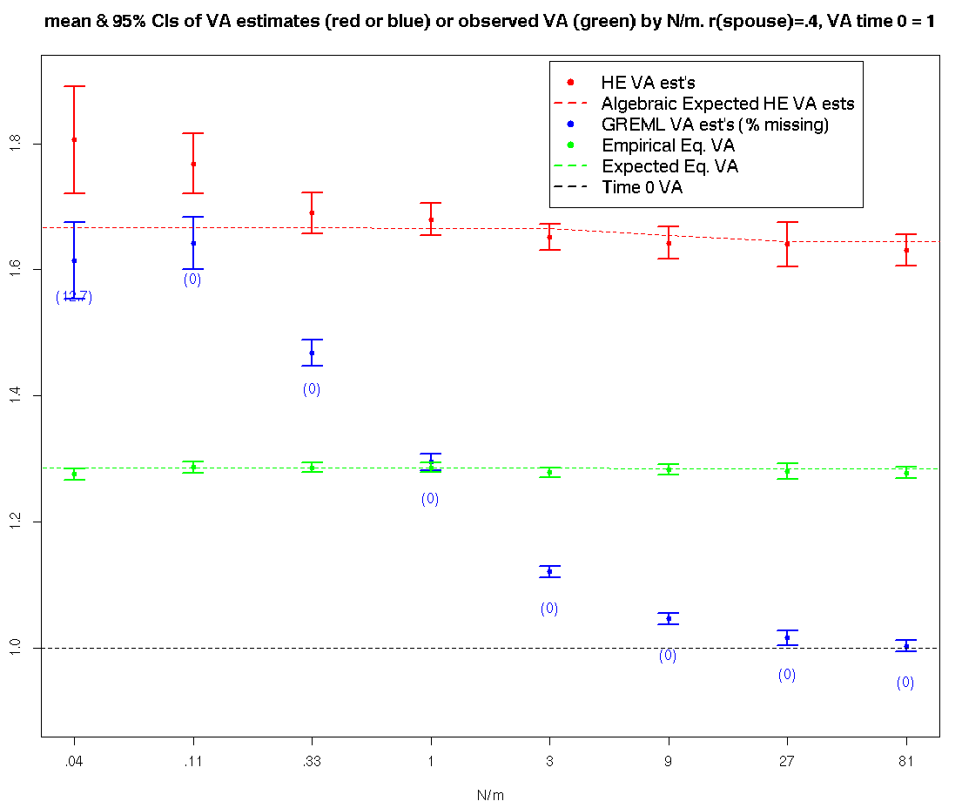
We don’t predict HE estimates to change as a function of m or N. GREML estimates are clearly a function of N/m, which occurs because when N>>m, the effects of each SNP are separable.

Slide 101
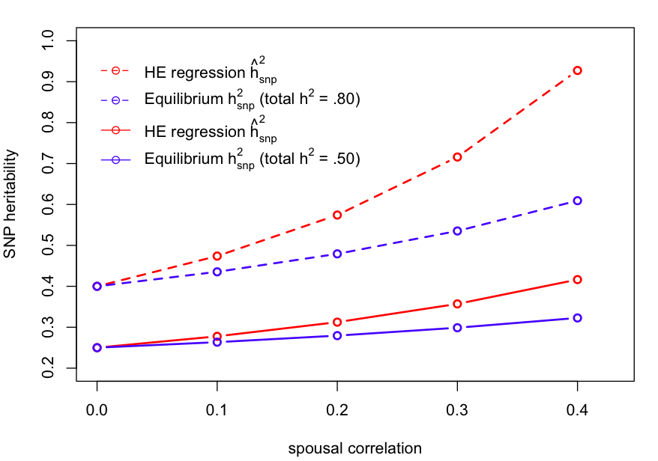
Predicted h²_{snp} biases assuming SNPs tag 50% of true VA

Slide 102
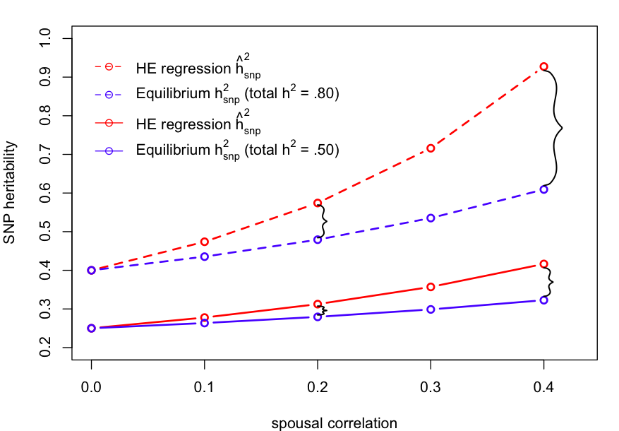
Predicted h2_{snp} biases assuming SNPs tag 50% of true VA
.52
.20
.29
.12

Slide 103
Potential degree of over-estimation for various traits
Trait | r(spouse) | h²_{ETFD} from literature | h²_{snp} from literature | corrected h²_{snp} | % Over-estimated
Extraversion | .01 | .23 | .15 | .15 | 0
Neuroticism | .08 | .24 | .16 | .155 | .03
Height | .20 | .70 | .45 | .39 | .15
IQ | .35 | .62 | .35 | .28 | .25
Political Pref. | .48 | .26 | .18 | .15 | .20

Slide 104

Simulations
Rasool Tahmasbi
Simulated populations under AM using GeneEvolve (Tahmasbi & Keller, 2016).
CVs: 1000
Heritability: 0.5
Relative pruning: >.05
Spousal phenotypic correlation: .4
Took mean of 100 iterations

Slide 105
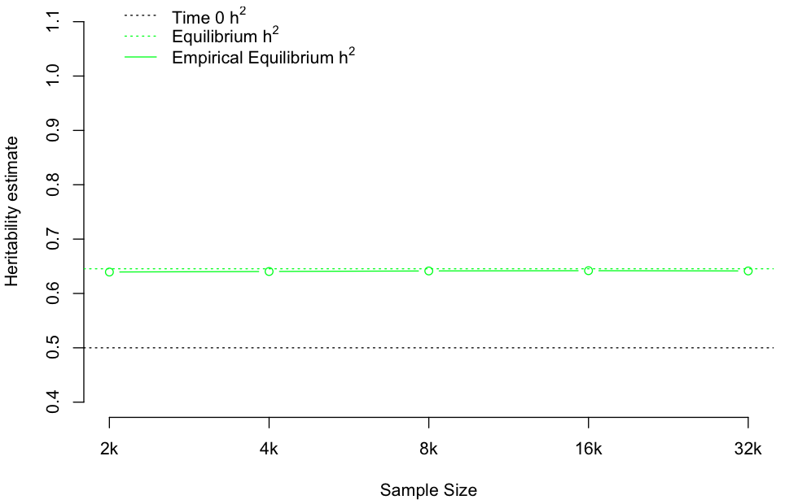
GeneEvolve Simulation Results

Slide 106
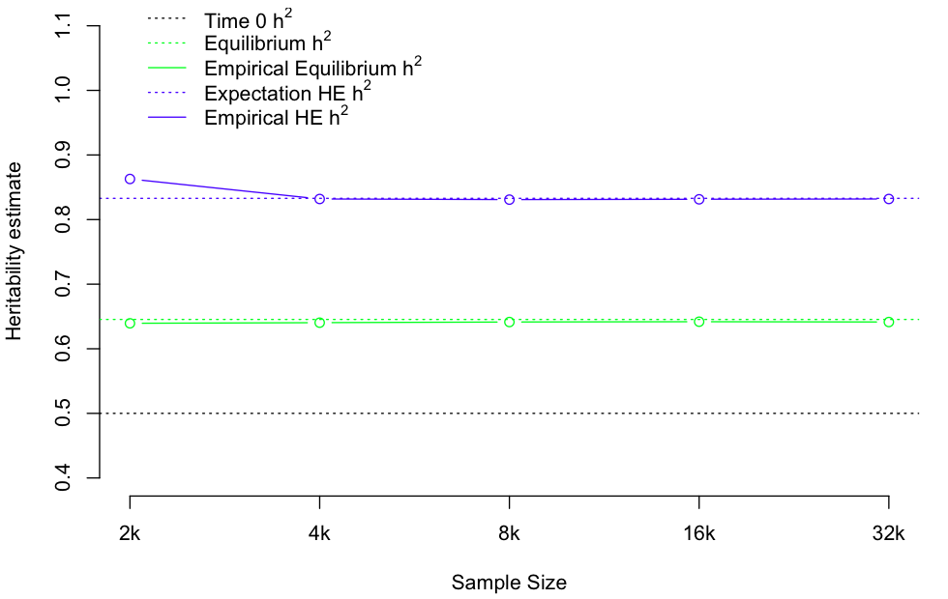
GeneEvolve Simulation Results

Slide 107
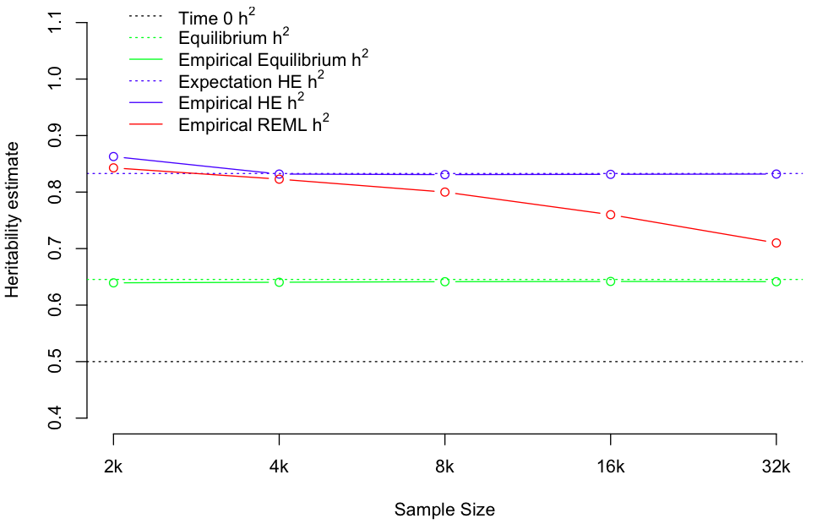
GeneEvolve Simulation Results

Slide 108
HE vs. GREML estimates
For most realistic situations, m>>N, and thus GREML and HE estimates are similar: both over-estimate equilibrium h²_{snp}
We can vary N (holding m constant) to see if AM is biasing estimates in real data

Slide 109

HE (blue) vs. REML (red) h²_{snp} estimates of systolic BP - UK Biobank

Slide 110

HE (blue) vs. REML (red) h²_{snp} estimates of height - UK Biobank

Slide 111

HE (blue) vs. REML (red) VA estimates of fluid IQ - UK Biobank

Slide 112
Summary – bias due to AM
AM creates upward biases in HE and REML h2_{SNP} estimates
  We see evidence for this in UK Biobank data for height but not for fluid IQ
  Natural selection creates negative LD among CVs. The combined effect of AM and NS could cancel each other out.
Remaining issues:
  Unsure how to account for the bias. LDMS GREML does not help.
  Need to understand the effects of NS on h2_{snp}

Slide 113
Big picture: Using SNPs to estimate h2
There has been a great deal of excitement about using SNPs to estimate h2
Large sequence reference panels (TopMed) allow SNPs to be imputed down to MAF ~ .0001.
  h2_{snp} will approach h2
  Also allows investigation of allelic spectra, and importance of biological/evolutionary annotations
  By understanding true h2, can begin understanding importance of familial environmental factors
However, it is crucial to understand the factors that can bias these estimates
  LDMS accounts for biases due to MAF & stratification
  But not for biases caused by AM (and probably NS)

Slide 114

Acknowledgements
Collaborators
Consortia/Databases
Haplotype Reference Consortium
UK Biobank
University of Queensland
Peter Visscher
Jian Yang
Naomi Wray
Mike Goddard
CU
Matt Jones
Broad Institute
Ben Neale
Postdoctoral Fellows
Teresa de Candia
Luke Evans
Rasool Tahmasbi
Graduate Students
Emma Johnson
Richard Border
Funding
NIMH K01 MH085812 (Keller)
NIMH R01 MH100141 (Keller)

Slide 115


Slide 116


