Slide 1
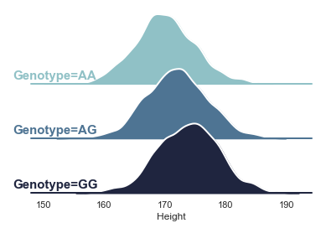

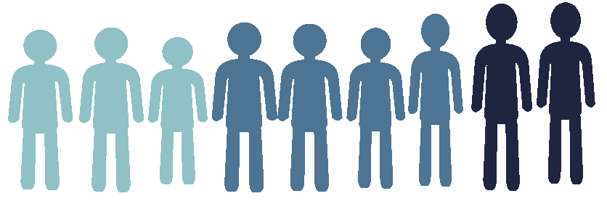
Polygenic Prediction
Aysu Okbay
Amsterdam UMC
a.okbay@amsterdamumc.nl

Slide 2
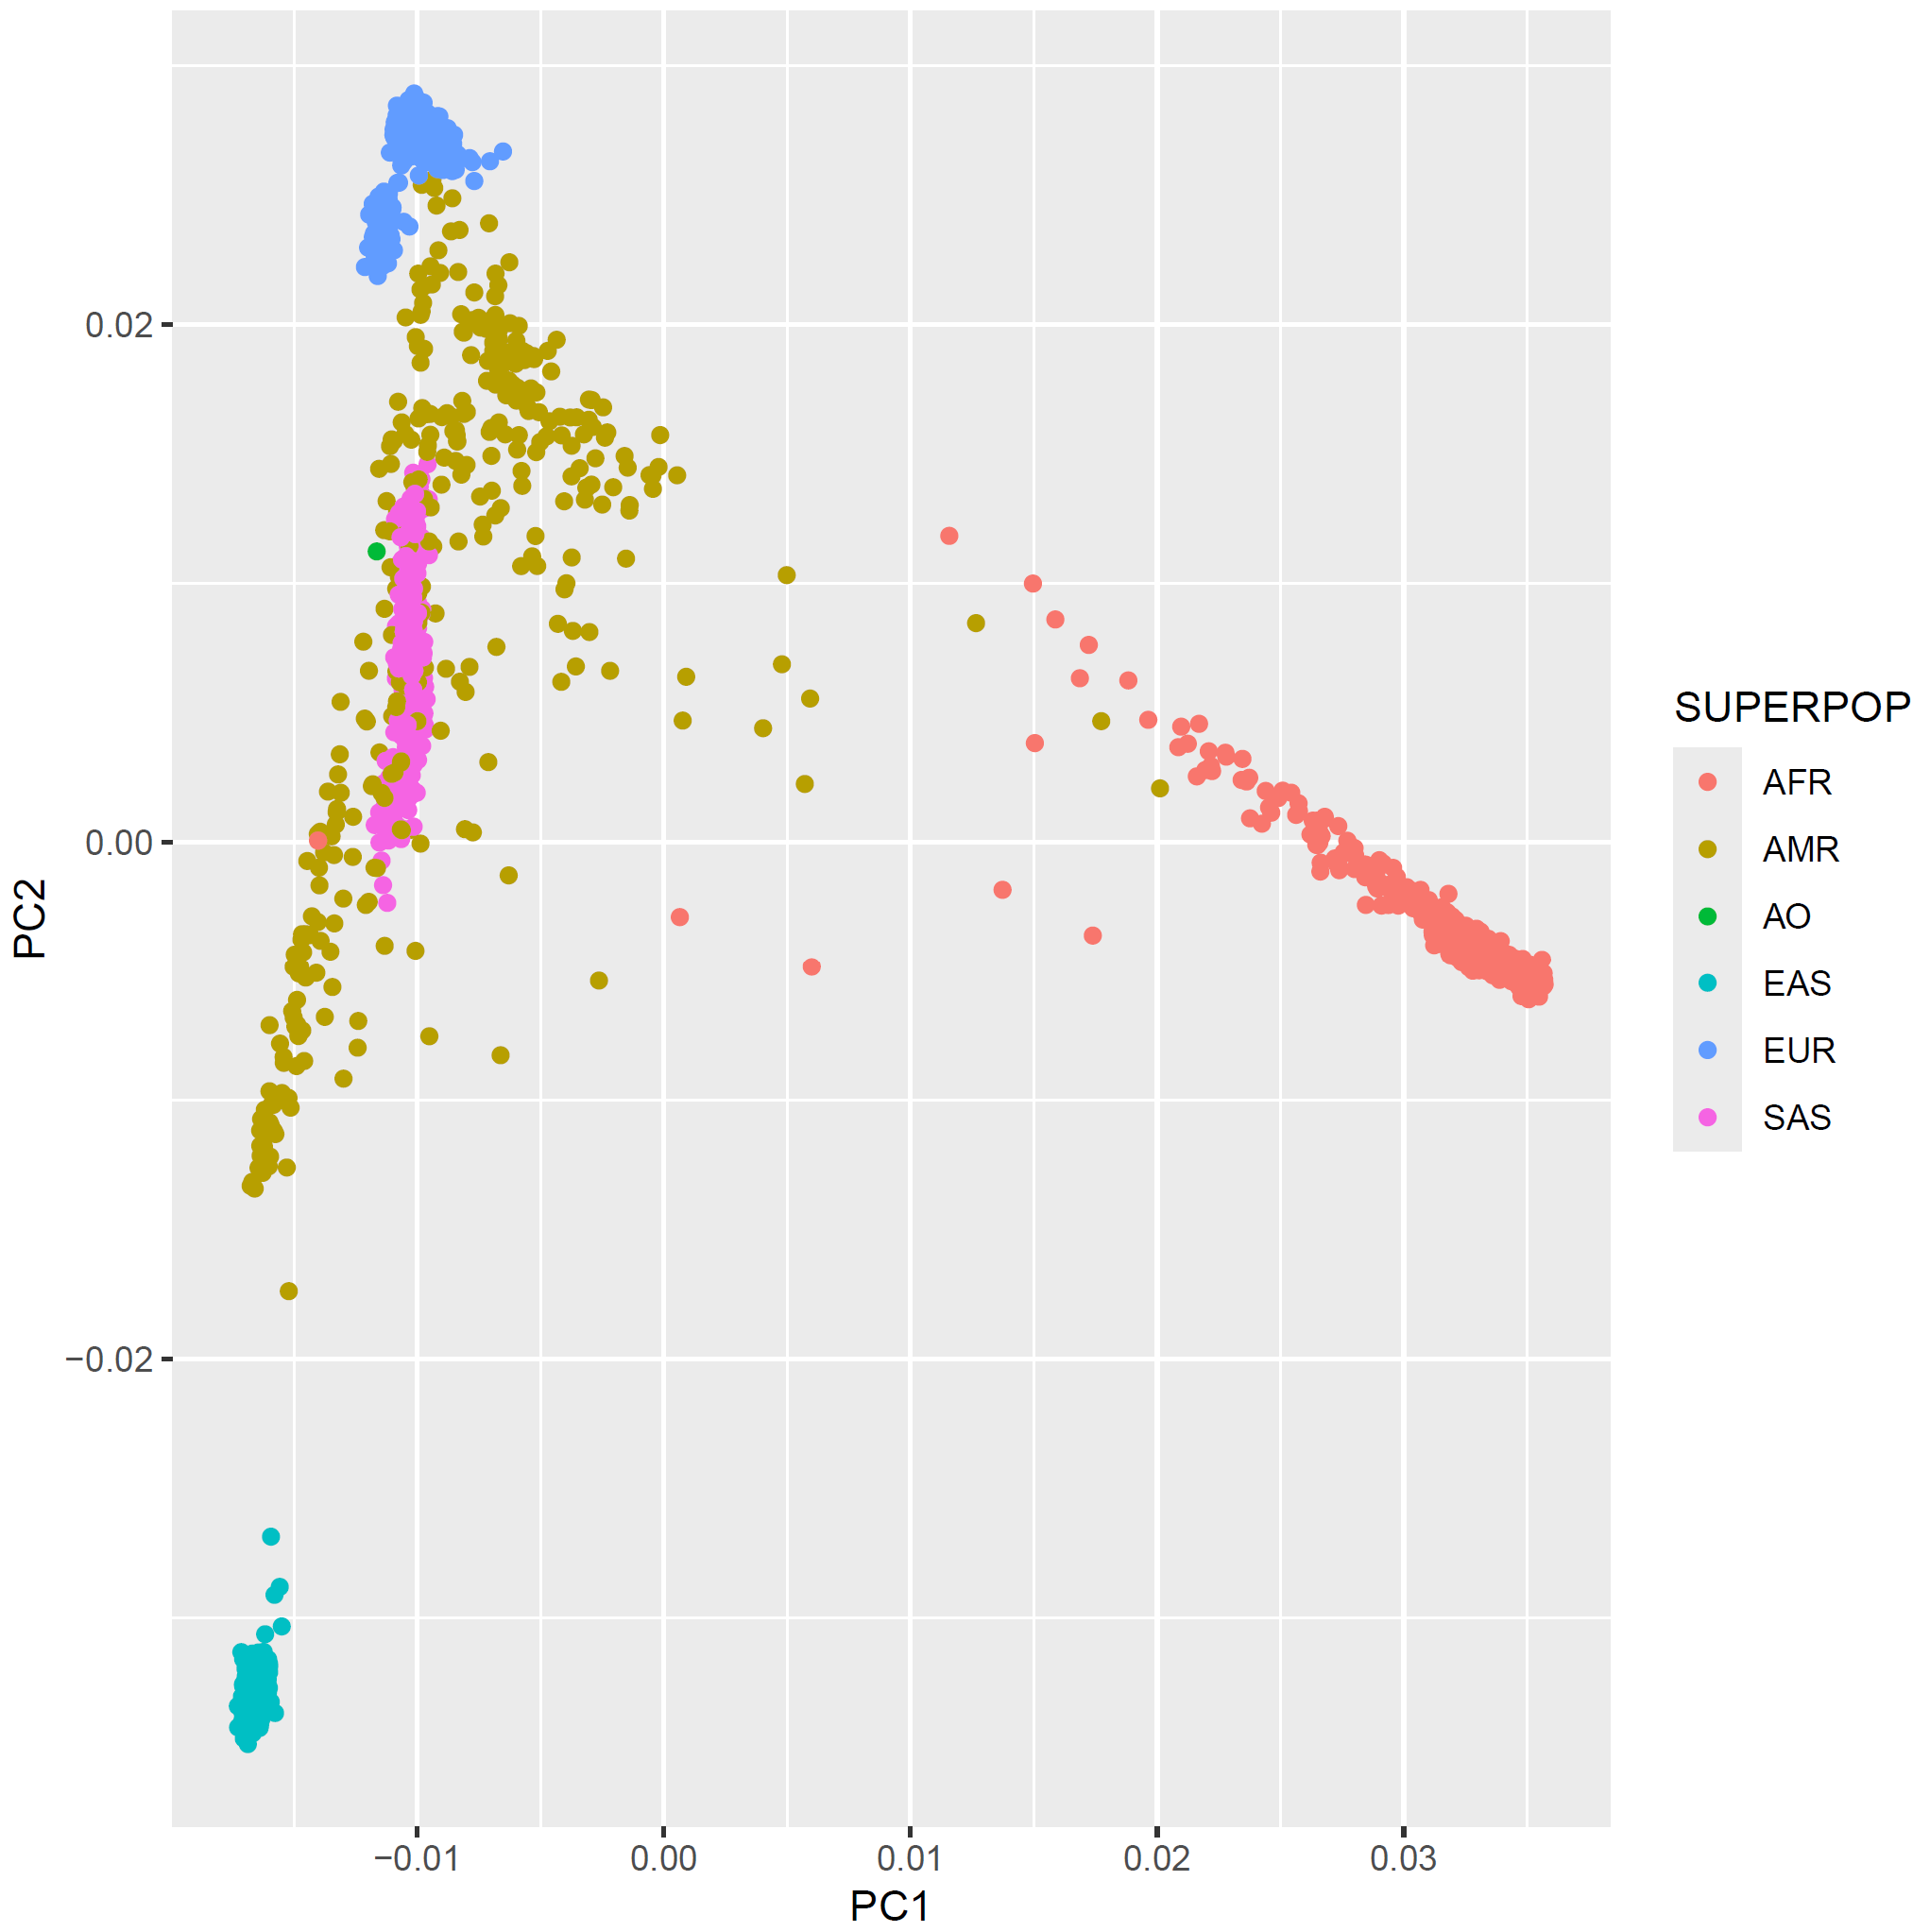
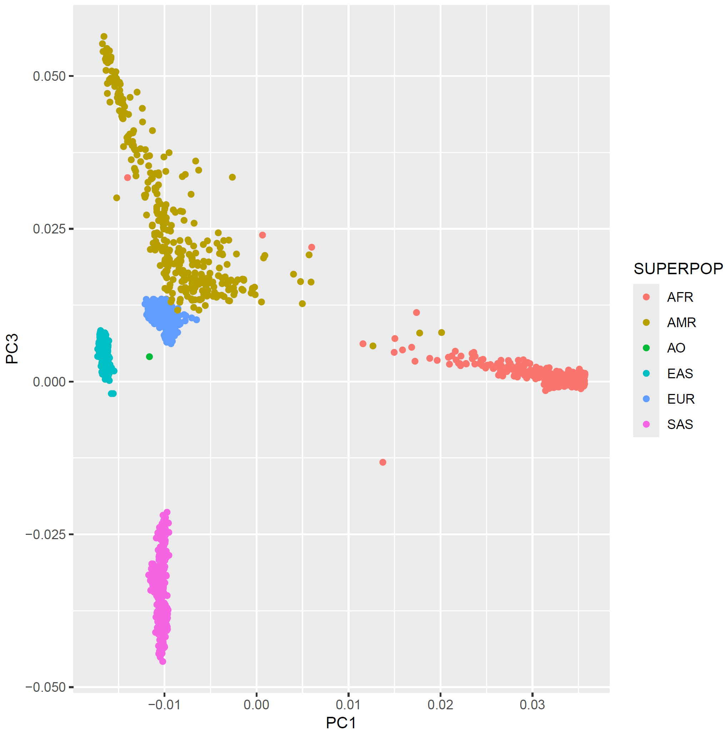

Slide 3
Outline
A literal history of PGIs
What is a polygenic index?
Theoretical framework
Constructing polygenic indices
Applications
Limitations & pitfalls

Slide 4
Polygenic index (PGI)
Polygenic score
(PGS)
Polygenic risk score (PRS)
Genome-wide score (GWS)
Genetic risk score (GRS)

Slide 5

A literal history of polygenic indices
Once upon a time, people thought all human traits were influenced by a handful of genes.
In their folly, they came up with candidate genes chosen out of a few whose function were known
Thus, started the era of candidate gene studies, and the following replication crisis.
In the silence that followed the wake of these studies, tiny little GWAS started to emerge from the ashes
They identified a few tiny genetic breadcrumbs that barely explained a fraction of the traits they were chasing. The top hits were underwhelming, the heritability gaps yawning…

Slide 6
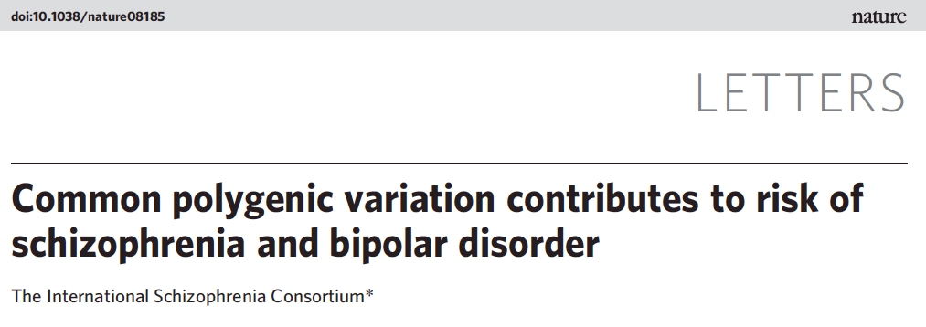
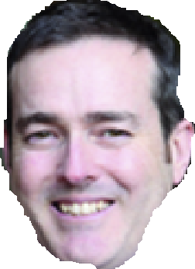
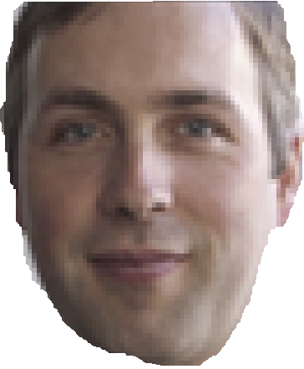
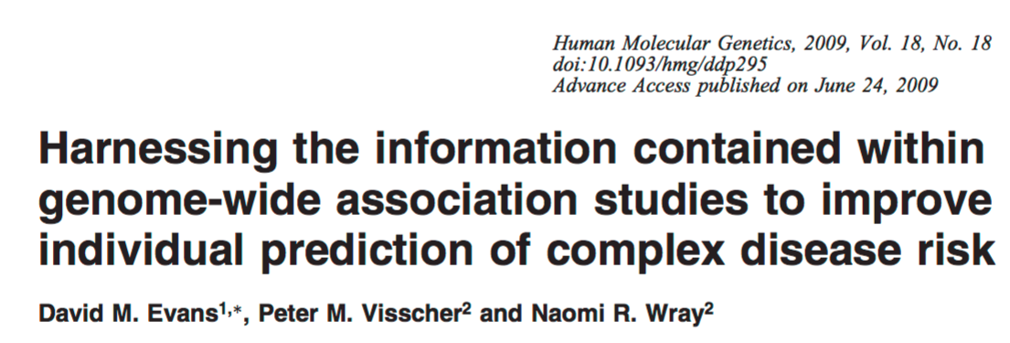
It was then (2009) that a statistical alchemist came to the rescue.. Today, we know him as…
Sean Purcell
It is said that around the same time, in the land down under, a lesser wizard came up with the same idea, but there is absolutely no written record of this.

Slide 7
Outline
A literal history of PGIs
What is a polygenic index?
Predictive power of polygenic indices
Constructing polygenic indices
Applications
Limitations & pitfalls

Slide 8
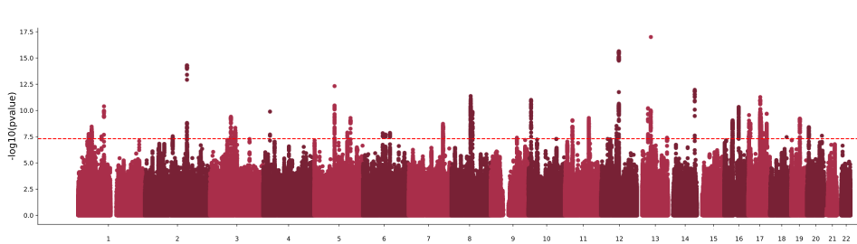

What is a polygenic index?
Effect size of 2cm per G allele
+2
+4
+4
+0
+0
+0
+2
+2
+2

Slide 9
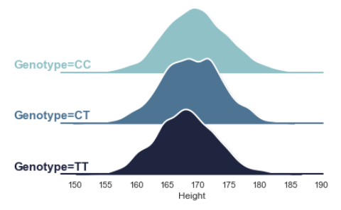
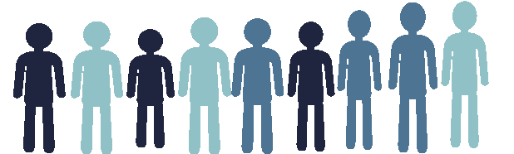
Effect size of -1 per T allele
+0
+0
-1
-1
+0
-2
-2
-1
-2
+4
+4
+0
+0
+0
+2
+2
+2
+2

Slide 10
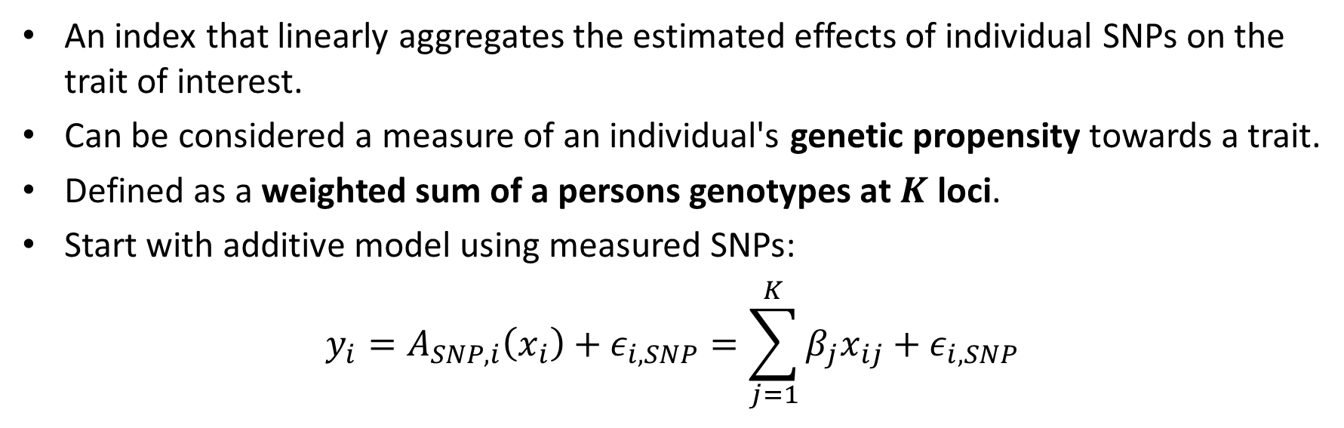
What is a polygenic index?
An index that linearly aggregates the estimated effects of individual SNPs on the trait of interest.
Can be considered a measure of an individual's genetic propensity towards a trait.
Defined as a weighted sum of a persons genotypes at $K$ loci.
Start with additive model using measured SNPs:
$$y_{i}=A_{SNP,i}\left(x_{i}\right)+ε_{i,SNP}=\sum_{j=1}^{K}{β_{j}x_{ij}}+ε_{i,SNP}$$
additive SNP factor

Slide 11


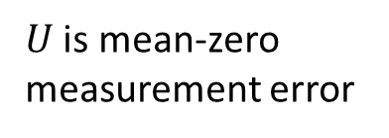
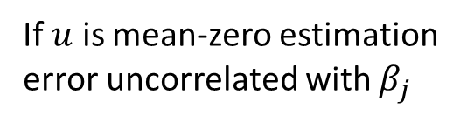


What is a polygenic index?
Additive SNP factor:
$$A_{SNP,i}\left(x_{i}\right)≡\sum_{j=1}^{K}{β_{j}x_{ij}}$$
PGI:
$${\hat{A}}_{SNP,i}\left(x_{i}\right)≡\sum_{j=1}^{K}{\hat{β_{j}}x_{ij}}$$
True effect size of SNP j
Estimated effect size of SNP j
$$\hat{β_{j}}=β_{j}+u_{j}$$
$⇒ {\hat{A}}_{SNP,i}=\sum_{j=1}^{K}{\left(β_{j}+u_{j}\right)x_{ij}}=A_{SNP,i}+U_{i}$ where $U_{i}=\sum_{j=1}^{K}{u_{j}x_{ij}}$
If $u$ is mean-zero estimation error uncorrelated with $β_{j}$
$U$ is mean-zero measurement error
$$E\left({\hat{A}}_{i} | A_{i}\right)=A_{i}$$

Slide 12
Outline
A literal history of PGIs
What is a polygenic index?
Predictive power of polygenic indices
Constructing polygenic indices
Applications
Limitations & pitfalls

Slide 13

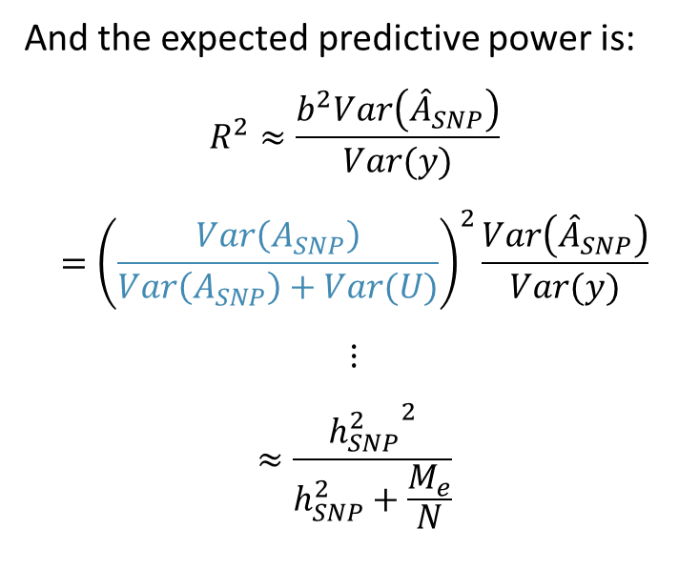

Predictive power of a polygenic index
If we regress $y$ on ${\hat{A}}_{SNP}$ we get an OLS coefficient of
$$b=\frac{Cov\left({\hat{A}}_{SNP},y\right)}{Var({\hat{A}}_{SNP})}$$
$$=\frac{Cov\left(A_{SNP}+U_{i},A_{SNP}+ε_{SNP}\right)}{Var\left(A_{SNP}+U\right)}$$
$$=\frac{Var\left(A_{SNP}\right)}{Var\left(A_{SNP}\right)+Var(U)}$$
And the expected predictive power is:
$$R^{2}≈\frac{b^{2}Var\left({\hat{A}}_{SNP}\right)}{Var(y)}$$
$$={\left(\frac{Var\left(A_{SNP}\right)}{Var\left(A_{SNP}\right)+Var(U)}\right)}^{2}\frac{Var\left({\hat{A}}_{SNP}\right)}{Var(y)}$$
$$⋮$$
$$≈\frac{{h_{SNP}^{2}}^{2}}{h_{SNP}^{2}+\frac{M_{e}}{N}}$$
Sometimes called the Daetwyler formula (Daetwyler et al. 2008)
OLS:
$$y_{i}=a+bx_{i}+ε_{i}$$
$b=\frac{Cov\left(x,y\right)}{Var\left(x\right)}$, $R^{2}=\frac{b^{2}Var\left(x\right)}{Var\left(y\right)}$
Effective number of SNPs in the PGI, estimated to be between 50k-70k in genome-wide data for EUR ancestry (Wray et al. 2013)

Slide 14
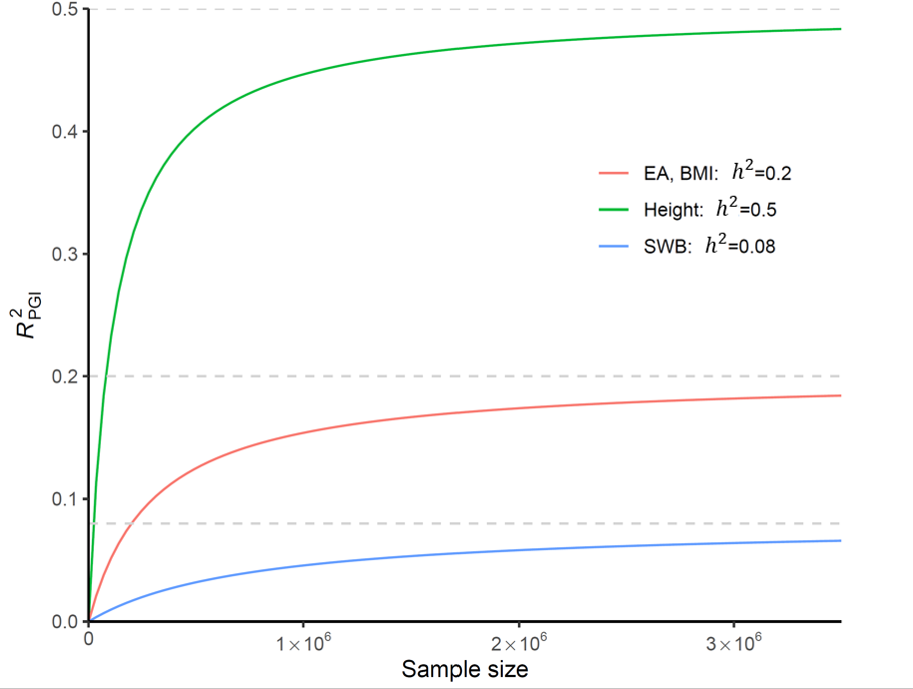
Theoretical projections for $R_{PGI}^{2}$

Slide 15
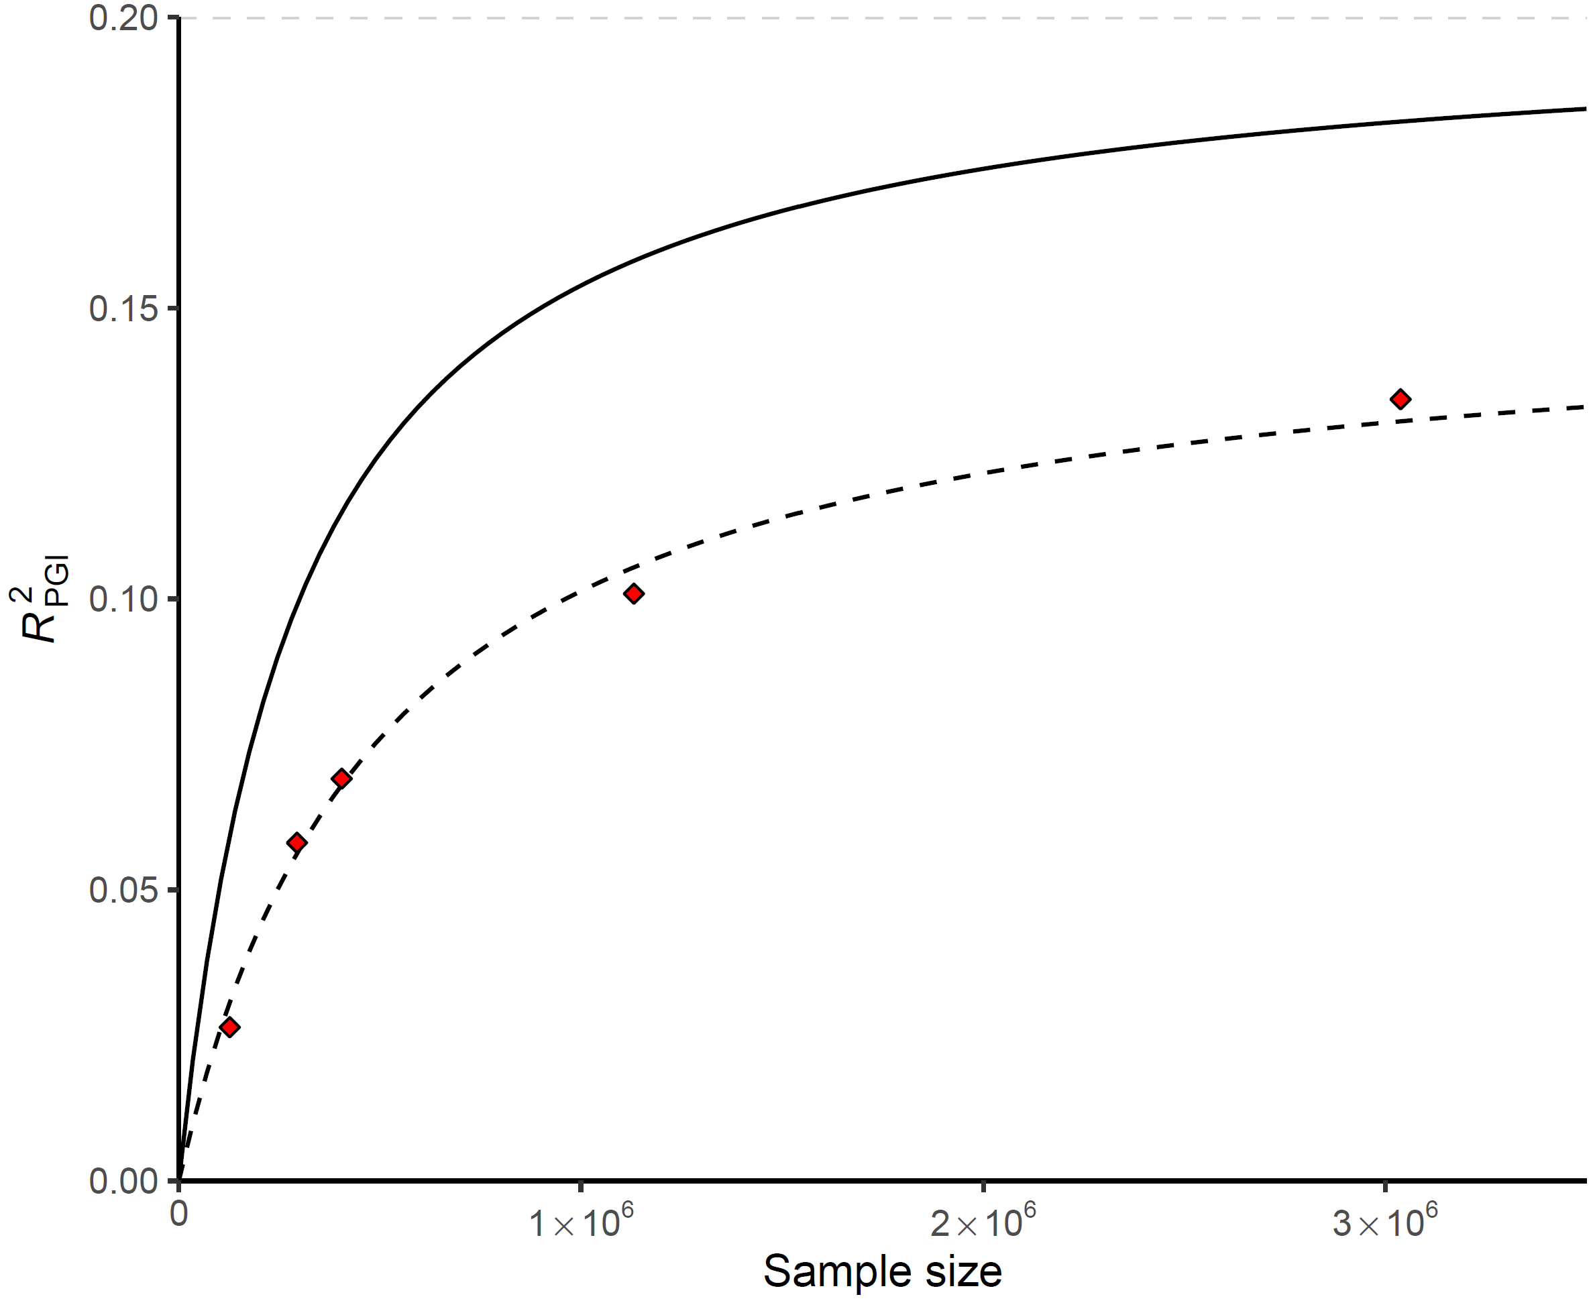
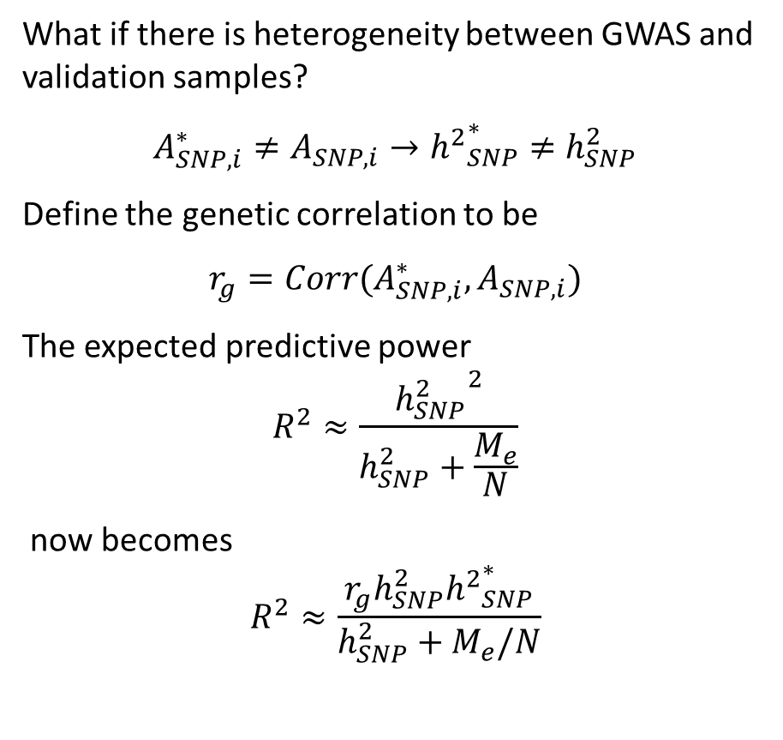
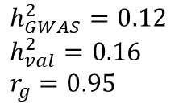
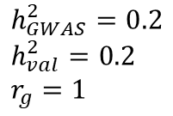
Predictive power and heterogeneity
What if there is heterogeneity between GWAS and validation samples?
$$A_{SNP,i}^{∗}≠A_{SNP,i}→{h^{2}}_{SNP}^{∗}≠h_{SNP}^{2}$$
Define the genetic correlation to be
$$r_{g}=Corr(A_{SNP,i}^{∗},A_{SNP,i})$$
The expected predictive power
$$R^{2}≈\frac{{h_{SNP}^{2}}^{2}}{h_{SNP}^{2}+\frac{M_{e}}{N}}$$
now becomes
$$R^{2}≈\frac{r_{g}h_{SNP}^{2}{h^{2}}_{SNP}^{∗}}{h_{SNP}^{2}+M_{e}/N}$$
$h_{GWAS}^{2}=0.2$
$h_{val}^{2}=0.2$
$r_{g}=1$
$h_{GWAS}^{2}=0.12$
$h_{val}^{2}=0.16$
$r_{g}=0.95$
EA4 (2022)
EA3 (2018)
EA2 Discovery + Replication (2016)
EA2 Discovery (2016)
EA1 (2013)
(De Vlaming et al. 2016)

Slide 16
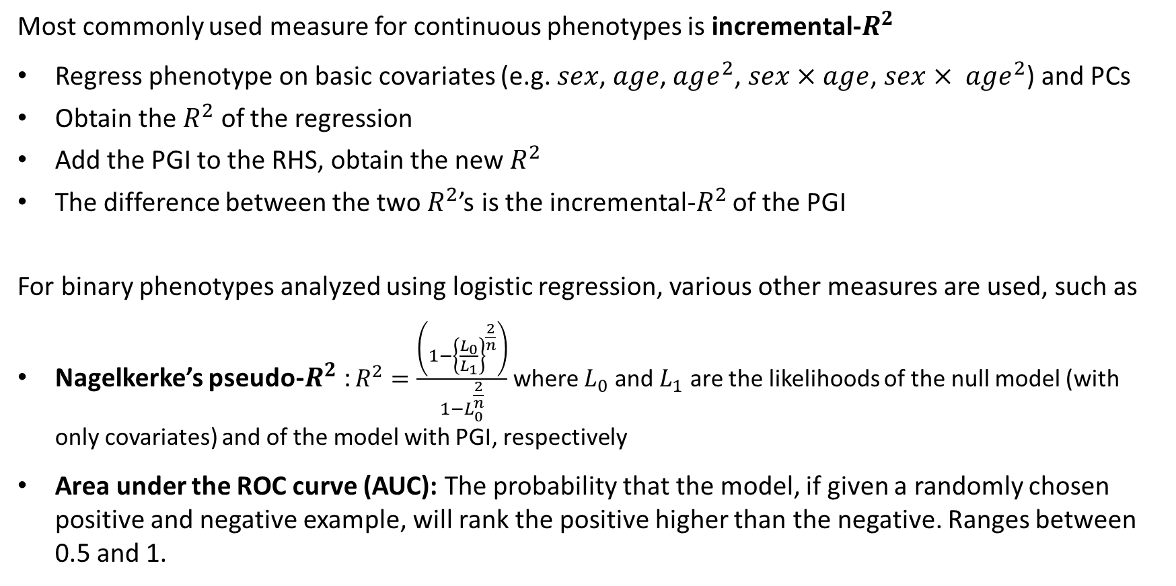
Measuring observed predictive power
Most commonly used measure for continuous phenotypes is incremental-$R^{2}$
Regress phenotype on basic covariates (e.g. $sex$, $age$, $age^{2}$, $sex×age$, $sex× age^{2}$) and PCs
Obtain the $R^{2}$ of the regression
Add the PGI to the RHS, obtain the new $R^{2}$
The difference between the two $R^{2}$’s is the incremental-$R^{2}$ of the PGI
For binary phenotypes analyzed using logistic regression, various other measures are used, such as
Nagelkerke’s pseudo-$R^{2}$: $R^{2}=\frac{\left(1−{\left\{\frac{L_{0}}{L_{1}}\right\}}^{\frac{2}{n}}\right)}{1−L_{0}^{\frac{2}{n}}}$ where $L_{0}$ and $L_{1}$ are the likelihoods of the null model (with only covariates) and of the model with PGI, respectively
Area under the ROC curve (AUC): The probability that the model, if given a randomly chosen positive and negative example, will rank the positive higher than the negative. Ranges between 0.5 and 1.

Slide 17
Outline
A literal history of PGIs
What is a polygenic index?
Predictive power of polygenic indices
Constructing polygenic indices
Applications
Limitations & pitfalls

Slide 18

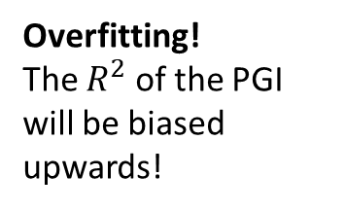
Constructing polygenic indices
What is needed?
Individual-level genotype data from a prediction sample.
Weights: GWAS summary statistics from a discovery sample
Reference genotypes to estimate LD
Caution: The prediction sample should not overlap with the discovery sample!
GWAS
PGI
Overfitting!
The $R^{2}$ of the PGI will be biased upwards!
GWAS
PGI

Slide 19

Weights
GWAS results give us ${\hat{β}}_{j}^{GWAS}$, not $β_{j}$. Two issues to consider when constructing $\sum_{j=1}^{K}{{\hat{β}}_{j}^{GWAS}x_{ij}}$ :
For some SNPs, ${\hat{β}}_{j}^{GWAS}$ may be a very noisy estimate of $β_{j}$ and/or $β_{j}$ may be close to 0, so adding those SNPs will add more noise than signal
If we include all SNPs, we will overweight (“double-count”) SNPs with high LD scores

Slide 20

Two solutions
Clumping and thresholding
Include only the most strongly associated SNP from each LD block (Purcell et al., 2009)
Bayesian approaches
Include all SNPs but adjust the effect sizes for LD
$$\sum_{j=1}^{K}{{\hat{β}}_{j}^{GWAS}x_{ij}}$$
Weights: Set equal to GWAS coefficients.
Loci: Selected by
using a clumping algorithm that ensures the included markers are all approximately independent of each other
omitting SNPs whose P value for association with the phenotype is above a certain threshold
Weights: Set to GWAS coefficients adjusted for LD → approximate results from a theoretical multiple regression of the phenotype on all SNPs
Loci: Include all SNPs, no LD-based pruning
Examples: LDpred (Vilhjalmsson et al. 2015, Prive et al. 2020 ), PRS-CS (Ge et al. 2019), SBayesR (Lloyd-Jones et al. 2019)

Slide 21








C+T
Cohort: Health and Retirement Study
Phenotype: Educational attainment
$$5×{10}^{−8}$$
$$5×{10}^{−5}$$
$$5×{10}^{−3}$$
$$5×{10}^{−2}$$
$$5×{10}^{−1}$$
$$1$$
$r^{2}$=
$r^{2}$=
$r^{2}$=
$r^{2}$=
$r^{2}$=

Slide 22
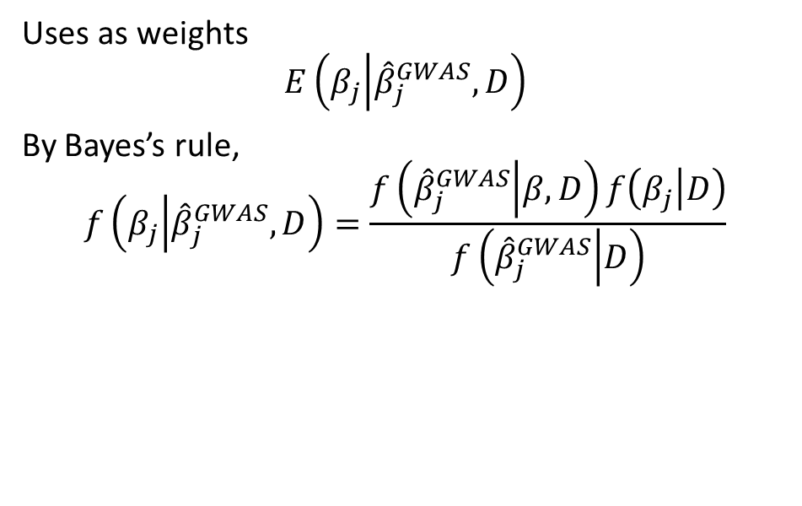
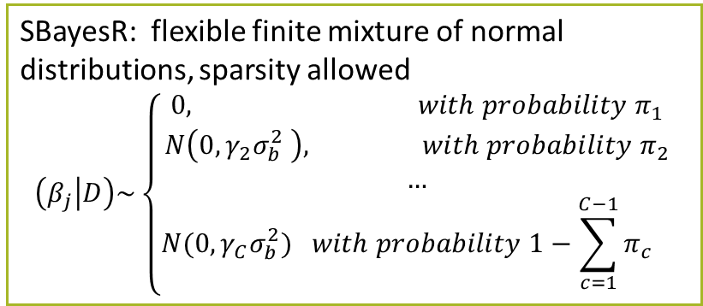
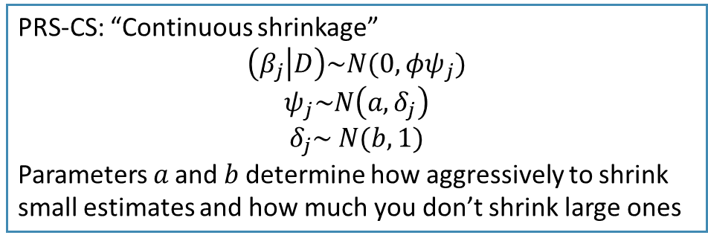
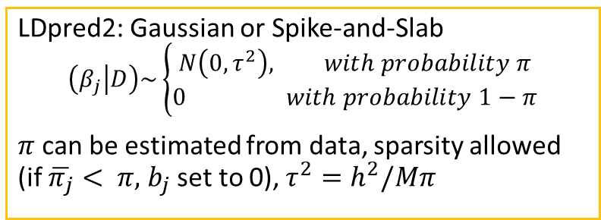
Bayesian approaches
Uses as weights
$$E\left(β_{j} | {\hat{β}}_{j}^{GWAS},D\right)$$
By Bayes’s rule,
$$f\left(β_{j} | {\hat{β}}_{j}^{GWAS},D\right)=\frac{f\left({\hat{β}}_{j}^{GWAS} | β,D\right)f\left(β_{j} | D\right)}{f\left({\hat{β}}_{j}^{GWAS} | D\right)}$$
LDpred2: Gaussian or Spike-and-Slab
$$\left(β_{j} | D\right)\sim \left\{\begin{aligned}N\left(0,τ^{2}\right), with probability π \\ 0 with probability 1−π\end{aligned}\right.$$
$π$ can be estimated from data, sparsity allowed (if $\overline{π_{j}}< π,$ $b_{j}$ set to 0), $τ^{2}=h^{2}/Mπ$
LD matrix
SBayesR: flexible finite mixture of normal distributions, sparsity allowed
$$\left(β_{j} | D\right)\sim \left\{\begin{aligned}0, with probability π_{1} \\ &N\left(0,γ_{2}σ_{b}^{2} \right), with probability π_{2} \\ … \\ N(0,γ_{C}σ_{b}^{2}) with probability {1−\sum_{c=1}^{C−1}{π_{c}}}_{}\end{aligned}\right.$$
Shrinkage depends on the prior!
PRS-CS: “Continuous shrinkage”
$$\left(β_{j} | D\right)\sim N(0,φψ_{j})$$
$$ψ_{j}\sim N\left(a,δ_{j}\right)$$
$$δ_{j}\sim N(b,1)$$
Parameters 𝑎 and 𝑏 determine how aggressively to shrink small estimates and how much you don’t shrink large ones
Notes:
LDpred2 – Implemented in bigsnpR
Gibbs sampler to estimate joint SNP effects (replacing clumping)
Models long range LD such as that found near the HLA region
SBayesR – Implemented in GCTB
Combines a likelihood connecting the joint effects with GWAS summary statistics and a finite mixture of normal distribution priors for marker effects.
Estimates joint SNP effects using Bayesian multiple regression
Typically uses four normal distributions with mean zero and variances
Then performs a Markov chain Monte Carlo Gibbs sampling for the model parameters
Lassosum (and lassosum2) – Implemented in bigsnpR
Penalized (LASSO) regression (complementary to LDpred2 for MHC)
PRS-CS
Joint SNP effects using Bayesian regression with continuous shrinkage priors
JAMPred
Two step Bayesian regression framework

Slide 23
Practical considerations – LD reference data
How to choose LD reference data?
Some software tools (e.g. SBayesR, PRS-CS) make available previously calculated LD estimates
These are usually limited to a set of good quality SNPs (e.g. HapMap3) to reduce errors in LD estimation and computational burden while ensuring sufficient coverage
But you can also estimate your own! Why would you?
  You may want to include more SNPs
  The available LD reference data may not be a good match for the ancestry of your GWAS
If you decide to obtain your own LD estimates, you should make sure that the quality of your data is good. Bayesian approaches are very sensitive to errors in LD estimates!

Slide 24
Practical considerations – LD reference data
Points to consider when estimating LD
The sample is large and representative of the GWAS sample
Sequenced genotypes are best. Imputation inaccuracy introduces noise into LD estimates. If you’re using imputed data, apply a strict imputation accuracy filter
Data are cleaned
  sample-level filters: related individuals, ancestry outliers, individuals with low genotyping rate
  SNP-level filters: low SNP call rate, MAF, HWE P-value (genotyped SNPs), imputation accuracy (imputed SNPs)
There are no genotyping or imputation batch effects.
  May lead to errors in LD estimation if genotyping is done with multiple arrays or imputation in multiple batches.

Slide 25
Practical considerations - GWAS
Restricting set of SNPs
The SNPs included in the PGI will be limited to the intersection of GWAS, LD reference sample and validation data.
It is a good idea to limit the SNPs in the GWAS to those available in the validation data prior to adjusting for LD, especially if the overlap is rather poor (e.g. if you only have array SNPs in the validation data)
The Bayesian software will assume all SNPs in the GWAS will be included in the PGI and make LD adjustments to maximize prediction accuracy. If some SNPs cannot be included because they are not in the validation data, the adjustments will be suboptimal.
As an additional QC step, you can exclude SNPs whose MAF is very different from the LD reference data

Slide 26
Practical considerations – Validation data
Applying some QC to validation data to minimize noise and genotyping errors is recommended:
  sample-level filters: limit to a single genetic ancestry, drop individuals with low genotyping rate
  SNP-level filters: drop SNPs with low call rate, MAF, HWE P-value (genotyped SNPs), imputation accuracy (imputed SNPs)
Restrict the GWAS to SNPs available in the validation data after the above QC steps are applied
If you are using imputed data, use dosages rather than hard calls. Hard calls don’t account for imputation uncertainty!

Slide 27

C+T vs Bayesian approaches
Clumping and thresholding
Faster and easier, but too black & white
If clumping $r^{2}$ or P-value cutoffs too strict, it drops potentially causal SNPs.
If clumping $r^{2}$ and P-value cutoffs too relaxed, there is a lot of double-counting and noise
Bayesian approaches
utilize information from all SNPs by adjusting SNP weights for LD, but
  if the reference panel is not a good match for the population from which summary statistics were obtained, prediction accuracy might be compromised
  the assumed prior distribution might not accurately model the true genetic architecture

Slide 28
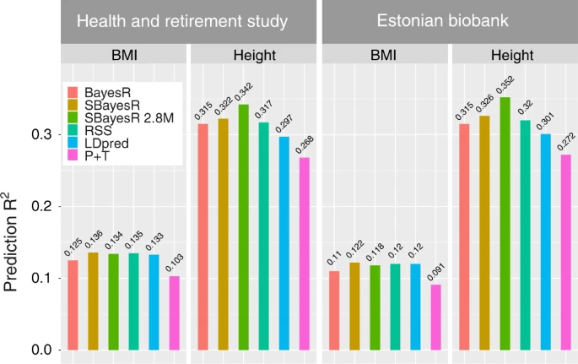
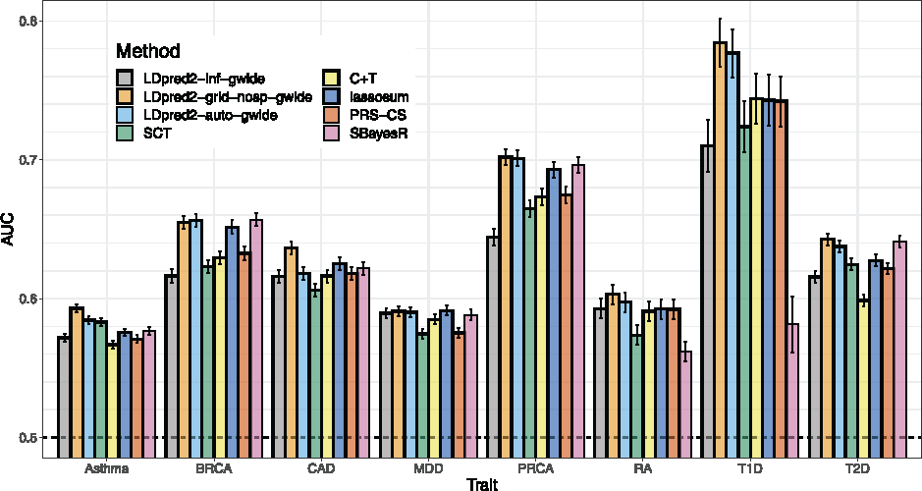
If the purpose is to maximize predictive power, then Bayesian approaches clearly do better
Source: Privé, Arbel, Vilhjálmsson (2020)
Source: Lloyd-Jones et al (2019)
There may still be uses for C+T, for example when you want to include SNPs most likely to be associated (e.g. in mendelian randomization)

Slide 29
Outline
A literal history of PGIs
What is a polygenic index?
Predictive power of polygenic indices
Constructing polygenic indices
Applications
Limitations and pitfalls

Slide 30
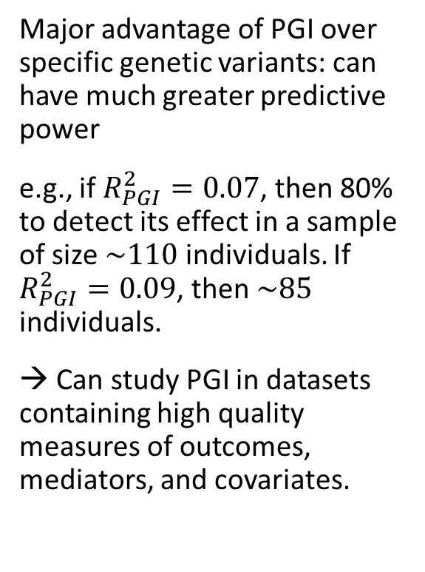

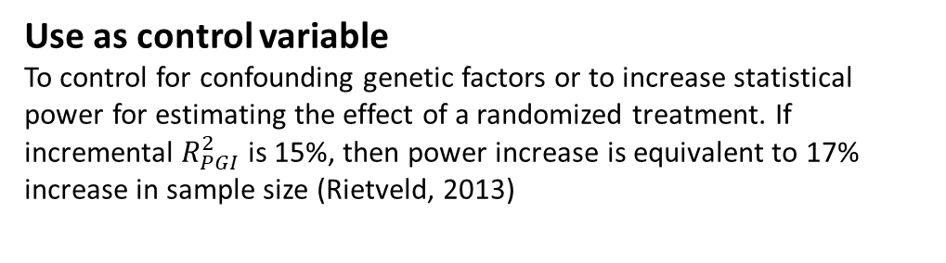
Applications
Identify correlates of genetic factors
e.g. Educational attainment PGI predicts early speech acquisition and is mediated by cognitive ability (Belsky et al., 2016).
Major advantage of PGI over specific genetic variants: can have much greater predictive power
e.g., if $R_{PGI}^{2}=0.07$, then 80% to detect its effect in a sample of size $\sim 110$ individuals. If $R_{PGI}^{2}=0.09$, then $\sim 85$ individuals.
→ Can study PGI in datasets containing high quality measures of outcomes, mediators, and covariates.
Identify causal effects of genetic factors
Sibling data and family fixed effects → causal effect of PGI
Study GxE
e.g. Increase of compulsory schooling age in U.K. reduces BMI only among those with a high-BMI PGI (Barcellos, Carvalho, and Turley 2016)
Use as control variable
To control for confounding genetic factors or to increase statistical power for estimating the effect of a randomized treatment. If incremental $R_{PGI}^{2}$ is 15%, then power increase is equivalent to 17% increase in sample size (Rietveld, 2013)
Identify at-risk individuals
Personalized treatment
$$⋮$$

Slide 31
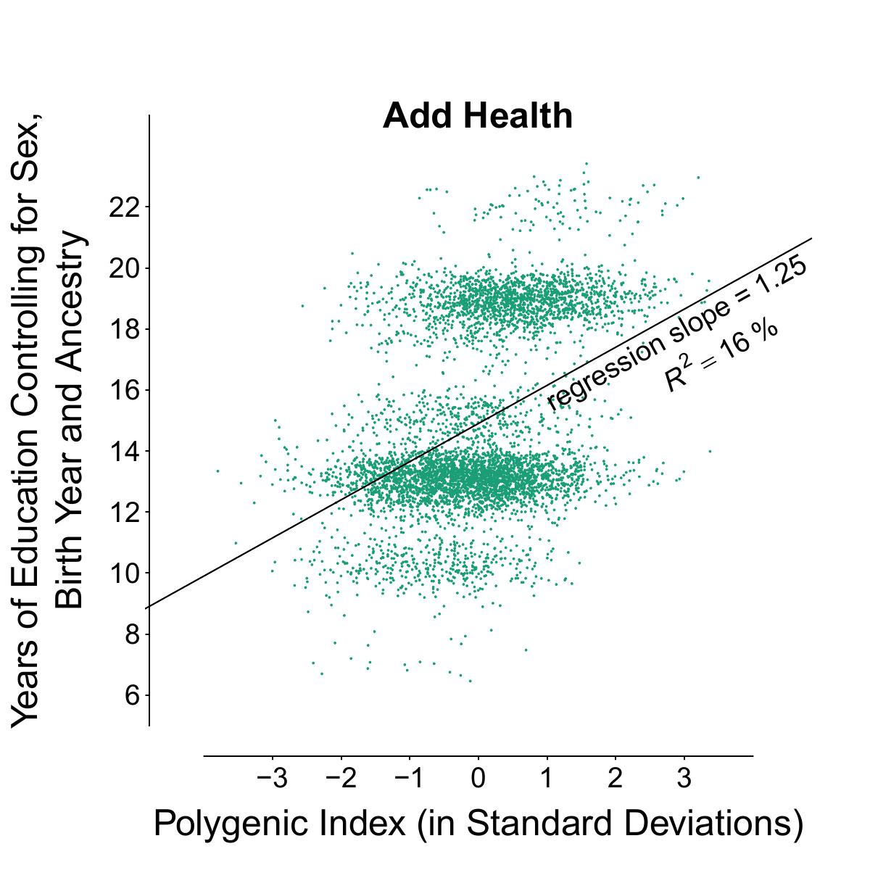
Individual-level prediction is not accurate enough for most complex phenotypes!
Source: Okbay et al. (2022)

Slide 32
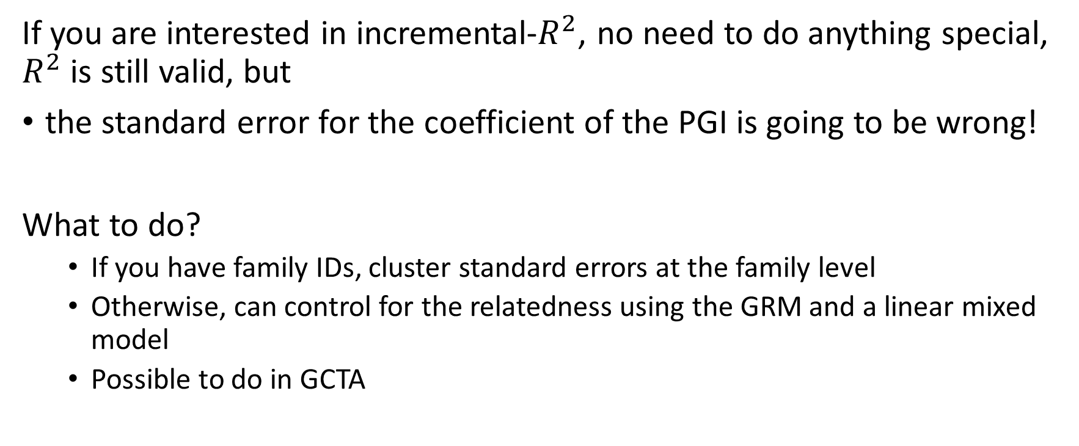
Prediction with related samples
If you are interested in incremental-$R^{2}$, no need to do anything special, $R^{2}$ is still valid, but
the standard error for the coefficient of the PGI is going to be wrong!
What to do?
  If you have family IDs, cluster standard errors at the family level
  Otherwise, can control for the relatedness using the GRM and a linear mixed model
  Possible to do in GCTA

Slide 33
Outline
A literal history of PGIs
What is a polygenic index?
Predictive power of polygenic indices
Constructing polygenic indices
Applications
Limitations and pitfalls

Slide 34
LIMITATIONS & PITFALLS
Mechanisms are poorly understood.
Including many genetic variants
  increases predictive power
  requires including genetic variants with unknown function
makes it hard to specify what is captured by PGI.

Slide 35
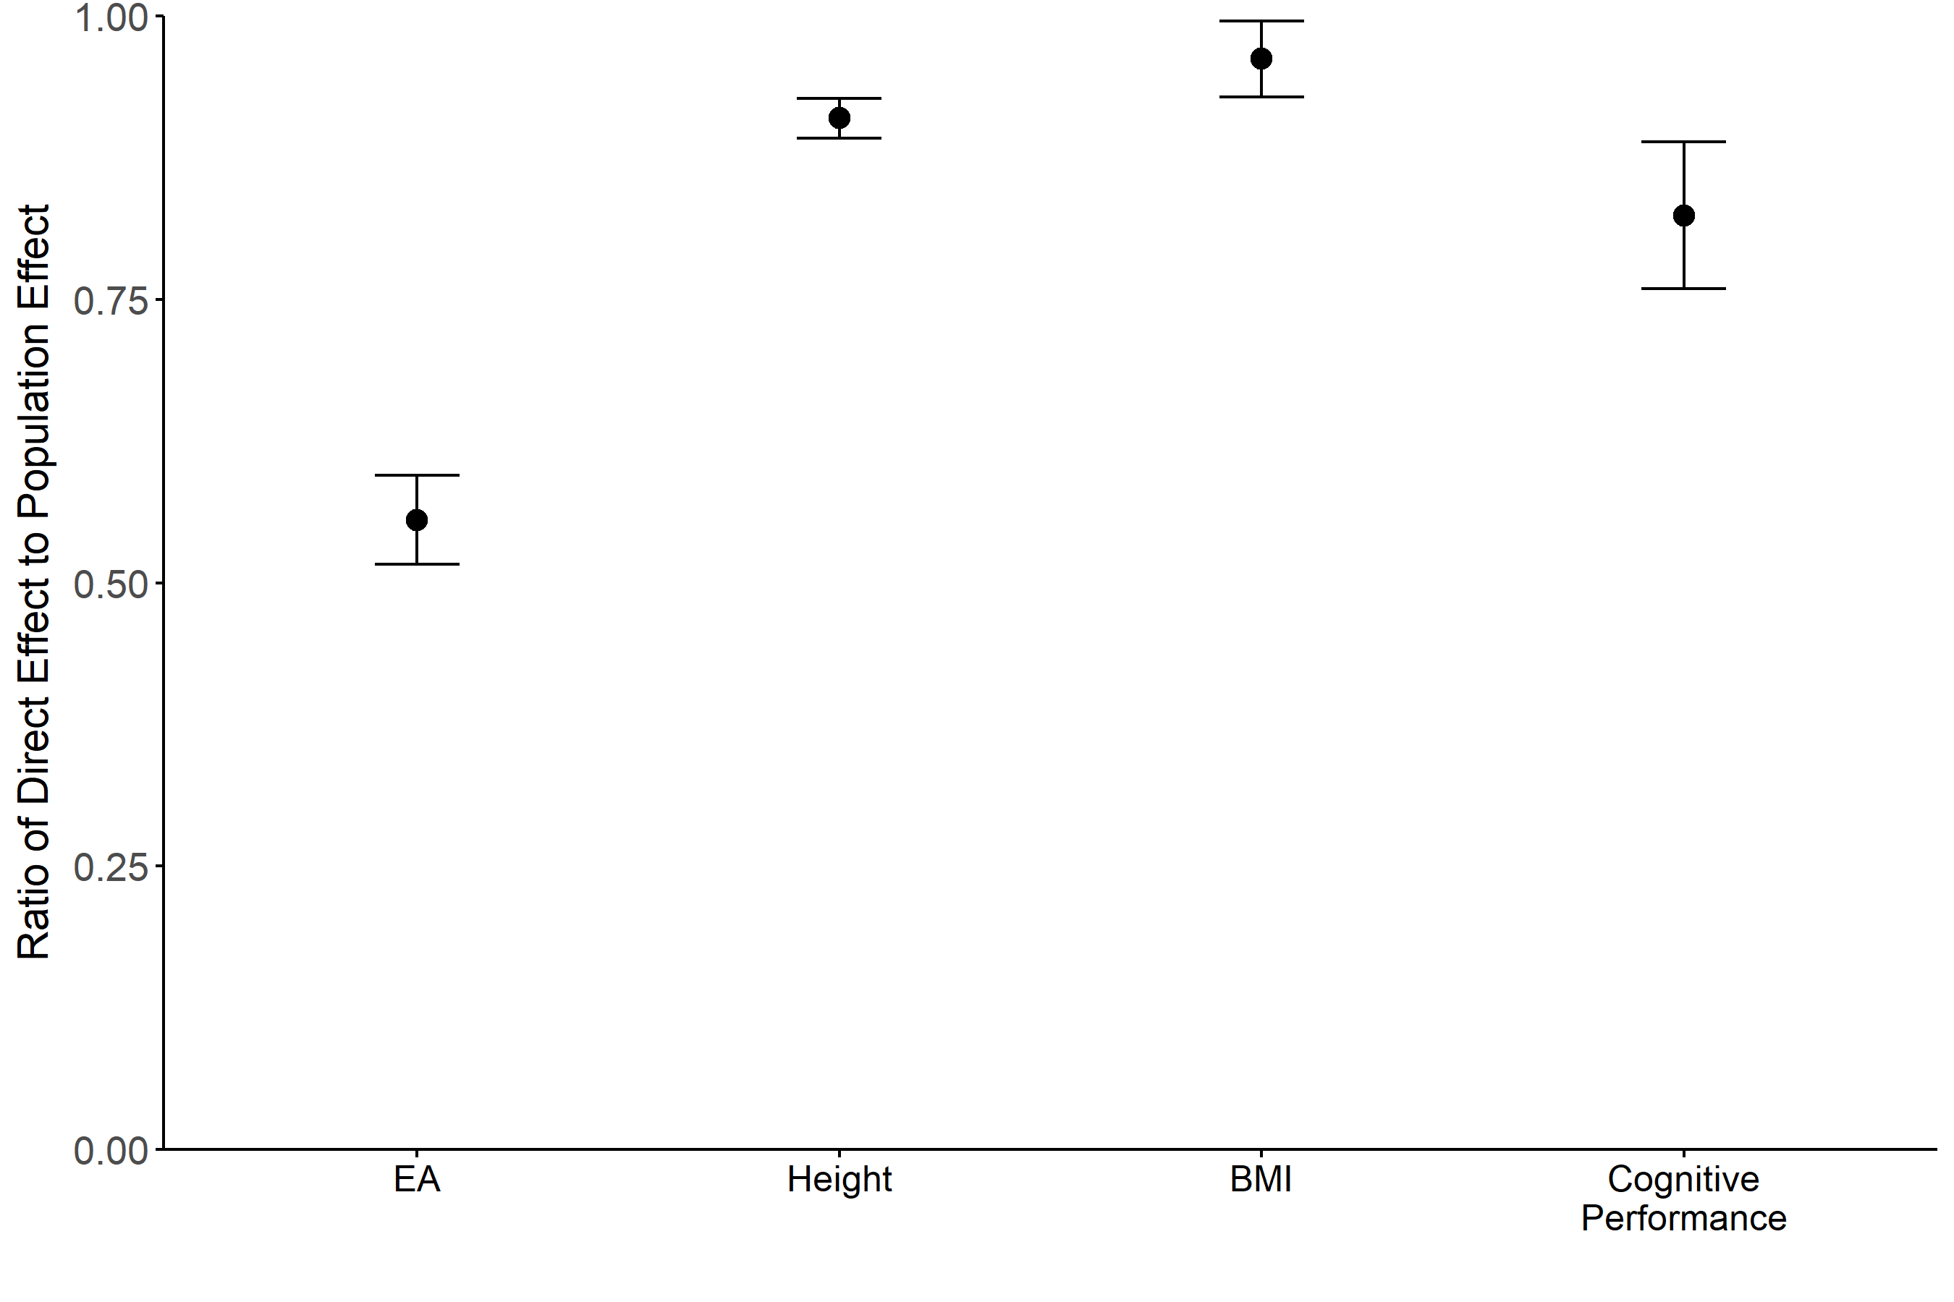
LIMITATIONS & PITFALLS
The predictive power of the PGI may not be solely due to the causal effect of genetic variants included in the PGI!
Gene-environment correlation
  Population stratification
  Indirect genetic effects
Assortative mating
Solutions:
Within-family prediction
PGIs based on within-family GWAS
Source: Okbay et al. (2022)

Slide 36
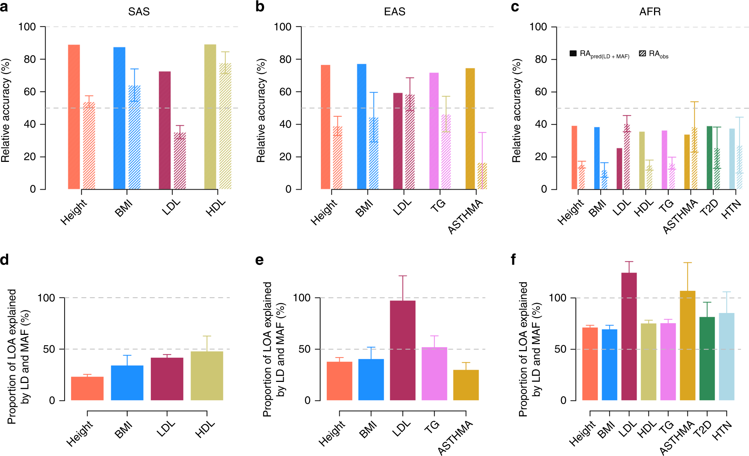
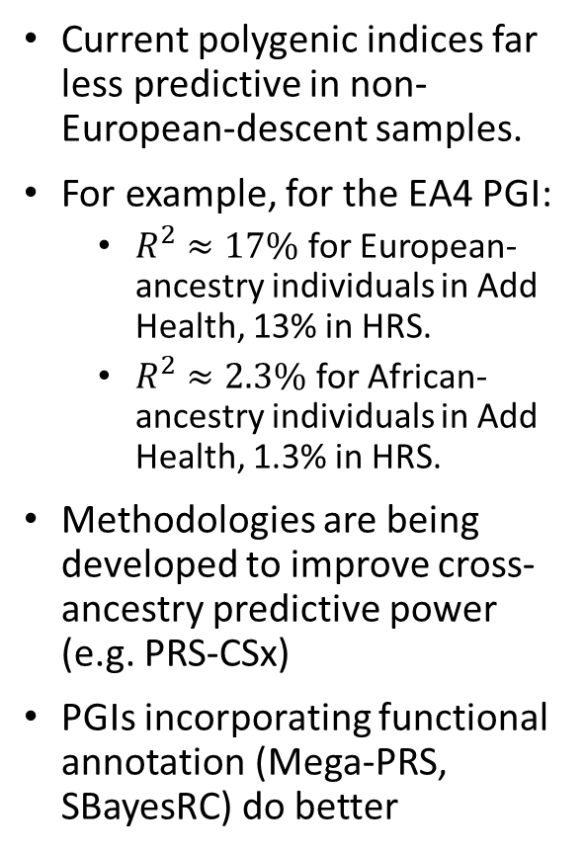
LIMITATIONS & PITFALLS
Current polygenic indices far less predictive in non-European-descent samples.
For example, for the EA4 PGI:
  $R^{2}≈17\%$ for European-ancestry individuals in Add Health, 13% in HRS.
  $R^{2}≈2.3\%$ for African-ancestry individuals in Add Health, 1.3% in HRS.
Methodologies are being developed to improve cross-ancestry predictive power (e.g. PRS-CSx)
PGIs incorporating functional annotation (Mega-PRS, SBayesRC) do better
Source: Wang et al. (2020)

Slide 37
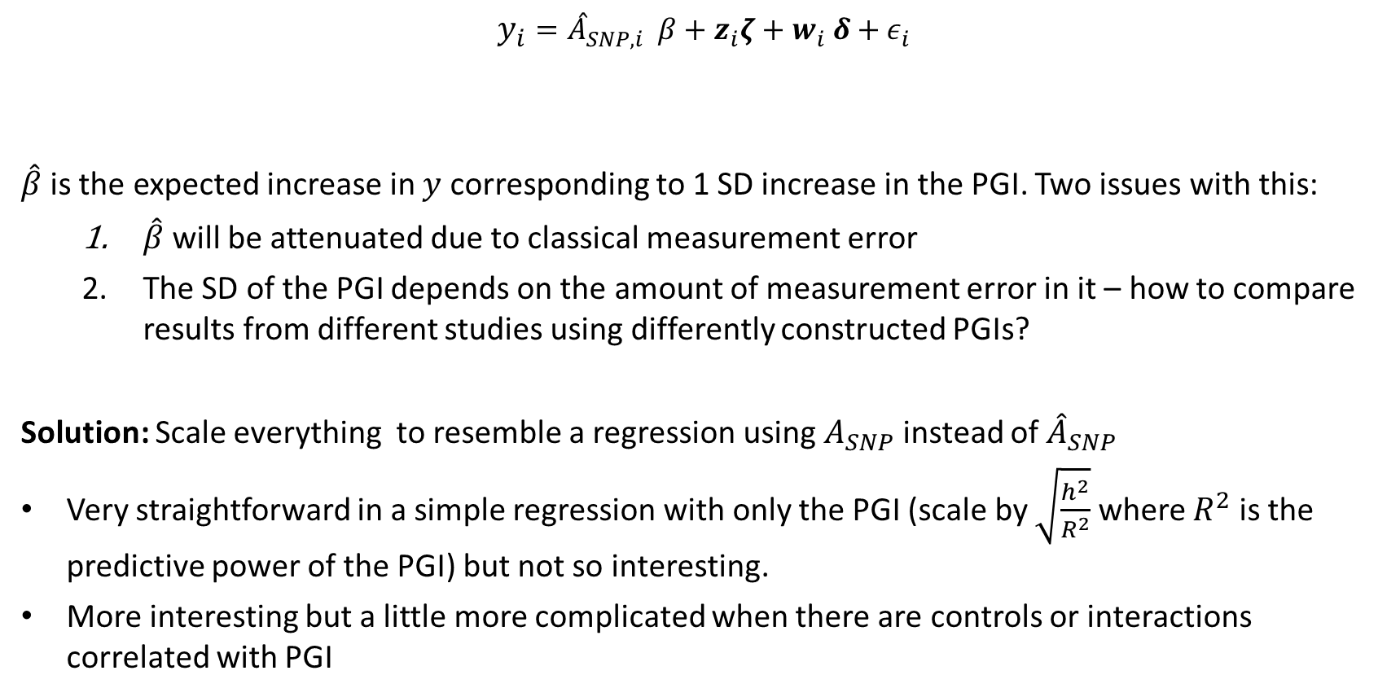
MEASUREMENT ERROR
$$y_{i}={\hat{A}}_{SNP,i} β+z_{i}ζ+w_{i} δ+ε_{i}$$
$\hat{β}$is the expected increase in $y$ corresponding to 1 SD increase in the PGI. Two issues with this:
  $\hat{β}$ will be attenuated due to classical measurement error
  The SD of the PGI depends on the amount of measurement error in it – how to compare results from different studies using differently constructed PGIs?
Solution: Scale everything to resemble a regression using $A_{SNP}$ instead of ${\hat{A}}_{SNP}$
Very straightforward in a simple regression with only the PGI (scale by $\sqrt{\frac{h^{2}}{R^{2}}}$ where $R^{2}$ is the predictive power of the PGI) but not so interesting.
More interesting but a little more complicated when there are controls or interactions correlated with PGI
phenotype
Standardized PGI
Controls
Interaction terms

Slide 38
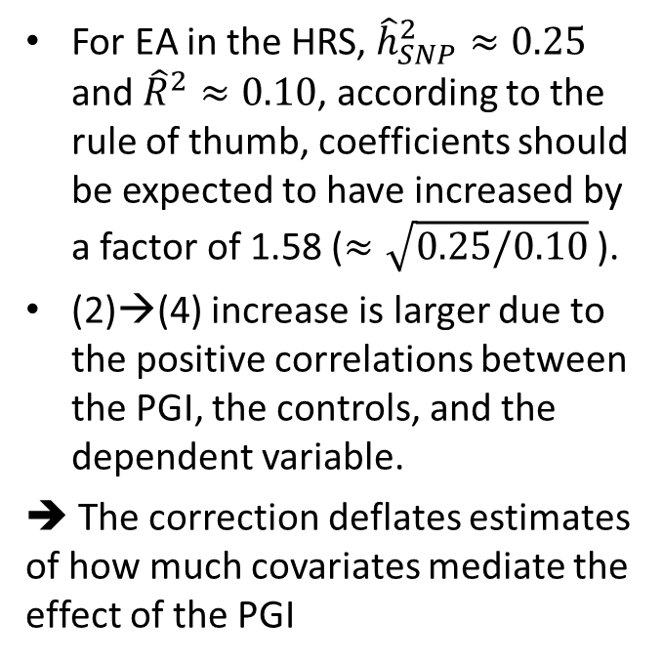




PGI-correct Python tool
https://github.com/JonJala/pgi_correct
Papageorge, N. W. & Thom, K. Genes, Education, and Labor Market Outcomes: Evidence from the Health and Retirement Study. J. Eur. Econ. Assoc. 18, 1351–1399 (2020).
Panel A. Association Between EA and the PGI, Without and With Controls for Parental EA
 | Original |  |  |  | Corrected
 | (1) |  | (2) |  | (3) |  | (4)
EA PGI | 0.844 (0.026) |  | 0.619 (0.024) |  | 1.318 (0.041) |  | 1.104 (0.042)
Father’s EA | - |  | 0.154 (0.010) |  | - |  | 0.112 (0.010)
Mother’s EA | - |  | 0.176 (0.011) |  | - |  | 0.141 (0.012)
# Obs. | 8,537 |  | 8,537 |  | 8,537 |  | 8,537
For EA in the HRS, ${\hat{h}}_{SNP}^{2}≈0.25$ and ${\hat{R}}^{2}≈0.10$, according to the rule of thumb, coefficients should be expected to have increased by a factor of 1.58 ($≈\sqrt{0.25/0.10}$).
(2)→(4) increase is larger due to the positive correlations between the PGI, the controls, and the dependent variable.
➔ The correction deflates estimates of how much covariates mediate the effect of the PGI
$$×1.56$$
$$×1.78$$
$$×0.73$$
$$×0.84$$

Slide 39
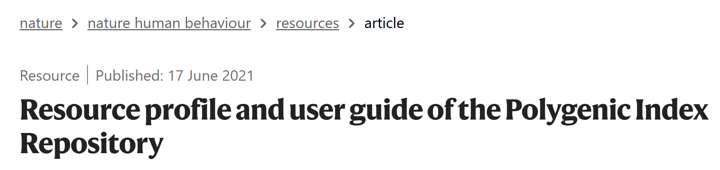





















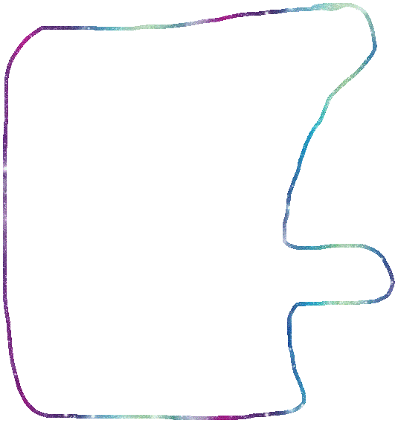
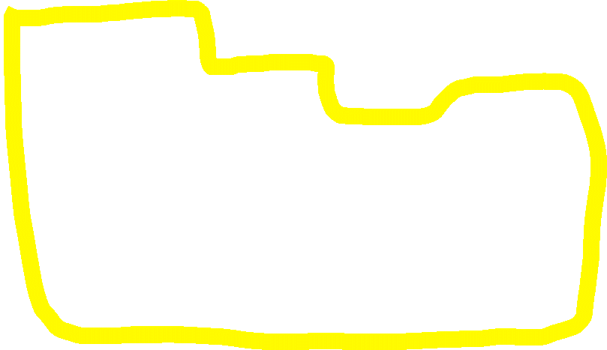

PGI Repository
First release includes 47 phenotypes in 11 datasets.
PGIs based on GWAS including 23andMe for many phenotypes.
Second release about to come out
  20 datasets
  60 phenotypes: anthropometric, cognitive, reproductive, biomarkers, health, psychiatric, substance use
  Parental PGIs based on imputed parental genotypes in datasets with sib or parent-offspring pairs

Slide 40

QUESTIONS?

Slide 41
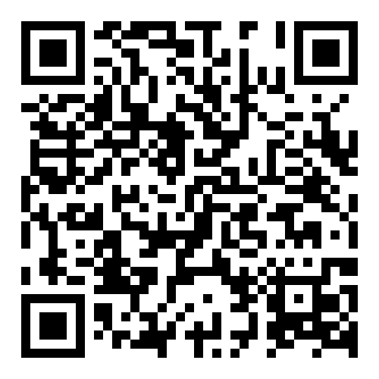
Practical
Five steps:
  GWAS sumstats
  Genotype data
  SBayesR
  Making PGIs
  Prediction
It is ok if you don’t finish it all, feel free to work on the remaining parts in your own time.
https://qimr.az1.qualtrics.com/jfe/form/SV_7OEO4h4KZgDZMc6

Slide 42
Reading materials
Dudbridge, F. Power and Predictive Accuracy of Polygenic Risk Scores. PLoS Genet. 9, e1003348 (2013). (Theoretical framework, power)
Wray, N. R. et al. Pitfalls of predicting complex traits from SNPs. Nat. Rev. Genet. 14, 507–15 (2013). (Complexities of interpretation)
Lloyd-Jones, L. R. et al. Improved polygenic prediction by Bayesian multiple regression on summary statistics. Nat. Commun. 10, 5086 (2019). (SBayesR methodology)
Ni, G. et al. A Comparison of Ten Polygenic Score Methods for Psychiatric Disorders Applied Across Multiple Cohorts. Biol. Psychiatry 90, 611–620 (2021). (Overview of methods)
Martin, A. R. et al. Clinical use of current polygenic risk scores may exacerbate health disparities. Nat. Genet. 51, 584–591 (2019). (Poor cross-ancestry portability of PGIs and consequences)
Wang, Y. et al. Theoretical and empirical quantification of the accuracy of polygenic scores in ancestry divergent populations. Nat. Commun. 11, 1–9 (2020). (Factors contributing to poor cross-ancestry portability of PGIs)
Ruan, Y. et al. Improving polygenic prediction in ancestrally diverse populations. Nat. Genet. 1–8 (2022). (Methodology to improve cross-ancestry prediction: PRS-CSx)
Becker, J. et al. Resource profile and user guide of the Polygenic Index Repository. Nat. Hum. Behav. (2021) doi:10.1038/s41562-021-01119-3. (Measurement correction)
Zheng, Z. et al. Leveraging functional genomic annotations and genome coverage to improve polygenic prediction of complex traits within and between ancestries. Nat. Genet. 2024 565 56, 767–777 (2024). (Methodology to incorporate functional annotations into PGIs)
Okbay, A. et al. Polygenic prediction of educational attainment within and between families from genome-wide association analyses in 3 million individuals. Nat. Genet. 54, 437–449 (2022), Supplementary Note Section 7. (Contribution of confounders to PGI predictive power)

