Slide 1

Mixed model methods for GWAS
2025 International Statistical Genetics Workshop
Wei Zhou, Ph.D.
Massachusetts General Hospital/Harvard Medical School
Broad Institute
wzhou@broadinstitute.org

Slide 2
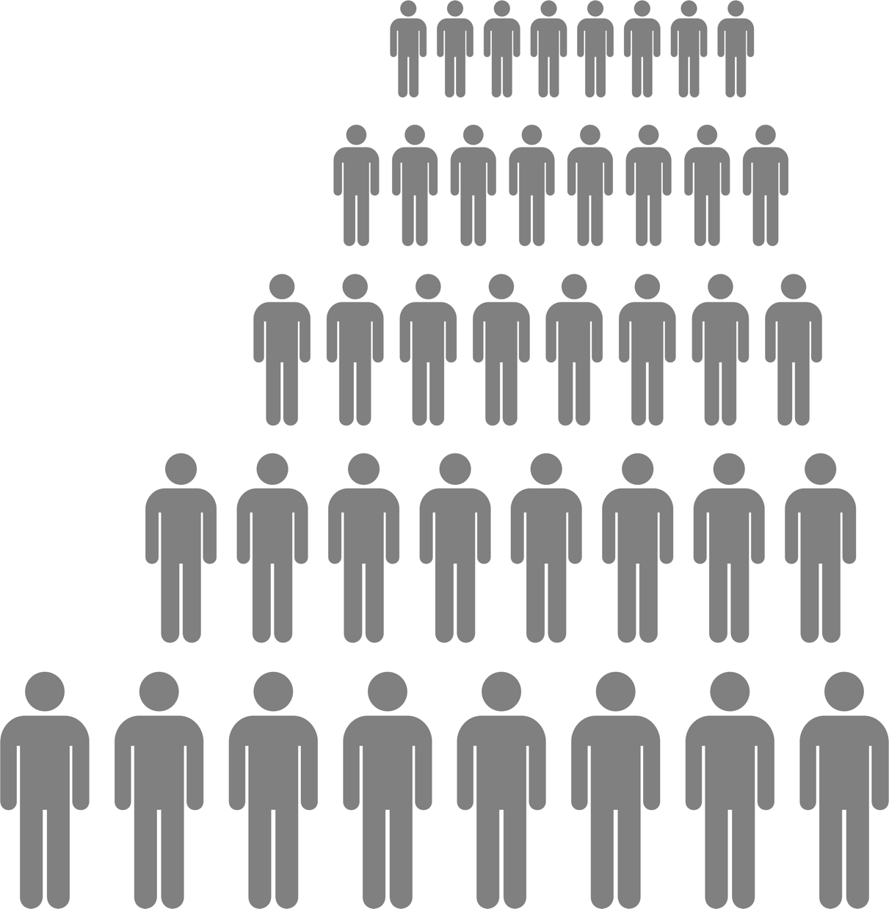

UKBB: UK Biobank
>1,000 phenotypes curated from ICD codes
N=500,000
N_{white British}= 408,961
28 million genetic variants
Established 2007 in the United Kingdom
Data collected from 2006 – 2010
Bycroft et al, Nature, 2018
Sudlow et al, PLoS Med, 2015

Slide 3
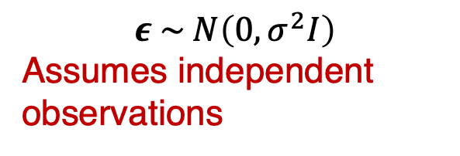

Challenges in genetic association studies
Optimization strategies
Large scale data
Sample relatedness
Linear model:
$$Y_{i}=X_{i}α+G_{i}β+ε_{i}$$
Logistic model:
$${logit(π}_{i}) =X_{i}α+G_{i}β$$
$$ε \sim N\left(0,σ^{2}I\right)$$
Assumes independent observations
  1 in 3 has at least one relative up to the 3rd degree in UK Biobank
  Inflated type I errors
  Biased effect estimates

Slide 4

GWAS results based on linear or logistic regression can be biased when the independence assumption between samples is violated
Linear model:
$$Y_{i}=X_{i}α+G_{i}β+ε_{i}$$
Logistic model:
$${logit(π}_{i}) =X_{i}α+G_{i}β$$
Assumes independent observations
Spurious associations, Inflated type I errors
Biased effect estimates
Familial or cryptic sample relatedness
Population stratification

Slide 5
Challenges in genetic association studies
Optimization strategies
Large scale data
Sample relatedness
Linear model:
$$Y_{i}=X_{i}α+G_{i}β+ε_{i}$$
Logistic model:
$${logit(π}_{i}) =X_{i}α+G_{i}β$$
$$ε \sim N\left(0,σ^{2}I\right)$$
Assumes independent observations
  1 in 3 has at least one relative up to the 3rd degree in UK Biobank
  Inflated type I errors
  Biased effect estimates
By excluding up to 3rd degree relatives in samples with EUR ancestry, we will lose ~10% of samples (out of 400k)

Slide 6

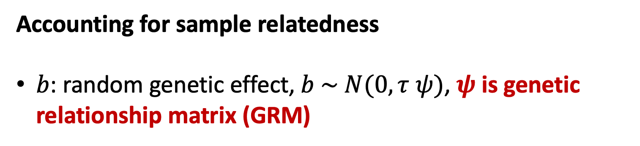
Linear mixed model for GWAS
$$Y_{i}=X_{i}α+G_{i}β+b_{i}+ε_{i}$$
Accounting for sample relatedness
$b$: random genetic effect, $b \sim N(0,\text{τ} ψ)$, $ψ$is genetic relationship matrix (GRM)
Notes:
GRAMMAR (Aulchenko, Y. S. et.al 2007); EMMAX (Kang, H. M. et.al 2010); TASSEL (Zhang, Z. et.al 2010); GCTA (Yang, Jian, et al. 2011); FaST-LMM (Lippert, C. et al. 2011); GEMMA (Zhou, X., & Stephens, M. 2012); BOLT-LMM (Loh, P.R. et al. 2015)

Slide 7
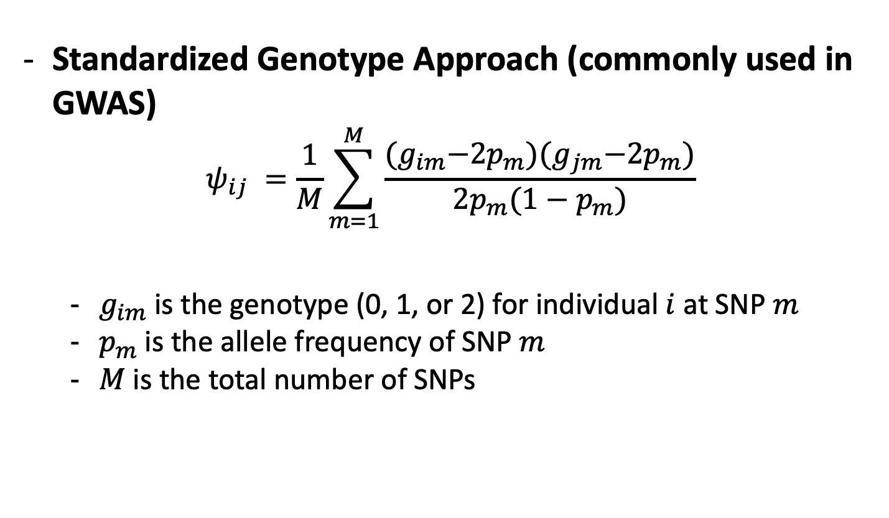
Genetic relationship matrix
Standardized Genotype Approach (commonly used in GWAS)
$$ψ_{ij} =\frac{1}{M}\sum_{m=1}^{M}{\frac{{(g}_{im}−2p_{m}){(g}_{jm}−2p_{m})}{2p_{m}(1−p_{m})}}$$
  $g_{im}$is the genotype (0, 1, or 2) for individual $i$ at SNP $m$
  $p_{m}$is the allele frequency of SNP $m$
  $M$is the total number of SNPs
Square, symmetric matrix

Slide 8
Linear mixed model methods for GWAS
FASTA
Two-step
WM Chen and GR Abecasis
2007
Compressed MLM P3D
Z Zhang
et al.
2010
EMMAX
HM Kang
et al.
2010
BOLT-LMM
PR Loh
et al.
2015
GRAMMAR-Gamma
GR Svishcheva et al.
2012
Q+K
J Yu et al.
2006
EMMA
HM Kang et al.
2008
FaST-LMM
C Lippert et al.
2011
GEMMA
X Zhou et al.
2012

Slide 9
Binary trait in UKBB | N _{Case} | N _{Control}
Colorectal cancer | 4,562 | 382,756

Slide 10
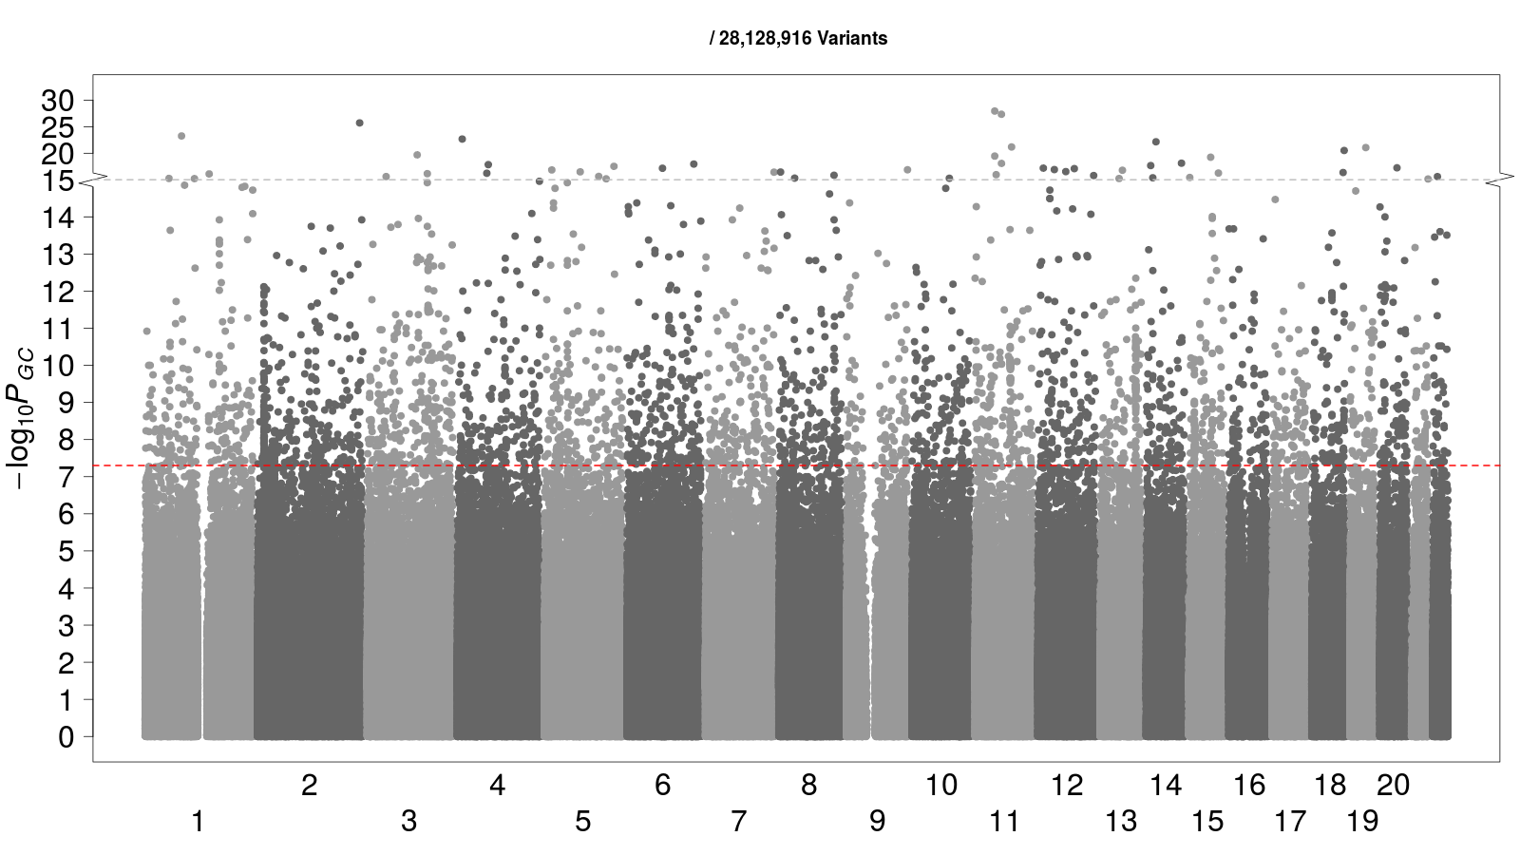
Inflated type I error rates were observed after using BOLT-LMM for binary phenotypes
Binary Traits | N _{Case} | N _{Control}
Colorectal cancer | 4,562 | 382,756
Loh et al., 2015

Slide 11

Challenges in biobank-based GWASs
Linear mixed model
Sample relatedness
Linear mixed model:
$$Y_{i}=X_{i}α+G_{i}β+b_{i}+ε_{i}$$
?

Slide 12
Linear Mixed Model for Binary Phenotypes?
  Assumes homoscedasticity (constant residual variance)
    Violated by binary traits
Inflated type I error rates
With disease, 1
No disease, 0
0
1
2
Dosages of the tested SNP

Slide 13
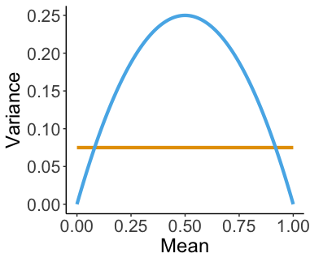
Linear mixed model for binary phenotypes (0 and 1)?
True mean-variance relationship
Linear model assumed
mean-variance relationship
adapted from Chen, H., Wang, C., et. al. (2016)
Notes:
lGRAMMAR (Aulchenko, Y. S. et.al 2007); EMMAX (Kang, H. M. et.al 2010); TASSEL (Zhang, Z. et.al 2010); GCTA (Yang, Jian, et al. 2011); FaST-LMM (Lippert, C. et al. 2011); GEMMA (Zhou, X., & Stephens, M. 2012); BOLT-LMM (Loh, P.R. et al. 2015)

Slide 14
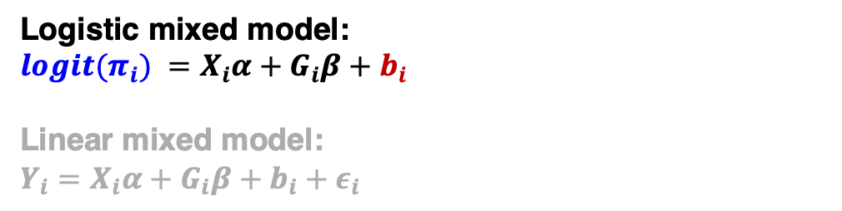
Use logistic mixed model for binary phenotypes
Linear
Logistic mixed model
Sample relatedness
Logistic mixed model:
$${logit(π}_{i}) =X_{i}α+G_{i}β+b_{i}$$
Linear mixed model:
$$Y_{i}=X_{i}α+G_{i}β+b_{i}+ε_{i}$$
GMMAT: Chen, H., Wang, C., et. al. (2016)

Slide 15
GMMAT: Logistic Mixed Model Association Test
FASTA
Two-step
WM Chen and GR Abecasis
2007
Compressed MLM P3D
Z Zhang
et al.
2010
EMMAX
HM Kang
et al.
2010
BOLT-LMM
PR Loh
et al.
2015
GRAMMAR-Gamma
GR Svishcheva et al.
2012
GMMAT
H Chen et al.
2016
Q+K
J Yu et al.
2006
EMMA
HM Kang et al.
2008
FaST-LMM
C Lippert et al.
2011
GEMMA
X Zhou et al.
2012

Slide 16
Binary Traits | N _{Case} | N _{Control}
Colorectal cancer | 4,562 | 382,756
It would take GMMAT ~ 669 Gb of memory and ~ 184 CPU years to run a GWAS for one phenotype
Optimization NEEDED!
GMMAT: Chen, H., Wang, C., et. al. (2016)

Slide 17
Optimize logistic mixed model method for biobank-scale data
Optimization strategies
Large scale data
Logistic mixed model
Sample relatedness
Loh et al., 2015

Slide 18

Inflated type I error rates were still observed
after using logistic mixed model for binary phenotypes
Binary Traits | N _{Case} | N _{Control}
Colorectal cancer | 4,562 | 382,756

Slide 19
Challenges in biobank-based GWASs
Optimization strategies
Large scale data
Logistic mixed model
Sample relatedness
?
Loh et al., 2015

Slide 20
Unbalanced case-control ratios are commonly observed for binary phenotypes in biobanks
1,663 Binary Phenotypes in the UK Biobank

Slide 21
Test statistics do not converge to Normal distribution, leading to inflated type I error rates
Unbalanced case-control ratio
Optimization strategies
Large scale data
Logistic mixed model
Sample relatedness
Ma, et al. (2013)

Slide 22
Saddlepoint approximation (SPA) is used to account for unbalanced case-control ratio
Saddlepoint approximation
Unbalanced case-control ratio
Optimization strategies
Large scale data
Logistic mixed model
Sample relatedness
SPA uses the entire moment generating function -> more accurate p-values
vs.
Normal distribution only uses the first two moments (mean and variance)
Daniels, 1954
Dey et al., 2017

Slide 23
SAIGE
(Scalable and Accurate Implementation of GEneralized mixed model)
was developed to conduct GWAS in large-scale biobanks
Saddlepoint approximation
Unbalanced case-control ratio
Optimization strategies
Large scale data
Mixed models
Sample relatedness
Zhou et al. Nat. Genet. 2018

Slide 24
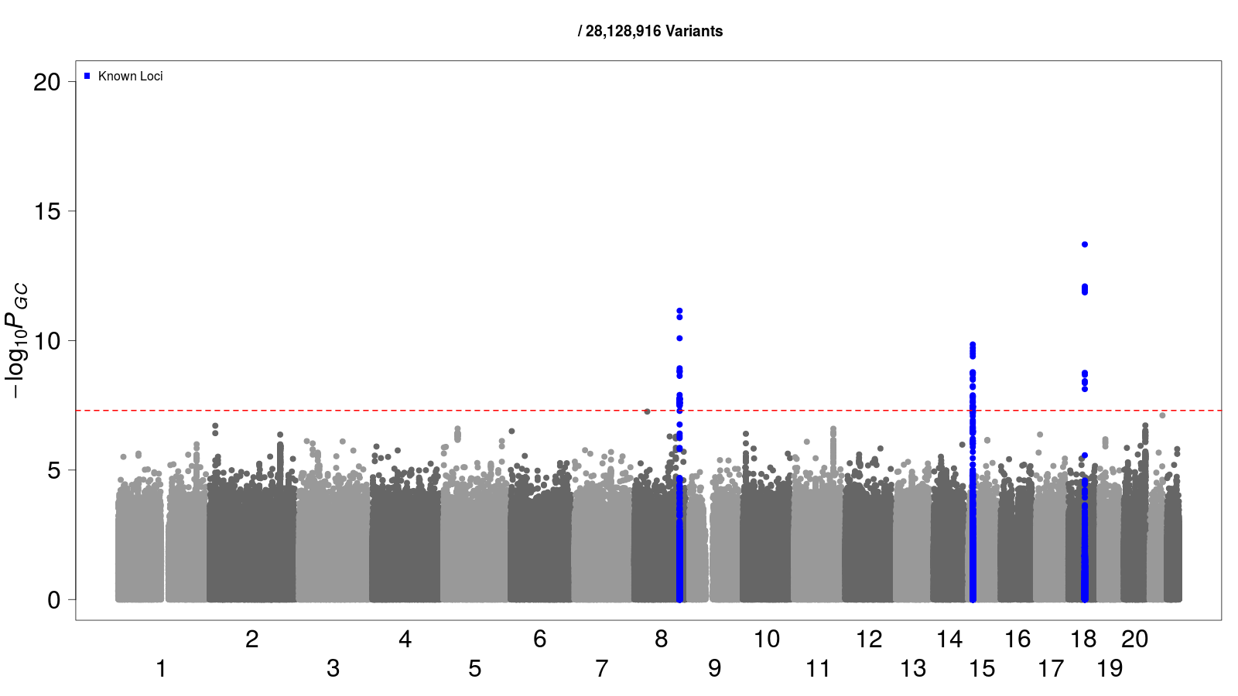
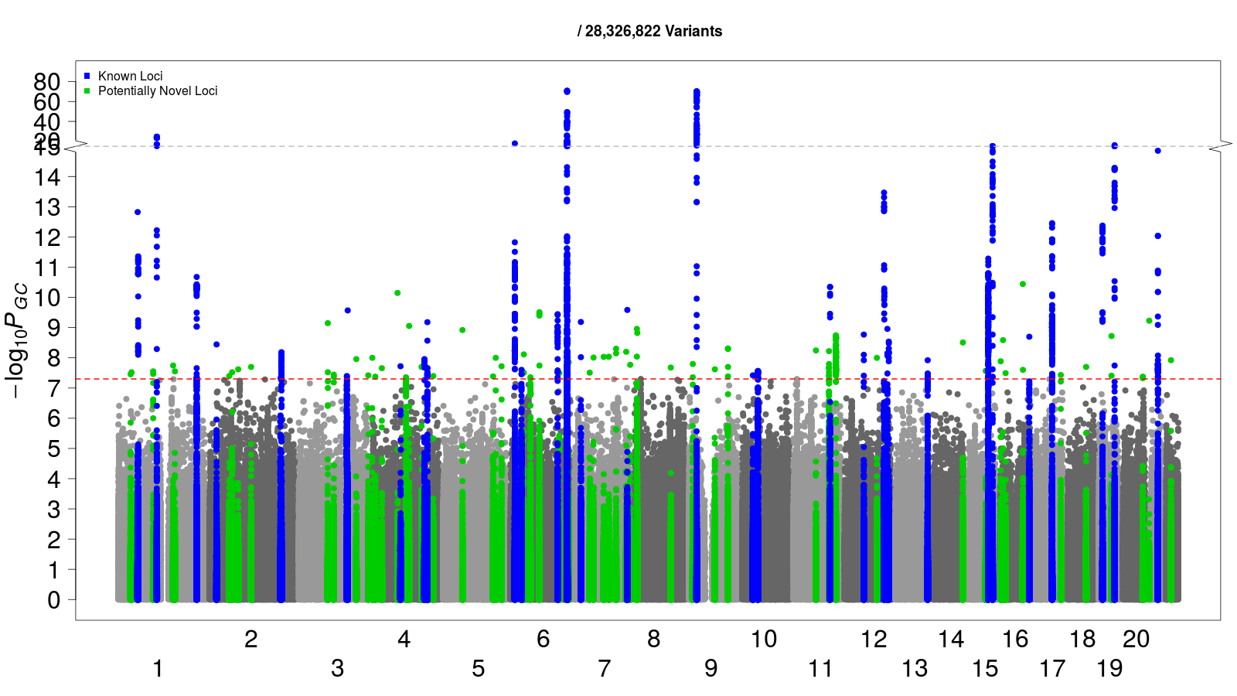
Colorectal cancer
4,562 Cases
382,756 Controls
Case: Control = 1:84
Linear mixed model
Logistic mixed model
Logistic mixed model
+SPA (SAIGE)

Slide 25
Thyroid cancer
358 Cases
407,399 Controls
Case: Control = 1:1138

Slide 26
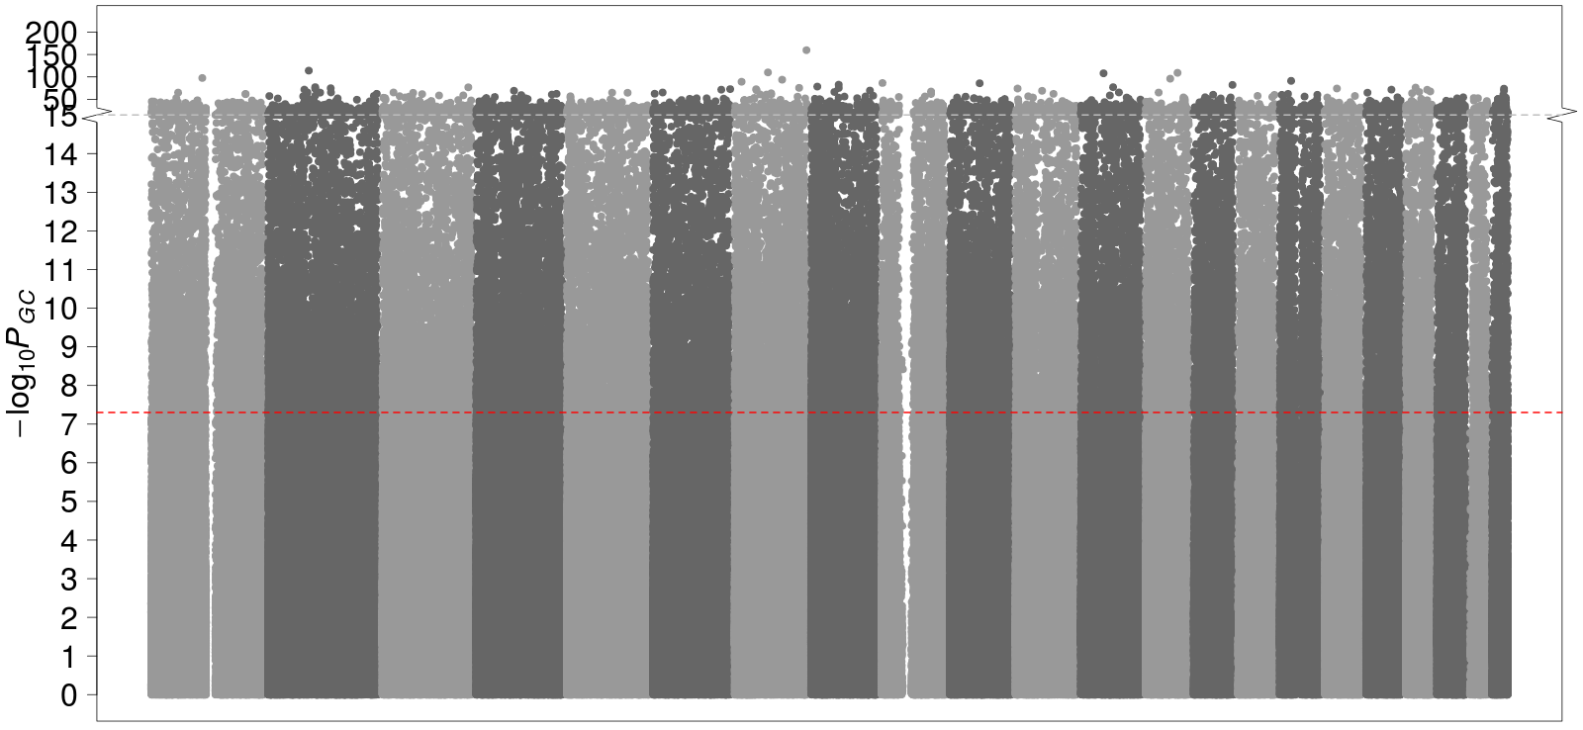
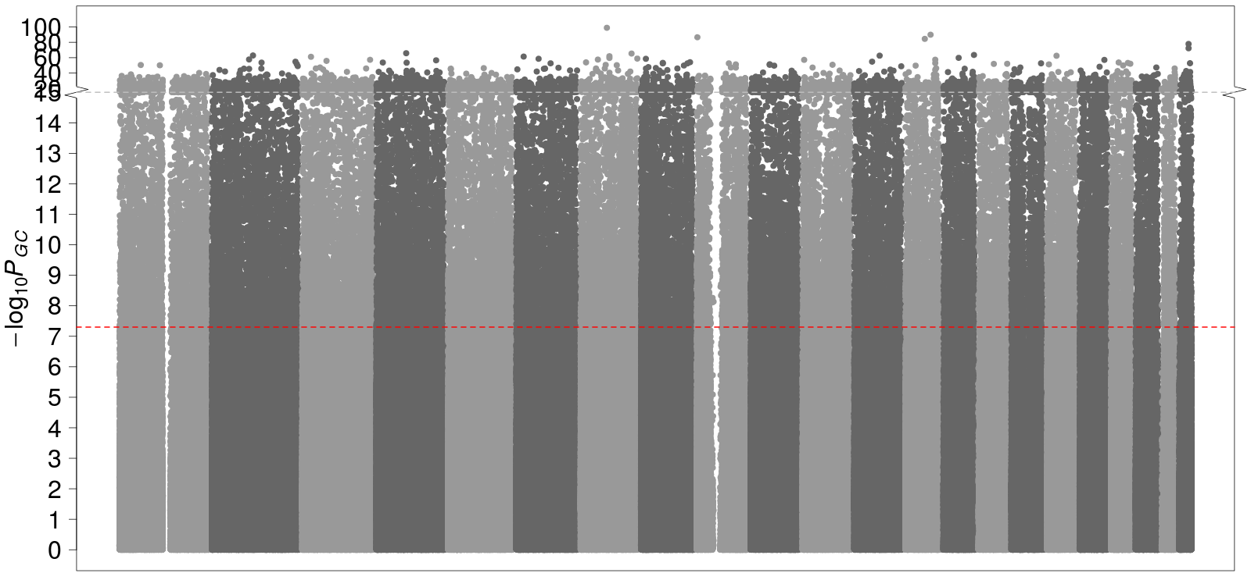
Thyroid cancer
358 Cases
407,399 Controls
Case: Control = 1:1138
Linear mixed model
Logistic mixed model

Slide 27
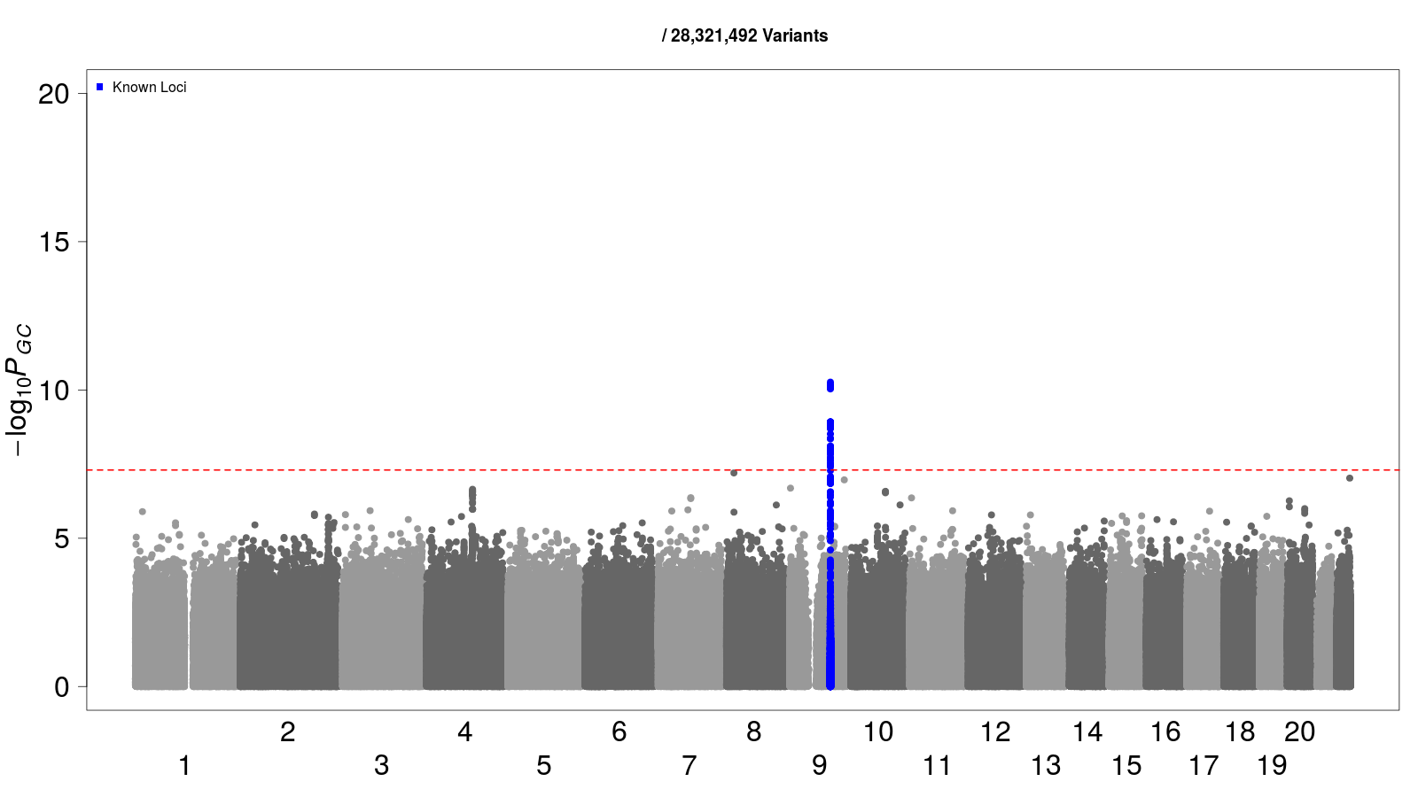
Thyroid cancer
358 Cases
407,399 Controls
Case: Control = 1:1138
Linear mixed model
Logistic mixed model
Logistic mixed model
+SPA

Slide 28
FASTA
Two-step
WM Chen and
GR Abecasis
2007
Compressed MLM P3D
Z Zhang
et al.
2010
BOLT-LMM
PR Loh
et al.
2015
EMMAX
HM Kang
et al.
2010
GMMAT
H Chen
et al.
2016
SAIGE
Zhou
et al.
2018
GRAMMAR-Gamma
GR Svishcheva et al.
2012
Q+K
J Yu et al.
2006
EMMA
HM Kang
et al.
2008
FaST-LMM
C Lippert
et al.
2011
GEMMA
X Zhou et al.
2012
SAIGE documentation: https://saigegit.github.io/SAIGE-doc/

Slide 29

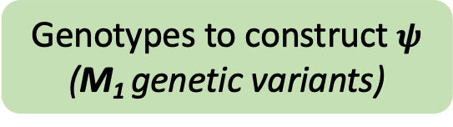
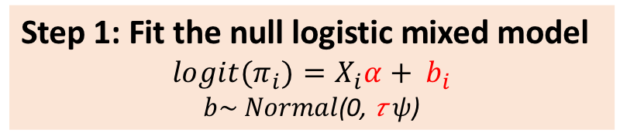
SAIGE
Phenotype
Non-genetic covariates
(N individuals)
Genotypes to construct $ψ$
(M₁ genetic variants)
Step 1: Fit the null logistic mixed model
$${logit(π}_{i})=X_{i}α+ b_{i}$$
$b\sim Normal$(0, 𝜏$ψ$)
$\hat{α },\hat{b}$ , $\hat{\text{τ}}$

Slide 30
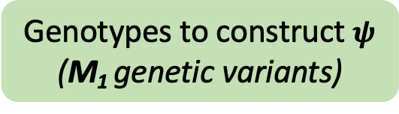
SAIGE
Phenotype
Non-genetic covariates
(N individuals)
Genotypes to construct $ψ$
(M₁ genetic variants)
Step 1: Fit the null logistic mixed model
$${logit(π}_{i})=X_{i}α+ b_{i}$$
$b\sim Normal$(0, 𝜏$ψ$)
$\hat{α },\hat{b}$ , $\hat{\text{τ}}$
Genotypes/Dosages for genetic variants to be tested
(M genetic variants)
Step 2: Perform association test for each genetic marker
Apply SPA to score tests
Association Results (p-values…)
Notes:
Our method, Scalable and Accurate Implementation of GEneralized mixed model (SAIGE), uses the saddlepoint approximation (SPA)^{27–29} to calibrate unbalanced case-control ratios in score tests based on logistic mixed models.

Slide 31
Run Time and Memory Usage
Log-log plots of the estimated run time (A) and memory use (B) as a function of sample size (N) for testing for testing 71 million markers with info ≥ 0.3 as in UK Biobank.
Notes:
Benchmarking was performed on randomly sub-sampled UK Biobank data with 408,458 white British participants and 200,000 markers for the cardiovascular diseases (PheCode = 411). The plotted run time is the projected computation time for testing 71 million markers with info ≥ 0.3.

Slide 32
More popular methods developed to improve the computational efficiency for running mixed model-based GWAS in large biobanks
FASTA
Two-step
WM Chen and
GR Abecasis
2007
Compressed MLM P3D
Z Zhang
et al.
2010
EMMAX
HM Kang
et al.
2010
BOLT-LMM
PR Loh
et al.
2015
GMMAT
H Chen
et al.
2016
SAIGE
Zhou
et al.
2018
FastGWA
Jiang
et al.
2019
Regenie
Mbatchou
et al.
2021
GRAMMAR-Gamma
GR Svishcheva et al.
2012
Q+K
J Yu et al.
2006
EMMA
HM Kang
et al.
2008
FaST-LMM
C Lippert
et al.
2011
GEMMA
X Zhou et al.
2012

Slide 33
Challenges of GWAS in large-scale cohorts/biobanks
Saddlepoint approximation
Unbalanced case-control ratio
Optimization strategies
Large scale data
Mixed models
Sample relatedness

Slide 34
Saddlepoint approximation/Firth correction
Unbalanced case-control ratio
Optimization strategies
Large scale data
Mixed model
Sample relatedness
In today’s practical
Today’s practical is on Qualtrics:
https://qimr.az1.qualtrics.com/jfe/form/SV_036Ckv3AMwjqewu
Link is in Qualtrics.txt

Slide 35
Testing common variants
Binary traits
Related samples
YES
NO
Case: control < 1:10
Case: control < 1:10
YES
NO
YES
NO
SAIGE
fastGWA-GLMM
Regenie
PLINK –glm
SPAtest (fast)
PLINK –glm
(Firth test, relatively slower)
GMMAT (slow but good for small sample sizes)
SAIGE
fastGWA-GLMM
Regenie

Slide 36
Testing common variants
Binary traits
Related samples
YES
NO
Case: control < 1:10
Case: control < 1:10
YES
NO
YES
NO
SAIGE
fastGWA-GLMM
Regenie
PLINK –glm
SPAtest (fast)
PLINK –glm firth (slow)
GMMAT (slow but good for small sample sizes)
SAIGE
fastGWA-GLMM
Regenie

Slide 37
Reference
SPAtest: Dey, Rounak, Ellen M. Schmidt, Goncalo R. Abecasis, and Seunggeun Lee. "A fast and accurate algorithm to test for binary phenotypes and its application to PheWAS." The American Journal of Human Genetics 101, no. 1 (2017): 37-49.
BOLT-LMM: Loh, Po-Ru, George Tucker, Brendan K. Bulik-Sullivan, Bjarni J. Vilhjalmsson, Hilary K. Finucane, Rany M. Salem, Daniel I. Chasman et al. "Efficient Bayesian mixed-model analysis increases association power in large cohorts." Nature genetics 47, no. 3 (2015): 284.
SAIGE: Zhou, Wei, Jonas B. Nielsen, Lars G. Fritsche, Rounak Dey, Maiken E. Gabrielsen, Brooke N. Wolford, Jonathon LeFaive et al. "Efficiently controlling for case-control imbalance and sample relatedness in large-scale genetic association studies." Nature genetics 50, no. 9 (2018): 1335-1341.
SAIGE-GENE: Zhou, Wei*, Zhangchen Zhao*, Jonas B. Nielsen, Lars G. Fritsche, Jonathon LeFaive, Sarah A. Gagliano Taliun, Wenjian Bi et al. "Scalable generalized linear mixed model for region-based association tests in large biobanks and cohorts." Nature genetics 52, no. 6 (2020): 634-639.
SAIGE-GENE+: Zhou, Wei*, Wenjian Bi*, Zhangchen Zhao*, Kushal K. Dey, Karthik A. Jagadeesh, Konrad J. Karczewski, Mark J. Daly, Benjamin M. Neale, and Seunggeun Lee. "SAIGE-GENE+ improves the efficiency and accuracy of set-based rare variant association tests." Nature genetics 54, no. 10 (2022): 1466-1469.

Slide 38
Reference
GEMMA: Zhou, Xiang, and Matthew Stephens. "Genome-wide efficient mixed-model analysis for association studies." Nature genetics 44, no. 7 (2012): 821-824.
GMMAT: Chen, Han, Chaolong Wang, Matthew P. Conomos, Adrienne M. Stilp, Zilin Li, Tamar Sofer, Adam A. Szpiro et al. "Control for population structure and relatedness for binary traits in genetic association studies via logistic mixed models." The American Journal of Human Genetics 98, no. 4 (2016): 653-666.
Regenie: Mbatchou, Joelle, Leland Barnard, Joshua Backman, Anthony Marcketta, Jack A. Kosmicki, Andrey Ziyatdinov, Christian Benner et al. "Computationally efficient whole-genome regression for quantitative and binary traits." Nature genetics 53, no. 7 (2021): 1097-110
SMMAT: Chen, Han, Jennifer E. Huffman, Jennifer A. Brody, Chaolong Wang, Seunggeun Lee, Zilin Li, Stephanie M. Gogarten et al. "Efficient variant set mixed model association tests for continuous and binary traits in large-scale whole-genome sequencing studies." The American Journal of Human Genetics 104, no. 2 (2019): 260-274.
fastGWA-GLMM: Jiang, Longda, Zhili Zheng, Hailing Fang, and Jian Yang. "A generalized linear mixed model association tool for biobank-scale data." Nature genetics 53, no. 11 (2021): 1616-1621.
fastGWA: Jiang, Longda, Zhili Zheng, Ting Qi, Kathryn E. Kemper, Naomi R. Wray, Peter M. Visscher, and Jian Yang. "A resource-efficient tool for mixed model association analysis of large-scale data." Nature genetics 51, no. 12 (2019): 1749-1755.
PLINK: Purcell, Shaun, Benjamin Neale, Kathe Todd-Brown, Lori Thomas, Manuel AR Ferreira, David Bender, Julian Maller et al. "PLINK: a tool set for whole-genome association and population-based linkage analyses." The American journal of human genetics 81, no. 3 (2007): 559-575.

Slide 39
Backup slides

Slide 40
Different types of phenotypes require different statistical models for association tests
Quantitative
  eg. LDL cholesterol level, height
  Linear regression
Binary
  eg. Schizophrenia, Type 2 Diabetes
  Logistic regression
Ordinal/categorical
  eg. On a scale of 1-10 how much do you like smoking
  Proportional odds logistic regression, Multinomial regression
Time-to-event (TTE)
  eg. Age at skin cancer onset, Time of death after diagnosis of lung cancer
  Survival analysis model

Slide 41
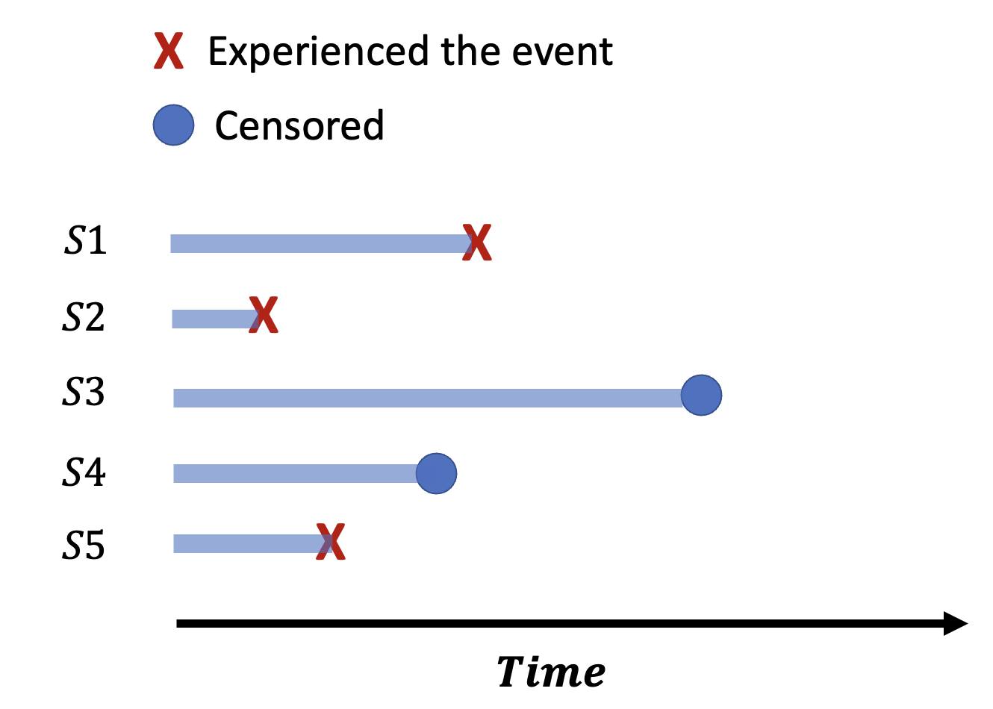
Mixed model method for other types of phenotypes
Ordinal phenotypes
  Common variants:
    POLMM: Proportional Odds Logistic Mixed Model
    Bi et al., AJHG 2021
  Rare variants:
    POLMM-GENE
    Bi* and Zhou* et al., AJHG 2023
Time-to-event phenotypes
  Common variants:
    GATE: Genetic Analysis of Time-to-Event phenotypes
    R library: https://github.com/weizhou0/GATE
    Recently merged to SAIGE v1.4.4
    Dey* and Zhou* et al., Nature Comm 2022: 5437.

Slide 42
Phenome-wide GWAS resources for large biobanks
UK Biobank
  HRC imputed and TopMed imputed
    https://pheweb.sph.umich.edu/
    1403 binary phenotypes based on Phecodes in White British samples
    PheWeb: Taliun et al., Nat Genet. 2020. https://github.com/statgen/pheweb

Slide 43
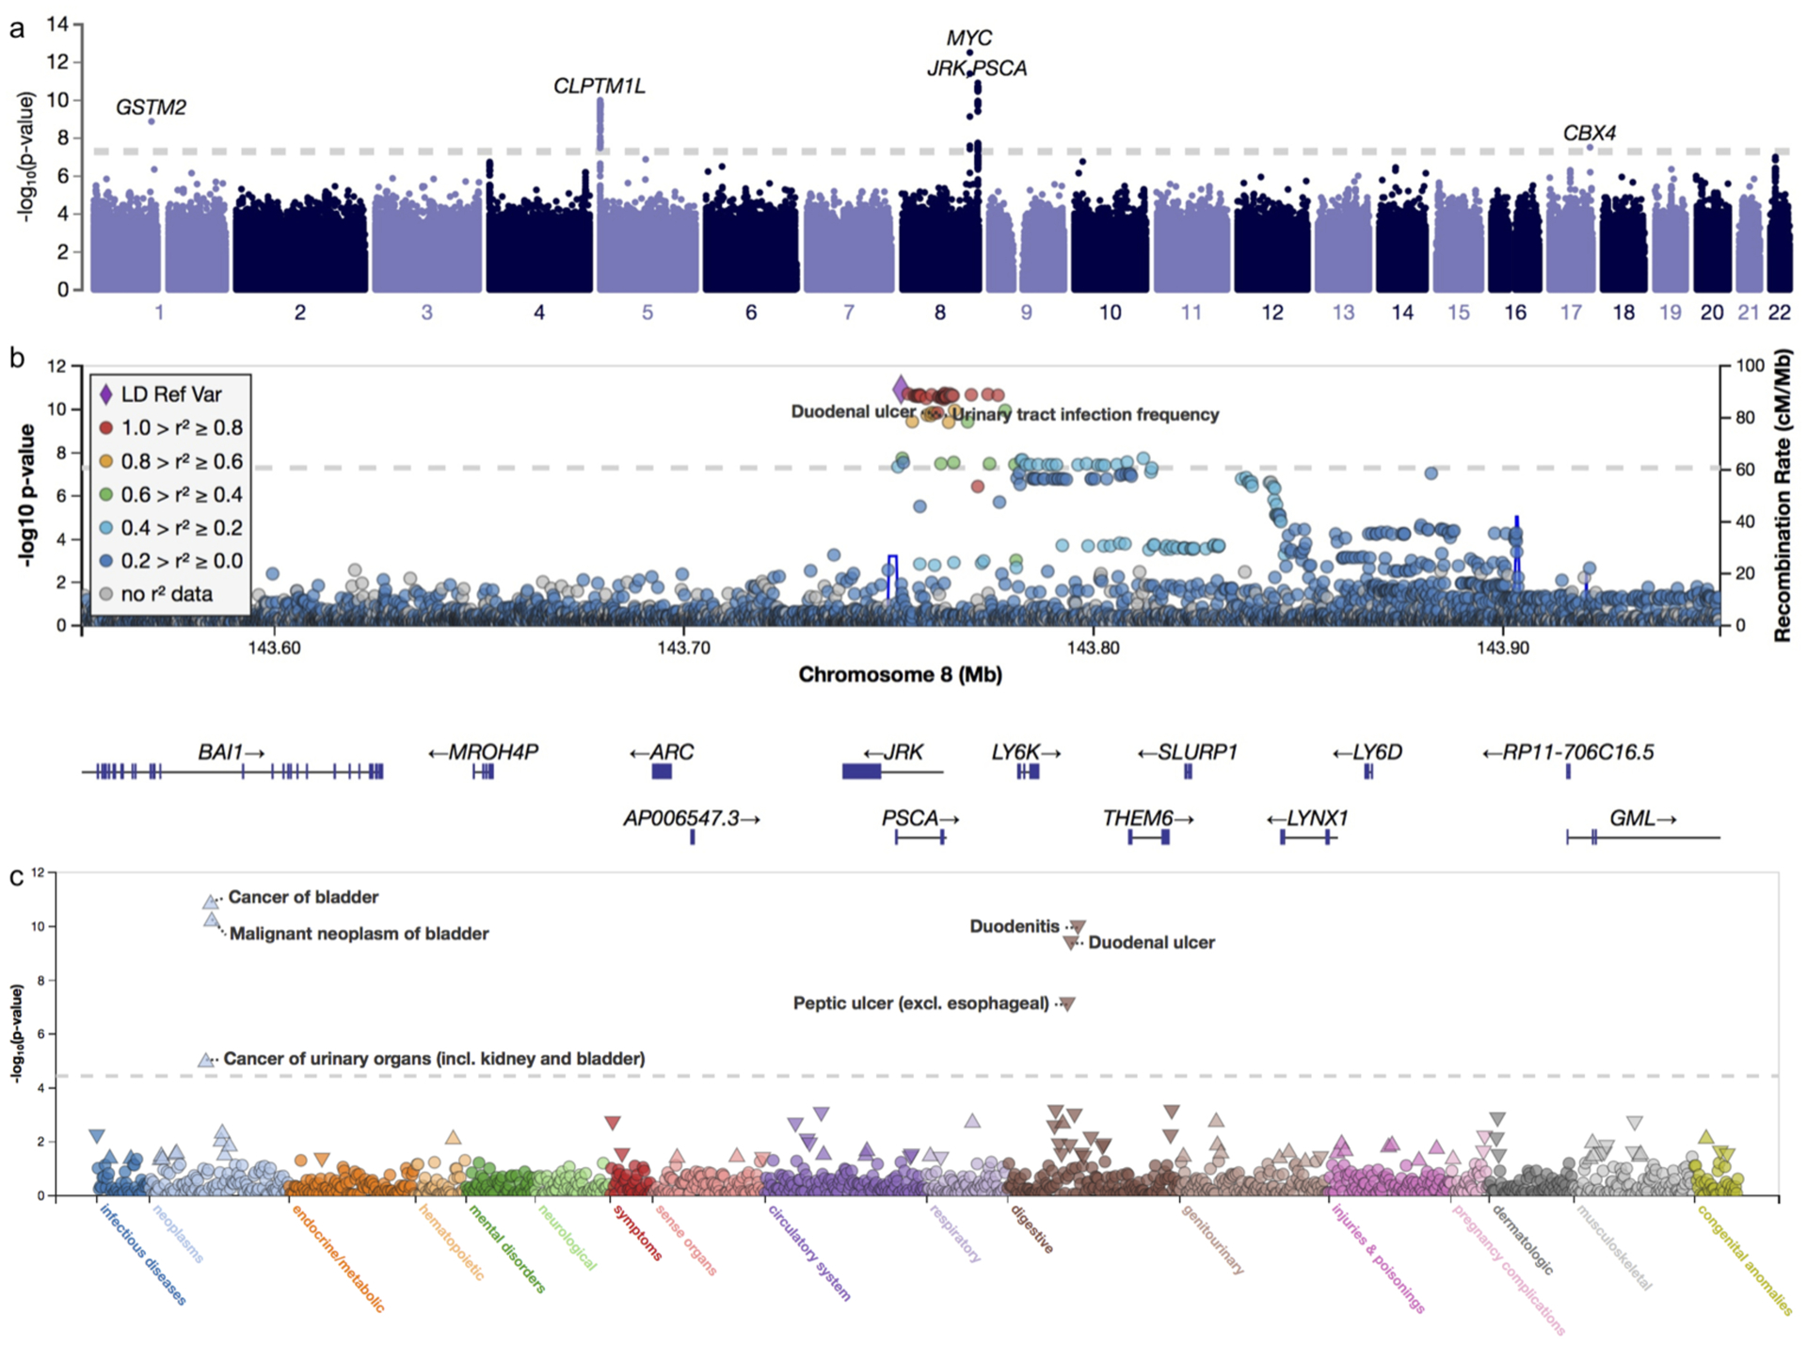
Interactive views of genetic associations in the UK Biobank instance of PheWeb
Manhattan Plot - GWAS
LocusZoom Plot
(Pruim et al., 2010)
Figure 1 from Taliun et al., Nat Genet. 2020

Slide 44
Phenome-wide GWAS resources for large biobanks
UK Biobank
  HRC imputed and TopMed imputed
    https://pheweb.sph.umich.edu/
    1403 binary phenotypes based on Phecodes in White British samples
    PheWeb: Taliun et al., Nat Genet. 2020. https://github.com/statgen/pheweb
  Neale lab – round 1 and 2
    https://www.nealelab.is/uk-biobank
    Sex stratified PheGWAS
  Pan-UKBB:
    https://pan.ukbb.broadinstitute.org/
    7,228 quantitative and binary phenotypes, across 6 continental ancestry groups, for a total of 16,131 GWAS
    All variants with INFO > 0.8, and MAC > 20 in that population (up to 28 million variants)
  Genebass:
    https://app.genebass.org/
    4,529 quantitative and binary phenotypes on 394,841 exomes
    57,650 group tests per phenotype (pLoF, missense, synonymous for each gene)

Slide 45
Phenome-wide GWAS resources for large biobanks
FinnGen project (412,181 individuals, 2,408 endpoints): https://r10.finngen.fi/
Michigan Genomic Initiative (80,381 individuals, 1,728 endpoints): https://pheweb.org/MGI/
Biobank Japan: https://pheweb.jp/
Taiwan Biobank: https://taiwanview.twbiobank.org.tw/pheweb.php
Million Veteran Program (MVP):
  Verma et al.,Science, 2024

Slide 46
Biobank meta-analysis results
Global Biobank Meta-analysis Flagship project (24 biobanks with up to 2.2 million individuals for 14 exemplary disease endpoints)
  http://results.globalbiobankmeta.org/
FinnGen + UKBB + MVP (1.5 million individuals for ~300 binary phenotypes)
  https://mvp-ukbb.finngen.fi/

Slide 47
Zhou et al., 2018

