Slide 1
Introduction to GWAS
Sarah Medland

Slide 2
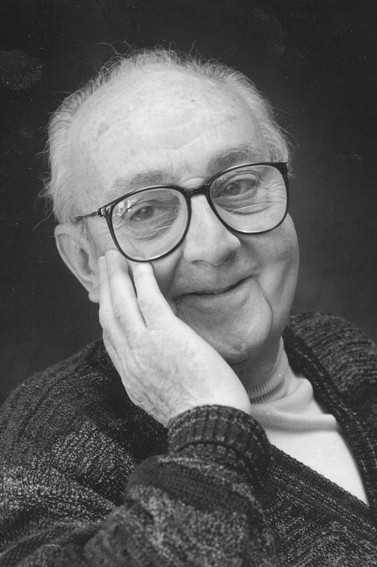
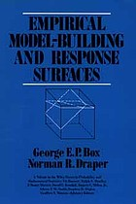
George Box
“Remember that all models are wrong; the practical question is how wrong do they have to be to not be useful.”
Box, G.E.P. and Draper, N.R. (1987) Empirical model-building and response surfaces. New York: Wiley. p424

Slide 3


Slide 4
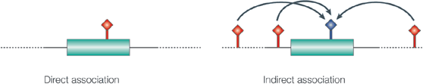
What is GWAS
A hypothesis free study of genetic variation across the
entire human genome
Tests for genetic associations with continuous traits or
with the presence / absence of disease
With a focus on common loci
Can detect with direct and indirect signals
Hirschhorn & Daly. Nat Rev Genet (2014)

Slide 5
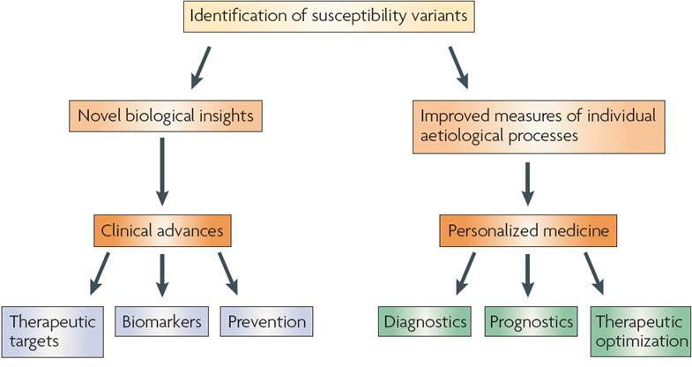
Why do it?
McCarthy et al. Nat Rev Genet (2008)

Slide 6

Association with unrelated individuals

Slide 7
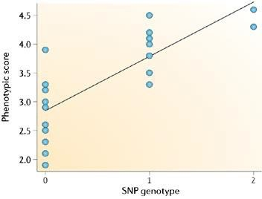
Quantitative Trait
Linear Regression
Ŷ = α + βX + ε
Ŷ = score on phenotype
X = 0, 1 or 2 copies of allele (“G”)
β = 0 no association
β > 0 G allele associated with higher score on trait β < 0 G allele associated with lower score on trait
Balding. Nat Rev Genet (2006)

Slide 8

Genetic association tests
To identify genetic variants that are associated with a complex trait
 |  |  |  |  |  |  |  |  |  |  |  |  |  |  | Height (cm)
… | A | C | C | T | A | G | C | T | A | T | C | C | T | … | 163
… | A | C | C | T | A | G | C | T | A | T | C | C | T | …
… | A | C | C | T | A | G | C | T | A | T | C | C | T | … | 170
… | A | C | C | C | A | G | C | T | A | T | C | C | T | …
… | A | C | C | T | A | G | C | T | A | T | C | C | T | … | 165
… | A | C | C | T | A | G | C | T | A | T | C | C | T | …
… | A | C | C | C | A | G | C | T | A | T | C | C | T | … | 190
… | A | C | C | C | A | G | C | T | A | T | C | C | T | …
… | A | C | C | T | A | G | C | T | A | T | C | C | T | … | 176
… | A | C | C | C | A | G | C | T | A | T | C | C | T | …
SNP 1
SNP 1
Height (CM)
TT
CT
CC

Slide 9
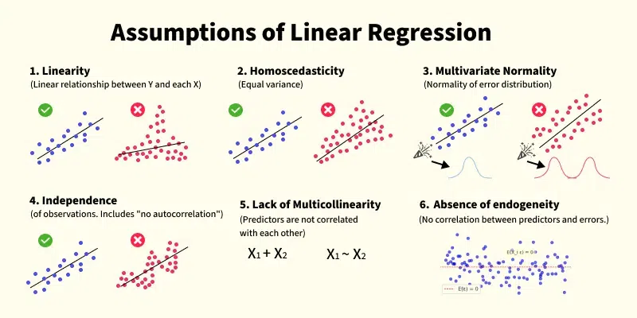

Slide 10
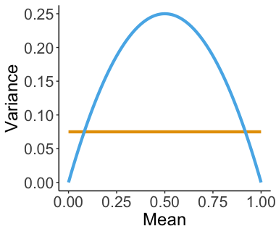
Using linear regression for binary phenotypes (coded as 0 and 1) can lead to inflated type I errors
True mean-variance relationship
Linear model assumed
mean-variance relationship
adapted from Chen, H., Wang, C., et. al. (2016)

Slide 11
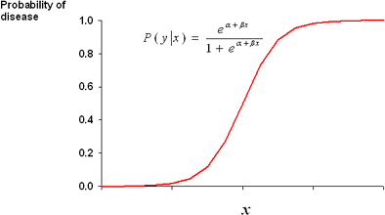
Case-Control
Logistic Regression
Controls Cases
A/A
A/A
G/A
ln(P/1-P) = α + βX + ε
G/G
G/A
A/A
G/A
G/G
G/A
β = difference in log odds for cases vs. controls
A/A
A/A
A/A
G/A
G/G
A/A
e^{(β)} = difference in odds
= Odd Ratio (OR)
A/A
G/A
G/G
G/G
A/A
Allelic effect is an OR: OR > 1 increased risk OR < 1 decreased risk
The G allele is associated with disease

Slide 12
Genetic association tests
To identify genetic variants that are associated with a complex trait
 |  |  |  |  |  |  |  |  |  |  |  |  |  |  | Height (cm)
… | A | C | C | T | A | G | C | T | A | T | C | C | T | … | 163
… | A | C | C | T | A | G | C | T | A | T | C | C | T | …
… | A | C | C | T | A | G | C | T | A | T | C | C | T | … | 170
… | A | C | C | C | A | G | C | T | A | T | C | C | T | …
… | A | C | C | T | A | G | C | T | A | T | C | C | T | … | 165
… | A | C | C | T | A | G | C | T | A | T | C | C | T | …
… | A | C | C | C | A | G | C | T | A | T | C | C | T | … | 190
… | A | C | C | C | A | G | C | T | A | T | C | C | T | …
… | A | C | C | T | A | G | C | T | A | T | C | C | T | … | 176
… | A | C | C | C | A | G | C | T | A | T | C | C | T | …
SNP 1
SNP 1
Height (CM)
TT
CT
CC
Linear regression: $Y=Xα+Gβ+ε$
$G$ = 0, 1, or 2
$X$: covariates, e.g. age, sex, ancestry, batch…
H₀$: β=$0
H₁$: β≠$ 0

Slide 13




Genetic association tests
To identify genetic variants that are associated with a complex disease/disorder
No
Yes
SNP 1
Frequency of C
SNP 1
… | A | C | C | T | A | G | C | T | A | T | C | C | T | …
… | A | C | C | T | A | G | C | T | A | T | C | C | T | …
… | A | C | C | T | A | G | C | T | A | T | C | C | T | …
… | A | C | C | C | A | G | C | T | A | T | C | C | T | …
… | A | C | C | T | A | G | C | T | A | T | C | C | T | …
… | A | C | C | T | A | G | C | T | A | T | C | C | T | …
… | A | C | C | T | A | G | C | T | A | T | C | C | T | …
… | A | C | C | C | A | G | C | T | A | T | C | C | T | …
… | A | C | C | T | A | G | C | T | A | T | C | C | T | …
… | A | C | C | C | A | G | C | T | A | T | C | C | T | …
VS.
Cases
2/4 = 50%
Controls:
1/6 = 16.7%

Slide 14
Genetic association tests
To identify genetic variants that are associated with a complex disease/disorder
No
Yes
SNP 1
Frequency of C
SNP 1
… | A | C | C | T | A | G | C | T | A | T | C | C | T | …
… | A | C | C | T | A | G | C | T | A | T | C | C | T | …
… | A | C | C | T | A | G | C | T | A | T | C | C | T | …
… | A | C | C | C | A | G | C | T | A | T | C | C | T | …
… | A | C | C | T | A | G | C | T | A | T | C | C | T | …
… | A | C | C | T | A | G | C | T | A | T | C | C | T | …
… | A | C | C | T | A | G | C | T | A | T | C | C | T | …
… | A | C | C | C | A | G | C | T | A | T | C | C | T | …
… | A | C | C | T | A | G | C | T | A | T | C | C | T | …
… | A | C | C | C | A | G | C | T | A | T | C | C | T | …
VS.
Cases
2/4 = 50%
Controls:
1/6 = 16.7%
Logistic regression: $logit(π)=Xα+Gβ$
$π$: probability of being a case given X and G
$G$ = 0, 1, or 2
H₀$: β=$0
H₁$: β≠$ 0

Slide 15

Looking at results

Slide 16
QQ (quantile-quantile) plot
Checks the overall distribution of test statistics or –log10 p-values of our results with the expectation under the null hypothesis of no association (the diagonal line shows where the points should fall under the null).
Evaluates systematic bias and inflation (undetected sample duplications, unknown familial relationships, gross population stratification, problems in QC…).
Observed –log10 (p)
Expected –log10 (p)

Slide 17
Lambda
It is the ratio of the median of the empirically observed distribution of the test statistic to the expected median.
  The expected median of the chi-square distribution with one degree of freedom is 0.455.
  λ = median(χ2)/0.455
It quantifies the extent of the bulk inflation and the excess false positive rate.

Slide 18
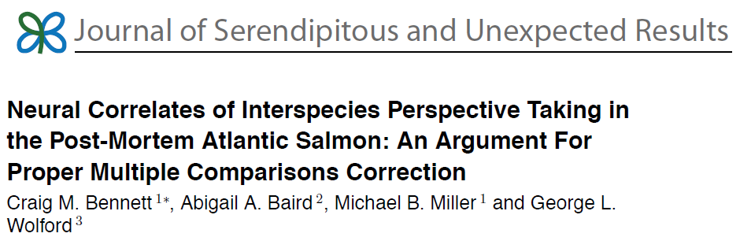
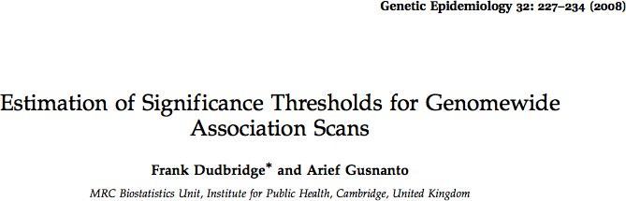
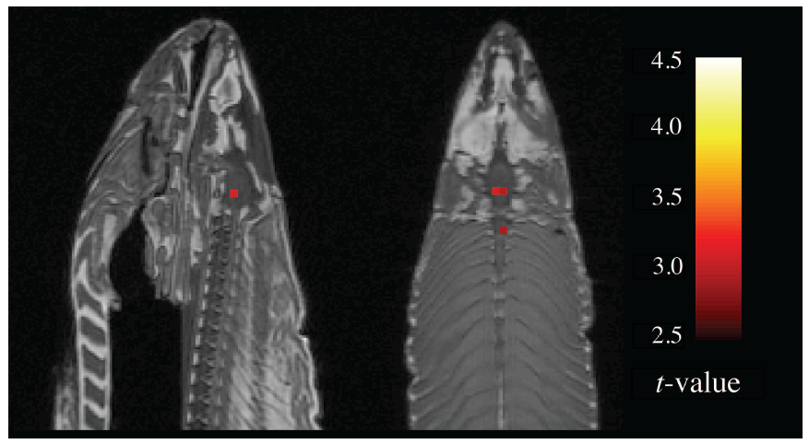
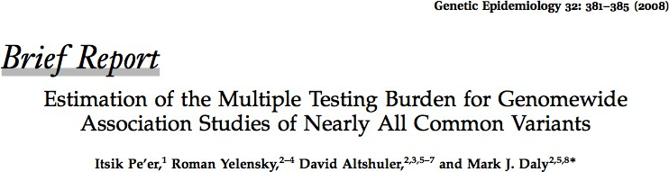
Multiple testing
p < 5 x 10⁻⁸

Slide 19
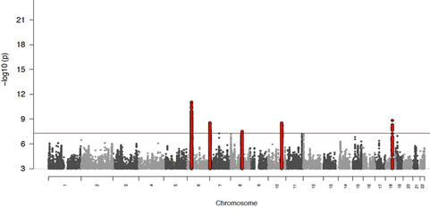
Manhattan plot
Plots the -log10 of the association p-value for each SNP against the genomic coordinates.
The strongest associations will have the smallest p-values and the –log10 of these p-values will have the highest height in the plot.

Slide 20
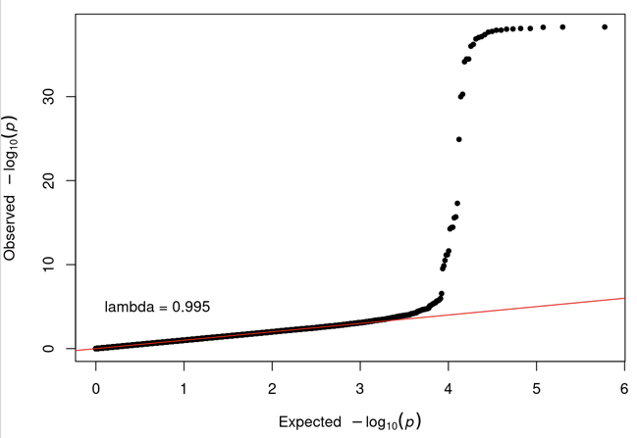
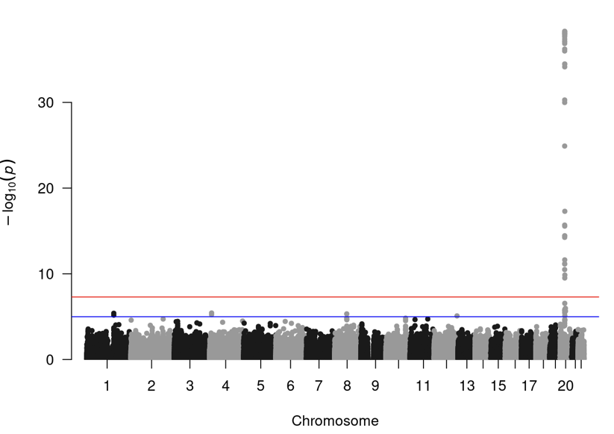
What are these telling us?

Slide 22
And these? What are these telling us?

Slide 23
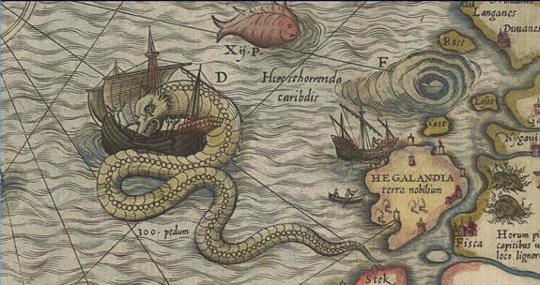
There be dragons…

Slide 24
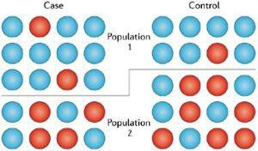




Confounders
Population Stratification
Mean trait or case frequency
differences between populations
Alleles with frequency differences between populations
False positive / negative associations
Balding. Nat Rev Genet (2006)

Slide 25
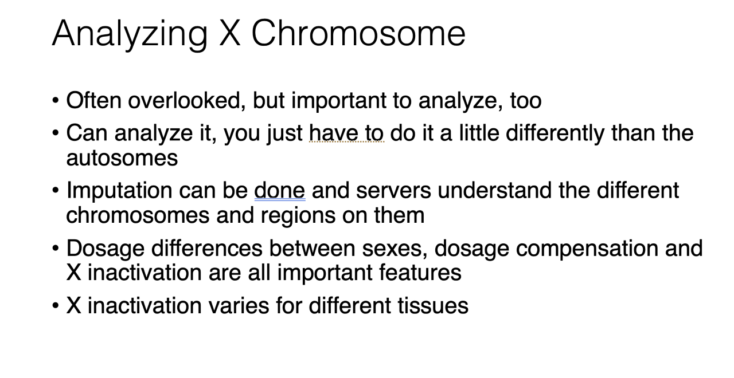
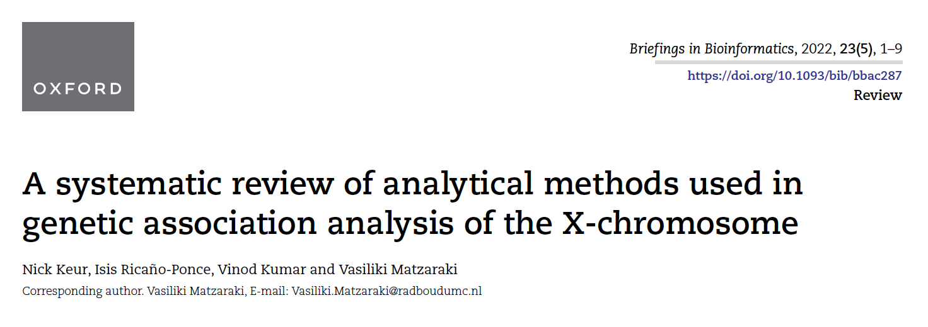
More to come later (Medland)

Slide 26
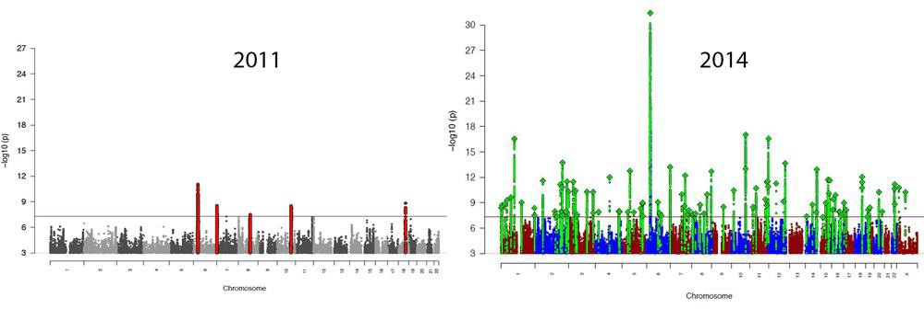
Sample Size & Power
Schizophrenia Working Group of the Psychiatric Genomics Consortium.
9,394 cases
12,462 controls
36,989 cases
113,075 controls

Slide 27
Power Calculation Tools
Consider: Effect size, Sample size, Prevalence, MAF
Purcell, Cherny, & Sham. Bioinformatics, 2003
http://zzz.bwh.harvard.edu/gpc/
Johnson & Abecasis. bioRxiv, 2017
https://csg.sph.umich.edu/abecasis/gas_power_calculator/i ndex.html

Slide 28
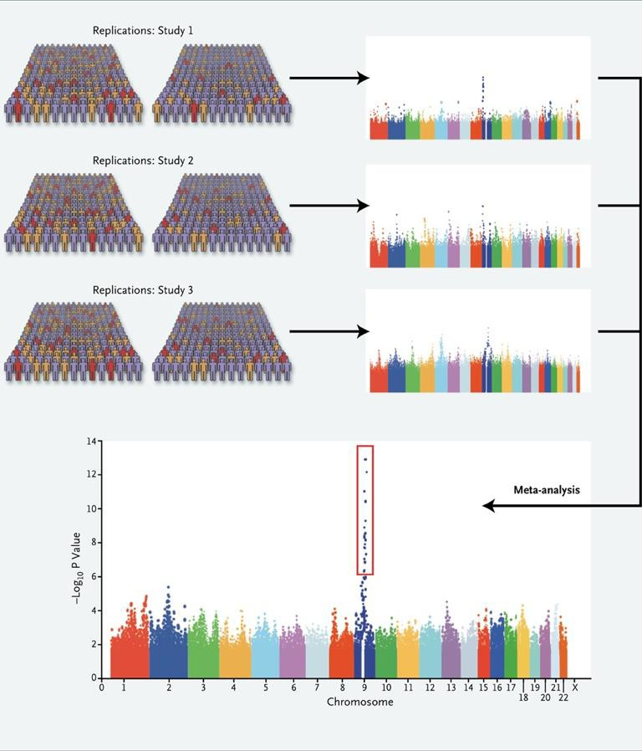
Replication
Significance
Size
Direction
Meta-analysis has mostly replaced replication…
More on this this afternoon
Manolio. N Engl J Med, 2010

Slide 29
There are many tools for GWAS
The most appropriate method depends on the structure of your data: stratification, relatedness Sample size Etc…
We’re going to use plink2 for today’s practical: fast, simple command line program that is a general workhorse software for managing data and running analyses.
  Original plink ped/map format
  Binary plink format (plink1.9): bed/bim/fam
    Fast, very useful
  Plink2 format: pgen/psam/pvar
    Very fast
    Saves space compared to others
    Can include dosage, phase, INFO (similar to VCF format)

Slide 31
Today’s practical is on qualtrics:
https://qimr.az1.qualtrics.com/jfe/form/SV_8IWskkB41ezAMlg
Link is in Qualtrics.txt

Slide 33
Association with family data

Slide 34
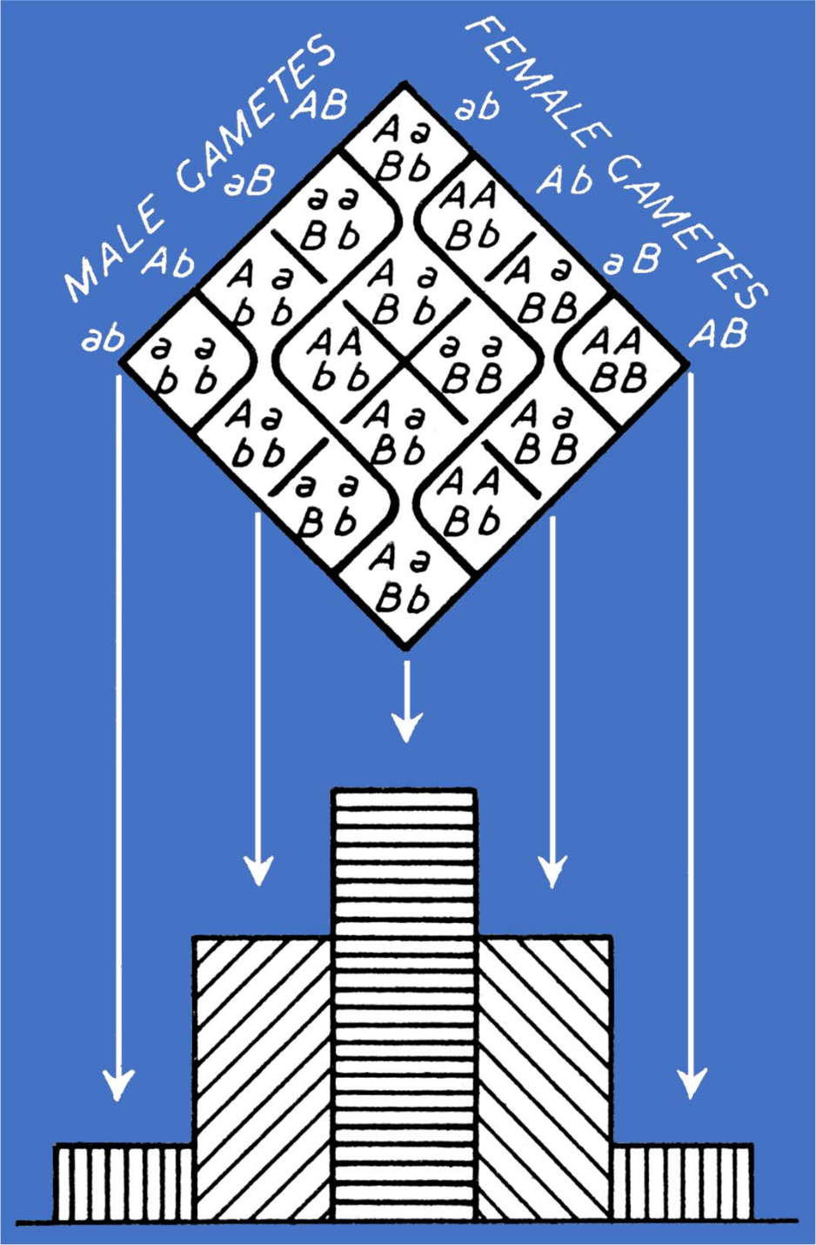
Punnett square
Two genes A and B. Parents are both heterozygotes (AaBb).
Their offspring may have different genotypes.
K Mather, Biometrical Genetics, Dover Publ, 1949

Slide 35
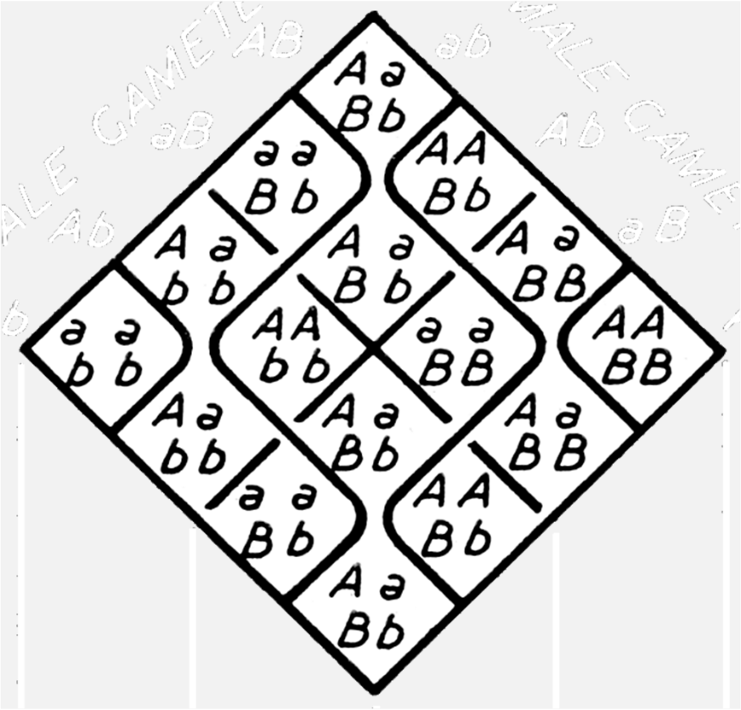
In the population traits of e.g. ab/ab individuals differ from the phenotypes of AB/AB individuals.
Do we see the same differences if these two individuals are siblings?
I.e., is variation within families equal to variation between families?
If yes: “true” genetic association If no: ? (confounding)

Slide 36
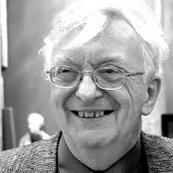
Lindon Eaves
(e.g. Inferring the Causes of Human Variation, 1977)
The genetic and environmental variation is partitioned into within and between family components.
G1=within ‐ family genetic component G2=between ‐ family genetic component E1=within‐family environment (“E”) E2=between‐family environment (“C”)
In the absence of GE interaction or GE correlation total variance is partitioned into: σ²t = σ²w + σ²b, and familial resemblance is: ICC = σ²b / (σ²w + σ²b)

Slide 37
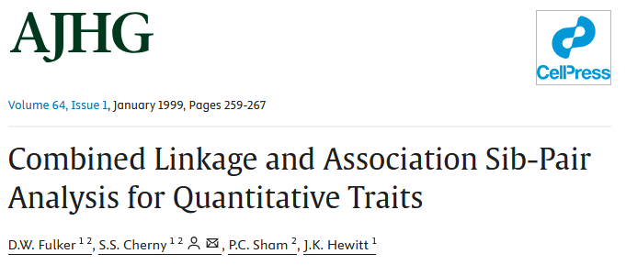
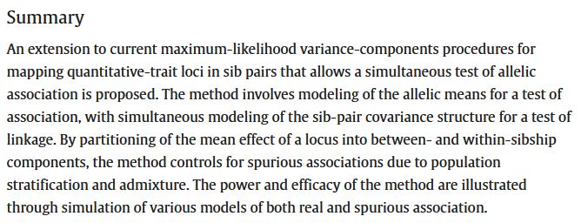

Slide 38
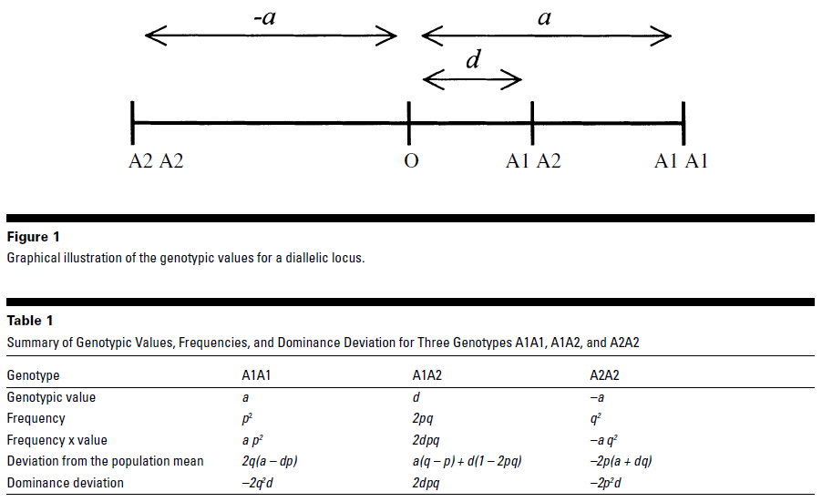

Slide 39
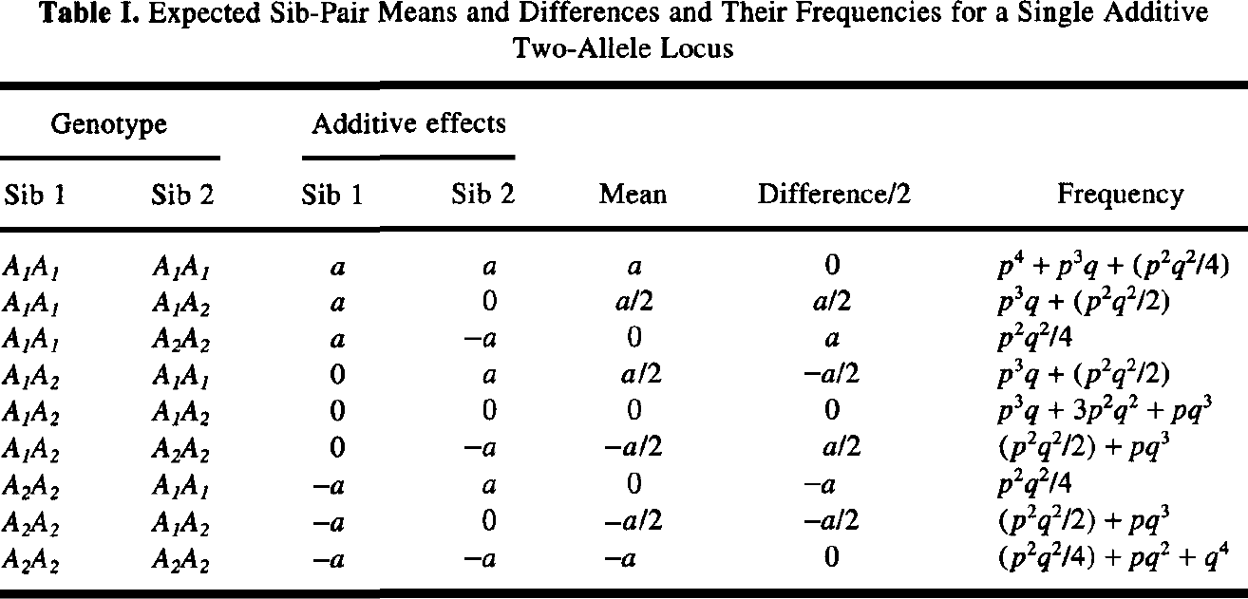

Slide 40
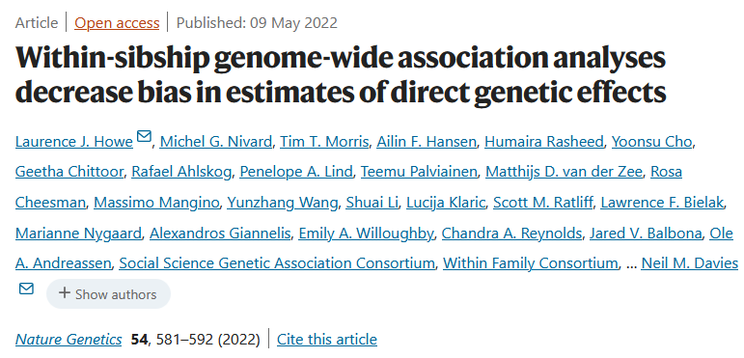
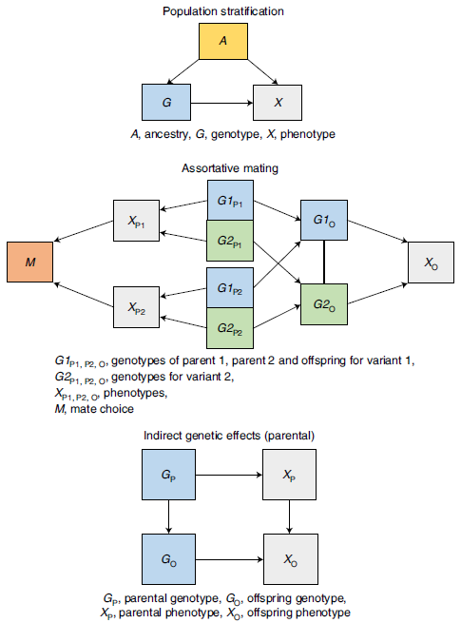
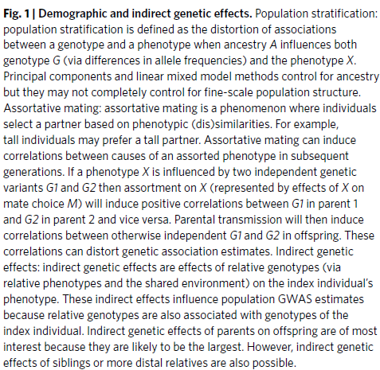

Slide 41
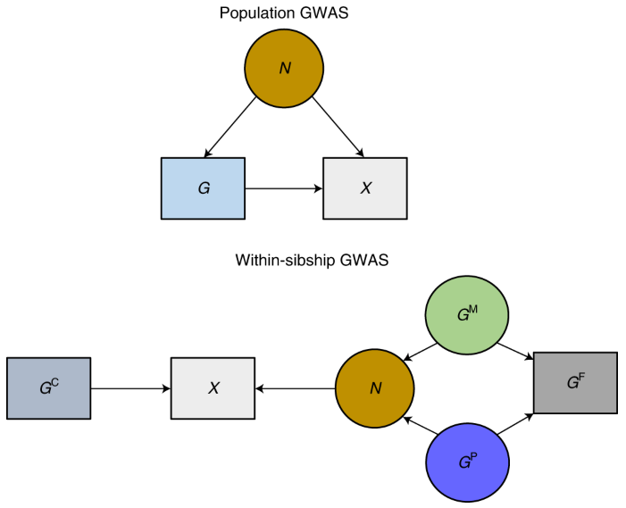
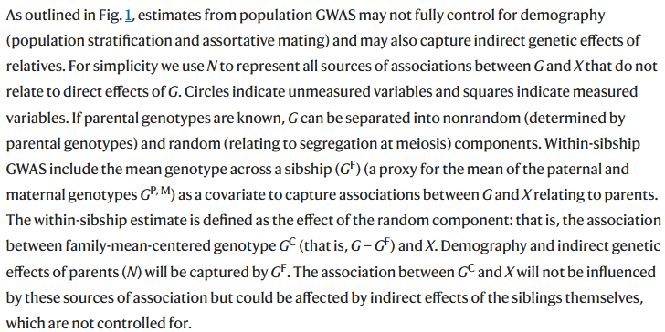

Slide 42
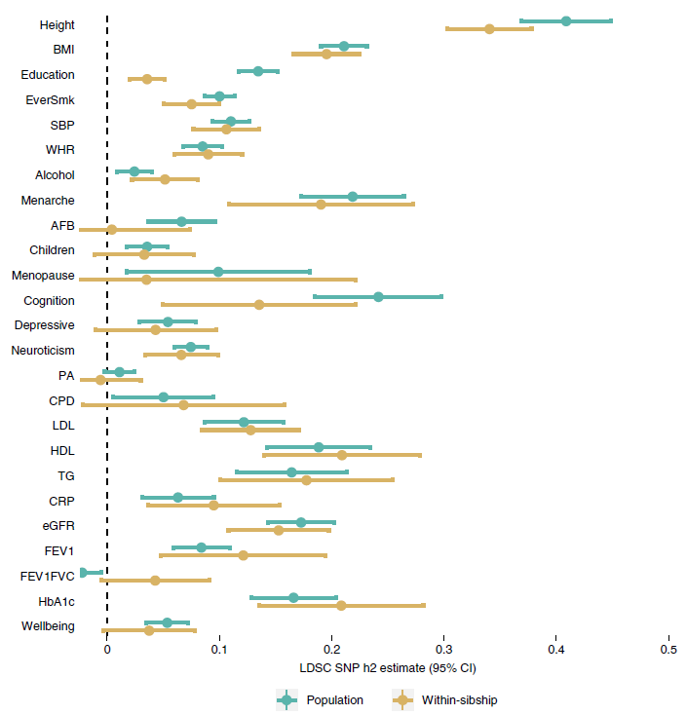

Slide 43
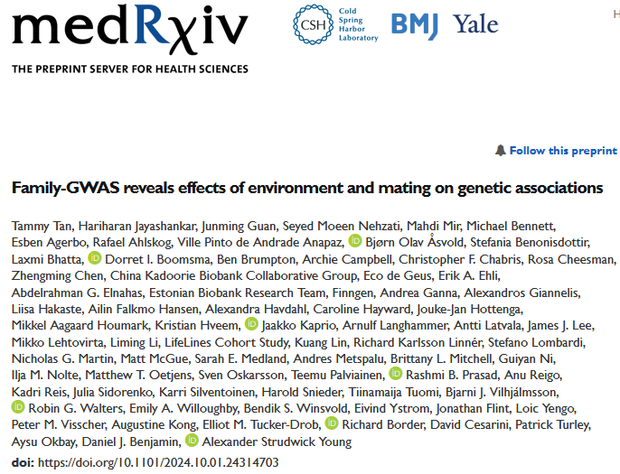
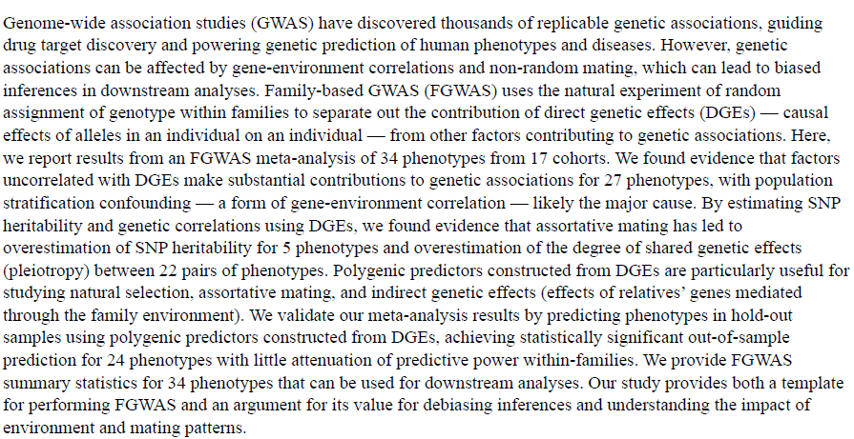

Slide 44
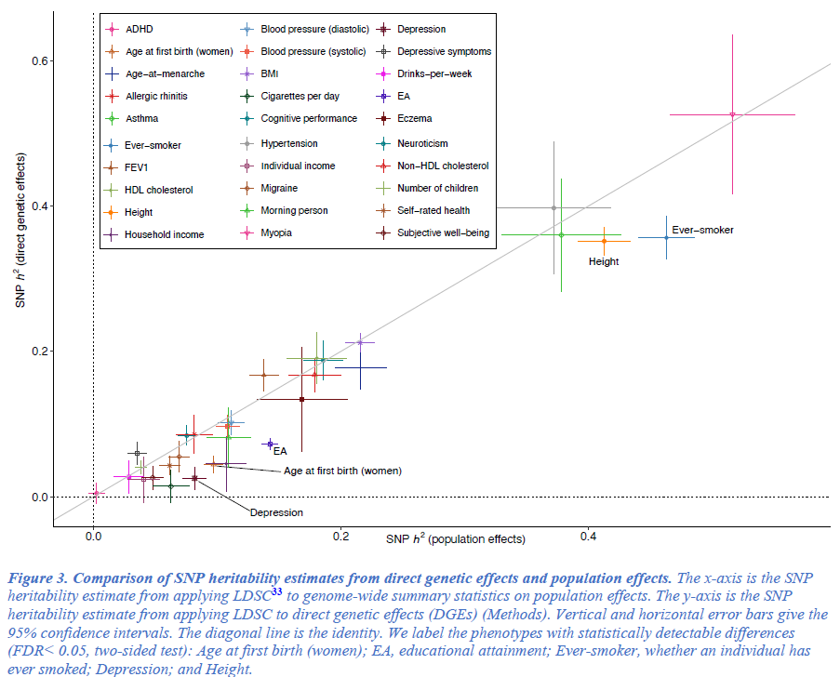

Slide 45
Why do it?
McCarthy et al. Nat Rev Genet (2008)

Slide 46
George Box
“Remember that all models are wrong; the practical question is how wrong do they have to be to not be useful.”
Box, G.E.P. and Draper, N.R. (1987) Empirical model-building and response surfaces. New York: Wiley. p424

Slide 47

Questions?

