Slide 1
Where to get data?

Slide 2
Options
Collect your own
Biobank data
Other raw data sources
Places to get sumstats

Slide 3
Collect your own data
Recruit a large sample
From clinics
From the public
www.aaastudy.org.au

Slide 4
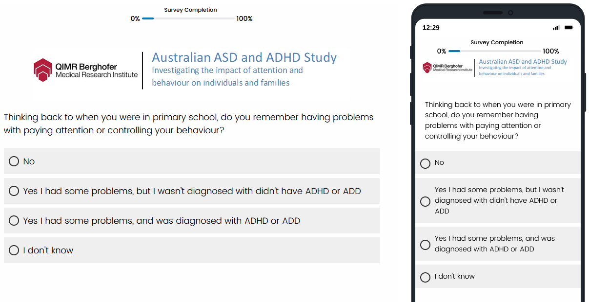
Collect your own data
2. Collect information from the participants

Slide 5
Collect your own data
3. Collect a DNA sample

Slide 6
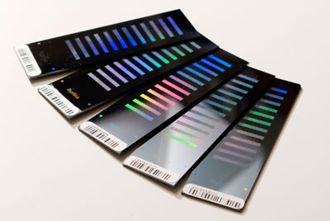
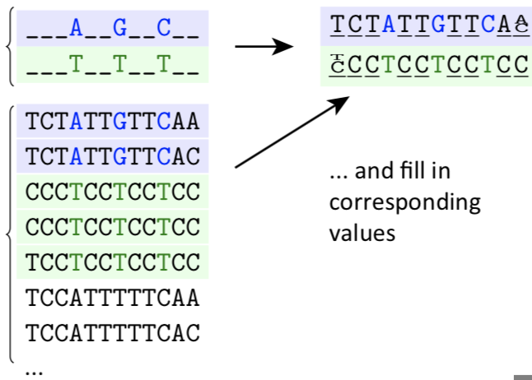
Collect your own data
4. Genotype the samples

Slide 7
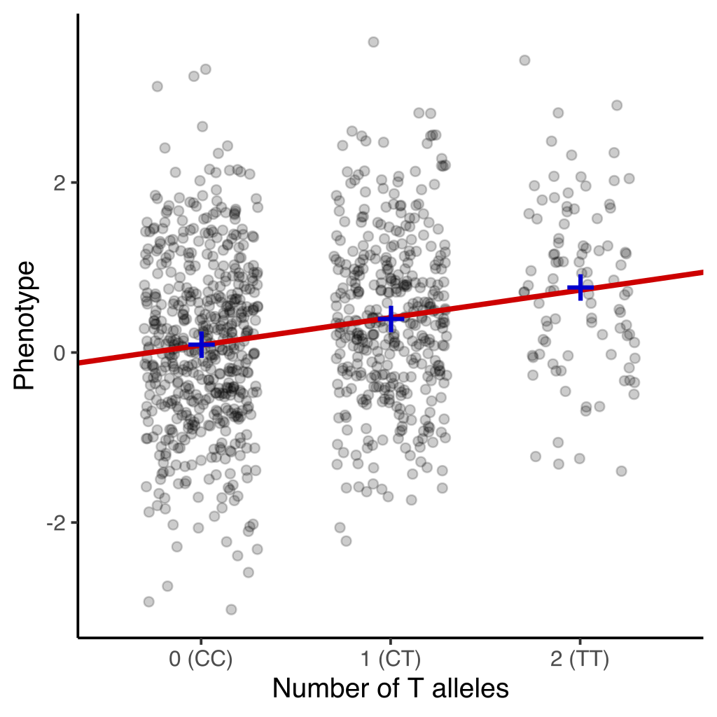
Collect your own data
5. Look for genetic variants that can predict trait (regression)

Slide 8
‘Open’ Biobanks
Until recently you could apply to download the phenotypes and genotypes
From now on you need to use the Research Analysis Platform (UKB-RAP)

Slide 9
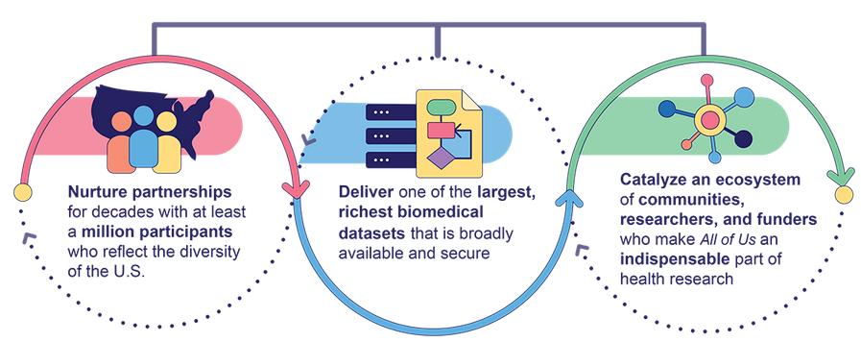
‘Open’ Biobanks
Access via RAP
Obtaining an account can be difficult if you are not a US person
No access/approval costs
Running costs $$$

Slide 10
Working on a RAP
RAP costs $$$$
Remember to stop processes that are not needed
Deleting data not needed
Timing can be difficult to work out
Share code and knowledge to help others
Downloading data/results files may require approval
ALLofUS – approval to download sumstats took about 2 days

Slide 11
Smaller biobanks
Health and Retirement Study – https://hrs.isr.umich.edu/about
Nurses health study - https://nurseshealthstudy.org/
ROSMAP - https://dss.niagads.org/cohorts/religious-orders-study-memory-and-aging-project-rosmap/
ALSPAC – https://www.bristol.ac.uk/alspac/

Slide 12
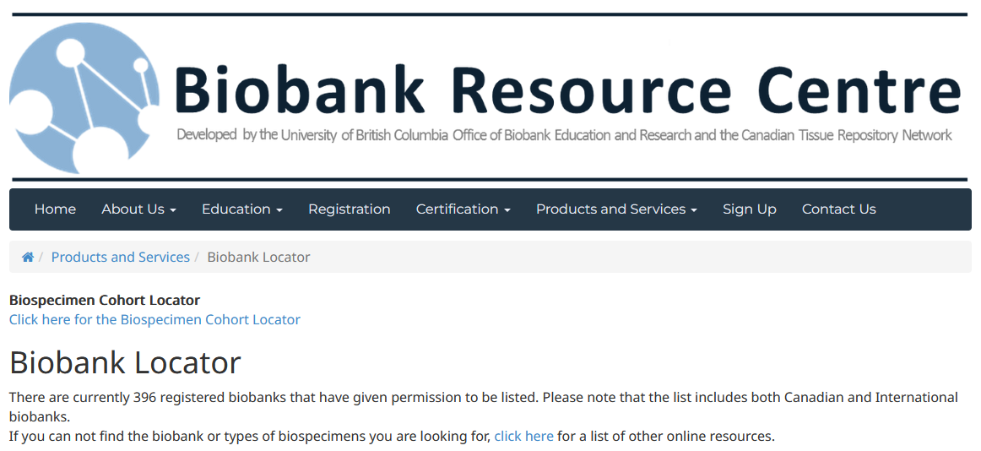
‘Closed’ Biobanks
Access via collaboration - often via a data-buddy system
23andMe
Million Veterans Study
BioVU
MOBA
Kadoorie Biobank
etc...

Slide 13
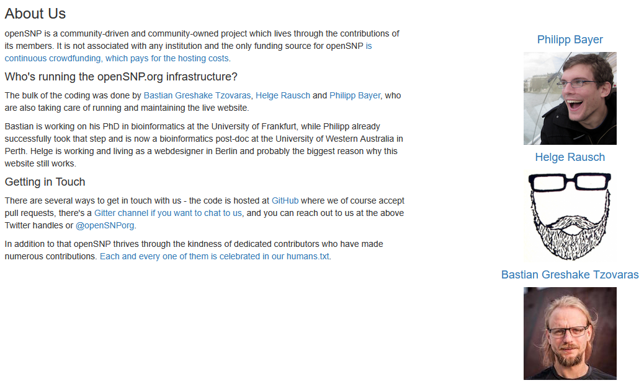
Other sources of raw (real) data

Slide 14
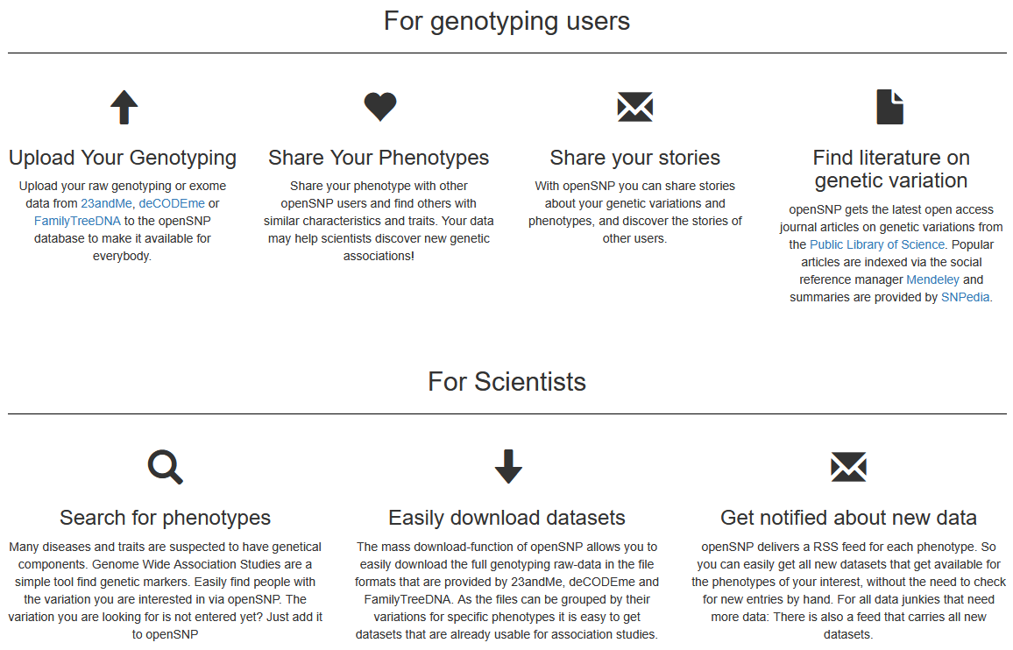
Open SNP

Slide 15
Places to get sumstats
All of US phenotypes (run by the Broad) -
you need a RAP account to be able to access
UK Biobank phenotypes (run by the Broad) - https://pan.ukbb.broadinstitute.org/downloads
FinGen - https://www.finngen.fi/en/access_results https://mvp-ukbb.finngen.fi/
Million Veterans - https://www.mvp.va.gov/pwa/discover-mvp-data

Slide 16
Places to get sumstats
PGC - https://pgc.unc.edu/for-researchers/download-results/
GIANT - https://portals.broadinstitute.org/collaboration/giant/index.php/GIANT_consortium_data_files
ENIGMA - https://enigma.ini.usc.edu/research/download-enigma-gwas-results/
GWAS Catalogue - https://www.ebi.ac.uk/gwas/ (patchy)
SSGAC - https://thessgac.com/ (requires account)
Authors of papers

Slide 17
Questions, comments, concerns…

