Slide 1

Principal Component Analyses of Genetic Data
Loic Yengo, PhD
Institute for Molecular Bioscience
The University of Queensland
l.yengo@imb.uq.edu.au

Slide 2
Outline
What is PCA?
What do we get when applying PCA to genetic data?
Using PCA to correct confounding in association studies
Practical considerations about PCA
More on PCA…

Slide 3
What is PCA?
Origin: Karl Pearson (1901)
Harold Hotelling (1930)

Slide 4
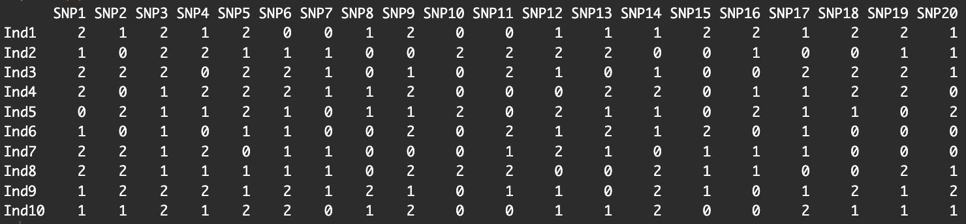
Intuition 1: Visualization
How do we visualize this data?
Yes! We need to summarize the data somehow to fit into 2D or 3D space?
So, how?
PCA solution: “Combine the data linearly to maximize the separation between data points.”

Slide 5




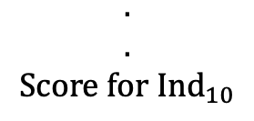

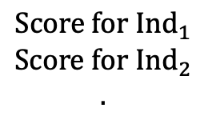





Intuition 1: Visualization
What does linearly mean?
If your data point is a “row” (here an individual)
$$\begin{matrix}Score for {Ind}_{1} \\ Score for {Ind}_{2} \\ .\end{matrix}$$
$$=Xw$$
$$w_{1}×$$
$$+$$
$$w_{2}×$$
$$+…+$$
$$w_{20}×$$
$$=$$
Each score is a linear combination of SNPs
$$\begin{matrix}. \\ . \\ Score for {Ind}_{10}\end{matrix}$$

Slide 6
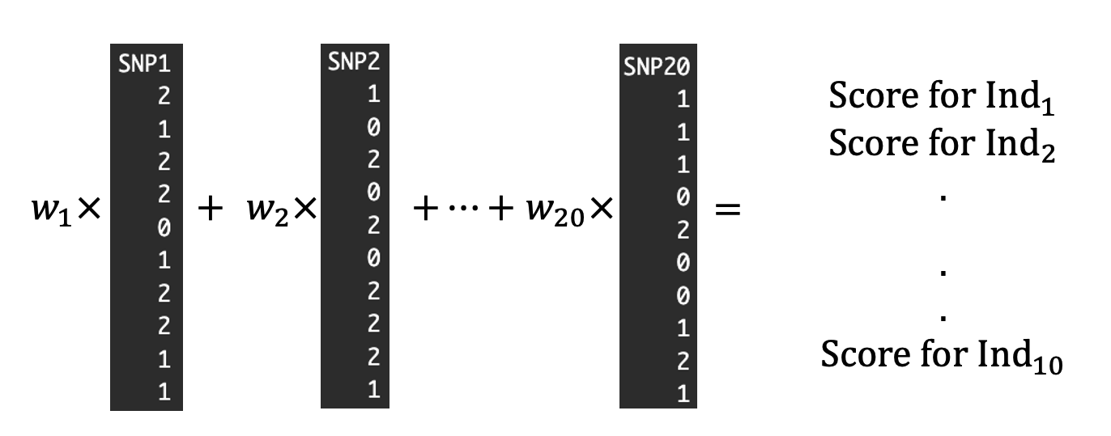
Intuition 1: Visualization
What does “maximize the separation” mean?
Choose the weights ($w_{1}$, $w_{2}$,…, $w_{20}$) such that the variance of the “score” is maximal.

Slide 7
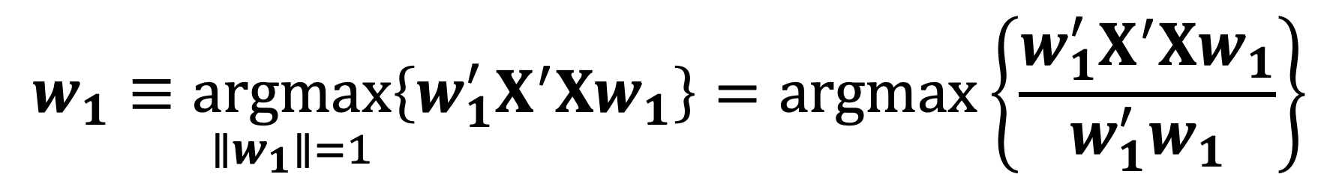
Formally!
PCA solution: “Combine the data linearly to maximize the separation between data points.”
$$w_{1}≡\underset{∥w_{1}∥=1}{argmax}\left\{w_{1}^{′}X^{′}Xw_{1}\right\}=\operatorname{argmax}\left\{\frac{w_{1}^{′}X^{′}Xw_{1}}{w_{1}^{′}w_{1}}\right\}$$
Definition: The weights $w$ are called principal components (PC) loadings.
Note: PC1 is “uniquely” defined except for the sign.

Slide 8
Intuition 2: Dimension Reduction
Is that enough to represent (summarize) the data?
PCA solution: “Repeat the process and look for orthogonal scores.”

Slide 9
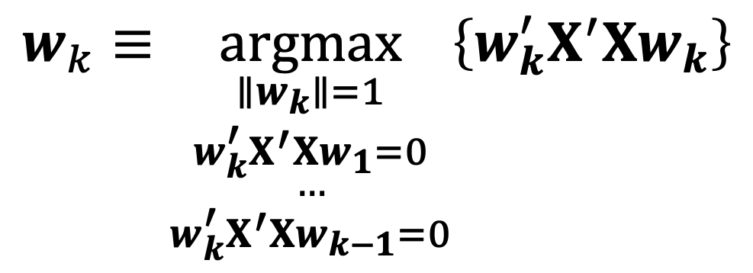
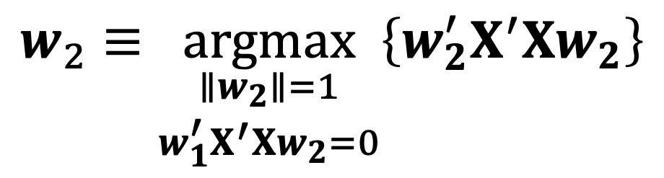
Formally!
PCA solution: “Repeat the process and look for orthogonal scores.”
$$w_{2}≡\underset{\begin{aligned}∥w_{2}∥=1 \\ w_{1}^{′}X^{′}Xw_{2}=0\end{aligned}}{argmax}\left\{w_{2}^{′}X^{′}Xw_{2}\right\}$$
$$w_{k}≡\underset{\begin{aligned}∥w_{k}∥=1 \\ w_{k}^{′}{X^{′}Xw}_{1}=0 \\ … \\ w_{k}^{′}{X^{′}Xw}_{k−1}=0\end{aligned}}{argmax}\left\{w_{k}^{′}X^{′}Xw_{k}\right\}$$

Slide 10
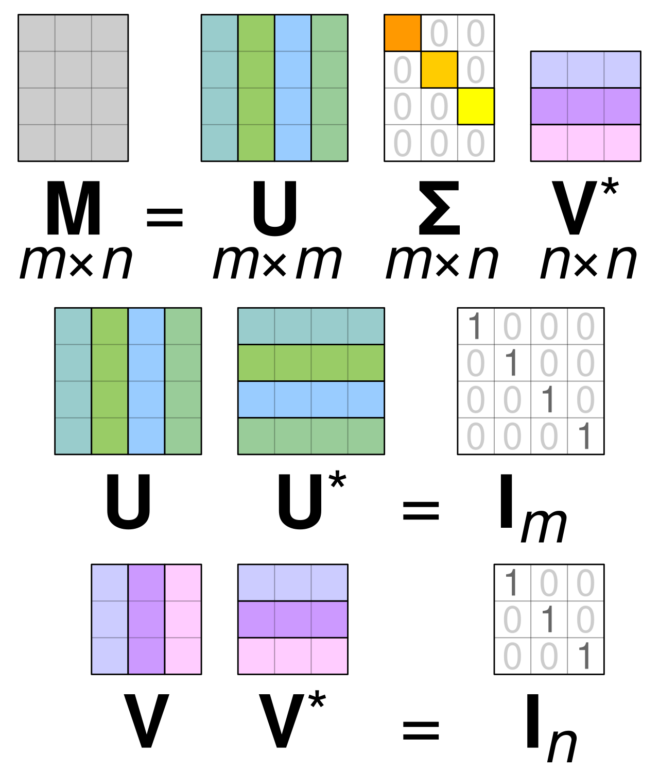

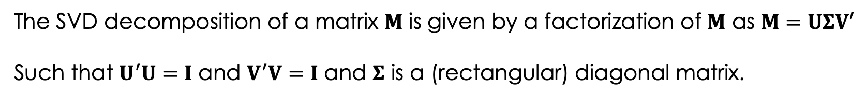
PCA and Singular Vector Decomposition
The SVD decomposition of a matrix $M$ is given by a factorization of $M$ as $M=UΣV′$
Such that $U^{′}U=I$ and $V^{′}V=I$ and $Σ$ is a (rectangular) diagonal matrix.
The columns of $U$ are called eigenvectors and are proportional to principal components of $M$.
Image from Wikipedia

Slide 11

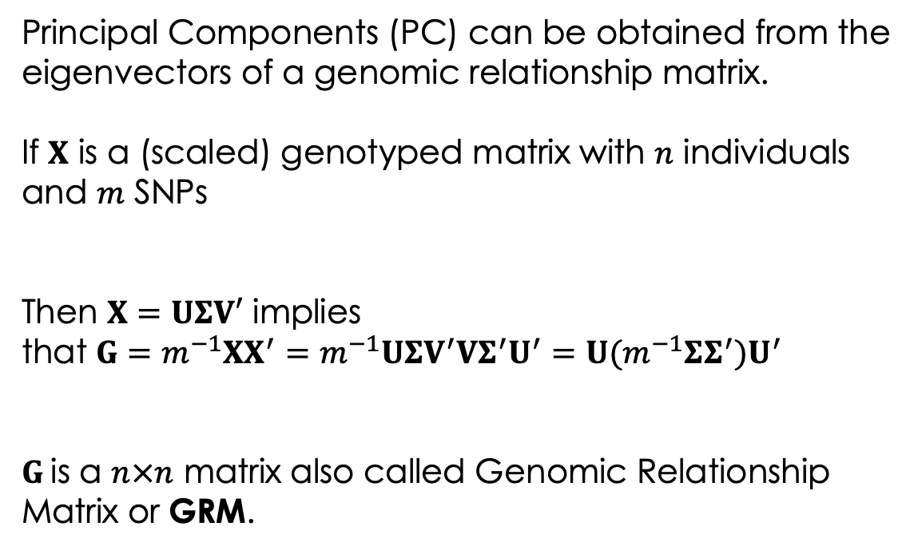
PCA and Genomic Relatedness
Principal Components (PC) can be obtained from the eigenvectors of a genomic relationship matrix.
If $X$ is a (scaled) genotyped matrix with $n$ individuals and $m$ SNPs
Then $X=UΣV′$ implies
that $G=m^{−1}XX^{′}=m^{−1}UΣV^{′}VΣ^{′}U^{′}=U(m^{−1}ΣΣ^{′}{)U}^{′}$
$G$is a $n×n$ matrix also called Genomic Relationship Matrix or GRM.

Slide 12
Summary
PCA is a statistical technique to visualize and reduce the dimension of data by summarizing the information as linear combinations of data points.
Those linear combinations (scores) are called Principal Components (PCs) and the weights PC loadings.
PCA has tight links with concepts such SVD decomposition of genomic relationship matrices (GRM).

Slide 13
What do we get when we apply PCA to genetic data?

Slide 14
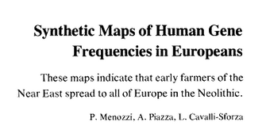
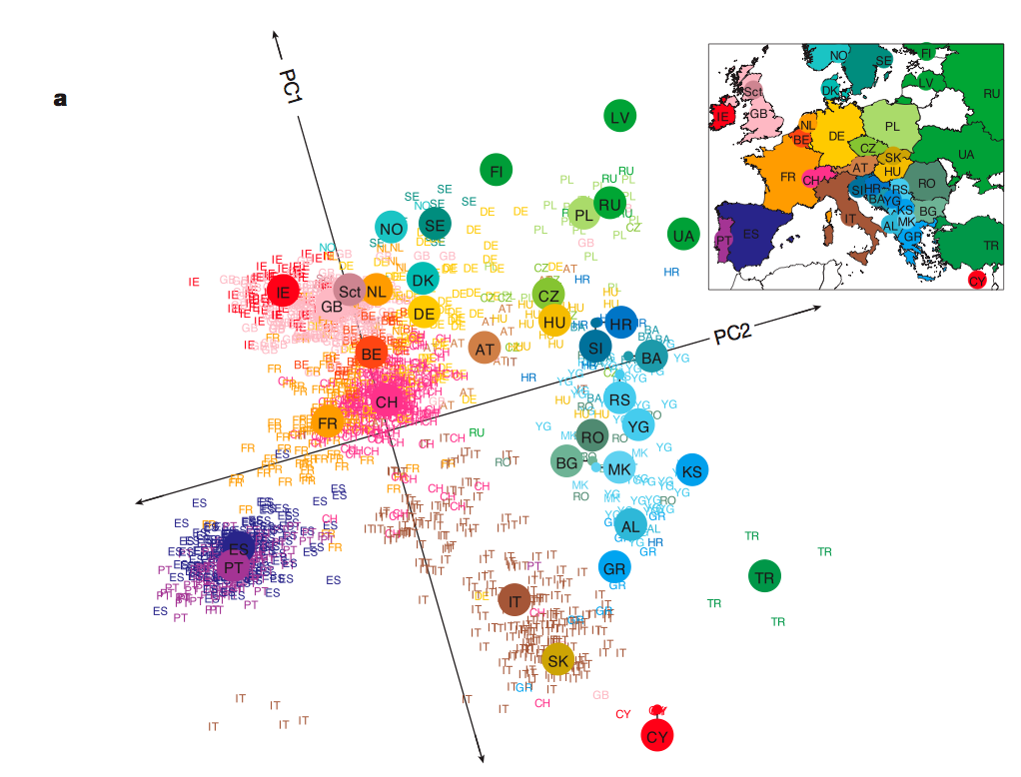
PCA detects genetic structures between (sub)populations
Ancestral population
p₀
p₁
p₂
p_{K}
Time
(drift)
Menozzi & Cavalli-Sforza. Science (1978)
[10 markers]
Derived
population 1
Derived
population 2
Derived
population K
Novembre et al. Nature (2008)
[200K SNPs]
Notes:
PCA applied to genetic data reveals the existence of population structures.
Just a reminded, population structure is defined by the existence of sub-groups in the sample/population who differ in allele or genotype frequencies.
The idea of using PCA for detecting structure in genetic data is quite old. One of the first (if not the first) use was in the paper by Menozzi and Cavalli-Sforza who use only about 10 genetic markers to detect structures present within Europe and suggested at the time that PCA could reflect geographical clustering. Another notable application was by Novembre et al. (2008) who showed that PCA recapitulate North-South and East-West gradients in Europe.

Slide 15
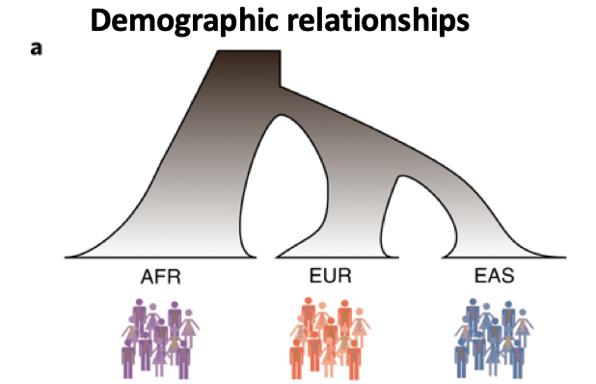

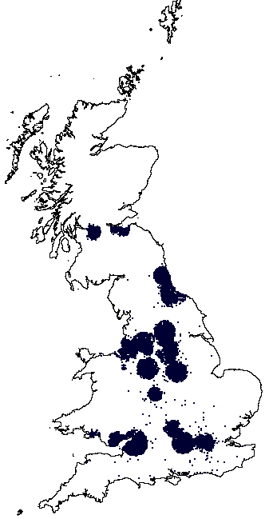
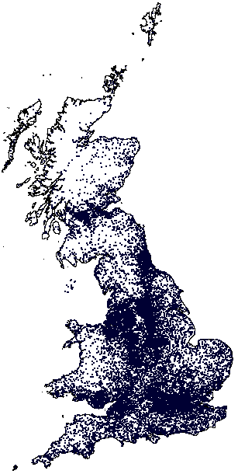
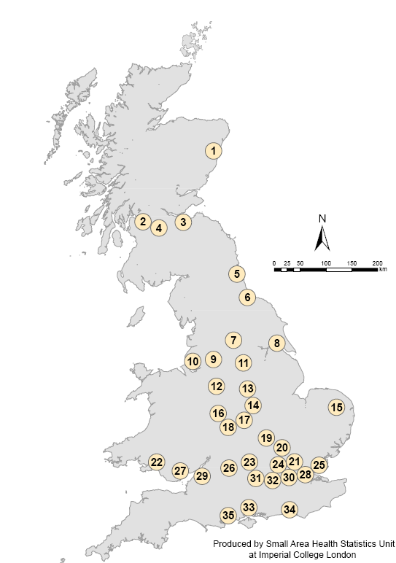

Genetic structures have different sources
Martin et. al., Nat. Genet (2019)
Assessment centers
Current living address
Partner’s Choice
Place of birth
Migrations
Notes:
Old structures
Recent structures
Future structures

Slide 16
Interpretating PCs can be challenging…
What is the “evolutionary force” causing the structure that I observe?
Answering this question is entire field of research, which expands beyond PCA
  What structures are detectable using PCA
  How to detect structures when PCA does not work

Slide 17
Interpretating PCs can be challenging…
PCA informs about population structures at different times, depending on allele frequency (rare variant => more recent history)
Rare variant stratification (i.e., more recent history) can be missed
The type structure detected depends on the set of variants used as input!
Notes:
First, a model where the structure extends infinitely far back in time (perpetual structure
model; e.g. Mathieson and McVean, 2012) and second, a model where the structure originated
100 generations ago (recent structure model). This second model is motivated by the observation
from ancient DNA that Britain experienced an almost complete population replacement within the
last 4,500 years (Olalde et al., 2018), providing an upper bound for the establishment of present-
day geographic structure in Britain.
When structure is recent, it is driven largely by rare variants which tend to have a more recent origin
(Gravel et al., 2011; Fu et al., 2013; O’Connor et al., 2015) and are therefore less likely to be
shared among demes. Common variants, because they are older and usually predate the onset of
structure in our model, are more likely to be shared among demes and have not drifted enough in
100 generations to capture the spatial structure effectively.

Slide 18
Summary
PCA detects genetic structures in a sample of genomes.
PCA is agnostic to the structure detected, which makes interpretation challenging.
The type of structure depends on the set of variants used as input.

Slide 19
Using PCA to correct confounding in association analyses?

Slide 20
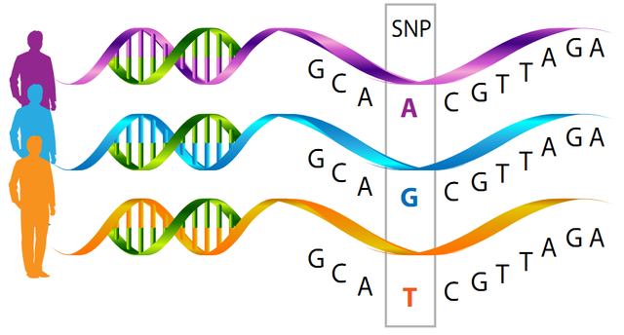
Genome-wide association studies
Association = allele frequency differences between cases and controls
Allele A
Allele G
Allele T
More alleles T in Cases
Less alleles T in Controls
Large sample sizes are required…

Slide 21

Population stratification: chopstick example
Sample 1 Americans: χ²=0, p=1
 | Use of chopsticks
 | Yes | No | Total
Allele 1 | 320 | 320 | 640
Allele 2 | 80 | 80 | 160
Total | 400 | 400 | 800
Sample 2 Chinese: χ²=0, p=1
 | Use of chopsticks
 | Yes | No | Total
Allele 1 | 320 | 20 | 340
Allele 2 | 320 | 20 | 340
Total | 640 | 40 | 680

Slide 22
Population stratification: chopstick example
Sample 1 Americans: χ²=0, p=1
 | Use of chopsticks
 | Yes | No | Total
Allele 1 | 320 | 320 | 640
Allele 2 | 80 | 80 | 160
Total | 400 | 400 | 800
Sample 2 Chinese: χ²=0, p=1
 | Use of chopsticks
 | Yes | No | Total
Allele 1 | 320 | 20 | 340
Allele 2 | 320 | 20 | 340
Total | 640 | 40 | 680
There is a clear difference between Americans and Chinese in proportion of “cases” and “controls”

Slide 23
Population stratification: chopstick example
Sample 1 Americans: χ²=0, p=1
 | Use of chopsticks
 | Yes | No | Total
Allele 1 | 320 | 320 | 640
Allele 2 | 80 | 80 | 160
Total | 400 | 400 | 800
Sample 2 Chinese: χ²=0, p=1
 | Use of chopsticks
 | Yes | No | Total
Allele 1 | 320 | 20 | 340
Allele 2 | 320 | 20 | 340
Total | 640 | 40 | 680
There is a clear allele frequency difference between Americans and Chinese

Slide 24
Population stratification: chopstick example
Sample 1 Americans: χ²=0, p=1
 | Use of chopsticks
 | Yes | No | Total
Allele 1 | 320 | 320 | 640
Allele 2 | 80 | 80 | 160
Total | 400 | 400 | 800
Sample 2 Chinese: χ²=0, p=1
 | Use of chopsticks
 | Yes | No | Total
Allele 1 | 320 | 20 | 340
Allele 2 | 320 | 20 | 340
Total | 640 | 40 | 680

Slide 25
Population stratification: chopstick example
Sample 1 Americans: χ²=0, p=1
 | Use of chopsticks
 | Yes | No | Total
Allele 1 | 320 | 320 | 640
Allele 2 | 80 | 80 | 160
Total | 400 | 400 | 800
Sample 2 Chinese: χ²=0, p=1
 | Use of chopsticks
 | Yes | No | Total
Allele 1 | 320 | 20 | 340
Allele 2 | 320 | 20 | 340
Total | 640 | 40 | 680
Sample 1 + 2 = Americans + Chinese: χ²=34.2, p=4.9 × 10⁻⁹
 | Use of chopsticks
 | Yes | No | Total
Allele 1 | 640 | 340 | 980
Allele 2 | 400 | 100 | 500
Total | 1040 | 440 | 1480

Slide 26

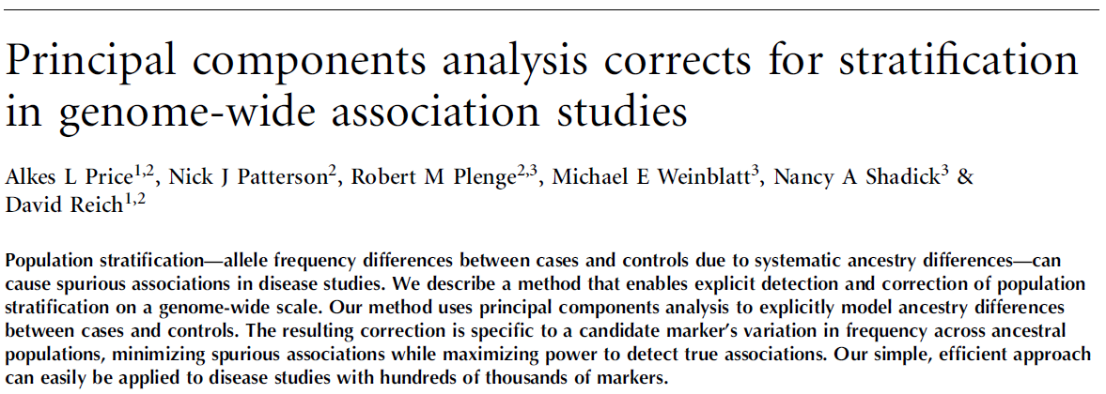
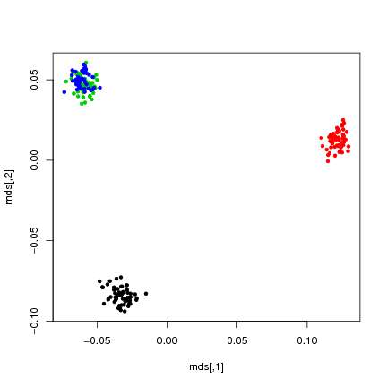
Price et. al., Nat. Genet (2006)
CEPH/European
Yoruba
Han Chinese
Japanese
Notes:
Highlight differences between structure and stratification…

Slide 27
Practical considerations about PCA?

Slide 28
Caveats
Allele frequency threshold
Impact of sample size
Impact of LD
Projected PCA analysis

Slide 29
Caveats
Allele frequency threshold
Impact of sample size
Impact of LD
Projected PCA analysis

Slide 30
Impact of allele frequencies
Match frequency spectrum between SNPs tested for association and those used in PCA

Slide 31
Caveats
Allele frequency threshold
Impact of sample size
Impact of LD
Projected PCA analysis

Slide 32
PCA performance depends on sample size
F_{ST} model: Balding-Nichols
E[p_{i}|p₀] = p₀
var[p_{i}|p₀] = F_{ST} p₀(1- p₀)
s = (1- F_{ST})/ F_{ST}
p_{i}~Beta[sp₀,s(1- p₀)]
p₀
Ancestral population
p₁
p₂
Derived population 1
Derived population 2

Slide 33
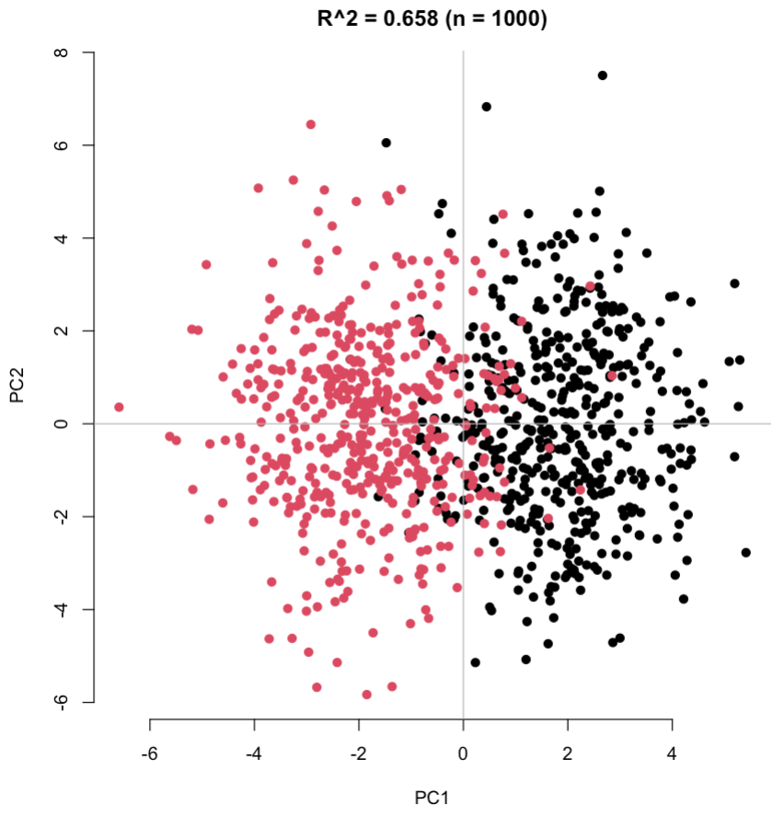
PCA performance depends on sample size
F_{ST} model: Balding-Nichols
p₀
Ancestral population
p₁
p₂
Derived population 1
Derived population 2

Slide 34
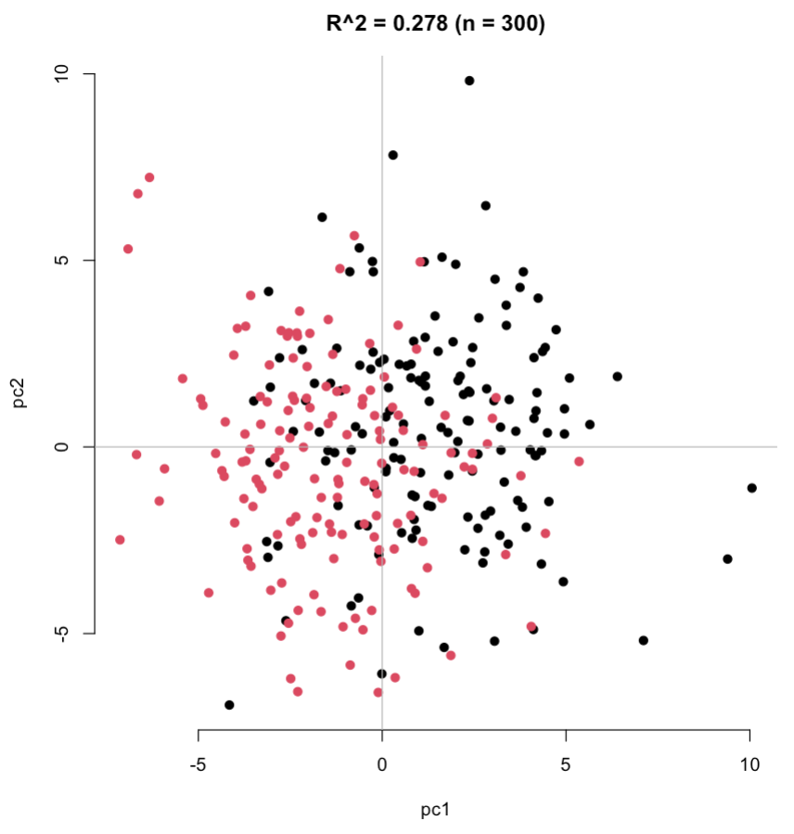
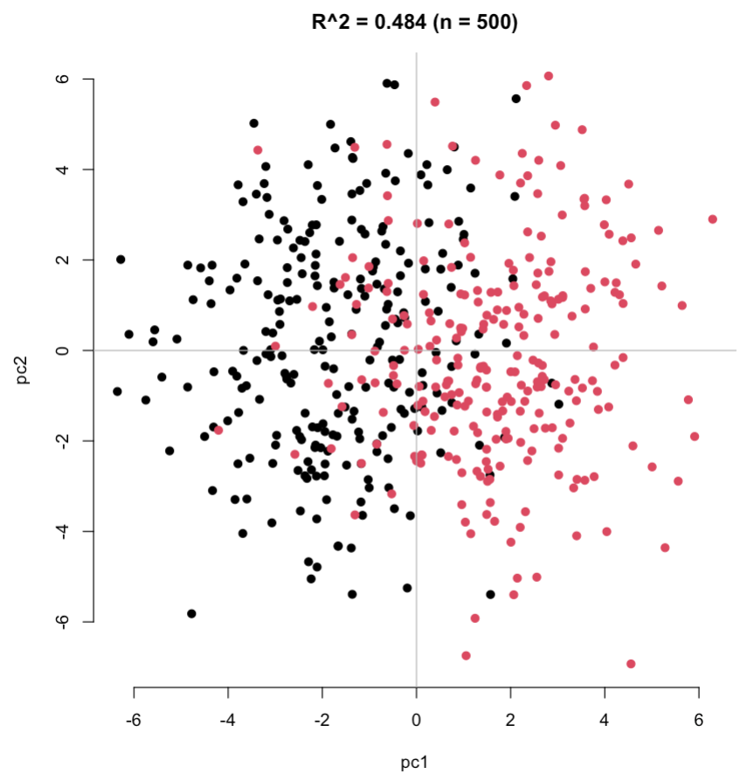
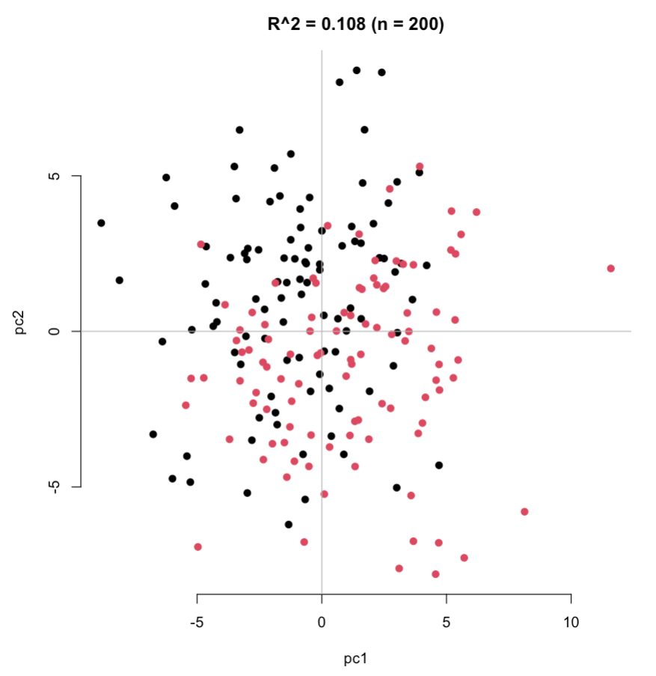
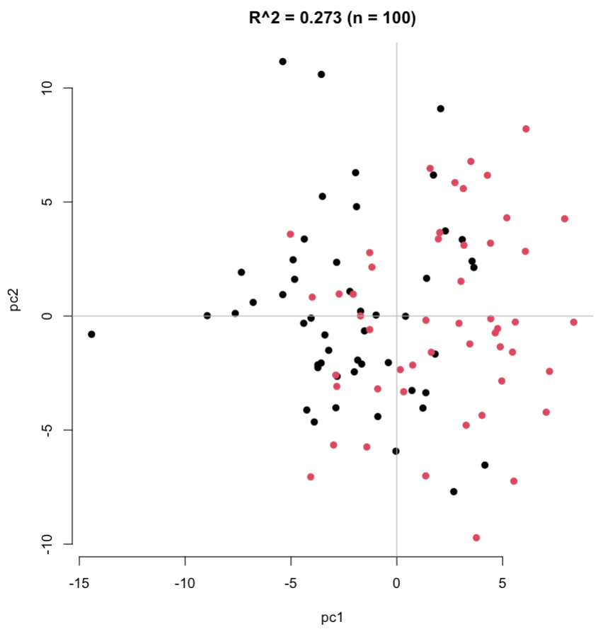
PCA performance depends on sample size

Slide 35
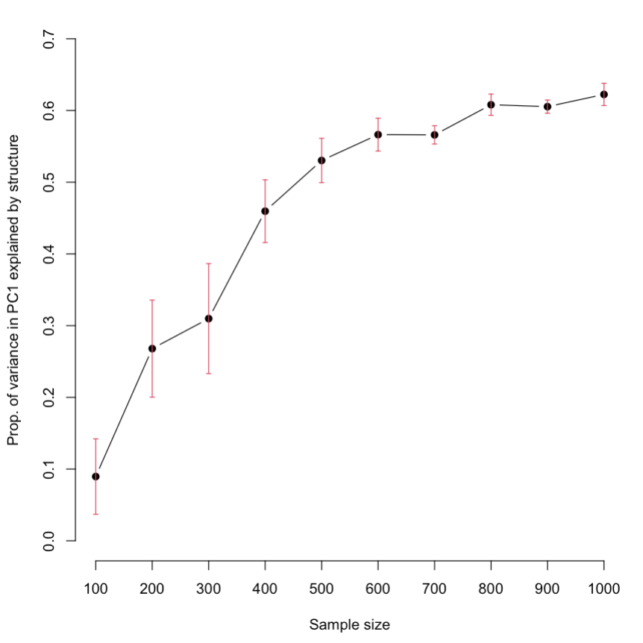
PCA performance depends on sample size
Implications
Structures are easier to detect in large samples
Adjustment for PC in small samples in sub-optimal

Slide 36
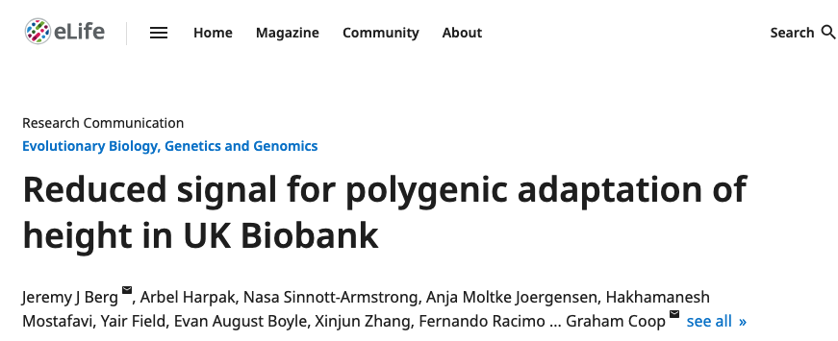
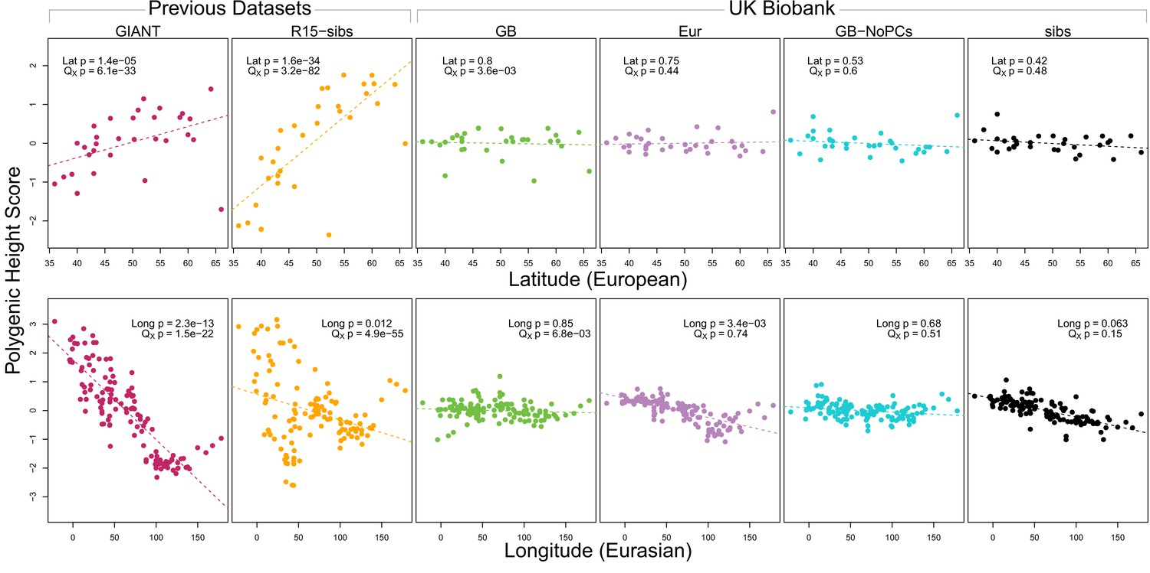
Residual stratification in GWAS meta-analyses

Slide 37
Caveats
Allele frequency threshold
Impact of sample size
Impact of LD
Projected PCA analysis

Slide 38
How much LD impacts PCA?
R DEMO

Slide 39
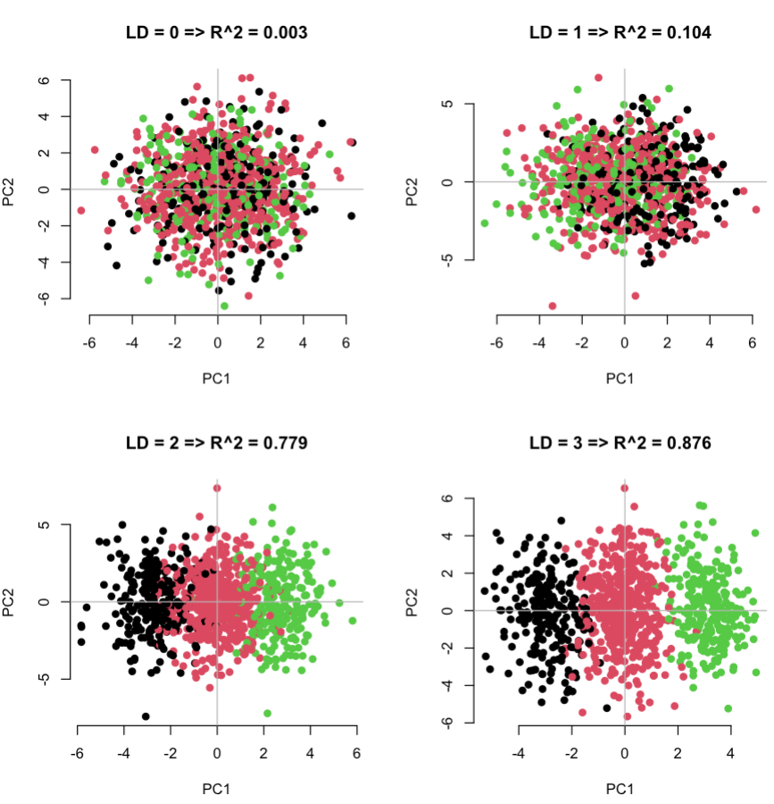
How much LD impacts PCA?
(1) PCA is skewed towards detecting structures within regions of the genome with high LD.
(2) Structures within these regions may not be relevant for your phenotype of interest.
(3) LD pruning reduces this bias and often improves the ability to correct for confounding.
(4) Remove long-range LD loci (MHC, large inversion, etc.) .

Slide 40
Caveats
Allele frequency threshold
Impact of sample size
Impact of LD
Projected PCA analysis

Slide 41
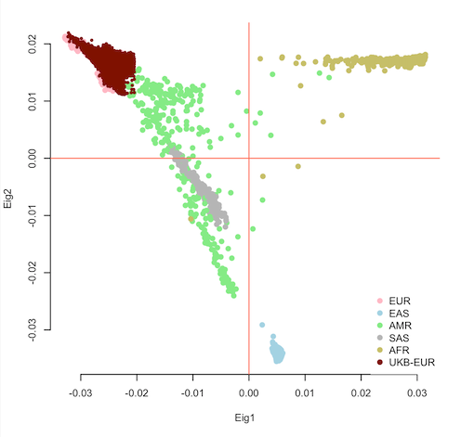
Projected PCA
Why?
Because you don’t have enough genetic diversity in your sample!
Or to reduce computation.
To reduce biases due to relatedness
Project?
PC are linear combinations. So, if you know the loadings then you can represent anyone on the PC map.
Sometimes it is better to “learn” the structures from a reference population then “project” your sample onto the resulting PC map.

Slide 42
More on PCA?

Slide 43


How many PCs should I use?
Well, it depends…
Now, if you use PCs in an association analysis then the answer is “all” (ala Linear Mixed Models)

Slide 44
Scaling PCA?
PCA can be a very computationally intensive. Solutions
Use subsets
Use random projection-based algorithms (PLINK) – good if N>5K

Slide 45
Many software tools available
EIGENSTRAT: from genotype only
PLINK: from genotype and GRM
GCTA: from GRM only
Or even R (if you can load the data; e.g., BigSNPr package)
Etc.

Slide 46
PCA checklist
Run and visualize a PCA of genetic data once my life
Use PCA to identify groups of individuals with similar ancestries
Use PCA to correct biases due to population stratification

