Slide 1

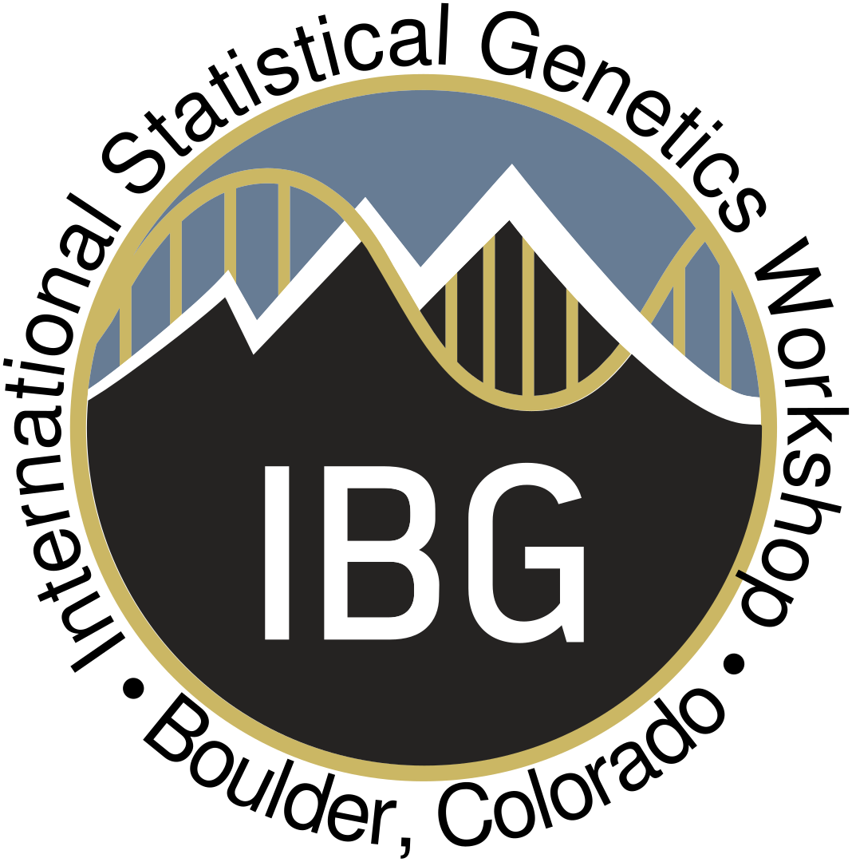
Introduction to Population Genetics Theory
Ask your questions here!
Loic Yengo, PhD
Institute for Molecular Bioscience
The University of Queensland
l.yengo@imb.uq.edu.au

Slide 2
Population Genetics Theory is concerned with characterizing and quantifying genetic variation within and between populations.
Notes:
Population Genetics Theory is concerned with characterizing and quantifying genetic variation within and between populations.
So, what is genetic variation and what is a population are the two questions we need to answer to better understand what this theory is about.

Slide 3
What is a Population?

Slide 4
“All inhabitants of particular place” – Oxford dictionary
[BIOLOGY] – “A community of animals, plants, or humans among whose members interbreeding occurs” – Oxford dictionary
“Any complete group with at least one characteristic in common” – Australian Bureau of Statistics
“All the inhabitants of a country, territory, or geographic area, total or for a given sex and/or age group, at a specific point of time. In demographic terms it is the total number of inhabitants of a given sex and/or age group that actually live within the border limits of the country, territory, or geographic area at a specific point of time, usually mid-year. The mid-year population refers to the actual population at July 1st.” – World Health Organization

Slide 5
“All inhabitants of particular place” – Oxford dictionary
[BIOLOGY] – “A community of animals, plants, or humans among whose members interbreeding occurs” – Oxford dictionary
“Any complete group with at least one characteristic in common” – Australian Bureau of Statistics
“All the inhabitants of a country, territory, or geographic area, total or for a given sex and/or age group, at a specific point of time. In demographic terms it is the total number of inhabitants of a given sex and/or age group that actually live within the border limits of the country, territory, or geographic area at a specific point of time, usually mid-year. The mid-year population refers to the actual population at July 1st.” – World Health Organization

Slide 6

Source: https://www.shutterstock.com/image-photo/water-splashwater-splash-isolated-on-backgroundwater-573666874?src=sv-vkrkfiyUnpA-vYq4Oog-1-16
A population is a concrete abstraction…
1. Population = Group of individuals
2. Who is inside or outside is arbitrary, i.e., depends on your research question
Are these drops from the same population?
Time
Space

Slide 7
What is Genetic Variation?

Slide 8
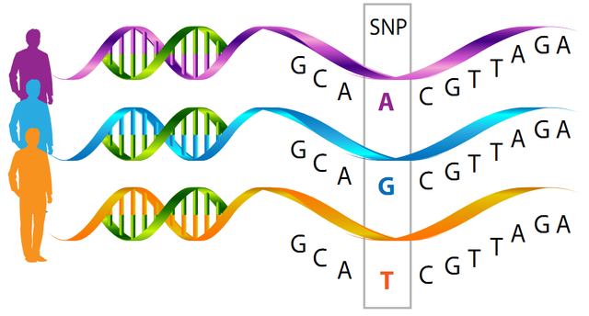
Genetic variation…
There is a near infinite number of ways to measure a distance between DNA sequences of two individuals
Number of repeats
Inversions
Deletions
Single letter (nucleotide) changes
…
Allele A
Allele G
Allele T
Single Nucleotide Polymorphisms

Slide 9
Definitions
Allele = possible state of the DNA sequence at a given locus.
Genotype = defined by the states of all alleles at the locus.
Examples: In a diploid individual. If there are three alleles A, G and T, then possible genotypes are AA, GG, TT (homozygote) and AG, AT, GT (heterozygote)
Allele A
Allele G
Allele T
Single Nucleotide Polymorphisms
Notes:
For the purpose of this lecture, we will mostly focus on SNPs in diploid individuals.

Slide 10
Population Genetics Theory is the theory of alleles and genotypes frequencies within and between groups of individuals.
Notes:
We can summarize what population genetics theory is about using this quote from Falconer’s

Slide 11
Outline
Hardy-Weinberg Equilibrium
What drives changes in allele/genotype frequencies?
How can you measure genetic distance between populations?
Linkage Disequilibrium
Learn more: https://www.colorado.edu/ibg/isg-workshop/isgw-online-resources/2-introduction-population-genetics

Slide 12
Hardy-Weinberg Equilibrium
G. H. Hardy (1877 – 1947)
W. Weinberg (1862 - 1937)

Slide 13
Relationship between alleles and genotypes frequencies
Let’s consider a population of N diploid individuals at a particular locus with two alleles 0 and 1.
We denote n₀₀, n₀₁ and n₁₁ the genotypes counts and n₀ and n₁ the allele counts in the population. So, n₀₀ + n₀₁ + n₁₁ = N.
We have the following relationships:
=> n₀ = 2n₀₀ + n₀₁ and n₁ = 2n₁₁ + n₀₁.
=> p₀ = n₀ /(2N) = (n₀₀ /N) + 0.5(n₀₁ /N) and p₁ = 1- p₀.
p₀ = p₀₀ + 0.5p₀₁ and p₁ = 1- p₀.
In general, we can not predict the genotype frequencies from the allele frequencies (under-determined).

Slide 14
If genotypes and alleles frequencies are constant from one generation to the next, then the population is said to be under Hardy-Weinberg Equilibrium.
Notes:
Population Genetics Theory is concerned with characterizing and quantifying genetic variation within and between populations.
So, what is genetic variation and what is a population are the two questions we need to answer to better understand what this theory is about.

Slide 15
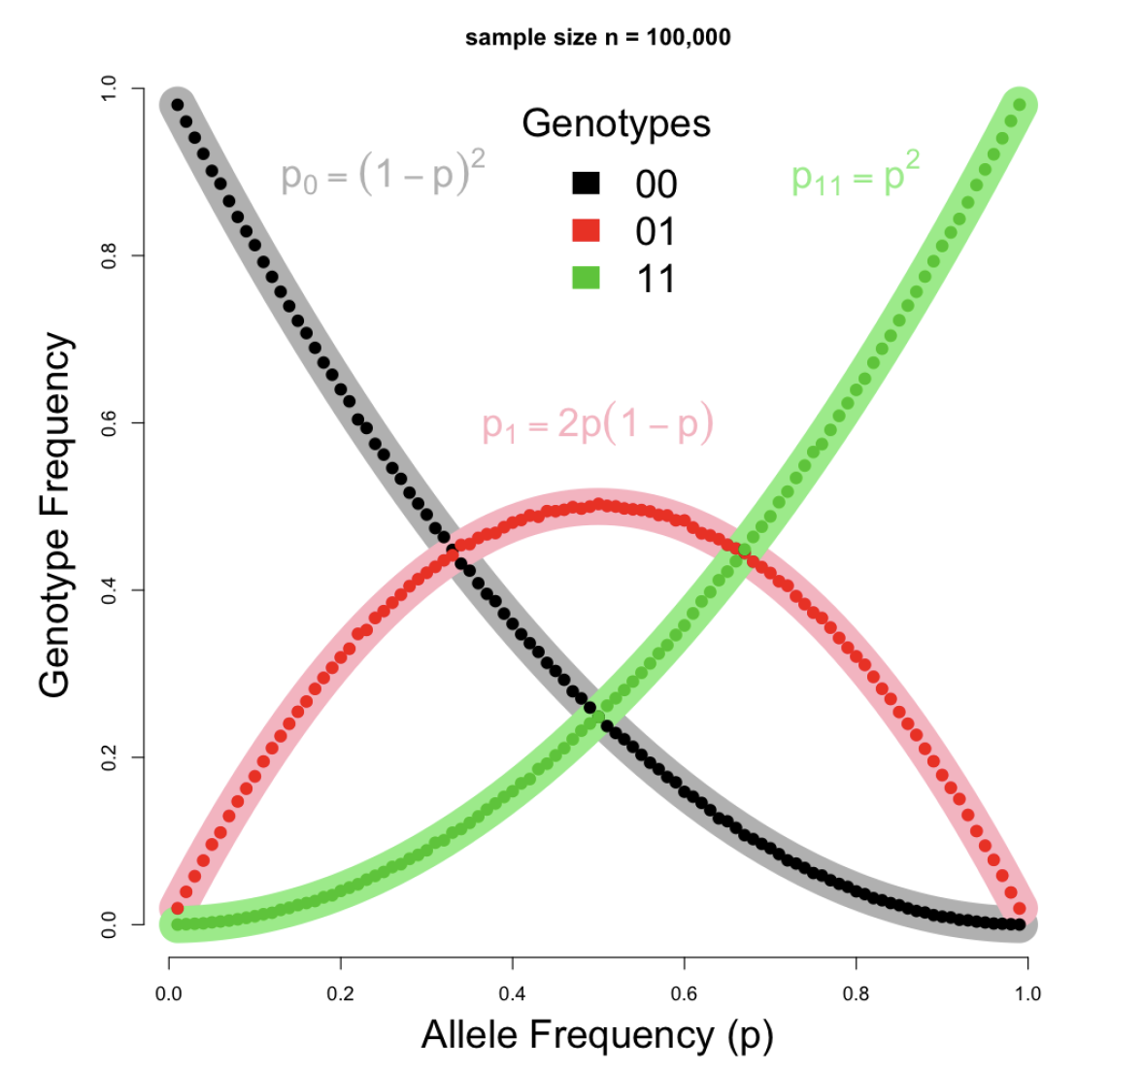
If genotypes and alleles frequencies are constant from one generation to the next, then the population is said to be under Hardy-Weinberg Equilibrium*.
*This is the diploid / autosomal version of the HWE.
Notes:
Population Genetics Theory is concerned with characterizing and quantifying genetic variation within and between populations.
So, what is genetic variation and what is a population are the two questions we need to answer to better understand what this theory is about.

Slide 16
Under which assumption(s) does HWE holds?
Constant allele frequency:
no migration,
no mutation,
no natural selection
Random mating (diploid individuals, sexual reproduction, allele frequencies are the same between sexes)
Large population size

Slide 17
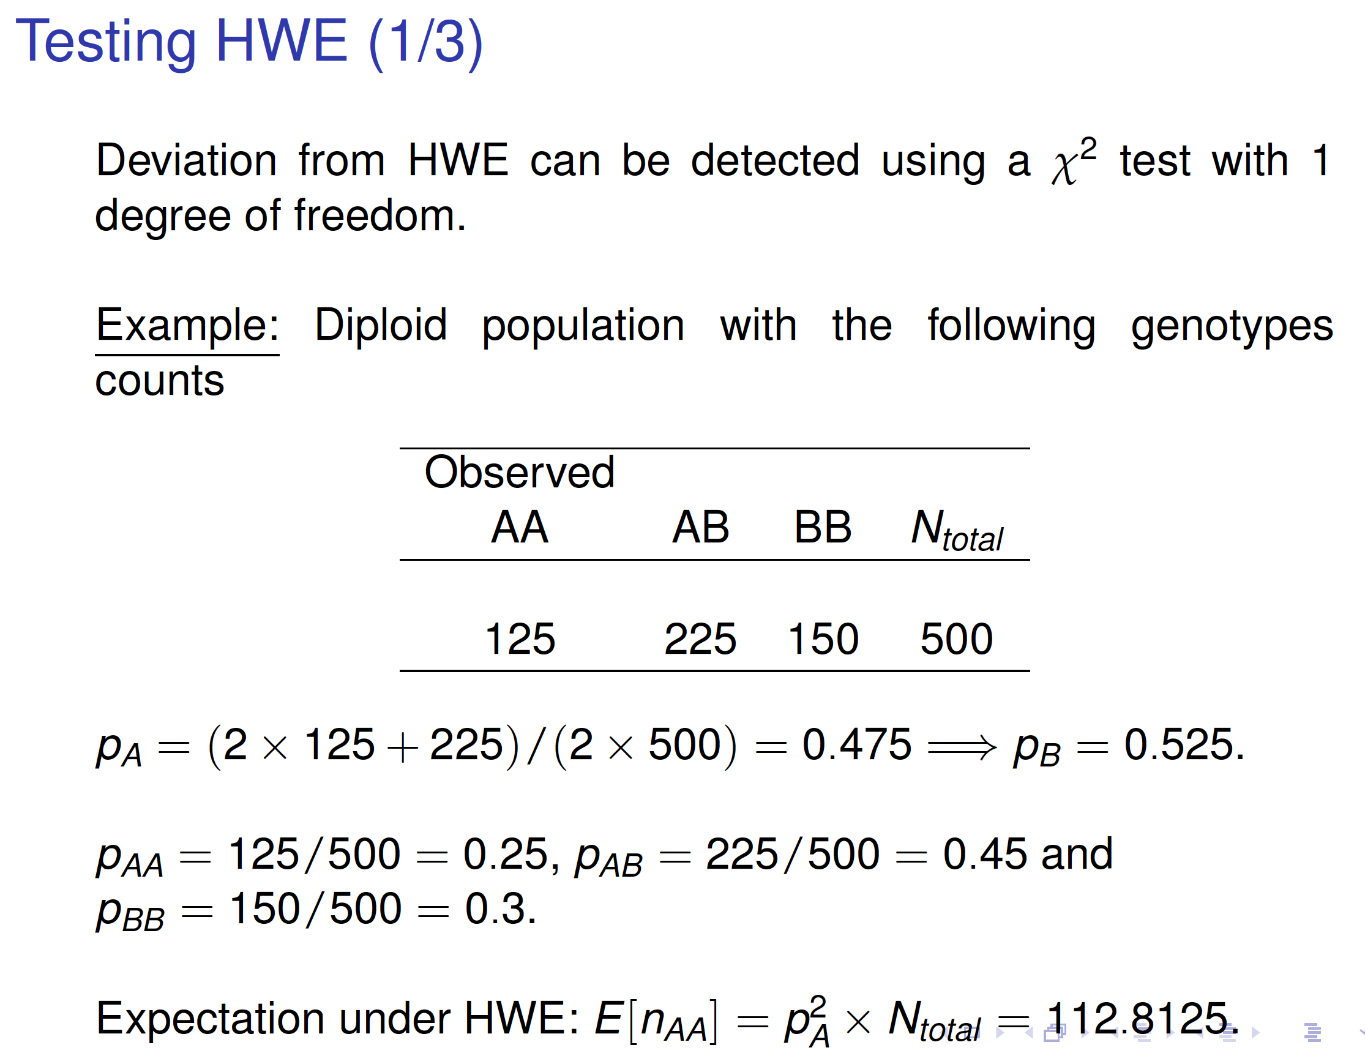

Slide 18
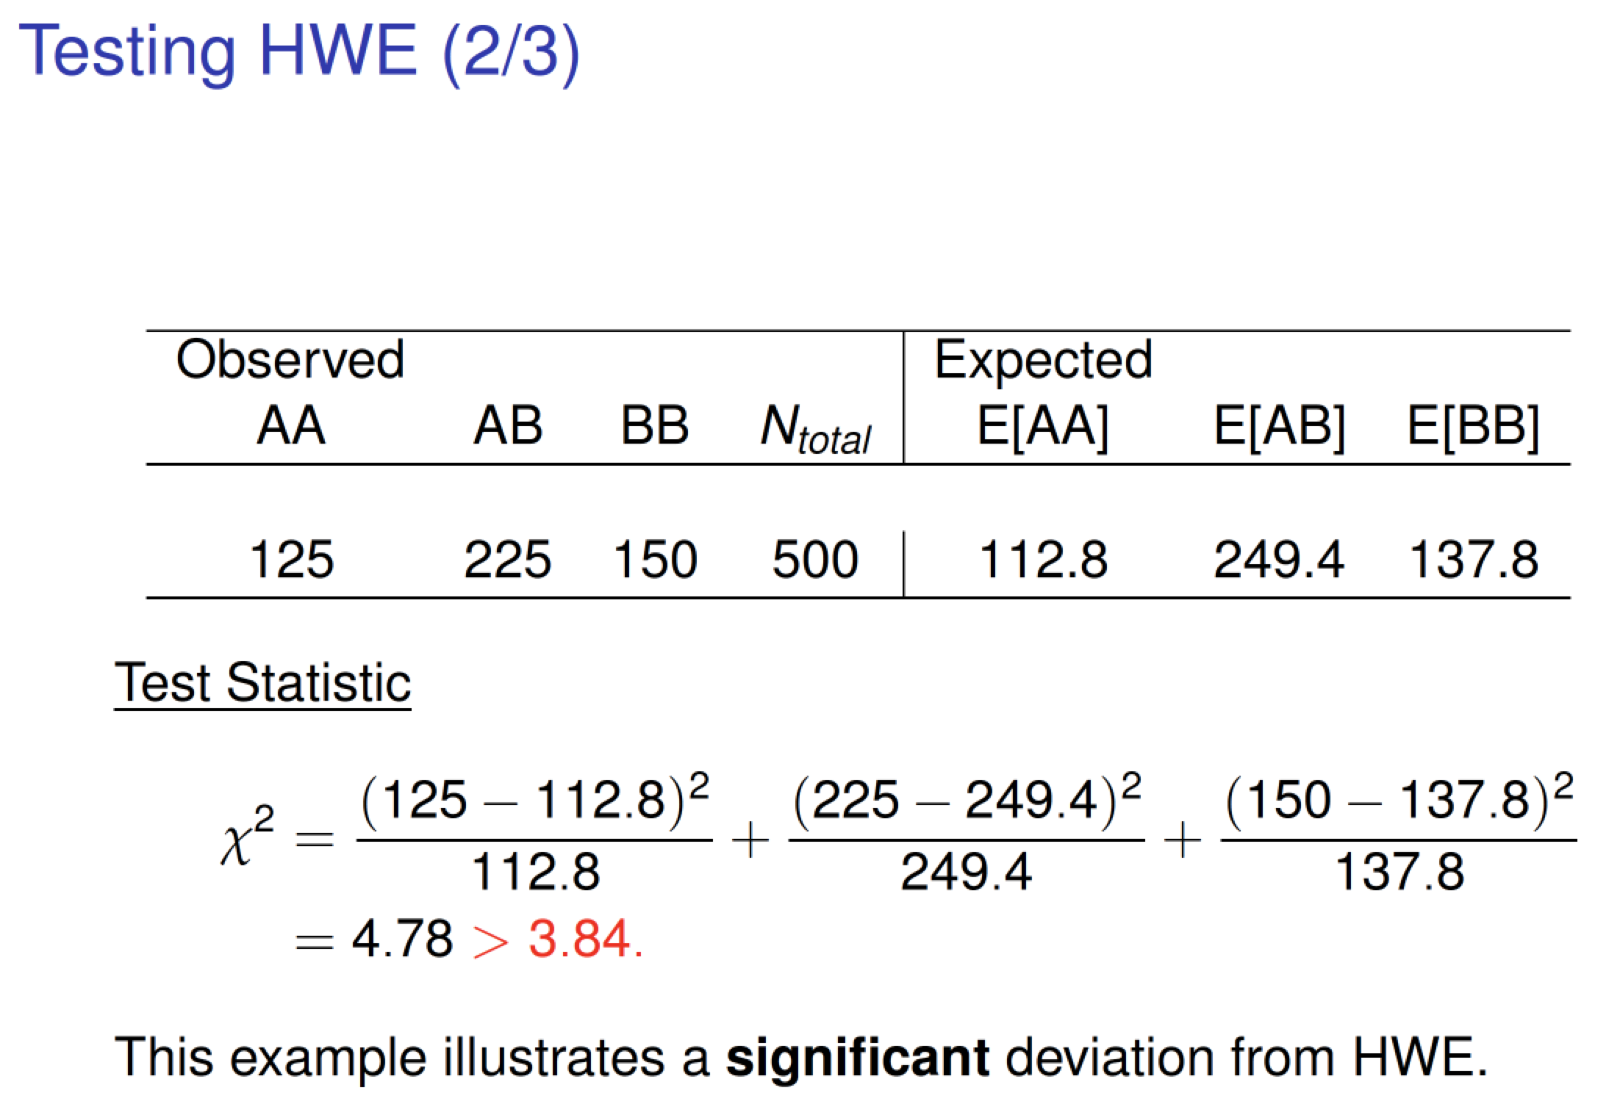

Slide 19
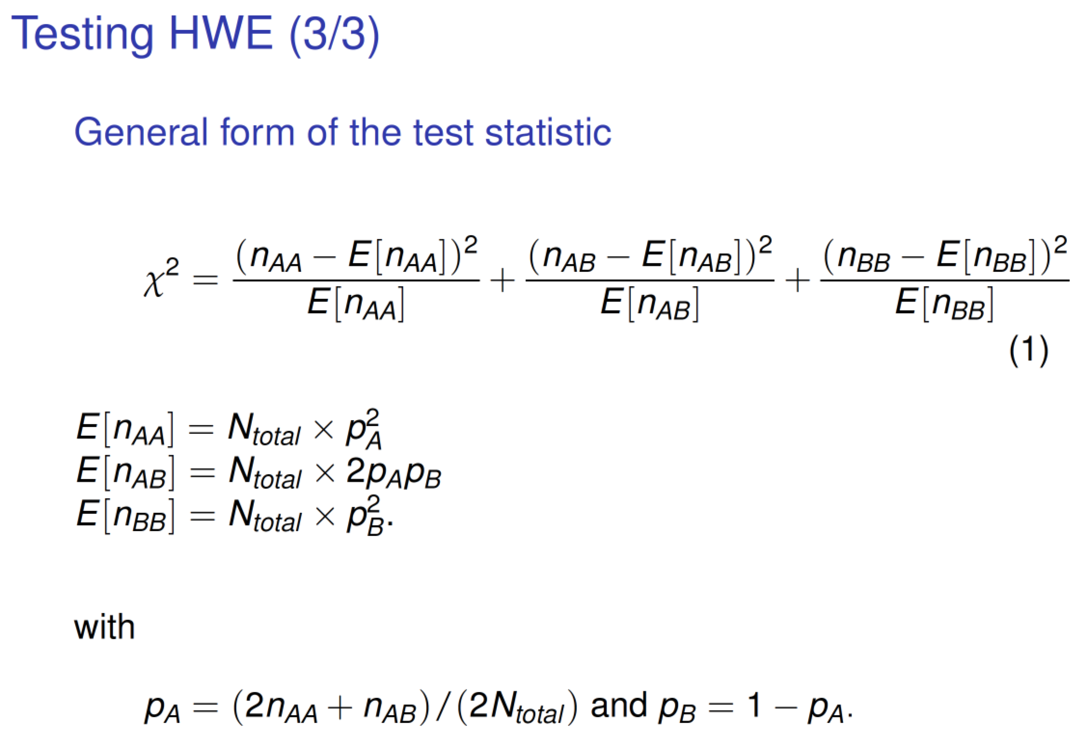

Slide 20
Summary
Population can be characterized by the frequency distribution of alleles and genotypes
Under certain assumptions, genotype frequencies can be predicted from allele frequencies (Hardy-Weinberg Equilibrium)
HWE can be extended to sex-linked loci and polyploid individuals
Deviation from HWE can be used to inform non-random mating (e.g., inbreeding), population history or quality of genetic data (see GWAS lectures)

Slide 21
Changes of Allele and Genotype Frequencies

Slide 22
Main evolutionary forces
1. Mutation / Migration: new alleles in the population
2. Natural selection (fitness)
3. Genetic drift (Wright-Fisher’s model of neutral evolution)
4. Demography: bottleneck / expansion

Slide 23
Main evolutionary forces affecting allele frequencies
1. Mutation / Migration: new alleles in the population
2. Natural selection (fitness)
3. Genetic drift (Wright-Fisher’s model of neutral evolution)
4. Demography: bottleneck / expansion

Slide 24
Wright-Fisher’s model
Let us consider a population of 2N individuals (N males and N females). At each generation we randomly form N pairs of mates. Each pair to generate 2 progenies.
How do allele frequencies change over time in that population?
Let’s run some simulations…

Slide 25
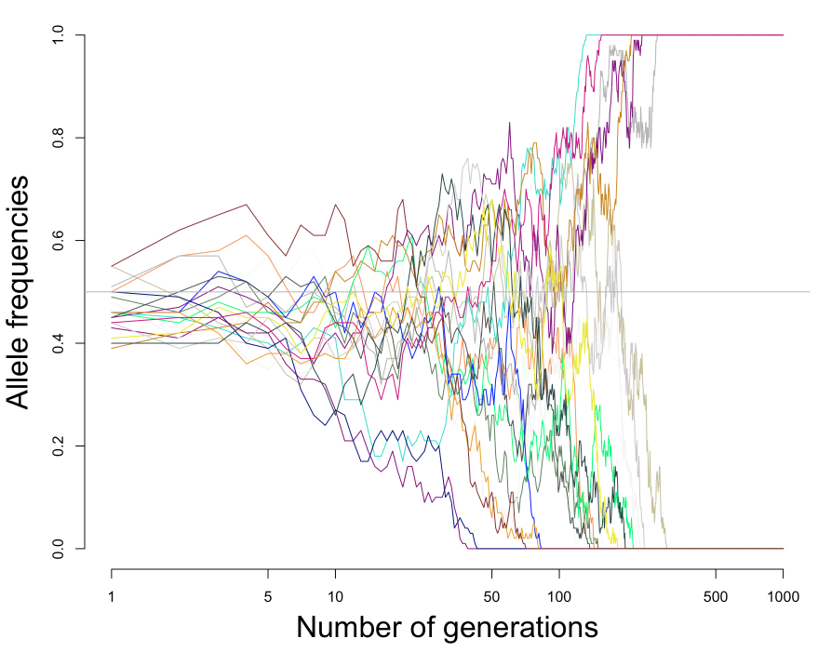
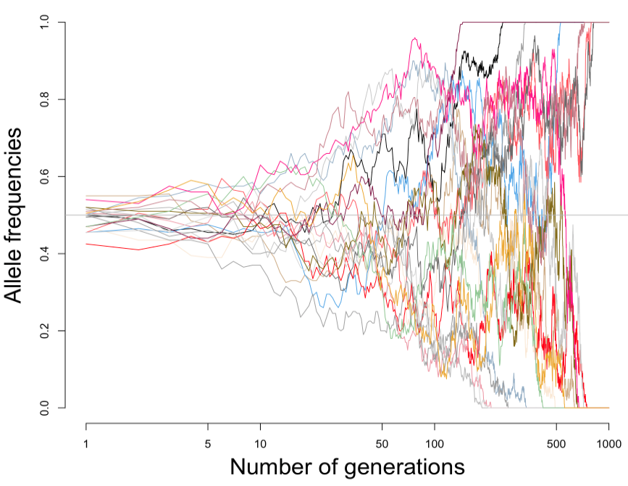
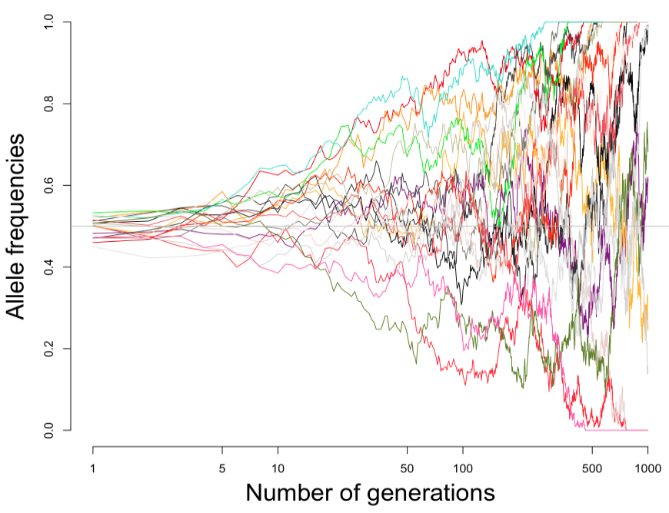
N=50
N=100
N=200

Slide 26
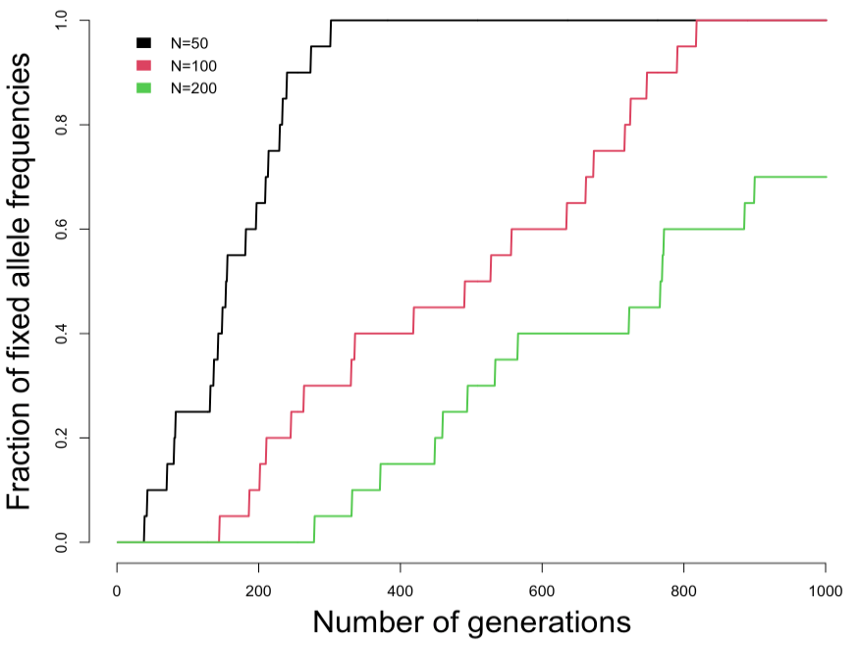
Time to fixation or fixation rate depends on
Effective population size
Allele frequency
Formulas available in textbooks (e.g., Crow & Kimura (1970))

Slide 27
50 shades of natural selection…
Negative (purifying) selection: deleterious alleles are maintained at low frequencies
Positive selection: advantage allele rises at high frequencies (adaptation to high altitude)
Balancing/Stabilizing selection tries to maintain an optimum value in the population (e.g., birthweight)
Frequency of
mutation
10,000 years ago
today
Recommended: Walsh & Lynch, 2018

Slide 28
Summary and other considerations
Genetic drift, selection, migration, mutation can change allele (and genotype) frequencies
Non-random mating (e.g., inbreeding) can increase homozygosity and change genotype frequencies.
Strength of selection and degree of dominance is required to predict how selection will change genotype frequencies
Drift can dominate selection sometimes: s<1/(2Ne)

Slide 29
Wright’s Fixation Index (F_{ST})

Slide 30
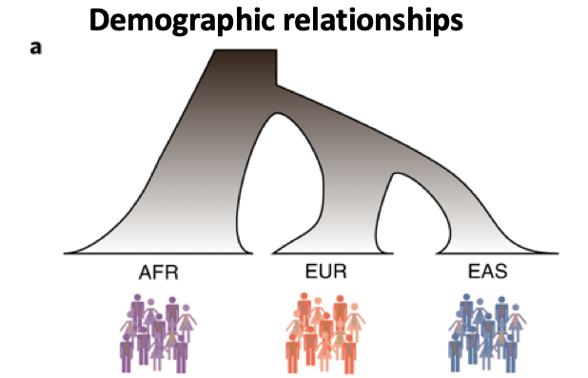
Population structure = frequency differences between populations
Ancestral population
p₀
Martin et. al., Nature Genetics, 2019
Time
(drift)
p₁
p₂
p_{K}
Derived population 1
Derived population 2
Derived population K
Notes:
The concept of Fst is important to compare populations. We can assume

Slide 31
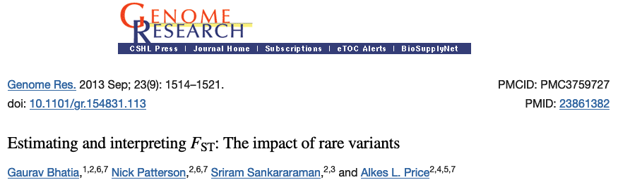
Many definitions and many estimators
Ancestral population
p₀
F_{ST} as a ratio of variance (Wright):
F_{ST}=var_{B}(X)/[var_{B}(X)+var_{W}(X)]; X=0,1 (allelic state)
F_{ST}=0: no frequency differences between populations
F_{ST}=> 1: allele is fixed in one population (fixation index)
Estimators
Weir & Cochram (1984)
Nei (1973)
Hudson (1992)
p₁
p₂
p_{K}
Time
(drift)
Derived
population 1
Derived
population 2
Derived
population K
Weir & Hill (2002) definition
var(p_{i}|p₀) = F_{ST} p₀ (1-p₀)

Slide 32
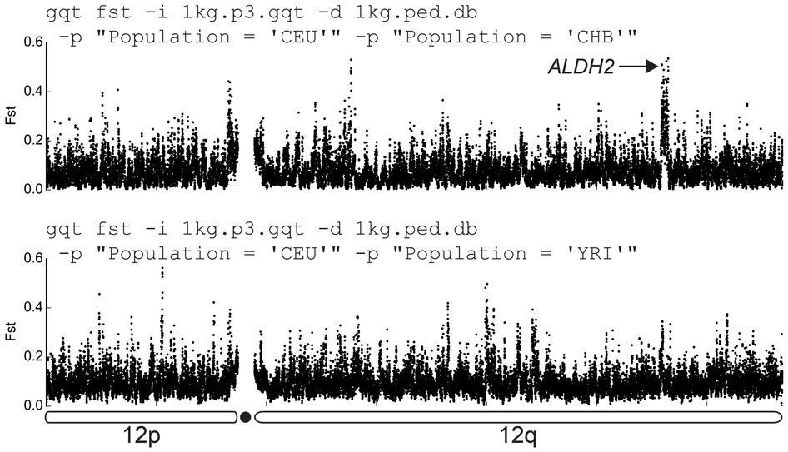
F_{ST} varies across the genome => not just drift at play here!
Typical F_{ST} ranges
F_{ST} is ~0.1- 0.2 between continental groups
F_{ST} is ~0.01- 0.05 within continental groups
F_{ST} is <0.01within countries
Layer R.M. et al. Efficient genotype compression and analysis of large
genetic-variation data sets. Nature Methods (2016).
Notes:
Fst is typically reported as a genome-wide measure but keep in mind that Fst can vary across the genome. This is actually one of the methods used to detect deviation from drift…

Slide 33
Let’s play again…
Practical Part 2

Slide 34
Linkage Disequilibrium

Slide 35
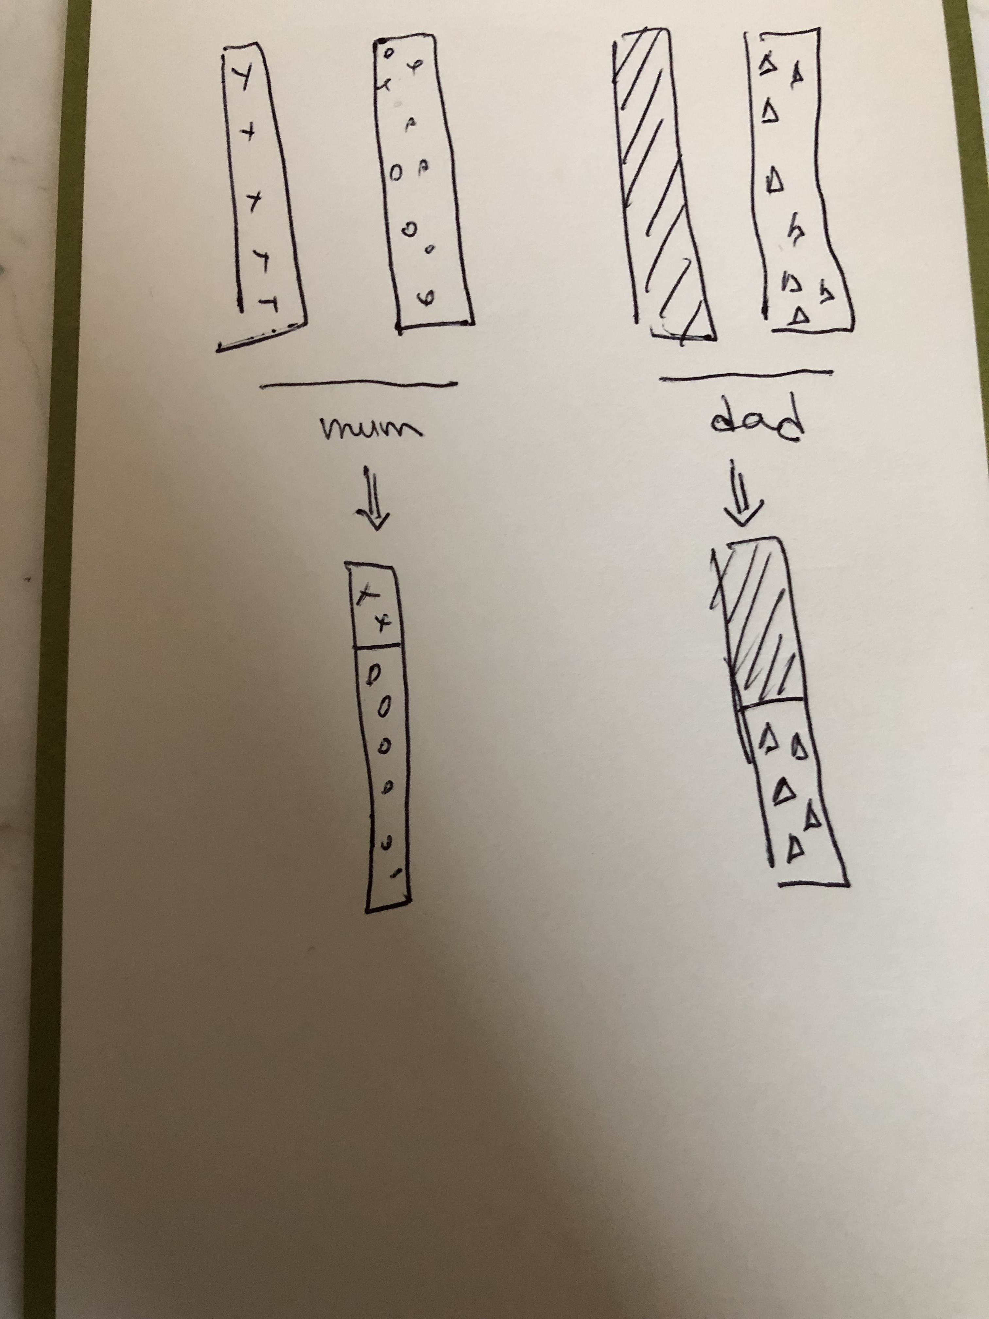
Meoisis and genetic linkage
In sexual reproduction gametes are produced during specialized cell division called meiosis.
Meiosis involves multiple phases prophase, meiosis I and II) in which genetic information is exchanged between homologous chromosomes: recombination.
Recombinant chromosomes are then transmitted to the offspring.
=> Close DNA sequences on a chromosome will tend to be transmitted together: linkage disequilibrium (LD).

Slide 36
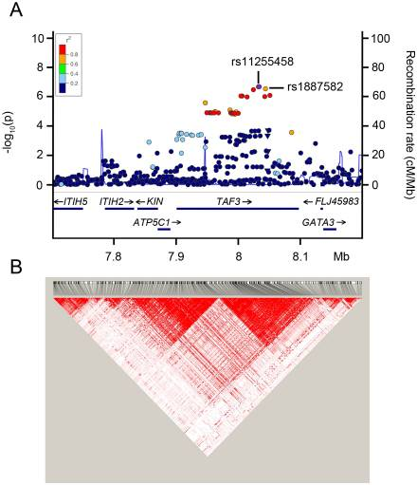
Haplotype
Haplotype = Group of variants within a chromosome (e.g., within a LD block)
A₁
A₂
Maternal Chromosome
A₁
a₂
Paternal Chromosome
Pistis et al. (2013) Plos One

Slide 37
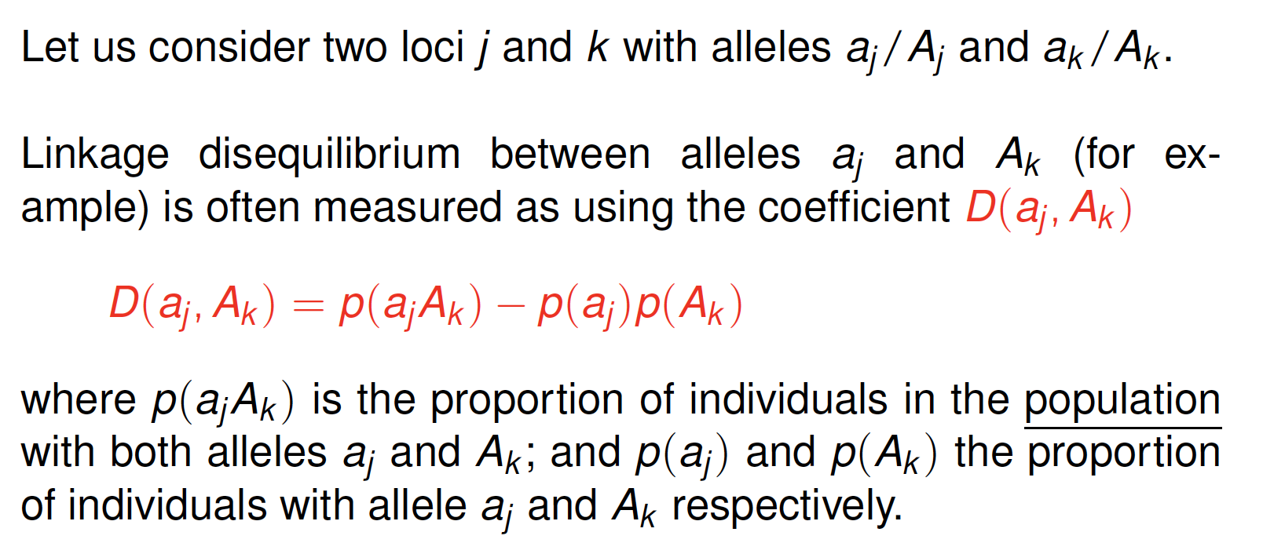
Statistical measures of linkage disequilibrium (1/3)

Slide 38
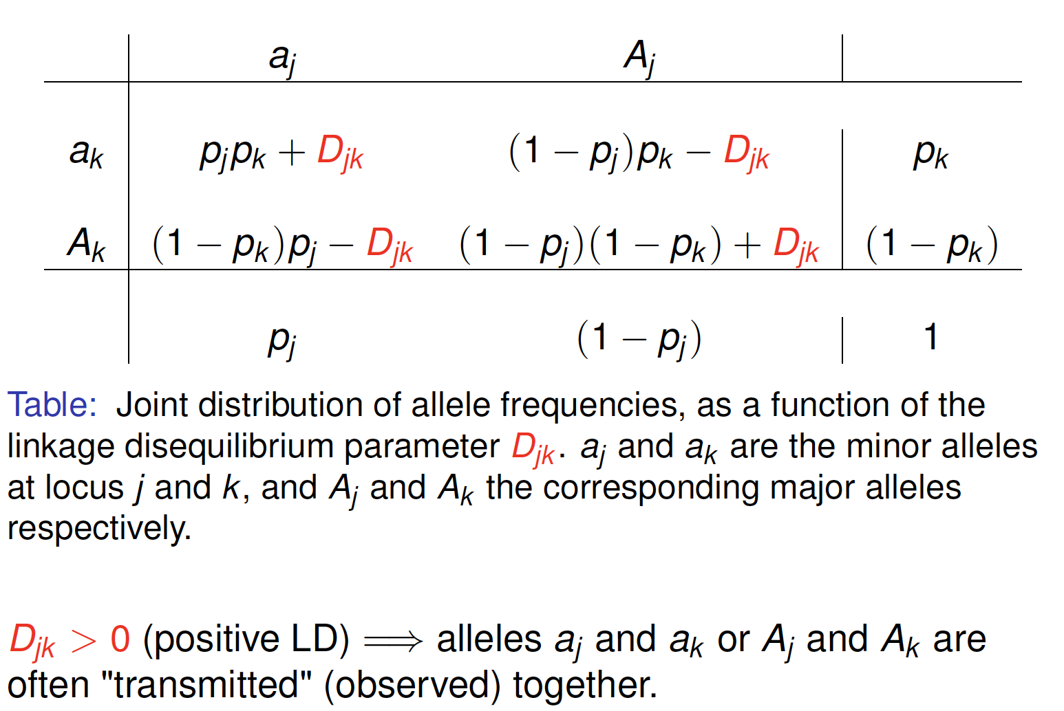
Statistical measures of linkage disequilibrium (2/3)

Slide 39
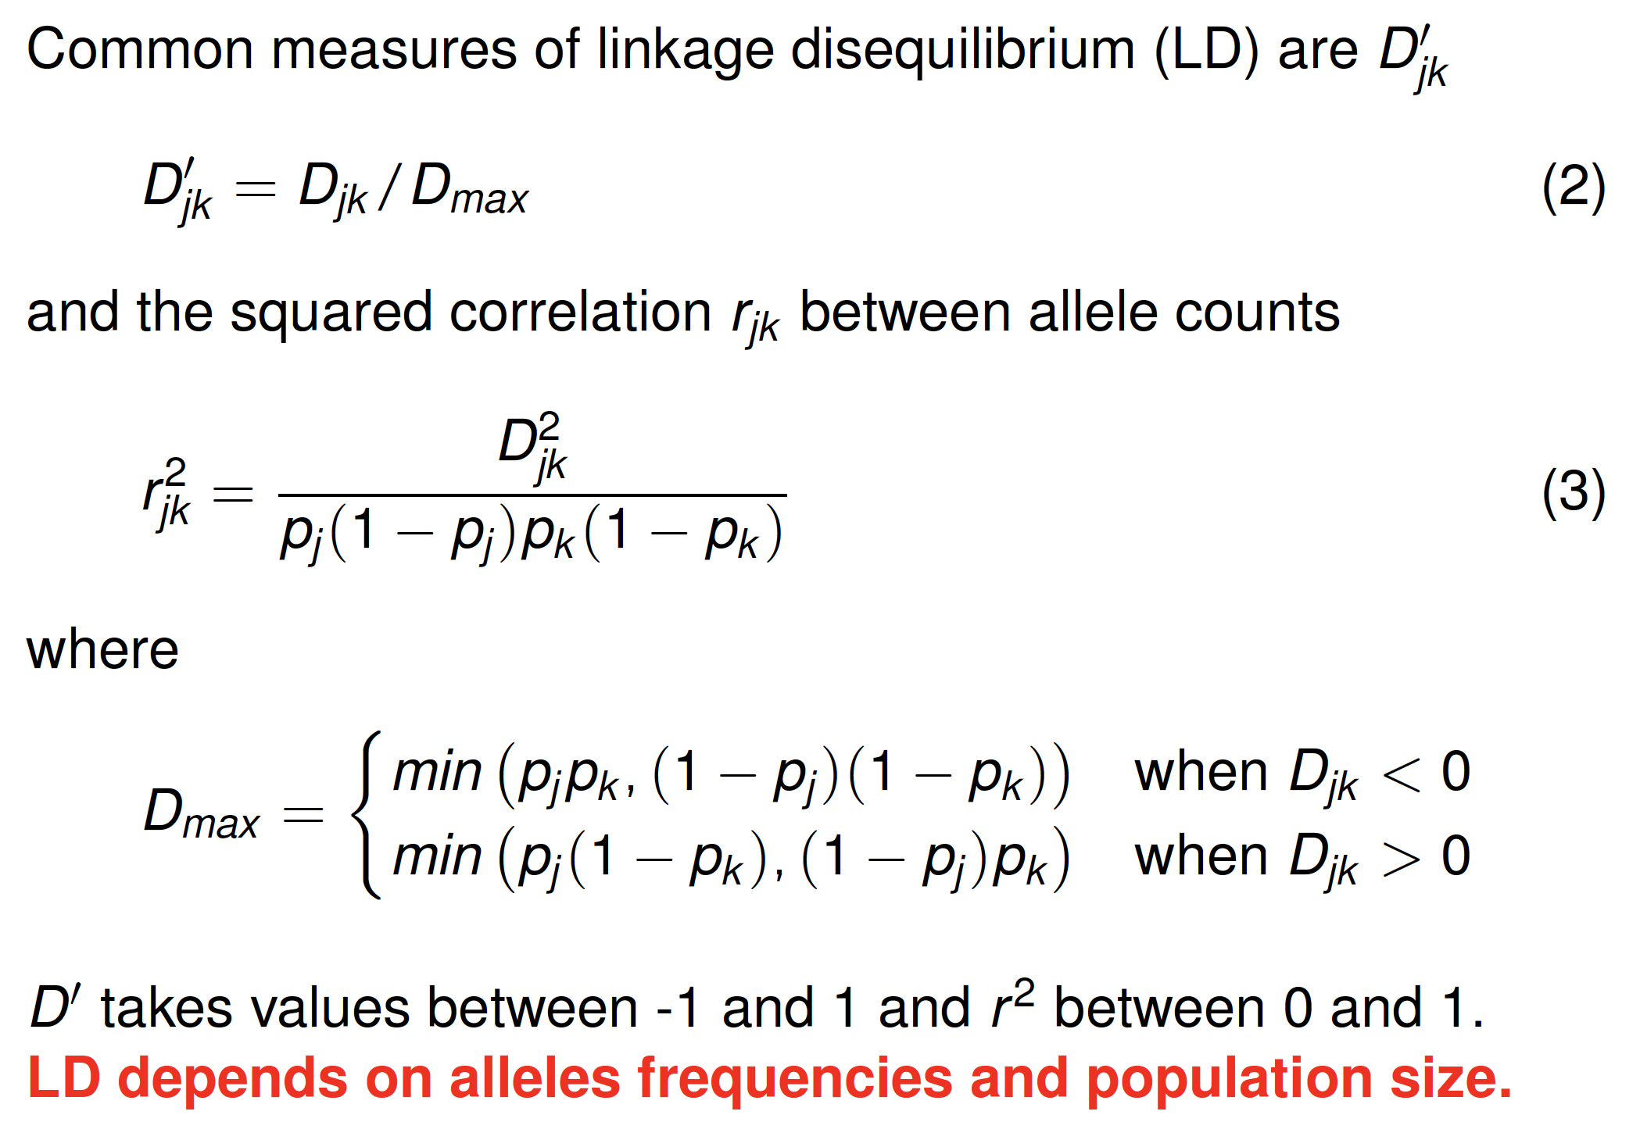
Statistical measures of linkage disequilibrium (3/3)

Slide 40
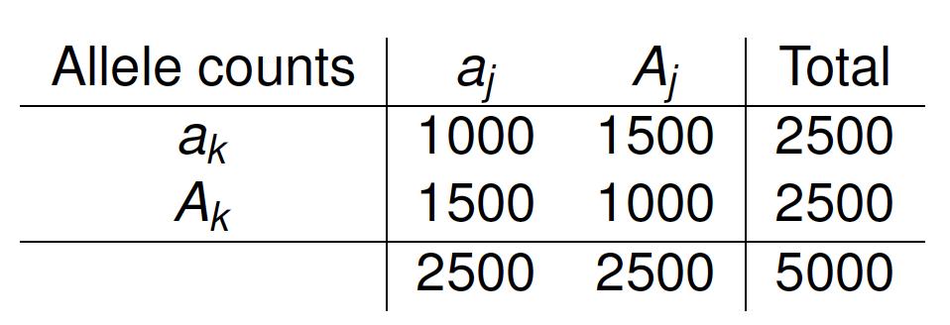
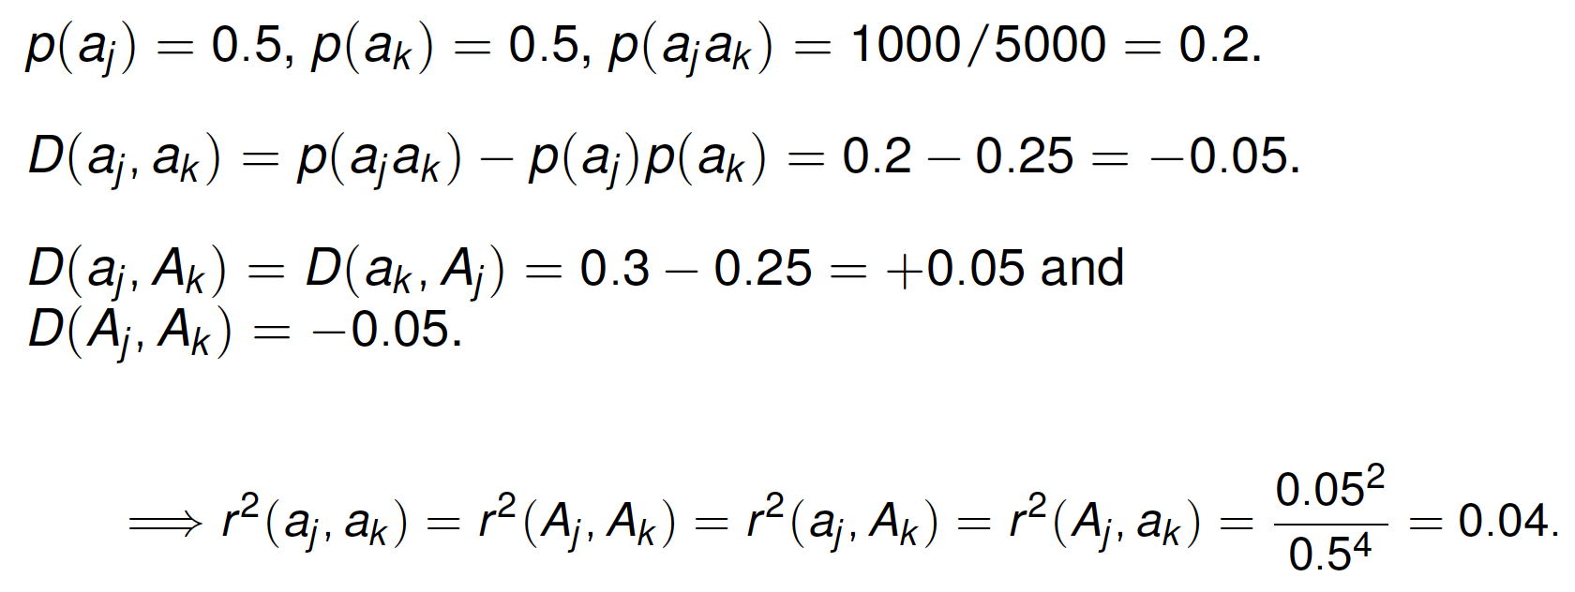
LD calculations (1/2)

Slide 41
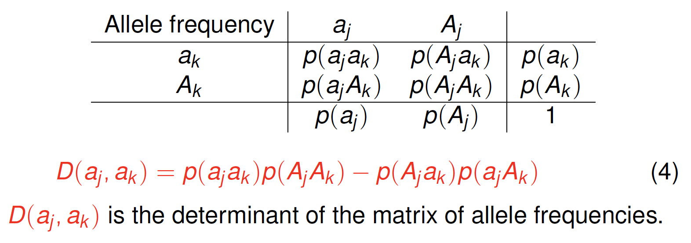
LD calculations (2/2)

Slide 42
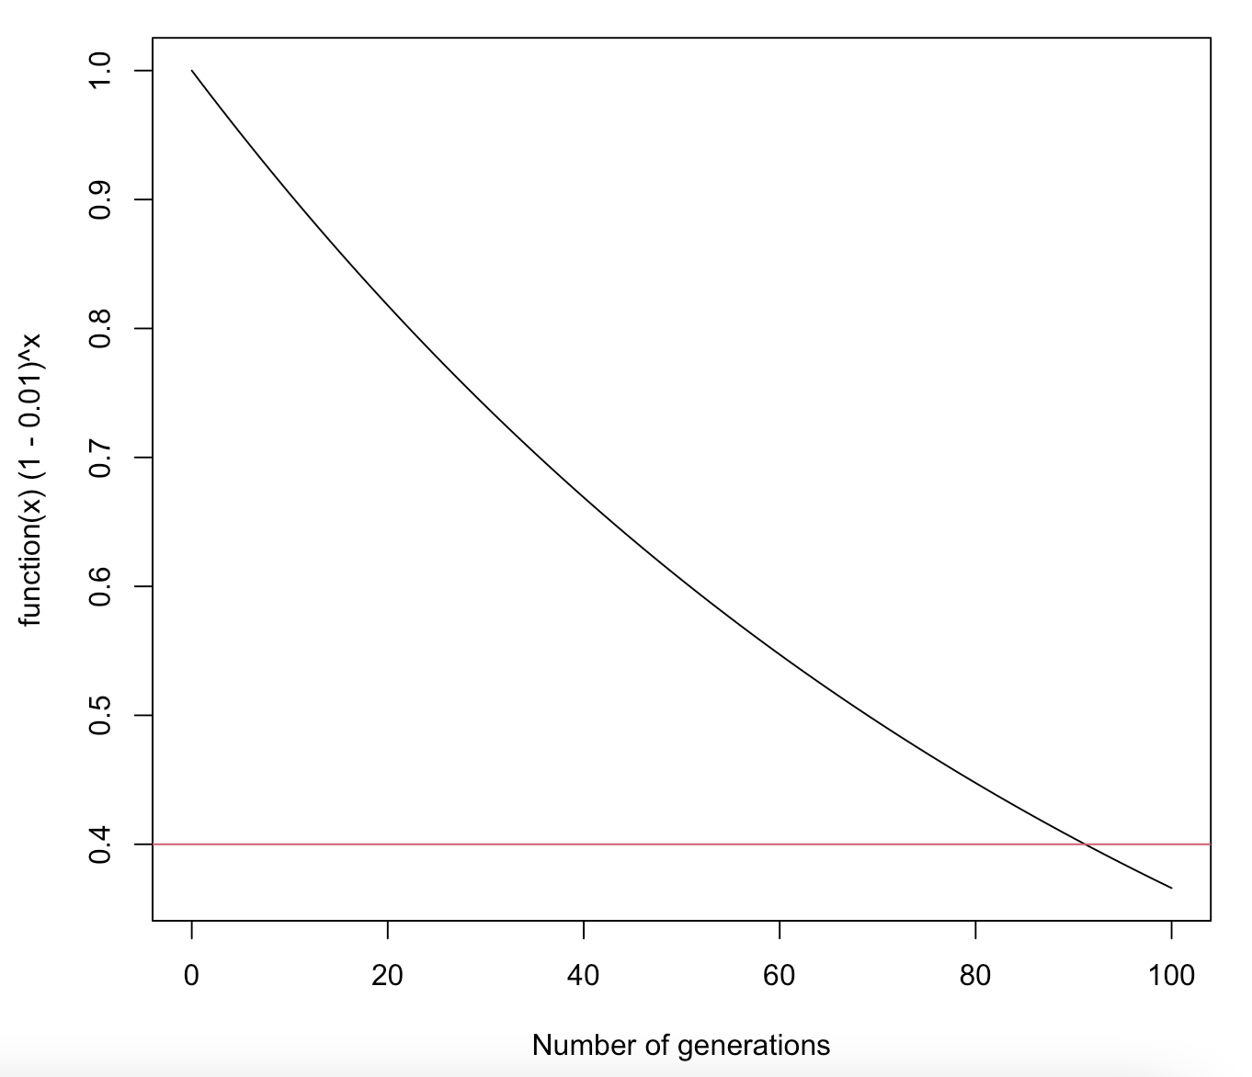
LD decay over time
Let us consider two loci with alleles A₁ and A₂. We denote r_{n} the
frequency of A₁A₂ in the current generation and c the probability
of recombination between locus 1 and locus 2.
Under random mating the frequency of A₁A₂ in the next generation
can be written
r_{t+1} = r_{t} (1 - c) + c p(A₁)p(A₂)
In terms of of disequilibrium can be expressed as
D_{t+1}(A₁,A₂) = r_{t+1} - p(A₁)p(A₂)
D_{t+1}(A₁,A₂) = [r_{t} (1 - c) + c p(A₁)p(A₂)] - p(A₁)p(A₂)
D_{t+1}(A₁,A₂) = D_{t}(A₁,A₂)(1 - c)
This can be generalized as
D_{t}(A₁,A₂) / D₀(A₁,A₂) = (1 - c)^{t}
A₁
A₂

Slide 43
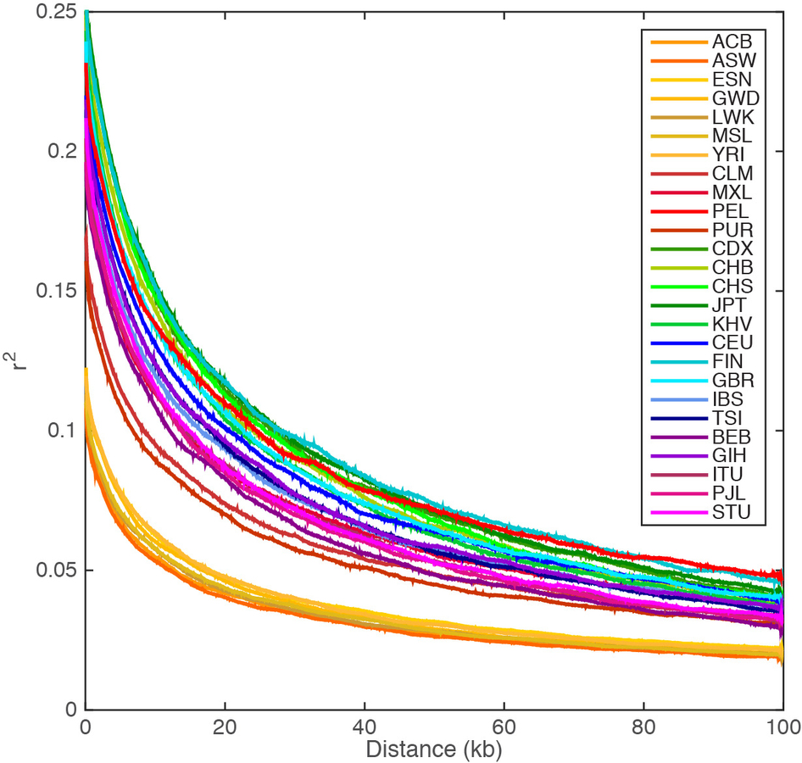
LD decay with physical distance
A reasons why LD might differ between populations…
Demographic history [Effective population size: Large N_{e} => small LD]
Selection [positive selection increases LD]
A. Auton et al. (1000 Genomes Consortium) A Global
Reference for Human Genetic Variation. Nature (2015).

Slide 44
Summary

Slide 45
Summary – outline (again)
Hardy-Weinberg Equilibrium
What drives changes in allele/genotype frequencies?
How can you measure genetic distance between populations?
Linkage Disequilibrium

Slide 46
In this lecture…
Key parameters to describe the genetic constitution of a population are
  Alleles and genotypes frequencies (Hardy-Weinberg Equilibrium)
  Correlations between alleles: linkage disequilibrium (LD)
Key parameter to compare frequency differences between populations: F_{ST} = var(p_{i})/[p₀(1-p₀)]
Frequencies and LD are affected by drift, demography (Ne), selection, etc.

