Slide 1
From Wright-Fisher to modern genetics
Benjamin Neale, PhD
Boulder Workshop

Slide 2
What does it mean to be a scientist?

Slide 3
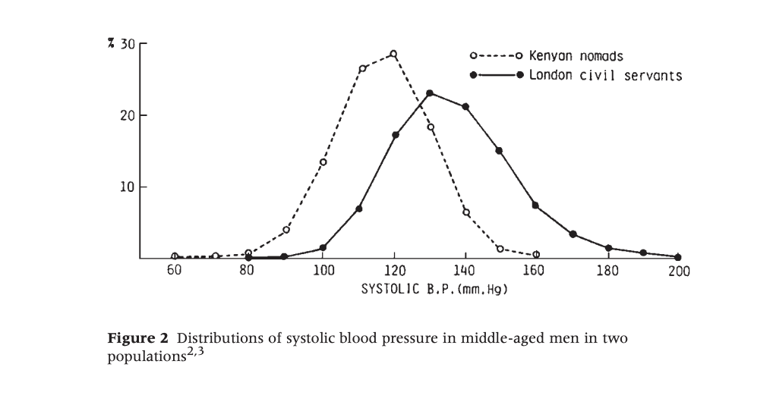
Sick individuals and sick populations Rose 1985

Slide 4
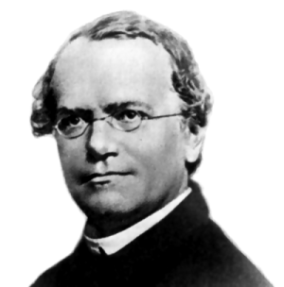
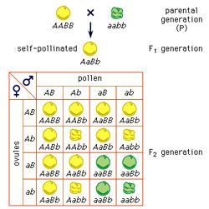
Mendelian Genetics

Slide 5
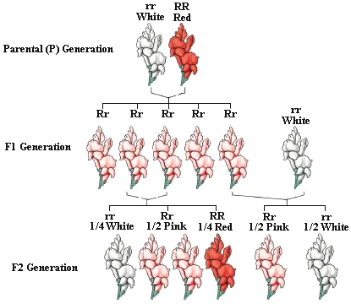
Co-dominance

Slide 6
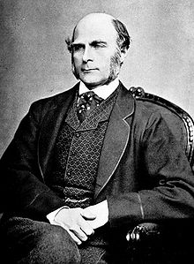
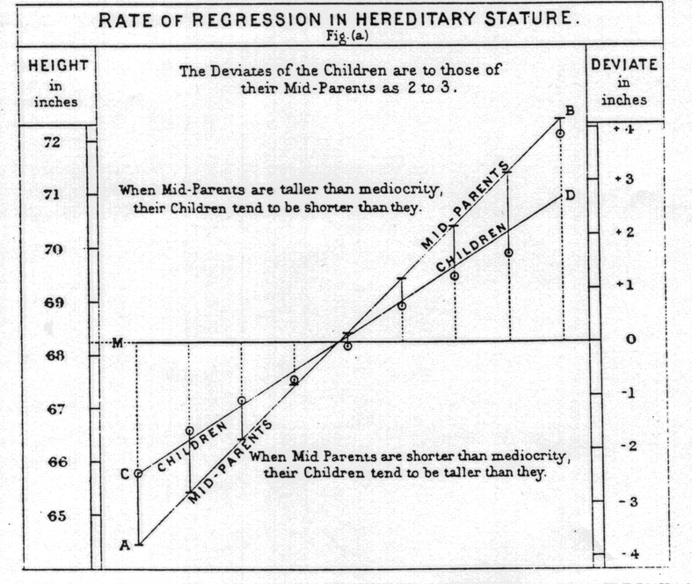

Slide 7
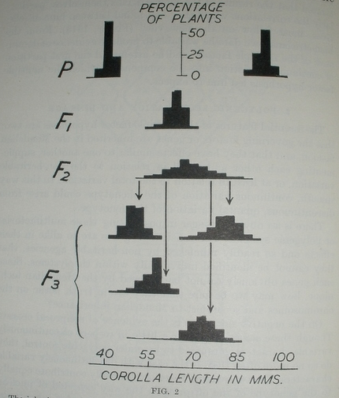
East 1915: Inheritance of Corolla Length in Nicotiana longiflora

Slide 8
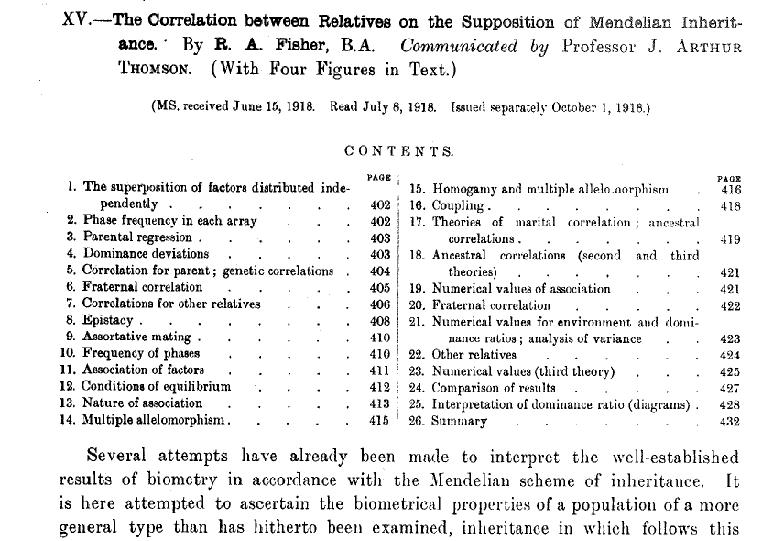
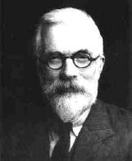
Neo-Darwinist Reconciliation
Ronald Fisher (1918)

Slide 9
One Coin toss
2 outcomes
Probability
0.6
0.5
0.4
0.3
0.2
0.1
0
Heads
Tails
Outcome

Slide 10
Two Coin toss
3 outcomes
Probability
0.6
0.5
0.4
0.3
0.2
0.1
0
HH
HT/TH
TT
Outcome

Slide 11
Four Coin toss
5 outcomes
Probability
0.4
0.3
0.2
0.1
0
HHHH
HHHT
HHTT
HTTT
TTTT
Outcome

Slide 12
Ten Coin toss
11 outcomes
Probability
0.3
0.25
0.2
0.15
0.1
0.05
0
Outcome

Slide 13
Infinite Outcomes
Gauss 1827; de Moivre 1738

Slide 14
Liability threshold model
Pearson and Lee (1901)

Slide 15
Genotype with an additive effect
d = 0 (no dominance)
– a
d
+a
+a
+a
m = 0
aa
Aa
AA
Additive model
Manuel Ferreira

Slide 16
Source of variation
Aa
aa
AA

Slide 17
Genotype with an additive and dominance effects
d > 0 (dominance)
– a
d
+a
+a+d
+a-d
m = 0
aa
Aa
AA
Dominant model

Slide 18
How much mean and variance?
1. Defining the Mean (X)
e.g. cholesterol levels in the population
Genotypes
AA
Aa
aa
Effect, x
a
d
-a
Frequencies, f(x)
p²
2pq
q²
Mean (X)
= a(p²) + d(2pq) – a(q²)
= a(p-q) + 2pqd

Slide 19
How much mean and variance?
2. Contribution of the QTL to the Variance (X)
Genotypes
AA
Aa
aa
Effect, x
a
d
-a
Frequencies, f(x)
p²
2pq
q²
Var (X)
= (a-m)²p² + (d-m)²2pq + (-a-m)²q²
= V_{QTL}
Heritability of X at this locus = V_{QTL} / V _{Total}

Slide 20
How much mean and variance?
Var (X)
= (a-m)²p² + (d-m)²2pq + (-a-m)²q²
m = a(p-q) + 2pqd
= 2pq[a+(q-p)d]² + (2pqd)²
= V_{AQTL} + V_{DQTL}
Additive effects: the main effects of individual alleles
Dominance effects: represent the deviation from additive effects

Slide 21
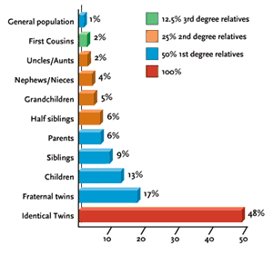
Twin and family studies – probability of having schizophrenia conditional on relative
Near continuous fall off of risk – proportional to amount of shared genome
Gottesman 2001 Genes and More

Slide 22
What about the genome?

Slide 23
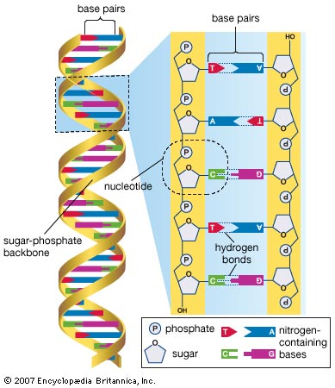
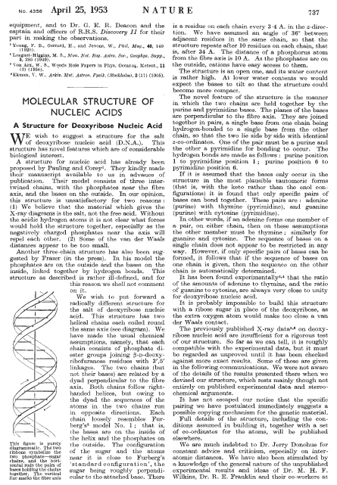
DNA
Structure
1953 Watson & Crick
Bases: A, C, G, T
Notes:
W & C were the first to propose the correct structure of DNA in a short paper in 1953.
A DNA molecule contains two helical chains, held together side-by-side through hydrogen bonds.
The building block of each chain is a nucleotide, which contains a sugar residue, a phosphate group and a nitrogen-containing base.
The first two elements do not change between nucleotides. However, nucleotides can differ with respect to the base that they carry: Adenosine, cytosine, guanine and thymine.
It is the sequence of these 4 letters throughout our DNA that encodes all the necessary information to make all the proteins in our body.

Slide 24
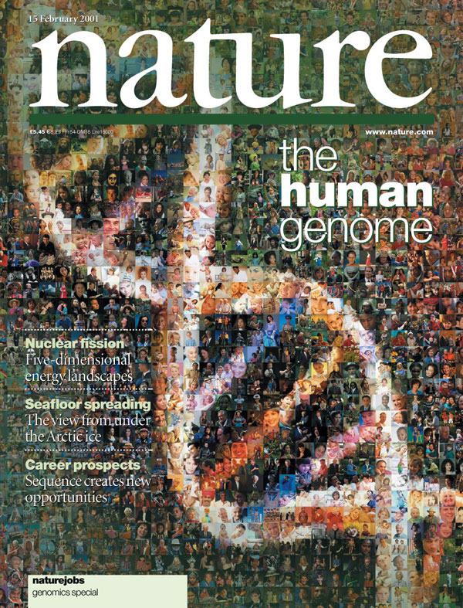
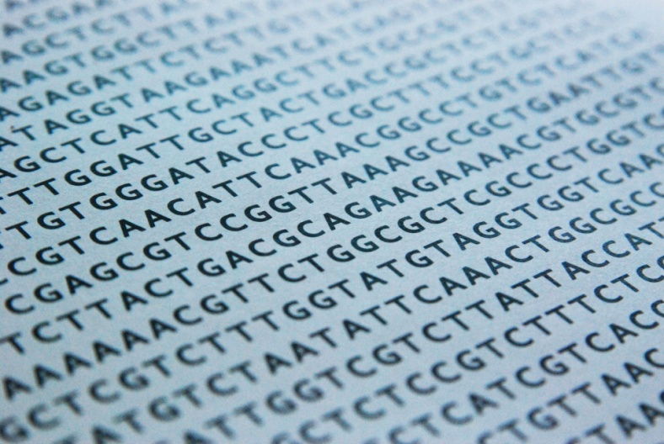
DNA
Sequence
10 years
USD $3 billion
Sequence DNA of one single person
~ 3,000,000,000 nucleotides
2001
Notes:
It is therefore not surprising that one of the major scientific goals in the 1990s was to determine the entire sequence of our DNA.
This was achieved in 10 years, at a cost of $3 billion USD, involving researchers from all over the world.
What they did was to isolate the DNA from a single person, put it through very expensive machines and determine for one nucleotide after another, what was the base attached to it: and A, C, G or T.
They found that our DNA has ~3 billion nucleotides, and so 3 billion bases or letters whose sequence encodes ~20,000 genes.
This sequence was made freely available for anyone to use.

Slide 25
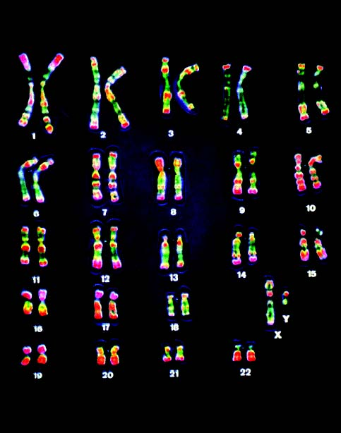
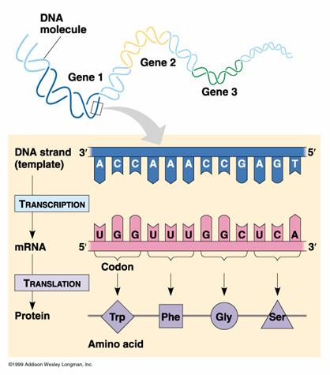
DNA
Organization
23 pairs of chromosomes
“pairs”: one copy from father, one mother
~20,000 genes

Slide 26
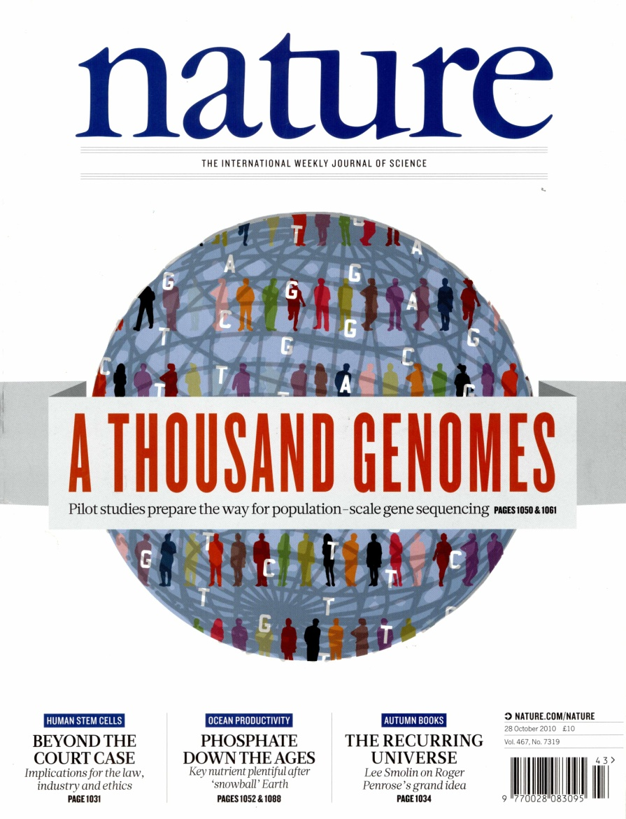
DNA
Variation
Sequenced DNA of >1,000 individuals
5 years
Less than $5,000 per individual
~3,000,000,000 bases
~30,000,000
different
Contribute to making us different:
how we look
behave,
diseases,
etc
2010

Slide 27
DNA
30,000,000 nucleotides where the base can differ between people
  Single Nucleotide Polymorphism, SNP
DNA sequence
Genotype
Chrom.
SNP 2
SNP 1
Mat
GTAACTTGGGATCTAGACCAGATAGAT
GTAACTTGGGATCTAGACCAGATAGAT
GTAACTTGGGATCTAGACCAGATAGAT
GTAACTTGGGATCTCGACCAGATAGAT
GTAACTTGGGATCTCGACCAGATAGAT
GTAACTTGGGATCTCGACCATATAGAT
Person 1
A A
G G
Pat
Mat
Person 2
A C
G G
Pat
Mat
Person 3
C C
G T
Pat
SNP 1
SNP 2
  Mutation that arose at some point in evolution
  Typically, each SNP has two alleles (bases)
  Each SNP is eventually given an “rs” number rs214621

Slide 28
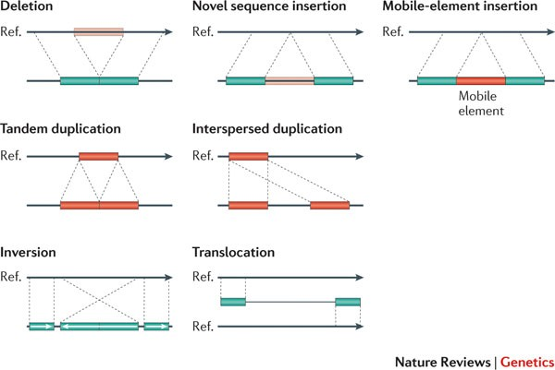
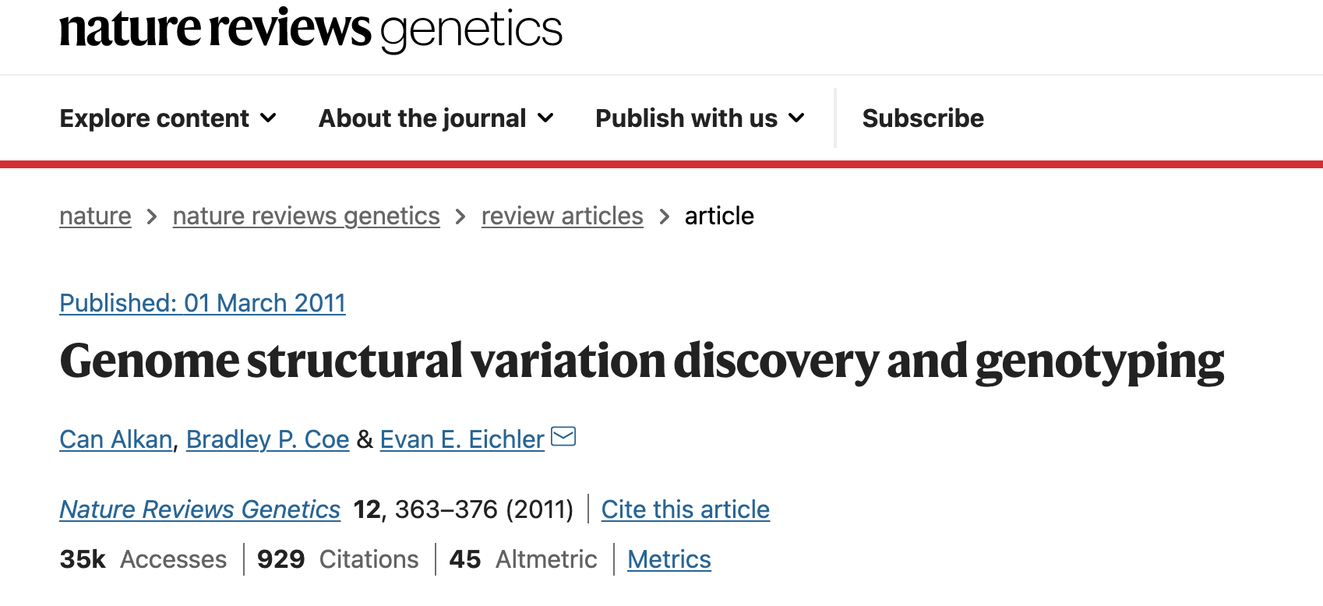
Other kinds of variation

Slide 29
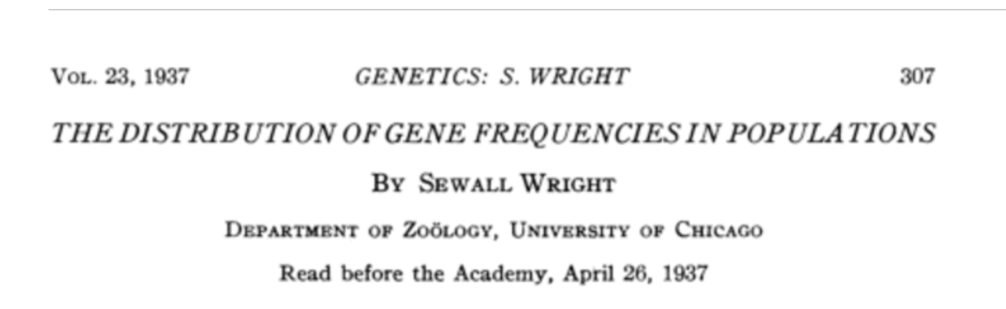
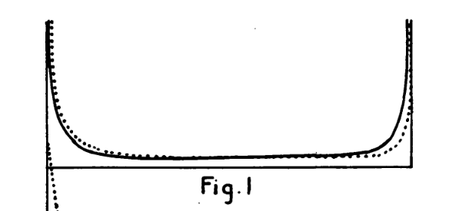
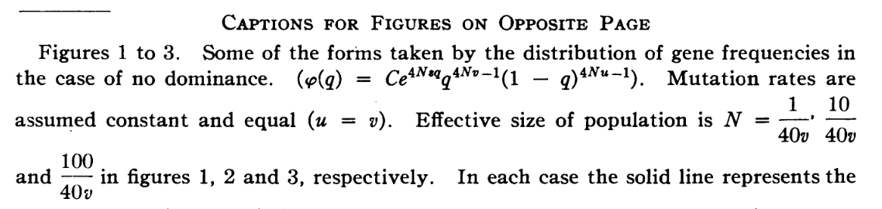
Distribution of allele frequencies

Slide 30
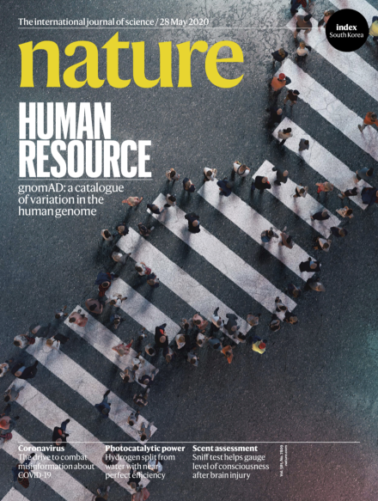

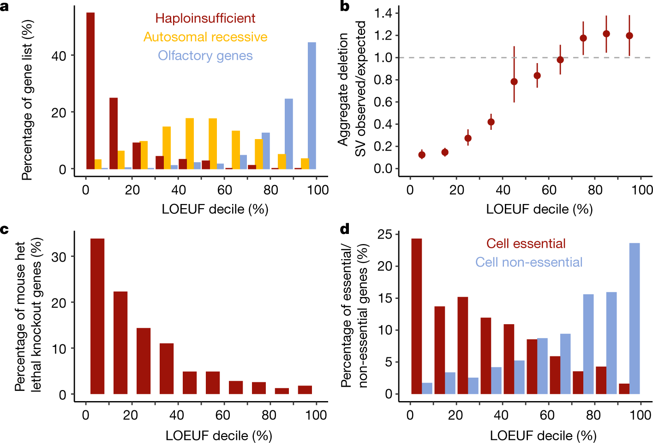
Surveys of variation
2020
The Genome Aggregation Database (gnomAD) has aggregated 15,708 whole genomes and 125,748 exomes

Slide 31

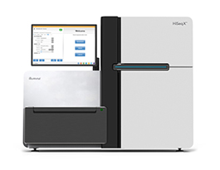
Ways to assay genetic variation
Arrays
Exomes
Genomes
Upside Hits + epi Gene identification Comprehensive capture
Downside Hit interpretation Limited Scope Cost (small N)

Slide 32
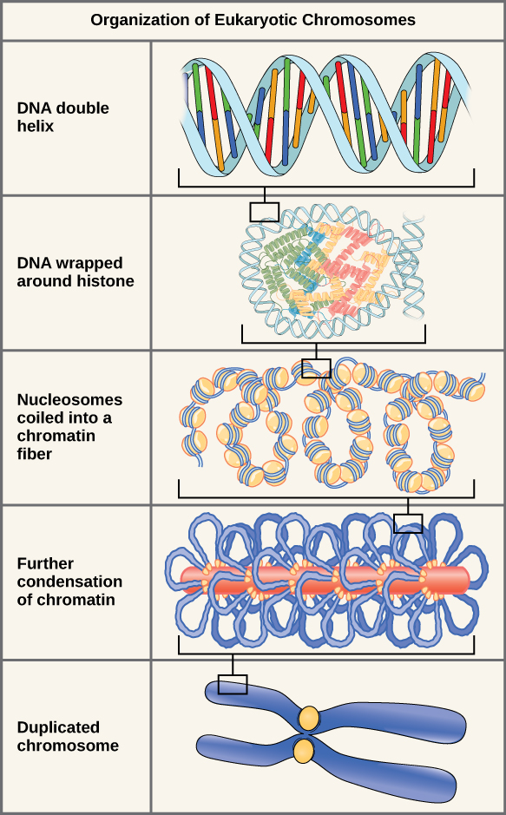
Other interesting things about our genome
The genome is dynamic
DNA is chemically modified
-e.g. methylation
It acquires somatic mutations
-particularly in response to mutagens

Slide 33
Example of epigenetic assay – ATAC-Seq
Open Chromatin -> genes in the region might be expressed
Dynamic process in the cell – changes in response to stimulus

Slide 34
Finding and quantifying the impact of genetic variation on traits

Slide 35
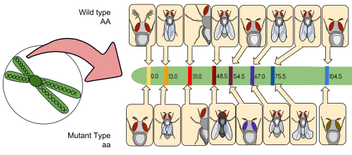
Linkage analysis – fruit flies and simple traits
h/t Wikipedia entry on genetic linkage

Slide 36
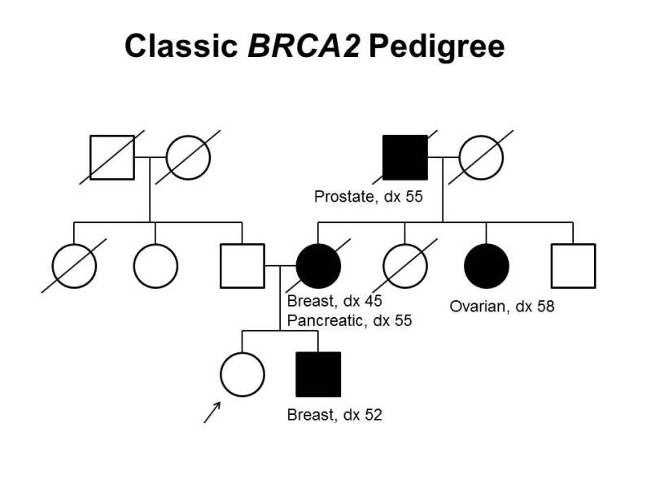
Building linkage maps
Collect families
Genotype ‘microsatellites’ - variable length polymorphisms
Trace the inherited chunks of chromosomes
Find identity-by-descent
https://www.ncbi.nlm.nih.gov/books/NBK65767/figure/CDR0000062855__2586/

Slide 37
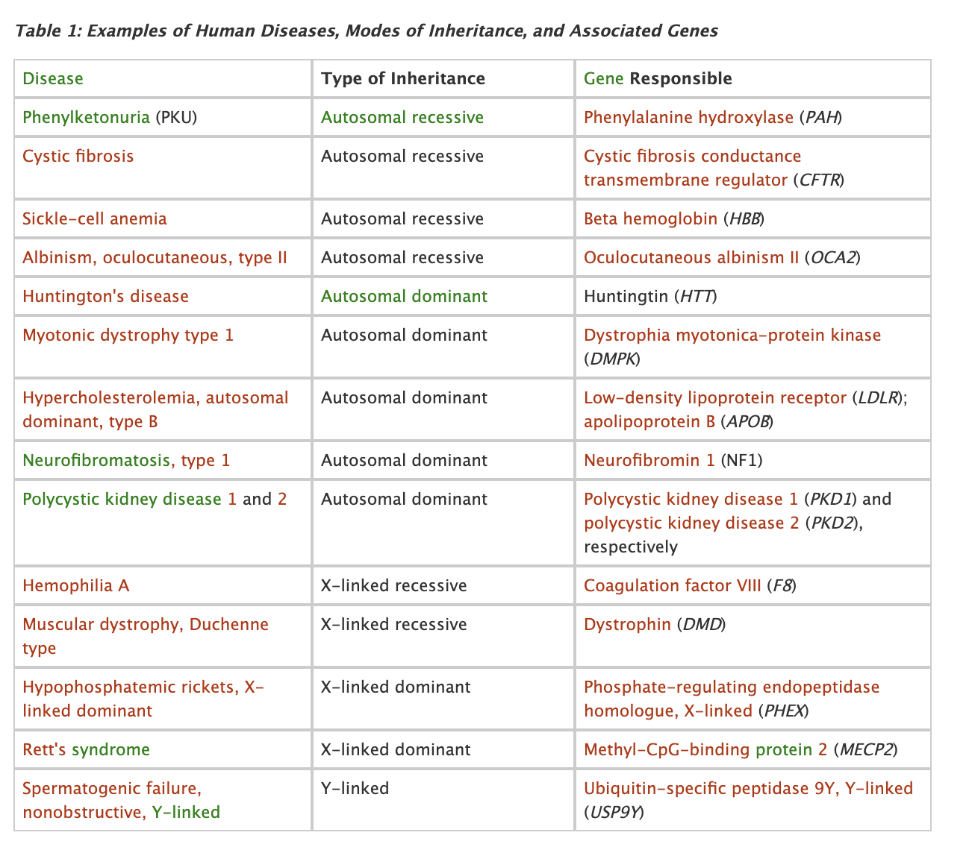
Linkage found the gene for many single gene disorders
However, linkage basically did not work for most complex traits with a handful of counterexamples including:
APOE for Alzheimer’s Disease
BRCA for breast cancer
NOD2 in Crohn’s Disease
Same approach as BRCA example
Tracing inheritance in families

Slide 38
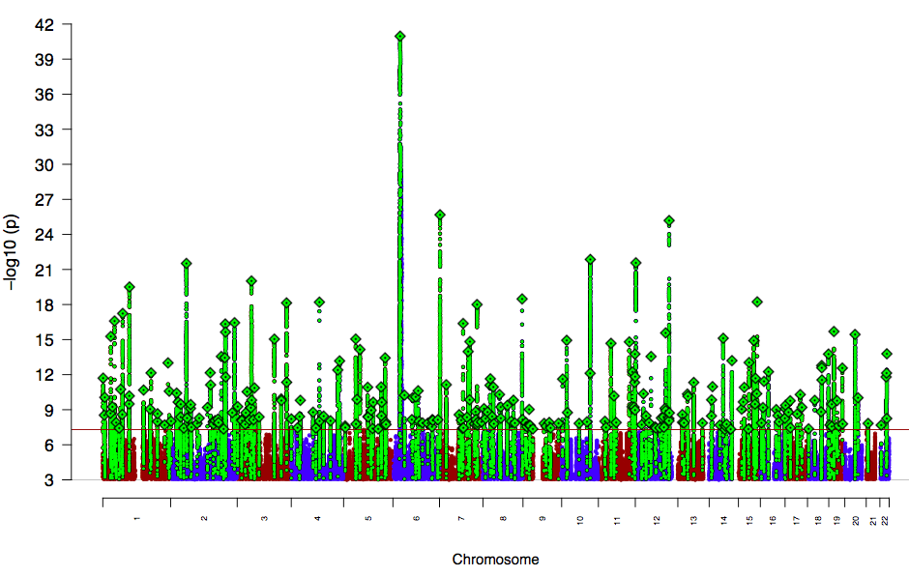



Common variant discovery in schizophrenia
PGC schizophrenia working group
Analysis lead:
Stephan Ripke
PGC-SCZ chair:
Mick O’Donovan
PGC Lead PI:
Pat Sullivan
69,369 with schizophrenia
236,642 without Dx
270 loci

Slide 39
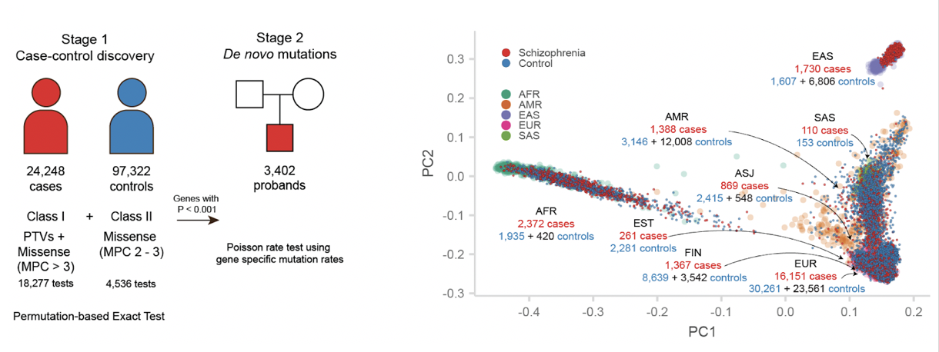
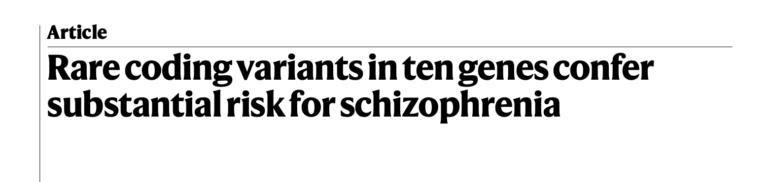
Schizophrenia exome meta-analysis (SCHEMA) data and definitions
TJ Singh
Nature, 2022

Slide 40
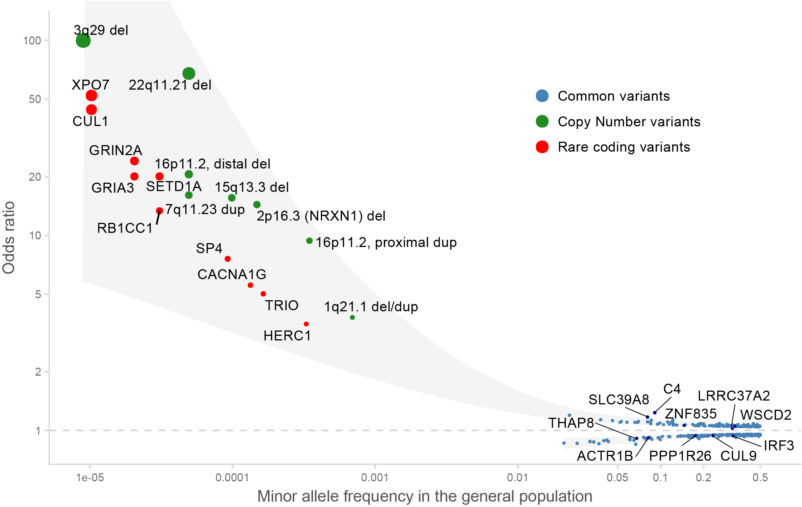
Known genetic architecture of schizophrenia

Slide 41
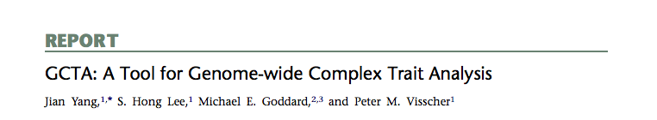
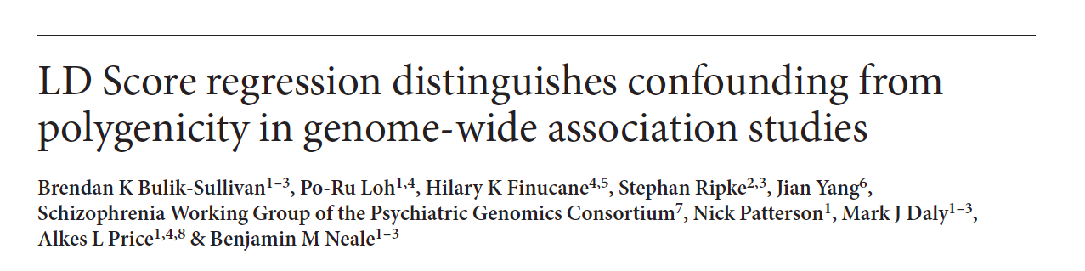
Polygenes!
Many small genetic effects
Can we develop a little further?
We can assume a distribution of SNP effects and now generate estimates of heritability
β

Slide 42
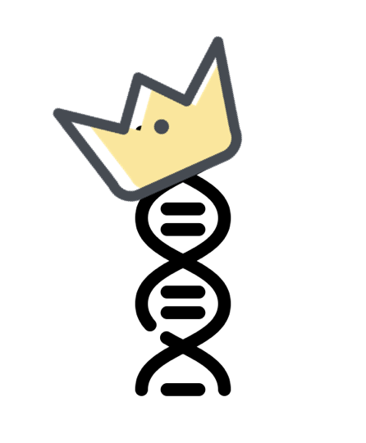
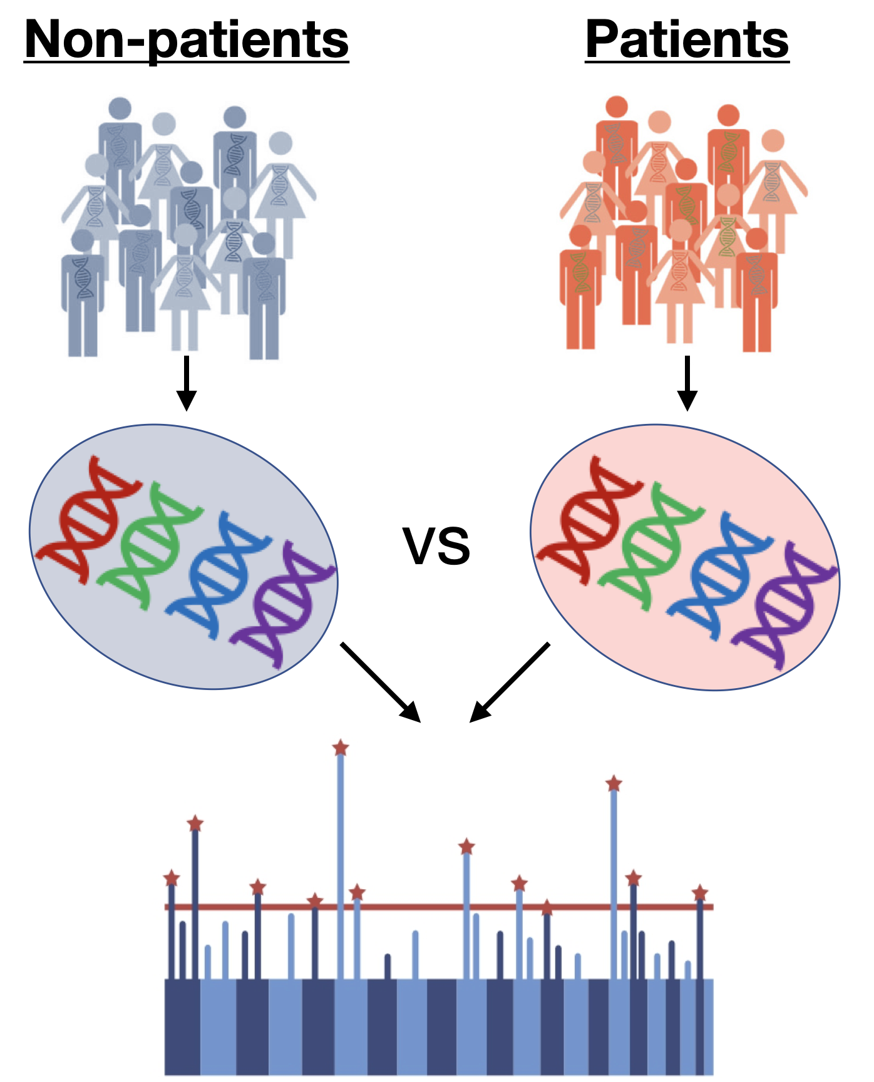
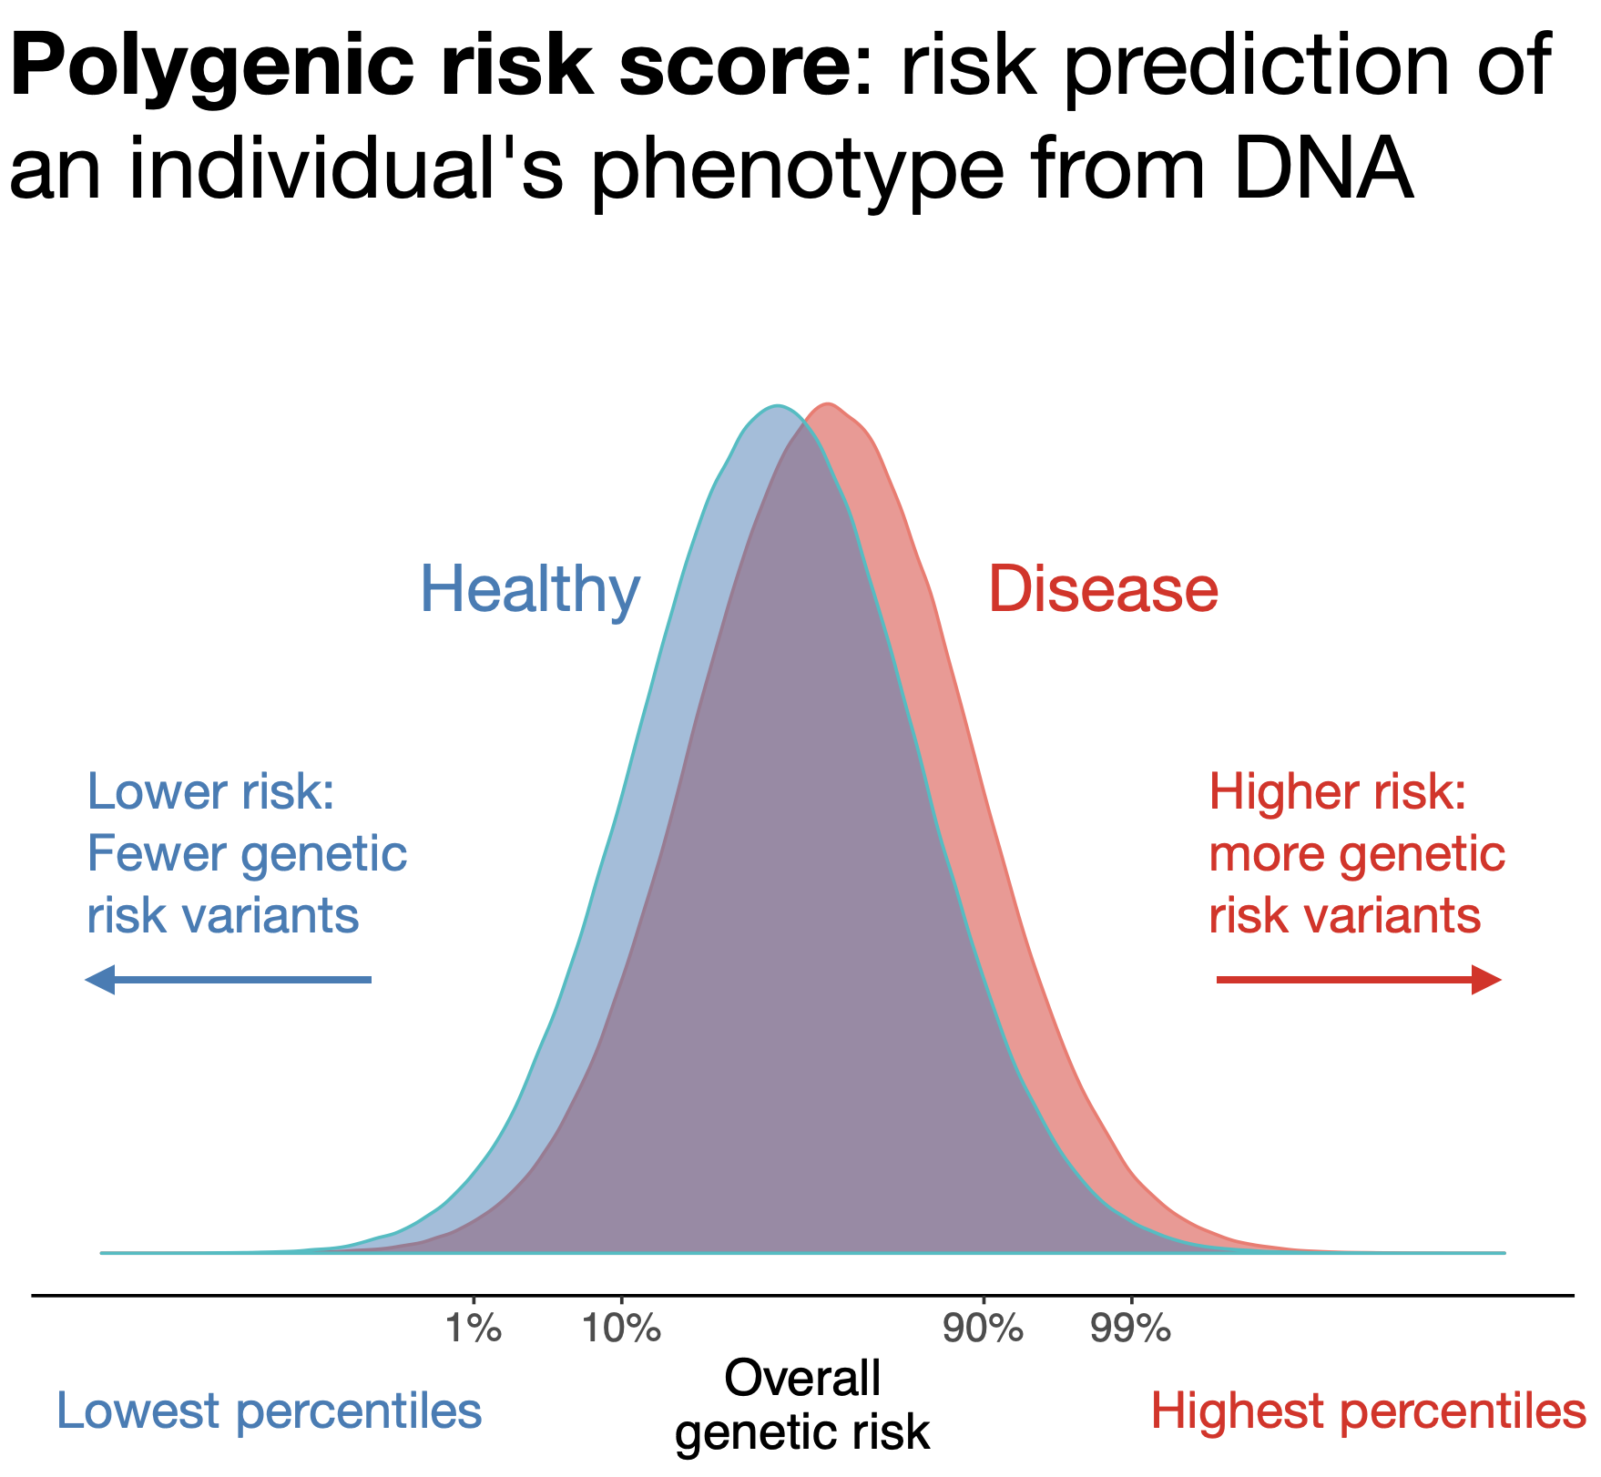
The rise of the polygenic score
Notes:
Polygenic scores use genetic studies to predicts a individuals' phenotypes or traits (in this case highly heritable psychiatric disorders) from their DNA.
We need millions of individuals
These aren’t yet super useful to individuals but likely will be to populations as screening tools
Preventative medicine, risk stratification tool, like cholesterol or family history
Research: deep phenotyping
Clinical trials: high-risk identification
Routine clinical use? Differential diagnosis, preventative medicine

Slide 43
The rise of the polygenic score
Research: deep phenotyping
Clinical trials: high-risk identification
Routine clinical use? preventative medicine
Embryo selection??? 🤯
Notes:
Polygenic scores use genetic studies to predicts a individuals' phenotypes or traits (in this case highly heritable psychiatric disorders) from their DNA.
We need millions of individuals
These aren’t yet super useful to individuals but likely will be to populations as screening tools
Preventative medicine, risk stratification tool, like cholesterol or family history
Research: deep phenotyping
Clinical trials: high-risk identification
Routine clinical use? Differential diagnosis, preventative medicine

Slide 44
Some questions that you might learn how to answer over the course
Can we quantify the impact genetic variation has on trait variation?
How do we analyze unrelated individuals?
Is it possible to estimate individual genetic risk?
What genes and variants matter?
How do we analyze family data?
Can we find causal relationships using genetics?
How do we protect against artifacts and confounds in genetic analysis?
What do associated variants do biologically?
How do we analyze rare genetic variation?

