Slide 1
Simulation and Power
Brad Verhulst
International Statistical Genetics Workshop
March 8th, 2024

Slide 2
Motivations for Simulating Data
Model Testing
  Can I generate a data to test whether my model works as advertised?
Bias Testing
  What happens if the data I generate doesn’t match the model that I want to fit?
Power Analysis
  How many people would I need to have to be reasonably confident that I will accurately reject the null hypothesis?

Slide 3
Motivations for Simulating Data
Simulations for Model Testing
  Often used in methodological development.
  Does the model that I am building recover the “true” estimates
  What does the distribution of the parameters look like

Slide 4
Motivations for Simulating Data
Simulations for Bias Testing
  This allows you to test how violations in the assumptions will bias the parameter estimates.
  You can simulate models that cannot be identified (and therefore could not be fit)
  Only some parameters will be biased.
    Knowing where the bias is allows you to think about how your model will be affected by unmodeled (and potentially unmodel-able) parameters

Slide 5
Motivations for Simulating Data
Simulations for Power Analysis
  Simulating data that corresponds with the way you think the world work will allow you to estimate how many people you will need to reasonably identify a significant effect.
Two primary methods for power analysis in twin studies:
  Monte Carlo Power analysis.
    Simulate and evaluate the model. The proportion of times your parameter is significant is your power.
  Non-Centrality Parameter approach:
    Identify how much each observation contributes to the effect (on average).
    The NCP scales linearly with sample size

Slide 6
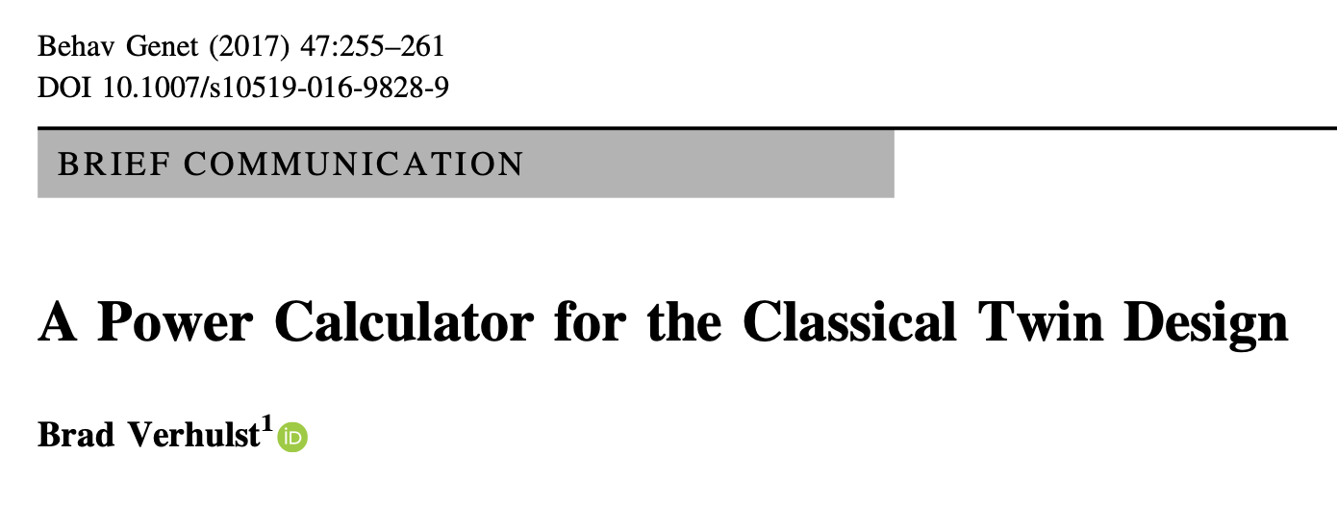
The NCP approach is implemented for a variety of examples in this paper
This approach does not work if you want to include definition variables

Slide 7
Simulations in the Alt Script
General Simulations
  Linear Regression
  Latent Factor
  ACE
Simulating Bias
  ACE model with rAC and rAE
Simulations elsewhere in the workshop
  Simulations for the CPM and IPM model on Wednesday (Me)
  Simulations for the prs-rGE model (Dan)
  Simulations for Doc Model (Madhur)

