Slide 1
We will be working in qualtrics : https://qimr.az1.qualtrics.com/jfe/form/SV_bjXq3wCxYVR0SEu
We will be using the script TrioGCTA_Practical_2024.R
You will need to copy simulated data into your folder:
# Create a directory to hold today's work mkdir day4_triogcta
# Move into that directory, and then copy over my folder cd day4_triogcta cp -r /home/ziada/2024/day4_triogcta/TrioGCTA_practical* ./

Slide 2
# NB!! this GRM becomes computationally intensive when working with larger data sets < 60,000 trios
# in that case we would recommend using the programming language Julia which is known for its speed in high performance computing
# Contact Espen Eilertsen e.m.eilertsen@psykologi.uio.no for Julia scripts
##################################################
# STEP 2: Compute GRM (genetic relatedness matrix) #
##################################################
A = GRM(dat) #create a genetic relatedness matrix

Slide 3
#############################################
# STEP 3: Subset GRM into blocks
#############################################
mid = 1:1000
pid = 1001:2000
oid = 2001:3000
Amm = A[mid, mid]
App = A[pid, pid]
Aoo = A[oid, oid]
Dpm = A[pid, mid] + A[mid, pid]
Dom = A[oid, mid] + A[mid, oid]
Dop = A[oid, pid] + A[pid, oid]
# These blocks define the correlation structure of each family members effects i.e., direct indirect covariance
# The implied structure of the model can be described by these blocks alone

Slide 4
Here we specify the owner of the phenotype, this will influence how we interpret the parameters
##################################################
# STEP 4: Define the trio model in open mx
##################################################
# set up model
yX = cbind(dat@ped$pheno[oid], 1) # create a matrix including phenotype data and a column of ones
colnames(yX) = c("y", "x")
K = 1000 # Number of trios

Slide 5
Bonus script questions?

Slide 6
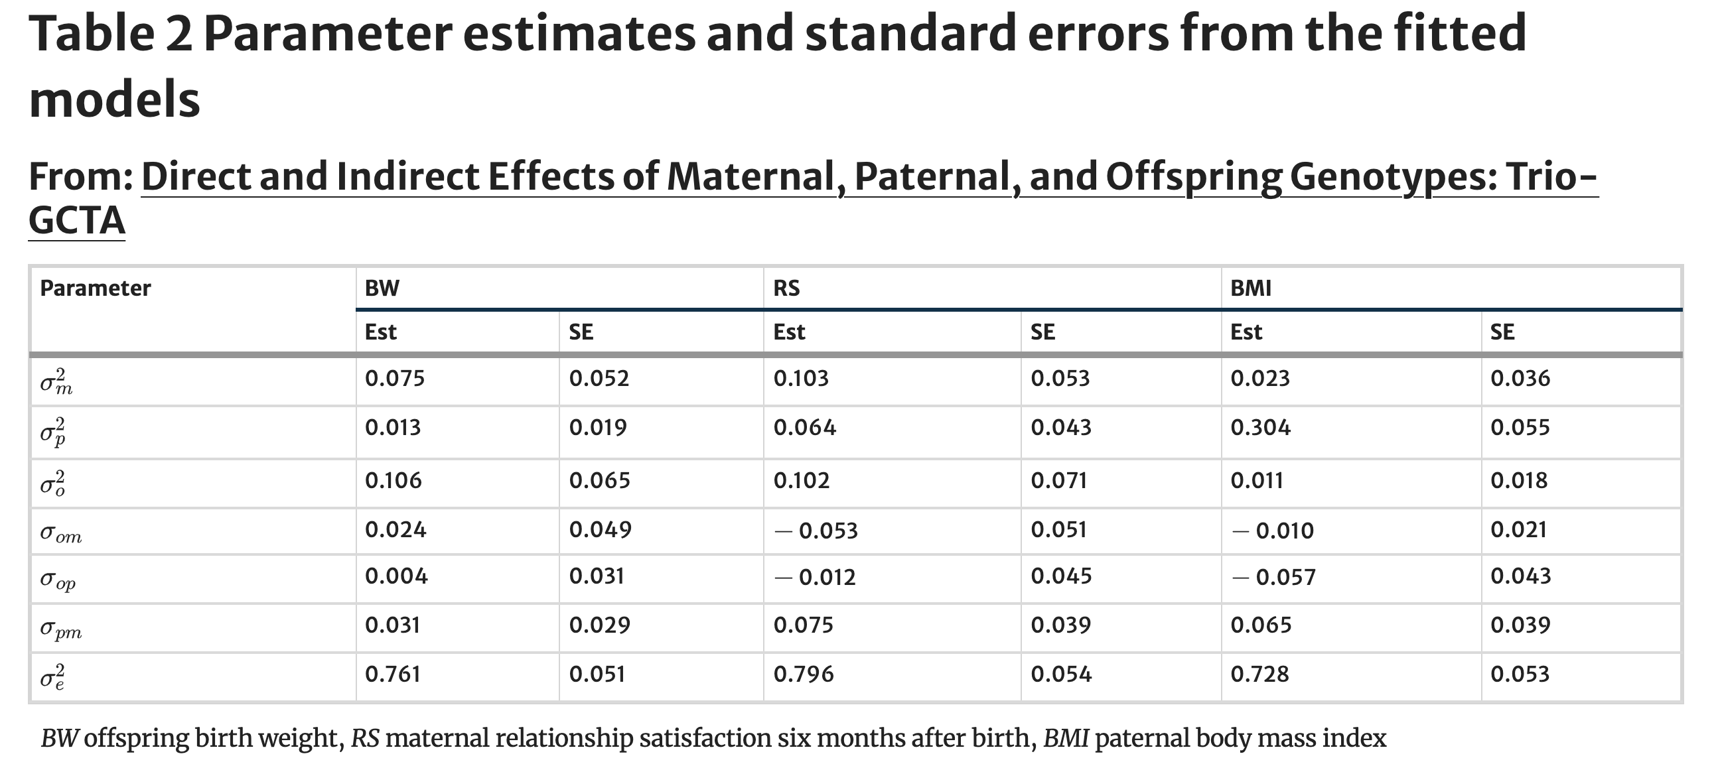
Eilertsen, E. et al., (2021). Behavior Genetics, 51, 154-161.

Slide 7
For a more detailed analysis it would be preferable to fit alternative nested models as seen above and compare whether simpler models are equally supported by the data.

