Slide 1
Trio GCTA and Within-family GWAS
Perline Demange, PhD
PROMENTA Research Center
University of Oslo
perlined@uio.no
Ziada Ayorech, PhD
PROMENTA Research Center
University of Oslo
ziada.ayorech@psykologi.uio.no

Slide 2
Day 4 ISPG

Slide 3
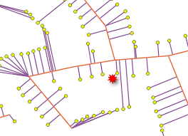
Trajectories to ISPG

Slide 4
How to estimate direct and indirect genetic effects?
Individual trait model:
indirect effects on the phenotype of the index person (e.g child) mediated by phenotype of other individuals
Limited to the phenotype and traits correlated with the phenotype
In the case of PGS inherits the issues with PGS and the GWAS weights
Other option?

Slide 5
How to estimate direct and indirect genetic effects?
Individual trait model:
indirect effects on the phenotype of the index person (e.g child) mediated by phenotype of other individuals
Variance decomposition model:
avoid specification of the phenotypes that underlie the indirect genetic effects, instead quantifying the total contributions from these effects while being agnostic as to the underlying mechanisms

Slide 6
How to estimate direct and indirect genetic effects?
Individual trait model:
Based on PGS:
PGS-SEM
Trios/Non-transmitted
Adoption
Within-sibling
Variance decomposition model:
Twin models (+ PGS)
GCTA models:
RDR
MGCTA
TrioGCTA
GWAS of direct and indirect genetic effects
Within-sibling GWAS
with SEM modeling

Slide 7
How to estimate direct and indirect genetic effects?
Individual trait model:
Based on PGS:
PGS-SEM
Trios/Non-transmitted
Adoption
Within-sibling
Variance decomposition model:
Twin models (+ PGS)
GCTA models:
RDR
MGCTA
TrioGCTA
GWAS of direct and indirect genetic effects
Within-sibling GWAS
with SEM modeling

Slide 8
The big picture of heritability estimation
A shared limitation of genomic methods applied to unrelated individuals is an inability to account for environmental confounding
Adapted from Barry, C. J. S., Walker, V. M., Cheesman, R., Davey Smith, G., Morris, T. T., & Davies, N. M. (2023).. International Journal of Epidemiology, 52(2), 624-632.

Slide 9
How to estimate direct and indirect genetic effects?
each a product of our genes and our environments
our environments include the relatives around us
Phenotype
Notes:
cute graph

Slide 10
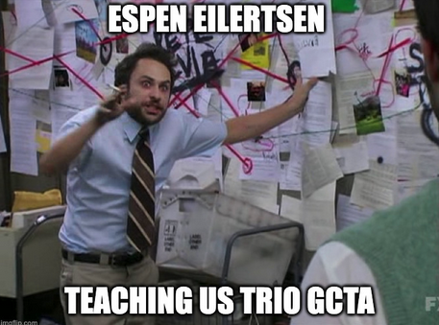
TrioGCTA
Eilertsen, E. et al., (2021). Behavior Genetics, 51, 154-161.

Slide 11
How did we get here
GREML GCTA on unrelated individuals
MGCTA
Trio GCTA

Slide 12
GREML GCTA
In 2010, Yang et al. introduced the G-REML framework:
genome-wide genetic similarity between unrelated individuals is used to partition phenotypic variance into genetic components of variation explained by tagged SNPs and residual sources of variation
First new quantitative genetic analytic method in 100 year’s
Yang J, et al., (2010). Nat Genet 42:565–569

Slide 13
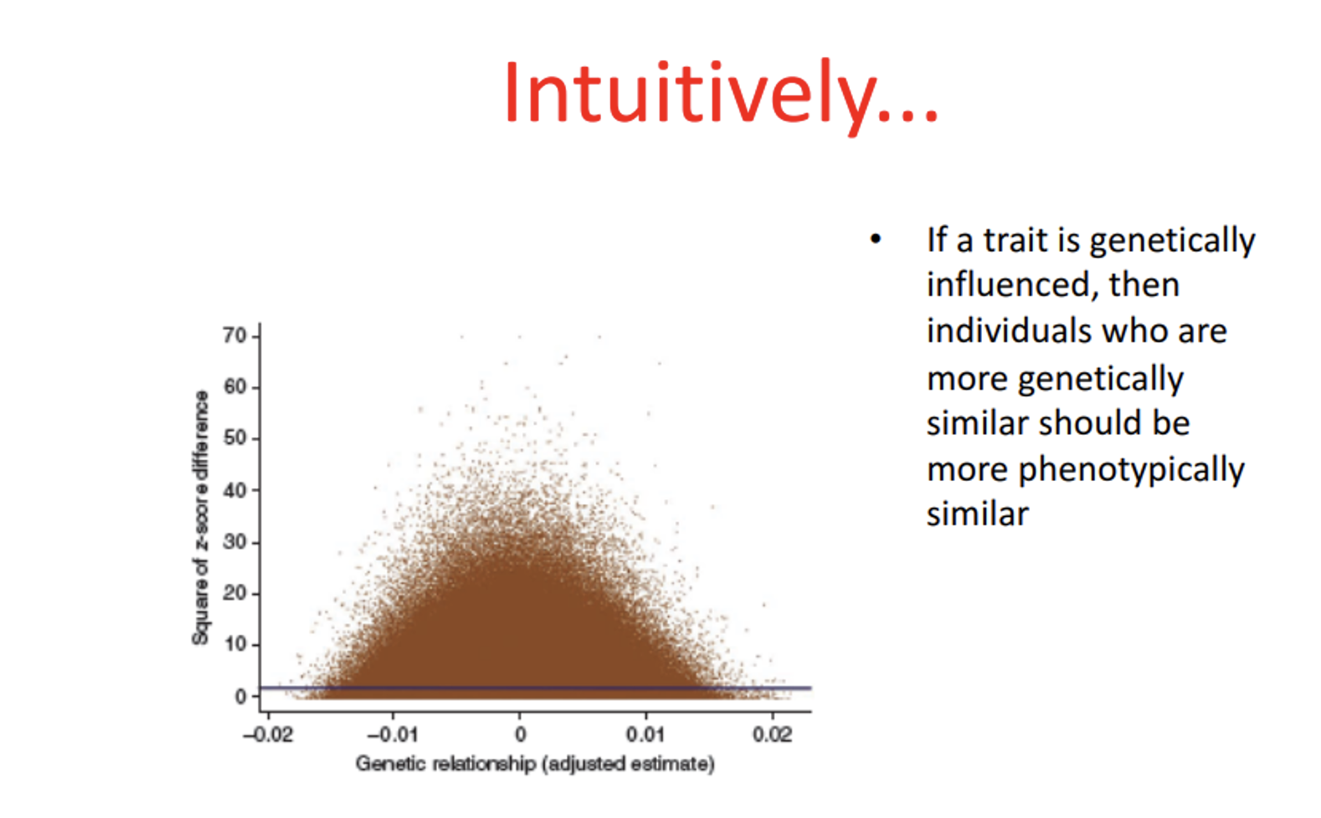
GREML GCTA intuition
uses unrelated individuals who vary randomly in genetic similarity by chance

Slide 14
Classic Twin Design
Squared intrapair phenotypic difference
0 0.5 1
Genetic similarity
Adapted from Dave Evans M-GCTA ISPG slides

Slide 15
GREML GCTA
Classic Twin Design
Builds intuition on why the sample size requirements for twin versus greml GCTA models is so different
Squared intrapair phenotypic difference
0 0.5 1
Genetic similarity
Adapted from Dave Evans M-GCTA ISPG slides

Slide 16
GREML GCTA
Practically, this method involves two steps:
Estimating a genetic relatedness matrix:
Estimate variance components
Partitions phenotypic variance into proportion explained by tagged SNPs and residual variance
Quantifies the pairwise genetic relatedness between pairs of individuals in the sample

Slide 17
Key assumptions of GREML GCTA on unrelated
All genetic effects are direct
Individuals do not share environmental influences
GREML only captures direct, additive effects of common SNPs
random mating
strong assumptions about genetic architecture
true genetic effect variance–covariance structure between pairs of individuals is known
the same genetic variants can have both direct and indirect effects, failing to account for the indirect genetic effects of relatives when attempting to measure heritability can result in misleading quantifications of the importance of direct genetic effects
Phenotype

Slide 18
MGCTA
Extends GREML GCTA to estimate the proportion of the child’s phenotypic variance explained by the maternal (or paternal) and offspring genotype
Eaves LJ, Pourcain BS, Smith GD, York TP, Evans DM (2014). Behav Genet 44:445–455
Qiao, Z., Zheng, J., Helgeland, Ø., Vaudel, M., Johansson, S., Njølstad, P. R., ... & Evans, D. M. (2020).. Behavior Genetics, 50, 51-66.

Slide 19
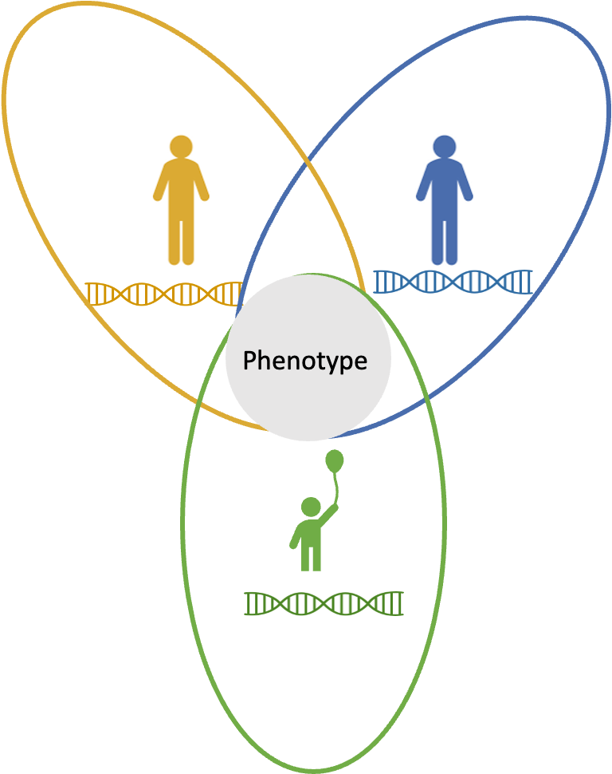
MGCTA
Observed (measured) variables
Latent (unmeasured) factors
Causal relationships
Correlational relationships
Maternal
Maternal
One parent at a time
These genes don’t have affect on offspring phenotype when in mother
Genes in mothers that do affect offspring genotype
Maternal genotype
G_{Mc}
G_{MM}
m
1/2
P
Phenotype
1/2
e
h
c
the same genetic variants can have both direct and indirect effects
G_{cM}
E
G_{cc}
Offspring genotype
Offspring
Eaves LJ, Pourcain BS, Smith GD, York TP, Evans DM (2014). Behav Genet 44:445–455
Qiao, Z., Zheng, J., Helgeland, Ø., Vaudel, M., Johansson, S., Njølstad, P. R., ... & Evans, D. M. (2020).. Behavior Genetics, 50, 51-66.

Slide 20
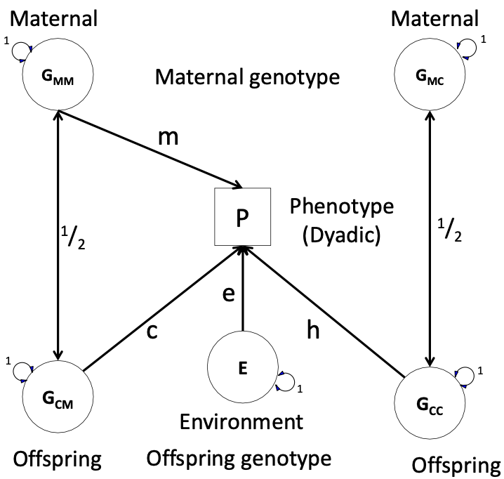
MGCTA
Observed (measured) variables
Latent (unmeasured) factors
Causal relationships
Correlational relationships
One parent at a time
Double headed arrows around latent factors to emphasize every latent factor is standardized to unit variance
Eaves LJ, Pourcain BS, Smith GD, York TP, Evans DM (2014). Behav Genet 44:445–455
Qiao, Z., Zheng, J., Helgeland, Ø., Vaudel, M., Johansson, S., Njølstad, P. R., ... & Evans, D. M. (2020).. Behavior Genetics, 50, 51-66.

Slide 21
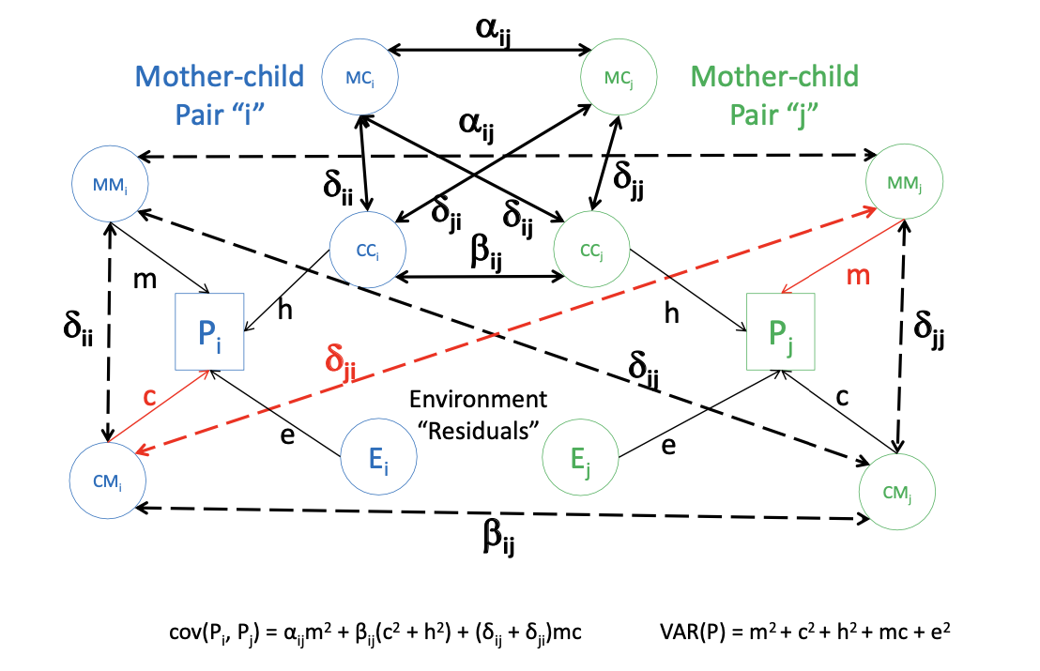
MGCTA
Observed (measured) variables
Latent (unmeasured) factors
Causal relationships
Correlational relationships
The maths and path tracing are described beautifully here
https://www.colorado.edu/ibg/international-workshop/2022-international-statistical-genetics-workshop/syllabus/m-gcta-trio-gcta
Eaves LJ, Pourcain BS, Smith GD, York TP, Evans DM (2014). Behav Genet 44:445–455
Qiao, Z., Zheng, J., Helgeland, Ø., Vaudel, M., Johansson, S., Njølstad, P. R., ... & Evans, D. M. (2020).. Behavior Genetics, 50, 51-66.

Slide 22
TRIO GCTA
Very similar to MGCTA except can simultaneously model both parents
Model is applicable to any family member being the ‘focal individual’

Slide 23
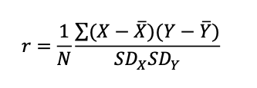
Trio GCTA Step 1: estimate GRM
X is now the dosage (0,1,2 ) of a SNP
Mean is now the average genotype
The formula for the GRM is analogous to the formula for a pearson correlation
The GRM formula is described beautifully here
https://www.colorado.edu/ibg/isg-workshop/online-lectures-and-practicals/g2-gcta-greml-m-gcta-part-2-gcta-genetic-relationship

Slide 24
Trio GCTA Step 1: estimate GRM
n
n
Crucially!! Your trio data are organised with all mothers, stacked on top of all fathers, who are stacked on top of all offspring
n x n matrix capturing the degree of relatedness
between every pair of individuals at every SNP location

Slide 25
Trio GCTA additional Step 1: subset GRM into blocks
mid = 1:2
pid = 3:4
oid = 5:6
Amm = A[mid, mid]
App = A[pid, pid]
Aoo = A[oid, oid]
Dpm = A[pid, mid] + A[mid, pid
Dom = A[oid, mid] + A[mid, oid]
Dop = A[oid, pid] + A[pid, oid]
These blocks define the correlation structure of each family members effects and will be used to hold their relative direct and indirect effects and their covariances

Slide 26
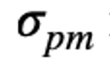
GREML Step 2 : estimate variance components
Mother’s genotype
Father’s genotype
Child’s
test score
e
Child’s
genotype

Slide 27
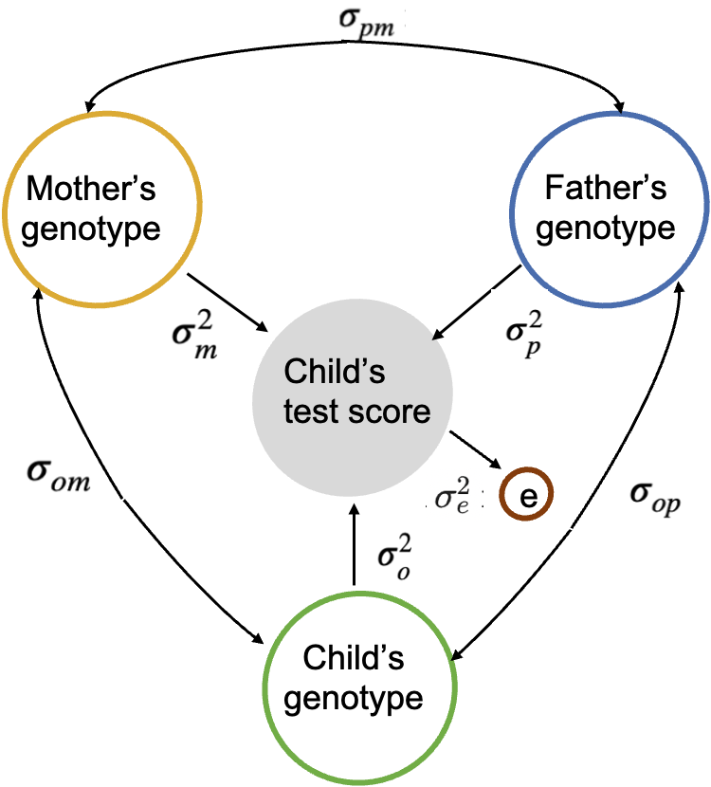
GREML Step 2 : estimate variance components
The extent to which the same SNPs contribute to direct and indirect effects
Direct or Indirect depending on focal individual
we do not include the covariance between the father and mother in the calculation of the total variance. We do this under the assumption that parents are unrelated and have an expected genetic relatedness of 0.

Slide 28
Expected covariance structure of phenotype across all individuals
M = SNPs available for all individuals
Multiply by transpose*
matrices of maternal, paternal and offspring standardized genotype dosages are represented by Z_{m}, Z_{p}, Z_{o}, respectively.
*Matrix algebra to allow us to work with matrices and vectors: we swap rows and columns.
If Z_{m} is a K X M matrix, then Z_{m}^{T} is a M X K matrix.

Slide 29
Mother’s genotype
Father’s genotype
Child’s
test score
Covariance
e
Residual variance
Child’s
genotype

Slide 30
Adapted from Barry, C. J. S., Walker, V. M., Cheesman, R., Davey Smith, G., Morris, T. T., & Davies, N. M. (2023).. International Journal of Epidemiology, 52(2), 624-632.

Slide 31
Now for the practical
https://qimr.az1.qualtrics.com/jfe/form/SV_bjXq3wCxYVR0SEu
# Create a directory to hold today's work mkdir day4_triogcta
# Move into that directory, and then copy over my folder cd day4_triogcta cp -r /home/ziada/2024/Day-4/TrioGCTA_practical* ./

