Slide 1
Estimating Intergenerational Transmission
Jared V. Balbona | Matthew C. Keller

Slide 2
“Okay yeah, that explains a lot.”

Slide 3


Slide 4
Parents and offspring tend to be quite similar.
…Why?

Slide 5

Maternal
Genotype
Shared Genetic Effects
Paternal
Genotype

Slide 6
Maternal
Genotype
Shared Genetic Effects
Offspring
Genotype
Paternal
Genotype

Slide 7
Maternal
Genotype
Shared Genetic Effects
Genes shared between parents and offspring
Paternal
Genotype

Slide 8
Parental
Phenotype
Shared Genetic Effects
Genes shared between parents and offspring
Offspring
Phenotype

Slide 9
Parental
Phenotype
Offspring
Phenotype

Slide 10

Parental
Phenotype
Offspring
Phenotype

Slide 11
Parental
Phenotype
Vertical
Transmission
(aka “Cultural Transmission”)
The phenomenon where a
parental phenotype directly influences an offspring phenotypes via the
familial environment
Familial
Environment
Offspring
Phenotype

Slide 12
Parental
Phenotype
Genes shared between parents and offspring
Offspring
Phenotype

Slide 13
Parental
Phenotype
Genes shared between parents and offspring
Familial
Environment
Familial
Environment
Offspring
Phenotype

Slide 14
Parental
Phenotype
Genetic Nurture
A type of Passive Gene-Environment Covariance
Familial
Environment
Familial
Environment
Offspring
Phenotype
Offspring
Phenotype

Slide 15
Parental
Phenotype
Genes shared between parents and offspring
Familial
Environment
Offspring
Phenotype

Slide 16
Genes shared between parents and offspring
Offspring
Phenotype

Slide 17
Parental
Phenotype
Genes shared between parents and offspring
Familial
Environment
Offspring
Phenotype

Slide 18
If unaccounted for,
genetic nurture and vertical transmission:
Parental
Phenotype
Will upwardly bias estimates of SNP effects from GWAS
Will downwardly bias estimates of additive genetic effects (A) in twin ACE models
Will upwardly bias estimates of additive genetic effects (A) in twin AE and ADE models
We’ll be missing out on stuff that’s just like, generally cool to know about
Familial
Environment
Offspring
Phenotype

Slide 19
Parental
Phenotype
Genes shared between parents and offspring
Familial
Environment
Offspring
Phenotype

Slide 20
Parental
Phenotype
Genes shared between parents and offspring
Familial
Environment
Offspring
Phenotype

Slide 21
Parental
Phenotype
Genes shared between parents and offspring
Familial
Environment
Offspring
Phenotype

Slide 22
Parental
Phenotype
Genes shared between parents and offspring
Familial
Environment
Offspring
Phenotype

Slide 23
Parental
Phenotype
Genes shared between parents and offspring
Familial
Environment
Offspring
Phenotype

Slide 24
Parental
Phenotype
Biological Parents
Adoptive Parents
Genes shared between parents and offspring
Genes NOT shared between parents and offspring
Offspring
Phenotype

Slide 25
”All models are wrong, some are useful.”
— George E.P. Box
— Mike Hunter
— Sarah Medland
— Ben Neale
-
— Matt Keller
— Jared Balbona

Slide 26
Parental
Phenotype
Biological Parents
Adoptive Parents
Parental alleles transmitted to the offspring
Parental alleles not transmitted to the offspring
Offspring
Phenotype

Slide 27
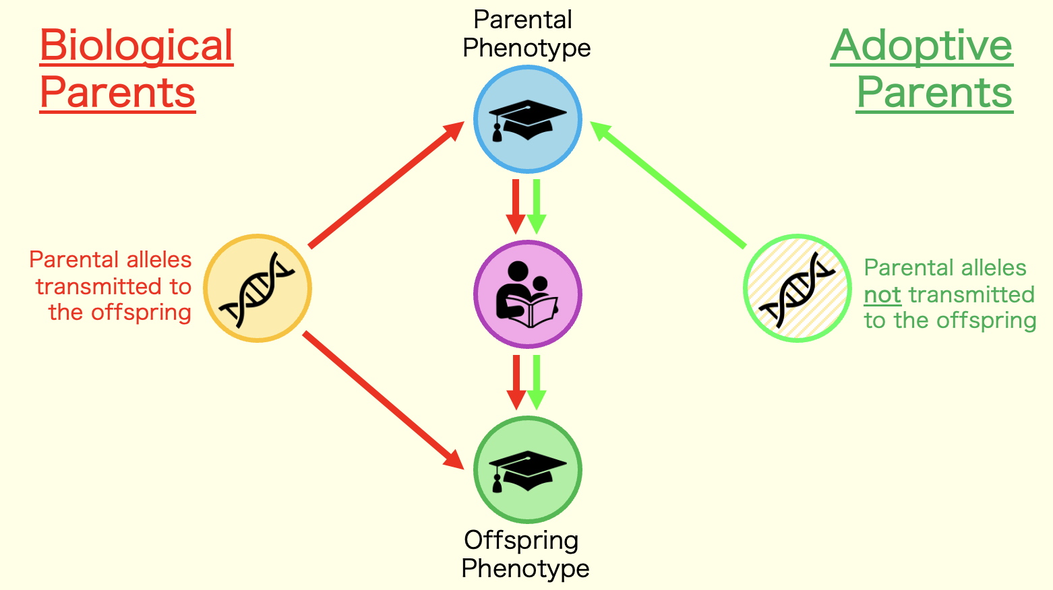
Assumptions
Child’s genotype is uncorrelated with adoptive parents’
  No selective placement
  No within-family adoption
Equivalence of environments provided by biological and adoptive parents
Random mating between the parents
Generalizable to all individuals

Slide 28
Limitations
Difficult sample to collect– Often small and proprietary

Slide 29
Parental
Phenotype
Biological Parents
Adoptive Parents
Parental alleles transmitted to the offspring
Parental alleles not transmitted to the offspring
Offspring
Phenotype

Slide 30
Parental
Phenotype
Biological Parents
(of adopted away offspring)
Adoptive Parents
Parental alleles transmitted to the offspring
Parental alleles not transmitted to the offspring
Offspring
Phenotype

Slide 31
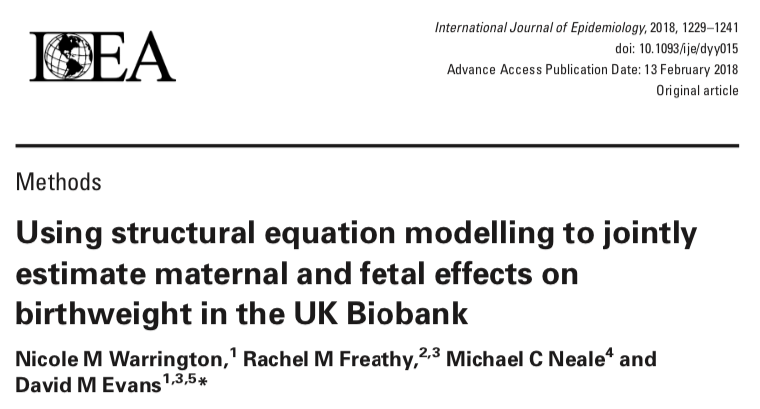
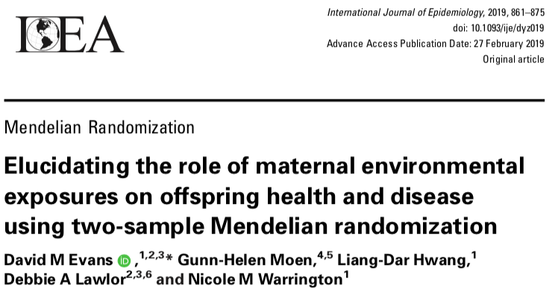
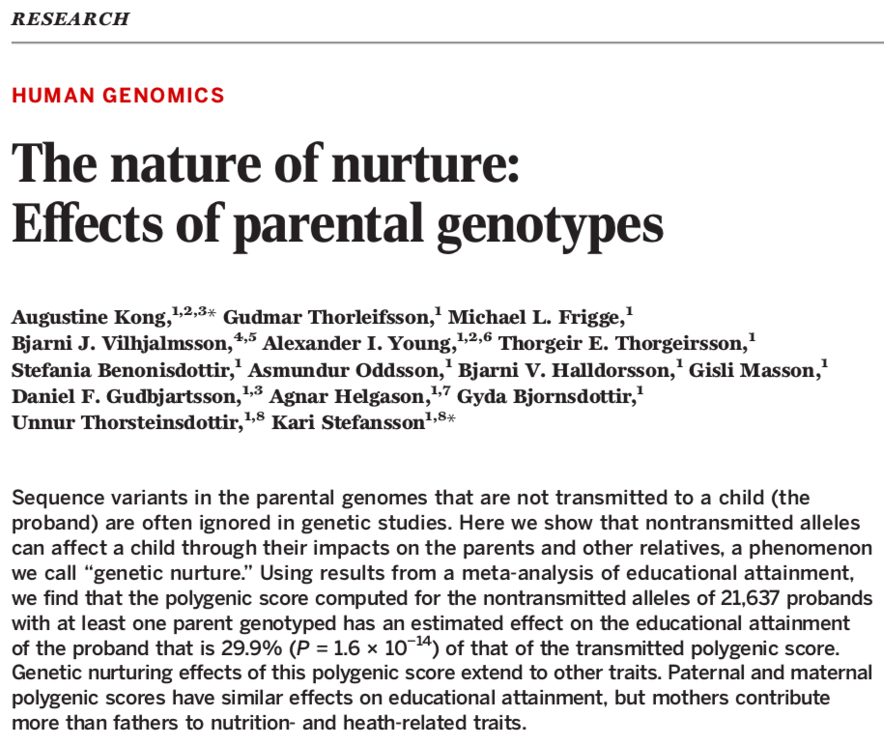

Slide 33
Maternal
Genotype
Parental alleles transmitted to the offspring
Parental alleles not transmitted to the offspring
Paternal
Genotype

Slide 34
Parental alleles transmitted to the offspring
Parental alleles not transmitted to the offspring

Slide 35
Parental
Phenotype
Parental alleles transmitted to the offspring
Parental alleles not transmitted to the offspring
Offspring
Phenotype

Slide 36
Parental
Phenotype
Parental alleles transmitted to the offspring
Parental alleles not transmitted to the offspring
Offspring
Phenotype

Slide 37
Parental
Phenotype
Transmitted
Alleles
Non-Transmitted Alleles
Parental alleles transmitted to the offspring
Parental alleles not transmitted to the offspring
Offspring
Phenotype

Slide 38
Parental
Phenotype
Biological Parents
Adoptive Parents
Parental alleles transmitted to the offspring
Parental alleles not transmitted to the offspring
Offspring
Phenotype

Slide 39
Kong et
al. Model
Assumes no assortative mating beyond the parental generation
No estimate of the vertical transmission effect itself.
Cumbersome math that cannot be extended to other, more common scenarios (e.g., data without trios).

Slide 40
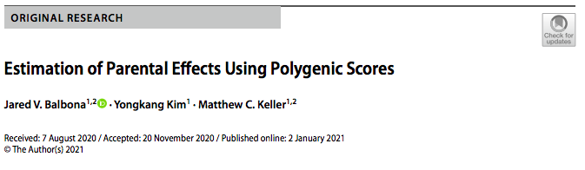

Slide 41
Kong et
al. Model
SEM-PGS
Model
Assumes no assortative mating beyond the parental generation
No estimate of the vertical transmission effect itself.
Cumbersome math that cannot be extended to other, more common scenarios (e.g., data without trios).
  Allows for all types of assortative mating
  Estimates genetic nurture and vertical transmission
  Not biased by missing data
  Allows for extensions to fit whatever trait and data you have
  Easy to use!

Slide 42
Paternal
Maternal
Offspring

Slide 43
Parental
Phenotype
Shared Genetic Effects
Genes shared between parents and offspring
Offspring
Phenotype

Slide 44
Paternal
Maternal
Offspring

Slide 45
Paternal
Maternal
Offspring

Slide 46
Paternal
Maternal
Offspring

Slide 47
Parental
Phenotype
Genetic Nurture
A type of Passive Gene-Environment Covariance
Familial
Environment
Familial
Environment
Offspring
Phenotype
Offspring
Phenotype

Slide 48
Paternal
Maternal
Offspring

Slide 49
Paternal
Maternal
Offspring

Slide 50
ε
ε
ε

Slide 51
ε
ε
ε

Slide 52















$$k$$
$$V_{\text{ε}}$$
$$V_{\text{ε}}$$
$$k$$
ε
ε
𝛿
𝛿
$\frac{w}{2}$
1
1
$\frac{w}{2}$
1
1
$$V_{F}$$
$$V_{F}$$
$\frac{w}{2}$
𝛿
$\frac{w}{2}$
$$f$$
$$f$$
𝛿
$$k$$
1
$$k$$
𝛿
𝛿
1
ε
$$V_{\text{ε}}$$

Slide 53















$$k$$
$$V_{\text{ε}}$$
$$V_{\text{ε}}$$
$$k$$
NT_{p}
NT_{m}
ε_{p}
ε_{m}
𝛿
𝛿
$\frac{w}{2}$
1
1
$\frac{w}{2}$
F_{p}
1
Y_{p}
Y_{m}
1
F_{m}
$$V_{F}$$
$$V_{F}$$
$\frac{w}{2}$
𝛿
$\frac{w}{2}$
$$f$$
$$f$$
𝛿
T_{p}
F_{o}
T_{m}
$$k$$
1
$$k$$
𝛿
𝛿
Y_{o}
Y: Phenotypic Value
SEM-PGS
T: PGS made from the parent’s transmitted alleles
1
NT: PGS made from the parent’s non-transmitted alleles
F: The familial env
ε_{o}
m, p, and o: Maternal, paternal, and offspring
$$V_{\text{ε}}$$

Slide 54















$$k$$
$$V_{\text{ε}}$$
$$V_{\text{ε}}$$
$$k$$
NT_{p}
NT_{m}
ε_{p}
ε_{m}
𝛿
𝛿
$\frac{w}{2}$
1
1
$\frac{w}{2}$
F_{p}
1
Y_{p}
Y_{m}
1
F_{m}
$$V_{F}$$
$$V_{F}$$
$\frac{w}{2}$
𝛿
$\frac{w}{2}$
$$f$$
$$f$$
𝛿
T_{p}
F_{o}
T_{m}
$$k$$
1
$$k$$
𝛿
𝛿
Y_{o}
1
Model 0:
Vertical Transmission
Assortative Mating
ε_{o}
$$V_{\text{ε}}$$

Slide 55
$$k$$
$$V_{\text{ε}}$$
$$V_{\text{ε}}$$
$$k$$
NT_{p}
NT_{m}
ε_{p}
ε_{m}
𝛿
𝛿
$\frac{w}{2}$
1
1
$\frac{w}{2}$
F_{p}
1
Y_{p}
Y_{m}
1
F_{m}
$$V_{F}$$
$$V_{F}$$
$\frac{w}{2}$
𝛿
$\frac{w}{2}$
$$f$$
$$f$$
𝛿
T_{p}
F_{o}
T_{m}
$$k$$
1
$$k$$
𝛿
𝛿
Y_{o}
cov(Y_{o} , NT_{p}) = ?
1
Model 0:
Vertical Transmission
Assortative Mating
ε_{o}
$$V_{\text{ε}}$$

Slide 56
$$k$$
$$V_{\text{ε}}$$
$$V_{\text{ε}}$$
$$k$$
NT_{p}
NT_{m}
ε_{p}
ε_{m}
𝛿
𝛿
$\frac{w}{2}$
1
1
$\frac{w}{2}$
F_{p}
1
Y_{p}
Y_{m}
1
F_{m}
$$V_{F}$$
$$V_{F}$$
$\frac{w}{2}$
𝛿
$\frac{w}{2}$
$$f$$
$$f$$
𝛿
T_{p}
F_{o}
T_{m}
$$k$$
1
$$k$$
𝛿
𝛿
Y_{o}
cov(Y_{o} , NT_{p}) = ?
1
Model 0:
Vertical Transmission
Assortative Mating
ε_{o}
$$V_{\text{ε}}$$

Slide 57
Path Tracing Rules
(described in Balbona et al., 2021)
A chain begins by travelling backwards against the direction of a single or double-headed arrow (from the arrow’s head to its tail). However, once a double-headed arrow has been traversed, the direction reverses such that the chain now travels forwards, in the direction of the arrows.
A chain must include exactly one double-headed arrow (a variance or a covariance term), which is equivalent to stating that a chain must change directions exactly once. This is necessary because double-headed arrows provide the proper scaling for the coefficients in each chain.
All chains must be counted exactly once and each must be unique. However, the order of the links in the chains matters. For example, despite being algebraically equivalent, the chain
Y_{p} → NT_{p} → T_{p} → Y_{p} is distinct from the chain Y_{p} → T_{p} → NT_{p} → Y_{p} in Figure1. Both are unique and both must be counted in determining the variance of Y_{p} .
Co-paths may only be traversed once in a given chain, and a chain must be legitimate before traversing the co-path. However, once the co-path is crossed, the first two rules above reset. A chain must therefore contain exactly one double-headed arrow before traversing the co-path, and one double-headed arrow after traversing the co-path. Thus, co-paths connect two legitimate chains to create a single, longer chain.

Slide 58
$$k$$
$$V_{\text{ε}}$$
$$V_{\text{ε}}$$
$$k$$
NT_{p}
NT_{m}
ε_{p}
ε_{m}
𝛿
𝛿
$\frac{w}{2}$
1
1
$\frac{w}{2}$
F_{p}
1
Y_{p}
Y_{m}
1
F_{m}
$$V_{F}$$
$$V_{F}$$
$\frac{w}{2}$
𝛿
$\frac{w}{2}$
$$f$$
$$f$$
𝛿
T_{p}
F_{o}
T_{m}
$$k$$
1
$$k$$
𝛿
𝛿
Y_{o}
1
Model 0:
Vertical Transmission
Assortative Mating
ε_{o}
$$V_{\text{ε}}$$

Slide 59
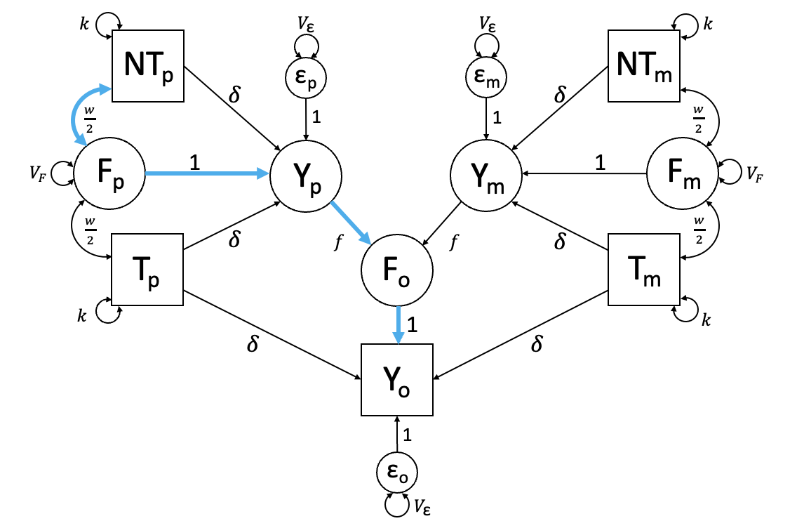
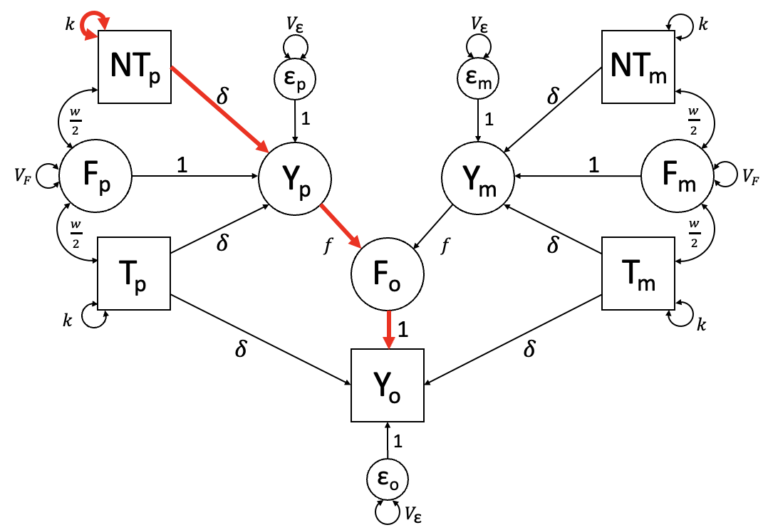


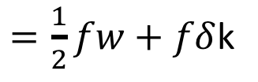
cov(Y_{o} , NT_{p})
$$+ ( 1∗f∗\text{δ}∗k)$$
$$= \left( 1∗f∗1∗\frac{w}{2} \right)$$
$=\frac{1}{2}fw+f\text{δ}$k

Slide 60
$$k$$
$$V_{\text{ε}}$$
$$V_{\text{ε}}$$
$$k$$
NT_{p}
NT_{m}
ε_{p}
ε_{m}
𝛿
𝛿
$\frac{w}{2}$
1
1
$\frac{w}{2}$
F_{p}
1
Y_{p}
Y_{m}
1
F_{m}
$$V_{F}$$
$$V_{F}$$
$\frac{w}{2}$
𝛿
$\frac{w}{2}$
$$f$$
$$f$$
𝛿
T_{p}
F_{o}
T_{m}
$$k$$
1
$$k$$
𝛿
𝛿
Y_{o}
1
Model 0:
Vertical Transmission
Assortative Mating
ε_{o}
$$V_{\text{ε}}$$

Slide 61

$$k$$
$$V_{\text{ε}}$$
$$V_{\text{ε}}$$
$$k$$
NT_{p}
NT_{m}
ε_{p}
ε_{m}
𝛿
𝛿
$\frac{w}{2}$
1
1
$\frac{w}{2}$
F_{p}
1
Y_{p}
$$μ$$
Y_{m}
1
F_{m}
$$V_{F}$$
$$V_{F}$$
$\frac{w}{2}$
𝛿
$\frac{w}{2}$
$$f$$
$$f$$
𝛿
T_{p}
F_{o}
T_{m}
$$k$$
1
$$k$$
𝛿
𝛿
Y_{o}
1
Vertical Transmission
Assortative Mating
ε_{o}
$$V_{\text{ε}}$$

Slide 62






$$k \text{+} g$$
$$V_{\text{ε}}$$
$$V_{\text{ε}}$$
$k$ + $g$
NT_{p}
NT_{m}
ε_{p}
ε_{m}
𝛿
𝛿
$\frac{w}{2}$
1
1
$\frac{w}{2}$
F_{p}
1
Y_{p}
$$μ$$
Y_{m}
1
F_{m}
$$g$$
$$V_{F}$$
$$V_{F}$$
$$g$$
$\frac{w}{2}$
𝛿
$\frac{w}{2}$
$$f$$
$$f$$
𝛿
T_{p}
F_{o}
T_{m}
$$k \text{+} g$$
1
$k \text{+}$ $g$
𝛿
𝛿
Y_{o}
1
Model 1:
Vertical Transmission
Assortative Mating
ε_{o}
$$V_{\text{ε}}$$

Slide 63
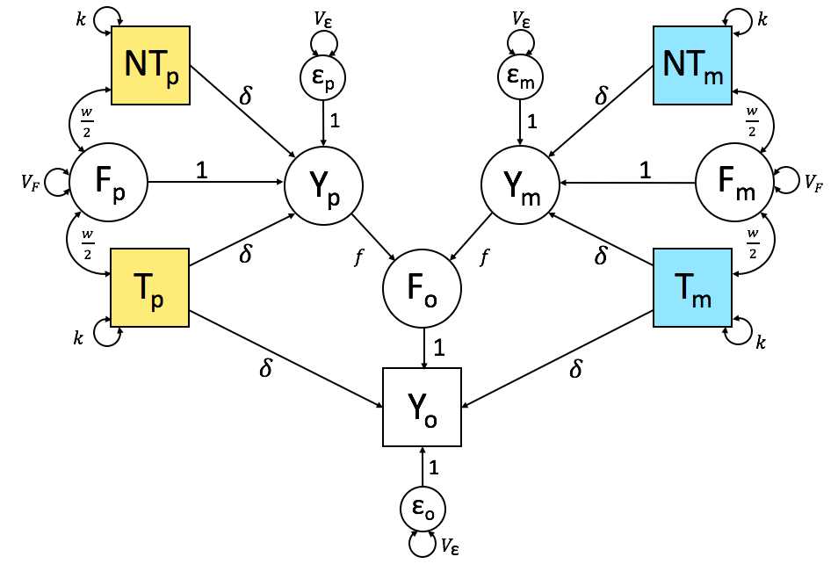
Offspring’s Genome
NT_{p}
NT_{M}
T_{P}
T_{M}
No Assortment

Slide 64

Offspring’s Genome
NT_{p}
NT_{M}
$$μ$$
T_{P}
T_{M}
1 Generation of Assortment

Slide 65
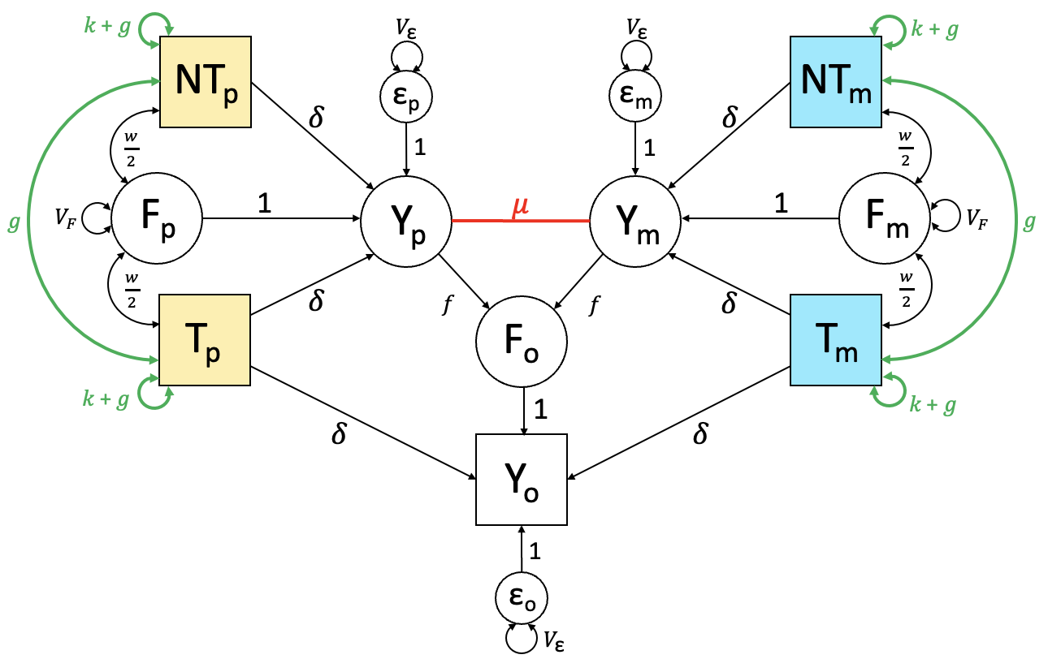
Offspring’s Genome
NT_{p}
NT_{M}
T_{P}
T_{M}
1 Generation of Assortment
>

Slide 66
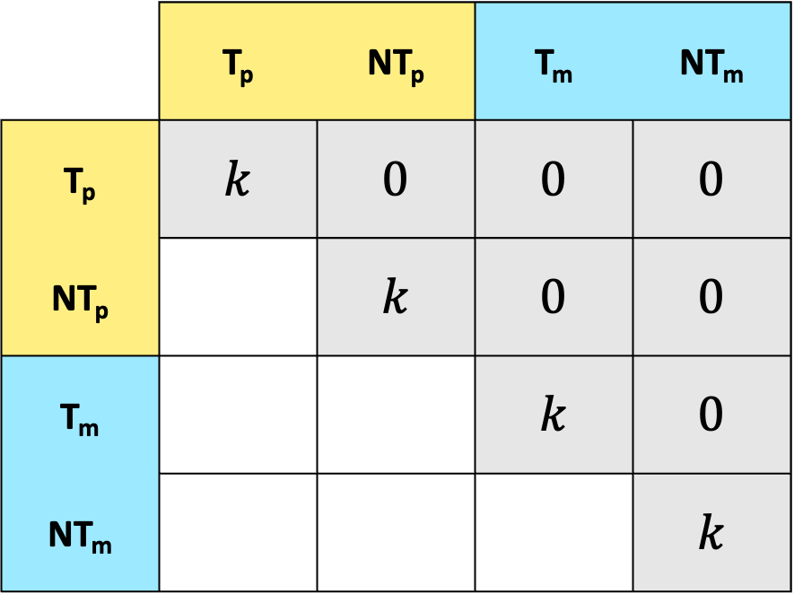
 | T_{p} | NT_{p} | T_{m} | NT_{m}
T_{p} | $$k$$ | $$0$$ | $$0$$ | $$0$$
NT_{p} |  | $$k$$ | $$0$$ | $$0$$
T_{m} |  |  | $$k$$ | $$0$$
NT_{m} |  |  |  | $$k$$
No Assortment

Slide 67

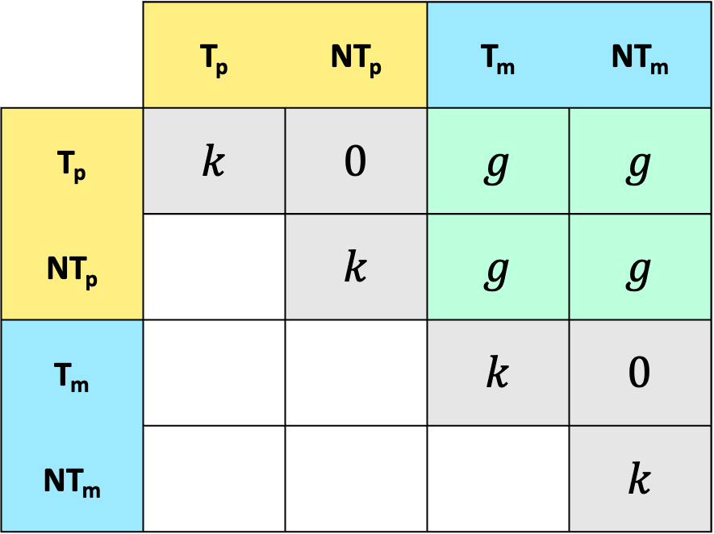
$g$ : Increase in PGS (co)variances due to AM
 | T_{p} | NT_{p} | T_{m} | NT_{m}
T_{p} | $$k$$ | $$0$$ | $$g$$ | $$g$$
NT_{p} |  | $$k$$ | $$g$$ | $$g$$
T_{m} |  |  | $$k$$ | $$0$$
NT_{m} |  |  |  | $$k$$
$$μ$$
1 Generation of Assortment

Slide 68
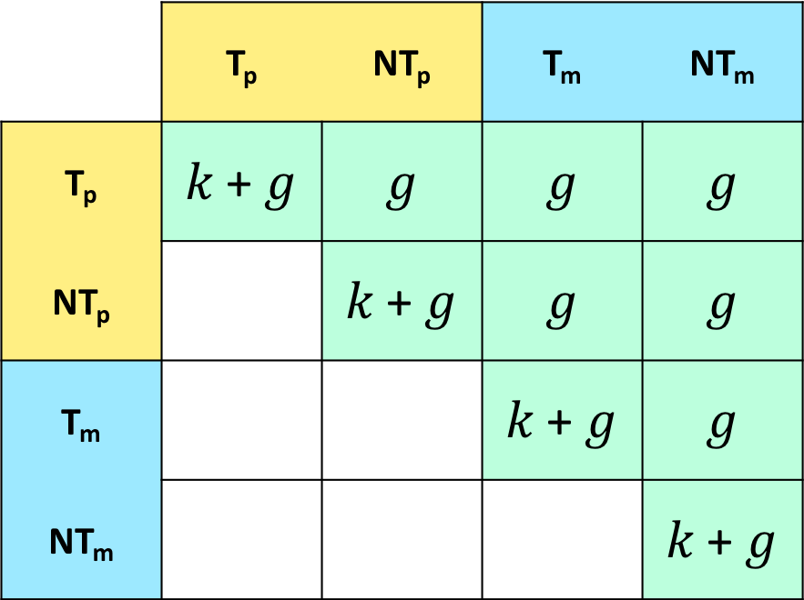

$g$ : Increase in PGS (co)variances due to AM
 | T_{p} | NT_{p} | T_{m} | NT_{m}
T_{p} | $$k \text{+} g$$ | $$g$$ | $$g$$ | $$g$$
NT_{p} |  | $$k \text{+} g$$ | $$g$$ | $$g$$
T_{m} |  |  | $$k \text{+} g$$ | $$g$$
NT_{m} |  |  |  | $$k \text{+} g$$
1 Generation of Assortment
>

Slide 69







$$k \text{+} g$$
$$V_{\text{ε}}$$
$$V_{\text{ε}}$$
$k$ + $g$
NT_{p}
NT_{m}
ε_{p}
ε_{m}
𝛿
𝛿
$\frac{w}{2}$
1
1
$\frac{w}{2}$
F_{p}
1
Y_{p}
$$μ$$
Y_{m}
1
F_{m}
$$g$$
$$V_{F}$$
$$V_{F}$$
$$g$$
$\frac{w}{2}$
𝛿
$\frac{w}{2}$
$$f$$
$$f$$
𝛿
T_{p}
F_{o}
T_{m}
$$k \text{+} g$$
1
$k \text{+}$ $g$
𝛿
𝛿
Y_{o}
1
ε_{o}
$$V_{\text{ε}}$$

Slide 70
$$k \text{+} g$$
$$V_{\text{ε}}$$
$$V_{\text{ε}}$$
$k$ + $g$
NT_{p}
NT_{m}
ε_{p}
ε_{m}
𝛿
𝛿
$\frac{w}{2}$
1
1
$\frac{w}{2}$
F_{p}
1
Y_{p}
$$μ$$
Y_{m}
1
F_{m}
$$g$$
$$V_{F}$$
$$V_{F}$$
$$g$$
$\frac{w}{2}$
𝛿
$\frac{w}{2}$
$$f$$
$$f$$
𝛿
T_{p}
F_{o}
T_{m}
$$k \text{+} g$$
1
$k \text{+}$ $g$
𝛿
𝛿
Y_{o}
1
ε_{o}
$$V_{\text{ε}}$$

Slide 71
$$k \text{+} g$$
$$V_{\text{ε}}$$
$$V_{\text{ε}}$$
$k$ + $g$
NT_{p}
NT_{m}
ε_{p}
ε_{m}
𝛿
𝛿
$\frac{w}{2}$
1
1
$\frac{w}{2}$
F_{p}
1
Y_{p}
$$μ$$
Y_{m}
1
F_{m}
$$g$$
$$V_{F}$$
$$V_{F}$$
$$g$$
$\frac{w}{2}$
𝛿
$\frac{w}{2}$
$$f$$
$$f$$
𝛿
T_{p}
F_{o}
T_{m}
$$k \text{+} g$$
1
$k \text{+}$ $g$
𝛿
𝛿
Y_{o}
1
ε_{o}
$$V_{\text{ε}}$$

Slide 72
$$k \text{+} g$$
$$V_{\text{ε}}$$
$$V_{\text{ε}}$$
$k$ + $g$
NT_{p}
NT_{m}
ε_{p}
ε_{m}
𝛿
𝛿
$\frac{w}{2}$
1
1
$\frac{w}{2}$
F_{p}
1
Y_{p}
$$μ$$
Y_{m}
1
F_{m}
$$g$$
$$V_{F}$$
$$V_{F}$$
$$g$$
$\frac{w}{2}$
𝛿
$\frac{w}{2}$
$$f$$
$$f$$
𝛿
T_{p}
F_{o}
T_{m}
$$k \text{+} g$$
1
$k \text{+}$ $g$
𝛿
𝛿
Y_{o}
1
ε_{o}
$$V_{\text{ε}}$$

Slide 73
$$k \text{+} g$$
$$V_{\text{ε}}$$
$$V_{\text{ε}}$$
$k$ + $g$
NT_{p}
NT_{m}
ε_{p}
ε_{m}
𝛿
𝛿
$\frac{w}{2}$
1
1
$\frac{w}{2}$
F_{p}
1
Y_{p}
$$μ$$
Y_{m}
1
F_{m}
$$g$$
$$V_{F}$$
$$V_{F}$$
$$g$$
$\frac{w}{2}$
𝛿
$\frac{w}{2}$
$$f$$
$$f$$
𝛿
T_{p}
F_{o}
T_{m}
$$k \text{+} g$$
1
$k \text{+}$ $g$
𝛿
𝛿
Y_{o}
1
ε_{o}
$$V_{\text{ε}}$$

Slide 74
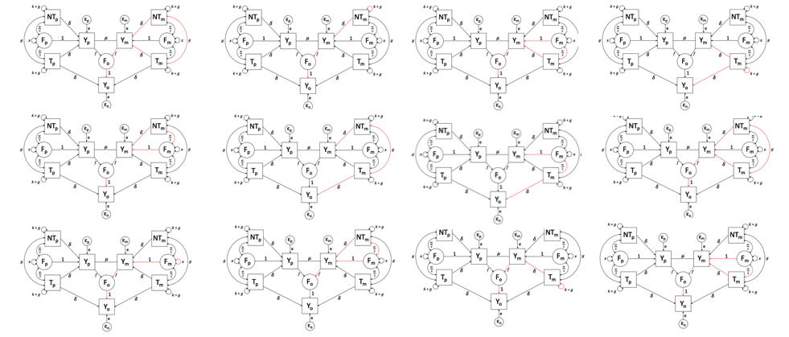
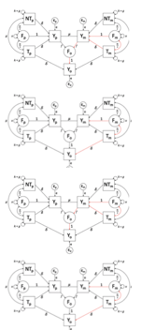
Model 1:
Vertical Transmission
Assortative Mating

Slide 75
$$k \text{+} g$$
$$V_{\text{ε}}$$
$$V_{\text{ε}}$$
$k$ + $g$
NT_{p}
NT_{m}
ε_{p}
ε_{m}
𝛿
𝛿
$\frac{w}{2}$
1
1
$\frac{w}{2}$
F_{p}
1
Y_{p}
$$μ$$
Y_{m}
1
F_{m}
$$g$$
$$V_{F}$$
$$V_{F}$$
$$g$$
$\frac{w}{2}$
𝛿
$\frac{w}{2}$
$$f$$
$$f$$
𝛿
T_{p}
F_{o}
T_{m}
$$k \text{+} g$$
1
$k \text{+}$ $g$
𝛿
𝛿
Y_{o}
Ω : cov(Y_{p} , NT_{p})
V_{Y} : var(Y_{m})
1
ε_{o}
$$V_{\text{ε}}$$

Slide 76
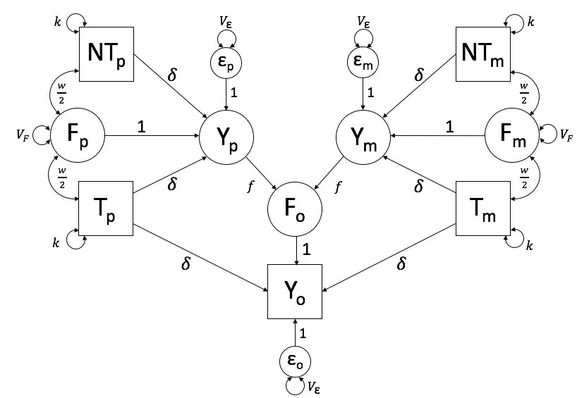
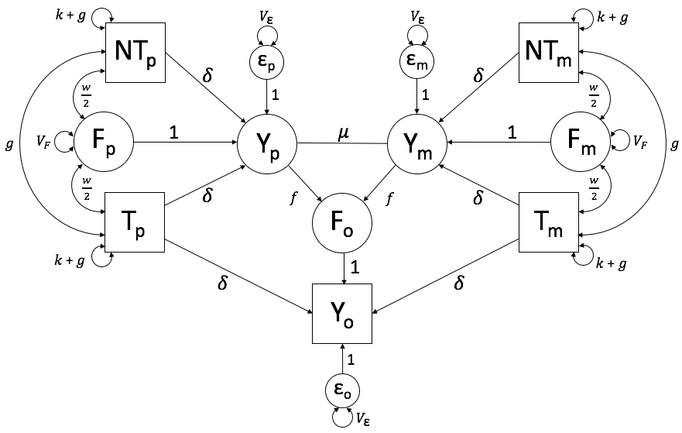
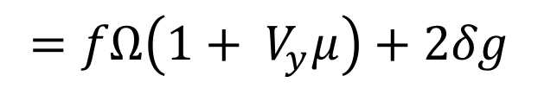


Model 0:
Vertical Transmission,
Assortative Mating
Model 1:
Vertical Transmission,
Assortative Mating
cov(Y_{o} , NT_{p}) = ?
$$=f(\frac{w}{2}+\text{δ}\text{k}\text{)}$$
$$=fΩ\left(1+ V_{y}μ\right)+2δg$$
$$=fΩ$$

Slide 77
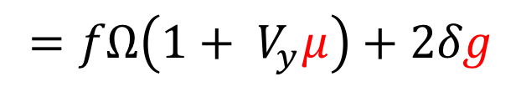
Model 0:
Vertical Transmission,
Assortative Mating
Model 1:
Vertical Transmission,
Assortative Mating
cov(Y_{o} , NT_{p}) = ?
$$=f(\frac{w}{2}+\text{δ}\text{k}\text{)}$$
$$=fΩ\left(1+ V_{y}μ\right)+2δg$$
$$=fΩ$$

Slide 78
Assumptions / Limitations
Does not look at the full impact of parental influence
Requires sufficiently predictive PGS’s
Results can be biased if the discovery GWAS themselves are biased by stratification
Does not account for horizontal transmission (i.e., sibling effects)
*

Slide 79
Some other extensions we’re
working on

Slide 80
$$k \text{+} g$$
$$V_{\text{ε}}$$
$$V_{\text{ε}}$$
$k$ + $g$
NT_{p}
NT_{m}
ε_{p}
ε_{m}
𝛿
𝛿
$\frac{w}{2}$
1
1
$\frac{w}{2}$
F_{p}
1
Y_{p}
$$μ$$
Y_{m}
1
F_{m}
$$g$$
$$V_{F}$$
$$V_{F}$$
$$g$$
$\frac{w}{2}$
𝛿
$\frac{w}{2}$
$$f$$
$$f$$
𝛿
T_{p}
F_{o}
T_{m}
$$k \text{+} g$$
1
$k \text{+}$ $g$
𝛿
𝛿
Y_{o}
1
Model 1:
Vertical Transmission
Assortative Mating
ε_{o}
$$V_{\text{ε}}$$

Slide 81





































$$j \text{+} h$$
$$j \text{+} h$$
$$i$$
LNT_{p}
$$V_{\text{ε}}$$
$$V_{\text{ε}}$$
LNT_{m}
$$i$$
$\frac{v}{2}$
$\frac{v}{2}$
NT_{p}
$$a$$
ε_{p}
ε_{m}
$$a$$
NT_{m}
$$i$$
$$i$$
$\frac{w}{2}$
𝛿
1
1
𝛿
$\frac{w}{2}$
$$k \text{+} g$$
$$\text{μ}$$
$$k \text{+} g$$
$$h$$
$$g$$
$$V_{F}$$
F_{p}
1
Y_{p}
Y_{m}
1
F_{m}
$$V_{F}$$
$$g$$
$$h$$
$$k \text{+} g$$
$$k \text{+} g$$
$\frac{w}{2}$
$$f$$
$$f$$
$\frac{w}{2}$
T_{p}
𝛿
𝛿
T_{m}
$$i$$
$$a$$
$$a$$
$$i$$
F_{o}
$\frac{v}{2}$
$\frac{v}{2}$
LT_{p}
𝛿
1
𝛿
LT_{m}
$$i$$
$$i$$
$$a$$
$$a$$
Y_{o}
$$j \text{+} h$$
$$j \text{+} h$$
Model 2:
Vertical Transmission
Assortative Mating
1
ε_{o}
Additive Genetic Variance
$$V_{\text{ε}}$$

Slide 82
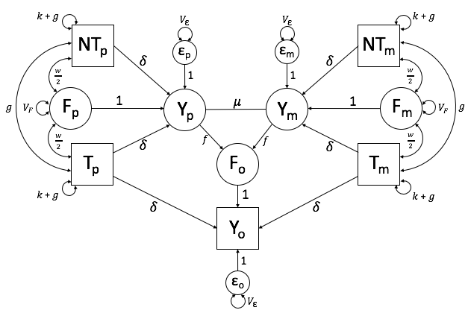
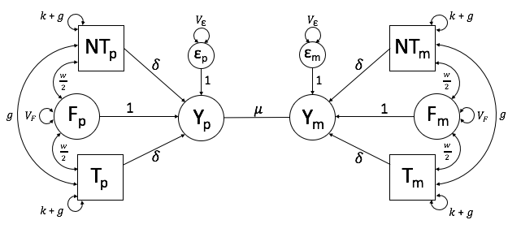
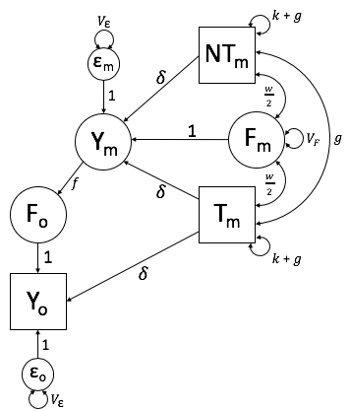
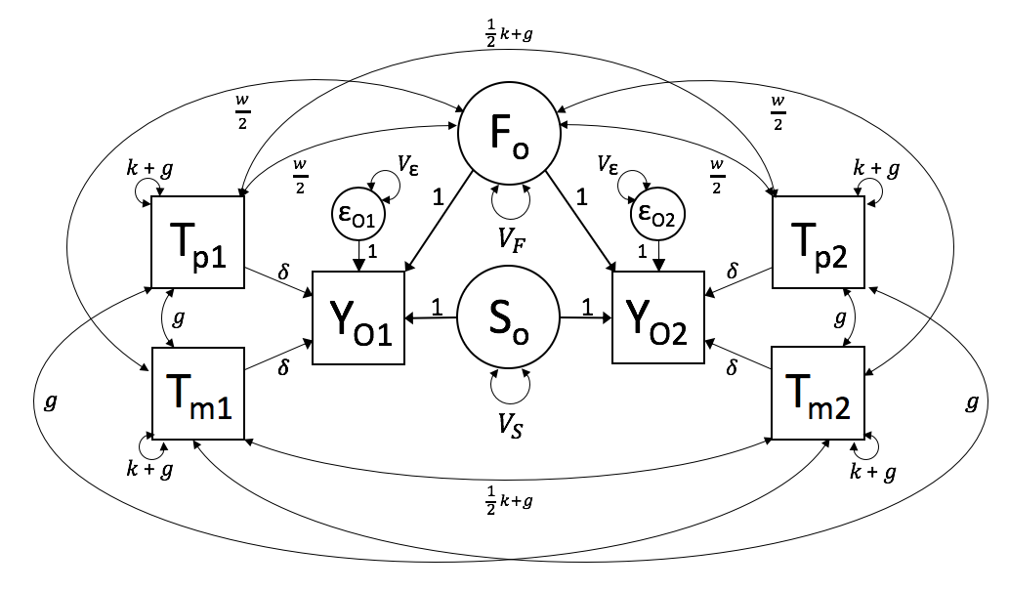
Trio
Spouse
Parent-Offspring
Sibling

Slide 83
























$\left[\begin{matrix}{V_{\text{ε}}}_{x} & {V_{\text{ε}}}_{xz} \\ {V_{\text{ε}}}_{xz} & {V_{\text{ε}}}_{z}\end{matrix}\right]$
$\left[\begin{matrix}{V_{\text{ε}}}_{x} & {V_{\text{ε}}}_{xz} \\ {V_{\text{ε}}}_{xz} & {V_{\text{ε}}}_{z}\end{matrix}\right]$
$\left[\begin{matrix}k_{x} & k_{xz} \\ k_{xz} & k_{z}\end{matrix}\right]$ + $\left[\begin{matrix}g_{x} & g_{xz} \\ g_{xz} & g_{z}\end{matrix}\right]$
$\left[\begin{matrix}k_{x} & k_{xz} \\ k_{xz} & k_{z}\end{matrix}\right]$ + $\left[\begin{matrix}g_{x} & g_{xz} \\ g_{xz} & g_{z}\end{matrix}\right]$
NT_{p}
NT_{m}
ε_{p}
ε_{m}
$$\left[\begin{matrix}{\text{δ}}_{x} & 0 \\ 0 & {\text{δ}}_{z}\end{matrix}\right]$$
$$\left[\begin{matrix}{\text{δ}}_{x} & 0 \\ 0 & {\text{δ}}_{z}\end{matrix}\right]$$
$$\frac{1}{2}\left[\begin{matrix}w_{x} & w_{xz} \\ w_{zx} & w_{z}\end{matrix}\right]$$
1
1
$$\frac{1}{2}\left[\begin{matrix}w_{x} & w_{xz} \\ w_{zx} & w_{z}\end{matrix}\right]$$
F_{p}
1
Y_{p}
$\left[\begin{matrix}{μ }_{x} & {μ }_{xz} \\ {μ }_{xz} & {μ }_{z}\end{matrix}\right]$
Y_{m}
1
F_{m}
$\left[\begin{matrix}g_{x} & g_{xz} \\ g_{xz} & g_{z}\end{matrix}\right]$
$\left[\begin{matrix}{V_{\text{F}}}_{x} & {V_{\text{F}}}_{xz} \\ {V_{\text{F}}}_{xz} & {V_{\text{F}}}_{z}\end{matrix}\right]$
$\left[\begin{matrix}{V_{\text{F}}}_{x} & {V_{\text{F}}}_{xz} \\ {V_{\text{F}}}_{xz} & {V_{\text{F}}}_{z}\end{matrix}\right]$
$\left[\begin{matrix}g_{x} & g_{xz} \\ g_{xz} & g_{z}\end{matrix}\right]$
$$\frac{1}{2}\left[\begin{matrix}w_{x} & w_{xz} \\ w_{zx} & w_{z}\end{matrix}\right]$$
$$\left[\begin{matrix}f_{x} & f_{xz} \\ f_{zx} & f_{z}\end{matrix}\right]$$
$$\left[\begin{matrix}f_{x} & f_{xz} \\ f_{zx} & f_{z}\end{matrix}\right]$$
$$\frac{1}{2}\left[\begin{matrix}w_{x} & w_{xz} \\ w_{zx} & w_{z}\end{matrix}\right]$$
T_{p}
$$\left[\begin{matrix}{\text{δ}}_{x} & 0 \\ 0 & {\text{δ}}_{z}\end{matrix}\right]$$
F_{o}
$$\left[\begin{matrix}{\text{δ}}_{x} & 0 \\ 0 & {\text{δ}}_{z}\end{matrix}\right]$$
T_{m}
1
$\left[\begin{matrix}k_{x} & k_{xz} \\ k_{xz} & k_{z}\end{matrix}\right]$ + $\left[\begin{matrix}g_{x} & g_{xz} \\ g_{xz} & g_{z}\end{matrix}\right]$
$$\left[\begin{matrix}{\text{δ}}_{x} & 0 \\ 0 & {\text{δ}}_{z}\end{matrix}\right]$$
$\left[\begin{matrix}k_{x} & k_{xz} \\ k_{xz} & k_{z}\end{matrix}\right]$ + $\left[\begin{matrix}g_{x} & g_{xz} \\ g_{xz} & g_{z}\end{matrix}\right]$
$$\left[\begin{matrix}{\text{δ}}_{x} & 0 \\ 0 & {\text{δ}}_{z}\end{matrix}\right]$$
Y_{o}
Bivariate version of
SEM-PGS
1
ε_{o}
$\left[\begin{matrix}{V_{\text{ε}}}_{x} & {V_{\text{ε}}}_{xz} \\ {V_{\text{ε}}}_{xz} & {V_{\text{ε}}}_{z}\end{matrix}\right]$

Slide 84















$$k \text{+} g$$
$$V_{\text{ε}}$$
$$V_{\text{ε}}$$
$k$ + $g$
NT_{p}
NT_{m}
ε_{p}
ε_{m}
𝛿
𝛿
$\frac{w}{2}$
1
1
$\frac{w}{2}$
F_{p}
1
Y_{p}
$$μ$$
Y_{m}
1
F_{m}
$$g$$
$$V_{F}$$
$$V_{F}$$
$$g$$
$\frac{w}{2}$
𝛿
$$f_{pd}$$
$$f_{md}$$
$\frac{w}{2}$
𝛿
T_{p}
F_{o}
T_{m}
$$k \text{+} g$$
1
$k \text{+}$ $g$
𝛿
𝛿
Y_{d}
SEM-PGS
accounting for parent and offspring sex effects
1
ε_{d}
$$V_{\text{ε}}$$

Slide 85
Multi-generational SEM-PGS

Slide 86
Final Note

Slide 87
Overview of the Script

Slide 88
Step 1
x = 2yz
y = x/z - y
z = (x + z) / 3y

Slide 89
Step 1
Step 2
x = 2yz
y = x/z - y
z = (x + z) / 3y
x
y
z

Slide 90
Step 1
Step 2
x = 2yz
y = x/z - y
z = (x + z) / 3y
x
y
z
Step 3
3
1
6
5
4
6
2
4
2
5
3
1
0
8
3
2
1
9

Slide 91
Step 1
Step 2
x = 2yz
y = x/z - y
z = (x + z) / 3y
x
y
z
Step 3
Step 4
6
1
vs.
3

