Slide 1
Gene-Environment Correlation
(and combined PGI + Twin model)
Daniel Gustavson
March 7, 2024
International Statistical genetics workshop

Slide 2
Genes and Environments are not Independent
Gene-Environment Interaction (Tuesday)
  Impact of the environment depends on genetic risk
Gene-Environment Correlation
  Genetic propensities are correlated with environmental niches
  “Genetic Nurture” (parental genotype influences offspring outcomes by shaping the environments parents provide; e.g., Kong, et al. 2018)
Slides & Practical Materials: /home/faculty/daneg/2024/Twin_PGI/
Notes:
“Genetic nurture” is used to describe the phenomenon by which parental nature (i.e., parental genotype) influences offspring outcomes by shaping the environment that parents provide.

Slide 3
Gene Environment Correlation (rGE)
Passive rGE
  Parents pass on genes and also provide an environment correlated with those genes, both of which influence the child’s development
Active rGE
  A child’s genetic background influences their choice of environment
Evocative/reactive rGE
  A child’s genetic background traits influences the reaction of others (and the environment provided by them)
Slides & Practical Materials: /home/faculty/daneg/2024/Twin_PGI/

Slide 4

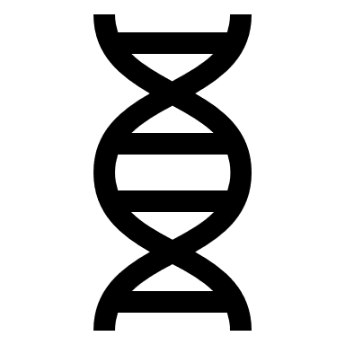



Passive rGE
Slides & Practical Materials: /home/faculty/daneg/2024/Twin_PGI/

Slide 5
Passive rGE
Slides & Practical Materials: /home/faculty/daneg/2024/Twin_PGI/

Slide 6
Consequences of unmodeled rGE
Passive rGE
  Upwardly biases shared environmental influences (e.g., rMZ & rDZ)
Slides & Practical Materials: /home/faculty/daneg/2024/Twin_PGI/

Slide 7
Gene Environment Correlation (rGE)
Passive rGE
  Parents pass on genes and also provide an environment, both of which influence the child’s development
Active rGE
  A child’s genetic background influences their choice of environment
Evocative/reactive rGE
  A child’s genetic background traits influences the reaction of others (and the environment provided by them)
Slides & Practical Materials: /home/faculty/daneg/2024/Twin_PGI/

Slide 8






Active rGE
Slides & Practical Materials: /home/faculty/daneg/2024/Twin_PGI/
Notes:
High vs. moderate or low

Slide 9
Gene Environment Correlation (rGE)
Passive rGE
  Parents pass on genes and also provide an environment, both of which influence the child’s development
Active rGE
  A child’s genetic background influences their choice of environment
Evocative/reactive rGE
  A child’s genetic background influences the reaction of others (and the environment provided by them)
Slides & Practical Materials: /home/faculty/daneg/2024/Twin_PGI/

Slide 10



Evocative rGE
Slides & Practical Materials: /home/faculty/daneg/2024/Twin_PGI/

Slide 11


Passive vs. Evocative rGE
Slides & Practical Materials: /home/faculty/daneg/2024/Twin_PGI/

Slide 12
Consequences of unmodeled rGE
Passive rGE (positive)
  Upwardly biases shared environmental influences on parenting (e.g., rMZ & rDZ)
  Downwardly biases genetic influences
  As A or C approach zero (and/or E increases), the impact of bias is minimized
Active or Evocative rGE (positive)
  Upwardly biases genetic influences on parenting (e.g., rMZ & rDZ)
  As A or C approach zero (and/or E increases), the impact of bias is minimized
Neiderhiser et al. (2004) Developmental Psychology
Verhulst & Hatemi (2013) Political Analysis
Slides & Practical Materials: /home/faculty/daneg/2024/Twin_PGI/

Slide 13
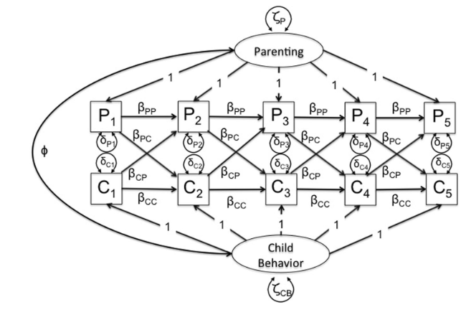
How do we identify active rGE?
Moscati et al. (2016) Behavior Genetics
Slides & Practical Materials: /home/faculty/daneg/2024/Twin_PGI/

Slide 14
How do we identify passive rGE?
Adoption Design
Slides & Practical Materials: /home/faculty/daneg/2024/Twin_PGI/

Slide 15
How do we identify passive rGE?
Adoption Design
Family Environment
Genetics
Child Trait
Environment
Family Environment
Environment
Child Trait
Knopik et al. (2017) Behavioral Genetics (7th ed)
Slides & Practical Materials: /home/faculty/daneg/2024/Twin_PGI/
Notes:
Ethics of adoption studies. We can’t randomize, always put kids in best possible homes and people assort kids. Ascertainment issues about who is in these studies. Great scientific model but doesn’t always work. We also don’t want to separate twins or siblings.

Slide 16
How do we identify passive rGE?
Adoption Design
Children of Twins Design
Slides & Practical Materials: /home/faculty/daneg/2024/Twin_PGI/

Slide 17




Child of Twins Design
Genetics &
Environment
Genetics only
For example, see
Silberg, Maes, & Eaves (2010)
Journal of Child Psychology and Psychiatry
Slides & Practical Materials: /home/faculty/daneg/2024/Twin_PGI/

Slide 18
How do we identify passive rGE?
Adoption Design
Children of Twins Design
Genetic Nurture
Slides & Practical Materials: /home/faculty/daneg/2024/Twin_PGI/

Slide 19
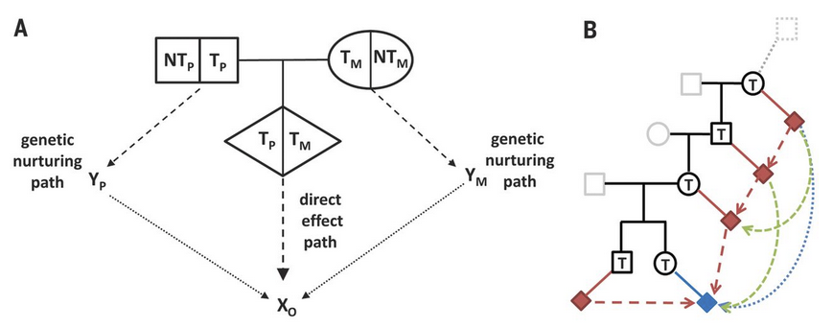
Kong et al. (2018) Science
Slides & Practical Materials: /home/faculty/daneg/2024/Twin_PGI/
Notes:
(A) Alleles at an autosomal site carried by a parents-offspring trio are labeled with respect to the offspring (proband). T_{P} and T_{M} denote, respectively, the alleles transmitted from the father and the mother to the proband, and NT_{P} and NT_{M} denote the paternal and maternal alleles that are not transmitted. The transmitted alleles can influence the phenotype of the offspring, X_{O}, through a direct path. The alleles of the parents, both transmitted and nontransmitted, can influence the parents’ phenotypes, Y_{P} and Y_{M}, and through them may have a nurturing effect on X_{O}. This pathway combines a genetic effect (T_{P}, NT_{P}, T_{M}, and NT_{M}) on Y_{P} and Y_{M} with a nurturing effect (Y_{P} and Y_{M}) on X_{O}. Note that although X_{O} is often an individual trait of interest, Y would include a much broader set of phenotypes and is not completely known. (B) Red diamonds denote phenotypes of relatives; the blue diamond denotes the phenotype of the proband. Using the maternally transmitted allele as an example (denoted by T), we highlight that, in addition to the parents, the genetic nurturing effect can be manifested through the phenotypes of older ancestors and nonancestors such as siblings.

Slide 20
How do we identify passive rGE?
Adoption Design
Children of Twins Design
Genetic Nurture
Extended Twin Models / Cascade Model (next session)
Slides & Practical Materials: /home/faculty/daneg/2024/Twin_PGI/

Slide 21
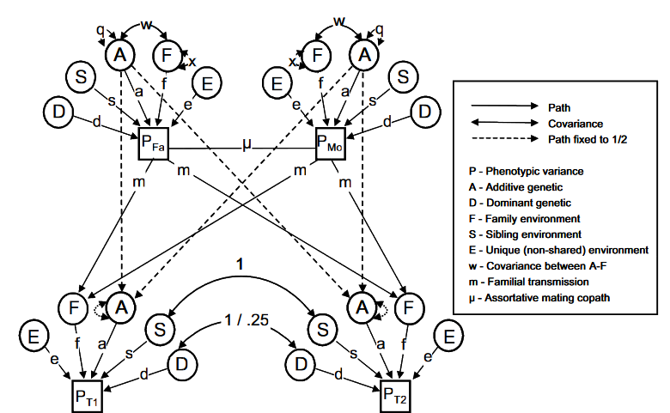
Keller et al. (2009)
Twin Research & Human Genetics
Slides & Practical Materials: /home/faculty/daneg/2024/Twin_PGI/

Slide 22
How do we identify passive rGE?
Adoption Design
Children of Twins Design
Genetic Nurture
Extended Twin Models / Cascade Model (next session)
Twin + PGI Approach (Dolan et al. 2021; Bruins, et al. 2023)
Slides & Practical Materials: /home/faculty/daneg/2024/Twin_PGI/

Slide 23
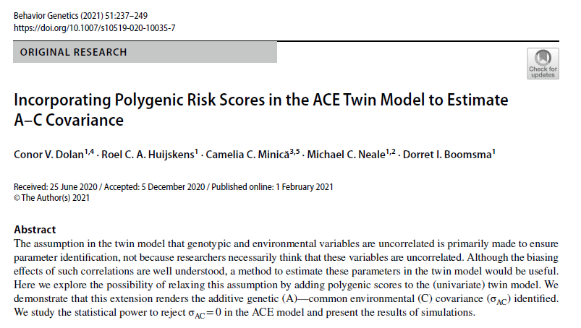
Slides & Practical Materials: /home/faculty/daneg/2024/Twin_PGI/

Slide 24
AC
σ²_{Ap}
σ²_{Aq}
σ²_{C}
σ²_{E}
A_{PGI}
A_{Q}
C
E
AC
1
1
1
1
p
PGI
(T1)
Phenotype
(Twin 1)
Dolan et al. (2021) Behavior Genetics
Slides & Practical Materials: /home/faculty/daneg/2024/Twin_PGI/

Slide 25
1/.5
1/.5
AC
1
AC
σ²_{Ap}
σ²_{Aq}
σ²_{C}
σ²_{E}
σ²_{Ap}
σ²_{Aq}
σ²_{C}
σ²_{E}
A_{PGI}
A_{Q}
C
E
A_{PGI}
A_{Q}
C
E
AC
AC
1/.5*AC
1
1
1
1
1
1
1
1
p
p
PGI
(T1)
Phenotype
(Twin 1)
PGI
(T2)
Phenotype
(Twin 2)
Dolan et al. (2021) Behavior Genetics
Slides & Practical Materials: /home/faculty/daneg/2024/Twin_PGI/

Slide 26
Assumptions and Discussion
A_{PGI} is representative subset of A_{Q}
  PGIs are effectively capturing same information as the remaining heritability, but imperfectly
  But is this really true? A_{PGI} could never have de novo mutation or rare variants
A_{PGI} is correlated with C to the same extend that A_{Q} is
  What happens if this is not the case?
  By assumption we could only fit one of these two options, but by toggling between them we could try both
A_{PGI} and A_{Q} are both nonzero
A_{PGI} is not correlated with A_{Q}
Slides & Practical Materials: /home/faculty/daneg/2024/Twin_PGI/

Slide 27
AC
r12
σ²_{Ap}
σ²_{Aq}
σ²_{C}
σ²_{E}
A_{PGI}
A_{Q}
C
E
AC
1
1
1
1
p
PGI
(T1)
Phenotype
(Twin 1)
Slides & Practical Materials: /home/faculty/daneg/2024/Twin_PGI/
Notes:
Wave at MR-DoC2 as well.

Slide 28
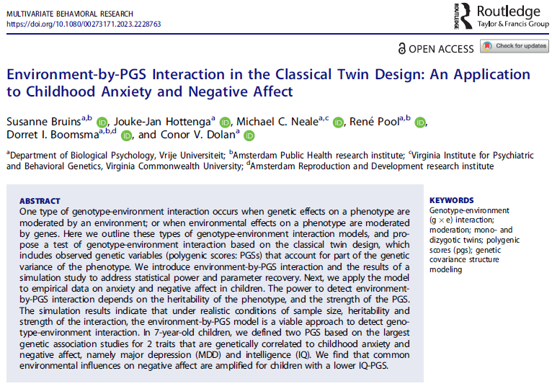
Slides & Practical Materials: /home/faculty/daneg/2024/Twin_PGI/
Notes:
We could also think about this as a measured moderator

Slide 29
1
1
1
1
A_{PGI}
A_{Q}
C
E
a_{Q}
c + b_{c}*PGI
a_{PGI}
1
e + b_{e}*PGI
PGI
(T1)
Phenotype
(Twin 1)
Bruins et al. (2023) Multivariate Behavioral Research
Slides & Practical Materials: /home/faculty/daneg/2024/Twin_PGI/

Slide 30
Polygenic Indices (PGIs/PGSs)
Quantification of genetic liability for a trait
  In the context of a disease, it may capture risk due to genes (i.e., polygenic risk score; PRS)
Analytical Concerns:
  Focus analyses on a single ancestry at a time?
  Control for ancestry-based principal components
  Monozygotic twins are 100% identical and therefore have the same PGI
Slides & Practical Materials: /home/faculty/daneg/2024/Twin_PGI/
Notes:
Depends on your research question (generalizability sample)

Slide 31
PGI + Twin Practical
UNIX:
mkdir Twin_PGI/
cp -r /home/faculty/daneg/Twin_PGI/* Twin_PGI/
cd Twin_PGI/practical
  Rstudio:
    system("mkdir $HOME/Twin_PGI/")
    system("cp -R /home/faculty/daneg/2024/Twin_PGI/* $HOME/Twin_PGI/")
    setwd("~/Twin_PGI/")
https://qimr.az1.qualtrics.com/jfe/form/SV_dpy2LRErlNs6Jmu
Slides & Practical Materials: /home/faculty/daneg/2024/Twin_PGI/

Slide 32
Practical considerations

Slide 33
Parameter | Full Model | No AC Covariance
A_{PGI} | 16% | 23%
A_{Q} | 24% | 25%
C | 24% | 35%
E | 16% | 17%
AC Covariance | 19% | -

Slide 34
Information Criteria:
| df Penalty | Parameters Penalty | Sample-Size Adjusted
AIC: -990.4557 13009.54 13009.62
BIC: -40151.9657 13054.35 13028.94
CFI: NA
TLI: 1 (also known as NNFI)
RMSEA: 0 [95% CI (NA, NA)]
Prob(RMSEA <= 0.05): NA
To get additional fit indices, see help(mxRefModels)

Slide 35
# Fit model normally
ACModelFit <- mxTryHard(ACModel, extraTries = 200)
summary(ACModelFit)
## Fit reference models to get CFI etc.
factorSat <- mxRefModels(ACModelFit, run=T)
#summary(factorSat$Independence)
#summary(factorSat$Saturated)
summary(ACModelFit, refModels=factorSat)

Slide 36
chi-square: χ² ( df=15 ) = -0.0003213478, p = 1
Information Criteria:
| df Penalty | Parameters Penalty | Sample-Size Adjusted
AIC: -990.4557 13009.54 13009.62
BIC: -40151.9657 13054.35 13028.94
CFI: 1.005239
TLI: 1.003144 (also known as NNFI)
RMSEA: 0 *(Non-centrality parameter is negative) [95% CI (0, 0)]
Prob(RMSEA <= 0.05): 1

Slide 37
AC
r12
σ
σ
σ
σ
A_{PGI}
A_{Q}
C
E
AC
1
1
1
1
p
PGI
(T1)
Phenotype
(Twin 1)
Slides & Practical Materials: /home/faculty/daneg/2024/Twin_PGI/
Notes:
Wave at MR-DoC2 as well.

Slide 38
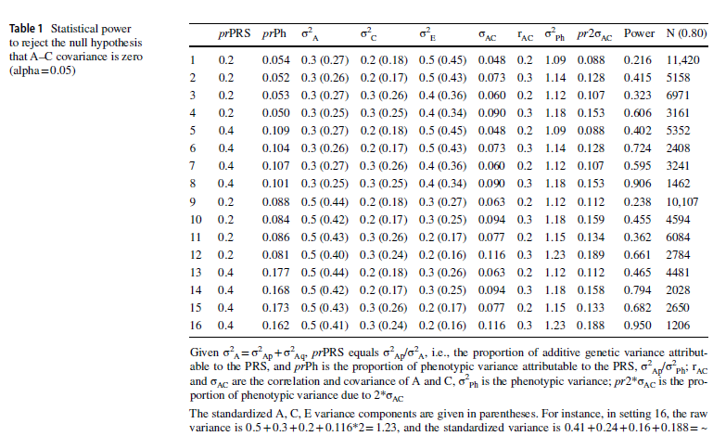

Slide 39
mxAlgebra(SA1 + SA2 + 2*r12*sqrt(SA1*SA2), name="SA"),
mxAlgebra(r12*sqrt(SA1)*sqrt(SA2), name="C12"),
mxAlgebra( (SA1+r12*sqrt(SA1*SA2))*solve(SA), name="g1"),
mxAlgebra( (SA2+r12*sqrt(SA1*SA2))*solve(SA), name="g2"),
# AC covariances
mxAlgebra(g1*(CAC), name="CA1"),
mxAlgebra(g2*(CAC), name="CA2"),
….
mxAlgebra(expression=rbind(
# E A1 A2 C E A1 A2 C
cbind(SE, 0, 0, 0, 0, 0, 0, 0), # E
cbind( 0, SA1, C12, CA1, 0, SA1, C12, CA1), # A1
cbind( 0, C12, SA2, CA2, 0, C12, SA2, CA2), # A2
cbind( 0, CA1, CA2, SC, 0, CA1, CA2, SC), # C
cbind( 0, 0, 0, 0, SE, 0, 0, 0), # E
cbind( 0, SA1, C12, CA1, 0, SA1, C12, CA1), # A1
cbind( 0, C12, SA2, CA2, 0, C12, SA2, CA2), # A2
cbind( 0, CA1, CA2, SC, 0, CA1, CA2, SC)), # C
name='latSmz'),

Slide 41
Extra development notes:
Could add the r12 assumption test
Regress PGS out of mean?
If you look in this file you’ll have all the alebra you want to do. We’ll source that function, do an ACE function, ACE + covariate, ACE cov. Then spit out those models (possibly with the additional 2 models).

Slide 43
Evokative rGE

