Slide 1
Creating and using polygenic scores
Perline Demange & Margot van de Weijer

Slide 2
What is a polygenic score?
A measure of an individual’s genetic propensity towards a phenotype relative to a population
An index that linearly aggregates the estimated effects of individual SNPs on the trait of interest

Slide 3
An aside on terminology
Polygenic score (PGS)
Polygenic risk score (PRS)
Polygenic index (PGI)
Genetic risk score
Allele score
Etc.
Notes:
Dont come at me but this is how it is. I alwyas use different once also. Not a big deal

Slide 4
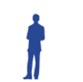

Slide 5
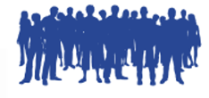

Slide 8
How to construct a PGS?
Obtain GWAS summary statistics from a large discovery sample
Obtain independent sample that had genome-wide data
Align and select SNPs in common between the two samples
Select independent SNPS by pruning based on LD
Restrict to SNPs with a p-value that is lower than a certain threshold
Construct PGS by summing up alleles weighted by betas from the sumstats
Evaluate strength of association by regressing the phenotype on the PGS
Clumping
and thresholding
Mills, Barban, Tropf. 2020

Slide 9
1. Obtain GWAS summary statistics from a large discovery sample
What are the criteria to choose a GWAS?
Discovery sample is the same ancestry as the target sample
If the allele frequencies are too different, the PGS won’t be predictive
Target sample is not included in the discovery sample
Overfitting = overestimation of prediction
GWAS is well-powered:
Large sample size
SNP heritability of the trait reported by GWAS is high
The definition of the phenotype used in the GWAS is appropriate
Self-reported anxiety vs anxiety diagnosis
BMI in children vs in adult, etc.

Slide 10
Open access GWAS sumstats
Look for the information in the GWAS paper
GWAS catalog, PGC consortium, SSGAC consortium, etc.
LOOK AT THE README

Slide 11
2. Obtain independent sample that has genome-wide data
Independent samples:
Exclude participants (and relatives) that were in the GWAS sample
And/Or (usually easier)
Exclude the sample from the discovery GWAS (email the authors)

Slide 12
3. Align and select SNPs in common between the two samples
Select SNPs available in both samples and maximize SNPs used
Align strands: make sure the alleles were measured on the same strand (+ or - )
Often done by the software
https://mrcieu.github.io/TwoSampleMR/articles/harmonise.html

Slide 13
4. Which SNPs to include in the score?
For some SNPs, β(GWAS) may be a very noisy estimate of the true β or the true β may be close to 0, so adding those SNPS will add more noise than signal
We will overweight (“double-count”) SNPs with high LD scores

Slide 14
Linkage disequilibrium

Slide 15
Different approaches
Only include the most strongly associated SNP for each LD block
Clumping and thresholding (Purcell et al 2009)
Plink
PRSice (Choi & O’Reilly 2019)
Include all SNPs but adjust the effect size for LD
Bayesian approaches
LDpred (Prive et al. 2020)
PRS-CS (Ge et al 2019)
SBayesR (Lloyd-Jones et al 2019)
Penalized regressions
Lassosum (Mak et al. 2017)

Slide 16
Which method is better?

Slide 17
Which method is better?
Clumping and thresholding:
Pro:
Fast
Easy
Con:
Too black and white, very sensitive to the choice of the parameters
Bayesian approaches:
Pro:
Use all info available (all SNPs)
Con:
Sensitive to reference panel being a good match in order to have proper adjustment for LD
Assumed prior distribution is probably not the true genetic architecture

Slide 18
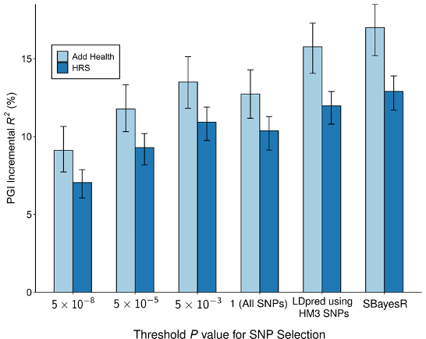
What do you want the PGS for?
Maximize predictive power: Bayesian methods are probably best
Select SNPs more likely to be causal and less likely to be pleiotropic (e.g. for MR): C+T is best
Notes:
+ help with invetsiagting architecture

Slide 19
4. Select independent SNPs by prunning based on LD: Clumping
How independent is independent? Choosing clumping parameters:
R² threshold: do not want to double-count but also not lose signal
LD window (distance in kb):
If too large, errors in LD estimates can lead to apparent LD between unlinked loci
If too small, there is a risk of not accounting for LD between linked loci

Slide 20
5. Restrict to SNPs with a p-value that is lower than a certain threshold: Thresholding
What is noise? Choosing p-value cutoff:
If high polygenicity, we expect prediction to increase with more SNPs included
If low powered GWAS with larger p-values, a strict threshold might drop too many SNPS

Slide 21
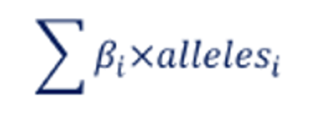
6. Construct PGS by summing up alleles weighted by betas from the sumtats
Some softwares do all at once, some just give you the adjusted weights and you can run this step in Plink afterwards
Advantage of making the SNPs selection and adjusting weights independently is that you can share those and allow for reproductible PGS construction across samples.

Slide 22
Clumping and thresholding with Plink

Slide 23
Trait increasing allele?
Effect allele | Non-effect allele (other allele)
Alternative | Reference
A2 ??? | A1 ???
A1 ??? | A0 ???
Minor allele ??? | Major allele ???
If you get it wrong, you will have a negative association when you should have a positive one…

Slide 24
PGS limitations
Inherits all biases in the discovery GWAS
Gene-environment correlation
Population stratification
GWAS ascertainment bias, etc.
Interacts with the “biases” in the target sample
Population stratification -> adjust for principal components

