Slide 1
Genomic SEM Practical ISG Workshop 2024

Slide 2
Let’s start by going to:
https://workshop.colorado.edu/rstudio/
And clicking on the terminal tab.
cp -r /faculty/andrew/GenomicSEM_2024 .
cd GenomicSEM_2024/

Slide 3
Now let’s go over to the console and setwd for this new folder you just copied

Slide 4
Now let’s go to File at the top and open the .R script with the commands we will be running

Slide 5
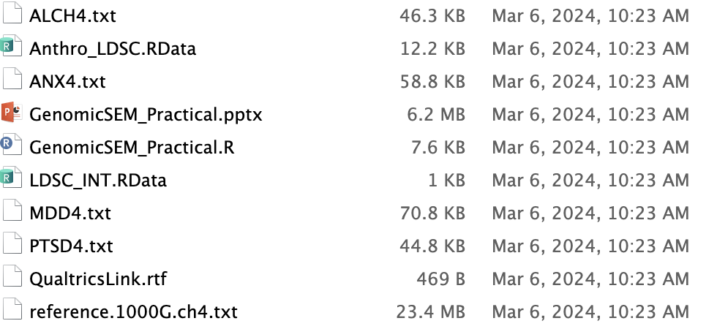
Open the R script “GenomicSEM_Practical.R”

Slide 6
Line 2 of R code: the Qualtrics link
https://qimr.az1.qualtrics.com/jfe/form/SV_72kzAByH72t9URo

Slide 7
Practical outline
I. Background and Sales Pitch
II. Estimating genome-wide models
III. Estimating multivariate GWAS in Genomic SEM
IV. More practice with genome-wide models

Slide 8
I. Background and Sales Pitch

Slide 9
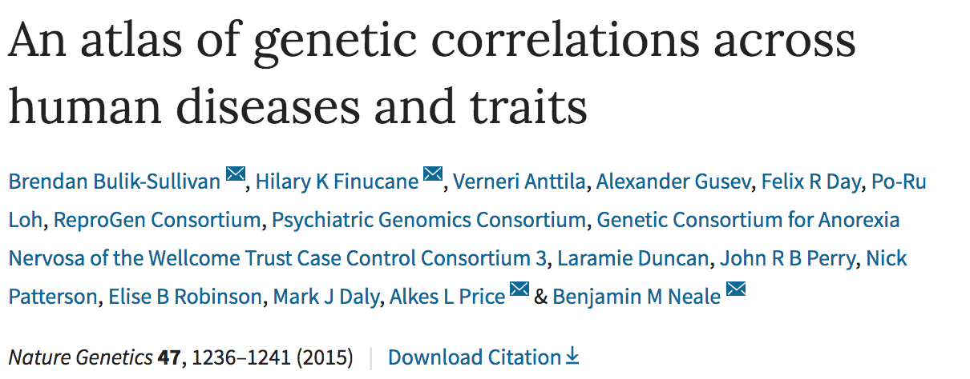
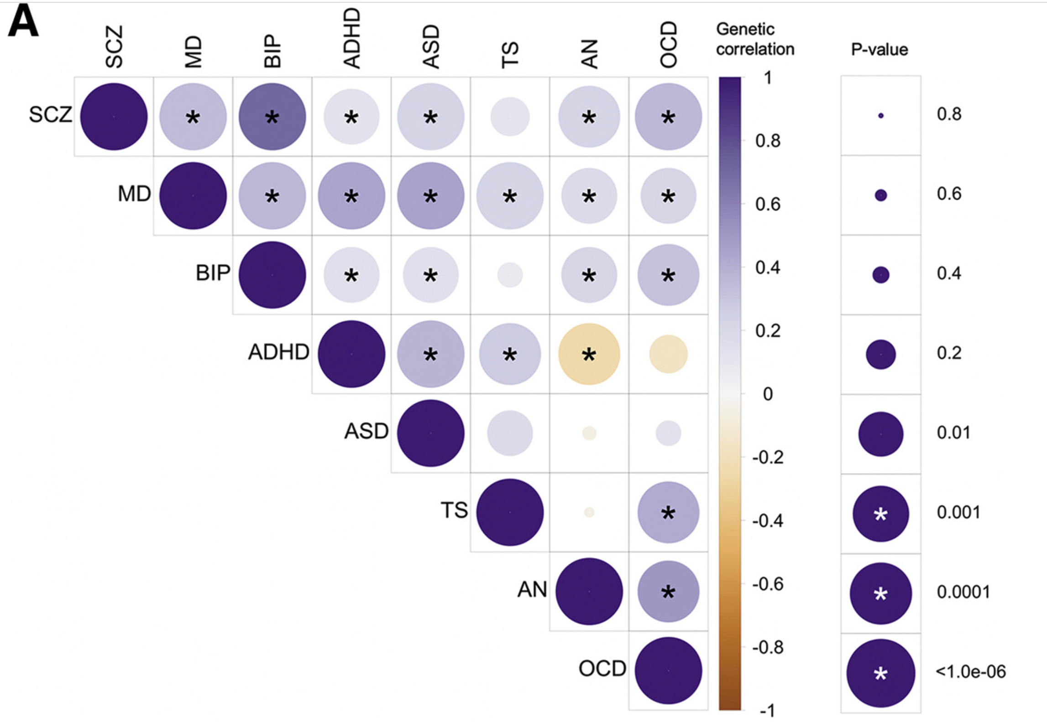
Pervasive Overlap Necessitates Methods for Analyzing Genetic Co-Morbidity
Estimates genetic correlations between samples with varying degrees of sample overlap using publicly available data
Bulik-Sullivan et al., 2015; Lee et al., 2019
Notes:
What I want to start with is this heatmap.
This heatmap shows shared risk across different disorders for the entire genome.
Will notice that many of the cells are colored, suggesting genetic overlap
I’m a psychologist so I’ll focus on psychiatric traits, but you’ll see this for other traits as well.

Slide 10
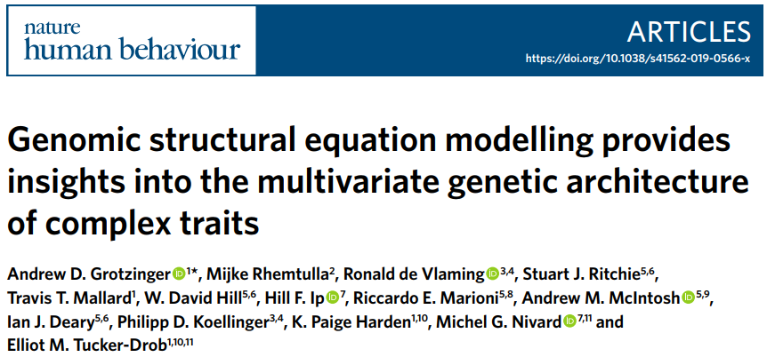
Genomic SEM
Genomic SEM provides flexible framework for estimating limitless number of structural equation models using multivariate genetic data from GWAS summary statistics for even mutually exclusive traits

Slide 11
Genetics of Early Onset Schizophrenia
Genetics of Late Onset Schizophrenia
Genetics of Early Onset Anorexia Nervosa
Genetics of Late Onset Anorexia Nervosa
Notes:
Between person covariances requires there to be an opportunity of observing the variable
Allows you to estimate correlations never measured in the same people
Opportunities to observe those in the same sample.
Psychosis for AN

Slide 12
Genetics of Early Onset Schizophrenia
Genetics of Late Onset Schizophrenia
Genetics of Early Onset Anorexia Nervosa
Genetics of Late Onset Anorexia Nervosa
Notes:
Between person covariances requires there to be an opportunity of observing the variable
Allows you to estimate correlations never measured in the same people
Opportunities to observe those in the same sample.
Psychosis for AN

Slide 13
Genetics of Early Onset Schizophrenia
Genetics of Late Onset Schizophrenia
Genetics of Early Onset Anorexia Nervosa
Genetics of Late Onset Anorexia Nervosa
Notes:
Between person covariances requires there to be an opportunity of observing the variable
Allows you to estimate correlations never measured in the same people
Opportunities to observe those in the same sample.
Psychosis for AN

Slide 14
Genetics of Early Onset Schizophrenia
Genetics of Late Onset Schizophrenia
Genetics of Early Onset Anorexia Nervosa
Genetics of Late Onset Anorexia Nervosa
Notes:
Between person covariances requires there to be an opportunity of observing the variable
Allows you to estimate correlations never measured in the same people
Opportunities to observe those in the same sample.
Psychosis for AN

Slide 15
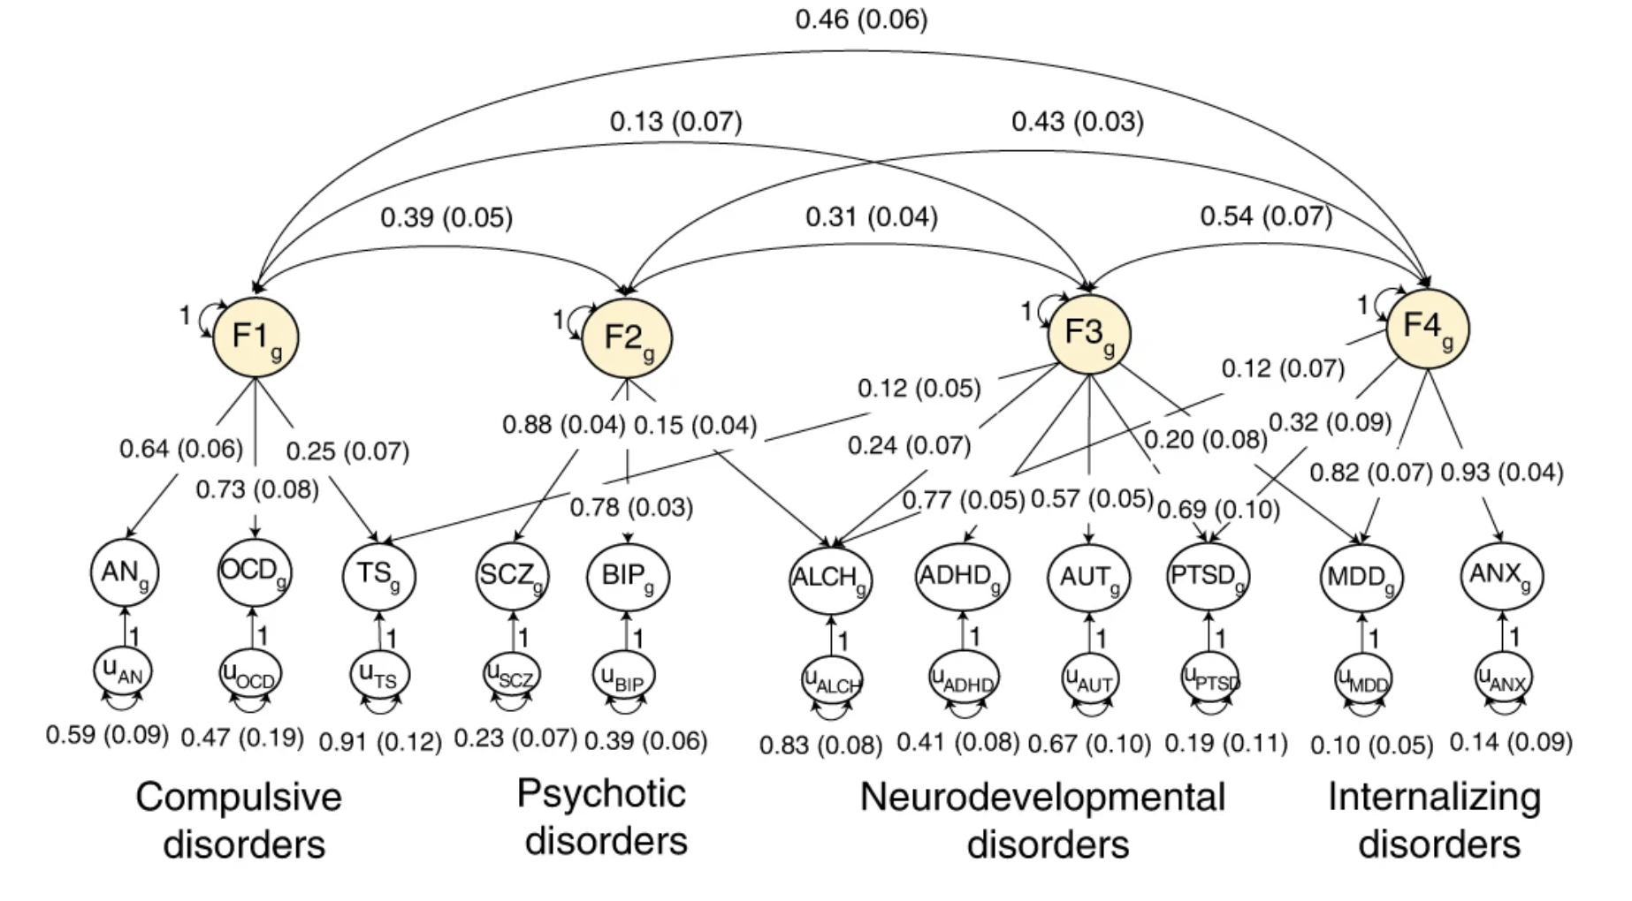
Can estimate genomic factor models
Grotzinger et al. (2022)
Notes:
Just verbalize what happens with MDD. When we expand this model to 11 disorders, most notably by include 2 other key internalizing disorders ANX and PTSD, we are able to identify a fourth factor on which major depression now loads strongly. Otherwise the three factor structure has been entirely replicated and now extended on the basis of this new data.

Slide 16
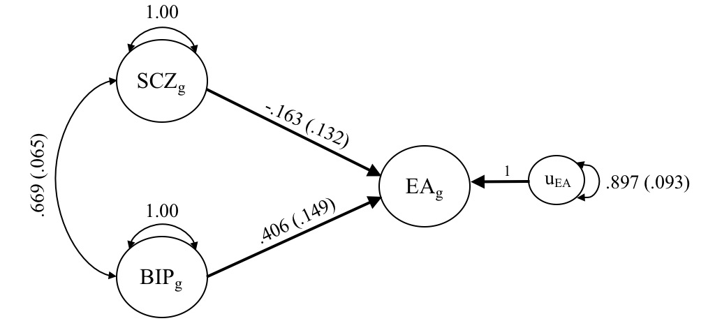
Genetic Multiple Regression
SCZ
.67 | BIP
.11 | .30 | EA
EA_{g} = b₁ × SCZ_{g} + b₂ × BIP_{g} + u
Notes:
No longer significantly associated with EA after accounting for relationship with bipolar, and is if anything negative.
For some might debate for 20 minutes what is driving the positive relationship between BIP and SCZ. If we already know the covariance matrix then we simply need to turn that matrix into a set of coefficients and don’t need to use raw data to minimize the sum of squared erorrs/maximizing the R^2 or variance explained.
There can be a misconception that to fit this model you need the raw data, but we know how they interrelate already and so we can do that with the covariance matrix.

Slide 17
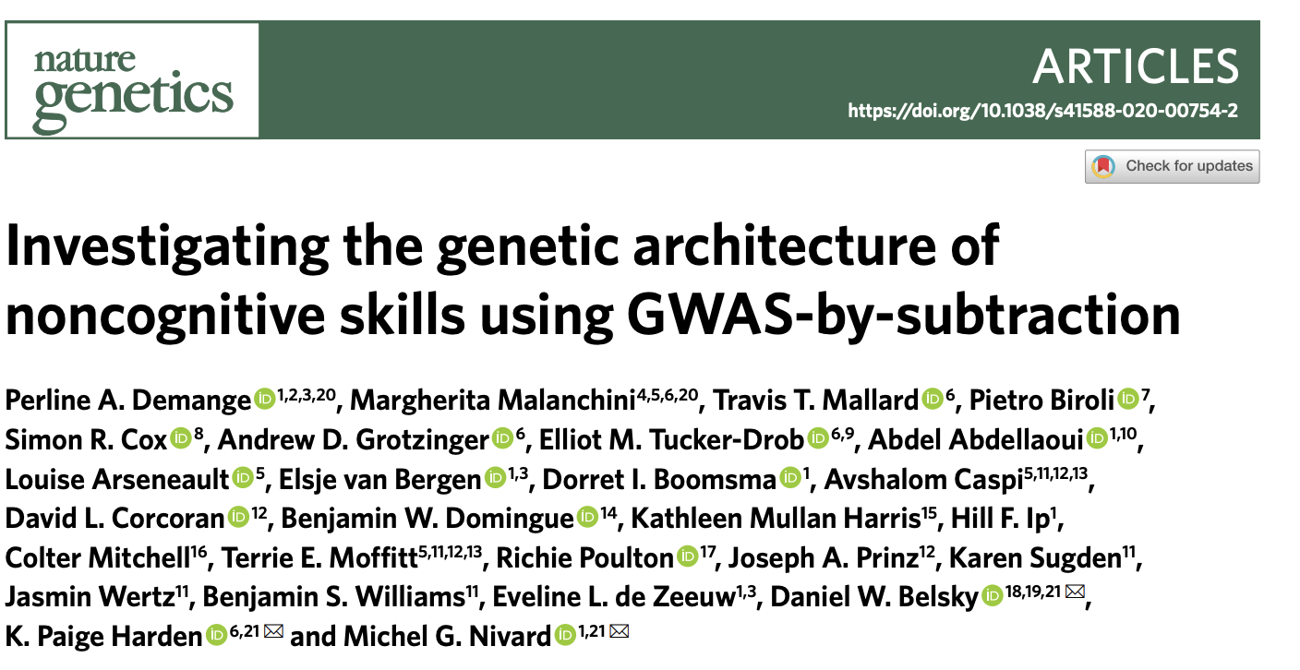
GWAS-by-subtraction
2pq
SNP
βCog
βNon-cog
0
1
1
Cog
Non-cog
$λ$Cog–EA
$λ$Non-cog–EA
$λ$Cog–CP
Cognitive performance
Educational attainment
0
0
0

Slide 18
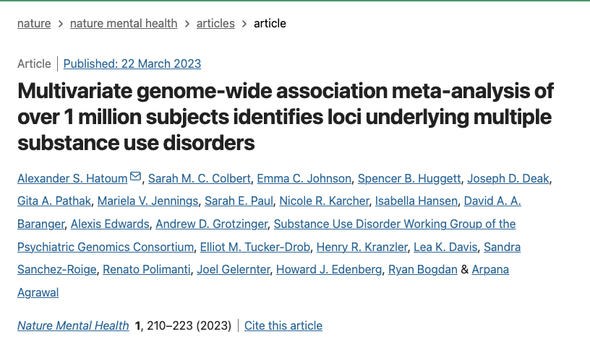
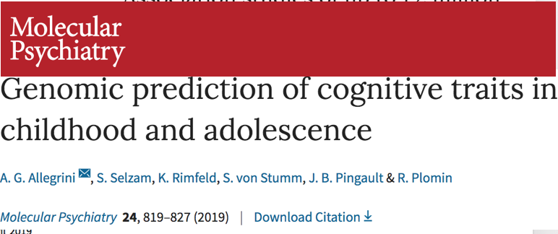
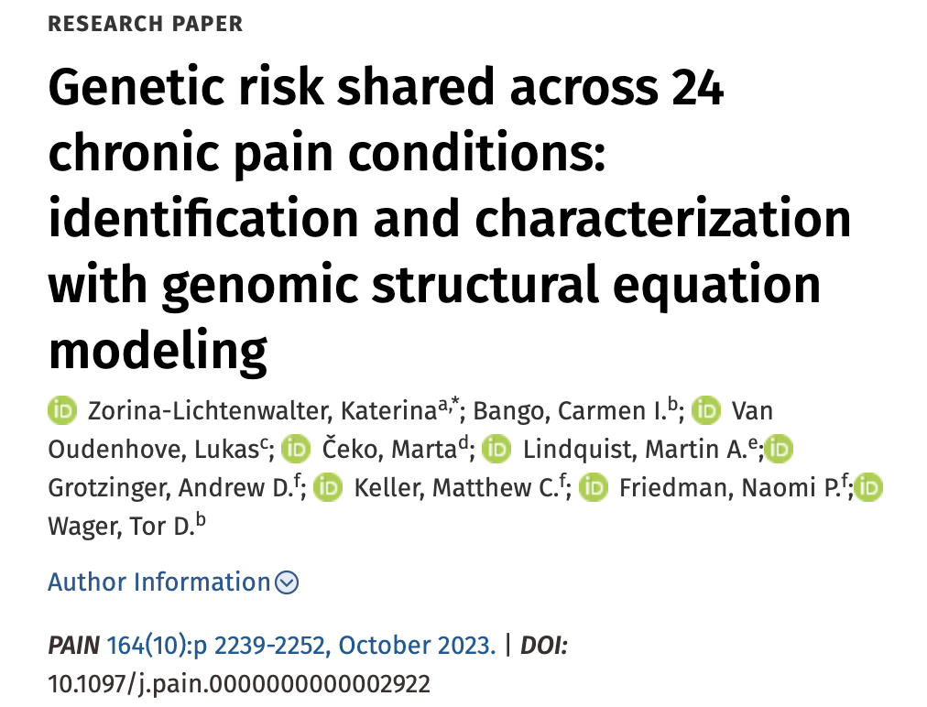
Notes:
Add journal; and allegrinir is not on biorxiv

Slide 19
Selling the product
Now

Slide 20
Selling the product
I know what the grad students in the audience must be thinking

Slide 21
Selling the product
You’re selling us an amazing tool to flexibly model genetic overlap across even mutually exclusive traits.
But I can barely pay rent and my bar tab, there’s no way I can afford this

Slide 22
Selling the product
But you know what…

Slide 23
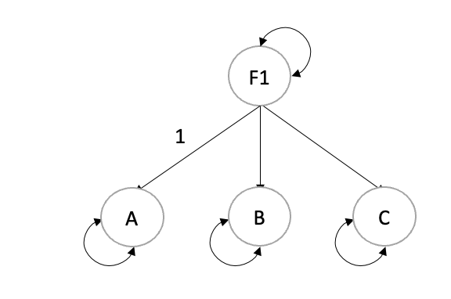
Selling the product
I like this group and I’m feeling generous so I’m going to slash our prices just for you
Flexible modeling framework
Genomic SEM

Slide 24
Selling the product
*Staged call

Slide 25
Selling the product
Ya’ll, at these prices we are practically (literally) giving the product away:
$0 down
$0 monthly payment
No annual fees

Slide 26
Selling the product
Alright, but what about the data? That costs money doesn’t it?

Slide 27
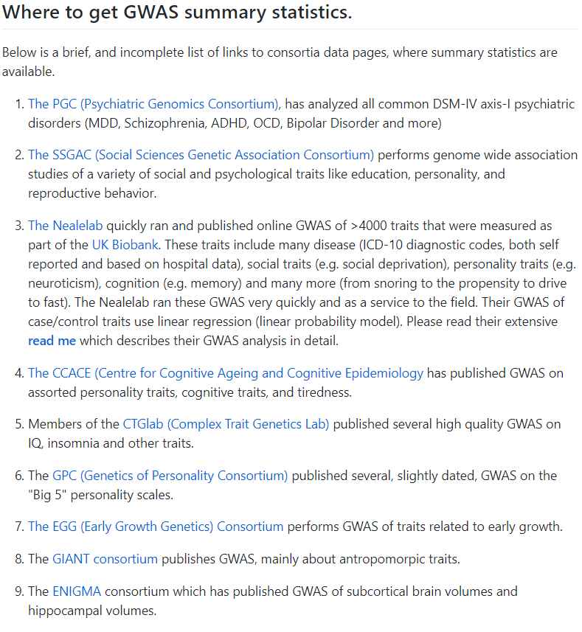
Where to get FREE summary statistics
List lots of resources on the Genomic SEM Wiki:
https://github.com/GenomicSEM/GenomicSEM/wiki/2.-Important-resources-and-key-information

Slide 28
https://www.ebi.ac.uk/gwas/
https://pheweb.jp/
https://www.finngen.fi/en/access_results
https://pgc.unc.edu/for-researchers/download-results/
https://docs.google.com/spreadsheets/d/1AeeADtT0U1AukliiNyiVzVRdLYPkTbruQSk38DeutU8/edit#gid=268241601
https://enigma.ini.usc.edu/research/download-enigma-gwas-results/

Slide 29
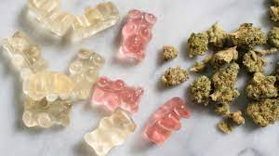
You aren’t dreaming this product is as good as it sounds

Slide 30
II. Estimating Genome-wide Models

Slide 31
Three Primary Steps
1. Munge the summary statistics (munge)
2. Run LD-Score Regression to obtain the genetic covariance and sampling covariance matrices (ldsc)
3. Specify and run the model (usermodel)

Slide 32
Lab
Using GWAS summary statistics for:
Major Depressive Disorder (Cases = 170,756; Controls = 329,443; Howard et al., 2019)
Anxiety Disorders (Cases = 31,977; Controls = 82,114; Purves et al., 2020)
Alcohol use disorder (Cases = 8,485; Controls = 20,272; Walters et al., 2018)
PTSD (Cases = 2,424; Controls = 7,113; Duncan et al., 2018)

Slide 33
We are going to start with Step 3: Estimating the genome-wide model

Slide 34
How to specify a model in lavaan
We use the lavaan formula language, slightly extended:
Regression:
A ~ B
(Co)variance:
A ~~ A; A ~~ B
Factor:
F1 =~ A + B + C + D
Fix a parameter:
A ~~ 1*B (the covariance between A and B is 1)
Name a parameter:
A ~~ a*B (the covariance between A and B = parameter label a)
Allows you to use model constraints for this parameter:
a > .001

Slide 35
Let’s make that a bit more specific
Model1 <- “ A ~ B
B ~ C”
Model2 <- “ A ~ B
A ~ C
B ~~ C”
C
B
A
B
A
C

Slide 36
Identifying the factor option 1: Unit variance identification
1
Model3 <- “ F1 =~ NA*A + B + C
F1 ~~ 1*F1”
Note that the above is the same as running
Model3 <- “ F1 =~ A + B + C”
And setting the argument std.lv = TRUE
Where std.lv denotes standardized latent variables
F1
A
B
C

Slide 37
Identifying the factor option 2: Unit loading identification
Model3 <- “ F1 =~ 1*A + B + C”
F1
1
A
B
C

Slide 38
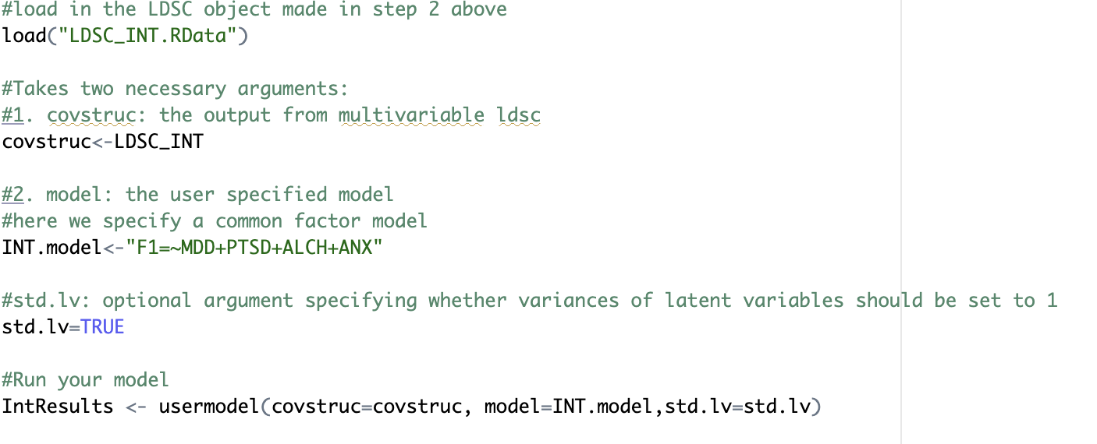
Specifying Arguments in usermodel

Slide 39
IntResults$results
P-values
Estimates and SE for model applied to genetic covariance matrix
Estimates and SE for model applied to genetic correlation matrix matrix
Parameter being estimated
Fully standardized estimates

Slide 40
IntResults$modelfit
chisq: The model chi-square, reflecting index of exact fit to observed data, with lower values indicating better fit.
df and p_chisq: The degrees of freedom and p-value for the model chi-square.
AIC: Akaike Information Criterion. Can be used to compare models regardless of whether they are nested.
CFI: Comparative Fit Index. Higher = better. > .90 = acceptable fit; > .95 = good model fit
SRMR: Standardized Room Mean Square Residual. Lower = better. < .10 = acceptable fit; < .05 = good fit

Slide 41
Let’s go to the code and fill out the Qualtrics questions for genome-wide models

Slide 42
III. Multivariate GWAS in Genomic SEM

Slide 43
Four Primary Steps
Munge the summary statistics (munge)
Run LD-Score Regression to obtain the genetic covariance and sampling covariance matrices (ldsc)
Prepare the summary statistics for multivariate GWAS (sumstats)
Run the multivariate GWAS (userGWAS)
These two steps mirror that for models without SNP effects and need not be run again for the same traits

Slide 44
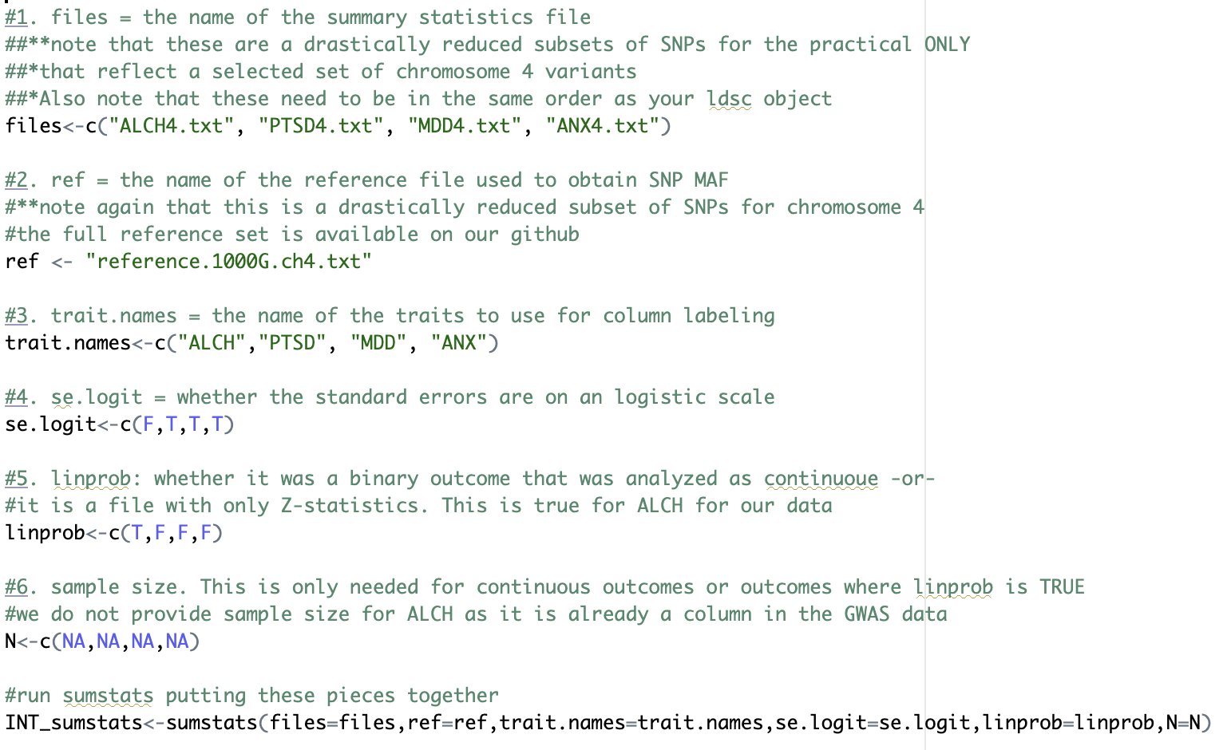
Step 3: sumstats example code Note that the traits need to be in the same order as for LDSC
Flowchart on github to help you figure out arguments for sumstats

Slide 45
The linear probability model argument for ALCH
sumstats needs a beta and SE to perform analyses, but sometimes the summary data only has a Z-statistic (or it was a binary outcome analyzed as continuous).
In these cases, linprob is set as TRUE for that trait and the sum of effective sample size is needed

Slide 46
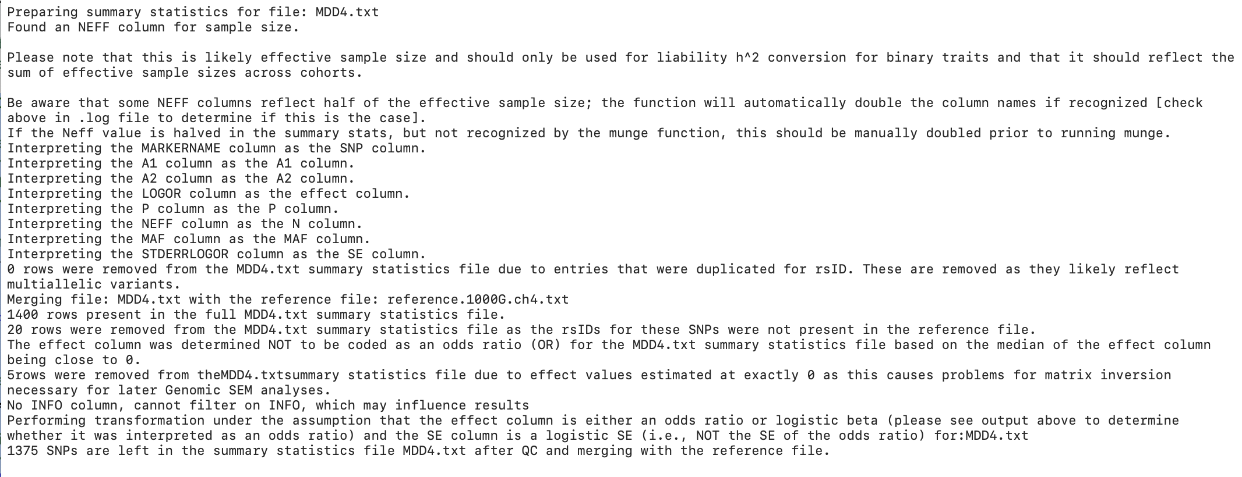
Examine the .log file for MDD

Slide 47
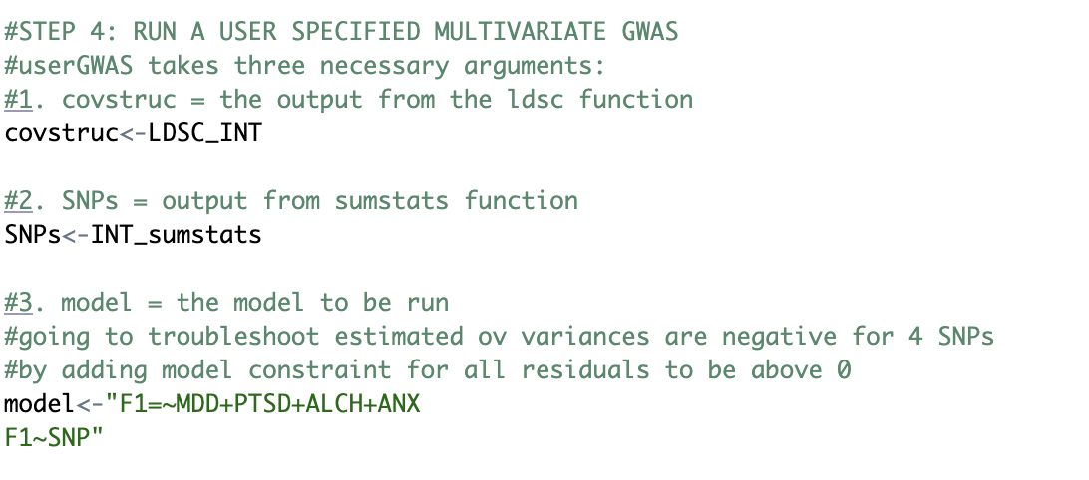
Step 4: userGWAS example code

Slide 48
Step 4: userGWAS example code

Slide 49
Estimates of SNP level heterogeneity (Q_{SNP})
Asks to what extent the effect of the SNP operates through the common factor
$χ^{2}$distributed test statistic, indexing fit of the common pathways model against independent pathways model
1
u_{F}
$e_{F }^{2}$
F_{G}
1
SNP_{m}
$\hat{b}$_{SNPm,F}
F_{G}
$${σ\text{SNP}}_{ }^{2}$$
SNP_{m}
$${σ\text{SNP}}_{ }^{2}$$
λ_{V1}
λ_{V5}
λ_{V1}
λ_{V5}
λ_{V2}
λ_{V3}
λ_{V4}
λ_{V2}
λ_{V3}
λ_{V4}
$\hat{b}$_{SNPm,V1}
$\hat{b}$_{SNPm,V2}
$\hat{b}$_{SNPm,V3}
$\hat{b}$_{SNPm,V4}
$\hat{b}$_{SNPm,V5}
V_{2g}
V_{1g}
V_{2g}
V_{3g}
V_{4g}
V_{5g}
V_{1g}
V_{3g}
V_{4g}
V_{5g}
1
1
1
1
1
1
1
1
1
1
u_{V2}
u_{V3}
1
u_{V1}
u_{V2}
u_{V3}
u_{V4}
u_{V5}
u_{V1}
u_{V4}
u_{V5}
$${eV1}_{ }^{2}$$
$${eV3}_{ }^{2}$$
$${eV4}_{ }^{2}$$
$${eV5}_{ }^{2}$$
$${eV1}_{ }^{2}$$
$${eV2}_{ }^{2}$$
$${eV3}_{ }^{2}$$
$${eV4}_{ }^{2}$$
$${eV5}_{ }^{2}$$
$${eV2}_{ }^{2}$$
Notes:
What’s valuable about this is that it is a test of the homogeneity assumption that the genetic covariance structure applies across the genome, and obtain a heterogenetiy statistic for each SNP in the GWAS
What you can here in red are the effect of the SNP through the factor (SNP effects factor, which affects indicators). What the Q-stat indexes the extent to which the paths in black are also needed. Those paths allow for individual effects of the SNP directly on the disorders without being mediated by the factor.

Slide 50
Q_{SNP} : QC Metric and a Result
For some projects, you might just use Q_{SNP} to prune your factor GWAS results for SNPs that are unlikely to operate via the factor
In other instances, your traits might be so highly correlated, but currently considered distinct phenotypes, such that your research question includes investigating what SNPs differentiate your traits
Notes:
What’s valuable about this is that it is a test of the homogeneity assumption that the genetic covariance structure applies across the genome, and obtain a heterogenetiy statistic for each SNP in the GWAS
What you can here in red are the effect of the SNP through the factor (SNP effects factor, which affects indicators). What the Q-stat indexes the extent to which the paths in black are also needed. Those paths allow for individual effects of the SNP directly on the disorders without being mediated by the factor.

Slide 51
If you have multiple factors, you can get a Q_{SNP} specific metric for each factor. For example, you could have a SNP that fits one factor well, but is very disorder-specific for another factor
Grotzinger et al. (2022)
Notes:
Just verbalize what happens with MDD. When we expand this model to 11 disorders, most notably by include 2 other key internalizing disorders ANX and PTSD, we are able to identify a fourth factor on which major depression now loads strongly. Otherwise the three factor structure has been entirely replicated and now extended on the basis of this new data.

Slide 52
Q_{SNP} : Better, Faster, Stronger
It used to be that you had to estimate a separate independent pathways follow-up model.
This was slow, error prone, not computationally efficient
Introducing today that Q_{SNP} is now an argument for userGWAS that will automatically calculate this metric for every factor that is predicted by a SNP without estimating a follow-up model
Notes:
What’s valuable about this is that it is a test of the homogeneity assumption that the genetic covariance structure applies across the genome, and obtain a heterogenetiy statistic for each SNP in the GWAS
What you can here in red are the effect of the SNP through the factor (SNP effects factor, which affects indicators). What the Q-stat indexes the extent to which the paths in black are also needed. Those paths allow for individual effects of the SNP directly on the disorders without being mediated by the factor.

Slide 53
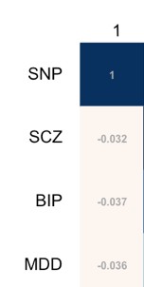
Behind the scenes
userGWAS combines output from Steps 2 (ldsc) and 3 (sumstats) to be able to specify a model with SNP effects
Creates as many covariance matrices as there are SNPs across traits
Introducing today: the measurement model (the factor loadings and correlations) is fixed across SNPs as a default to speed up analysis and improve interpretability (can be turned on/off with fix_measurement argument)
Step 3: Run sumstats
Step 4: userGWAS combines the two
Step 2: Run ldsc
+
=

Slide 54
First five rows of the output
The parameter being estimates (SNP effect on factor)
Multivariate GWAS p-value
Beta and SE of SNP effect on factor
Q_{SNP} p-value

Slide 55
Let’s go to the code and fill out the Qualtrics questions for multivariate GWAS

Slide 56
If you finish early, go onto next slides/section of code to play around more with specifying your own model at the genome-wide level

Slide 57
Anthropometric traits
Note that you do not need to include all variables in the model

Slide 58
Variable Names
BMI = Body Mass Index
WHR = Waist Hip Ratio
Waist = Waist Circumference
Hip = Hip circumference
CO = childhood obesity
Height = Height
BL = Birth Length
BW = Birth Weight
IHC = Infant Head Circumference

Slide 59
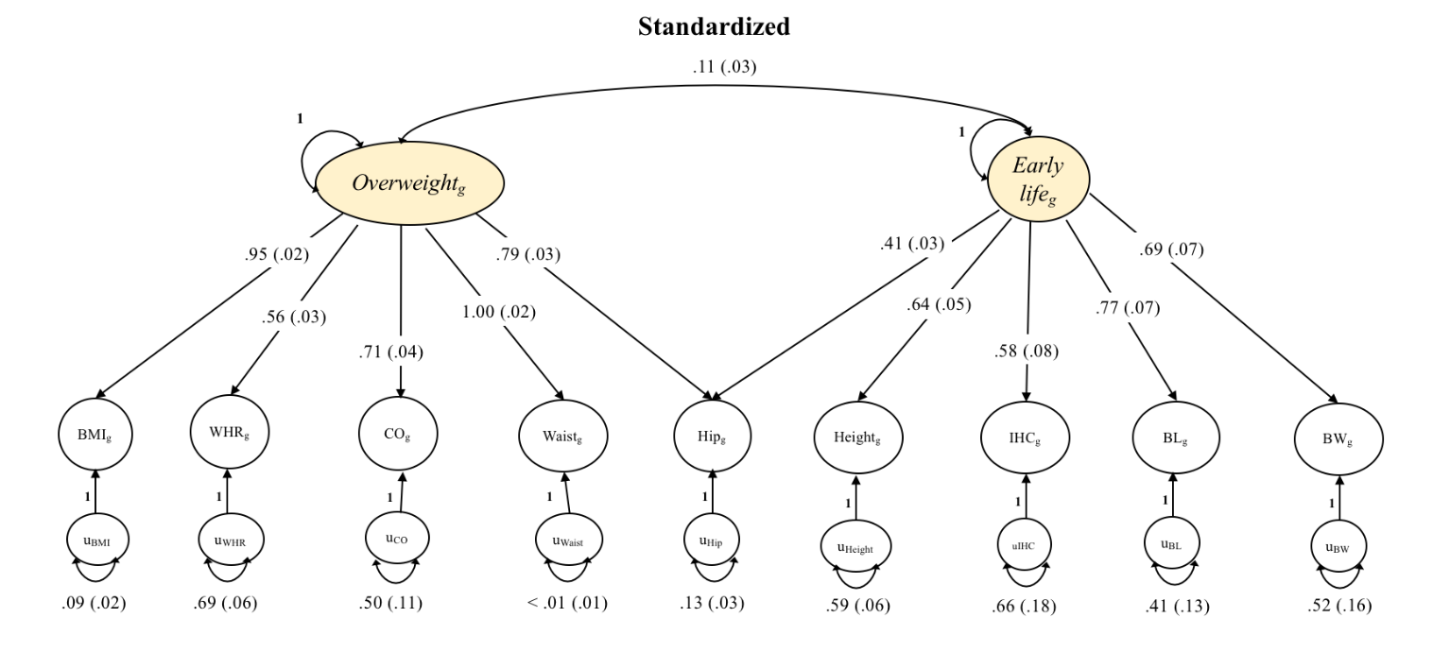
Example model that could be fit to the data
(but you should fit your own)

Slide 60
Pre-register your model by writing it down on paper beforehand.
The goal is not to just pick models until you get “a result”
Rather, we want to test theories or take a documented data-driven approach

Slide 61
Final Notes
Parallel processing and MPI for userGWAS is available
Parallel is the same as serial processing, except that it takes an additional cores argument specifying how many cores to use
Ideal run-time scenario: split jobs across computing nodes on a cluster and run in-parallel
All runs are independent of one another!

Slide 62
Overview
Ask questions on our google forum
https://groups.google.com/forum/#!forum/genomic-sem-users
Lots can be done using existing, openly available GWAS summary statistics
Models are flexible and up to the user

Slide 63
Factor model (genome-wide)
Stratified Genomic SEM (functional annotations)
Transcriptome-wide SEM (gene expression)
Multivariate GWAS (SNPs)
We’ve gone over factor models and multivariate GWAS but two additional sets of functions are available for functional annotations and gene expression analyses
Biological Level of Analysis

Slide 64
Resources
See paper at: rdcu.be/bvn7t
See github at: https://github.com/GenomicSEM/GenomicSEM
See tutorials at: https://github.com/GenomicSEM/GenomicSEM/wiki

