Slide 1
Latent Factor Models in Twins
Brad Verhulst
Daniel Gustavson
International Statistical Genetics Workshop
March 6th, 2024

Slide 2
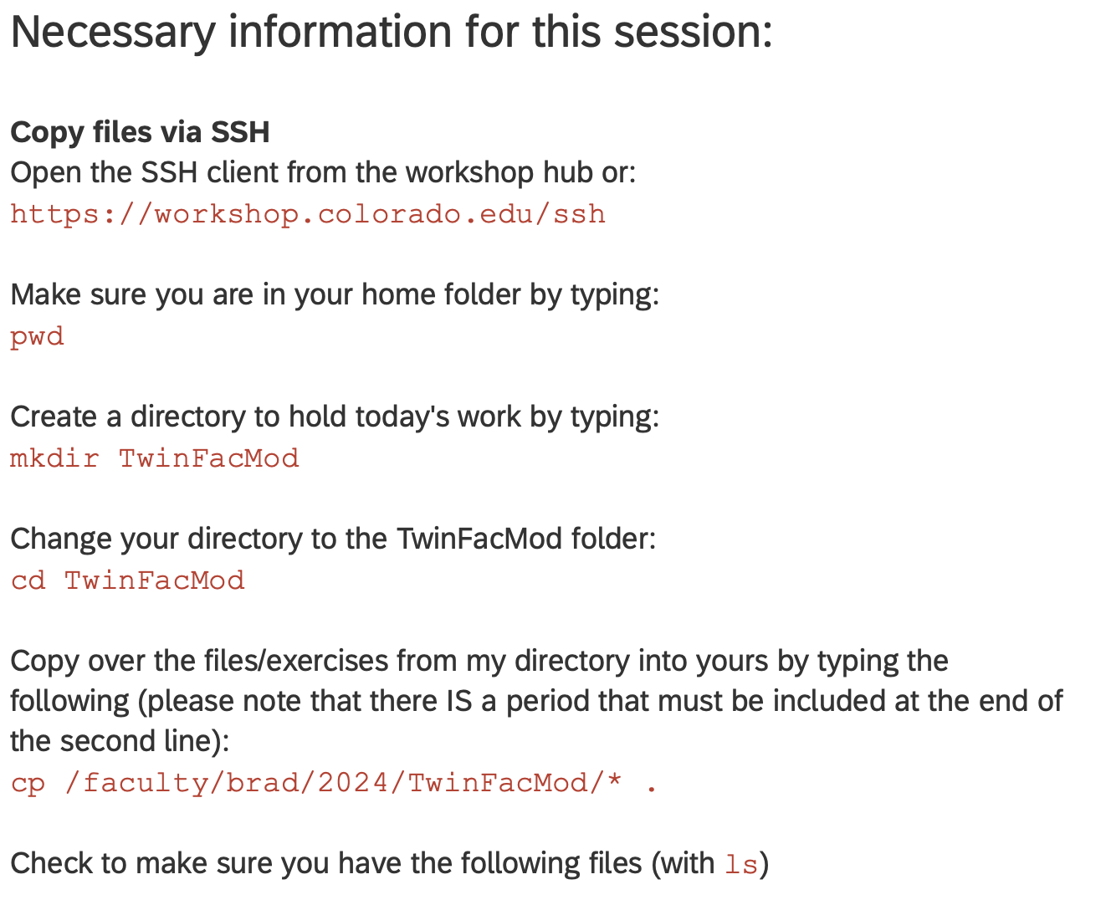

Slide 3
Utility of Structural Equation Modeling
Structural Equation Modeling attempts to explain the covariance matrix of all the variables in the analysis rather than the variation in a single dependent variable
If there is only one dependent variable and one independent variable, SEM reduces to regression
Flexible framework to estimate a variety of causal and correlational models:
  Confirmatory Factor Analysis
  Path Analysis (mediation, feedback loops)
  Regression (linear, logistic, ordinal)
Three major advantages of SEM over traditional multivariate techniques:
Explicit focus on measurement (error)
Estimate latent variables
Test complex theoretical structures

Slide 4

Factor Analysis
Factor analysis is a way to explain the covariance between a set of observed and latent variables
  Observed variables are concepts that can be directly measured (e.g., Items from questionnaires)
  Latent variables are concepts that must be inferred (through a mathematical model) from observed variables

Slide 5
Confirmatory Factor Analysis (CFA)
CFA
  Theory driven model
  Must specify which variables are related in advance
    Both latent and manifest
  Caution: It is possible to write/draw unidentified models
Example: Depression is the cause of the DSM Depression Symptoms:
1) Depressed mood
2) Anhedonia
3) Changes in weight
4) Insomnia or hypersomnia
5) Psychomotor agitation or retardation
6) Fatigue
7) Feelings of worthlessness or guilt
8) Diminished ability to think or concentrate
9) Suicidal ideation

Slide 6
Model Specification Steps
Model formulation. Specification of the structural
equation model based on theory or empirical findings.
Model identification. Is there a unique solution for all free parameters in the specified model?
Model estimation. Parameter estimation and fit function.
Model evaluation. Does the model fit the data?
Model modification. Re-specification or modification of the model, if needed.

Slide 7
Review of Path Tracing Rules
To derive the expected variance/covariance of any item(s) from path diagrams.
We find every path chain connecting one variable to another:
  Start at first variable
  Go backward through zero or more one-headed arrows
  Change direction one two-headed arrow
  Go forward through zero or more one-headed arrows
  Stop at second variable.
  No loops, i.e., no going through a variable more than once in each direction.
  Multiply all the coefficients along the path
Then, sum of all paths between the two variables.

Slide 8
Phenotypic Common Factor Model
1
F₁
Measurement Model
λ₁
λ₂
λ₃
λ₄
λ₅
X₁
X₂
X₃
X₄
X₅
Observed Variables
Means Model
μ₁
μ₂
μ₃
μ₄
μ₅
1
δ
δ
δ
δ
δ
Residuals Model
δ₁
δ₂
δ₃
δ₄
δ₅

Slide 9
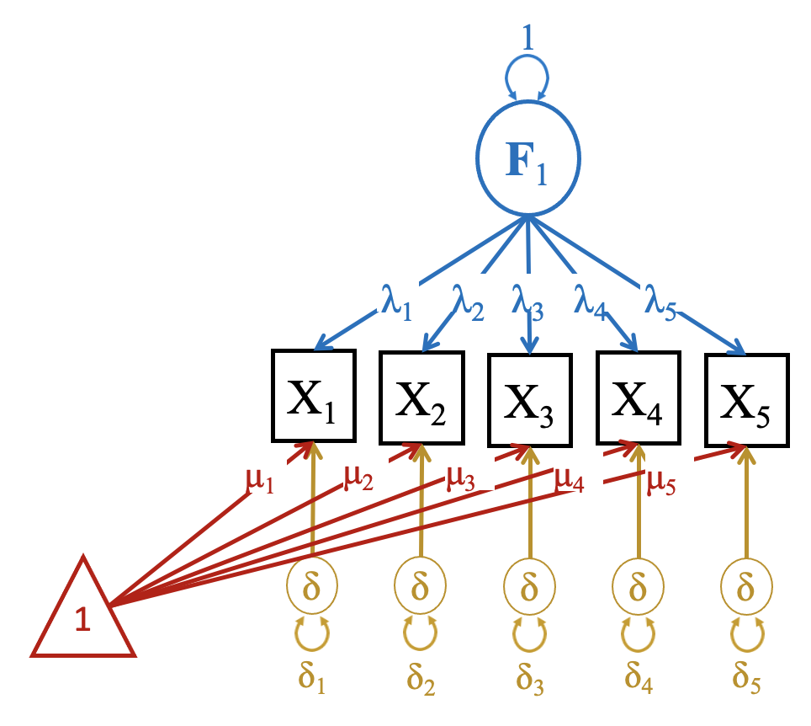
Interpreting a CFA
Measurement Model
Factor Loadings (Regression of the item on the latent factor)
  A 1 unit increase in the latent factor is associated with a lambda increase in the observed variable
The larger the magnitude of the factor loading, the more central the item is to the interpretation of the latent factor
Residuals Model
Variance in the observed variables not explained by the latent factor
Some items may have large residuals, or variance that cannot be explained by covariation with the other items in the model
Means Model
The expected means of the observed variables
If we include covariates (e.g., age, sex), the means are intercepts from a regression model
This means model is saturated and will fit almost perfectly (but it doesn’t have to be)

Slide 10
Latent Variables and Identification
Identification of the Scale of the Latent Factor: Two Approaches
  Constrain the variance of the latent factor to 1
      This standardizes the latent factor to have a unit variance
      We typically assume that the mean is zero
    Under these circumstances, distribution of the latent factor is assumed to be standard normal
  Constrain one of the factor loadings
    This fixes the scale of the latent factor to equal that of the variable with the fixed factor loading
      A unit increase in x_{i} corresponds to a unit increase in the latent factor
      The latent factor is assumed to be normally distributed (but is longer follows a standard normal distribution)
    This is the default in many SEM programs (e.g., Mplus)

Slide 11
Identification of CFA Models
The t-Rule: t ≤ ½ q(q+1)
  The number of free parameters t in the model must be equal to or less than the number of unique elements in the covariance matrix, q(q+1)/2.
    ‘Unique’ means different expectations
  The t-Rule is necessary but not sufficient
The 3 Indicator Rule:
  A 1 Factor model is identified if there are three indicators with non-zero loadings and a diagonal residual matrix.
  With more than three indicators of a factor the model may be over-identified.
  Multifactor models are identified if:
    Each factor has 3 indicators
    Each row has one and only one nonzero (free) element (This implies simple structure)
    The residual matrix is diagonal
These are sufficient conditions, but they are not necessary:
  Exceptions can be made (i.e., Correlated Residuals, Cross-loadings)
The Two-Indicator Rule:
  The residual matrix is diagonal
  One loading (for each factor) is fixed (probably to 1).

Slide 12



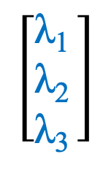
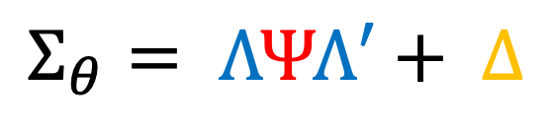
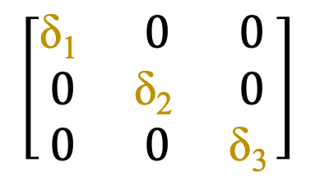
Phenotypic Common Factor Model
$$Σ_{θ}= ΛΨΛ′+ Δ$$
𝛹
F₁
$$\left[\begin{matrix}\text{λ}\text{1 } \\ \text{λ}\text{2 } \\ \text{λ}\text{3 }\end{matrix}\right]$$
$$\left[Ψ\right]$$
$$\left[\begin{matrix}\text{λ}\text{1} & \text{λ}\text{2} & \text{λ}\text{3}\end{matrix}\right]$$
$$\left[\begin{matrix}\text{δ}\text{1 } & 0 & 0 \\ 0 & \text{δ}\text{2 } & 0 \\ 0 & 0 & \text{δ}\text{3 }\end{matrix}\right]$$
$$+$$
λ₁
λ₂
λ₃
X₁
X₂
X₃
δ₁
δ₂
δ₃

Slide 13
Latent Variable Models in Twins
Familial
Resemblance
1
1
We assume that the same Measurement Models, Means Models, and Residuals Models are equal for everyone
(T₁/T₂ and MZ/DZ)
F₁
F₁
λ₁
λ₂
λ₃
λ₄
λ₅
λ₁
λ₂
λ₃
λ₄
λ₅
X₁
X₂
X₃
X₄
X₅
X₁
X₂
X₃
X₄
X₅
δ₁
δ₂
δ₃
δ₄
δ₅
δ₁
δ₂
δ₃
δ₄
δ₅
Twin 1
Twin 2

Slide 14
Common Pathway Model
Common Constraint:
V_{a} + V_{c} + V_{e} = 1
V_{c}
V_{a} or ½V_{a}
Measurement Model
Variance Decomposition
V_{e}
V_{c}
V_{a}
V_{a}
V_{c}
V_{e}
E
C
A
A
C
E
F₁
F₁
Standard Measurement Model
λ₁
λ₂
λ₃
λ₁
λ₂
λ₃
Measurement, Means, and Residuals Models are the same for everyone
X₁
X₂
X₃
X₁
X₂
X₃
Residuals Model
Variance Decomposition
E
E
E
E
E
E
S_{1e}
C
A
S_{2e}
C
S_{3e}
C
A
S_{1e}
C
A
S_{2e}
C
S_{3e}
C
S_{1c}
S_{2c}
A
S_{3c}
S_{1c}
S_{2c}
A
S_{3c}
A
S_{1a}
S_{2a}
S_{3a}
S_{1a}
S_{2a}
S_{3a}

Slide 15
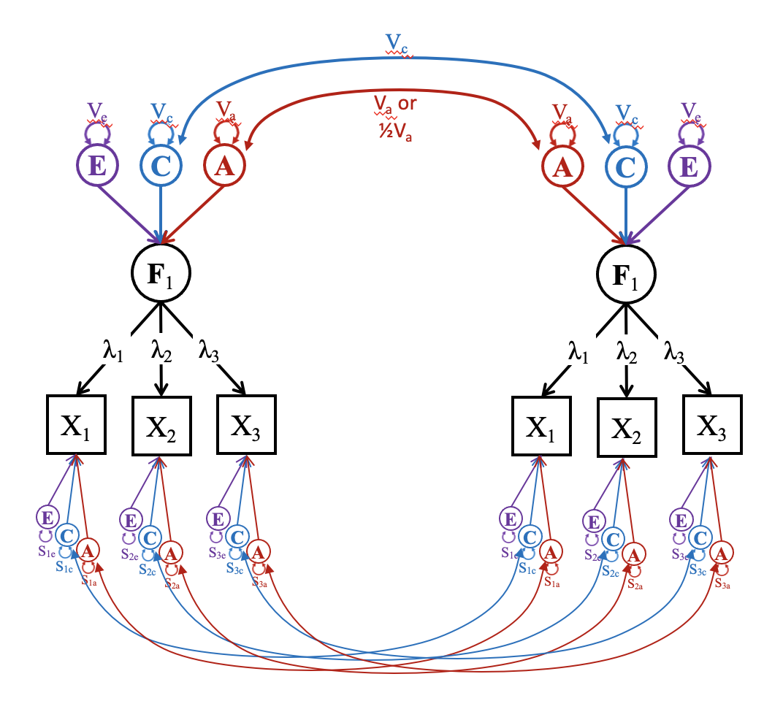




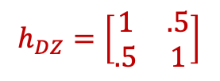

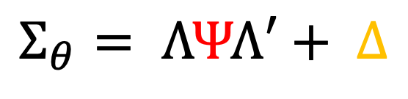
Common Pathway Model Algebra
$$Σ_{θ}= ΛΨΛ′+ Δ$$
$$h_{MZ}=\left[\begin{matrix}1 & 1 \\ 1 & 1\end{matrix}\right]$$
$$Ψ ={h⊗V}_{a}+{s⊗V}_{c}+{d⊗V}_{e}$$
$$h_{DZ}=\left[\begin{matrix}1 & .5 \\ .5 & 1\end{matrix}\right]$$
$$Δ={h⊗S}_{a}+{s⊗S}_{c}+ {d⊗S}_{e}$$
$$s=\left[\begin{matrix}1 & 1 \\ 1 & 1\end{matrix}\right]$$
$$d=\left[\begin{matrix}1 & 0 \\ 0 & 1\end{matrix}\right]$$

Slide 16

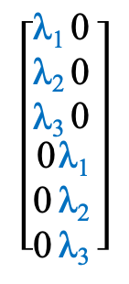
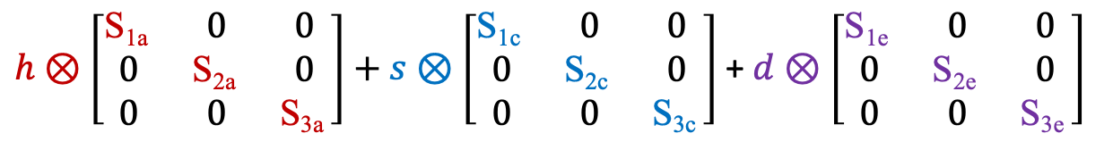

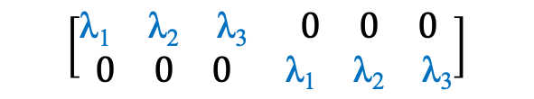
Common Pathway Model Algebra
Measurement Model
Variance Decomposition
$$\left[\begin{aligned}\begin{matrix}\text{λ}\text{1 } \\ \text{λ}\text{2 } \\ \text{λ}\text{3 }\end{matrix}\begin{matrix}\text{0} \\ \text{0} \\ \text{0} \end{matrix} \\ \begin{matrix}\text{0} \\ \text{0} \\ \text{0} \end{matrix}\begin{matrix}\text{λ}\text{1 } \\ \text{λ}\text{2 } \\ \text{λ}\text{3 }\end{matrix}\end{aligned}\right]$$
$$\left[{h⊗V}_{a}+{s⊗V}_{c}+{d⊗V}_{e}\right]$$
$$\left[\begin{matrix}\begin{matrix}\text{λ}\text{1} & \text{λ}\text{2} & \text{λ}\text{3}\end{matrix} & \begin{matrix}0 & 0 & 0\end{matrix} \\ \begin{matrix}0 & 0 & 0\end{matrix} & \begin{matrix}\text{λ}\text{1} & \text{λ}\text{2} & \text{λ}\text{3}\end{matrix}\end{matrix}\right]$$
$$+$$
$h⊗\left[\begin{matrix}\text{S}\text{1}\text{a} & 0 & 0 \\ 0 & \text{S}\text{2}\text{a} & 0 \\ 0 & 0 & \text{S}\text{3}\text{a} \end{matrix}\right]+s⊗\left[\begin{matrix}\text{S}\text{1}\text{c} & 0 & 0 \\ 0 & \text{S}\text{2}\text{c} & 0 \\ 0 & 0 & \text{S}\text{3}\text{c} \end{matrix}\right]$ + $d⊗\left[\begin{matrix}\text{S}\text{1}\text{e} & 0 & 0 \\ 0 & \text{S}\text{2}\text{e} & 0 \\ 0 & 0 & \text{S}\text{3}\text{e} \end{matrix}\right]$
Residuals Model
Variance Decomposition

Slide 17
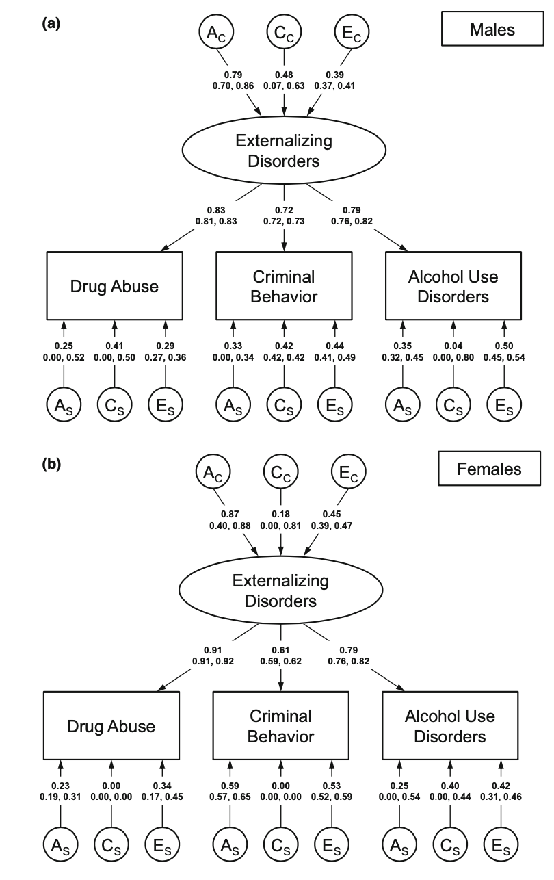
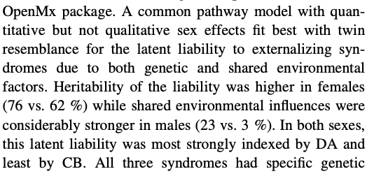
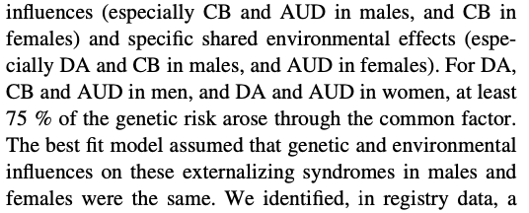
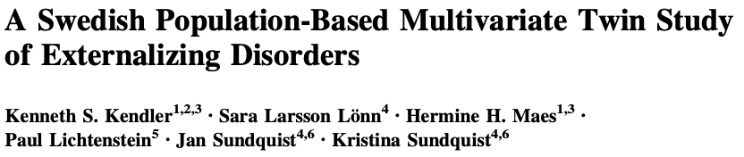

Common Pathway Model in Action

Slide 18
Independent Pathway Model
1
1 or ½
1
1
1
1
1
1
Separate Measurement Models for each Variance Component
E
C
A
A
C
E
λ_{3e}
λ_{1c}
λ_{3c}
λ_{1a}
λ_{3a}
λ_{1c}
λ_{3c}
λ_{1a}
λ_{2e}
λ_{2c}
λ_{2a}
λ_{2a}
λ_{2c}
λ_{2a}
λ_{1e}
λ_{3a}
λ_{1a}
λ_{3a}
X₁
X₂
X₃
Measurement, Means, and Residuals Models are the same for everyone
X₁
X₂
X₃
Residuals Model
Variance Decomposition
E
E
E
E
E
E
S_{1e}
C
A
S_{2e}
C
S_{3e}
C
A
S_{1e}
C
A
S_{2e}
C
S_{3e}
C
S_{1c}
S_{2c}
A
S_{3c}
S_{1c}
S_{2c}
A
S_{3c}
A
S_{1a}
S_{2a}
S_{3a}
S_{1a}
S_{2a}
S_{3a}

Slide 19
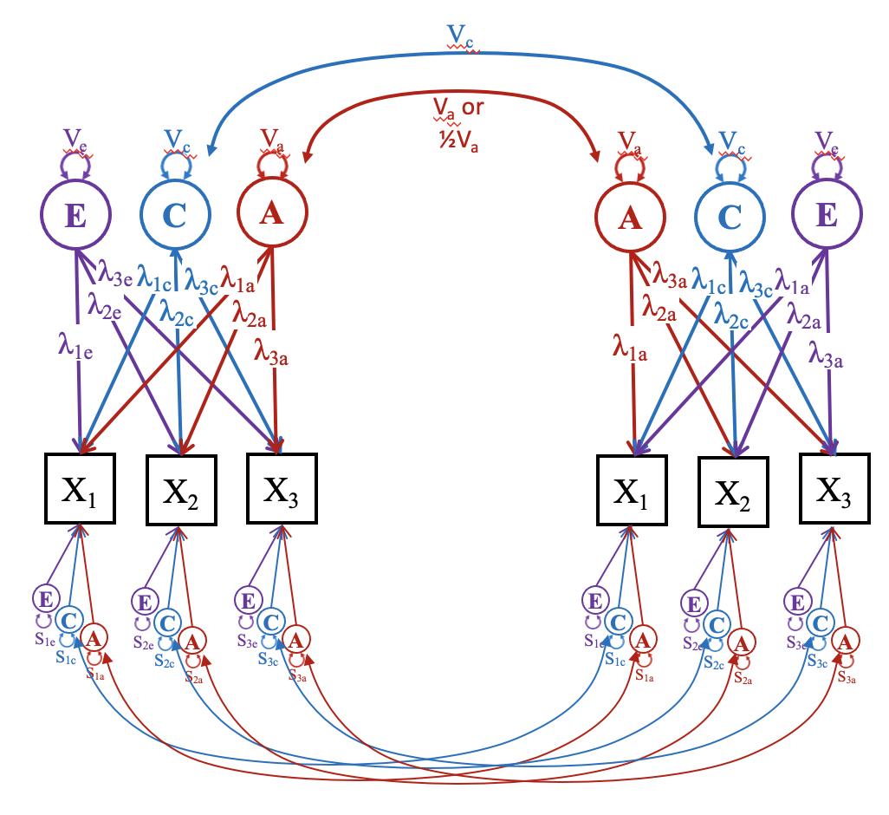

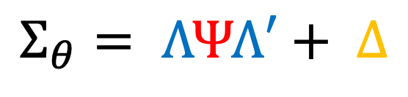
Independent Pathway Model Algebra
$$Σ_{θ}= ΛΨΛ′+ Δ$$
$$Δ={h⊗S}_{a}+{s⊗S}_{c}+ {d⊗S}_{e}$$
$ΛΨΛ^{′}=h⊗Λ_{a}Λ_{a}^{′}$ +$s⊗Λ_{c}Λ_{c}^{′}$ + $d⊗ Λ_{e}Λ_{e}^{′}$

Slide 20
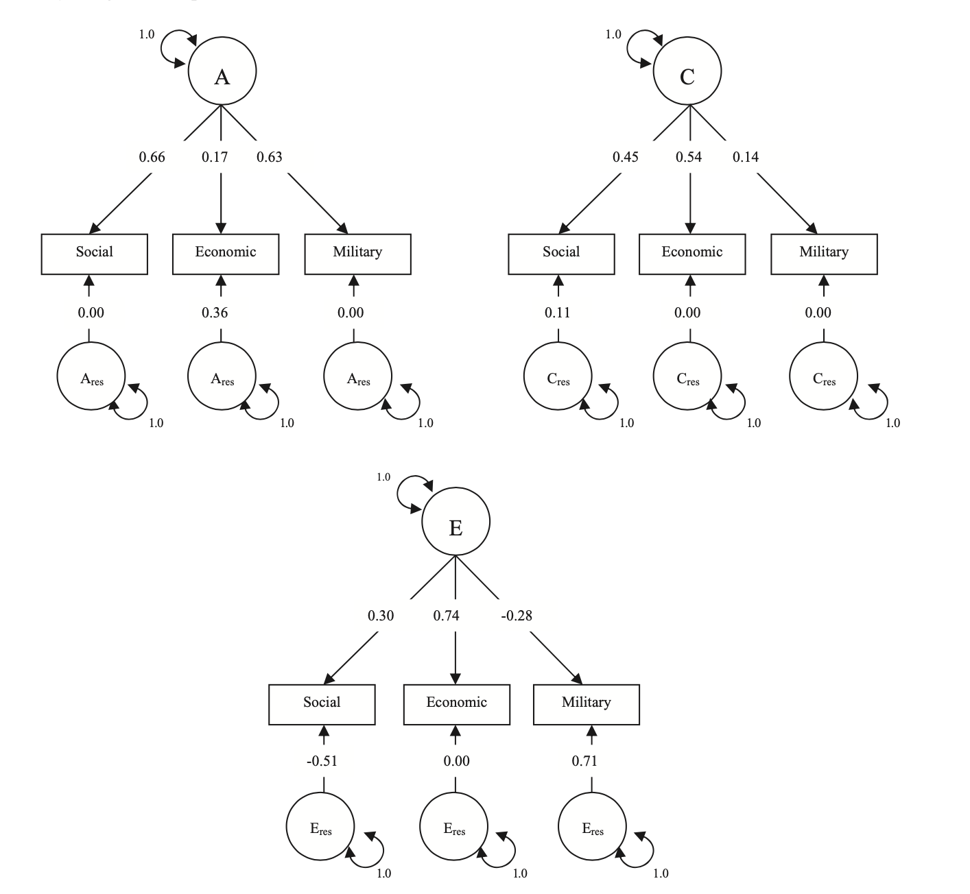


Independent Pathway Model in Action
Bottom-up process that leads to genetic covariation between political attitude dimensions
Top-down processes that leads to shared environmental covariation between political attitude dimensions

Slide 21
Saturated Multivariate Twin Models
In multivariate twin analyses, saturated models are essential comparison models to gauge the fit of hypothesis driven models (i.e. Common and Independent pathway models).
Saturated models freely estimate all possible covariances and therefore should fit the data as accurately as possible.
Therefore, comparing hypothesis driven models to the saturate model allows us to test how much worse the hypothesis driven models fits the observed data.

Slide 22





Saturated Multivariate Twin Models
$$\left[\begin{matrix}\begin{matrix}σ_{1}^{2} & σ_{1,2} & σ_{1,3} \\ σ_{1,2} & σ_{2}^{2} & σ_{2,3} \\ σ_{1,3} & σ_{2,3} & σ_{3}^{2}\end{matrix} & \begin{matrix}σ_{1,1} & σ_{1,2} & σ_{1,3} \\ σ_{1,2} & σ_{2,2} & σ_{2,3} \\ σ_{1,3} & σ_{2,3} & σ_{3,3}\end{matrix} \\ \begin{matrix}σ_{1,1} & σ_{1,2} & σ_{1,3} \\ σ_{1,2} & σ_{2,2} & σ_{2,3} \\ σ_{1,3} & σ_{2,3} & σ_{3,3}\end{matrix} & \begin{matrix}σ_{1}^{2} & σ_{1,2} & σ_{1,3} \\ σ_{1,2} & σ_{2}^{2} & σ_{2,3} \\ σ_{1,3} & σ_{2,3} & σ_{3}^{2}\end{matrix}\end{matrix}\right]$$
Direct Symmetric Matrix
$$\left[\begin{matrix}\begin{matrix}V_{a1} & a_{1,2} & a_{1,3} \\ a_{1,2} & V_{a2} & a_{2,3} \\ a_{1,3} & a_{2,3} & V_{a3}\end{matrix} & \begin{matrix}a_{1,1} & a_{1,2} & a_{1,3} \\ a_{1,2} & a_{2,2} & a_{2,3} \\ a_{1,3} & a_{2,3} & a_{3,3}\end{matrix} \\ \begin{matrix}a_{1,1} & a_{1,2} & a_{1,3} \\ a_{1,2} & a_{2,2} & a_{2,3} \\ a_{1,3} & a_{2,3} & a_{3,3}\end{matrix} & \begin{matrix}V_{a1} & a_{1,2} & a_{1,3} \\ a_{1,2} & V_{a2} & a_{2,3} \\ a_{1,3} & a_{2,3} & V_{a3}\end{matrix}\end{matrix}\right]$$
$$\left[\begin{matrix}\begin{matrix}V_{c1} & c_{1,2} & c_{1,3} \\ c_{1,2} & V_{c2} & c_{2,3} \\ c_{1,3} & c_{2,3} & V_{c3}\end{matrix} & \begin{matrix}c_{1,1} & c_{1,2} & c_{1,3} \\ c_{1,2} & c_{2,2} & c_{2,3} \\ c_{1,3} & c_{2,3} & c_{3,3}\end{matrix} \\ \begin{matrix}c_{1,1} & c_{1,2} & c_{1,3} \\ c_{1,2} & c_{2,2} & c_{2,3} \\ c_{1,3} & c_{2,3} & c_{3,3}\end{matrix} & \begin{matrix}V_{c1} & c_{1,2} & c_{1,3} \\ c_{1,2} & V_{c2} & c_{2,3} \\ c_{1,3} & c_{2,3} & V_{c3}\end{matrix}\end{matrix}\right]$$
$$\left[\begin{matrix}\begin{matrix}V_{e1} & e_{1,2} & e_{1,3} \\ e_{1,2} & V_{e2} & e_{2,3} \\ e_{1,3} & e_{2,3} & V_{e3}\end{matrix} & \begin{matrix}e_{1,1} & e_{1,2} & e_{1,3} \\ e_{1,2} & e_{2,2} & e_{2,3} \\ e_{1,3} & e_{2,3} & e_{3,3}\end{matrix} \\ \begin{matrix}e_{1,1} & e_{1,2} & e_{1,3} \\ e_{1,2} & e_{2,2} & e_{2,3} \\ e_{1,3} & e_{2,3} & e_{3,3}\end{matrix} & \begin{matrix}V_{e1} & e_{1,2} & e_{1,3} \\ e_{1,2} & V_{e2} & e_{2,3} \\ e_{1,3} & e_{2,3} & V_{e3}\end{matrix}\end{matrix}\right]$$
+
+
$SatCov={h⊗V}_{a}$ + ${s⊗V}_{c}$ + ${d⊗V}_{e}$

Slide 23

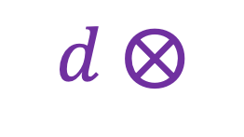







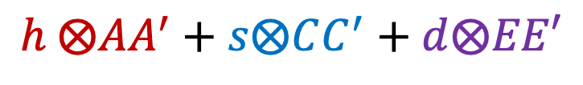

Saturated Multivariate Twin Models
Cholesky Decomposition
$$SatCov=$$
$$h ⨂AA^{′}+s⨂CC^{′}+d⨂EE′$$
[
[
]
]
1
1
1
1
1
1
+
A₁
A₂
A₃
C₁
C₂
C₃
$$h ⨂$$
$$\begin{matrix}a_{11} & 0 & 0 \\ a_{21} & a_{22} & 0 \\ a_{31} & a_{32} & a_{33}\end{matrix}$$
$$\begin{matrix}a_{11} & a_{21} & a_{31} \\ 0 & a_{22} & a_{32} \\ 0 & 0 & a_{33}\end{matrix}$$
[
]
[
]
+
$$\begin{matrix}c_{11} & 0 & 0 \\ c_{21} & c_{22} & 0 \\ c_{31} & c_{32} & c_{33}\end{matrix}$$
$$\begin{matrix}c_{11} & c_{21} & c_{31} \\ 0 & c_{22} & c_{32} \\ 0 & 0 & c_{33}\end{matrix}$$
$$s ⨂$$
X₁
X₂
X₃
[
[
]
]
$$\begin{matrix}e_{11} & 0 & 0 \\ e_{21} & e_{22} & 0 \\ e_{31} & e_{32} & e_{33}\end{matrix}$$
$$\begin{matrix}e_{11} & e_{21} & e_{31} \\ 0 & e_{22} & e_{32} \\ 0 & 0 & e_{33}\end{matrix}$$
$$d ⨂$$
E₁
E₂
E₃
1
1
1

Slide 24
Cholesky Problems
The Cholesky Decomposition implicitly constrains all variance parameters to be positive
  (Seems sensible)
This constraint truncates the distribution of the variance parameters under the null distribution
  (Meaning the p-values are wrong)
Under the null, the test statistics is distributed as a mixture distribution of 0, 𝟀²(1), … 𝟀²(k).

Slide 25
Intuition behind the Problem
rMZ = .50
rDZ = .25
If rMZ is .50 and rDZ is .25:
Va = 0.5
Vc = 0
Ve = 0.5
In repeated sampling, sometimes rMZ will be slightly overestimated and rDZ will be slightly underestimated.
If so, C will be negative
Other times, rMZ will be slightly underestimated and rDZ will be slightly overestimated.
If so, C will be positive

Slide 26
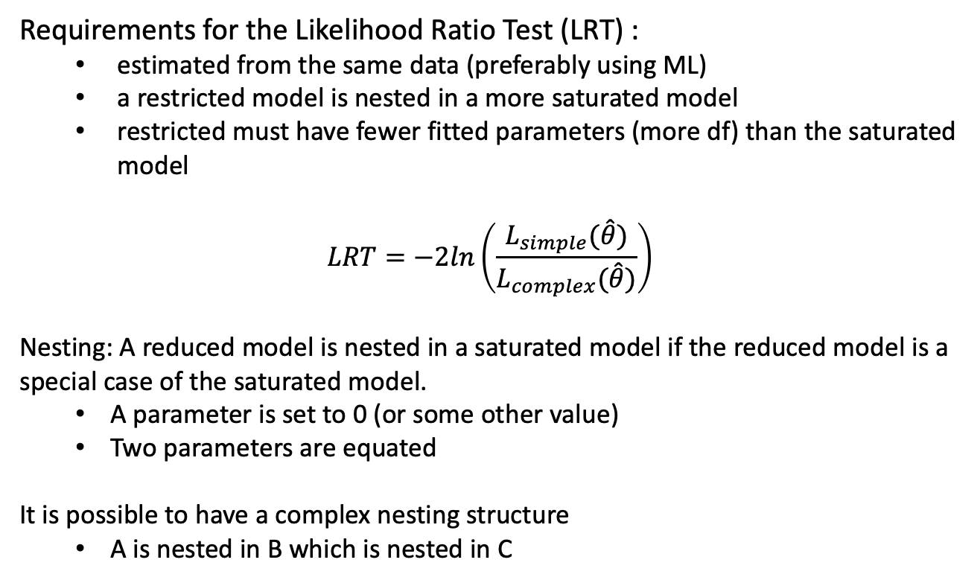
Model Evaluation
Requirements for the Likelihood Ratio Test (LRT) :
  estimated from the same data (preferably using ML)
  a restricted model is nested in a more saturated model
  restricted must have fewer fitted parameters (more df) than the saturated model
$$LRT=−2ln\left(\frac{L_{simple}(\hat{θ})}{L_{complex}(\hat{θ})}\right)$$
Nesting: A reduced model is nested in a saturated model if the reduced model is a special case of the saturated model.
  A parameter is set to 0 (or some other value)
  Two parameters are equated
It is possible to have a complex nesting structure
  A is nested in B which is nested in C

Slide 27
Assumption Testing and Model Fitting
More
Saturated
Completely Saturated Model
  All possible variances, covariances and means are freely estimated
Saturated Model
  Equating cross-twin cross trait covariances within zygosity (e.g. r_{t1v1-t2v2} = r_{t1v2-t2v1})
Equal means and variances across twin order
Equal means and variances across Zygosity
Under certain regularity conditions, the twice the negative log of the likelihoods between the saturated and restricted model will be distributed as a 𝟀² with the degrees of freedom equal to the difference in the number of parameters estimated in each model
Less
Saturated

Slide 28
Model Fitting in MV Twin Studies
Common Pathway Model
Latent ACE
Specific ACE
Latent AE
Specific ACE
Latent CE
Specific ACE
Latent ACE
Specific AE
Latent ACE
Specific CE
Latent AE
Specific AE
Latent AE
Specific CE

Slide 29


Order Dependent Results
Caution: The interpretation of your “Best” model may depend on the order that you conducted your model comparisons.
After fitting my full CPM I dropped the latent C in my model
Then I couldn’t drop the specific C!
Therefore, shared environmental factors affect the item residuals
After fitting my full CPM, I dropped the specific Cs in my model
Then I couldn’t drop the latent C!
Therefore, shared environmental factors affect the latent factor

Slide 30
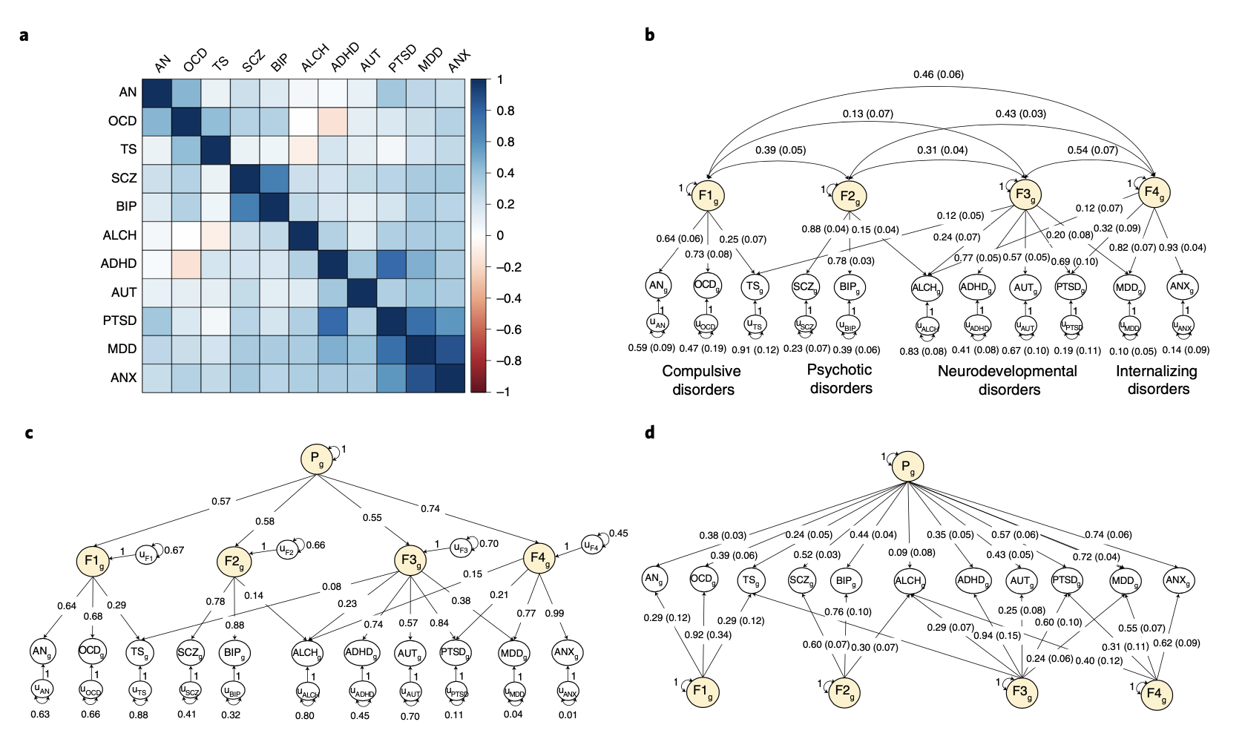

Related Examples from the Literature
GenomicSEM

Slide 31
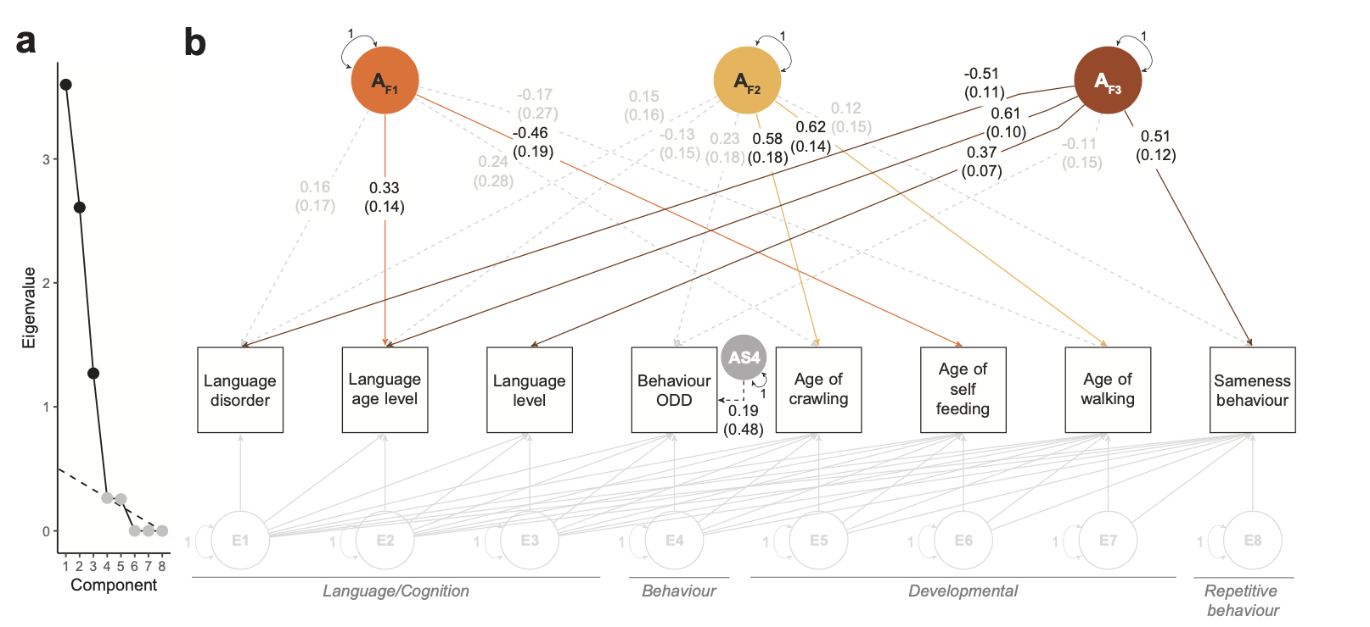
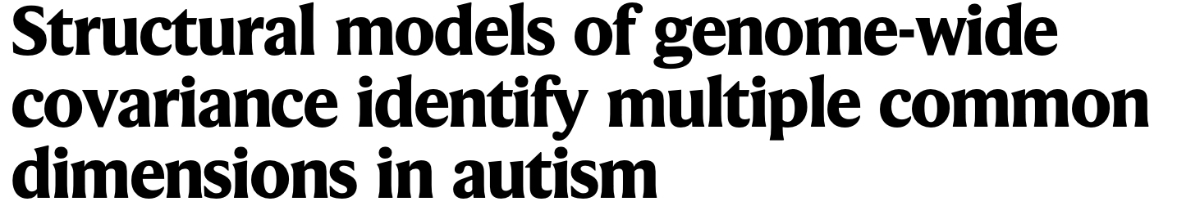

Related Examples from the Literature
GRM-SEM

Slide 32
Multivariate Twin Practical
Qualitrics Link:
  https://qimr.az1.qualtrics.com/jfe/form/SV_0dmHAEyYb4bPbIG
Read in data
  There are two sets of datasets - only select one
Run the assumption testing models
  There are 4 sequentially more restricted models
Run the CPM
Run the IPM

Slide 33
Dataset 1: Common Pathway Model
 | Obs | Sim
Va | 0.50 | 0.50
Vc | 0 | 0
Ve | 0.50 | 0.50
V_{e}
V_{c}
V_{a}
E
C
A
 | Obs | Sim
λ₁ | 0.80 | 0.80
λ₂ | 0.75 | 0.75
λ₃ | 0.70 | 0.70
λ₄ | 0.65 | 0.65
F₁
λ₁
λ₂
λ₃
λ₄
X₁
X₂
X₃
X₄
Obs
Sim
 | As | Cs | Es
x₁ | 0.07 | 0.11 | 0.18
x₂ | 0.13 | 0.09 | 0.22
x₃ | 0.25 | 0 | 0.25
x₄ | 0 | 0.29 | 0.29
 | As | Cs | Es
x₁ | .072 | .108 | .180
x₂ | .131 | .088 | .219
x₃ | .255 | 0 | .255
x₄ | 0 | .289 | .289
E
E
E
E
S_{1e}
C
A
S_{2e}
C
S_{3e}
C
A
S_{3e}
C
A
S_{1c}
S_{2c}
A
S_{3c}
S_{3c}
S_{1a}
S_{2a}
S_{3a}
S_{3a}

Slide 34
Independent Pathway Model
Obs
Sim
1
1
1
 | A | C | E
λ₁ | -.50 | -.20 | -.50
λ₂ | -.40 | -.25 | -.55
λ₃ | -.45 | -.15 | -.45
λ₄ | -.30 | -.20 | -.60
 | A | C | E
λ₁ | .50 | .20 | .50
λ₂ | .40 | .25 | .55
λ₃ | .45 | .15 | .45
λ₄ | .30 | .20 | .60
E
C
A
λ_{4e}
λ_{1c}
λ_{4c}
λ_{1a}
λ_{3e}
λ_{2c}
λ_{3c}
λ_{2e}
λ_{2a}
λ_{1e}
λ_{3a}
λ_{4a}
X₁
X₂
X₃
X₃
Obs
Sim
 | As | Cs | Es
x₁ | 0.09 | 0.14 | 0.23
x₂ | 0.14 | 0.09 | 0.24
x₃ | 0.29 | 0 | 0.29
x₄ | 0 | 0.25 | 0.25
 | As | Cs | Es
x₁ | .092 | .138 | .230
x₂ | .143 | .095 | .238
x₃ | .286 | 0 | .286
x₄ | 0 | .255 | .255
E
E
E
E
S_{1e}
C
A
S_{2e}
C
S_{3e}
C
A
S_{3e}
C
S_{1c}
S_{2c}
A
S_{3c}
S_{3c}
A
S_{1a}
S_{2a}
S_{3a}
S_{3a}

Slide 35




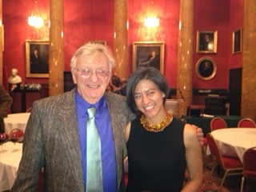

Acknowledgements

