Slide 1
Intro to bi/multivariate genetic analysis / Bivariate twin models
Margot van de Weijer & Chelsea Sawyers

Slide 2
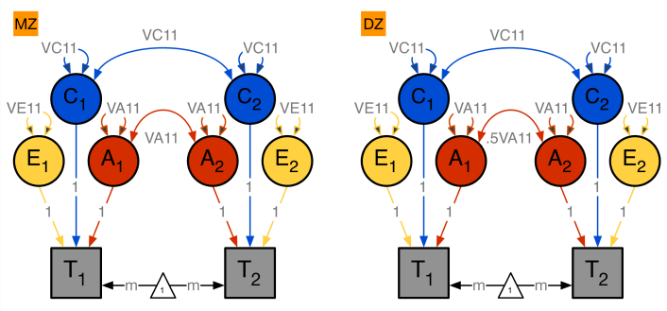
Remember univariate twin models?
What are the contributions of additive genetic (A), dominant genetic /shared environmental (D or C), and unique environmental(E) factors to the variance?
In normal language:
To what extent are individual differences in a trait (lets say height) explained by genetic or environmental differences between people?

Slide 3
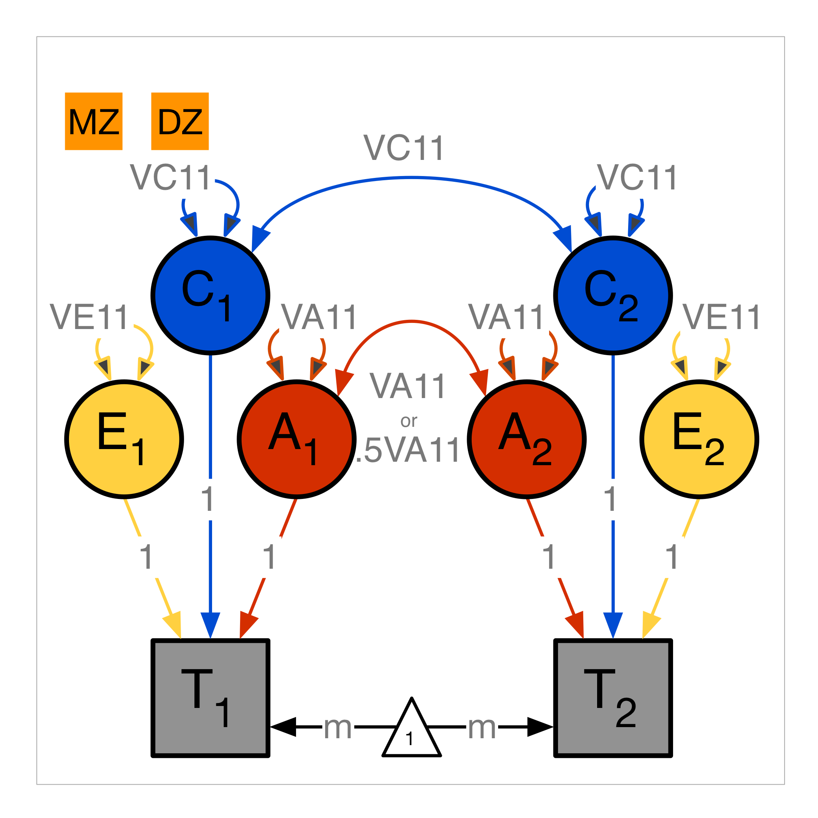
Expected covariance matrix in MZ and DZ twin pairs
 | MZ Twin 1 | MZ Twin 2
MZ Twin 1 | Var(A)+Var(C)+Var(E)
MZ Twin 2 | Var(A) + Var(C) | Var(A)+Var(C)+Var(E)
 | DZ Twin 1 | DZ Twin 2
DZ Twin 1 | Var(A)+Var(C)+Var(E)
DZ Twin 2 | 0.5*Var(A) + Var(C) | Var(A)+Var(C)+Var(E)

Slide 4
What do we do when there are 2 (or more) traits?
What are the contributions of additive genetic, dominant genetic/shared environmental, and unique environmental factors to the covariance between two traits?
Or in normal language:
Why are two traits related to each other? To what extent is the correlation between height and weight explained by shared genetics, shared environment, and non-shared environment?

Slide 5
What do we do when there are 2 (or more) traits?

Slide 6
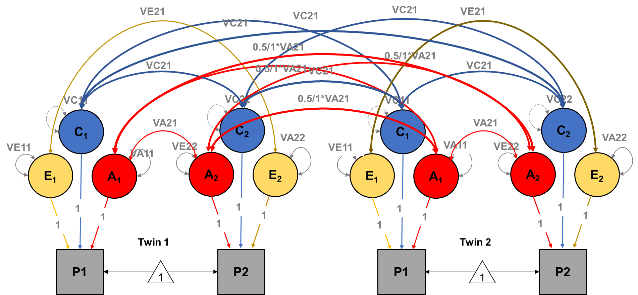
What do we do when there are 2 (or more) traits?

Slide 8
Lets go through this step by step…
Notes:
Add cholesky?

Slide 9
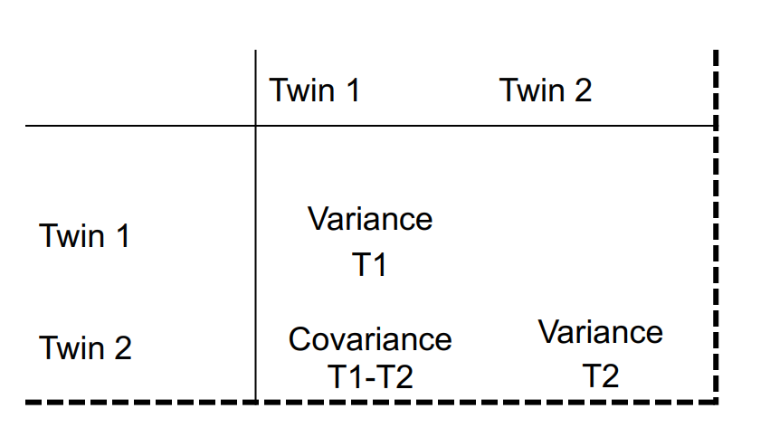
Univariate variance-covariance matrix

Slide 10
What happens when we add another phenotype
The covariance between phenotype 1 and phenotype 2 in twin 1 → the cross-trait covariance within individuals
- This is what you normally study outside of a twin context; the association between a and b in a bunch of individuals

Slide 11
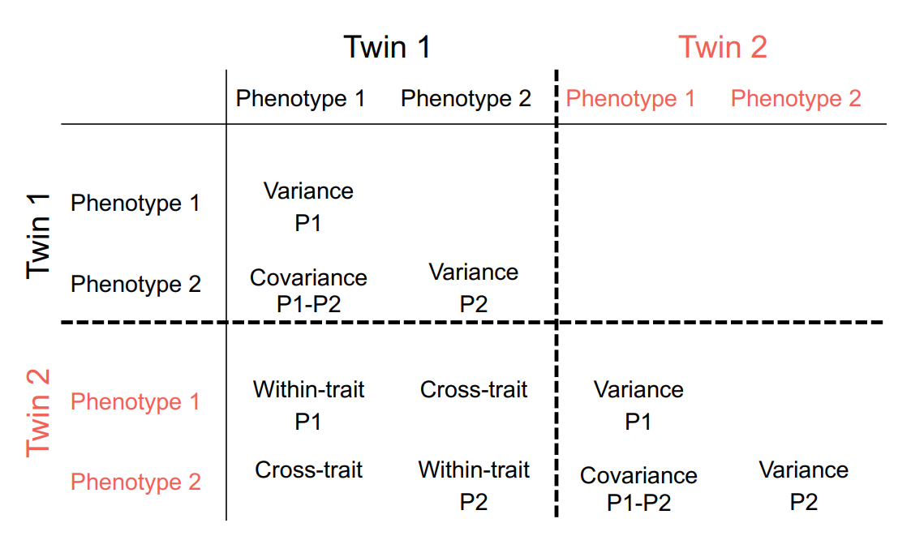
What happens when we add another phenotype and another twin
This is new: the cross-twin cross-trait covariance:
CTCT MZ>DZ? Likely genetic influences on the covariance.
CTCT MZ=DZ? Covariance likely mostly common environmental
This is what we looked at in the univariate case
Notes:
P = A+C+E bij de vakken COV sigma = AC

Slide 12
How do these two things relate to each other?

Slide 13
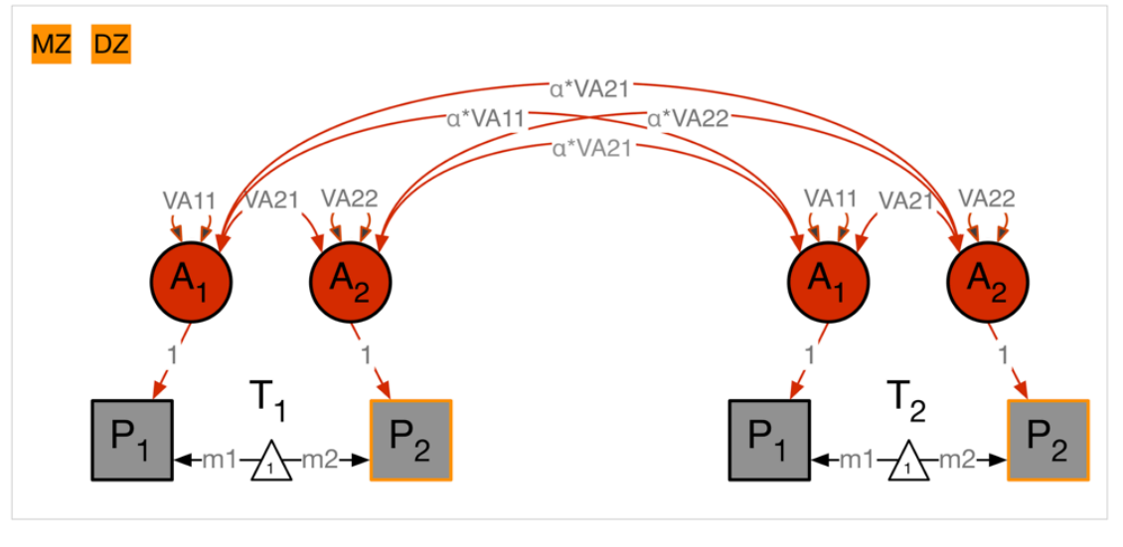
Lets zoom in on 1 variance component only (A)

Slide 14
For twin 1:

Slide 15
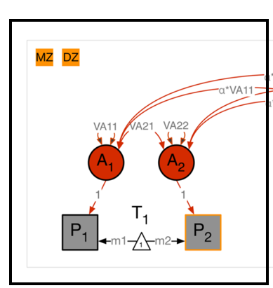
Within-twin covariance
 |  | Twin 1
 |  | Phenotype 1 | Phenotype 2
Twin 1 | Phenotype 1 | VA11 | VA21
 | Phenotype 2 | VA21 | VA22

Slide 16
Cross-twin covariance
MZ (a=1) or DZ (a=.5) |  | Twin 1
 |  | Pheno 1 | Pheno 2
Twin 2 | Pheno 1 | a*VA11 | a*VA21
 | Pheno 2 | a*VA21 | a*VA22

Slide 17
Cross-twin covariance
MZ (a=1) or DZ (a=.5) |  | Twin 1
 |  | Pheno 1 | Pheno 2
Twin 2 | Pheno 1 | A* VA_{(2x2)}
 | Pheno 2

Slide 18
P1 = Height
P2 = Weight
 |  | Twin 1 |  | Twin 2
 |  | Height | Weight | Height | Weight
Twin 1 | Height
 | Weight
Twin 2 | Height
 | Weight

Slide 19
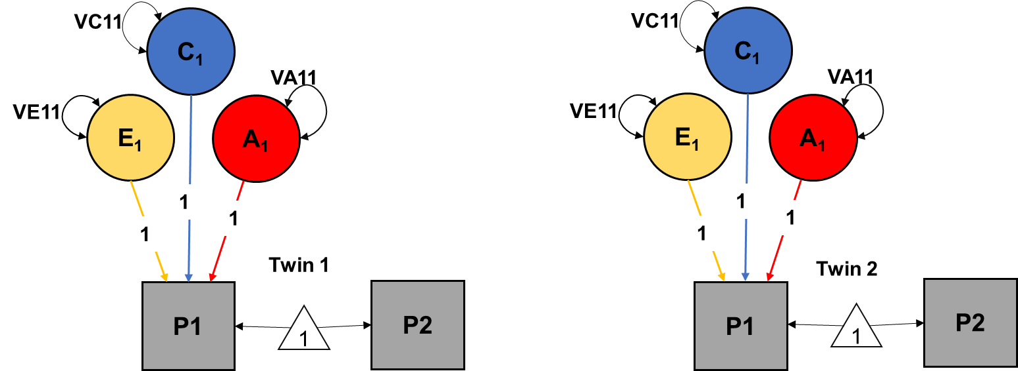
Add within-trait, within-twin estimates for height
(variance height is equal across twins and zygosity groups)
 |  | Twin 1 |  | Twin 2
 |  | Height | Weight | Height | Weight
Twin 1 | Height | VA11 + VC11 + VE11
 | Weight
Twin 2 | Height |  |  | VA11 + VC11 + VE11
 | Weight

Slide 20
Add within-trait,
within-twin estimates for Weight
(variance weight is equal across twins and zygosity groups)
 |  | Twin 1 |  | Twin 2
 |  | Height | Weight | Height | Weight
Twin 1 | Height | VA11 + VC11 + VE11
 | Weight |  | VA22 + VC22 + VE22
Twin 2 | Height |  |  | VA11 + VC11 + VE11
 | Weight |  |  |  | VA22 + VC22 + VE22

Slide 21
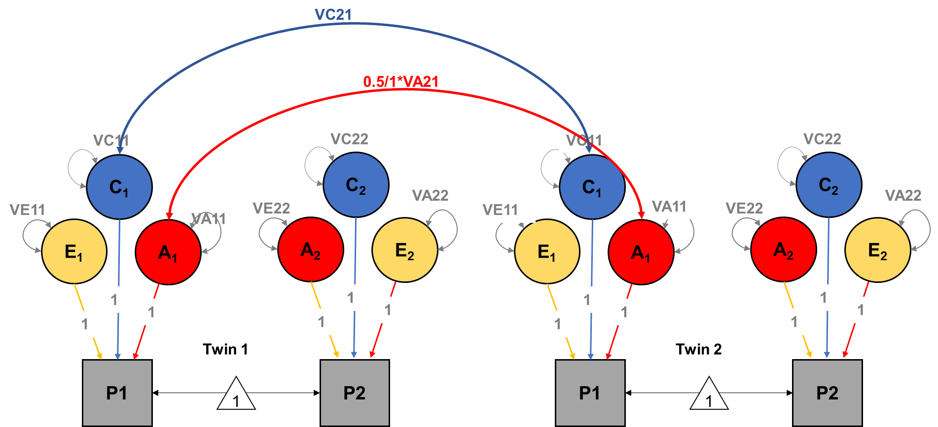
Add within-trait,
cross-twin estimates for Height
(like in a univariate model)
(differ across zygosity)
 |  | Twin 1 |  | Twin 2
 |  | Height | Weight | Height | Weight
Twin 1 | Height | VA11 + VC11 + VE11 |  | 0.5/1* VA11 + VC11
 | Weight |  | VA22 + VC22 + VE22
Twin 2 | Height | 0.5/1* VA11 + VC11 |  | VA11 + VC11 + VE11
 | Weight |  |  |  | VA22 + VC22 + VE22

Slide 22
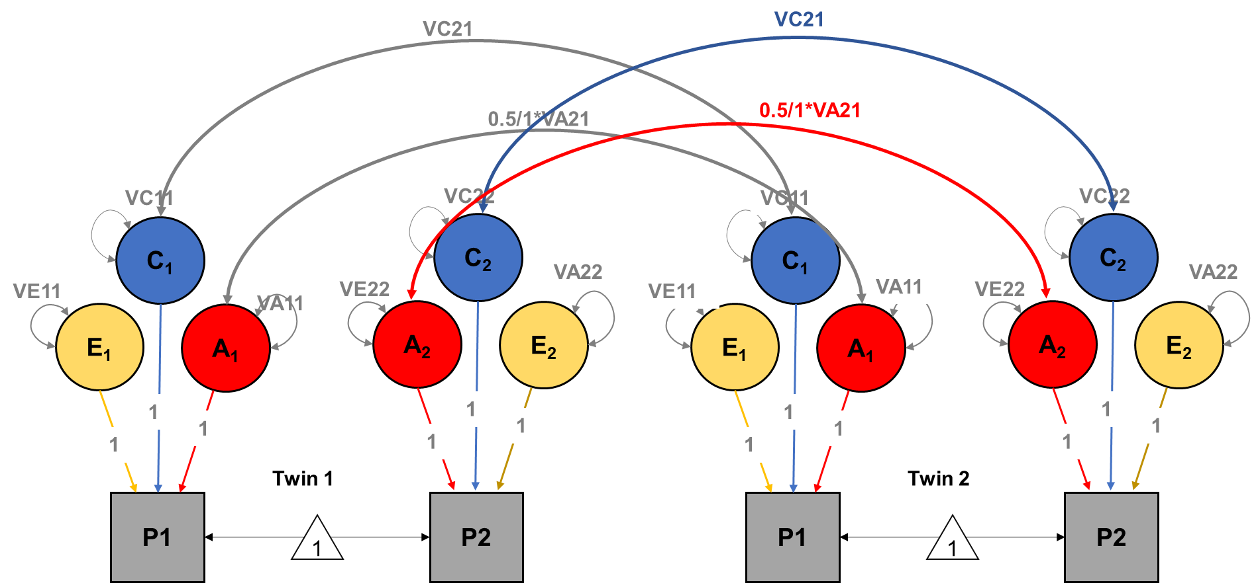
Add within-trait,
cross-twin estimates for Weight
(like in a univariate model)
(differs across zygosity)
 |  | Twin 1 |  | Twin 2
 |  | Height | Weight | Height | Weight
Twin 1 | Height | VA11 + VC11 + VE11 |  | 0.5/1* VA11 + VC11
 | Weight |  | VA22 + VC22 + VE22 |  | 0.5/1* VA22 + VC22
Twin 2 | Height | 0.5/1* VA11 + VC11 |  | VA11 + VC11 + VE11
 | Weight |  | 0.5/1* VA22 + VC22 |  | VA22 + VC22 + VE22

Slide 23
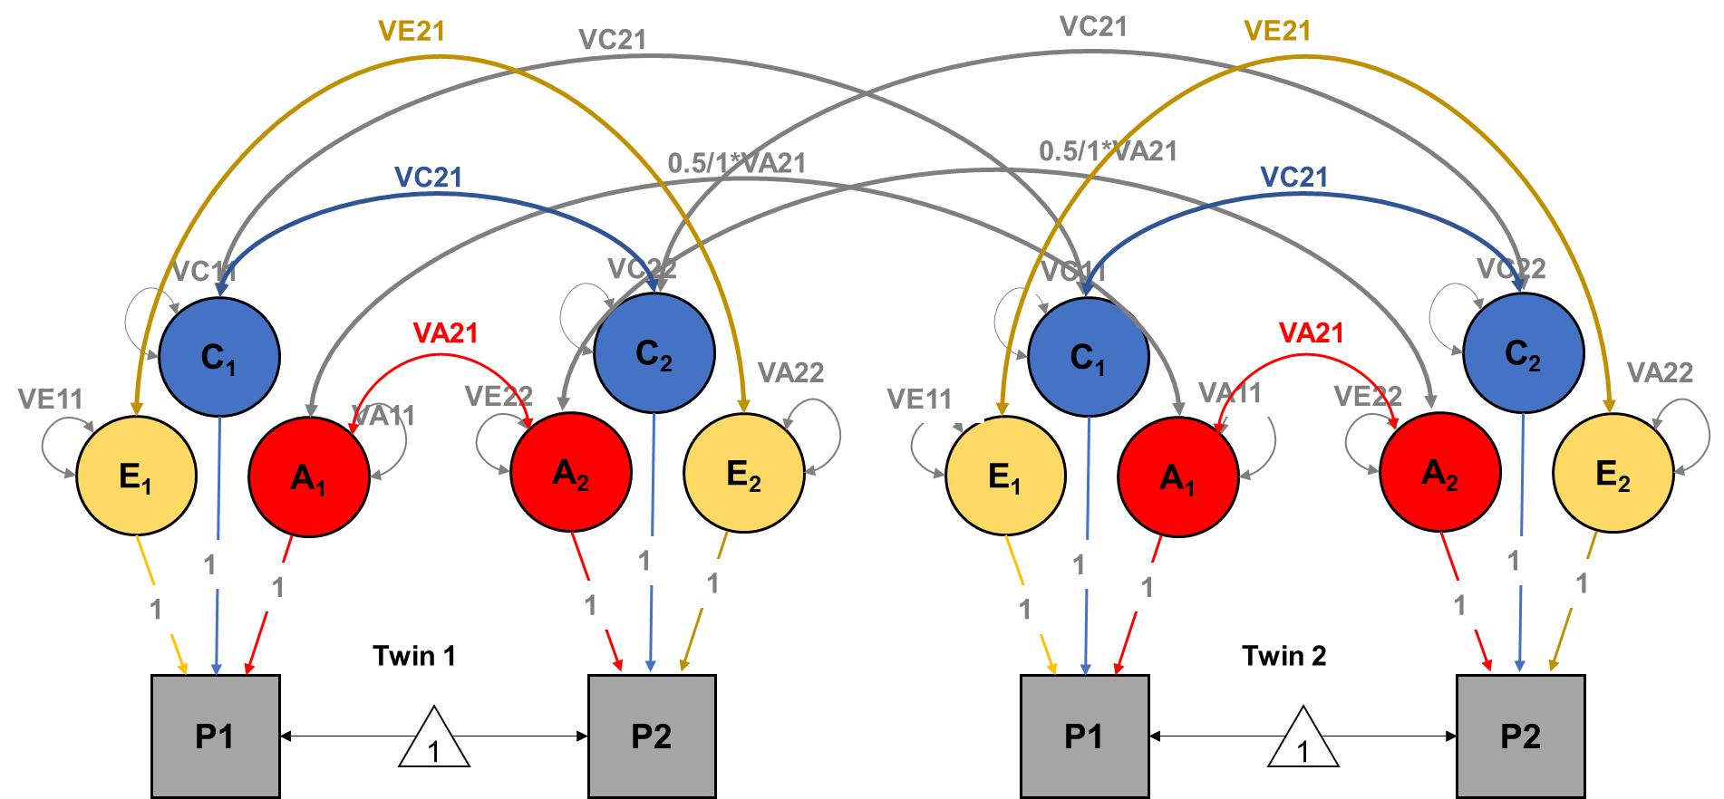
Add within-twin, cross-trait estimates
(covariance of height and weight same across twins and zygosity groups)
 |  | Twin 1 |  | Twin 2
 |  | Height | Weight | Height | Weight
Twin 1 | Height | VA11 + VC11 + VE11 | VA21 + VC21 + VE21 | 0.5/1* VA11 + VC11
 | Weight | VA21 + VC21 + VE21 | VA22 + VC22 + VE22 |  | 0.5/1* VA22 + VC22
Twin 2 | Height | 0.5/1* VA11 + VC11 |  | VA11 + VC11 + VE11 | VA21 + VC21 + VE21
 | Weight |  | 0.5/1* VA22 + VC22 | VA21 + VC21 + VE21 | VA22 + VC22 + VE22

Slide 24
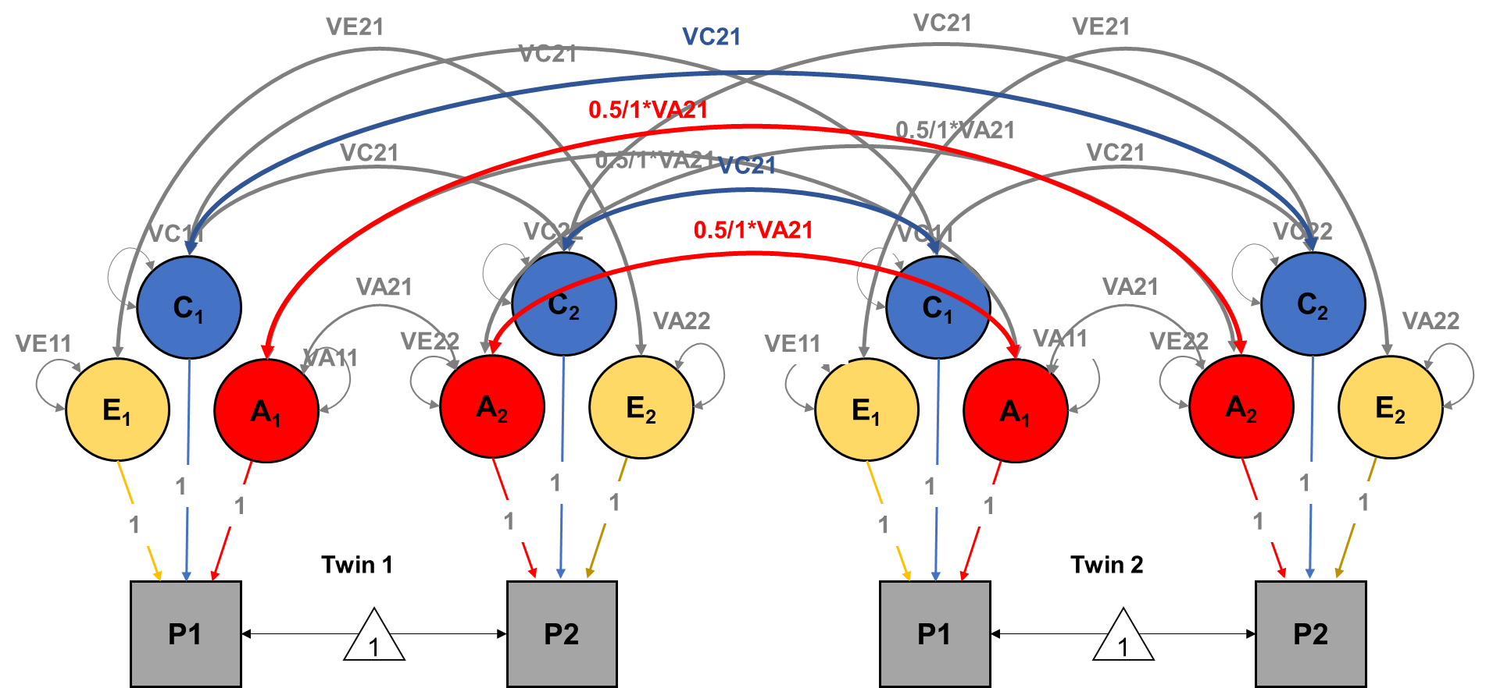
Add cross-twin, cross-trait estimates
(differs across zygosity)
 |  | Twin 1 |  | Twin 2
 |  | Height | Weight | Height | Weight
Twin 1 | Height | VA11 + VC11 + VE11 | VA21 + VC21 + VE21 | 0.5/1* VA11 + VC11 | 0.5/1* VA21 + VC21
 | Weight | VA21 + VC21 + VE21 | VA22 + VC22 + VE22 | 0.5/1* VA21 + VC21 | 0.5/1* VA22 + VC22
Twin 2 | Height | 0.5/1* VA11 + VC11 | 0.5/1* VA21 + VC21 | VA11 + VC11 + VE11 | VA21 + VC21 + VE21
 | Weight | 0.5/1* VA21 + VC21 | 0.5/1* VA22 + VC22 | VA21 + VC21 + VE21 | VA22 + VC22 + VE22
Notes:
Hierna 4 matrixen zoals in het script (terug relateren naar slide zonder ACE)

Slide 25
How do we do this in OpenMx?
 |  | Twin 1 |  | Twin 2
 |  | Height | Weight | Height | Weight
Twin 1 | Height | VA_{(2x2)} + VC_{(2x2)} + VE_{(2x2)} |  | 0.5/1 * VA_{(2x2)} + VC_{(2x2)}
 | Weight
Twin 2 | Height | 0.5/1 * VA_{(2x2)} + VC_{(2x2)} |  | VA_{(2x2)} + VC_{(2x2)} + VE_{(2x2)}
 | Weight
Notes:
Hierna 4 matrixen zoals in het script (terug relateren naar slide zonder ACE)

Slide 26
From covariance to correlation
Using the covariance and standard deviations, we can calculate genetic and environmental correlations
$$Correlation= \frac{cov(x,y)}{sd\left(x\right)∗sd(y)}$$
$= \frac{cov(x,y)}{\sqrt{var\left(x\right)∗var(y)}}$

Slide 27
The genetic correlation
 | Height | Weight
Height | VA11 = 4.20 | VA21 = 2.23
Weight | VA21 = 2.23 | VA22 = 2.03
$$Correlation = \frac{cov(x,y)}{\sqrt{var\left(x\right)∗var(y)}}$$

Slide 28
The genetic correlation
$$Correlation = \frac{cov(x,y)}{\sqrt{var\left(x\right)∗var(y)}}$$
 | Height | Weight
Height | VA11 = 4.20 | VA21 = 2.23
Weight | VA21 = 2.23 | VA22 = 2.03
$$Rg = \frac{2.23}{\sqrt{4.20∗2.03}}$$
$$= \frac{2.23}{2.92}$$
$$=.76$$

Slide 29
The genetic correlation
Imagine height and weight phenotypically correlating .70, with a genetic correlation of 90%. Does this mean that genes are the most important factor for explaining this phenotypic correlation?
We need information on the bivariate heritability – the extent to which genetic factors explain covariance between height and weight. Genetic factors might explain only 1% of the covariance between height and weight, even with a genetic correlation of 1.

Slide 30
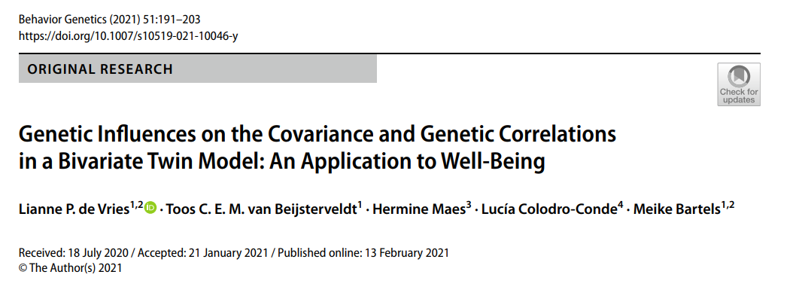
The genetic correlation
A genetic correlation between height and weight of .76 means that the genetic factors influencing height and weight share a 76% overlap
It does not say something about how much height and weight correlate in general, or the extent to which genes are important for that correlation.
recommended read about this →

Slide 31
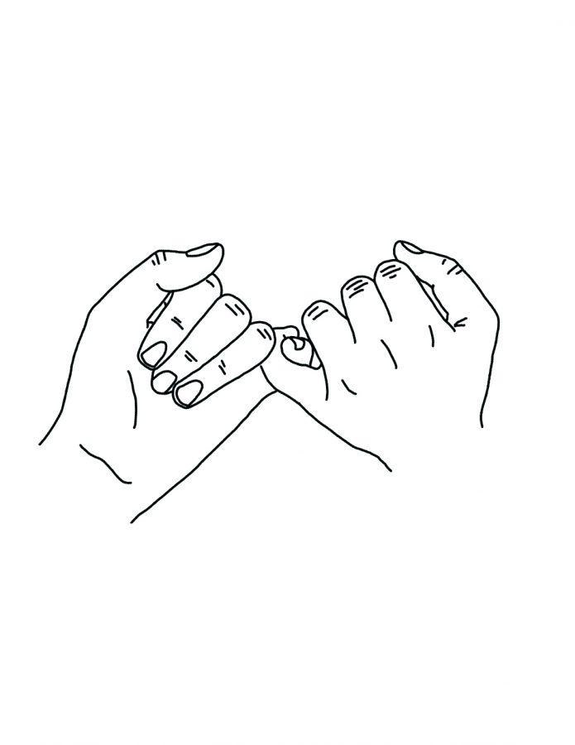
Lets go through to all of this together step by step by means of a practical…
I promise it will start to make more sense….

Slide 32
We are going to use the “twinData” dataset which is readily available in OpenMx. Some information on this dataset:
Description
Australian twin (18+) data with 3,808 observations on the 12 variables, It is a wide dataset, with two individuals per line. Families are identified by the variable “fam”.
“Zygosity” is coded as a factor with 5-levels: MZFF, MZMM, DZFF, DZMM, DZOS, but for this practical we will be working with 2 groups (MZs and DZs)
Variable zyg codes twin-zygosity as follows: 1 == MZFF (i.e MZ females) 2 == MZMM (i.e MZ males) 3 == DZFF 4 == DZMM 5 == DZOS opposite sex pairs
Note: zyg 6:10 are for an older cohort in the sample. So: 6 == MZFF (i.e MZ females) 7 == MZMM (i.e MZ males) 8 == DZFF 9 == DZMM 10 == DZOS opposite sex pairs

Slide 33
Copy the folder margot/2024/Day-3/practical_bivtwinmodels into your workspace in Rstudio: system("cp -R /faculty/margot/2024/Day-3/practical_bivtwinmodels/* ./ ") → We will be working in Qualtrics. The link to the Qualtrics is in the top of the twoADE script! → the practical consists of 2 parts: we will go over part 1 together before commencing with part 2.

Slide 34
Saturated model script
In the folder there is a script for the saturated model, and a script for the bivariate model. For the sake of time, we will skip the saturated model, but lets take a look at the MZ and DZ correlations for height and weight as produced by this script first:
MZ | Height T1 | Weight T1 | Height T2 | Weight T2
Height T1 | 1 | .51 | .88 | .43
Weight T1 | .51 | 1 | .50 | .85
Height T2 | .88 | .50 | 1 | .47
Weight T2 | .43 | .85 | .47 | 1
Compare the MZ and DZ correlations for height and weight.
If MZ > 2*DZ, we fit an ADE model
If MZ < 2*DZ, we fit an ACE model
What are the MZ and DZ correlations for height and weight? Does this indicate ADE or ACE models?
DZ | Height T1 | Weight T1 | Height T2 | Weight T2
Height T1 | 1 | .44 | .43 | .23
Weight T1 | .44 | 1 | .16 | .33
Height T2 | .43 | .16 | 1 | .44
Weight T2 | .23 | .33 | .44 | 1
Notes:
Cross-twin cross-trait

Slide 35
Height:
MZ = .88
DZ = .43
MZ > 2*DZ
Weight
MZ = .85
DZ = .33
MZ > 2*DZ
MZ | Height T1 | Weight T1 | Height T2 | Weight T2
Height T1 | 1 | .51 | .88 | .43
Weight T1 | .51 | 1 | .50 | .85
Height T2 | .88 | .50 | 1 | .47
Weight T2 | .43 | .85 | .47 | 1
DZ | Height T1 | Weight T1 | Height T2 | Weight T2
Height T1 | 1 | .44 | .43 | .23
Weight T1 | .44 | 1 | .16 | .33
Height T2 | .43 | .16 | 1 | .44
Weight T2 | .23 | .33 | .44 | 1

Slide 36
Open the script “twoADEvc.R”* in Rstudio
*all credits for the script go to Hermine

Slide 37
Lets have a look at the data first
# Load Libraries & Options
rm(list=ls())
library(OpenMx)
library(psych)
source("miFunctions.R")
# ----------------------------------------------------------------------------------------------------------------------
# PREPARE DATA
#Load Data
data(twinData)
dim(twinData)
describe(twinData[,1:12], skew=F)
Please have a look at the means and standard deviations for weight and height, what do you see?

Slide 38
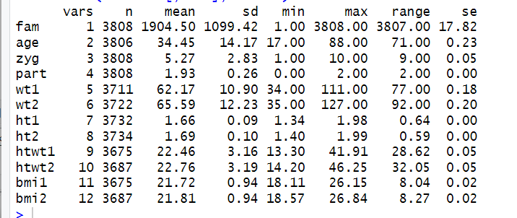
These are the variables we are interested in for this practical

Slide 39
Prepare the data
Run the following bit of code
# Load Data
data(twinData)
dim(twinData) describe(twinData[,1:12], skew=F)
twinData[,'ht1'] <- twinData[,'ht1']*10
twinData[,'ht2'] <- twinData[,'ht2']*10
twinData[,'wt1'] <- twinData[,'wt1']/10
twinData[,'wt2'] <- twinData[,'wt2']/10
describe(twinData[,1:12], skew=F) → have another look and compare, what has changed?

Slide 40
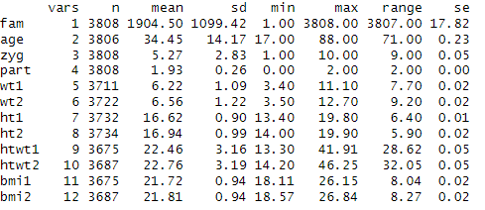

Slide 41
Select variables + data and have a look
Run the following bits of code: # Select Variables for Analysis vars <- c('ht','wt') # list of variables names nv <- 2 # number of variables ntv <- nv*2 # number of total variables selVars <- paste(vars,c(rep(1,nv),rep(2,nv)),sep="") # Select Data for Analysis mzData <- subset(twinData, zyg==1, selVars) dzData <- subset(twinData, zyg==3, selVars) # Generate Descriptive Statistics colMeans(mzData,na.rm=TRUE) colMeans(dzData,na.rm=TRUE) cov(mzData,use="complete") cov(dzData,use="complete") What is the cross-twin cross-trait correlation for weight and height in MZ twins? And in DZ twins?

Slide 42
Set starting values
# Set Starting Values
svMe <- c(X1,X2) # start value for means
svPa <- .2 # start value for path coefficient for a
svPe <- .5 # start value for path coefficient for e
Try to add sensible starting values for the means (first mean is height, the second is weight) based on the descriptives you just produced.
What did you fill in for X1 and X2?

Slide 44
Prepare the model (1)
Run the following part of the code: # Create Algebra for expected Mean Matrices meanG <- mxMatrix( type="Full", nrow=1, ncol=ntv, free=TRUE, values=svMe, labels=labVars("mean",vars), name="meanG" ) # Create Matrices for Variance Components covA <- mxMatrix( type="Symm", nrow=nv, ncol=nv, free=TRUE, values=valDiag(svPa,nv), label=labLower("VA",nv), name="VA" ) covD <- mxMatrix( type="Symm", nrow=nv, ncol=nv, free=TRUE, values=valDiag(svPa,nv), label=labLower("VD",nv), name="VD" ) covE <- mxMatrix( type="Symm", nrow=nv, ncol=nv, free=TRUE, values=valDiag(svPa,nv), label=labLower("VE",nv), name="VE" ) Take a look at the object covA. What kind of matrix did we just make? What do the labels refer to?

Slide 45
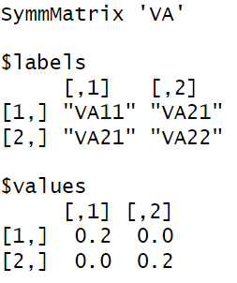
What kind of matrices did we just make?
Take a look at covA:
 |  | Twin 1
 |  | height | weight
Twin 1 | height | VA11 | VA21
 | weight | VA21 | VA22
=
=

Slide 46
Prepare the model (2)
We have made objects with the mean and variance matrices, now lets create the algebra for the expected variance/covariance matrices in MZ and DZ twin pairs.
Run the following lines of code: # Create Algebra for expected Variance/Covariance Matrices in MZ & DZ twins covP <- mxAlgebra( expression= VA+VD+VE, name="V" ) covMZ <- mxAlgebra( expression= VA+VD, name="cMZ" ) covDZ <- mxAlgebra( expression= 0.5%x%VA+ 0.25%x%VD, name="cDZ" ) expCovMZ <- mxAlgebra( expression= rbind( cbind(V, cMZ), cbind(t(cMZ), V)), name="expCovMZ" ) expCovDZ <- mxAlgebra( expression= rbind( cbind(V, cDZ), cbind(t(cDZ), V)), name="expCovDZ" ) Again, take a look at the objects you just made. Why is the formule used for the object "covMZ" not the same as in the object "covDZ"?
What about the "expCovMZ"and "expCovDZ" objects, what are these objects?

Slide 47
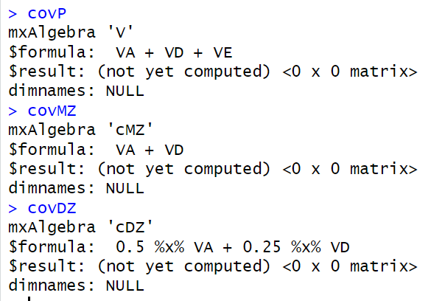
 |  | Twin 1 |  | Twin 2
 |  | Height | Weight | Height | Weight
Twin 1 | Height | VA11 + VD11 + VE11 | VA21 + VD21 + VE21 | 0.5/1* VA11 + VC11 | 0.5/1* VA11 + 0.25/1* VD11
 | Weight | VA21 + VD21 + VE21 | VA22 + VD22 + VE22 | 0.5/1* VA11 + 0.25/1* VD11 | 0.5/1* VA22 + 0.25/1* VD22
Twin 2 | Height | 0.5/1* VA11 + 0.25/1* VD11 | 0.5/1* VA11 + 0.25/1* VD11 | VA11 + VD11 + VE11 | VA21 + VD21 + VE21
 | Weight | 0.5/1* VA11 + 0.25/1* VD11 | 0.5/1* VA22 + 0.25/1* VD22 | VA21 + VD21 + VE21 | VA22 + VC22 + VE22
=

Slide 48
Prepare the model (3)
Continue preparing the model with the following code: # Create Data Objects for Multiple Groups dataMZ <- mxData( observed=mzData, type="raw" ) dataDZ <- mxData( observed=dzData, type="raw" ) # Create Expectation Objects for Multiple Groups ‘expMZ <- mxExpectationNormal( covariance="expCovMZ", means="meanG", dimnames=selVars ) expDZ <- mxExpectationNormal( covariance="expCovDZ", means="meanG", dimnames=selVars ) funML <- mxFitFunctionML() # Create Model Objects for Multiple Groups pars <- list( meanG, covA, covD, covE, covP ) modelMZ <- mxModel( pars, covMZ, expCovMZ, dataMZ, expMZ, funML, name="MZ" ) modelDZ <- mxModel( pars, covDZ, expCovDZ, dataDZ, expDZ, funML, name="DZ" ) multi <- mxFitFunctionMultigroup( c("MZ","DZ") ) # Create Algebra for Standardization matI <- mxMatrix( type="Iden", nrow=nv, ncol=nv, name="I" ) invSD <- mxAlgebra( expression=solve(sqrt(I*V)), name="iSD" ) # Calculate genetic and environmental correlations corA <- mxAlgebra( expression=solve(sqrt(I*VA))%&%VA, name ="rA" ) corD <- mxAlgebra( expression=solve(sqrt(I*VD))%&%VD, name ="rD" ) corE <- mxAlgebra( expression=solve(sqrt(I*VE))%&%VE, name ="rE" ) In this last step, we create objects for calculating the genetic and environmental correlation. What do these reflect?

Slide 49
corA <- mxAlgebra( expression=solve(sqrt(I*VA))%&%VA, name ="rA" )
Here we go from a covariance to a correlation matrix using the genetic covariance matrix VA $\left({VA11 VA21 \atop VA21 VA22}\right)$and an identity matrix $\left({1 0 \atop 0 1}\right)$.
solve(sqrt(I*VA) will give us standard deviations for VA11 and VA22 in a matrix, and then invert this matrix
This inverted matrix is post-multiplied by VA, meaning that each element in the covariance matrix is divided by the product of the standard deviations. In other words: by dividing the covariance by the product of the standard deviations, we get the genetic correlations!

Slide 50
Or just do cov2cor…
(mxAlgebra(cov2cor(VA), name="rA"))

Slide 51
Prepare the model (4)
Run the last steps of preparing the model, and continue by running the model # Create Algebra for Unstandardized and Standardized Variance Components rowUS <- rep('US',nv) colUS <- rep(c('VA','VD','VE','SA','SD','SE'),each=nv) estUS <- mxAlgebra( expression=cbind(VA,VD,VE,VA/V,VD/V,VE/V), name="US", dimnames=list(rowUS,colUS) ) # Create Confidence Interval Objects odd <- seq(1+3*nv,2*3*nv,nv) even <- seq(2+3*nv,2*3*nv,nv) ciADE <- mxCI( c("US[1,odd]","US[2,odd]","US[2,even]") ) # Build Model with Confidence Intervals calc <- list( matI, invSD, corA, corD, corE, estUS, ciADE ) modelADE <- mxModel( "twoADEvc", pars, modelMZ, modelDZ, multi, calc )

Slide 52
# Run ADE ModelfitADE <- mxRun( modelADE, intervals=T ) sumADE <- summary( fitADE )
1) Take a look at the standardized and unstandardized variance components using fitADE$US and note them down in Qualtrics.
2) According to the ADE model, what percentage of the variance in height and weight is explained by additive genetic factors? and what percentage by dominant genetic and unique environmental factors?
3) Take a look at the genetic and environmental correlations using fitADE$rA, fitADE$rD and fitADE$rE and note them down below:

Slide 53
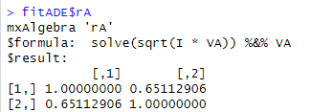
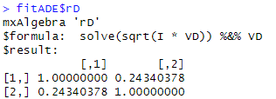
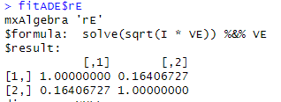
Unstandardized matrices:
Standardized matrices:
rA
rD
rE

Slide 54
To see if we can drop D or A, we are going to run submodels. First we will run an AE model where the D variance-covariance components are forced to zero. Next, in that same model, we also force A at zero (so an E model). By comparing the fit of these models, we make a choice on what model fits our data best. Run the code below: # RUN SUBMODELS # Run AE model modelAE <- mxModel( fitADE, name="twoAEvc" ) modelAE <- omxSetParameters( modelAE, labels=labLower("VD",nv), free=FALSE, values=0 ) fitAE <- mxRun( modelAE, intervals=T ) fitGofs(fitAE); fitEstCis(fitAE) # Run E model modelE <- mxModel( fitAE, name="twoEvc" ) modelE <- omxSetParameters( modelE, labels=labLower("VA",nv), free=FALSE, values=0 ) fitE <- mxRun( modelE, intervals=T ) fitGofs(fitE); fitEstCis(fitE) # Print Comparative Fit Statistics mxCompare( fitADE, nested <- list(fitAE, fitE) ) Note down the fit statistics and log likelihood test results

Slide 55
If the p-value of the log-likelihood test is significant, it indicates that the model you are testing against has significantly worse fit than the your base model. Using a p-value threshold of .05, which model would you select based on your results?

Slide 56
It seems an AE model is the best fit for our bivariate model including height and weight. Note down some of the final estimates from this model in Qualtrics:
Additive genetic correlation (rA)
Unique environmental correlation (rE)
The heritability of height (standardized VA11)
The heritability of weight (standardized VA22)
The standardized unique environmental component for height (standardized VE11)
The standardized unique environmental component for weight (standardized VE22)

Slide 57
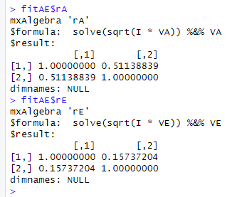
The additive genetic correlation should be around .51. What does this mean?

Slide 58
Other resources
The go-to resource for all scripts; https://hermine-maes.squarespace.com/
We ran a simple model with 2 groups, this can be extended to include 5 groups (and a lot of different types of models)
We used continuous data, you can also run models using binary/ordinal data (or combinations of these data types
Not a fan of OpenMx? You can also run these models in Mplus (https://www.statmodel.com/examples/genetics.shtml). Do not ask me questions about this, ask Yayouk Willems (willems@mpib-berlin.mpg.de)
Notes:
→ Add that you can do different types of variables together (96 cautionary tales about cholesky)

