Slide 1
Welcome to Day 3!
To prepare your files for today please:
Create new directory in your workspace:
mkdir Day-3/
Enter the directory and copy files:
cd Day-3
cp /faculty/chelsea/2024/Day-3/Ordinal -R .
**Do NOT forget the ‘.’ at the end of the above line!**

Slide 2
Working with Ordinal Data
Chelsea Sawyers and Elizabeth Prom-Wormley

Slide 3
Objectives
Explain why binary and ordinal data cannot be treated as continuous measures in analyses
How to implement thresholds in OpenMx

Slide 4
Ordinal data
Often measure behaviors using limited number of ordered categories:
  Absence (0) or presence (1) of a disorder
  Severity of a disorder
  Score on a single Likert item ‘none/some/lots’
  Number of symptoms (far from ideal)
In such cases the data take the form of counts, i.e. the number of individuals within each category of response
ORDINAL DATA REQUIRES DIFFERENT STATICAL METHODS
Notes:
Ordinal data is any measure that uses a limited number of ordered categories such as absence/presence or severity of disorder
This data takes the form of response counts for each category of response

Slide 5
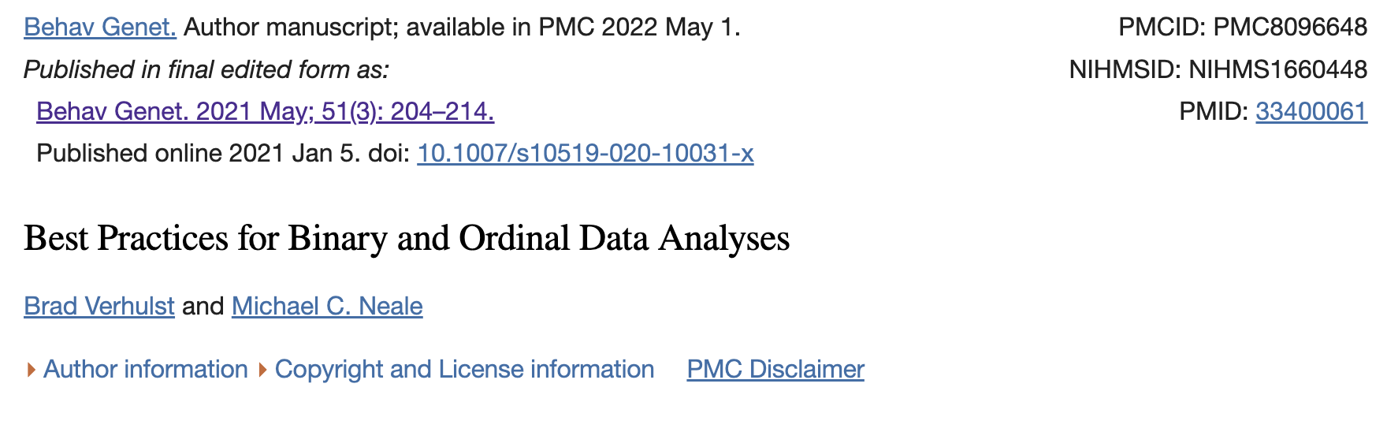
Using Continuous methods on Ordinal Data
Underestimate the correlation/parameters
  Worse for binary than for categorical/ordinal
Notes:
What is the problem with treating binary/ordinal data as continuous data?

Slide 6
Problems with the treating ordinal variables as continuous
Normality – Ordinal variables are not distributed normally, obviously
This means that the error terms cannot be normally distributed
Notes:
What causes this problem? – Assumption of normality is violated. Since Ordinal variables are not distributed normally, the error terms cannot be distributed normally. See 2 categories in the figure and if we assume they are continuous we see they don’t follow a normal distribution

Slide 7
Two Ways of Thinking about Binary Dependent Variables
Assume that the observed binary variable is indicative of an underlying, latent (unobserved) continuous, normally distributed variable.
  We call the unobserved variable a Liability
Assume the Binary Variable as a random draw from a Binomial (or Bernouilli) Distribution (Non-Linear Probability Model). Genuinely categorical responses, no underlying continuous distribution.
Notes:
You can derive models from both assumptions, the difference is for the second method is a lot more math and gets you the the same place. The liability model extends to multiple thresholds much easier than the second method

Slide 8
Binary Variables as indicators of Latent Continuous Variables
Assume that the observed binary variable is indicative of an underlying, latent (unobserved) continuous, normally distributed variable.
Assumptions:
  Categories reflect an imprecise measurement of an underlying normal distribution of liability. This liability is thought to be influenced by many many things, each of which does almost nothing. The Central Limit Theorem predicts that variation should be distributed according to the normal or Gaussian distribution.
  The liability distribution has 1 or more thresholds
Notes:
If we use the first approach then we have 2 main assumptions about what the numbers mean. First, the categories are an imprecise measure of the liability which is influenced by many things. And the variation should be normally distributed.
Second, liability distribution has 1 or more thresholds. We will start with 1

Slide 9
Fundamentals of the
Threshold Model
Threshold
{
Density of y*
1 if y* > τ
0 if y* < τ
y =
Observed values of y
Liability
Dimension
Notes:
Fundamentals of the threshold model is that we have an underlying liability towards a trait. We are going to draw a threshold at a particular value. Anything less than the threshold is observable as 0 and more than threshold is 1 or affected. Only see the binary outcome, could be an extreme or mild case or a subclinical

Slide 10
For disorders:
Affected
individuals
The risk or liability to a disorder is normally distributed
When an individual exceeds a threshold they have the disorder. Prevalence: proportion of affected individuals.
For a single questionnaire item score, e.g,
0 = not at all
1 = sometimes
2 = always
0
1
2
Does not make sense to talk about prevalence: we simply count the endorsements of each response category
Notes:
The Liability Threshold model when applied binary data uses prevalence and when applied to ordinal data uses counts for each response category rather than prevalence

Slide 11
Ideas behind the Liability Threshold Model (LTM)
We can only observe binary outcomes, affected or unaffected, but people can be more or less affected.
Since the variables are latent (and therefore not directly observed) we cannot estimate the means and variances we did for continuous variables.
Thus, we have to make assumptions about them (pretend that they are some arbitrary value).

Slide 12
Identifying Assumptions
Mean Assumption
  The intercept (mean) is 0
  or
  The threshold is 0 (τ = 0)
  Either of these two assumptions provide equivalent model fit and the intercept is a transformation of τ.
Variance Assumption
  Var(ε|x) = 1 in the normal-ogive model
  Var(ε|x) = π²/3 in the logit model.
Assumption 3
  The conditional mean of ε is 0.
  This is the same assumption as we make for continuous variables, and allows the parameters to be unbiased
The traditional assumption
The Probit Model
The Logit Model
Notes:
What kind of assumptions can we make? Need to make assumptions about the mean, the variance, and the Residuals, The mean assumption is that either we fix the interscept or the threshold to 0, puts this on a standard normal distribution. Variance assumption is the variance of the error term given the model is either 1 if using the standard normal distribution as our underlying distribution which equivalent to the probit model or we can fix the variance of the ordinal trait to pi squared/3 to put it on the logit scale. Doesn’t matter which assumption you make, some slight differences on the tails of the distribution they will give basically the same results. Final assumption is the conditional mean of the error term is 0 given the model. Basically means there is no bias in the parameter estimates, which is the same as assumptions for continuous measures.

Slide 13
Identifying Assumptions of Ordinal Associations
The assumptions are arbitrary
  The same model can be specified in different ways, but the parameters will estimate different things. The -2lnL should be the same for models that are transformations of each other.
The assumptions are necessary.
  Because the latent dimension is only measured indirectly, by ordinal items, we have no direct information on its variance. The thresholds could expand or contract (think accordion) to completely compensate for a change in variance.
Notes:
Ok we’ve made some assumptions, and its important to remember they are arbitrary. Models can be specified multiple ways and the parameters estimated will be different values but fit should be the same for models that are transformations. These assumptions are necessary though because we are not directly measuring the liability

Slide 14
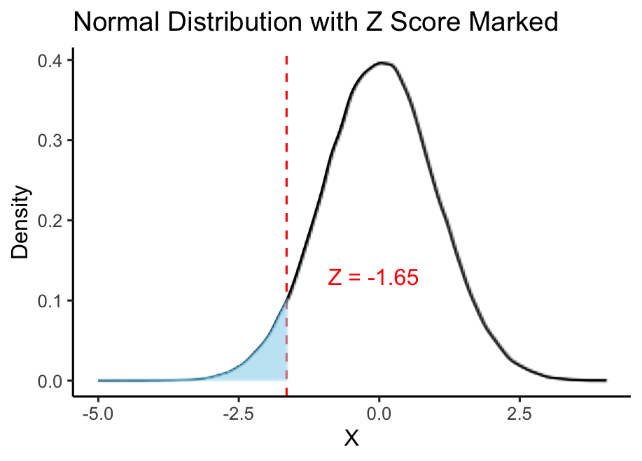
Fundamentals of the
Threshold Model
If τ is -1.65 then 5% of the distribution will be to the left of τ and 95% will be to the right
If we had 1000 people, 50 would be less than τ and 950 would be more than τ
The threshold is just a z score and can be interpreted as such
Notes:
What does this threshold mean? Threshold is just a zscore in the binary case. IF the threshold is -1.65 then 5% is to the left and 95% is to the right

Slide 15
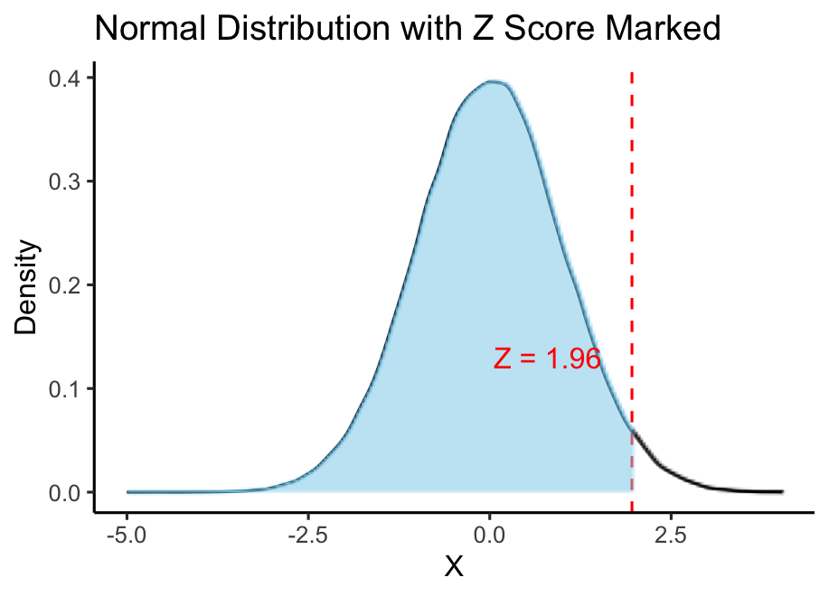
Fundamentals of the
Threshold Model
If τ is 1.96 then 97.5% of the distribution will be to the left of τ and 2.5% will be to the right
If we had 1000 people, 975 would be less than τ and 25 would be more than τ
The threshold is just a z score and can be interpreted as such
Notes:
Alternatively if the threshold was at 1.96 then 97.5% of the distribution would be to the left and 2.5% would be to the right.

Slide 16
Time for Data
Open BinaryWarmup.R
Copy from: /home/chelsea/2024/Day-3/Ordinal
If you did not do so at the beginning
Notes:
** Complete BinaryWarmUp.R through line 75 before moving on **
*should be at 9 minutes by this slide

Slide 17
What About Twins?

Slide 18
Two binary traits (e.g., data from twins)
Contingency Table with 4 observed cells:
Cell a: pairs concordant for unaffected
Cells b&c: pairs discordant for the disorder
Cell d: pairs concordant for affected
 | 0 | 1
0 | a | b
1 | c | d
0 = unaffected
1 = affected
Notes:
What happens when we have Categorical Data for Twins ?
This is probably how most of us are familiar our data. As contingency tables. When the measured trait is dichotomous, we can partition our observations into pairs concordant for not having the disorder (a), pairs concordant for the disorder (d) and discordant pairs in which one is affected and one is unaffected (b and c). These frequencies are summarized in a 2x2 contingency table. So how do we go from thresholds and 1 variable to this table of thresholds for 2 variables?

Slide 19
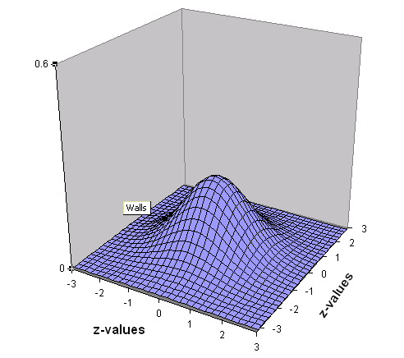
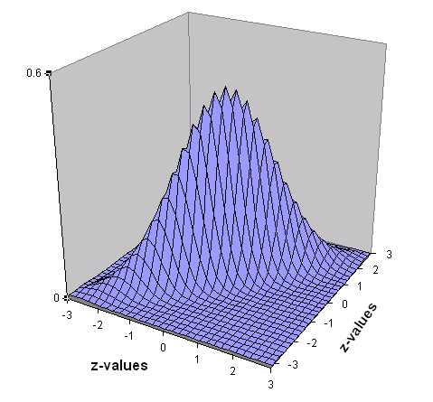
Joint Liability Threshold Model for twin pairs
Pairs are assumed to follow a bivariate normal distribution, where both traits have a mean of 0 and standard deviation of 1, and the correlation between them is what we want to know.
The shape of a bivariate normal distribution is determined by the correlation between the traits
r =.00
r =.90
Notes:
When we have twin pair data, the assumption now is that the joint distribution of liabilities of twin pairs follows a bivariate normal distribution,
where both traits have a mean of 0 and standard deviation 1, but the correlation between them is unknown.
The shape of this bivariate normal distribution is determined by the correlation. When correlation is 0, the shape is a mound, when it is .9 it’s a sharp ridge where most of the distribution falls along the diagonal

Slide 20
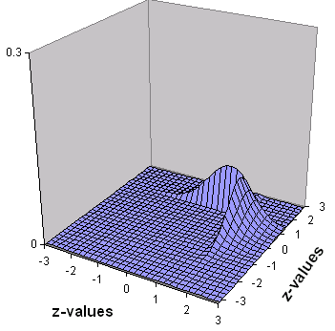
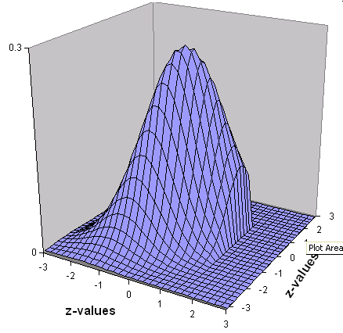
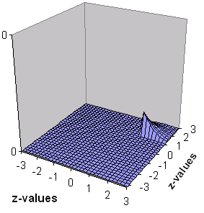
The observed cell proportions relate to the proportions of the Bivariate Normal Distribution with a certain correlation between the latent variables (y₁ and y₂), each cut at a certain threshold
In other words, the joint probability of a certain response combination is the volume under the BND surface bounded by appropriate thresholds on each liability
y2 y1 | 0 | 1
0 | 100 | 01
1 | 10 | 11
To calculate the cell proportions we rely on Numerical Integration of the Bivariate Normal Distribution over the two liabilities
e.g. the probability that both twins are above T
Notes:
We can carve up this BND into different sections based on the thresholds used to create the contingency table
Observed cell proportions relate to different proportions of the BND with a certain correlation between the latent variables, each cut at a specific threshold.
Basically the join probability of the different response combinations is the volume under the BND with the specific thresholds as cut points.
This gives us different shapes to our pie we have cut. Let’s walk through them now.
When we use the liability threshold framework we can see the unaffected/unaffected takes up the large portion of the joint distribution. Compared to when twin 1 and 2 both exceed the threshold which is this lower corner of the distribution. And the discordant twins are the two diagonal shapes.
Cell proportions are calculated using the numerical integration of the bivariate normal distribution, and that is all the further I am going to go into that.

Slide 21
Estimation of Correlations and Thresholds
Since the Bivariate Normal distribution is a known mathematical distribution, for each correlation (∑) and any set of thresholds on the liabilities we know what the expected proportions are in each cell.
Therefore, observed cell proportions of our data will inform on the most likely correlation and threshold on each liability.
y2 y1 | 0 | 1
0 | .87 | .05
1 | .05 | .03
r = 0.60
T_{c1}=T_{c2} = 1.4 (z-value)
Notes:
Since we know the distribution for each correlation and set of thresholds we know what the expected proportions are for each cell.
Therefore working backwards the observed cell proprtions from the data will give use the correlations and thresholds for each liability. IF 87% were un/un and 10% discordant split between the two cells, and 3% in the affected/affected cells we can calculate a tetracorchic correlation of .6 where the 2 twin thresholds were equal to 1.4.

Slide 22
More Practice Available!
If you would like to work more with this threshold model to see how correlations shape the bivariate normal distribution and how we can move from correlations to estimated cell proportions in contingency tables, please work through the Ordinal Data Challenge R script and Qualtrics on your own time
https://qimr.az1.qualtrics.com/jfe/form/SV_4YoLFEuPnBc6QCy

Slide 23
Moving to ordinal Data!

Slide 24
Intuition behind the Multiple Threshold Liability model
τ
₁
τ
₂
τ
₃
τ
₄
Distribution of the liability
Observed values
0
1
2
3
4
Notes:
Many times things are measured on ordinal scales and not just binary. As the number of categories increases so does the power to detect significant associations. Fundamentally the threshold model remains the same. With 4 thresholds we now have 5 categories. The liability distribution is still the same. Interpretation of the multiple threshold liability model is the same as the single threshold liability model.
The BND can be further sliced up based on these additional thresholds

Slide 25
Now Time for TwinS!
Notes:
Remainder of the time we will go through the twin model specifications for ordinal data

Slide 26
Twin Models
Estimate correlation in liabilities separately for MZ and DZ pairs from contingency table
Variance decomposition (A, C, E) can be applied to the liability of the trait
Correlations in liability are determined by path model
Estimate of the heritability of the liability
Notes:
When data on MZ and DZ twin pairs are available, then of course we can estimate a correlation in liability for each type of twins.
However, we can also go further by fitting a model for the liability that would explain these MZ and DZ correlations. We can decompose the liability correlation into A, C and E, as we do for continuous traits, where correlations in liability are determined by path model.
This leads to an estimate of the heritability of the liability rather than the heritability of the observed variable.

Slide 27
Transitioning from Continuous Logic to Ordinal Logic
Ordinal data has 1 less degree of freedom compared to continuous data
    MZcov, DZcov, Prevalence
    No information on the variance
Thinking about our ACE/ADE model
    4 parameters being estimated
    A C E mean
ACE/ADE model is unidentified without adding a constraint
Notes:
So now let’s go over how we do just that.
A few things to keep in mind as we move from continuous ACE models to ordinal ACE models. There is 1 less degree of freedom since there is no information on the variance of the trait but we still have 4 parameters being estimated. Therefore the ACE model is unidentified without adding a constraint

Slide 28
Two Approaches to the Liability Threshold Model
Traditional
  Maps data to a standard normal distribution
  Total variance constrained to be 1
Alternate
  Fixes an alternate parameter (usually E)
  Estimates the remaining parameters
Notes:
Two ways to handle constraint. First would be to constrain variance to 1 , alternative is to fix one of the parameters (usually E). Traditionally the variance is constrained which provides an easier time with interpretability

Slide 29
ACE Liability Model
Vc
Ve
Vc
Va
Va
Vc
Ve
E
C
A
A
C
E
Va/.5Va
Variance
constraint
L
L
1
1
Threshold
model
Unaf
¯
Unaf
Aff
¯
Aff
Twin 1
Twin 2
Notes:
This is what the resulting model looks like.
This is not a proper path diagram, in that the path tracing rules do not apply for the arrows below the latent liability circles.
It shows the underlying assumptions of liability, thresholds etc. And shows that what we start from is just counts for pairs of twins.

Slide 30
Power issues
Ordinal data / Liability Threshold Model: less power than analyses on continuous data
Neale, Eaves & Kendler 1994
Solutions:
1. Bigger samples
2. Use more categories
controls
controls
cases
sub-clinical
cases
Notes:
Sometimes it is necessary to convert very skewed data into an ordinal scale, but if possible its better to analyse continuous data since using the LTM has lower power than analysing the same phenotype if you have continuous data. This means you’ll be less certain of your parameter estimates (because they will have larger confidence intervals).
But there are some things you can do to get some of this power back.
Firstly, you can get more people, but this can be expensive and you may have finished data collection by the time you realise your variable needs to be categorical.
Rather than binary data, try using several categories, such as fine-graining your cases into those severely affected and those mildly affected (e.g. model 2 thresholds, which might separate people with no disease, moderate disease and severe disease)
Neale, Eaves & Kendler 1994, The power of the classical twin study to resolve variation in threshold traits

Slide 31
Time for MORE Data
Open oneACEvo.R
Copy from: /faculty/chelsea/2024/Day-3/Ordinal
If you did not do so at the beginning
Notes:
Now we are going to go over the script. Please open oneACEvo.R script

Slide 32
Translating Back to the SEM Approach in OpenMx
Notes:
So far we have reviewed the theory behind ordinal data now we are going to see how this is implemented in OpenMx.

Slide 33
Univariate Analysis with Ordinal Data
A Roadmap
1*- Use the data to test basic assumptions inherent to standard ACE (ADE) models
  Saturated Model
2- Estimate contributions of genetic and environmental effects on the liability of a trait
ADE or ACE Models
3**- Test ADE (ACE) submodels to identify and report significant genetic and environmental contributions
  AE or E Only Models
  *Not reviewing saturated model in this practical
  ** Maybe if there’s time
Notes:
Today we are going to do steps 2 and 3, and review the main differences in the ACE model between continuous and ordinal data and what that looks like in the scripts

Slide 34
Back to R…
Copy from: /faculty/chelsea/2024/Day-3/Ordinal
If you did not do so at the beginning
Notes:
The rest of the practical we will be using the script as we go through these slides. First lets load libraries and prepare data

Slide 35
Handling Ordinal Data in OpenMx
# Declare variables to be ordered Factors for OpenMx
mzDataF <- mxFactor( x=mzData, levels=c(0:nth) )
dzDataF <- mxFactor( x=dzData, levels=c(0:nth) )
Notes:
First let OpenMx know there is an ordered factor variable with mxFactor, must do for MZ and DZ data

Slide 36
Handling Ordinal Data in OpenMx
1- Determine the 1st threshold
svLTh <- -1.5 # start value for first threshold
2- Determine displacements between 1st threshold and subsequent thresholds
svITh <- 1 # start value for increments
3- Add the 1st threshold and the displacement to obtain the subsequent thresholds
svTh <- matrix(rep(c(svLTh,(rep(svITh,nth-1)))),nrow=nth,ncol=nv)
svTh = (1x nth)
-1.5
1
1
Notes:
First difference from continuous data is specifying threshold start values and threshold lower bounds on lines 58-61. Final matrix is a 1 x 3 matrix that accounts for each threshold
36

Slide 37
Matrix and Algebra for Expected Means
meanG <- mxMatrix( type="Zero", nrow=1, ncol=nv, name=”meanG" )
0 | 0
1X2 Matrix
Notes:
MeanG starts the same as with continuous data

Slide 38
Matrices for Expected Thresholds
thinG <- mxMatrix( type="Full", nrow=nth, ncol=ntv, free=TRUE, values=svTh, lbound=lbTh, labels=labTh("th",vars,nth), name="thinG" )
* The positive bounds on the increments stop the thresholds going ‘backwards’, i.e. they preserve the ordering of the categories
Inc <- mxMatrix( type="Lower", nrow=nth, ncol=nth, free=FALSE, values=1, name="Inc" )
Th1 | th1
inc1 | inc1
Inc1 | inc1
3X2 Matrix
1 | 0 | 0
1 | 1 | 0
1 | 1 | 1
3X3 Matrix
Notes:
Here is where the bulk of the changes are in lines 72-74. Values are assigned the svTh (start value threshold) and the lbound is also set
ThinG (threshold increase G) is twin 1 and twin 2 means side by side, and the number of rows equals the number of thresholds
Inc (increase) matrix is 3x3. Let’s now go over what it is used for

Slide 39
Algebra for Expected Thresholds
threG <- mxAlgebra( expression= inc %*% thinG, name="threG" )
1 | 0 | 0
1 | 1 | 0
1 | 1 | 1
Th1 | th1
inc1 | inc1
Inc1 | inc1
Th1 | Th1
Th1 +inc | Th1 +inc
Th1 +inc2 | Th1 +inc2
% * %
=
A multiplication is used to ensure that any threshold is higher than the previous one. This is necessary for the optimization procedure involving numerical integration over the MVN
Note: this only works if the increments are POSITIVE values, therefore a BOUND statement around the increments are necessary
With labels=
t1thobmi | t1thobmi
t2thobmi | t2thobmi
t3thobmi | t3thobmi
Notes:
To get the threshold G use matrix multiplication of the increase matrix and the threshold increase to get a matrix which forces any threshold to be higher than the previous one. Necessary for the optimization procedure integrating over the multivariate normal distribution

Slide 40
ADE Model Deconstructed
Variance Components
covA <- mxMatrix( type="Symm", nrow=nv, ncol=nv, free=TRUE, values=svPa, label="VA11", name="VA" )
covD <- mxMatrix( type="Symm", nrow=nv, ncol=nv, free=TRUE, values=svPa, label="VD11", name="VD" )
covE <- mxMatrix( type="Symm", nrow=nv, ncol=nv, free=TRUE, values=svPa, label="VE11", name=" VE" ) #
VA
1 x 1 matrix
VD
1 x 1 matrix
VE
1 x 1 matrix
Notes:
You’ve already seen this and have reviewed it extensively, nothing changes in the Variance component specification

Slide 41
ADE Liability Model
MZ = 1
DZ= 0.5
MZ=1
DZ=.25
1
1
1
1
1
1
A
D
E
A
D
E
a
d
e
a
d
e
Variance
Constraint
L_{T1}
L_{T2}
1
1
Threshold
Model
covMZ <- mxAlgebra(expression= VA+ 0.25%x%VD, name="cMZ" )
covDZ <- mxAlgebra( expression= 0.5%x%VA+ 0.25%x%VD, name="cDZ”)
expCovMZ <- mxAlgebra( expression= rbind( cbind(V, cMZ), cbind(t(cMZ), V)), name="expCovMZ" )
expCovDZ <- mxAlgebra( expression= rbind( cbind(V, cDZ), cbind(t(cDZ), V)), name="expCovDZ" )
Notes:
Now we build out the covariance and expected covariance matrices for MZ/DZ

Slide 42
ADE Model Deconstructed
Constraint on Variance of Ordinal Variables
covP <- mxAlgebra( expression= VA+VD+VE, name=" V " )
var1 <- mxConstraint(expression=diag2vec(V)==1, name="Var1" )
V
1 x 1 matrix
1
1 x 1 matrix
Why is the variance being constrained?
Notes:
Here is where the constraint is on lines

Slide 43
Let’s look at the output

Slide 44
How Many Parameters?
A
D
E
Thresholds (3)
Notes:
Mean was fixed to 0 and variance was fixed to 1

Slide 45
Questions to Consider
Are there any submodels that are appropriate to use instead of ADE?
What are your conclusions regarding genetic and environmental influences on BMI?

Slide 46
Objectives
Explain why binary and ordinal data cannot be treated as continuous measures in analyses
How to implement thresholds in OpenMx models
Notes:
What are our take aways for today?
You can’t treat ordinal data with continuous methods because the estimates will be bias.
We have methods available to address these issues, so please if you get nothing else from this session take away the fact that there are methods that appropriately handle ordinal data.

Slide 47
Resources for twin modeling
If you need twin code an excellent resource is:
https://hermine-maes.squarespace.com/#/onea5/
If you have OpenMx questions:
https://openmx.ssri.psu.edu/forums
Want to know more about OpenMx?
https://openmx.ssri.psu.edu/

