Slide 1



LD Score: theory
Benjamin Neale, Ph.D.
Analytic and Translational Genetics Unit, MGH
Stanley Center for Psychiatric Research & Program in Medical and Population Genetics, Broad Institute

Slide 2
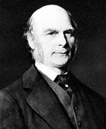
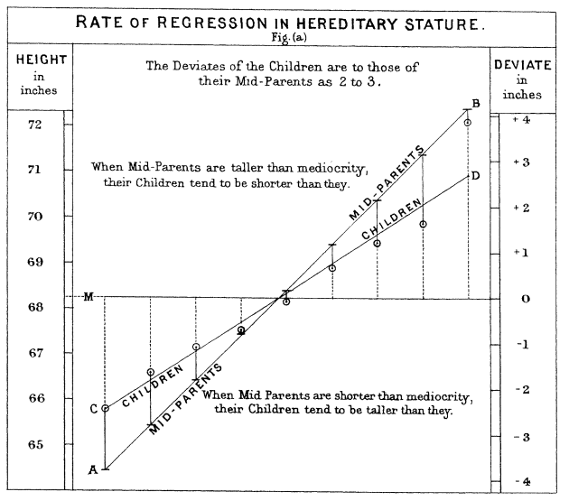
Francis Galton
Twin and family studies
Relatives are more similar than random pairs
Identical twins are more similar than fraternal twins
Average estimate of heritability 49%
69% of twin studies support a purely additive genetic model

Slide 3
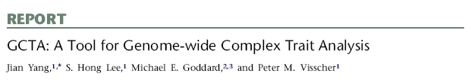
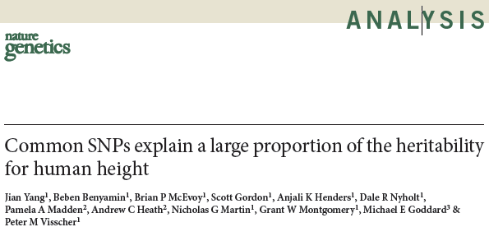
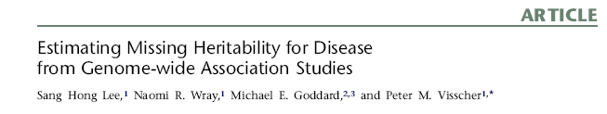
GREML/GCTA
Use estimated genetic similarity
heritability

Slide 4
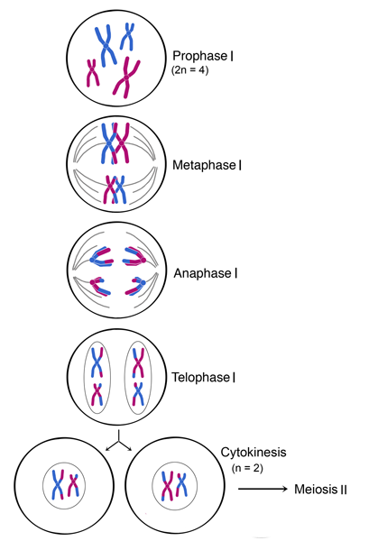
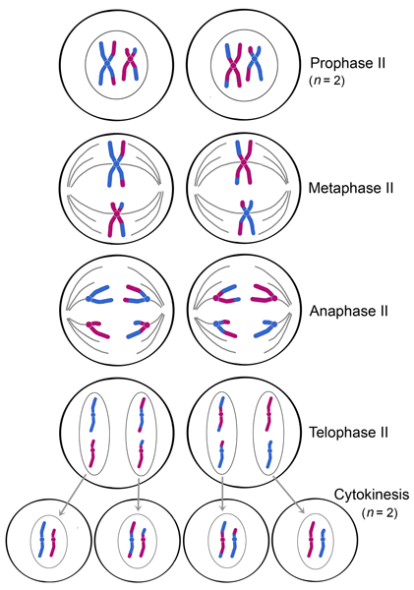
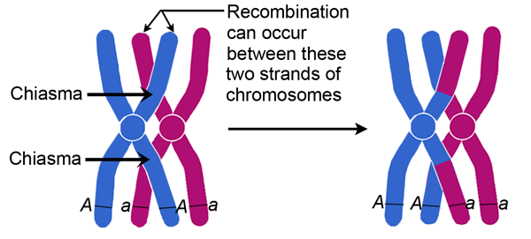
What happens to our genomes when making sperm and egg cells?

Slide 5
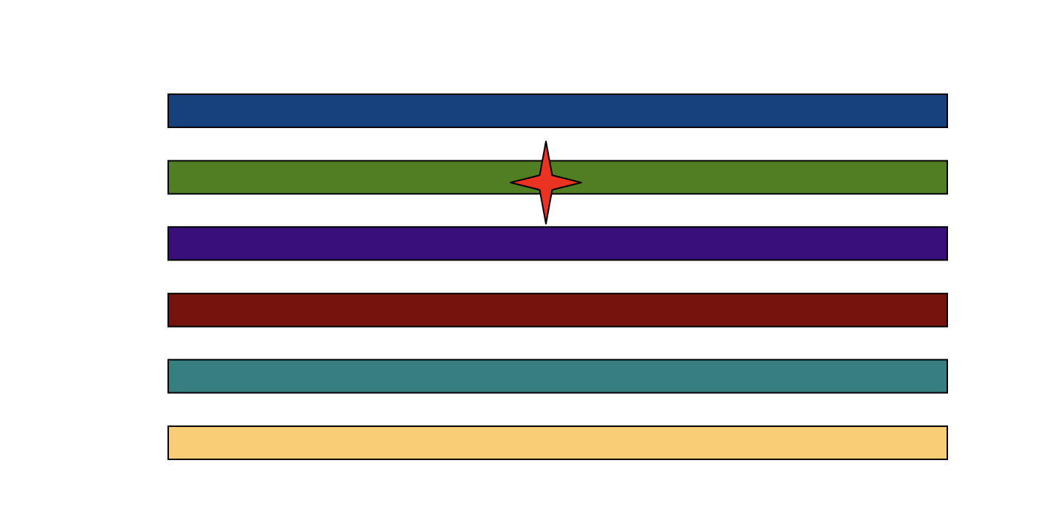
What happens when a new mutation arises?

Slide 6
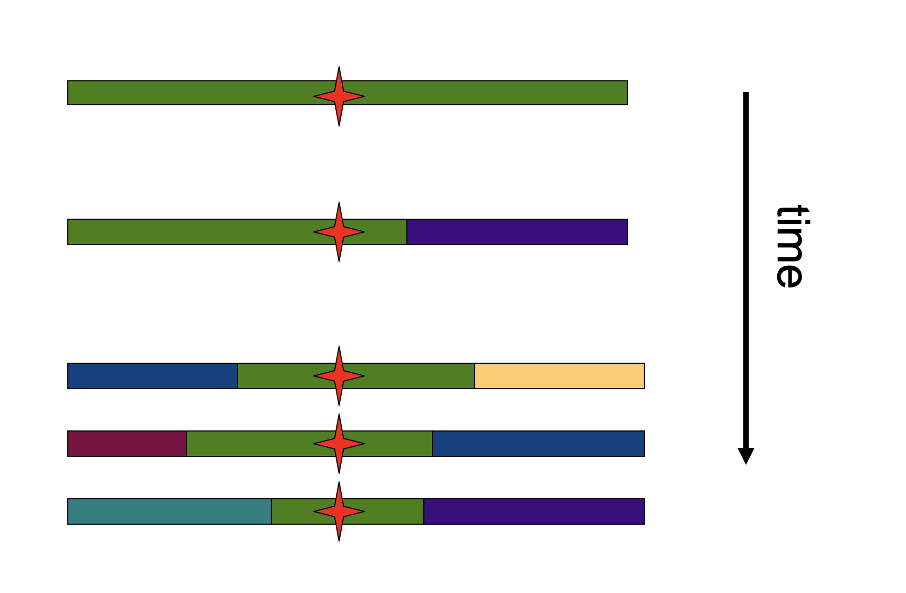
Recombination mixes up the haplotype structure

Slide 7

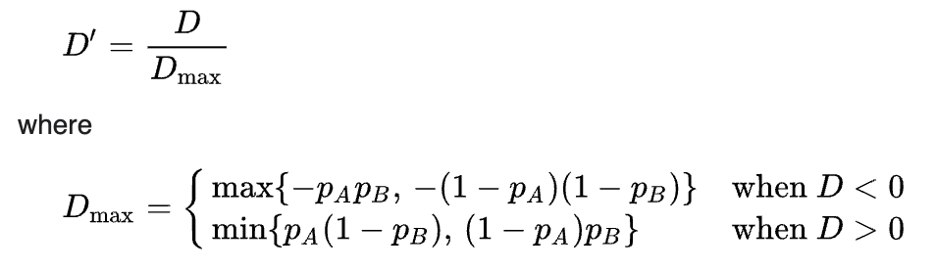
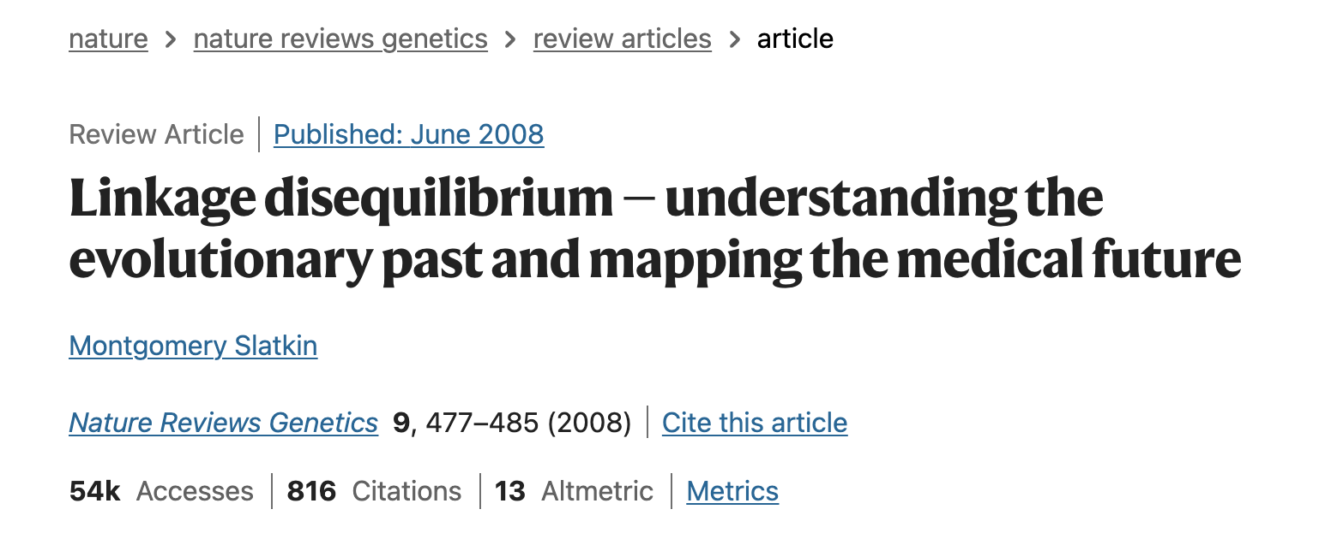
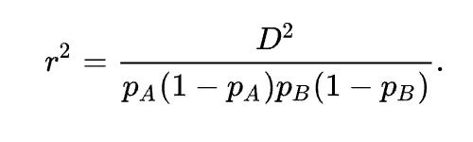
Estimators of LD
A/a
B/b
Two SNPs A and B
Genotypes: AA, Aa, aa
BB, Bb, bb

Slide 8
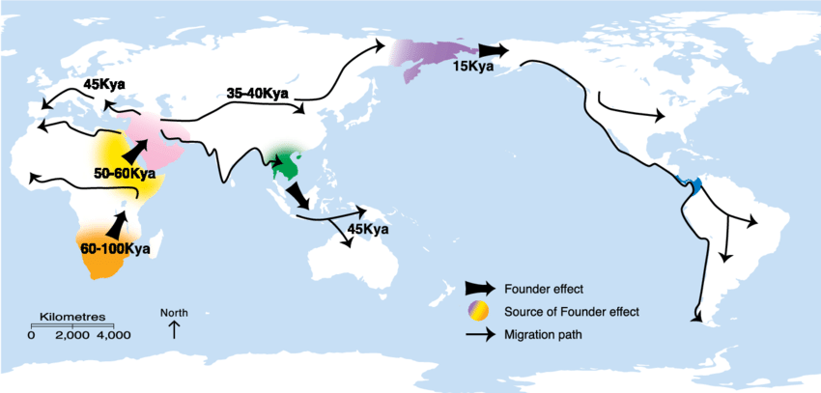
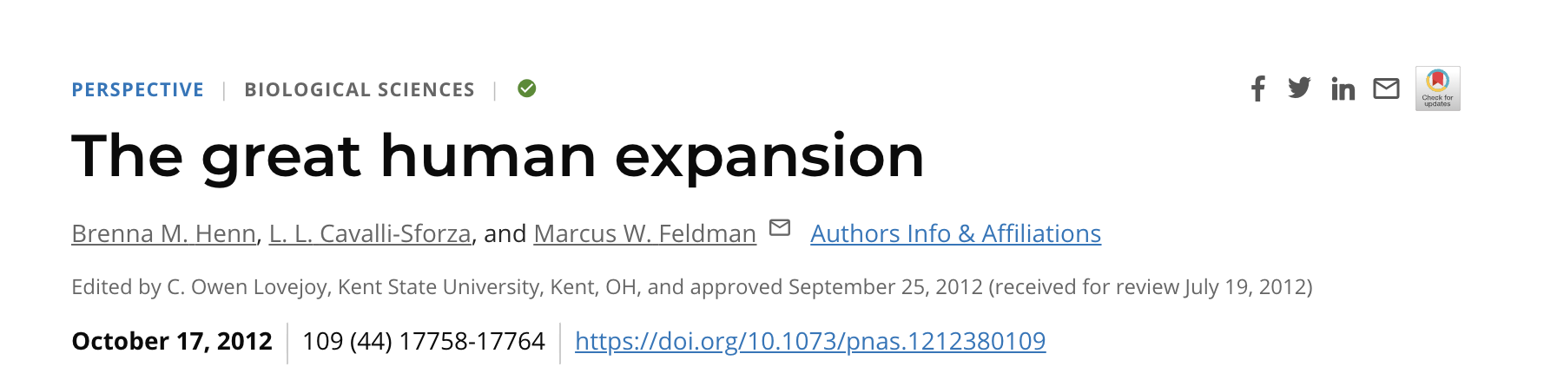
Genetic ancestry
Henn et al. (2012)

Slide 9
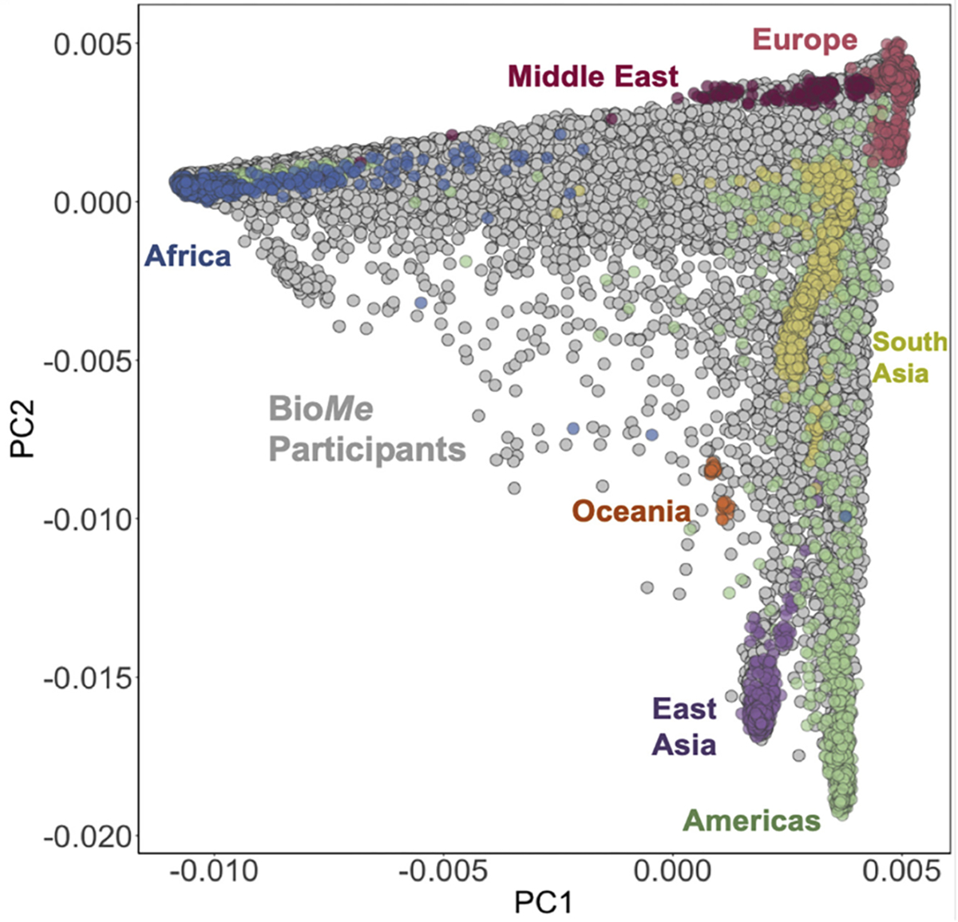
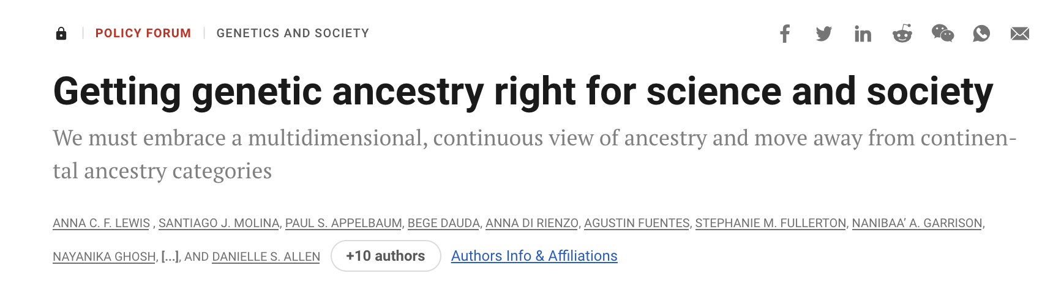
Principal component analysis on genetic data estimates structure

Slide 10





LD Score regression
With thanks
Brendan Bulik-Sullivan
Hilary Finucane
Po-Ru Loh
Mark Daly
Alkes Price

Slide 11
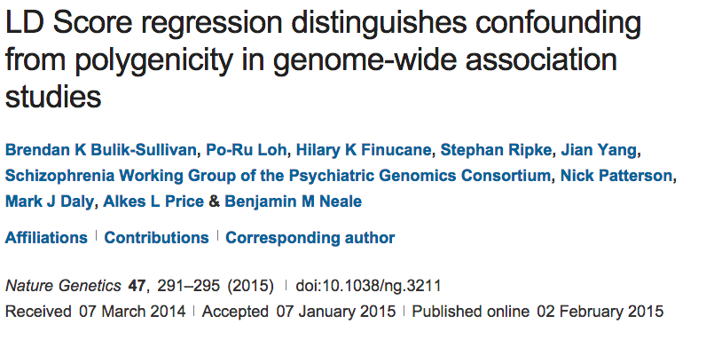
How does LD shape association?

Slide 12
How does LD shape association?
Lonely SNPs [no LD]
LD blocks

Slide 13
How does LD shape association?
Lonely SNPs [no LD]
LD blocks
*
Causal variants
*
Association
All markers correlated with a causal variant show association

Slide 14
How does LD shape association?
Lonely SNPs [no LD]
LD blocks
*
Causal variants
*
Association
Lonely SNPs only show association if they are causal

Slide 15
What happens under polygenicity?
Lonely SNPs [no LD]
LD blocks
*
Causal variants
Assuming a uniform prior, we see SNPs with more LD friends showing more association
The more you tag, the more likely you are to tag a causal variant

Slide 16
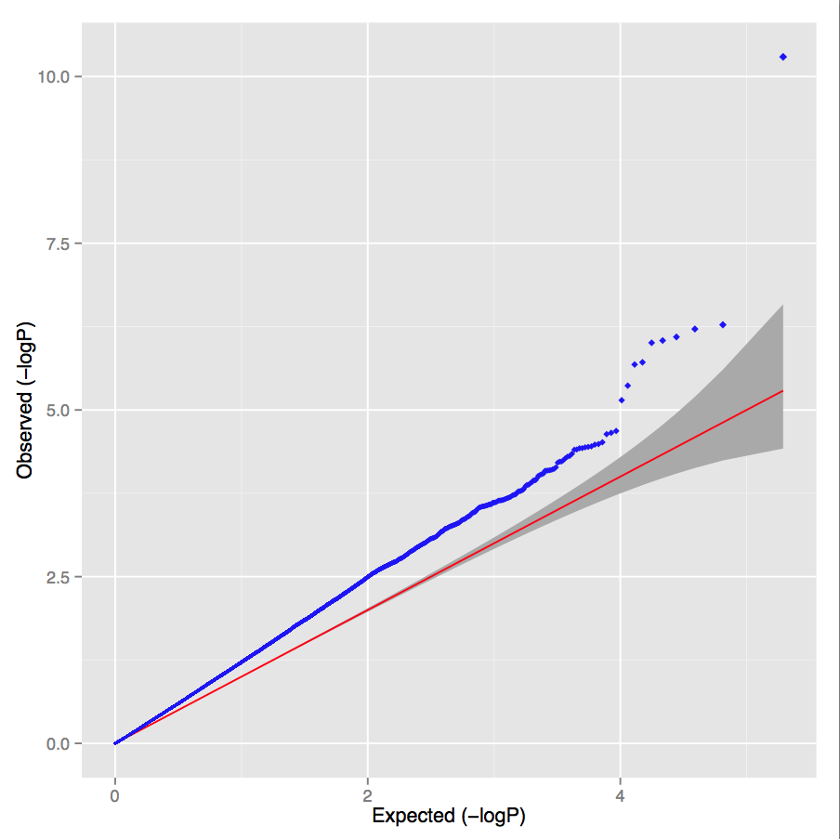
Simulated polygenic architecture
Lambda = 1.30 LD score intercept = 1.02

Slide 17
What happens under stratification?
Lonely SNPs [no LD]
LD blocks
*
Causal variants
Under pure drift we expect LD to have no relationship to differences in allele frequencies between populations

Slide 18
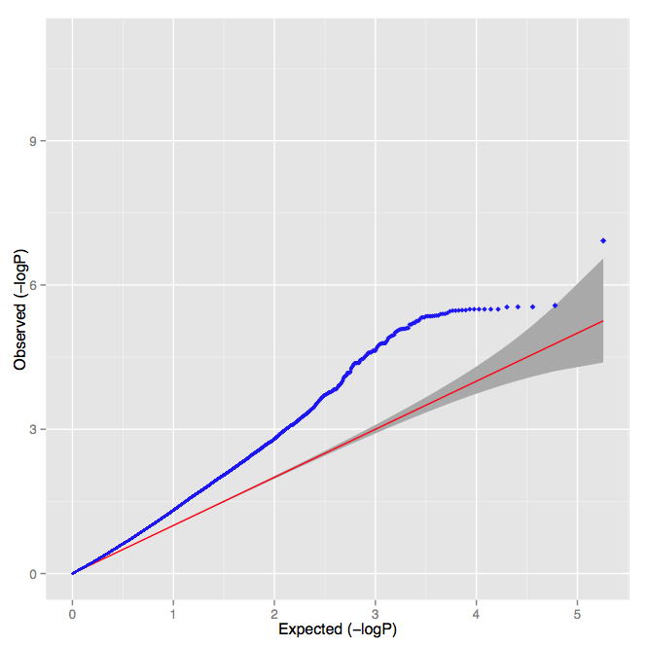
UK controls versus Sweden controls
Lambda = 1.30 LD score intercept = 1.32

Slide 19
PGC Schizophrenia
Lambda = 1.48
Intercept = 1.06
Slope p-value < 10⁻³⁰⁰
Overwhelming majority of inflation is consistent with polygenic architecture

Slide 20
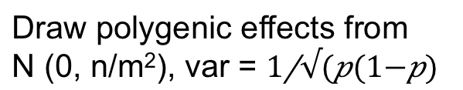
LD Score regression
Draw polygenic effects from
N (0, n/m²), var =
β
What is the E[χ²] for variant j?
New estimator of heritability
where N=sample size, M=# of SNPs, a=inflation due to confounding,
h²g is heritability (total obs.) and l_{j} is the LD Score
Bulik-Sullivan et al. Nature Genetics 2015
Yang et al. EJHG 2011

Slide 21
What isn’t in LD score?
Genetic variation that is not tagged well by common variation
Heterogeneity of traits

Slide 22
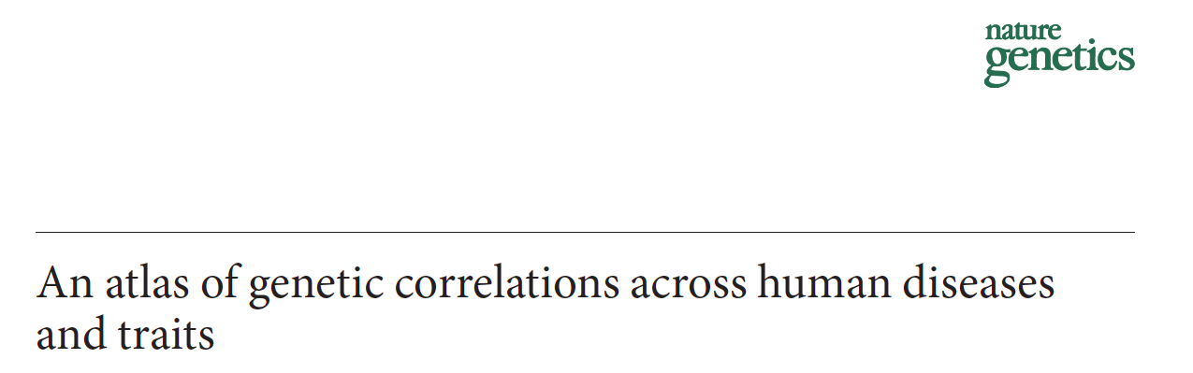
Genetic Correlation
Method in:

Slide 23
Potential sources of genetic correlation
Genetic
effects
Genetic
effects
Trait 1
Trait 2
Trait 1
Trait 2
Trait 1 exerts causal effect on Trait 2
Genetic effects influence
Trait 1 and Trait 2

Slide 24
LD Score regression
Genetic correlation
Trait 1
Slope estimates heritability

Slide 25
LD Score regression
Genetic correlation
Trait 1
We can a second trait and obtain two heritability estimates
Trait 2

Slide 26
LD Score regression
Genetic correlation
Trait 1
Z*Z = χ²
So we can estimate genetic covariance from the product of the Z-scores
Trait 2

Slide 27
LD Score regression
Genetic correlation
Trait 1
Z*Z = χ²
So we can estimate genetic covariance from the product of the Z-scores for the two traits
R_{G} = 0.5
Trait 2
R_{G}

Slide 28
LD Score regression
Genetic correlation
Trait 1
Here R_{G} = 0
This approach is robust to sample overlap as all variants are equally inflated
Trait 2
R_{G}

