Slide 1
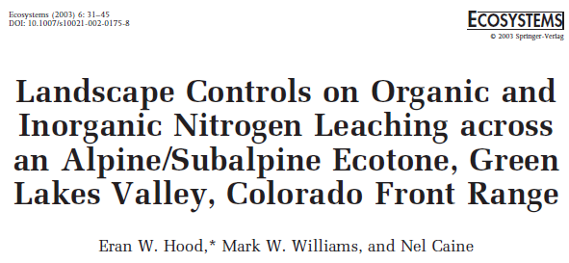
Using genotypic data in our models
Sarah Medland
Boulder 2024

Slide 2
Overview
Today I’ll talk a bit about
How we get genotypic data
What we do to get it ready to use
Estimating relatedness
GWAS
PRS

Slide 3
Vocab/ terminology
Locus/Variant/Marker
a given point in your genome
≠ gene

Slide 4
Vocab/ terminology
Allele
1 of the 2 copies of a variant at a given locus
related concept – ambiguous snp

Slide 5
Vocab/ terminology
Linkage disequilibrium/ LD
measure of whether an allele at one locus tends to be found more often with an allele at another locus.
related concept – LD block

Slide 6
Vocab/ terminology
Terminology about locations within the genome
Base pair location/BP
Build
Centimorgan
strand

Slide 7
Obtaining genotypic data and getting it ready to use

Slide 8
How do we get genetic data?
1. Recruit a large sample
From clinics
From the public
From an existing twin/cohort sample
Pay to access an existing sample
UK Biobank…

Slide 9
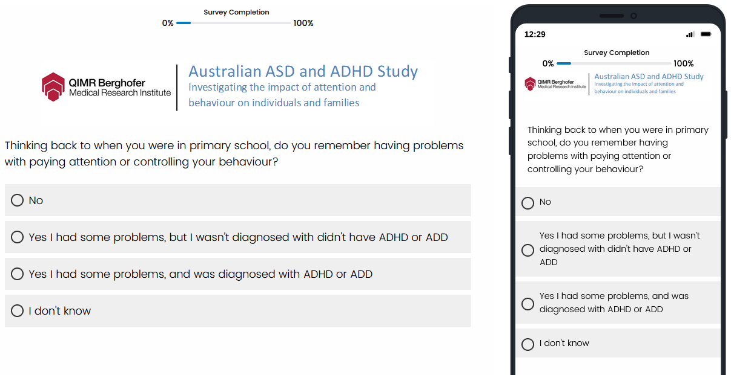
How do we get genetic data?
2. Collect information from the participants

Slide 10
How do we get genetic data?
3. Collect a DNA sample

Slide 11
How do we get genetic data?
4. Extract the DNA
For non lab trained folk this webpage gives a lay overview that you might find helpful
https://learn.genetics.utah.edu/content/labs/extraction/howto/

Slide 12
How do we get genetic data?
5. Genotype the samples

Slide 13
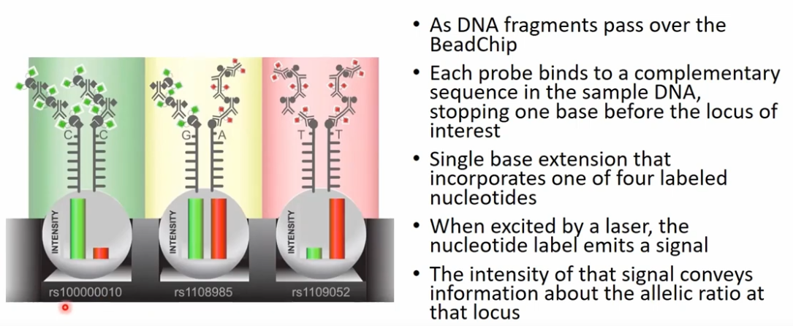
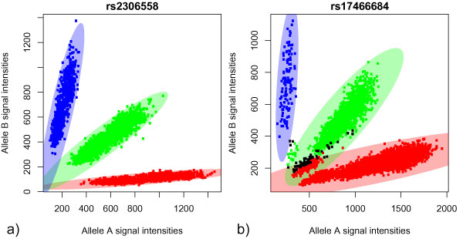
How do we get genetic data?
5. Genotype the samples

Slide 14
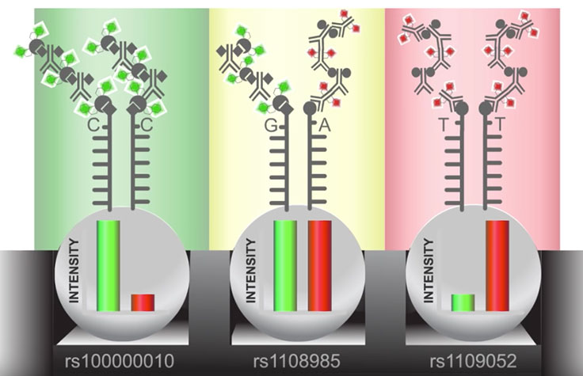
How do we get genetic data?
5. Genotype the samples

Slide 15
What do we do to get it ready to use?
Quality Control
Genotype level – allele frequency, missingness, Hardy-Weinberg Equilibrium (distribution of alleles)
Sample level – missingness, heterozygosity, chromosomal distributions
Come back next year to learn how to do this

Slide 16
What do we do to get it ready to use?
Imputation
We pay to genotype ~.4-1M markers
Through imputation we can get data for ~9M extra markers for free*

Slide 17
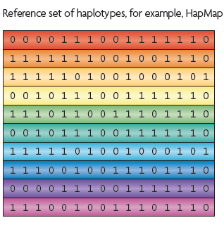
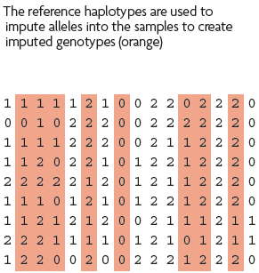
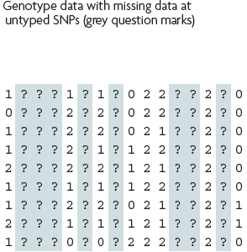
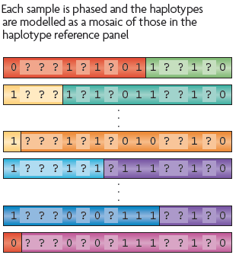
What is imputation? (Marchini & Howie 2010)

Slide 18
Imputation reference sets
Publicly Available References
HapMap
1KGP – phase 3 version v5
References only available via custom imputation servers
HRC - 64,976 haplotypes 39,235,157 SNPs
CAPPA – African American/Caribbean
Multi-ethnic HLA
Genome Asia Pilot - GAsP
TopMed - 97,256 haplotypes 308,107,085 SNPs (b38)

Slide 19
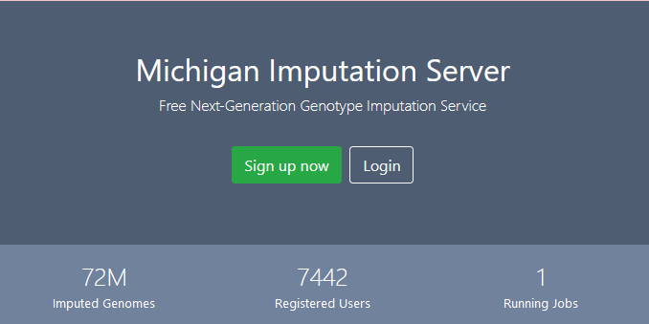
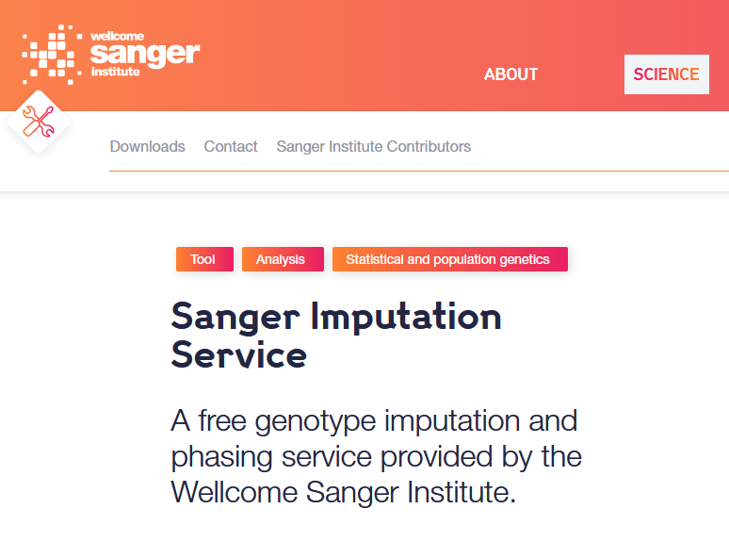
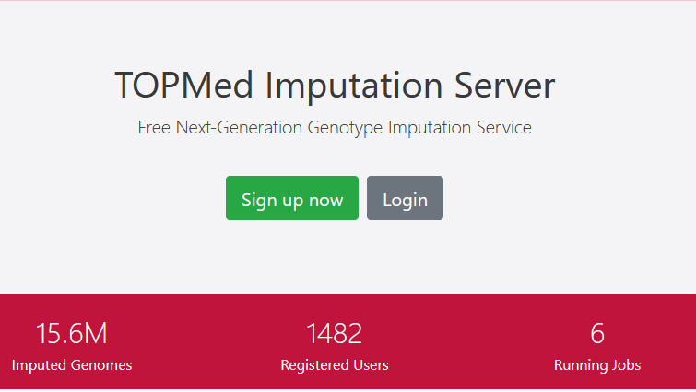

Slide 20
DIY – Use a cookbook!
http://genome.sph.umich.edu/wiki/Minimac3_Imputation_Cookbook OR http://genome.sph.umich.edu/wiki/IMPUTE2:_1000_Genomes_Imputation_Cookbook
UMich Imputation Server
https://imputationserver.sph.umich.edu/
Sanger Imputation Server
https://imputation.sanger.ac.uk/
TOPMed Imputation Server
https://imputation.biodatacatalyst.nhlbi.nih.gov/

Slide 21
Output
2 commonly used genotype output formats
Hard call or best guess
Dosage data (most common – 1 number per SNP, 1-2)

Slide 22
Output
Not all markers are well imputed

Slide 23
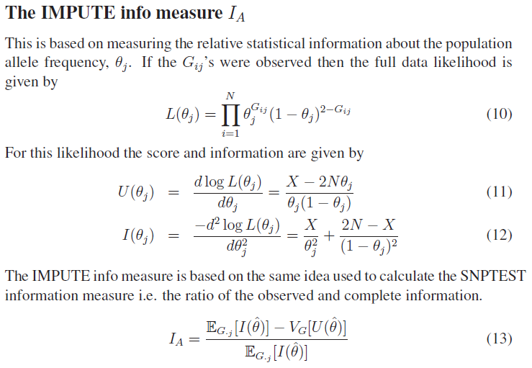
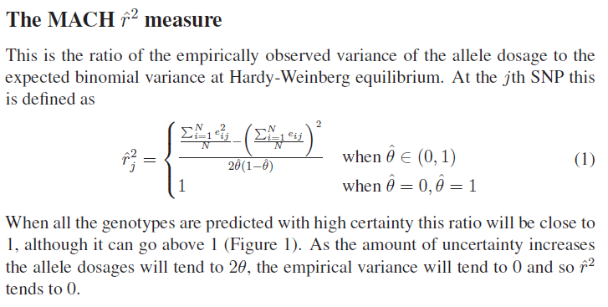
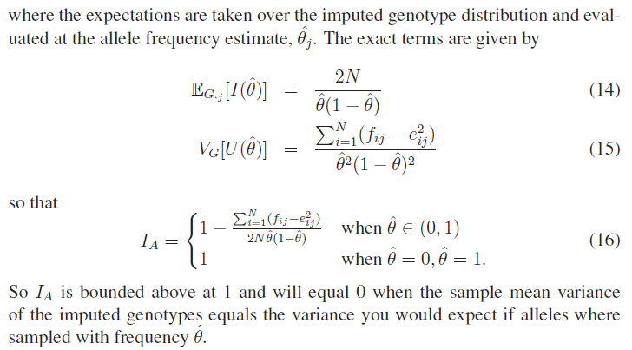
The r² metrics differ between imputation programs
Imputation accuracy is calculated differently by the two main imputation programs
But is highly correlated and conceptually the same

Slide 24
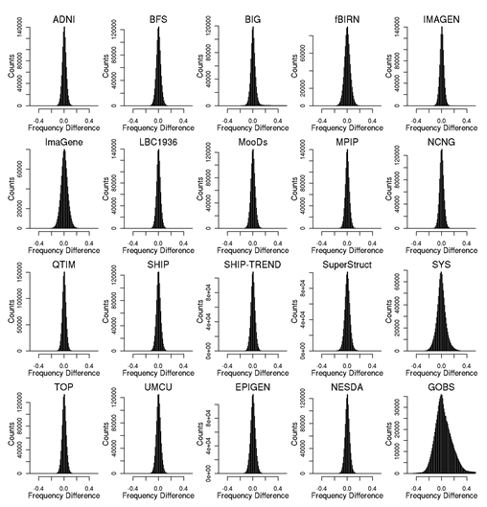
Post imputation QC
After imputation you need to check that it worked and the data look ok
Things to check
Plot r² across each chromosome look to see where it drops off
Plot MAF-reference MAF

Slide 25
Estimating relatedness
Slide Credit: Loci Yengo

Slide 26
Genetic relationship matrices
Genetic relationship matrices (GRM) are important tools for estimating heritability
Yesterday we used family level GRM based on expected relatedness
MZ |  | DZ
1 | 1 | 1 | .5
1 | 1 | .5 | 1

Slide 27
Genetic relationship matrices
We can also calculate a GRM using SNP data.
There are many ways to calculate a GRM using SNP data
Common to use the standard estimator implemented in the software GCTA (but often calculated using Plink)

Slide 28
Standard GRM estimator
Example of GRM between
N=3 individuals
m=1000 SNPs
[$bash] zless myGRM.grm.gz
1 1 1000 0.99
1 2 1000 -0.01
1 3 1000 0.01
2 2 1000 1.03
2 3 1000 0.03
3 3 1000 1.01
where, $x_{ij}$ and $x_{ik}$ are the minor allele count ($x_{ij}$, $x_{ik}$ = 0,1 or 2)
at SNP i for individuals j and k respectively, $p_{i}$ the minor allele frequency (MAF) of SNP I and $m$ the number of SNPs used to
calculate the GRM.

Slide 29
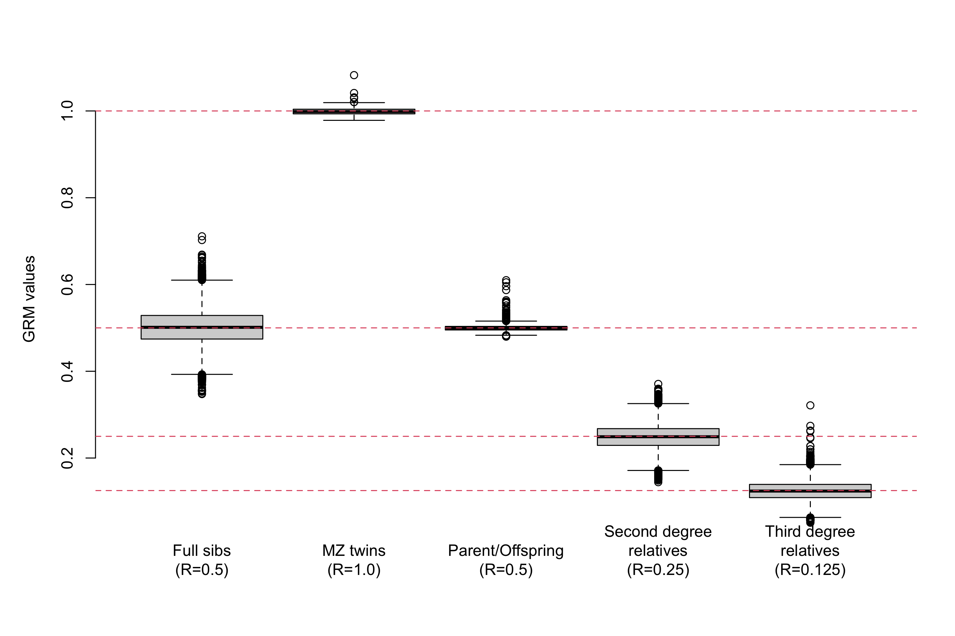
Distribution of GRM values
The expectation (over a large sample of relatives) of the ${\hat{π}}_{jk}$ = the expected relatedness
Observed relatedness may be still vary within a type of pedigree relationship.
Data from UK Biobank participants
(Application number 12505)

Slide 30
Genetic relationship matrices
Later today we will use relatedness calculated from SNPs in an OpenMx model to estimate heritability
On Thursday we will use relatedness calculated from SNPs to run Trio-GCTA

Slide 31
Analysing our genotypic data…

Slide 32
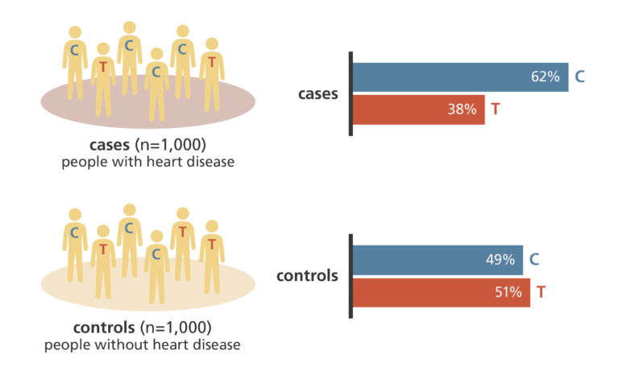
Association analyses
https://www.yourgenome.org/theme/genome-wide-association-studies/

Slide 33
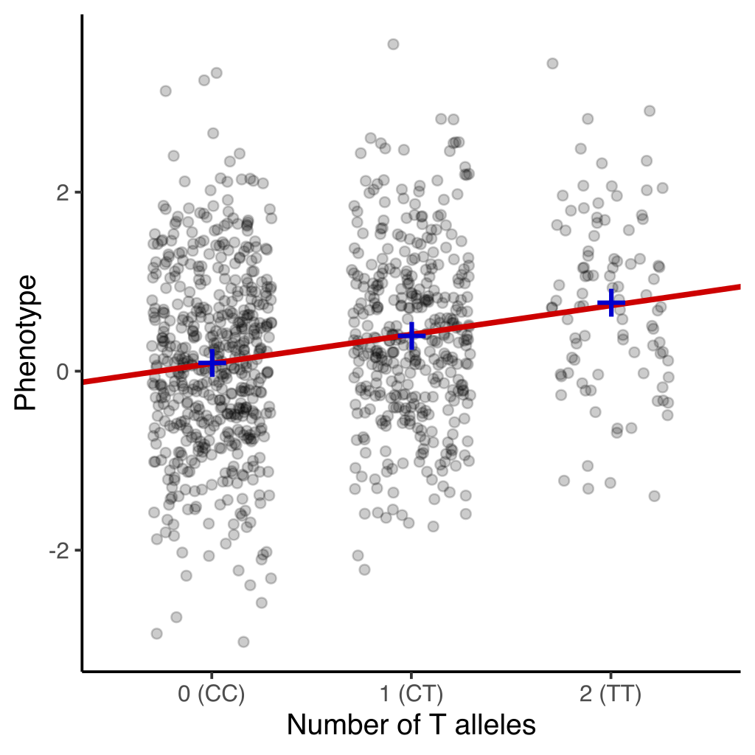
Association analyses

Slide 34
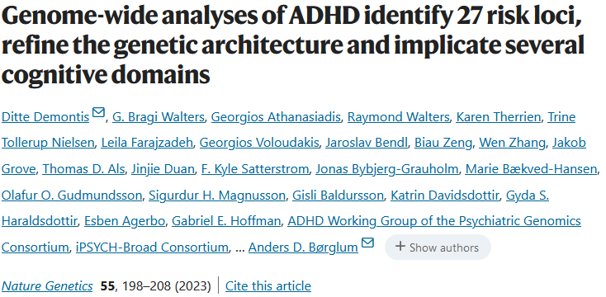
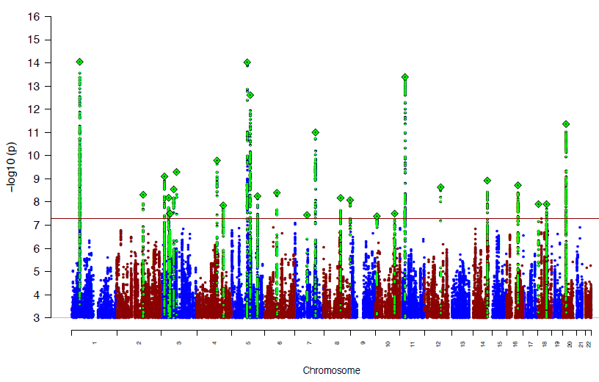
Genome-wide Association Study (GWAS)

Slide 35
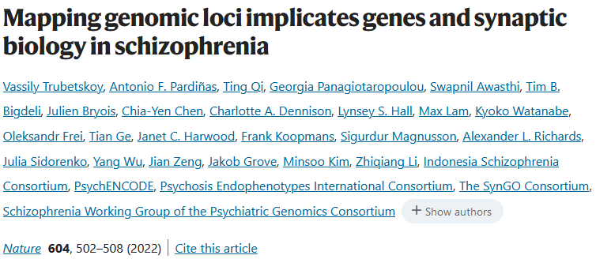
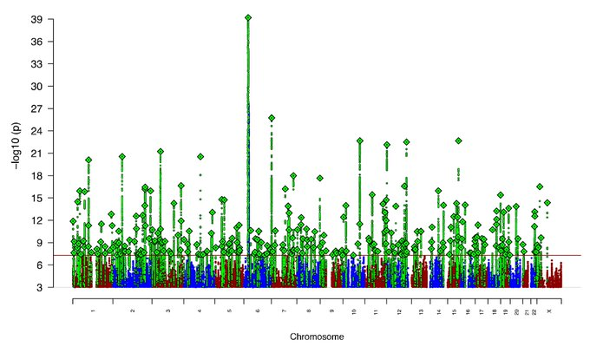
What will we find if we keep looking?
38,899 people living with ADHD,
186,843 without
74,776 people living with Schizophrenia, 101,023 without

Slide 36
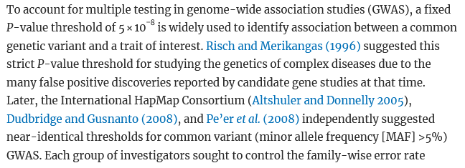
GWAS typically uses a significance threshold of 5x10⁻⁸
This is based on the approximate number of independent tests conducted
Caveat: Many/most follow-up analyses use full distribution of effect estimates and don’t restrict to significant loci

Slide 37
Finding variants influencing the trait is important BUT
The next steps to determine function and mechanism are $$$$$
Better to have robust findings that will replicate than find more variants

Slide 38
Publicly available summary statistics
Most GWAS efforts make their results publicly available
http://www.nealelab.is/uk-biobank
https://pgc.unc.edu/for-researchers/download-results/
https://enigma.ini.usc.edu/research/download-enigma-gwas-results/

Slide 39
GWAS output = PRS input GWAS output = MR input GWAS output = LDscore input GWAS output = SNP h² input …

Slide 40
Polygenic Scores
Perline will be talking more about this tomorrow morning
8am

Slide 41
Polygenic Scores
Many names same concept
Polygenic Risk Scores (PRS)
Polygenic Scores (PGS)
Allelic Scores
Polygenic Index (PCI
Polygenic risk score – Weighted sum of alleles which quantify the effect of several genetic variants on an individual’s phenotype.

Slide 42
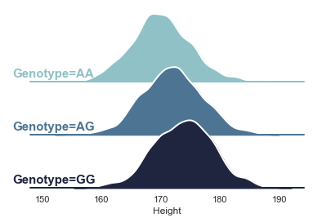
Average increase of 2cm per copy of the G allele. So the effect size of this variant would be approximately 2.
Slide credit: Adrian Campos

Slide 43
In a new sample we would expect AG individuals to be on average 2cm taller than AA and 2cm shorter than GG

Slide 44
PRS overview
Effect size of 2cm per G allele
+2
+4
+4
+0
+0
+0
+2
+2
+2

Slide 45
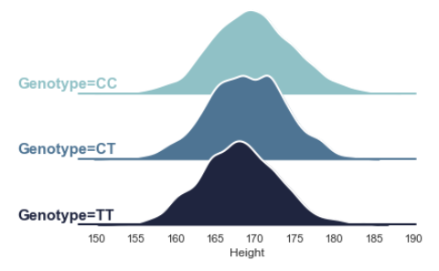
Effect size of -1 per T allele

Slide 46
Effect size of -1 per T allele
+0
+0
-1
-1
+0
-2
-2
-1
-2
+4
+4
+0
+0
+0
+2
+2
+2
+2

Slide 47
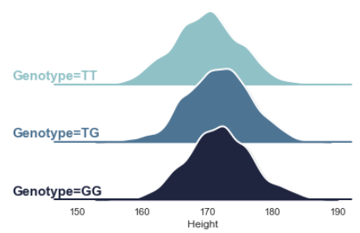
Effect size of +0.5 per G allele

Slide 48
Effect size of +0.5 per G allele
+0.5
+0
-0.5
+0
+0.5
+0
+0.5
+0.5
+1
+0
+0
-1
-1
+0
-2
-2
-1
-2
+4
+4
+0
+0
+0
+2
+2
+2
+2

Slide 49
Complex traits are highly polygenic!
From above we can see there are many more genetic variants that contribute to the phenotype
Common variants typically have a small effect size (our example is an exaggeration for a common variant!). This would cause single-loci based prediction useless
We can combine the information we gain from several genetic variants to estimate an overall score and gain a better estimate of the trait. This is essentially what a PRS does

Slide 50
Polygenic Scores
A couple of important gotchas
You need to make sure the weights are being applied to the right allele (ambiguous snps)
The individuals you are calculating the PRS for needs to be completely independent from the individuals in the GWAS

Slide 51
Polygenic Scores
Numerous methods
Clumping and thresholding
Bayesian approaches

Slide 52
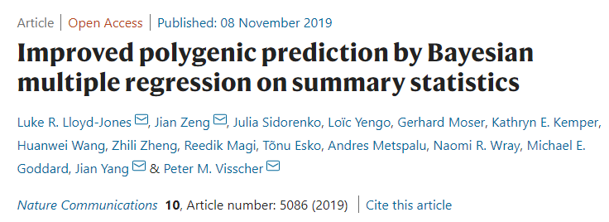
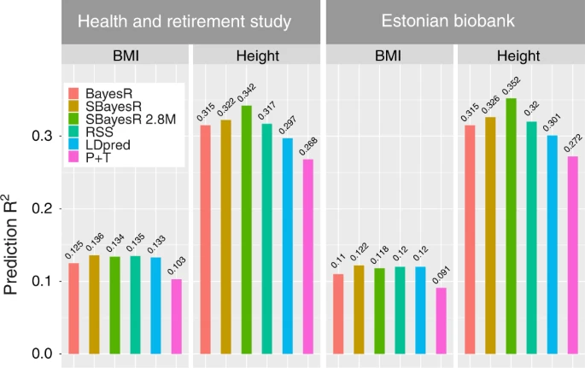
SBayesR
Combines a likelihood connecting the joint effects with GWAS summary statistics and a finite mixture of normal distribution priors for marker effects.
Models the SNP effect sizes as a mixture of normal distributions with mean zero and different variances.
Requires GWAS summary statistics with FREQ, BETA, SE and N; and an LD reference matrix
Lloyd-Jones, Jian Zeng, et al (2019)

Slide 53
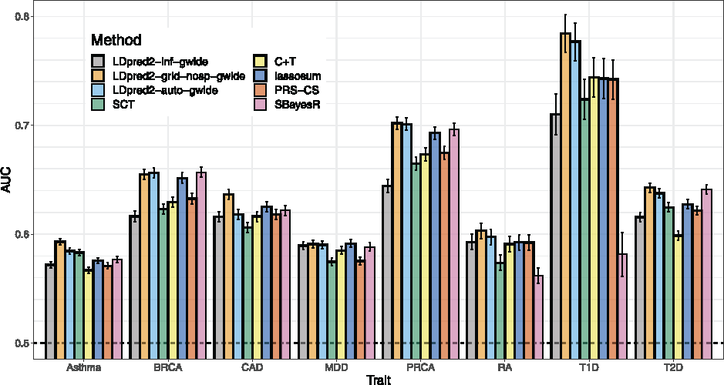
LDpred2
Addressed instability issues in LDpred providing a more stable workflow. Models long range LD such as that found near the HLA region.
Also derives an expectation of joint effects given marginal effects and correlation between SNPs
Assumes:
With p= proportion of causal variants and h2 estimated using Ldscore regression. Grid for p:
Bioinformatics, Volume 36, Issue 22-23, 1 December 2020, Pages 5424–5431

Slide 54
Polygenic Scores
Working across samples
Replicating the finding
Requires the same snps, same weights etc
Restrict the pool of possible SNPs to those available across all cohorts
Replicating the concept
Different clumping and/or weights

Slide 55
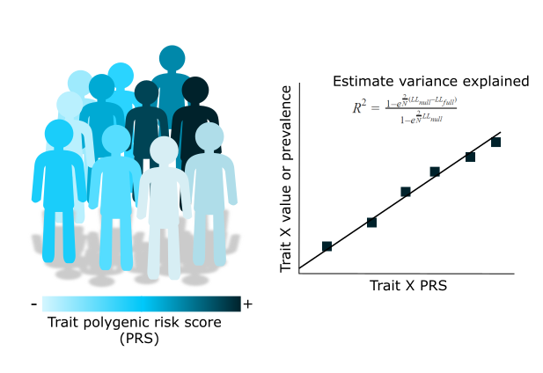
PRS – trait association

Slide 56
PRS – trait association
Think about your sample:
> Is it a family based sample?
! Adjust for relatedness e.g. LMM
> Is it homogeneous in terms of ancestry?
-Always a good idea to adjust for genetic PCs
>Does it match the GWAS ancestry?
Think about your trait:
> Is it continuous – linear regression
> Binary – logistic or probit regression
> Ordinal – cumulative linked mixed models
> Always remember potential confounders of the trait and of the discovery GWAS
Notes:
PRS are a tool that allow us to test hypotheses regarding the genetic liability to a trait.
We will eventually need to perform associations between our PRS and a trait of interest.
The trait of interest will depend on what our question is and what the PRS is being used for, but regardless of it there are important considerations:

Slide 57
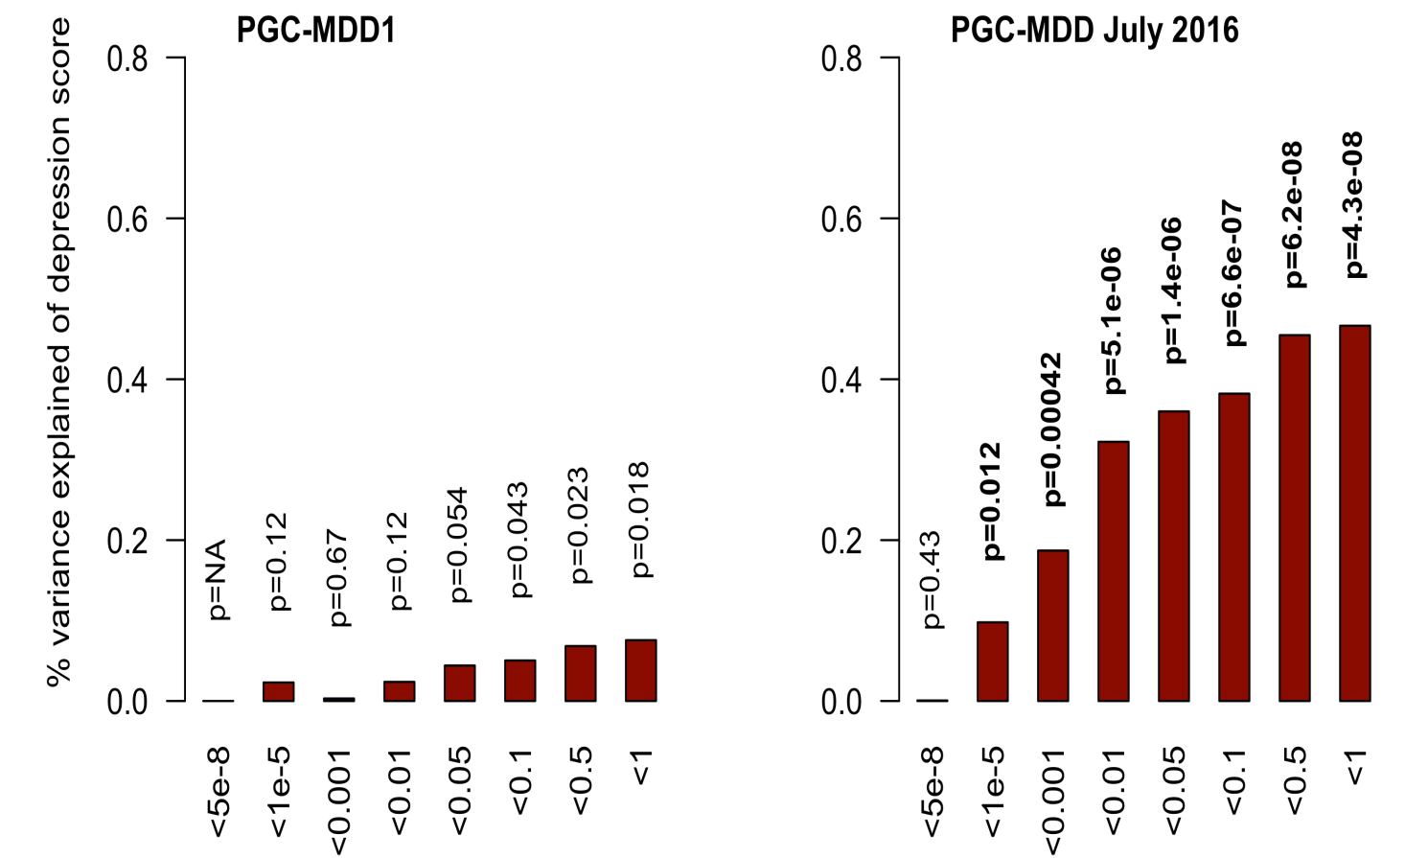
Power of PRS analysis increases with GWAS sample size
PGC-MDD1: N=18k
max variance explained = 0.08%, p=0.018
PGC-MDD2: N=163k
max variance explained =0.46%,
p= 5.01e-08
Colodro-Conde L, Couvy-Duchesne B, et al, (2017) Molecular Psychiatry

Slide 58
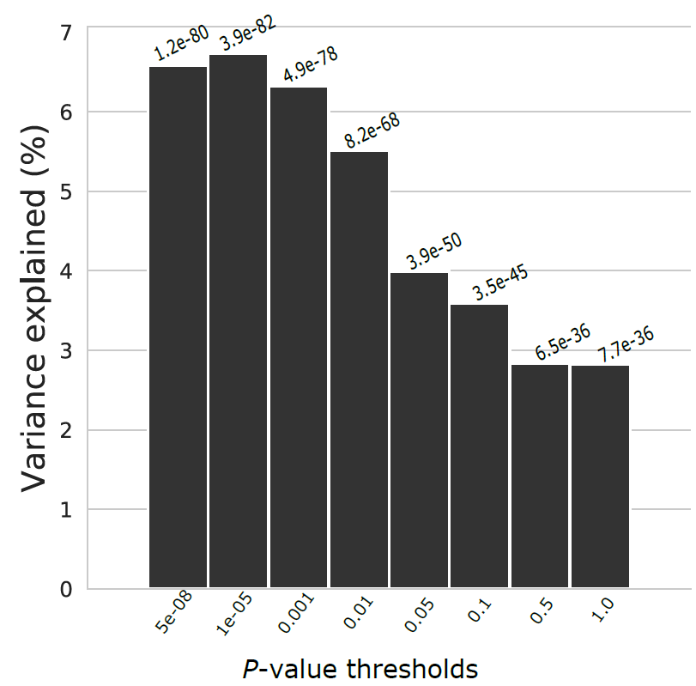
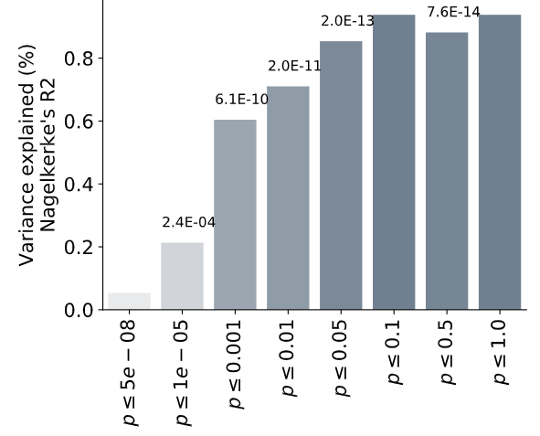
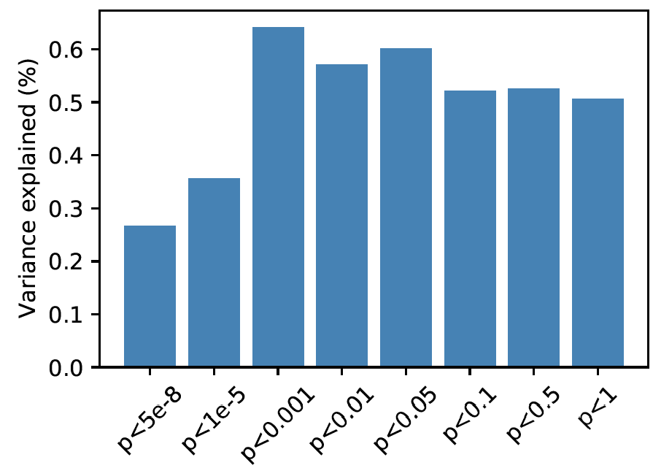
C+T also allows us to explore the pattern of variance explained
Variance explained = partial R² for quantitative traits. Different ways of estimating it for binary traits

Slide 59
Applications
Quantify variance explained & explore architecture
Risk stratification
(i.e. identifying people to later test for specific disease)
Aid in clinical diagnosis
Test for genetic overlap between traits
(e.g. does a Depression PRS predict cardiovascular disease?)
Trait imputation when not measured
(obviously imperfect and dependent on heritability)
Personalized treatment
(GWAS on treatment response are gaining power)
Any hypothesis where you rely on a risk or liability
(e.g. GxE interactions)

Slide 60
Additional considerations in mental health
When people present it is not usually a question of if someone has a future risk
Individuals or their families typically seek help
Individuals often present with symptoms that might fit more than one diagnostic criterion
So the question is usually one of differential diagnosis

Slide 61
How is mental health different?
Comorbidity (co-occurrence) is the rule than the exception
Presentations and diagnoses are expected to change over time
This is ≠ misdiagnosis
PRS is static across the lifespan

Slide 62
Further complications…
Diagnoses are used for more than just treatment planning
Medico-legal contexts
Criminal, Civil and Family proceedings
Compensation
Access to support
Financial, Educational, Housing, Social

Slide 63
Further complications…
Because of this, diagnostic processes are ideally
Static
Reproducible
Easy to implement
Useable in low resource settings
Measurement invariant

Slide 64
References for PRS
Wray NR, Goddard, ME, Visscher PM. Prediction of individual genetic risk to disease from genome-wide association studies. Genome Research. 2007; 7(10):1520-28.
Evans DM, Visscher PM., Wray NR. Harnessing the information contained within genome-wide association studies to improve individual prediction of complex disease risk. Human Molecular Genetics. 2009; 18(18): 3525-3531.
International Schizophrenia Consortium, Purcell SM, Wray NR, Stone JL, Visscher PM, O'Donovan MC, Sullivan PF, Sklar P . Common polygenic variation contributes to risk of schizophrenia and bipolar disorder. Nature. 2009; 460(7256):748-52
Evans DM, Brion MJ, Paternoster L, Kemp JP, McMahon G, Munafò M, Whitfield JB, Medland SE, Montgomery GW; GIANT Consortium; CRP Consortium; TAG Consortium, Timpson NJ, St Pourcain B, Lawlor DA, Martin NG, Dehghan A, Hirschhorn J, Smith GD. Mining the human phenome using allelic scores that index biological intermediates. PLoS Genet. 2013,9(10):e1003919.
Dudbridge F. Power and predictive accuracy of polygenic risk scores. PLoS Genet. 2013 Mar;9(3):e1003348. Epub 2013 Mar 21. Erratum in: PLoS Genet. 2013;9(4). (Important discussion of power)
Wray NR, Lee SH, Mehta D, Vinkhuyzen AA, Dudbridge F, Middeldorp CM. Research review: Polygenic methods and their application to psychiatric traits. J Child Psychol Psychiatry. 2014;55(10):1068-87. (Very good concrete description of the traditional methods).
Wray NR, Yang J, Hayes BJ, Price AL, Goddard ME, Visscher PM. Pitfalls of predicting complex traits from SNPs. Nat Rev Genet. 2013;14(7):507-15. (Very good discussion of the complexities of interpretation).
Witte JS, Visscher PM, Wray NR. The contribution of genetic variants to disease depends on the ruler. Nat Rev Genet. 2014;15(11):765-76. (Important in the understanding of the effects of ascertainment on PRS work).
Shah S, Bonder MJ, Marioni RE, Zhu Z, McRae AF, Zhernakova A, Harris SE, Liewald D, Henders AK, Mendelson MM, Liu C, Joehanes R, Liang L; BIOS Consortium, Levy D, Martin NG, Starr JM, Wijmenga C, Wray NR, Yang J, Montgomery GW, Franke L, Deary IJ, Visscher PM. Improving Phenotypic Prediction by Combining Genetic and Epigenetic Associations. Am J Hum Genet. 2015; 97(1):75-85. (Important for the conceptualization of polygenicity)

Slide 65
Questions?

