Slide 1
Model building, assumptions and the practice of science
Benjamin Neale, Ph.D.
International Statistical Genetics Workshop
March 4th 2024

Slide 2
All science starts with fantasy

Slide 3
An example model
Consider a genotype, G
What might we want to know about this genotype?

Slide 4
An example model
Consider a genotype, G
What might we want to know about this genotype?
Number of distinct alleles?
Frequency?
Effect size?

Slide 5
An example model
Consider a trait, T
What might we want to know about this trait?

Slide 6
An example model
Consider a trait, T
What might we want to know about this trait?
Mean?
Distribution?
Sources of variation?

Slide 7
An example model
Consider our G and T (cheers)
Let us say that T = 𝛃*G + E

Slide 8
An example model
Consider our G and T (cheers)
Let us say that T = 𝛃*G + E
How do we figure out the heritability of T?

Slide 9
An example model
Consider our G and T (cheers)
Let us say that T = 𝛃*G + E
How do we figure out the heritability of T?
Var(T) = Var(𝛃 *G + E)
Recall Var(X + Y) = Var(X) + Var(Y) + 2*Cov(X,Y)
So Var(T) = Var(𝛃 *G) + Var(E) + 2*Cov(𝛃 *G,E)

Slide 10
An example model
Consider our G and T (cheers)
Let us say that T = 𝛃*G + E
How do we figure out the heritability of T?
Var(T) = Var(𝛃 *G + E)
Recall Var(X + Y) = Var(X) + Var(Y) + 2*Cov(X,Y)
So Var(T) = Var(𝛃 *G) + Var(E) + 2*Cov(𝛃 *G,E)
Recall Var(K*X) = K²Var(X) and Cov(K*X,Y) = K*Cov(X,Y)
So Var(T) = 𝛃^{2*}Var(G) + Var(E) + 2𝛃*Cov(G,E)

Slide 11
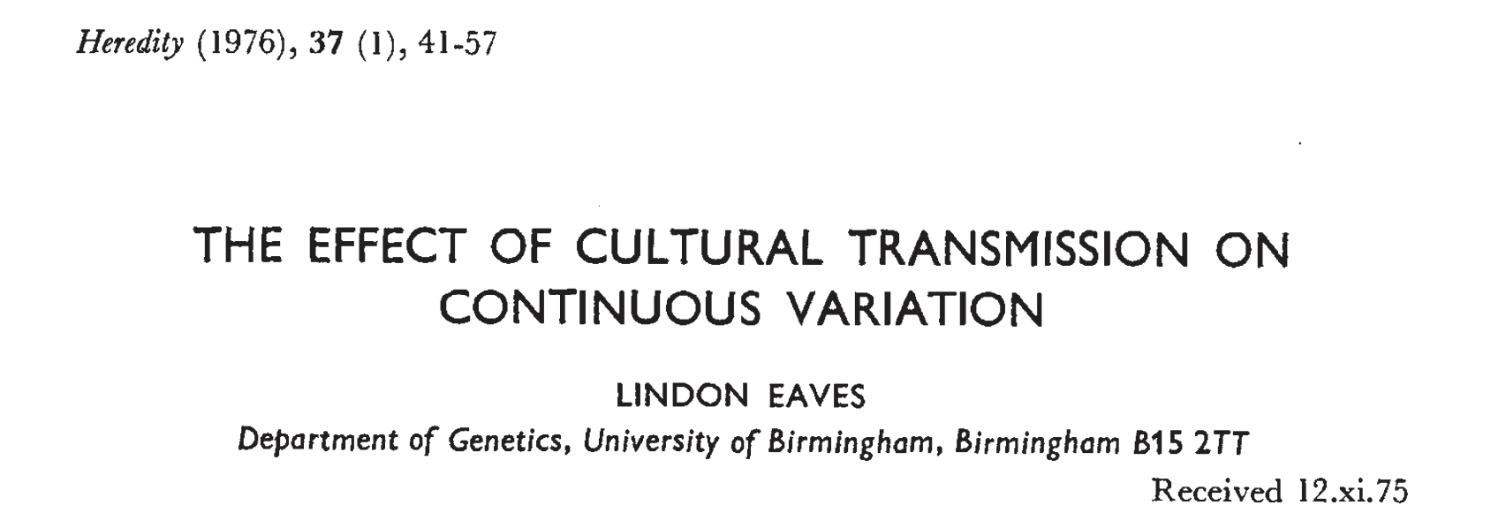

Slide 13
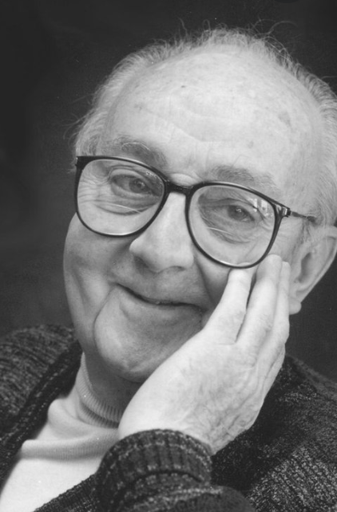
Models in science
Scientific models represent natural phenomena in a logical and simplified way, allowing for better understanding and/or prediction of the phenomena
Models must make multiple simplifying assumptions.
To the degree that these assumptions are unmet (do not reflect the true complexity in the real world), biases result
”All models are wrong, some are useful.” - George Box
Notes:
EXAMPLES:
climate models that simulate interactions of drivers of climate
economic models that represent economic process by a set of economic variables and their inter-relationships
cellular modeling the represent the many cellular subsystems and their cause-effect and sometimes recursive relationships
MODELS are not theories themselves, but they are born from theory and aid in testing of hypotheses stemming from those theories

Slide 14
Classical twin design model
V_{C}
V_{D} / ¼V_{D}
E
C
D
A
V_{A} / ½V_{A}
A
D
C
E
Tw1
Tw2

Slide 15
For a univariate twin model – can we estimate all these parameters?
V_{C}
V_{D} / ¼V_{D}
E
C
D
A
V_{A} / ½V_{A}
A
D
C
E
Tw1
Tw2

Slide 16
For a univariate twin model – can we estimate all these parameters? NO!
V_{C}
V_{D} / ¼V_{D}
E
C
D
A
V_{A} / ½V_{A}
A
D
C
E
Tw1
Tw2

Slide 17
Model identification
The number of statistics ≥ the number of parameters
Necessary but not sufficient
Each parameters can be expressed as a distinct combination of statistics
Alternately – that the parameters are not collinear
Algebraic identification can be performed although is considered tedious and error-prone for complex models
Empirical detection of non-identification can be shown when different sets of parameter estimates yield identical likelihoods and those likelihoods are the maximum likelihood
Alternatively, in OpenMx, use mxCheckIdentification(model)

Slide 18
So what do we do instead?
V_{C}
V_{D} / ¼V_{D}
E
C
D
A
V_{A} / ½V_{A}
A
D
C
E
Tw1
By convention, fit ACE when $${\hat{CV}}_{MZ}{<2\hat{CV}}_{DZ}$$
Tw2
$${\hat{V}}_{P}$$
$${\hat{V}}_{P}$$
$${\hat{CV}}_{MZ}$$
$${\hat{V}}_{P}$$
$${\hat{CV}}_{DZ}$$
$${\hat{V}}_{P}$$

Slide 19
So what do we do instead?
V_{C}
V_{D} / ¼V_{D}
E
C
D
A
V_{A} / ½V_{A}
A
D
C
E
Tw1
By convention, fit ADE when $${\hat{CV}}_{MZ}{>2\hat{CV}}_{DZ}$$
Tw2
$${\hat{V}}_{P}$$
$${\hat{V}}_{P}$$
$${\hat{CV}}_{MZ}$$
$${\hat{V}}_{P}$$
$${\hat{CV}}_{DZ}$$
$${\hat{V}}_{P}$$

Slide 20
True vs. Estimated parameters
V_{A}, V_{C}, V_{D}, V_{E}: population parameters. The true values (typically unknowable) in the population
${\hat{V}}_{A}$, ${\hat{V}}_{C}$, ${\hat{V}}_{D}$, ${\hat{V}}_{E}:$estimated values of V_{A}, V_{C}, V_{D}, and V_{E}
$\hat{θ}$ differs from θ due to:
1) sampling variability
2) bias (= E[$\hat{θ}$] - θ)

Slide 21
Precision and Bias - visually

Slide 22
Do methods have assumptions?

Slide 23
Do methods have assumptions? - YES
Assumptions of linear regression
Linear relationship
Multivariate normality
No or little multicollinearity
No auto-correlation
Homoscedasticity

Slide 24
Deriving algebraic expectations of variance component estimates
1) In an ACE model, we assume V_{D}=0. To get algebraic expectations of ${\hat{V}}_{A}$ and ${\hat{V}}_{C}$ in an ACE model, write down what ${CV}_{MZ}$ and ${CV}_{DZ}$ are assumed to be composed of:
${CV}_{MZ}$ = V_{A} + V_{C}
${CV}_{DZ}$ = ½V_{A} + V_{C}
2) To get an estimate of one term (e.g., V_{A}), find a contrast of linear transformations of these two equations that cancel out one parameter (e.g., V_{C}) and isolate the other (e.g., V_{A}). E.g.:
${CV}_{MZ}$ – ${CV}_{DZ}$ = ½V_{A}. Thus 2(${CV}_{MZ}$ – ${CV}_{DZ}$ ) = V_{A}.
Thus, an estimator of V_{A}:
${\hat{V}}_{A}$= 2(${\hat{CV}}_{MZ}$ – ${\hat{CV}}_{DZ}$ )
3) Similarly, to cancel out V_{A} and isolate V_{C}:
${\hat{V}}_{C}$= 2${\hat{CV}}_{DZ}$ - ${\hat{CV}}_{MZ}$

Slide 25
Pen & Paper Practice 1: Algebraic expectations of ADE model
Use what we just learned to derive algebraic expectations of the estimates of V_{A} and V_{D} in an ADE model (where we assume V_{C}=0). As a hint, in this situation, we assume V_{C}=0 and therefore:
${CV}_{MZ}$ = V_{A} + V_{D}
${CV}_{DZ}$ = ½V_{A} + ¼V_{D}
To get ${\hat{V}}_{A},$think of possible contrasts of linear transformations of these equations that cancel out V_{D} and isolate V_{A}.(and vice-versa for ${\hat{V}}_{D}$)
QUESTION1.1: What is your estimator of V_{A} (${\hat{V}}_{A}$) in an ADE model?
QUESTION1.2: What is your estimator of V_{D} (${\hat{V}}_{D})$in an ADE model?

Slide 26
Pen & Paper Practice 1: Algebraic expectations of ADE model
QUESTION1.1: What is your estimator of V_{A} (${\hat{V}}_{A}$) in an ADE model?
QUESTION1.2: What is your estimator of V_{D} (${\hat{V}}_{D})$in an ADE model?

Slide 27
Pen & Paper Practice 1: Algebraic expectations of ADE model
QUESTION1.1: What is your estimator of V_{A} (${\hat{V}}_{A}$) in an ADE model?
${CV}_{MZ}$ = V_{A} + V_{D}
${CV}_{DZ}$ = ½V_{A} + ¼V_{D}
$\text{4*}{CV}_{DZ}\text{ – }{CV}_{MZ}\text{ = 2}\text{VA}\text{ + }\text{VD}\text{ – }\text{VA}\text{ – }\text{VD}\text{ = }\text{V}\text{A}$
QUESTION1.2: What is your estimator of V_{D} (${\hat{V}}_{D})$in an ADE model?
${CV}_{MZ}$ = V_{A} + V_{D}
${CV}_{DZ}$ = ½V_{A} + ¼V_{D}
${CV}_{MZ}$ - 2* ${CV}_{DZ}$ = (V_{A} + V_{D}) – 2*(½V_{A} + ¼V_{D}) = ½V_{D}
2 *(${CV}_{MZ}$ - 2* ${CV}_{DZ}$) = V_{D}

Slide 28
Can we derive algebraic expectations of bias in estimates due to misspecification
1) We want to know what happens when we “misspecify” the model (here, when a parameter assumed to be 0 in the model is not 0). To do this, first write out one of your estimators. E.g., in an ACE model:
${\hat{V}}_{A}$= 2(${\hat{CV}}_{MZ}$ – ${\hat{CV}}_{DZ}$ )
2) Consider the true compositions of parameters used in the estimators (i.e., if you got an assumption wrong). If V_{D} is actually non-zero, then:
${CV}_{MZ}$ = V_{A} + V_{C} + V_{D}
${CV}_{DZ}$ = ½V_{A} + V_{C}+ ¼V_{D}
3) Finally, just substitute the true compositions of ${CV}_{MZ}$ and ${CV}_{DZ}$ into ${\hat{CV}}_{MZ}$ and ${\hat{CV}}_{DZ}$ used in the estimator. Thus, for ${\hat{V}}_{A}$in an ACE:
${\hat{V}}_{A}$= 2*(V_{A} + V_{D} + V_{C} – ½V_{A} – ¼V_{D} – V_{C}) = V_{A} + $3/2$V_{D}
In word: when V_{D} $≠$ 0 but one fits an ACE model, ${\hat{V}}_{A}$is biased upwards by 1.5 of whatever V_{D} truly is.
4) Similarly, ${\hat{V}}_{C}$= V_{C} - ½V_{D}: ${\hat{V}}_{C}$ is biased down by ½ of what V_{D} is.

Slide 29
Pen & Paper Practice 2: Deriving biases of ADE
1) Use what we just learned to derive the bias in ${\hat{V}}_{A}$and ${\hat{V}}_{D}$in an ADE model (where we assume V_{C}=0). Recall:
${\hat{V}}_{A}$= 4${\hat{CV}}_{DZ}$ – ${\hat{CV}}_{MZ}$
${\hat{V}}_{D}$= 2${\hat{CV}}_{MZ}$ – 4 ${\hat{CV}}_{DZ}$
${CV}_{MZ}$ = V_{A} + V_{D} + V_{C}
${CV}_{DZ}$ = ½V_{A} + ¼V_{D} + V_{C}
2) Now just substitute the true compositions of ${CV}_{MZ}$ and ${CV}_{DZ}$ into ${\hat{CV}}_{MZ}$ and ${\hat{CV}}_{DZ}$ used in the estimator to see how our estimates are biased.
QUESTION2.1: How is ${\hat{V}}_{A}$ is biased in an ADE model when V_{C} (contrary to our assumption) is actually non-zero?
QUESTION2.2: How is ${\hat{V}}_{D}$ biased in an ADE model when V_{C} (contrary to our assumption) is actually non-zero?

Slide 30
Pen & Paper Practice: Deriving biases of ADE
QUESTION2.1: How is ${\hat{V}}_{A}$ biased in an ADE model when V_{C}$≠$ 0?
QUESTION2.2: How is ${\hat{V}}_{D}$ biased in an ADE model when V_{C}$≠$ 0?

Slide 31
Pen & Paper Practice: Deriving biases of ADE
QUESTION2.1: How is ${\hat{V}}_{A}$ biased in an ADE model when V_{C}$≠$ 0?
${\hat{V}}_{A}$= 4${\hat{CV}}_{DZ}$ – ${\hat{CV}}_{MZ}$
${\hat{V}}_{A}$ = 4(½V_{A} + ¼V_{D} + V_{C}) – (V_{A} + V_{D} + V_{C})
${\hat{V}}_{A}$ = V_{A} + 3V_{C}
QUESTION2.2: How is ${\hat{V}}_{D}$ biased in an ADE model when V_{C}$≠$ 0?
${\hat{V}}_{D}$= 2${\hat{CV}}_{MZ}$ – 4 ${\hat{CV}}_{DZ}$
${\hat{V}}_{D}$ = 2(V_{A} + V_{D} + V_{C}) – 4(½V_{A} + ¼V_{D} + V_{C})
${\hat{V}}_{D}$ = V_{D} – 2V_{C}

Slide 32
Question for consideration
If the assumptions of the CTD model that either $V_{C}$ or $V_{D}$ is zero is violated (i.e., A, C, and D simultaneously influence phenotypic variation)... [choose all that apply]
a) the interpretation of the estimated parameters should be altered; e.g., ${\hat{V}}_{A}$ should be considered an amalgam of $V_{A}$ and $V_{D}$ (in ACE model) or of $V_{A}$ and $V_{C}$ (in ADE model)
b) there is no point in doing the analysis
c) the estimated parameter values will be biased

Slide 33
Question for consideration
An ADE model finds that ${\hat{V}}_{A}$ = .30 and ${\hat{V}}_{D}$ = .10. This implies that shared environmental factors do not influence the trait in question.
a) TRUE
b) FALSE

Slide 34
Question for consideration
We run an ADE model and find that ${\hat{V}}_{A}$ = .69 and that ${\hat{V}}_{D}$ = .05. If in truth, $V_{C}$ = .10, what will the effect on the estimated parameters be? [choose all that apply]
a) ${\hat{V}}_{A}$ will be biased (too low)
b) ${\hat{V}}_{A}$ will be biased (too high)
c) ${\hat{V}}_{D}$ will be biased (too low)
d) ${\hat{V}}_{D}$ will be biased (too high)
e) there is no effect on the estimated parameters; however, by not estimating $V_{C}$ (aka, fixing it to zero), we underestimated $V_{C}$

Slide 35
Biases in parameter estimates when $V_{D}$ or $V_{C}$ is 0
In ACE Models (bias induced in setting ${\hat{V}}_{D}=$0):
${\hat{V}}_{A}=V_{A}+3/2V_{D}$
${\hat{V}}_{C}=V_{C}−1/2V_{D}$
In ADE Models (bias induced in setting ${\hat{V}}_{C}=$0):
${\hat{V}}_{A}=V_{A}+3V_{C}$
${\hat{V}}_{D}=V_{D}−2V_{C}$
Thus, $V_{A}$ is typically over-estimated and $V_{C}$ and $V_{D}$ under-estimated.
However, things are more complicated when one considers the possibility of epistasis, assortative mating, etc.

Slide 36
Question for consideration
What are the typical assumptions of a classical twin model? [choose all that apply]
a) only genetic factors cause MZ twins to be more correlated than DZ twins
b) either $V_{D}$ or $V_{C}$ is zero
c) no epistasis
d) no assortative mating
e) no gene-environment interactions or correlations

Slide 37
What are the typical effects of violations of assumptions in the CTD?
a) Only genetic factors cause MZ twins to be more correlated than DZ twins:
${\hat{V}}_{A}$ & ${\hat{V}}_{D}$ overestimated and ${\hat{V}}_{C}$ underestimated
b) Either $V_{D}$ or $V_{C}$ is zero:
${\hat{V}}_{A}$ overestimated and ${\hat{V}}_{D}$& ${\hat{V}}_{C}$underestimated
c) No epistasis:
${\hat{V}}_{D}$ or ${\hat{V}}_{A}$ overestimated and ${\hat{V}}_{C}$ underestimated
d) No assortative mating:
${\hat{V}}_{A}$ and/or ${\hat{V}}_{D}$ underestimated and ${\hat{V}}_{C}$ overestimated
e) No gene-environment interactions or correlations: AxC: ${\hat{V}}_{A}$ overestimated AxE: ${\hat{V}}_{E}$ overestimated passive Cov(A,C): ${\hat{V}}_{C}$ overestimate

Slide 38
Conclusions
All models require assumptions. Generally, the more these assumptions are violated, the more estimates are biased
Understanding biases allows you to understand how to interpret estimates with the proper nuance
In all models, including the CTD, be cautious of reifying parameter estimates!
${\hat{V}}_{A}$ is amalgam of mostly $V_{A}$ but also $V_{D}$ & $V_{C}$.
${\hat{V}}_{C} \& {\hat{V}}_{D}$may often be underestimates
Interpret ${\hat{V}}_{D}$as a (potentially downwardly biased) estimate of $V_{NA}$
${\hat{V}}_{A}$/${\hat{V}}_{P}$ (in ACE) or (${\hat{V}}_{A}$+${\hat{V}}_{D}$)/${\hat{V}}_{P}$ (in ADE) are decent estimates of broad sense h².

