Slide 1
ACE/ADE Twin models
Sarah Medland and Hermine Maes 2024

Slide 2
Today - sarah/2024/monday
We pickup from the saturated model
We will look at:
Extending the modelling to estimate heritability

Slide 3
Important structural stuff
openMx has a very fluid and flexible structure
Each code snippet is being saved as an object
We tend to reuse the object names in our scripts
There are very few ‘reserved’ names
Naming a matrix “mean” does not make it a mean.

Slide 4
Important structural stuff
No reserved names
We often use (and reuse) boring but meaningful names
make matrices VA VC VE
estimate VP = VA + VC + VE
But it would also work if we did this
make matrices Coffee Milk Ice
estimate Frappe = Coffee + Milk + Ice

Slide 5
Important structural stuff
Because we tend to reuse the object names in our scripts you might need to remove these recycled objects from our work space to keep things tidy
rm(list=ls())
tends to freakout seasoned R uses – sorry
Remember the project also contains the data so these files can become very large.
Storing projects that contain data requires careful thinking about data security and can be an IRB risk if the project ‘leaves the building’

Slide 6
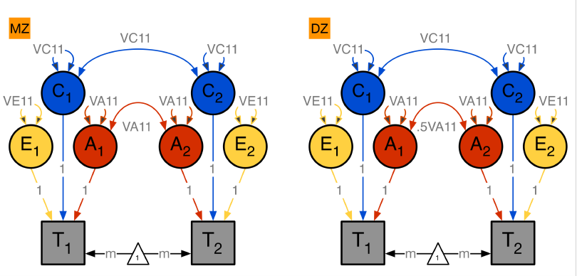
Today
MZ and DZ pairs – estimating A, C and E

Slide 7
MZ
A+C+E | A+C
A+C | A+C+E
covP <- mxAlgebra( expression= VA+VC+VE, name="V" )
covMZ <- mxAlgebra( expression= VA+VC, name="cMZ" )
expCovMZ <- mxAlgebra( expression= rbind( cbind(V, cMZ),
cbind(t(cMZ), V)),
name="expCovMZ" )
V | cMZ
cMZ | V

Slide 8
DZ
A+C+E | .5⊗A+C
.5⊗A+C | A+C+E
covP <- mxAlgebra( expression= VA+VC+VE, name="V" )
covDZ <- mxAlgebra( expression= 0.5%x%VA+VC, name="cDZ" )
expCovDZ <- mxAlgebra( expression= rbind( cbind(V, cDZ),
cbind(t(cDZ), V)),
name="expCovDZ" )
V | cDZ
cDZ | V

Slide 9
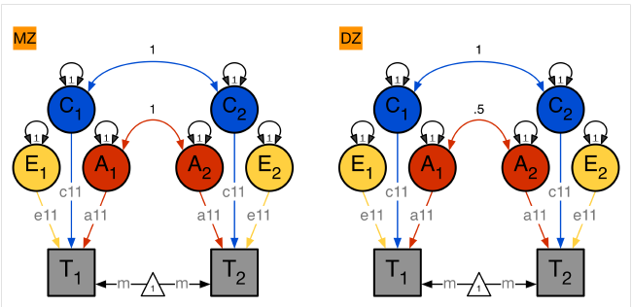
Change in approach

Slide 10
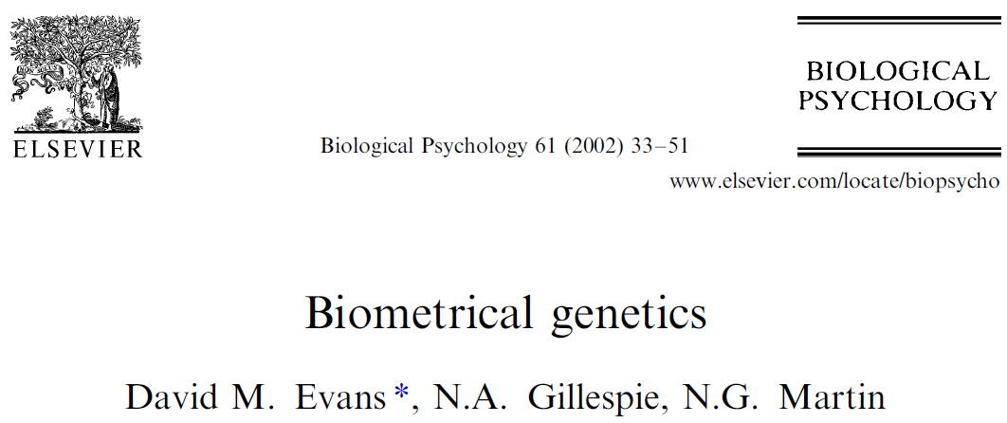
Two very useful papers in the ACE folder

Slide 11
Practical time
In R studio
system("cp -R /faculty/sarah/2024/ACE/* ./ ")
Qualtrics link is in ACE.txt
https://qimr.az1.qualtrics.com/jfe/form/SV_aXZTsTpDqACPQpM

Slide 12
Lets recap
The % variation in a trait attributable to genetic effects in a population.
The extent to which individual differences in genetics contribute to individual differences in observed behaviour in a large group of people
Heritability should be thought about deterministically at the individual level
These analyses don’t tell us what the genetic or environmental factors are.

Slide 13
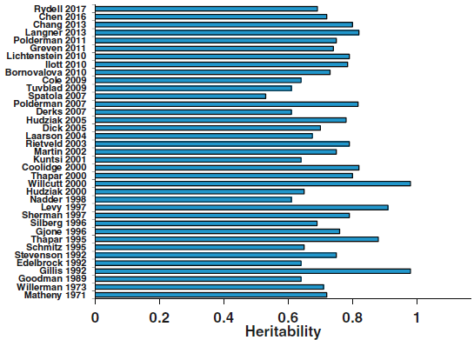
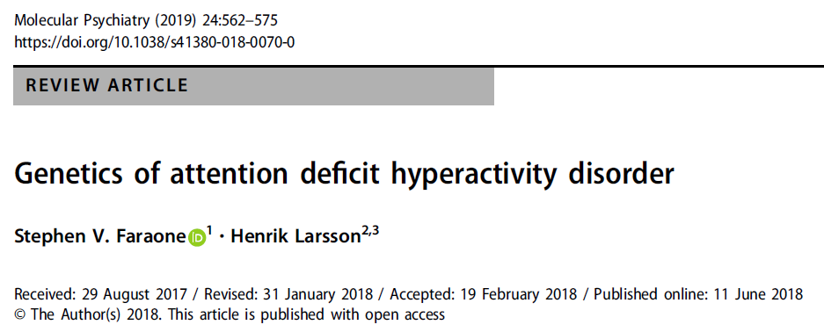
For example
About 75% of the variation in ADHD can be explained by genetic effects
Heritability of 75%

Slide 14
This does not mean…
That 75% of an individual’s behaviour is due to their genetics and the other 25% is due to their environment
Genetic control 3am-9pm. Environmental control 9pm-3am
That 75% of people have ADHD because of a genetic reason and 25% have ADHD because of an environmental reason
A child of someone with ADHD has a 75% chance of developing ADHD

Slide 15
Important to remember
Our results are estimates based on the data we’ve analysed
The won’t necessarily generalize
Across time or space

Slide 16
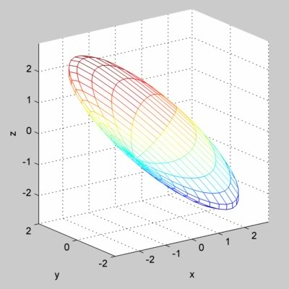
Thinking out side the box…
Rather than thinking about estimates as fixed points I like to think about parameter space…
Imagine an ACE/ADE model as a solution space bounded by CIs

Slide 17
Important to remember
“Remember that all models are wrong; the practical question is how wrong do they have to be to not be useful”
George E P Box and Norman R Draper. 1986. Empirical Model-Building and Response Surface. John Wiley & Sons, Inc., New York, NY, USA.

Slide 18
Important to remember
“Remember that all models are wrong; the practical question is how wrong do they have to be to not be useful”
George E P Box and Norman R Draper. 1986. Empirical Model-Building and Response Surface. John Wiley & Sons, Inc., New York, NY, USA.

Slide 19
Questions?

