Slide 1
Intro to Unix / R / computing
Please answer the survey before we start!
2024 Edition
8AM - Monday 4th March
José J. Morosoli
Elizabeth Prom-Wormley
with thanks to Sarah Medland
https://forms.office.com/e/ibLW7WNNec

Slide 2
Welcome!
https://forms.office.com/e/ibLW7WNNec
Getting the most out of the workshop:
Ask questions!
Try to sit next to someone you don’t already know.
Work with someone with different skillset and experience level.
You will have access to your files after you leave.
Come to the social functions.
Do ask questions!!
In person, email, or on the forum.
https://isgw-forum.colorado.edu/
https://isgw-forum.colorado.edu

Slide 3
A diverse community!
https://forms.office.com/e/ibLW7WNNec
José J. Morosoli
Diverse skillsets, backgrounds, research focus, experience levels… and timezones!
Be open, be kind, be respectful. We are all learners.

Slide 4
Survey results!

Slide 5
Getting started
https://workshop.colorado.edu/

Slide 6
Getting started
graphical user interface (GUI)
command-line interface (CLI)

Slide 7
Why Unix? Why?
It allows you to automate tasks.
Replicability: one script, multiple re-runs.
It is more efficient (i.e., fast), scalable and stable than other systems, not to mention open source (e.g., Windows, MacOS).
Big data (e.g., genetic data) is usually stored and analyzed in high-performance computing (HPCs) environments, which for multiple reasons (see above) are based on this language.

Slide 8
Getting started
Open the first exercise:
https://qualtrics.ucl.ac.uk/jfe/form/SV_0pHnuiW6juZ9ezs
Open the SSH tab and log in with your username.

Slide 9
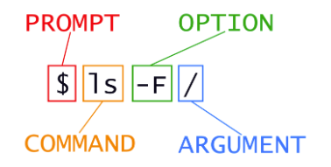
Intro to Unix: Glossary
Graphical User Interface (GUI): platform to interact with a computer that involves point and clicking and using menus.
Command Line Interface (CLI): text-based platform where you can input text commands to interact with a computer.
Unix: an operative system (just like Windows or MacOS).
Shell: program where users can type commands.
Bash: most popular shell in Unix.
Prompt: symbol that indicates that the shell is waiting for input.
Command: Pre-defined “words” that tell the system what to do, they can be modified using options and sometimes require arguments to indicate what files to operate on, the paths to find them, etc.

Slide 10
Setting up our home directory
!
/
Note:
We need to include “ / ” in the path whenever we want to give Unix the full path to the file or directory we are interacting with or using.
bin
data
home
tmp
[your-username]
Files: store information.
Directories: hold files or other directories.
File system: part of the operating system responsible for managing files and directories
2024
Day-1
File 1
File 2
File 3
/home/[user]/2024/Day-1/Unix-R
Unix-R

Slide 11
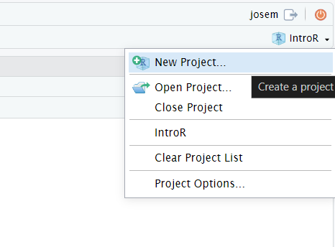
Next stop: R
Go to the next Qualtrics link:
https://qualtrics.ucl.ac.uk/jfe/form/SV_6FGfSGwaABJQo1E
Create a R project:
Creates/finds a working directory for you.
Remembers its location.
Makes it easier to resume work after a break.
Click on IntroToR2024.R to open it.
Directory: ~/2024/Day-1/Unix-R

Slide 12
Similarities between Unix and R
Unix and R offer command-line interfaces.
Both support scripting for automation.
Active communities and extensive package.
Open-source.
Customizable.
Similar commands but not the same!
E.g., pwd vs getwd()
DeepAI (b. 2016)
Unix r programming languages are friends, 2024
Digital work

Slide 13
Important tabs:
Reminds you of prior code you used.
Record of objects you have created.
Text Editor:
Where you write and save your scripts.
Important tabs:
File explorer.
Graphs you produce.
Packages you have stored.
Help files.
Console: similar to your Unix shell.
Keeps log, you can type commands directly.
Can be cleared using Ctrl+L.

Slide 14
Resources
Software carpentry: https://software-carpentry.org/lessons/index.html
https://stackoverflow.com/ and https://unix.stackexchange.com/
UNIX cheatsheet in /home/josem/2024/Day-1/Unix-R.
Specific resources for R:
R for SAS and SPSS Users: https://science.nature.nps.gov/im/datamgmt/statistics/R/documents/R_for_SAS_SPSS_users.pdf
An R Style Guide: http://google-styleguide.googlecode.com/svn/trunk/Rguide.xml
Rseek: A search engine for all things R related (http://www.rseek.org)
R-Bloggers.
Quick-R's section on graphics: http://www.statmethods.net/advgraphs/parameters.html
More information on data frames: http://www.r-bloggers.com/exploratory-data-analysis-useful-r-functions-for-exploring-a-data-frame.
Details on how to develop your own package: http://r-pkgs.had.co.nz

Slide 15
R Code – Best practices
https://www.r-bloggers.com/2018/09/r-code-best-practices/
https://www.library.ucsb.edu/sites/default/files/dls-n01-2021-filenaming.pdf

