Slide 1
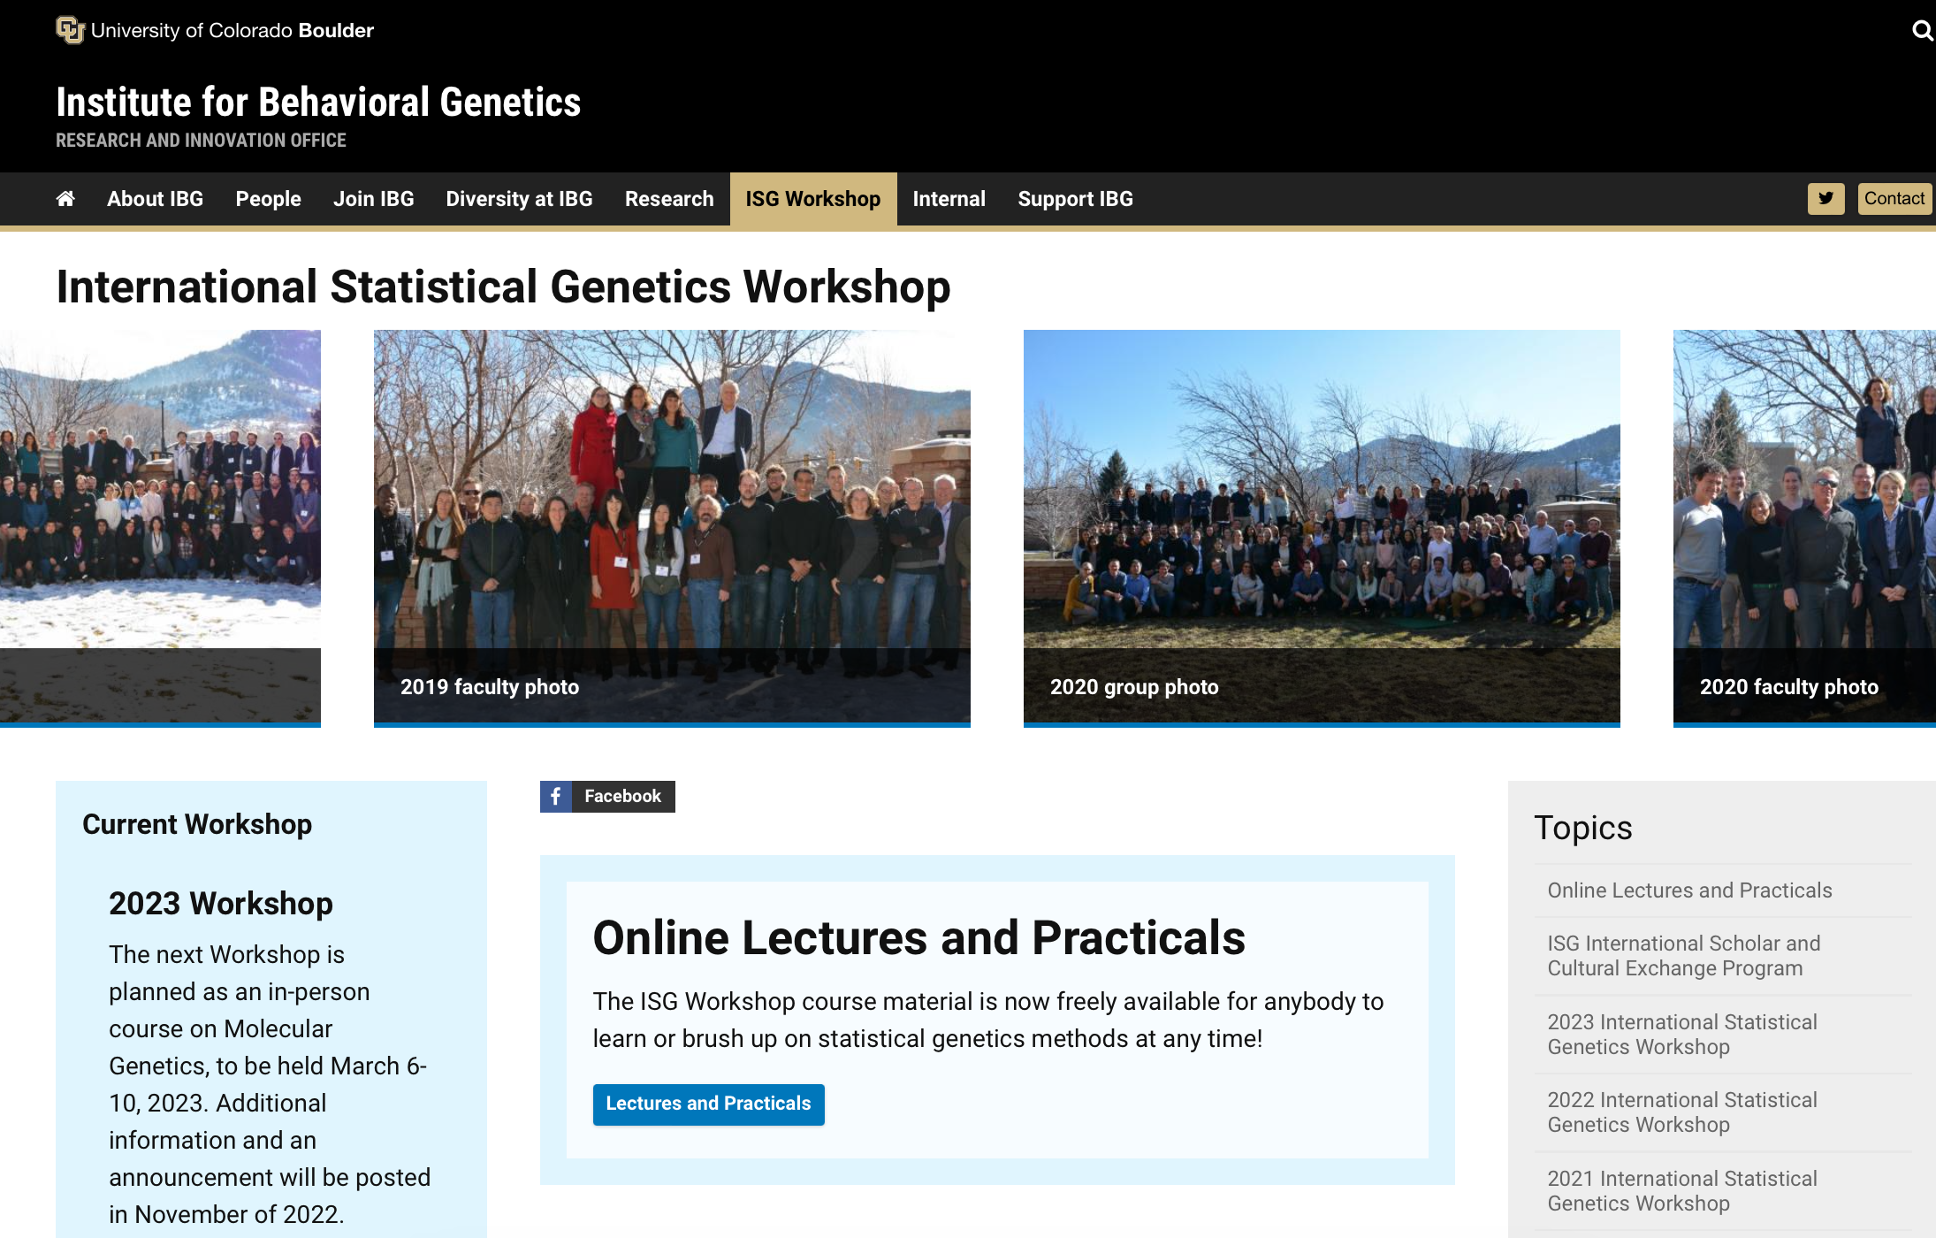
ISG 2023 Lightning Rounds

Slide 2
Talks
3:35 Nick: Depression and Genetics of non-identical (DZ) twinning
3:42 Dorret: Multi-omics of MZ twinning
3:49 Loic: Reconciling linkage and association studies of height using 107,000 sibling pairs
3:56 Tim: Standardizing scalable representations and formats for the era of million-sample sequencing datasets
4:03 Liz: Including the wisdom of community and participant voices in genetically informative research: A Richmond story
4:10 Rohan: Applications of statistical genetics to substance use disorders & related behaviors
4:17 Sarah: The Equinox Conference
4:24 Abdel: Behavior <-> Genetics
4:31 Brittany Dissecting heterogeneity in depression
4:38 Mike: Detecting latent variable interactions
4:45 Matt: Behavioral genetics in the molecular age

Slide 3
Nick Martin

Slide 4
Two intriguing questions
Why is depression prevalence 20% in females and 10% in males? (similar inequalities in almost every other complex trait)

Slide 5
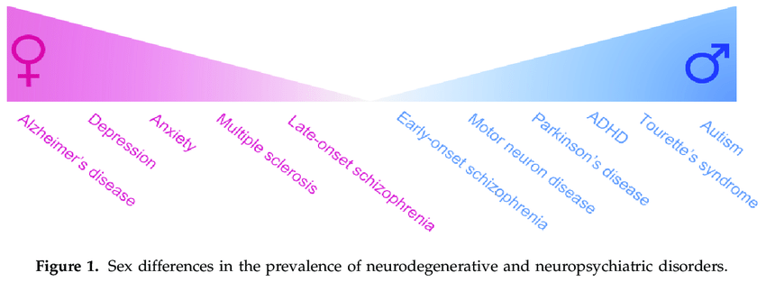
Also applies to continuous traits e.g. height

Slide 6
How well does the MDD GWAS predict Depression caseness (DSM5)?
Prediction from PGC (Howard minus Oz, using SBayesR) into AGDS +QSkin
genetic correlation between the sexes not significantly different from one
(rGmf= 0.90 s.e. 0.06; p = 0.096) ##
##

Slide 7
Some ideas
Measurement invariance for the 9 MDD symptoms – do they have the same salience in females and males, early onset/ late onset? (Dorret)
Need completely separate GWAS for females and males
  Use sex- specific recombination map? (Sarah M)
  Are betas the same in females and males? – test for SNP x sex interaction
  Cross prediction into the other sex
Is the sex prevalence difference confined to the reproductive years ? Interaction with sex hormone PRS

Slide 8
Two intriguing questions
(2) Genetics of [spontaneous] nonidentical (DZ) twinning:
why is frequency 20/1000 births in Africa and 2/1000 in east Asia – 10 fold difference!
[8/1000 in europeans]

Slide 9
New GWAS meta-analysis hits for DZ twinning – 8265 MoDZT cases, 264k controls

Slide 10
Frequency of GNRH1 SNP in world populations
note for G allele Africans>Europeans>East Asians
GNRH1
This SNP goes in the expected direction of ancestry frequencies in DZT - but others do not
Need to integrate across all significant DZT SNPs
See if we can explain Africans 20/k > europ 8/k > E Asians 2/k

Slide 11
The correlation between population twinning rates from 47 non-European
populations and predicted DZT PRS for each population based on European effect sizes of the 26 top SNPs
European PRS gives poor prediction of twinning rate in other ancestries. We need GWAS in Asia and Africa!
David Duffy

Slide 12
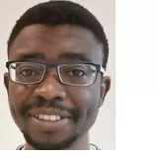
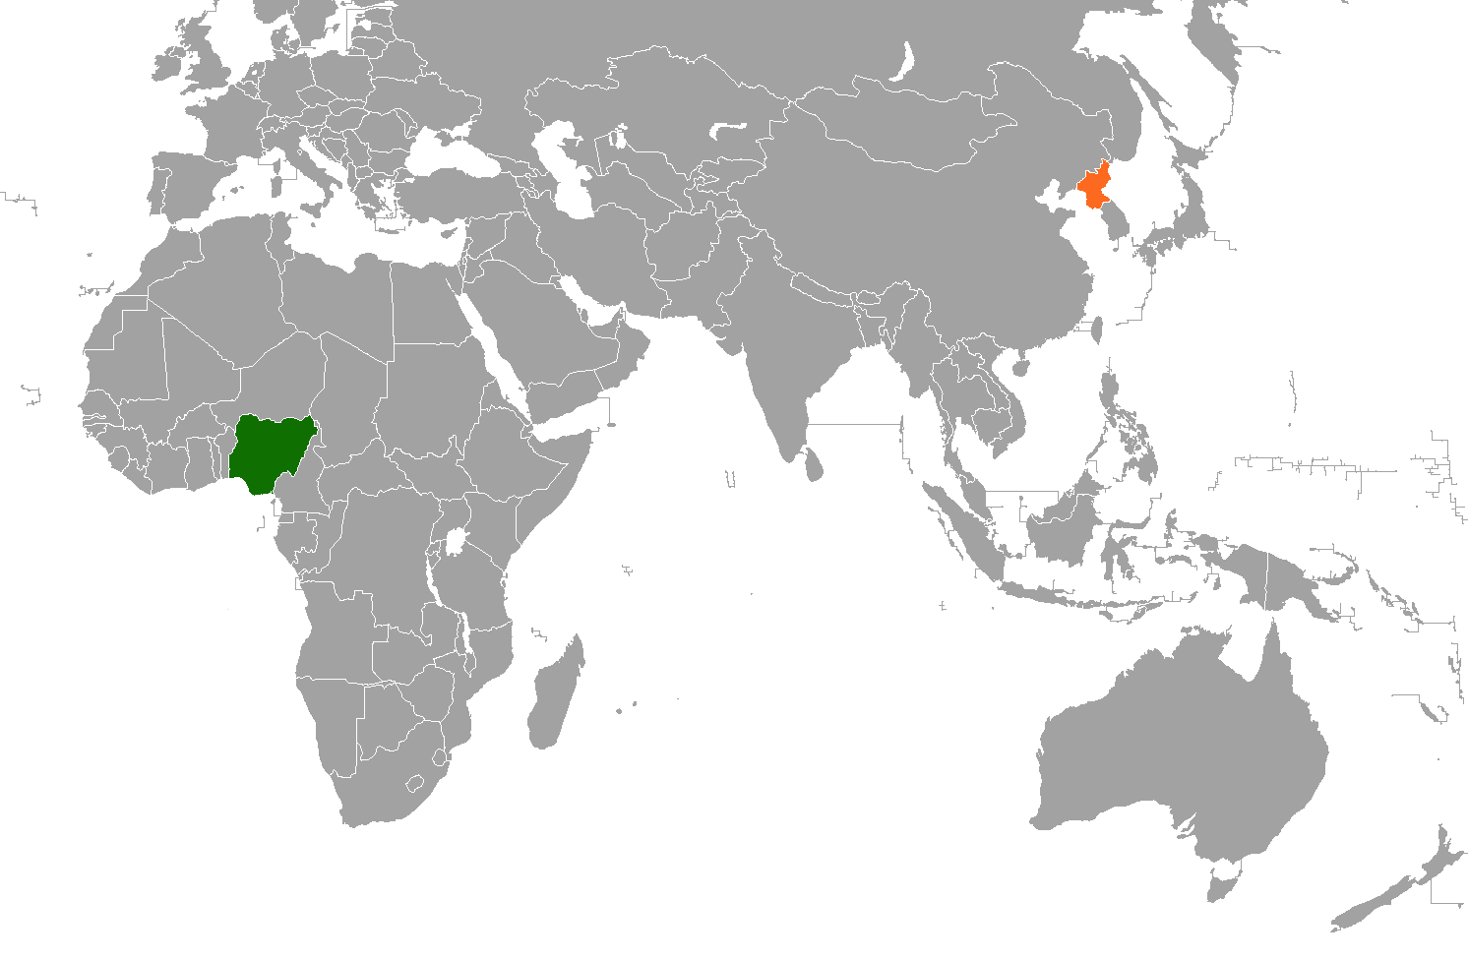
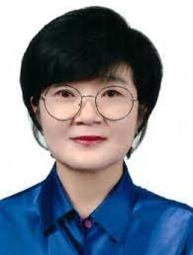
Plan to collect 1000 MoDZT and 1000 controls each in Korea and Nigeria
Olakunle Oginni
Korea
2/1000 DZT
Nigeria
20/1000 DZT
Yoon-Mi Hur

Slide 13
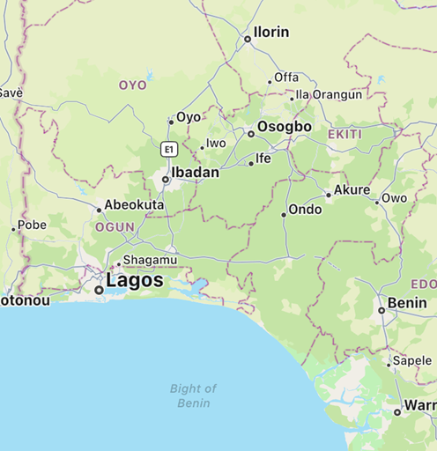
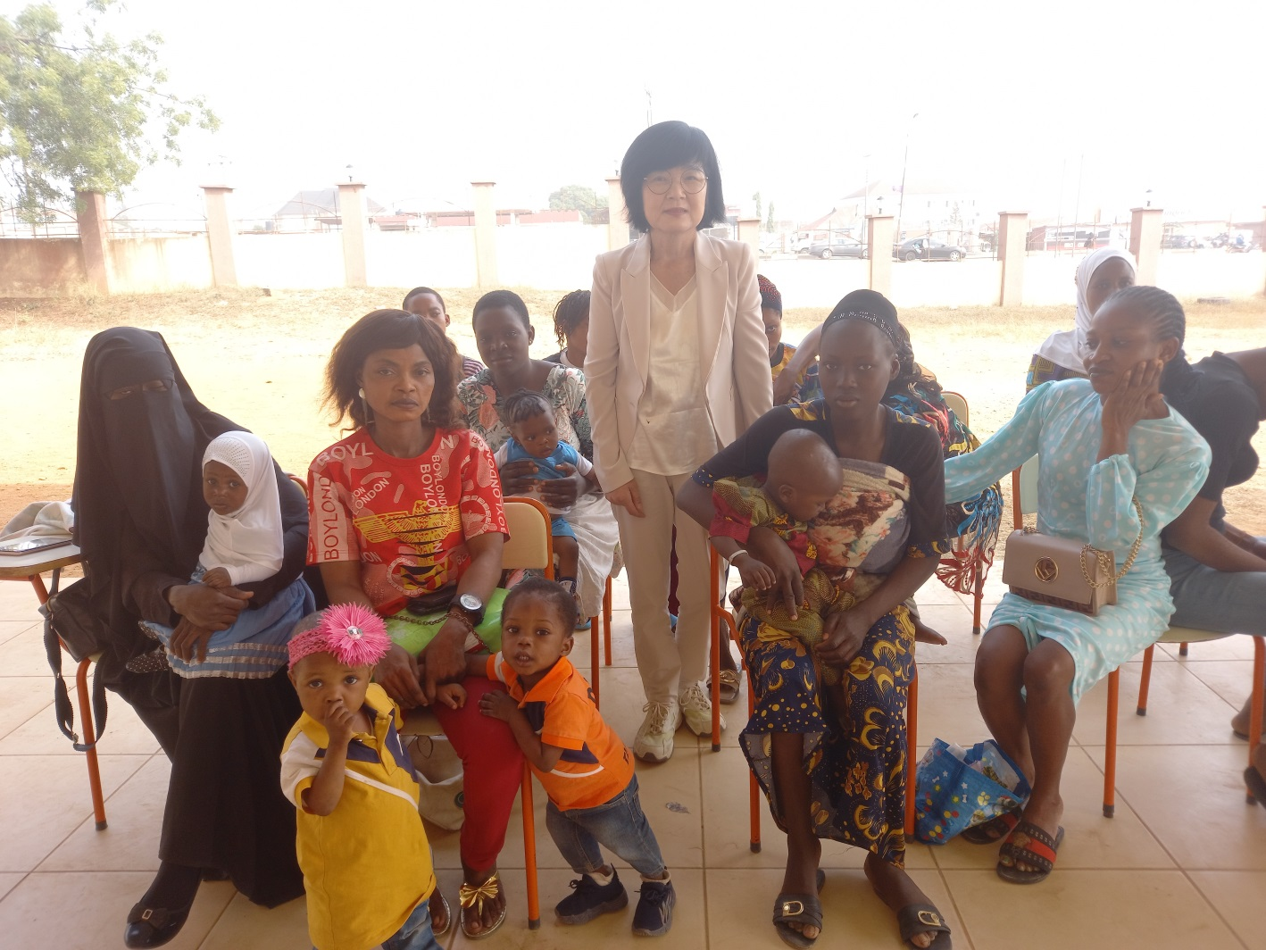
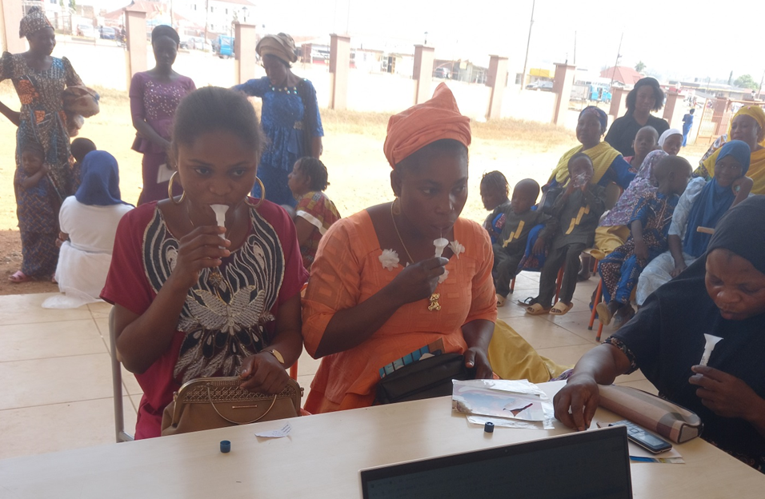
Collecting saliva samples from MoDZTs in Osogbo grammar school

Slide 14
Dorret Boomsma

Slide 15

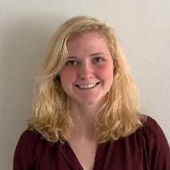



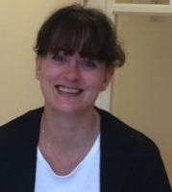
Multi-omics of twinning
BIObanks Netherlands Internet Collaboration (BBMRI-BIONIC) -> MDD
Open Data Infrastructure for Social Science and Economic Innovations (ODISSEI)
Longitudinal and Multi-omics of aggression /adhd
Microchimerism

Slide 16
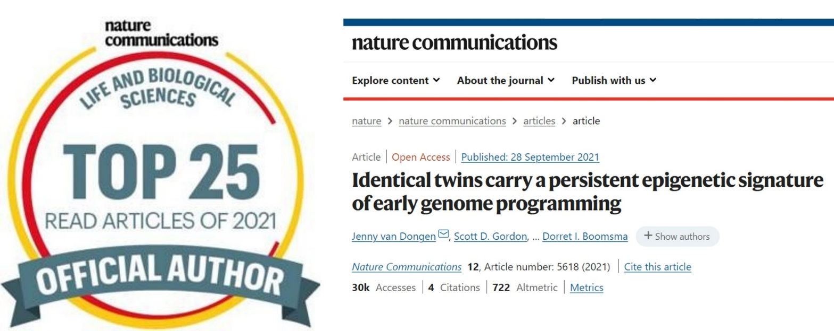
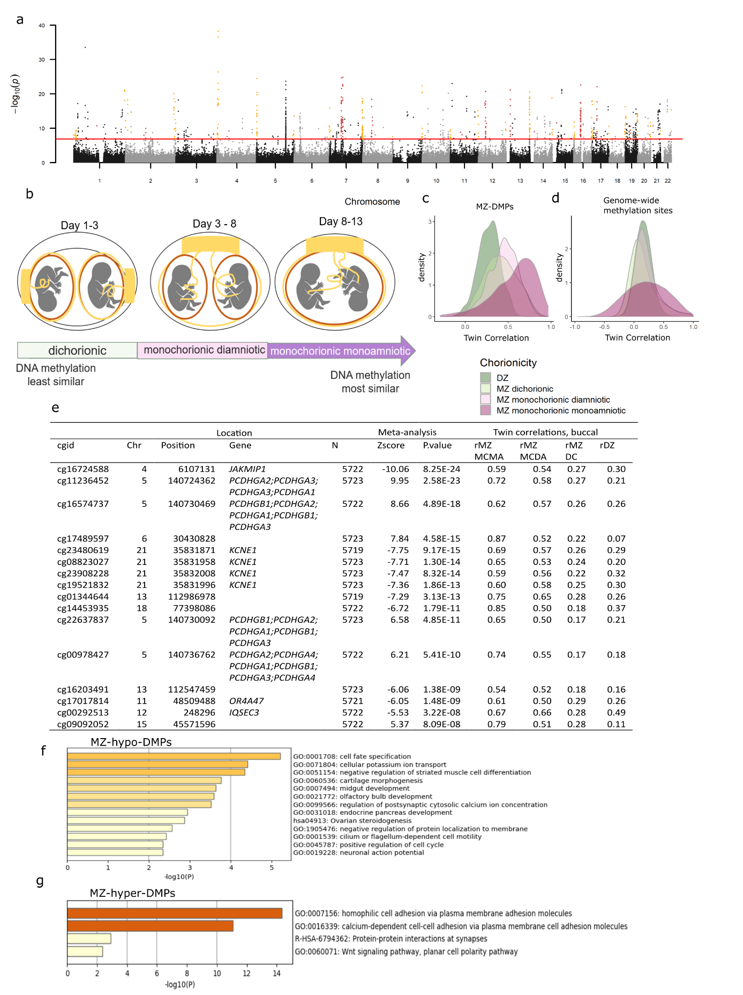
MZ twinning and differential DNA methylation
Hypomethylation near telomeres Hypermethylation near centromeres

Slide 17
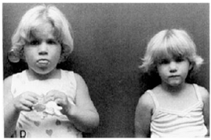
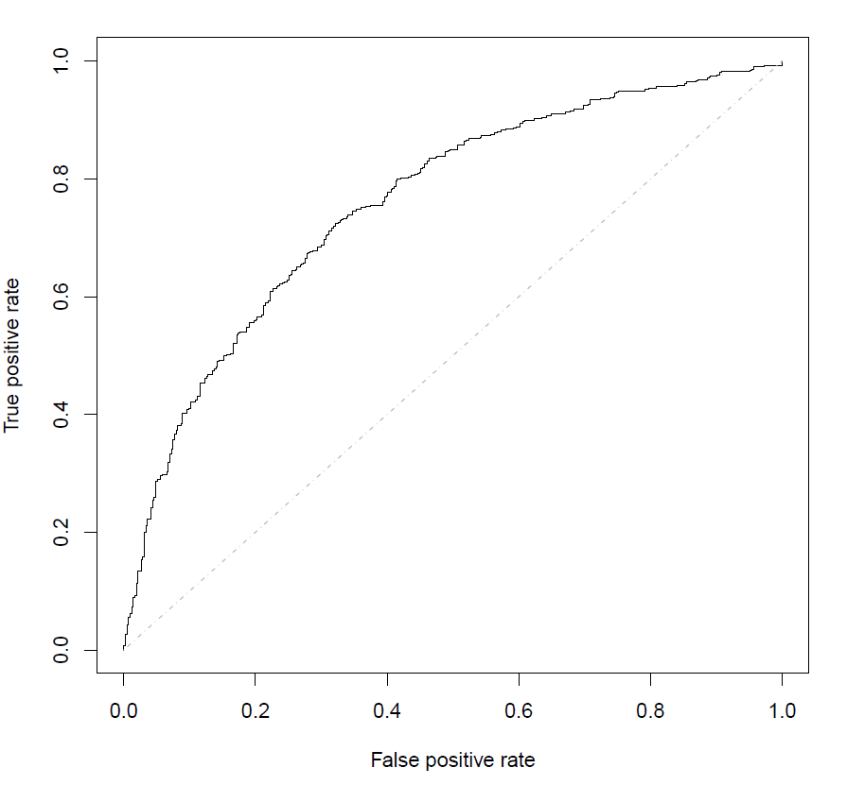
First molecular evidence for a signature for MZ twinning in humans
A signature of MZ twinning event that persists, through many rounds of mitosis, to adult somatic tissues.
Tool to examine link between MZ twinning and congenital disorders (e.g. imprinting disorders, Amyoplasia).
Cause effect, or byproduct?
New possibilities to examine vanishing twin syndrome
Beckwith-Wiedemann Syndrome
AUC~ 0.80
Diagnosis of MZ twinning using an epigenetic predictor

Slide 18
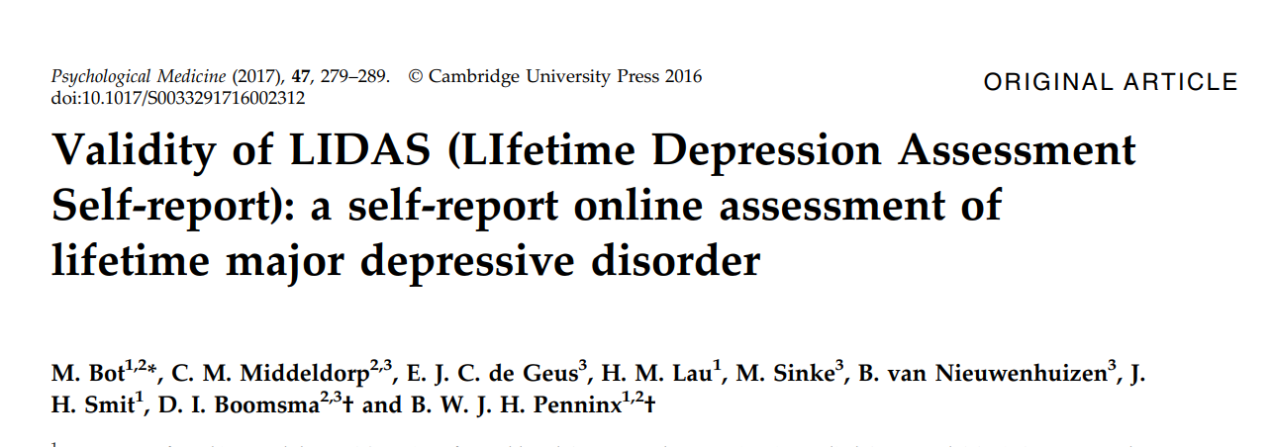


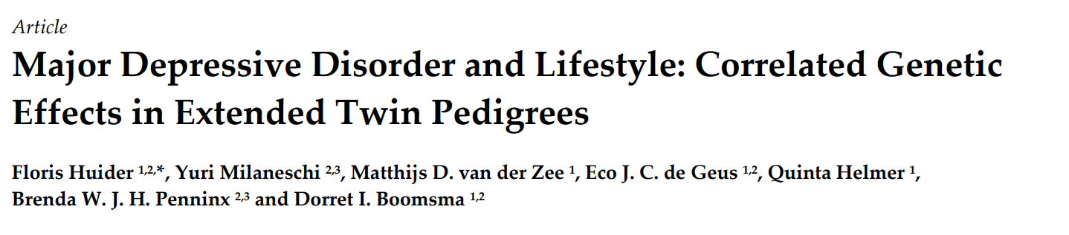
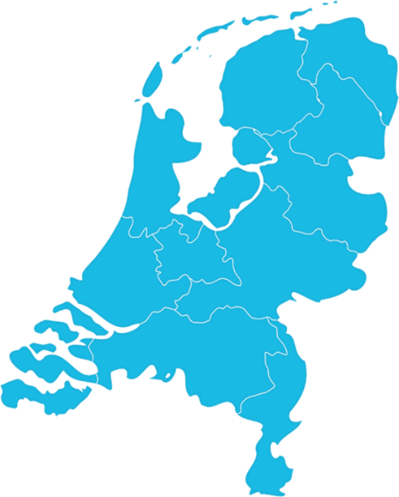





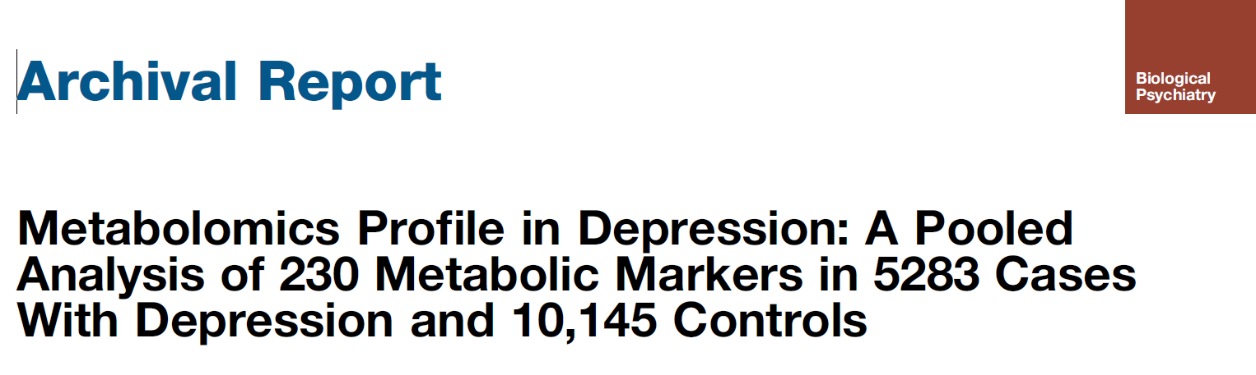




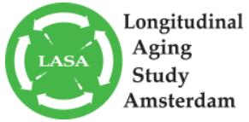

NESDAsib
BIObanks Netherlands Internet Collaboration (BIONIC)
Goal: characterize the genetics of depression in the Netherlands.
13 Dutch cohorts, depression and genotype data at a central location.
Phenotype data N = 100,000 / genotype data N = 70,000
Collaboration with UK and Australia

Slide 19
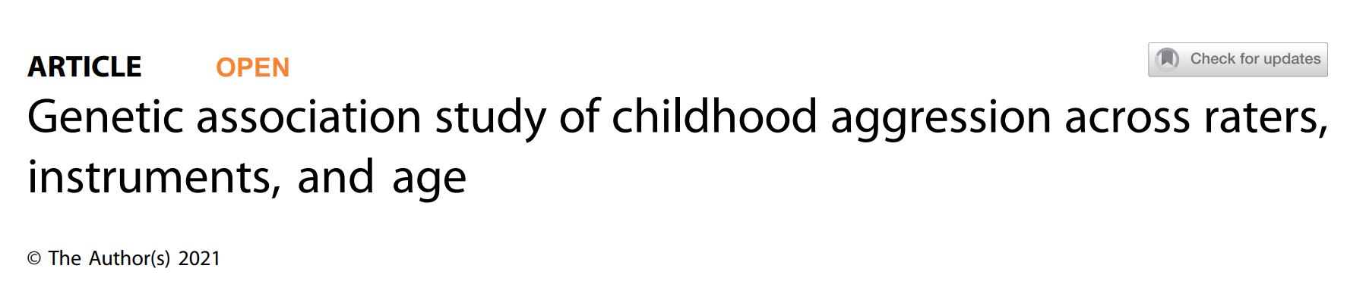
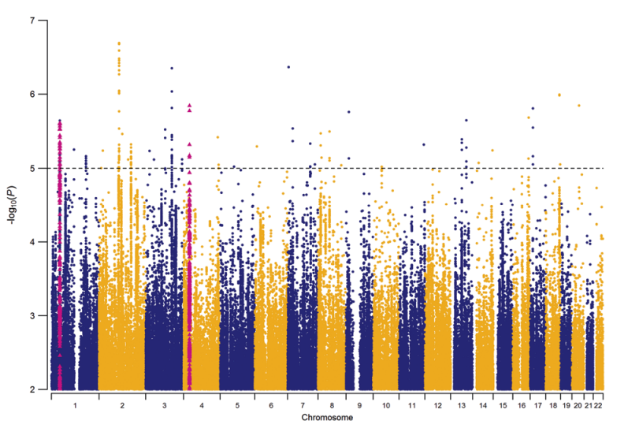
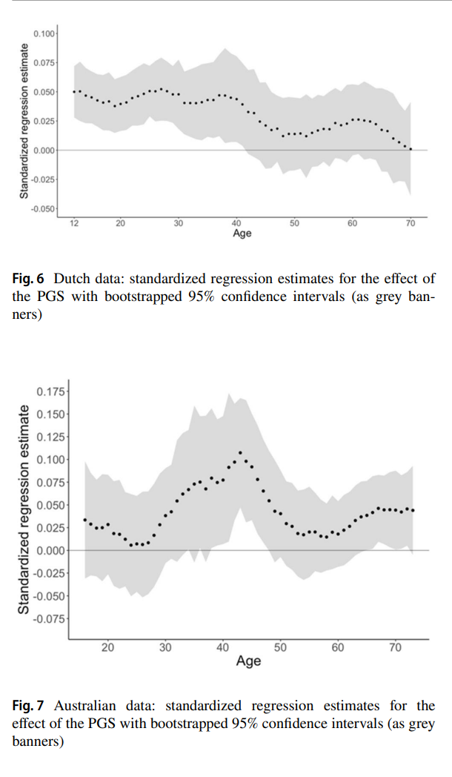
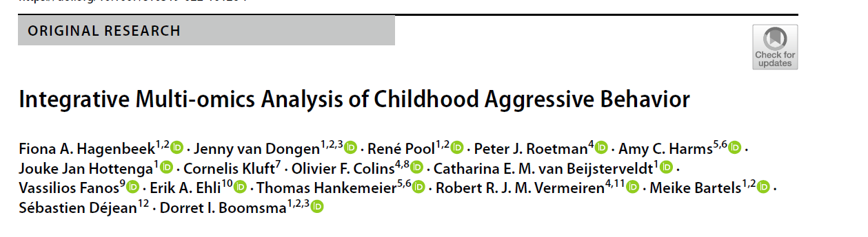
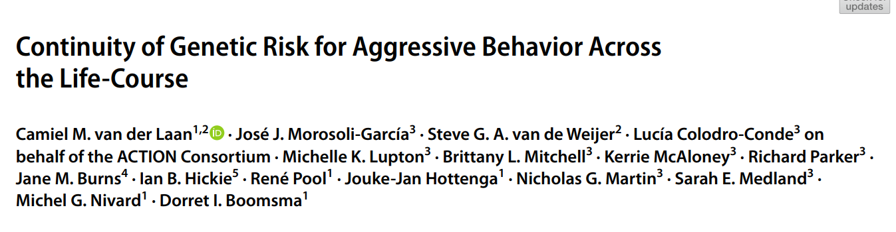
Ip et al. Trans. Psychiatry, 2021
OSFPreprints: https://osf.io/rne4s/
Maximizing the Value of Twin Studies in Health and Behaviour
Hagenbeek, Hirzinger, Breunig, Bruins, Kuznetsov, Schut, Odintsova, Boomsma

Slide 20
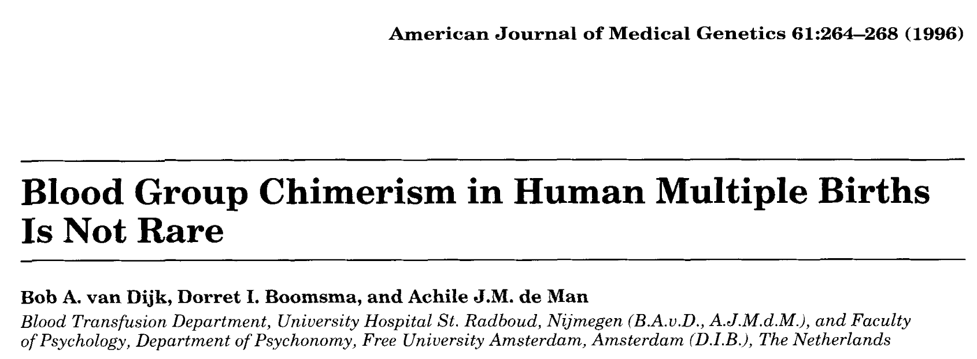
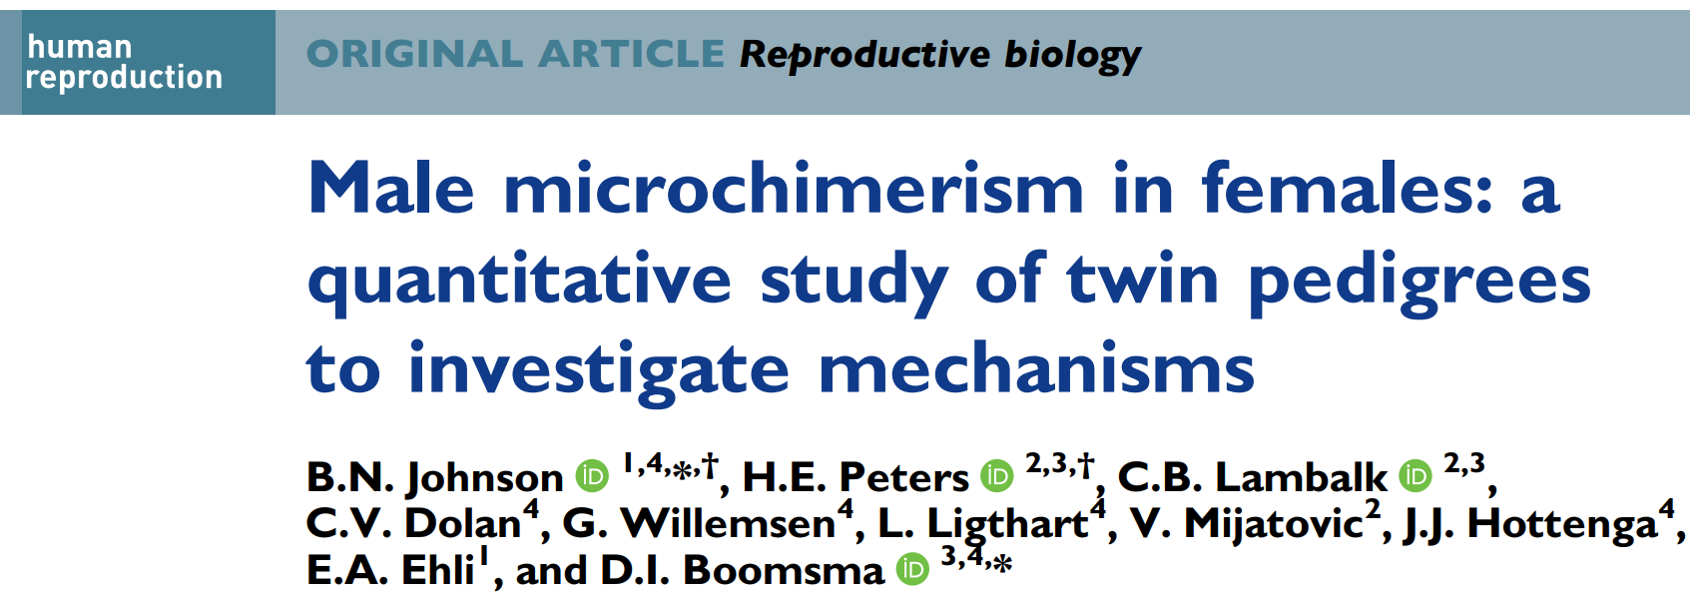
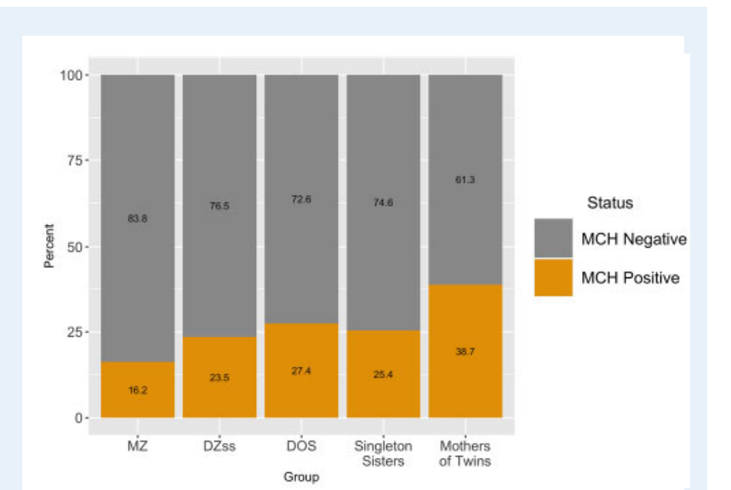
8% prevalence of blood group chimerism in 552 dizygotic twin pairs and 24 triplet sets for multiple red cell blood group antigens.
26.9% of women have having detectable male microchimerism in their peripheral blood samples
Prevalence of male microchimerism in women does not differ between MZ, DZ same-sex and DZ opposite-sex twins, sisters, mothers of twins.
(qPCR data for male genome equivalents by measure of DYS14 and b-globin targets)

Slide 21
Loic Yengo

Slide 22
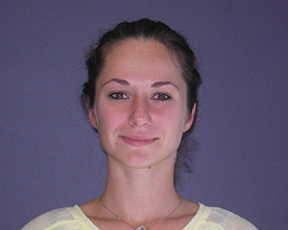

Reconciling linkage and Association Studies of height using 107,000 sibling pairs
Julia Sidorenko et al. (unpublished)
Peter Visscher
Loic Yengo, UQ

Slide 23
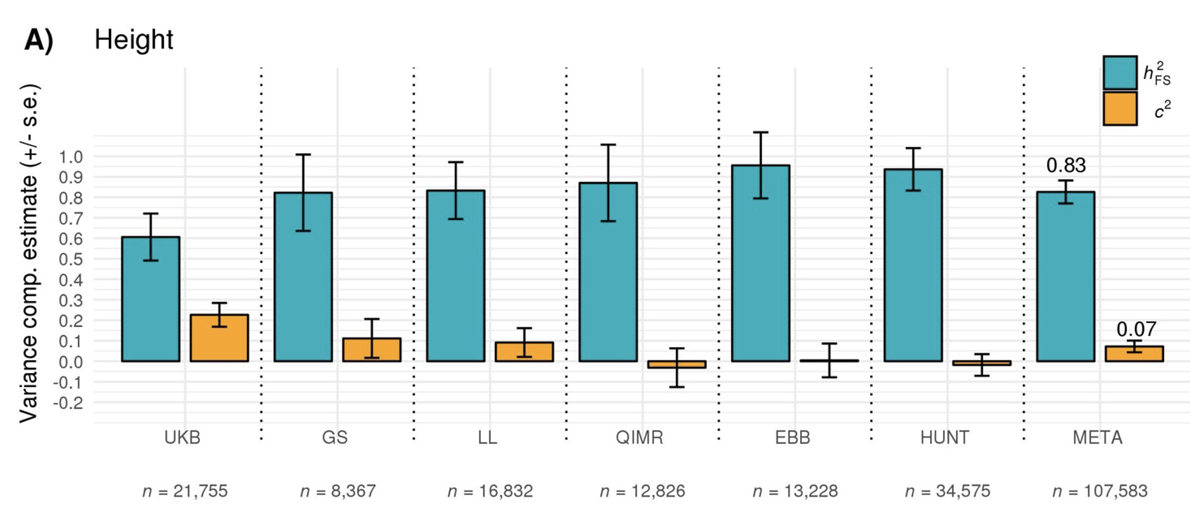
A “clean” estimate of h² for height
h² estimate are similar to pedigree-based between-families estimates

Slide 24
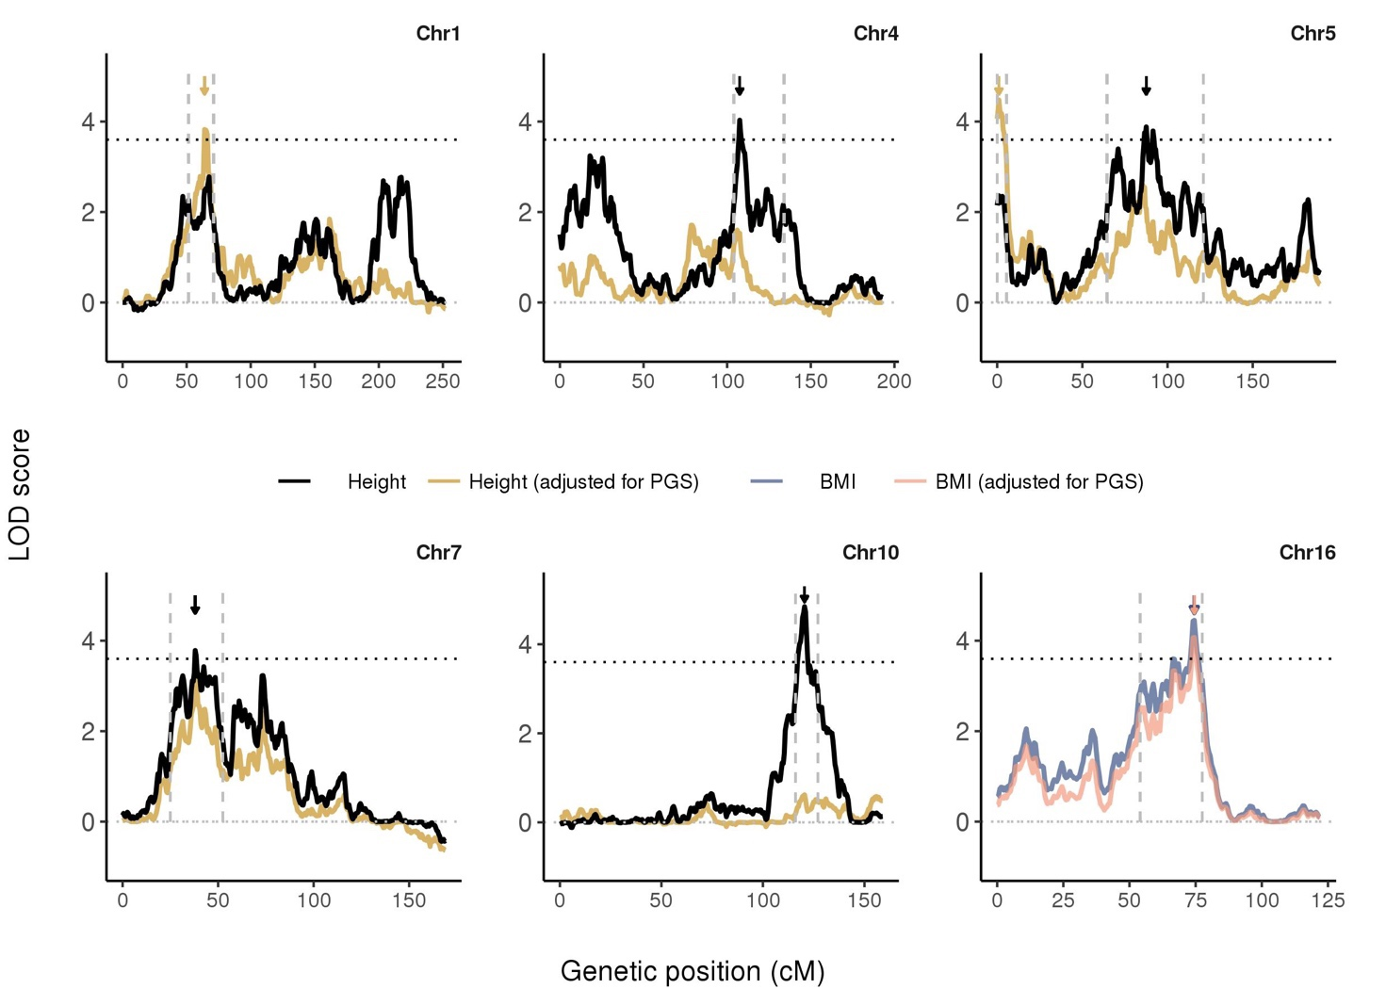
Linkage Peaks disappear fitting PGS
Peaks drop when fitting PGS
Detect new peaks too!

Slide 25
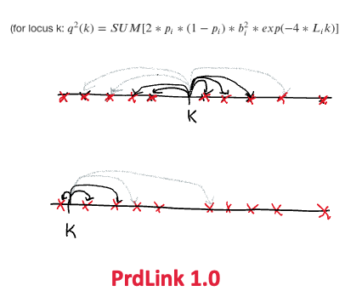
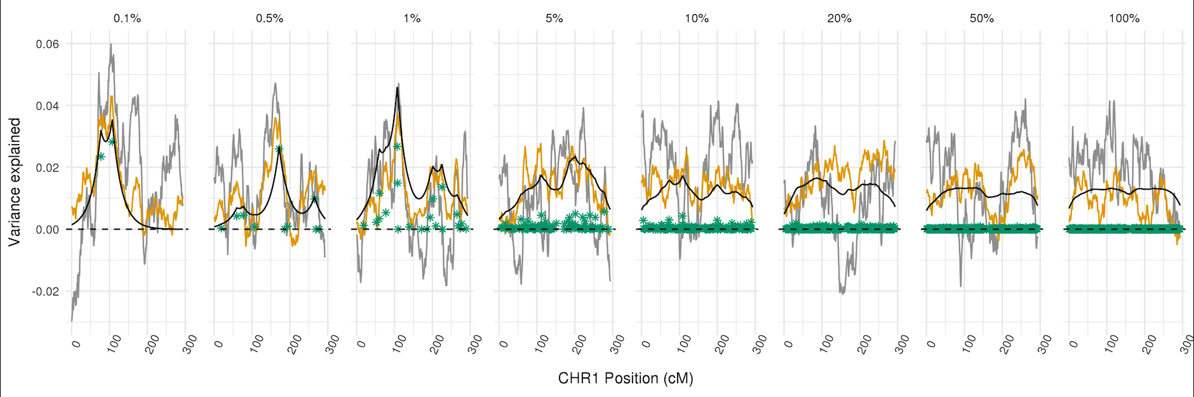
Measuring Colocalization of GWAS and linkage signals
Dekkers & Dentine (1991)

Slide 26
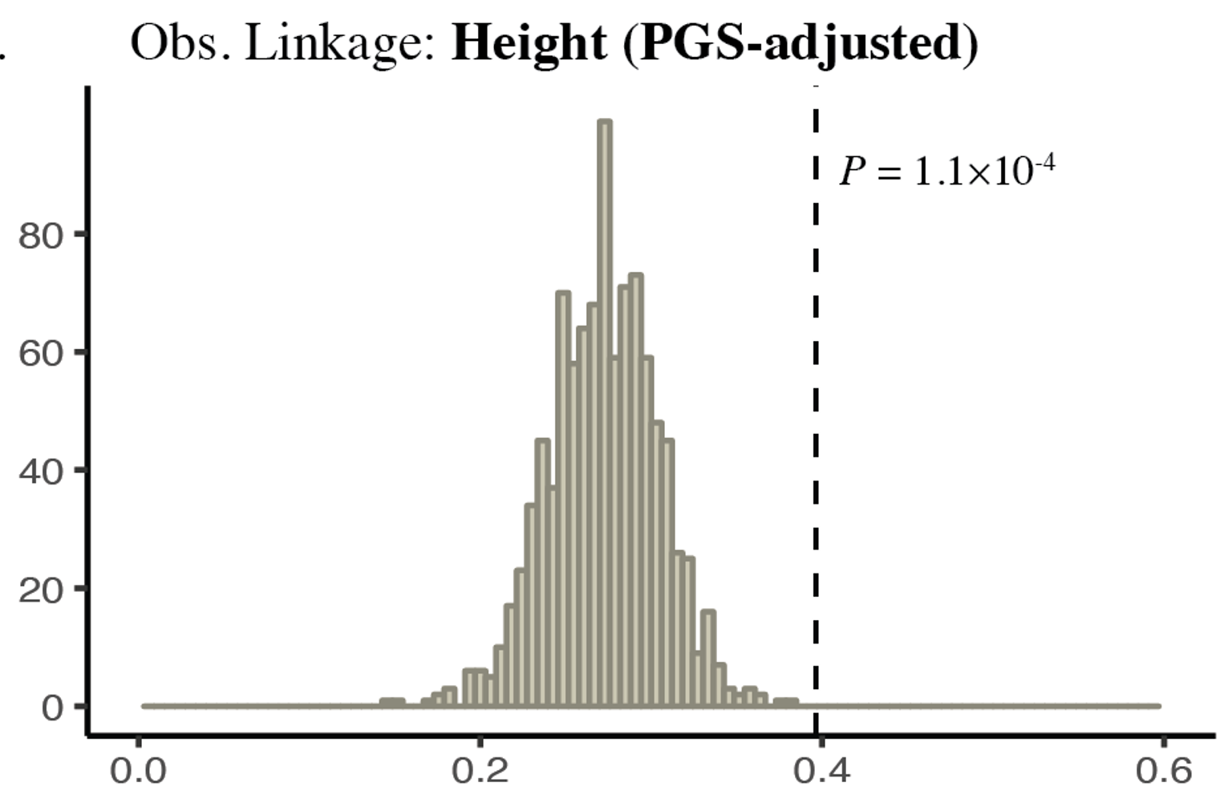
Still-missing heritability colocalizes with GWAS hits

Slide 27
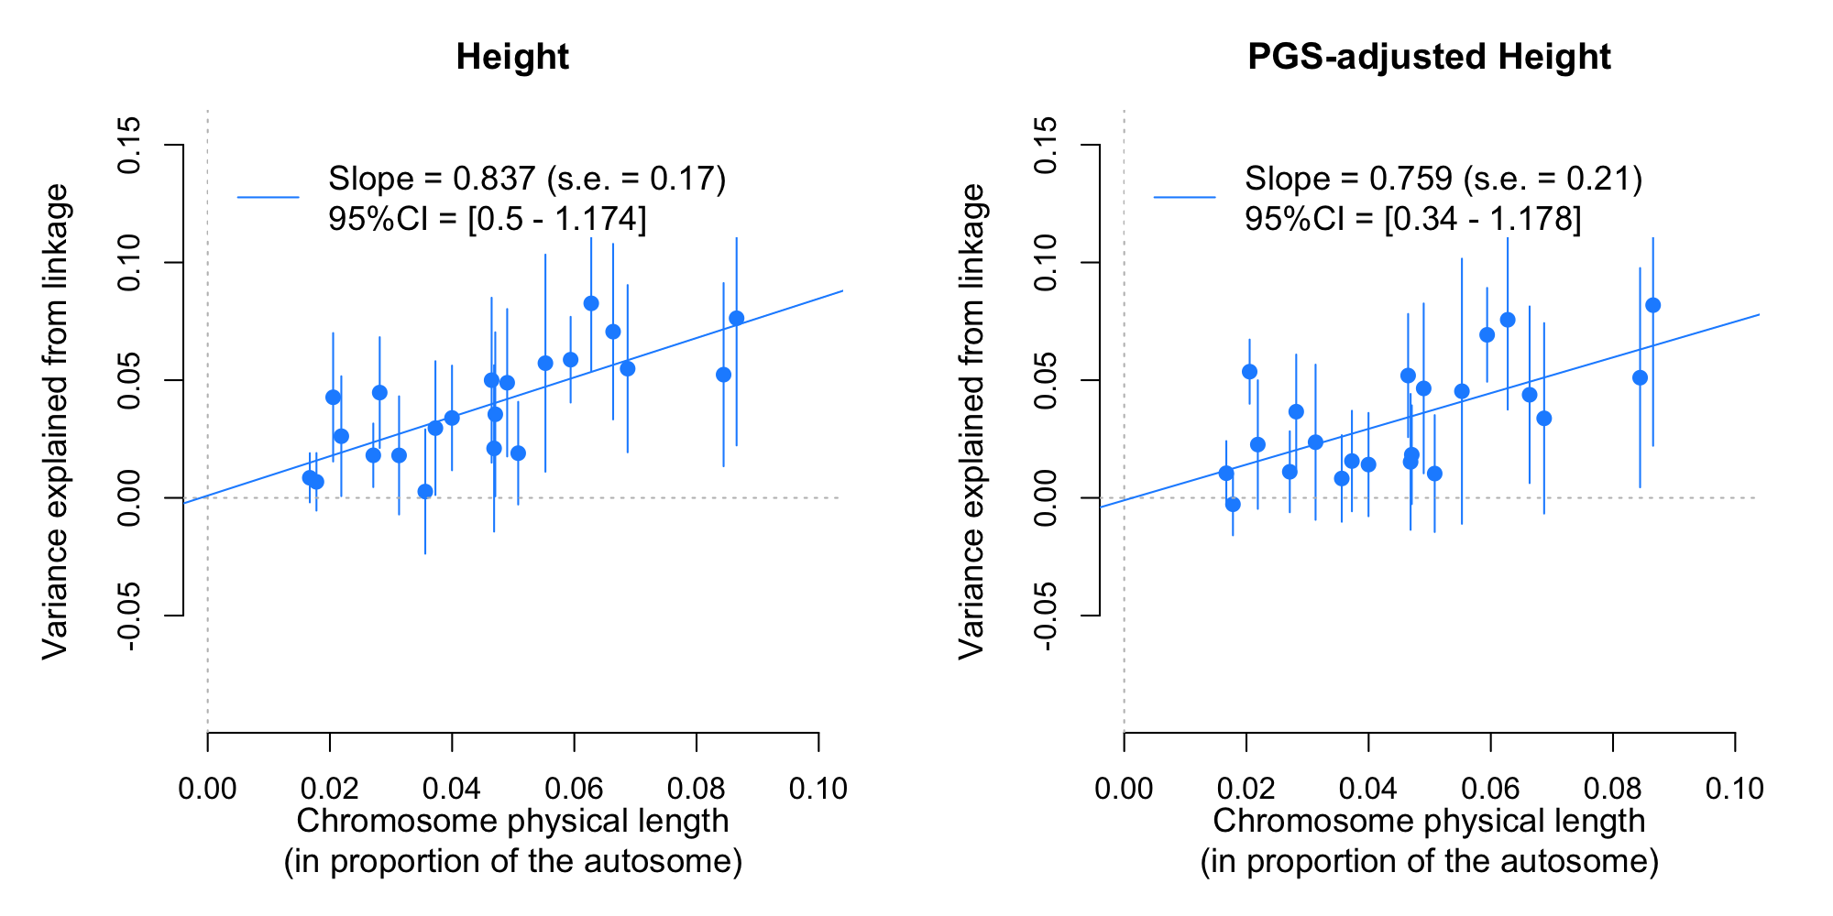
Still-missing heritability is polygenic

Slide 28
Tim Poterba

Slide 29
Standardizing scalable representations and formats for the era of million-sample sequencing datasets
Tim Poterba
Neale Lab, Broad Institute

Slide 30
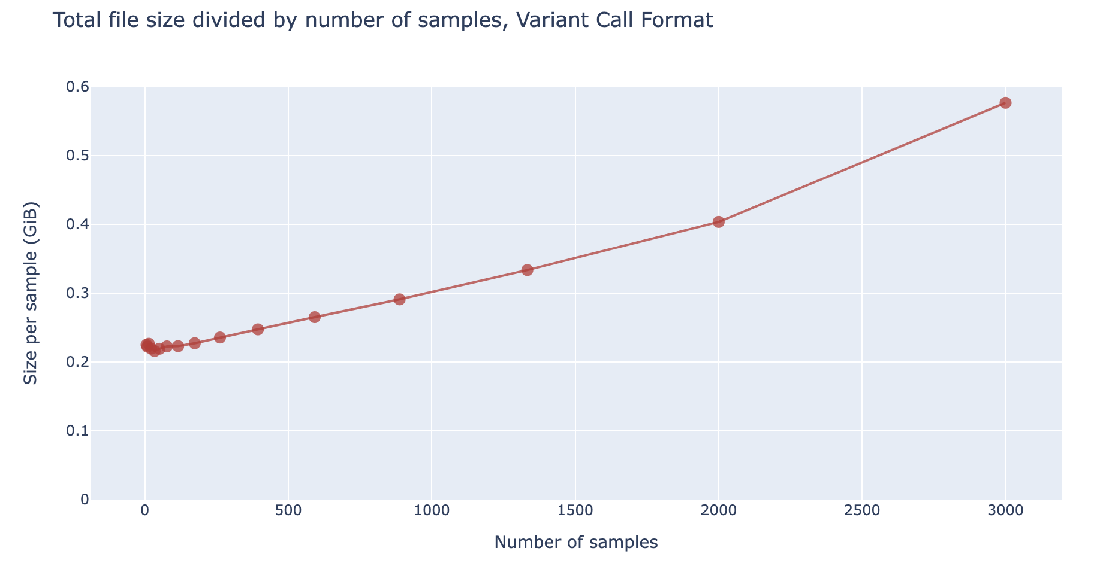
Variant Call Format (VCF) - ubiquitous format for sequenced cohorts
The problem – VCF grows super-linearly in the number of samples, even though the amount of information grows linearly!

Slide 31
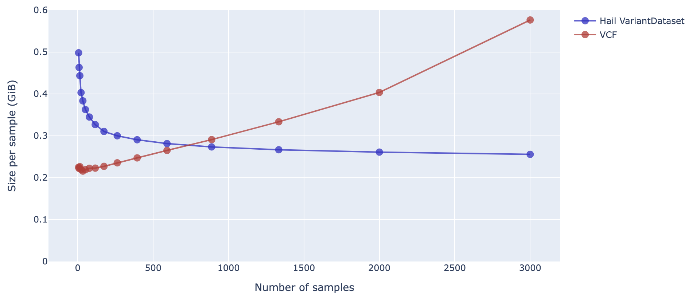
VariantDataset (VDS) - a data model that (+) scales linearly, (+) is losslessly mergeable, (+) can be merged!
How do we standardize a better representation?

Slide 32
Elizabeth Prom-Wormley

Slide 33
Including the Wisdom of Community and Participant Voices in Genetically Informative Research:
A Richmond Story
Elizabeth Prom-Wormley MPH, PhD
Hermine Maes, PhD
Virginia Commonwealth University

Slide 34
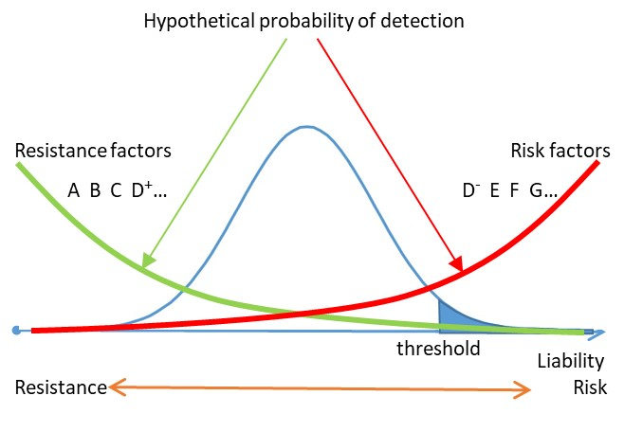
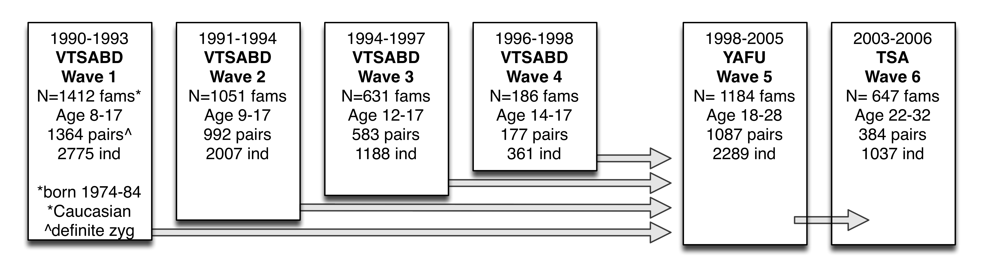
Virginia Twin Study of Adolescent Behavioral Development + The Resist! Project
Data Collection
Mixed Methods Approach to establish
an index of resistance factors (~120 twins)
Secondary Data Analysis
Analyze collected variables to assess low- end of liability to substance use (resistance)
Assess substance use trajectories of liability groups
Conduct data mining of environmental factors to identify most important for resistance
Wave 7 Data Collection of VTSABD Twins
Resistance factors index*
Substance use behaviors, other behaviors

Slide 35
Why Do You Focus on Our Deficits?
2014
2020
East End Residents
Alexis Edwards, PhD
Amy Popovich
Aquanetta Scott
Brandon Wormley
Brenda Kenney
Brittany McDermott
Cheryl Groce-Wright
Cynthia Newbille
Danita Gregory
De’Nisha Wilson
Dyanne Broidy
Faisal Ilyas
Gwen Corleigh Creighton
Helen Frye
Joanne Towles
Joseph Real
Katherine Crawford
Laleta Fritz
Michelle Wagner
Naomi Davis
Natalie Bareis
Patricia Willaford
Rhonda Perry-Acholes
Richard Seely
Shikitia Taylor
Stephanie Carrington
Tony Cornelious
Team RIA
Dr. Omobukola
Usidame
Courtney Blondino
James Clifford
VCU Office of Community Engagement
Richmond Memorial Health Foundation
Engaging Richmond
Richmond Promise Neighborhoods-Community Action Network
7th District Health and Wellness Initiative
Richmond Health and Wellness Program
Peter Paul Community Action Network
Richmond City Health District- Stephanie Carrington, Ivy Bell, Catherine Long
Planned Parenthood- LaNeda Wright
Faith Covenant Christian Fellowship Church- Justin Parkinson
Richmond City Public Schools, Office of Engagement
Darryl Williams, Erin Brown
VCU Health Hub at 25th- Natalie Pennywell, KJ Ricasata
5th Street Baptist Church
Church Hill Association
Neighborhood Resource Center
Survey Subcommittee
Candice Turner, Chanel Bea, Chimere Miles, Kim Young, Sherika Gillison-Chew
Team RIA (Research Inspiring Action)
Courtney Blondino, Kia Miles, Mariam Sankoh, Angela Liu, Syreen Goulamine, Anna Lee, Nora Mulroy, Jim Clifford, Brandon Wormley, Edith Prom, Trenece Wilson, Brittini Myrick, Alyson Vanlandingham, Heather Liffert, Maya Tucker, and the undergrad army

Slide 36
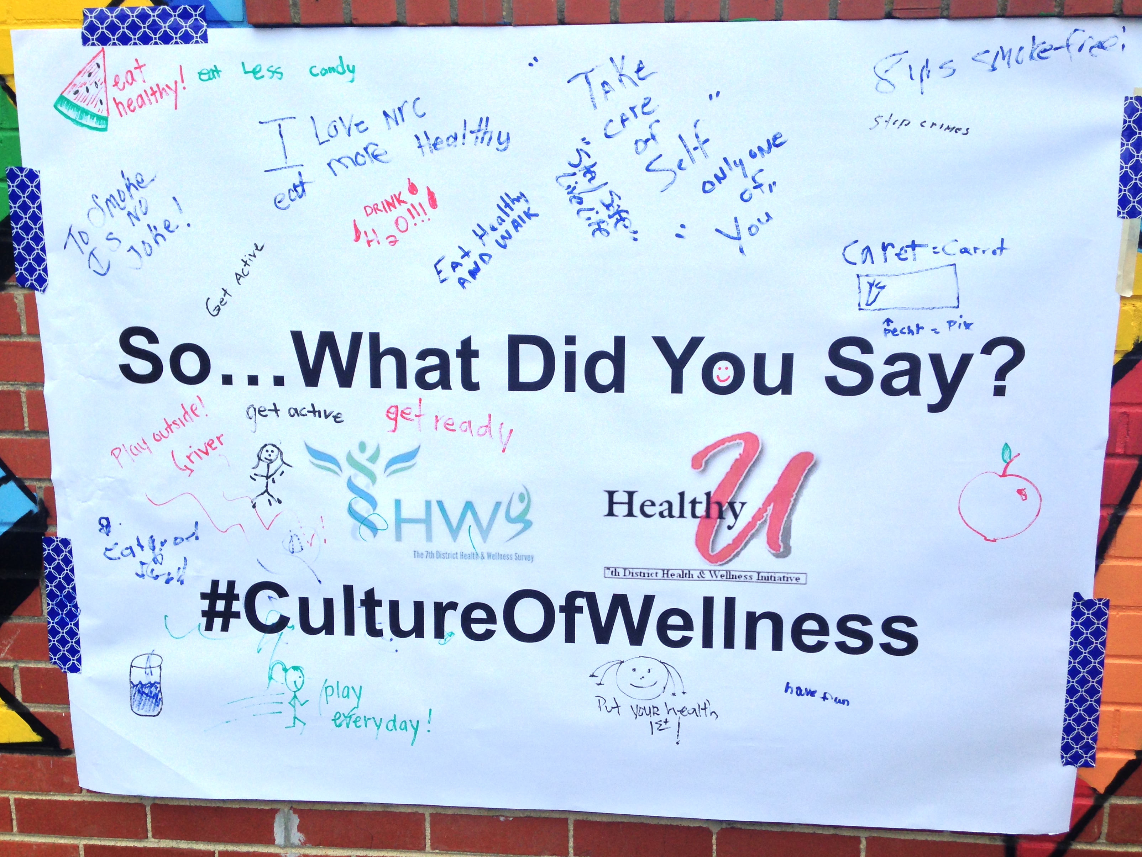

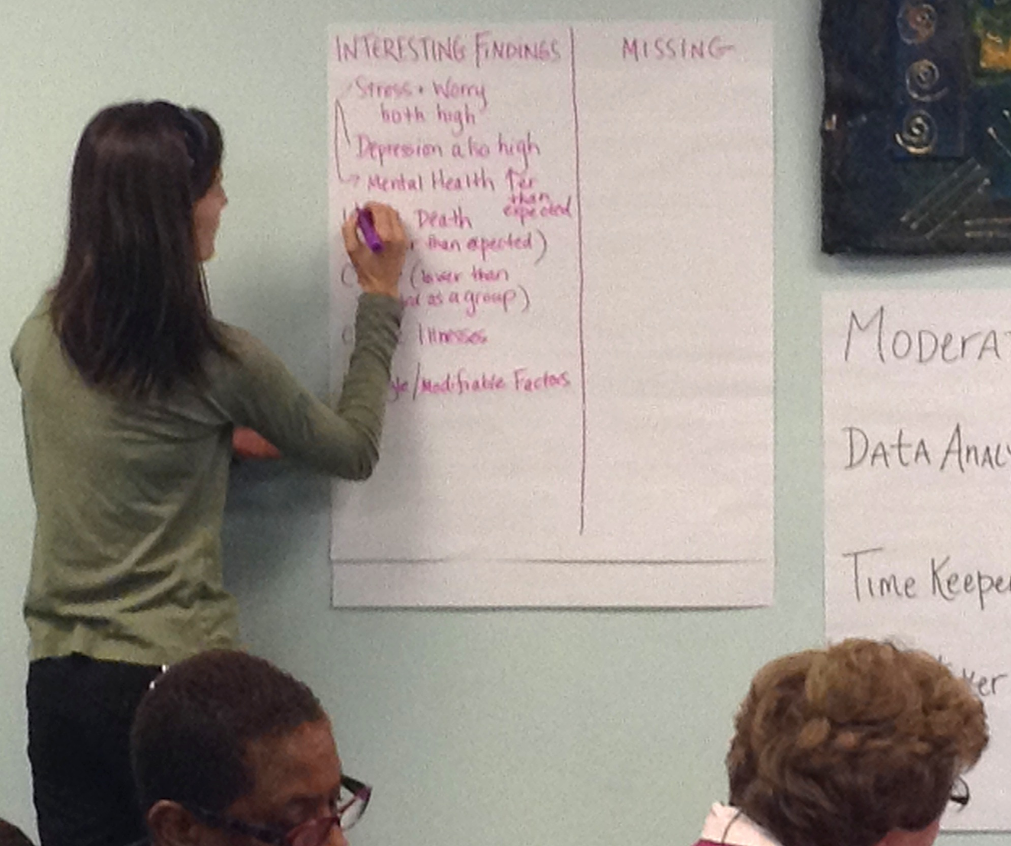
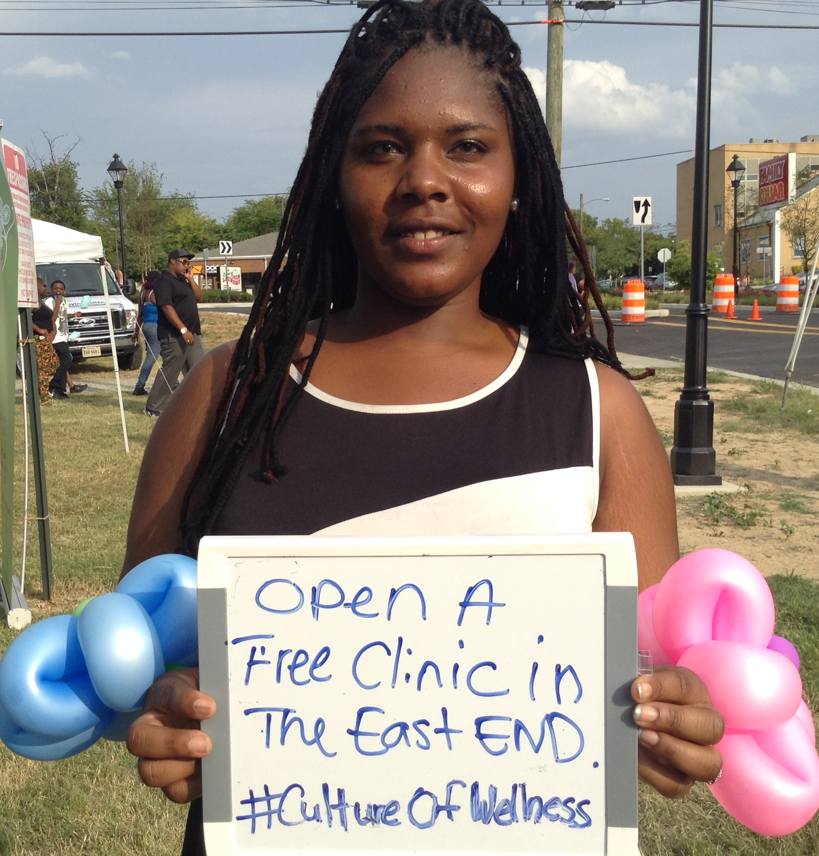
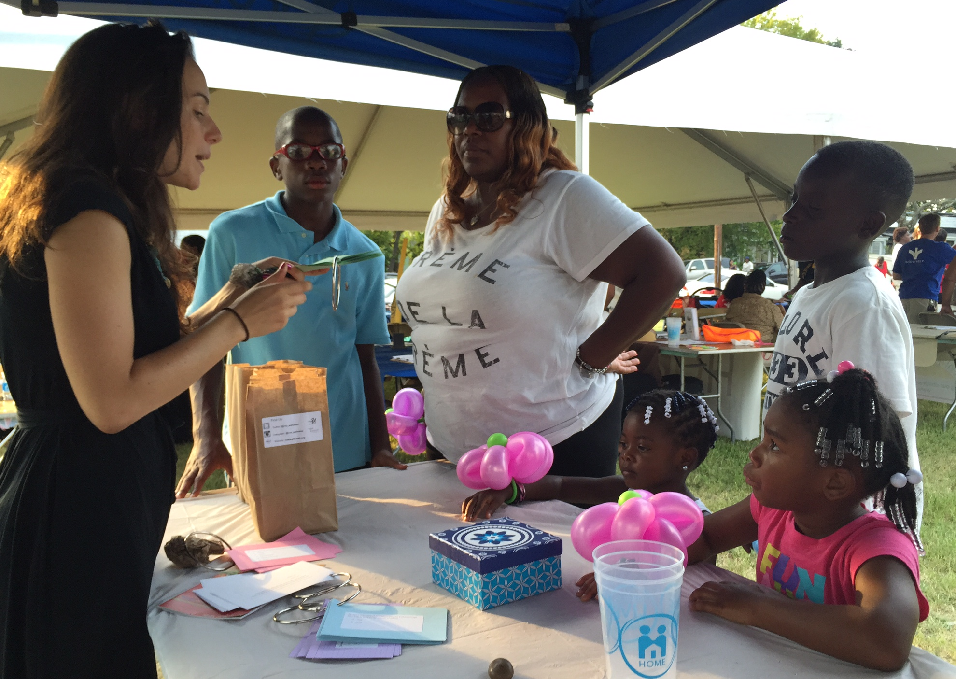
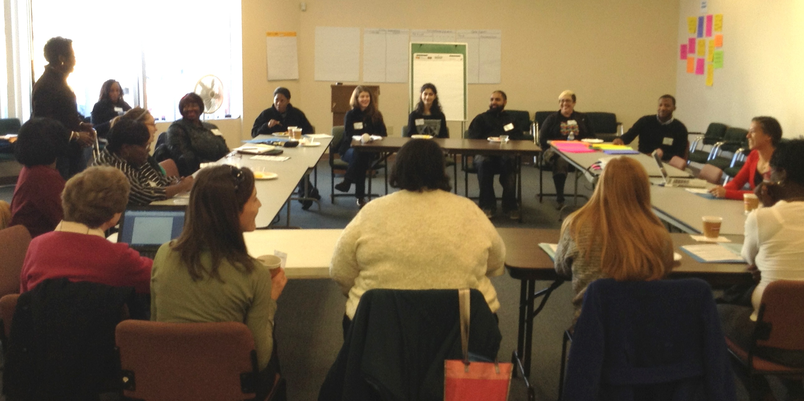
What’s the Benefit for Us?
Why Do You Focus on Our Deficits?

Slide 37
Actions Requiring Minimum Effort
Uplift the work of groups that do community-engaged research REGARDLESS of funding status
  Consistently share skills, knowledge and resources without expectations
Offer training for staff /community members who might be interested in learning more about research or research-related skills
  Community Advisory Board
  Community/Academia Research Fellows Program
  Seminars/workshops (opportunities for trainees!)
Incorporate publicly facing segments to research retreats/workshops or classic research products (e.g., flyers, blog posts) for ALL
  Consult with community members AND compensate when possible
  Community events

Slide 38
Thank You
Looking for a postdoctoral fellowship?
We’re hiring!
Elizabeth.Prom-Wormley@vcuhealth.org

Slide 39
Rohan Palmer

Slide 40


Applications of Statistical Genetics to Substance Use Disorders & Related Behaviors
Rohan H C Palmer, PhD
Principal Investigator
Associate Professor of Psychology

Slide 41
Research Goals
Environment
Genetics
Brain & Body
Behavior
Identify mechanisms of risk for addiction and related behaviors using bio-behavioral approaches
Enhance gene finding strategies for psychiatric genetics
  Data mining large populations
  Phenotype refinement
  Incorporation of knowledge across different omics’ / species
  Developing new translational technologies

Slide 42





The Many Facets of Drug Addiction
Addiction
A chronically relapsing disorder
Compulsion to seek and take a drug
Loss of control in limiting intake
Characterizations
Emergence of a negative emotional state (e.g. dysphoria, anxiety, irritability) when access to the drug is prevented
EF
ADHD
DNA
Self Regulation
Experiences
Memory
Personality Traits
Epigenetics
Notes:
Addiction is a chronically relapsing disorder characterized by a compulsion to seek and take a drug, loss of control in limiting intake, and the emergence of a negative emotional state (e.g. dysphoria, anxiety, irritability) when access to the drug is prevented.

Slide 43
Understanding Drug Behaviors
Approaches
Twins and Relatives
Population Registries
Comorbidity Studies
Longitudinal Studies
Quasi-Experimental Studies
Methods Development
Translational Studies

Slide 44

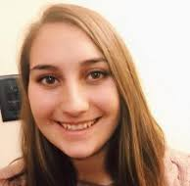
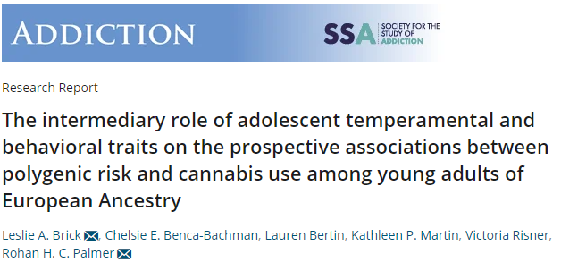

Polygenic Applications to Addictive Behaviors
R01DA042742 [Palmer]

Slide 45
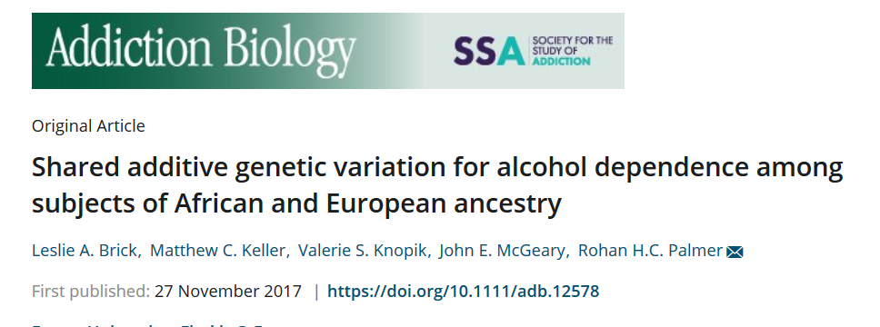
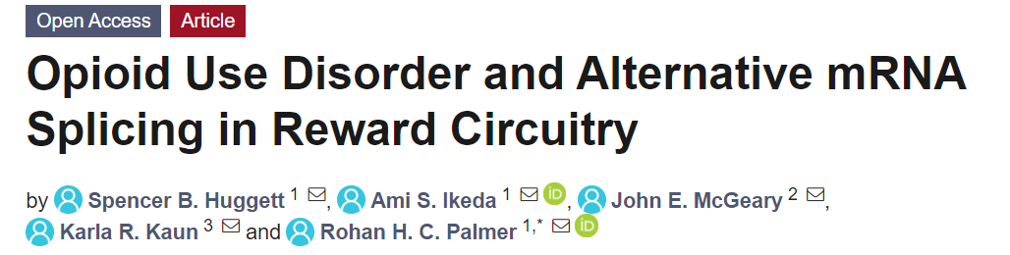

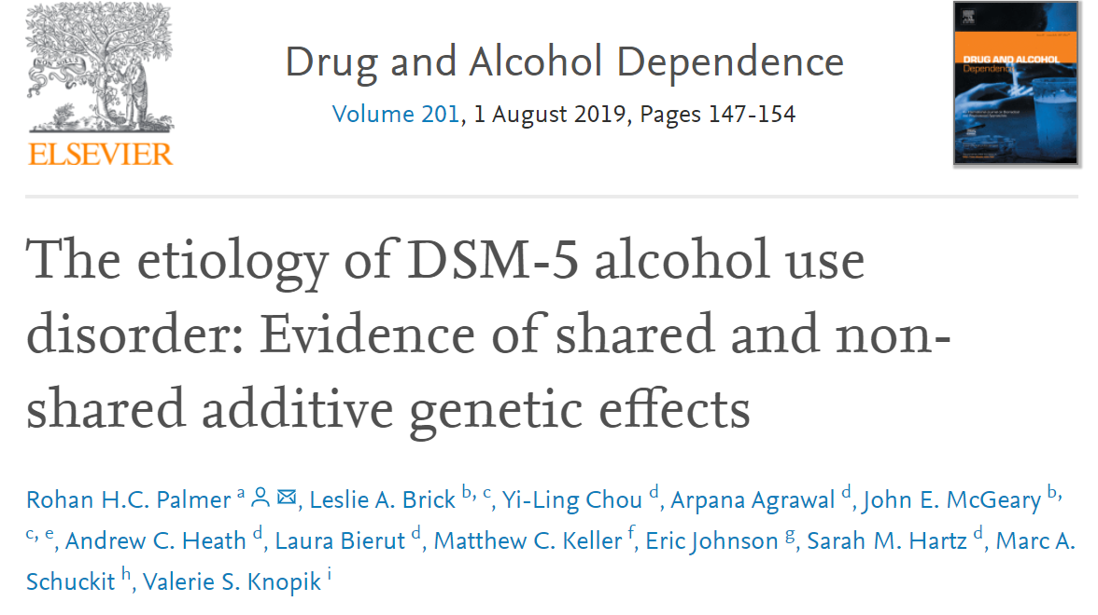

Genetic Studies in Substance Use Disorder
K01AA021113 [Palmer]
DP1DA042103 [Palmer]

Slide 46






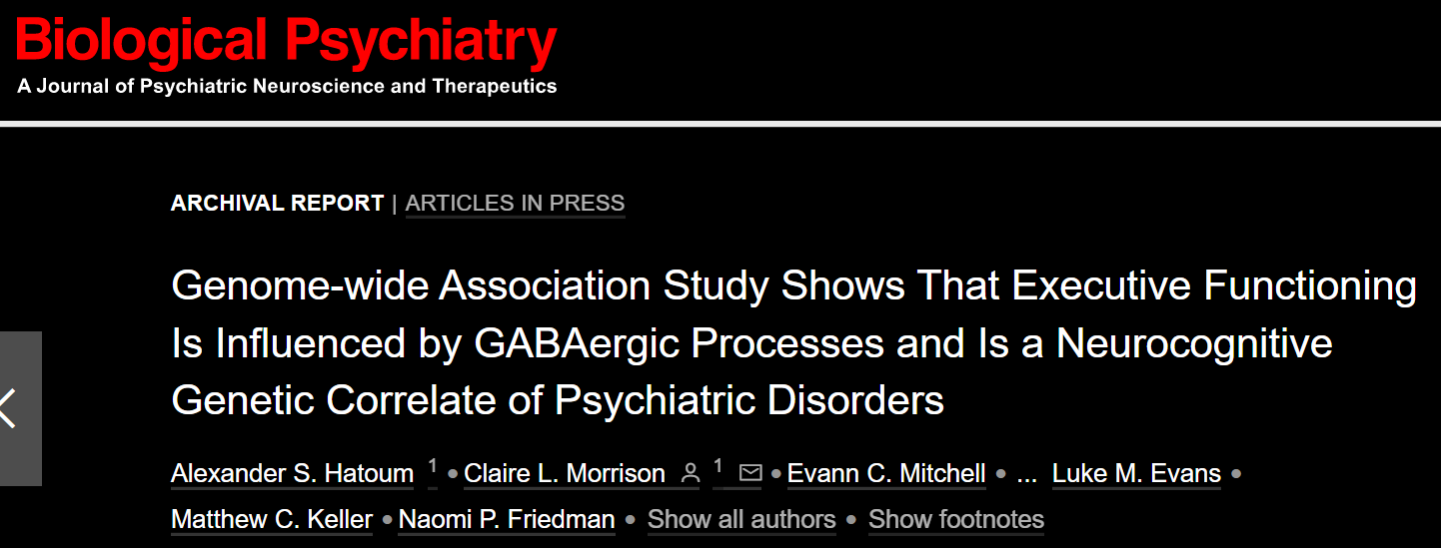
Genetic Studies of Cognition & Psychopathology
R01DA042742 [Palmer]

Slide 47
Ongoing works

Slide 48



Genetics Study of PolySubstance Use
    414 hits
    h² = 0.48 (0.02)
R01DA042742 [Palmer]
Notes:
Distinct Associations Among Genetic Internalizing and Externalizing Factors with Polysubstance Use Among Young Adults
General liability to SU & SUD is etiologically complex, but influenced by both genetic and environmental (non-genetic) factors.
Multiple pathways may potentiate risk for problematic SU, with central psychiatric domains consistently supported that encompass both internalizing & externalizing traits
GATHER GWAS summary statistics from large studies of internalizing, externalizing, and substance use behavior
FIT genetic factor model to parse out common variance across substance use with internalizing and externalizing domains:
Substance use-related psychopathology
Non-substance use internalizing
Non-substance use externalizing
CONDUCT multivariate GWAS using resulting factors
COMPUTE PGS from multivariate GWAS results
EVALUATE whether PGSs associated with polysubstance use

Slide 49
PGSs predict Polydrug Use in AddHealth
Regress the PSU factor on the PGSs to evaluate the genetic effect of internalizing and externalizing traits separate from variance related to SU-related psychopathology.
R01DA042742 [Palmer]

Slide 50
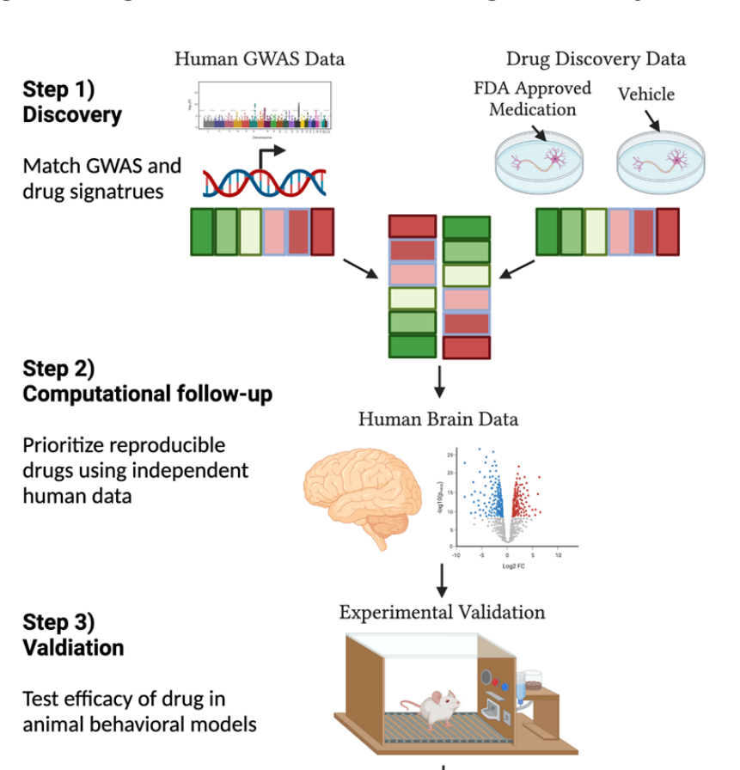






Therapies for Cocaine & Opioid Addiction
Ibrutinib attenuates cocaine locomotor behavior
DP1DA042103 [Palmer]
Notes:
Users take cocaine in binges, in which cocaine is used repeatedly and at increasingly higher doses. This can lead to increased irritability, restlessness, panic attacks, paranoia, and even a full-blown psychosis, in which the individual loses touch with reality and experiences auditory hallucinations.² With increasing doses or higher frequency of use, the risk of adverse psychological or physiological effects increases. We developed a pipeline that leverages GWAS, TWAS, Transcriptomics, animal models, and gene expression profiles of existing medications to screen possible repurposable drugs for addiction.
Middle: Preliminary Drug Repurposing results from CUD GWAS & Brain RNA data
Preliminary results from drug-repurposing analyses on CUD GWAS and brain RNA data. We have identified repurposable medication targets using both inferred expression based on the CUD GWAS data and CUD brain RNA data. Medications with positive betas are positively associated with CUD and those with negative betas are negatively associated with CUD. The dashed red-line indicates padj < .05. Circles indicate results from CUD GWAS and triangles represent results from CUD brain RNA data. We have been following up on a brotuon tyrosine kinase inhibitor called ibrutinib.
Right figure: We saw a significant overall effect when contrasting the cocaine group against mice that received cocaine and 100 mg/kg ibrutinib (Figure 6; F_{(6,48)} = 21.06, p<0.001). Notably, this effect was replicated when examining Ibrutinib’s effects on Amphetamine-induced locomotor activity (F(6,49)=7.17, p<.001). Further, Ibrutinib treatment effect alone at 100mg/kg had no significant effect on locomotor behavior in both studies.
Division of Therapeutics and Medical Consequences (DTMC)

Slide 51
Accepting postdoctoral trainees
Contact Rohan.Palmer@Emory.edu

Slide 52
Sarah Medland

Slide 53

THE EQUINOX
CONFERENCE
Statistical Genetics – Genetic Epidemiology – Behaviour Genetics
21 September
Free – Accessible – Open – Supportive – Inclusive
http://equinoxconference.org/

Slide 54
How Does it work?
23.5 hours of science
Continuous zoom call
All presenters scheduled to talk during their usual waking hours
Join when you can – watch a recording later

Slide 55
Abstracts are open to...
People who are currently finding it difficult to travel to attend in-person conferences
  For any reason
People whose work is so cross disciplinary that it is hard to find a 'home'

Slide 56
EVERY ONE is WELCOME to ATTEND!

Slide 57
Abdel Abdellaoui

Slide 58


a.abdellaoui@amsterdamumc.nl
dr_appie

Slide 59








1849
Today
Catholic
Protestant
Non-religious

Slide 60




Lower educated fathers
Higher educated fathers
Below average migration distance
Above average migration distance
Educational attainment was significantly associated with F_{roh} (inbreeding)
But parental education was much more significantly associated with F_{roh}
Why?
  Higher educated parents migrated significantly more often and greater distances
  There is strong assortative mating for educational attainment

Slide 61

Correlation between offspring ancestry and geography significantly decreased as parental education increased

Slide 62
Polygenic Scores
PCs

Slide 63


Educational Attainment Polygenic Score
(EA3, without British cohorts)
Townsend Index (measure of economic deprivation)
Overall Health
Brexit
(Leave Votes)

Slide 65


Slide 66
Brittany Mitchell

Slide 67


Dissecting heterogeneity in depression
BRITTANY MITCHELL

Slide 68

What we know about mdd
Highly complex and heterogeneous in presentation – chronic course, age at onset, treatment response
Heterogeneous symptom profile – DSM-5 MDD diagnosis requires at least 5 of 9 symptoms
Debate surrounding depression reflecting one or more underlying conditions

Slide 69

Associations with age of onset

Slide 70

Are there differences in PRS between subtypes of depression?

Slide 71



Going forward…
Differences in genetic risk factors underlying features and subtypes?
Do these influence treatment response and/or side-effects?
Incorporating anxiety and other highly co-morbid disorders -Can we find any genetic distinctions?
BIONIC

Slide 72
Michael Neale

Slide 73
Product of Variables (PoV) Modeling
Michael C Neale & Steven M Boker
Virginia Institute for Psychiatric and Behavioral Genetics
Virginia Commonwealth University
Boulder Colorado NIMH Workshop July 2023

Slide 74

Multiple Regression with Interaction
Standard Approach: $y=a+β_{1}X1+β_{2}X2+β_{3}X$
Uses OBSERVED X1, X2 and OBSERVED product X1X2
How Do you Multiply Latent Variables, e.g., GxE Interaction?
Individuals’ Scores are Unknown

Slide 75

A New Kind of Variable
Latent variable with no unique variance
Dummy variables are summation nodes
Asterisk in a circle represents product node
This model is under-identified has no XY observed variable
Needs to have multiple indicators for identification

Slide 76


New Method

Slide 77


Works with Missing Data! (Unlike lm)

Slide 78
OpenMx Syntax for Product Variables
Draw Them in Onyx
Specify Model in mxPath Format
  Manifest, Latent and Product: Legal Node Types
New Tracing Rules for Model Evaluation: Multiply Inputs
Experiment with it! OpenMx 2.20 or higher

Slide 79



Thank You!
Philip Vinh, Luis Araujo, Madhur Singh, Daniel Zhao, Joshua Pritikin, Hermine Maes
NIDA R01 DA049867, OpenMx Team

Slide 80
Matt Keller

Slide 81
Behavioral Genetics in the molecular age
Matthew Keller
CU Boulder

Slide 82
Recruiting postdocs in Keller Lab
If interested in using genomic data in family-based samples to understand genetic architecture and causes of familial similarity, please contact me (matthew.c.keller@gmail.com)
Start date from now until fall 2023…

Slide 83
Ability for GWAS estimates to deliver biological insights rests on them estimating direct genetic effects
Direct genetic effect: the true causal effect of a genetic variant independent of genetic and environmental background
  crucial for interpreting GWAS associations & downstream estimates in biological terms
Population genetic effect: the true association between a genetic variant and a trait in a particular population at a given time.
  includes direct effect PLUS the effects of all genetic and environmental factors correlated with the genetic variant

Slide 84
Increasing evidence calls into question the expectation that GWAS associations always reflect direct genetic effects
Population-based samples provide estimates of the population genetic effect, not the direct genetic effect
3 major confounders of direct genetic effect estimates in population-based samples:
  Population stratification
  Indirect genetic effects
  Assortative mating

Slide 85
Within-family GWAS studies present a simple and elegant solution to the most concerning confounders of population-based GWAS
Genetic variation within families is due to random segregations of chromosomes during production of sperm and eggs (meiosis) in the parents.
These random segregations are independent of confounding factors in the environment and non-random mating in the parents.

Slide 86
Family-based samples have incredible value to GWAS and beyond
Despite lower power, within-family estimates of direct effects can be more accurate than pop-based estimates at reasonable n (e.g., 250k – 500k)
Estimate indirect genetic effects and the full variance accounted for by vertical transmission (Balbona et al., 2022)
Estimate the strength, change over time, and causes of assortative mating (Kim et al, in prep)
Estimate individual-level de novo mutation rates, recombination rates, parent-of-origin effects, and uniparental disomy
Improve phenotypic and genetic data quality
Investigate many family-centric issues of interest to sociology, economics, psychology, etc. – divorce, kinship networks, social inequality, etc.
Notes:
We can test signature of primary AM using polygenic scores
They should be correlated across chromosomes; Yengo et al, 2018
We (Kim et al.) are comparing the polygenic correlation across chromosomes to phenotypic partner correlations in the UKB to understand this question.

Slide 87
Summary
We are entering an exciting time where BG methods and family data are going to be increasingly central to molecular genetics methods
These are exactly the types of approaches we have emphasized at the workshop

Slide 88
2024 ISG Workshop
Biometrical Genetics
Classical Twin Design
Causes of Variation
Genomewide Association [GWAS]
Measurement
plink
Extended Pedigree Models
Heterogeneity
GwSEM
Sex Limitation
Mendelian Randomization [MR]
Matrix Algebra
OpenMx
LD score regression
Simulation
GxE interaction
Power
Structural Equation Modeling [SEM]
Genetic Nurture
Genetic Factor Models
Binary & Ordinal Data
Developmental Models
Within-family Designs
Genetic correlation
Path Analysis
Polygenic Scores
Genetic Relationship Matrix [GRM]
Model Assumptions
Likelihood
MR-DOC
Genomic SEM
ACE model
Multivariate Models
AC covariance
Cross-lagged Models
M-GCTA
Direction of Causation [DOC]
GREML
Ascertainment
Genetic Complex Trait Analysis [GCTA]

Slide 89

A Big Thank You to
Jeff & his team
Matt & his admin team
NIH & Regeneron all the faculty

Slide 90

Thank you!!

