Slide 1
Fine-mapping, colocalization, & a bit more on pop gen and rare variation/sequencing
Ben Neale
March 10th

Slide 2
So you’ve done a GWAS and found some associations – what now?
Some questions to contemplate:
What are the causal variant/variants driving the signal?
What are the proximal biological consequences of those base pair differences?
What are genes, cells and biological processes that are perturbed by these differences?
How do those perturbations influence physiology?
Or as Lindon used to say “What does it all mean”

Slide 3
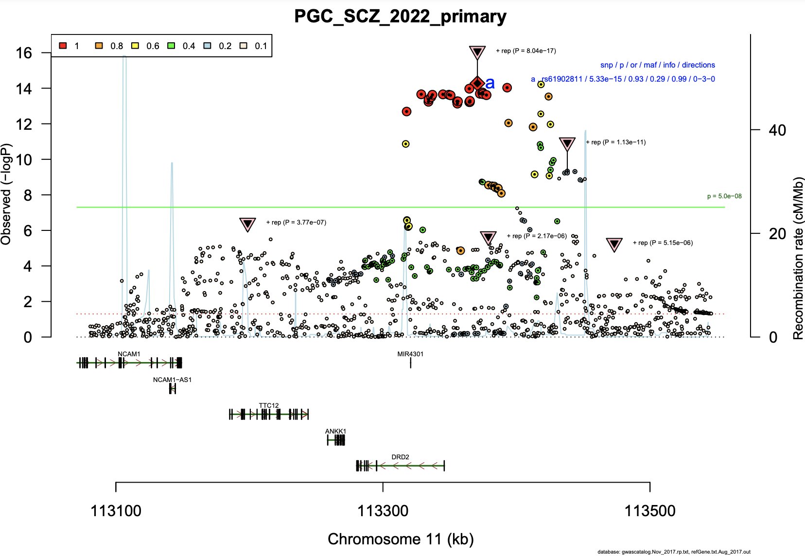
A typical locus zoom plot
https://data.broadinstitute.org/mpg/ricopili/

Slide 4
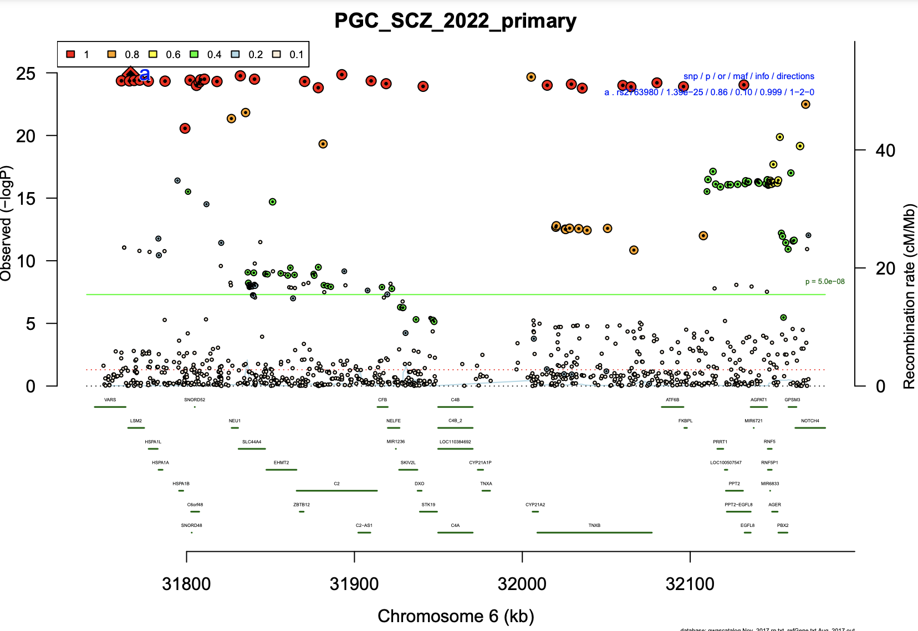
A more complicated locus zoom plot
https://data.broadinstitute.org/mpg/ricopili/

Slide 5
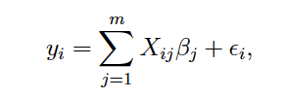
Statistical fine-mapping - some modeling considerations
Residual effects on trait y
including measurement error
Phenotype for individual i
Effect of genetic variant j
Genotype vector of m markers

Slide 6
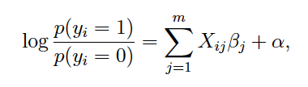
We can also consider the binary case
Phenotype y coded as 0/1 for individual i
Residual effects on trait y
including measurement error
Genotype vector of m markers
Effect of genetic variant j

Slide 7
Statistical fine-mapping – conceptual introduction
+ LD =

Slide 8
Statistical fine-mapping – conceptual introduction
- LD =

Slide 9
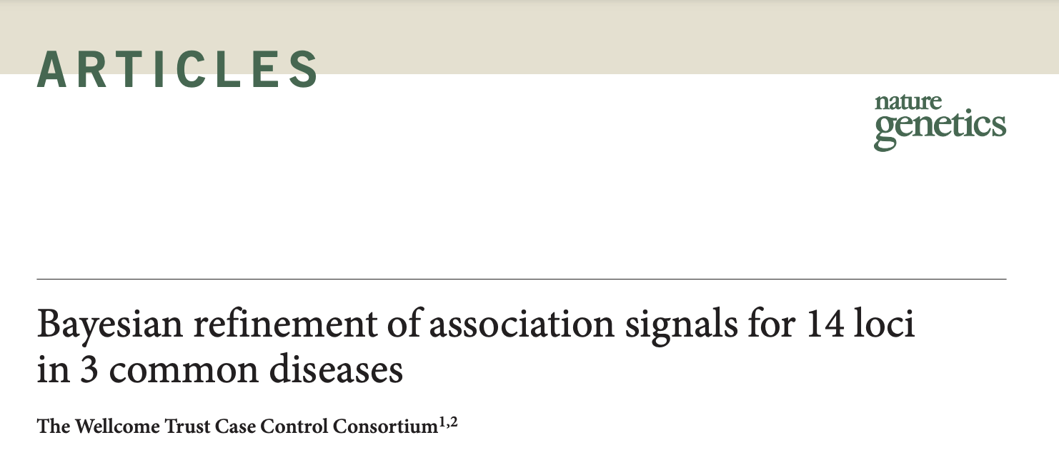
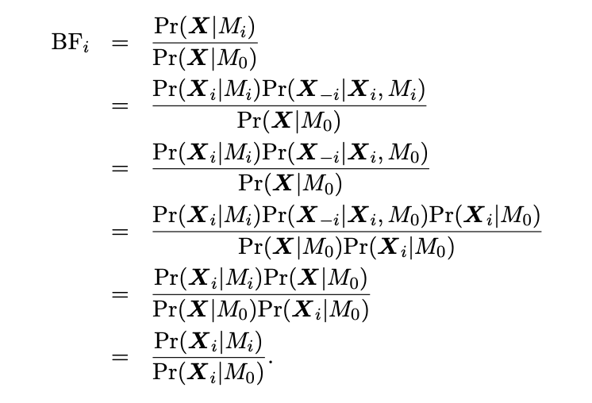
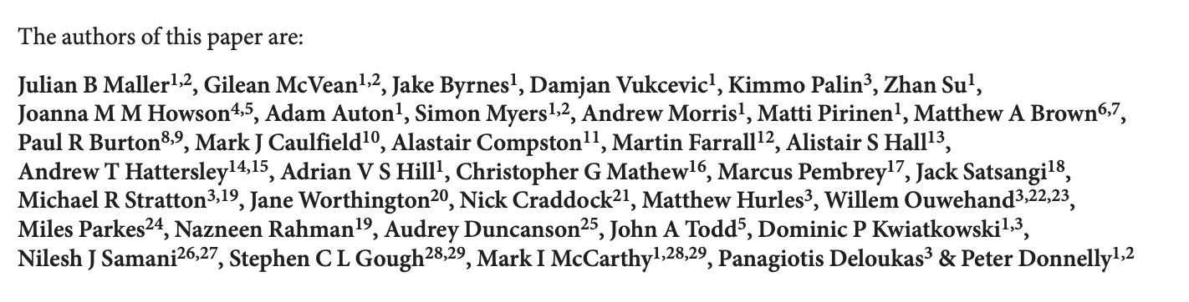
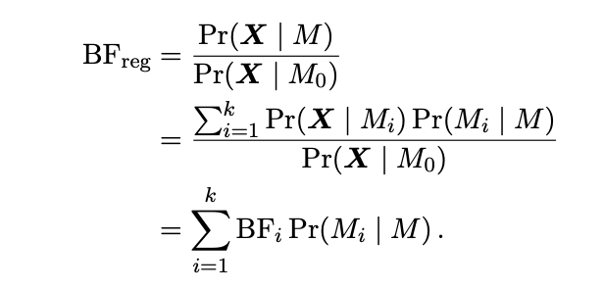
Among the simplest models – Maller et al.
Formalized Marchini et al. 2007 and Servin & Stephens PLoS Genet 2007
Assumes a single causal variant

Slide 10

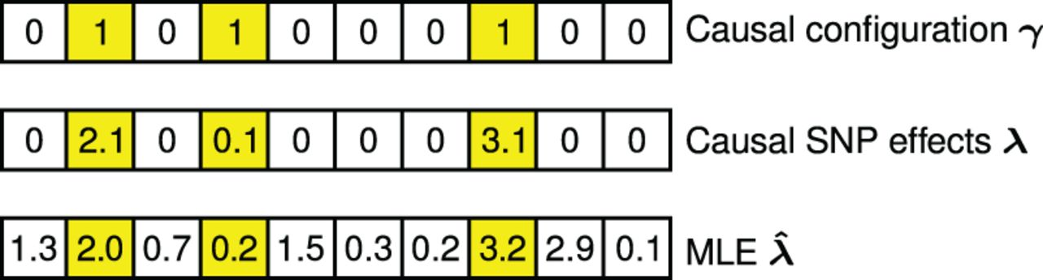
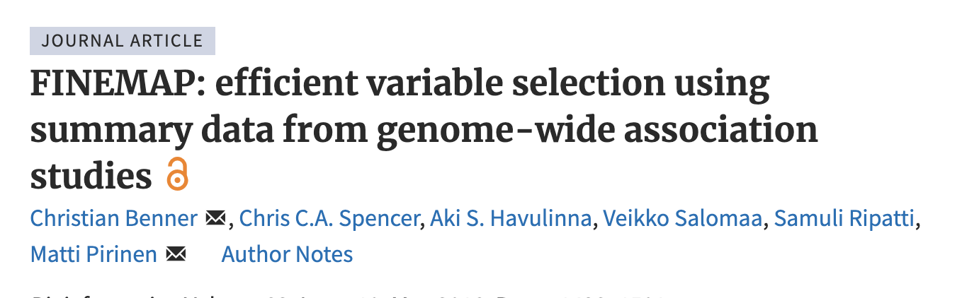
Maybe there is more than one causal SNP?
Fig. 1. The binary indicator vector γ determines which SNPs have non-zero causal effects (). The corresponding causal ...
User-specified prior variance for causal SNPs
Variance of the trait
Diagonal matrix with elements of gamma on the diagonal

Slide 11
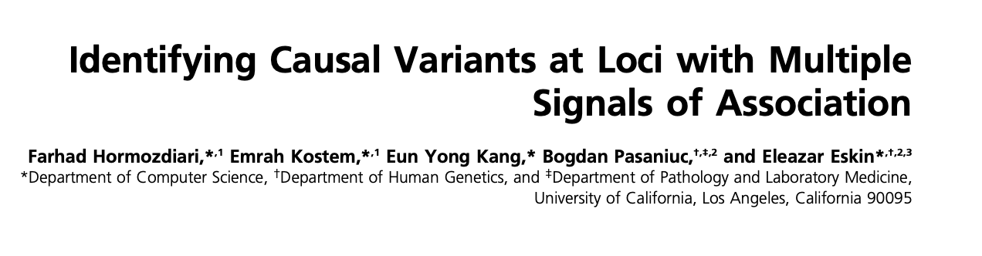
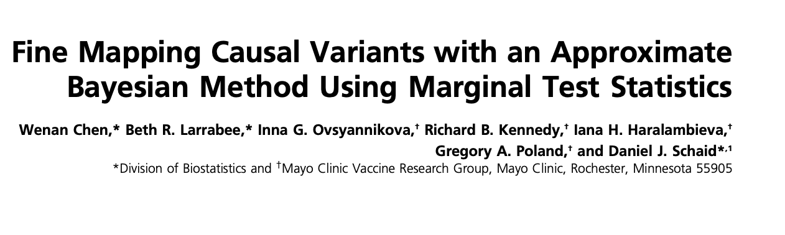
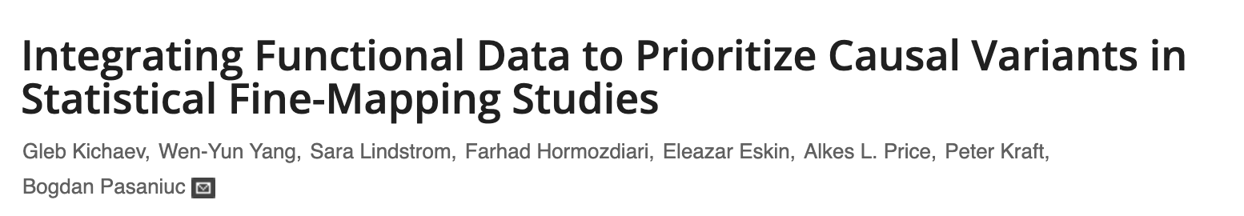
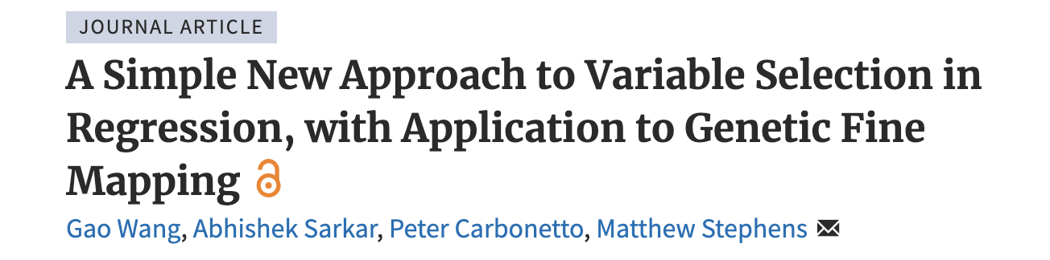
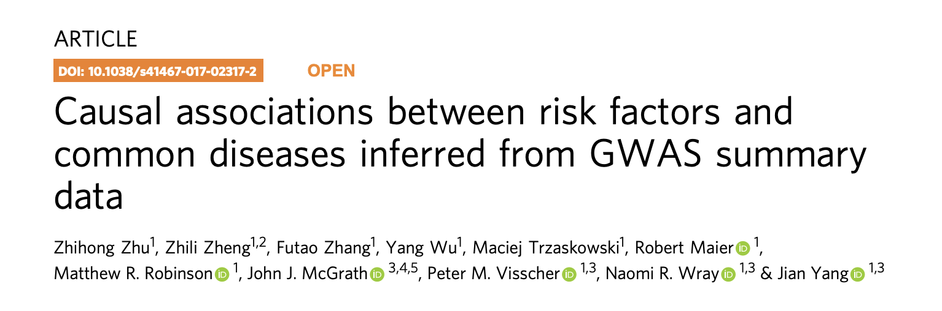
Many methods for multiple causal variants
Caviar - 2014
Caviarbf - 2015
PAINTOR - 2015
FINEMAP - 2016
SuSIE - 2020
COJO and COJO-ABF - 2018

Slide 12
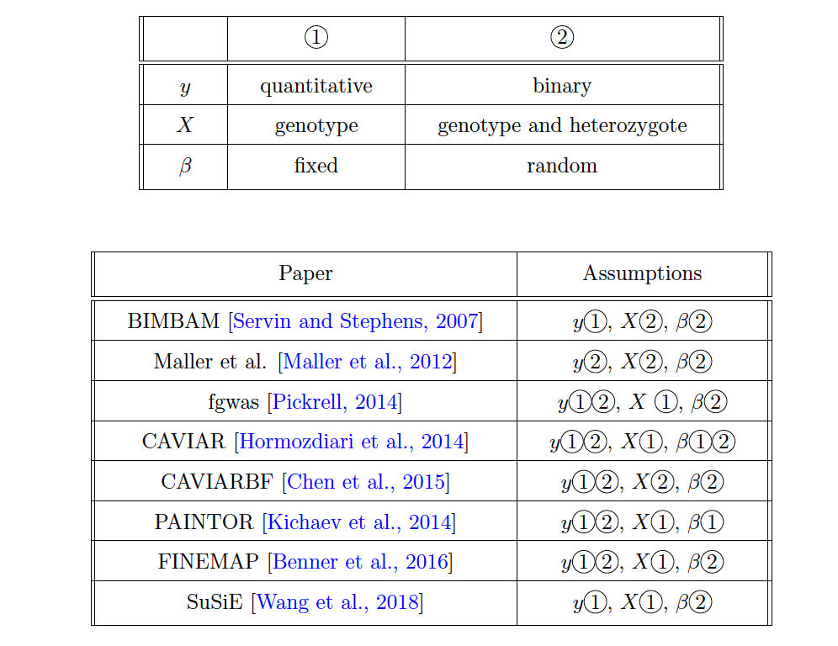
Handy guide to assumptions differences in methods
Ran Cui

Slide 13
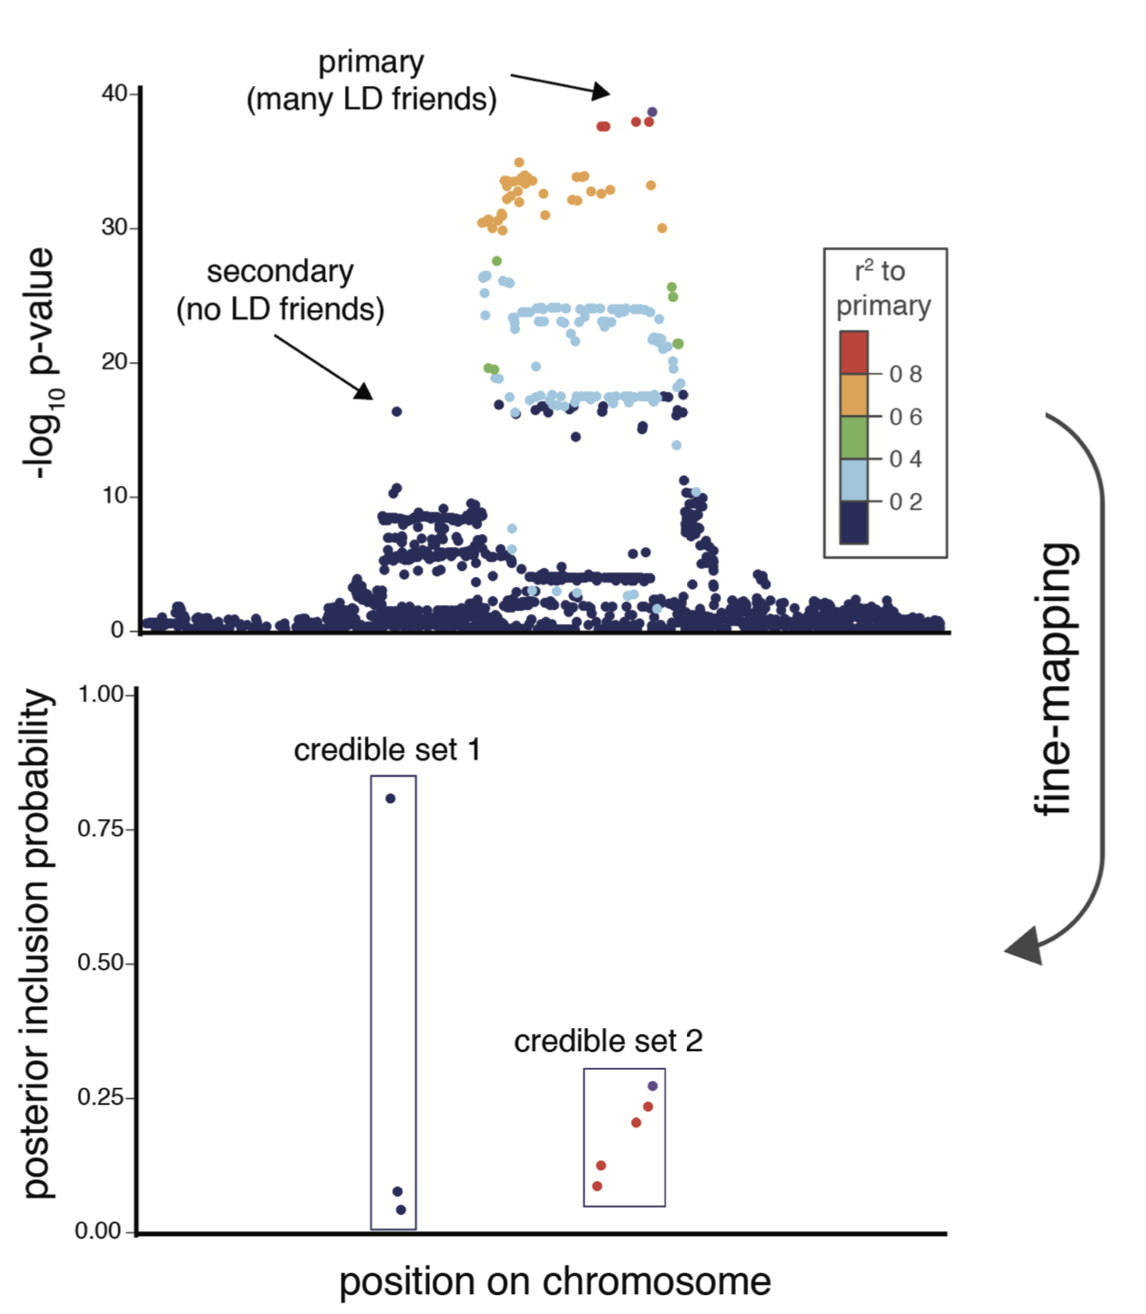
Fine-mapping quantifies causal probability
Posterior inclusion probability (PIP)
  Probability under the model, given the data, that the variant is causal for the disease
95% credible set (CS)
  Smallest set of variants for a single effect that together have > 95% probability of being causal for the disease
Jacob Ulirsch

Slide 14
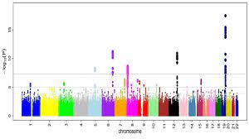

How robust are these methods? Replication Failure Rate
Lather rinse repeat to inspect PIP calibration
Take large well-powered GWAS study
Run fine-mapping on genome-wide significant loci
Downsample to 100K individuals
Run a GWAS
https://www.biorxiv.org/content/10.1101/2022.10.21.513123v1.full.pdf

Slide 15
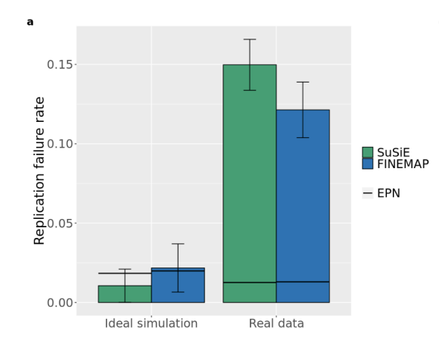
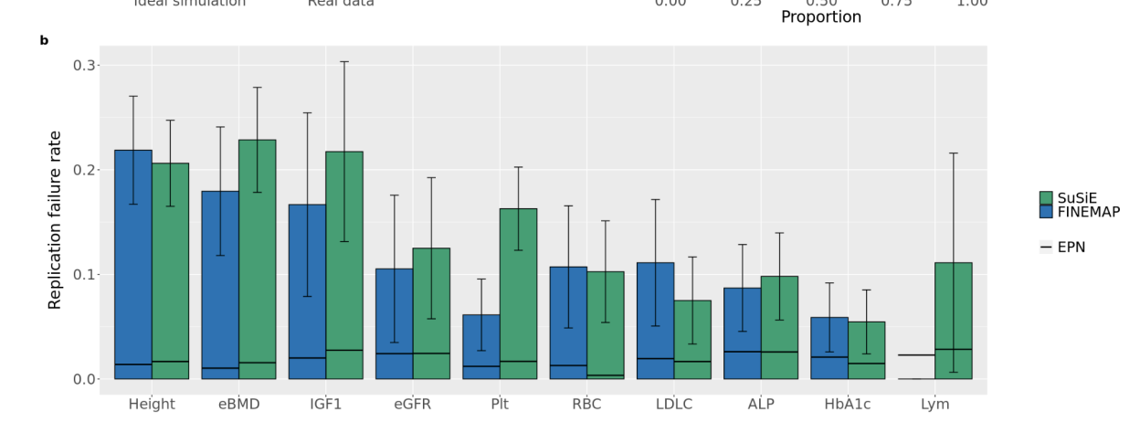


Replication Failure Rate
https://www.biorxiv.org/content/10.1101/2022.10.21.513123v1.full.pdf

Slide 16
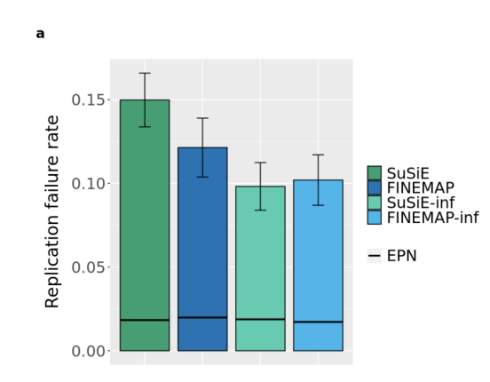

What about modeling an ‘infinitesimal’ contribution?
Take this model
And add this consideration:

Slide 17
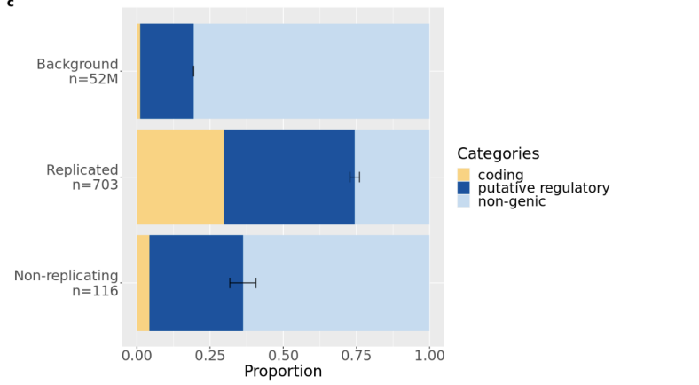
Adding functional information improves but does not guarantee replicability!

Slide 18
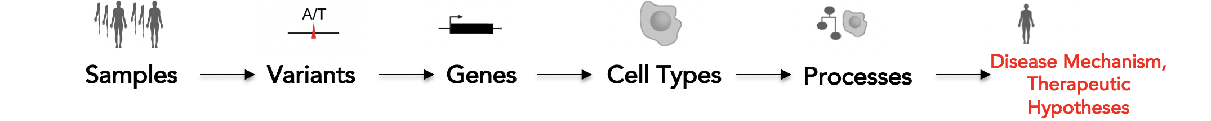
How does the associated variant impact function?
*
This is the GWAS!
*Claussnitzer

Slide 19
How does the associated variant impact function?
This is the an eQTL study
eQTL = expression quantitative trait locus

Slide 20

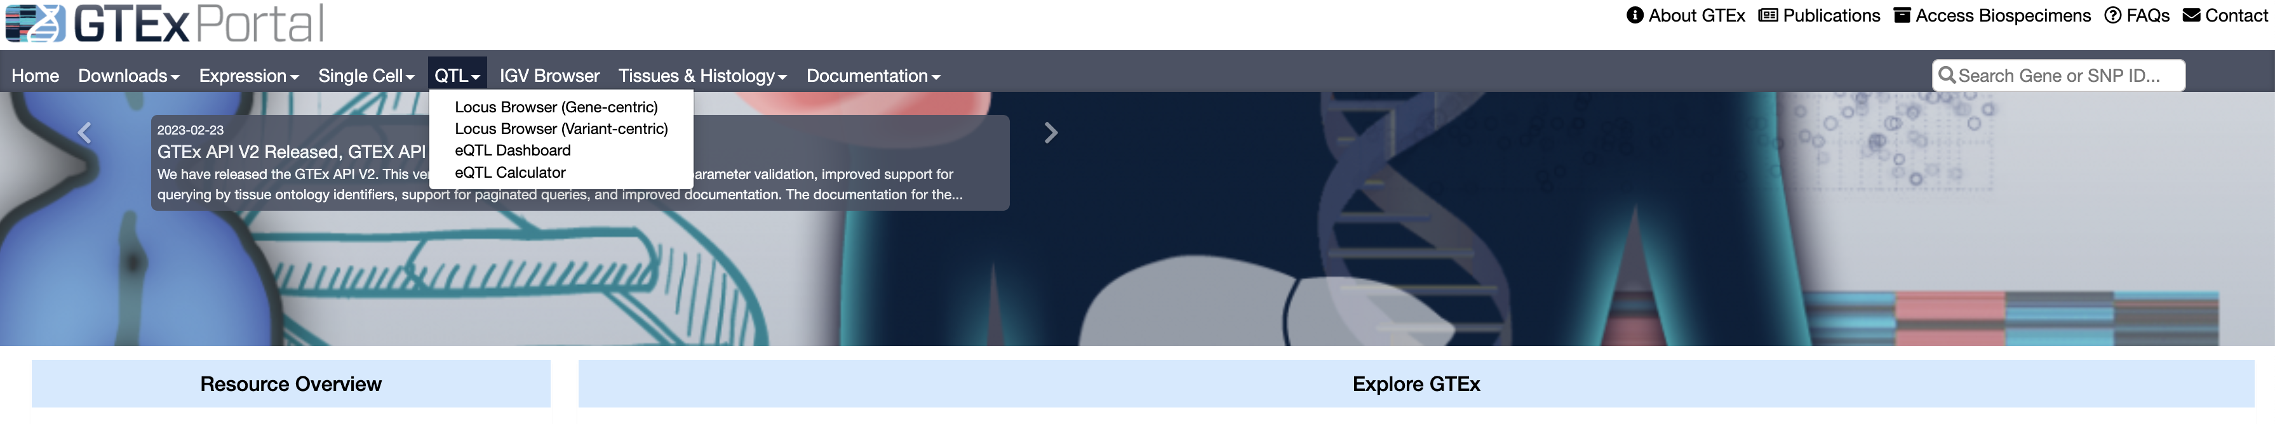
Exploring eQTL resources
Navigate to https://gtexportal.org/home
Click QTL browser
Click Locus Browser (Gene-centric)

Slide 21
Explore your favorite gene!

Slide 22
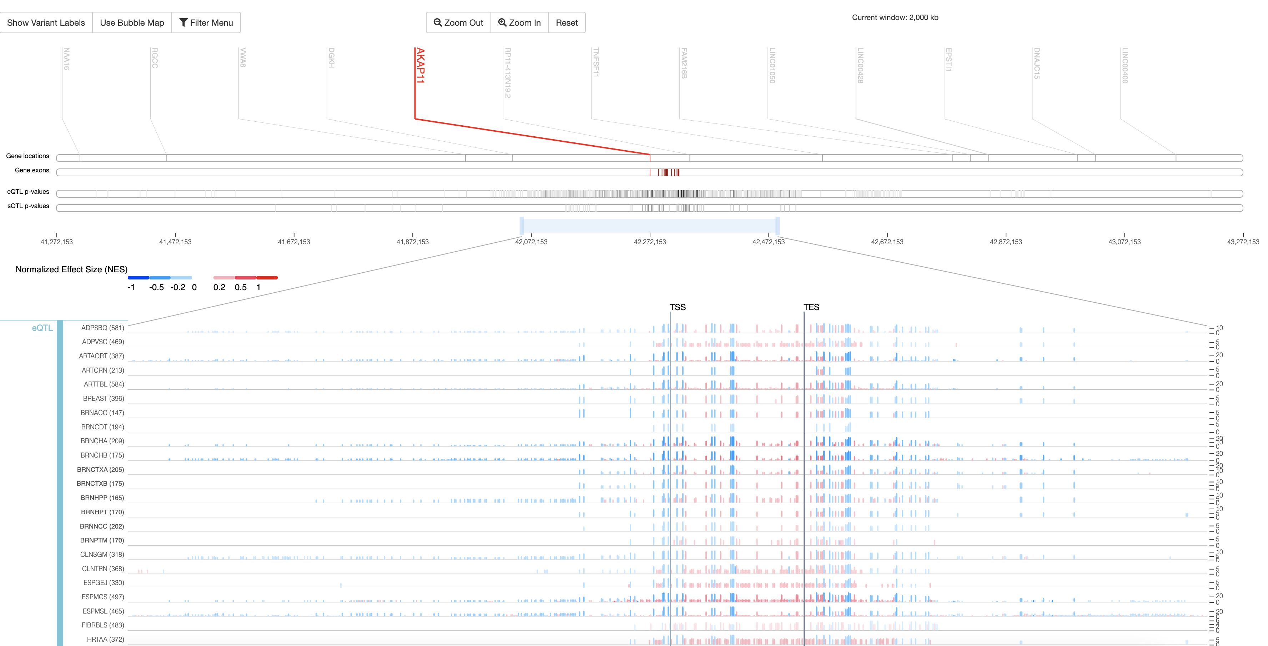
Example – AKAP11

Slide 23
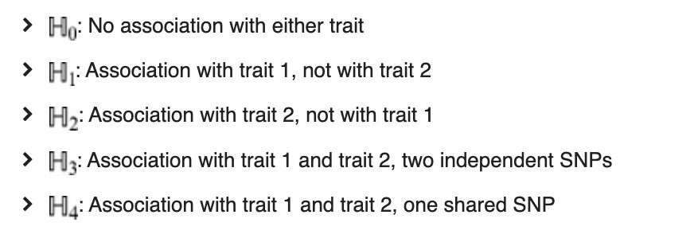
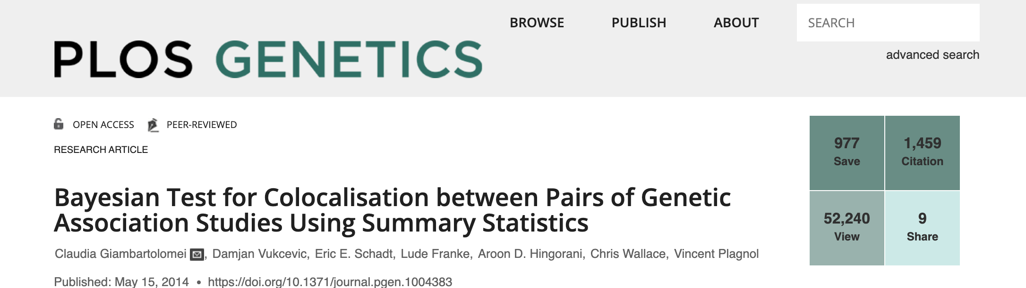
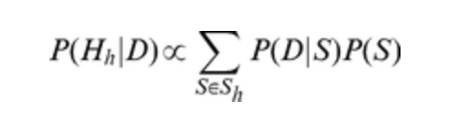
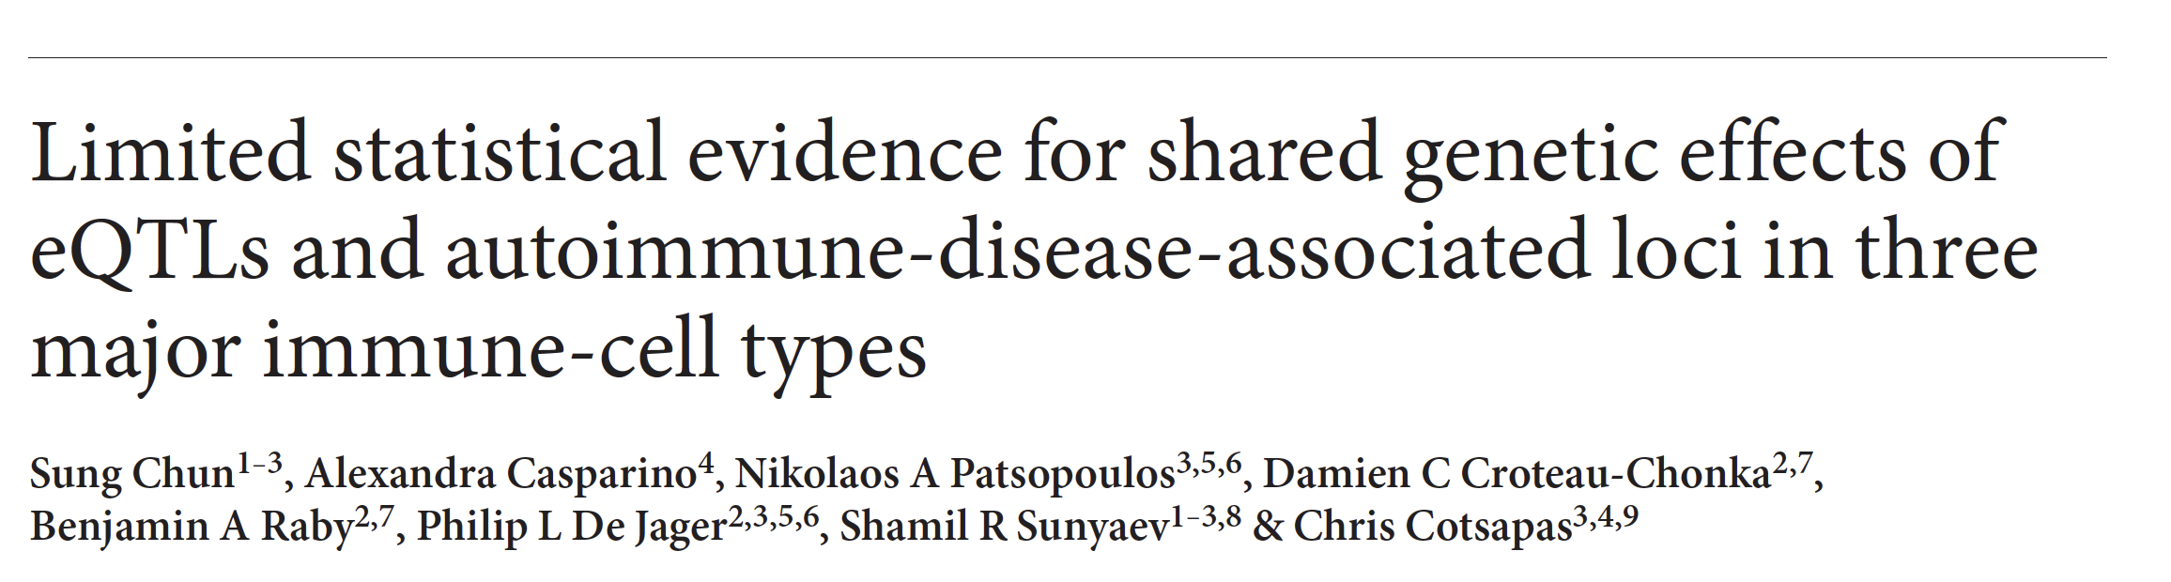
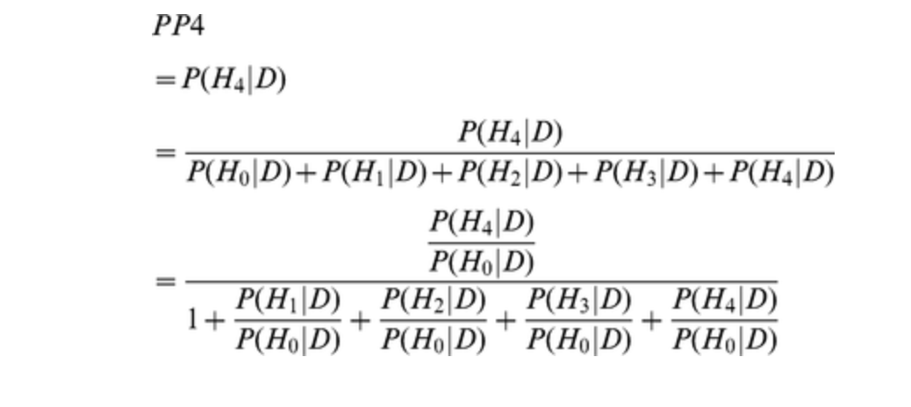
Can we test whether these associations are the same?
COLOC
JLIM
JLIM model – maximum likelihood treatment rather than Bayesian

Slide 24
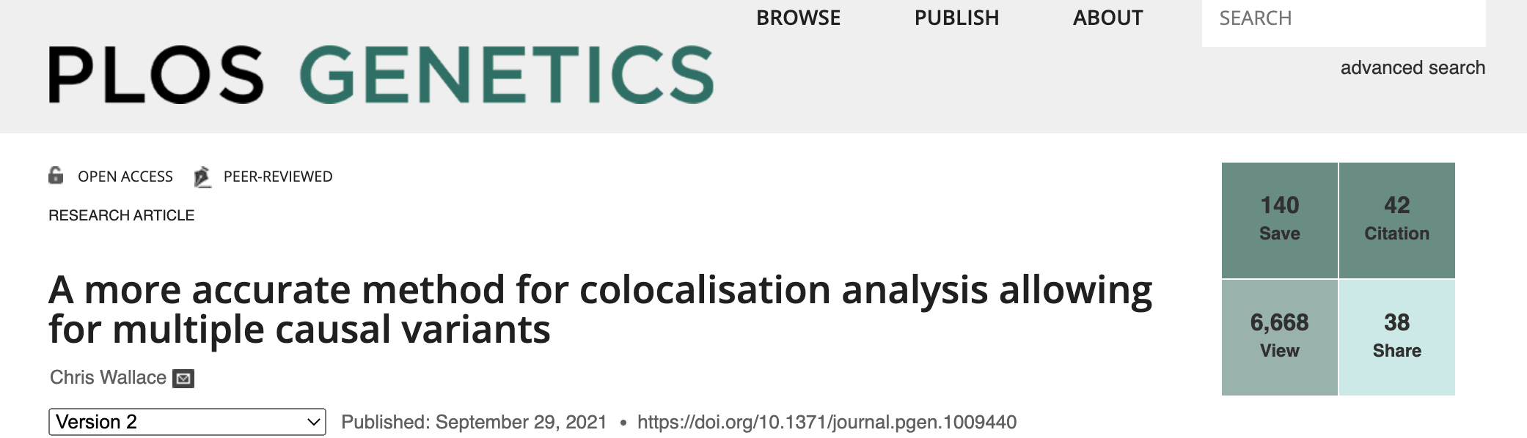
Managing multiple variants
Naturally fits into the methodology
Coloc multivariate extension

Slide 25
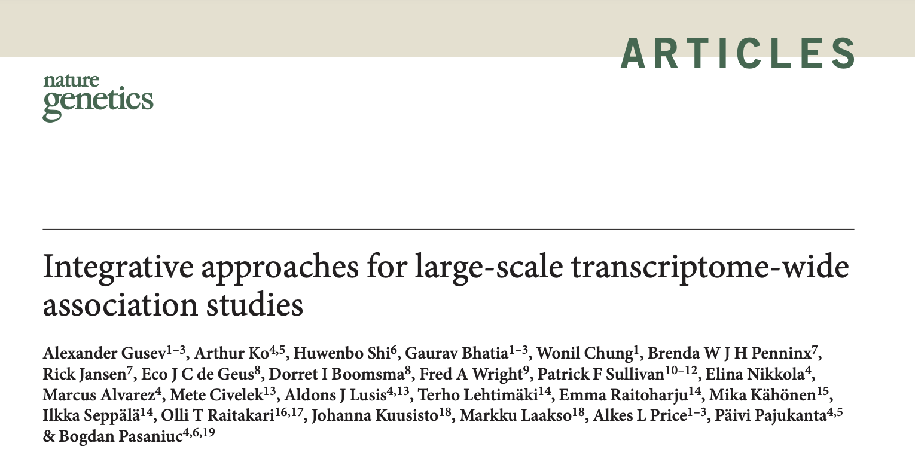
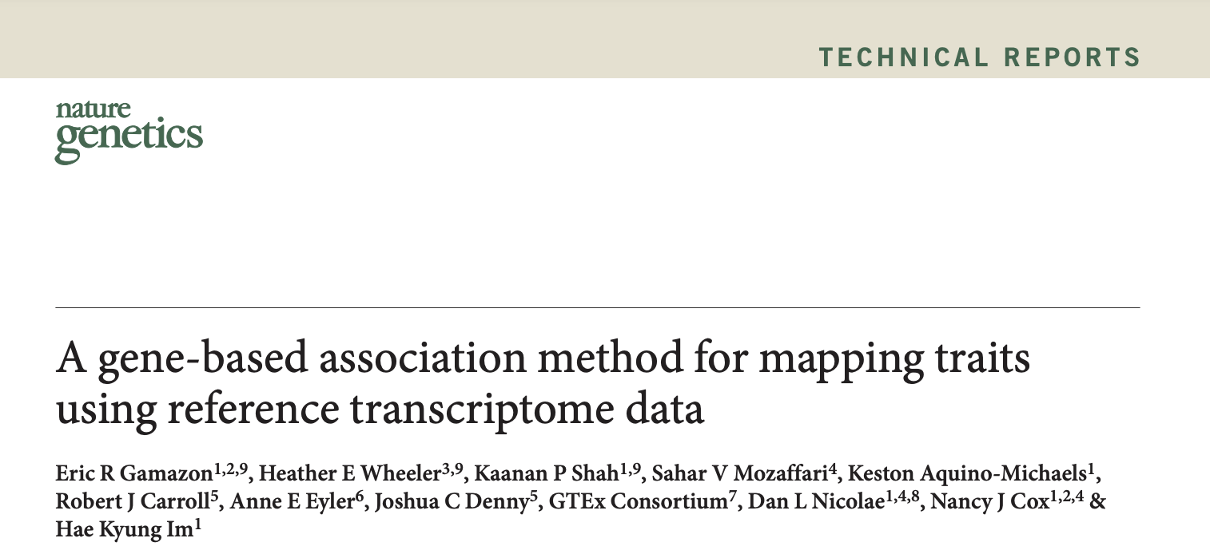
Alternate approaches – with potential specificity challenges
TWAS
PrediXcan

Slide 26
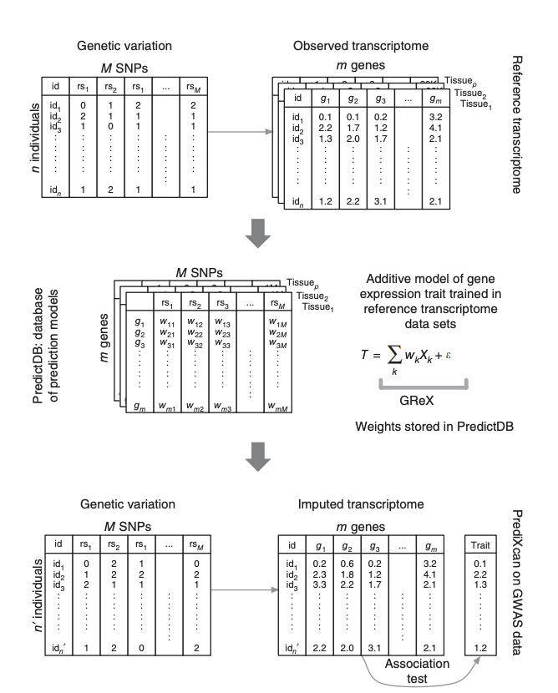
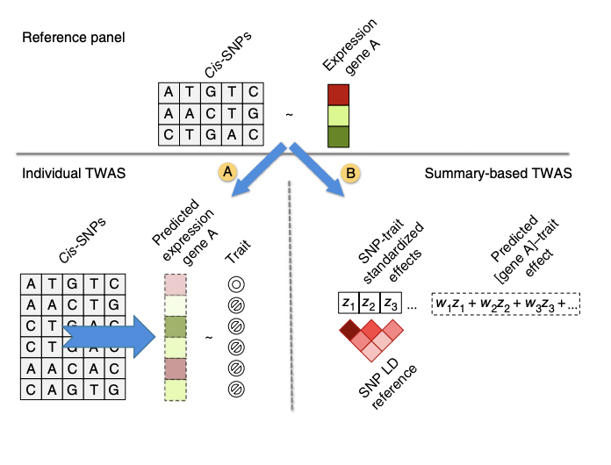
TWAS and PrediXcan descriptions
TWAS
Why ought we be concerned?
PrediXcan

Slide 27
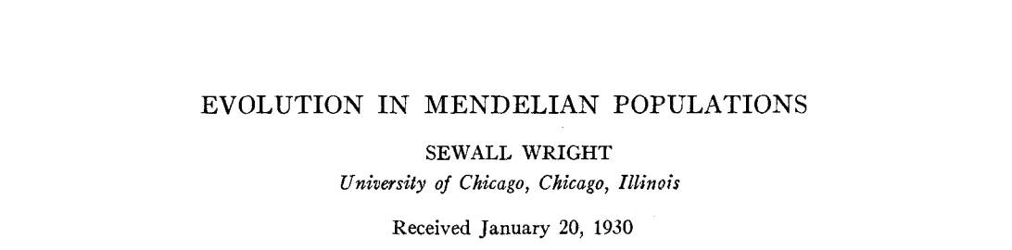

Wright-Fisher

Slide 28
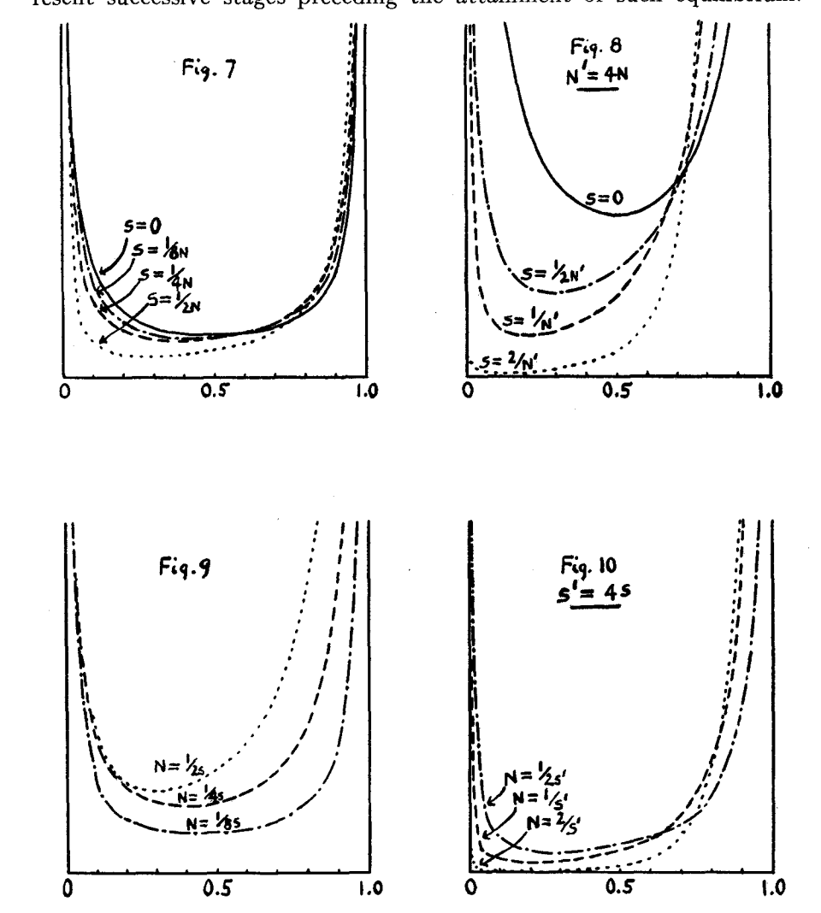
Wright 1930
Site frequency spectra

Slide 29
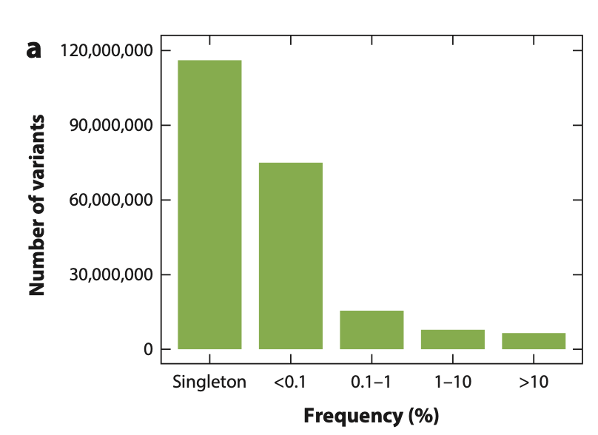
Empirical SFS – very close to drift

Slide 30
Variance explained (alpha =0) – effect size is constant across frequency spectrum
Recall variance explained is 2pqa^2

Slide 31
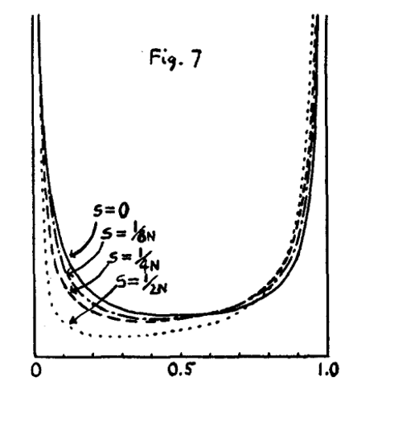
When we add the SFS + variance explained when alpha =0
*
=

Slide 32

Few preparatory remarks for the session

Slide 33
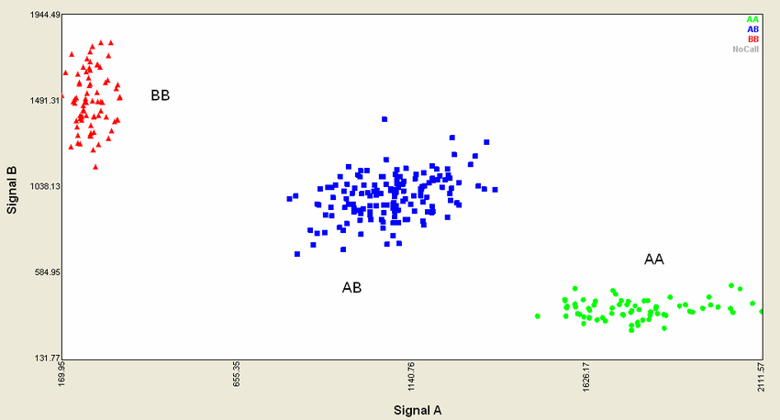
Microarray (genotyping)
QC removes loci with bad binding chemistry
Samples can be assigned high-confidence genotype calls at remaining loci
PLINK BED files include AA/AB/BB/NA call states, no probability information.
https://www.researchgate.net/publication/266330694_Analysis_of_genetic_relatedness_using_DNA_microarrays

Slide 34
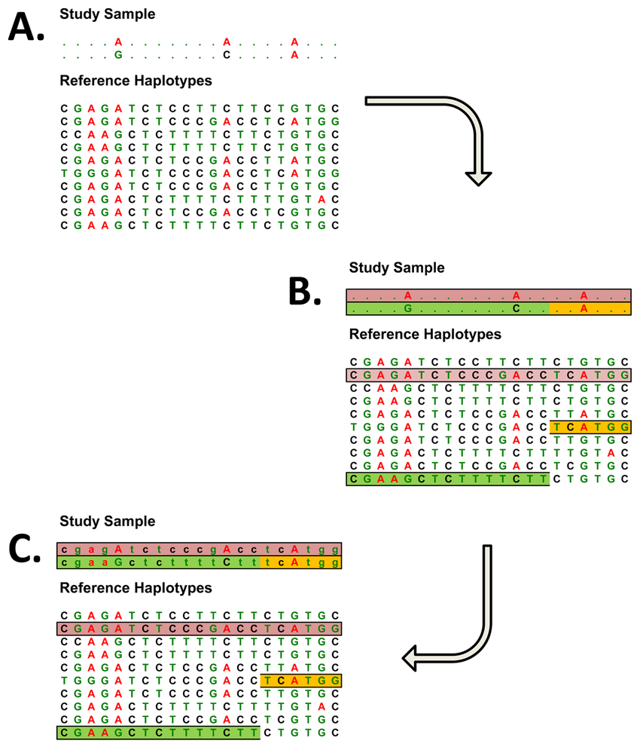
Microarray + imputation
Genotypes at directly measured SNPs are “hard calls”
Genotypes at imputed SNPs are probability distributions over possible genotype states, or a genotype dosage.
Oxford BGEN files contain probabilities for each genotype configuration.
.
https://www.researchgate.net/publication/26775265_Genotype_Imputation

Slide 35
So where do sequencing data originate?

Slide 36
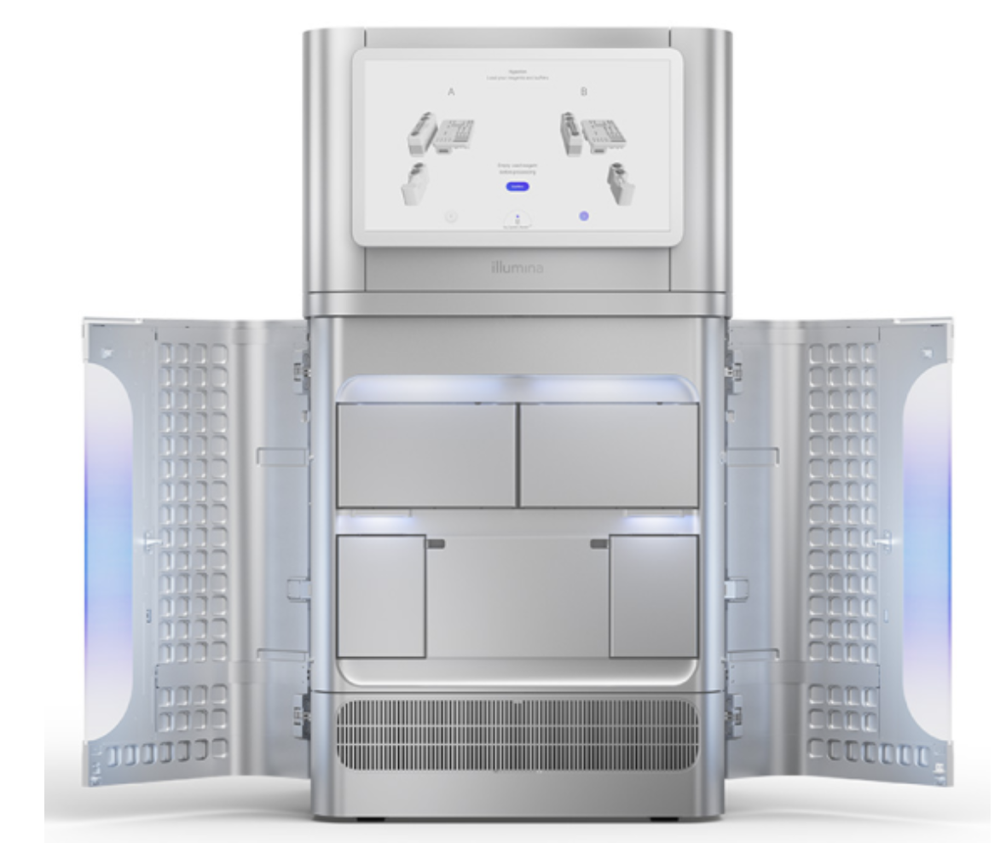
High-throughput sequencing
https://www.illumina.com/systems/sequencing-platforms/novaseq-x-plus.html
Also called:
  Shotgun sequencing
  Short read sequencing
  Next generation sequencing
Genome is broken down into small segments, and many segments are read in parallel
Segments are computationally assembled into a complete sequence using overlaps (de novo assembly) or aligned against an existing reference genome (alignment).
Illumina NovaSeqX
3 Terabases per flow cell run

Slide 37
From unmapped reads to true genetic variation in next-generation sequencing data
Raw short reads
Mapping and alignment
Region 1
Region 2
NovaSeq
Human reference genome
A single run of a sequencer generates ~2400-3000 GB ~150bp short reads
The origin of each read from the human genome sequence is found
Quality calibration and annotation
Identifying genetic variation
Region 1
Region 2
Region 1
Region 2
Human reference genome
Human reference genome
SNP
The quality of each read is calibrated and additional information annotated for downstream analyses
SNPs and indels from the reference are found where the reads collectively provide evidence of a variant

Slide 38
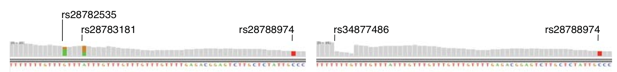
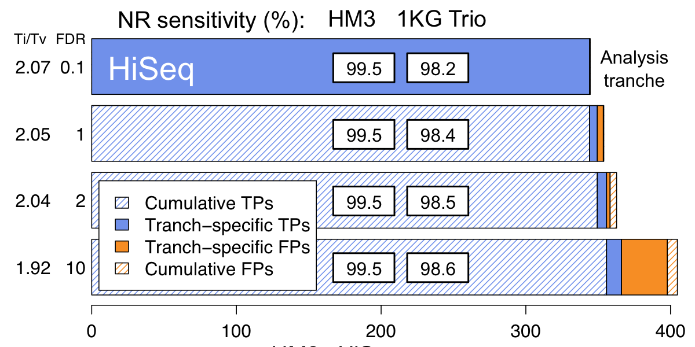
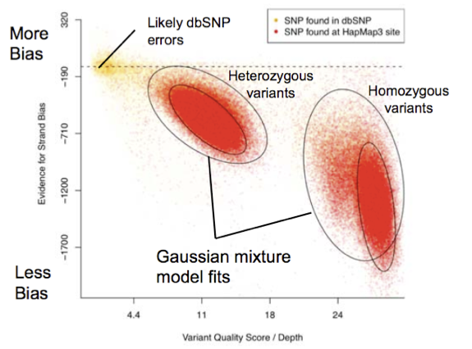
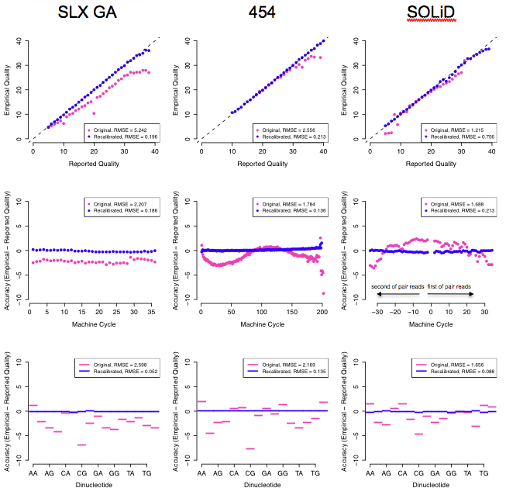
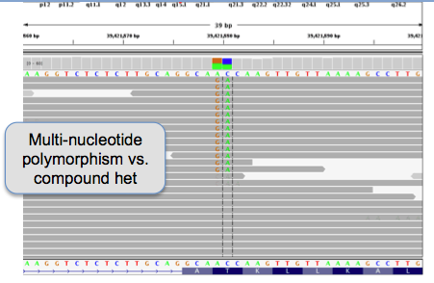
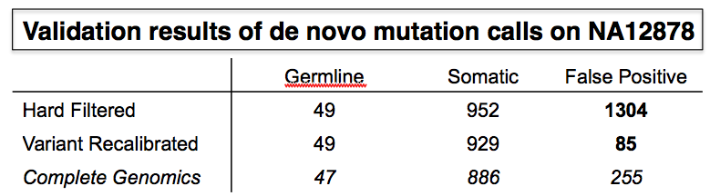
Data processing and analysis methods
Local realignment
Variation discovery and genotyping
Novel SNPs found
Base quality score recalibration
Adaptive error modeling
Read-backed phasing
VariantEval

Slide 39
Sequenced variant calls
GT - best-guess genotype.
  0/0 for homozygous reference, 1/2 for heterozygous non-reference, ./. for missing
GQ - conditional genotype quality.
  GQ 10, 20, 30 indicate 90%, 99%, 99.9% confidence in GT.
DP - total read depth
AD - read depth by allele.
  AD = [10, 8] indicates 10 reads from the reference, 8 from first alternate.
PL - scaled likelihoods of each genotype configuration.

Slide 40
Sequencing data QC…
…is hard. For a few:
depth is important: contamination and mapping errors can cause spurious heterozygous calls
Low-complexity regions are filled with insertions and deletions that defy a fixed reference genome
Handling multiallelic sites is complicated, and often necessary

