Slide 1



Annotating GWAS results
Danielle Posthuma & Douglas Wightman
CTGlab – VU Amsterdam
shared drive Danielle/FUMA_new2023.ppt

Slide 2
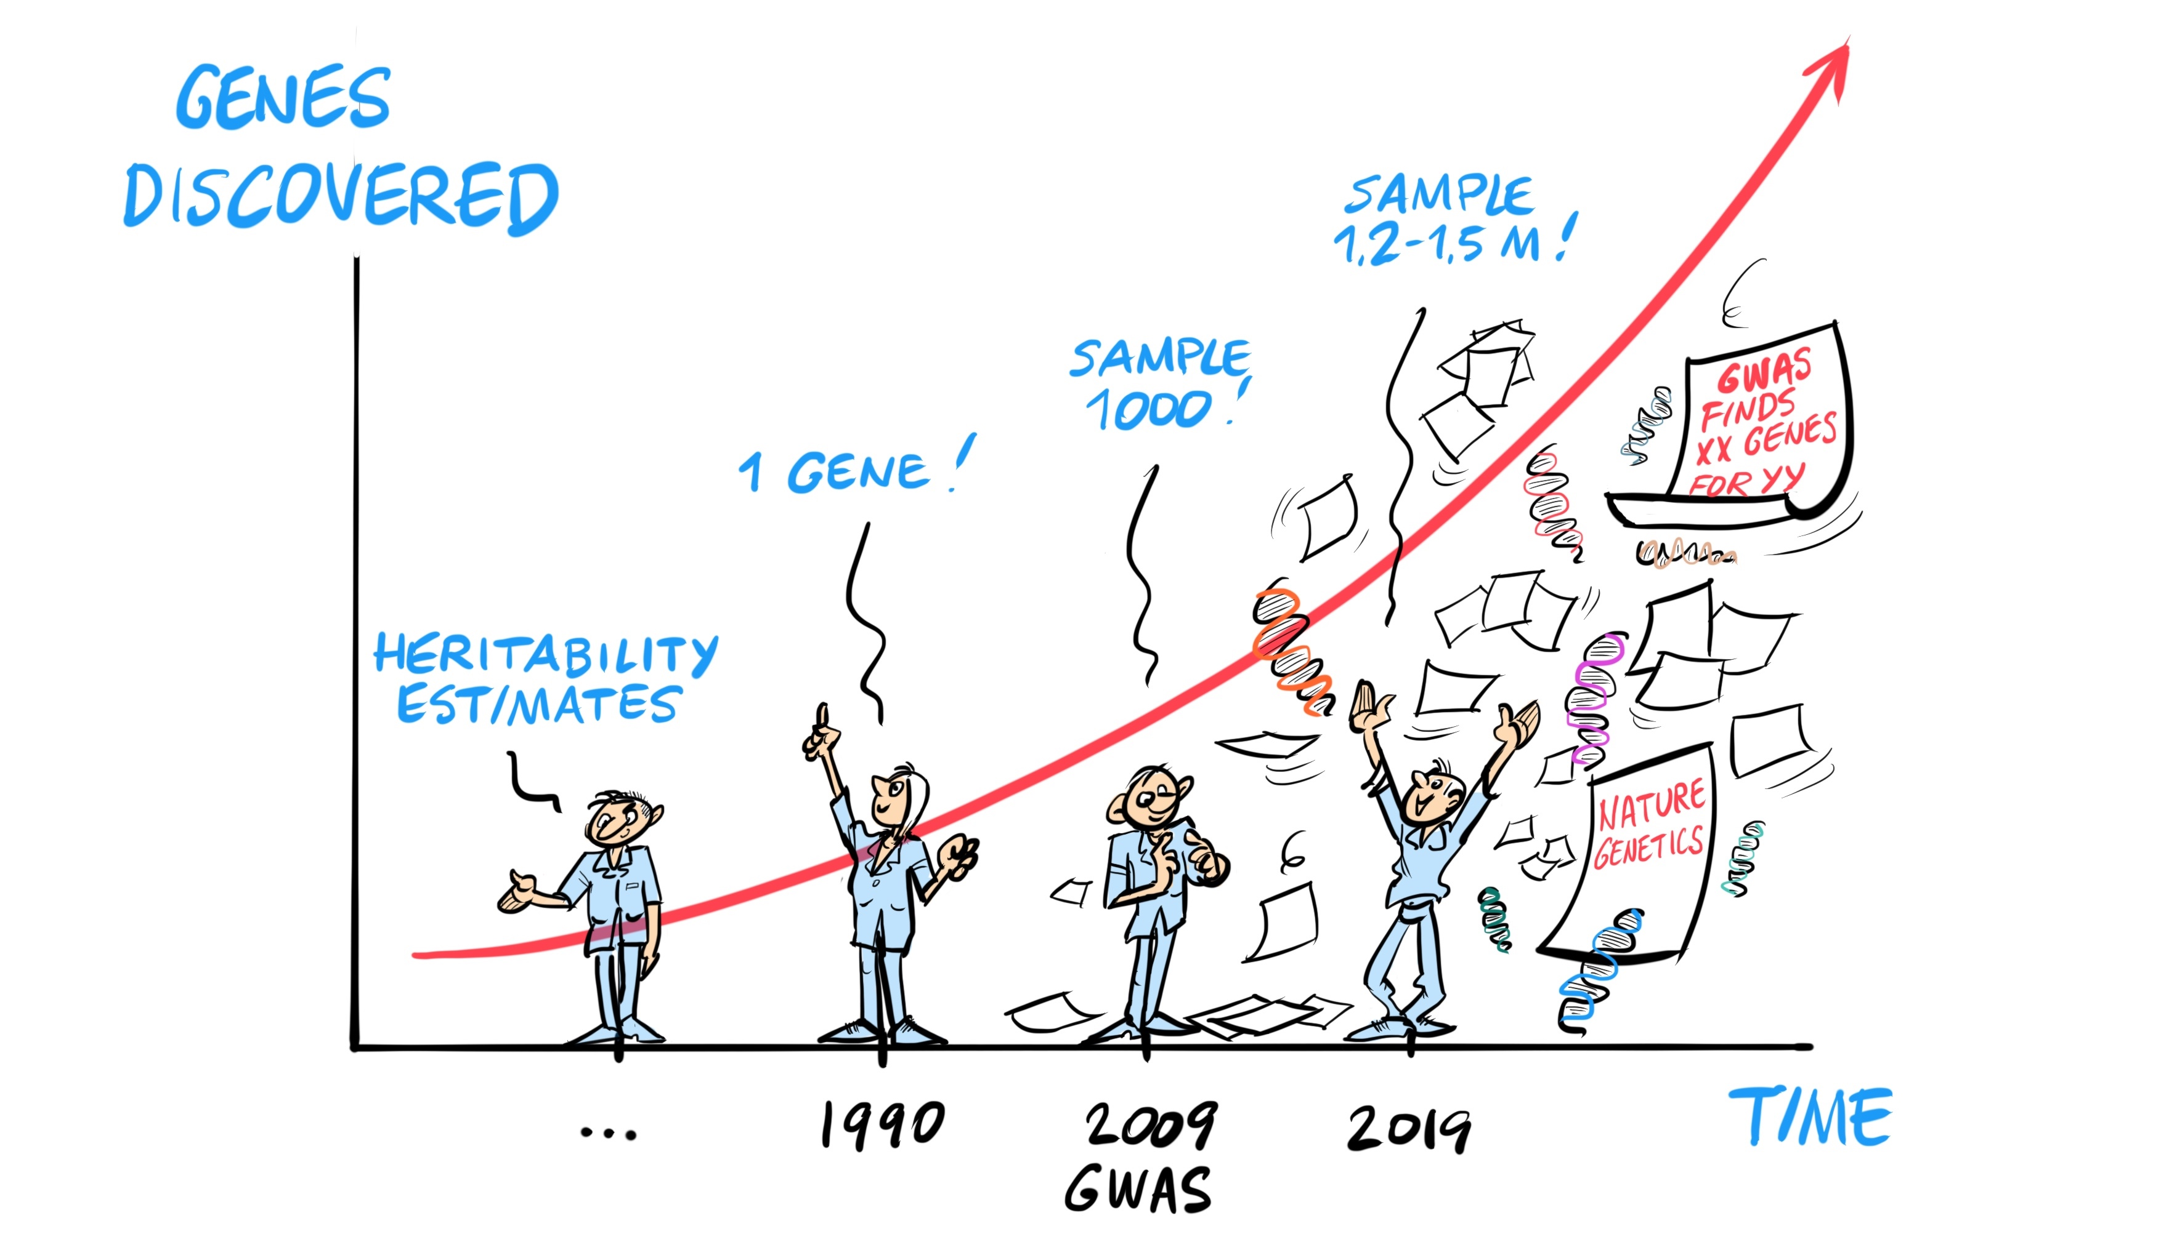
The revolution in genetics

Slide 3
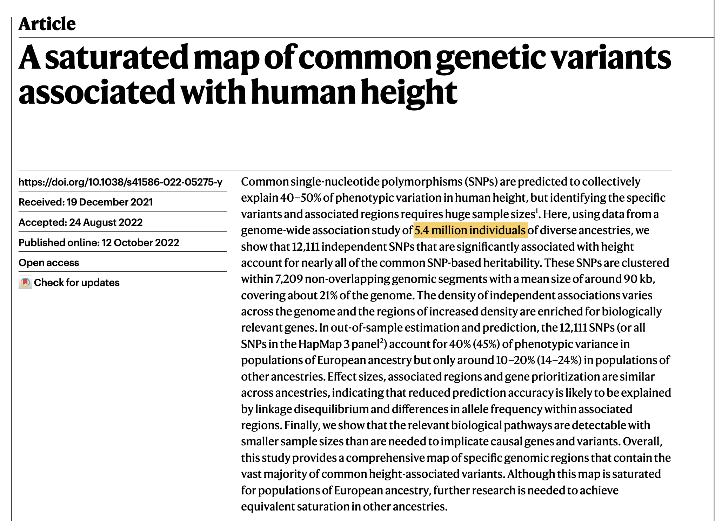
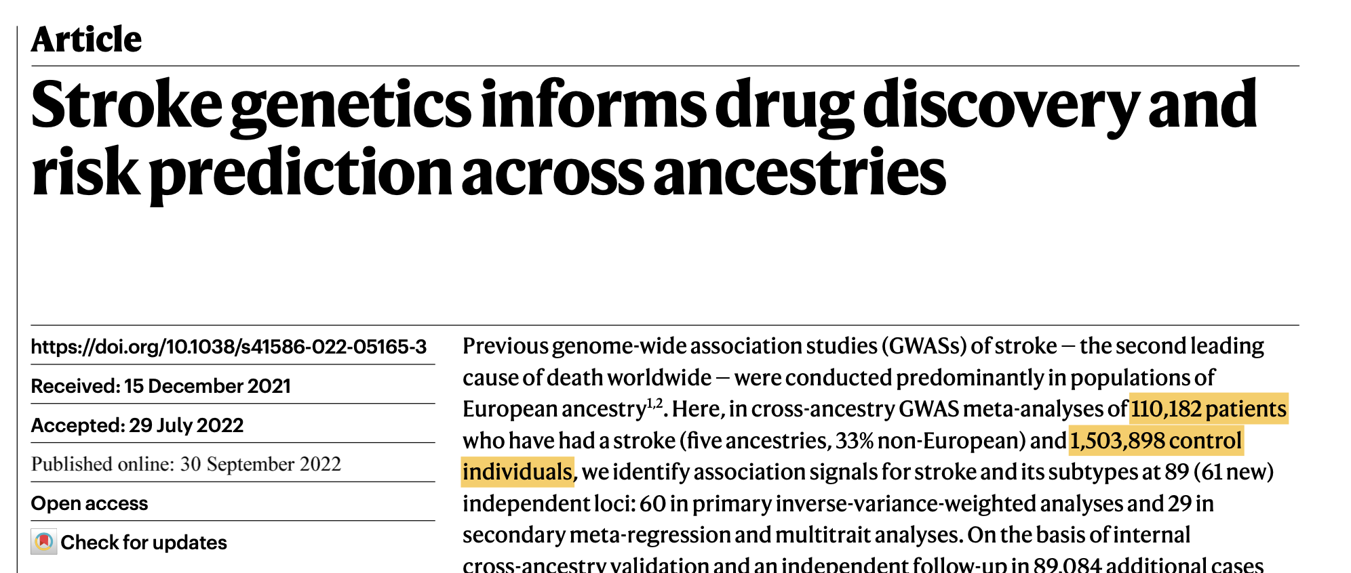
Current genome-wide discovery studies
They are HUGE: sample sizes typically 100,000’s, but even over 1 million is not uncommon!
Standard quality control and analyses pipelines are thoroughly benchmarked and widely shared
Good quality GWAS study ALWAYS includes out of sample replication(s) (most journals would not accept without attempted replication)
There may still be some ‘bad quality’ GWAS studies (small, replication not included), but generally:
The primary outcome of most GWAS studies is replicable,
and highly reliable. Although slight changes in the order of
significance may occur with increasing sample size and
increasing accuracy, top hits are unlikely to be refuted

Slide 4
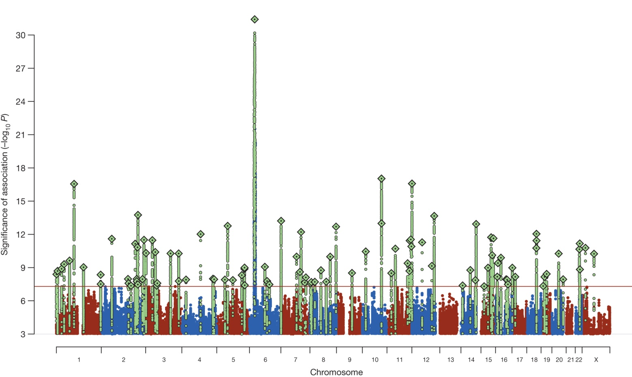
The revolution in genetics…
Lots of genes associated with many traits, but..
..unfortunately, this success has not yet translated at the same pace into mechanistic insight.
GWAS alone does not provide mechanistic insight: GWAS can provide testable hypotheses on biological mechanisms – functional follow up studies are needed to prove causality/involved mechanisms etc
S Ripke et al. Nature (2014)

Slide 5
Why do we need mechanistic insight?
To understand: if we want to explain why some people fall ill and others don’t, we want to know what happens at molecular, cellular and organismal levels
To treat: mechanistic insight may aid in developing novel treatments by providing starting points
For prediction we do not necessarily need mechanistic insight though. But - prediction makes most sense if it can be tailored to treatment

Slide 6
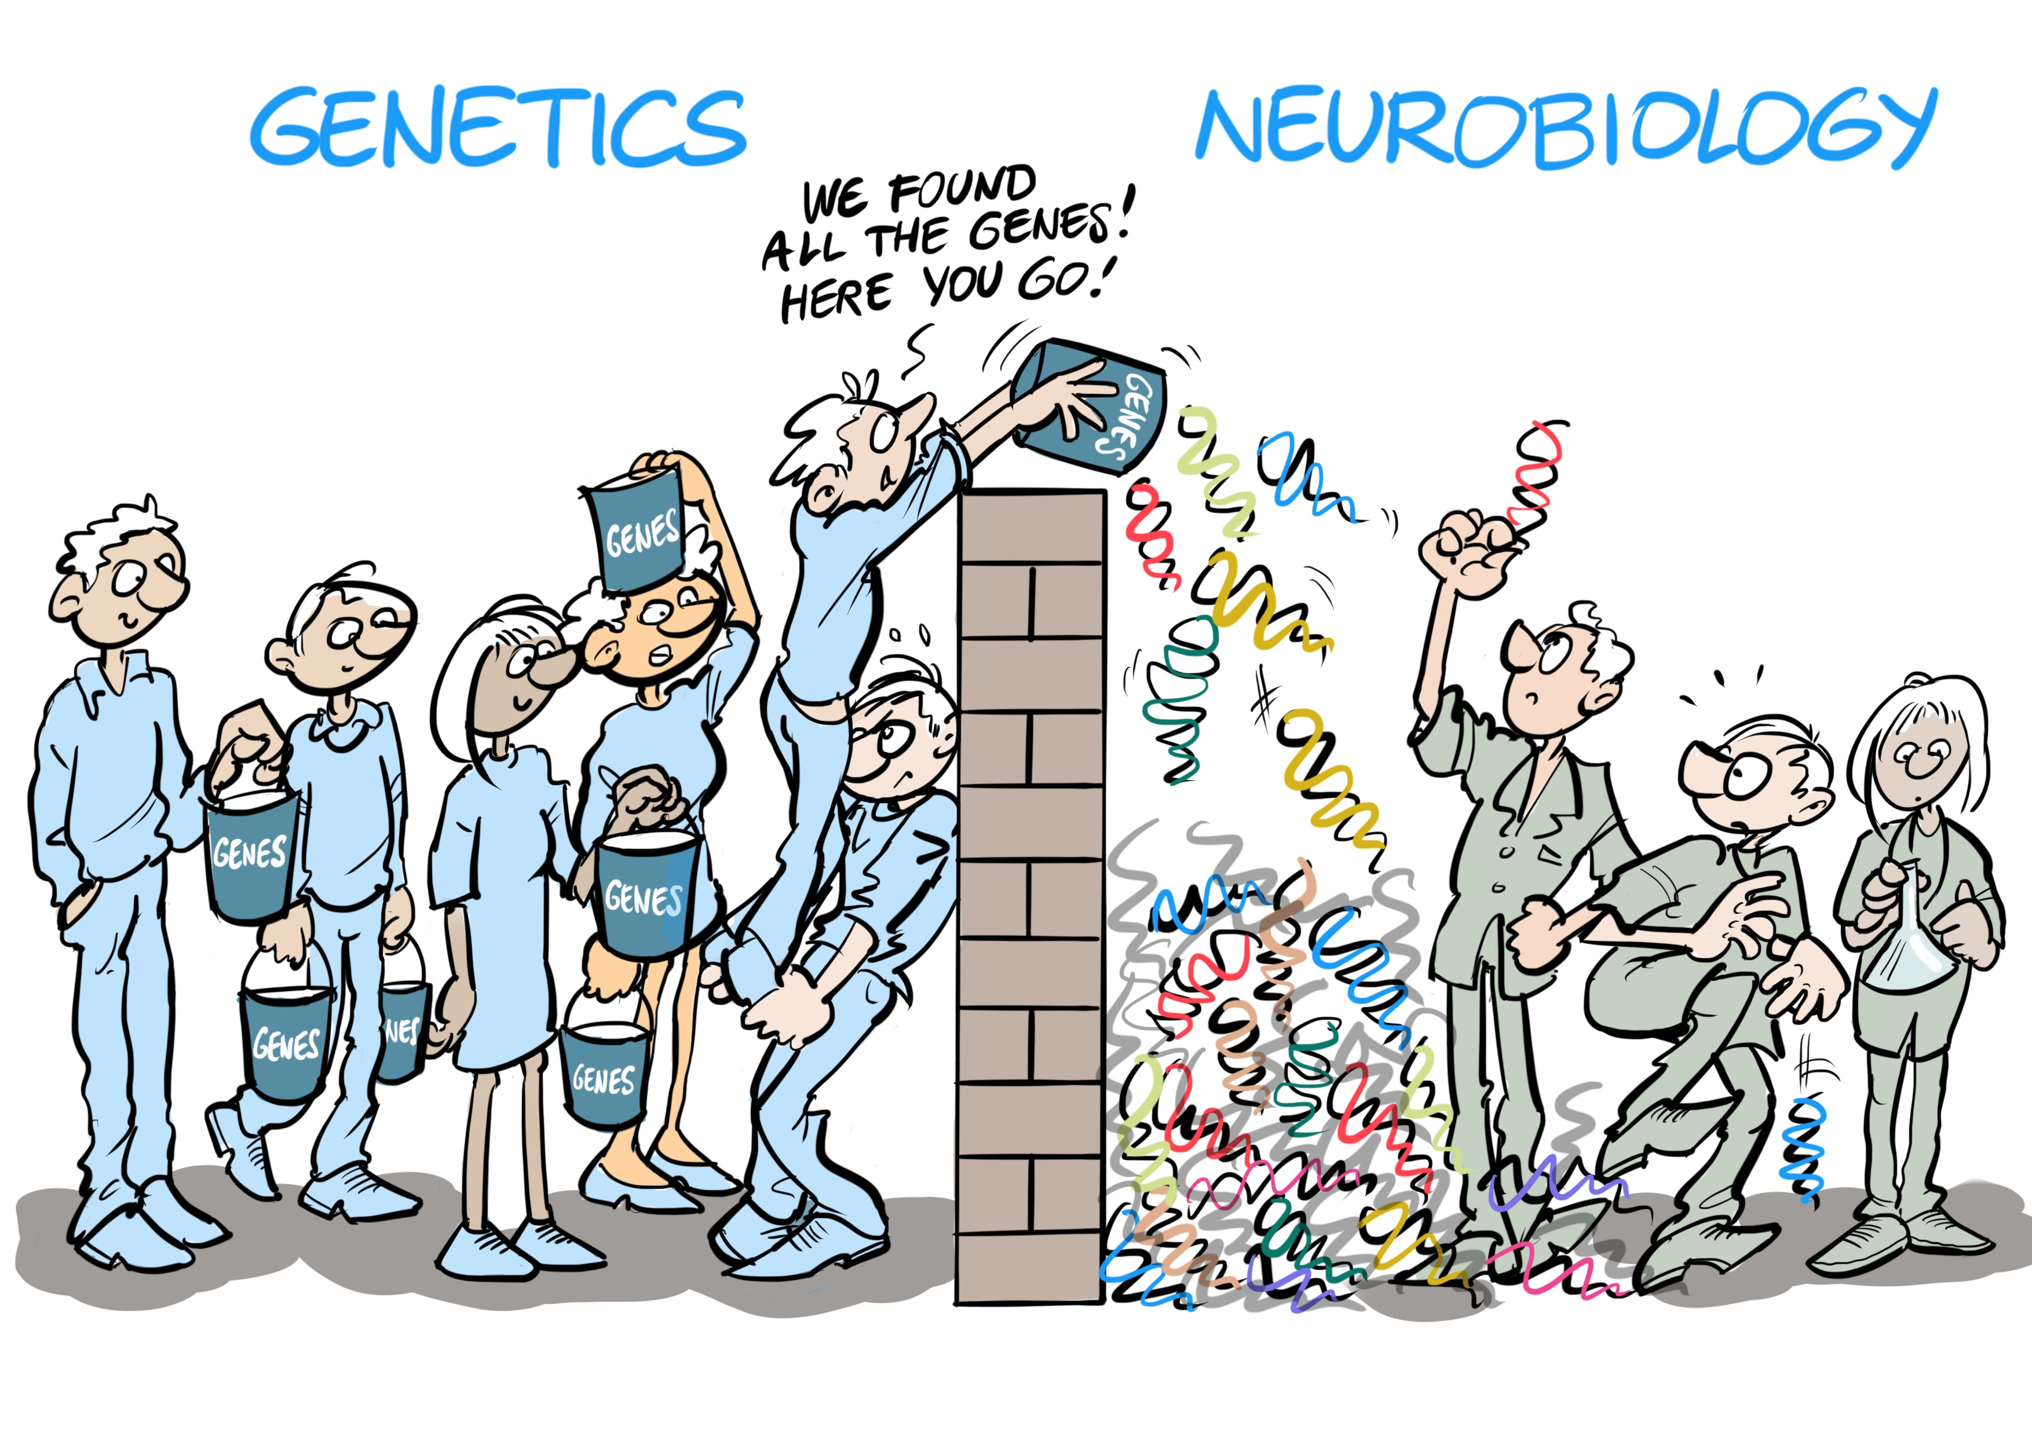
Why is translation of GWAS into mechanistic insight so hard?

Slide 7
Challenges in interpreting GWAS outcome
1. Correlation between variants (LD)
Significant association P-values are distributed over blocks of correlated genetic variants: actual causal variant is unclear

Slide 8
Challenges in interpreting GWAS outcome
1. Correlation between variants (LD)
Significant association P-values are distributed over blocks of correlated genetic variants: actual causal variant is unclear
Solution: - functional annotation (functional variants more likely to be causal than non-functional ones, e.g. tools FUMA, VEP, ANNOVAR)
- statistical fine-mapping (the known correlation structure can be modeled against the observed pattern of association values to pinpoint the most likely causal SNPs, this can be integrated with functional information (e.g. tools FINEMAP, PAINTOR)

Slide 9
Challenges in interpreting GWAS outcome
2. Many GWAS hits are in non-coding regions
The majority of GWAS hits are not in exonic regions but are intronic or non-genic. That means they do not directly lead to a different protein structure and their impact on protein function may be less straightforward to assess.

Slide 10
Coding and Non-coding SNPs
Coding SNPs
Non-synonymous SNPs
Loss of Function (Stop gain, Stop loss)
Splicing SNPs
Non-coding SNPs
Enhancer/Promoter regions
Transcription Factor Binding Sites (TFBSs)
Direct effect on gene product/proteins
Indirect effect on gene products
Enhancer
Protein
TF
Promoter
gene
mRNA
Enhancer
SNP
Expression quantitative loci (eQTLs)
TF
gene
Promoter
gene

Slide 11
Challenges in interpreting GWAS outcome
2. Many GWAS hits are in non-coding regions
The majority of GWAS hits are not in exonic regions but are intronic or non-genic. That means they do not directly lead to a different protein structure and their impact on protein function may be less straightforward to assess.
Solution: link GWAS variants to genes via functional annotation using regulatory information from external resources, such as GTEX (e-QTL), chromatin interactions, i.e. add information on the association of a variant with DNA transcription and RNA or protein levels

Slide 12
Challenges in interpreting GWAS outcome
3. Many traits are polygenic
When a trait is polygenic, multiple genetic variants of small effect contribute. A single genetic variant, even if it is known to be causal, is usually not informative for biology

Slide 13
Challenges in interpreting GWAS outcome
3. Many traits are polygenic
When a trait is polygenic, multiple genetic variants of small effect contribute. A single genetic variant, even if it is known to be causal, is usually not informative for biology
Solution: map associated SNPs to genes and look for convergence in biological pathways, shared cellular or synaptic function, co-localization, co-expression in tissue or cell types (e.g. tools MAGMA, Ldscore regression, DEPICT)
This will be covered in next session on gene-set analysis

Slide 14
Awesome GWAS results
S Ripke et al. Nature (2014)

Slide 15
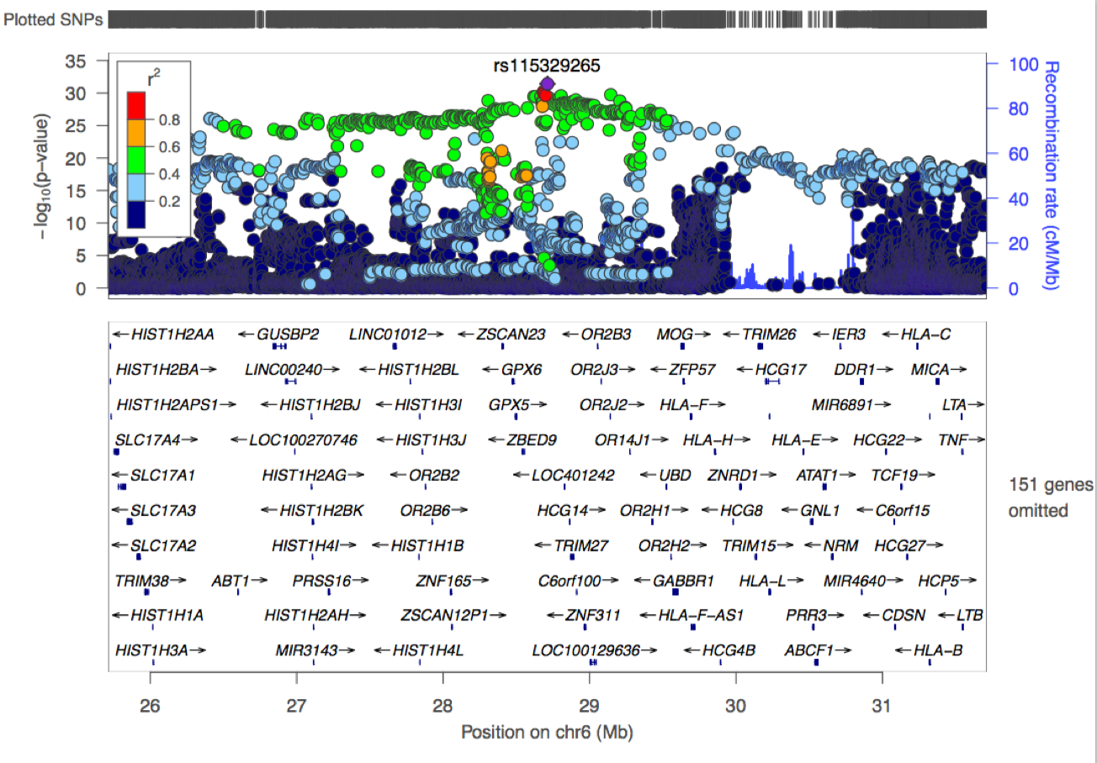
Awesome GWAS results - but how to interpret?

Slide 16
GWAS risk locus

Slide 17
GWAS risk locus

Slide 18
GWAS risk locus

Slide 19
GWAS risk locus
Deleterious coding SNPs
rs943037
CADD=17.62
rs284860
CADD=15.56
rs6163
CADD=12.94

Slide 20
GWAS risk locus
eQTLs affecting expression of NT5C2
eQTLs affecting expression of ARL3
eQTLs in Brain

Slide 21
GWAS risk locus
RegulomeDB score 1f

Slide 22
GWAS risk locus
HiC interaction in Brain

Slide 23
GWAS risk locus
Deleterious coding SNPs
eQTLs in Brain
HiC interaction in Brain
Notes:
By combining multiple information, you can start understanding what king of biological functions are laying under the risk locus

Slide 24
Post-GWAS annotations and prioritization
PLINK
1. Linkage disequilibrium (LD)
Identify all SNPs in LD with significant hits.

Slide 25
Post-GWAS annotations and prioritization
PLINK
1. Linkage disequilibrium (LD)
Identify all SNPs in LD with significant hits.
2. Variant annotation
Functional consequence on genes (e.g. exonic, intronic or splicing site)
ANNOVAR

Slide 26

Post-GWAS annotations and prioritization
PLINK
1. Linkage disequilibrium (LD)
Identify all SNPs in LD with significant hits.
2. Variant annotation
Functional consequence on genes e.g. exonic, intronic or splicing site)
ANNOVAR
3. Functional annotation
Deleteriousness, regulatory elements and epigenetic data
CADD
HiC

Slide 27
Post-GWAS annotations and prioritization
PLINK
1. Linkage disequilibrium (LD)
Identify all SNPs in LD with significant hits.
2. Variant annotation
Functional consequence on genes (e.g. exonic, intronic or splicing site)
Multiple databases
Multiple software
Multiple steps
Reformatting of data
Time-consuming + error prone
ANNOVAR
3. Functional annotation
Deleteriousness, regulatory elements and epigenetic data
CADD
HiC
4. Functional analyses of genes
Tissue specific expression, gene set analyses

Slide 28
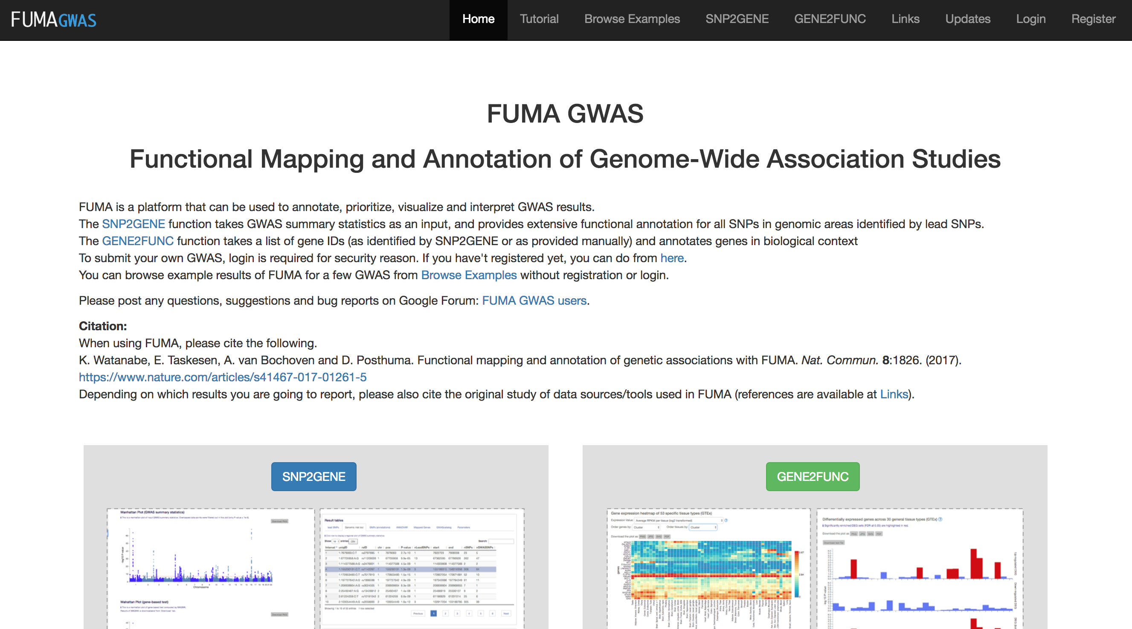
FUMA: Functional Mapping and Annotation
of genetic associations
Available at http://fuma.ctglab.nl
Developed by Kyoko Watanabe

Slide 29
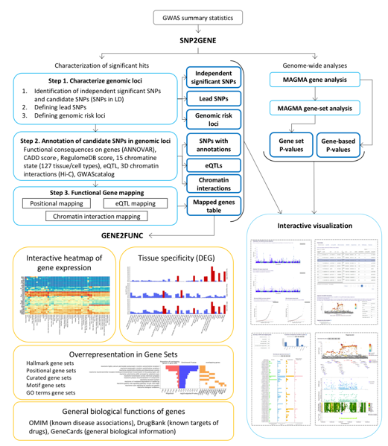
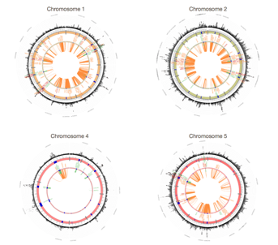
FUMA
Upload GWAS summary statistics
Use default settings or adjust as desired
Output:
Defined risk loci
Manhattan & QQ plots
Gene-based and gene-set analyses, incl tissue and cell type
Extensive annotations of all SNPs in risk loci in LD with top SNPs
Variant to gene mapping using position, eQTL, chromatin interaction
Look-up of SNPs in gwas catalogue
Lots of visualizations and downloadable tables
Upload list of gene names
Output:
- gene-set and tissue enrichments

Slide 30
FUMA
Upload GWAS summary statistics
Use default settings or adjust as desired
Output:
Defined risk loci
Manhattan & QQ plots
Gene-based and gene-set analyses, incl tissue and cell type
Extensive annotations of all SNPs in risk loci in LD with top SNPs
Variant to gene mapping using position, eQTL, chromatin interaction
Look-up of SNPs in gwas catalogue
Lots of visualizations and downloadable tables
Upload list of gene names
Output:
- gene-set and tissue enrichments
SNP2GENE
GENE2FUNC

Slide 31
SNP2GENE
GWAS summary statistics
Independent significant SNPs
Step 1. Characterize genomic risk loci
Lead SNPs
Genomic risk loci

Slide 32
SNP2GENE
GWAS summary statistics
Independent significant SNPs
Step 1. Characterize genomic risk loci
Lead SNPs
Genomic risk loci
Step 2. Annotation of candidate SNPs in genomic loci
SNPs with annotations
ANNOVAR, CADD, RegulomeDB, Open chromatin state,
eQTLs (GTEx, 2xBlood eQTLs, BRAINEAC), Hi-C
eQTLs

Slide 33
SNP2GENE
GWAS summary statistics
Independent significant SNPs
Step 1. Characterize genomic risk loci
Lead SNPs
Genomic risk loci
Step 2. Annotation of candidate SNPs in genomic loci
SNPs with annotations
ANNOVAR, CADD, RegulomeDB, Open chromatin state,
eQTLs (GTEx, 2xBlood eQTLs, BRAINEAC), Hi-C
eQTLs
Step 3. Functional Gene mapping
Positional mapping
eQTL mapping
Mapped genes table
Chromatin interaction mapping

Slide 34
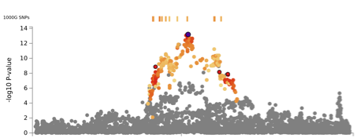
Gene Mapping
Positional mapping
Mapped genes
Un-mapped genes

Slide 35
Gene Mapping
Positional mapping
Mapped genes
Un-mapped genes
Intergenic
exonic

Slide 36
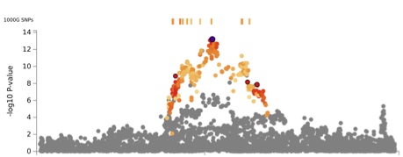
Gene Mapping
Positional mapping
eQTL mapping
Mapped genes
Mapped genes
Un-mapped genes
Un-mapped genes
Intergenic
exonic

Slide 37
Gene Mapping
Positional mapping
eQTL mapping
Mapped genes
Mapped genes
Un-mapped genes
Un-mapped genes
Intergenic
exonic
Optional filtering of SNPs based on functional annotations prior to gene mapping
CADD score (>12.37 is considered as highly deleterious)
RegulomeDB score (categorical score from 1a to 7)
15-core chromatin status (1-7 states are considered as open, tissue specific)
*Parameters can be set for each mapping separately

Slide 38
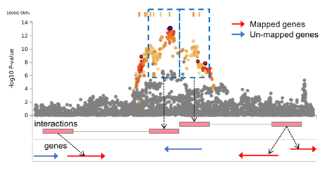
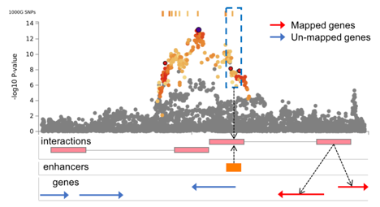
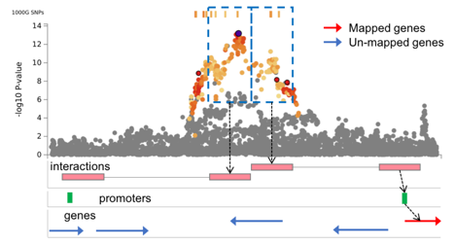
Gene Mapping
Chromatin interaction mapping
Map SNPs in a genomic region interacting with promoter region of genes (250bp up- and 500bp downstream of TSS) in selected tissue types.
SNPs can be further filtered on overlap with predicted enhancers or promotor regions from Roadmap.

Slide 39
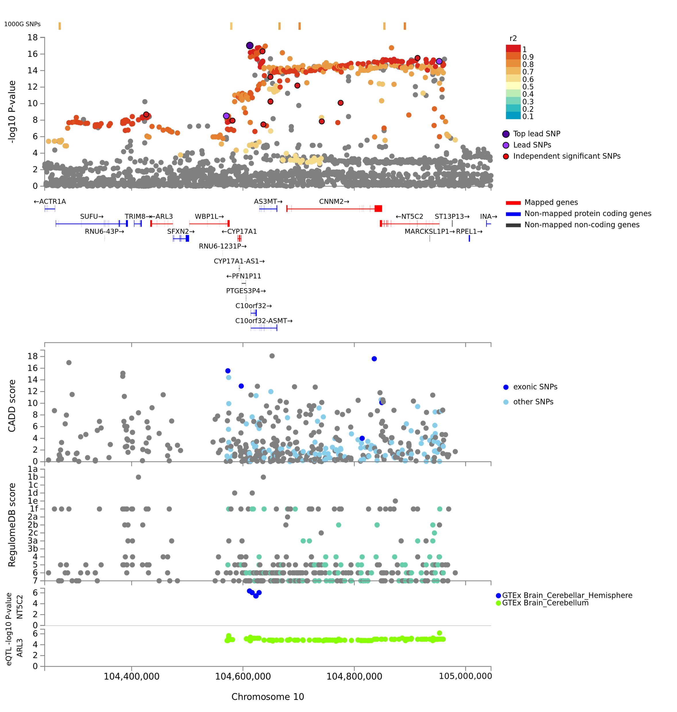
FUMA: regional plot
GWAS P-value
Genes
CADD score
RegulomeDB score
eQTLs

Slide 40
FUMA: regional plot
GWAS P-value
Deleterious coding SNPs
Genes
CADD score
RegulomeDB score
eQTLs

Slide 41
FUMA: regional plot
GWAS P-value
Deleterious coding SNPs
Genes
CADD score
RegulomeDB score
eQTLs in Brain
eQTLs

Slide 42
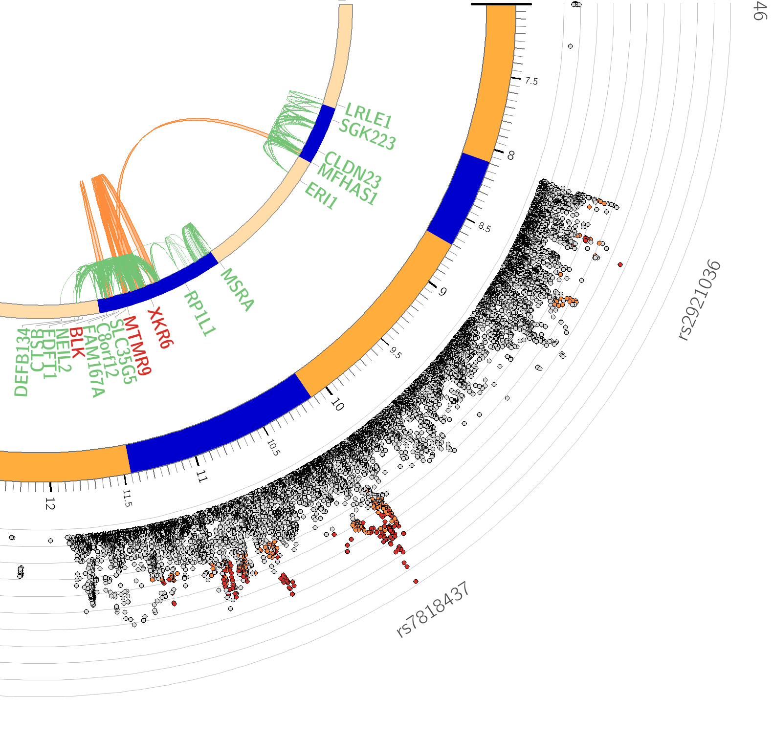
FUMA: circos plot
Chromosome 8
Chromatin interactions can map SNPs to distal genes.
Nagel, M. et al. Meta-Analysis of Genome-wide Association Studies for Neuroticism in 449,484 Individuals Identifies Novel Genetic Loci and Pathways. (2018) Nat. Genet.

Slide 43
FUMA: circos plot
Chromosome 8
Chromatin interactions can map SNPs to distal genes.
Cross loci interaction
XKR6 is mapped by within and cross loci interactions and also mapped by eQTLs.
Nagel, M. et al. Meta-Analysis of Genome-wide Association Studies for Neuroticism in 449,484 Individuals Identifies Novel Genetic Loci and Pathways. (2018) Nat. Genet.

Slide 44
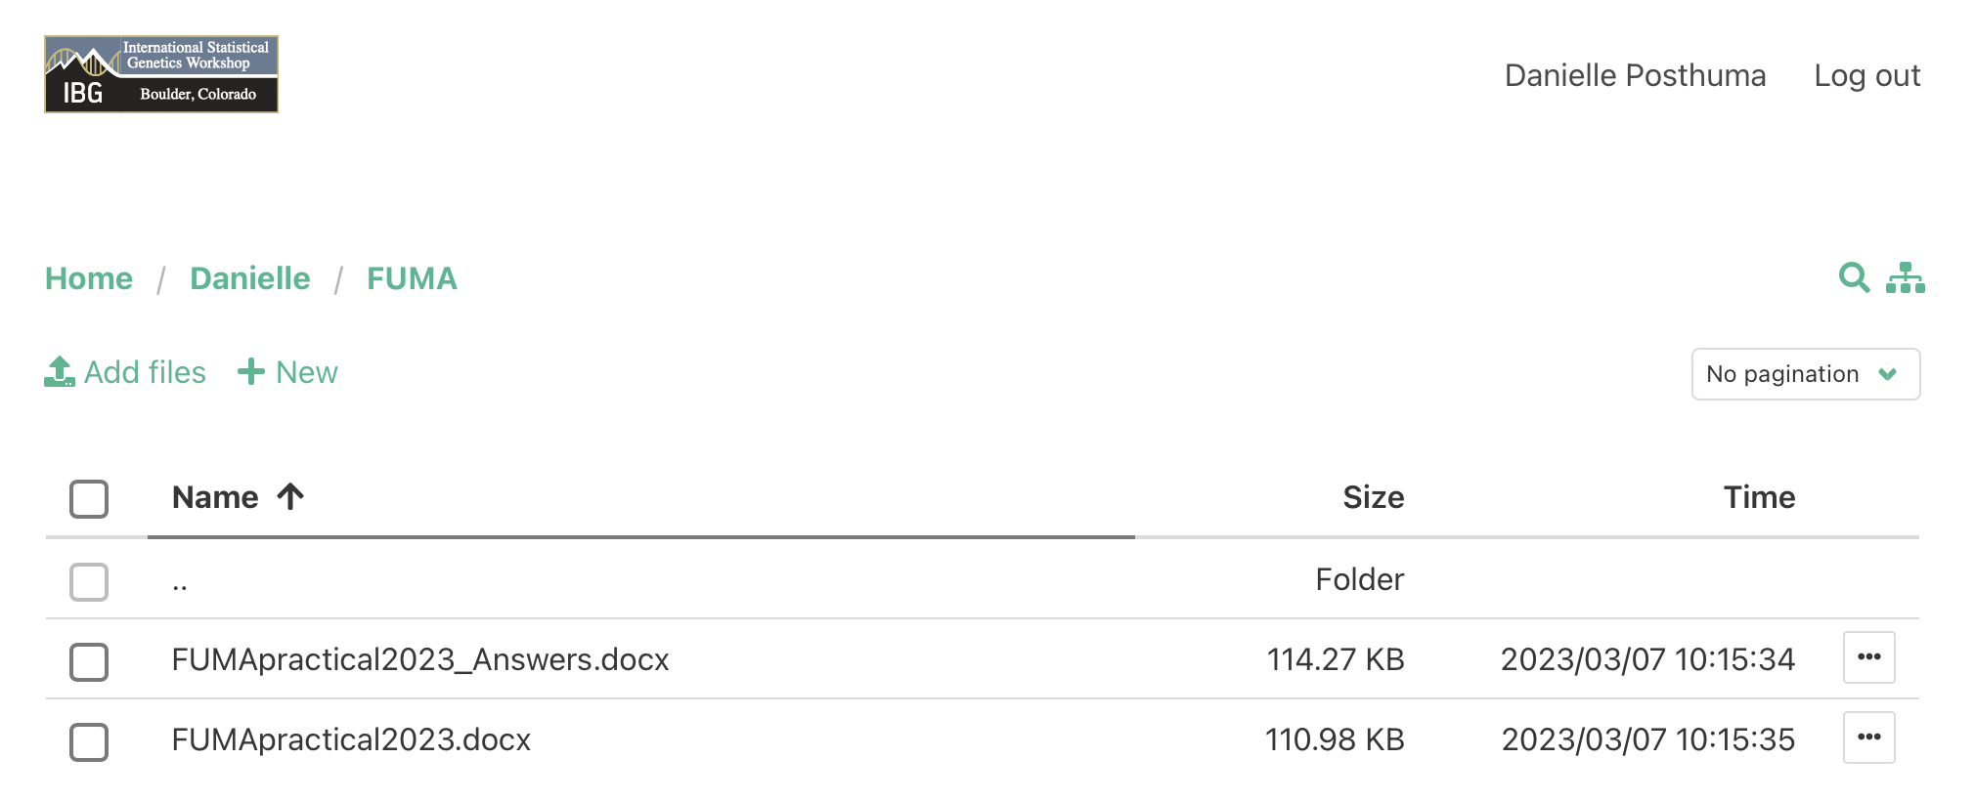
FUMA Practical
Shared file area:
Home/Danielle/FUMA/FUMApractical2023.docx

