Slide 1


Sensitivity Analyses in Mendelian Randomization Studies
David Evans
Institute for Molecular Bioscience
University of Queensland

Slide 2
This Session
Inverse variance weighted MR
Heterogeneity tests
Multivariable MR
MR Egger
MR Weighted Median
MR Modal Estimator
Steiger Filtering

Slide 3
Inverse Variance Weighted Fixed Effects Meta-analysis

Slide 4
Inverse variance weighted (IVW) fixed effects method
There is one underlying ‘true’ effect
All deviations of sample effects from the ‘true’ effect are due to chance
For N studies, each study i contributes more to the meta analysis if its standard error is lower

Slide 5
Calculate p-value

Slide 6
Fixed Effects IVW-MR and Weighted Linear regression
IVW is equivalent to a weighted regression of SNP-outcome effects on SNP-exposure effects passing through the origin
The weights are 1/SE_SNP_outcome
The slope is the estimate of the causal effect
Confounders
SNP 1
SNP 2
SNP 3
LDL
CHD
SNP 4

Slide 7
Performing MR With Summary Statistics

Slide 8
The Issue of Strand
Evans et al (2021) Behav Genet

Slide 9
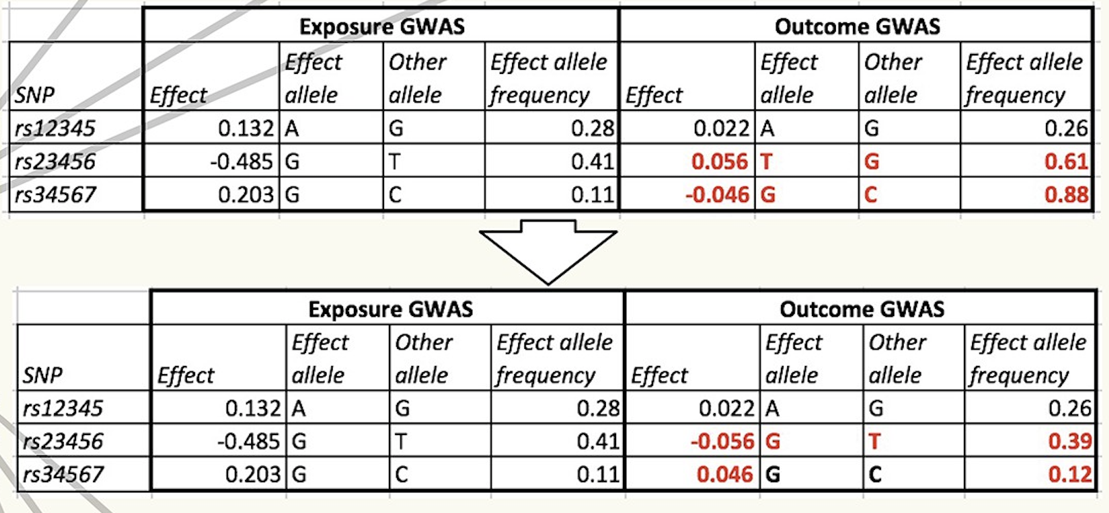
Harmonise exposure and outcome effects

Slide 10
Strand issue exercise
SNP | Study 1 alleles | Study 1 allele freq | Study 2 alleles | Study 2 allele freq | Verdict
rs1 | A/G | 0.2 | A/G | 0.2
rs2 | G/T | 0.3 | T/G | 0.72
rs3 | G/C | 0.65 | G/C | 0.62
rs4 | A/T | 0.49 | A/T | 0.50
rs5 | A/T | 0.12 | A/T | 0.89
rs6 | A/G | 0.4 | A/T | 0.4

Slide 11
MR methods for handling horizontal pleiotropy
Many methods now exist

Slide 12
What is the problem?
Mendelian Randomization (MR) uses genetic variants to test for causal relationships between phenotypic exposures and disease-related outcomes
Due to the proliferation of GWAS, it is increasingly common for MR analyses to use large numbers of genetic variants
Increased power but greater potential for pleiotropy
Pleiotropic variants affect biological pathways other than the exposure under investigation and therefore can lead to biased causal estimates and false positives under the null

Slide 13
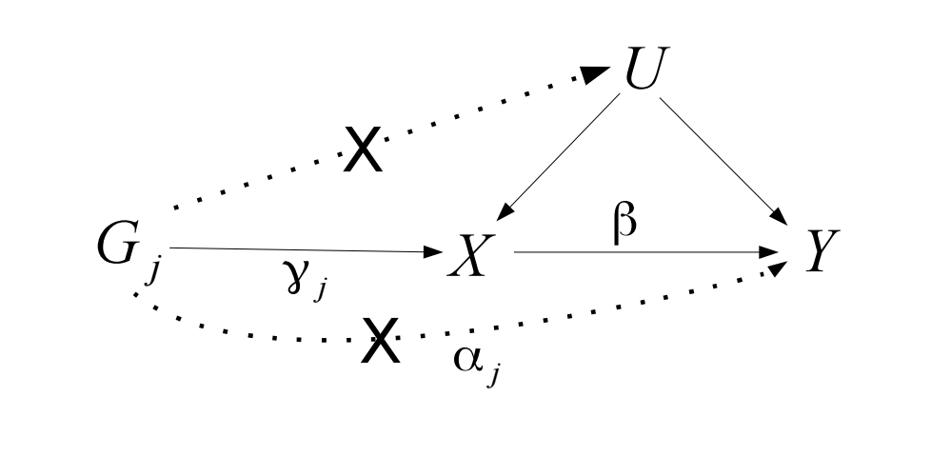
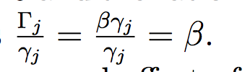
Two Sample MR:
Single Variants
Wald = Beta-GY
Beta-GX
Causal estimate using Wald method:
Notes:
Single causal estimate from the ratio estimator / Wald method

Slide 14
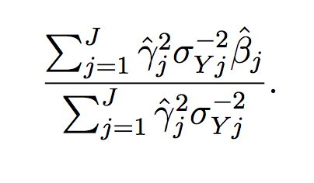

Two Sample MR:
Multiple Variants
Causal estimate using IVW
from summarised data:
(Approximates TSLS)
Notes:
With multiple genetic variants, causal effect estimated using TSLS – weighted average of the ratio estimates calculated using each genetic variant in turn.
If the genetic variants are uncorrelated, inverse-variance weighted estimated using summarized data can be calculated.
In infite samples IVW = TSLS, but will differ slightly in finite samples
Beta-hat = study specific IV estimates (YZ/XZ)

Slide 15
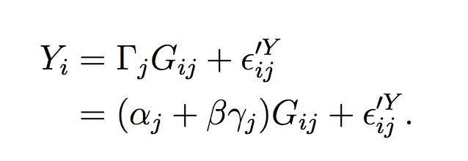

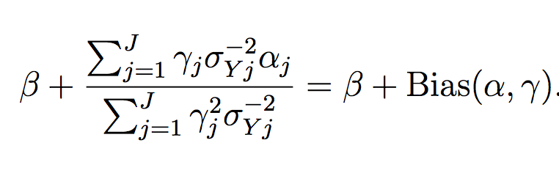
MR – with direct pleiotropy
.
Single variant Wald estimate:
Multiple variant
TSLS / IVW :
Notes:
Estimate will be biased unless alphaj = 0; or the alphaj’s cancel out

Slide 16
Heterogeneity
We expect that each SNP represents an independent study, and each should give an unbiased (if imprecise) estimate of the causal effect of x on y
Heterogeneity, where effect estimates are more different than expected due to standard errors, arises because at least some of the instruments are invalid
Cochran’s Q statistic
n=6 instruments
Expect Q = 5 if there is no heterogeneity
Q is chi-square distributed with n-1 degrees of freedom

Slide 17
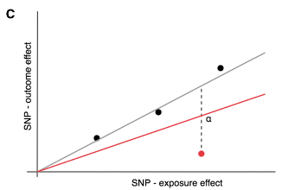
Option 1: Remove outliers
Some SNPs might contribute to the majority of the heterogeneity
If we assume these are the invalid instruments then the IVW estimate excluding them should be less biased
However – beware of:
Cherry picking – remove outliers will artificially provide a more precise estimate
What if the outlier is the only valid instrument, and all the others are invalid?
  E.g. cis-variants for gene expression, DNA methylation, protein levels. CRP levels are best instrumented by variants within the CRP gene region. Most other variants that come up in CRP GWAS are upstream effects related to inflammation

Slide 18
Option 2: Multivariable MR
We are testing for whether X1 has an influence on Y
We know that some instruments for X1 also have influences on X2
This opens up the possibility of horizontal pleiotropy biasing our estimate
What is the X1-Y association adjusting for X2?

Slide 19
Option 3: Fit a model that is robust to some model of horizontal pleiotropy
IVW fixed effects estimate assumes all SNPs are valid instruments, and averages across them all
IVW random effects model allows all SNPs to be drawn from a different distribution – the estimate is the same but the standard error is larger if there is any heterogeneity
Several others…

Slide 20
MR Egger Regression

Slide 21
MR Egger Regression: Central concept
In Mendelian Randomization when multiple genetic variants are being used as IVs, Egger regression can:
  Identify the presence of ‘directional’ pleiotropy
  (biasing the IV estimate)
  provide a less biased causal estimate
  (in the presence of pleiotropy)

Slide 22
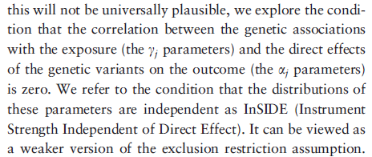
InSIDE Assumption
Relaxing MR’s assumptions
.
W
Notes:
Standard MR has 3 assumptions.
InSIDE relaxes the third assumption

Slide 23
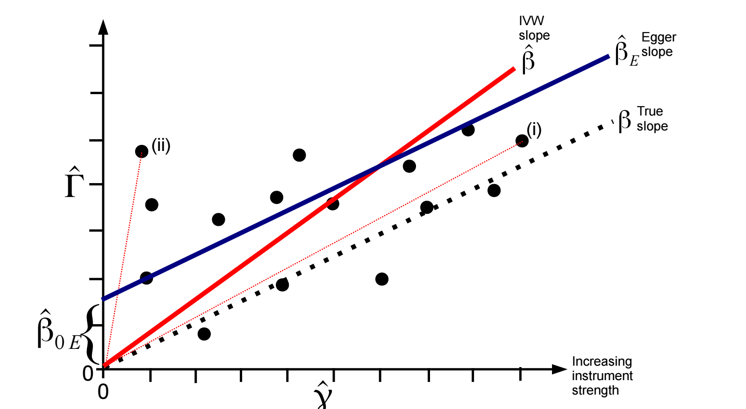
Example:
ALL INVALID INSTRUMENTS
INSIDE ASSUMPTION SATISFIED
SNP – outcome association
SNP – exposure association
Notes:
This is equal to the coefficient
from a weighted regression of the gene–outcome association
estimates (^C j) on the gene–exposure association estimates
(^cj) with the intercept constrained to zero, and
weighted by the inverse of the precision of the IV–outcome
coefficients (r2
Yj ).

Slide 24


InSIDE:
Bias of ratio estimator
SNP – outcome association
SNP – exposure association
Notes:
Since bias is inversely proportional to SNP-exposure association, ratio estimates for stronger genetic variants (such as (i) ) will be on average closer to the true causal effect

Slide 25
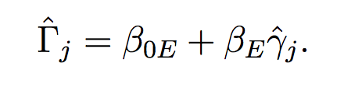
Egger regression:
Intercept not constrained to zero
Egger’s test assesses whether the intercept term is significantly different from zero. The estimated values of the intercept can be interpreted as the average pleiotropic effect across all genetic variants. An intercept term different from zero indicates directional pleiotropy
Notes:
Egger’s test assesses whether the intercept term is significantly different from zero. This will occur if estimates from weaker genetic variants are more skewed towards higher/lower values compared with estimates from stronger genetic variants.
The estimated values of the intercept can be interpreted as average pleiotropic effect across all genetic variants.
An intercept term different from zero indicates overall directional pleiotropy (ie pleiotropy not balanced around the null)

Slide 26
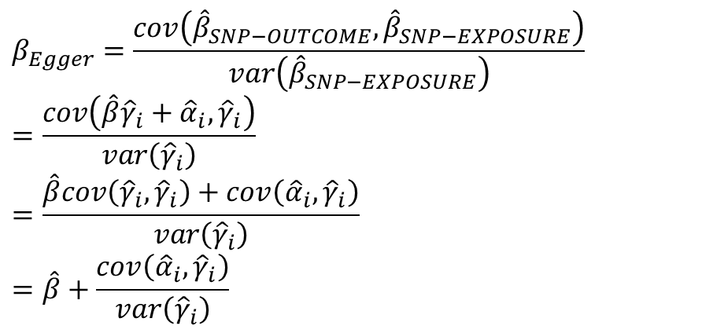


Why Does It Work?
SNP – outcome association
.
.
SNP – exposure association
$$β_{Egger}=\frac{cov\left({\hat{β}}_{SNP−OUTCOME},{\hat{β}}_{SNP−EXPOSURE}\right)}{var\left({\hat{β}}_{SNP−EXPOSURE}\right)} =\frac{cov\left(\hat{β}{\hat{γ}}_{i}+{\hat{α}}_{i},{\hat{γ}}_{i}\right)}{var\left({\hat{γ}}_{i}\right)}$$
$$=\frac{\hat{β}cov\left({\hat{γ}}_{i},{\hat{γ}}_{i}\right)+cov\left({\hat{α}}_{i},{\hat{γ}}_{i}\right)}{var\left({\hat{γ}}_{i}\right)}$$
$$=\hat{β}+\frac{cov\left({\hat{α}}_{i},{\hat{γ}}_{i}\right)}{var\left({\hat{γ}}_{i}\right)}$$
$$As N→∞, cov\left({\hat{α}}_{i},{\hat{γ}}_{i}\right)→cov\left(α_{i},γ_{i}\right)$$
$As \#markers→∞, cov\left(α_{i},γ_{i}\right)→$ 0

Slide 27
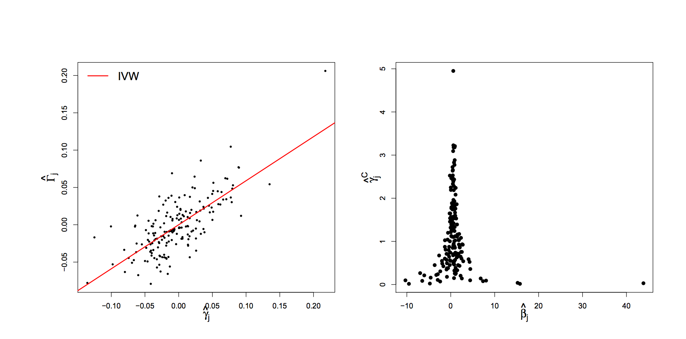
Height and lung function
SNP-Lung Function
SNP-Height
SNP - Height
Causal estimate
IVW = 0.59 (95% CI: 0.50, 0.67 )
Egger = 0.58 (95% CI: 0.50, 0.67); intercept -0.001 p=0.5
Notes:
180 variants for height
Funnel plot suggests little asymmetry present (indicative of no directional pleiotropy); supported by concordance between egger test and IVW, and the lack of significant intercept

Slide 28
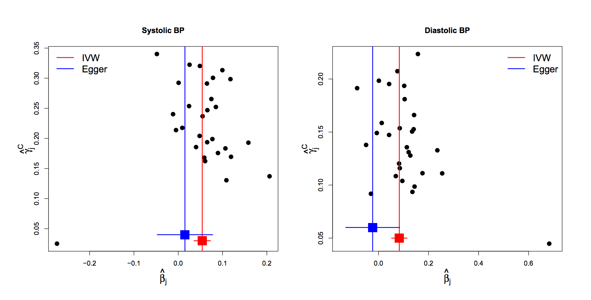
BP and Coronary Disease
FUNNEL PLOTS
Visual evidence for asymmetry
Notes:
Some asymmetry is present in these funnel plots, consistent with directional pleiotropy
Eg for SBP, 10 of the 13 weakest variants have IV estimates greater than the IVW causal effect

Slide 29
BP and Coronary Disease
FUNNEL PLOTS
Notes:
Some asymmetry is present in these funnel plots, consistent with directional pleiotropy
Eg for SBP, 10 of the 13 weakest variants have IV estimates greater than the IVW causal effect

Slide 30
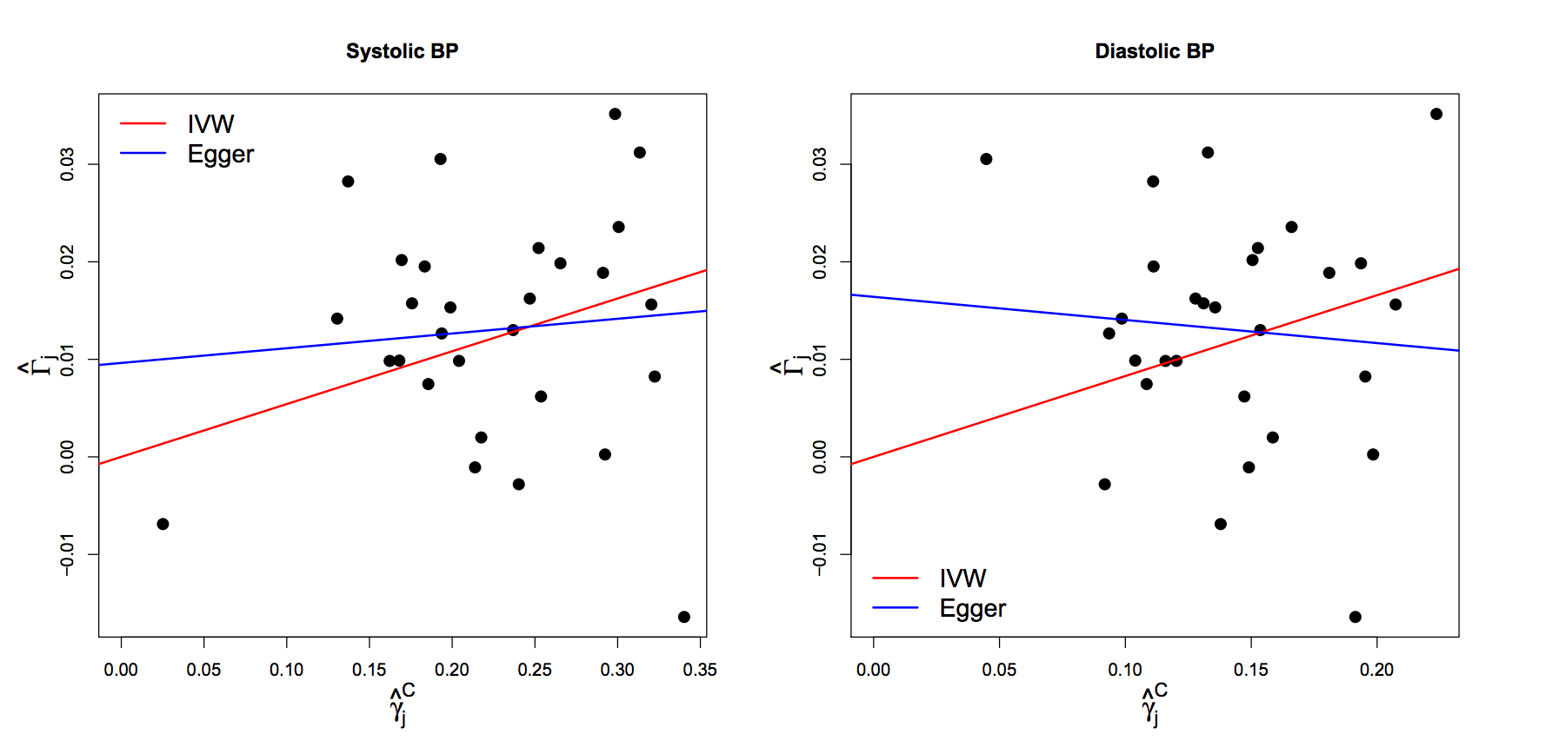
BP and Coronary Disease
Scatter Plots
Egger test for intercept p=0.2
Egger test for intercept p=0.054
Notes:
Intercepts deviate from zero but not strong statistical evidence for difference!

Slide 31
BP and Coronary Disease
FUNNEL PLOTS
IVW= 0.054 logOR/mmHg p=4x10⁻⁶
Egger =0.015 logOR/mmHg p=0.6
IVW= 0.083 logOR/mmHg p=1x10⁻⁵
Egger =-0.024 logOR/mmHg p=0.7

Slide 32
Weighted Median Approach

Slide 33
Simple Median Method
Order instrumental variables estimates and take the median
Like all subsequent estimators it enjoys a 50% breakdown limit

Slide 34
Weighted Median Method
^
γ_{j}²
w_{j}’
w_{j}’ =
___
w_{j} =
____
σ²_{Yj}
Σ_{j}w_{j}’

Slide 35
Penalized Weighted Median Method
Although the invalid IVs do not contribute directly to the median estimate, they do
influence it in small samples
Like all subsequent estimators it enjoys a 50% breakdown limit

Slide 36
Penalized Weighted Median Method
One way of minimizing this problem is down-weighting the contribution to the analysis of genetic variants with heterogeneous ratio estimates
Heterogeneity between estimates can be quantified by Cochrane’s Q statistic:
The Q statistic has a chi-squared distribution on J – 1 degrees of freedom under the null hypothesis of no heterogeneity
Each individual component of Q has a chi-square distribution with 1 df. Bowden proposes using a one sided upper P value (denoted q_{j}):
Q = Σ_{j}Q_{j}
=
^
^
Σ_{j}w_{j}’(β_{j} - β)²
w_{j}* = w’_{j} × min(1, 20q_{j})

Slide 37
Penalized Weighted Median Method

Slide 38
Mode Based Estimator

Slide 39
ZEMPA
Notes:
Modal Based Estimator
ZEMPA
Zero Modal Pleiotropy Assumption (most frequent value of alpha is zero)
-Weighted vs Unweighted MBE
-Kernel density estimation
Consistent if the largest weights among the k subsets are
contributed by valid instruments (i.e. ZEMPA), regardless
of the type of horizontal pleiotropy
Analogy between the mode-based estimate (MBE) and the histogram
An analogy can be drawn between the proposed MBE method and histograms. Consider a hypothetical bimodal variable $V$, which was simulated by concatenating two normally distributed variables: $V_{1}\sim N(0,1)$ and $V_{2}\sim N(5,25)$. In this example, the mode of $V$ would be zero, because the distribution with the smallest dispersion is centred at zero. We can use histograms to obtain a rough mode estimate of $V$ using the midpoint of the highest bar.
To make the histogram, it is necessary to define the break points of each bar, which here will be equally-spaced, starting from the minimum value of $V$ and ending at the maximum value of $V$. As shown in Supplementary Figure 1A, using six equally-spaced bars does not provide enough resolution to detect bimodality in $V$. As a result, the mode estimate is biased upwards. In panel B (20 equally-spaced bars), it can be clearly seen that $V$ is bimodal, and the mode estimate is less biased. However, when 100 equally-spaced bars are used (panel C), the data appears to be multimodal, because such spacing criteria was too stringent, so that random fluctuations under the same underlying distribution end up looking like being different distributions in the histogram. While this would not be a problem in infinite samples, it results in numerical instability of the mode estimate in finite samples. So, among panels A-C, the histogram in panel B provides the best bias-variance trade-off, and would be the best one to display the distribution of $V$.
As panels D-F illustrate, the proposed smoothed empirical density function approach is analogous to the histogram: the smoothed empirical density function is roughly similar to connecting the midpoints of each bar of the histogram (in other words, a “smoothed histogram”); the mode estimate based on the smoothed empirical density function is roughly similar to the mode estimate using the midpoint of the highest bar; and decreasing the tuning parameter $φ$ is analogous to increasing the number of equally-spaced bars in the histogram. Panels D-F also illustrate that the mode (as estimated by our proposed method) and the mean can be substantially different in case of bimodality, and our mode estimate being close to the centre of the main distribution.

Slide 40
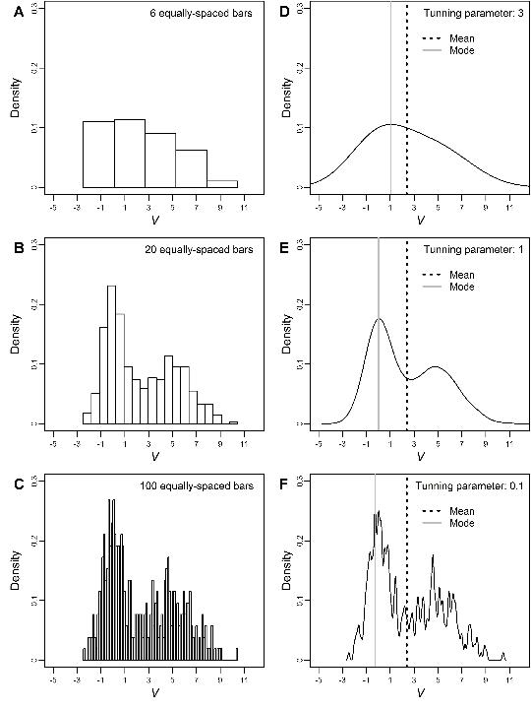

Slide 41
Summary of Robust Estimators
Random effects
IVW
No horizontal pleiotropy

Slide 42
Reverse causal instruments

Slide 43
Problem: MR of type 2 diabetes on BMI
GWAS of T2D reveals FTO variant
- Famously associated with BMI

Slide 45
Can we avoid including reverse-causal SNPs as instruments?
If A causes B and B causes C
The effect of A on B should be larger than the effect of A on C
Expect that
r²(SNP,B) = r²(SNP,A) x r²(SNP,B)
SNP
A
B
r²(SNP,A)
r²(A,B)
Steiger test used to evaluate if r²(SNP,A) > r²(SNP,B)
If this is not satisfied, infer that this instrument is not influencing the exposure primarily.

Slide 46
Summary
MR uses natural randomization to mimic an RCT
It is useful, data is abundant, but it is not a panacea for causal inference
Often valuable for proving that an hypothesised association is not causal
Crucial to perform sensitivity analyses and obtain metrics regarding the likely reliability of the MR estimates

Slide 47
References
Bowden et al. Detecting individual and global horizontal pleiotropy in Mendelian randomization: a job for the humble heterogeneity statistic? American Journal of Epidemiology 2018, kwy185
Bowden et al. Consistent estimation in Mendelian randomization with some invalid instruments using a weighted median estimator Genet Epideml 40(4), 304-14
Bowden et al. Robust inference in summary data Mendelian randomization via the zero modal pleiotropy assumption Int J Epidemiol 46(6), 1985-1998
Bowden et al. Mendelian randomization with invalid instruments: effect estimation and bias through Egger regression. Int J Epidemiol, 44(2), 512-25
Burgess et al. Multivariable Mendelian randomization: the use of pleiotropic genetic variants to estimate causal effects. Am J Epidemiol, 181(4), 251-60
Hemani et al. Evaluating the potential role of pleiotropy in Mendelian randomization studies Human Molecular Genetics, Volume 27, Issue R2, 1 August 2018, Pages R195–R208
Hemani et al. Orienting the causal relationship between imprecisely measured traits using GWAS summary data PLoS Genet 2017 13(11): e1007081

