Slide 1
Challenges and opportunities in the analysis of more than a million participants from diverse populations
2023 International Statistical Genetics Workshop
Timothy Thornton
Senior Director
Analytical Genetics
Regeneron Genetics Center
10.March.2023

Slide 2



REGENERON
NEVER STOP ASKING WHY
George Yancapoulos
Len Schleifer
Founded in 1988 by Scientists
RGC is proud to sponsor the International Scholar and Cultural Exchange Program (ISCEP)
for the International Statistical Genetics Workshop 2023!
Tarrytown, NY
Regeneron Genetics Center
2 │ Confidential
Notes:
Gets updated

Slide 3


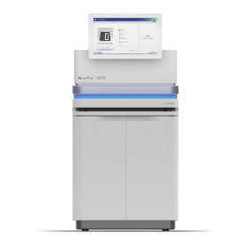
Regeneron Genetics Center (RGC)
Established In 2014 And Is Now One Of The Largest Operational Human Sequencing Efforts
CLOUD BASED INFORMATICS & ANALYSIS
SAMPLE
BIOBANKING
LIBRARY PREPARATION AND EXOME CAPTURE
ILLUMINA-BASED SEQUENCING
Mission:
Taking large scale human genetics to the next level for target discovery, support existing targets and identify novel indications

Slide 4

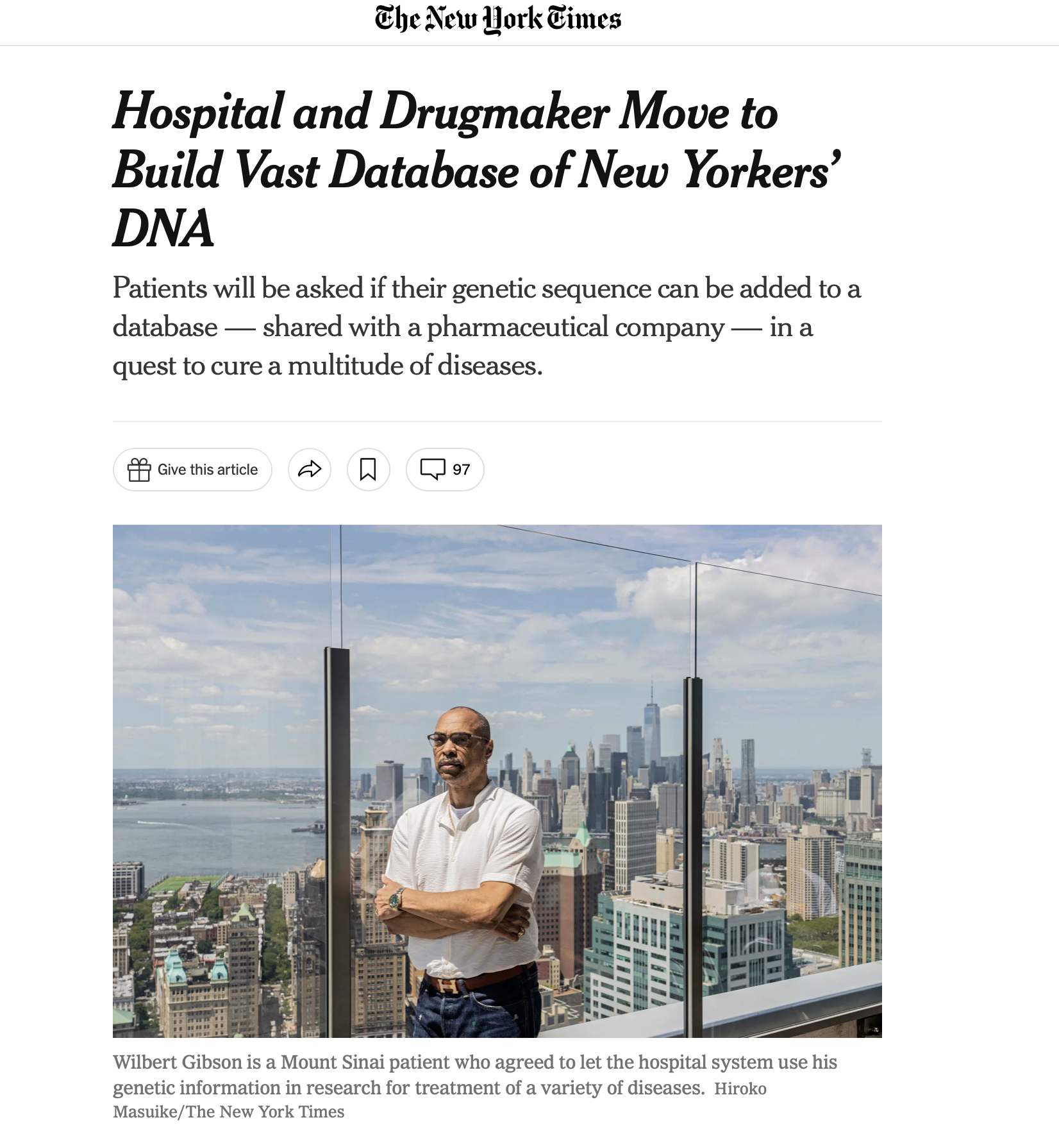

Regeneron Genetics Center:
Unprecedented Speed, Scale & Integration
All accomplished in just the first 8 years!
RGC has the most diverse collection and catalogue of human coding variation to date
4

Slide 5



















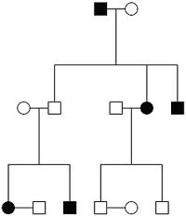























  Leveraging Resources Across Genetic Architectures & Phenotypes
  120+ Research Collaborations – Over 2,000,000 exomes sequenced to date
Integrated approaches across genetic trait architectures . . .
General Population
MCPS
FOUNDER &
SPECIAL
POPULATIONS
Phenotype Specific Cohorts
FAMILY
BASED
STUDIES
GENERAL
POPULATION
Family Studies
PHENOTYPE
SPECIFIC
COHORTS
z
Founder & Special Populations
. . . will power genomic discovery

Slide 6
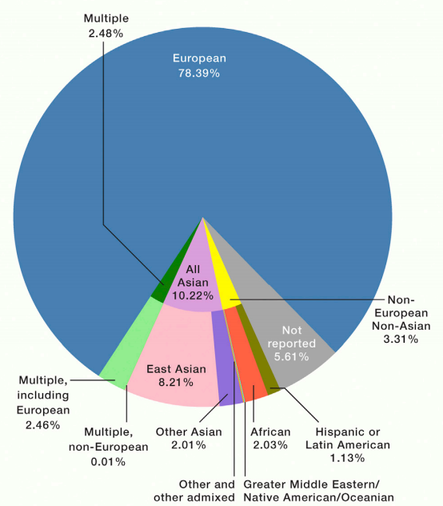
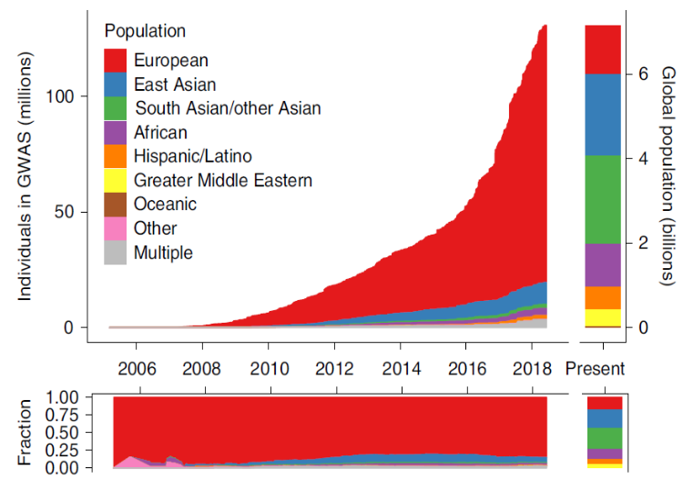
Genomic Diversity is Lacking…
BUT the RGC is Building Diversity
Ancestry of GWAS Participants Over Time
(compared with the global population)
Cell, 2019
% of Genomic Information
Genetic Screenings
Predicting Disease Risks
Personalized Medicine
These are NOT accurate for other ancestry groups
Martin et al. (Nature Genetics, 2019)
2021 Season
The Players Tribune Jun 4, 2021

Slide 7

RGC COLLABORATIONS AROUND THE WORLD
NORTH AMERICA
EUROPE
AFRICA
MIDDLE EAST/SOUTH ASIA
OCEANIA
CANADA
BELGIUM
ITALY
NIGERIA
INDIA
AUSTRALIA
MEXICO
CROATIA
SWEDEN
SOUTH AFRICA
ISRAEL
NEW ZEALAND
UNITED STATES
FRANCE
UNITED KINGDOM
GHANA
PAKISTAN
NORFOLK ISLANDS
NEWFOUNDLAND
GERMANY
CYPRUS
ETHIOPIA
BANGLADESH
PUERTO RICO
FINLAND
CAMAROON
SINGAPORE
SOUTH AMERICA
FAROE ISLANDS
MADAGASCAR
CHILE
SARDINIA
GAMBIA
BRAZIL
CHIZUMULU ISLANDS
COLOMBIA
MALAWI
KOREA
Sequenced cohorts
RAPA NUI
KENYA
TAIWAN
Potential cohorts
TANZANIA
ASIA
  Over 300,000 individuals of African, South Asian, East Asian and Admixed American ancestry
7 │ Confidential

Slide 8
Technologies at RGC Include:
EXOMES, ARRAYS & IMPUTATION
Target protein coding exons at depth >20x
Results in ~20,000 coding variants per individual
Genotype or capture 0.5 – 1.5M common variants
Impute remaining variants using reference panel
Platforms are mature
Analyses strategy evolving (imputation references)
WHOLE GENOME SEQUENCING
Sequence entire genome at depth of ~30x
Platforms evolving (e.g. read-length, amplification)
Analyses strategies evolving (e.g. mapping, assembly)

Slide 9
Challenges:
Computational pipelines that can accommodate large-scale sequencing and genotyping data on more than a million study subjects from diverse populations
Appropriately accounting for (and leveraging) diverse and admixed genomes that are essential for a variety of downstream genetic analyses
LARGE-SCALE Sequencing STUDIES FROM DIVERSE POPULATIONS
9 │ Confidential

Slide 10
Opportunities:
  Identification of novel variants underlying phenotypic diversity and new therapeutic targets
  New insights into human health and health disparities, particularly for underserved populations
  Characterization of the genetic architecture of worldwide populations
LARGE-SCALE Sequencing STUDIES FROM DIVERSE POPULATIONS
10 │ Confidential

Slide 11
Computational pipelines for analysis of 1+ million samples from diverse populations
Relatedness estimation/inference and pedigree reconstruction in large-scale samples

Slide 12
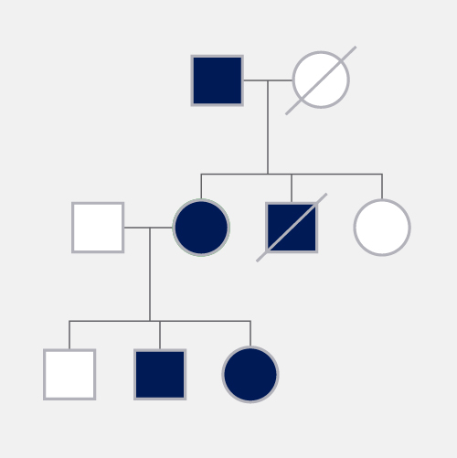
Relatedness inference in complex studies
Relatedness inference, estimation, and correction is essential for validity of many down-stream genetic analyses
Large-scale studies often include related individuals
Requires specific attention:
  Accounting for relationships in PCA
  Can induce spurious associations
Challenging in many settings:
  Can fail in settings with admixture
  Computationally costly for biobank-scale

Slide 13
Relatedness Estimation Approaches
There are two main approaches for estimating/inferring relatedness for pairs of individuals from genome-wide data
  Methods based on average allele sharing statistics across the genome for a pair
  Methods based on the length and number of segments inferred to be shared identical-by-descent (IBD) across the genome for a pair

Slide 14
Relatedness Estimation: Average Allele Sharing
PLINK (Purcell et al., AJHG 2007)
  Uses allele frequencies estimated from the sample
  Limitations: Biased relatedness estimates in samples with population structure
KING-robust estimator (Manichaikul et al., 2010)
  Estimator assumes discrete population structure (no admixture)
  Limitations: Biased estimates in admixed populations
REAP (Thornton et al. , AJHG 2012) and PC-Relate (Conomos et al., AJHG 2016)
  Allows for admixture
  Uses admixture proportions or PCS to calculate ancestry/population-specific allele frequencies
  Limitations:
    Requires reliable estimates of admixture proportions and ancestry/population-specific allele frequencies
    Biased results if (1) admixture portions are mispecified or (2) PCs not fully capturing ancestry
    SCALABILITY ISSUES WITH LARGE-BIOBANK STUDIES!

Slide 15
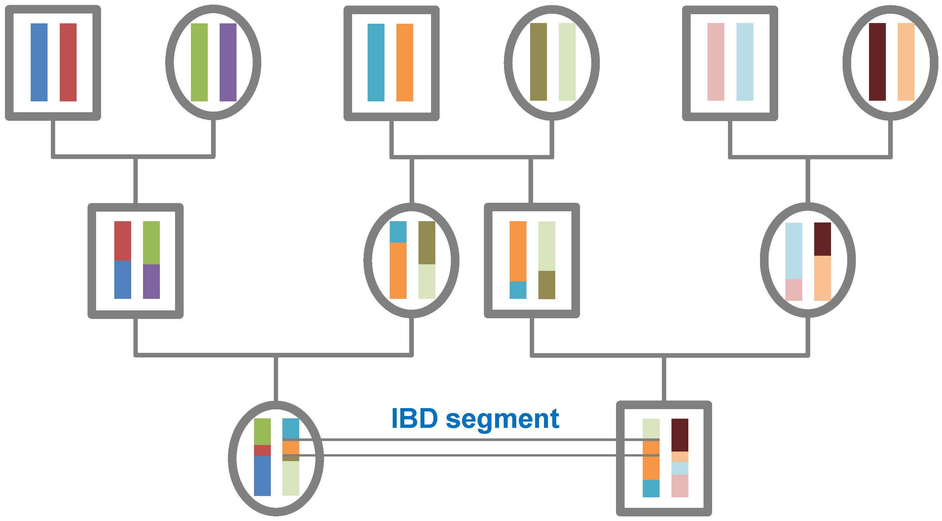
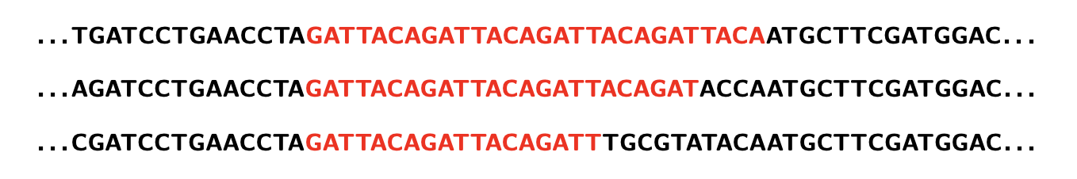
Relatedness Estimation: IBD SEGMENT DETECTION
IBD segments inferred based on long segments of identical-by-state allele IBS sharing
  methods call segments IBD based on pairs of individuals sharing many mega-bases of alleles IBS
  Methods available for phased or unphased genetic data:
    KING: unphased data with ibdseg
    TRUFFLE: unphased data (Dimitromanolakis et al., 2019)
    hap-IBD: phased data (Browning et al., 2021)
    iLASH: phased data (Shemirani et al., 2021)
    RaPID: phased genotype data (Naseri et al., 2019)
IBD detection performance in large-scale ancestrally diverse samples?

Slide 16
Relatedness pipeline architecture: Automated pipeline
Step1
QC: Filter inputs
  Missingness: 0.05 variant missingness threshold
  Heterozygosity: HWE 1E-20 (PLINK: keep few het)
PLINK commands
DNAnexus applets
Step 2
KING: Run IBD segmentation
Priority:
  Retain as much of sample as possible
  Need high quality variants for reliable IBD segment breakpoints
  KING allows parallelization by splitting data into K chunks; K included as input in the applet
KING commands
Data processing
PLINK commands
-Staples et al (AJHG, 2014): PRIMUS for reconstructing pedigrees, get nuclear families
-
Step 3
PRIMUS: Run pedigree reconstruction
Data processing
PRIMUS commands

Slide 17
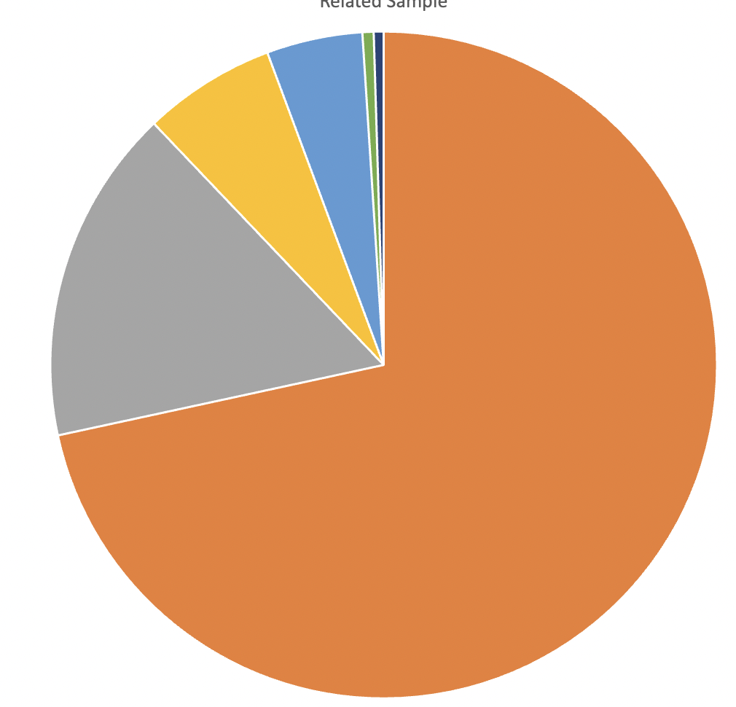
Scalable Relatedness Pipeline: Application to 1+ Million Diverse Samples
Study of 46 cohorts with genome-wide data at RGC
1,144,542 individuals with shared variant set
Relationships detected using pipeline
EAS 1%
SAS
5%
6%
AFR
AMR
16%
EUR
72%
Total input sample
n=1144542
‘Final’ sample
n=1144134
Dropped – flagged individuals
n=408
Ancestry distribution for 1+ Million samples at RGC
Notes:
Coding variants in canonical transcripts
GnomAD genome V3.0
TOPMED freeze8
GnomAD exome V2.1.1
1ME what cohorts included; composition
emphasize analysis sample size;
drop cohorts cannot be analyzed;

Slide 18
Scalable Relatedness Pipeline: Application to 1+ Million Samples
Total input sample
n=1144542
‘Final’ sample
n=1144134
IBD segments and relatedness inferred for more than
654 billion pairs of individuals.
Pipeline completed in less than a day!
Dropped – flagged individuals
n=408
Sample size | Dup/MZ | Parent offspring | Full sibling | 2nd | 3rd
1144134 | 3178 | 137900 | 120217 | 325032 | 7398108
Important feature: No re-estimation of existing samples needed with future data freezes!

Slide 19
Computational pipelines for analysis of large bio-bank scale samples from diverse populations
Whole Genome Regression For Complex Trait Mapping

Slide 20
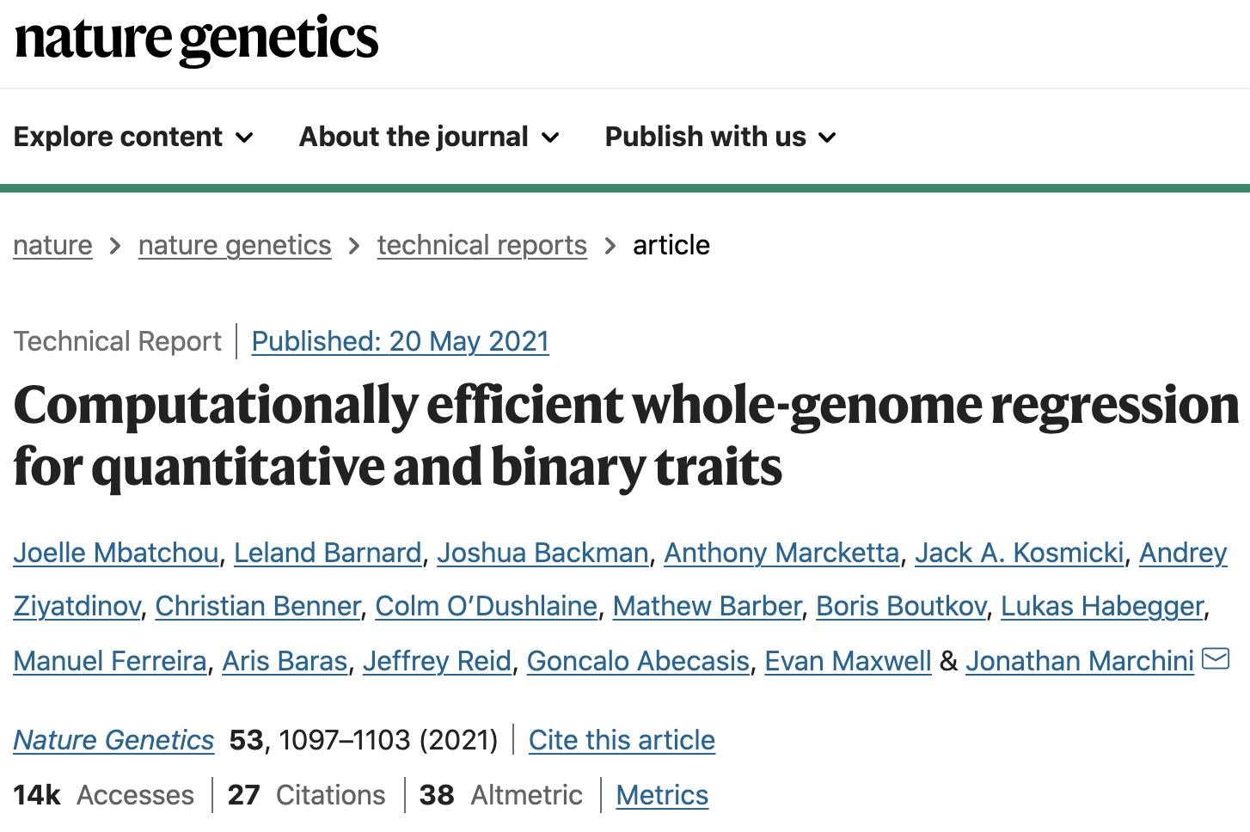
REGENIE
Computationally efficient WGR
Works on both quantitative and binary
  Correction using penalized Firth/SPA for highly imbalanced binary traits
Controls for population structure & relatedness through WGR framework
Can process multiple phenotypes
Decoupled WGR & association testing step
Extended to gene-based testing
Publicly available in C++ software on Github
Apache Spark based implementation http://projectglow.io/

Slide 21
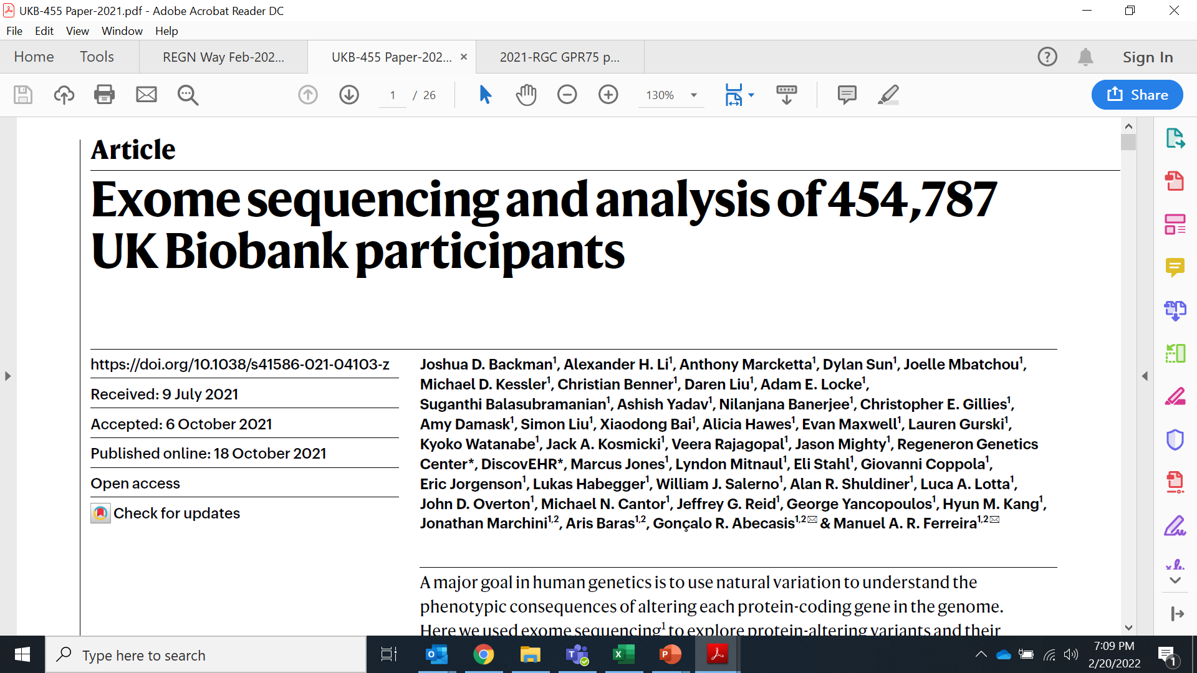
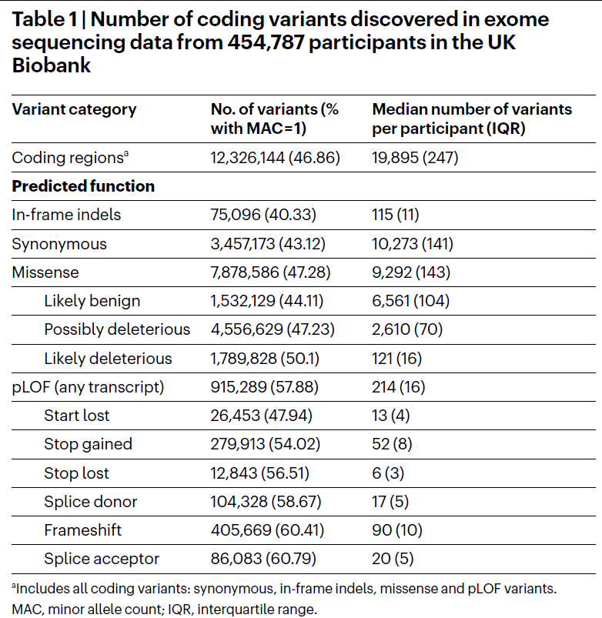
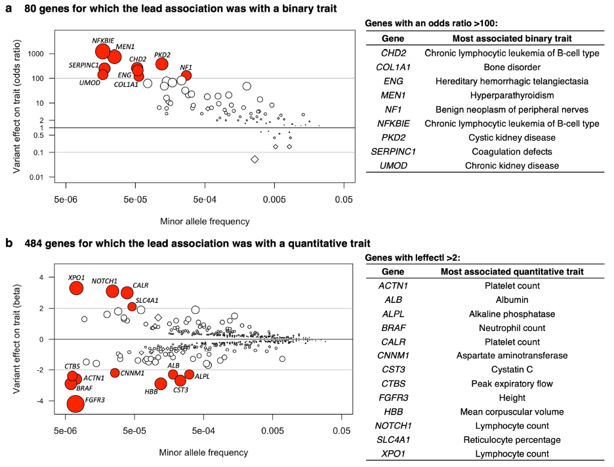
Nature | Vol 599 | 25 November 2021
Performed exome sequencing of 454,787 participants
Identified ~12M coding variants, ~1M putative loss-of-function variants and ~ 1.8M deleterious missense variants
Tested association with 3,994 health-related traits & found 564 genes with trait associations at P ≤ 2.18 × 10-11
Rare variant associations were enriched in loci from genome-wide association studies, but 91% (most) were independent of common variant signals

Slide 22
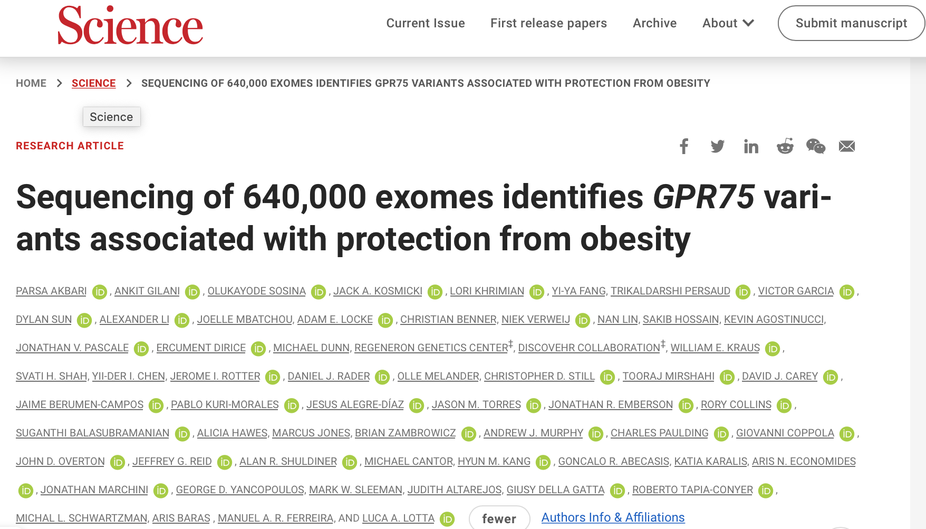
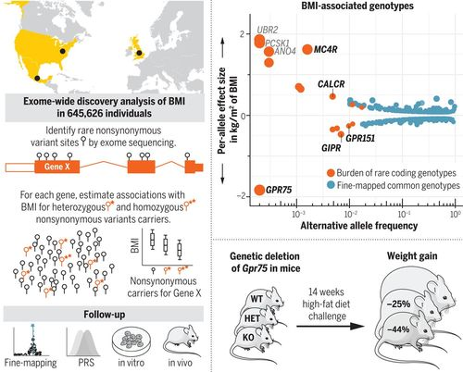
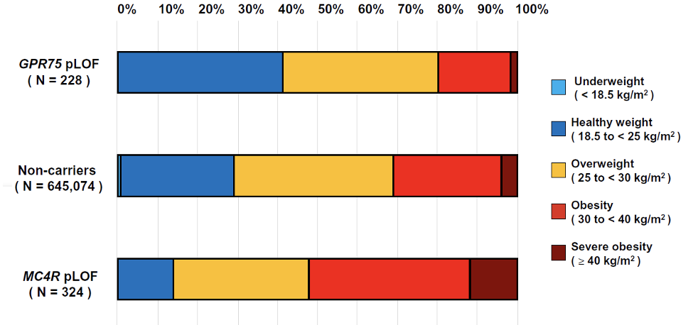
Diverse RGC cohorts: Novel genetic discoveries and therapeutic targets
  Rare predicted loss of function coding variants in GPR75 for heterozygous carriers found to be associated with
    Lower BMI (-1.8 kg/m²)
    Lower body weight (~5.3 kg or 11.7 lbs lower)
    Protection against obesity (54% lower odds)
  GPR75 knock-out mice show resistance to weight gain in high-fat diet challenge, as well as healthier insulin and fasting glucose profiles

Slide 23
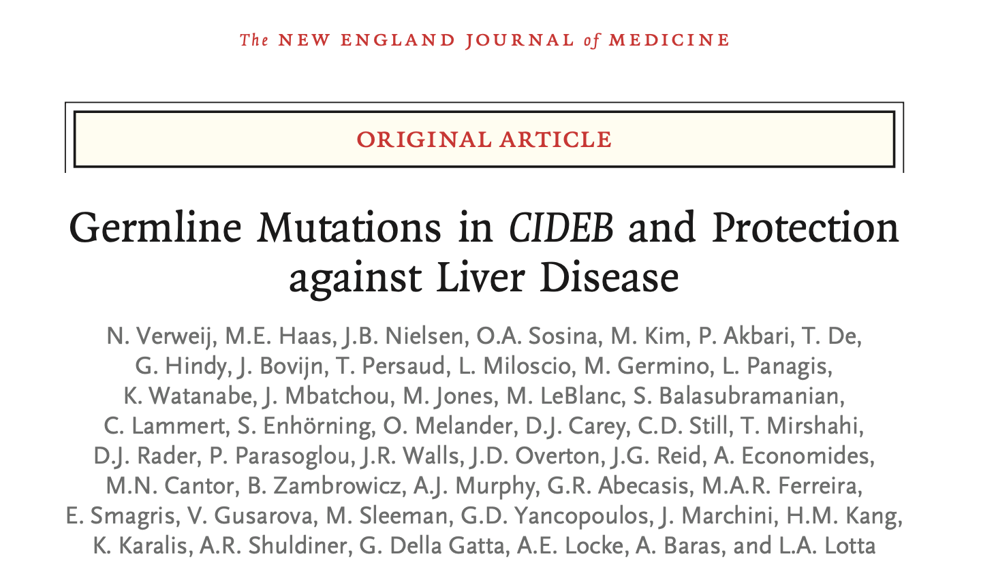
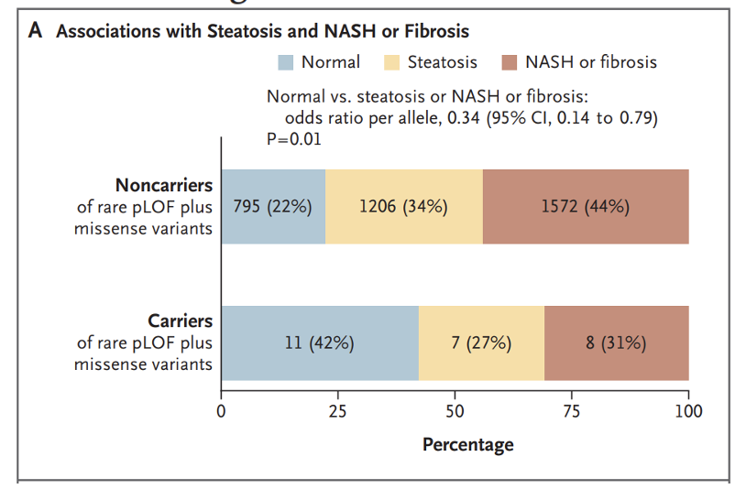
Diverse RGC cohorts: Novel genetic discoveries and therapeutic targets
Verweij et al. (2022) N Engl J Med 387:332-344
  Rare predicted loss-of-function variants plus missense variants in CIDEB associated with 33% lower odds of liver disease of any cause

Slide 24
Leveraging Diverse and Admixed Genomes
The Mexico City Prospective Study

Slide 25
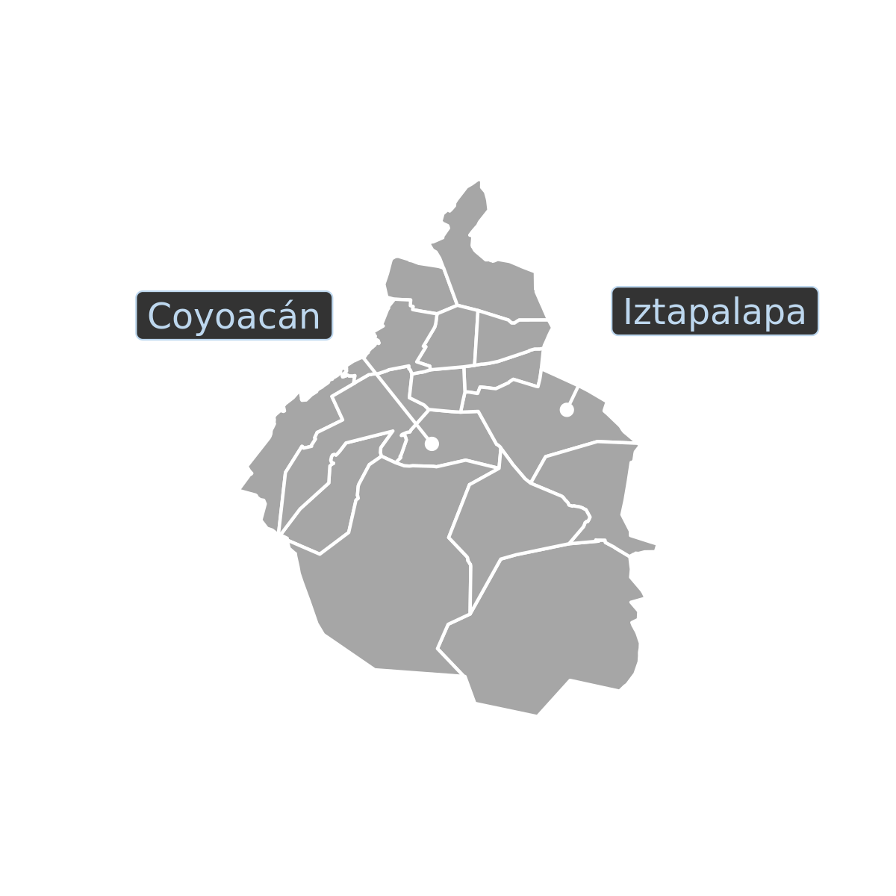
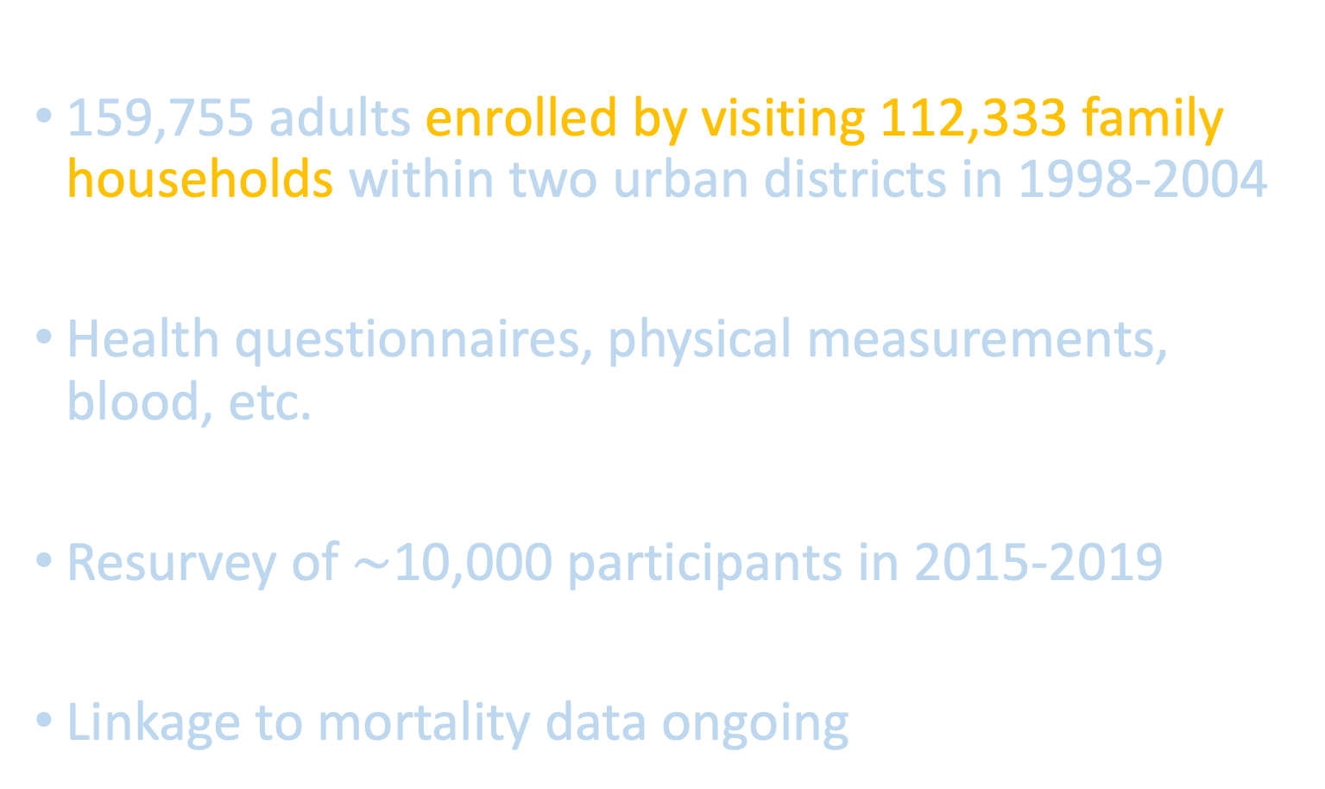
The Mexico City Prospective Study (MCPS)
Founded by epidemiologists from Mexico City and Oxford
159,755 adults enrolled by visiting 112,333 family households within two urban districts in 1998-2004
Health questionnaires, physical measurements, blood, etc.
Resurvey of $\sim$10,000 participants in 2015-2019
Linkage to mortality data ongoing
Notes:
Today I will be talking about the Mexico City Prospective Study.
It was founded by epidemiologists from Mexico City and Oxford more than 20 years ago. They established a prospective cohort to study risk factors for chronic diseases in a Mexican population.
Between 1998 and 2004, they visited over 112 thousand family households and enrolled almost 160 thousand adults from two districts of Mexico City, Coyoacán and Iztapalapa.
The participants completed health questionnaires, had physical measurements taken, and provided blood samples.
The study is still active through resurvey of participants and linkage to mortality data.

Slide 26
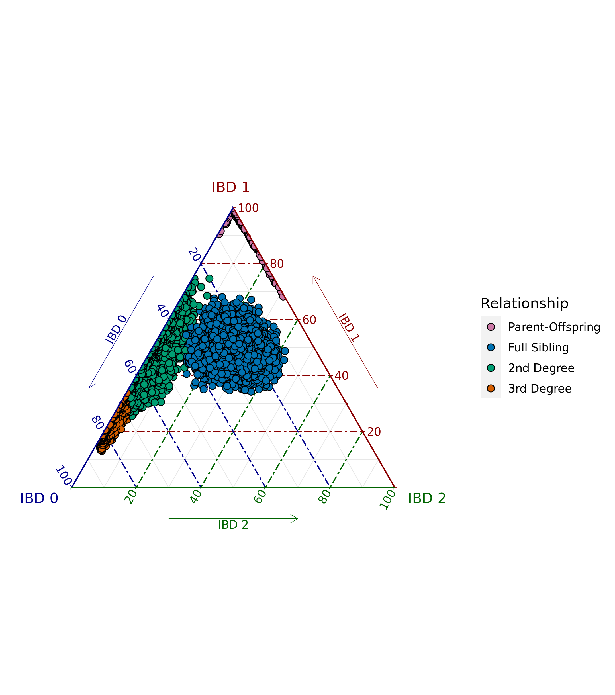
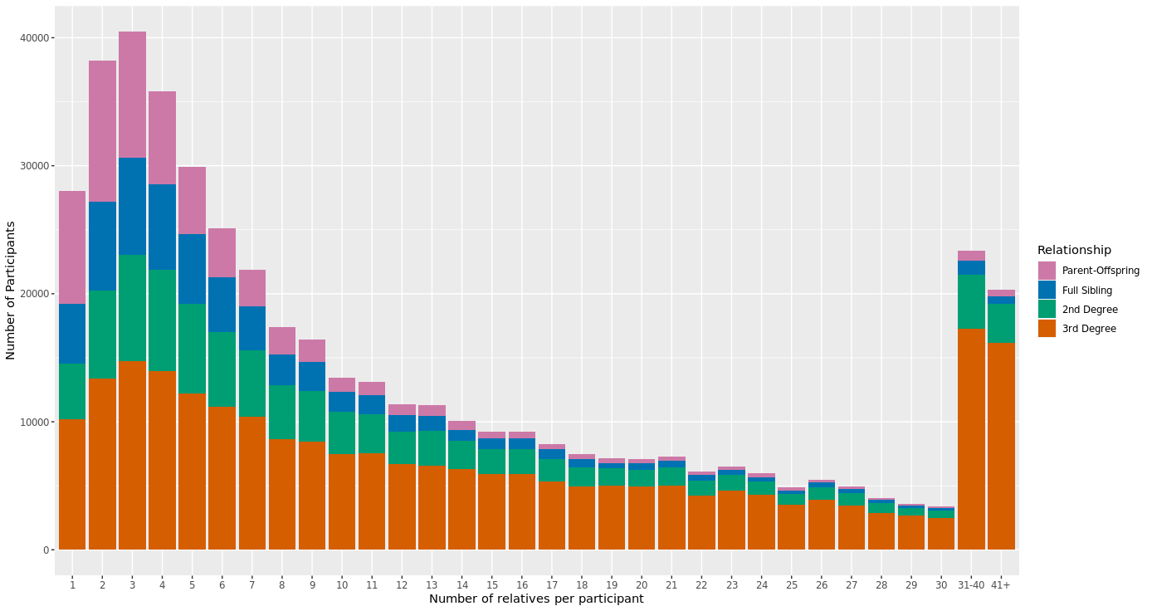
IBD-Based Relatedness Pipeline: MCPS
IRobust to admixture and scalable to large-scale bio-bank samples.
Proportion of the genome estimated to have 0, 1 or 2 alleles identical-by-descent (IBD)
Distribution of the number of relatives per participant
Parent-Offspring | Full-Siblings | Second-Degree | Third-Degree
31,597 | 29,482 | 47,080 | 120,180
Tim Thornton

Slide 27
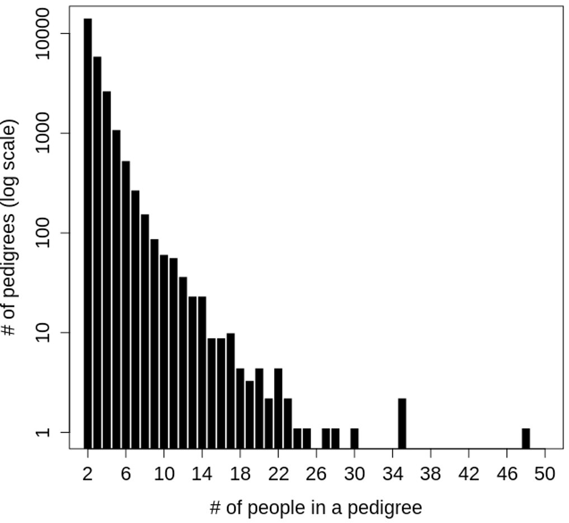
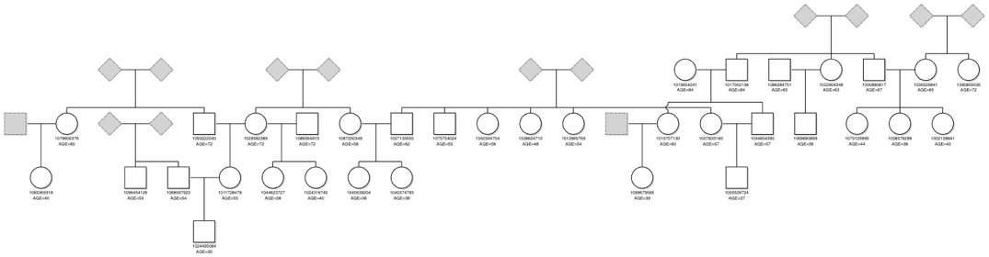
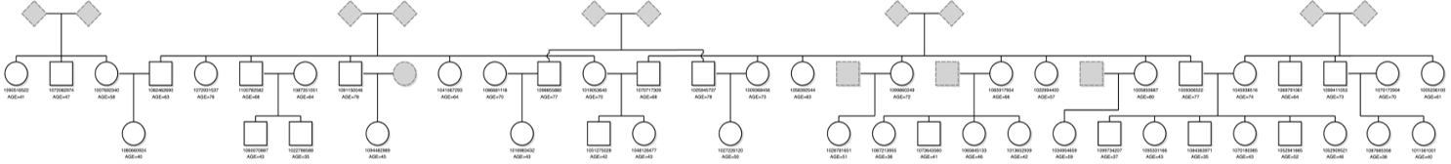
Pedigree Reconstruction in MCPS with PRIMUS
99.3% of 1st degree pedigrees reconstructed unambiguously​ with PRIMUS
3,595 nuclear families​
2,268 trios​
869 quartets​
308 quintets​
100 sextets​
34 septet​
11 octets​
3 nonets​
2 decets
Jeff Staples

Slide 28
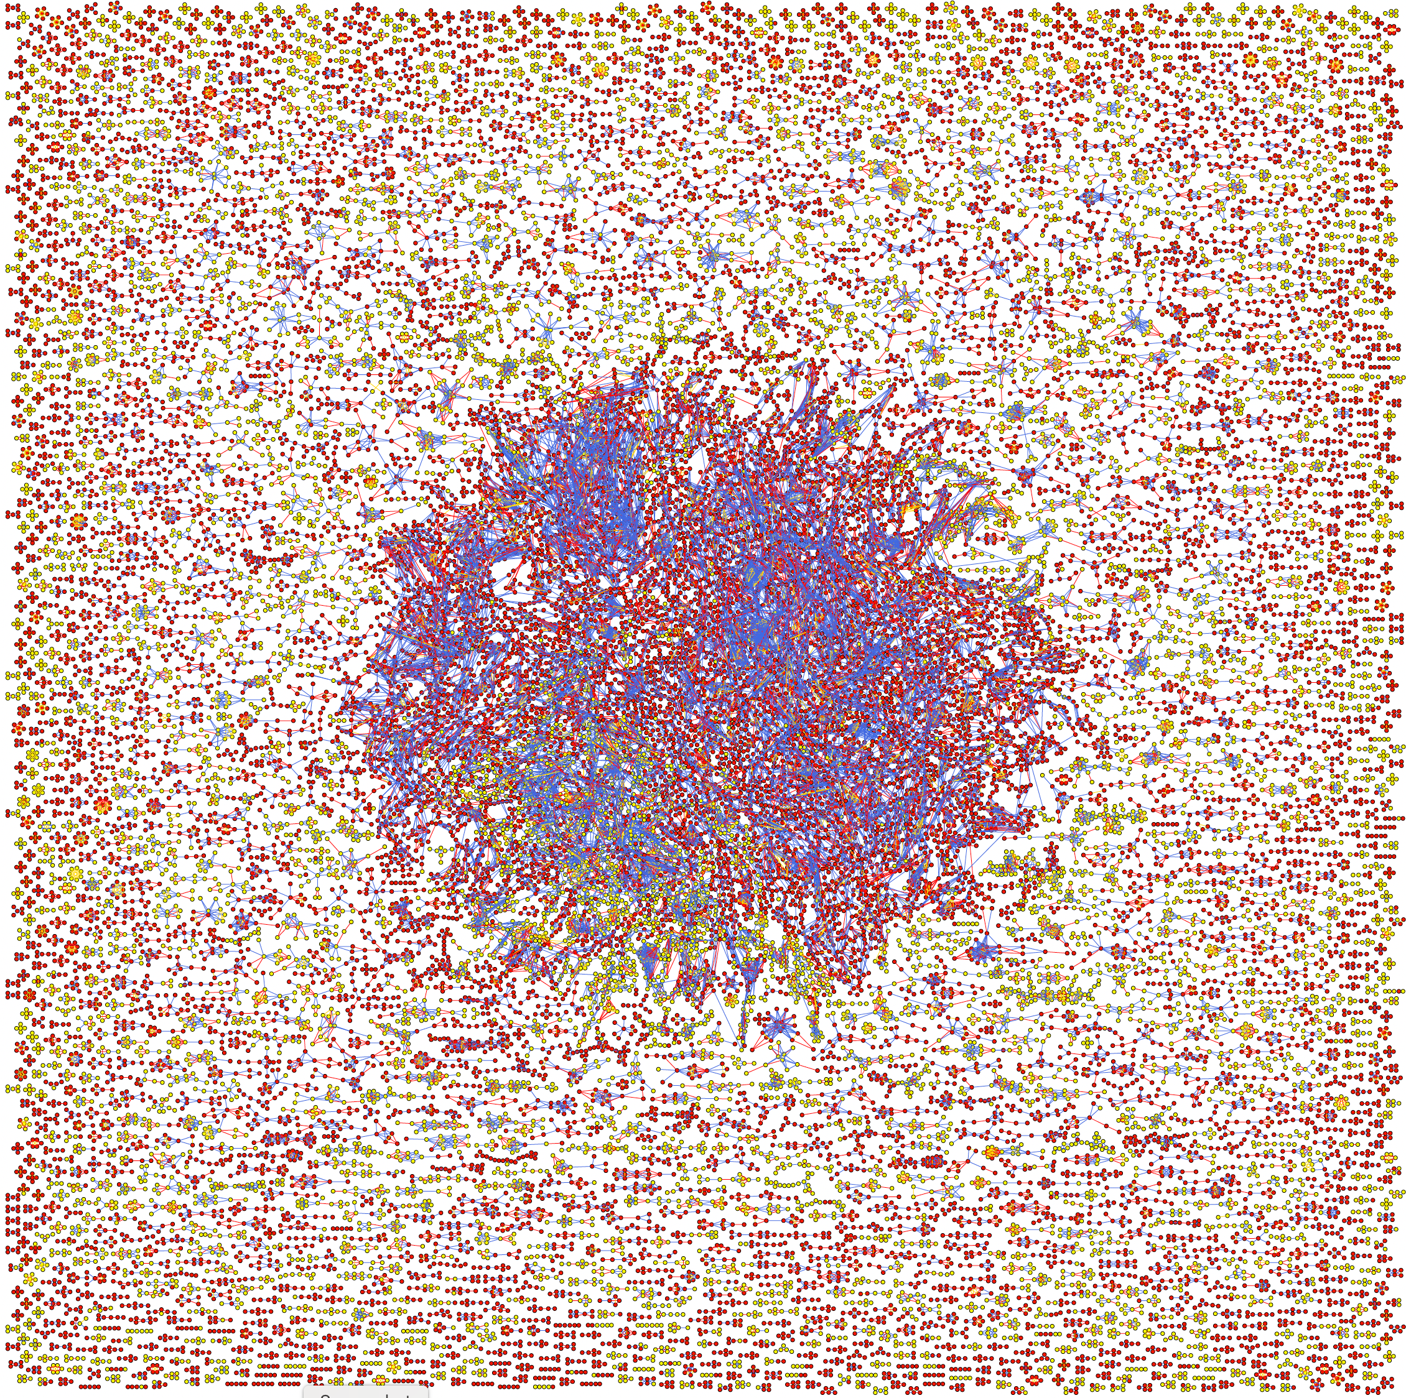
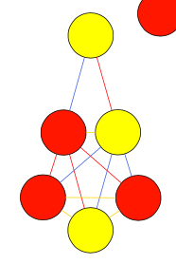
MCPS 2nd degree network of families > 4 in size
Nodes are individuals​
Red = Iztapalapa​
Yellow = Coyoacan
Edges are relationships​
Red = Parent/child​
Gold = Full-sibling ​
Blue = 2nd degree
Render by Graphviz’s sfdp layout engine​
Uses a “spring” model relying on a force-directed approach to minimize edge length​
Relatives are plotted closer to each other
Jeff Staples

Slide 29
MCPS is the largest non-European ancestry sequencing study
Collaboration between the National Autonomous University of Mexico, the National Institute of Genomic Medicine in Mexico, Oxford Population Health, Regeneron, Astra Zeneca and Abbvie.
Genotyping Array | Whole Exome Sequencing (WES) | Whole Genome Sequencing (WGS)
140,829 | 141,046 | 9,950
0.56M | 4.0M† | 131.9M
 | 1.4M†,* | 31.5M**
Samples
All variants
Unique variants
†coding only
*not found in UK Biobank, TOPMed & gnomAD
**not found in TOPMed & gnomAD
Notes:
A few years ago, the academic institutions, who founded MCPS, partnered with Regeneron to do a genetic study of this cohort.
The Regeneron Genetics Center performed genotyping and WES for 140,000 individuals, and WGS for a smaller set of about 10,000 individuals.
From the WES data, we identified 4M coding variants with 1.4M variants unique to MCPS, not seen in other external datasets. WGS data revealed 132M variants with 32M unique variants.
To date, MCPS is the largest sequencing study in Mexico, and also one of the most extensive genetic datasets of non-European ancestry.

Slide 30
Two resources derived from MCPS sequencing data
MCPS allele frequency browser https://rgc-mcps.regeneron.com/
142 million variants in combined dataset of Array, WES and WGS
Ancestry-specific allele frequencies from sequencing data
MCPS10K imputation reference panel
Phasing of 9,950 WGS samples
To be included in TOPMed reference panel
Notes:
In today talk I will focus on 2 aspects of the study.
First, I will describe an allele freq. browser with 142M variants and a novel method to estimate ancestry-specific frequencies.
Second, I will present an imputation reference panel created by phasing whole genomes.

Slide 31
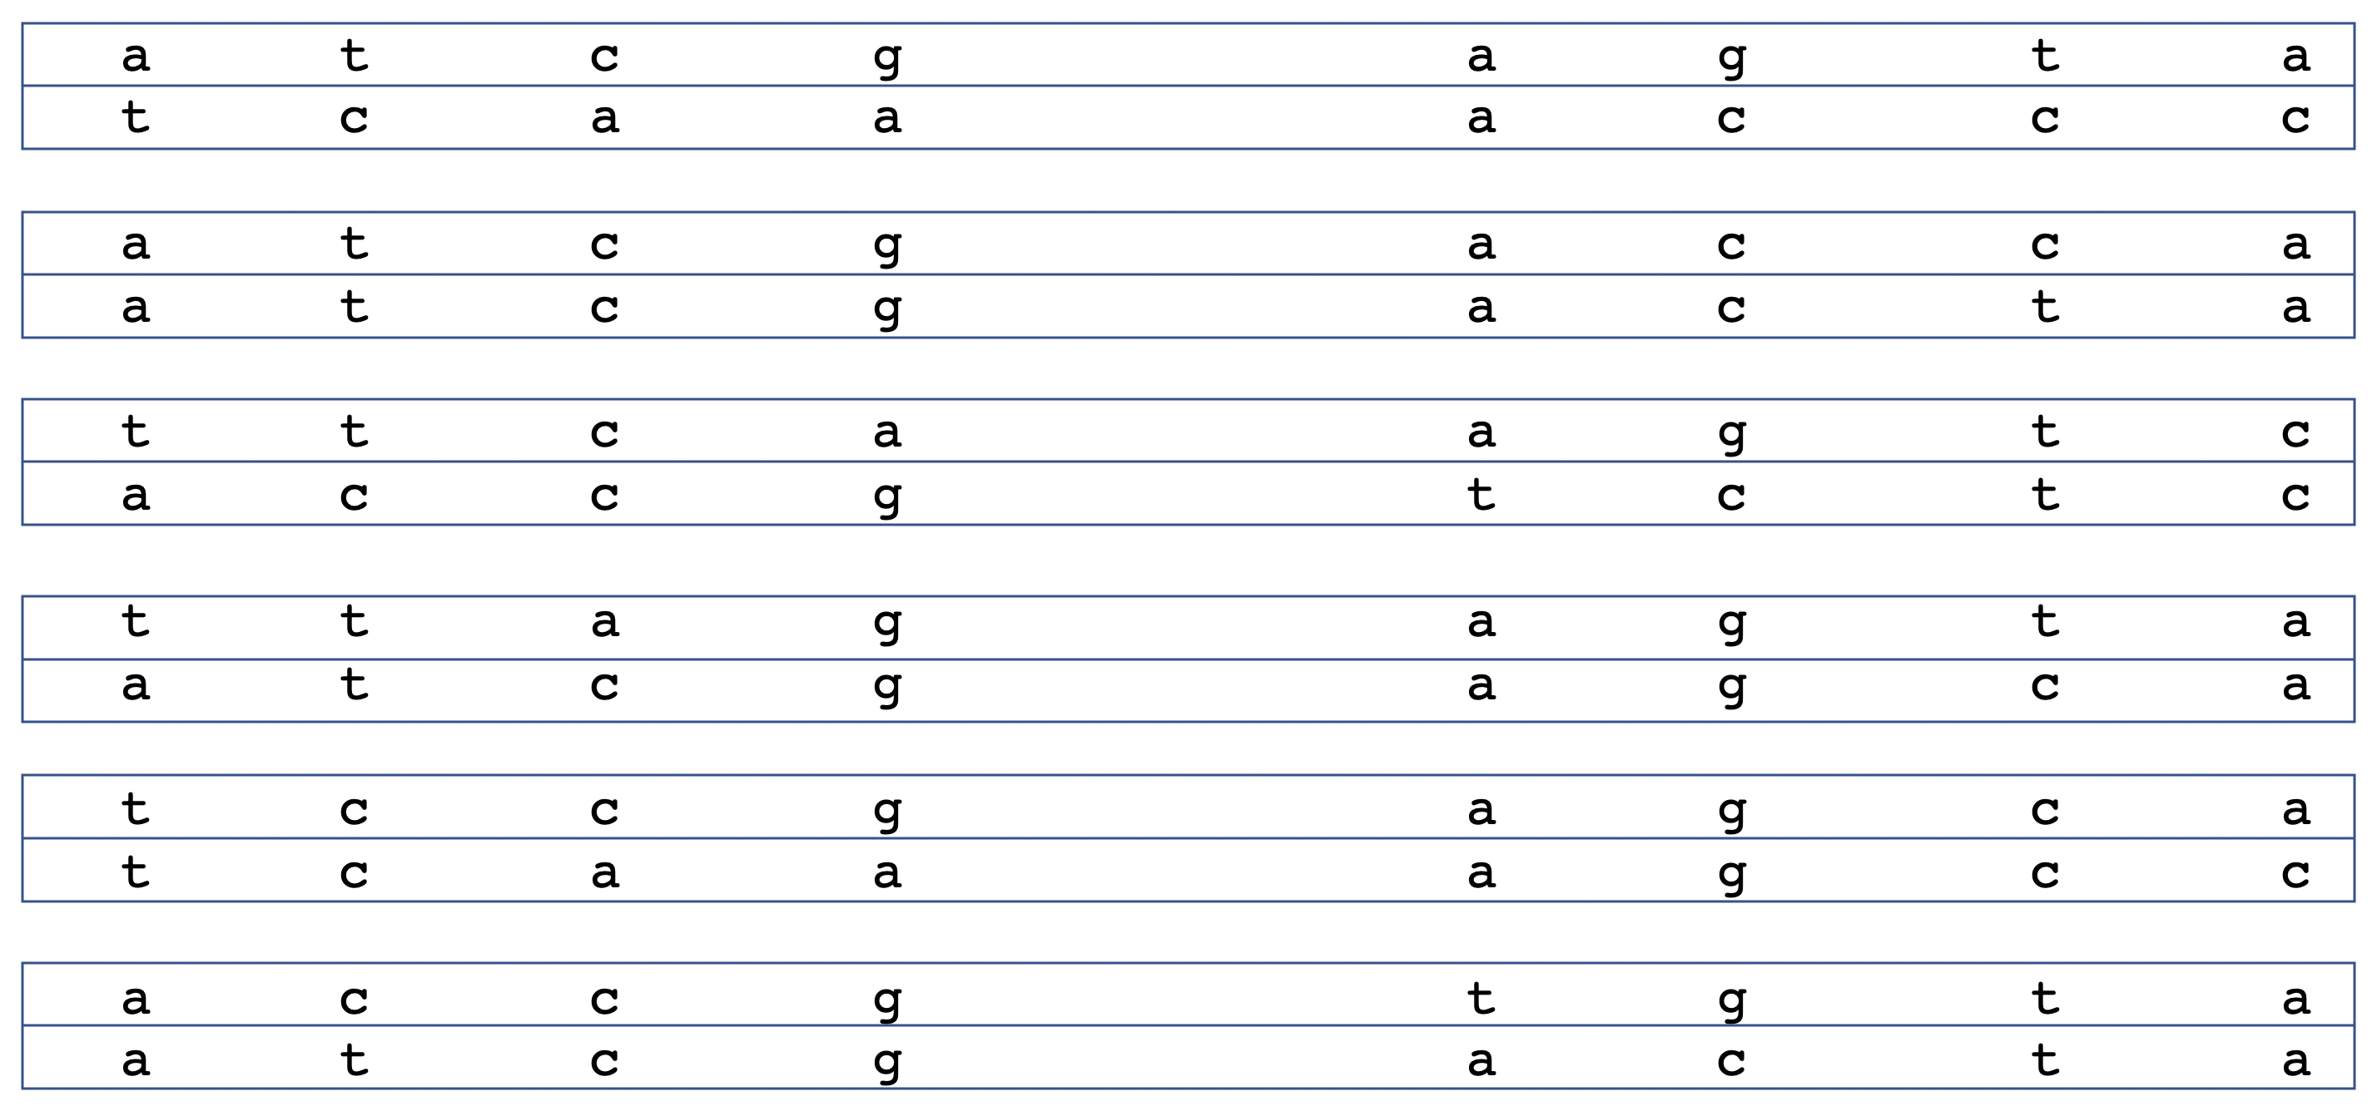
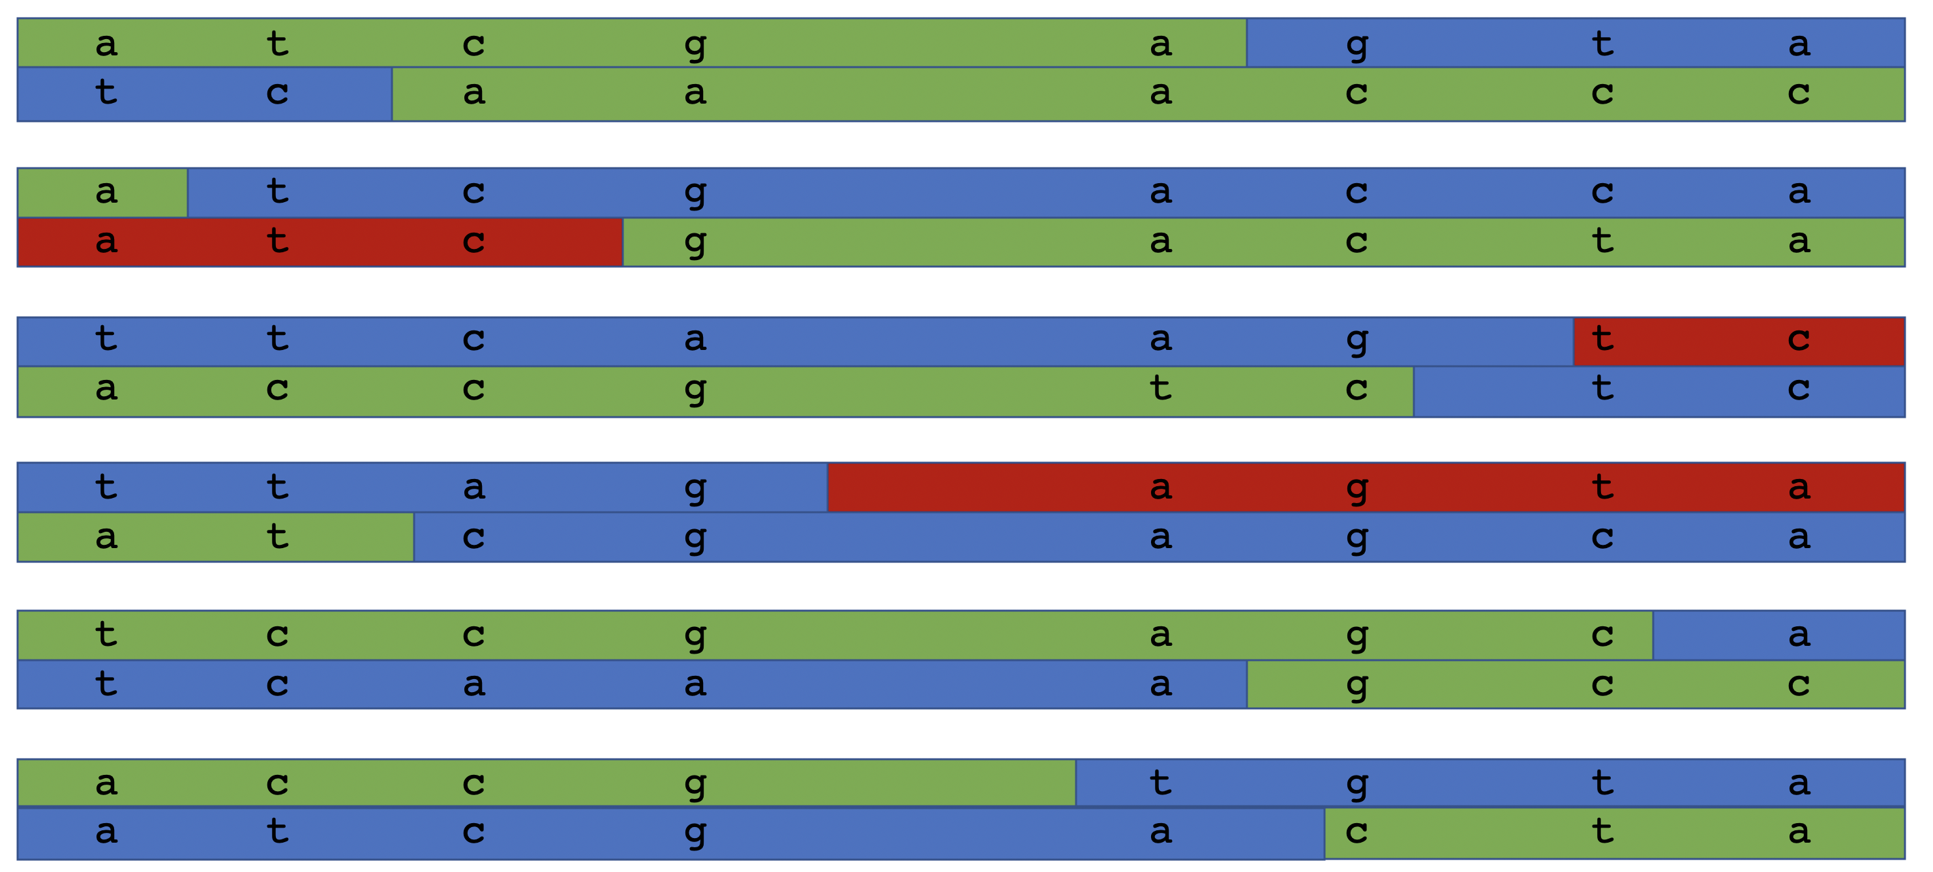
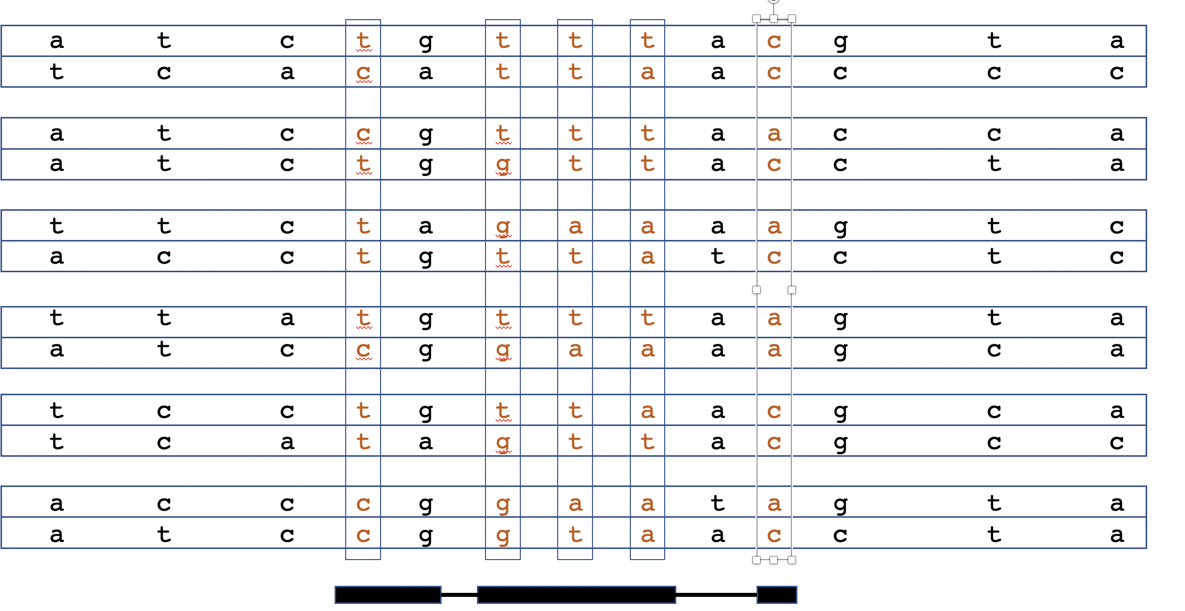
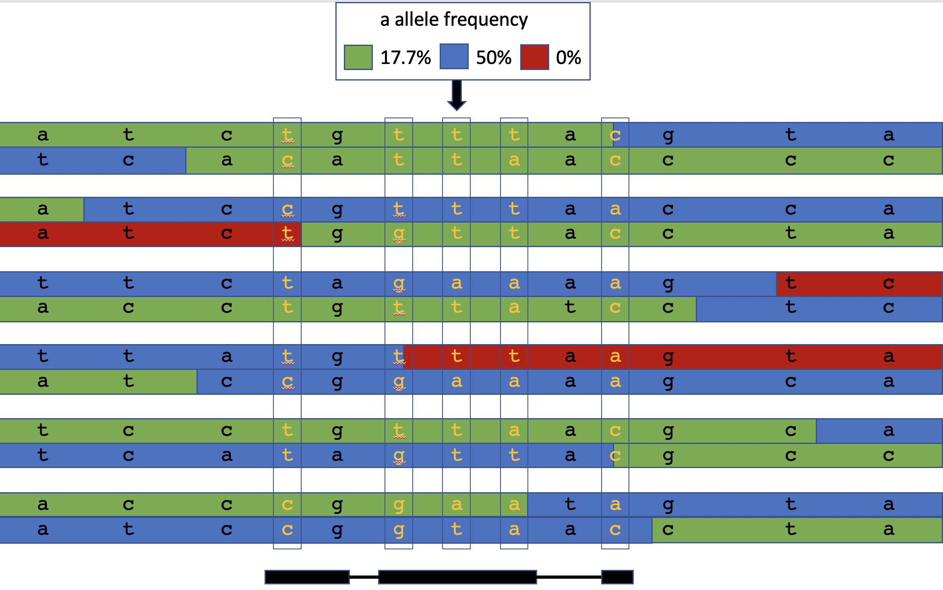
Schematic of ancestry specific allele frequencies
Phase Array dataset
Local ancestry inference
Phase WES/WGS variants onto array scaffold
Combine ancestry segments with phased exome data to estimate ancestry-specific frequencies

Slide 32
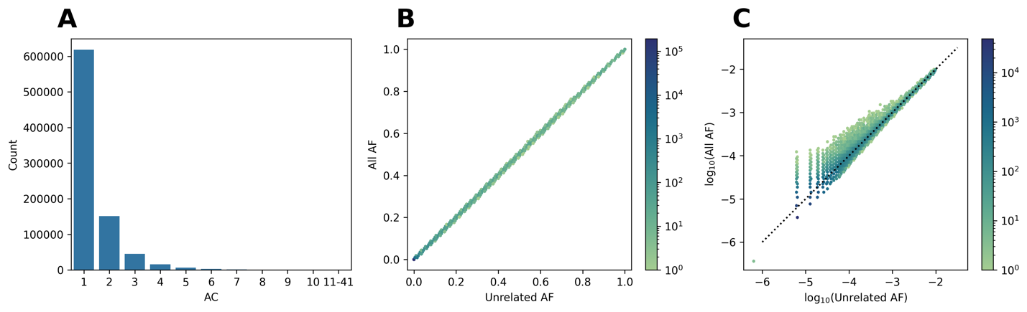
MCPS Allele Frequencies Browser: All Participants vs. Unrelated Subset?
(A) Histogram of the alternate allele count of variants missing from the unrelated subset computed from the combined WES and array dataset for all chromosomes. (B) Hexbin plot of allele frequencies computed using the unrelated subset (x­-axis) and all samples (y-axis) and for chromosome 22. (C) Hexbin plot of log₁₀ allele frequencies of rare variants (AAF<0.01) on chromosome 22.

Slide 33
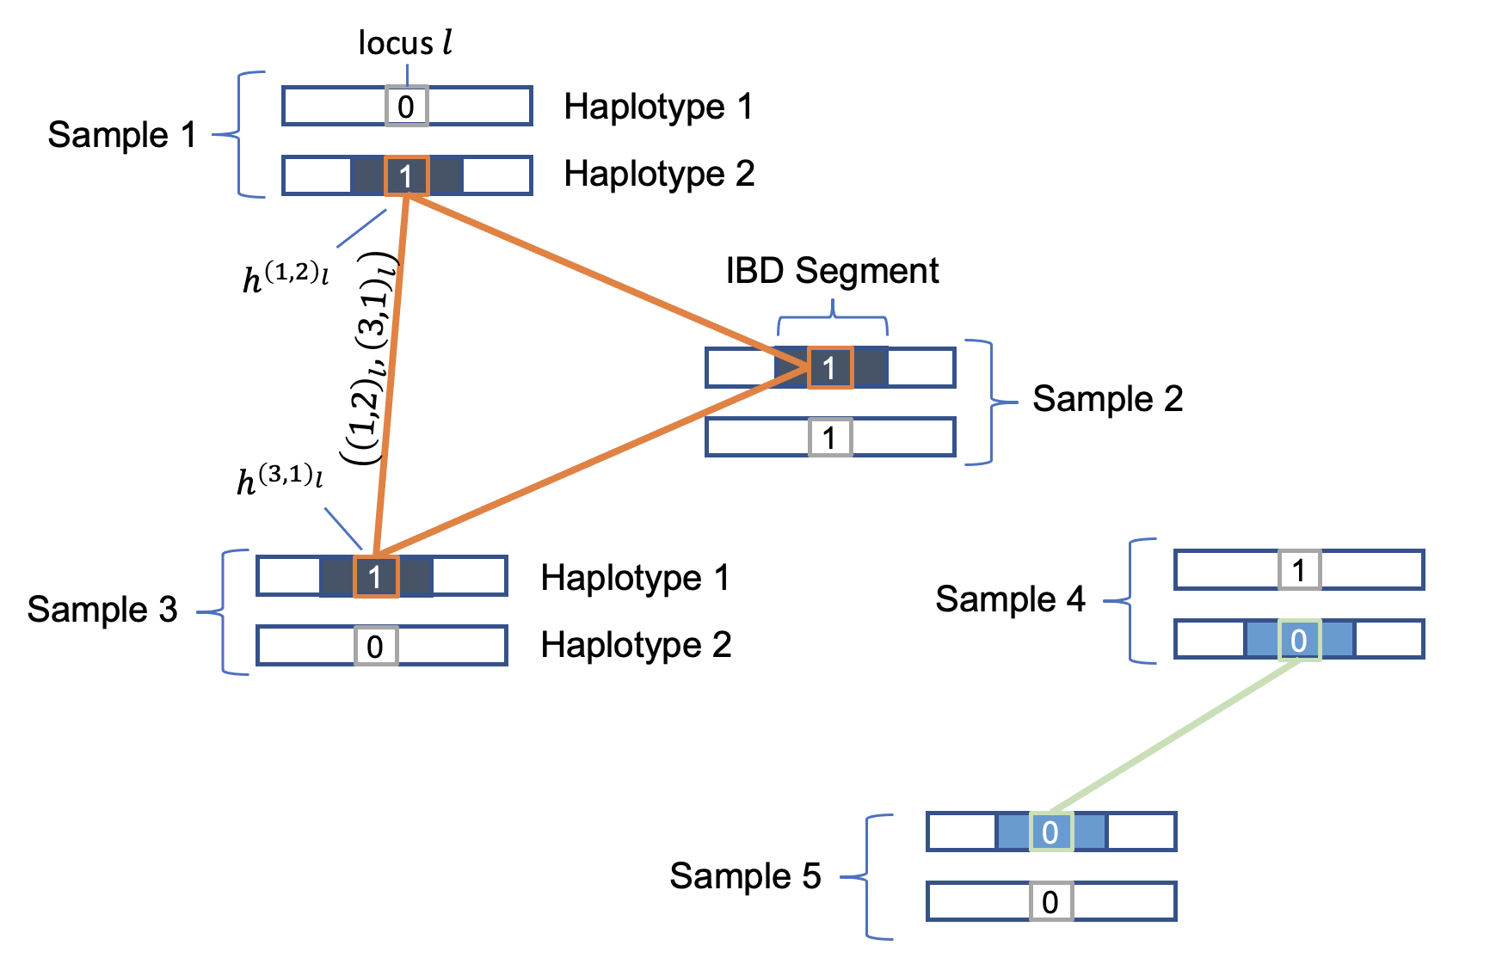
NEW APPROACH: Relatedness-Corrected Allele Frequencies Using IBD Segments

Slide 34

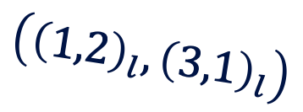

IBD Graph at Specific Genomic Location
Sample 1
IBD Segment
$$h^{{\left(1,2\right)}_{l}}$$
Sample 3
$$h^{{\left(3,1\right)}_{l}}$$
Sample 4
$$\left({\left(1,2\right)}_{l},{\left(3,1\right)}_{l}\right)$$
0
1
1
1
0
1
1
0
0
0
Sample 2
Sample 5

Slide 35
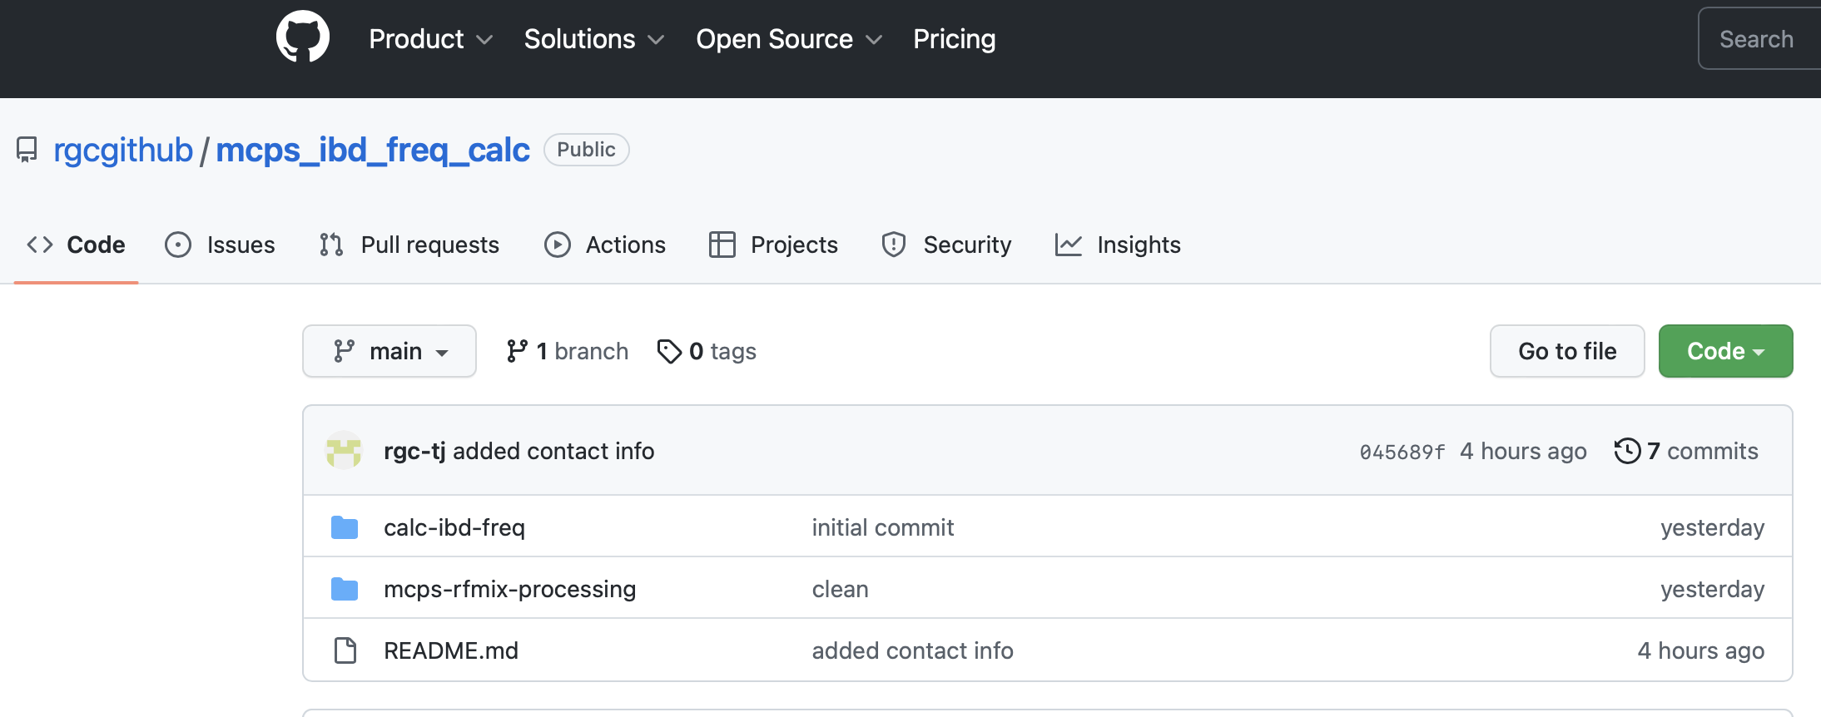

NEW APPROACH: Relatedness-Corrected Allele Frequencies Using IBD Segments
IBD segments define breakpoints where the relatedness structure changes along the genome
Algorithm
For each IBD graph along the genome:
1. Grab variants that fall in the span of the graph
2. Compute connected components of the graph
3. Set AC = # of alternate allele connected components
4. Set AN = total # of connected components
IBD Graphs
G1
G2
G3
$$⋯$$
G9
G10
*
*
*
*
*
*
*
*
*
IBD Segments
Breakpoints
Genome

Slide 36
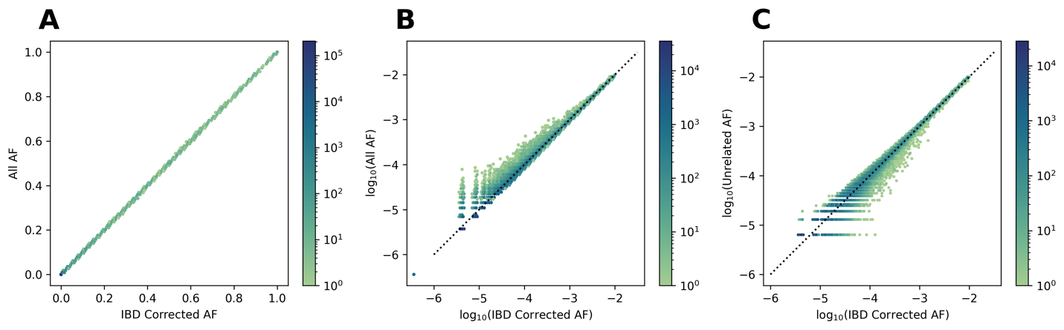
(A) Alternate allele frequencies computed for chromosome 22 correcting for IBD (x-axis) and computed from all samples (y-axis). (B) Log₁₀ alternate allele frequencies for rare variants (AAF<0.01) computed for chromosome 22 correcting for IBD (x-axis) and computed from all samples (y-axis). (C) Log₁₀ alternate allele frequencies for rare variants (AAF<0.01) computed for chromosome 22 correcting for IBD (x-axis) and computed from unrelated samples (y-axis).

Slide 37
>10-fold increase in size compared to gnomAD
Study | Source | # samples* | Effective # Indigenous samples | # variants
gnomAD¹ | WGS | 7,612 | 4,610 | 14.8M**
MCPS | WGS | 9,950 | 6,549 | 131.9M
MCPS | WES | 141,046 | 91,856 | 9.3M
142M variants
→10-fold increase
20-fold increase
in WES sample size
* Latino/Admixed American samples
**bi-allelic variants with low genotype missingness ($≤$10%) and an AF $>$ 0.1%
¹Wilson et al., AHGS 2021
Notes:
We next applied our method to MCPS WES and WGS data and estimated ancestry-specific allele frequencies for all 142M variants.
This is a 10-fold increase in number of variants compared to gnomAD.
And we have a 20-fold increase in samples size for the exome variants.

Slide 38
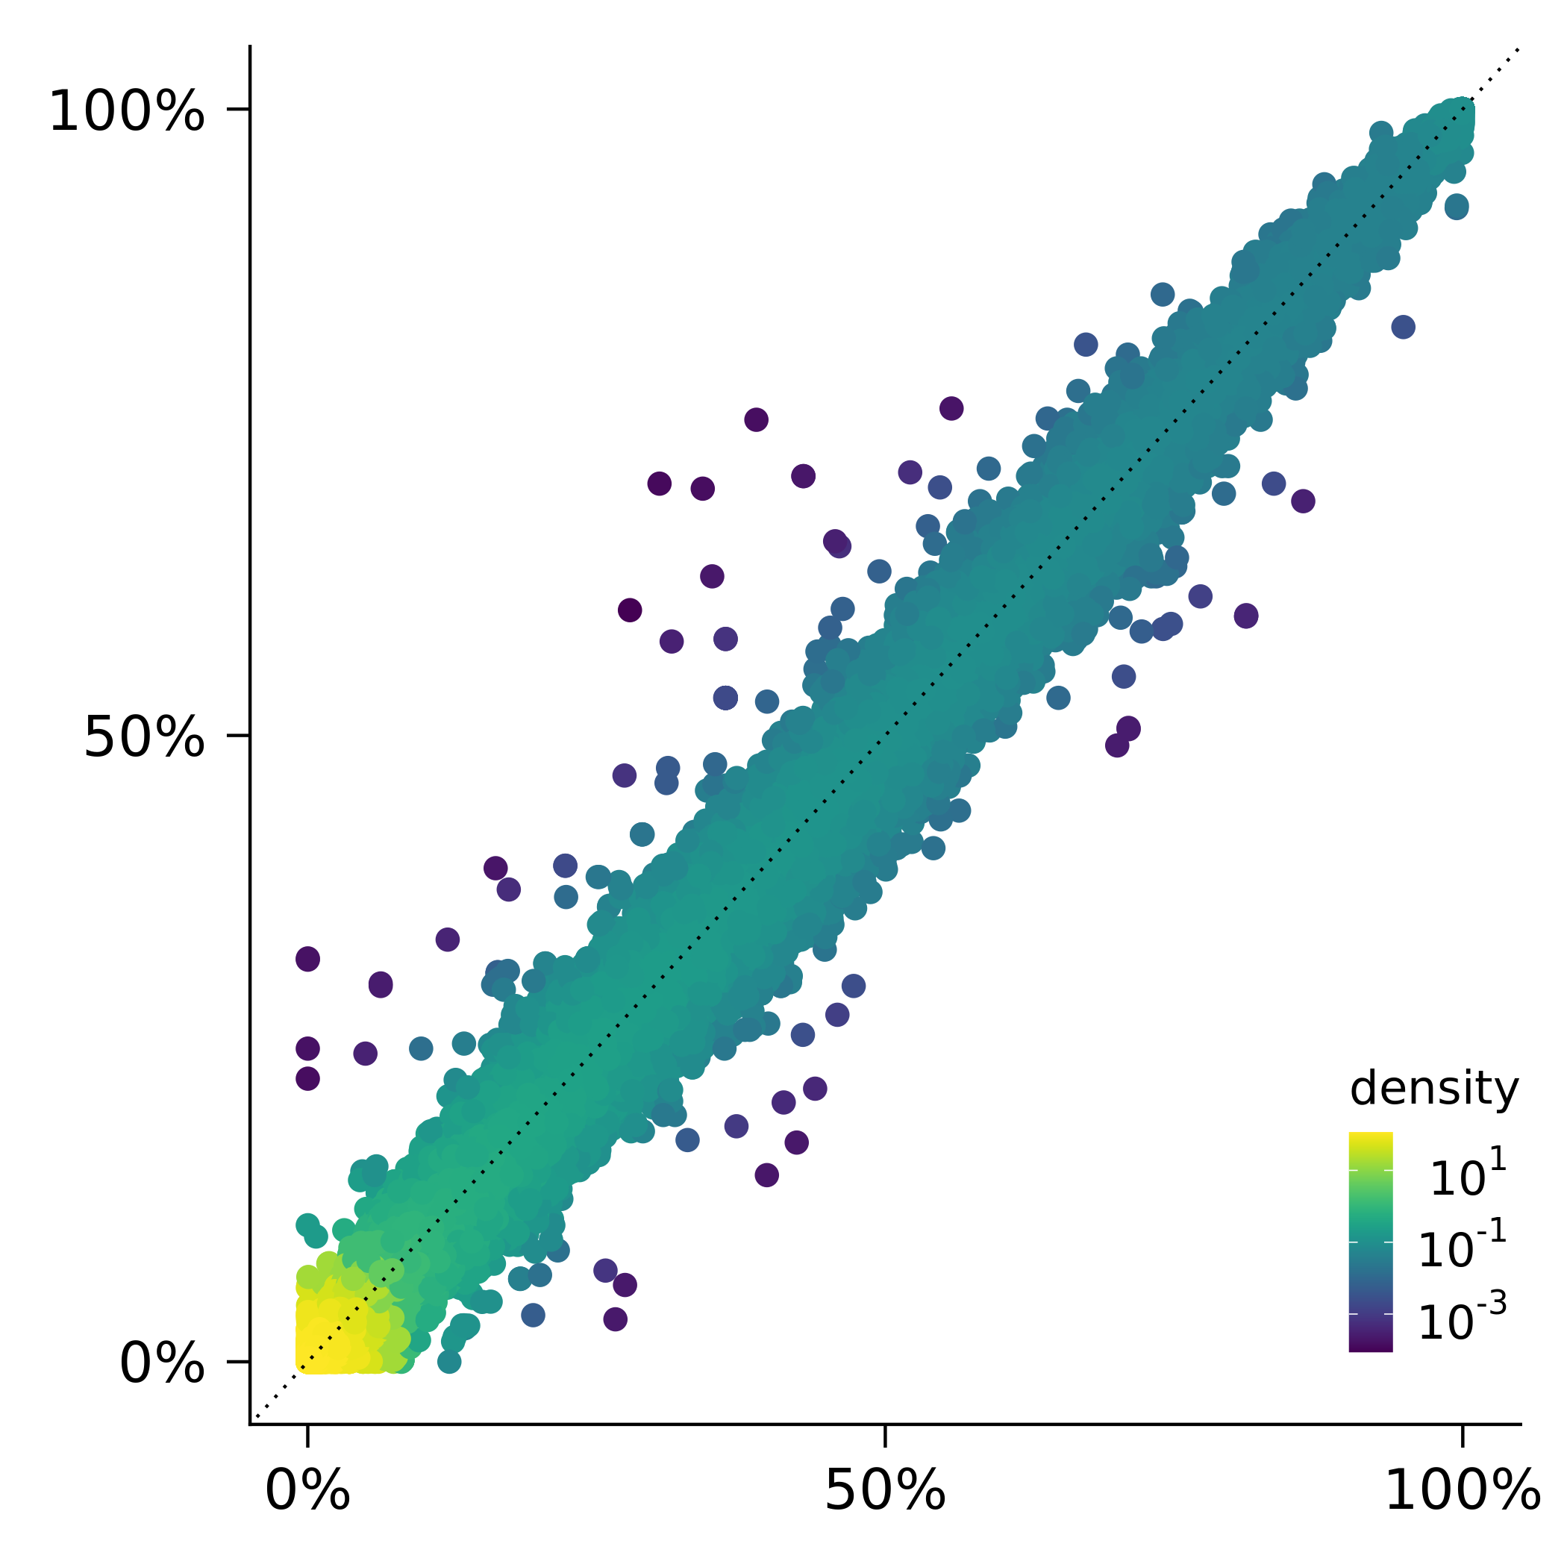
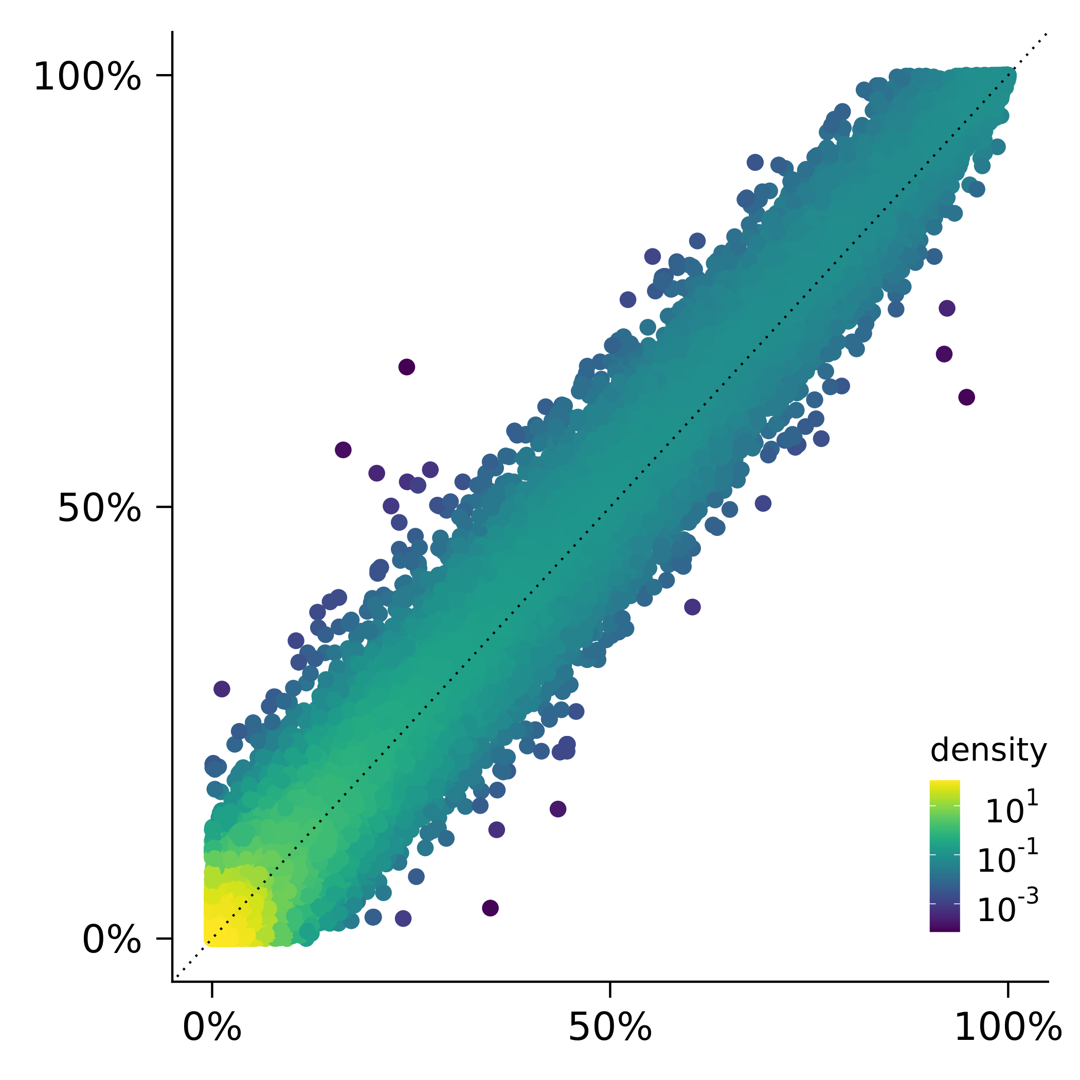
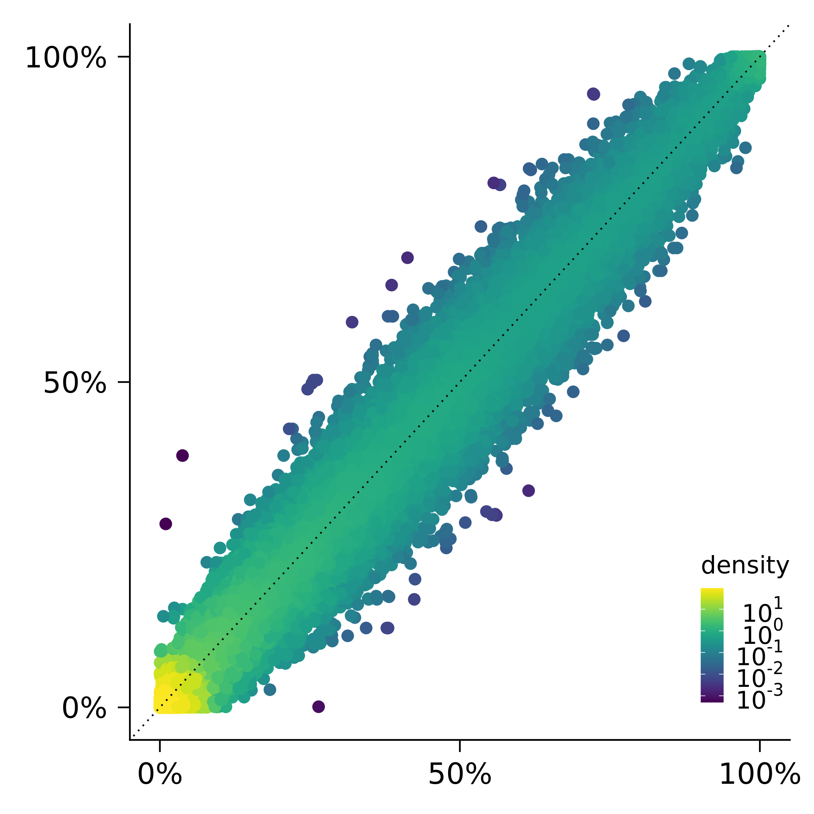
MCPS WES AF estimates agree with gnomAD
European
r² = 0.99
African
r² = 0.98
Indigenous
r² = 0.99
MCPS European
MCPS African
MCPS Indigenous Mexican
gnomAD Non-Finish European
gnomAD African/African American
gnomAD Amerindigenous
Notes:
We find that our results agree very well with gnomAD.
The plot on the left shows a correlation of 0.99 between European frequencies estimated in gnomAD Non-Finish Europeans and MCPS samples.
The plot in the middle shows a correlation of 0.98 for the African ancestry.
And the plot on the right shows a correlation of 0.99 between frequencies for gnomAD Amerindigenous and MCPS Indigenous Mexican ancestries.

Slide 39
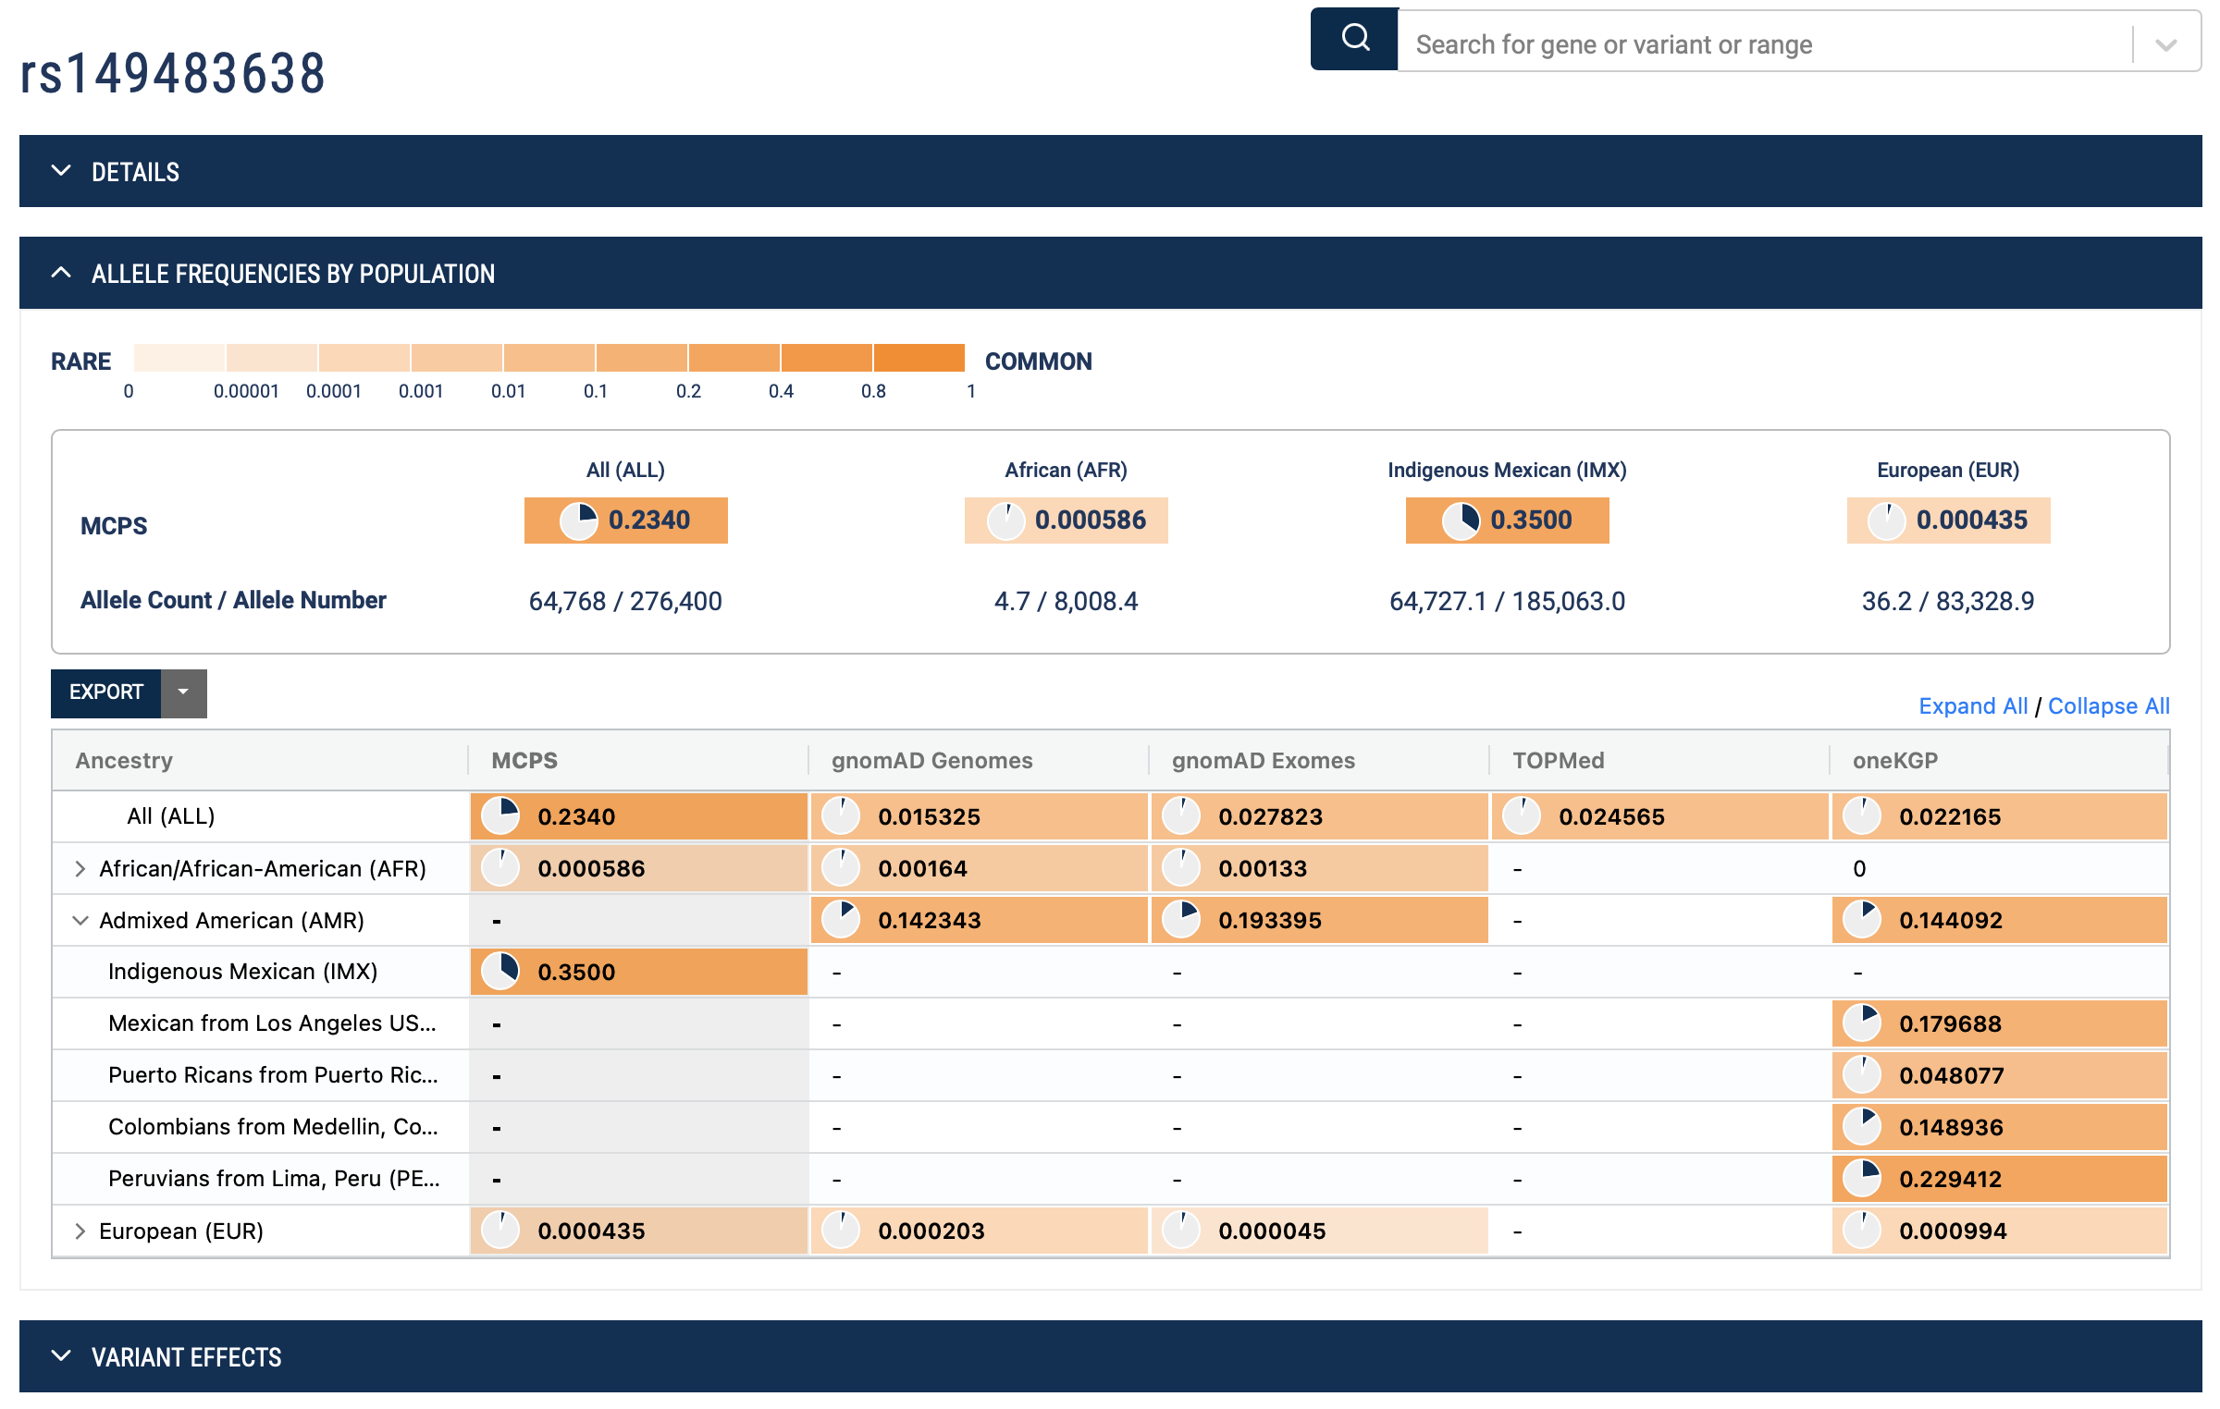
MCPS Variant Browser https://rgc-mcps.regeneron.com/
Database of 142M variants
Raw VCF data files with allele frequencies are available for download
Notes:
We have developed and released the MCPS Variant Browser, publicly available at rgc-mcps.regeneron.com.
Here is a screenshot for the splice acceptor variant in the IGF2 gene, the T2D locus discovered in Latino GWAS. The top bar shows the MCPS estimates with the overall frequency of 23%, the Indigenous frequency of 35% and nearly 0 European and African frequencies.
The browser also adds information from other public databases like gnomAD, TOPMed and 1,000 Genomes.

Slide 40

Acknowledgments
National Autonomous University of Mexico
Jesús Alegre-Díaz
Raul Ramirez-Reyes
Rogelio Santacruz-Benítez
Jaime Berumen
Pablo Kuri-Morales
Roberto Tapia-Conyer
Regeneron Genetics Center
Jonathan Marchini
Sheila M. Gaynor
Andrey Ziyatdinov
Tyler Joseph
Joshua Backman
Joelle Mbatchou
Yuxin Zou
Daren Liu
Jeffrey Staples
Razvan Panea
Alex Popov
Xiaodong Bai
Suganthi Balasubramanian
Lukas Habegger
Rouel Lanche
Alex Lopez
Evan Maxwell
Marcus Jones
Eric Jorgenson
Will Salerno
John Overton
Jeffrey Reid
Goncalo Abecasis
Lyndon Mitnaul
Aris Baras
Instituto Nacional de Medicina Genómica, Mexico City
Humberto García-Ortiz
Lorena Orozco-Orozco
Oxford
Jason Torres
Michael Turner
Rachel Wade
Rory Collins
Michael R Hill
Jonathan R Emberson
AstraZeneca
Abhishek Nag
Katherine Smith
Slavé Petrovski
AbbVie
Mark Reppell
University of Michigan
Sebastian Zollner
Yuxin Zou

Slide 41

We are hiring! Visit our website for all posted positions:
careers.regeneron.com
Open Position in Statistical Genetics:
https://careers.regeneron.com/job/R20103/Associate-Manager-Statistical-Genetics
  Please contact Joelle Mbatchou for specific interest: joelle.mbatchou@regeneron.com
Regeneron Genetics Center
41 │ Confidential
Notes:
Gets updated

Slide 42

THANK YOU!
Contact Information:
timothy.thornton@regeneron.com
42 │ Confidential

