Slide 1
LD-Score Heritability + Genetic Correlation
Andrew Grotzinger
2023 International Statistical Genetics Workshop
March 8th, 2023

Slide 2
Where to put questions for this practical on the forum
https://isgw-forum.colorado.edu/

Slide 3
Let’s start by going to:
https://workshop.colorado.edu/rstudio/
And clicking on the terminal tab.

Slide 4
Copy over the practical files from that terminal tab
cp -r /faculty/andrew/LDSC_Practical_2023 .

Slide 5
Now let’s go over to the console and setwd for this new folder you just copied

Slide 6
Now let’s go to File at the top and open the .R script with the commands we will be running

Slide 7
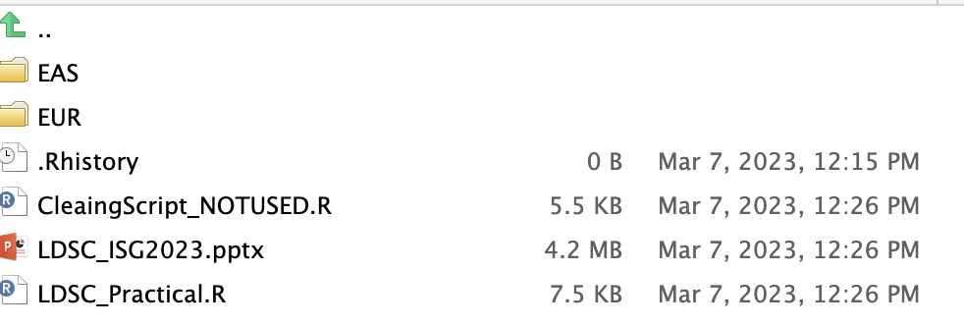
Finally let’s open the R script “LDSC_Practical.R”

Slide 8
Outline
Background
Univariate LDSC
Bivariate LDSC
Practical for Continuous Traits
Liability Scale Heritability for Binary Traits
Practical for Binary Traits

Slide 9
I. Background

Slide 10
Toy Example: 2 True Causal Variants
Imagine that there are two causal variants in the population.
All variants in LD with those variants are going to be estimated as having an affect on the phenotype, Y
The LD-score of a variant is the sum of r² across SNPs.
Phenotype Y
$𝓁_{j}= \sum_{i}{r_{ij}^{2}}$
Notes:
each solid arrow double counts the effect of the causal variant on the phenotype, so there is a greater appearance of association for the high ld example even though the causal variant has the same true effect size in both scenarios. Here we would say the signal is true, because the SNPs with higher LD have bigger arrows.

Slide 11
= Causal Variants
Trait Y

Slide 12
= Causal Variants
= High LD Variants
Trait Y

Slide 13
= Causal Variants
= High LD Variants
= Medium LD Variants
Trait Y

Slide 14
= Causal Variants
= High LD Variants
= Medium LD Variants
Trait Y
= Low LD Variants

Slide 15
Because traits are highly polygenic:
Variants with higher LD are more likely to pick up effect of causal variant
Estimated Heritability = strength of association between LD and SNP effect size
LD-scores are going to be more strongly related to effective size for traits with stronger genetic signal (i.e., higher heritability)
Bulik-Sullivan et al., 2015
Notes:
The more you tag, the more likely you are to tag a causal variant

Slide 16
II. Univariate LDSC

Slide 17
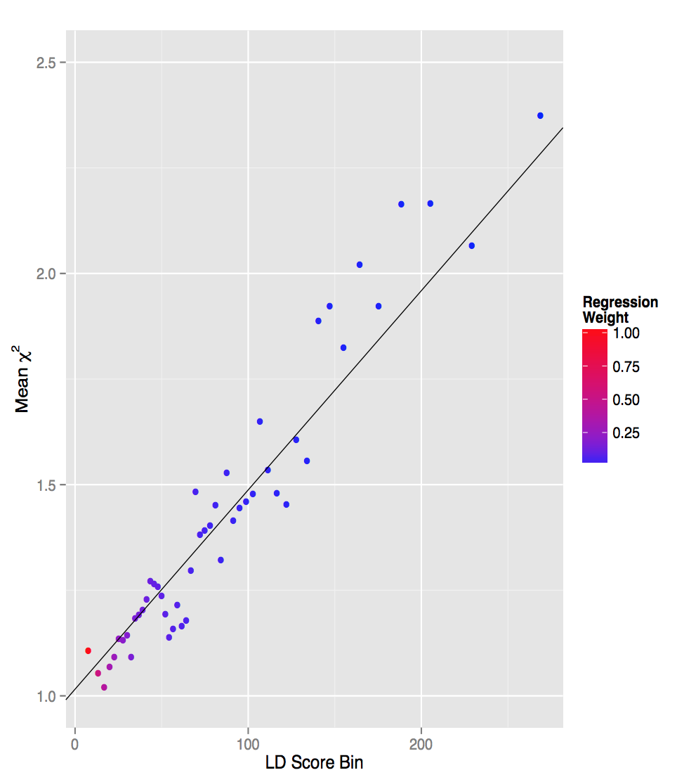
To estimate SNP Heritability:
Regress GWAS chi-square against LD Scores for all SNPs (not just significant ones)
Unbiased by sample overlap or cryptic population stratification
Only effect the average test statistic (the LDSC intercept) but not the relationship between test statistics and LD Scores (the slope)
Chi-square

Slide 18
$$E\left[χ^{2}| 𝓁_{j}\right]=\frac{{Nh}^{2}}{M}𝓁_{j}+Na+1$$

Slide 19
$$E\left[χ^{2}| 𝓁_{j}\right]=\frac{{Nh}^{2}}{M}𝓁_{j}+Na+1$$
The expectation for the GWAS chi-square given the LD-score for the SNP j
This is the “Y” variable in the linear regression

Slide 20
$$E\left[χ^{2}| 𝓁_{j}\right]=\frac{{Nh}^{2}}{M}𝓁_{j}+Na+1$$
N = Sample size
M = number of SNPs used to estimate the LD-scores
h² = SNP-based heritability
This whole piece can be thought as the estimated “beta” in the linear regression

Slide 21
If you have two traits that have the exact same GWAS estimates (i.e., same p-value)
Trait 1: N = 50,000
Trait 2: N= 100,000
Trait 1 must be more heritable given equivalent results at 1/2 the sample size

Slide 22
$$E\left[χ^{2}| 𝓁_{j}\right]=\frac{{Nh}^{2}}{M}𝓁_{j}+Na+1$$
$𝓁_{j}= \sum_{i}{r_{ij }^{2}}$
The LD-score of SNP j
This is the ”X” variable in the linear regression

Slide 23
$$E\left[χ^{2}| 𝓁_{j}\right]=\frac{{Nh}^{2}}{M}𝓁_{j}+Na+1$$
N is sample size again
a is confounding biases
This whole piece is the “intercept” in the linear regression
Notes:
If even low LD SNPs (where the regression line is hitting the y-axis) are above the null, this indicates that population stratification, crypic relatedness, and the like are contributing to estimaets

Slide 24
Putting it all together, this is ultimately a simple linear regression equation to back out the implied heritability estimates
$$E\left[χ^{2}| 𝓁_{j}\right]=\frac{{Nh}^{2}}{M}𝓁_{j}+Na+1$$

Slide 25
III. Bivariate LDSC

Slide 26
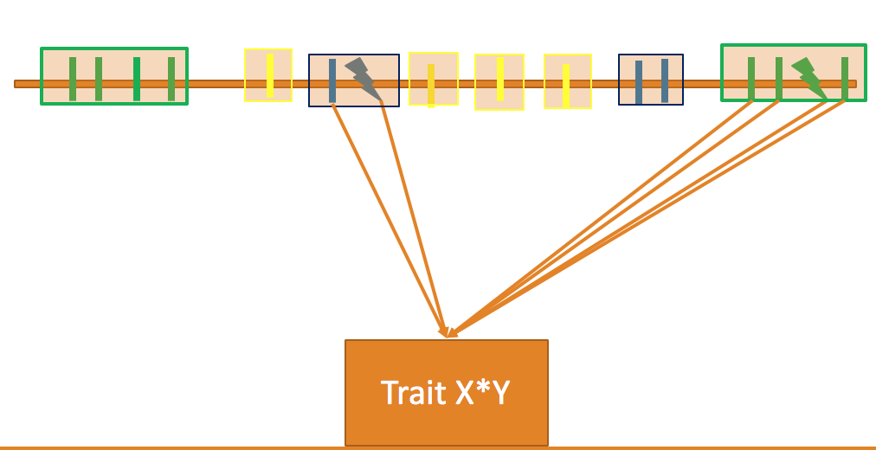
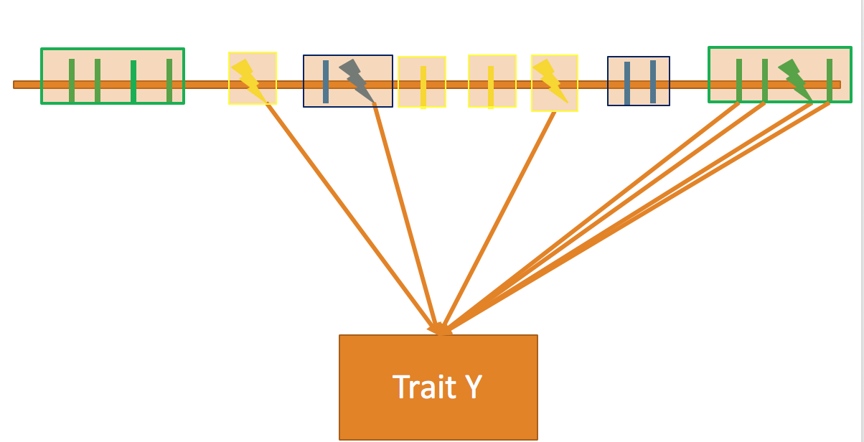
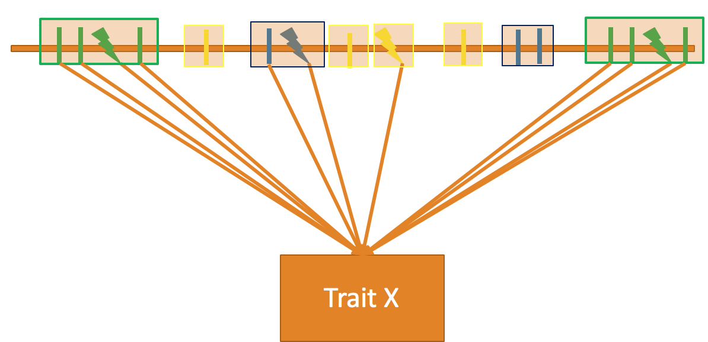
Traits do not need to be from the same sample!
The genetic code is the link (the bridge) across these estimates
Offers chance to examine even mutually exclusive traits

Slide 27
Co-heritability
(genetic covariance) =
strength of association between LD and product of effect sizes for two different phenotypes (Y1*Y2)
Y1*Y2 Z-statistics
0
Bulik-Sullivan et al., 2015
Notes:
The stronger the relationship between LD-score and effect size, the stronger the genetic signal and the higerhthe co-heritability

Slide 28
$$E\left[z_{1j}z_{2j} |𝓁_{j}\right]=\frac{\sqrt{N_{1}N_{2} }ρ_{g}}{M}𝓁_{j}+\sqrt{N_{1}N_{2}}a+\frac{ρN_{s}}{\sqrt{N_{1}N_{2}}}$$

Slide 29
$$E\left[z_{1j}z_{2j} |𝓁_{j}\right]=\frac{\sqrt{N_{1}N_{2} }ρ_{g}}{M}𝓁_{j}+\sqrt{N_{1}N_{2}}a+\frac{ρN_{s}}{\sqrt{N_{1}N_{2}}}$$
The expectation for the product of z-statistics across two traits given the LD-score for the SNP j
This again is the “Y” variable in the linear regression

Slide 30
$$E\left[z_{1j}z_{2j} |𝓁_{j}\right]=\frac{\sqrt{N_{1}N_{2} }ρ_{g}}{M}𝓁_{j}+\sqrt{N_{1}N_{2}}a+\frac{ρN_{s}}{\sqrt{N_{1}N_{2}}}$$
$\sqrt{N_{1}N_{2} }$ reflects the square root of the sample size
for trait 1 and trait 2
M is the number of SNPs
$ρ_{g}$ is the genetic covariance
This is the “beta” where again we back out the estimate we care about, which in this case is the genetic covariance

Slide 31
$$E\left[z_{1j}z_{2j} |𝓁_{j}\right]=\frac{\sqrt{N_{1}N_{2} }ρ_{g}}{M}𝓁_{j}+\sqrt{N_{1}N_{2}}a+\frac{ρN_{s}}{\sqrt{N_{1}N_{2}}}$$
Again, this is the LD-score for a given SNP j, which reflects our “X” variable

Slide 32
$$E\left[z_{1j}z_{2j} |𝓁_{j}\right]=\frac{\sqrt{N_{1}N_{2} }ρ_{g}}{M}𝓁_{j}+\sqrt{N_{1}N_{2}}a+\frac{ρN_{s}}{\sqrt{N_{1}N_{2}}}$$
Here we have the bivariate LDSC intercept.
$\sqrt{N_{1}N_{2}}a$ reflects shared sources of population stratification across the two samples.
$\frac{ρN_{s}}{\sqrt{N_{1}N_{2}}}$ reflects the phenotypic correlation among overlapping participant samples weighted by proportional sample overlap

Slide 33
Genetic Correlation
r_{g} = $\frac{ρ_{g}}{\sqrt{\text{h}\text{2}\text{Y}\text{1}\text{h}\text{2}\text{Y}\text{1 }}}$
In many instances, we are interested in the amount of genetic overlap on the standardized scale (i.e., genetic correlation).
What are some important things to keep in mind when interpreting this estimate?
Why is the bivariate LDSC equation only going to work within ancestry?

Slide 34
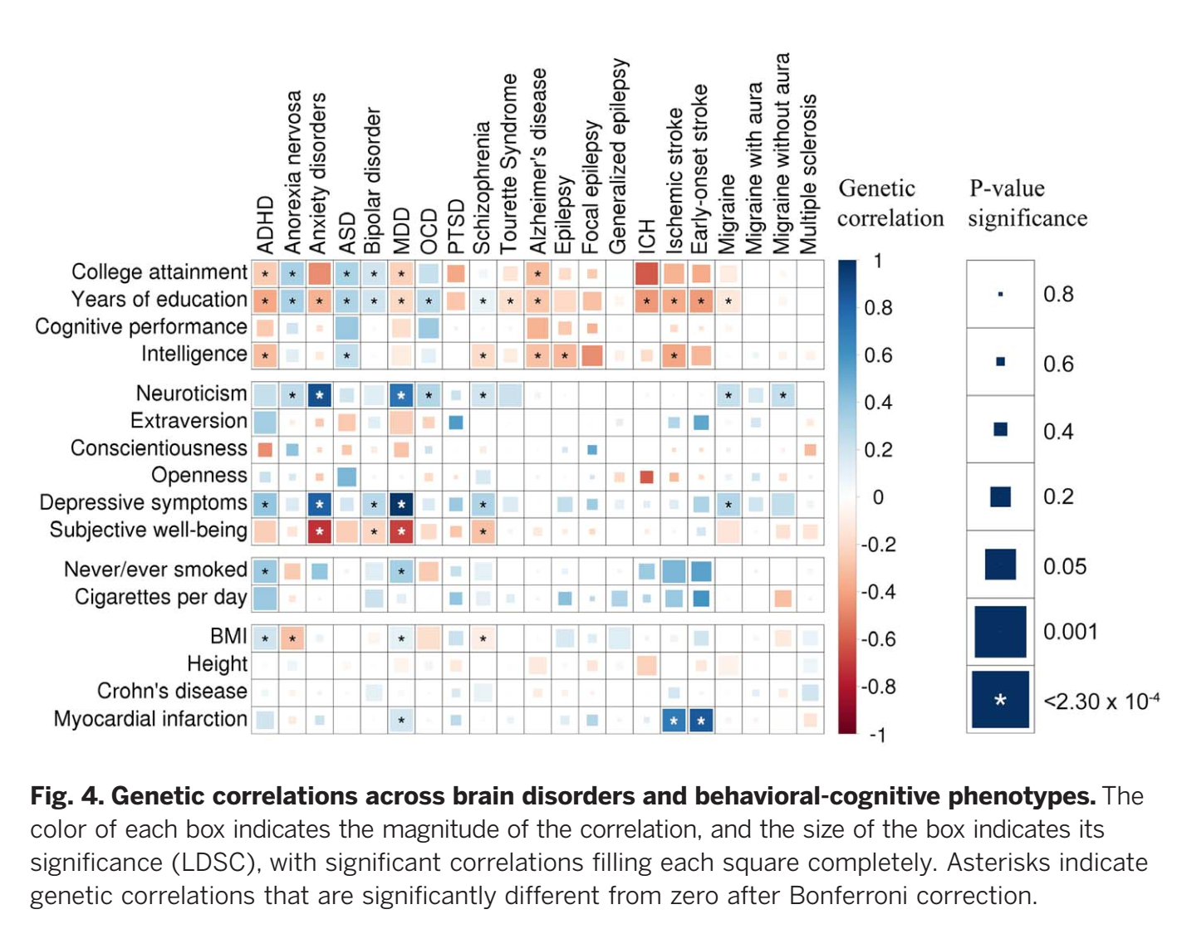
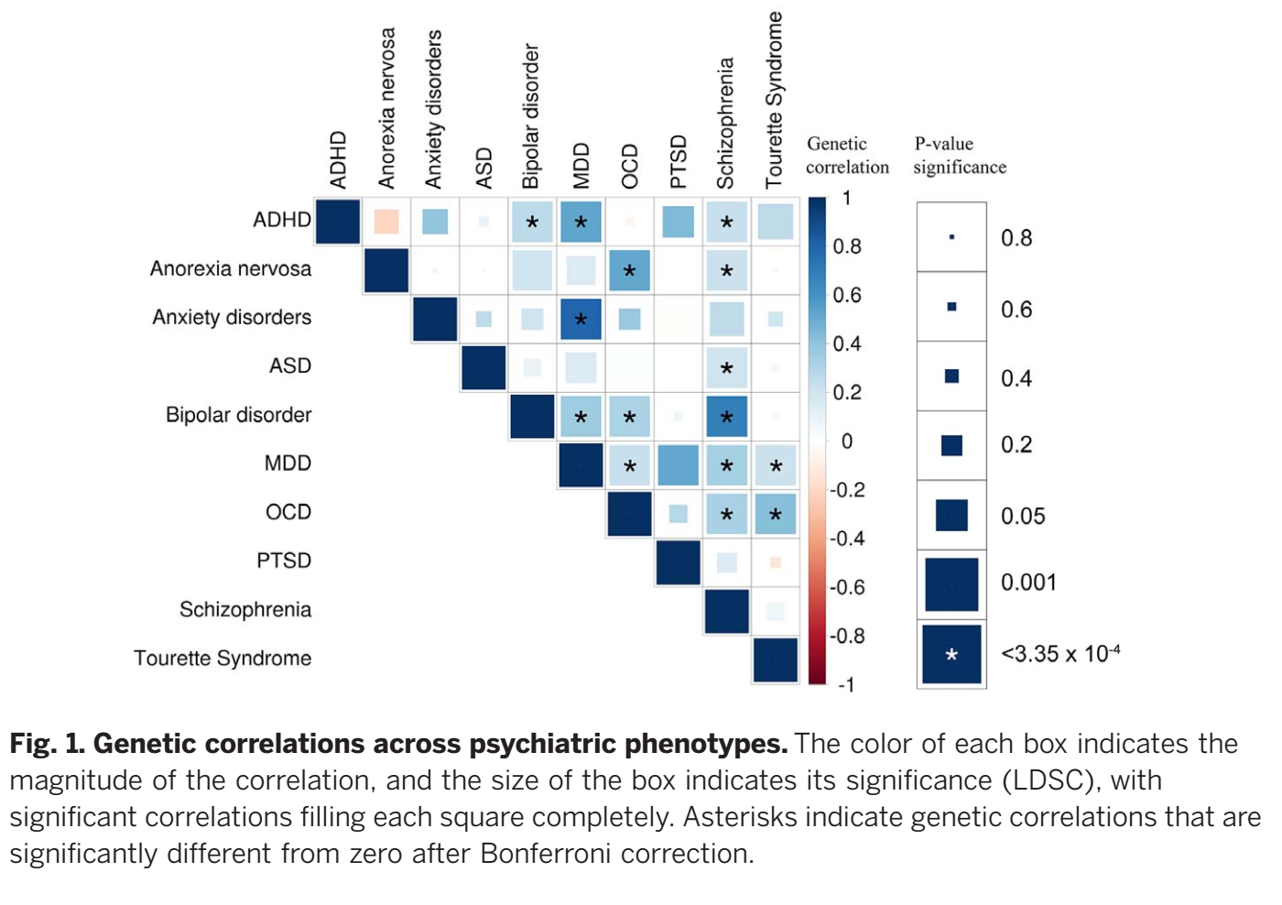
Allows us to produce genetic “heat maps” of genetic correlations across traits
Brainstorm Consortium, 2018
Notes:
What I want to start with is this heatmap.
This heatmap shows shared risk across different disorders for the entire genome.
Will notice that many of the cells are colored, suggesting genetic overlap
I’m a psychologist so I’ll focus on psychiatric traits, but you’ll see this for other traits as well.

Slide 35
IV. Practical for Continuous Traits

Slide 36
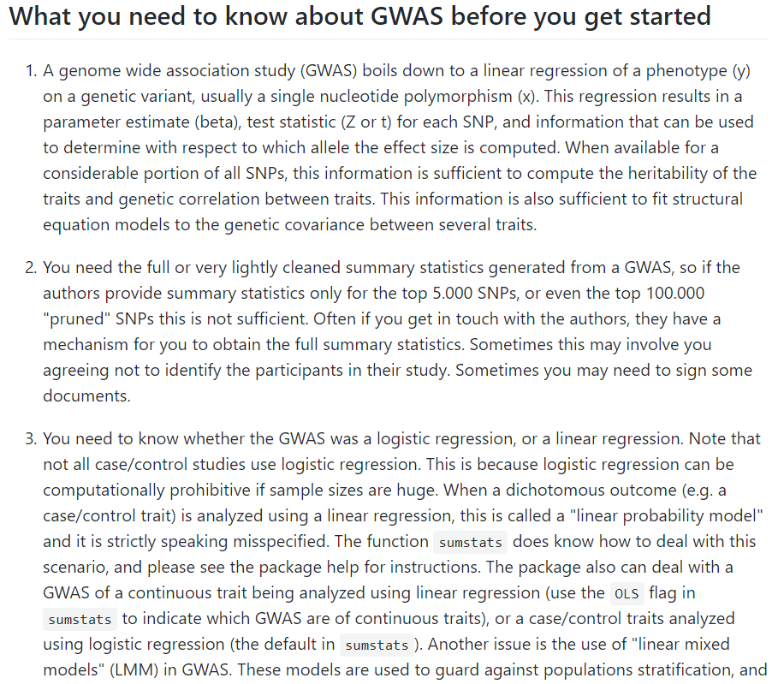
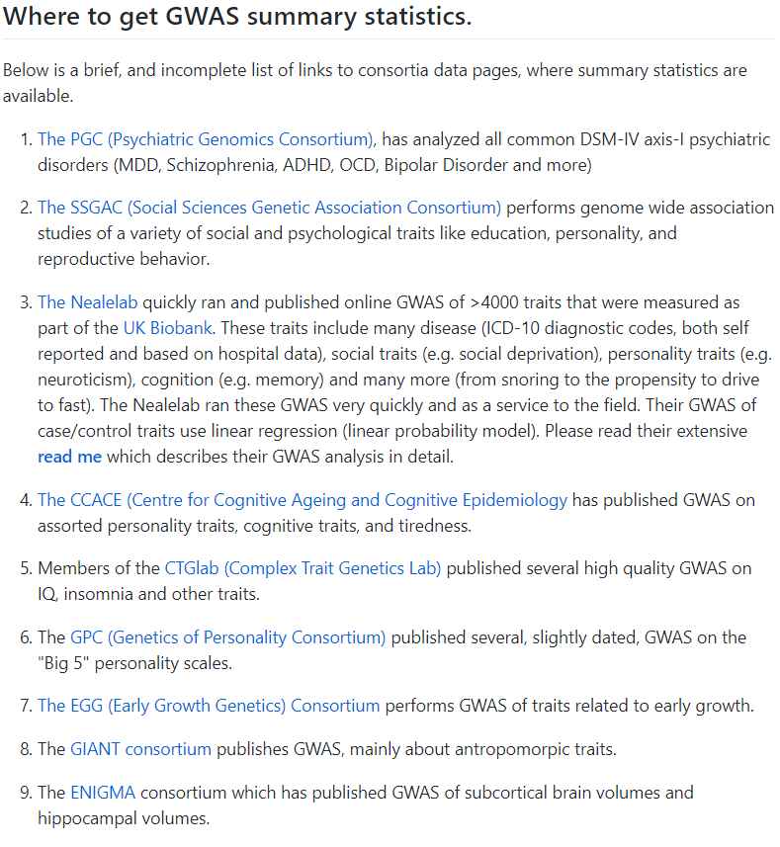
Where to get summary statistics
List lots of resources on the Genomic SEM Wiki:
https://github.com/GenomicSEM/GenomicSEM/wiki/2.-Important-resources-and-key-information

Slide 37
https://www.ebi.ac.uk/gwas/
https://pheweb.jp/
https://www.finngen.fi/en/access_results
https://pgc.unc.edu/for-researchers/download-results/
https://docs.google.com/spreadsheets/d/1AeeADtT0U1AukliiNyiVzVRdLYPkTbruQSk38DeutU8/edit#gid=268241601
https://enigma.ini.usc.edu/research/download-enigma-gwas-results/

Slide 38
Only TWO Primary Steps to estimate ldsc
Munge: convert raw data from one form to another
1. Munge the summary statistics (munge)
2. Run LD-Score Regression to obtain the genetic covariance and sampling covariance matrices (ldsc)

Slide 39
The summary statistics files input to the munge function at a minimum need to contain five pieces of information:
The rsID of the SNP.
An A1 allele column, indicating the effect allele.
An A2 allele column, indicating the non-effect allele.
A signed (+/-) effect column.
The p-value associated with this effect.

Slide 40
The munge function takes 6 arguments:
files: The name of the summary statistics files
hm3: The name of the reference file. Here we use Hapmap 3 SNPs.
trait.names: The trait names that will be used to name the saved files
N: The sample sizes associated with the traits.
info.filter: INFO filter. Package default is to retain SNPs with INFO > 0.9.
maf.filter: MAF filter. Package default is to retain SNPs with MAF > 0.01.

Slide 41
The ldsc function takes 6 arguments:
traits: a vector of file names/paths to files which point to the munged sumstats.
sample.prev: A vector of sample prevalences of length equal to the number of traits. If the trait is continuous, the values should equal NA.
population.prev: A vector of population prevalences. If the trait is continuous the values should equal NA.
4. ld: A folder of LD scores used as the independent variable in LDSC
5. wld: A folder of LDSC weights (Typically same folder as specified for the ld argument)
6. trait.names: The trait names.

Slide 42
We will be estimating LDSC for both European and East Asian Samples
Using European GWAS sumstats for:
Height (Yengo et al., 2022)
BMI from Pan UKB
Using East Asian GWAS sumstats for:
Height (Yengo et al., 2022)
BMI from Biobank Japan

Slide 43
LET’S GO TO THE CODE
In this first practical you will get practice running the munge and ldsc functions and plotting the output as a heatmap.
Make sure to look at the .log files produced by each function to get a sense of what they are each doing “behind the scenes”
In practice, you will always want to inspect these to ensure that columns are being interpreted correctly

Slide 44
munge .log file

Slide 45
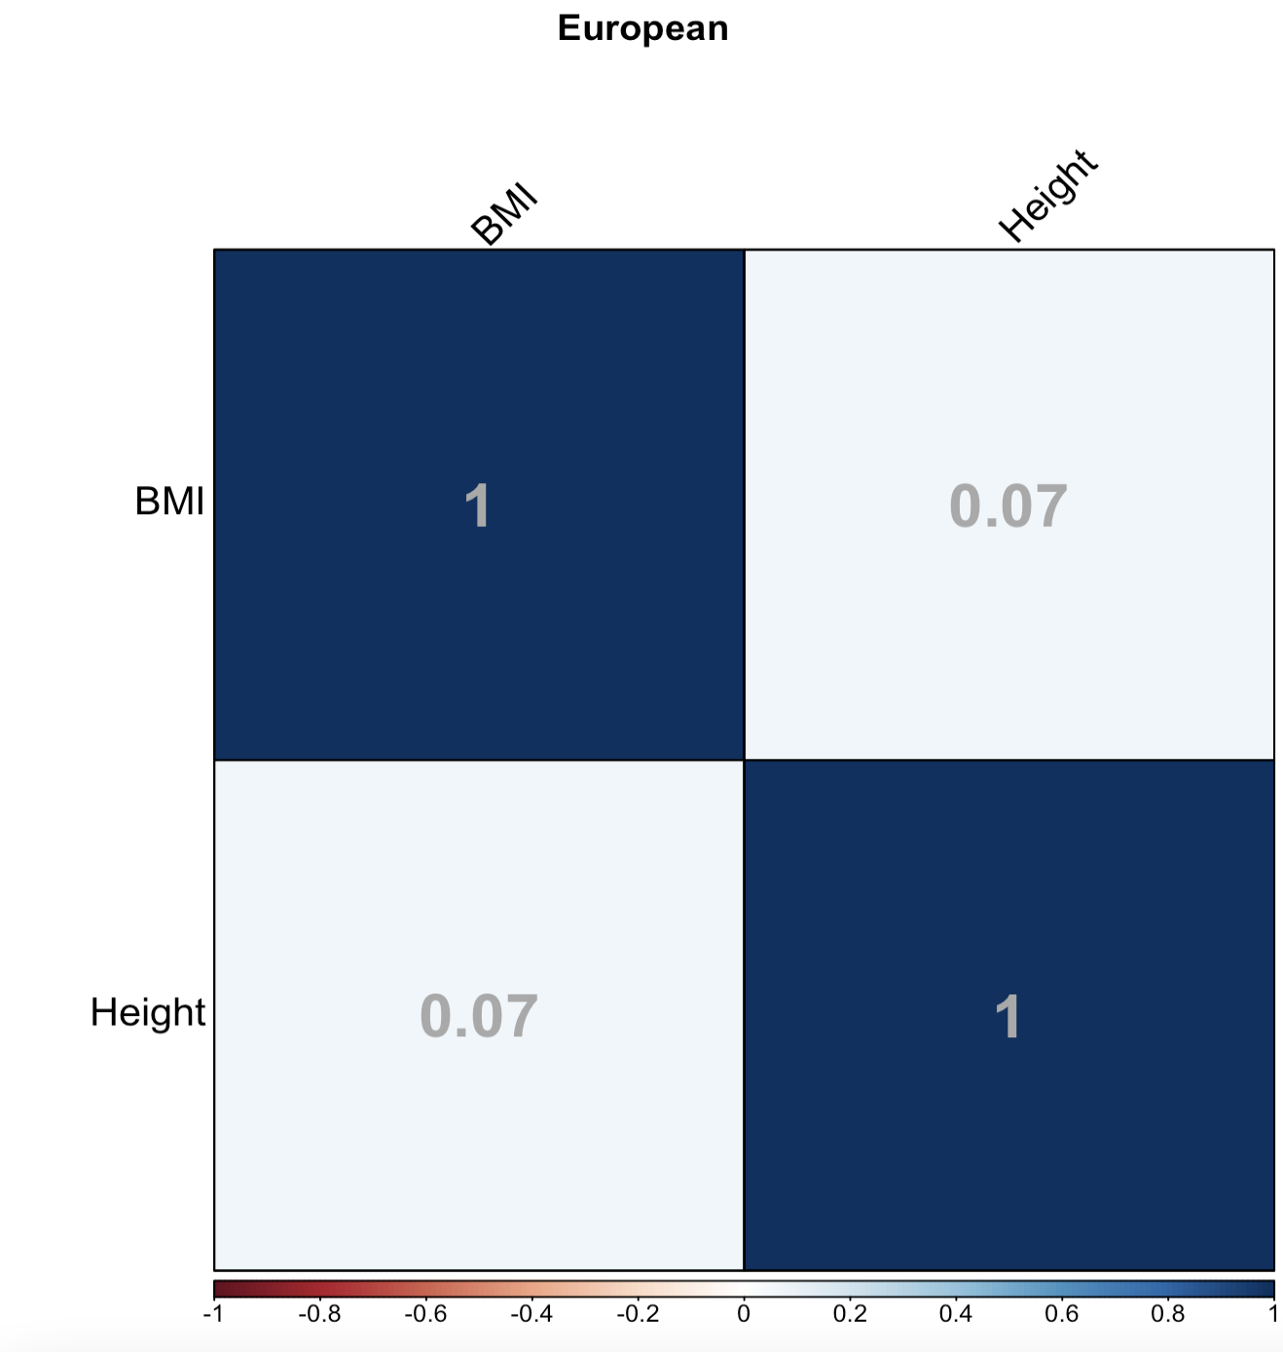

Slide 46
ldsc .log file

Slide 48
V. Liability Scale Heritability for Binary Traits

Slide 49
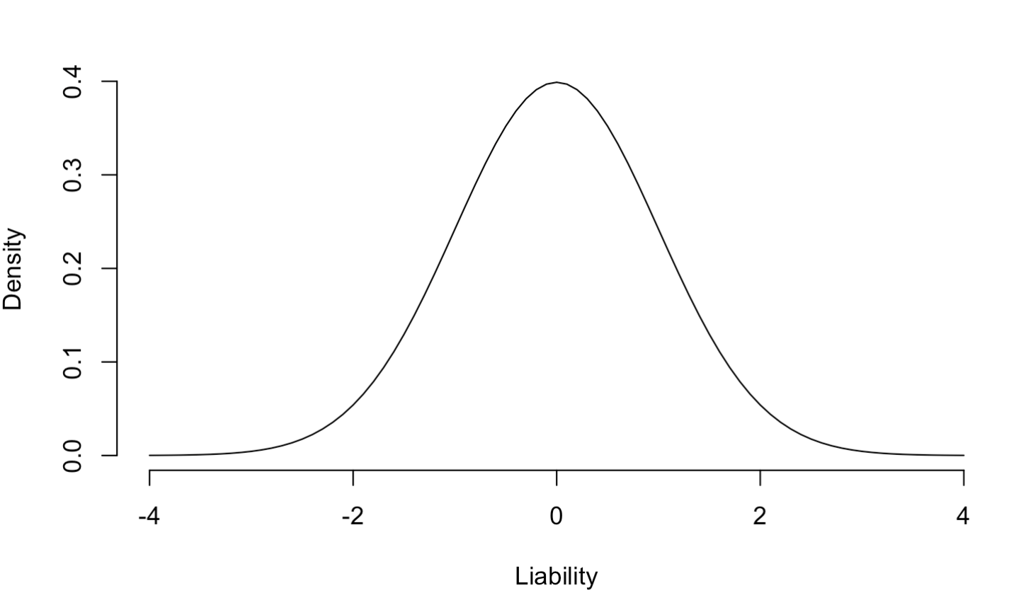
$$φ$$
height of the standard normal probability density function at the truncation threshold t
Threshold (t) at which diagnosis is made
Not diagnosed with disease (1-P)
Diagnosed with disease (P)

Slide 50
$${h_{l}^{2}=h}_{o}^{2}\frac{P(1−P)}{φ^{2}} \frac{P(1−P)}{v\left(1−v\right)}$$
This first part of this equation backs out the expected heritability estimate on that continuous distribution of risk (liability)
P is the population prevalence of the disorder.
$φ$ is the height of the continuous distribution of liability at the threshold t at which a diagnosis of the disorder is made

Slide 51
$${h_{l}^{2}=h}_{o}^{2}\frac{P(1−P)}{φ^{2}} \frac{P(1−P)}{v\left(1−v\right)}$$
This second part of this equation
performs the correction for participant ascertainment
P is again the population prevalence of the disorder.
v is the prevalence of the disorder in our participant sample.
The ratio then reflects the degree of ascertainment

Slide 52
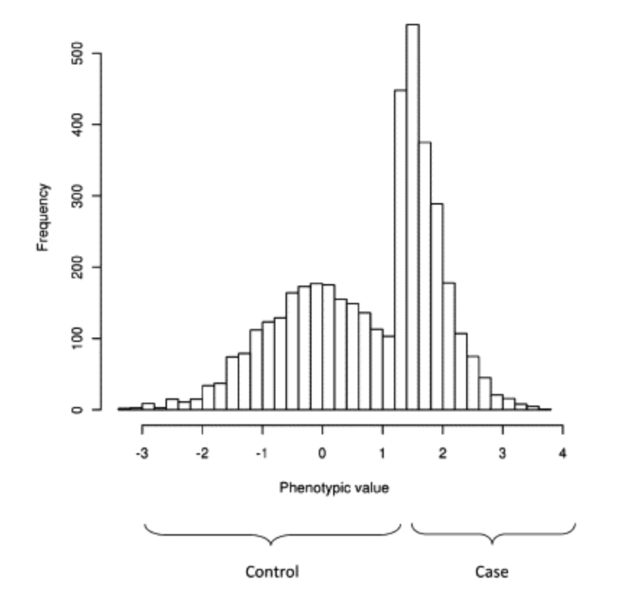
“In case-control studies the proportion of cases is usually (much) larger than the prevalence in the population yet estimates of genetic variation are most interpretable if they are not biased by this ascertainment”
Lee et al. (2011)

Slide 53
Cohort-specific ascertainment
As GWAS have continued to grow in sample size they often reflect meta-analyses of a series of contributing cohorts.
For pragmatic reasons relating to data sharing with raw genotypes cohorts often share the GWAS summary stats to be meta-analyzed with other summary stats
When this happens a correction for ascertainment within each cohort is required.
The reason: the ascertainment calculated using total cases and controls is not the same as ascertainment calculated within cohort
Sum of parts != sum of totals

Slide 54
$${h_{l}^{2}=h}_{o}^{2}\frac{P(1−P)}{φ^{2}} \frac{P(1−P)}{\sum_{k}{v_{k}\left(1−v_{k}\right)}}$$
In order to appropriately perform the ascertainment correction we need to calculate the sum of ascertainment across the contributing cohorts, k

Slide 55
$${EffN}_{k}= 4v_{k}\left(1−v_{k}\right)n_{k}$$
In practice, we use what’s call the effective sample size for this cohort-specific ascertainment correction.
The effective sample size is the sample size you would have had if the study design was balanced (50% cases and 50% controls)
Thus, it corrects the sample size for ascertainment and allows for summing sample size across cohorts.
We use sum of effective N as many GWAS pipelines (e.g., Ricopili) automatically output this for the GWAS

Slide 56
VI. Practical for Binary Traits

Slide 57
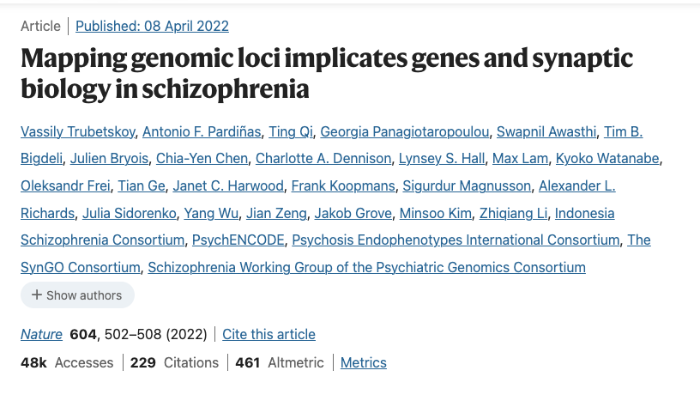
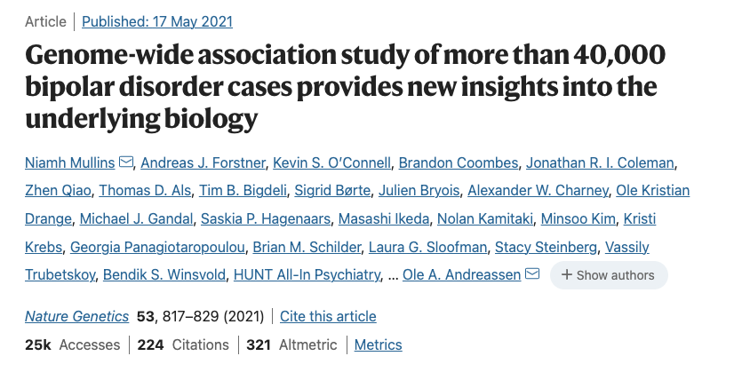
We will be estimating LDSC for European Samples for Bipolar Disorder and Schizophrenia

Slide 58
The ldsc function takes 6 arguments:
traits: a vector of file names/paths to files which point to the munged sumstats.
sample.prev: A vector of sample prevalences of length equal to the number of traits. Enter 0.5 if inputting sum of effective N.
population.prev: A vector of population prevalences.
ld: A folder of LD scores used as the independent variable in LDSC
5. wld: A folder of LDSC weights (Typically same folder as specified for the ld argument)
6. trait.names: The trait names.

Slide 59
LET’S GO TO THE CODE
In this second practical you will get practice running the munge and ldsc functions for binary traits
Note that bipolar disorder and schizophrenia are diagnostically exclusionary of one another.
What does a method like LDSC tell us about these two traits?

