Slide 1
Imputation
Sarah Medland
The 2023 International Statistical Genetics Workshop

Slide 2
cp /faculty/sarah/Imputation/qualtrics.txt
to your working directory

Slide 3
Open up the Qualtrics and start the imputation

Slide 4
Why do we impute?
3 main reasons for imputation
  Meta-analysis
  Fine Mapping
  Combining data from different chips
Other less common uses
  Sporadic missing data imputation
  Correction of genotyping errors
  Imputation of non-SNP variation

Slide 5
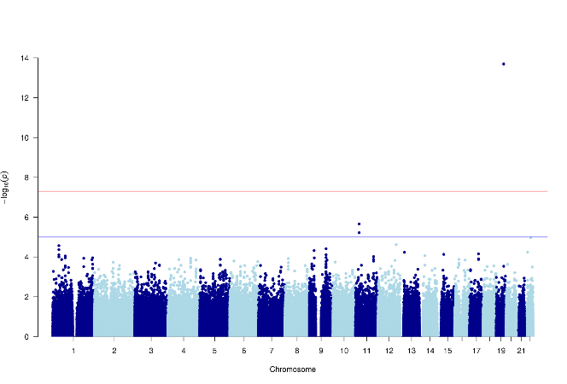
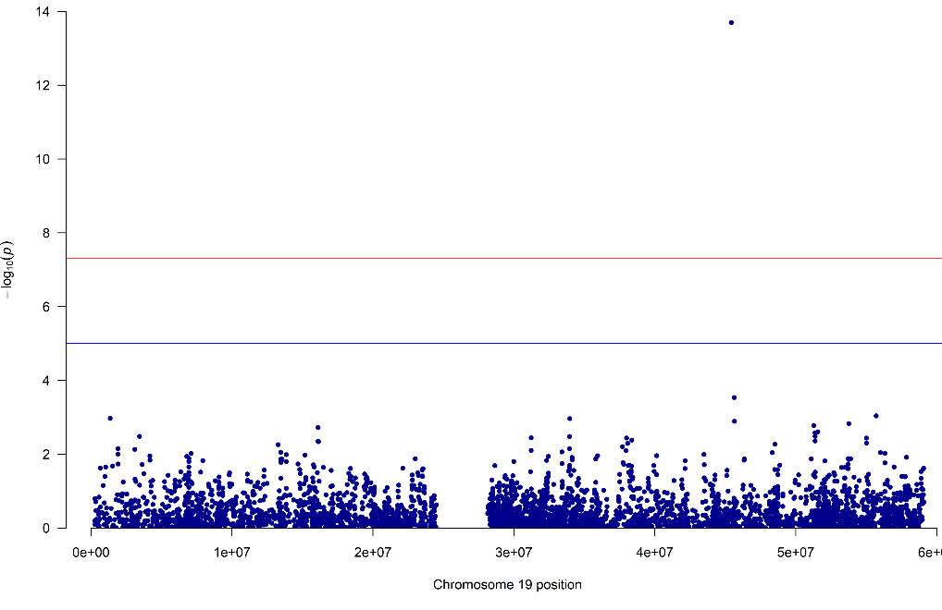
Fine Mapping
GWAS using only
genotyped SNPs

Slide 6
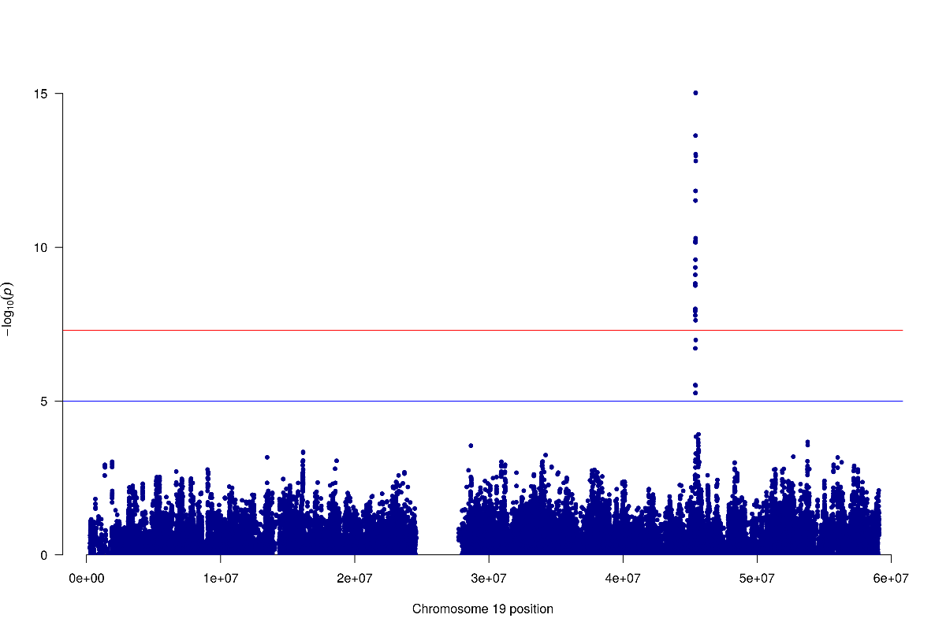
Fine Mapping
Genotyped only Post-Imputation

Slide 7
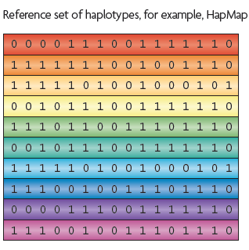
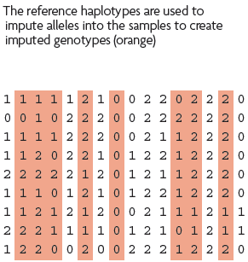
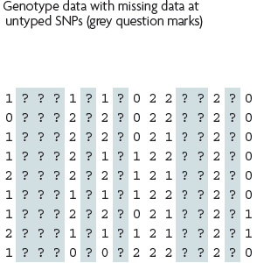
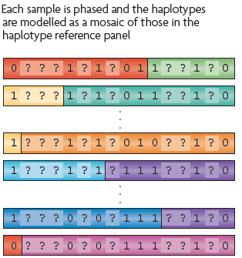
What is imputation? (Marchini & Howie 2010)

Slide 8
1. Starting Data
Genotyped sample
. | . | C | . | . | G | . | C | .
Reference haplotypes
A | G | A | T | C | T | C | C | T
A | G | C | T | C | T | C | A | T
A | G | A | T | C | G | C | C | T
A | G | A | T | C | T | A | C | T

Slide 9
2. Identify shared regions of chromosome
Genotyped sample
. | . | C | . | . | G | . | C | .
Reference haplotypes
A | G | A | T | C | T | C | C | T
A | G | C | T | C | T | C | A | T
A | G | A | T | C | G | C | C | T
A | G | A | T | C | T | A | C | T

Slide 10
3. Fill in missing genotypes
Genotyped sample
A | G | C | T | C | G | C | C | T
Reference haplotypes
A | G | A | T | C | T | C | C | T
A | G | C | T | C | T | C | A | T
A | G | A | T | C | G | C | C | T
A | G | A | T | C | T | A | C | T

Slide 11
Step 1 – QC & references
Current Publically Available References
  HapMapII (no phased X data officially released) 2.4M SNPS
  HapMapIII 1.3M SNPS
  1KGP – phase 3 version v5 (X imputation references released after the autosomes)

Slide 12
Step 1 – QC & references
References only available via custom imputation servers
  HRC - 64,976 haplotypes 39,235,157 SNPs
  CAPPA – African American/Carabbean
  Multi-ethnic HLA
  Genome Asia Pilot - GAsP
  TopMed - 97,256 haplotypes 308,107,085 SNPs (b38)

Slide 13
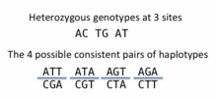
Step 2 – Phase your data
In this context it is really Haplotype Estimation
We take genotype data and try to reconstruct the haplotypes
  Can use reference data to improve this estimation

Slide 14
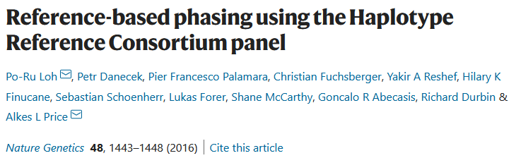
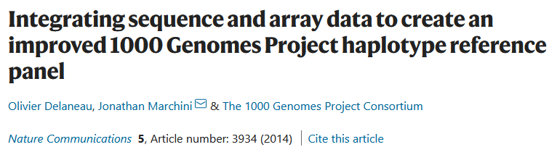
Phasing in Eagle2 or Shapeit2
Hidden Markov Models are used to reconstruct haplotypes in the genotyped data
These are used to provide scaffolds for the imputation

Slide 15
Step 3: Impute
Minimac4
Impute5
Positional Burrows Wheeler Transform (PBWT)
Beagle
never use plink for imputation!

Slide 16


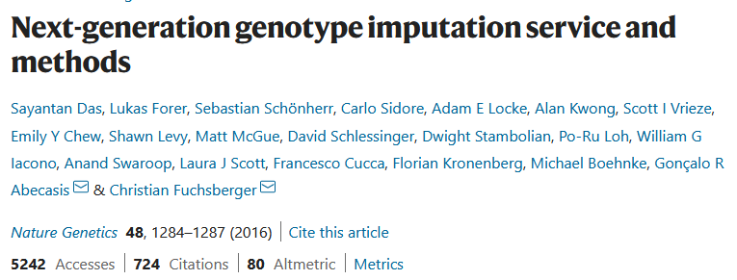
Minimac4
https://github.com/statgen/Minimac4
Building on the work from Gonçalo Abecasis, Christian Fuchsberger and colleagues
Analysis options
  SAIGE
  BoltLMM
  plink2

Slide 17

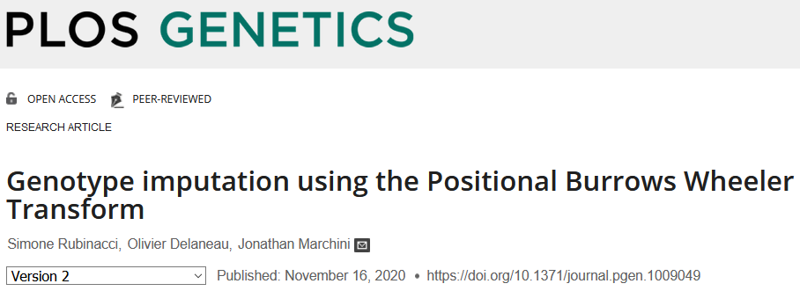
Impute5
https://jmarchini.org/software/#impute-5
Built by Jonathan Marchini and colleges
Incorporating Positional Burrows Wheeler Transform (PBWT)
Downstream analysis options
  BGENIE
  SNPtest
  Quicktest

Slide 18
Issue – in house vs online imputation
Legal restrictions
eg General Data Protection Regulation (GDRP)
IRB/Ethics restrictions
eg UK Biobank
Data sovereignty restrictions
Study specific

Slide 19
In house Options for imputation
Use a cookbook!
  http://genome.sph.umich.edu/wiki/Minimac3_Imputation_Cookbook OR http://genome.sph.umich.edu/wiki/IMPUTE2:_1000_Genomes_Imputation_Cookbook
Use a container
  eg https://github.com/HippocampusGirl/ImputationProtocol
  Use with singularity or docker
  Enables you to run the imputation on a stand alone computer or local server
  (You can think of this as a container that holds a pre-built environment with everything already set up for your task)

Slide 20
Online options for imputation
UMich Imputation Server
  https://imputationserver.sph.umich.edu/
Sanger Imputation Server
  https://imputation.sanger.ac.uk/
TOPMed Imputation Server
  https://imputation.biodatacatalyst.nhlbi.nih.gov/

Slide 21
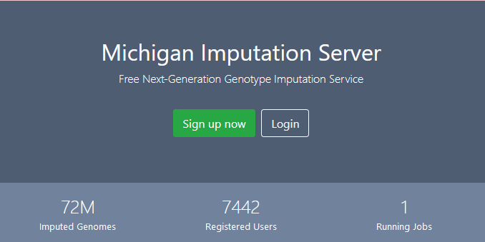
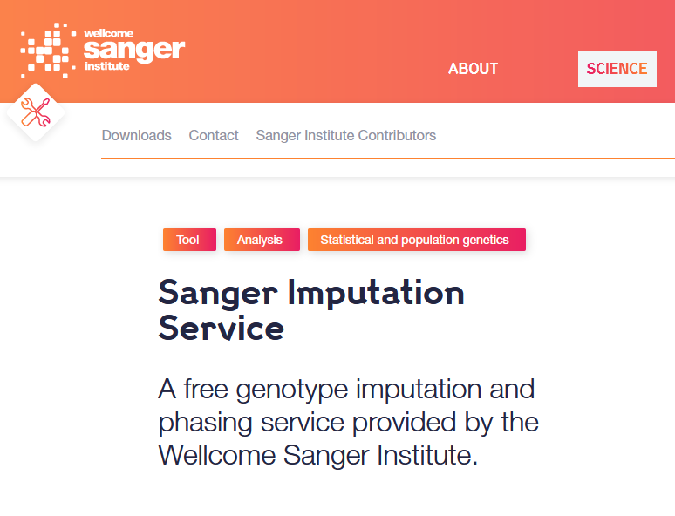
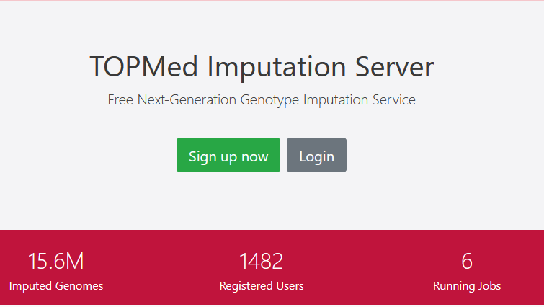

Slide 22
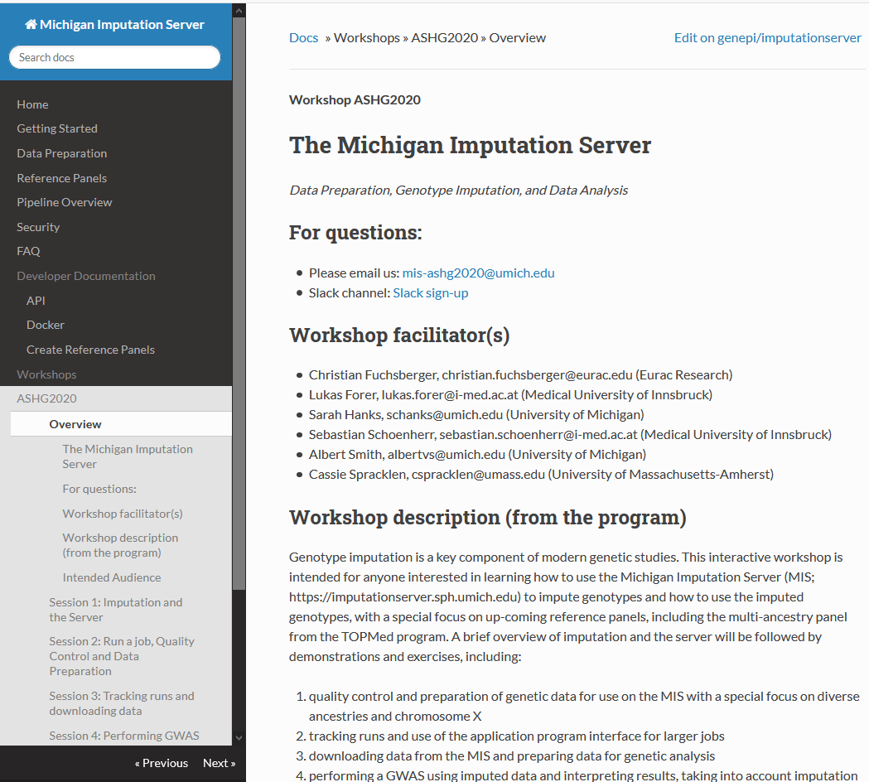
On the Michigan Imputation Server Site - Great practical workshop sessions from ASHG 2020
https://imputationserver.readthedocs.io/en/latest/workshops/ASHG2020/

Slide 23
Preparing your data
  Exclude snps with excessive missingness (>5%), low MAF (<1%), HWE violations (~P<10⁻⁶), Mendelian errors
  Drop strand ambiguous (palindromic) SNPs – ie A/T or C/G snps
  Update build and alignment (b37 vs b38)
  Output your data in the expected format for the phasing program you will use
    Check the naming convention for the program and reference you want to use
    rs278405739 OR 22:395704

Slide 24
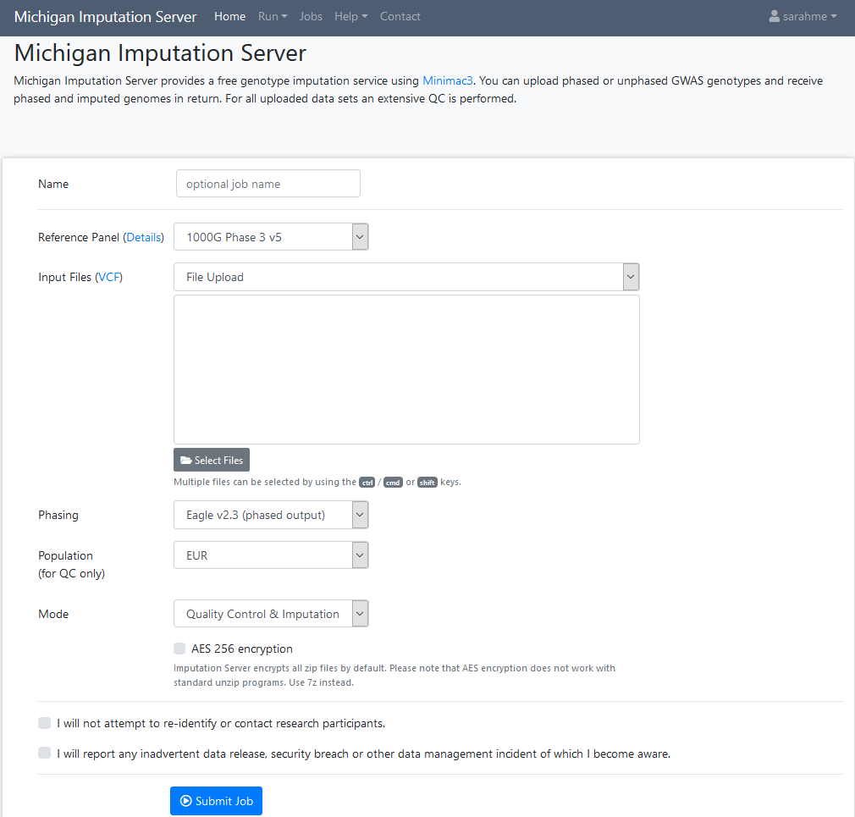

Slide 25
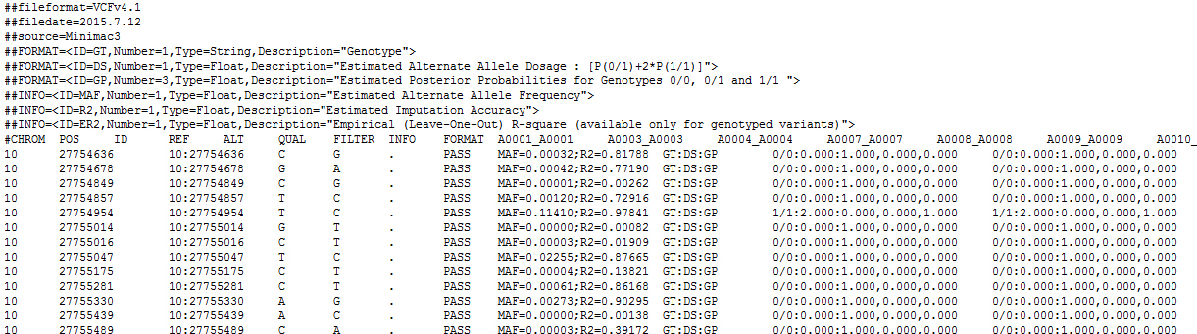
Output
3 main genotype output formats
  Hard call or best guess
  Dosage data (most common – 1 number per SNP, 1-2)
  Probs format (probability of AA AB and BB genotypes for each SNP)

Slide 26
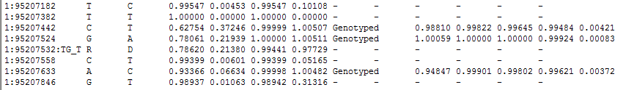
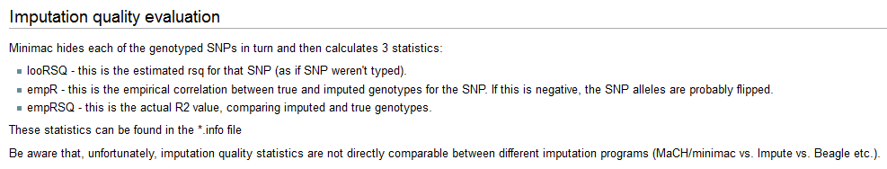
Output
Info files

Slide 27
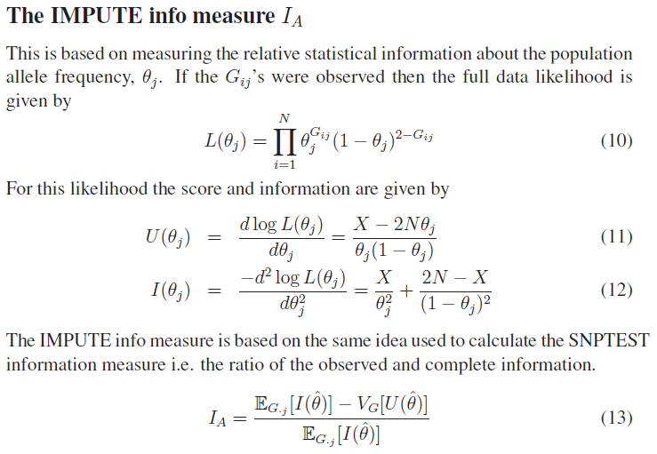
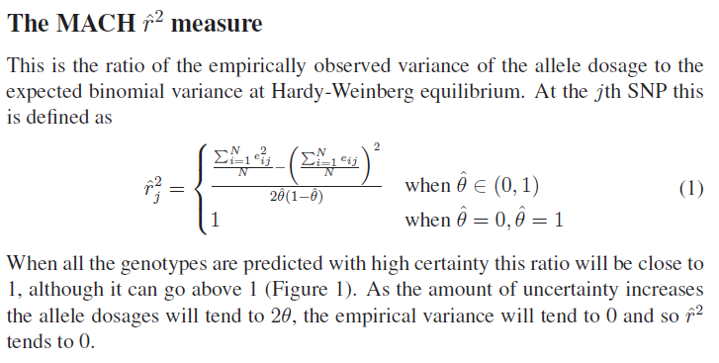
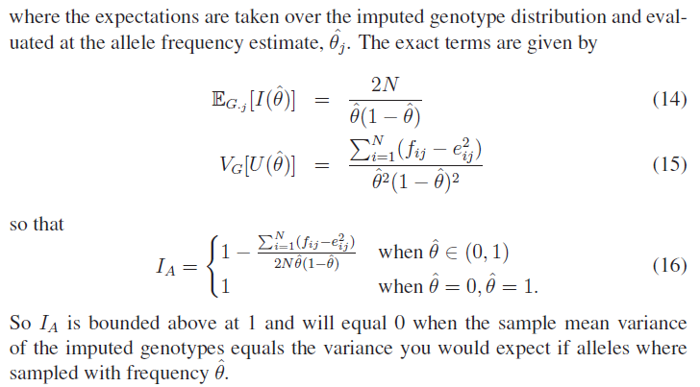
The r² metrics differ between imputation programs

Slide 28
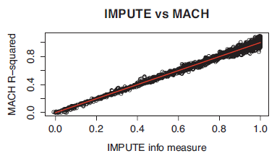
In general fairly close correlation
  rsq/ ProperInfo/ allelic Rsq
    1 = no uncertainty
    0 = complete uncertainty
    .8 on 1000 individuals = amount of data at the SNP is equivalent to a set of perfectly observed genotype data in a sample size of 800 individuals

Slide 29
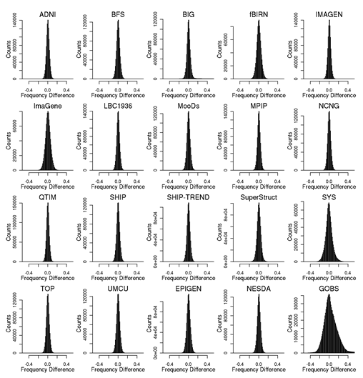
Post imputation QC
After imputation you need to check that it worked and the data look ok
Things to check
  Plot r² across each chromosome look to see where it drops off
  Plot MAF-reference MAF

Slide 30
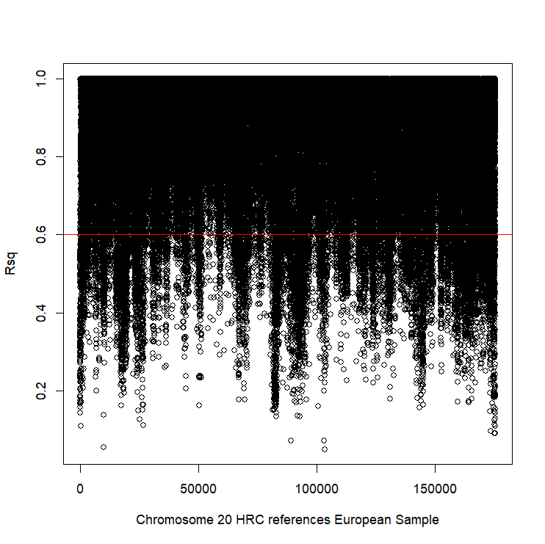
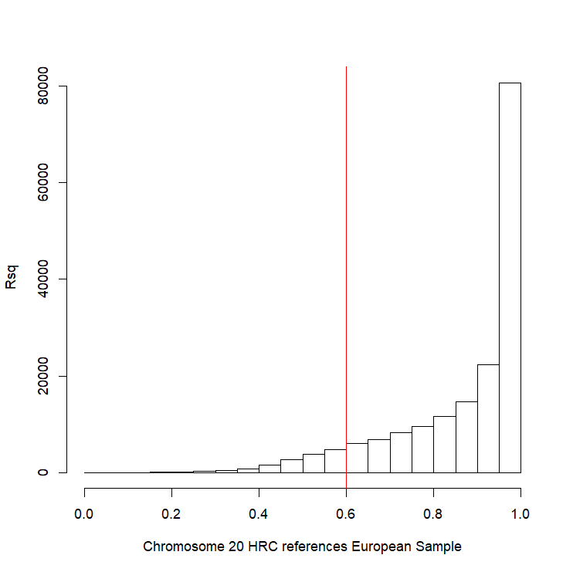
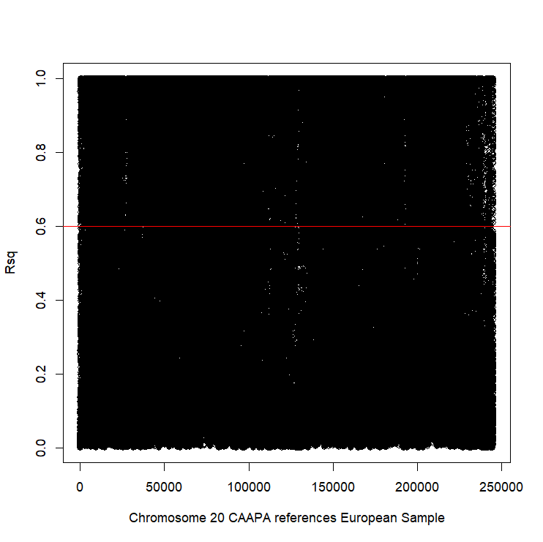
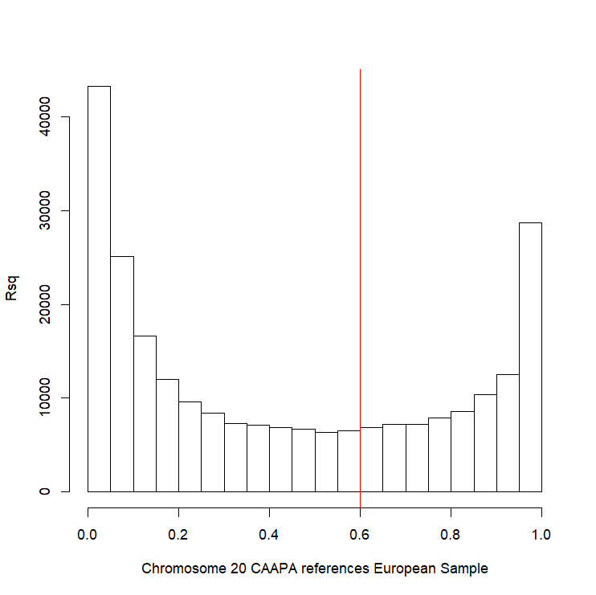
Good imputation
Bad imputation

Slide 31
Post imputation QC
Next run GWAS for a trait – ideally continuous, calculate lambda and plot:
  QQ
  Manhattan
  SE vs N
  P vs Z
Run the same trait on the observed genotypes – plot imputed vs observed

Slide 32
Last points
If you are running analyses for a consortium they will probably ask you to analyse all variants regardless of whether they pass QC or not…
(If you are setting up a meta-analysis consider allowing cohorts to ignore variants with MAF <.5% and low r2 – it will save you a lot of time)

Slide 33
Analysis of Imputed data using SAIGE
Back to qualtrics…

Slide 34

Imputed results (Manhattan plot only chr19)

Slide 35
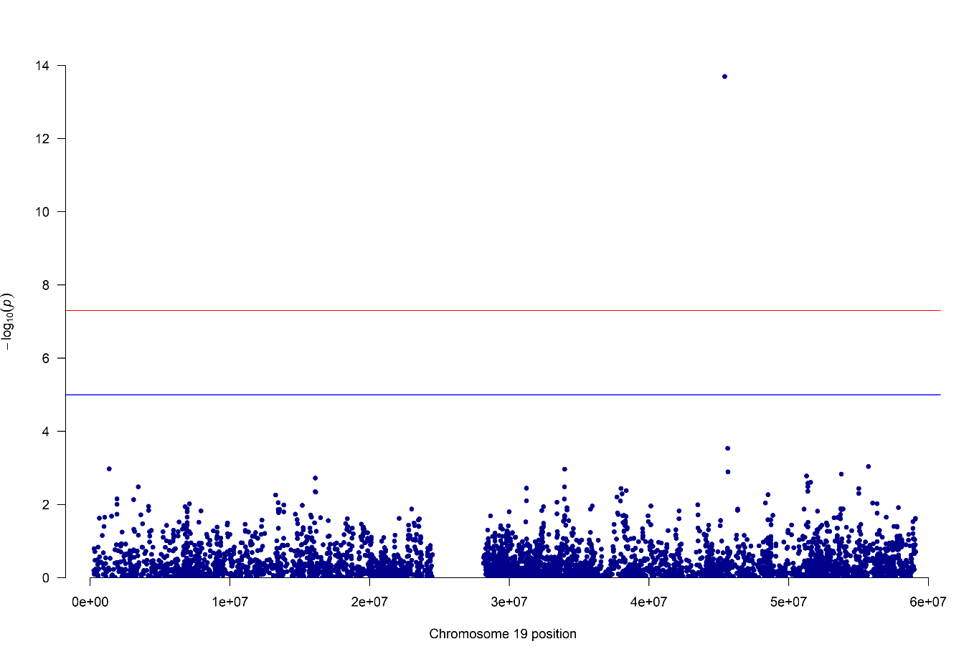
Compared to the genotyped snp results!

Slide 36
And Compare…
Genotyped
Imputed

Slide 37
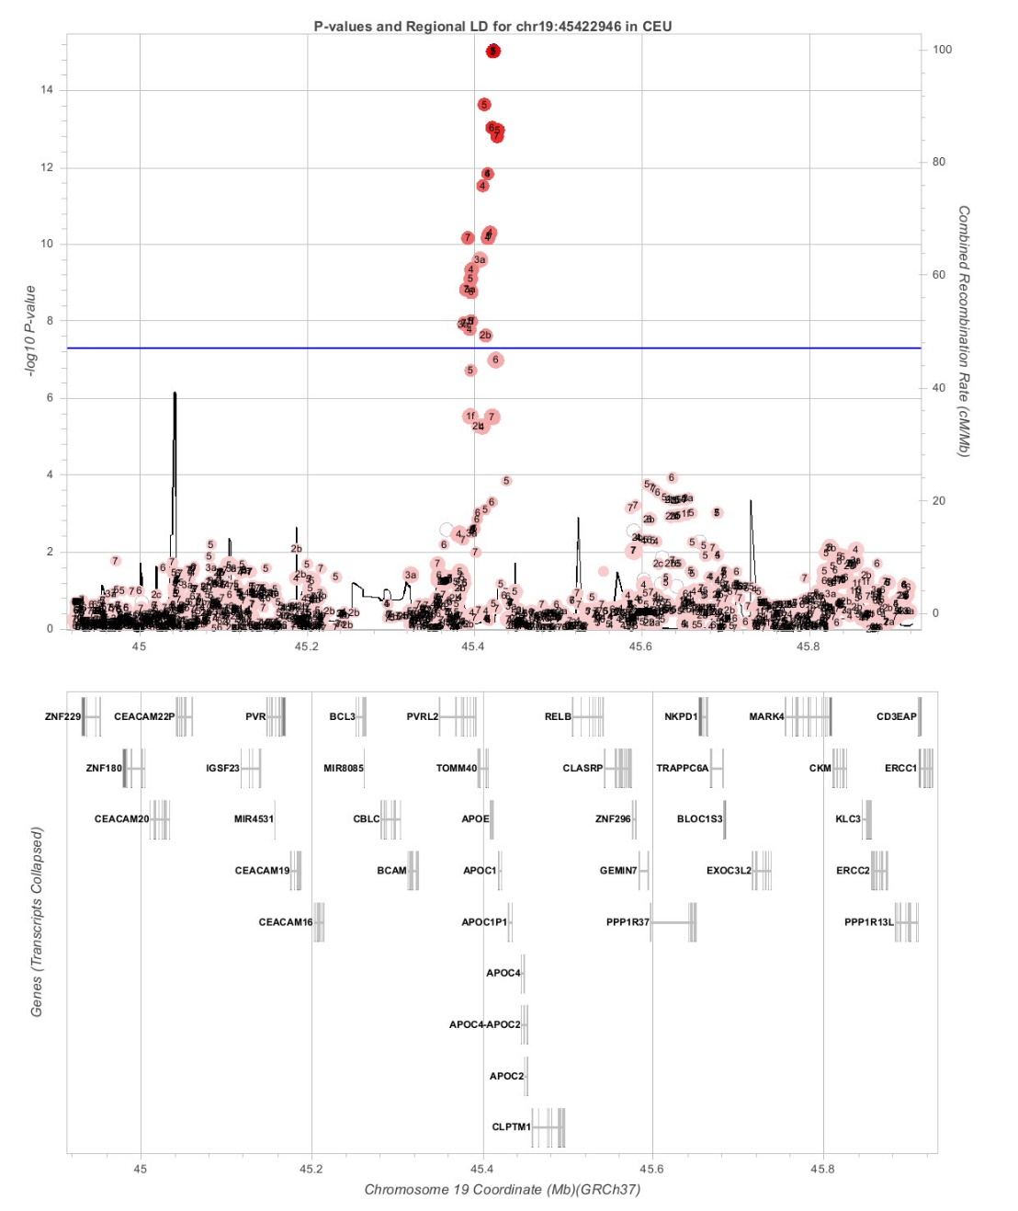
Imputed results (regional plot)

Slide 38

And Compare…
Genotyped
Imputed

Slide 39
Questions

