Slide 1
(Re) introduction to Linux Sarah Medland Boulder 2023

Slide 2
Getting the most out of the workshop
Ask questions!!!
Don’t sit next to someone you already know
Work with someone with a different skillset and different experience level
You will have access to your files after you leave
Come to the social functions
Ask questions!!!

Slide 3
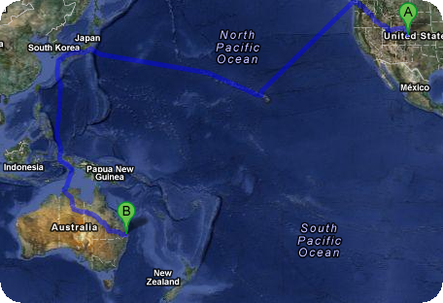
I work in Brisbane at QIMR
Sarah Medland

Slide 4
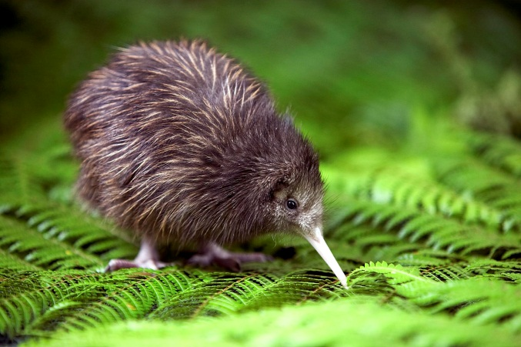
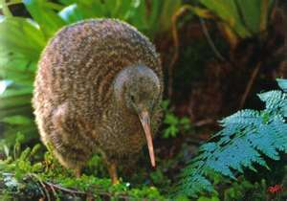
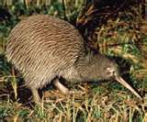
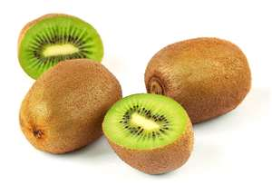
not

Slide 5
Superfast intro to Linux

Slide 6
File hygiene is very important
Files are stored in Unix format not DOS or Mac
Changes the line ending characters
Use dos2unix, unix2dos, mac2unix, unix2mac to change formats
Can use the file command to check format
Unix systems are case sensitive!
NO SPACES in your file/directory names!!
Wildcards ie dos2unix *.dat

Slide 7
Working in the terminal
Input …. Output
Input
Most commands don’t need input signifiers
< can be used to specify
Output
Without specifying most output will print to the screen
> can be used to direct
type: echo ‘this is a dummy file’
echo ‘this is a dummy file’ > dummy.txt
| (pipe) | more pauses the output after a screen worth of text has appeared hit the space bar to get the next screens worth

Slide 8
The manual
The man command can be used in conjunction with other commands to put up some basic instructions
type: man ls
ls is the list command it pulls up a list of the files in the directory
Also many many helpful webpages w examples

Slide 9
Permissions the ability to read, write and execute files
type: ls –l
These are the permissions
1st a directory flag (d or -)
then 3 letters to define the owners permissions
3 letters to define the groups permissions
3 letters to define the everyone else's permissions

Slide 10
Permissions the ability to read, write and execute files
read access
write access
execute
to ‘run’ script or a program the file must be made executable

Slide 11
Permissions the ability to read, write and execute files
To change the mode/permissions use chmod
a number of ways to do this
type: echo “this is a test” > dummy.txt
ls –l
chmod +x dummy.txt
ls –l
chmod -x dummy.txt
ls –l
what happened?

Slide 12
Useful ‘one liners’
cp copy
mv move = rename
rm remove
ls list
echo
head looks at the top 10 lines
tail looks at the last 10 lines
wc counts number of lines, words, characters
sed find and replace
grep find and report
awk restructure files
pwd find where you are
~/ get to your home directory
file reports type of file

Slide 13
Grep
search globally for lines matching the regular expression, and print them
For association output for chromosome 2
To extract the result for snp rs59831
Type: grep ‘rs59831’ output.txt > summary.txt

Slide 14
Grep
Useful flags
-v
reverse grep select line that does not have the pattern
-C x
To x rows before and after the target
-n
Print the line number before the line
Many more…

Slide 15
Awk
derived from the surnames of its authors — Alfred Aho, Peter Weinberger, and Brian Kernighan
Many functions
Very useful for restructuring data

Slide 16
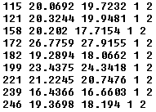
Awk
Ozbmi2.rec
awk ‘{ print $1, $10, $11, $4, $5 }’ ozbmi2.rec > new.rec

Slide 17
Awk
$1 = column 1
Print $0 = print whole line
add subtract multiply etc
change number of decimals
Many functions

Slide 18
Sort
Useful flags
-f ignore case
-n numeric sort
-r reverse
-c check if a file is sorted
-u prints only unique lines
-k2 sort starting at column 2
sort –fg –k 3 (sort in numeric order on column 3)

Slide 19
Zipping and unzipping
zip
zip my1st.zip *txt
zip –mTr my1st.zip *txt
unzip
unzip my1st.zip
gzip
gzip example.txt
Un-gzip
gzip –d example.txt.gz

Slide 20
tar
Unzipping tar.gz files
tar -xzvf example.tar.gz
Make Tar files
tar cvf MyProject.tar MyProject
List contents
tar tvf my-archive.tar
tar tzvf my-archive.tar.gz

Slide 21
Looking at your data
less filename
Allows you to scroll through your data
less –S filename
Shows a screen width of data (stops text wrapping)
zless –S filename
Allows you to look at a gz file without unzipping

Slide 22
Nano (text editor)
nano filename
Commands at bottom of screen
Save = crtl+O
Exit = crtl +X

Slide 23
Putting it together
Making a ‘shell’ script to automate analyses
<contents of imaginary file inefficient.sh>
pedstats –p 1.ped –d 1.dat –pdf --prefix:1
merlin –p 1.ped –d 1.dat –m 1.map --vc --pdf --prefix:1
pedstats –p 2.ped –d 2.dat –pdf --prefix:2
merlin –p 2.ped –d 2.dat –m 2.map --vc --pdf --prefix:2
pedstats –p 3.ped –d 3.dat –pdf --prefix:3
merlin –p 3.ped –d 3.dat –m 3.map --vc --pdf --prefix:3
To run this make inefficient.sh executable then type ./inefficient.sh

Slide 24
Loops 1
<contents of imaginary file loop_a.sh>
for $i in 1 2 3 4 5 6 7 8 9 10 11 12 13 14 15 16 17 18 19 20 21 22
do
pedstats –p $i.ped –d $i.dat --pdf --prefix:$i
merlin –p $i.ped –d $i.dat –m $i.map --vc --pdf --prefix:$i
done

Slide 25
Loops 2
<contents of imaginary file loop_b.sh>
for (( i = 1 ; i <= 22 ; i++ ))
do
pedstats –p $i.ped –d $i.dat --pdf --prefix:$i
merlin –p $i.ped –d $i.dat –m $i.map --vc --pdf --prefix:$i
done

Slide 26
Other bits
When working on servers
bg &
fg
nohup
crtl+c
crtl+z
which

Slide 27
Shutting down you unix session
exit
logout
quit
q

