Slide 1
Genetic Association Tests for
Common + Rare Variants
2023 International Statistical Genetics Workshop
March 6, 2023
Wei Zhou, Ph.D.

Slide 2

Genetic association tests
To identify genetic variants that are associated with a complex trait
 |  |  |  |  |  |  |  |  |  |  |  |  |  |  | Height (cm)
… | A | C | C | T | A | G | C | T | A | T | C | C | T | … | 163
… | A | C | C | T | A | G | C | T | A | T | C | C | T | …
… | A | C | C | T | A | G | C | T | A | T | C | C | T | … | 170
… | A | C | C | C | A | G | C | T | A | T | C | C | T | …
… | A | C | C | T | A | G | C | T | A | T | C | C | T | … | 165
… | A | C | C | T | A | G | C | T | A | T | C | C | T | …
… | A | C | C | C | A | G | C | T | A | T | C | C | T | … | 190
… | A | C | C | C | A | G | C | T | A | T | C | C | T | …
… | A | C | C | T | A | G | C | T | A | T | C | C | T | … | 176
… | A | C | C | C | A | G | C | T | A | T | C | C | T | …
SNP 1
SNP 1
Height (CM)
TT
CT
CC

Slide 3
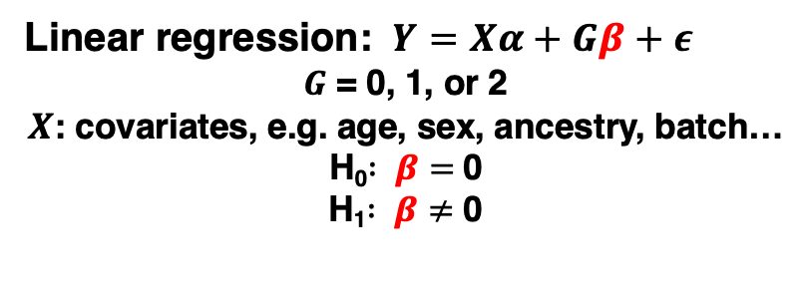
Genetic association tests
To identify genetic variants that are associated with a complex trait
 |  |  |  |  |  |  |  |  |  |  |  |  |  |  | Height (cm)
… | A | C | C | T | A | G | C | T | A | T | C | C | T | … | 163
… | A | C | C | T | A | G | C | T | A | T | C | C | T | …
… | A | C | C | T | A | G | C | T | A | T | C | C | T | … | 170
… | A | C | C | C | A | G | C | T | A | T | C | C | T | …
… | A | C | C | T | A | G | C | T | A | T | C | C | T | … | 165
… | A | C | C | T | A | G | C | T | A | T | C | C | T | …
… | A | C | C | C | A | G | C | T | A | T | C | C | T | … | 190
… | A | C | C | C | A | G | C | T | A | T | C | C | T | …
… | A | C | C | T | A | G | C | T | A | T | C | C | T | … | 176
… | A | C | C | C | A | G | C | T | A | T | C | C | T | …
SNP 1
SNP 1
Height (CM)
TT
CT
CC
Linear regression: $Y=Xα+Gβ+ε$
$G$ = 0, 1, or 2
$X$: covariates, e.g. age, sex, ancestry, batch…
H₀$: β=$0
H₁$: β≠$ 0

Slide 4




Genetic association tests
To identify genetic variants that are associated with a complex disease/disorder
No
Yes
SNP 1
Frequency of C
SNP 1
… | A | C | C | T | A | G | C | T | A | T | C | C | T | …
… | A | C | C | T | A | G | C | T | A | T | C | C | T | …
… | A | C | C | T | A | G | C | T | A | T | C | C | T | …
… | A | C | C | C | A | G | C | T | A | T | C | C | T | …
… | A | C | C | T | A | G | C | T | A | T | C | C | T | …
… | A | C | C | T | A | G | C | T | A | T | C | C | T | …
… | A | C | C | T | A | G | C | T | A | T | C | C | T | …
… | A | C | C | C | A | G | C | T | A | T | C | C | T | …
… | A | C | C | T | A | G | C | T | A | T | C | C | T | …
… | A | C | C | C | A | G | C | T | A | T | C | C | T | …
VS.
Cases
2/4 = 50%
Controls:
1/6 = 16.7%

Slide 5
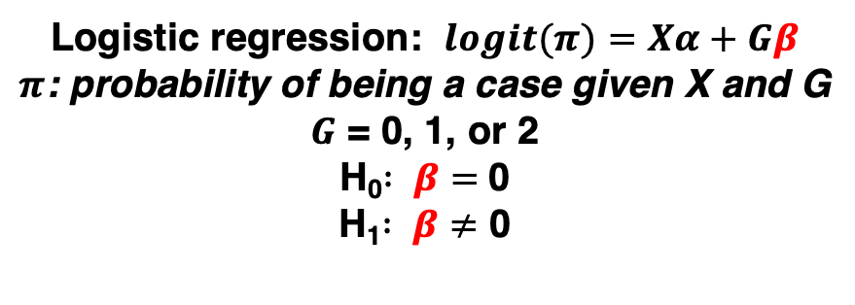
Genetic association tests
To identify genetic variants that are associated with a complex disease/disorder
No
Yes
SNP 1
Frequency of C
SNP 1
… | A | C | C | T | A | G | C | T | A | T | C | C | T | …
… | A | C | C | T | A | G | C | T | A | T | C | C | T | …
… | A | C | C | T | A | G | C | T | A | T | C | C | T | …
… | A | C | C | C | A | G | C | T | A | T | C | C | T | …
… | A | C | C | T | A | G | C | T | A | T | C | C | T | …
… | A | C | C | T | A | G | C | T | A | T | C | C | T | …
… | A | C | C | T | A | G | C | T | A | T | C | C | T | …
… | A | C | C | C | A | G | C | T | A | T | C | C | T | …
… | A | C | C | T | A | G | C | T | A | T | C | C | T | …
… | A | C | C | C | A | G | C | T | A | T | C | C | T | …
VS.
Cases
2/4 = 50%
Controls:
1/6 = 16.7%
Logistic regression: $logit(π)=Xα+Gβ$
$π$: probability of being a case given X and G
$G$ = 0, 1, or 2
H₀$: β=$0
H₁$: β≠$ 0

Slide 6
Different types of phenotypes require different statistical models for association tests
Quantitative
  eg. LDL cholesterol level, height
  Linear regression
Binary
  eg. Schizophrenia, Type 2 Diabetes
  Logistic regression
Ordinal/categorical
  eg. On a scale of 1-10 how much do you like smoking
  Multinomial regression
Time-to-event (TTE)
  eg. Age at skin cancer onset, Time of death after diagnosis of lung cancer
  Survival analysis model

Slide 7
Different types of phenotypes require different statistical models for association tests
Quantitative
  eg. LDL cholesterol level, height
  Linear regression
Binary
  eg. Schizophrenia, Type 2 Diabetes
  Logistic regression
Ordinal/categorical
  eg. On a scale of 1-10 how much do you like smoking
  Proportional odds logistic regression, Multinomial regression
Time-to-event (TTE)
  eg. Age at skin cancer onset, Time of death after diagnosis of lung cancer
  Survival analysis model

Slide 8
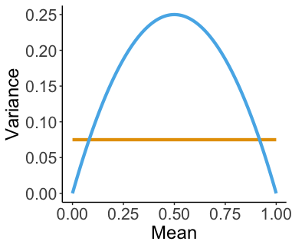
Using linear regression for binary phenotypes (coded as 0 and 1) can lead to inflated type I errors
True mean-variance relationship
Linear model assumed
mean-variance relationship
adapted from Chen, H., Wang, C., et. al. (2016)

Slide 9
Genetic association tests
To identify genetic variants that are associated with a complex disease/disorder
No
Yes
SNP 1
Frequency of C
SNP 1
… | A | C | C | T | A | G | C | T | A | T | C | C | T | …
… | A | C | C | T | A | G | C | T | A | T | C | C | T | …
… | A | C | C | T | A | G | C | T | A | T | C | C | T | …
… | A | C | C | C | A | G | C | T | A | T | C | C | T | …
… | A | C | C | T | A | G | C | T | A | T | C | C | T | …
… | A | C | C | T | A | G | C | T | A | T | C | C | T | …
… | A | C | C | T | A | G | C | T | A | T | C | C | T | …
… | A | C | C | C | A | G | C | T | A | T | C | C | T | …
… | A | C | C | T | A | G | C | T | A | T | C | C | T | …
… | A | C | C | C | A | G | C | T | A | T | C | C | T | …
VS.
Cases
2/4 = 50%
Controls:
1/6 = 16.7%
Logistic regression: $logit(π)=Xα+Gβ$
$π$: probability of being a case given X and G
$G$ = 0, 1, or 2
H₀$: β=$0
H₁$: β≠$ 0

Slide 10
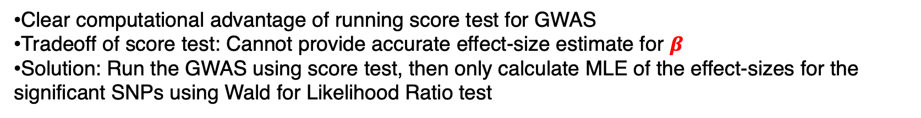

Standard asymptotic tests
In the example of testing 10 million genetic markers, one at a time:
H₀$: β=$0
H₁$: β≠$ 0
Test | Fit null model (H₀) | Fit full model (H₁)
Likelihood Ratio | 1 | 10M
Wald | 0 | 10M
Score | 1 | 0
Clear computational advantage of running score test for GWAS
Tradeoff of score test: Cannot provide accurate effect-size estimate for $β$
Solution: Run the GWAS using score test, then only calculate MLE of the effect-sizes for the significant SNPs using Wald for Likelihood Ratio test

Slide 11
Genome-Wide Association Study (GWAS)
30
25
20
-log10(P value)
15
10
5
0
Chromosome

Slide 12
Genome-Wide Association Study (GWAS)
Genome-wide significant threshold for p-value: 5x10⁻⁸
30
25
20
-log10(P value)
15
10
5
0
Chromosome

Slide 13
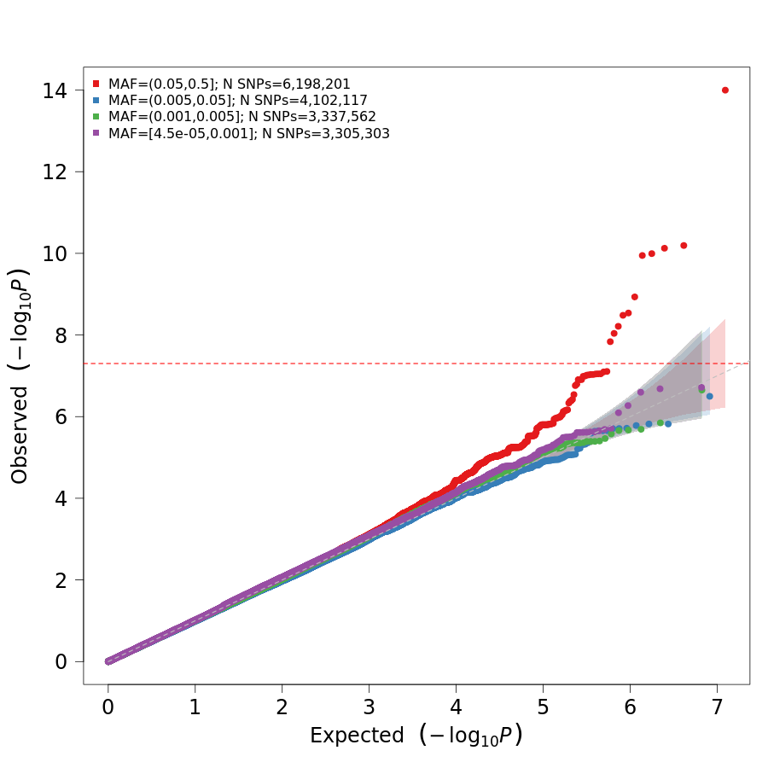
Visualize GWAS: quantile-quantile (QQ) plot

Slide 14
Different types of phenotypes require different statistical models for association tests
Quantitative
  eg. LDL cholesterol level, height
  Linear regression
Binary
  eg. Schizophrenia, Type 2 Diabetes
  Logistic regression
Ordinal/categorical
  eg. On a scale of 1-10 how much do you like smoking
  Proportional odds logistic regression, Multinomial regression
Time-to-event (TTE)
  eg. Age at skin cancer onset, Time of death after diagnosis of lung cancer
  Survival analysis model

Slide 15
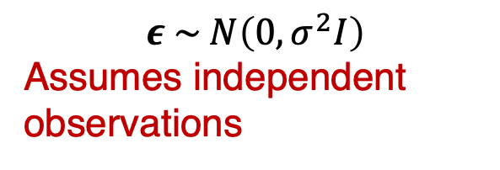

Challenges in genetic association studies
Optimization strategies
Large scale data
Sample relatedness
Linear model:
$$Y_{i}=X_{i}α+G_{i}β+ε_{i}$$
Logistic model:
$${logit(π}_{i}) =X_{i}α+G_{i}β$$
$$ε \sim N\left(0,σ^{2}I\right)$$
Assumes independent observations
  1 in 3 has at least one relative up to the 3rd degree in UK Biobank
  - inflated type I errors

Slide 16


Mixed models are used for genetic association tests with related samples
Optimization strategies
Large scale data
Mixed models
Sample relatedness
Linear mixed model:
$$Y_{i}=X_{i}α+G_{i}β+{b_{i}+ ε}_{i}$$
Logistic mixed model:
$${logit(π}_{i}) =X_{i}α+G_{i}β+b_{i}$$
$b$: random genetic effect $b \sim N(0,\text{τ} ψ)$, $ψ$is genetic relationship matrix (GRM)
  1 in 3 has at least one relative up to the 3rd degree in UK Biobank

Slide 17
Challenges in genetic association studies
Large scale data
Mixed models
Sample relatedness

Slide 18
Optimizations were applied for large-scale data
Optimization strategies
Large scale data
Mixed models
Sample relatedness

Slide 19
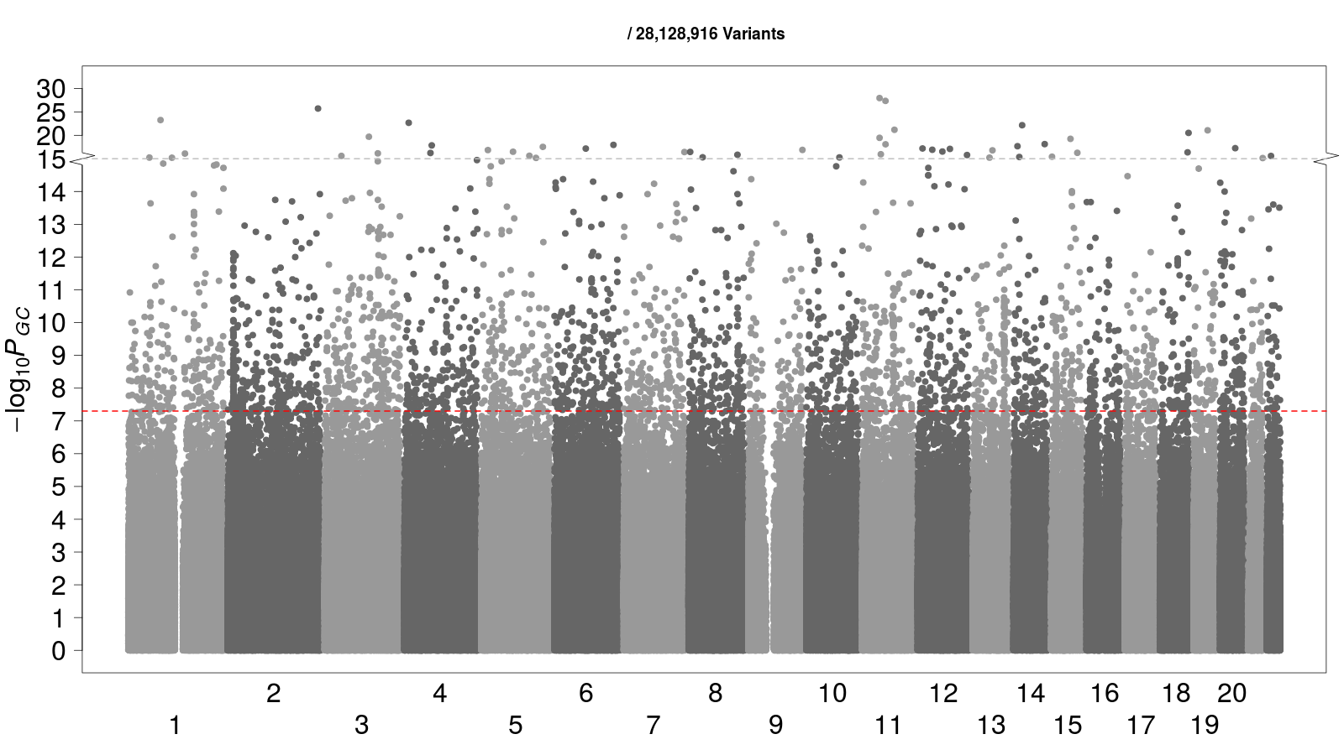

Colorectal cancer
4,562 Cases
382,756 Controls
Case: Control = 1:84
Linear mixed model
Logistic mixed model

Slide 20
Optimizations were applied for large-scale data
Optimization strategies
Large scale data
Mixed models
Sample relatedness
?

Slide 21
Unbalanced case-control ratios are commonly observed for binary phenotypes in biobanks
1,663 Binary Phenotypes in the UK Biobank

Slide 22
Test statistics do not converge to Normal distribution, leading to inflated type I error rates
Unbalanced case-control ratio
Optimization strategies
Large scale data
Mixed models
Sample relatedness
Ma et al., 2013

Slide 23
Saddlepoint approximation (SPA) is used to account for unbalanced case-control ratio
Saddlepoint Approximation
Unbalanced case-control ratio
Optimization strategies
Large scale data
Mixed models
Sample relatedness
SPA uses the entire moment generating function -> more accurate p-values
vs.
Normal distribution only uses the first two moments (mean and variance)
Daniels, 1954
Dey et al., 2017

Slide 24
SAIGE
(Scalable and Accurate Implementation of GEneralized mixed model)
was developed to conduct GWAS in large-scale biobanks
Saddlepoint approximation
Unbalanced case-control ratio
Optimization strategies
Large scale data
Mixed models
Sample relatedness
Zhou et al. Nat. Genet. 2018

Slide 25
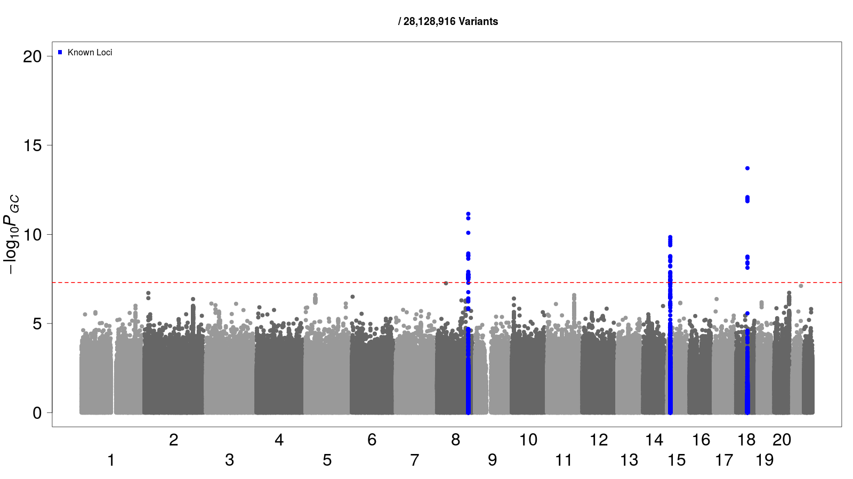
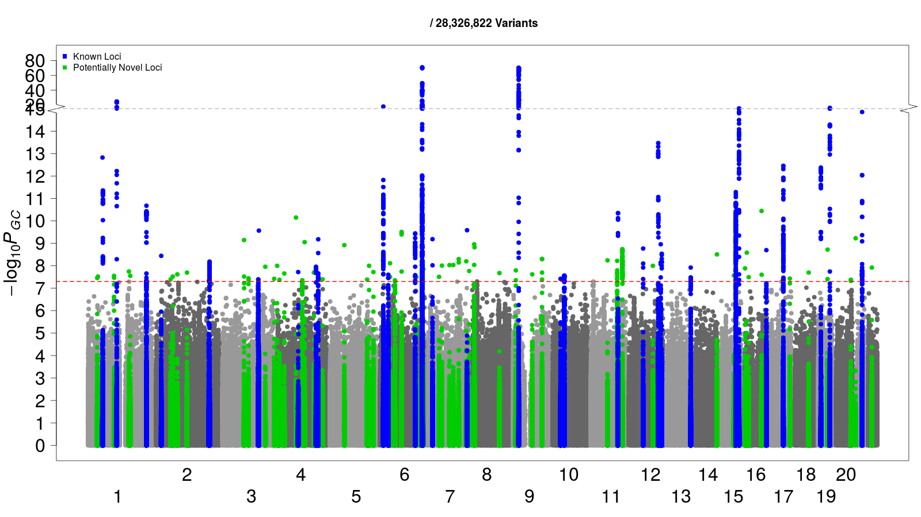
Colorectal cancer
4,562 Cases
382,756 Controls
Case: Control = 1:84
Linear mixed model
Logistic mixed model
Logistic mixed model
+SPA (SAIGE)

Slide 26
Thyroid cancer
358 Cases
407,399 Controls
Case: Control = 1:1138

Slide 27
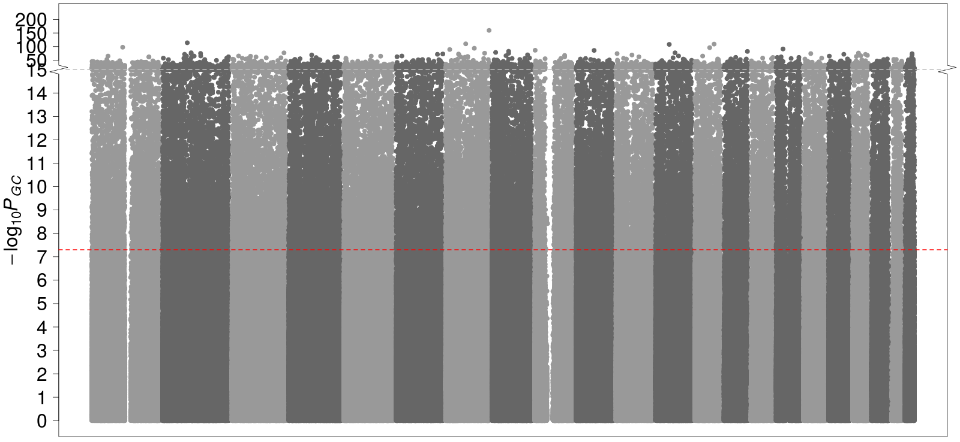
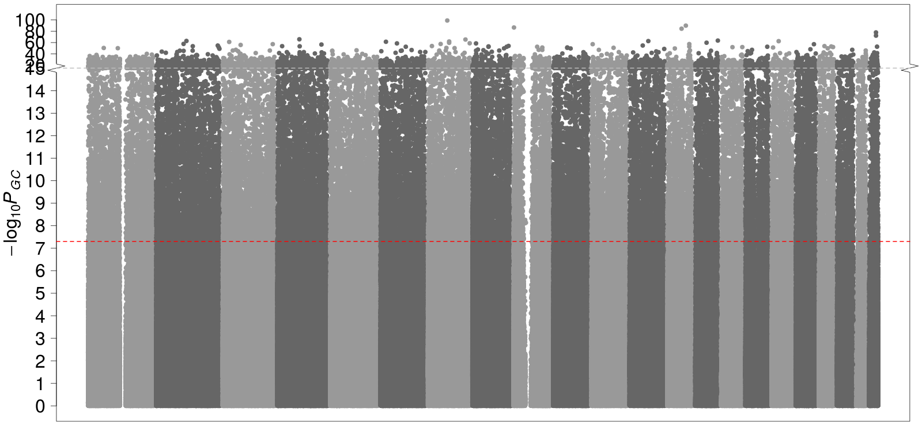
Thyroid cancer
358 Cases
407,399 Controls
Case: Control = 1:1138
Linear mixed model
Logistic mixed model

Slide 28
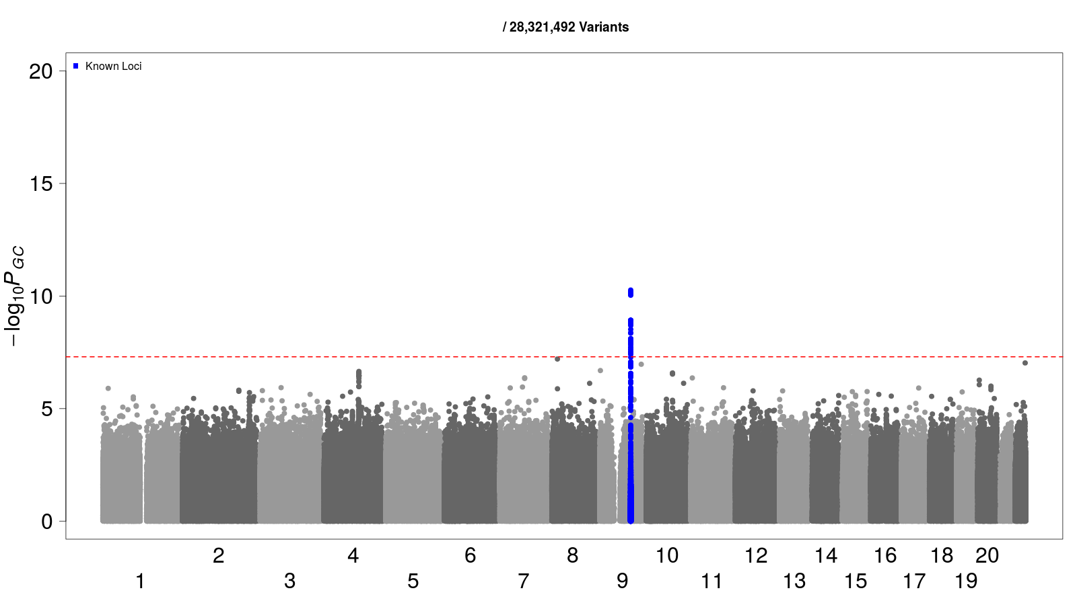
Thyroid cancer
358 Cases
407,399 Controls
Case: Control = 1:1138
Linear mixed model
Logistic mixed model
Logistic mixed model
+SPA

Slide 29

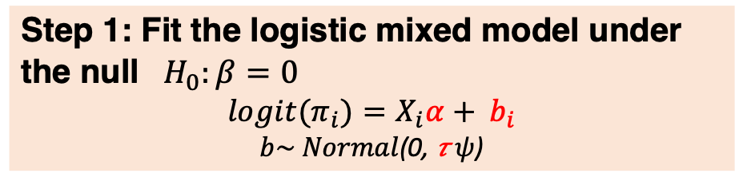
SAIGE
Step 1: Fit the logistic mixed model under the null ${ H}_{0}:β=0$
$${logit(π}_{i})=X_{i}α+ b_{i}$$
$b\sim Normal$(0, 𝜏$ψ$)
$\hat{α },\hat{b}$ , $\hat{\text{τ}}$
Step 2: Perform association test for each genetic marker
Apply SPA to score tests
Association Results (p-values…)
FASTA (Two-step)
Chen and Abecasis, 2007

Slide 30
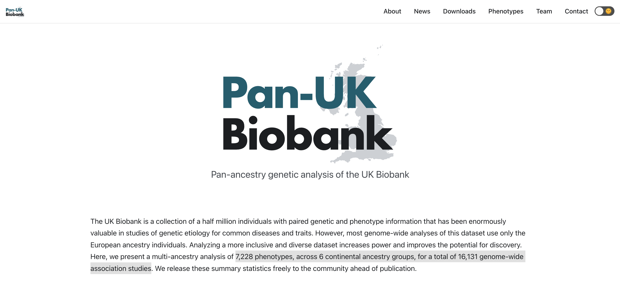
Pan-UKBB: run SAIGE for 7,228 phenotypes, across 6 continental ancestry groups, for a total of 16,131 GWAS
Konrad Karczewski
Alicia Martin
Hilary Finucane
Benjamin Neale
Mark Daly
Hail Team
https://pan.ukbb.broadinstitute.org/

Slide 31
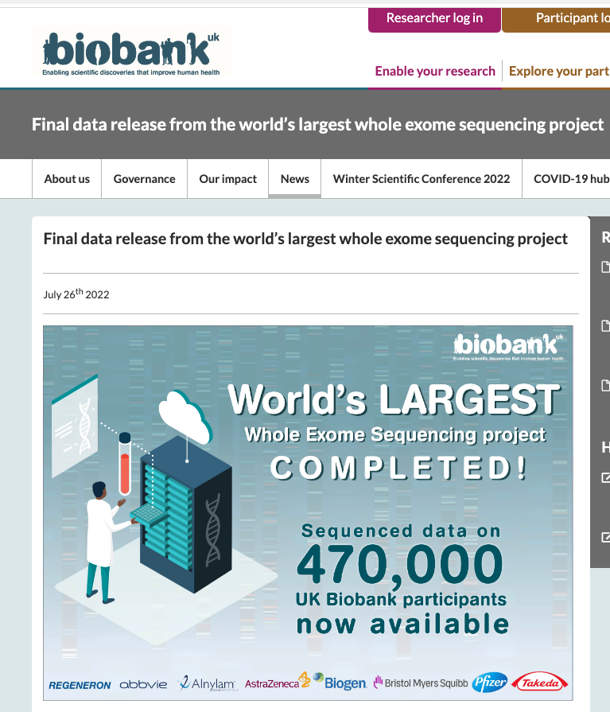
Sequencing data are being generated by biobanks allow for studying rare variant associations for complex diseases
Why studying rare variations?
Unexplained heritability
Precision medicine
Rare coding variants
  function
  therapeutic targets

Slide 32
Single-variant association tests are underpowered for rare variants
Saddlepoint Approximation
Unbalanced case-control ratio
Optimization strategies
Large scale data
Mixed models
Sample relatedness
underpowered for
rare variants

Slide 33
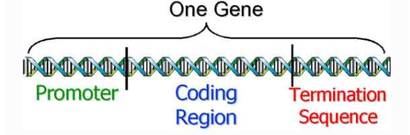
Solution: Test the joint effects of rare variants
  Grouping rare variants into functional units, i.e. genes, epigenetic features..
  Set-based tests
    Gene-based tests, group-based tests

Slide 34
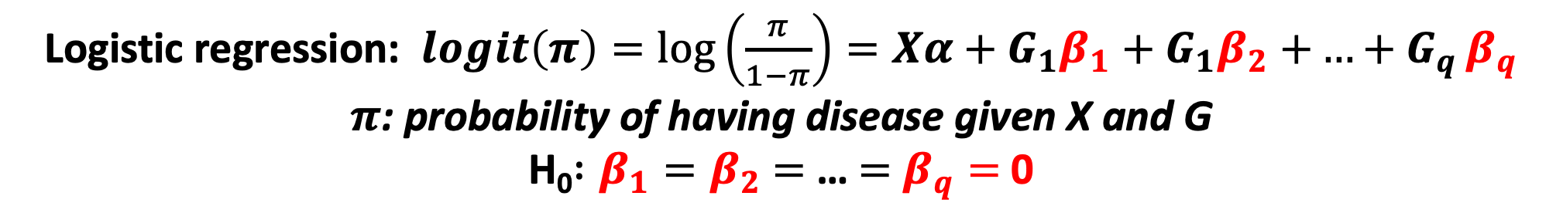
Logistic regression: $logit\left(π\right)=\log\left(\frac{π}{1−π}\right)=Xα+G_{1}β_{1}+G_{1}β_{2}$ $+{…+G}_{q}β_{q}$
$π$: probability of having disease given X and G
H₀$:β_{1}=β_{2}$ $=$ … $=$ $β_{q}=$0

Slide 35
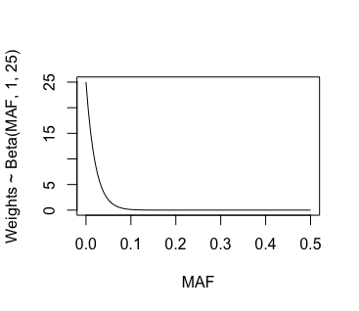
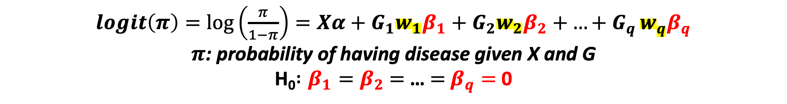
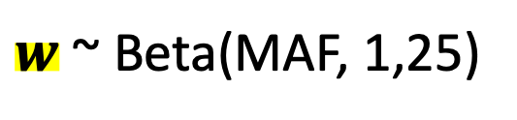
Incorporating weight for each variant
$logit\left(π\right)=\log\left(\frac{π}{1−π}\right)=Xα+G_{1}{w_{1}β}_{1}+G_{2}{w_{2}β}_{2}$ $+{…+G}_{q}{w_{q}β}_{q}$
$π$: probability of having disease given X and G
H₀$:β_{1}=β_{2}$ $=$ … $=$ $β_{q}=$0
$w$ ~ Beta(MAF, 1,25)
Wu et al., 2011

Slide 36
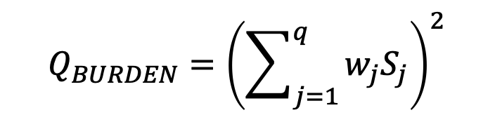



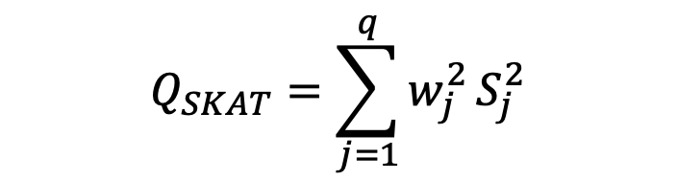


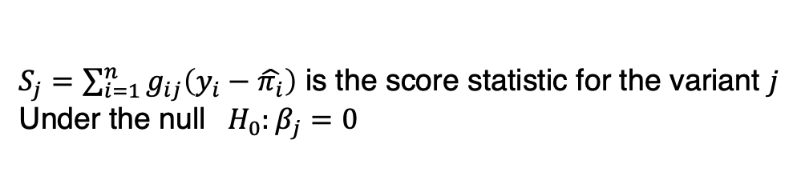
Set-based association tests: grouping rare variants to test (by genes, epigenetic features…)
$S_{j}=\sum_{i=1}^{n}{g_{ij}\left(y_{i}−\hat{π_{i}}\right)}$ is the score statistic for the variant $j$
Under the null ${ H}_{0}:β_{j}=0$
Wu et al., 2011

Slide 37

SKAT-O is more powerful than Burden and SKAT
Lee et al., 2012

Slide 38
Lee et al., 2014

Slide 39
SAIGE-GENE was the first method for rare variant associations tests of binary phenotypes in large-scale data
Saddlepoint approximation
Unbalanced case-control ratio
Optimization strategies
Large scale data
Linear/Logistic mixed model
Sample relatedness
Region/gene-based test
underpowered for
rare variants
Burden, SKAT, and SKAT-O (Lee et al., 2012)
Zhou* and Zhao* et al, Nat Genet, 2020

Slide 40
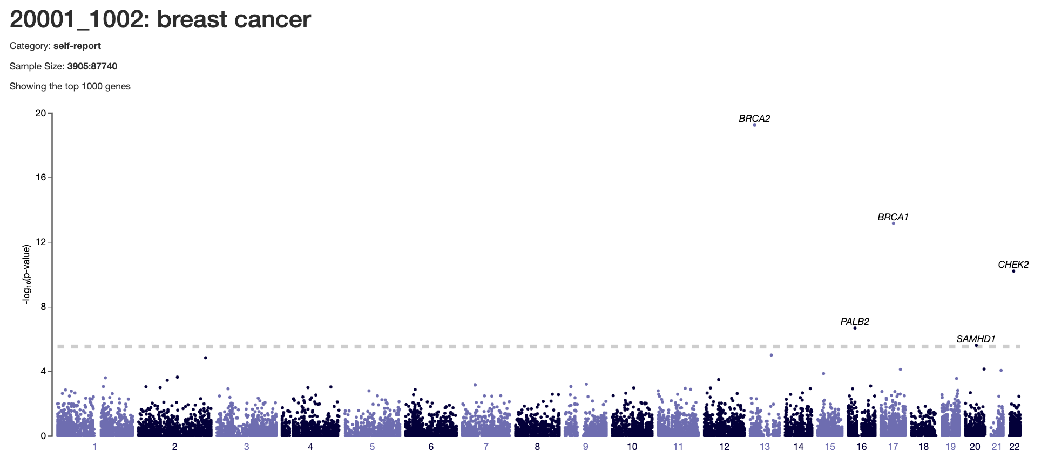
Set-based tests help identify genetic associations that are missed by single-variant tests
https://ukb-200kexome.leelabsg.org/pheno/20001_1002

Slide 41
Set-based tests help identify genetic associations that are missed by single-variant tests
https://ukb-200kexome.leelabsg.org/pheno/20001_1002

Slide 42
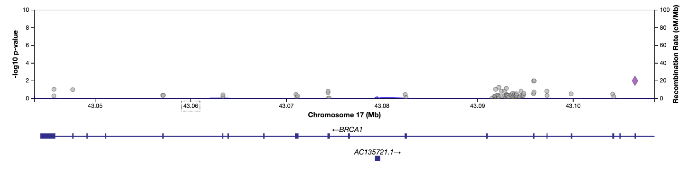
Set-based tests help identify genetic associations that are missed by single-variant tests
None of the single variants in BRCA1 have significant p-values
https://ukb-200kexome.leelabsg.org/pheno/20001_1002

Slide 43
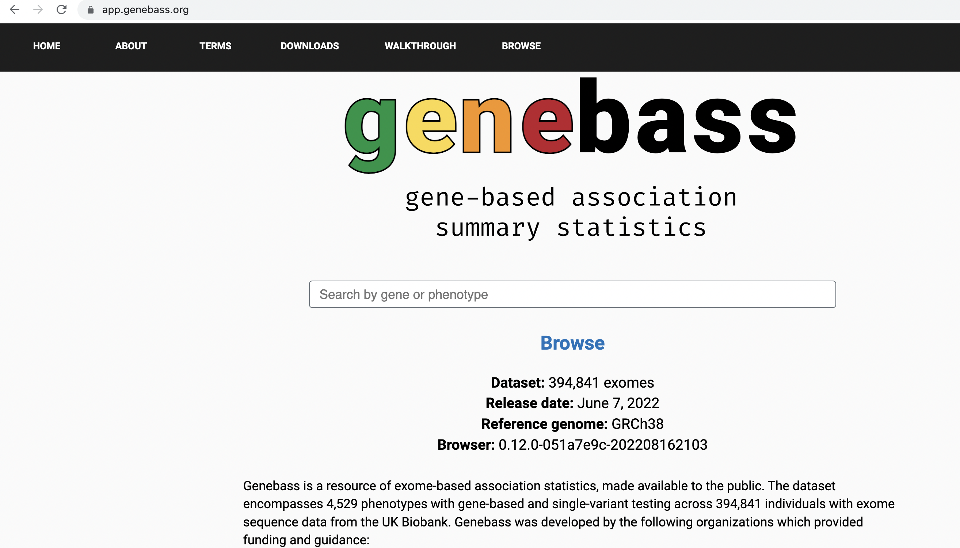
SAIGE-GENE was used to analyze 4,529 phenotypes on 394,841 exomes in UKBB
Karczewski et al., Cell Genomics, 2022

Slide 44
SAIGE-GENE+ improves the efficiency and accuracy of set-based rare variant association tests
Saddlepoint approximation
Unbalanced case-control ratio
Optimization strategies
Large scale data
Linear/Logistic mixed model
Sample relatedness
Region/gene-based test
Collapsing ultra-rare variants
underpowered for
rare variants
Improved computational efficiency
Improved type I error
Improved power
  multiple functional annotations
    LoF
    LoF+nonsynonymous
    LoF+nonsynonymous+synonymous
  multiple max MAF cutoffs
    0.01%
    0.1%
    1%
  Combined p-values using Cauchy combination method
Zhou*, Bi*, Zhao* et al, Nat Genet, 2022

Slide 45
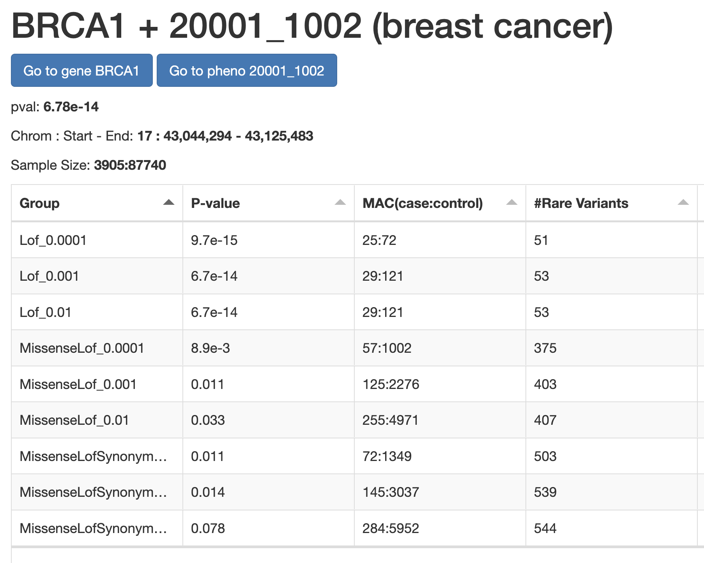
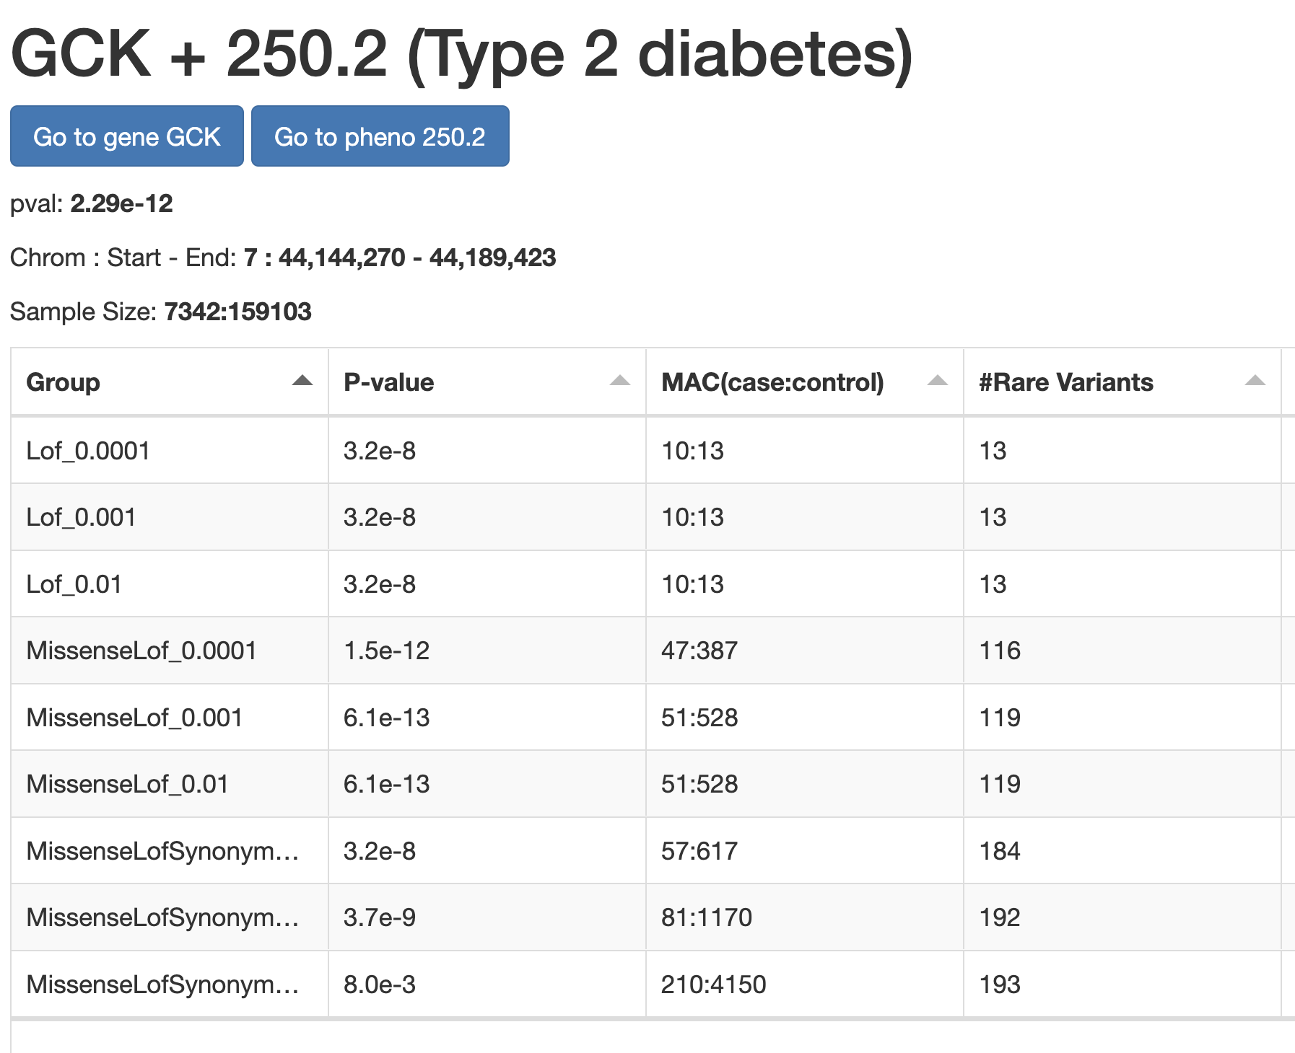
Rare variant associations can aggregate in different annotation and MAF groups
https://ukb-200kexome.leelabsg.org/assoc/BRCA1/20001_1002
https://ukb-200kexome.leelabsg.org/assoc/GCK/250.2

Slide 46
Quantitative traits
Common variants
Rare variants
Related samples
Related samples
YES
NO
YES
NO
PLINK
Large sample (N > 10,000)
Large sample (N > 10,000)
SKAT
NO
NO
YES
SMMAT
EmmaX-SKAT
SAIGE-GENE/SAIGE-GENE+
Regenie v3
STAAR
GCTA
GMMAT
GEMMA
BOLT-LMM
SAIGE
fastGWA
Regenie

Slide 47
Binary traits
Common variants
Rare variants
Related samples
Related samples
YES
NO
YES
NO
Case: control < 1:10
Case: control < 1:10
Case: control < 1:10
Case: control < 1:10
YES
NO
YES
NO
SAIGE
fastGWA-GLMM
Regenie
PLINK –glm
SPAtest (fast)
PLINK –glm firth (slow)
NO
YES
NO
YES
SAIGE-GENE+
Regenie v3
SKAT
SKAT binary
GMMAT (slow but good for small sample sizes)
SAIGE
fastGWA-GLMM
Regenie
SMMAT
EmmaX-SKAT
STAAR
SAIGE-GENE+
Regenie v3

Slide 48
Binary traits
Common variants
Rare variants
Related samples
Related samples
YES
NO
YES
NO
Case: control < 1:10
Case: control < 1:10
Case: control < 1:10
Case: control < 1:10
YES
NO
YES
NO
SAIGE
fastGWA-GLMM
Regenie
PLINK –glm
SPAtest (fast)
PLINK –glm firth (slow)
NO
YES
NO
YES
SAIGE-GENE+
Regenie v3
SKAT
SKAT binary
GMMAT (slow but good for small sample sizes)
SAIGE
fastGWA-GLMM
Regenie
SMMAT
EmmaX-SKAT
STAAR
SAIGE-GENE+
Regenie v3

Slide 49


Binary traits
Common variants
Rare variants
Related samples
Related samples
YES
NO
YES
NO
Case: control < 1:10
Case: control < 1:10
Case: control < 1:10
Case: control < 1:10
YES
NO
YES
NO
SAIGE
fastGWA-GLMM
Regenie
PLINK –glm
SPAtest (fast)
PLINK –glm firth (slow)
NO
YES
NO
YES
SAIGE-GENE+
Regenie v3
SKAT
SKAT binary
GMMAT (slow but good for small sample sizes)
SAIGE
fastGWA-GLMM
Regenie
SMMAT
EmmaX-SKAT
STAAR
SAIGE-GENE+
Regenie v3
Rounak Dey
Zhangchen Zhao

Slide 50
Reference
SKAT-O: Lee, Seunggeun, Mary J. Emond, Michael J. Bamshad, Kathleen C. Barnes, Mark J. Rieder, Deborah A. Nickerson, David C. Christiani et al. "Optimal unified approach for rare-variant association testing with application to small-sample case-control whole-exome sequencing studies." The American Journal of Human Genetics 91, no. 2 (2012): 224-237.
SKAT: Wu, Michael C., Seunggeun Lee, Tianxi Cai, Yun Li, Michael Boehnke, and Xihong Lin. "Rare-variant association testing for sequencing data with the sequence kernel association test." The American Journal of Human Genetics 89, no. 1 (2011): 82-93.
SKAT binary: Zhao, Zhangchen, Wenjian Bi, Wei Zhou, Peter VandeHaar, Lars G. Fritsche, and Seunggeun Lee. "UK Biobank whole-exome sequence binary phenome analysis with robust region-based rare-variant test." The American Journal of Human Genetics 106, no. 1 (2020): 3-12.
SPAtest: Dey, Rounak, Ellen M. Schmidt, Goncalo R. Abecasis, and Seunggeun Lee. "A fast and accurate algorithm to test for binary phenotypes and its application to PheWAS." The American Journal of Human Genetics 101, no. 1 (2017): 37-49.
BOLT-LMM: Loh, Po-Ru, George Tucker, Brendan K. Bulik-Sullivan, Bjarni J. Vilhjalmsson, Hilary K. Finucane, Rany M. Salem, Daniel I. Chasman et al. "Efficient Bayesian mixed-model analysis increases association power in large cohorts." Nature genetics 47, no. 3 (2015): 284.
SAIGE: Zhou, Wei, Jonas B. Nielsen, Lars G. Fritsche, Rounak Dey, Maiken E. Gabrielsen, Brooke N. Wolford, Jonathon LeFaive et al. "Efficiently controlling for case-control imbalance and sample relatedness in large-scale genetic association studies." Nature genetics 50, no. 9 (2018): 1335-1341.
SAIGE-GENE: Zhou, Wei*, Zhangchen Zhao*, Jonas B. Nielsen, Lars G. Fritsche, Jonathon LeFaive, Sarah A. Gagliano Taliun, Wenjian Bi et al. "Scalable generalized linear mixed model for region-based association tests in large biobanks and cohorts." Nature genetics 52, no. 6 (2020): 634-639.
SAIGE-GENE+: Zhou, Wei*, Wenjian Bi*, Zhangchen Zhao*, Kushal K. Dey, Karthik A. Jagadeesh, Konrad J. Karczewski, Mark J. Daly, Benjamin M. Neale, and Seunggeun Lee. "SAIGE-GENE+ improves the efficiency and accuracy of set-based rare variant association tests." Nature genetics 54, no. 10 (2022): 1466-1469.

Slide 51
Reference
GEMMA: Zhou, Xiang, and Matthew Stephens. "Genome-wide efficient mixed-model analysis for association studies." Nature genetics 44, no. 7 (2012): 821-824.
GMMAT: Chen, Han, Chaolong Wang, Matthew P. Conomos, Adrienne M. Stilp, Zilin Li, Tamar Sofer, Adam A. Szpiro et al. "Control for population structure and relatedness for binary traits in genetic association studies via logistic mixed models." The American Journal of Human Genetics 98, no. 4 (2016): 653-666.
Regenie: Mbatchou, Joelle, Leland Barnard, Joshua Backman, Anthony Marcketta, Jack A. Kosmicki, Andrey Ziyatdinov, Christian Benner et al. "Computationally efficient whole-genome regression for quantitative and binary traits." Nature genetics 53, no. 7 (2021): 1097-110
SMMAT: Chen, Han, Jennifer E. Huffman, Jennifer A. Brody, Chaolong Wang, Seunggeun Lee, Zilin Li, Stephanie M. Gogarten et al. "Efficient variant set mixed model association tests for continuous and binary traits in large-scale whole-genome sequencing studies." The American Journal of Human Genetics 104, no. 2 (2019): 260-274.
fastGWA-GLMM: Jiang, Longda, Zhili Zheng, Hailing Fang, and Jian Yang. "A generalized linear mixed model association tool for biobank-scale data." Nature genetics 53, no. 11 (2021): 1616-1621.
fastGWA: Jiang, Longda, Zhili Zheng, Ting Qi, Kathryn E. Kemper, Naomi R. Wray, Peter M. Visscher, and Jian Yang. "A resource-efficient tool for mixed model association analysis of large-scale data." Nature genetics 51, no. 12 (2019): 1749-1755.
STAAR: Li, Xihao, Zilin Li, Hufeng Zhou, Sheila M. Gaynor, Yaowu Liu, Han Chen, Ryan Sun et al. "Dynamic incorporation of multiple in silico functional annotations empowers rare variant association analysis of large whole-genome sequencing studies at scale." Nature genetics 52, no. 9 (2020): 969-983.
PLINK: Purcell, Shaun, Benjamin Neale, Kathe Todd-Brown, Lori Thomas, Manuel AR Ferreira, David Bender, Julian Maller et al. "PLINK: a tool set for whole-genome association and population-based linkage analyses." The American journal of human genetics 81, no. 3 (2007): 559-575.

Slide 52
Different types of phenotypes require different statistical models for association tests
Quantitative
  eg. LDL cholesterol level, height
  Linear regression
Binary
  eg. Schizophrenia, Type 2 Diabetes
  Logistic regression
Ordinal/categorical
  eg. On a scale of 1-10 how much do you like smoking
  Proportional odds logistic regression, Multinomial regression
Time-to-event (TTE)
  eg. Age at skin cancer onset, Time of death after diagnosis of lung cancer
  Survival analysis model

Slide 53

Mixed model method for other phenotype types
Ordinal phenotypes
  Common variants:
    POLMM: Proportional Odds Logistic Mixed Model
    Bi, Wenjian, Wei Zhou, Rounak Dey, Bhramar Mukherjee, Joshua N. Sampson, and Seunggeun Lee. "Efficient mixed model approach for large-scale genome-wide association studies of ordinal categorical phenotypes." The American Journal of Human Genetics 108, no. 5 (2021): 825-839.
  Rare variants:
    POLMM-GENE (under development)
Time-to-event phenotypes
  Common variants:
    GATE: Genetic Analysis of Time-to-Event phenotypes
    R library: https://github.com/weizhou0/GATE
    Common variants: Dey, Rounak*, Wei Zhou*, Tuomo Kiiskinen, Aki Havulinna, Amanda Elliott, Juha Karjalainen, Mitja Kurki et al. "Efficient and accurate frailty model approach for genome-wide survival association analysis in large-scale biobanks." Nature Communications 13, no. 1 (2022): 5437.

Slide 54
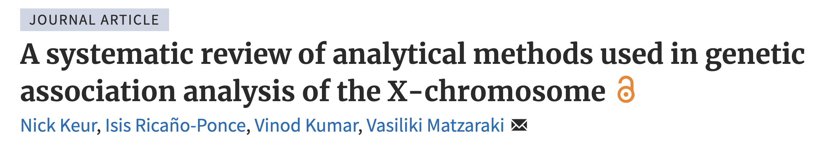
Analyzing X Chromosome
Complex diseases/traits present sexual dimorphic prevalence which points toward a potential contribution of the X-chromosome.
Quality control and imputation of X-chromosome genetic data require special attention to account for its unique properties.
Selection of statistical tests to identify associations with X-chromosome loci depends on the underlying X-chromosomal inactivation (XCI) model, HWE, sex-specific alleles and confounding variables.

Slide 55
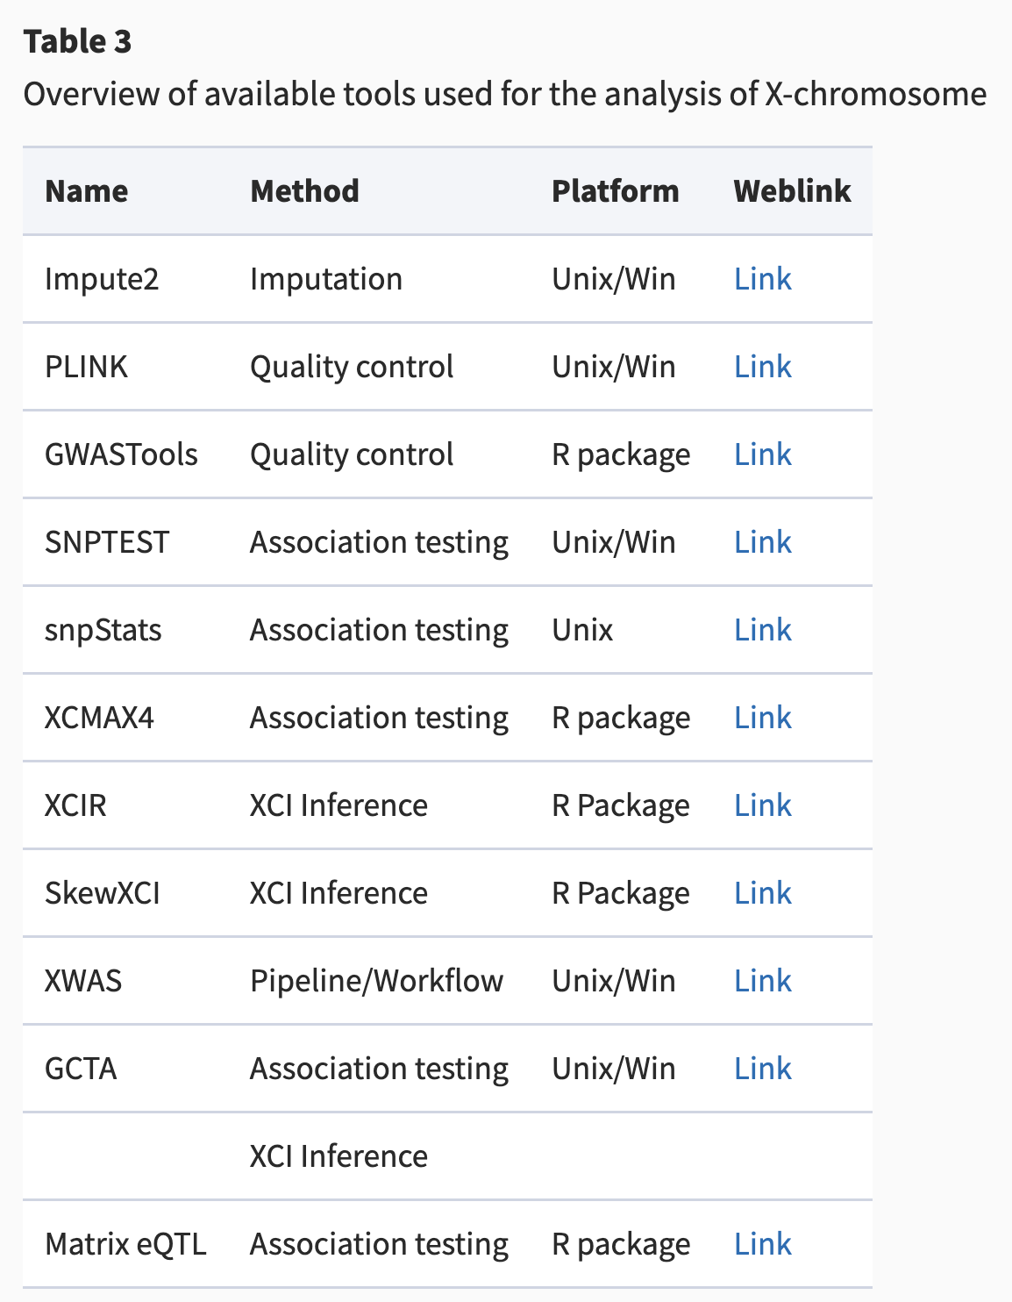

Slide 56
Binary traits
Common variants
Rare variants
Related samples
Related samples
YES
NO
YES
NO
Case: control < 1:10
Case: control < 1:10
Case: control < 1:10
Case: control < 1:10
YES
NO
YES
NO
SAIGE
fastGWA-GLMM
Regenie
PLINK –glm
SPAtest (fast)
PLINK –glm firth (slow)
NO
YES
NO
YES
SAIGE-GENE+
Regenie v3
SKAT
SKAT binary
GMMAT (slow but good for small sample sizes)
SAIGE
fastGWA-GLMM
Regenie
SMMAT
EmmaX-SKAT
STAAR
SAIGE-GENE+
Regenie v3
Rounak Dey
Zhangchen Zhao

Slide 57
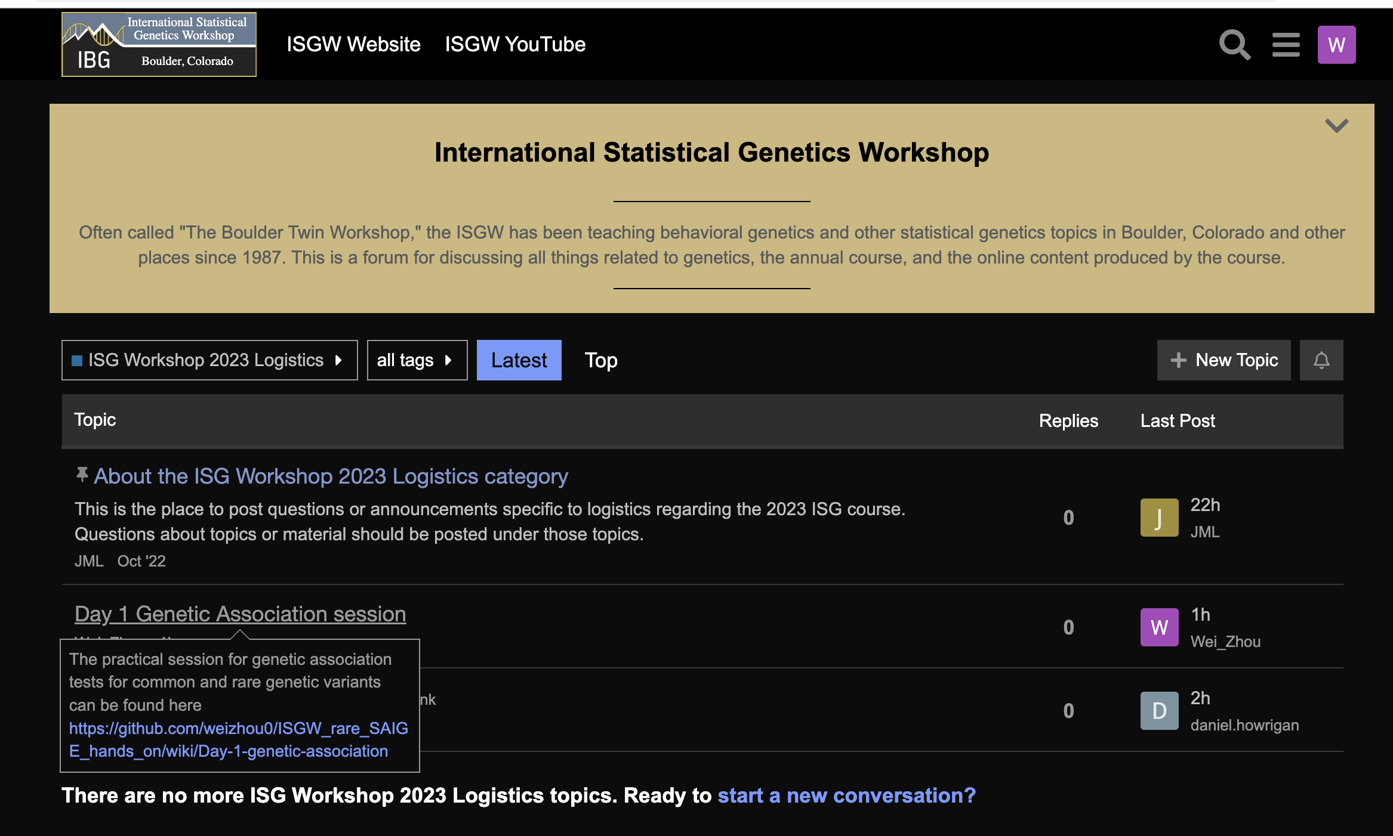
Hands-on
https://github.com/weizhou0/ISGW_rare_SAIGE_hands_on/wiki/Day-1-genetic-association
Questions: https://isgw-forum.colorado.edu/t/about-the-common-rare-variant-association-category/29/1

