Slide 1















37nd International Statistical Genetics
[ISG] Workshop
Ben Neale (codirector)
David Evans (codirector)
Nick Martin
Dorret Boomsma
Mike Neale
Hermine Maes
Sarah Medland
Brittany Mitchell
John Kemp
Wei Zhou
Michel Nivard
Abdel Abdellaoui
Elizabeth Prom-Wormley
Matt Keller (host)
John Hewitt
Jeff Lessem
Luke Evans
Andrew Grotzinger
Dan Gustavson
Dan Howrigan
Tim Poterba
Dan King
Danielle Posthuma
Aysu Okbay
Loic Yengo
Tim Thornton

Slide 2
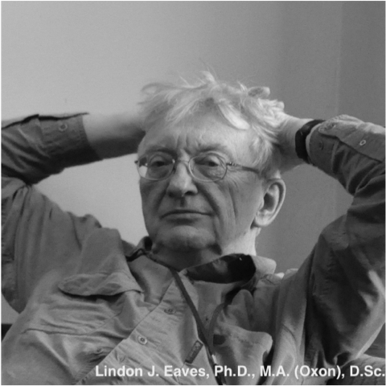

Slide 3
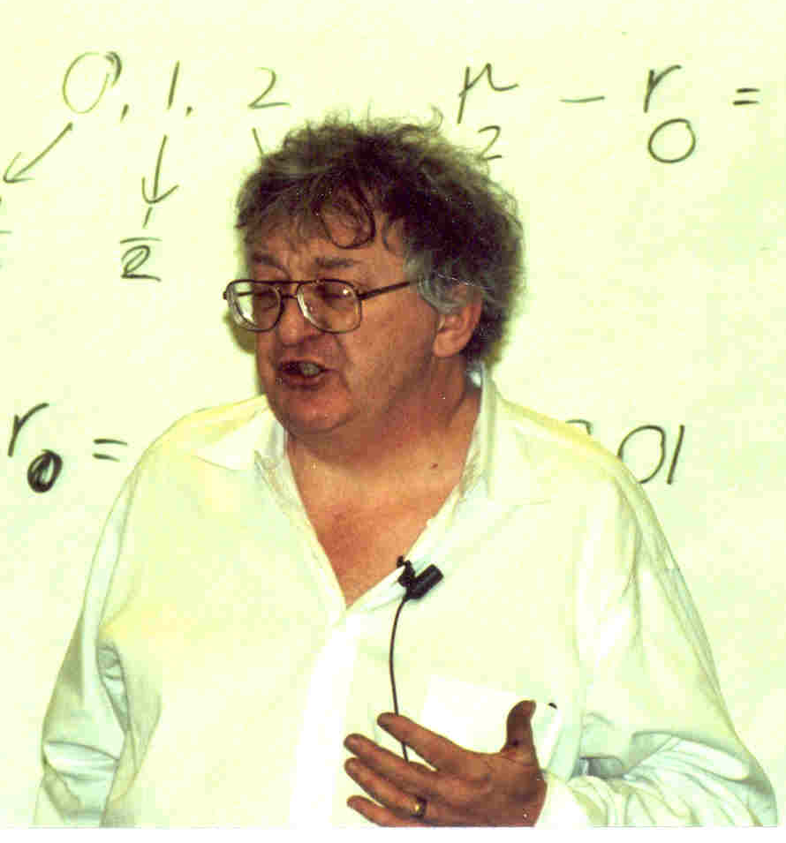

Slide 4
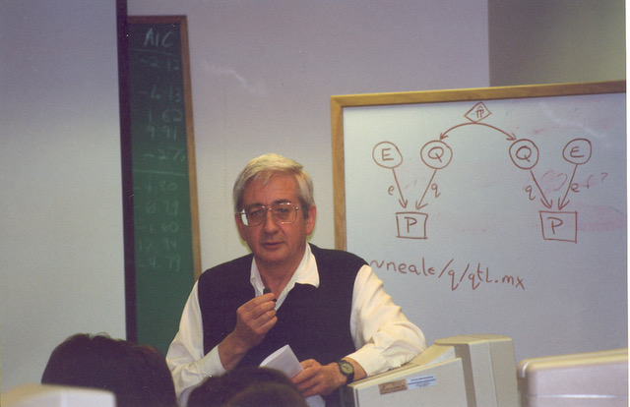

Slide 5
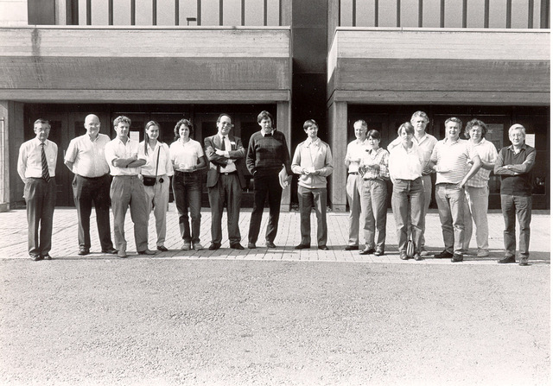

Slide 6
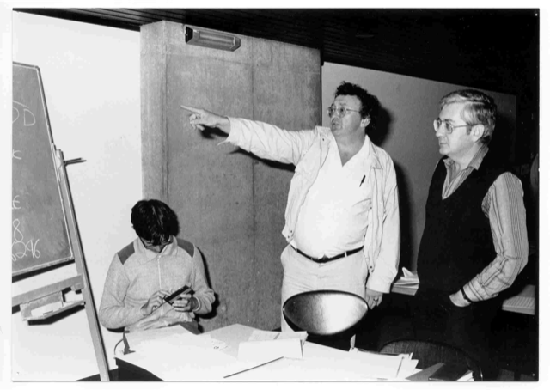

Slide 7

The genetics of complex traits: historical context and current challenges
Nick Martin
Queensland Institute
of Medical Research
Brisbane
Boulder workshop
March 6, 2023

Slide 8
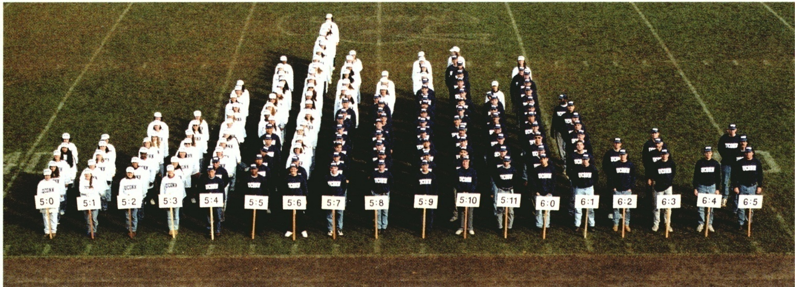
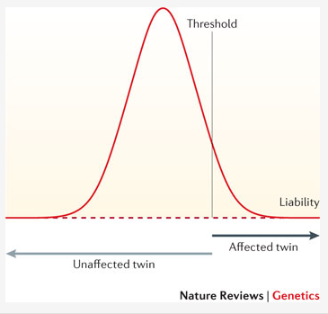
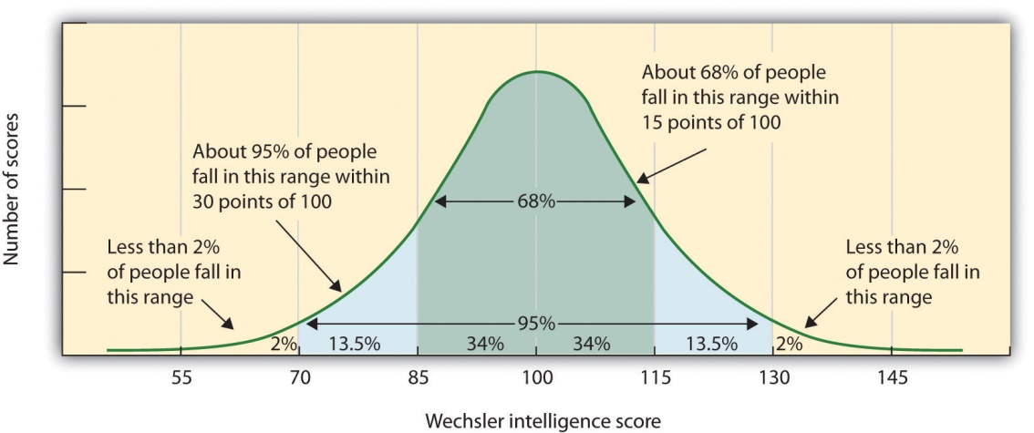
Human variation: Height
Human variation: IQ

Slide 9
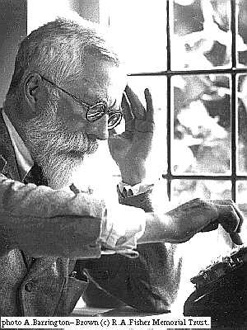
R.A. Fisher, 1918
The explanation of quantitative inheritance in Mendelian terms
1 Gene
→ 3 Genotypes
→ 3 Phenotypes
2 Genes
→ 9 Genotypes
→ 5 Phenotypes
3 Genes
→ 27 Genotypes
→ 7 Phenotypes
4 Genes
→ 81 Genotypes
→ 9 Phenotypes

Slide 10
Complex disorders account for most health burden
Examples
  Ischaemic heart disease (30-50%, F-M)
  Breast cancer (12%, F)
  Colorectal cancer (5%)
  Recurrent major depression (10%)
  ADHD (5%)
  Bipolar (2%)
  Schizophrenia (1%)
  Non-insulin dependent diabetes (5%)
  Asthma (10%)
  Essential hypertension (10-25%)
  etc…..

Slide 11
Multifactorial Threshold Model
of Disease – normally distributed “liability”
Multiple thresholds
Single threshold
unaffected affected
normal
mild
mod
severe
Disease liability
Disease liability

Slide 12
Variance components
Additive
Genetic
Effects
Dominance
Genetic
Effects
Unique
Environment
Shared
Environment
E
C
A
D
c
a
e
d
Phenotype
P = eE + aA + cC + dD

Slide 13
Genetic Epidemiology:
Stages of Genetic Mapping
Are there genes influencing this trait?
  Genetic epidemiological (twin / family) studies OR heritability based on measured genetic variants
Where are those genes?
  Linkage analysis
What are those genes?
  Association analysis (meta-analysis / pathway)
How do they work beyond the sequence?
  Epigenetics, transcriptomics, proteomics
What can we do with them ?
  Translational medicine

Slide 14
The value of twins to estimate genetic and environmental variance
MZ and DZ twins: determining zygosity using ABI Profiler™ genotyping
(9 STR markers + sex)
MZ
DZ
DZ

Slide 15
Height for 12yo MZ and DZ twins
MZ twins - 153 pairs, r = 0.94
DZ twins - 199 pairs, r = 0.60
Twin 1
Twin 1
Twin 2
Twin 2

Slide 16
Twin Correlations for Adult Stature
(Virginia 30,000 and Australia 22,000)

Slide 17
ACE Model for twin data
1
MZ=1.0 / DZ=0.5
E
C
A
A
C
E
e
c
a
a
c
e
P_{T1}
P_{T2}

Slide 18
Sources of variation in height
So total /twin /family /pedigree heritability ~80%
Additive
genetic
AM / Shared
environment
Non-shared
environment

Slide 19
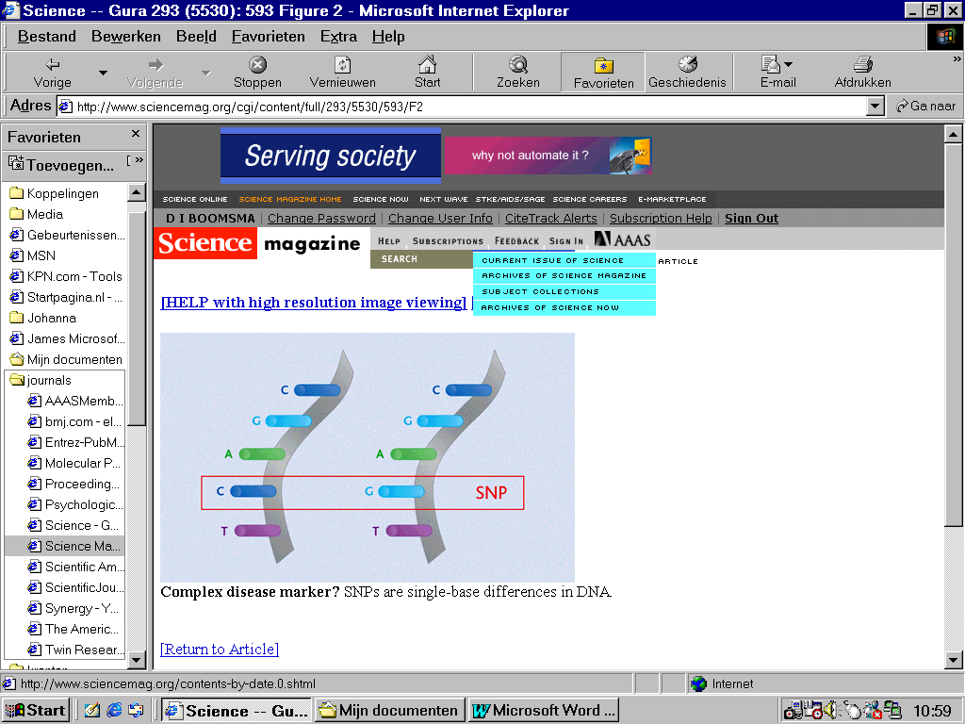
Finding the genes - association
Looks for correlation between specific alleles and phenotype (trait value, disease risk) using single nucleotide polymorphisms (SNPs)

Slide 20
Why do we use the average sib values of r_{a} = 0.5 and r_{d} = 0.25 when we can estimate the (almost) exact values for each sib pair from marker data ?
Classical twin design revisited:
Heritability estimation without MZ twins

Slide 21
x
1/4
1/4
1/4
1/4

Slide 22
IDENTITY BY DESCENT
Sib 1
Sib 2
4/16 = 1/4 sibs share BOTH parental alleles IBD = 2
8/16 = 1/2 sibs share ONE parental allele IBD = 1
4/16 = 1/4 sibs share NO parental alleles IBD = 0

Slide 23
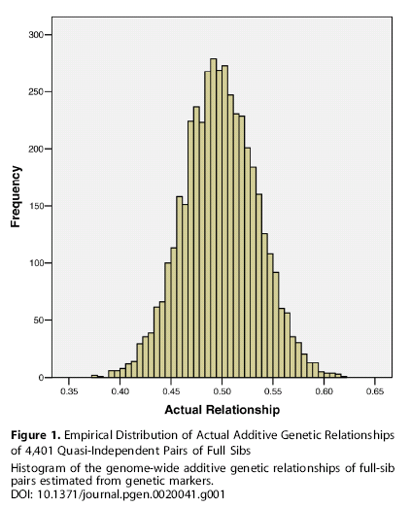

Slide 24
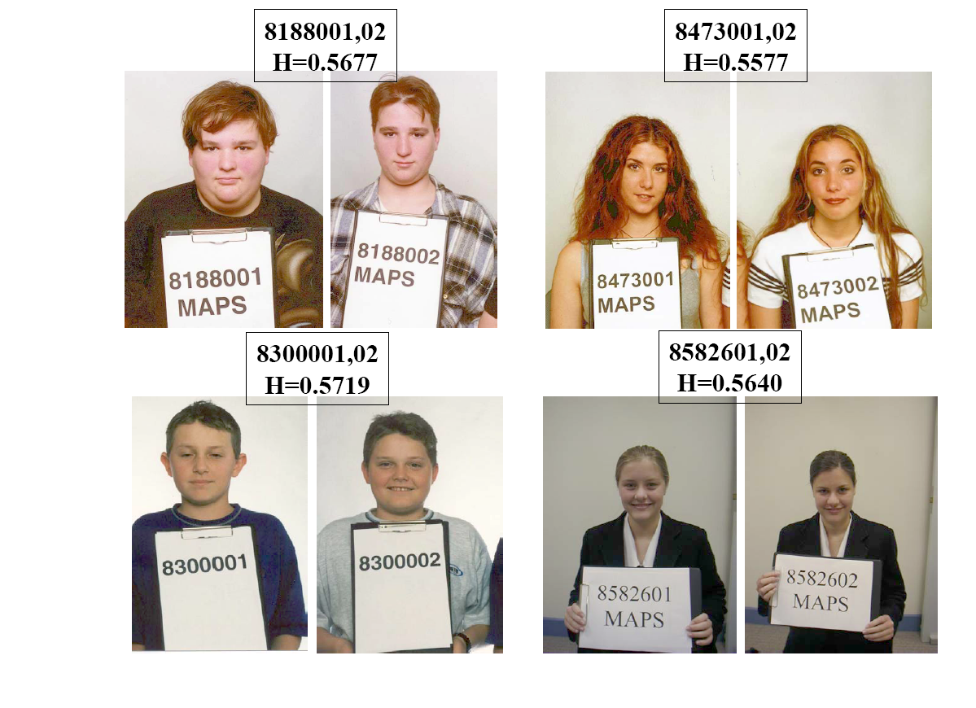
Do these high IBD-sharing DZ twins look more similar…….

Slide 25
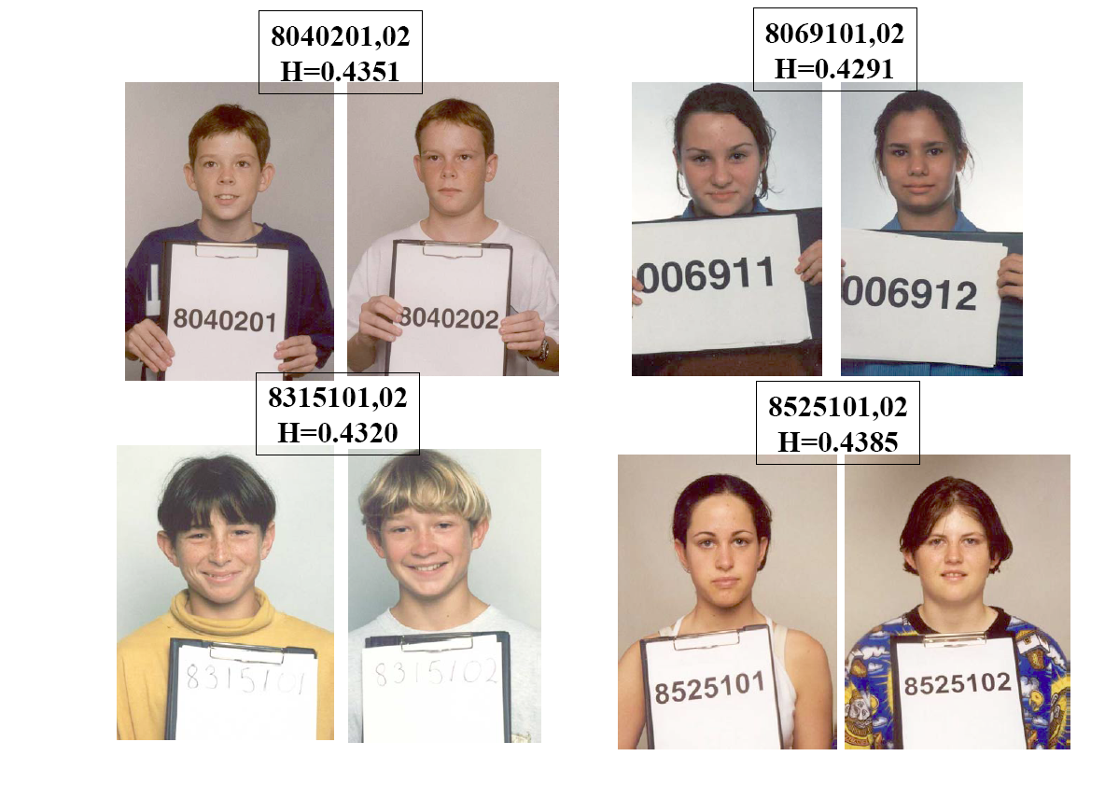
….than these low IBD sharing DZ twins ?

Slide 26
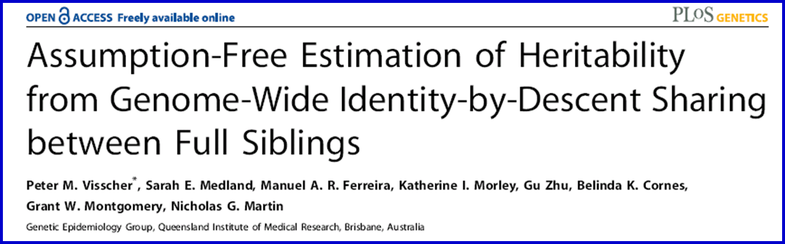
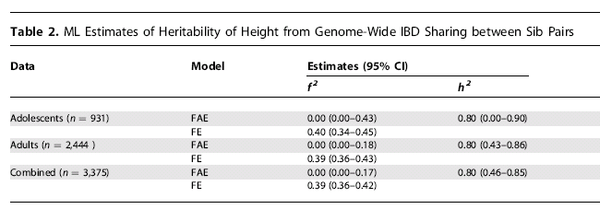
2006
From genotyped sibs alone (3375 pairs)
we can estimate h² = 0.80 (.46-.85)

Slide 27
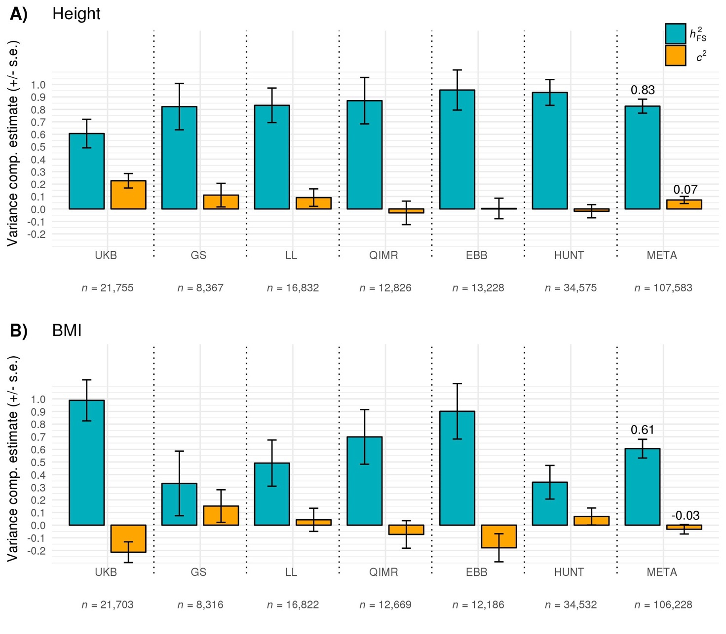
Reconciling Linkage and Association Studies of Complex Traits Using 107,000 Sibling Pairs
2023
Visscher, Yengo, Sidorenko et al, in press

Slide 28
4 Stages of Genetic Mapping
Are there genes influencing this trait?
  Genetic epidemiological studies
Where are those genes?
  Linkage analysis
What are those genes?
  Association analysis
What can we do with them ?
  Translational medicine

Slide 29
Association analysis
looks for correlation between specific alleles and phenotype (trait value, disease risk)
Single Nucleotide Polymorphisms (SNPs)

Slide 30
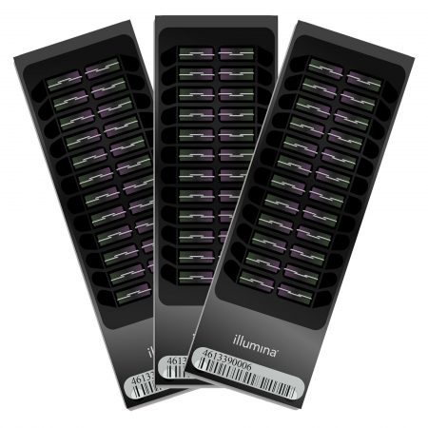
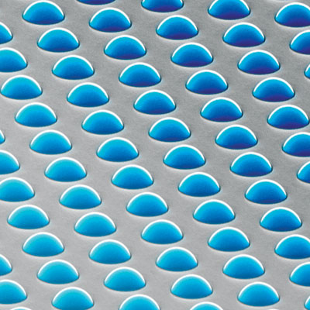
High density SNP arrays – up to 1 million SNPs

Slide 31
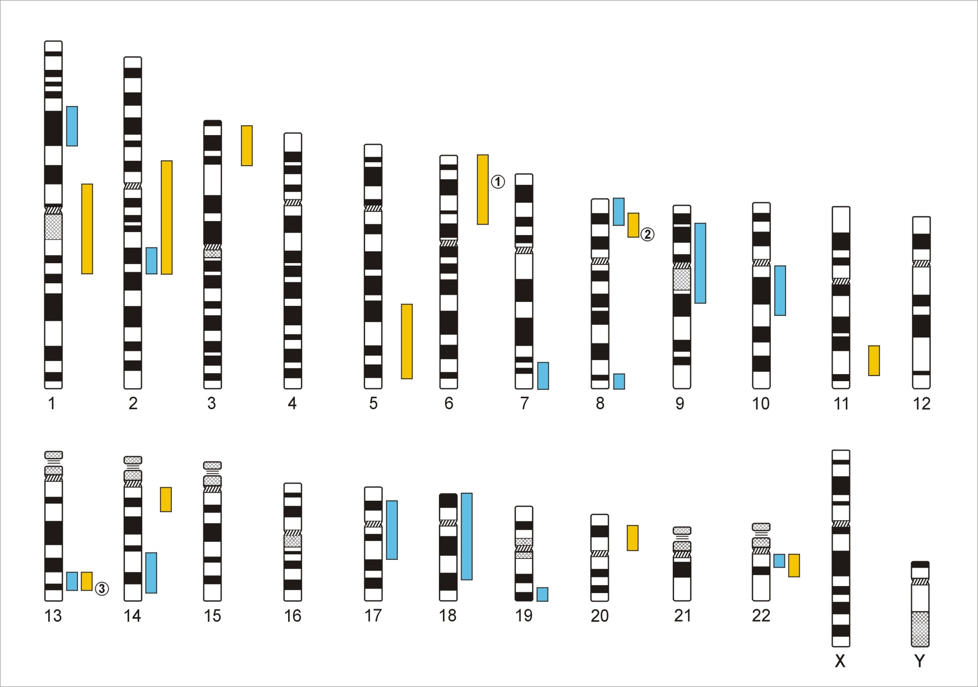
Genome-Wide Association Studies
500,000 – 5,000,000 SNPs
Human Genome - 3,1x10⁹ Base Pairs
Notes:
In a GWA the Genome which contains xx SNPs is examined using … SNPs

Slide 32
Linkage disequilibrium
David Evans

Slide 33
Linkage disequilibrium
time

Slide 34
Indirect association
this SNP will be associated with disease

Slide 35
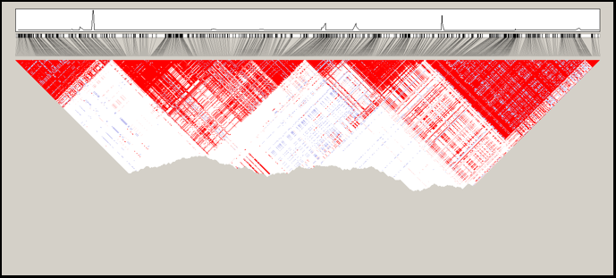
Linkage disequilibrium blocks
Jeff Barrett

Slide 36
Genetic Case Control Study
Controls
Cases
G/T
G/G
T/T
T/T
T/T
T/G
T/G
T/T
T/G
T/G
G/G
T/G
T/G
T/T
Allele G is ‘associated’ with disease

Slide 37
Allele-based tests (case-control)
Each individual contributes two counts to 2x2 table.
Test of association
where
X² has χ² distribution with 1 degrees of freedom under null hypothesis.
 | Cases | Controls | Total
G | n_{1A} | n_{1U} | n_{1·}
T | n_{0A} | n_{0U} | n_{0·}
Total | n_{·A} | n_{·U} | n··

Slide 38
Simple Regression Model of Association
(continuous trait)
Y_{i} = α + βX_{i} + e_{i}
where
Y_{i} = trait value for individual i
X_{i} = number of ‘A’ alleles an individual has
1.2
1
0.8
Y
0.6
0.4
0.2
0
X
0
1
2
Association test is whether β > 0

Slide 39
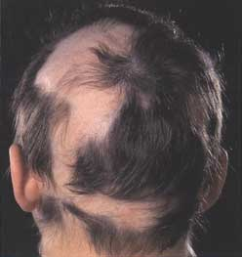
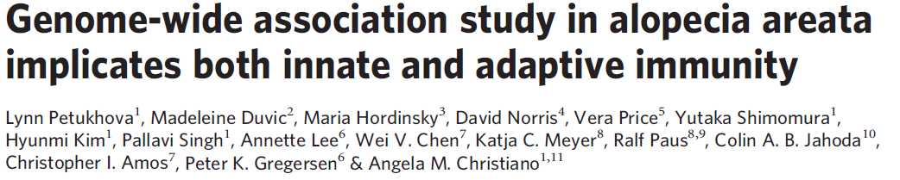
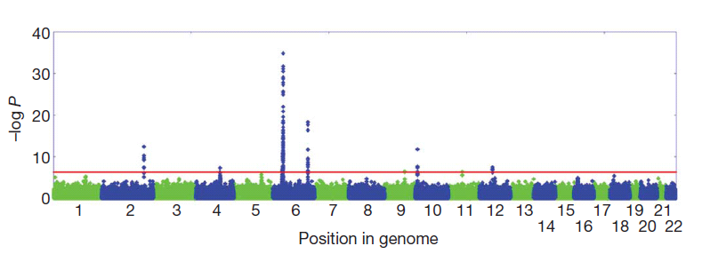

Slide 40
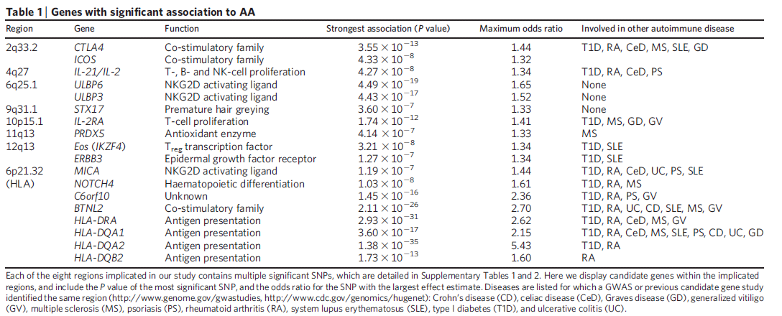
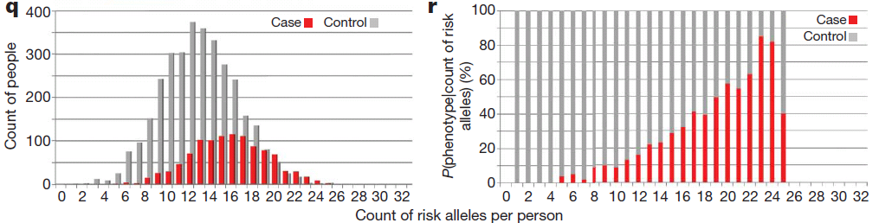

Slide 41
Total n = 477,522 (26,827 reporting same-sex sexual behavior)
GCTA h² = 32.4%
(95% CI 10.6 - 54.3)
Across sex Rg = 0.63 (95% CI, 0.48-0.78)

Slide 42

N = 5,314,291 !!
Loic Yengo, UQ
GWAS of 5.4 million individuals of diverse ancestries
12,111 independent common SNPs gw significant
Account for 45% of phenotypic variance in Europeans but only around 14–24% in other ancestries
Reduced prediction accuracy likely due to ancestry differences in LD and MAF

Slide 43
What about the other
80 – 45 = 35%
“missing heritability” ?

Slide 44
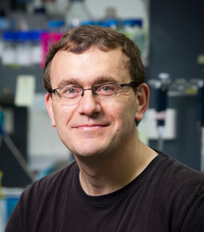
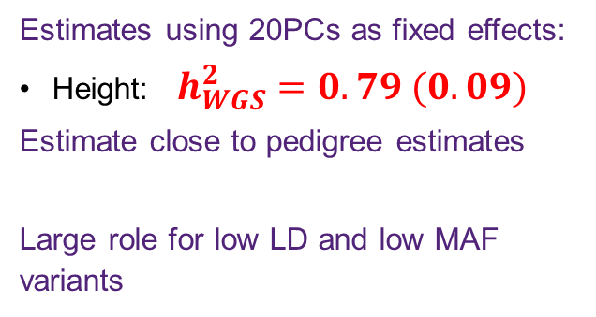
Using whole-genome sequence WGS data to recover the pedigree heritability?
Estimates using 20PCs as fixed effects:
Height: $h_{WGS}^{2}=0.79 (0.09)$
Estimate close to pedigree estimates
Large role for low LD and low MAF variants
Missing h² due to rare variants of large effect in low LD with array SNPs
Peter Visscher
Pierrick
Wainschtein
Nat Genet. 2022 March ; 54(3): 263

Slide 45
Ways to increase power
Imputation

Slide 46
Imputation
a g a g t t g a g g g a a c c t g a g a a
t g a g a c g a g g g a a a t t g a g a c
t g c g a c g g t g a t t c t c c a g a c
a g c g a c g a t g g t a c t t g a t c a
t a a g t t a g t a a t t c c c g a g c a
t g c a a t g a g g g a a a t t g t t a a
a g a g a c g g g g g a a a t t c t g c c
Reference haplotypes via sequencing studies
eg. 1000 Genomes Project
g a g g t a a
g c t a t t c
a t g g t t a
g c g g c a a
g c t g t t c
g c g g c a a
g t g g t a c
a t t a c a a
Slide from Jonathan Marchini

Slide 47
Imputation
a g a g t t g a g g g a a c c t g a g a a
t g a g a c g a g g g a a a t t g a g a c
t g c g a c g g t g a t t c t c c a g a c
a g c g a c g a t g g t a c t t g a t c a
t a a g t t a g t a a t t c c c g a g c a
t g c a a t g a g g g a a a t t g t t a a
a g a g a c g g g g g a a a t t c t g c c
Reference haplotypes via sequencing studies
eg. 1000 Genomes Project
? g ? ? ? a ? ? g ? g ? ? ? t ? ? a ? ? a
? g ? ? ? c ? ? t ? a ? ? ? t ? ? t ? ? c
? a ? ? ? t ? ? g ? g ? ? ? t ? ? t ? ? a
? g ? ? ? c ? ? g ? g ? ? ? c ? ? a ? ? a
? g ? ? ? c ? ? t ? g ? ? ? t ? ? t ? ? c
? g ? ? ? c ? ? g ? g ? ? ? c ? ? a ? ? a
? g ? ? ? t ? ? g ? g ? ? ? t ? ? a ? ? c
? a ? ? ? t ? ? t ? a ? ? ? c ? ? a ? ? a
Slide from Jonathan Marchini

Slide 48
Imputation
a g a g t t g a g g g a a c c t g a g a a
t g a g a c g a g g g a a a t t g a g a c
t g c g a c g g t g a t t c t c c a g a c
a g c g a c g a t g g t a c t t g a t c a
t a a g t t a g t a a t t c c c g a g c a
t g c a a t g a g g g a a a t t g t t a a
a g a g a c g g g g g a a a t t c t g c c
Reference haplotypes via sequencing studies
eg. 1000 Genomes Project
g a g g t a a
g c t a t t c
a t g g t t a
g c g g c a a
g c t g t t c
g c g g c a a
g t g g t a c
a t t a c a a
Imputation of unobserved alleles via matching of shared haplotypes
Slide from Jonathan Marchini

Slide 49
Imputation
a g a g t t g a g g g a a c c t g a g a a
t g a g a c g a g g g a a a t t g a g a c
t g c g a c g g t g a t t c t c c a g a c
a g c g a c g a t g g t a c t t g a t c a
t a a g t t a g t a a t t c c c g a g c a
t g c a a t g a g g g a a a t t g t t a a
a g a g a c g g g g g a a a t t c t g c c
Reference haplotypes via sequencing studies
eg. 1000 Genomes Project
a g a g t a g a g g g t a c t t g a t c a
t g c g a c g g t g a t t c t t c t g c c
t a a a a t g a g g g a a a t t g t t a a
t g a g a c g a g g g a a c c c g a g c a
a g c g a c g a t g g t a a t t c t g c c
a g a g a c g a g g g a a c c t g a g a a
t g c a a t g a g g g a a a t t g a g a c
t a a g t t a g t a a t t c c t g a t c a
Imputation of unobserved alleles via matching of shared haplotypes
Slide from Jonathan Marchini

Slide 50
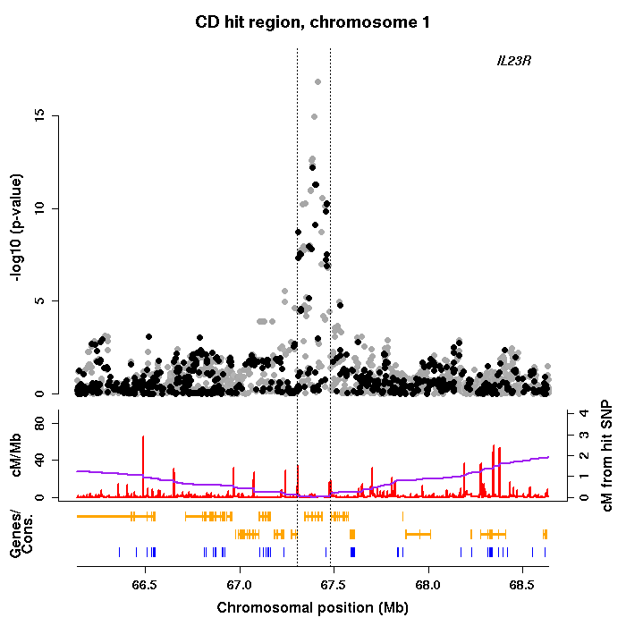
Imputation
a g a g t t g a g g g a a c c t g a g a a
t g a g a c g a g g g a a a t t g a g a c
t g c g a c g g t g a t t c t c c a g a c
a g c g a c g a t g g t a c t t g a t c a
t a a g t t a g t a a t t c c c g a g c a
t g c a a t g a g g g a a a t t g t t a a
a g a g a c g g g g g a a a t t c t g c c
GWAS of imputed genotypes
Increased power
Better resolution
Facilitates meta-analysis
a g a g t a g a g g g t a c t t g a t c a
t g c g a c g g t g a t t c t t c t g c c
t a a a a t g a g g g a a a t t g t t a a
t g a g a c g a g g g a a c c c g a g c a
a g c g a c g a t g g t a a t t c t g c c
a g a g a c g a g g g a a c c t g a g a a
t g c a a t g a g g g a a a t t g a g a c
t a a g t t a g t a a t t c c t g a t c a
Slide from Jonathan Marchini

Slide 51
Ways to increase power
Increase sample size

Slide 52
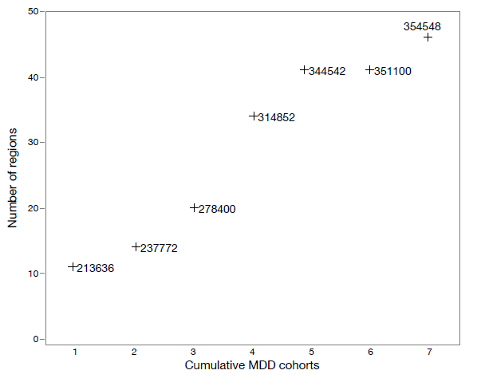
Larger samples lead to more SNP discovery
Results of GWA meta-analysis of seven cohorts for MDD. (a) Relation between adding cohorts and number of genome-wide significant genomic regions. Beginning with the largest cohort (1), added the next largest cohort (2) until all cohorts were included (7). The number next to each point shows the total effective sample size.

Slide 53
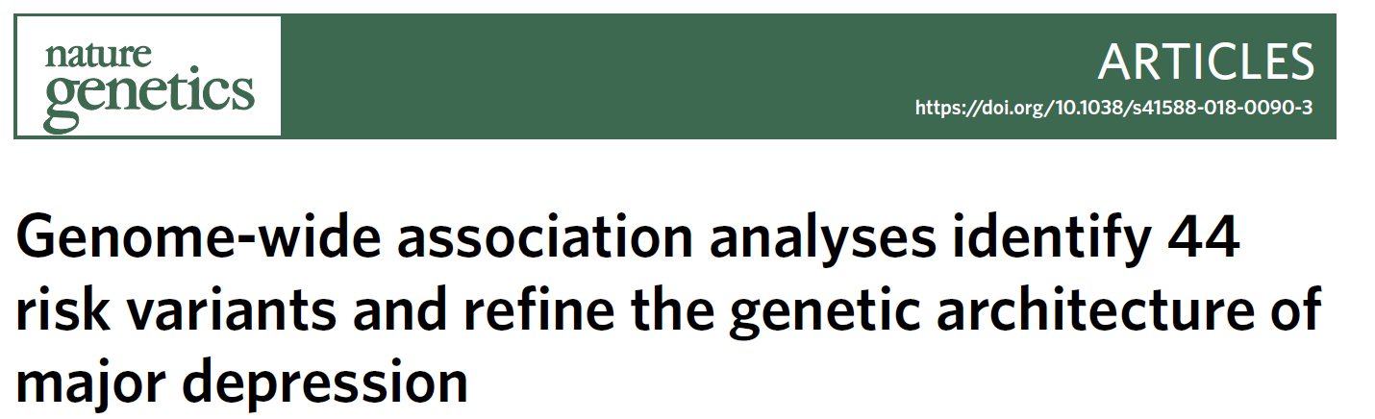
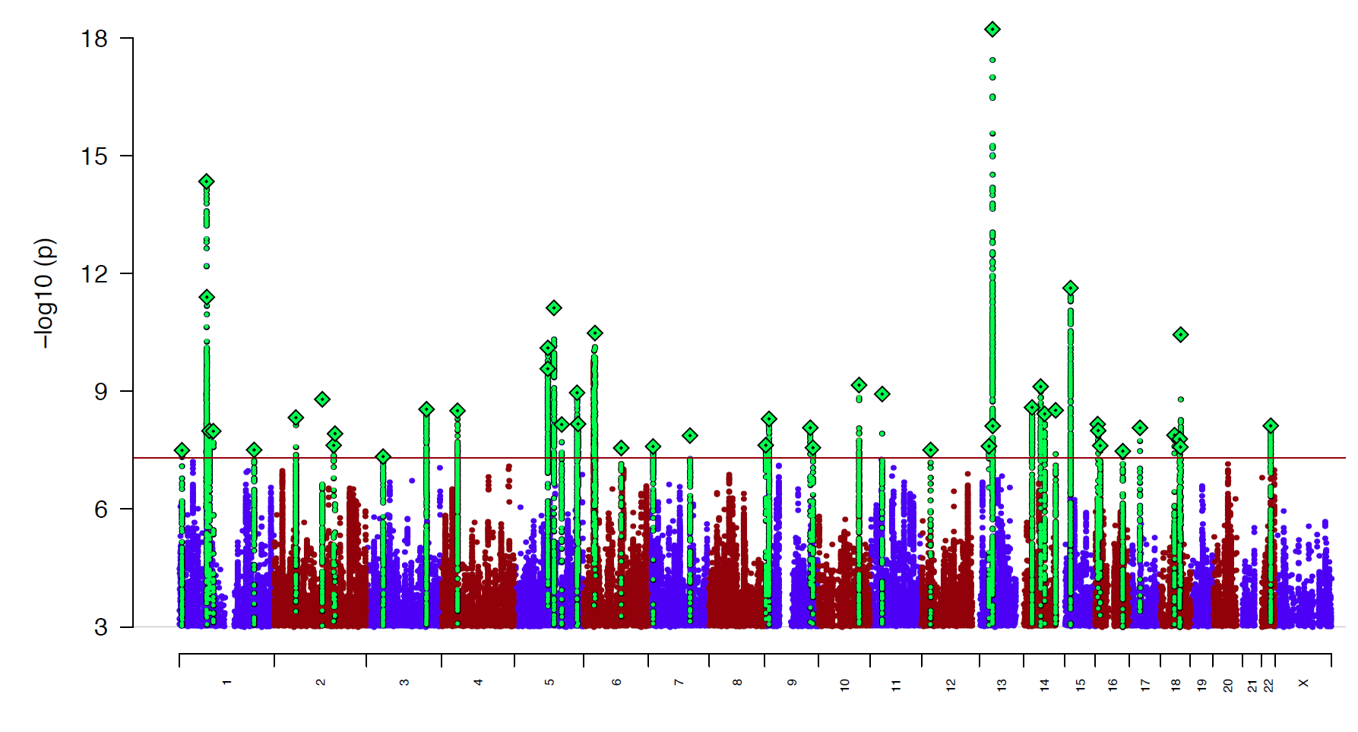
Depression : 135K MDD Cases and 345K Controls
44 hits
Nat Genet. 2018 May;50(5):635-637.
Led by Naomi Wray

Slide 54
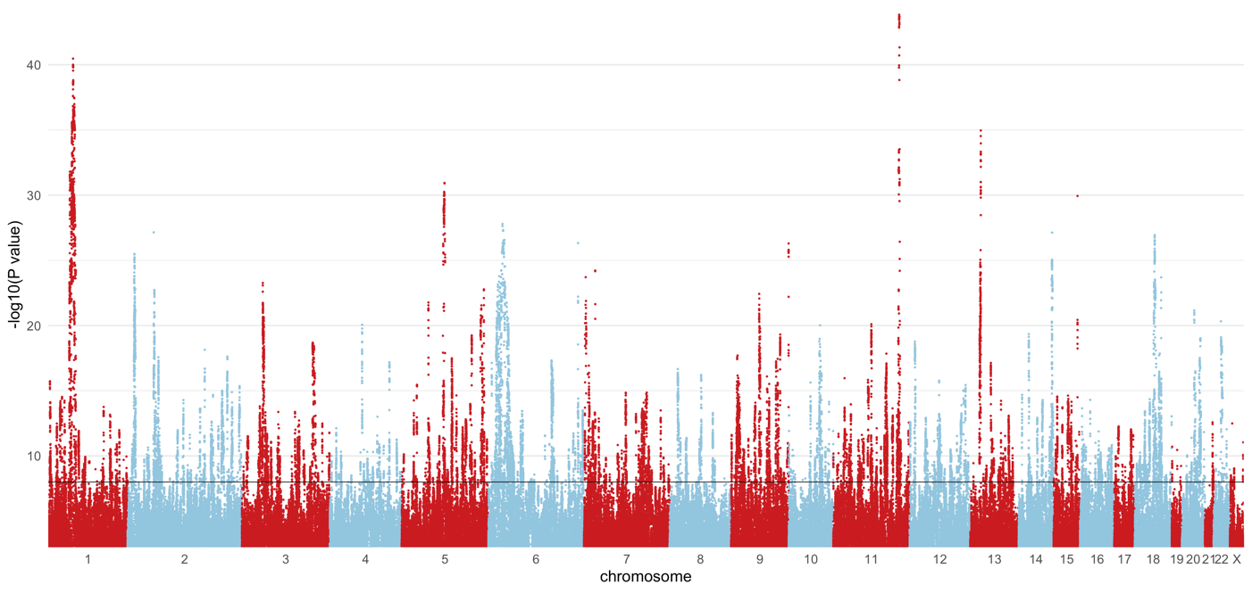
PGC MDD3 GWAS meta-analysis: 525,197 MD cases and 3,362,335 controls
SNPs = 713 regions (500kb) = 510 (without AGDS = 460)

Slide 55
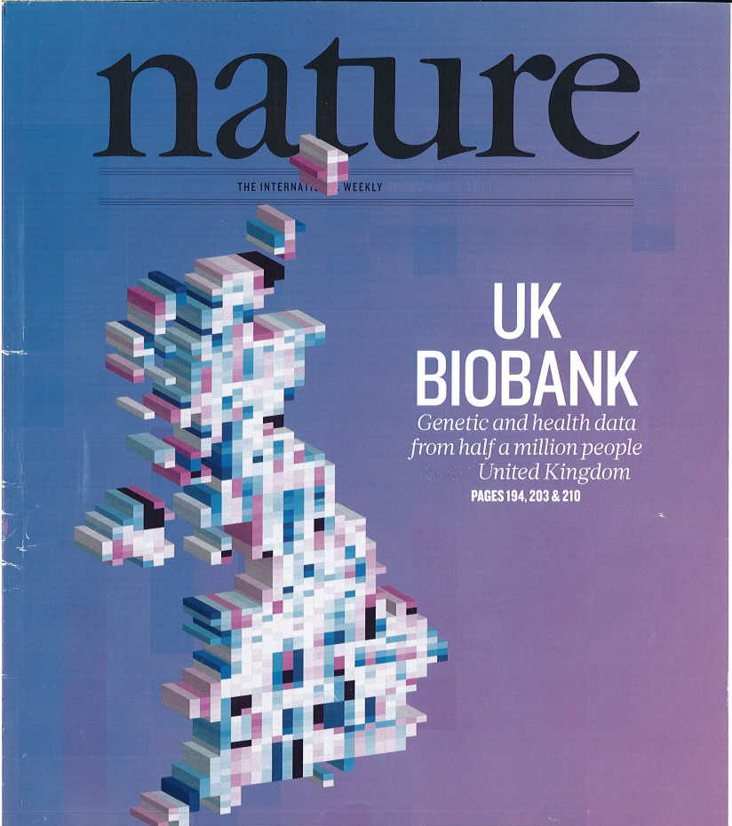
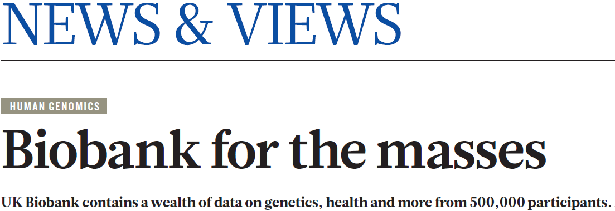
NATURE | VOL 562 | 11 OCTOBER 2018

Slide 56
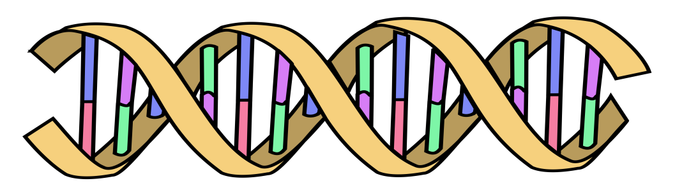
Polygenic Risk Scores
Polygenic Risk Scores capture (part of) someone’s genetic “risk” by summing all risk alleles weighted by the effect sizes estimated in a Genome-Wide Association Study (GWAS)
1×-.02 + 2×.01 + 1×.002 + 0×.03 + 2×.025
Polygenic score:
AC
CC
TT
.052
GG
AT
Effect sized from GWAS
β_{C}=-.02
β_{G}=.01
β_{A}=.002
β_{G}=.03
β_{T}=.025
Wray, Visscher, Goddard, 2007 – Oz!

Slide 57
MDD2 Polygenic Risk Score predicts risk in independent samples
Odd ratios of MDD per PRS decile relative to the first decile for iPSYCH and anchor cohorts.
Interdecile risk ~2.5

Slide 58
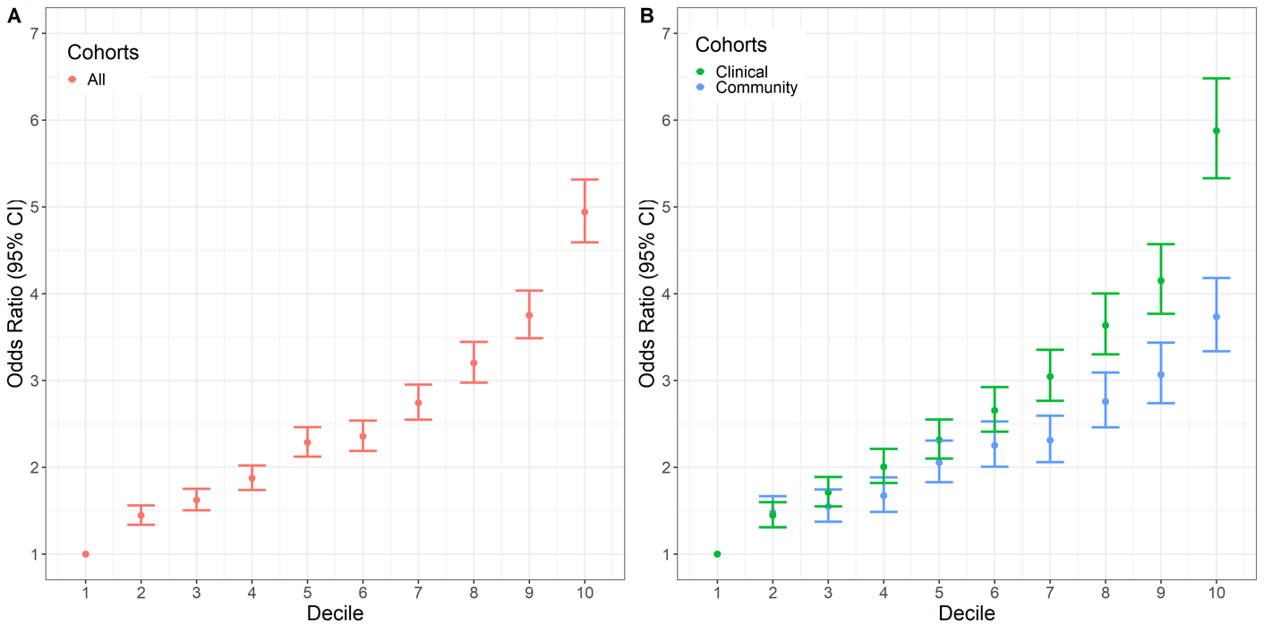
MDD3: MD risk in outsamples by PGS decile
Interdecile risk ~5
in total sample
IDR ~6 in clinical
samples vs.
~4 in “community”

Slide 59
Ways to increase power
Refine the phenotype

Slide 60
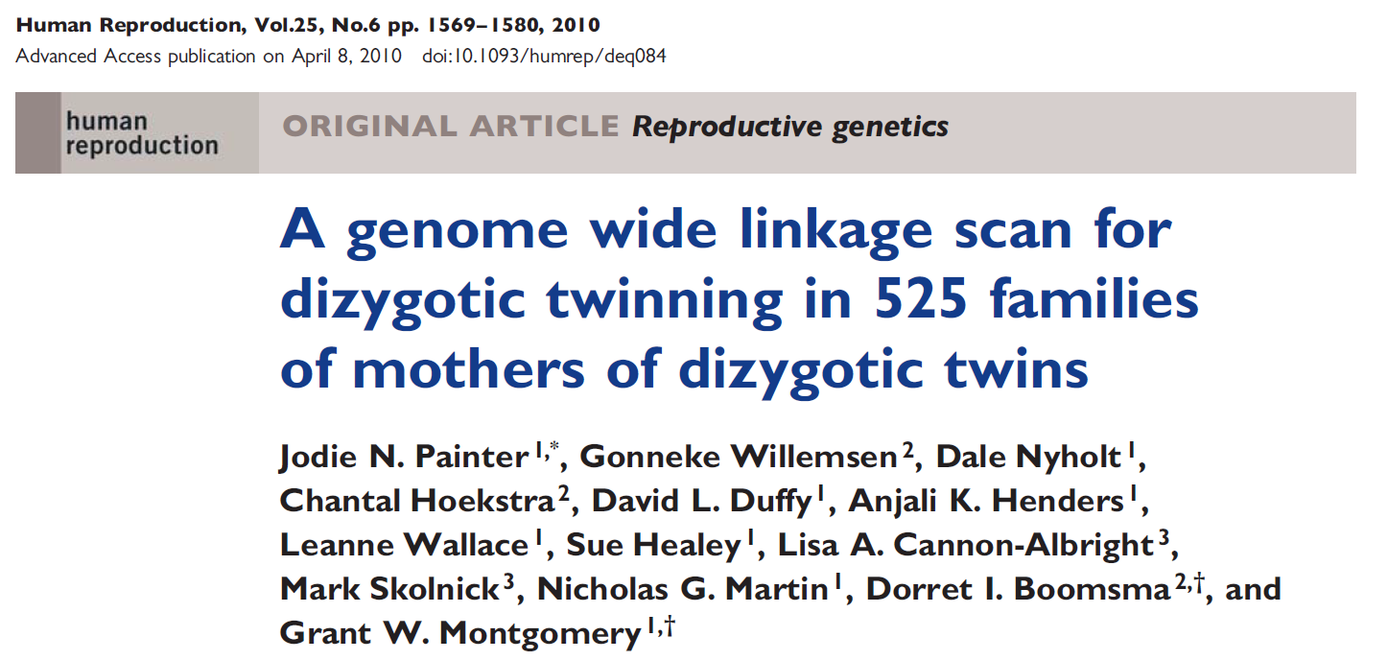
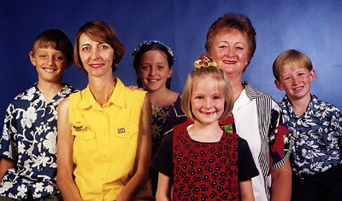

Slide 61
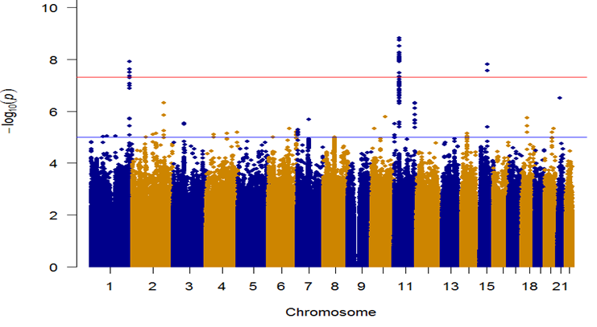
The importance of accurate phenotyping: GWAS for Being a Mother of DZ Twins - Before and after removing mothers who had used assisted reproductive technology
ART +
Hamdi Mbarek
SNP 2, P=1.53E-09
SNP 1, P=1.22E-08
SNP 3, P=1.563E-08
ART --

Slide 62
Ways to increase power
Combine related phenotypes

Slide 63

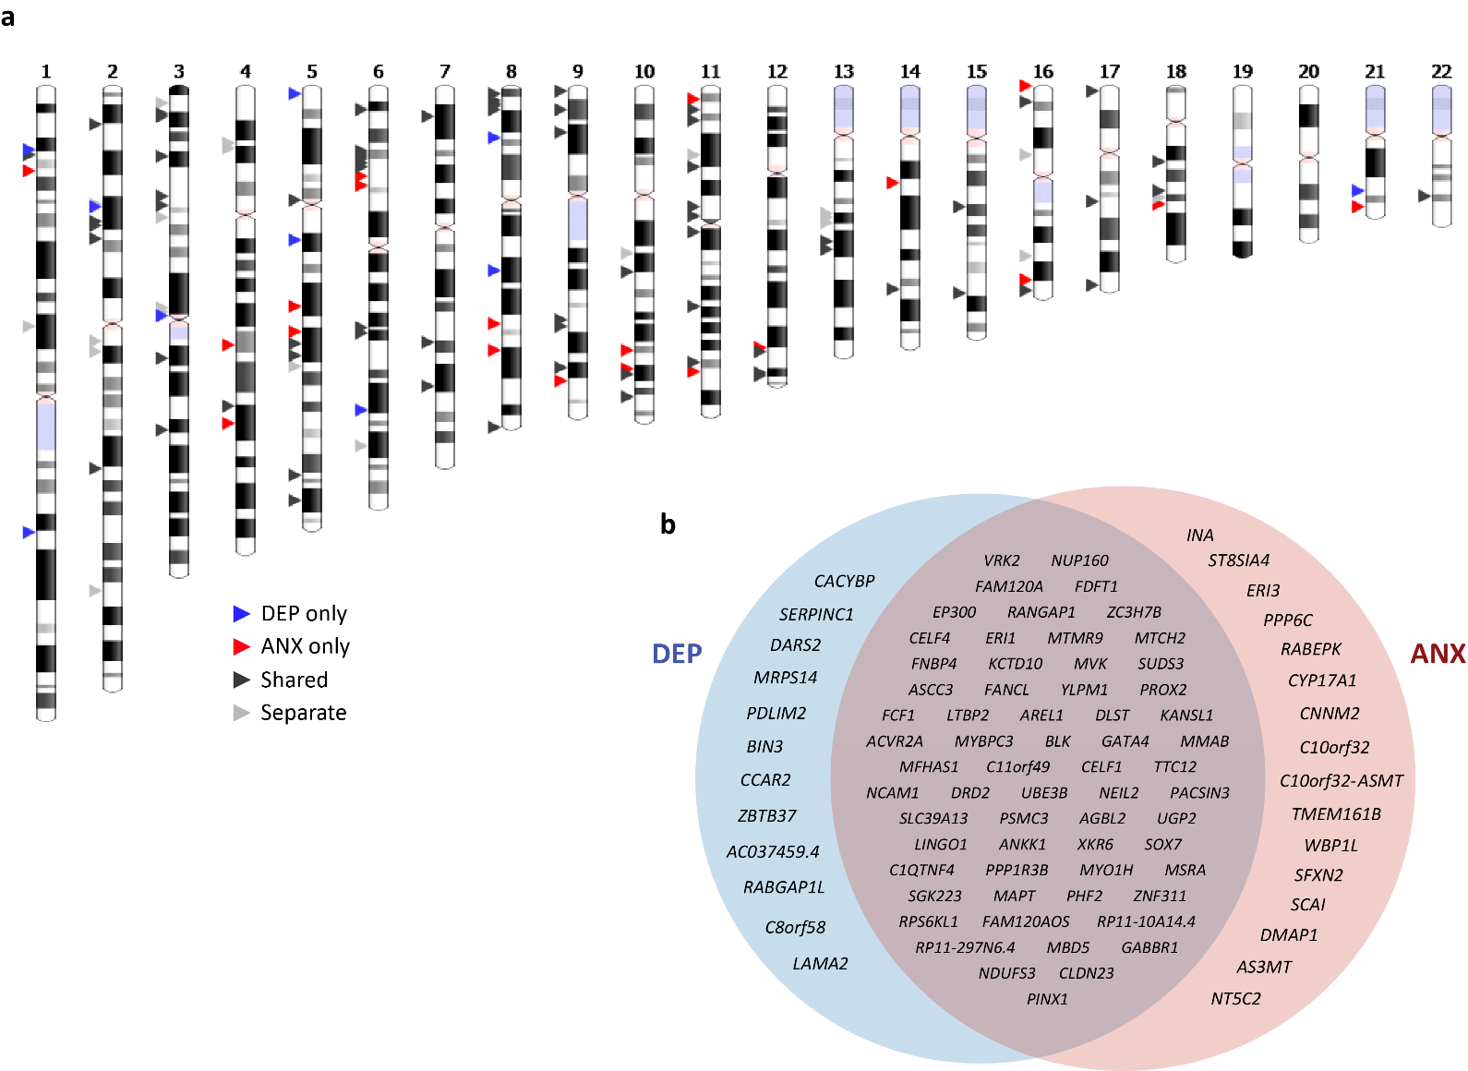

Genes in common – and specific - for Depression and Anxiety
Jackson Thorp
DEP only 10 regions; 63 mapped genes
ANX only 20 regions; 102 mapped genes
Shared 71 regions; 509 mapped genes
Separate 22 regions
Nature Human Behaviour 5, 1432–1442, 2021

Slide 64
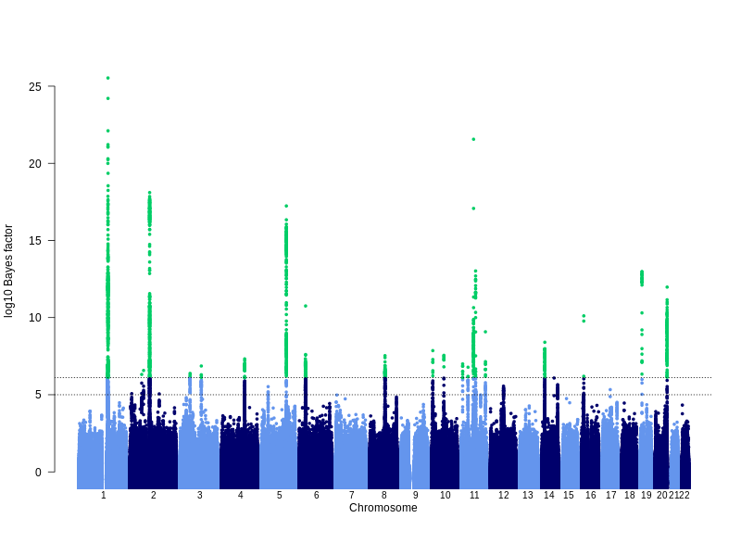
GWAS for eczema (21k cases, 98k controls, 27 hits)
Lavinia Paternoster
Notes:
Manhattan plot showing results of the trans-ethnic meta-analysis.
Explain bayes factor and cut-off equivalent to p-value 5x10-8

Slide 65
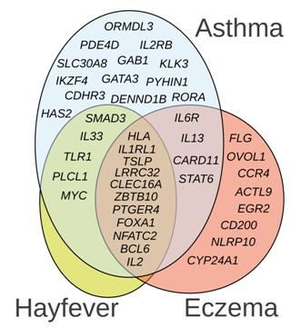
Risk factors overlap
(Thomsen 2006; van Beijsterveldt 2007)
ENVIRONMENTAL risk factors:
20% to 70% shared
COMMON TRIGGERS
GENETIC risk factors:
40% to 60% shared
COMMON MOLECULAR MECHANISMS
Manuel Ferreira

Slide 66
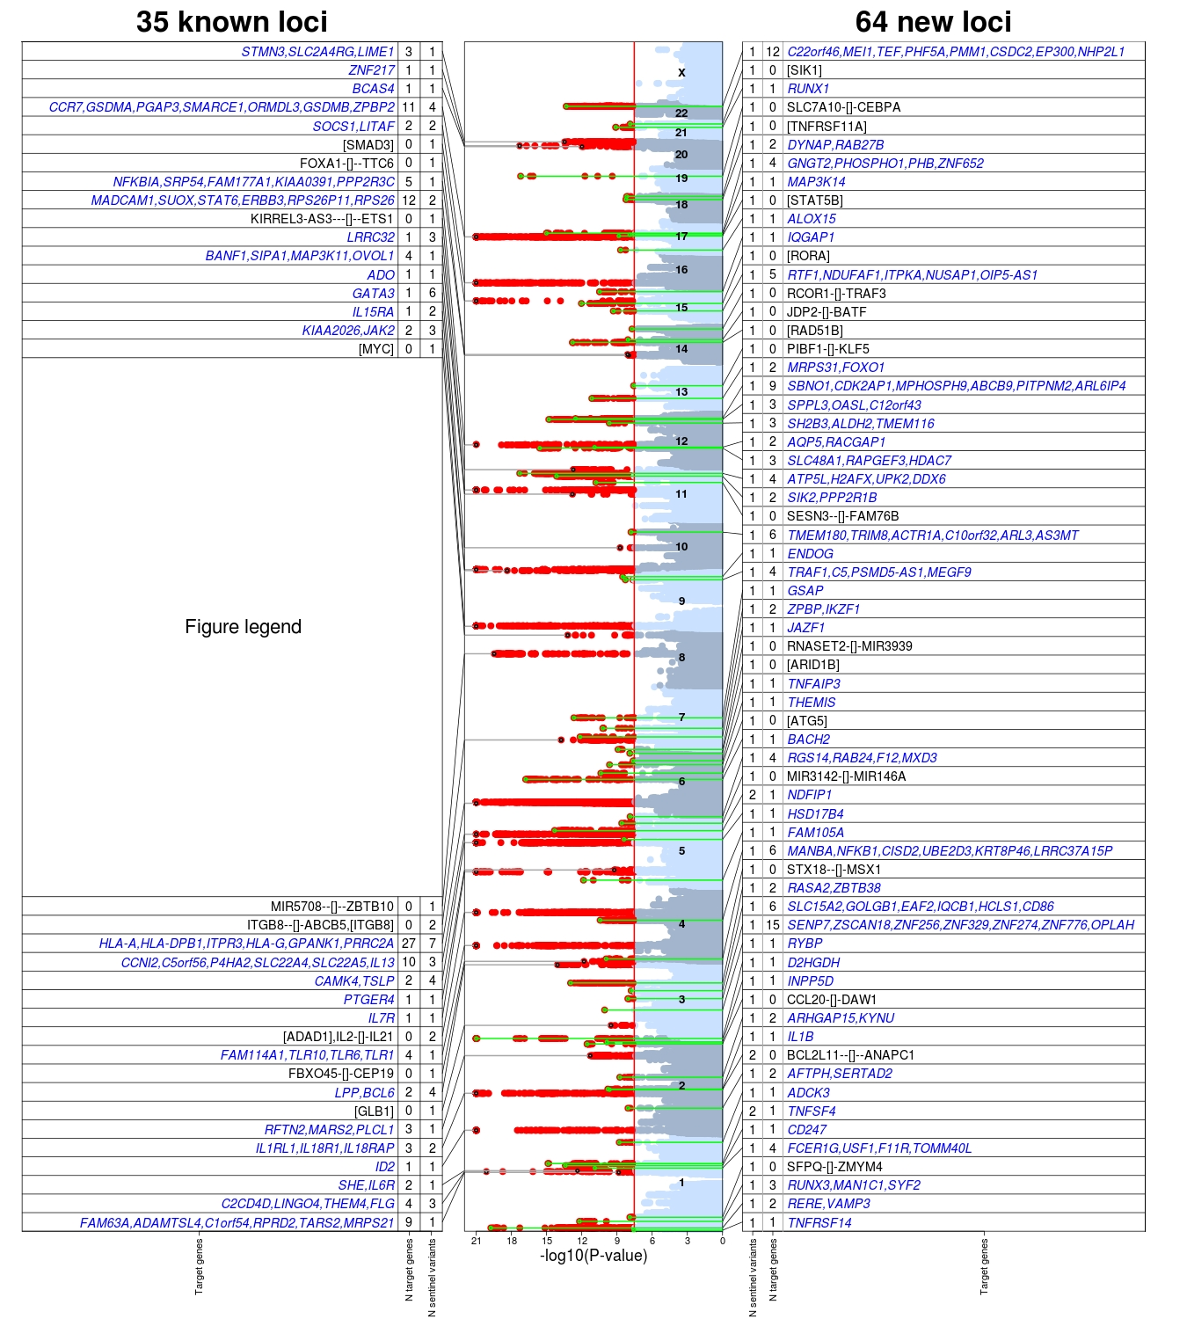
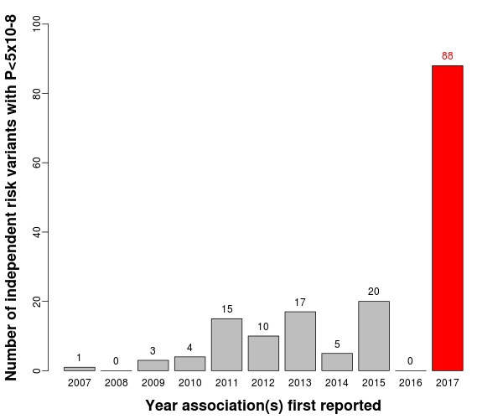
Manuel Ferreira

Slide 67
Ways to increase power
Use ungenotyped relatives as proxy cases (GWAX)

Slide 68
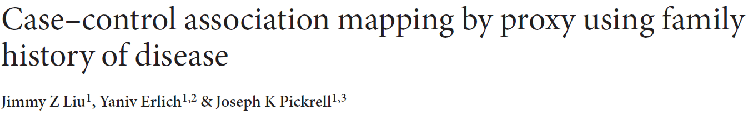
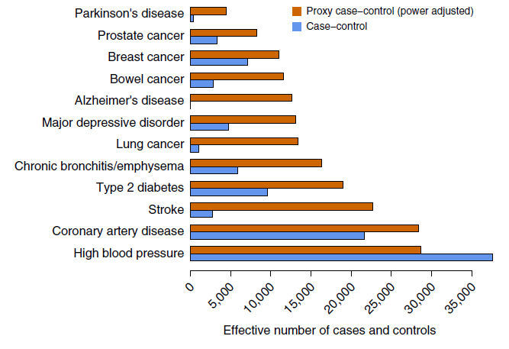
(GWAX)
For late-onset or rapidly lethal diseases it may be more practical to identify family members of cases.

Slide 69
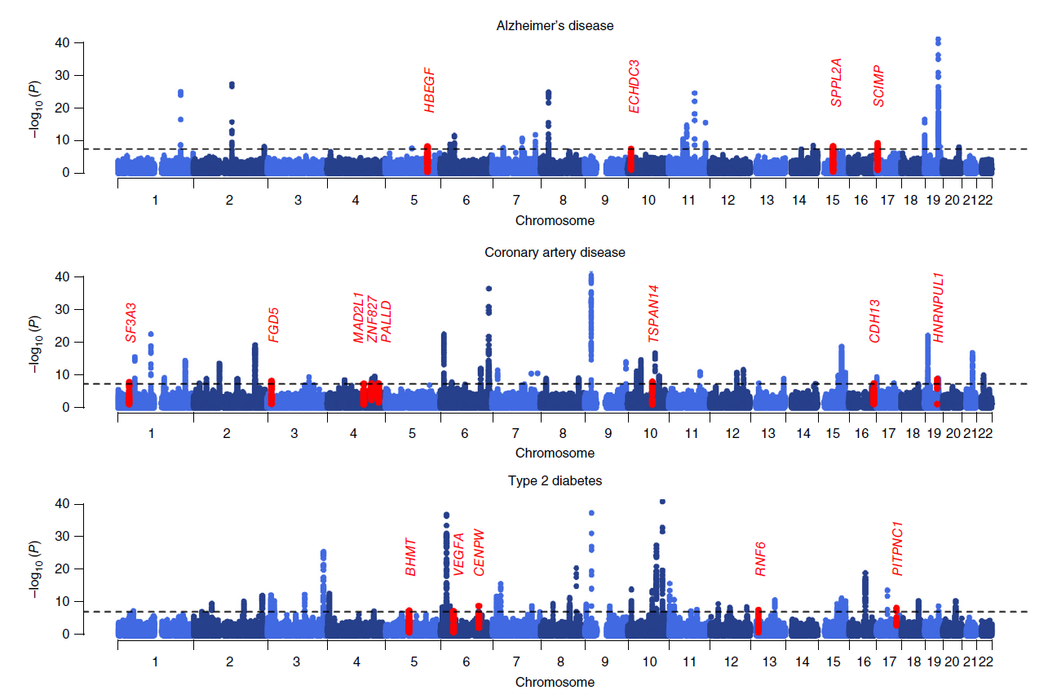
Meta-analysis results for GWAX + case-control studies
New hits are shown in red

Slide 70
Applications of GWAS
Investigate genetic correlation
The genetics of nurture
Direction of causation

Slide 71
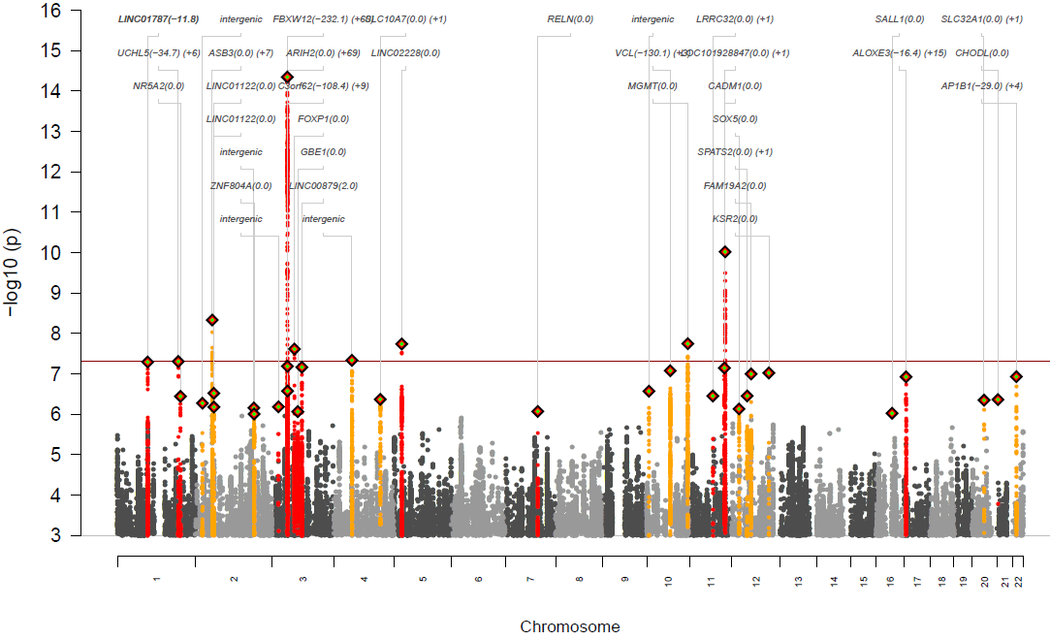
GWAS meta-analysis of anorexia nervosa (17k cases, 56k controls)

Slide 72
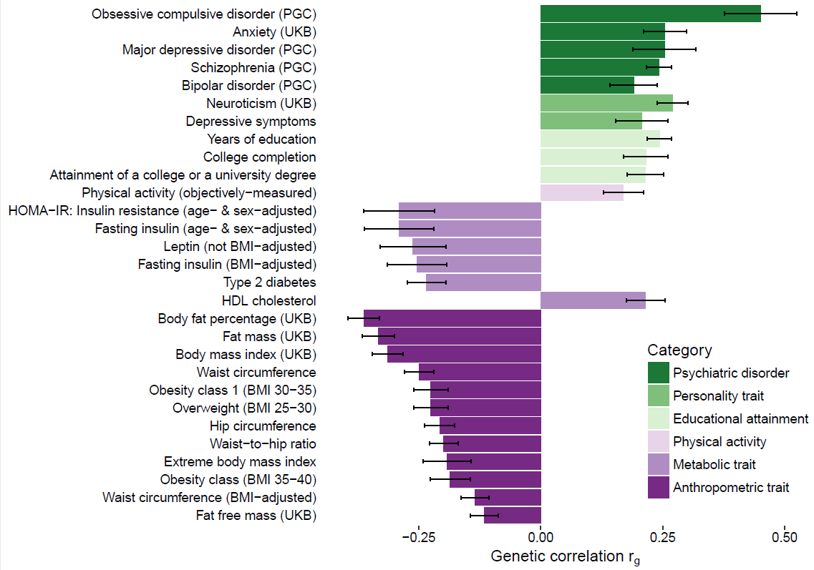
Significant genetic correlations (SNP-Rg) and 95% confidence intervals (error bars) between anorexia nervosa and traits, as estimated by LD score regression

Slide 73
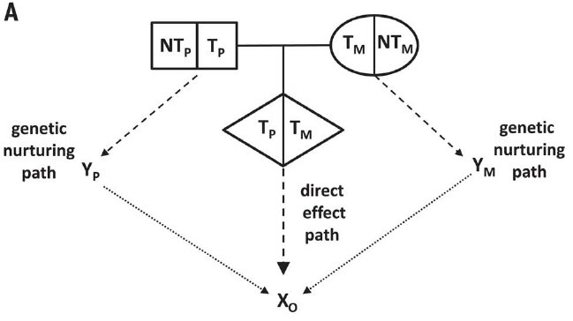
The nature of nurture: Effects of parental genotypes
Augustine Kong ………..Kari Stefansson
Nontransmitted alleles can affect a child through their impacts on the parents and other relatives, a phenomenon we call “genetic nurture.” Using results from a meta-analysis of educational attainment, we find that the polygenic score computed for the nontransmitted alleles of 21,637 probands with at least one parent genotyped has an estimated effect on the educational attainment of the proband that is 29.9% (P = 1.6 × 10⁻¹⁴) of that of the transmitted polygenic score.

Slide 74

Detection and interpretation of shared genetic influences on 42 human traits
Joseph K Pickrell, Tomaz Berisa, Jimmy Z Liu, Laure Ségurel, Joyce Y Tung & David A Hinds.
Nature Genetics 48; 709–717, 2016
Powerful GWAS for traits A and B can help determine direction of causation

Slide 76
Manhattan plot of the 25OHD (vitamin D) GWAS in the UK Biobank: n=417,580, 143 loci
John McGrath

Slide 77


Bidirectional Generalized Summary data level Mendelian Randomization (GSMR) between 25 hydroxyvitamin D concentrations and selected phenotypes
John McGrath

Slide 78
Pushing power to the limit
Search for rare variants

Slide 79
Led by Goncalo Abecasis, Manuel Ferreira @ Regeneron Inc – ex Boulder

Slide 80

We also run two journals (1)
Executive Editor: John K Hewitt
Managing Editor: Christina A Hewitt
Publisher: Springer Nature
http://www.bga.org

Slide 81

Editor: Nick Martin
Publisher: Cambridge University Press
Fully online
Fast turnaround
First submission free to workshop participants!!!!!☺

Slide 82


Slide 83


Slide 84

Egmond aan Zee, October 8, 2004

Slide 85


Slide 86


Slide 87


