Slide 1
Data QC / cleaning in
Genome-Wide Association Studies (GWAS)
2023 Statistical Genetics workshop
Presenter: Daniel Howrigan
Data group leader – Neale Lab (MGH, Broad Institute)
Slides adapted from previous workshop presenters:
Lucia Colodro Conde (QIMR), Katrina Grasby (QIMR), Shaun Purcell (HMS)
With help from:
John Kemp (University of Queensland) and Daniel Gustavson (IBG)

Slide 2
Session Outline – genetic data QC
Lecture portion (~40 minutes)
  Goals of GWAS
  What does genetic data look like?
  GWAS Quality Control (QC)
Practical portion (~40 minutes)
  Viewing genotype data
  Sample and SNP QC
  Relatedness checking
  Principal components analysis (PCA)

Slide 3
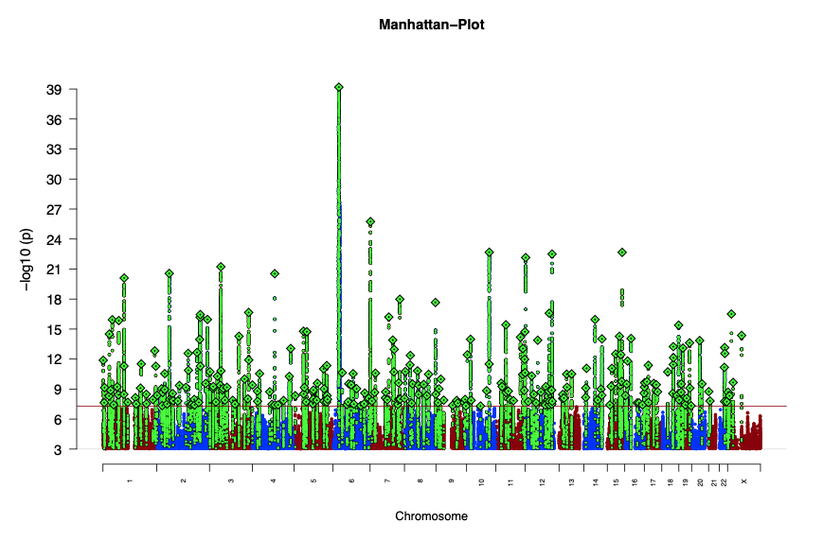

Goals of Genome Wide Association Studies
GWAS of Schizophrenia
Go from trait heritability towards biological mechanism
  What genes/genetic variants drive heritable differences?
Genome-wide interrogation
  Moving away from candidate gene studies
  Technological advancement and dropping cost
Flexible application of study design
  All heritable traits can be studied
  Biological/mathematical properties of DNA quite robust
GWAS of ~4,200 traits

Slide 4
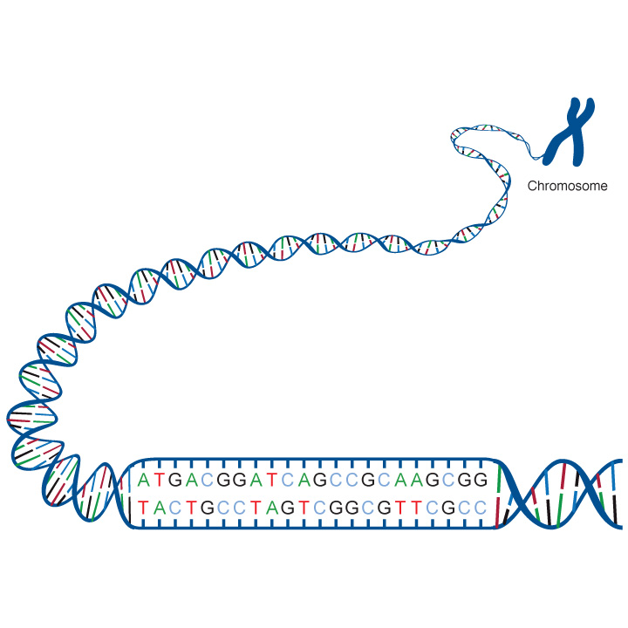
What does genetic data look like?
Single Nucleotide Polymorphism
SNP
Maternal Chromosome
Paternal Chromosome
Allele 1 = C
Allele 2 = A
Bi-allelic combinations = C/C, C/A, A/A
adenine (A), thymine (T), cytosine (C), guanine (G)
Genetic variation: differences in the sequence of DNA among individuals.
Mutation: a newly arisen variant

Slide 5
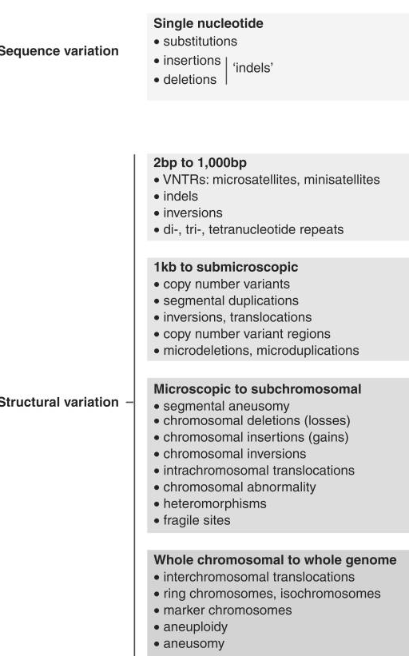
Examples of genetic variation
GWAS

Slide 6
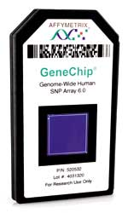
Genotyping on a chip
Affymetrix:
Illumina:
6.0 chip
Human1M BeadChip
>900,000 SNPs
CNV probes
82% coverage CEU HapMap
Accuracy 99.90%
>1 million SNPs
CNV probes
95% coverage CEU HapMap
Accuracy 99.94%
Notes:
from ~$300 USD/sample (=~200 euros)

Slide 7
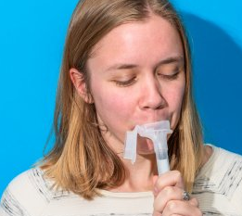
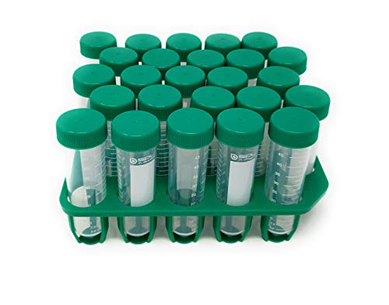

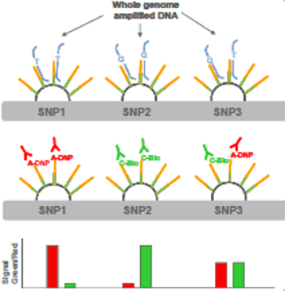
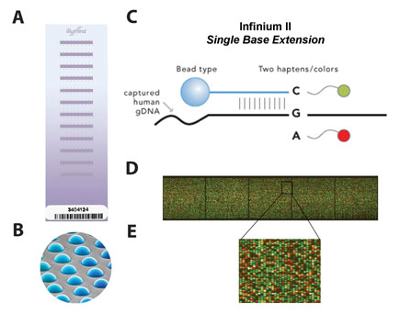
From DNA to data
Notes:
Barcoded spit kit; Manifest with ID details; Rack of tubes; Extract DNA; Aliquot some for archive, some for use; Plate some for SNP array.
SNP array beads have probes to locate genomic position; designed to fluoresce if next nucleotide is a specific base;

Slide 8
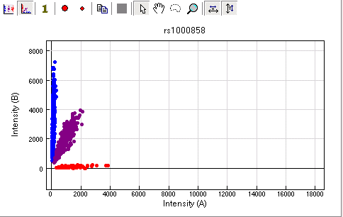
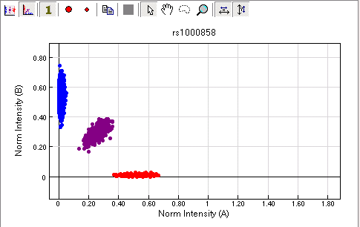
Good SNP (Illumina chip example)
Raw Intensity
Normalized Intensity
T/T
T/T
T/G
T/G
G/G
G/G
Each dot is an individual genotype
Notes:
Images from http://www.genome.gov/25522004 (6th talk)

Slide 9
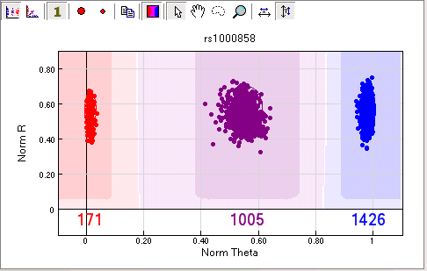
Same SNP, different view
Overall Intensity
AA
aa
Aa
Angular position
Notes:
Shaded areas would be called.

Slide 10
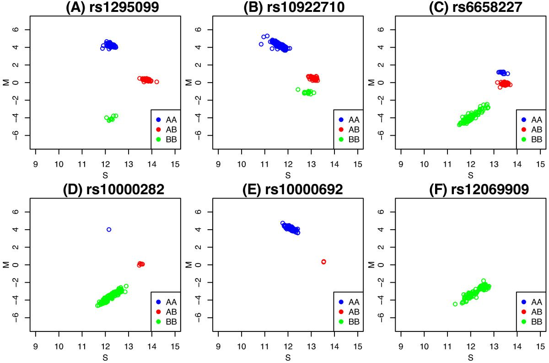
SNPs with different allele frequencies
High MAF
MAF = Minor Allele Frequency
AA
“Common SNPs” = MAF > 5%? 1%? 0.1?
“Low Frequency SNPs” = MAF < 1%
“Ultra-rare variants” = MAF < 1e5 (1 in 100k)
AB
BB
Less common MAF
Monoallelic in the sample
Notes:
Colour intensity read into genotyping code (a, c, t, g).
Top row: Ideally 3 clusters, e.g. AA AG GG; Overlap between clusters leads to missing genotype calls; If failed genotypes are biased to one allele it will biased estimates of frequencies.
Bottom row: Rare alleles; Monomorphic; Error in allele calling.
While image files are provided by genotyping company, the first genotyping quality steps are done by the genotyping company and a report returned with the genotyped data.

Slide 11
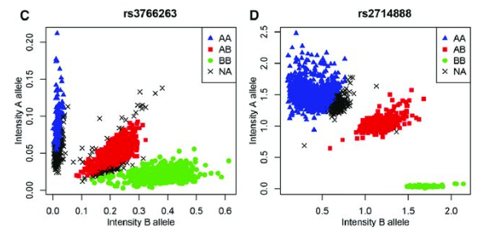
Bad SNP call examples
homalt
A2/A2
A1/A2
het
homref
A1/A1
Notes:
Colour intensity read into genotyping code (a, c, t, g).
Top row: Ideally 3 clusters, e.g. AA AG GG; Overlap between clusters leads to missing genotype calls; If failed genotypes are biased to one allele it will biased estimates of frequencies.
Bottom row: Rare alleles; Monomorphic; Error in allele calling.
While image files are provided by genotyping company, the first genotyping quality steps are done by the genotyping company and a report returned with the genotyped data.

Slide 12
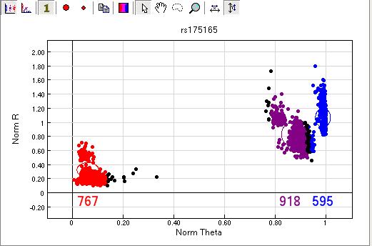
Bad SNP

Slide 13
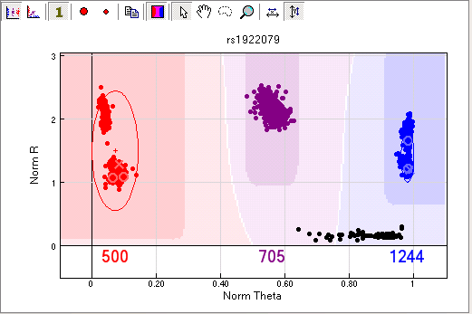
Another bad SNP
Duplications?
Deletion?

Slide 14
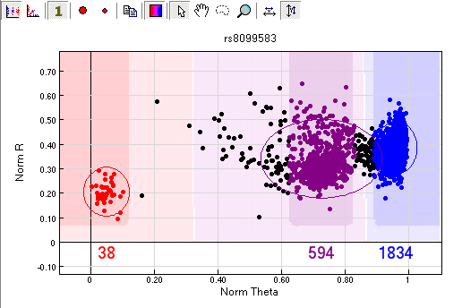
Another bad SNP

Slide 15
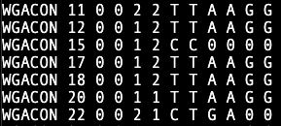
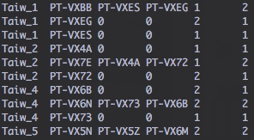
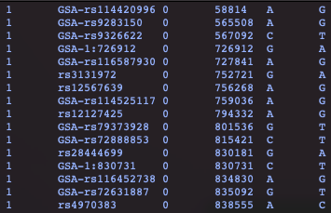
PLINK data format of GWAS data
Samples
Genetic variants
Genotype data
.fam file
.bim file (or .map file)
.ped file
FID IID PID MID SEX AFF
CHR SNP ID CM POS A1 A2
compression
.bed file
FID = family ID
IID = Individual ID
PID = paternal ID
MID = maternal ID
AFF = affection status
1 = control
2 = case
-9 or 0 = unknown
0101010010101010101
1010011101010101010
1101110101001010101
1101001011101101010
1101010101010111010
CHR = chromosome
POS = position
CM = Centimorgan (often unused)
A1 = 0 allele
A2 = 1 allele

Slide 16
GWAS QC

Slide 17
GWAS Quality Control (QC)
GOAL: Remove bad samples/SNPs, keep good samples/SNPs
Preliminary strategies (first pass)
  Poorly genotyped samples / SNP markers
  Potential genotype/phenotype mismatches
  Deviation away from expected heterozygosity
  Related or duplicated samples (population-based data)
Follow-up strategies
  Batch effects
  Quality differences between datasets
  Comparison with reference data
  …and more

Slide 18
Sample QC
Poorly genotyped individuals
  Poor quality DNA (high number of failed SNP calls)
  Contaminated DNA (unusual levels of heterozygosity)
Reporting error
  Indications of sample mix-up (sex check or ancestry match)
Related individuals
  Family-based and population-based samples require different experimental designs
  Related individuals can bias test statistics across the whole-genome
  In family-based association: Mendelian errors used as QC

Slide 19
SNP QC
Poorly genotyped SNPs
  Poor primer design / nonspecific DNA binding (high number of failed SNP calls)
  Poor clustering of genotype intensities (deviation from HWE)
  Mendelian errors (if family-based data available)
  Uninformative SNPs (too rare or mono-allelic)
Follow-up on association signals
  No QC protocol will eliminate all instances of genotyping error
  Re-analyze original intensity of significant associations (whenever possible)
  For meta-analysis, examining heterogeneity of SNP effect

Slide 20
Preliminary QC steps
SAMPLE: Sex-check (chr X heterozygosity)
SNP: Genotyping Call Rate (genotypes missed in individuals)
SAMPLE: Sample Call Rate (individuals missing genotypes)
SNP: Hardy-Weinberg Equilibrium
SAMPLE: Proportion of Heterozygosity
SAMPLE/SNP: Mendelian errors
SAMPLE: Genetic Relatedness
Notes:
Sex check compares sex of ped file with sex from genotype
Heterozygosity: excessive ~ DNA contamination, reduced ~ inbreeding
Order of QC will affect how many people or SNPs are kept/dropped

Slide 21
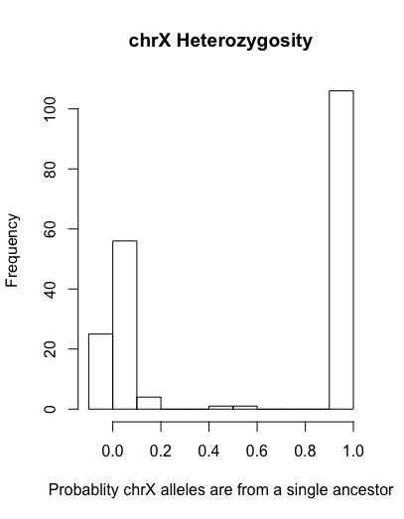
Confirming genetic sex
Primary question: Is the sample-level data correctly matching the SNP data?
Female sex = XX
Male sex = XY
Example .sexcheck file from PLINK (male=1, female=2)
Male
FID IID PEDSEX SNPSEX STATUS F
T304 T30411 1 1 OK 0.9857
A0641C 06410021C 1 1 OK 0.9841
T06013 T2601310 2 2 OK -0.06164
T01533 T2153321 1 1 OK 0.9841
T330 T33021 1 1 OK 0.9867
T191 T19120 2 2 OK 0.01155
T329 T32911 1 1 OK 0.9839
T07981 T2798111 1 1 OK 0.9822
A0601C 06010021C 1 1 OK 0.9858
A1008C 10080011C 1 1 OK 0.9817
A0880C 08800331C 1 1 OK 0.9818
T00894 T2089420 2 2 OK 0.01927
A0701C 07010011C 1 1 OK 0.9807
T02911 T2291121 1 1 OK 0.9851
T00588 T2058811 1 2 PROBLEM -0.3396
A0805C 08050031C 1 1 OK 0.9821
T07755 T2775520 2 2 OK -0.09906
T03676 T2367611 1 1 OK 0.9845
T082 T08220 2 1 PROBLEM 0.9833
Female
Chromosome X F-statistic

Slide 22
SNP genotyping call rate (“missingness”)
Bad SNP design, poor clustering…
Example .lmiss file from PLINK
Usually done iteratively
  Remove SNPs with < 95% call rate
  Run sample QC
  Remove SNPs with < 98% call rate
For case/control data
  Look at difference in genotyping rate
  Threshold usually at > 2% call rate difference
CHR SNP N_MISS N_GENO F_MISS
1 rs12565286 6 200 0.03
1 rs12124819 8 200 0.04
1 rs4970383 0 200 0
1 rs13303118 0 200 0
1 rs35940137 0 200 0
1 rs2465136 1 200 0.005
1 rs2488991 0 200 0
1 rs3766192 0 200 0
1 rs10907177 0 200 0
Example .missing file from PLINK
CHR SNP F_MISS_A F_MISS_U P
1 rs12565286 0.03125 0.03093 1
1 rs12124819 0.05208 0.03093 0.4974
1 rs2465136 0 0.01031 1
1 rs4970357 0 0.02062 0.4974
1 rs11466691 0 0.01031 1
1 rs11466681 0.01042 0.01031 1
1 rs34945898 0.03125 0 0.1211
1 rs715643 0.05208 0.02062 0.2787
1 rs13306651 0.01042 0.03093 0.6211

Slide 23
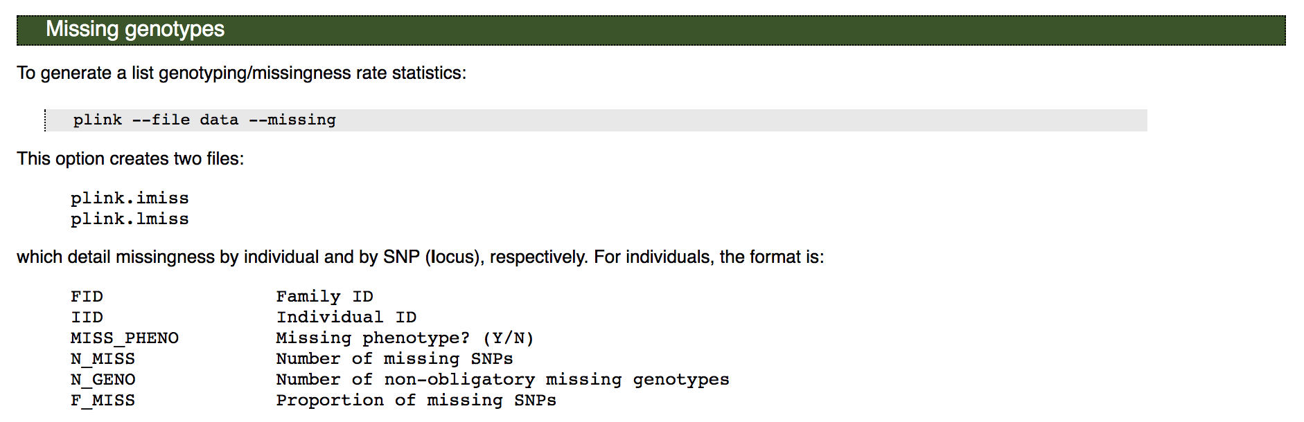
Sample genotyping call rate
Example .imiss file from PLINK
Low quality DNA, degradation, lab error, contamination
FID IID MISS_PHENO N_MISS N_GENO F_MISS
NA20505 NA20505 N 122 100310 0.001216
NA20504 NA20504 N 1406 100310 0.01402
NA20506 NA20506 N 204 100310 0.002034
NA20502 NA20502 N 847 100310 0.008444
NA20528 NA20528 N 219 100310 0.002183
NA20531 NA20531 N 96 100310 0.000957
NA20534 NA20534 N 338 100310 0.00337
NA20535 NA20535 N 182 100310 0.001814
NA20586 NA20586 N 214 100310 0.002133
http://zzz.bwh.harvard.edu/plink/summary.shtml#missing

Slide 24
Hardy-Weinberg Equilibrium (HWE)
A genetic variant is said to be in HWE if the genotype proportions can be predicted by the allele frequencies in the following way:
  If:
    f(A1) = p
    f(A2) = q
  Then:
    f(A1/A1) = p²
    f(A1/A2) = 2pq
    f(A2/A2) = q²
Example:
p = 0.2
q = 0.8
p2 = 0.04
2pq = 0.32
q2 = 0.64
In C/T SNP terms:
C allele freq. = 20%
T allele freq.= 80%
C/C freq. = 4%
C/T freq. = 32%
T/T freq. = 64%
p + q = 1
p² + 2pq + q² = 1

Slide 25
Testing for deviation from HWE
Deviations from HWE can be caused by:
  Non-random mating (inbreeding, assortative mating, …)
  Population stratification
  Mutation
  Limited population size
  Random genetic drift
  Gene flow
  Genotyping errors
  Selection (→ may be due to true association!)
So only extreme deviation from HWE (p < 10⁻⁶) is worrisome.
Example .hardy output in PLINK
CHR SNP TEST A1 A2 GENO O(HET) E(HET) P
1 rs12565286 ALL C G 0/17/170 0.09091 0.08678 1
1 rs12565286 AFF C G 0/6/87 0.06452 0.06243 1
1 rs12565286 UNAFF C G 0/11/83 0.117 0.1102 1
1 rs12124819 ALL G A 0/77/108 0.4162 0.3296 6.919e-05
1 rs12124819 AFF G A 0/41/50 0.4505 0.3491 0.004878
1 rs12124819 UNAFF G A 0/36/58 0.383 0.3096 0.02001
1 rs4970383 ALL A C 10/68/115 0.3523 0.352 1
1 rs4970383 AFF A C 3/36/57 0.375 0.3418 0.5488
1 rs4970383 UNAFF A C 7/32/58 0.3299 0.3618 0.401
Notes:
It is important to understand that in real populations, one or more of these "disturbing influences" are always in effect. That is, Hardy–Weinberg equilibrium is an ideal state that provides a baseline against which change can be analyzed.
Experience shows that SNPs with many genotyping errors show significant deviations from HWE.
It’s easier though to set liberal thresholds for exclusions and examine SNPs that show strong signals one by one closely than excluding all SNPs out of HWE, while they might be associated with the disease of interest.
Examining nearby correlated SNPs on how they do on the HWE test may also be a good way to check whether the deviation from HWE is due to genotyping error.

Slide 26
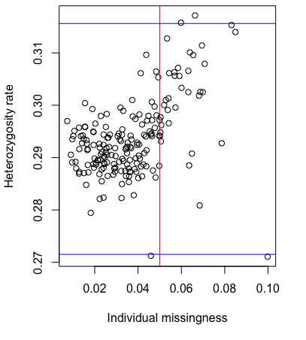
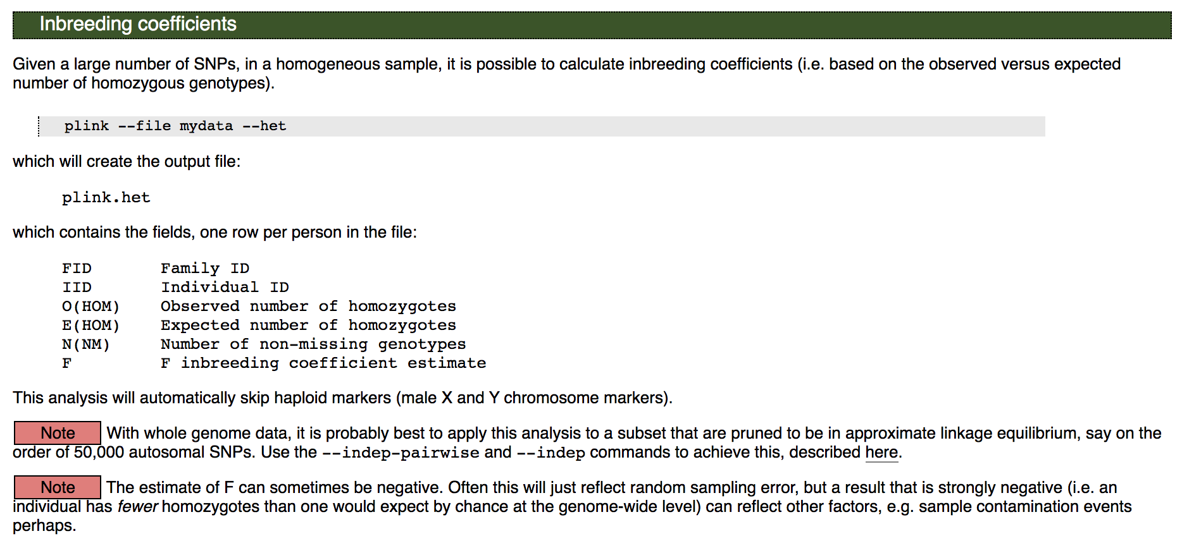
Proportion of heterozygosity (Fhet)
http://zzz.bwh.harvard.edu/plink/ibdibs.shtml#inbreeding

Slide 27
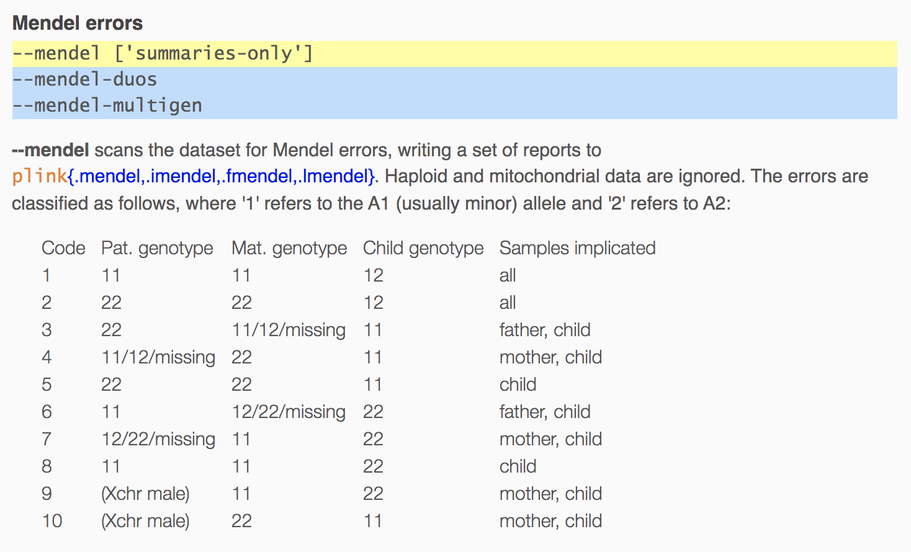
Mendelian errors
Requires parent-offspring data
Similar to genotyping rate, can be examined at sample and SNP level
High sample-level mendel error rate
  Parental uncertainty
High SNP-level mendel error rate
  Poor genotype quality
AA
AA
AT
https://www.cog-genomics.org/plink/1.9/basic_stats#mendel
de novo mutation is a type of mendelian error

Slide 28
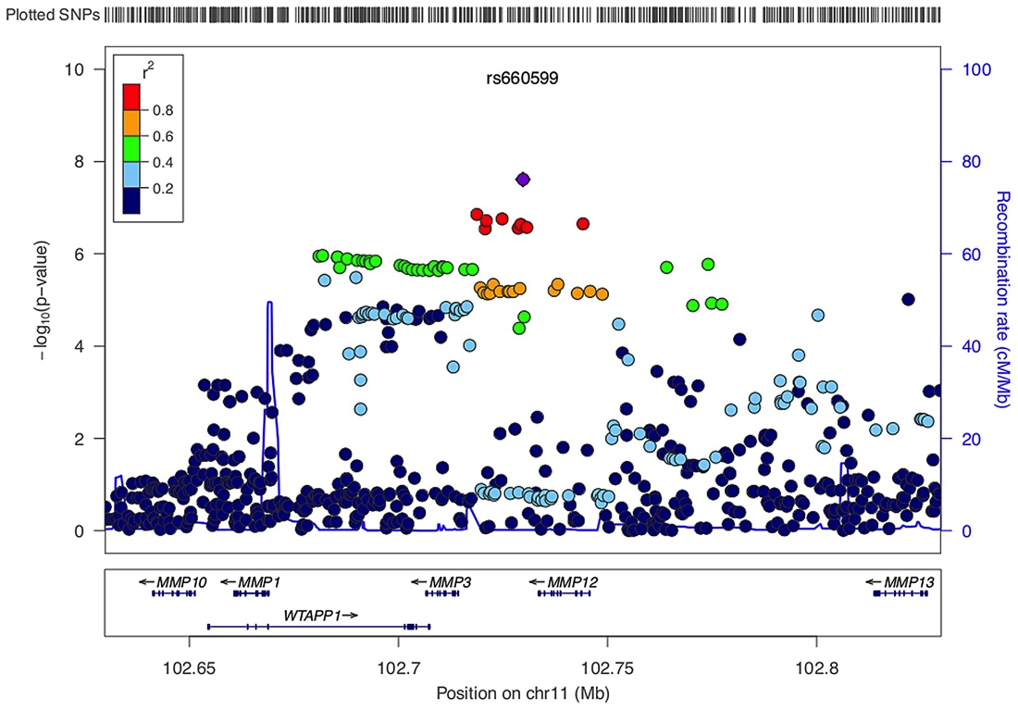
Linkage disequilibrium (LD) allows us to be more robust with our QC protocols
TL/DR: “Nearby SNPs are correlated”
Properties of linkage disequilibrium reduce the loss of signal sensitivity when removing SNPs
Strict multiple testing correction often requires very large samples - no single sample will drive a signal
LD must be taken into account when examining genetic relatedness, population stratification, and interpreting association

Slide 29
Genetic relatedness using Identity-By-Descent (IBD) calculation
Question: How much does a pair of samples share 0, 1, or both alleles?
Identical twins: Shares both alleles across entire genome (barring mutation events)
Requires using LD-pruned SNPs for accurate estimates
  Want each SNP to be an “independent” marker
Used to both “confirm” and “filter” related individuals

Slide 30
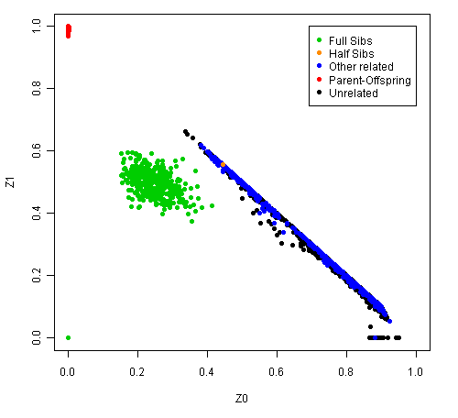
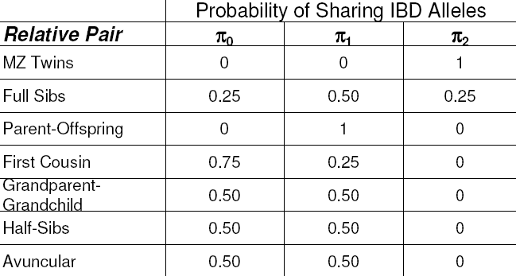
Checking genotype relatedness across samples
Example of .genome file in PLINK
FID1 IID1 FID2 IID2 RT EZ Z0 Z1 Z2 PI_HAT PHE DST PPC RATIO
NA20505 NA20505 NA20506 NA20506 UN NA 0.9872 0.0000 0.0128 0.0128 -1 0.771435 0.3446 1.9712
NA20505 NA20505 NA20502 NA20502 UN NA 0.9888 0.0096 0.0016 0.0064 -1 0.770233 0.3950 1.9808
NA20505 NA20505 NA20528 NA20528 UN NA 0.9733 0.0267 0.0000 0.0133 -1 0.770068 0.2922 1.9606
NA20505 NA20505 NA20531 NA20531 UN NA 0.9789 0.0205 0.0006 0.0109 -1 0.770976 0.7407 2.0479
NA20505 NA20505 NA20534 NA20534 UN NA 0.9602 0.0398 0.0000 0.0199 -1 0.772123 0.3046 1.9631
NA20505 NA20505 NA20535 NA20535 UN NA 0.9650 0.0350 0.0000 0.0175 -1 0.771054 0.6510 2.0285
NA20505 NA20505 NA20586 NA20586 UN NA 0.9728 0.0272 0.0000 0.0136 -1 0.770687 0.4281 1.9869
NA20505 NA20505 NA20756 NA20756 UN NA 0.9675 0.0325 0.0000 0.0163 -1 0.770762 0.6902 2.0365
NA20505 NA20505 NA20760 NA20760 UN NA 0.9344 0.0656 0.0000 0.0328 0 0.770978 0.8856 2.0904

Slide 31
Using genetic relatedness estimates
Confirm unrelated or “population-based” sample ascertainment
  Filter out related samples (pi-hat > 0.2 often used)
  “Cryptic relatedness” – related individuals identified in ”unrelated” sample
Confirm family structure (pedigree)
  Ensure parent-child and sibling relationship
Watch out for distinct ancestries
  Can skew IBD estimates and incorrectly identify recent relatedness
  PCrelate more robust to these patterns https://rdrr.io/bioc/GENESIS/man/pcrelate.html

Slide 32
Session Outline – genetic data QC
Practical portion (~40 minutes)
  Data checking
  Sample and SNP QC
  Relatedness checking
  Principal components analysis (PCA)
Go to: workshop.colorado.edu
  Slides + practical: /faculty/daniel/2023/QC
  Terminal: workshop.colorado.edu/ssh
  Rstudio: workshop.colorado.edu/rstudio

Slide 33
Script that you will be working through:
QC_practical_statgenWorkshop2023.txt
Full path: /faculty/daniel/2023/QC/QC_practical_statgenWorkshop2023.txt
Walk through this script and copy/paste commands to the ssh command line
Qualtrics version: https://ucsas.qualtrics.com/jfe/form/SV_eWpdYL7srw7Cy6W
Answers to be filled out by a single table member
See the ISGW forum for these and other useful links to start your practical session:
https://isgw-forum.colorado.edu/

Slide 34
# 1.1 Creating workspace
## Create day1 subdirectory (-p creates full path into new directories)
mkdir -p ~/day1/QC
## traverse into new subdirectory
cd ~/day1/QC
# 1.2 Copying over genetic dataset
# Copy the files to your working subdirectory
cp /faculty/daniel/2023/QC/* .
# Check you have the required files:
ls -l
# HM3.bed
# HM3.bim
# HM3.fam
# QC_practical_BoulderWorkshop2023.R
# QC_practical_BoulderWorkshop2023.sh
# QC_practical_BoulderWorkshop2023.txt
# cc.ped
# cc.map

Slide 35
## === Main QC ===
# STEP 1. Data and Formats
# STEP 2. Check for reported/genotype sex discrepancies
# STEP 3. Obtain information on individuals missing SNP data
# STEP 4. Variant QC: SNPs missing data; MAF; Hardy-Weinberg
# STEP 5. Sample QC: genotype call rate and heterozygosity
# STEP 6. LD-pruned SNP set
# STEP 7. Sample QC: sex check filtering using LD-pruned SNP set
# STEP 8. Sample QC: Checking for cryptic relatedness

