Slide 1
Day 2
Optional GWAS Practical
Luke Evans & Wei Zhou
Practical originally developed by Katrina Grasby and Lucía Colodro Conde
Questions: Please ask! You can also use the Q&A box under “Common & rare association”
Learning Goals:
1. Run a GWAS using real data
2. Familiarize yourself with the standard types of output form a GWAS
3. Practice using the command line
4. Improve your familiarity plink2, a common tool in genetics (beyond GWAS, too)
5. Interpret why peaks form in a Manhattan plot, and how to explore the genome around associated loci
There are 3 exercises in the practical.
  If you don’t finish, that’s OK – these resources are there for you to practice & use as you’re working through your own data.
  There are questions throughout the instructions – take some time to either look for the answer (e.g., in the output) or consider what the answers/results are telling you (e.g., why does a q-q plot look a certain way?)

Slide 2
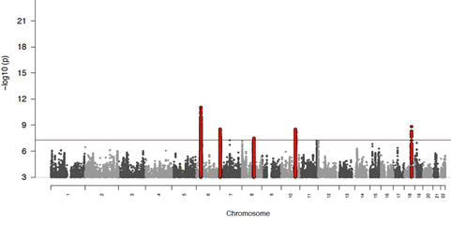
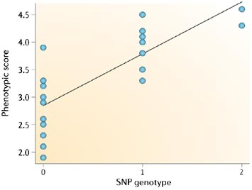
Recap of GWAS from yesterday
What is this line?
What does it represent?

Slide 3
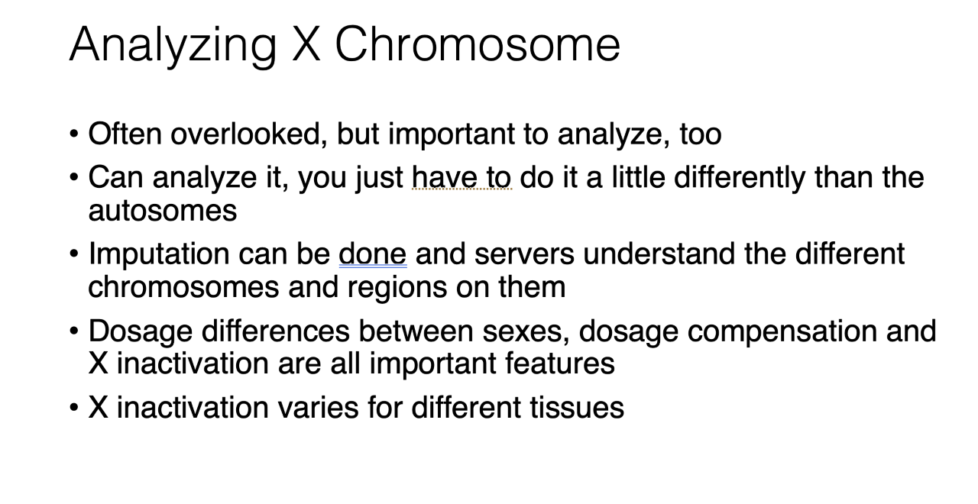
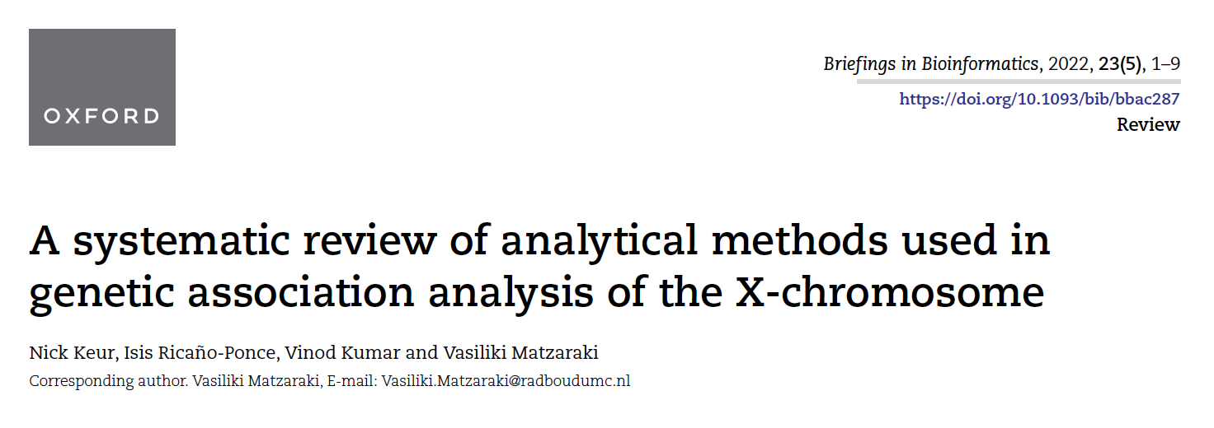
More to come later (Medland)

Slide 4
Quantitative traits
Common variants
Rare variants
Related samples
Related samples
YES
NO
YES
NO
PLINK
Large sample (N > 10,000)
Large sample (N > 10,000)
SKAT
NO
NO
YES
SMMAT
EmmaX-SKAT
SAIGE-GENE/SAIGE-GENE+
Regenie v3
STAAR
GCTA
GMMAT
GEMMA
BOLT-LMM
SAIGE
fastGWA
Regenie

Slide 5
Binary traits
Common variants
Rare variants
Related samples
Related samples
YES
NO
YES
NO
Case: control < 1:10
Case: control < 1:10
Case: control < 1:10
Case: control < 1:10
YES
NO
YES
NO
SAIGE
fastGWA-GLMM
Regenie
PLINK –glm
SPAtest (fast)
PLINK –glm firth (slow)
NO
YES
NO
YES
SAIGE-GENE+
Regenie v3
SKAT
SKAT binary
GMMAT (slow but good for small sample sizes)
SAIGE
fastGWA-GLMM
Regenie
SMMAT
EmmaX-SKAT
STAAR
SAIGE-GENE+
Regenie v3

Slide 6
There are many tools for GWAS
The most appropriate method depends on the structure of your data: stratification? Relatedness? Sample size? Etc…
Mixed linear models: SAIGE, BOLT-LMM, GCTA, FaST-LMM…
We’re going to use plink2 for today’s practical: fast, simple command line program that is a general workhorse software for managing data and running analyses.
  Original plink ped/map format
  Binary plink format (plink1.9): bed/bim/fam
    Fast, very useful
  Plink2 format: pgen/psam/pvar
    Very fast
    Saves space compared to others
    Can include dosage, phase, INFO (similar to VCF format)

Slide 7
QQ (quantile-quantile) plot
Checks the overall distribution of test statistics or –log10 p-values of our results with the expectation under the null hypothesis of no association (the diagonal line shows where the points should fall under the null).
Evaluates systematic bias and inflation (undetected sample duplications, unknown familial relationships, gross population stratification, problems in QC…).
Observed –log10 (p)
Expected –log10 (p)

Slide 8
Lambda
It is the ratio of the median of the empirically observed distribution of the test statistic to the expected median.
  The expected median of the chi-square distribution with one degree of freedom is 0.455.
  λ = median(χ2)/0.455
It quantifies the extent of the bulk inflation and the excess false positive rate.

Slide 9
Manhattan plot
Plots the -log10 of the association p-value for each SNP against the genomic coordinates.
The strongest associations will have the smallest p-values and the –log10 of these p-values will have the highest height in the plot.

Slide 10
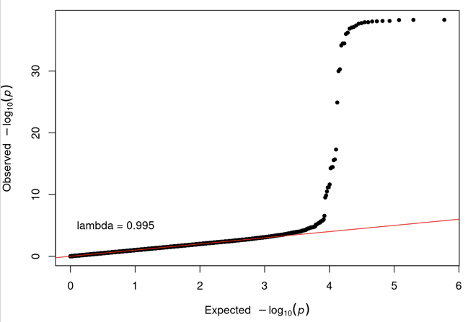
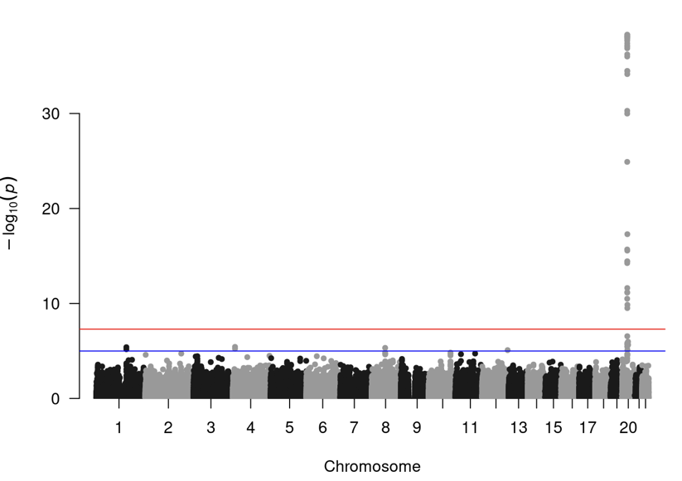
What are these telling us?

Slide 12
And these? What are these telling us?

Slide 13
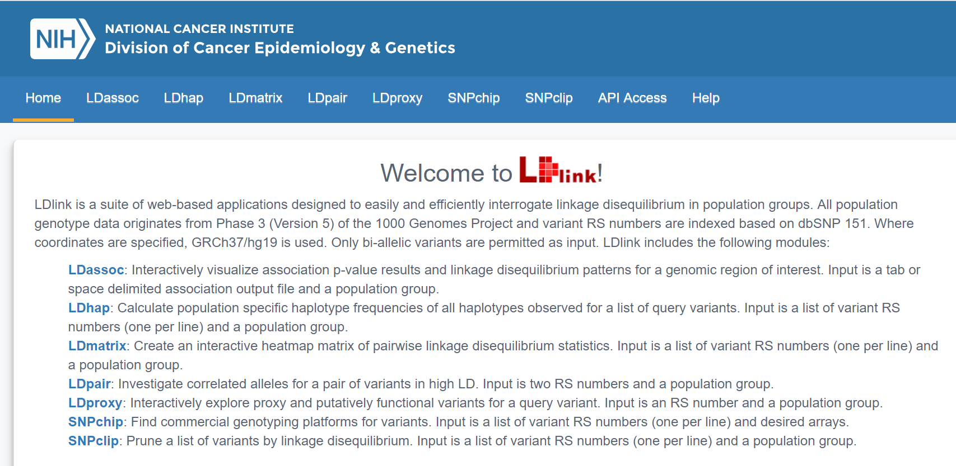
Regional plot
https://ldlink.nci.nih.gov/

Slide 14
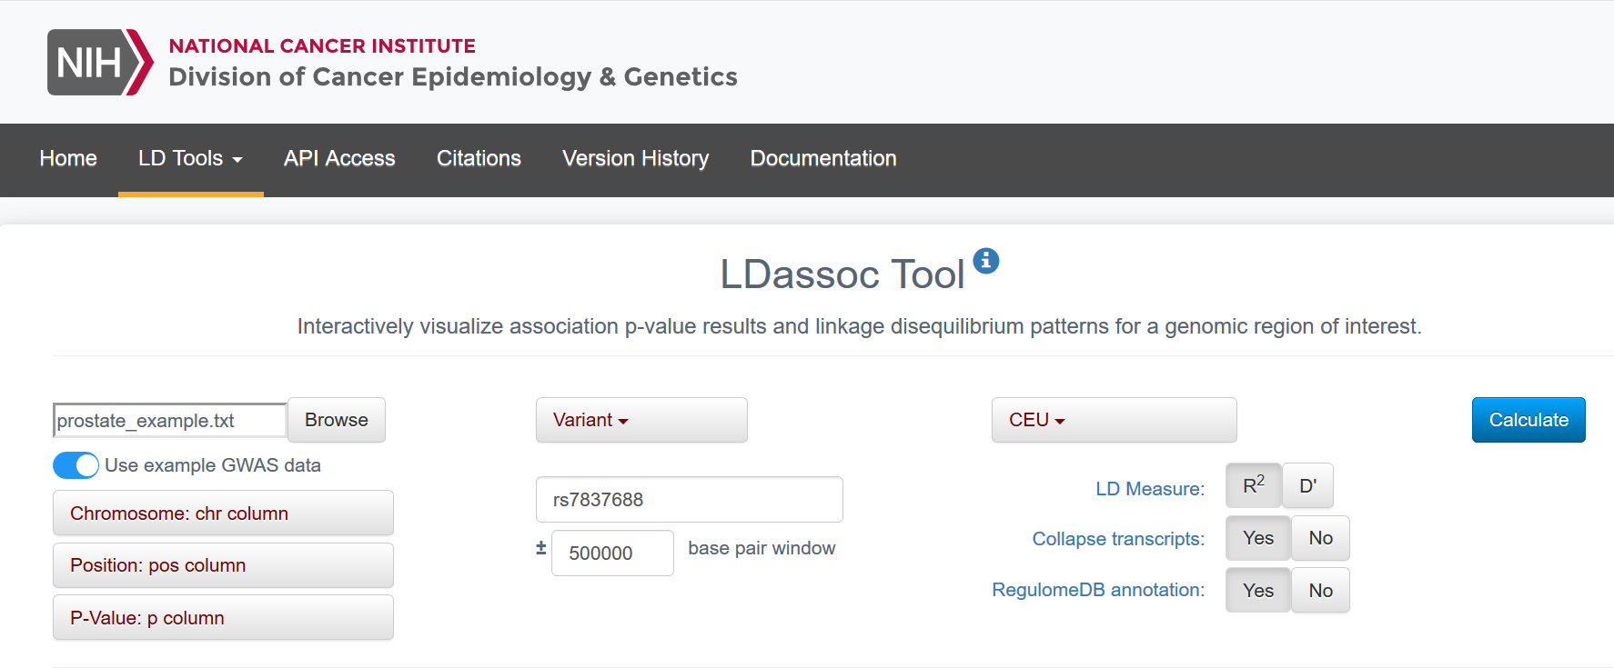

Slide 15
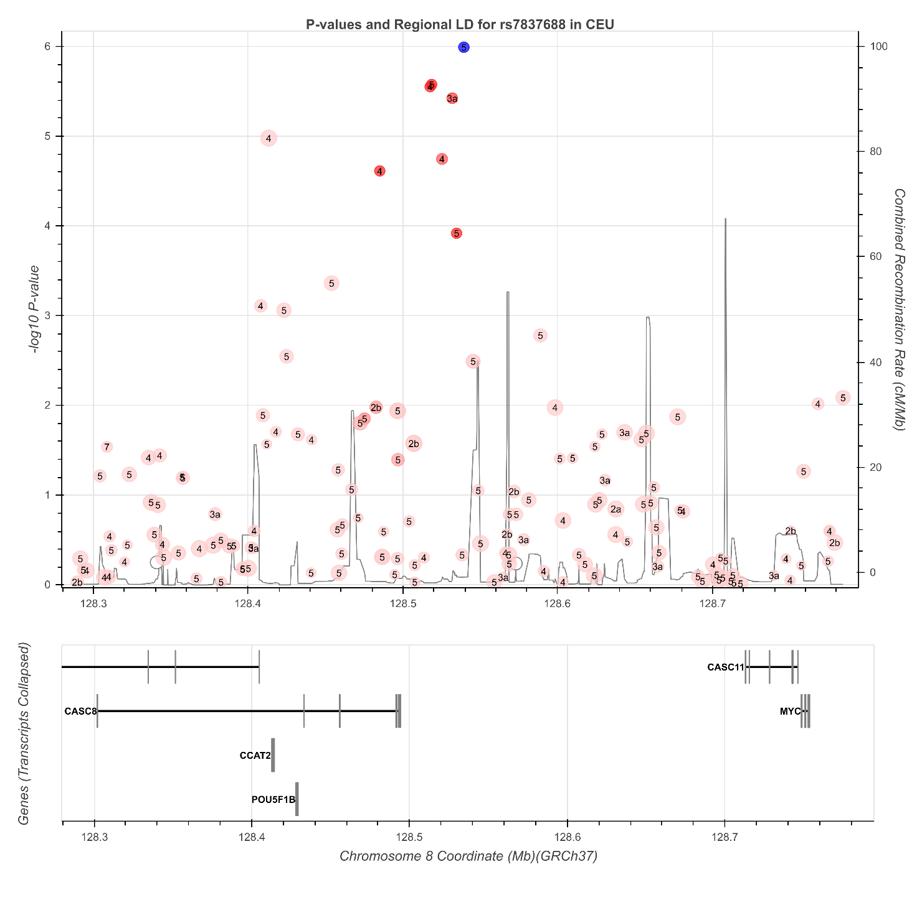

Slide 16
Today’s practical data are freely available from:
Source:
https://med.miami.edu/faculty/amanda-myers-phd
https://xzmxbgsv808roffneicreq.on.drv.tw/www.lfun/LFUN/LFUN/DATA.html

Slide 17
Set up – we’ll go through the first few commands together
We will use the text editor, the terminal, R Studio, and the browser.
Copy all the files by typing in your working directory:
cp -r /faculty/luke/2023/gwas2/ ./
The practical is “Day2_GWAS_Practical_INSTRUCTIONS.pdf”, and is available on the file sharing site.
A plain text version is also on the file sharing site
The rubric is “Day2_GWAS_Practical_RUBRIC.pdf”, and is available on the file sharing site.
Some commands in the instructions are missing (indicated with XXX) – it’s up to you & your group to determine what to include there.
Questions are in the instructions – some are about the specific results (what is N?) while others are asking you to think about what the results are telling you (QQ plot look OK?)

