Slide 1
Mendelian randomization: Practical 2
Does BMI causally affect Coronary Heart Disease?
Web utilities and software packages exist to carry out two sample MR analyses quickly and efficiently
This practical is not meant to illustrate the most efficient way to perform an MR study!
This practical is designed to show you what goes on “under the hood” of these black boxes and to get you familiar with some of the data cleaning and interpretation issues when performing two sample Mendelian randomization. We will also get you to run some of the MR sensitivity analyses too.

Slide 2
The Issue of Strand
Evans et al (2021) Behav Genet
SNP1 F (+) A/C ( AA / AC / CC )
SNP1 R (–) G/T ( GG / GT / TT )
SNP2 F (+) C/G (CC / CG / GG)
SNP1 R (–) G/C (GG / CG / CC)
Notes:
Diagram illustrating the concept of “strand” in genome-wide association studies. The figure shows a DNA sequence across eight nucleotides in three individuals for a hypothetical stretch of chromosome 3. Healthy individuals carry two homologous copies of chromosome 3, and so both copies of the chromosome are shown for each individual in this figure. Each chromosome consists of a double stranded linear nucleotide sequence which we have labelled according to the nucleotide base in each position. The top strands in the figure have been labelled as the forward strand, and the complementary reverse strands are labelled immediately below. Note the complementary pairing of bases across forward and reverse strands. Across the nucleotide sequence, we assume that only two sites are polymorphic across the population (labelled SNP1 and SNP2 in the diagram). The SNP at the first polymorphic site is an A/C SNP (if the forward strand is genotyped), or equivalently a G/T SNP (if the reverse strand is genotyped). In other words, if the forward strand is genotyped, individuals can have the genotypes “AA”, “AC” or “CC”. In contrast, if the reverse strand is genotyped then individuals can have genotypes “GG”, “GT” or “TT”. Importantly, if we didn’t know which strand were genotyped a priori we could work this out easily from looking at the genotypes in the sample. The difficulty is in resolving the strand of polymorphisms like the second SNP, which is a C/G SNP on both the forward and the reverse strands. In other words, individuals will have genotypes “CC”, “CG” or “GG” regardless of whether the forward or the reverse strand is genotyped, making it impossible to know which strand were actually genotyped without extra information. Thus for G/C SNPs (and A/T SNPs) it is often difficult to resolve strand in GWAS. This can potentially be very problematic when combining results across different samples in a GWAS meta-analysis and so needs to be done with caution

Slide 3
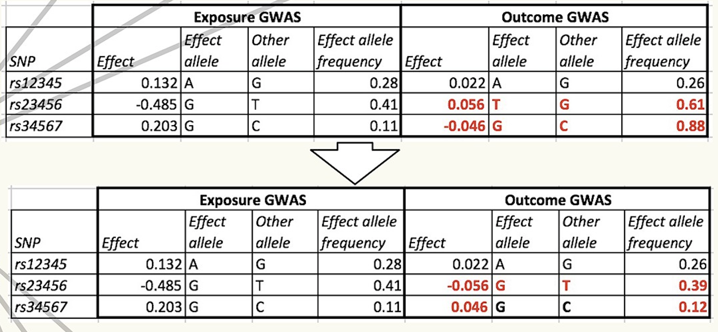
Harmonise exposure and outcome effects

Slide 4
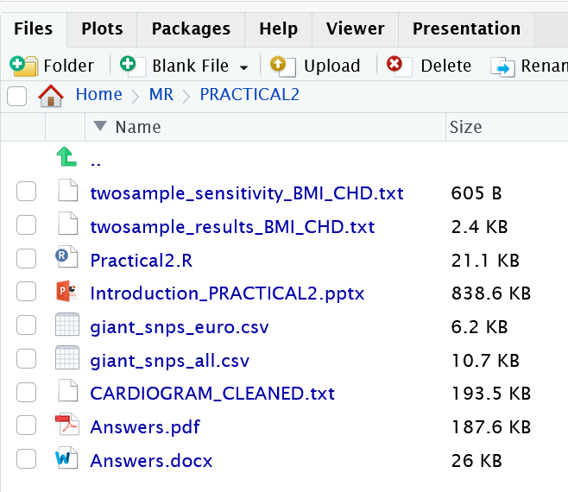
Mendelian randomization: Practical 2
# Use your web browser to navigate to: https://workshop.colorado.edu/rstudio/
#Login with your username and password
#Click on the “terminal” tab. This will take you to a UNIX like environment where you can copy the files over for this session’s #practical exercise
# Now go to your home directory, and move to the directory “MR” you previously created:
cd
cd MR
# Copy the PRACTICAL2 directory from David Evans’ Faculty drive into this directory
cp -r /faculty/davide/BOULDER2023/PRACTICAL2 .
#Move into your newly created PRACTICAL2 directory and print the working directory here
cd PRACTICAL2
pwd
#Instructions, commands and questions for this practical are located in the file Practical2.R
#Click on Practical2.R and it will open up
#Remember to set your working directory at the beginning of the prac in R studio e.g.
setwd("~/MR/PRACTICAL2")

Slide 5
We have limited time!!!
DO NOT FOCUS ON THE SYNTAX!!! (just accept that the code does what it says on the tin- go back later and check/run through)
Run the code in 5 blocks (labelled PART ONE through PART 5)

Slide 6
Sensitivity Analyses- BMI and CHD
parameter estimate se lower_CI upper_CI p_value
1 IVW beta 0.287658553 0.086237732 0.11590122 0.459415882 0.001318512
2 Weighted_median beta 0.379652982 0.117839188 0.08299413 0.554455224 0.005920437
3 Weighted_mode beta 0.311258179 0.129426222 0.05758745 0.564928912 0.018610428
4 MR-Egger beta 0.375935570 0.209803912 -0.04201525 0.793886395 0.077191677
parameter estimate se lower_CI upper_CI p_value
5 MR-Egger alpha -0.002791481 0.006041587 -0.01482694 0.009243978 0.645387108
Results look very consistent!
MR Egger lacks power- so look at coefficient rather than p value!
MR Egger intercept is a test for directional horizontal pleiotropy
Notes:
Answers - summary

