Slide 1
Mendelian randomization: Practical 1
# Use your web browser to navigate to: https://workshop.colorado.edu/rstudio/
#Login with your username and password
#Click on the “terminal” tab. This will take you to a UNIX like environment where you can copy the files over for this session’s #practical exercise
# Now go to your home directory, create a new working directory called “MR”, and move to it
cd
mkdir MR
cd MR

Slide 2
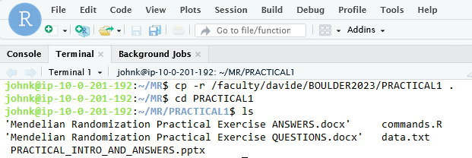
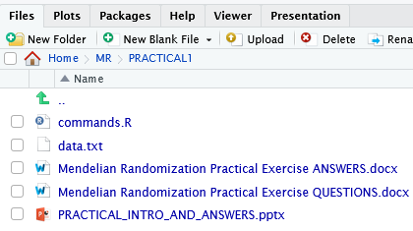
Mendelian randomization: Practical 1
# Copy the PRACTICAL1 directory from David Evans’ Faculty drive into this directory
cp -r /faculty/davide/BOULDER2023/PRACTICAL1 .
#Move into your newly created PRACTICAL1 directory and print the working directory here
cd PRACTICAL1
ls
#You should be able to navigate to the PRACTICAL1 directory using the point and click windows style directory in the lower right-hand half of the R studio server (under the files tab). First click Home, then MR and then PRACTICAL1
#Now load the list of commands you will run for the practical.
Click on the “Commands.R” file and the file will load up in the R Console (Top left)
1
2
3

Slide 3
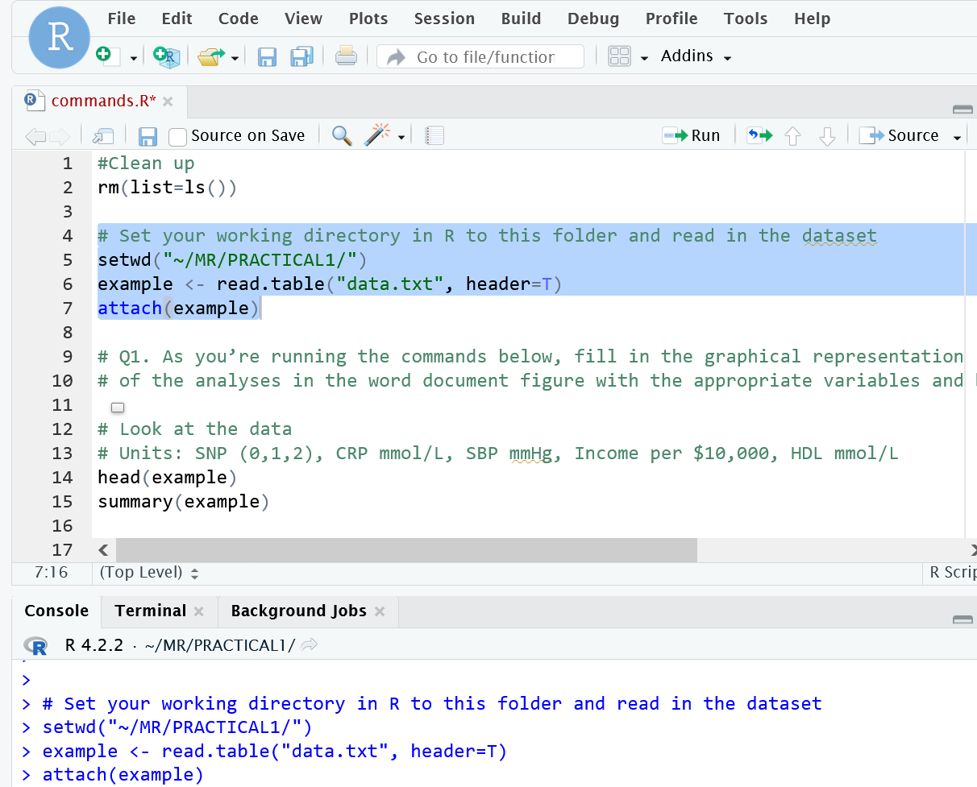
Mendelian randomization: Practical 1
#Change to the “Console” tab which will take you to R.
#Highlight code and Click Run to Clean up, Set your working directory to the PRACTICAL1, and load data
2.
1
3.

Slide 4
Mendelian randomization: Practical 1
Go to bottom right-hand window, and download “Mendelian_Randomization_Practical_Exercise_QUESTIONS.doc” onto your local pc.
Open the file and complete the practical.
#This file also contains R code, but it is recommended to work from the commands.R file that you loaded previously in R studio

Slide 5
Mendelian randomization: Practical 1
Does C-Reactive Protein causally affect Blood Pressure?
Confounders
(Income, HDL)
Observational β_{CRP-SBP} = ???
β_{SNP-INCOME} = ???
β_{SNP-HDL} = ???
X
β_{CRP-INCOME} = ???
β_{CRP-HDL} = ???
β_{INCOME-SBP} = ???
β_{HDL-SBP} = ???
rs3091244
CRP
SBP
β_{SNP-CRP} = ???
β_{CRP-SBP} = ???
β_{SNP-SBP} = ???

Slide 6
Observational β_{CRP-SBP} = 19.1 mmHg/CRP Unit; P < 2x10⁻¹⁶
Confounders
(Income, HDL)
β_{SNP-INCOME} = 0.0014; P = 0.9
β_{SNP-HDL} = 0.0025; P = 0.07
X
β_{CRP-INCOME} = -0.06; P < 2x10⁻¹⁶
β_{CRP-HDL} = -0.57; P < 2x10⁻¹⁶
β_{INCOME-SBP} = -0.93; P < 2x10⁻¹⁶
β_{HDL-SBP} = -28.4; P < 2x10⁻¹⁶
rs3091244
CRP
SBP
β_{SNP-CRP} = 0.04; P < 2x10⁻¹⁶
β_{CRP-SBP} = -2.4 mmHg/CRP Unit; P = 0.5
β_{SNP-SBP} = -0.10; P = 0.47

