Slide 1


Introduction to Mendelian Randomization: Using genes to inform causality
David Evans
Institute for Molecular Bioscience
University of Queensland

Slide 2

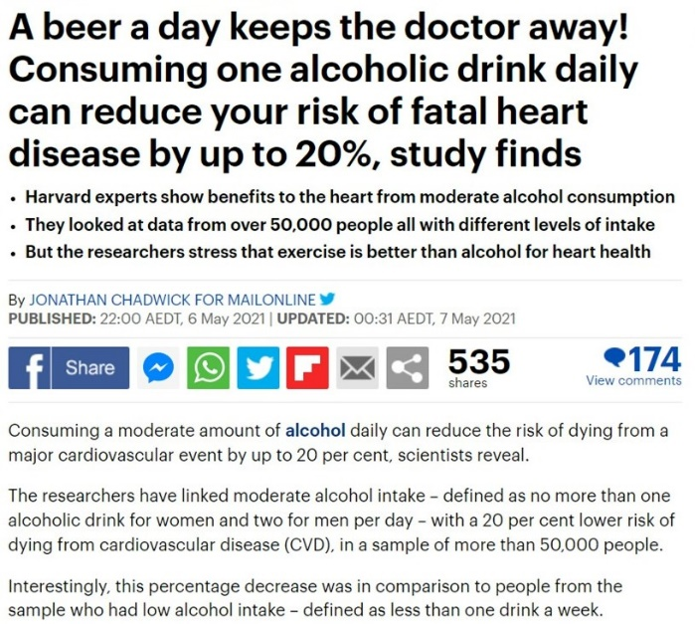

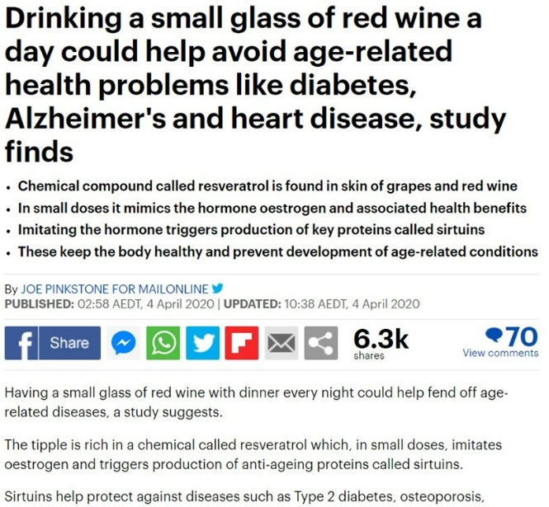

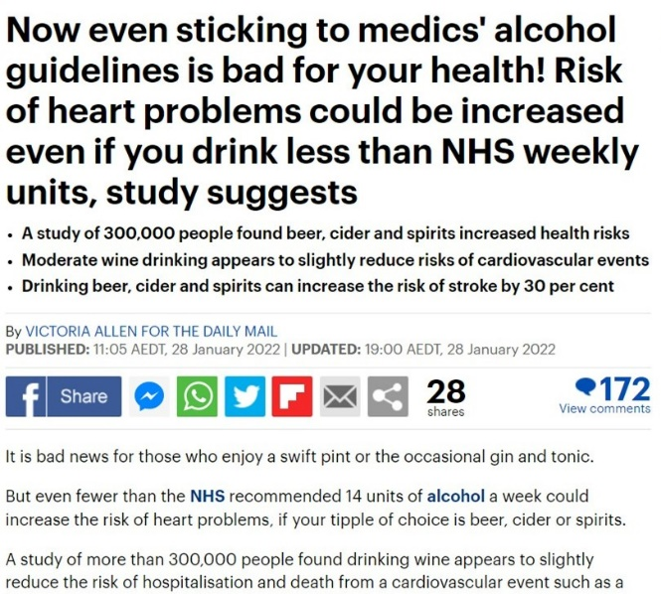
Alcohol and Heart Disease
(A) Alcohol increases risk of heart disease
(B) Alcohol decreases risk of heart disease
(C) No causal relationship
(D) Don’t know

Slide 3
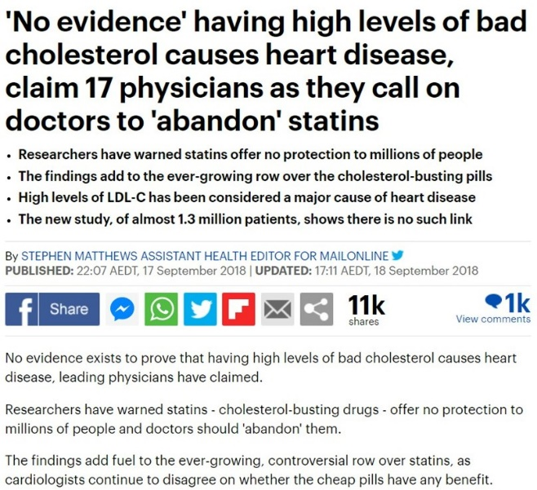
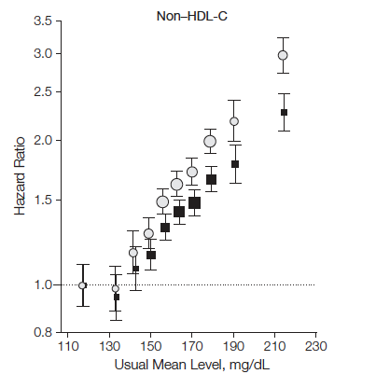
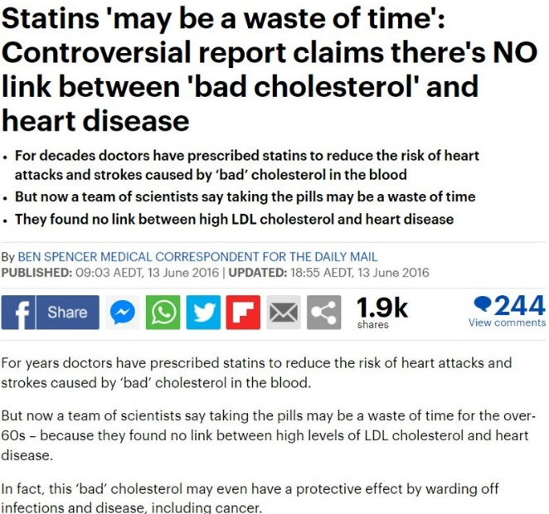
“Bad” LDL Cholesterol and Heart Disease
LDL-C
CHD Hazard Ratio
(A) High LDL decreases risk of heart disease
(B) High LDL increases risk of heart disease
(C) LDL is not causally related to heart disease

Slide 4
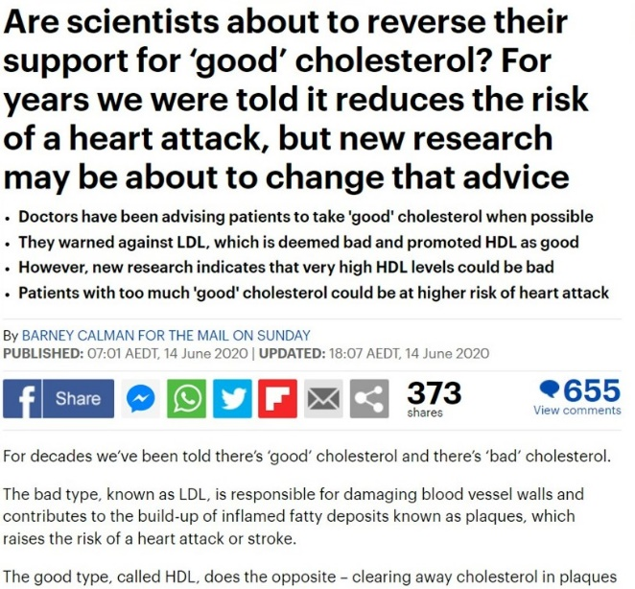
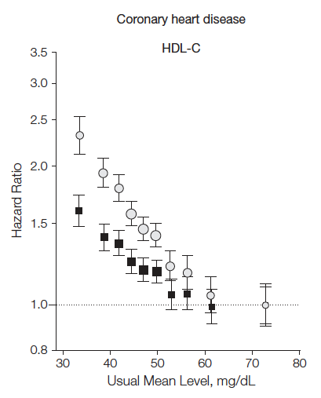
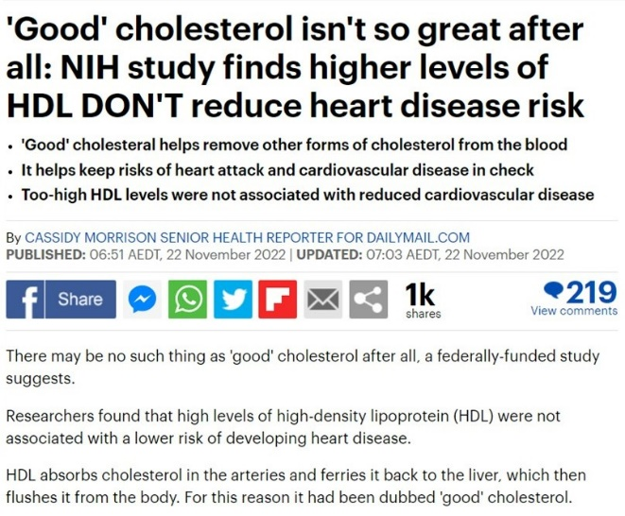
“Good” HDL Cholesterol and Heart Disease
(A) High HDL decreases risk of heart disease
(B) High HDL increases risk of heart disease
(C) HDL is not causally related to heart disease

Slide 5
Problems with inferring causality in observational studies

Slide 6
CHD risk according to duration of current Vitamin E
supplement use compared to no use
RR
Rimm et al NEJM 1993; 328: 1450-6

Slide 7
Use of vitamin supplements by US adults, 1987-2000
Percent
Source: Millen AE, Journal of American Dietetic Assoc 2004;104:942-950

Slide 8
Vitamin E supplement use and risk of Coronary Heart Disease
1.0
Stampfer et al NEJM 1993; 328: 144-9; Rimm et al NEJM 1993; 328: 1450-6; Eidelman et al
Arch Intern Med 2004; 164:1552-6

Slide 9
Many other exaMPLEs vitamin c, vitamin a, HRT, many drug targets…….
What’s the explanation?

Slide 10
Vitamin E levels and confounding risk factors:
Childhood SES
Manual social class
No car access
State pension only
Smoker
Obese
Daily alcohol
Exercise
Low fat diet
Height
Leg length
Women’s Heart and Health Study
Lawlor et al, Lancet 2004

Slide 11
Confounding
Smoking, diet, alcohol, socioeconomic position….
Confounders
Exposure
Outcome
Vitamin E
Heart disease

Slide 12
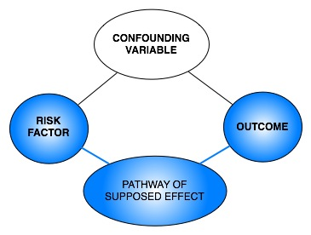
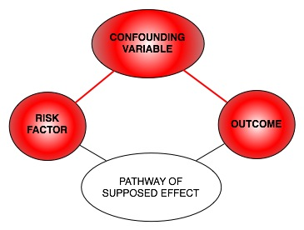
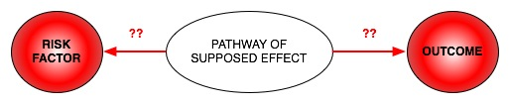
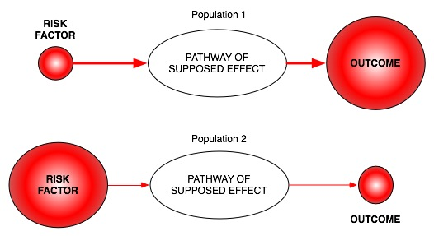
Classic limitations to “observational” science
Confounding
Reverse Causation
Bias

Slide 13
RCTs: the Gold Standard in Inferring Causality
RANDOMISED CONTROLLED TRIAL
Randomization
makes causal inference
possible
RANDOMIZATION METHOD
EXPOSED:
INTERVENTION
CONTROL:
NO INTERVENTION
CONFOUNDERS EQUAL BETWEEN GROUPS
OUTCOMES COMPARED BETWEEN GROUPS
Notes:
Ironic

Slide 14
The Need for Observational Studies
Randomized Controlled Trials (RCTs):
  Not always ethical or practically feasible eg anything toxic
  Expensive, requires experimentation in humans
  Impractical for long follow up times
  Should only be conducted on interventions that show very strong observational evidence in humans
Observational studies:
  Association between environmental exposures and disease measured in observational designs (non-experimental)
  eg case-control studies or cohort studies
  Reliably assigning causality in these types of studies is
  very limited

Slide 15
How does Mendelian randomization work?

Slide 16
What does MR do?
Assess causal relationship between two variables
Estimate magnitude of causal effect
How does it do this?
By harnessing Mendel’s laws of inheritance

Slide 17
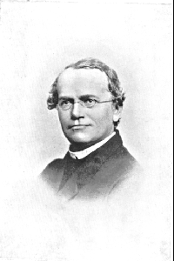
Mendel’s Laws of Inheritance
Segregation: alleles separate at meiosis and a randomly selected allele is transmitted to offspring
2. Independent assortment: alleles for separate traits are transmitted independently of one another
Mendel in 1862

Slide 18
Mendelian randomization and RCTs
MENDELIAN RANDOMIZATION
RANDOMISED CONTROLLED TRIAL
+ independent assortment
RANDOM SEGREGATION
OF ALLELES
RANDOMISATION METHOD
EXPOSED: FUNCTIONAL ALLELLES
CONTROL: NULL ALLELLES
EXPOSED:
INTERVENTION
CONTROL:
NO INTERVENTION
CONFOUNDERS EQUAL BETWEEN GROUPS
CONFOUNDERS EQUAL BETWEEN GROUPS
OUTCOMES COMPARED BETWEEN GROUPS
OUTCOMES COMPARED BETWEEN GROUPS

Slide 19
Mendelian randomization: Smoking and Lung Cancer
MENDELIAN RANDOMIZATION
RANDOMISED CONTROLLED TRIAL
+ independent assortment
RANDOM SEGREGATION
OF ALLELES
RANDOMISATION METHOD
Smokers:
C/C
Non Smokers:
C/T or T/T
EXPOSED:
SMOKERS
CONTROL:
NON SMOKERS
CONFOUNDERS EQUAL BETWEEN GROUPS
CONFOUNDERS EQUAL BETWEEN GROUPS
LUNG CANCER COMPARED
BETWEEN GROUPS
LUNG CANCER COMPARED
BETWEEN GROUPS

Slide 20
Mendelian Randomization:
3 Core Assumptions
Confounders
(2)
X
SNP
Exposure
Outcome
(1)
X
(3)
(1) SNP is associated with the exposure
(2) SNP is NOT associated with confounding variables
(3) SNP ONLY associated with outcome through the exposure

Slide 21
Why are genetic associations special?
Robustness to confounding due to Mendel’s laws:
  Law of segregation: inheritance of an allele is random and independent of environment etc
  Law of independent assortment: genes for different traits segregate independently (assuming not in LD)
The direction of causality is known – always from SNP to trait
Genetic variants are potentially very good instrumental variables
Using genetic variants as IVs is a special case of IV analysis, known as Mendelian randomization

Slide 22
Calculating causal effect estimates

Slide 23
Calculating Causal Effect Estimates
Confounders
SNP
Exposure
Outcome
β_{SNP-EXPOSURE}
β_{EXPOSURE-OUTCOME}
β_{SNP-OUTCOME}
After SNP identified robustly associated with exposure of interest:
- Two-stage least-squares (TSLS) regression
- Wald Estimator

Slide 24



Calculating Causal Effect Estimates
STAGE 1
STAGE 2
Exposure
Outcome
0
1
2
$${\hat{x}}_{0}$$
$${\hat{x}}_{1}$$
$${\hat{x}}_{2}$$
SNP
Exposure
(1) Regress exposure on SNP and obtain predicted values of the exposure (STAGE 1)
(2) Regress outcome on predicted values of the exposure (STAGE 2)
(3) Adjust standard errors
(4) Slope of 2nd stage regression is the estimate of the causal effect
*Needs to be done in the one sample (“One sample MR”)
Notes:
Intuitively taking out the variance of the exposure that is not due to genetics (i.e. the bit that could be due to confounding)

Slide 25

Calculating Causal Effect Estimates
Confounders
SNP
Exposure
Outcome
β_{SNP-EXPOSURE}
β_{EXPOSURE-OUTCOME}
β_{SNP-OUTCOME}
^
β_{SNP-OUTCOME}
= β_{EXPOSURE-OUTCOME} x
β_{SNP-EXPOSURE}
Causal effect by
Wald Estimator* :
β_{SNP-OUTCOME}
^
β_{SNP-EXPOSURE}
*Can be used in different samples (“Two sample MR”)
*Approximate SEs can be obtained by:
$$SE(β_{EXPOSURE−OUTCOME})≅\frac{σ_{SNP−OUTCOME}}{β_{SNP−EXPOSURE}}$$

Slide 26
Calculating Causal Effect Estimates
Confounders
SNP
Weight
BP
β_{SNP-WEIGHT}
β_{WEIGHT-BP}
0.5kg
β_{SNP-BP}
0.9mmHg
BP and weight:
0.9 mmHg/allele
0.5 kg/allele
=1.8 mmHg/kg
^
= change in outcome
per unit change in exposure
Causal effect by
Wald Estimator* :
β_{SNP-OUTCOME}
^
β_{SNP-EXPOSURE}
*Can be used in different samples (“Two sample MR”)
*Approximate SEs can be obtained by:
$$SE(β_{EXPOSURE−OUTCOME})≅\frac{σ_{SNP−OUTCOME}}{β_{SNP−EXPOSURE}}$$

Slide 27
MR can also be performed using just the results from GWAS
Also known as two-sample MR, SMR, or MR with summary data etc
Advantages:
  The data is readily available, non-disclosive, free, open source
  The exposure and outcome might not be measured in the same sample
  The sample size of the outcome variable, key to statistical power, is not limited by requiring overlapping measures of the exposure
Disadvantages:
  Some extensions of MR not possible, e.g. non-linear MR, use of GxE for negative controls, various sensitivity analyses

Slide 28
The Wide Applicability of MR
Traditional Observational Epidemiological Studies
Behavior Genetics and the Social Sciences
Molecular Studies
Pharmacogenomics

Slide 29
An Example using Mendelian randomization

Slide 30
MR Example using CRP
C-Reactive Protein (CRP) is a biomarker of inflammation
It is associated with BMI, metabolic syndrome, CHD and a number of other diseases
It is unclear whether these observational relationships are causal or due to confounding or reverse causality
This question is important from the perspective of intervention and drug development

Slide 31
“Bi-directional Mendelian Randomization”:
Testing causality and reverse causation
?
CRP
Genotype
CRP
BMI
NB. Note that the CRP SNP is an excellent instrument because (1) it is strongly related to CRP levels, and (2) because it is in the CRP gene itself, its effect is more likely to be mediated through changes in the level of CRP (i.e. less potential for horizontal pleiotropy)

Slide 32
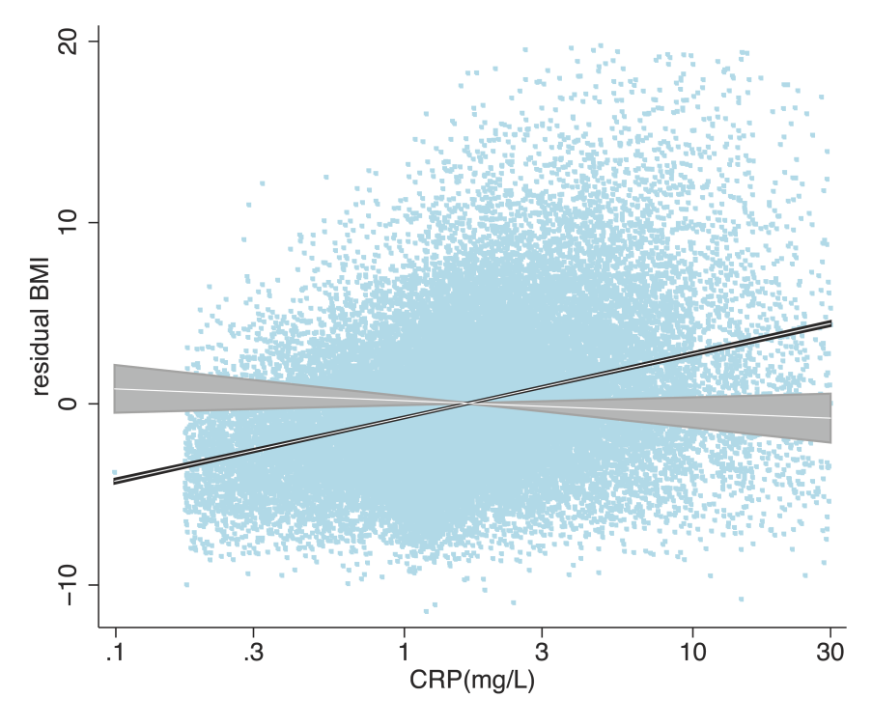
 | Effect estimates
 | Observational | MR Estimate | P_{IV} | P_{diff} | F_{first}
CRP -> BMI | 1.58 (1.53 – 1.62) | -0.30 (-0.78 – 0.18) | 0.2 | <0.00001 | 78.3
P_{IV}- Test of whether MR causal effect estimate different from zero
P_{diff}- Test of whether Observational and MR causal effect estimates are different from each other
F_{first}- Test of how strong the instrument for CRP is
Notes:
Make point that MR excellent for identifying strong observational associations that are not causal

Slide 33
“Bi-directional Mendelian Randomization”:
Testing causality and reverse causation
FTO
Genotype
BMI
?
CRP

Slide 34
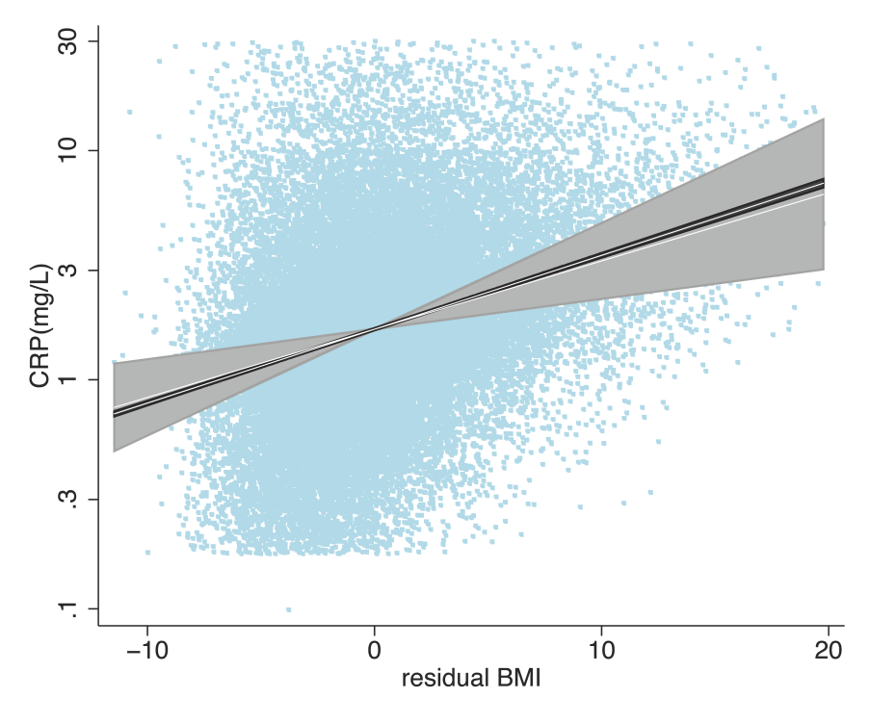
 | Effect estimates
 | Observational | MR Estimate | P_{IV} | P_{diff} | F_{first}
BMI -> CRP | 1.075 (1.073 – 1.077) | 1.06 (1.02 – 1.11) | 0.002 | 0.6 | 50.2
P_{IV}- Test of whether MR causal effect estimate different from zero
P_{diff}- Test of whether Observational and MR causal effect estimates are different from each other
F_{first}- Test of how strong the instrument for BMI is

Slide 35
Limitations to Mendelian randomization

Slide 36
Limitations to Mendelian Randomization
1- Population stratification
2- Canalisation (“Developmental compensation”)
3- The existence of instruments
4- Power and “weak instrument bias”
5- Pleiotropy

Slide 37
Power and Weak Instruments
Power:
  Genetic variants explain very small amounts of phenotypic variance in a given trait
  VERY large sample sizes are generally required
Weak instruments:
  Genetic variants that are weak proxies for the exposure
  Results in biased causal estimates from MR
Different impact of the bias from weak instruments:
  Single Sample MR: to the confounded estimate
  Two-Sample MR: to the null

Slide 38
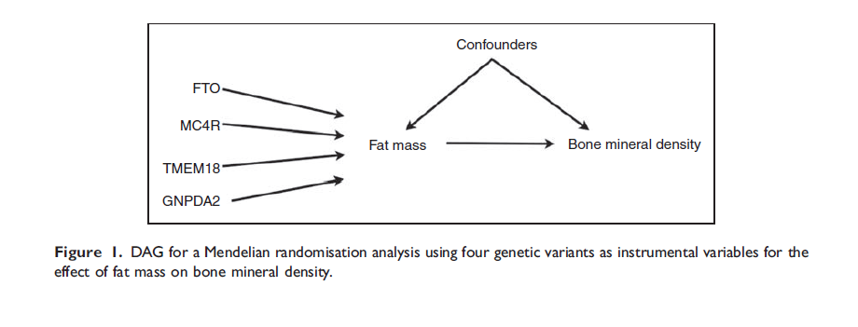
Using Multiple Genetic Variants as Instruments
Palmer et al (2011) Stat Method Res
Allelic scores
Testing multiple variants individually
Meta-analyse individual SNPs

Slide 39
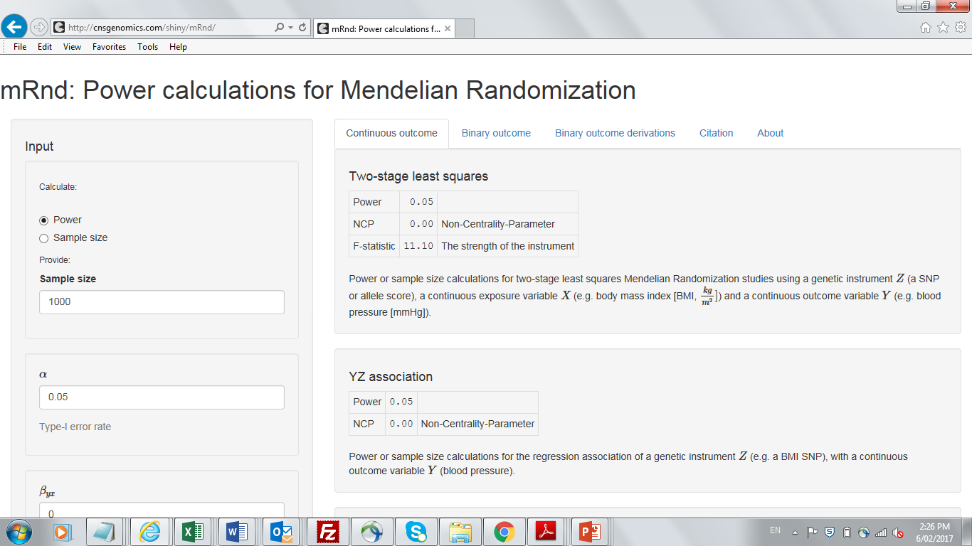
Calculating Power in Mendelian Randomization Studies

Slide 40
Limitations to Mendelian Randomization
1- Population stratification
2- Canalisation (“Developmental compensation”)
3- The existence of instruments
4- Power (also “weak instrument bias”)
5- Pleiotropy

Slide 41
Pleiotropy
Genetic variant influences more than one trait
Horizontal vs Vertical pleiotropy
Outcome
Exposure
Outcome
Exposure
G
G
Vertical Pleiotropy
Horizontal Pleiotropy

Slide 42
Pleiotropy
Genetic variant influences more than one trait
Pleiotropy only violates MR’s assumptions if it involves a pathway outside that of the exposure and is a pathway that affects your outcome
Violation
Outcome
Outcome
Exposure
B1
Exposure
B1
B 2
B 2
G
G

Slide 43



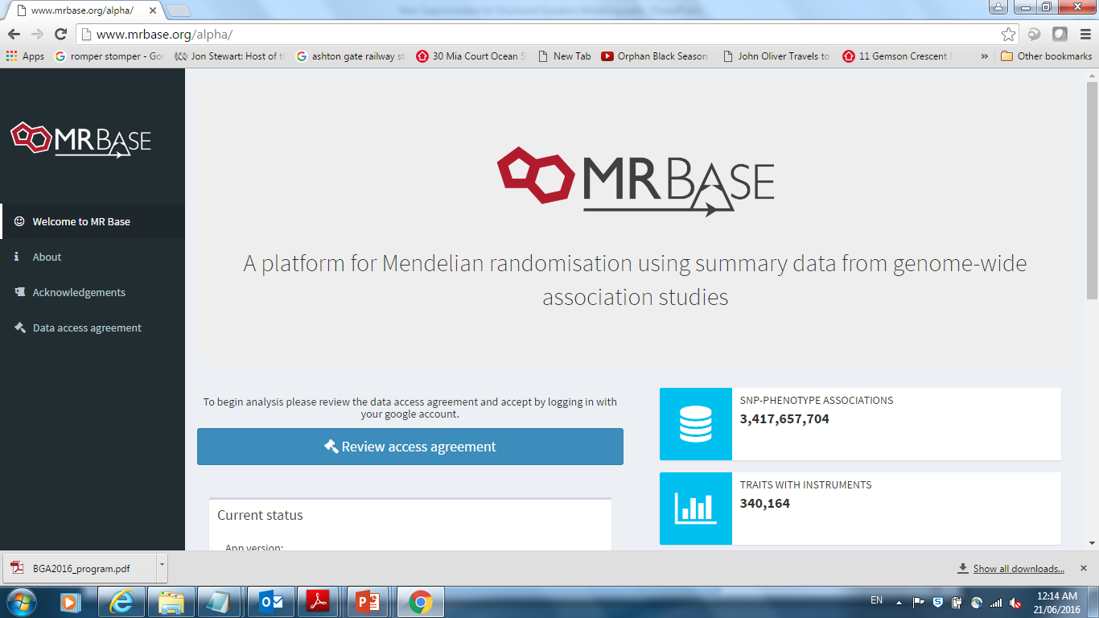
MR Base
http://www.mrbase.org/
Jie “Chris” Zheng
Gib Hemani
Phil Haycock

Slide 44
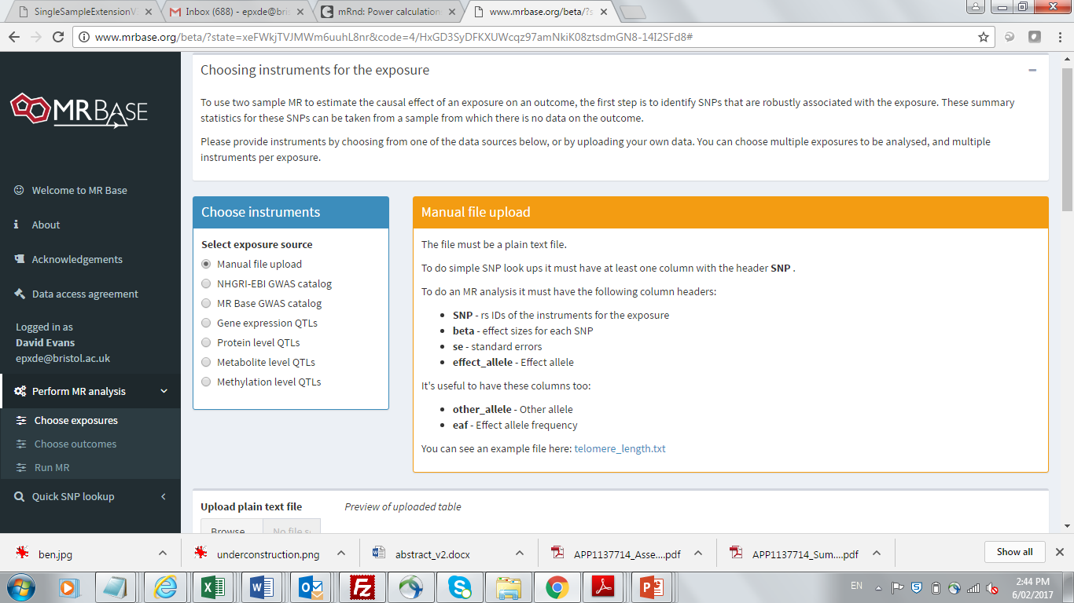

Slide 45
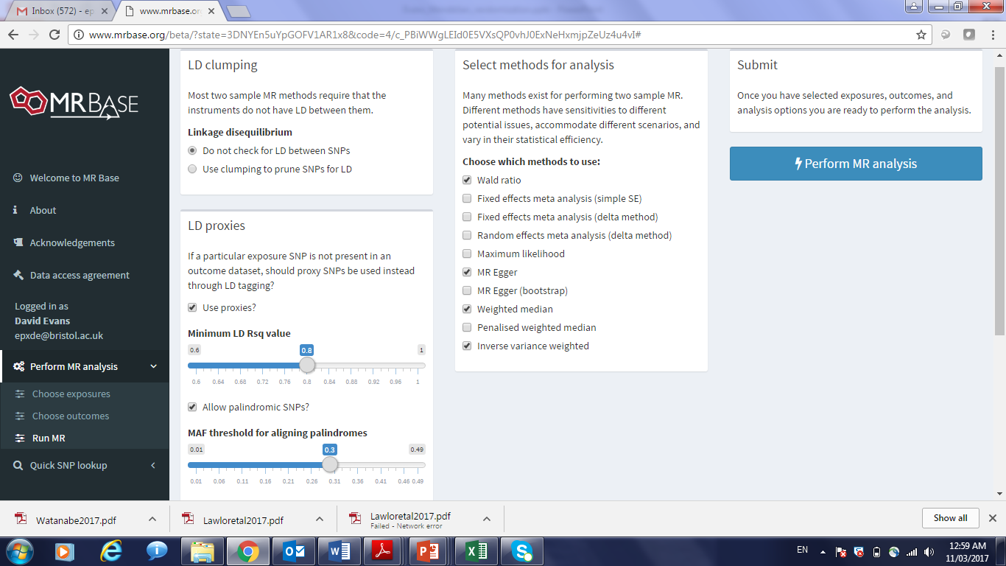

Slide 46
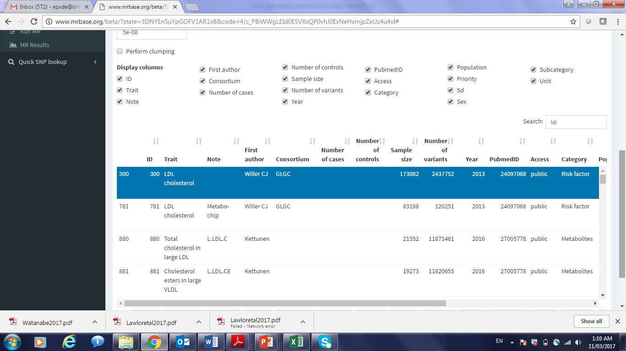

Slide 47
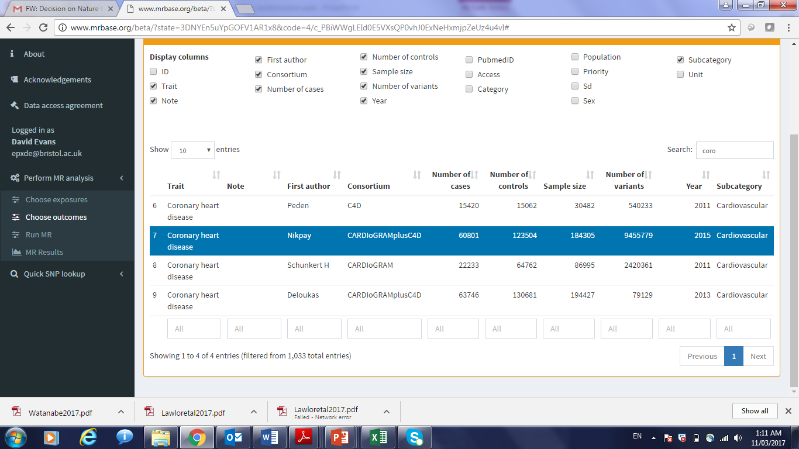

Slide 48
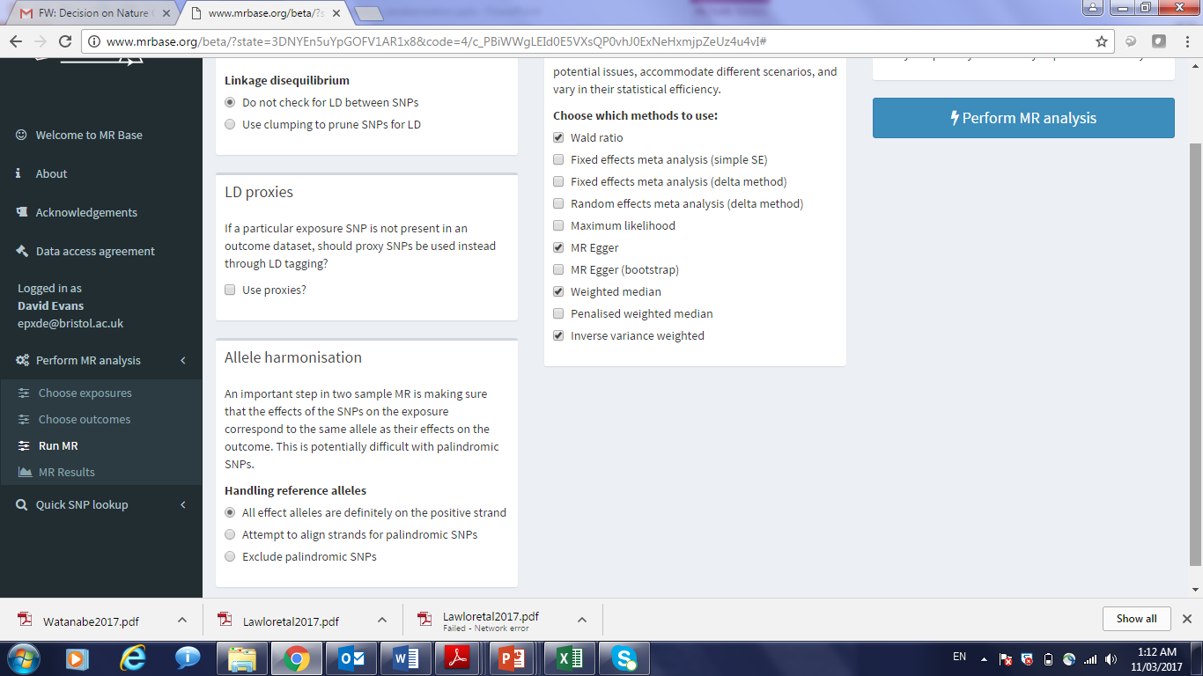

Slide 49
Alcohol and Heart Disease
(A) Alcohol increases risk of heart disease
(B) Alcohol decreases risk of heart disease
(C) No causal relationship
(D) Don’t know

Slide 50
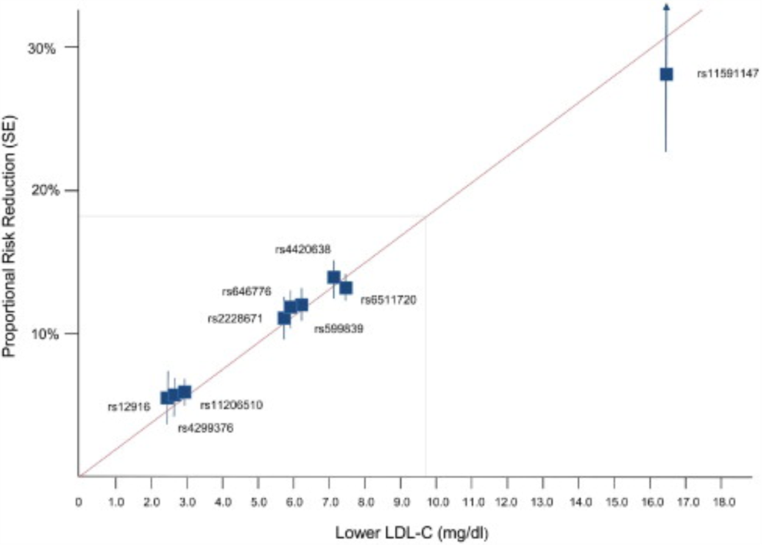
“Bad” LDL Cholesterol and Heart Disease
What would a data
point here indicate?
Ference et al, JACC 2012
(A) High LDL decreases risk of heart disease
(B) High LDL increases risk of heart disease
(C) LDL is not causally related to heart disease

Slide 51
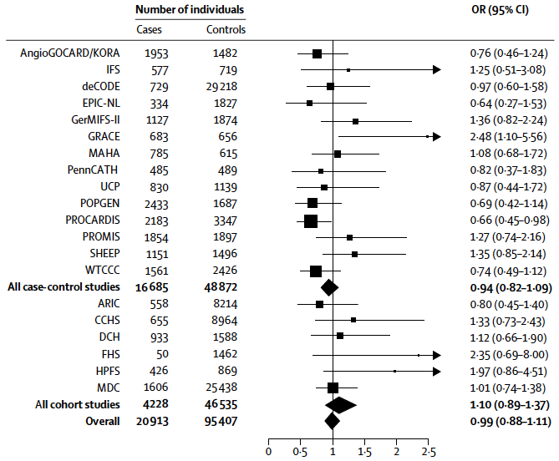
“Good” HDL Cholesterol and Heart Disease
(A) High HDL decreases risk of heart disease
(B) High HDL increases risk of heart disease
(C) HDL is not causally related to heart disease

Slide 52
Triangulation in Science
Nature (2018)

Slide 53
Useful References
Brion et al (2013). Calculating statistical power in Mendelian randomization studies. Int J Epidemiol, 42(5), 1497-501.
Davey-Smith & Hemani (2014). Mendelian randomization: genetic anchors for causal inference in epidemiological studies. Hum Mol Genet, 23(1), R89-98.
Davey-Smith & Ebrahim (2003). “Mendelian randomization”: can genetic epidemiology contribute to understanding environmental determinants of disease? IJE, 32, 1-22.
Davies et al (2018). Reading Mendelian randomization studies: a guide, glossary, and checklist for clinicians. BMJ, Jul 12, 362:k601.
Evans & Davey-Smith (2015). Mendelian randomization: New applications in the coming age of hypothesis free causality. Annu Rev Genomics Hum Genet, 16, 327-50.
Hemani et al. (2018). The MR-Base platform supports systematic causal inference across the human phenome. Elife, May 30, 7, e34408.
Munafo & Davey Smith (2018). Robust research needs many lines of evidence. Nature, 553(7689), 399-401.
Zheng et al. (2017). Recent developments in Mendelian randomization studies. Curr Epidemiol Rep, 4(4), 330-345.

Slide 54
MR Practical

