Slide 1
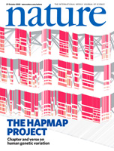
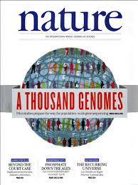
Grant-Writing Strategies for Computational Methods Development
Lisa D. Brooks, Ph.D.
Program Director (retired)
Genomic Variation Program, NHGRI
2023 International Statistical Genetics Workshop

Slide 2
Introduction
Lots of general information on NIH grant writing
https://grants.nih.gov/grants/how-to-apply-application-guide/format-and-write/write-your-application.htm
Today: grant-writing strategies for
statistical genetics methods development

Slide 3
General analysis methods as resources
Developing general analysis methods vs
applying analysis methods to specific diseases
Analysis methods as resources – multiple diseases
Not hypothesis-driven

Slide 4
Evaluation of applications
Importance of the problem
Apply to many diseases / conditions?
Enduring value of the work
Compare other methods – sometimes better
Technical competence of the methods
Power calculations
Understanding data errors
Innovation (more or less)

Slide 5
Other topics
Human subjects – explain either way
Diverse populations
Data and software sharing – broad is good!

