Slide 1
PRS & GRM
Sarah Medland, Baptiste Couvy-Duchesne & Lucia Colodro Conde
(with in no particular order, Jose Morosoli Garcia, Brittany Mitchell, Daniel Hwang, Penelope Lind, Jodie Painter, Ting Qi,
Jenny Van Dongen, Gabriella Blokland, Ben Neale,
Elizabeth Prom-Wormley, Brad Verhulst, Katrina Grasby

Slide 2

Acknowledgement of Country
I’d like to acknowledge the Turrbal and Yuggerah People as the traditional owners of the land where I live and work.
I pay my respects to the Elders past, present and emerging.

Slide 3
Copy the files for today’s tutorial
In this session we will be using terminal.
To get started ssh into the workshop server.
mkdir day7
cp –r /faculty/sarah/2022/Day7 .
The practical will use both R and the terminal
  Terminal commands are in blue
  R commands are in black
  https://qimr.az1.qualtrics.com/jfe/form/SV_a59UfSkgMuqusZ0

Slide 4
RECAP

Slide 5
What are Polygenic risk scores (PRS)?
PRS are a quantitative measure of the cumulative genetic risk or vulnerability that an individual possesses for a trait.
The traditional approach to calculating PRS is to construct a weighted sum of the betas (or other effect size measure) for a set of independent loci thresholded at different significance levels.
  Typically the independence is LD based (LD r2 <=.2) via clumping.

Slide 6
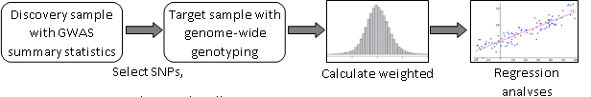
PRS Overview
Discovery GWAS
Independent Target sample with genotypes and phenotypes

Slide 7

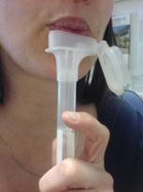
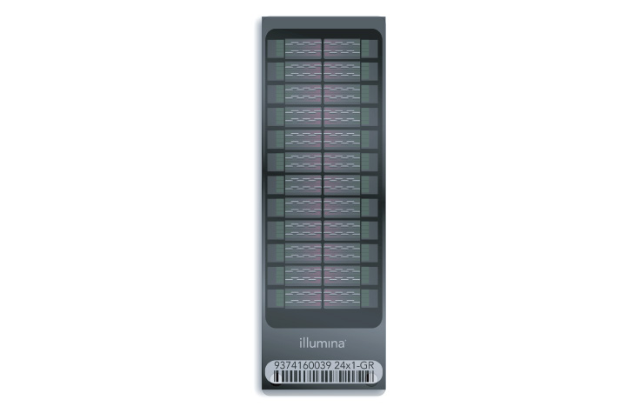
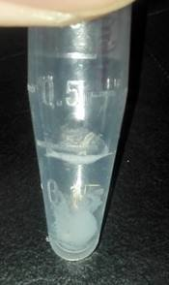
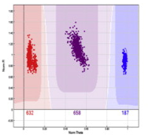
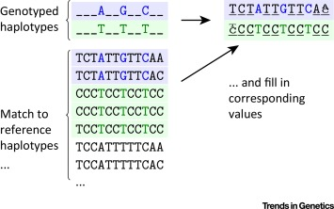
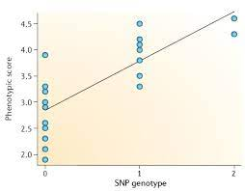
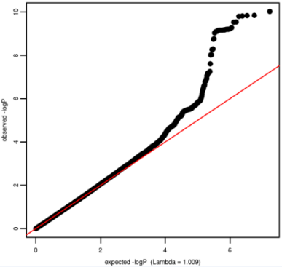
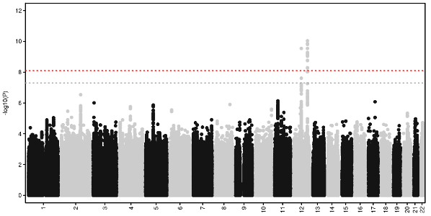
GWAS overview

Slide 8
PRS Overview
Discovery GWAS
Independent Target sample with genotypes and phenotypes

Slide 9
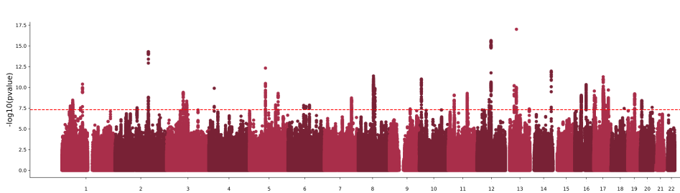
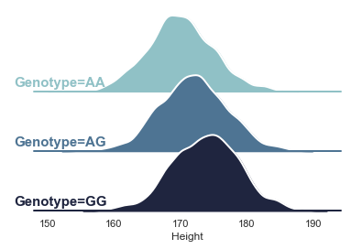

Effect size of 2cm per G allele
+2
+4
+4
+0
+0
+0
+2
+2
+2

Slide 10

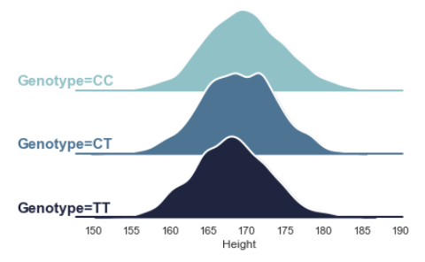

Effect size of -1 per T allele
+0
+0
-1
-1
+0
-2
-2
-1
-2
+4
+4
+0
+0
+0
+2
+2
+2
+2

Slide 11

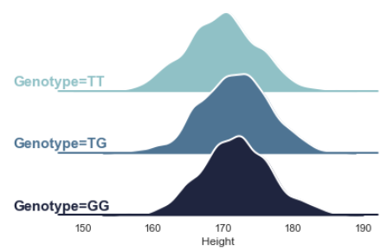

Effect size of +0.5 per G allele
+0.5
+0
-0.5
+0
+0.5
+0
+0.5
+0.5
+1
+0
+0
-1
-1
+0
-2
-2
-1
-2
+4
+4
+0
+0
+0
+2
+2
+2
+2

Slide 12
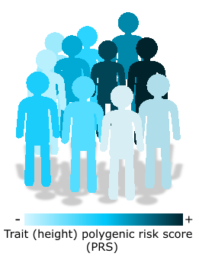

Repeat including the other variants and sum across all loci
Caution! The sample for which PRS will be calculated should be independent from that of the discovery GWAS. Sample overlap will bias your results.

Slide 13
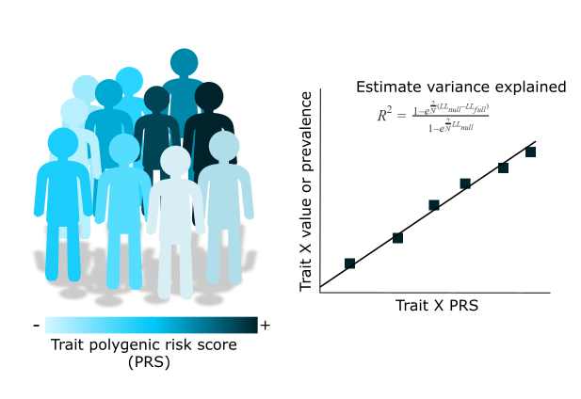
PRS – trait association
Notes:
PRS are a tool that allow us to test hypotheses regarding the genetic liability to a trait.
We will eventually need to perform associations between our PRS and a trait of interest.
The trait of interest will depend on what our question is and what the PRS is being used for, but regardless of it there are important considerations:

Slide 14
Types of PRS
Clumping+Thresholding:
PLINK
PRSice2
bigsnpR (R library)
Other types of PRS:
LDpred2 – Implemented in bigsnpR
SBayesR – Implemented in GCTB
Lassosum (and lassosum2) – Implemented in bigsnpR
PRS-CS
JAMPred

Slide 15
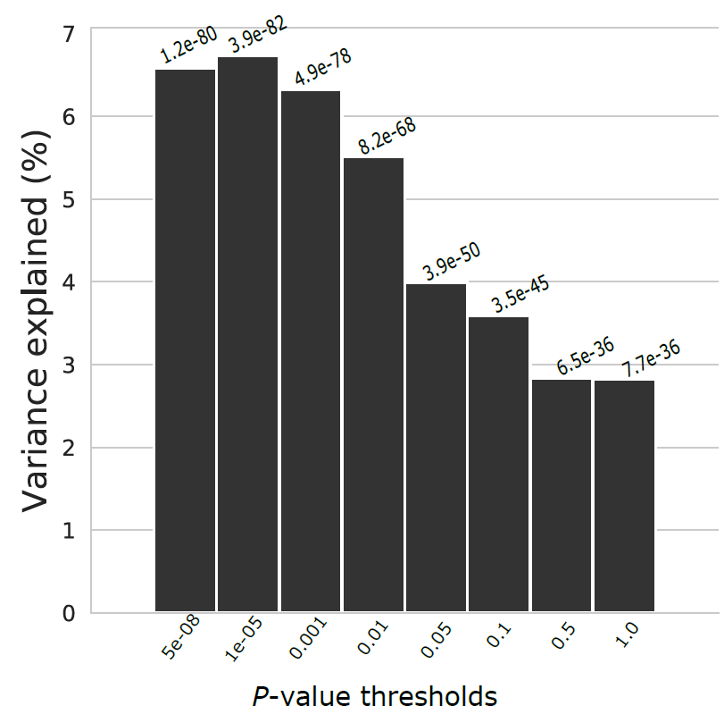
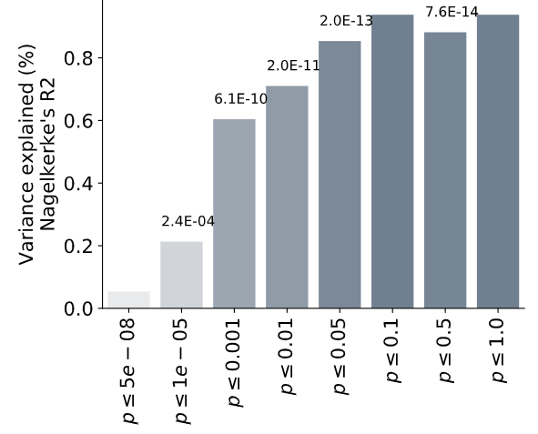
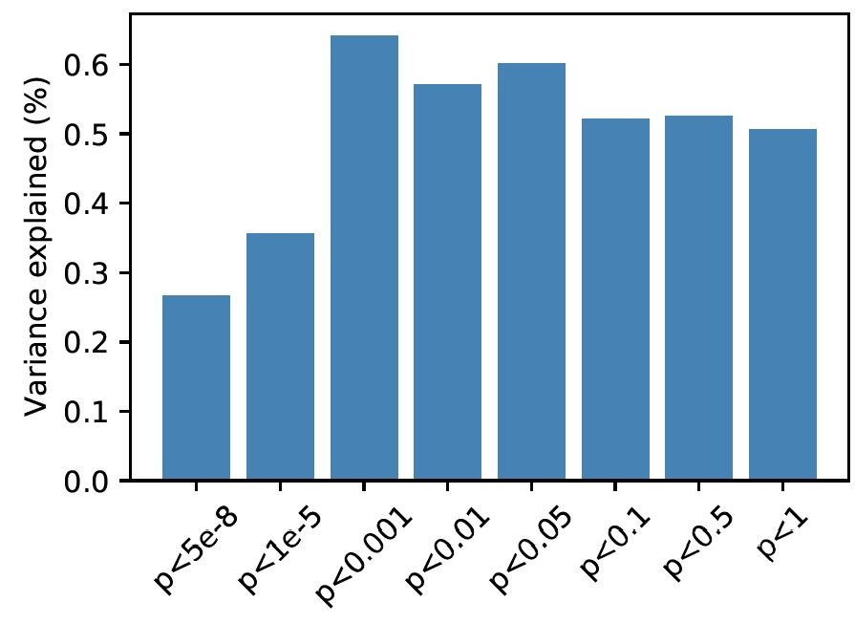
C+T allows us to explore the pattern of variance explained across the distribution of effect sizes/significance
Variance explained = partial R² for quantitative traits. Different ways of estimating it for binary traits

Slide 16
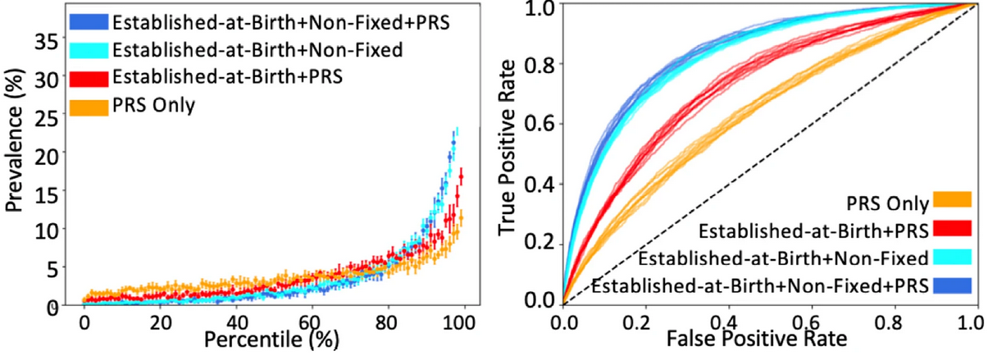
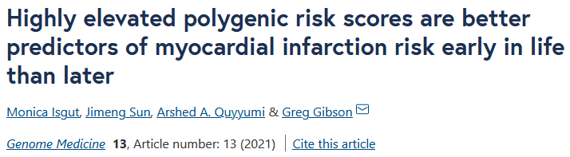
Other methods may be better if your goal is to find the best predictor

Slide 17
What can we do with this?
Research
  Explains as much variance as many demographic variables
Family history
  Useful where there is no reliable reporter in the family or in situations where families are estranged or the biological relatives are unknown
Diagnosis
  Yes but maybe not in the way it is typically discussed…

Slide 18
Main uses of PRS
Single disorder analyses
Cross-disorder analysis
Sub-type analysis

Slide 19
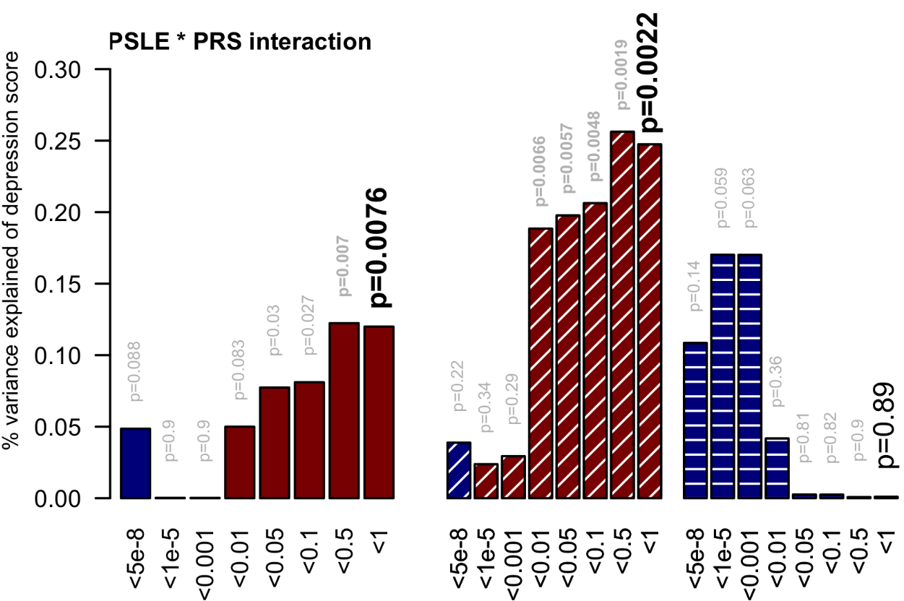
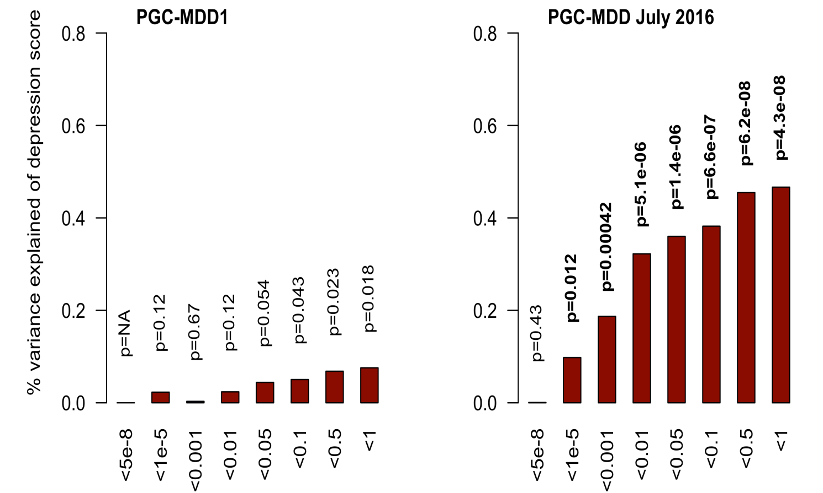
Single trait analyses

Slide 20
Moderated single trait analyses

Slide 21
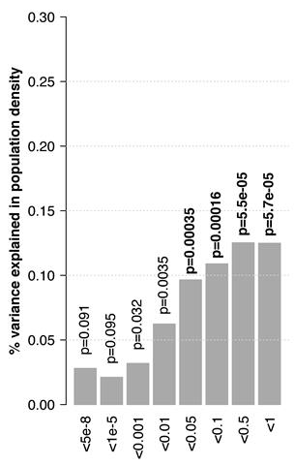
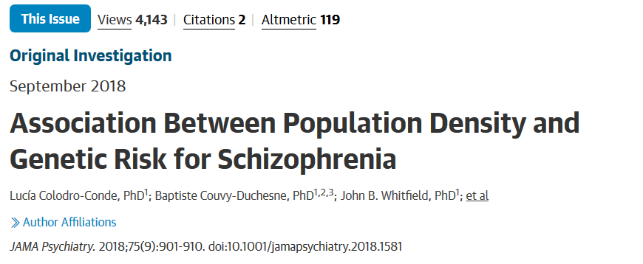
Cross-trait analysis
PRS-SCZ

Slide 22
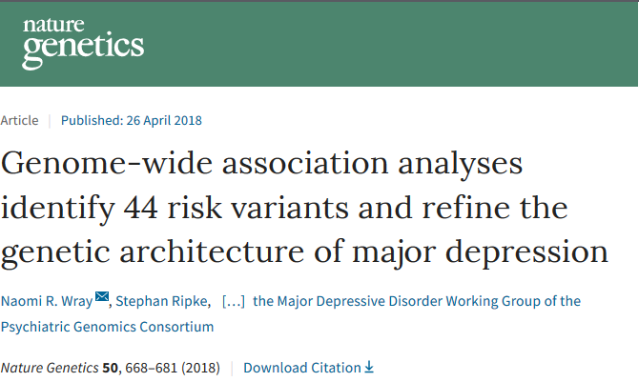
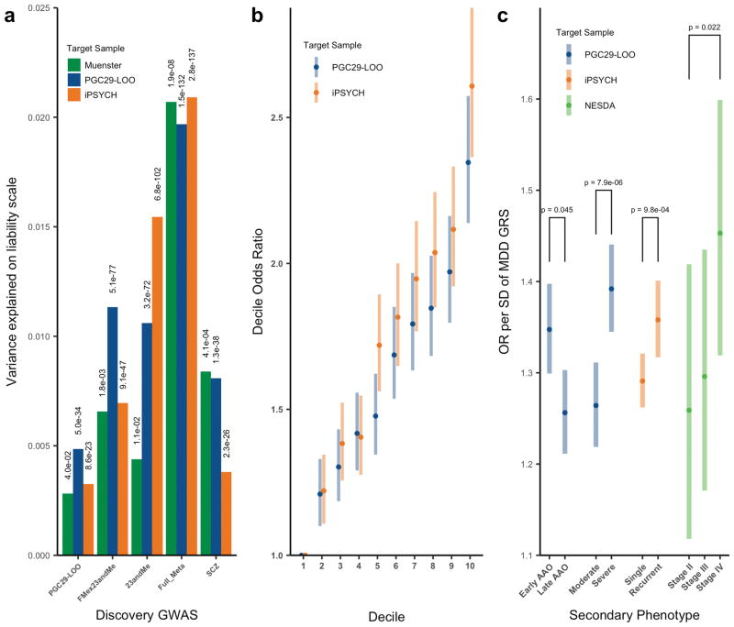
Sub-type analysis

Slide 23
PRS and power
The power of the predictor is a function of the power of the GWAS in the discovery sample (due to its impact on the accuracy of the estimation of the betas).
“I show that discouraging results in some previous studies were due to the low number of subjects studied, but a modest increase in study size would allow more successful analysis. However, I also show that, for genetics to become useful for predicting individual risk of disease, hundreds of thousands of subjects may be needed to estimate the gene effects.”
(Dudbridge, 2013)

Slide 24
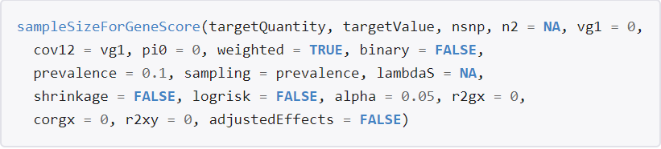
PRS and power
For simple power calculations you can use a regression power calculator (for r² of up to 0.5%).
As a general rule of thumb you usually want 2,000+ people in the target dataset.
R AVENGEME (https://github.com/DudbridgeLab/avengeme)
Power calculator for discovery (GWAS) sample needed to achieve prediction of r² in target sample

Slide 25
Power of PRS analysis increases with GWAS sample size
PGC-MDD1: N=18k
max variance explained = 0.08%, p=0.018
PGC-MDD2: N=163k
max variance explained =0.46%,
p= 5.01e-08
Colodro-Conde L,
Couvy-Duchesne B, et al, (2017) Molecular Psychiatry

Slide 26
A couple of “worked” examples

Slide 27



Slide 28
Background
The prevalence of schizophrenia is higher in urban areas than in rural areas
O.R. = 2.39 (1.62–3.51), (Vassos et al 2012, Schizophrenia Bulletin).
Two major hypotheses have been proposed to explain this phenomenon:
causation hypothesis: the stress of city life and undefined factors in the urban environment increase the risk of this disease.
selection hypothesis: individuals with genetic liability for schizophrenia move into urban areas.

Slide 29
Twin models have shown genetic factors have a higher impact on the country vs. city living as people grow older, while the impact of family background decreases.
Whitfield et al. 2005, Twin Research and Human Genetics

Slide 30
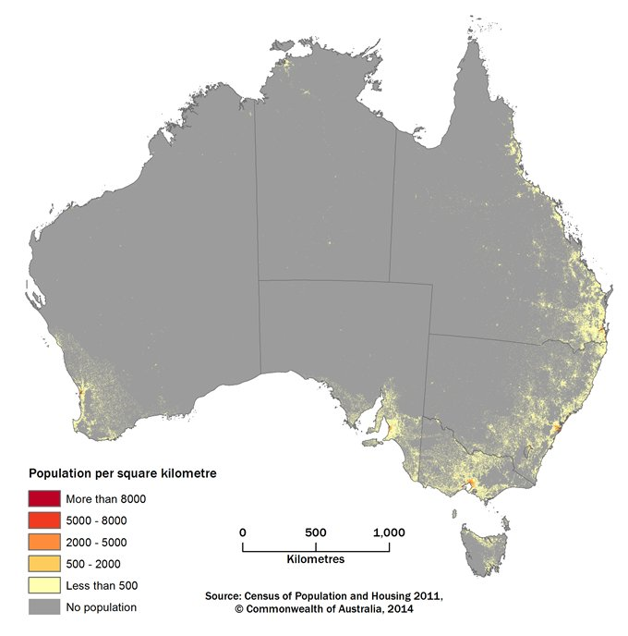
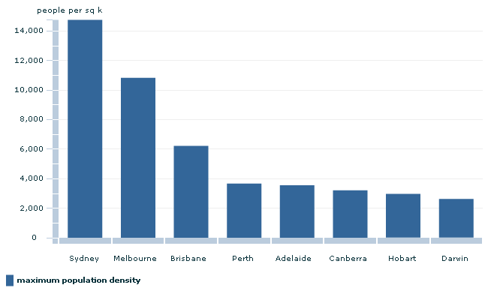
Hypothesis
Adults with higher genetic risk for schizophrenia are more likely to live in urbanised and populated areas than those with lower risk.
Methods
15,544 individuals in 7,015 families
Postcode data & genotypes
  Population density
  Remoteness
  Socio economic status (SES)

Slide 31
Analyses conducted in GCTA
phenotype= intercept + beta0*covariates + beta1*g + e with g ~ N(0, GRM)
phenotype: population density or remotedness
  covariates: PRS-SCZ, age, sex, (SES),
  4 first genetic principal components, imputation chip
e: error
GRM: Genetic correlation matrix

Slide 32
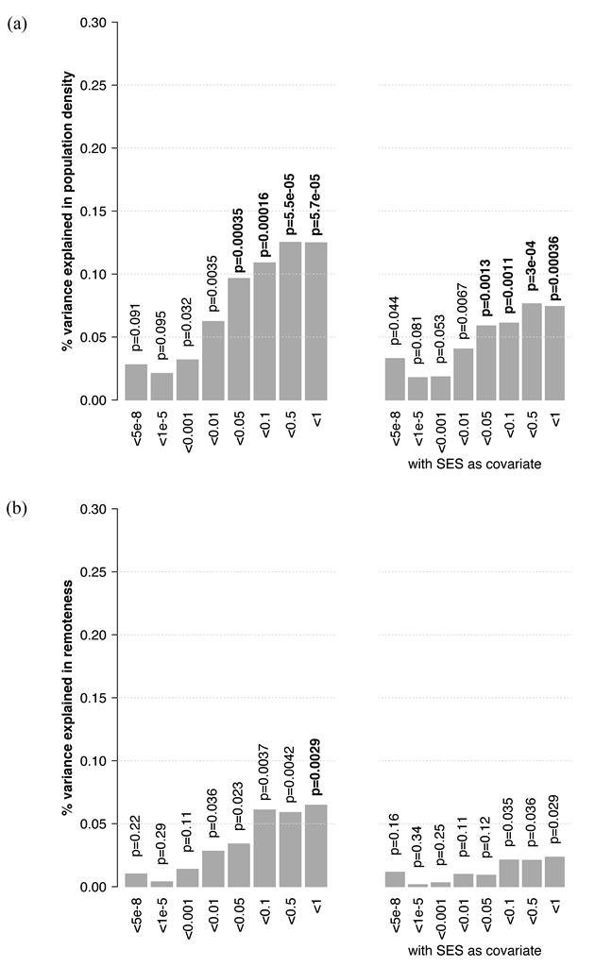

Slide 33
Conclusions
People with a higher genetic risk for schizophrenia may prefer to live in more urban and populated areas.
  Importantly, this study does not use a case-control sample but an unselected population sample where the genetic risk for schizophrenia was estimated.
Greater genetic predisposition to schizophrenia is at least one mechanism explaining why schizophrenia is more prevalent in city environments.

Slide 34
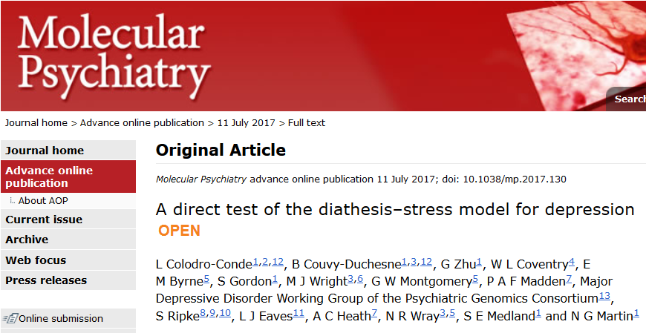

Slide 35
A couple of important methods papers

Slide 36
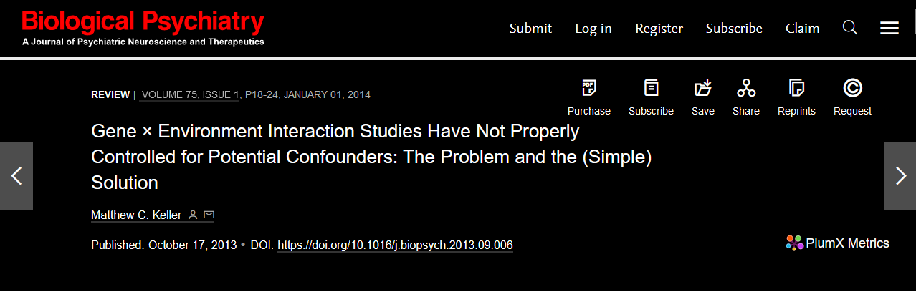

Slide 37

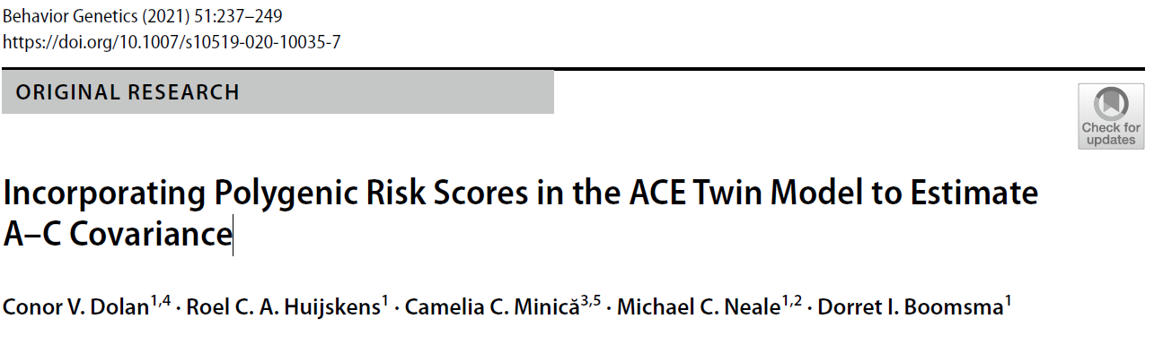

Slide 38

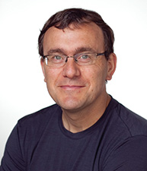



The classics
Wray NR, Goddard, ME, Visscher PM. Prediction of individual genetic risk to disease from genome-wide association studies. Genome Research. 2007; 7(10):1520-28.
Evans DM, Visscher PM., Wray NR. Harnessing the information contained within genome-wide association studies to improve individual prediction of complex disease risk. Human Molecular Genetics. 2009; 18(18): 3525-3531.
International Schizophrenia Consortium, Purcell SM, Wray NR, Stone JL, Visscher PM, O'Donovan MC, Sullivan PF, Sklar P . Common polygenic variation contributes to risk of schizophrenia and bipolar disorder. Nature. 2009; 460(7256):748-52
Evans DM, Brion MJ, Paternoster L, Kemp JP, McMahon G, Munafò M, Whitfield JB, Medland SE, Montgomery GW; GIANT Consortium; CRP Consortium; TAG Consortium, Timpson NJ, St Pourcain B, Lawlor DA, Martin NG, Dehghan A, Hirschhorn J, Smith GD. Mining the human phenome using allelic scores that index biological intermediates. PLoS Genet. 2013,9(10):e1003919.

Slide 39
Further reading
Dudbridge F. Power and predictive accuracy of polygenic risk scores. PLoS Genet. 2013 Mar;9(3):e1003348. Epub 2013 Mar 21. Erratum in: PLoS Genet. 2013;9(4). (Important discussion of power)
Wray NR, Lee SH, Mehta D, Vinkhuyzen AA, Dudbridge F, Middeldorp CM. Research review: Polygenic methods and their application to psychiatric traits. J Child Psychol Psychiatry. 2014;55(10):1068-87. (Very good concrete description of the traditional methods).
Wray NR, Yang J, Hayes BJ, Price AL, Goddard ME, Visscher PM. Pitfalls of predicting complex traits from SNPs. Nat Rev Genet. 2013;14(7):507-15. (Very good discussion of the complexities of interpretation).
Witte JS, Visscher PM, Wray NR. The contribution of genetic variants to disease depends on the ruler. Nat Rev Genet. 2014;15(11):765-76. (Important in the understanding of the effects of ascertainment on PRS work).
Shah S, Bonder MJ, Marioni RE, Zhu Z, McRae AF, Zhernakova A, Harris SE, Liewald D, Henders AK, Mendelson MM, Liu C, Joehanes R, Liang L; BIOS Consortium, Levy D, Martin NG, Starr JM, Wijmenga C, Wray NR, Yang J, Montgomery GW, Franke L, Deary IJ, Visscher PM. Improving Phenotypic Prediction by Combining Genetic and Epigenetic Associations. Am J Hum Genet. 2015; 97(1):75-85. (Important for the conceptualization of polygenicity)

Slide 40
Genetic Relatedness Matrices

Slide 41
We have been using GRMs since day 1
A | .5A
.5A | A
1 | .5
.5 | 1
Our DZ covariance for A could be written as A ⊗
Where is a the GRM containing the expected coefficients of relatedness
Instead of using the expectations we can estimate relatedness from genotypic data
We will do this as part of todays tutorial using a program called gcta
1 | .5
.5 | 1

Slide 42
Questions?

