Slide 1
Extended Twin Family Designs: The Motivation for Using Them
Matthew Keller
International Statistical Genetics Workshop 2022

Slide 2
The point of this lecture
Extending the Classical Twin Design (CTD) to include additional relative types not only allows estimation of additional quantities, but it also probably produces less biased estimates
Unlike the effects of violations of assumptions in the CTD, understanding the influence of biased assumptions in ETFDs requires simulation.
Notes:
They are rough characterizations of the importance of the genetic and environmental factors on trait variation that gloss over a lot of detail and nuance

Slide 3
Classical Twin Design (CTD)
Assumption biased up biased down
Either $V_{D}$or $V_{C}$ is zero ${\hat{V}}_{A}$ ${\hat{V}}_{C}$ & ${\hat{V}}_{D}$
No assortative mating ${\hat{V}}_{C}$ ${\hat{V}}_{D}$& ${\hat{V}}_{A}$
No A-C covariance ${\hat{V}}_{C}$ ${\hat{V}}_{A}$ & ${\hat{V}}_{D}$
1
A
1/.25
A
E
C
C
E
a
c
c
a
e
e
D
D
d
d
P_{T1}
P_{T2}

Slide 4
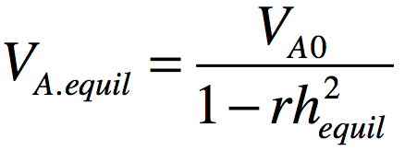
Assortative mating consequence on $V_{A}$
AM: phenotypic correlation between mating partners
Many examples (e.g., height ~.25; IQ ~ .4; Social attitudes ~ .6)
If AM leads to genetic similarity in partners (as it does if it’s primary phenotypic AM), there are genetic consequences:
Height $V_{A}$ increases in the population because ‘tall’ (‘short’) alleles are more concentrated in individuals than expected.
E.g., if you’re a ‘tall’ allele sitting in an egg and are waiting around to see what other height alleles you’ll get paired with from that sperm swimming to you, they are more likely than chance to be other ‘tall’ alleles (both at the same locus and at others; & this just considers the effects on $V_{A}$ in 1st gen)

Slide 5
AM consequence on relative covariance
AM increases genetic covariances and correlations between relatives (e.g., sibs, parents, cousins, etc). E.g.:
Consider again being a ‘tall’ allele in a zygote. This time you are watching your co-twin’s zygote get formed. Regardless of whether you exist (are IBD) in your co-twin’s zygote, you can expect more tall alleles in your co-twin’s zygote.
Thus, you can also expect to share more ‘tall’ alleles with your sibling(s) than expected under random mating.
AM biases ${\hat{V}}_{C}$ upwards and ${\hat{V}}_{A}$ (or ${\hat{V}}_{D}$) downwards
$r_{MZ.A1,A2}$is already 1 so AM cannot increase it
AM will increase $r_{DZ.A1,A2}$> .50
$$r_{A,DZ}=\frac{1}{2}(1+rh_{equil}^{2})$$

Slide 6
Passive G-E Covariance (aka “genetic nurture”)
Covariance between the average genetic effect in a family and the “familial environment” that occurs when parental trait directly influences the offspring trait, leading to covariance between genes affective a trait and the offspring rearing environment
E.g., educated parents pass on both genes and environments that predispose to higher education
Because it is a covariance between the average genetic effect and the familial environment, it increases the covariance of all siblings by the same amount regardless of their relatedness (e.g., MZ vs. DZ). It therefore mimics, and leads to an overestimate, of $V_{C}$ in the CTD.

Slide 7
Adding parents gets us around all these assumptions
Assumption biased up biased down
Either $V_{D}$or $V_{C}$ is zero
No assortative mating
No A-C covariance
We don’t have to make these
w
q
q
A
A
w
x
C
C
x
a
E
E
a
D
c
e
e
c
D
d
d
P_{Fa}
µ
P_{Ma}
Nuclear Twin Family Design
m
m
m
m
A
A
C
1/.25
C
E
a
a
E
e
c
D
D
c
e
d
d
P_{T1}
P_{T2}

Slide 8
We can model $V_{C}$ as either $V_{S}$ or $V_{F}$
With parents, we can break $V_{C}$ up into:
S = env. factors shared only between sibs
F = familial env factors passed from parents to offspring
But we can only estimate one of these (or more technically, three of $V_{A}$, $V_{S}$, $V_{F}$, & $V_{D}$)
S
C
F
1
1
A
1/.25
A
F
A
A
F
E
a
C
C
a
E
E
S
1/.25
S
E
e
c
D
D
c
e
e
f
a
s
s
a
f
e
d
d
d
D
D
d
P_{T1}
P_{T2}
P_{T1}
P_{T2}

Slide 9
Nuclear Twin Family Design (NTFD)
q
w
w
q
A
F
x
x
F
A
S
f
E
E
f
S
s
a
e
e
a
s
D
d
d
D
P_{Fa}
µ
P_{Ma}
m
m
m
m
Note: m estimated and f fixed to 1
z_{s}
F
A
A
F
E
S
z_{d}
S
E
f
a
s
s
a
f
e
e
D
D
d
d
P_{T1}
P_{T2}

Slide 10
On average across 38 traits CTD vs. ETFD results*
${\hat{V}}_{A}$ 65% higher in CTD
${\hat{V}}_{D}$ 43% lower in CTD
${\hat{V}}_{C}$ 45% lower in CTD when r(spouse)~0
${\hat{V}}_{C}$ 100% higher in CTD when r(spouse)>0
ETFD results are not perfect, but theory and simulation suggest they are, on average, much more accurate than CTD results.
Accuracy across all sims: CTD=.14; NTF=.07; ETFD=.045
${\hat{V}}_{G}$ 18% higher in CTD
* Coventry & Keller, 2005

Slide 11
Nuclear Twin Family Design (NTFD)
q
w
w
q
A
F
x
x
F
A
S
f
E
E
f
S
s
a
e
e
a
s
D
d
d
D
P_{Fa}
µ
P_{Ma}
m
m
m
m
Note: m estimated and f fixed to 1
z_{s}
F
A
A
F
E
S
z_{d}
S
E
f
a
s
s
a
f
e
e
D
D
d
d
P_{T1}
P_{T2}
Assumptions:
Only can estimate 3 of 4: $V_{A}$, $V_{D}$, $V_{S}$, $V_{F}$ (bias is variable)
Assortative mating due to primary phenotypic assortment (bias is variable)

Slide 12
Stealth
Include twins and their sibs, parents, spouses, and offspring…
Gives 17 unique covariances (MZ, DZ, Sib, P-O, Spousal, MZ avunc, DZ avunc, MZ cous, DZ cous, GP-GO, and 7 in-laws)
88 covariances with sex effects

Slide 13
Additional obs. covs with Stealth allow estimation of $V_{A}$, $V_{S}$, $V_{D}$, $V_{F}$, $V_{T}$
S
F
D
T
can be estimated simultaneously
= env. factors shared only between twins
A
T
1
F
A
A
F
E
S
1/.25
S
E
f
a
s
s
a
f
e
e
D
1/0
D
d
d
d
P_{T1}
t
T
T
t
P_{T2}
(Remember: we’re not just estimating more effects. More importantly, we’re reducing the bias in estimated effects –although perhaps at the expense of more variance in estimates)

Slide 14
Stealth
q
w
w
q
A
F
x
x
F
A
S
f
E
E
f
S
s
a
e
e
a
s
D
d
d
D
T
t
P_{Fa}
µ
P_{Ma}
t
T
m
m
m
m
q
w
1
w
q
A
F
x
F
A
1/.25
A
F
x
F
A
S
E
E
S
S
E
E
S
s
a
f
e
f
a
s
s
a
f
e
e
f
a
s
D
e
D
1/0
D
D
d
d
d
d
T
t
P_{Fa}
µ
P_{T1}
t
T
T
t
P_{T2}
µ
P_{Ma}
t
T
m
m
m
m
A
F
F
A
S
E
E
S
s
a
f
e
e
f
a
s
D
d
d
D
T
t
P_{Ch}
P_{Ch}
t
T

Slide 15
Stealth
Assumption biased up biased down
Primary assortative mating ${\hat{V}}_{A}$, ${\hat{V}}_{D}$, ${\hat{V}}_{F} { \hat{V}}_{A}$, ${\hat{V}}_{D}$, ${\hat{V}}_{F}$
No epistasis ${\hat{V}}_{A}$, ${\hat{V}}_{D}$ ${\hat{V}}_{S}$
No AxAge ${\hat{V}}_{D}$, ${\hat{V}}_{S}$ ${\hat{V}}_{A}$

Slide 16
Stealth
Assumption biased up biased down
Primary assortative mating ${\hat{V}}_{A}$, ${\hat{V}}_{D}$, ${\hat{V}}_{F} { \hat{V}}_{A}$, ${\hat{V}}_{D}$, ${\hat{V}}_{F}$
No epistasis ${\hat{V}}_{A}$, ${\hat{V}}_{D}$ ${\hat{V}}_{S}$
No AxAge ${\hat{V}}_{D}$, ${\hat{V}}_{S}$ ${\hat{V}}_{A}$
Phenotypic homogamy (primary AM): matching based on phenotypic similarity
Social homogamy: matching based on environmental similarity (e.g., religion)
Convergence: mates become more similar to each other (e.g., becoming more conservative when dating a conservative)

Slide 17
Cascade
~
µ
~
~
~
~
P_{Fa}
P_{Ma}
~
~
~
t
d
s
~
~
s
d
t
q
w
a
~
~
a
w
q
f
~
~
f
A
F
e
e
F
A
S
x
x
S
a
f
E
E
f
a
D
s
e
e
s
D
d
d
T
t
P_{Fa}
P_{Ma}
t
T
m
m
m
m
~
µ
~
~
~
~
~
~
P_{Sp}
P_{T1}
P_{T2}
µ
P_{Sp}
~
~
~
t
d
s
~
~
~
~
s
d
t
q
w
a
~
~
f
a
1
a
~
~
a
w
q
f
~
~
~
~
f
~
~
f
A
F
e
e
F
A
s
s
A
F
e
e
F
A
x
~
1/.25
~
x
S
E
E
S
d
d
S
E
E
S
a
f
f
a
~
~
a
f
f
a
s
e
e
s
t
t
s
e
e
s
D
d
d
D
1/0
D
d
d
D
T
t
P_{Fa}
P_{T1}
t
T
T
t
P_{T2}
P_{Ma}
t
T
m
m
m
m
A
F
F
A
S
E
E
S
s
a
f
e
e
f
a
s
D
d
d
D
T
t
P_{Ch}
P_{Ch}
t
T

Slide 18
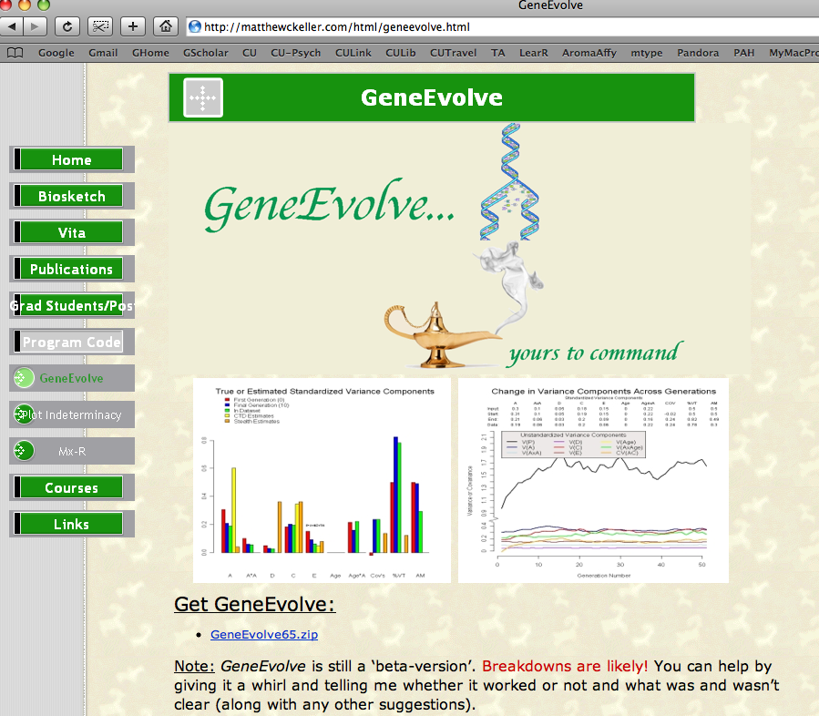
Simulation program: GeneEvolve

Slide 19
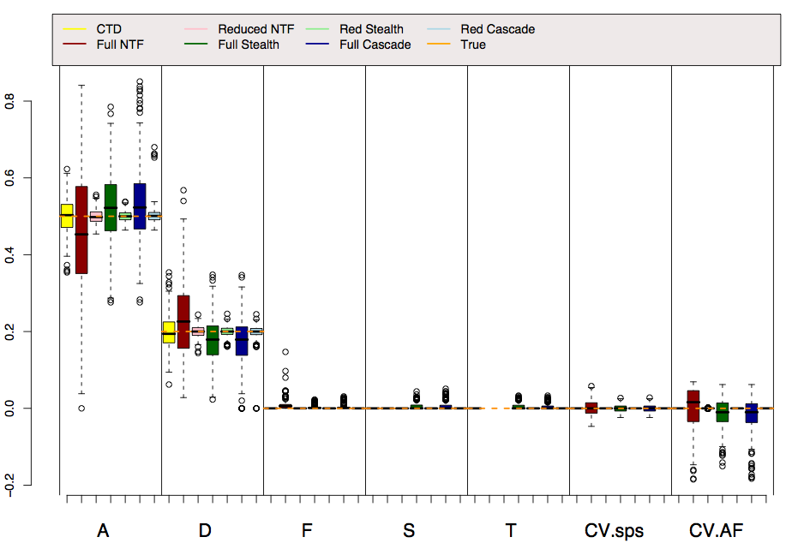
Reality: $V_{A}$ =.5, $V_{D}$=.2

Slide 20
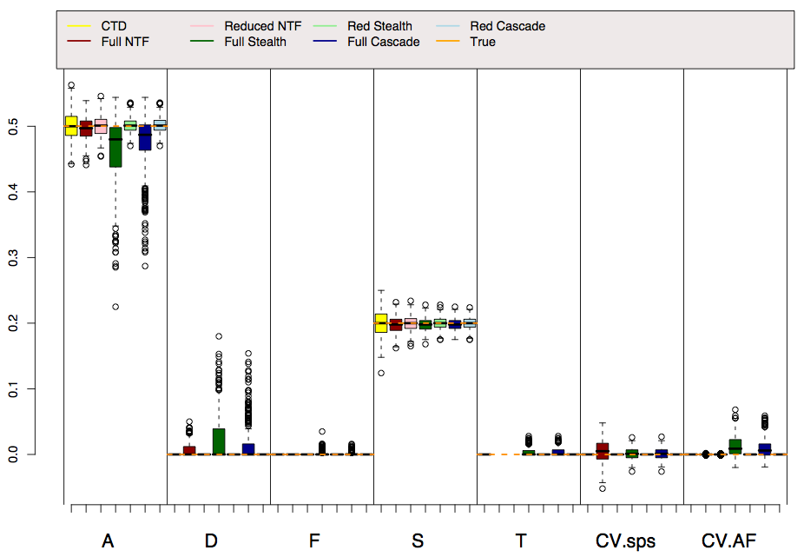
Reality: $V_{A}$ =.5, $V_{S}$ =.2

Slide 21
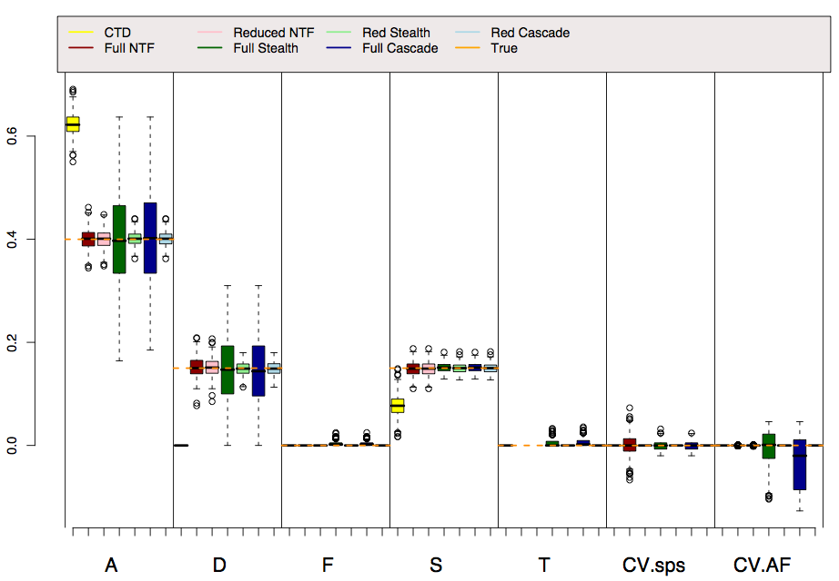
Reality: $V_{A}$=.4, $V_{D}$=.15, $V_{S}$=.15

Slide 22
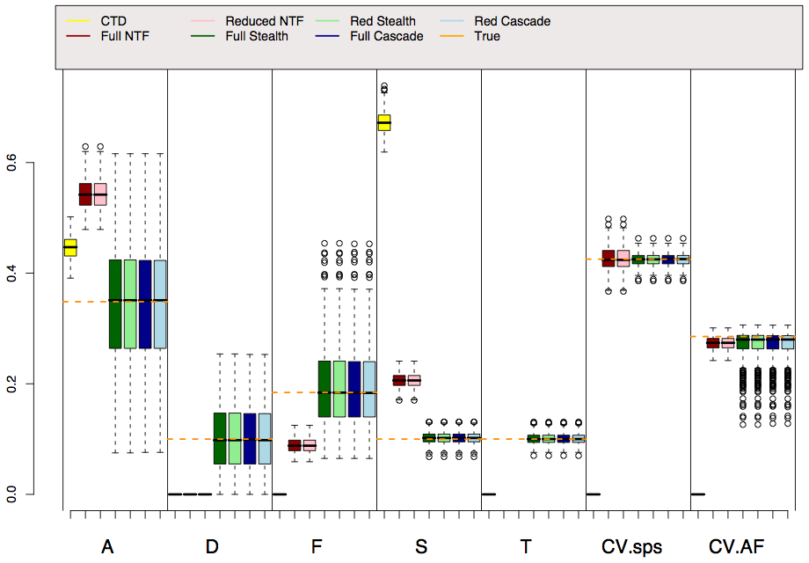
Reality: $V_{A}$=.35, $V_{D}$=.15, $V_{F}$=.2, $V_{S}$=.15, $V_{T}$=.15, AM=.3

Slide 23
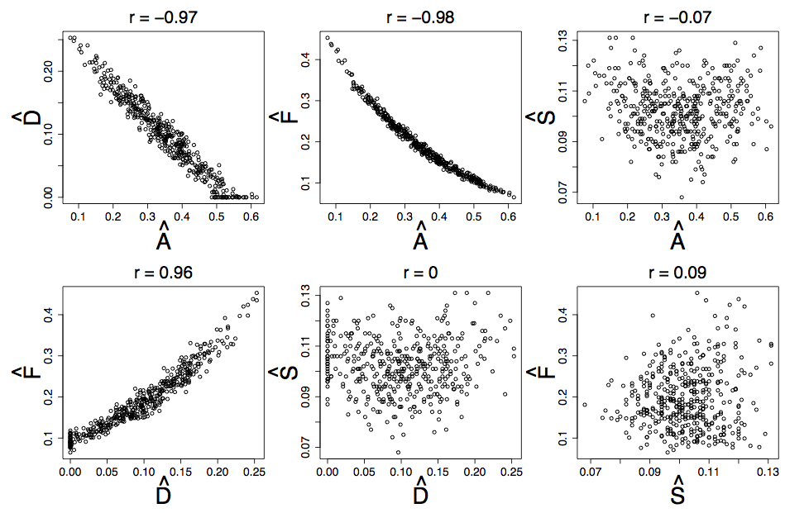
$V_{A}$, $V_{D}$, $V_{F}$ estimates are highly correlated in Stealth & Cascade

Slide 24
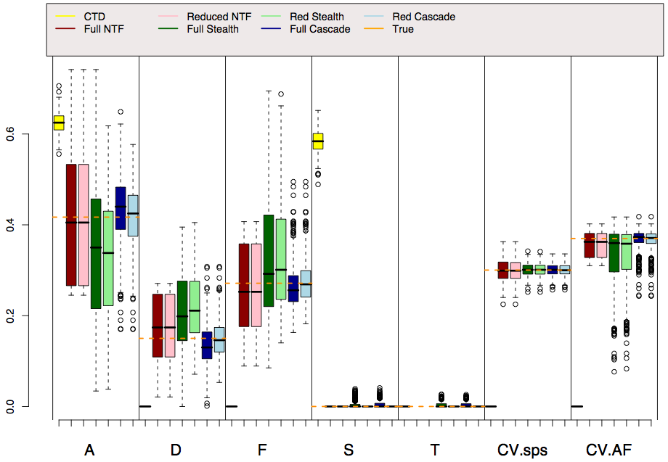
Reality: $V_{A}$=.45, $V_{D}$=.15, $V_{F}$=.25, AM=.3 (Soc Hom)

Slide 25
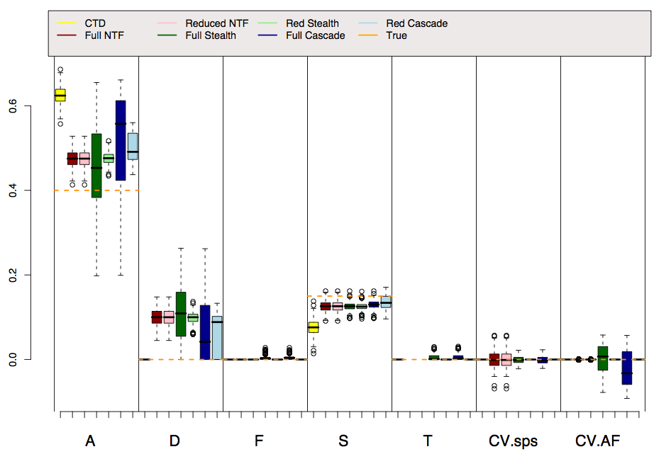
Reality: $V_{A}$=.4, $V_{A×A}$=.15, $V_{S}$=.15

Slide 26
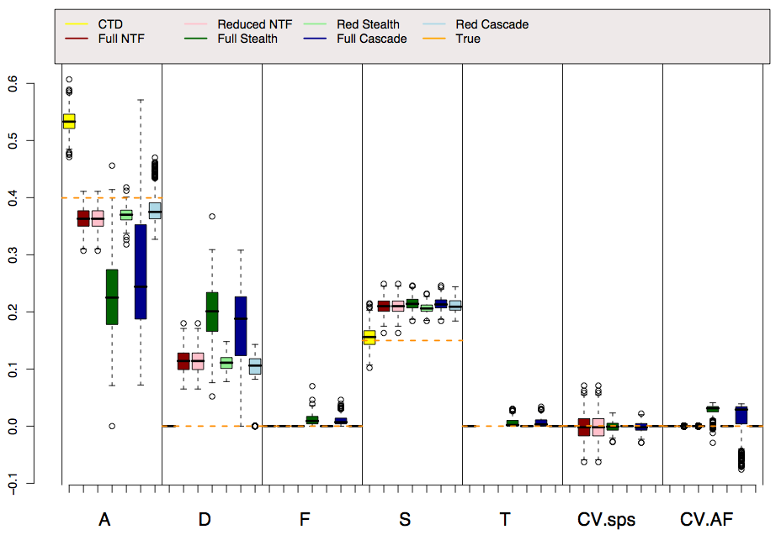
Reality: $V_{A}$=.4, $V_{A×Age}$=.15, $V_{S}$=.15

Slide 27
Conclusions
All models require assumptions. More assumptions = more biased estimates on average
Simulations provide assessments of NTFD, Stealth, and Cascade. These complicated models work as designed and are less biased and provide more nuanced understanding than CTDs
But ETFDs have drawbacks:
Complicated; easy to make mistakes
Require large datasets (e.g., n > 20k individuals) that are rarely collected
Require many assumptions (but fewer than CTD)

Slide 28
Further reading on this lecture
Eaves LJ, Last KA, Young PA, Martin NG (1978) Model-fitting approaches to the analysis of human behaviour. Heredity 41:249-320
Fulker DW (1982) Extensions of the classical twin method. Human Genetics. Part A: The Unfolding Genome (Progress in Clinical and Biological Research Vol 103A). p. 395-406
Fulker DW (1988) Genetic and cultural transmission in human behavior. Proceedings of the Second International conference on Quantitative Genetics
Eaves LJ, Heath AC, Martin NG, Neale MC, Meyer JM, Silberg JL, Corey LA, Truett K, Walter E (1999) Comparing the biological and cultural inheritance of stature and conservatism in the kinships of monozygotic and dizygotic twins. In: Cloninger CR (Ed) Proceedings of 1994 APPA Conference. p. 269-308
Keller MC & Coventry WL (2005). Quantifying and addressing parameter indeterminacy in the classical twin design. Twin Research and Human Genetics, 8, 201-213
Keller MC, Medland SE, Duncan LE, Hatemi PK, Neale MC, Maes HHM, Eaves LJ. Modeling extended twin family data I: Description of the Cascade Model. Twin Research and Human Genetics, 29, 8-18.
Keller MC, Medland SE, & Duncan LE (2010). Are extended twin family designs worth the trouble? A comparison of the bias, precision, and accuracy of parameters estimated in four twin family models. Behavior Genetics.

