Slide 1
Mendelian randomization: Practical 2
Does BMI causally affect Coronary Heart Disease?
Web utilities and software packages exist to carry out two sample MR analyses quickly and efficiently
This practical is not meant to illustrate the most efficient way to perform an MR study!
This practical is designed to show you what goes on “under the hood” of these black boxes and to get you familiar with some of the data cleaning and interpretation issues when performing two sample Mendelian randomization. We will also get you to run some of the MR sensitivity analyses too.

Slide 2
We have limited time!!!
DO NOT FOCUS ON THE SYNTAX!!! (just accept that the code does what it says on the tin- go back later and check/run through)
Remember to set your working directory at the beginning of the prac in R studio e.g.
setwd("/home/**YOURNAMEHERE**/MR/PRACTICAL2/")
Run the code in 5 blocks (labelled PART ONE through PART 5)
Timetable
00-10 Minutes PART ONE
10-20 minutes PART TWO
20-30 minutes PART THREE
30-40 minutes PART FOUR
40-50 minutes PART FIVE
50-60 minutes Group Discussion

Slide 3
Mendelian randomization: Practical 2
# Use your web browser to navigate to: https://workshop.colorado.edu/rstudio/
#Login with your username and password
#Click on the “terminal” tab. This will take you to a UNIX like environment where you can copy the files over for this session’s #practical exercise
# Now go to your home directory, and move to the directory “MR” you previously created:
cd
cd MR
# Copy the PRACTICAL2 directory from David Evans’ Faculty drive into this directory
cp -r /faculty/davide/BOULDER2021/PRACTICAL2 .
#Move into your newly created PRACTICAL2 directory and print the working directory here
cd PRACTICAL2
pwd
#Instructions, commands and questions for this practical are located in the file Practical2.R

Slide 4
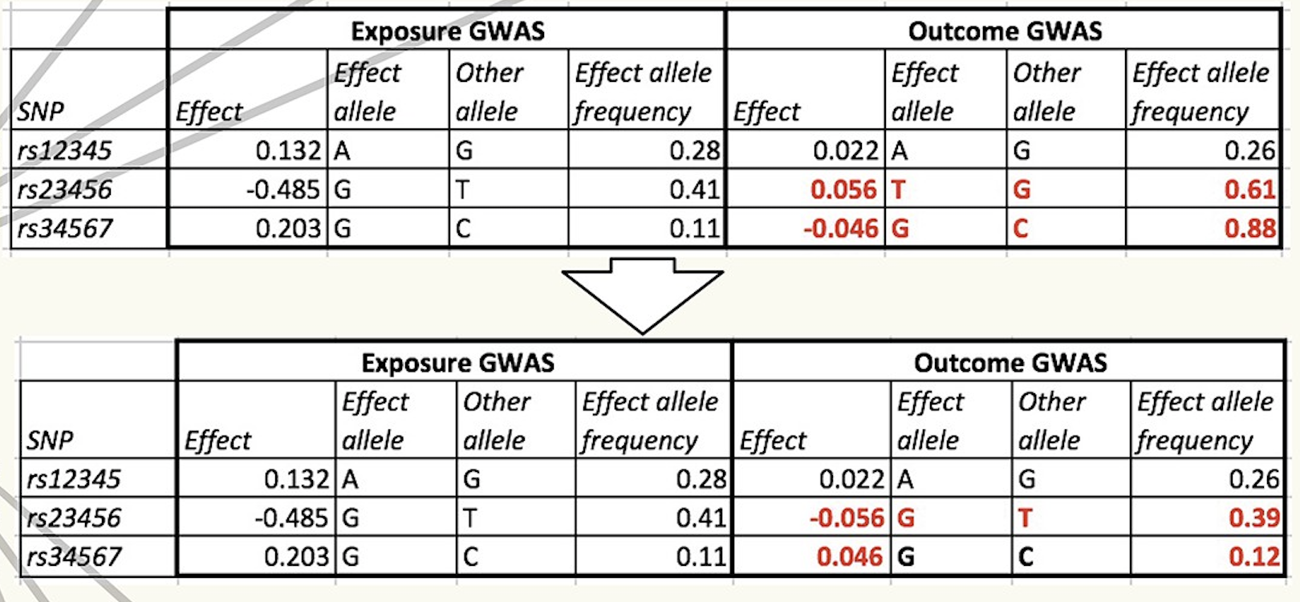
Harmonise exposure and outcome effects

Slide 5
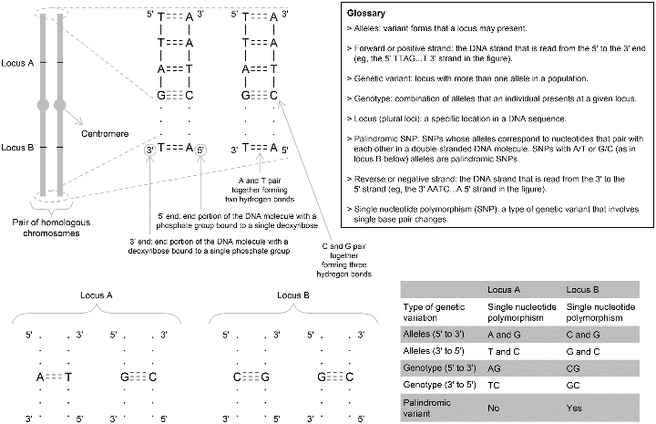
The Issue of Strand
Hartwig et al 2017

Slide 6
Sensitivity Analyses- BMI and CHD
parameter estimate se lower_CI upper_CI p_value
1 IVW beta 0.287658553 0.086237732 0.11590122 0.459415882 0.001318512
2 MR-Egger beta 0.375935570 0.209803912 -0.04201525 0.793886395 0.077191677
3 MR-Egger alpha -0.002791481 0.006041587 -0.01482694 0.009243978 0.645387108
4 Weighted_median beta 0.379652982 0.117839188 0.08299413 0.554455224 0.005920437
5 Weighted_mode beta 0.311258179 0.129426222 0.05758745 0.564928912 0.018610428
Results look very consistent!
MR Egger lacks power- so look at coefficient rather than p value!
MR Egger intercept is a test for directional horizontal pleiotropy

