Slide 1
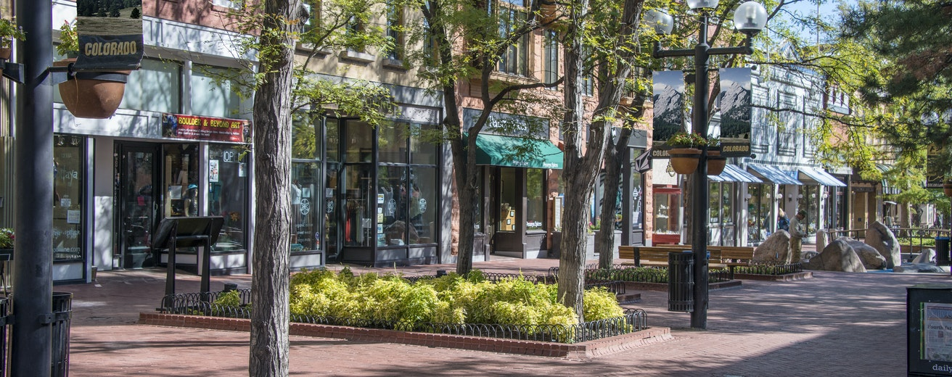
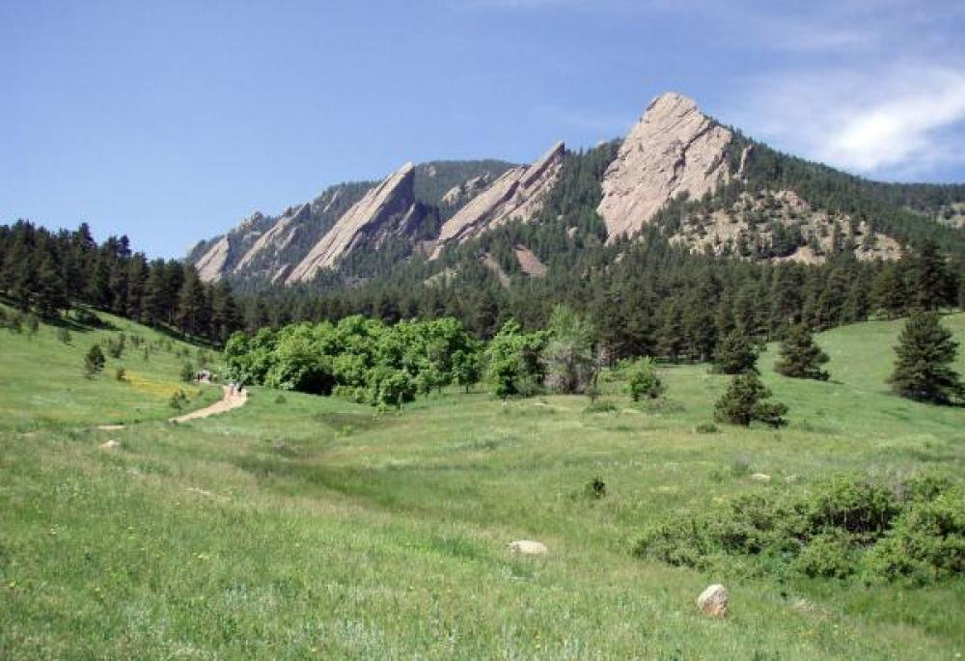
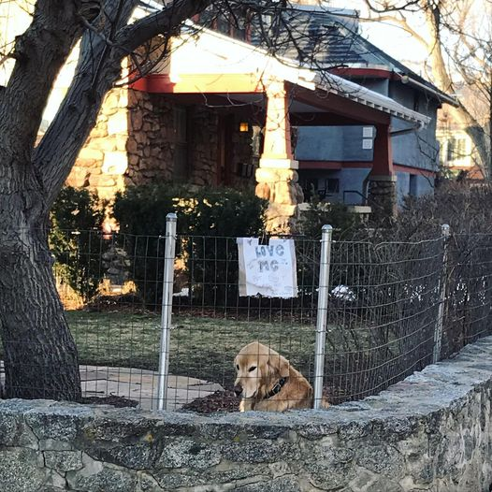
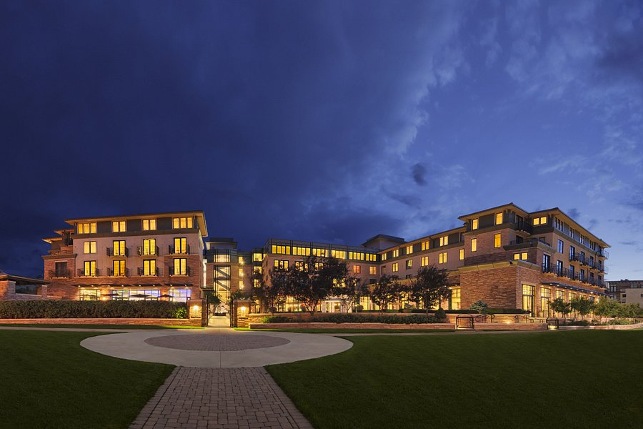
Mendelian randomization: Practical 1
Does C-Reactive Protein causally affect Blood Pressure?
Pearl St Mall
Hotel St Julien
The Flatirons
“Ajax”- A Boulder Resident

Slide 2
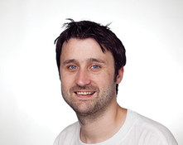
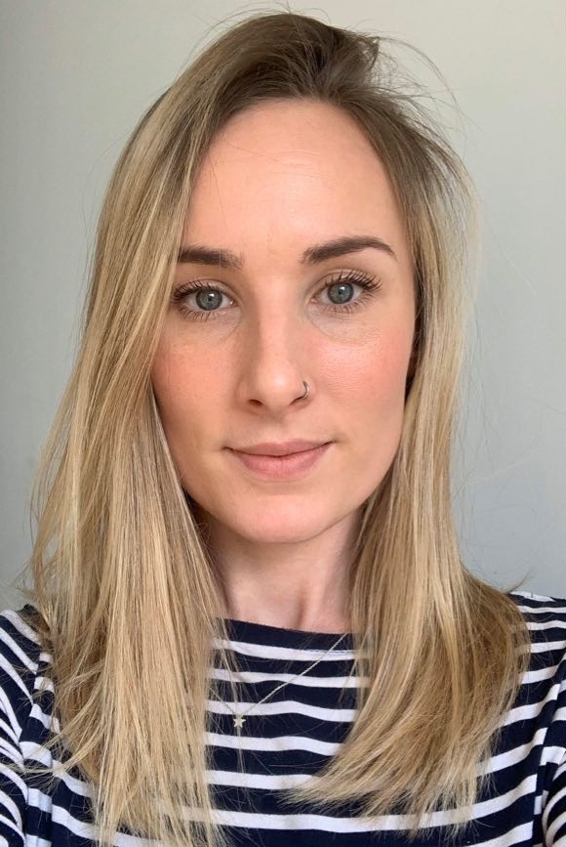
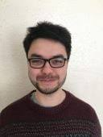
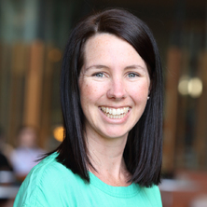
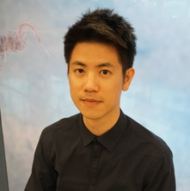
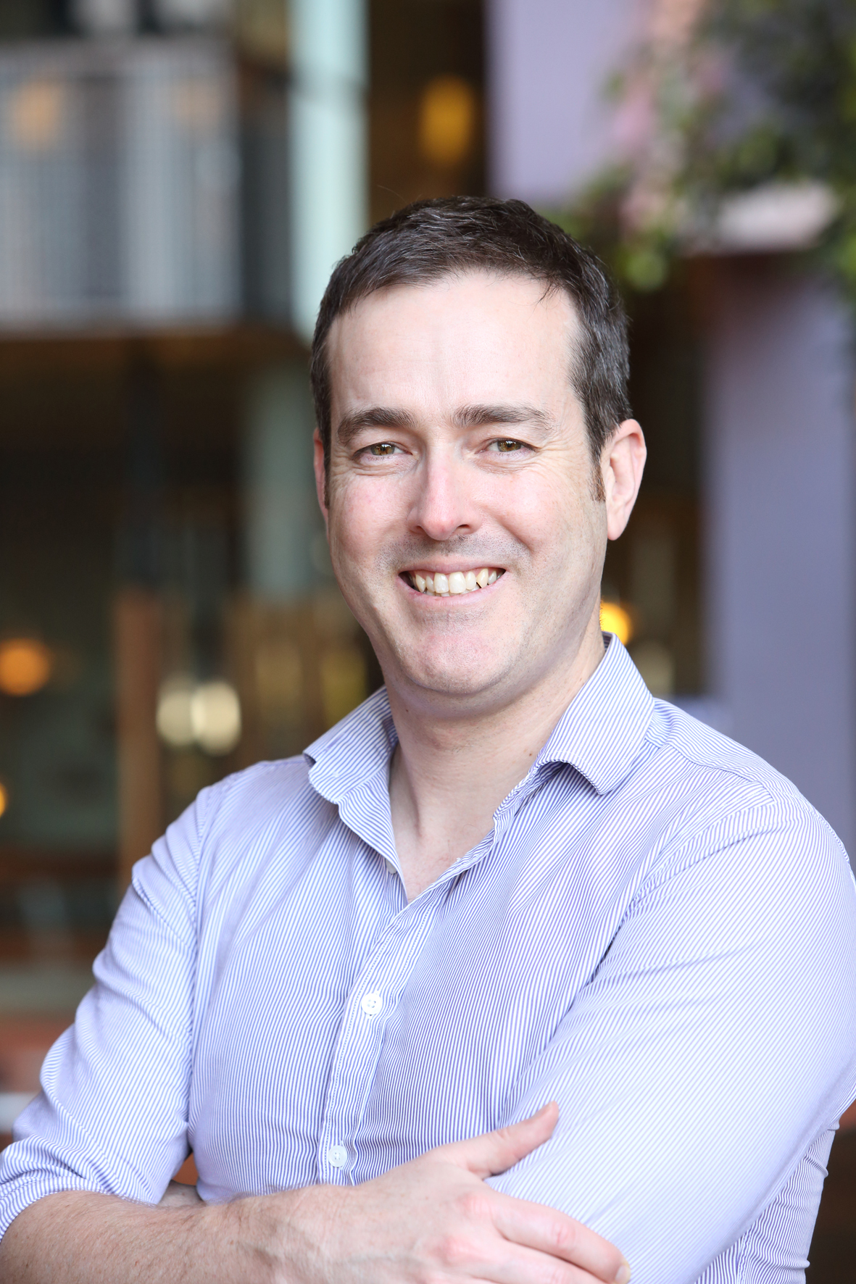
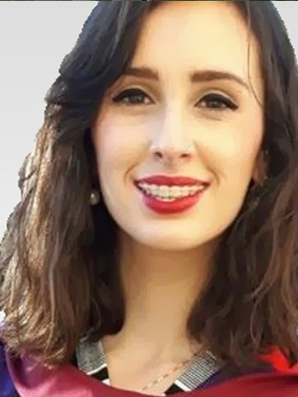
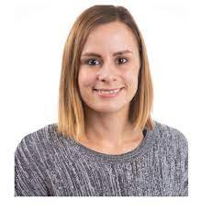
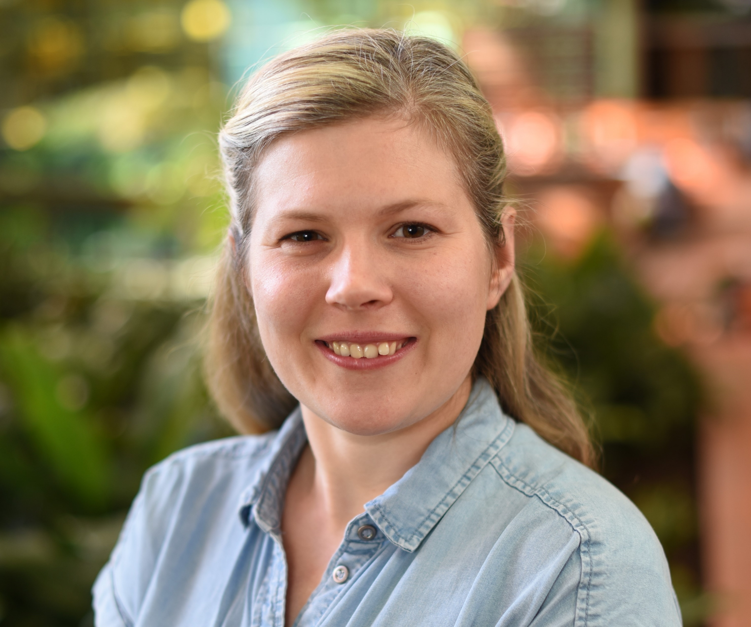
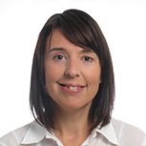
Tutors
End Byrne
(University of Queensland)
Emma Anderson
(University of Bristol)
Laurence Howe
(University of Bristol)
Nicole Warrington
(University of Queensland)
Daniel Hwang
(University of Queensland)
Dave Evans
(University of Queensland)
(University of Bristol)
Rebecca Richmond
(University of Bristol)
Kaitlin Wade
(University of Bristol)
Gunn-Helen Moen
(University of Oslo)
(University of Queensland)
Jodie Painter
(QIMR Berghofer
Medical Research Institute)
Tom Bond
(University of Bristol)

Slide 3
Mendelian randomization: Smoking and Lung Cancer
MENDELIAN RANDOMIZATION
RANDOMISED CONTROLLED TRIAL
+ independent assortment
RANDOM SEGREGATION
OF ALLELES
RANDOMISATION METHOD
Heavy Smokers:
C/C
Light/Non Smokers:
C/T or T/T
EXPOSED:
SMOKERS
CONTROL:
NON SMOKERS
CONFOUNDERS EQUAL BETWEEN GROUPS
CONFOUNDERS EQUAL BETWEEN GROUPS
LUNG CANCER COMPARED
BETWEEN GROUPS
LUNG CANCER COMPARED
BETWEEN GROUPS

Slide 4
Mendelian Randomization: 3 Core Assumptions
Confounders
(2)
X
SNP
Exposure
Outcome
(1)
X
(3)
(1) SNP is associated with the exposure
(2) SNP is NOT associated with confounding variables
(3) SNP ONLY associated with outcome through the exposure

Slide 5
Mendelian randomization: Practical 1
Does C-Reactive Protein causally affect Blood Pressure?
Confounders
(Income, HDL)
Observational β_{CRP-SBP} = ???
β_{SNP-INCOME} = ???
β_{SNP-HDL} = ???
X
β_{CRP-INCOME} = ???
β_{CRP-HDL} = ???
β_{INCOME-SBP} = ???
β_{HDL-SBP} = ???
rs3091244
CRP
SBP
β_{SNP-CRP} = ???
β_{CRP-SBP} = ???
β_{SNP-SBP} = ???

Slide 6
Mendelian randomization: Practical 1
# Use your web browser to navigate to: https://workshop.colorado.edu/rstudio/
#Login with your username and password
#Click on the “terminal” tab. This will take you to a UNIX like environment where you can copy the files over for this session’s #practical exercise
# Now go to your home directory, create a new working directory called “MR”, and move to it
cd
mkdir MR
cd MR
# Copy the PRACTICAL1 directory from David Evans’ Faculty drive into this directory
cp -r /faculty/davide/BOULDER2021/PRACTICAL1 .
#Move into your newly created PRACTICAL1 directory and print the working directory here
cd PRACTICAL1
pwd
#You should be able to navigate to your home directory using the point and click windows style directory in the lower right hand half #of the R studio server (under the files tab). Download the file Mendelian_Randomization_Practical_Exercise_QUESTIONS.doc onto your local machine. #This file contains all the instructions for the practical. Open the file and complete the practical.

Slide 7
Observational β_{CRP-SBP} = 19.1 mmHg/CRP Unit; P < 2x10⁻¹⁶
Confounders
(Income, HDL)
β_{SNP-INCOME} = 0.0014; P = 0.9
β_{SNP-HDL} = 0.0025; P = 0.07
X
β_{CRP-INCOME} = -0.06; P < 2x10⁻¹⁶
β_{CRP-HDL} = -0.57; P < 2x10⁻¹⁶
β_{INCOME-SBP} = -0.93; P < 2x10⁻¹⁶
β_{HDL-SBP} = -28.4; P < 2x10⁻¹⁶
rs3091244
CRP
SBP
β_{SNP-CRP} = 0.04; P < 2x10⁻¹⁶
β_{CRP-SBP} = -2.4 mmHg/CRP Unit; P = 0.5
β_{SNP-SBP} = -0.10; P = 0.47

Slide 8
Responsible Conduct of Research Question
What should PRS’s be used for? Clinical risk prediction; lifestyle choices; preventative medical intervention; insurance assessment; how about educational attainment prediction and assignment to school programs; prenatal testing and embryo selection; partner choice? Discuss!

